Slide 1
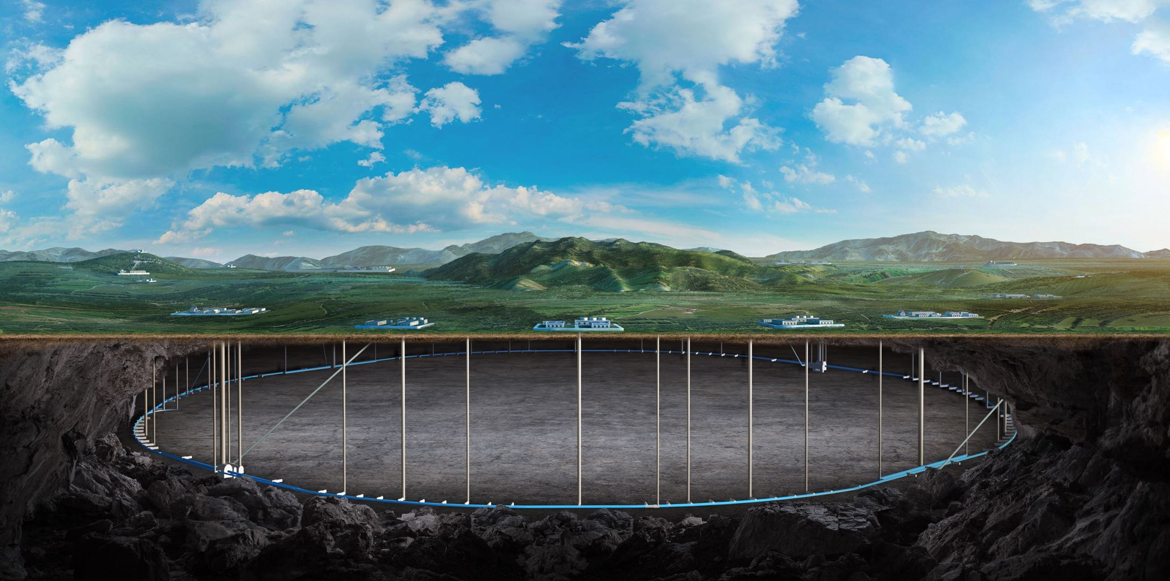


Mechanical Design of CEPC HCAL
Pei Yatian
On behalf of CEPC HCAL group
2025.11.08
Apr. 14, 2025, CEPC IDRC Review for CEPC Reference Detector TDR

Slide 2
Outline
Overview of HCAL structure
HCAL mechanics design
Barrel HCAL mechanics
Endcap HCAL mechanics
HCAL Cooling scheme
HCAL prototype and GS test structure

Slide 3
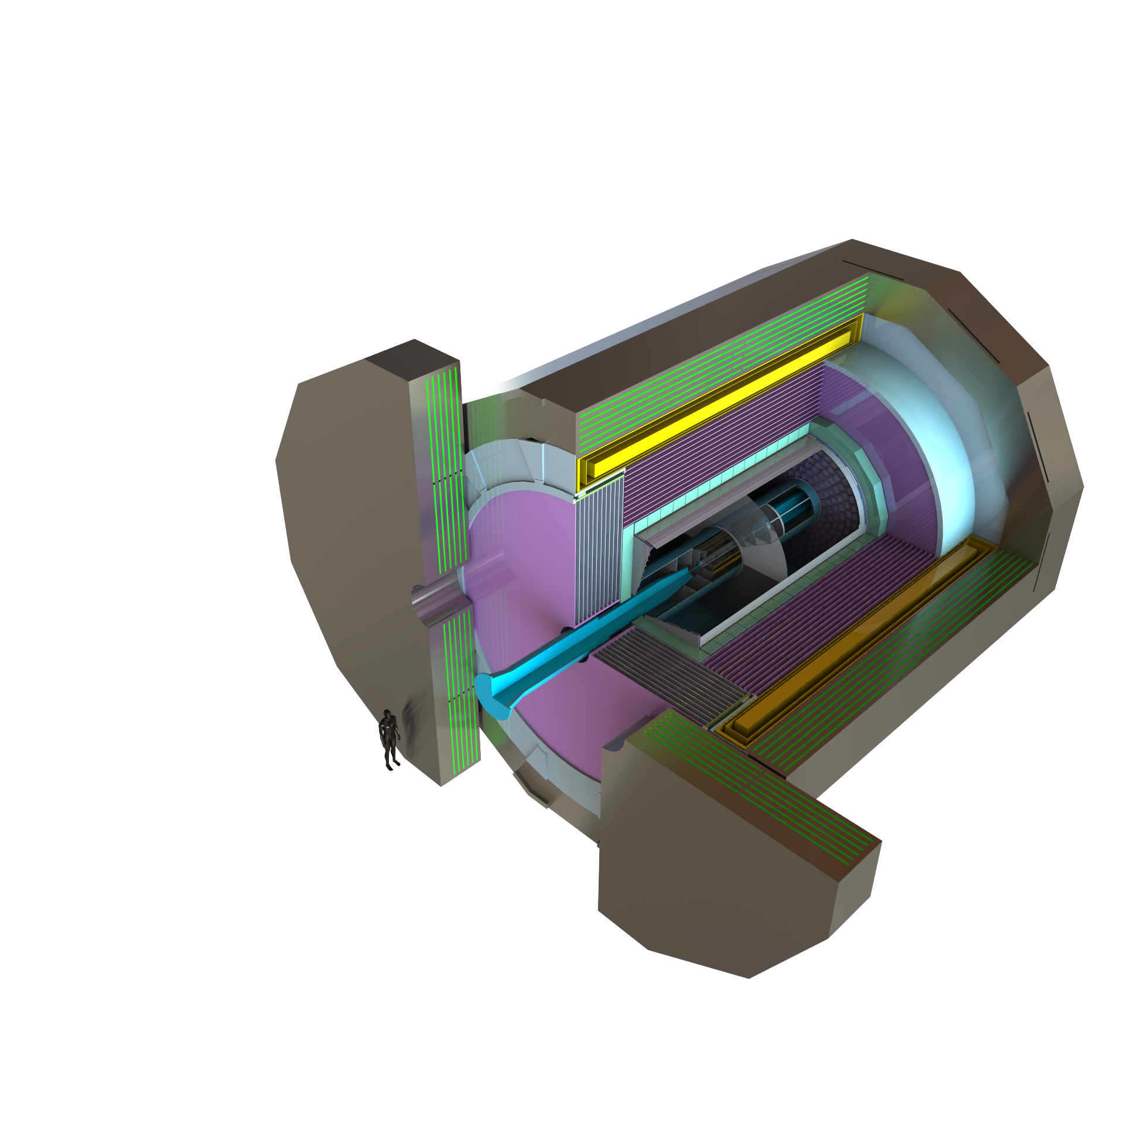
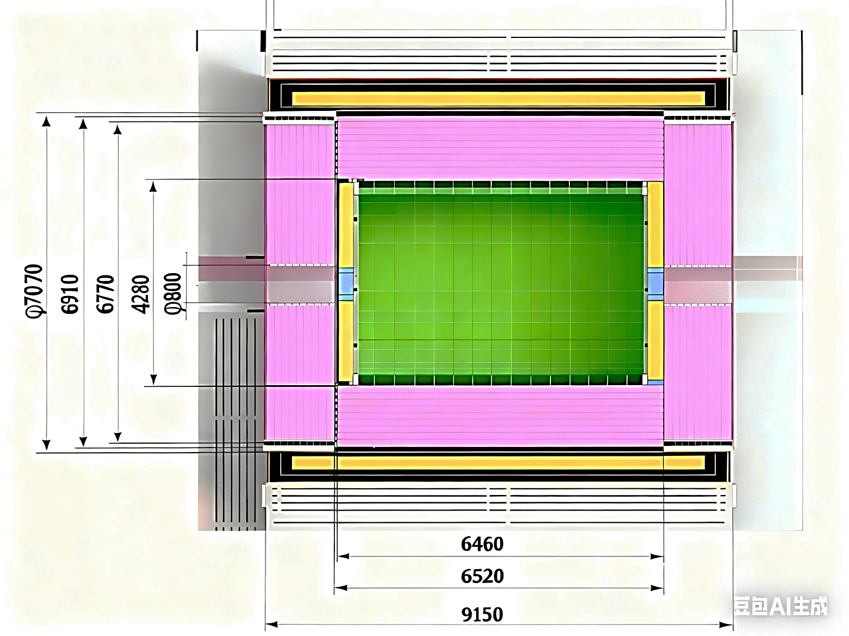

Overview of HCAL structure
Barrel HCAL
8
Endcap HCAL

Slide 4
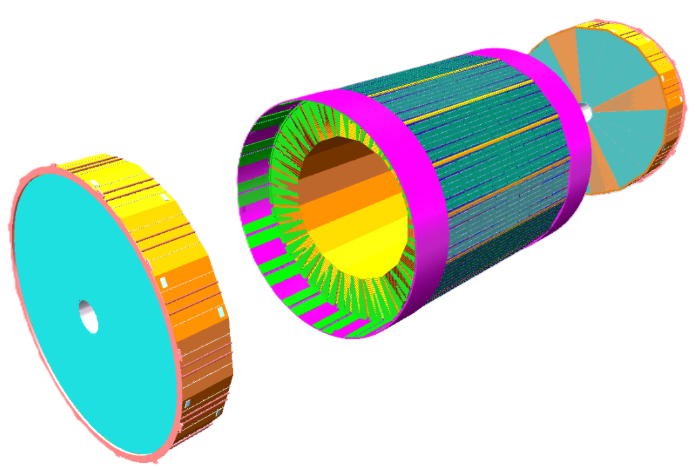
HCAL mechanics design
Layout for all the HCAL components
Endcap HCAL
Requirements:
Barrel HCAL
The support structure zone is as lower as possible.
The maximum stress of different materials need to be lower than their allowable stress level.
The deformation of different materials need to be controlled so that there will be no broken parts under different conditions.
Outer contour dimension tolerance need to be 0mm to -5mm and inner contour dimension tolerance need to be 0mm to +5mm.
Endcap HCAL
Support rings
General structure information:
The cross section of barrel HCAL is a regular hexdecagon
Total weight is 1679 tons and there are totally 5224960 glass scintillator

Slide 5
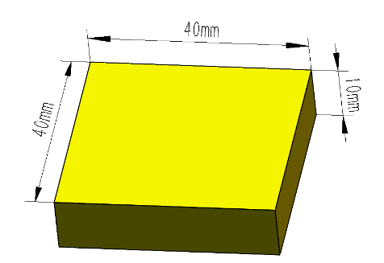
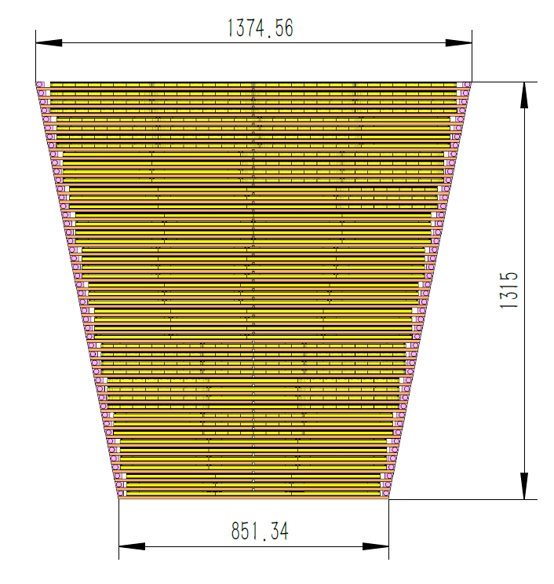
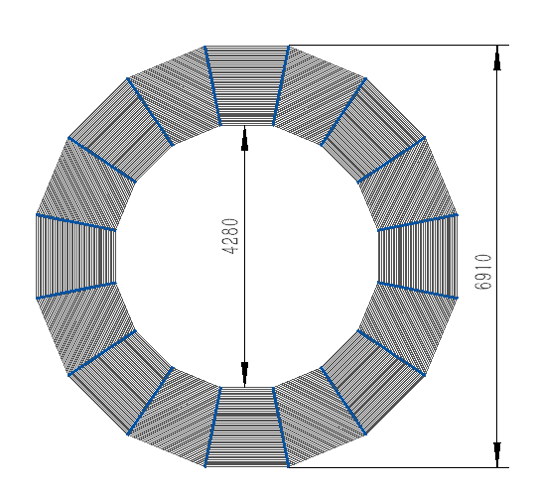
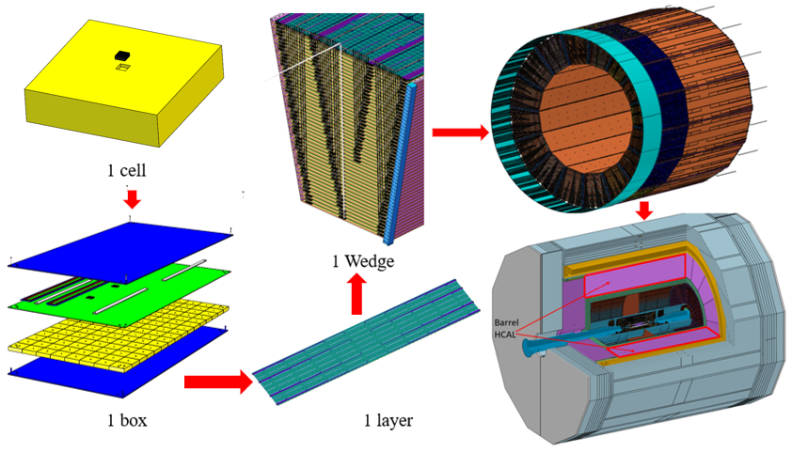
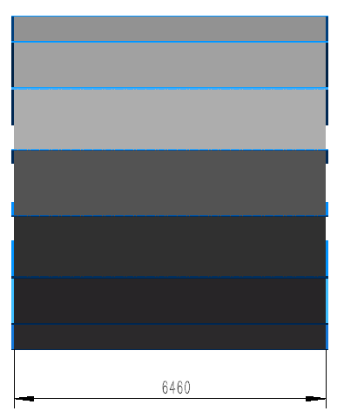
Barrel HCAL mechanics
Main Structure
Integration of barrel HCAL structure
1 Wedge dimension
 | Cell | Box | Layer | Wedge
Quantities | 3212800 | 27840 | 48*16=768 | 16
Total weight: 955 tons

Slide 6
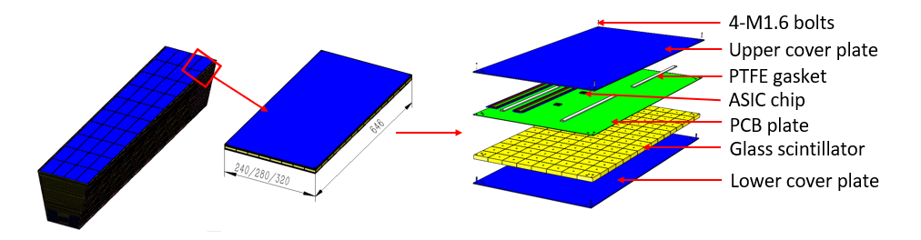
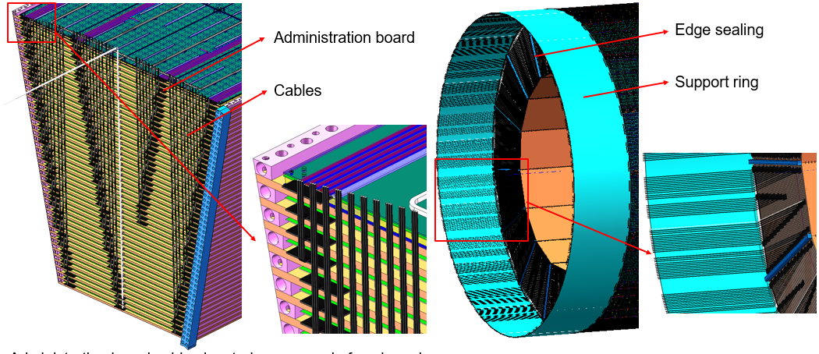
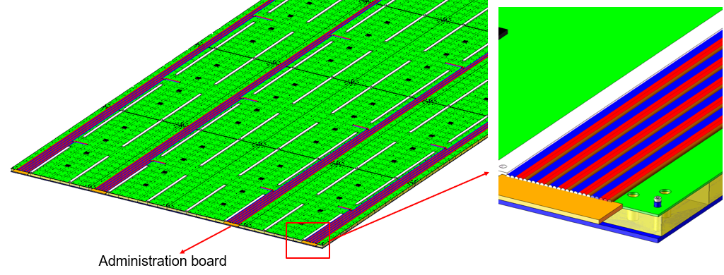
Barrel HCAL mechanics
One box structure
Cable routing scheme

Slide 7
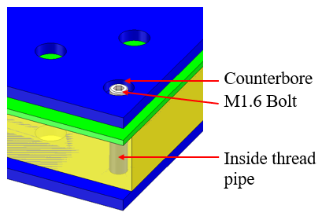
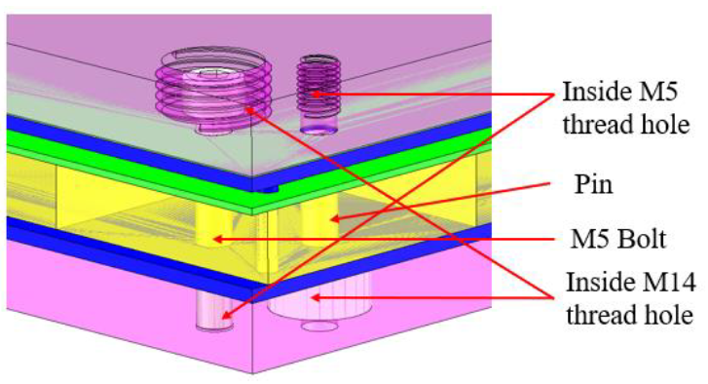
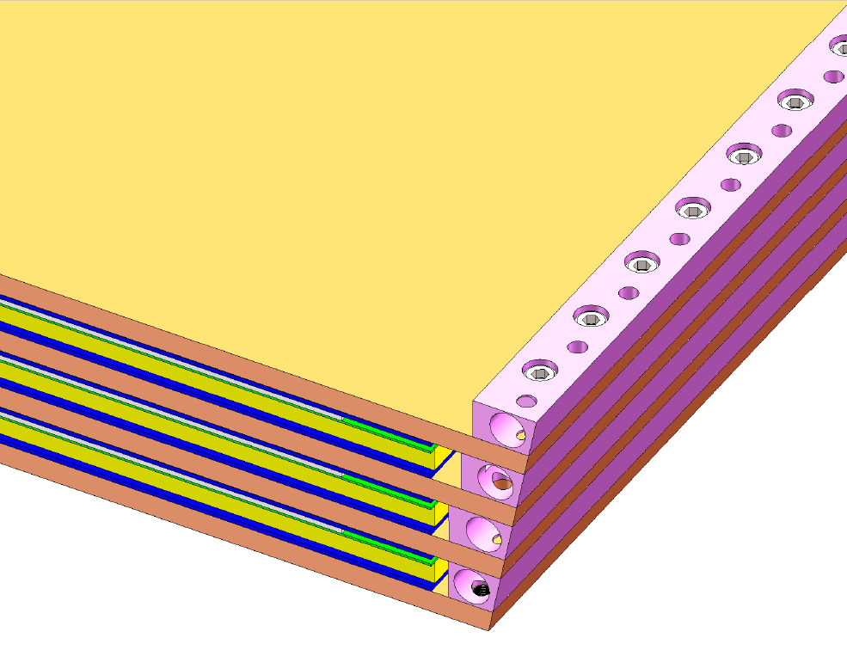
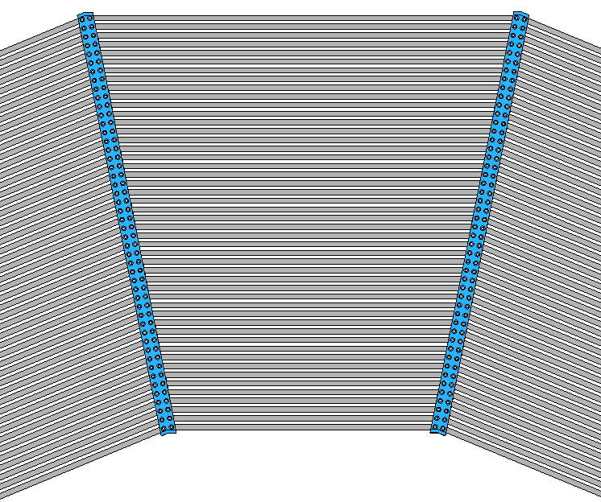
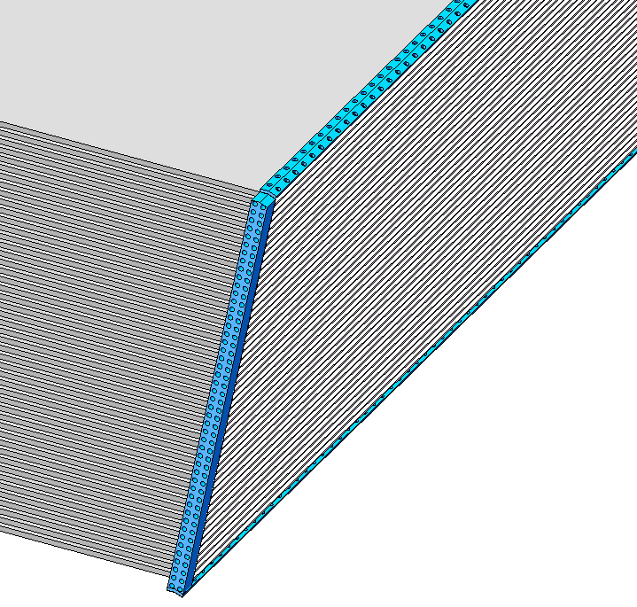
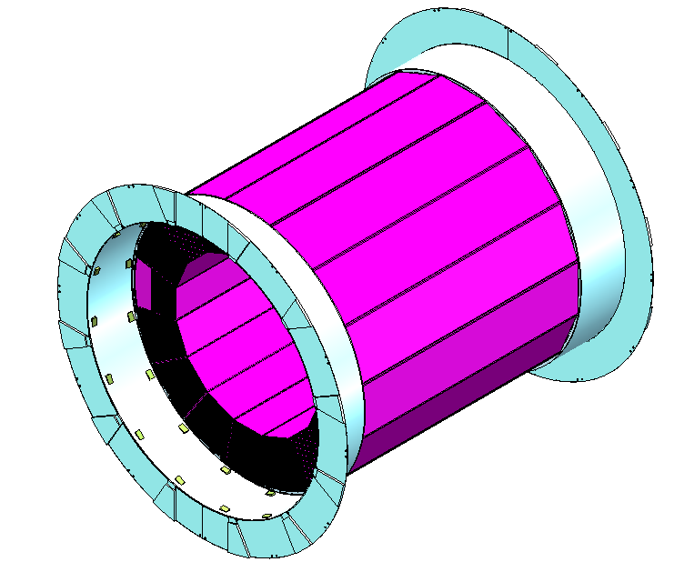
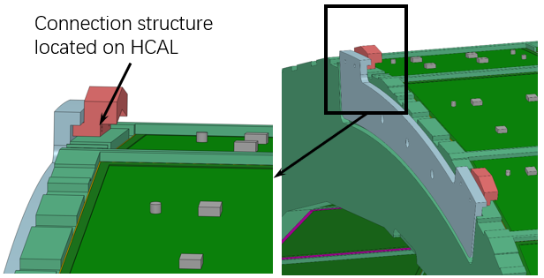
Barrel HCAL mechanics
Connection within one box
Connection between box and absorber layer
Connection between neighbor layers
Connection between two wedges
Connection between Barrel HCAL and support rings
Connection between Barrel HCAL and Barrel ECAL
Edge sealings

Slide 8
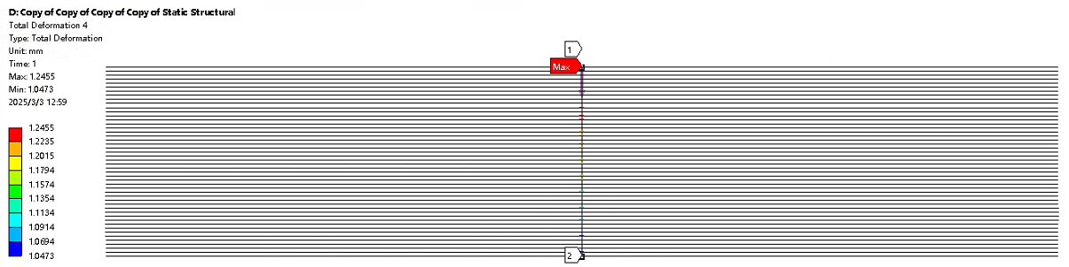
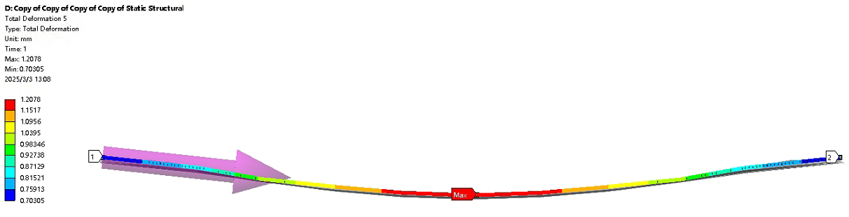
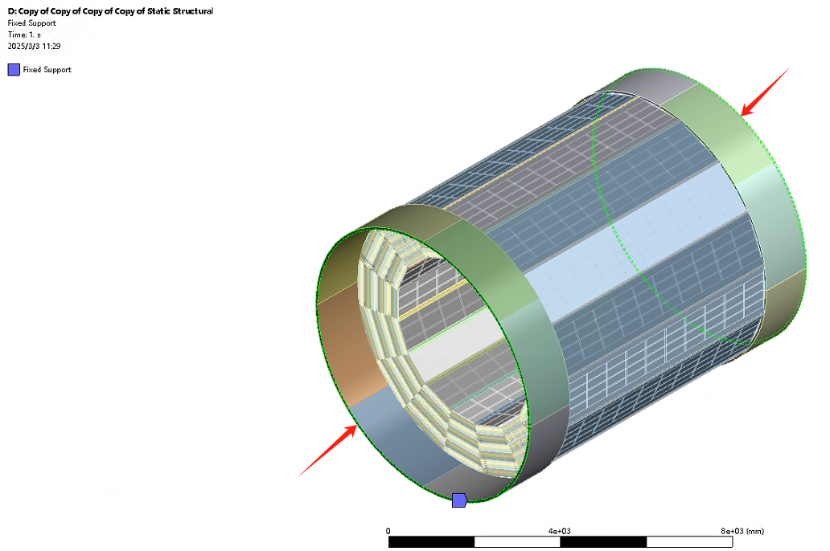
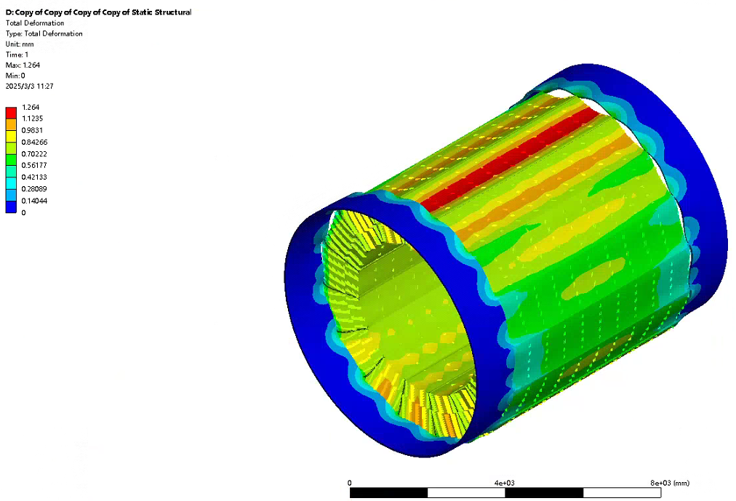
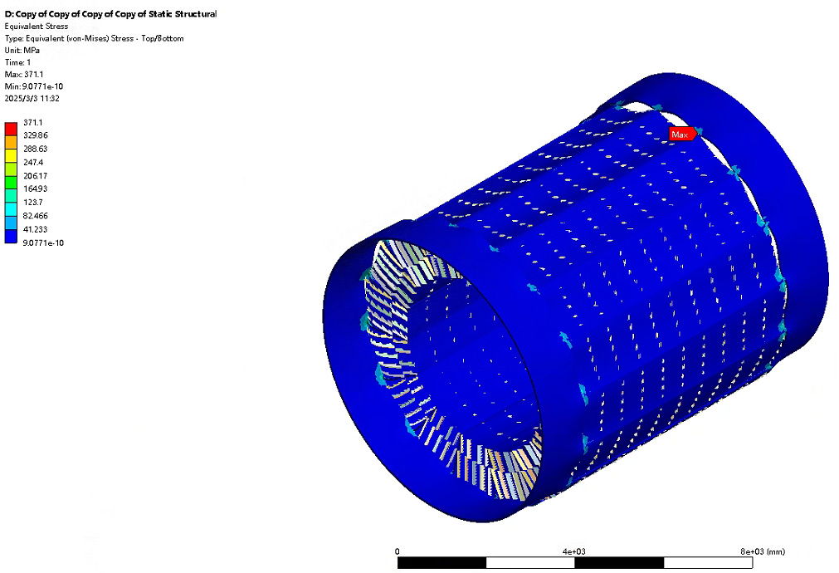
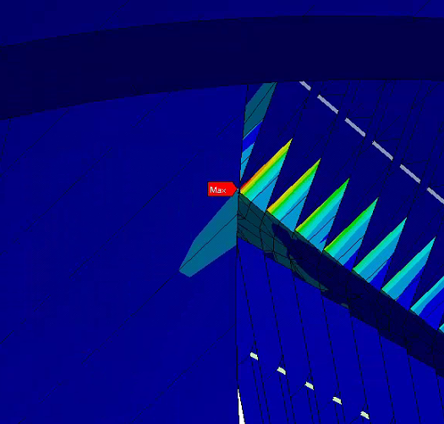
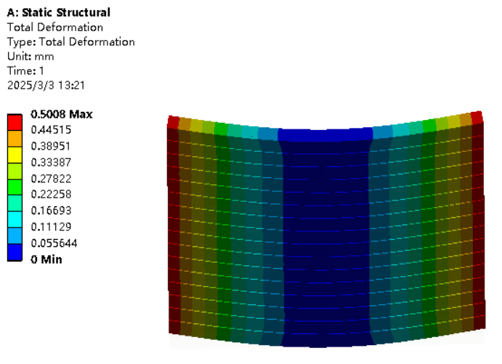
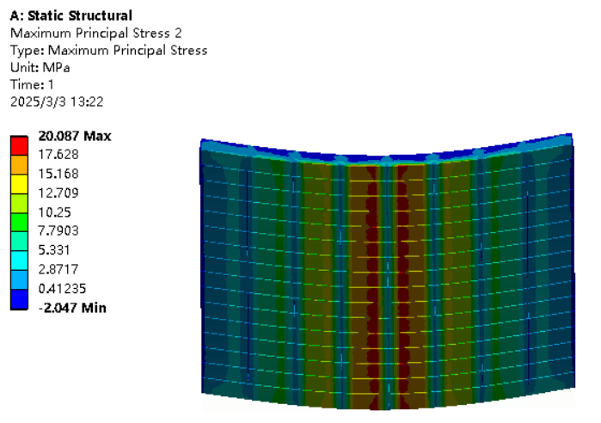
Barrel HCAL mechanics
FEA result of barrel HCAL
Active layer space analysis
Stress and deformation of barrel HCAL under different conditions
Parameter | Stress | Deformation
One wedge assembling condition | 24.7MPa | 0.33mm
16 wedges assembling condition | 190MPa | 0.66mm
The deformation difference between 48 layer is lower than 0.2mm
Barrel ECAL connection condition
The deformation of all 48 layers at the same X
The difference between the lowest point to highest point is 0.5mm
1.26mm
Boundary condition
Deformation within one layer
GS analysis
Changing the trapezoid beam from stainless steel to titanium alloy
20MPa
0.5mm
371.1MPa

Slide 9
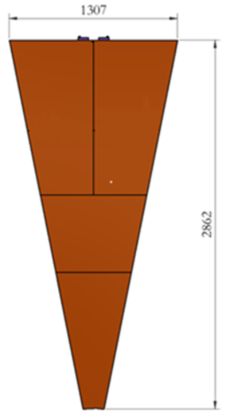
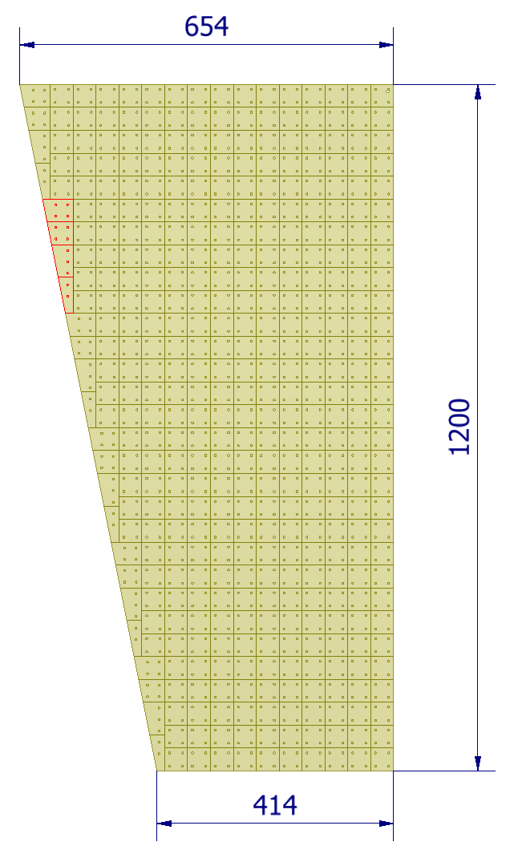
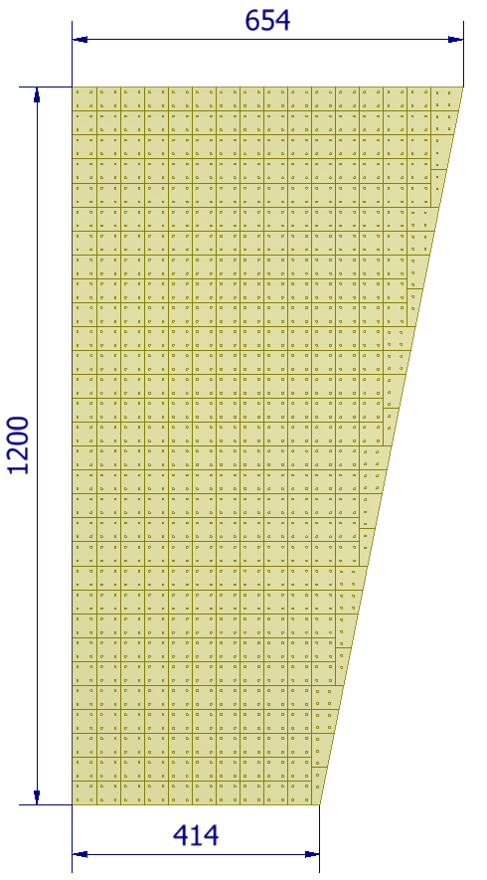
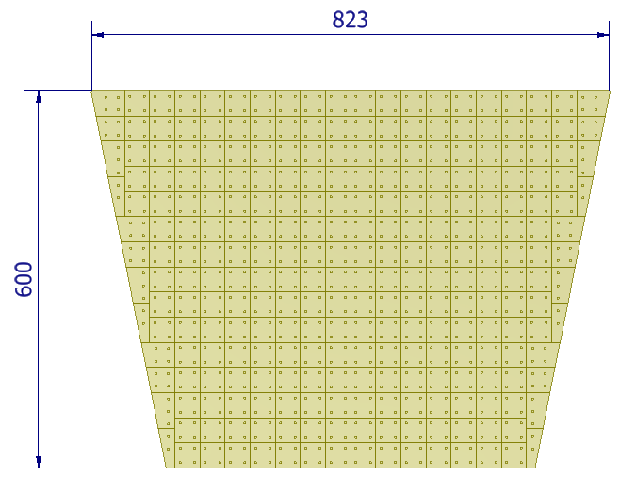
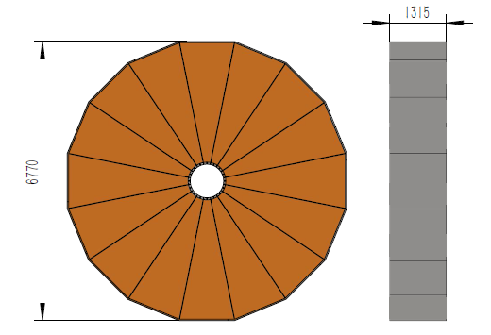
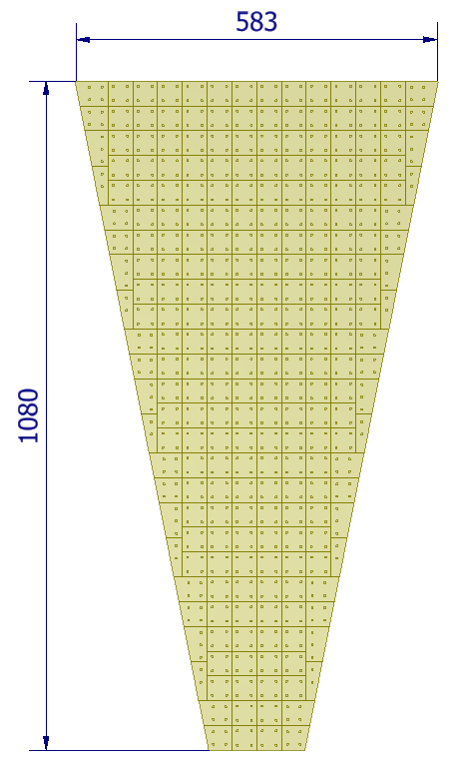
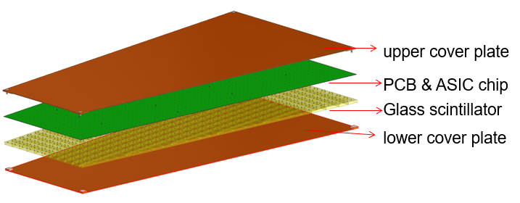
Endcap HCAL mechanics
Main Structure
Boxes in one layer
4 types boxes
4 kinds of abnormal shape GS
One box structure
 | Cell | Box | Layer | Wedge
Quantities | 1006080*2 | 3072*2 | 48*16*2 | 16*2
Total weight: 362*2=724 tons

Slide 10
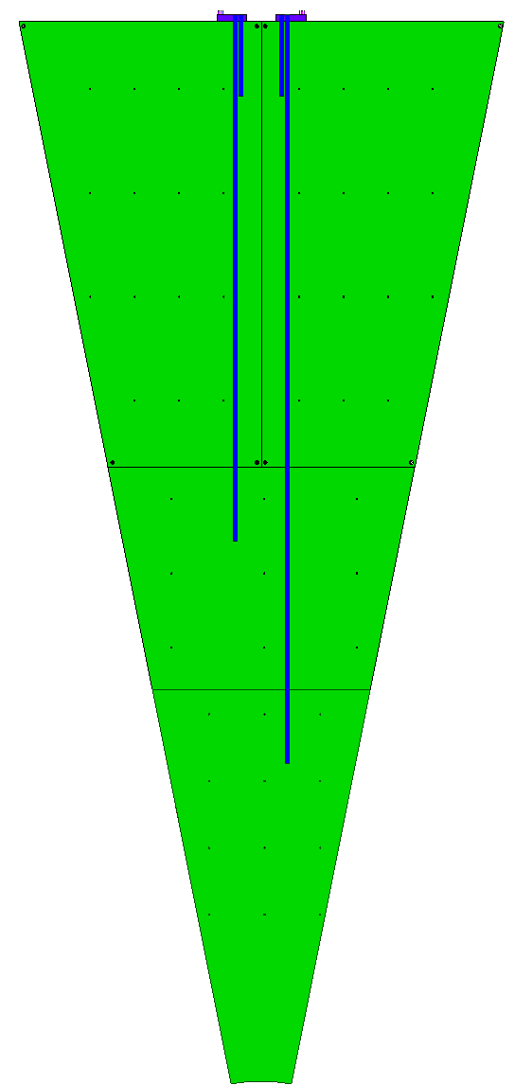
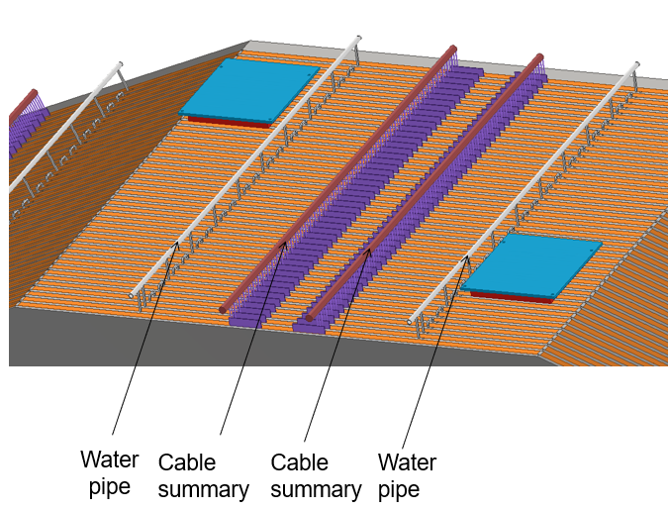
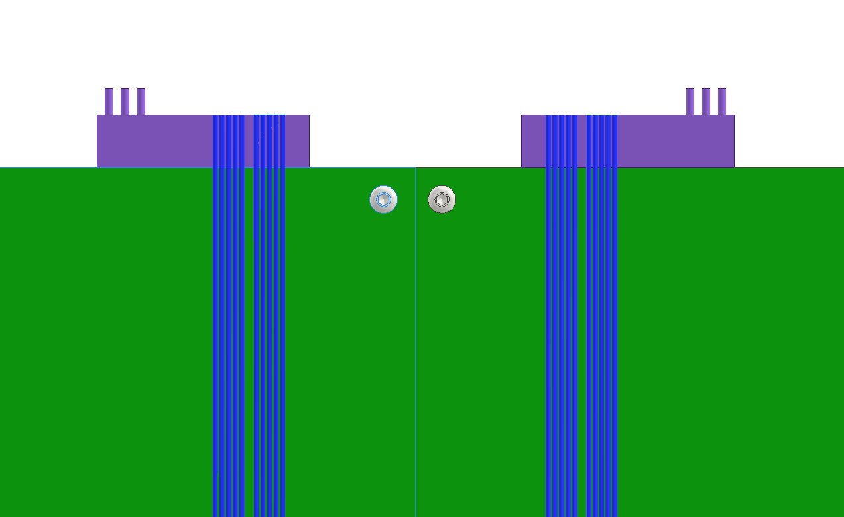
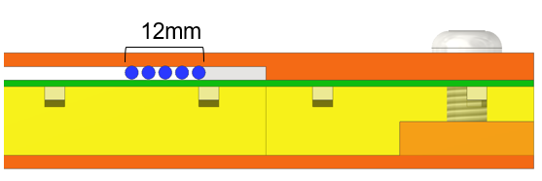
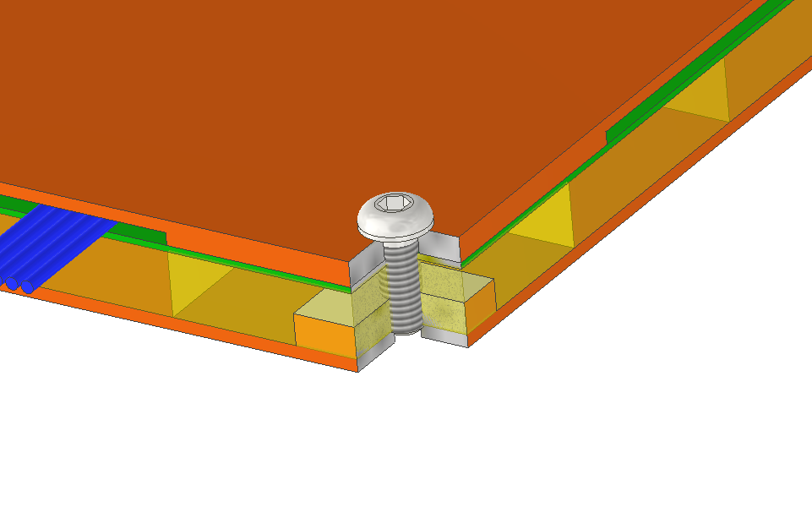
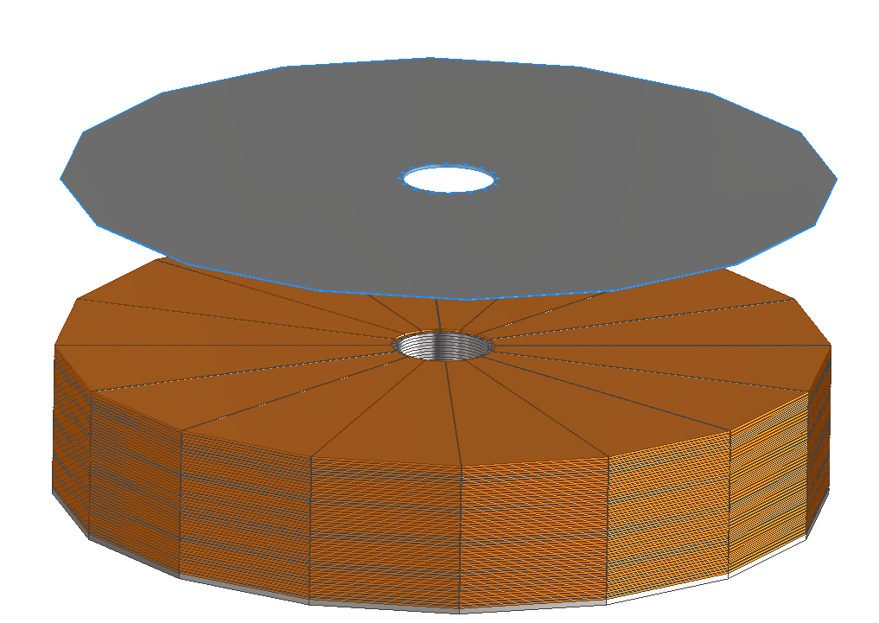
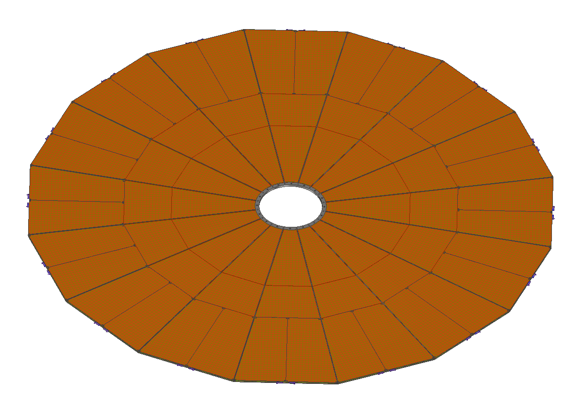
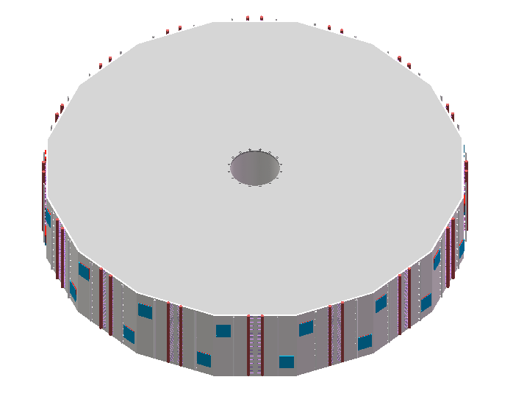
Endcap HCAL mechanics
Cable routing scheme
1
2
3
4
5 cables in one box
Cable diameter 2mm
Connection within one box
Connection between layers
Structure between neighbor wedges
Connection between end HCAL and support rings

Slide 11
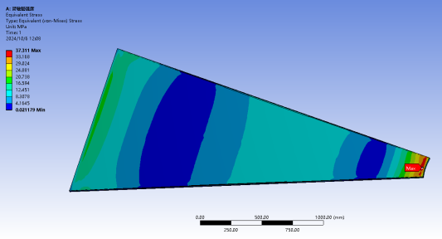
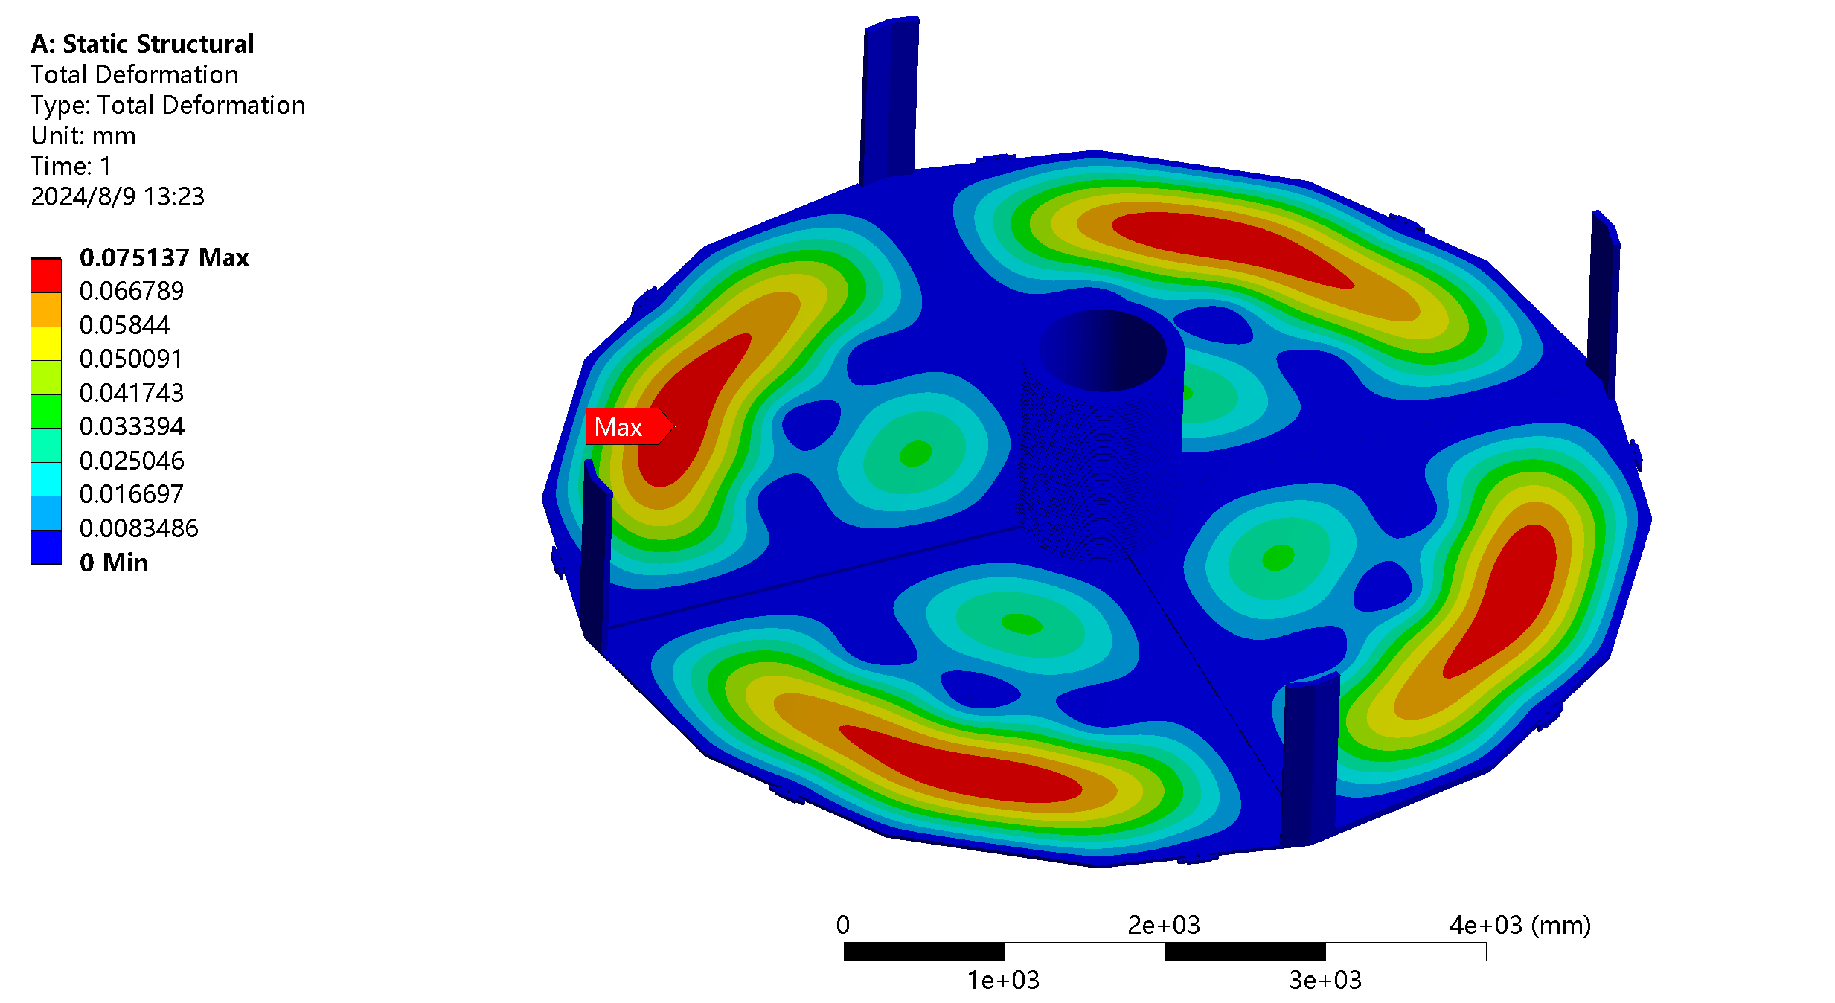
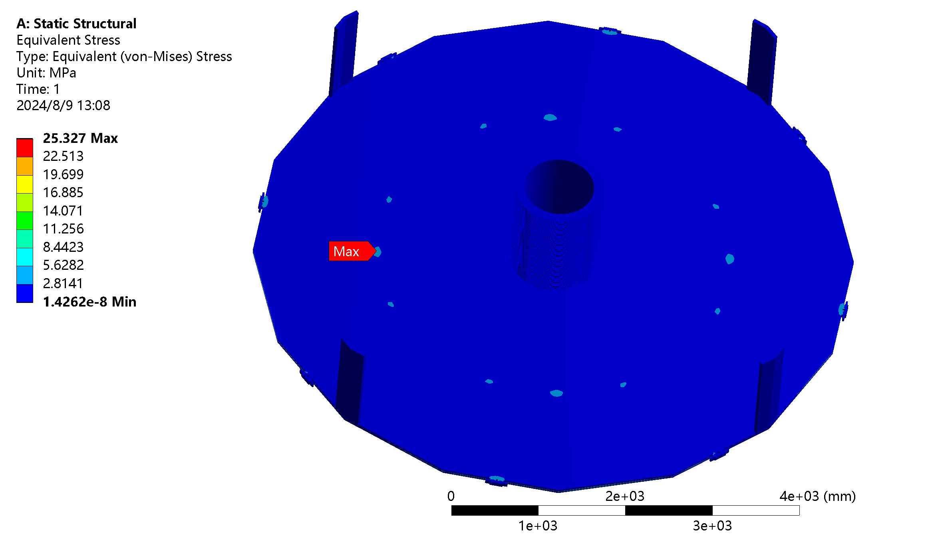
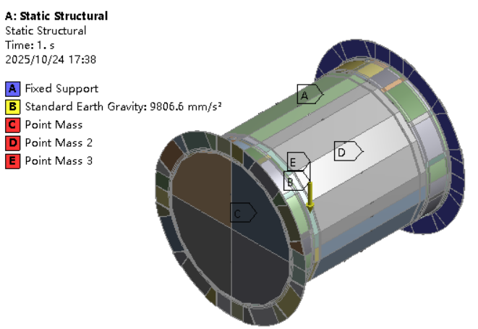
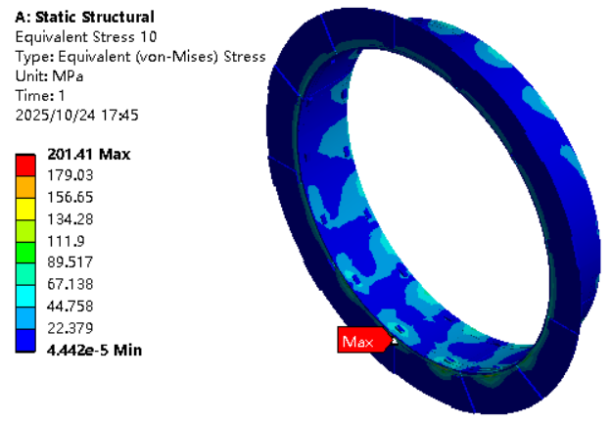
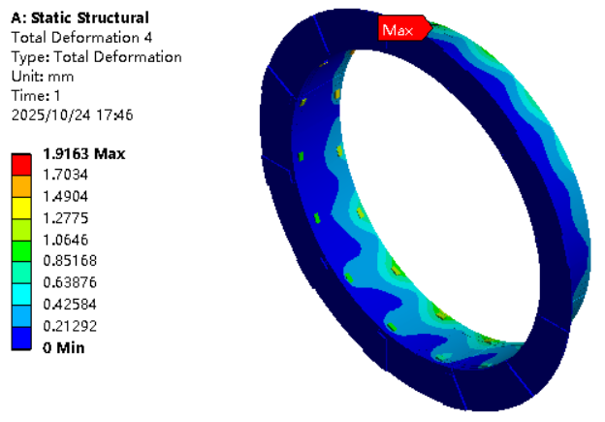
Endcap ECAL mechanics
FEA result
GS in one box
25.3MPa
0.075mm
The max principal stress of GS is 32MPa which is lower than its allowable stress 60MPa
Absorber structure during self-gravity condition
Connection parts are made of SS (18Mn18Cr)
1.5 safety factor

Slide 12
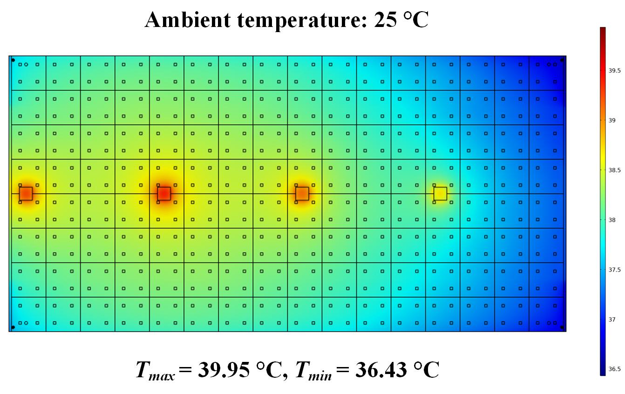
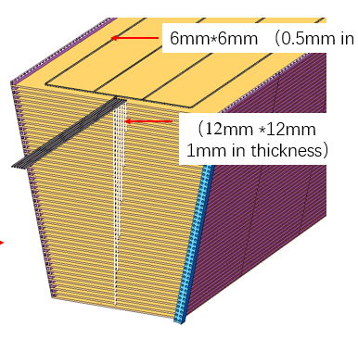


HCAL cooling system
Cooling scheme definition
The temperature error of different SiPM need to be controlled less than ±1.5℃
The excessively narrow interlayer gaps significantly reduce the efficiency of natural convection and air cooling, thereby failing to address the thermal management demands.
It is imperative to adopt liquid cooling technology to ensure efficient heat dissipation and temperature uniformity.
Cooling structure of barrel and end cap HCAL
FEA result of thermal performance of natural convection
4 pipes in each layer in parallel
8 layers gather in one pipe in parallel
One end is inlet and another end is outlet
1 pipe in each layer for one wedge
5 layers gather in one pipe in parallel for one wedge
There is one inlet and outlet for each region.
FEA result of thermal performance of air-cooling

Slide 13


HCAL cooling system
FEA simulation of cooling system
Temperature distribution of the HCAL through liquid cooling
Eight-in-one design of flow pipe
(b) Flow velocity distribution across different layers
Inlet temperature is 15 ℃ with a flow rate of 0.005 kg/s (corresponding to an inlet velocity of 0.1 m/s).
Effectively maintaining the temperature rise below 0.6 °C.
The maximum temperature variations of chips under the same modules were under 0.1 °C
Achieving a uniform flow velocity distribution across different layers
The pipe resistance and length of endcap HCAL is smaller than barrel HCAL, so the same scheme can also meet our requirement

Slide 14


HCAL prototype and GS test structure
Beam test for two HCAL prototypes
Beam test for GS
7 GS with same dimension
Beam goes through different position for each GS
1st GS chain
6 GS with different dimensions
Beam goes through the center of each GS
Different SiPM suppliers
2nd GS chain

Slide 15






HCAL prototype and GS test structure
HCAL prototypes
One box
Real prototype and beam test
SiPM read out
Lower cover plate
LED read out
GS with reflective coating
Electronics board
SiPM
LED
Box
Gasket
PCB plate
Absorber
plate
Upper cover plate
Cooling fins
Bottom plate
Bolts
7 Boxes in one prototype
9 GS in one box
@CERN

Slide 16
Thanks

