Slide 1
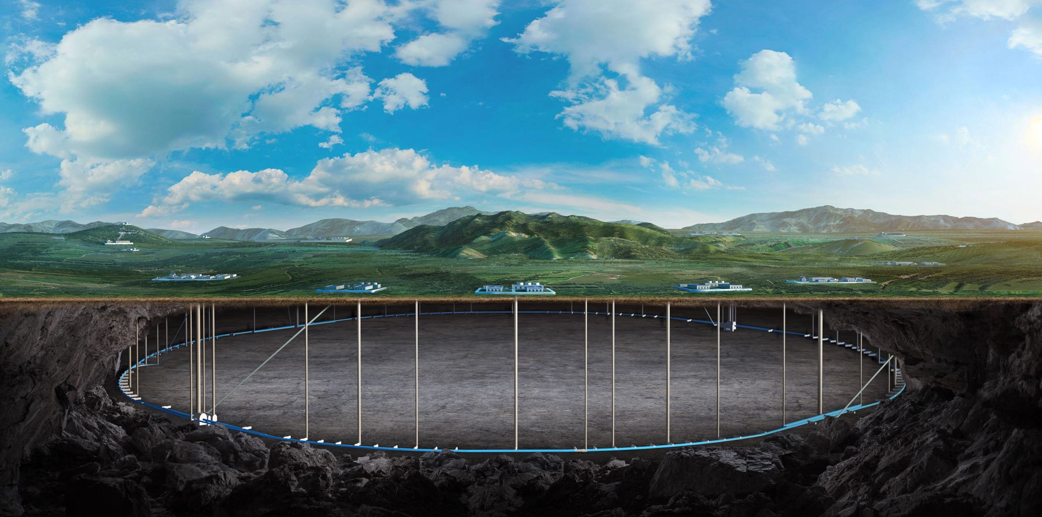


The overall readout electronics for the reference detector at CEPC
Zheng Wang
On behalf of the CEPC electronics group
November 8th, 2025 - CEPC Workshop 2025, Guangzhou

Slide 2
Outline
Requirements for the electronics
Global framework of the electronics system
Common electronics design & frontend ASICs
Research team and working plan
Summary

Slide 3
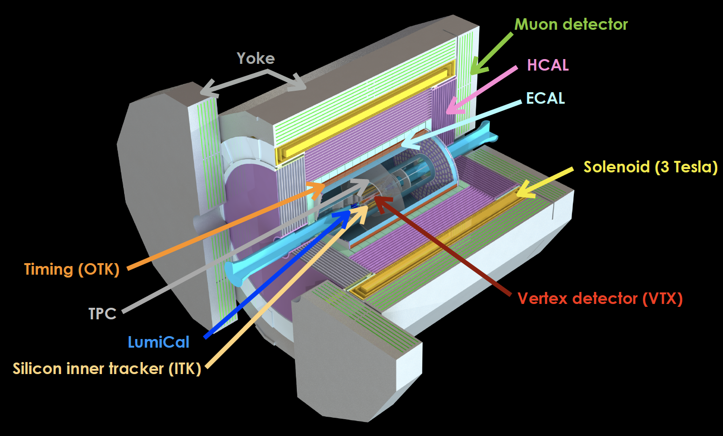
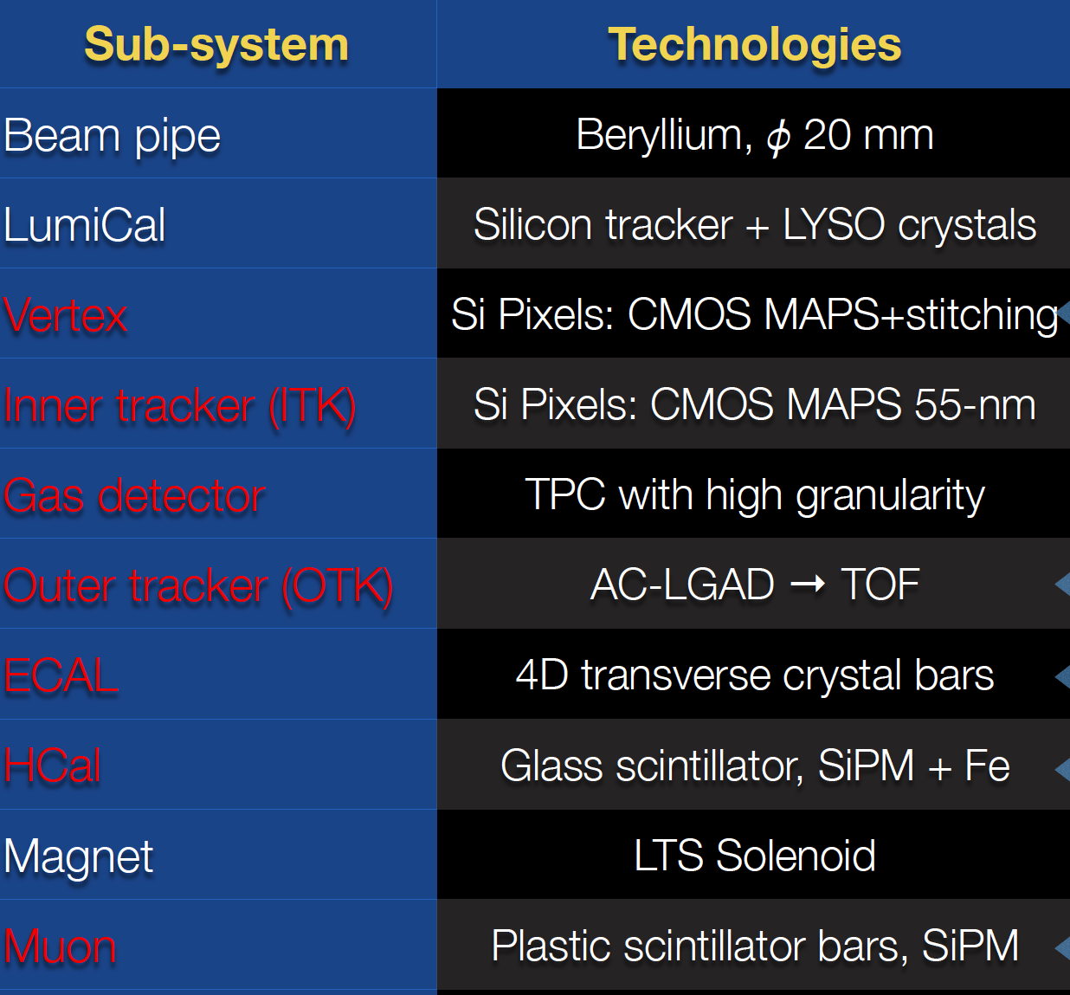
The Reference Detector
The electronic system is to readout tens of millions of detector channel in real time.

Slide 4
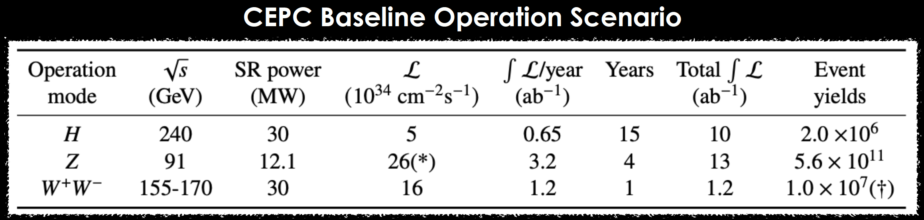
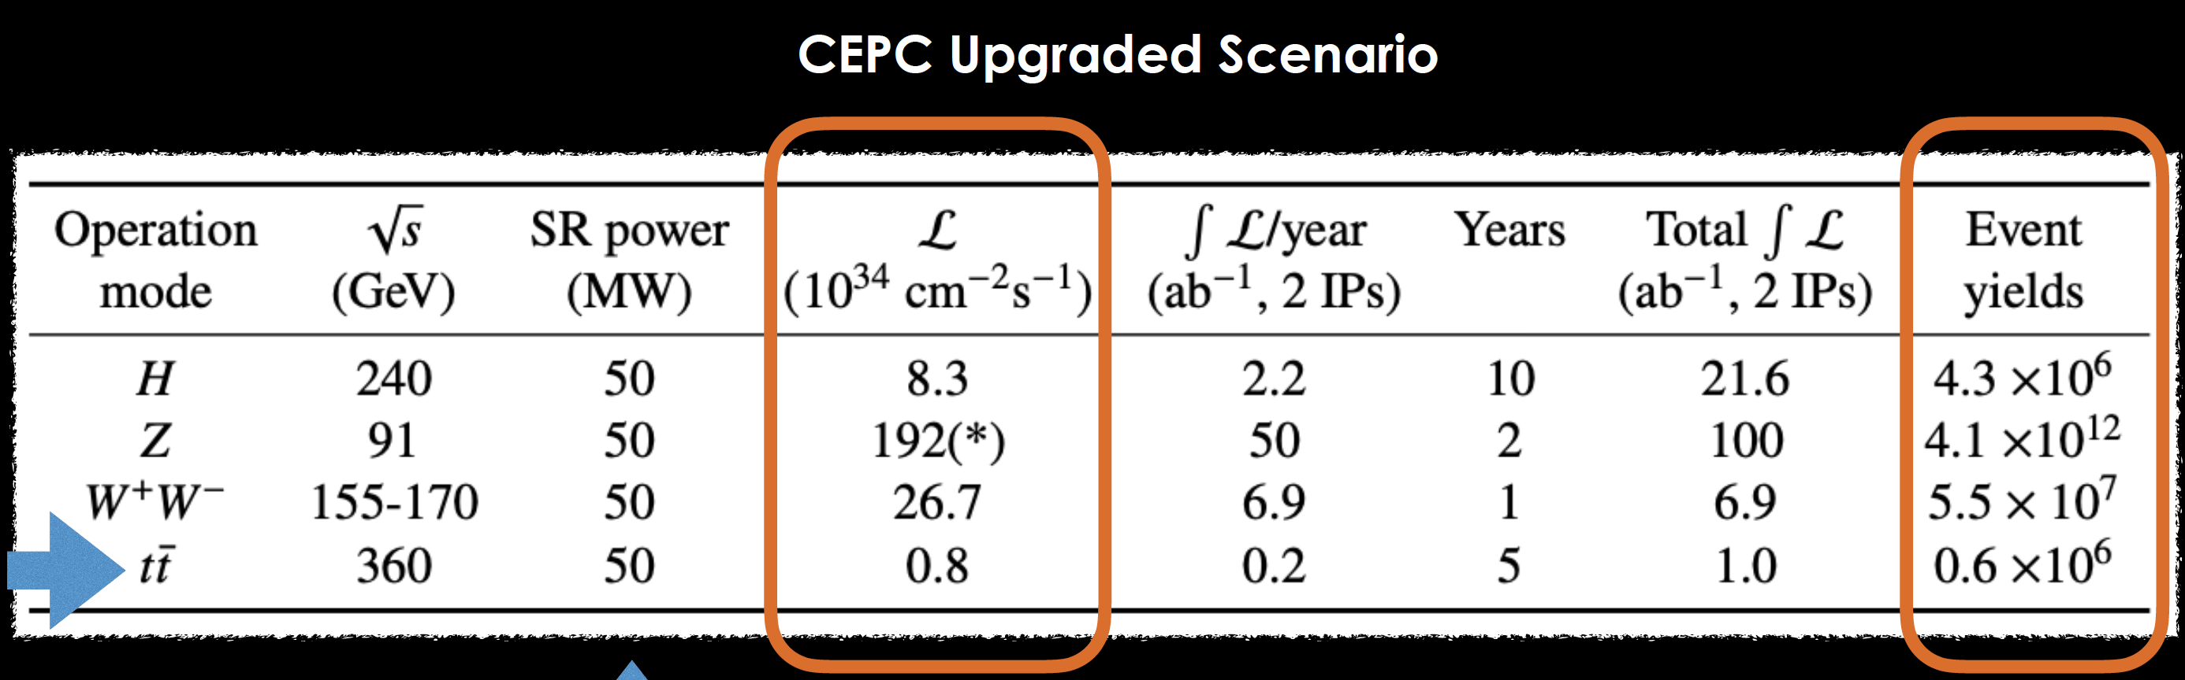
Requirements for the electronics
This talk will focus on electronics baseline design
Future upgrade possibility considered

Slide 5
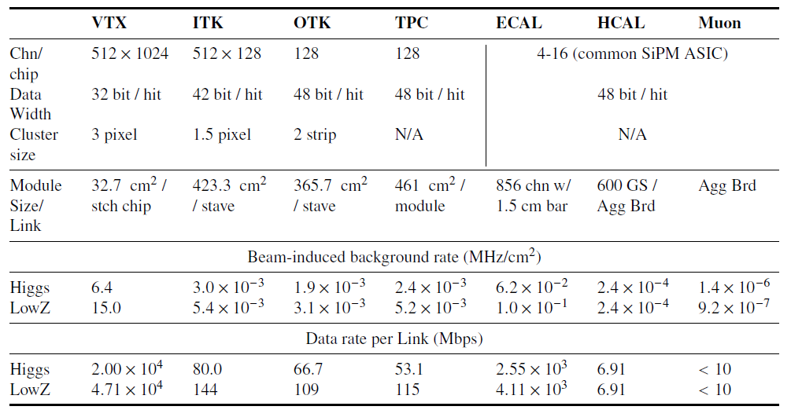
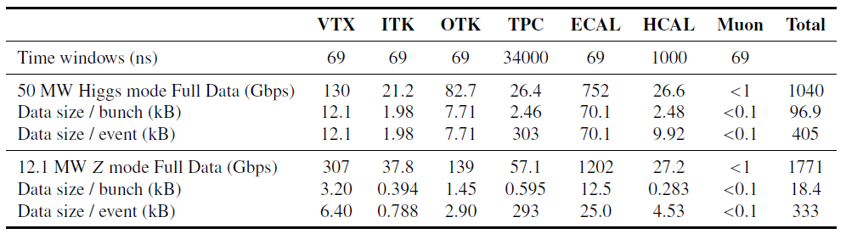
Critical Input from Sub-Det & MDI
Safety factor of 2 used for background rate estimation from MDI study
Endcap detectors have the highest hit rate, mostly from the beam background
Time window and data rate for TDAQ system
Max data rate for the detector:
1040 Gbps (for Higgs)
1771 Gbps (for LowLumZ)

Slide 6
Do we need hardware trigger ?
Two main frameworks for the electronics-TDAQ can be simply categorized as full data transmission (FEE-Triggerless readout) & readout with hardware trigger.
 | Full data transmission | Hardware Trigger
Where to acquire trigger info | On BEE | On FEE
Trigger latency tolerance | Medium-to-long | Short
Compatibility on Trigger Strategy | Hardware / software | Hardware only
FEE-ASIC complexity on Trigger | Simple | Complex on algorithm
Upgrade possibility on new trigger | High | Limited
FEE data throughput | Large | Small
Maturity | Mature but relatively new | Very mature
Resources needed for calculation | High | Low
Representative experiments | CMS, LHCb, … | ATLAS, BELLE2, BESIII, …

Slide 7
Global framework of the CEPC Electronics
Figure 11.2
Det-ASIC
Customized frontend
Det-ASIC
Data Aggregation & Data Buffering （FEDA）
Data Interface
（FEDI）
Optical Module
（OAT）
Det-ASIC
Det-ASIC
Data Link, Clock & Ctrl
Fiber
(Only)
DC-DC - LV
1.2/2.5V
（PAL-LV）
DC-DC - MV
12/48 V
(PAL-MV）
Power Management
Radiation tolerant
Common subsystems (data buffering, aggregation, transmission; powering)
A common BEE hardware, configurable for individual subsystems.
TDAQ interface is only on BEE
Trigger
Comm-Brd
Trg. Info.
Power Cable
BEE
Comm-Brd
DAQ
Slow Ctrl
Non Rad-tol
Backend: Common Platform

Slide 8
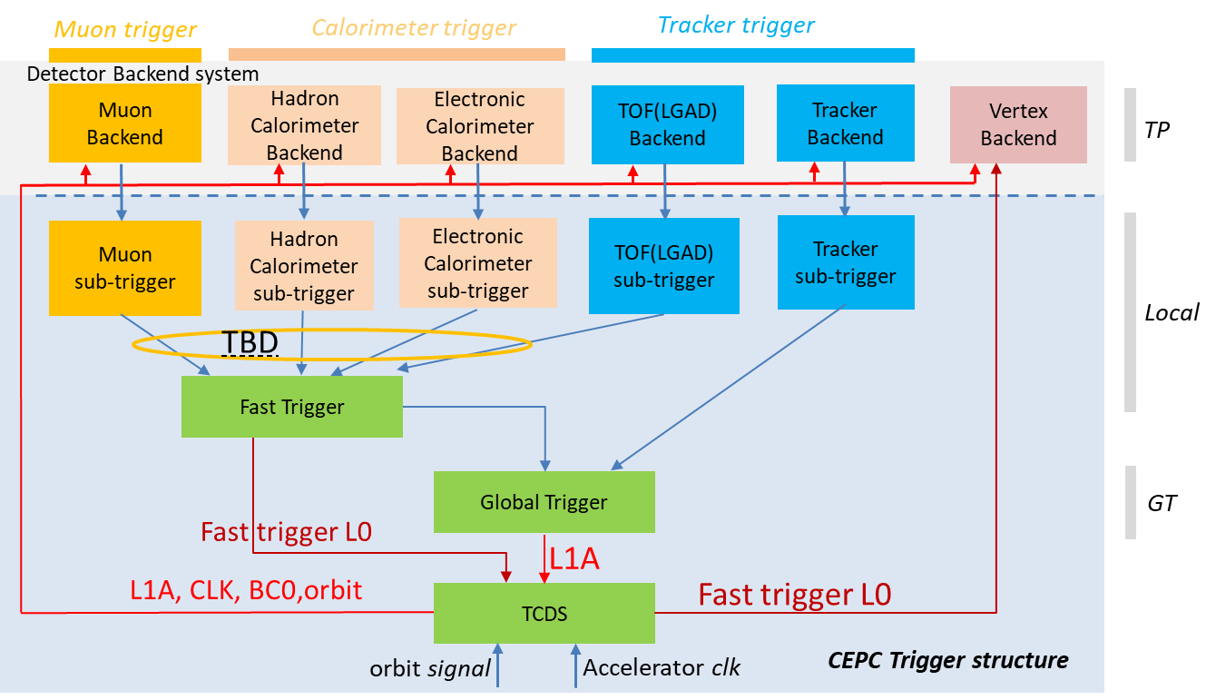
Backup scheme of the framework
The proposed framework was based on the estimated background rate of all sub-det.
Background rate indicated the data link capability can manage the Phase I operation of Higgs & LowLumiZ for first ten years.
For high LumiZ, the detector will upgrade
VTX, ITK.. (replaceable) can be upgraded with new chips
ECAL, HCAL (unreplaceable) will have more fiber channels
The hardware trigger scheme can serve as a backup plan, with sufficient on-detector data buffering and reasonable trigger latency.

Slide 9
Key Electronics Components
Frontend ASICs for sub-detectors
Common Data Link
Common Powering
Common Backend Electronics
Alternative Scheme based on Wireless Communication

Slide 10
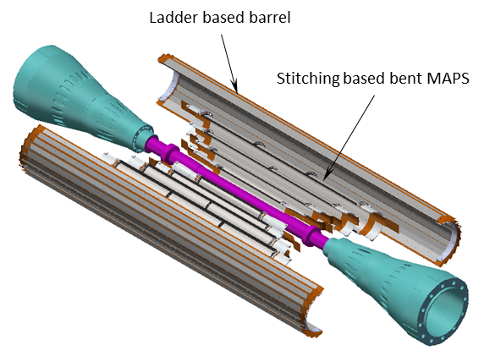
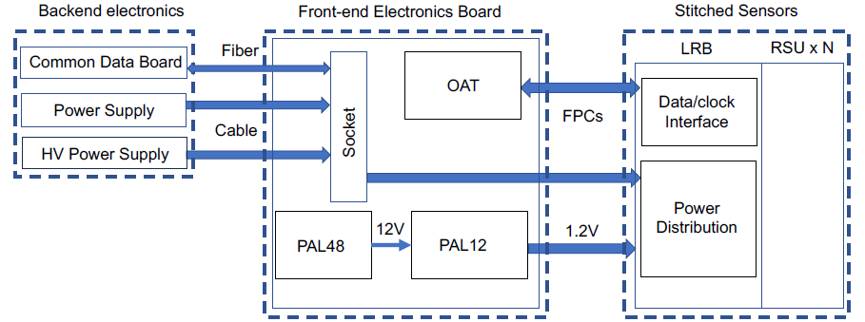
Vertex Detector Baseline layout
See Ying Zhang’s talk (11:30)
Baseline :4 single layer of bent MAPS + 1 double layer ladders
Inner layer: Use single bent MAPS for Inner layer (~0.15m²)
Low material budget 0.06%X₀ per layer
Different rotation angle in each layer to reduce dead area
Outer layer: Double layer Ladder (~0.28% X₀ per layer)
Long barrel layout covering cos θ<=0.991

Slide 11
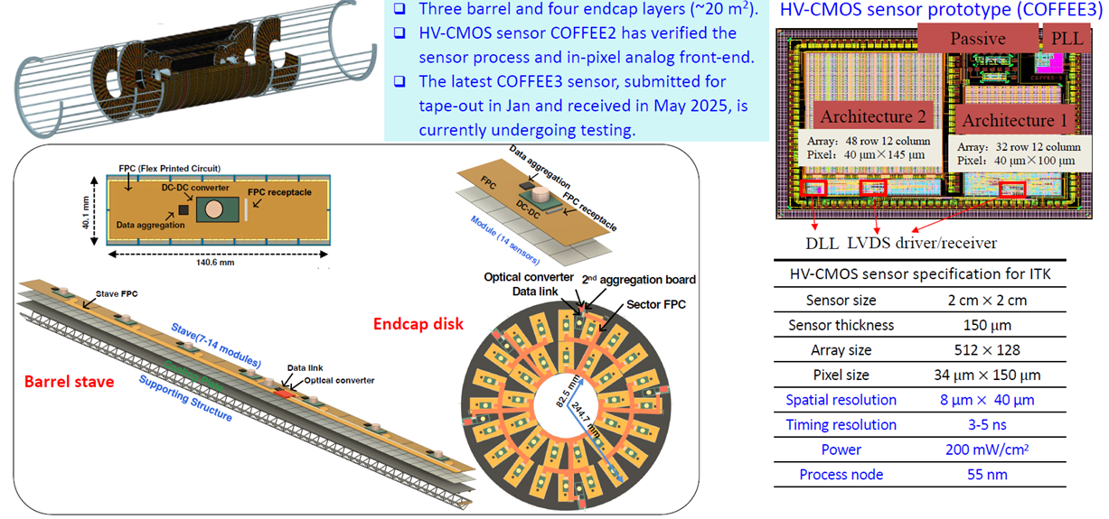
ITK Design with HV-CMOS Pixels

Slide 12
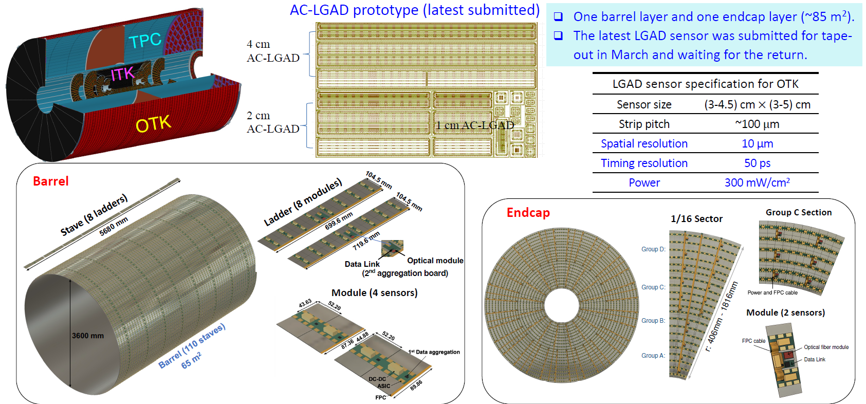
OTK Design Based on AC-LGAD Strip Sensor

Slide 13
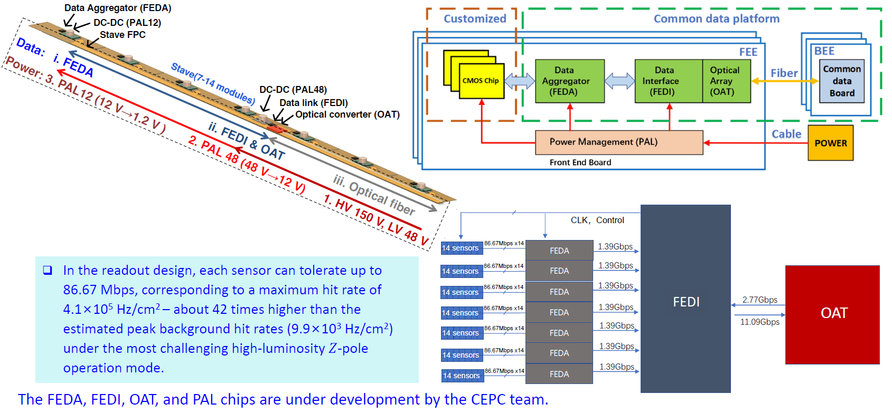
Readout Electronics framework for TRK
See Xiongbo yan ’s talk (11:50)

Slide 14
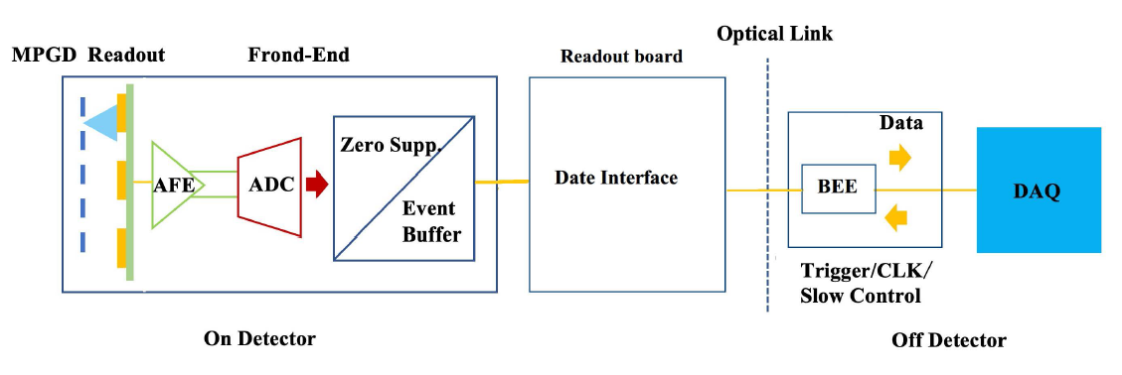
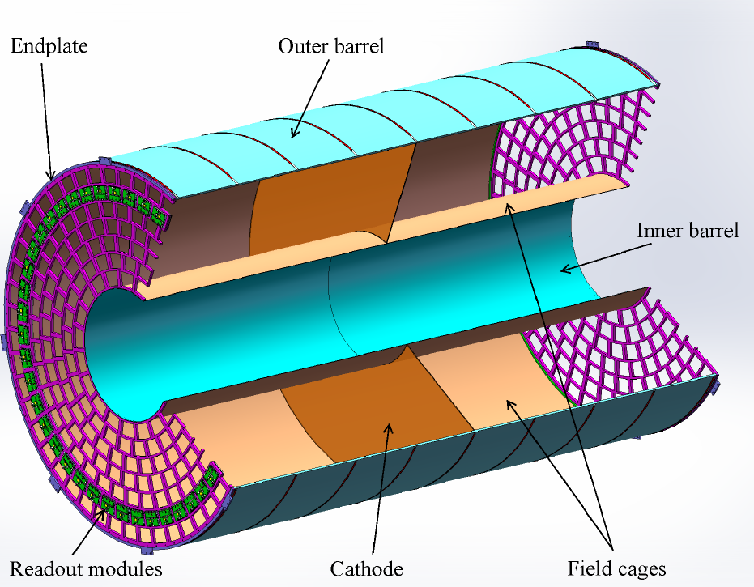
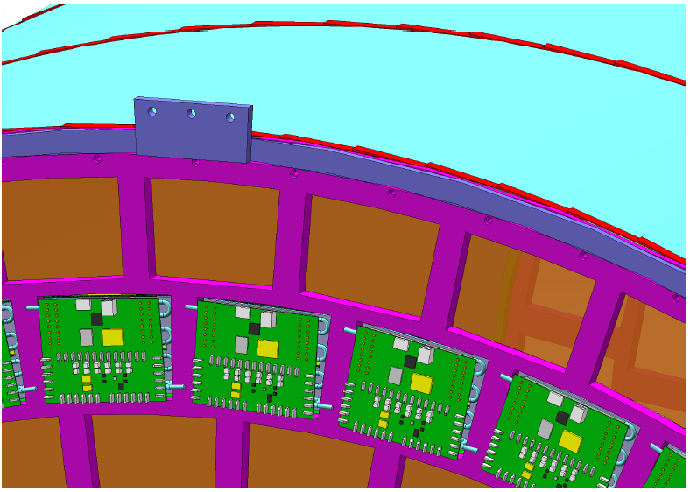
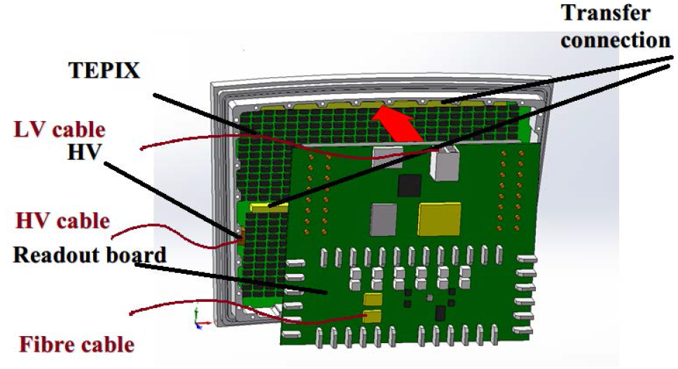
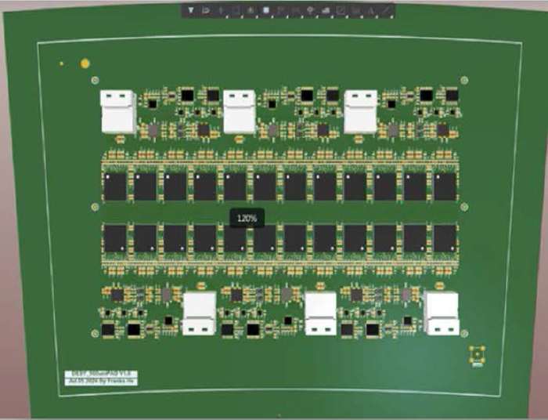
TPC electronics
See Zhi Deng’s talk (12:10)
On detector: readout modules
Double-mesh Micromegas with high granularity readout (500μm × 500μm pad size)
FEE board: a readout ASIC chip array. Interposer connection between pads and ASIC chis
Readout board: data interface and data concentrator
Off detector:
High-speed optical links
Off-detector BEE
Data Acquisition (DAQ) system

Slide 15
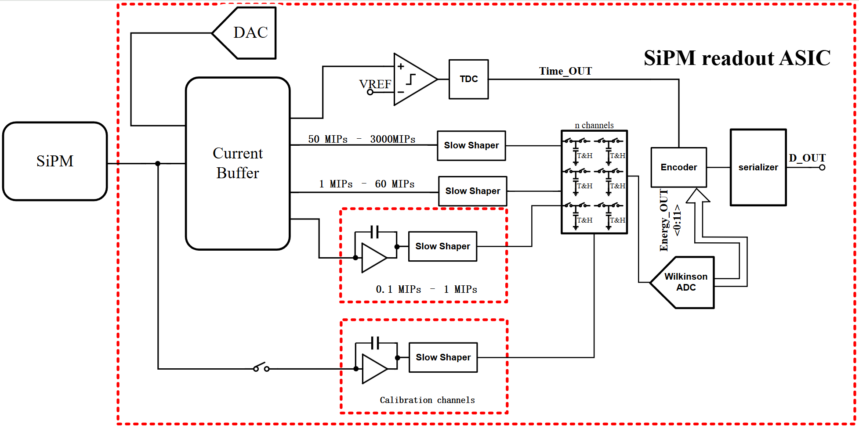
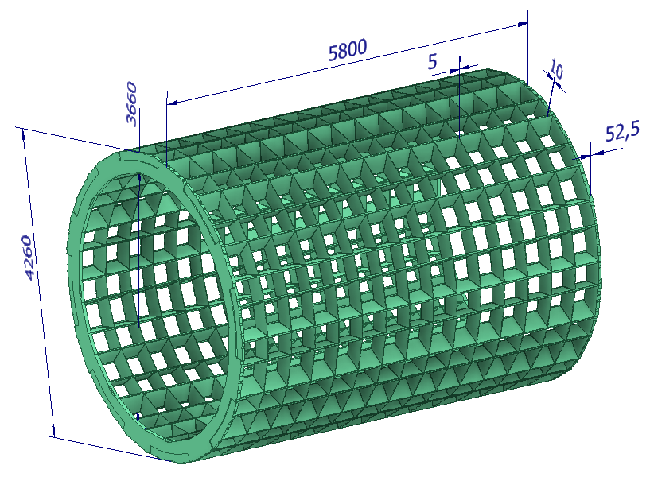
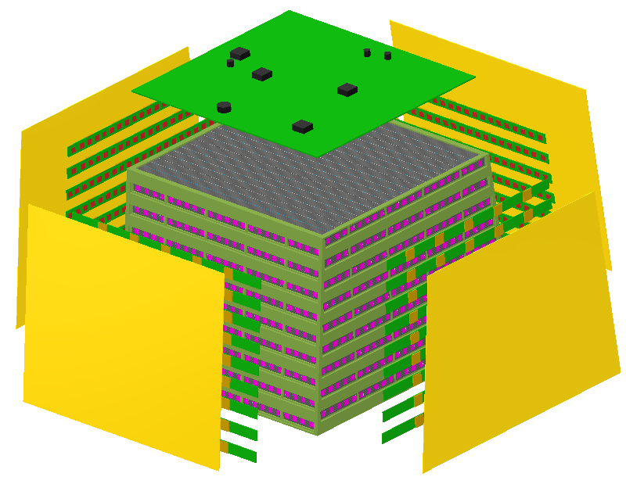
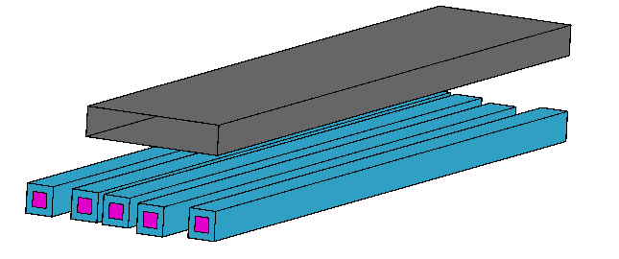
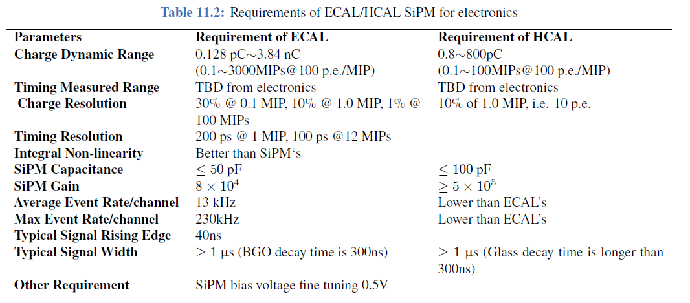
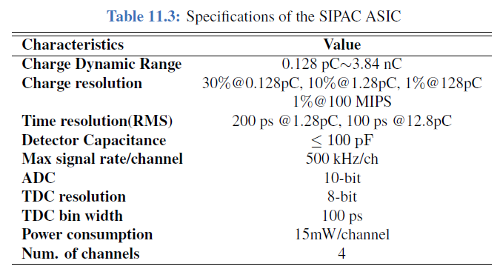
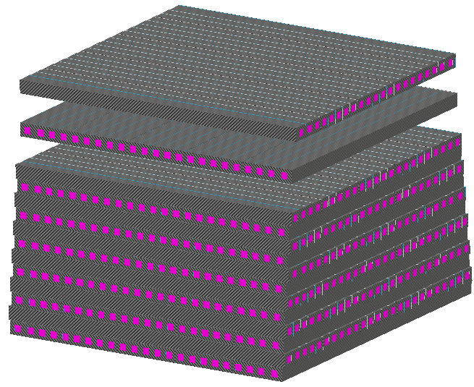
ECAL electronics
See Jinfan Chang’s talk (14:00)
See Huaishen Li’s talk (14:30)
Main Structure
Module Integration

Slide 16
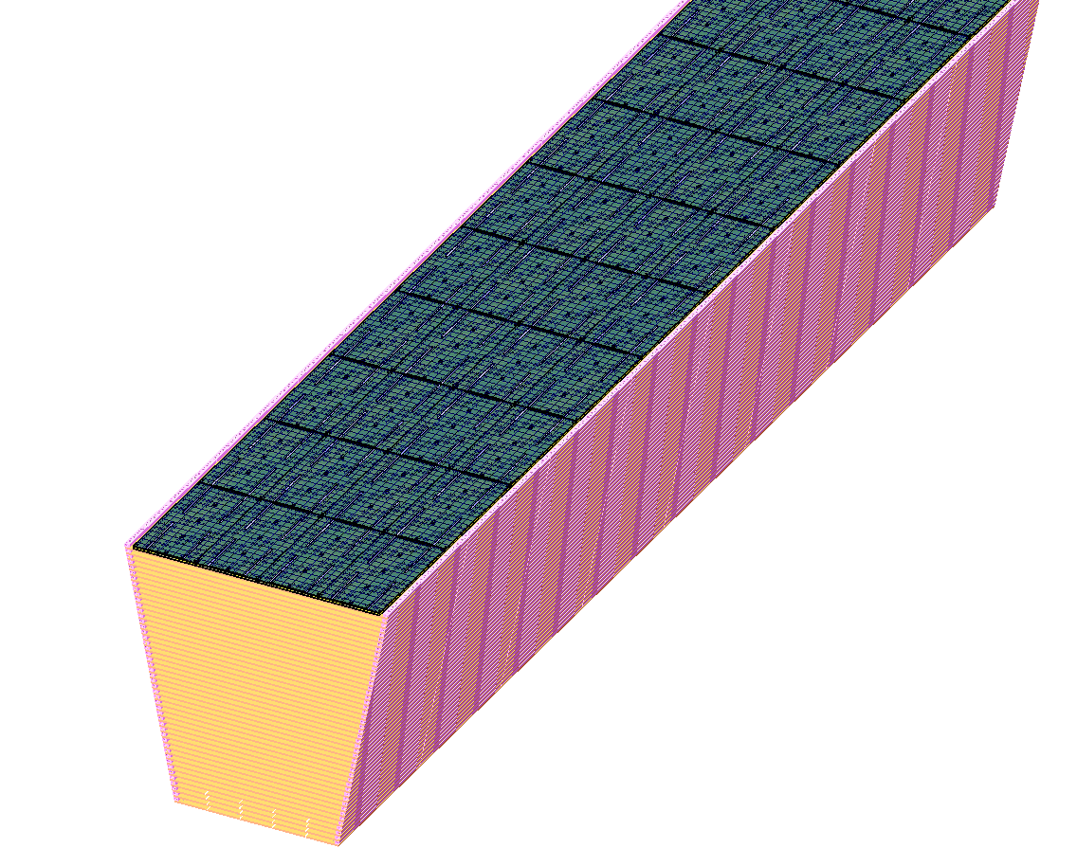
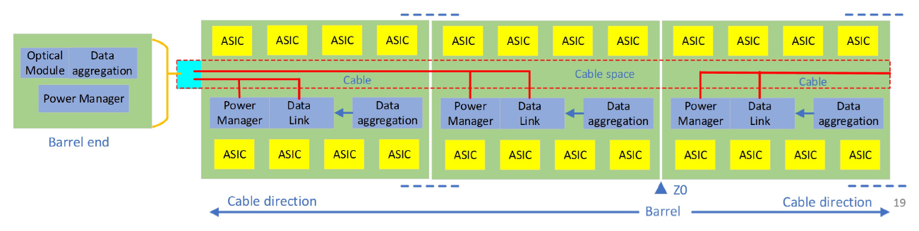
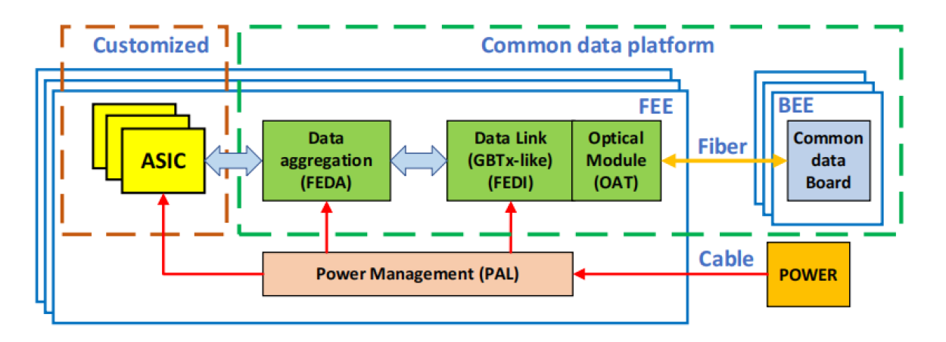
HCAL electronics
See Jinfan Chang’s talk (14:00)
FEE
Front-End boards in HCAL cell Box
thickness limited: 3.2mm = PCB 1.2mm + ASIC 2mm
SiPMs, ASICs and Data Aggregation
PCB dimensions: flexible in different positions
SiPM-readout ASIC
customized for CEPC calorimeter system
functionality: energy and time measurements
power consumption: 15mW/ch
Aggregation board at the end of barrel, cable connection
Energy Measurement: ASIC for ECAL & HCAL
Data transmission: common
Trigger mode: FEE triggerless readout

Slide 17
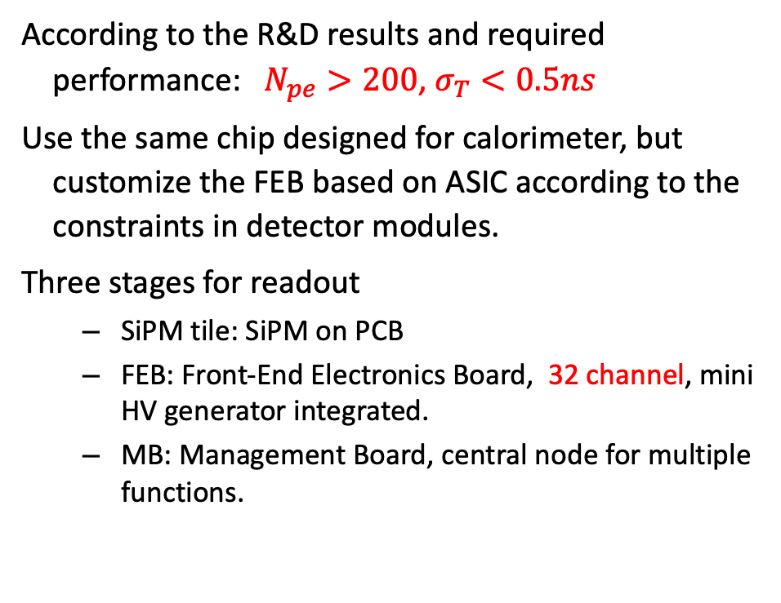
Muon electronics
See Jie Zhang’s talk (14:15)
According to the R&D results and required performance: $N_{pe}>200$, $σ_{T}<0.5ns$
Use the same chip designed for calorimeter, but customize the FEB based on ASIC according to the constraints in detector modules.
Three stages for readout
SiPM tile: SiPM on PCB
FEB: Front-End Electronics Board, 32 channel, mini HV generator integrated.
MB: Management Board, central node for multiple functions.
New
New
FEB
MB

Slide 18
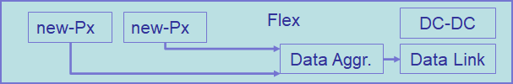
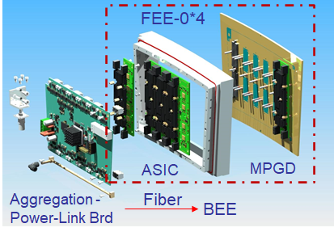
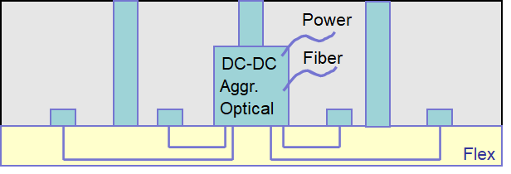
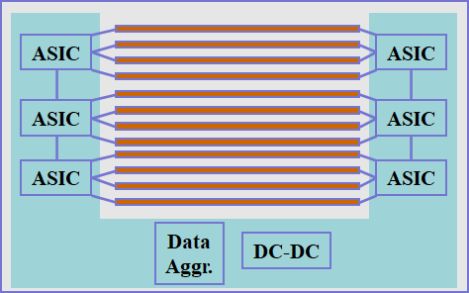
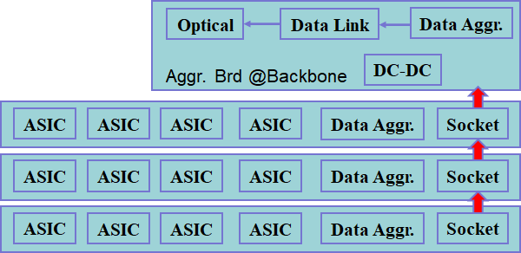
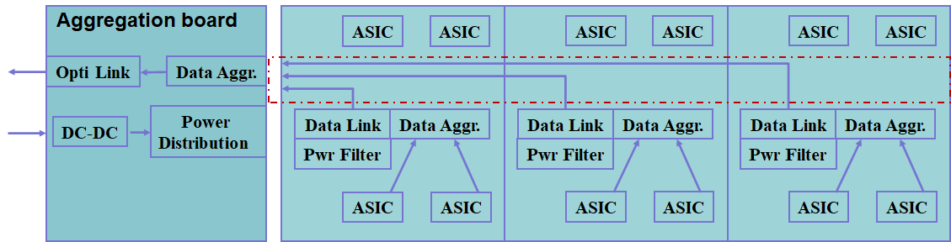
An overview of the sub-detector electronics
VTX
All sub-det readout electronics were proposed based on this unified framework, maximizing common design, easy for production and maintenance.
TPC
TRK
ECAL
HCAL

Slide 19
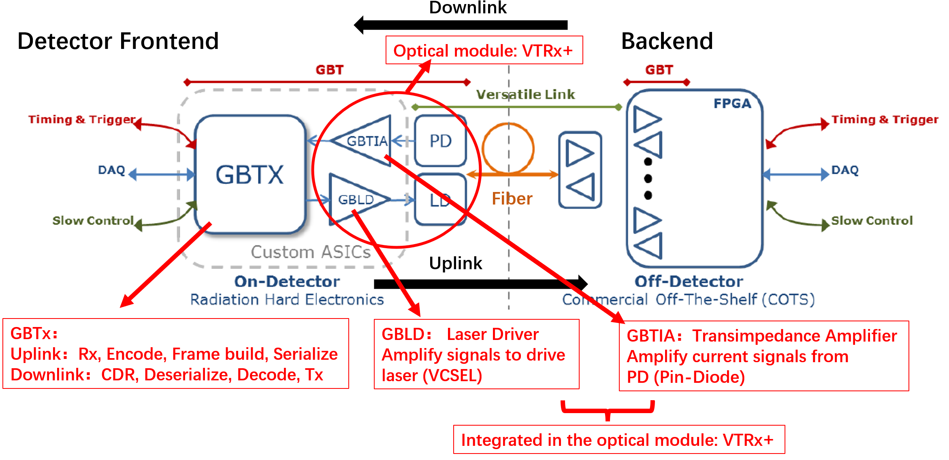
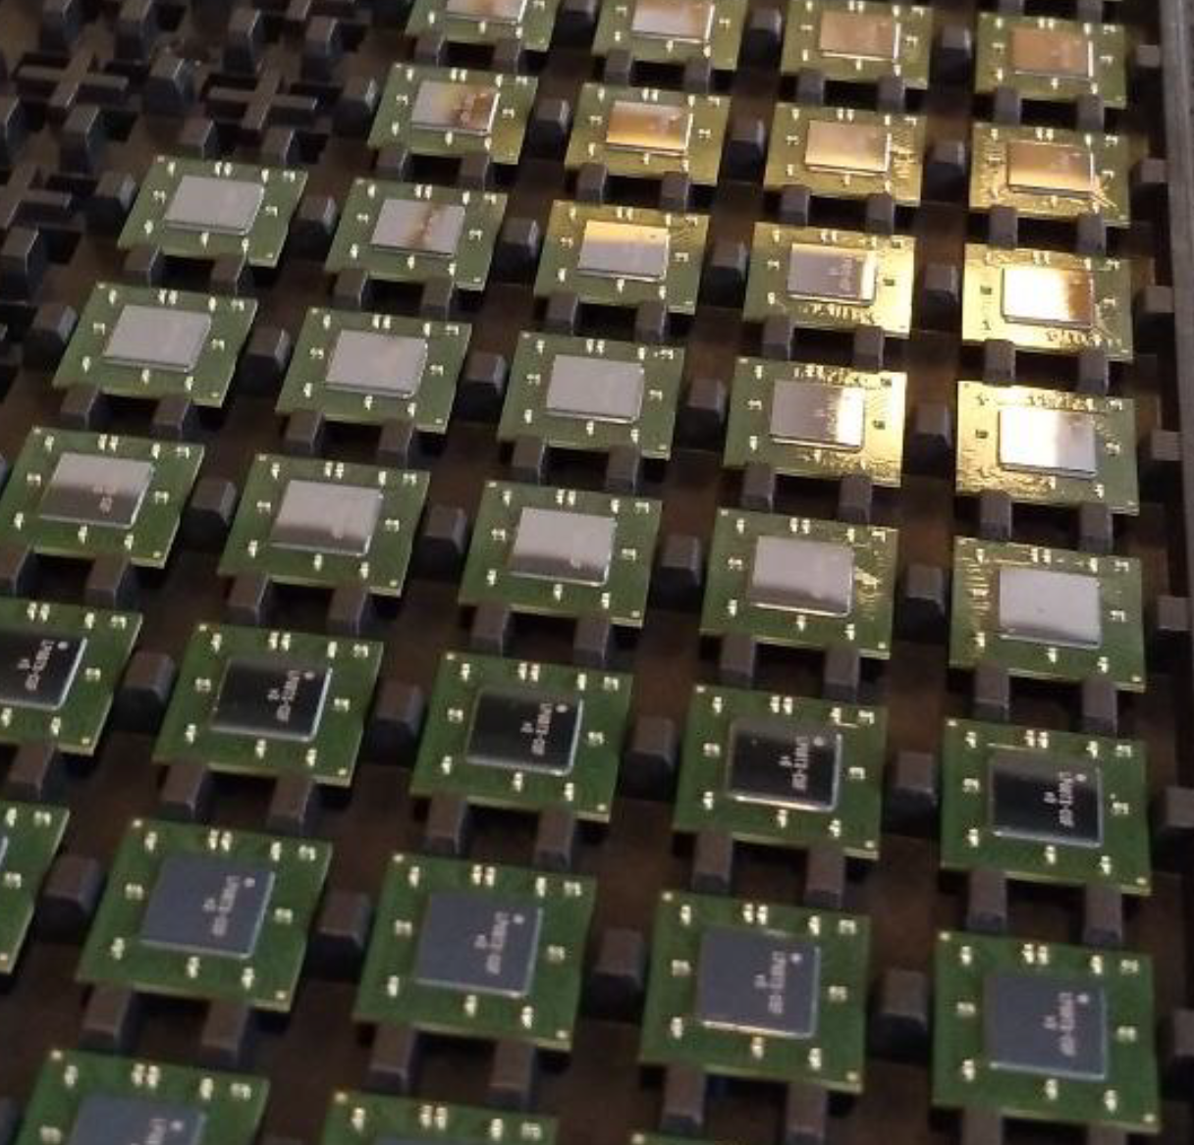
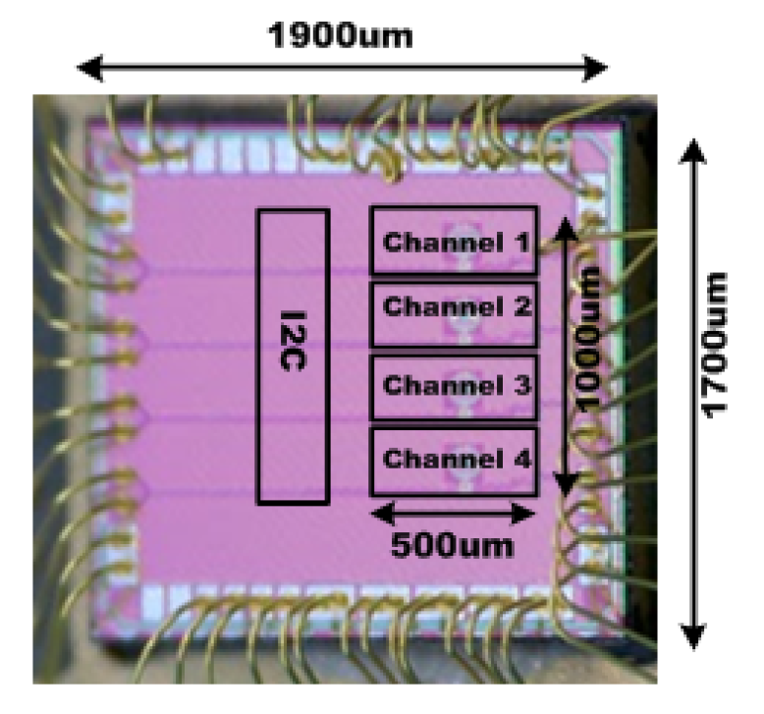
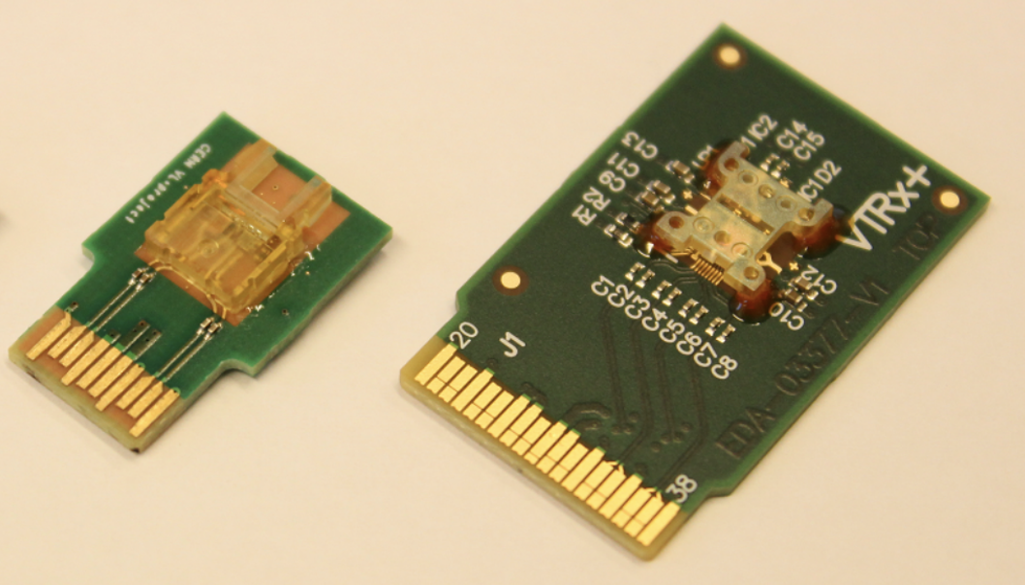
Technical Survey on Data Transmission
GBT Project:
The lpGBT & VTRx chip series, developed by CERN, are widely used by LHC.
Core components:
GBTx: Bidirectional Serdes ASIC
GBLD: Laser driver
GBTIA: Transimpedance amplifier
Customized Optical Module
However the base clock frequency of CEPC 43.3MHz is not compatible with lpGBT system
Our choice:
Build a GBT-like universal bidirectional data transmission system
Take the lpGBT as a reference, the protocol can be a minimum & necessary set for the readout, clocking & control
GBT Architecture Developed by CERN
Ref. P. Moreira, The GBT Project, 2007
lpGBTx
Uplink: 10.24Gbps
Downlink: 2.56 Gbps
GBLD (LDQ10)
10.24 Gbps x 4ch
GBTIA
2.56 Gbps
VTRx+
4Tx + 1Rx
Array Optical Module
GBT Series ASICs and optical module
Ref. P. Moreira, GBT Chipset Status and Production Plans, 2013

Slide 20
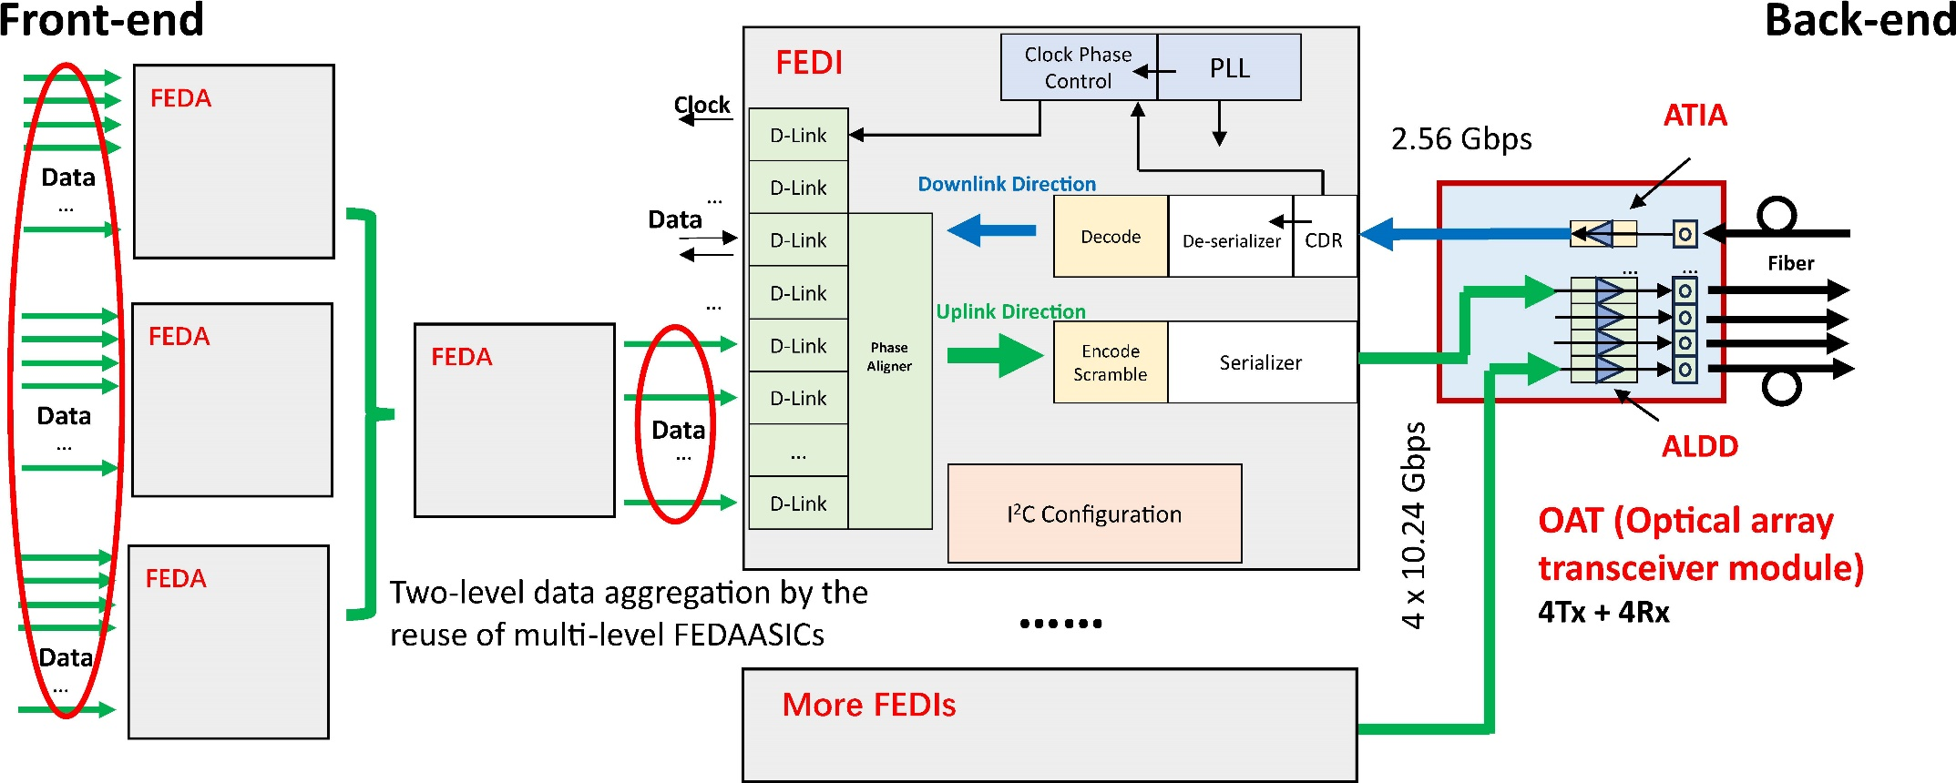
Detailed design on Data Transmission Structure
See Xiaomin Wei’s talk (15:10)
See Guoxiang Zhang’s talk (16:00)
First version ASICs submitted October, 2025
FEDA
FEDI
OAT
Pre-Aggregation ASIC (FEDA): Intend to fit with different front-end detector (different data rates/channels)
GBTx-like Data Link ASIC (FEDI): Bidirectional serdes ASIC including ser/des, PLL, CDR, code/decode …
Array Laser Driver ASIC (ALDD) + TIA ASIC (ATIA) + Customized Optical module (OAT)

Slide 21
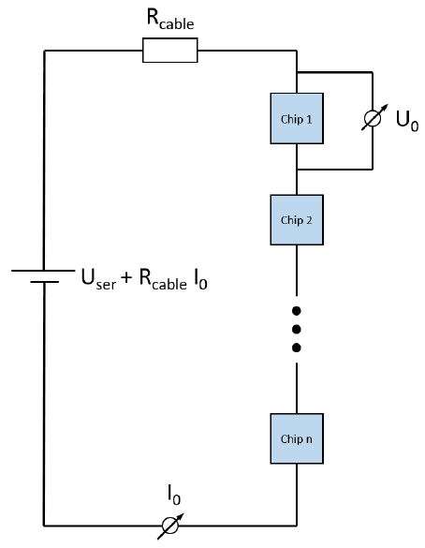
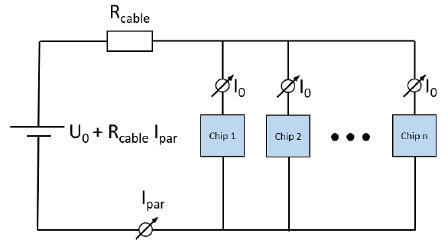
Technology Survey and Scheme on Powering
Ref. Malte Backhaus, 2018
 | Serial Power | Parallel Power
Material | Much less
Cabling | Much less
Installation | Much easier
Maturity | New | Very mature
System Reliability | Potential issue | Very robust
Parallel Powering
On powering distribution
Serial Powering is superior in many aspects (material, cabling and installation…) than Parallel Powering, especially on VTX & TRK
It is also a hot area with a lot of focused R&D
However, due to the common substrate at negative voltage for the stitching sensor in VTX, serial powering is not feasible
Our choice
As a general platform, we chose (conventional) Parallel Powering as the baseline scheme, while to keep pace on R&D of Serial Powering as the backup scheme
Serial Powering

Slide 22
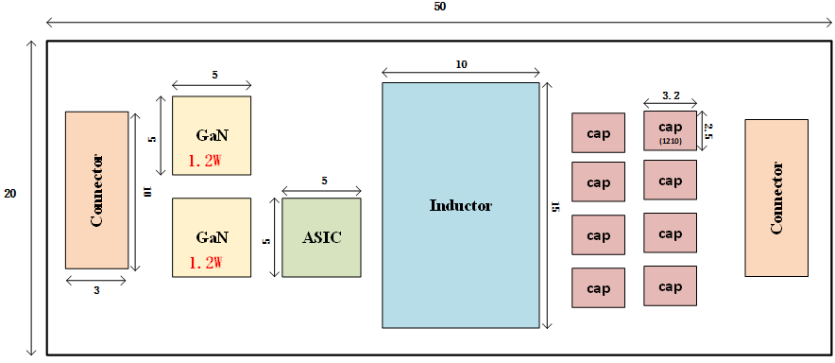
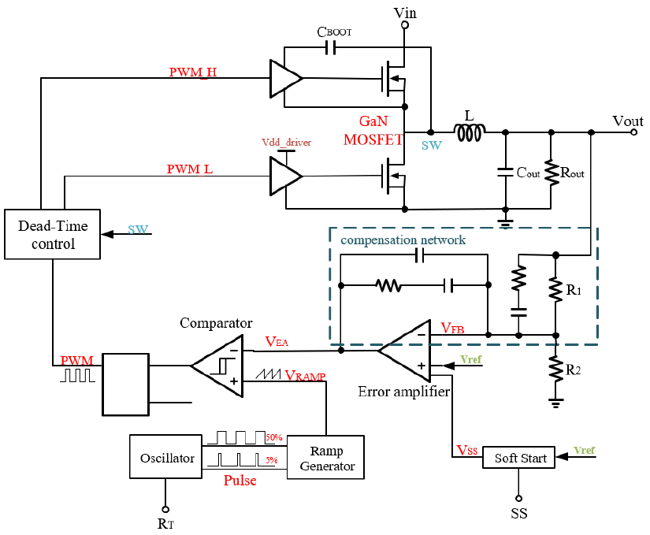
R&D efforts preliminary design on powering
See Jia Wang’s talk (16:55)
Design spec summarized from Sub-Det
Preliminary rad-tol. of COTS GaN verified
Proposed design of BUCK DC-DC convertor
PAL Series
Figure 11.52
 | Nominal | Range
Input V | 48V | 36V-48V
Output V | 1.2V | 1.2V、3.3V
Output Current | 10A
Output ripple | 10mVpp
Efficiency | 85% | 80%-85%-80%（light-nom -heavy）
Dimension | 50mmX20mmX6.7mm | Including cooling & shielding
TID | 5 Mrad（Si）
Magnet | 3T

Slide 23
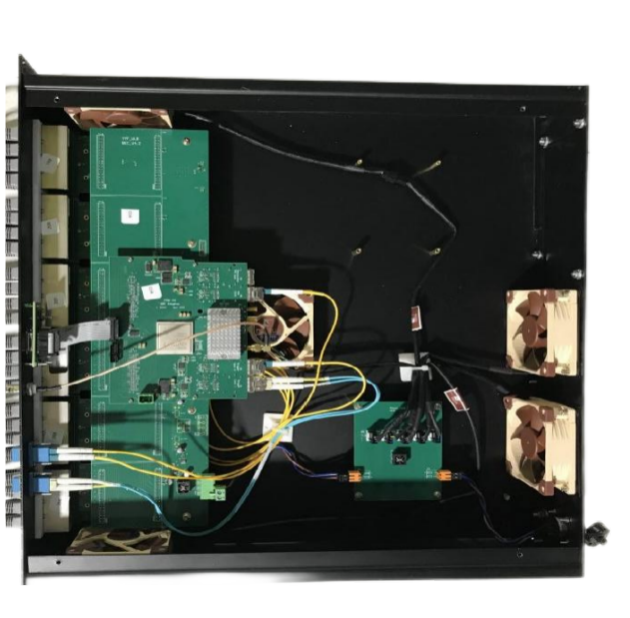
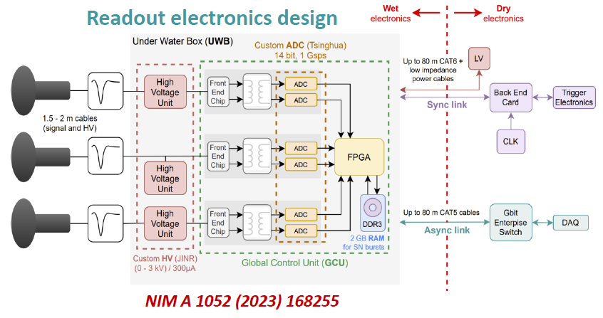
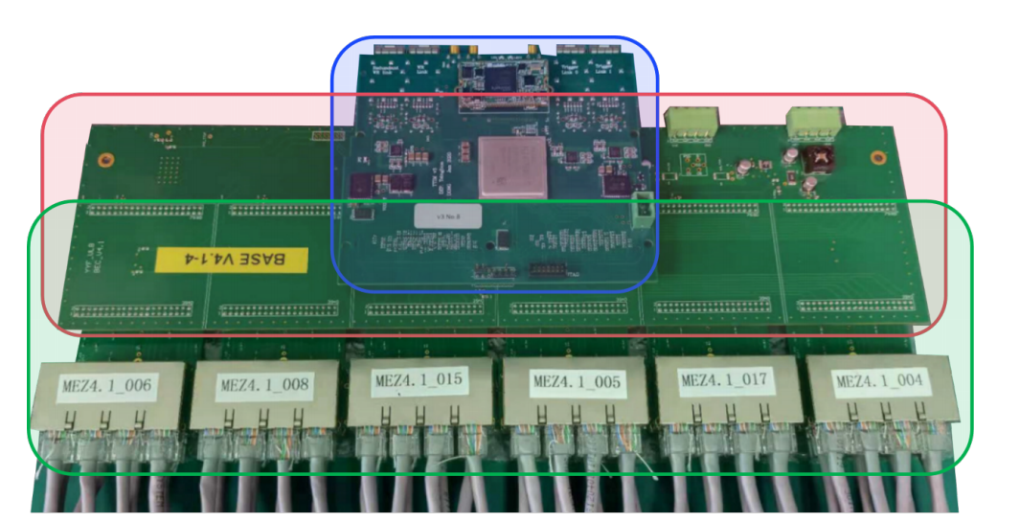
Related R&D and experience on BEE
The back-end box for the JUNO experiment
located between trigger system and front-end electronics,
Collects the incoming trigger request for trigger system,
Fanout the synchronized clock and the trigger decisions to front-end electronics.
Red box: The base board provides the power supply,
Blue box: Trigger and Time Interface Mezzanine (TTIM) with WR node,
Green box: The extenders interface with ethernet cables coming from underwater front-end boxes.

Slide 24
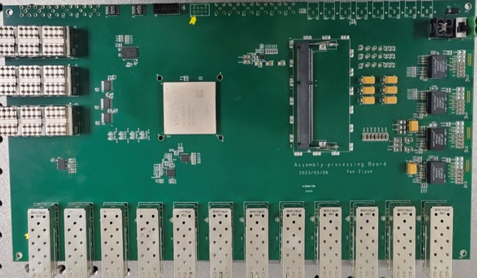
Detailed design on common BEE
See Jun Hu’s talk (17:10)
 | KC705 (XC7K325T-2FFG900C) | KCU105 (XCKU040-2FFVA1156E) | VC709 (XC7VX690T-2FFG1761C) | VCU108 (XCVU095-2FFVA2104E) | XCKU115
Logic Cells(k) | 326 | 530 | 693 | 1,176 | 1451
DSP Slices | 840 | 1920 | 3,600 | 768 | 5520
Memory(Kbits) | 16,020 | 21,100 | 52,920 | 60,800 | 75,900
Transceivers | 16(12.5Gb/s) | 20(16.3Gb/s) | 80(13.1Gb/s) | 32(16.3Gb/s) and 32(30.5Gb/s) | 64(16.3Gb/s)
I/O Pins | 500 | 520 | 1,000 | 832 | 832
Cost | 2748 (650) | 3882(1500) | 8094 | 7770
Data aggregation and processing board Prototype for Vertex detector
The back-end Card structure
Routing data from front-end optical link to highspeed network to DAQ.
receives clock, global control from TTC, and synchronized and fanout to front-end.
Real-time data processing, such as trigger algorithm and data assembly.
On-board storage for data buffering.
Xilinx Kintex UltraScale series preferable, cost-effective/availability.
Interface：SFP+ 10 Gbps✖️12 + QSFP 40 Gbps ✖️ 3
FPGA based machine learning for clustering, hit point searching, and tracking algorithms

Slide 25
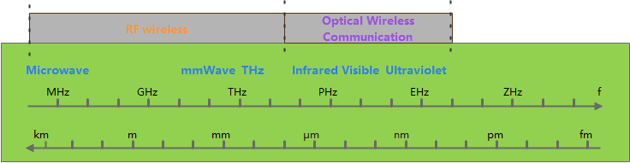
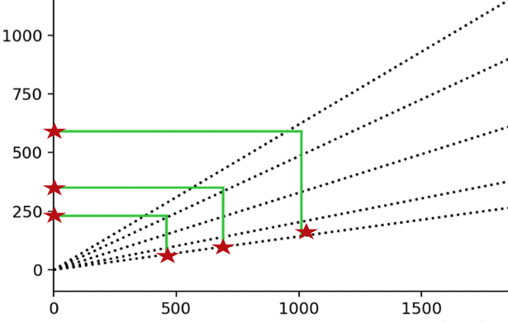
Alternative scheme based on wireless communication
Silicon Inner Tracker
Axial readout
R [mm]
Radial readout
WiFi (2.4GHz, 5GHz)
large antenna volume, high power consumption, narrow frequency band, and high interference
Millimeter Wave (24GHz，45GHz，60GHz，77GHz)
Optical wireless communication (OWC) / Free Space Optical (FSO)
Z [mm]
Radial readout with mm-wave
12- 24 cm distance
Data rate : < 30Mbps
Axial readout to endcap
Only at the outermost layer or dedicated aggregation layer.
Wireless communication based readout scheme was proposed to mitigate the cabling problem, as a backup scheme.

Slide 26



Recent progress on mm-wave transmission
Dummy Flex with MMW
Single-channel MMW RX/TX verified
Max distance: 1.25Gbps @ 67.5cm
Max line rate: 6.6Gbps @ 22.5cm
Multi-channel Millimeter-Wave transmission prototype in development
Millimeter-wave modules mass produced and tested
TX/RX flex PCBs and adapter boards produced, assembly in progress
FPGA data source board produced and tested
Repeater design: double-sided PCB, in progress
Focus: Multi-channel crosstalk validation
MMW transmission module
Multi-channel Millimeter-Wave transmission prototype
FPGA data source board

Slide 27


Electronics interface to the counting room
Data Link, Fibers & BEE
On-detector LV, HV & cables
Fibers：12,628
Power cables: 11,346
Total power consumption: 450 kW

Slide 28






Research team
Electronics working group was founded: IHEP + universities, ~50 staffs (not full time) + 60 posdoc/student. We are looking for more collaborators.
IHEP joined DRD7 collaboration in July 2025.
Overall electronics and BEE: IHEP(5)
Sub-detector readout electronics: IHEP(11), Tsinghua(5), CCNU(3), NPU(7), SDU(4), NJU(3)
Data link: CCNU(3), IHEP(3), USTC(2), NPU(4)
Powering: NPU(3), IHEP(2), USTC(2)

Slide 29
ASIC development & teams
Chip | Application | Functional | Foundry & technology | Similar chips | Leading person | Development team | Staff | Students
Taichu | VTX | VTX-Stitching | Towerjazz 180nm / 65nm | MOSAIX | Wei Wei (IHEP) | NPU, CCNU, SDU, NJU | 10 | 8
TEPIX | TPC | Pixel TPC | TSMC 180nm (SMIC 55nm) | Timepix3/4 | Zhi Deng (THU) | IHEP | 1 | 4
COFFEE | ITK | HVCMOS | SMIC 55nm HV | MightyPix | Yiming Li (IHEP) | ZJU, NPU, DMU，SDU, NJU | 8 | 12
LATRIC | OTK | LGAD-TOF | SMIC 55nm | ALTIROC | Xiongbo Yan (IHEP) | CCNU, WTU, HPU | 9 | 10
SIPAC | SiPM ASIC | ECAL, HCAL, Muon | SMIC 55nm | HGCROC、SPIROC | Huaishen Li (IHEP) | CCNU, NPU | 5 | 6
FEDI | Common Elec | Data Link | SMIC 55nm | lpGBT | Di Guo (CCNU) | IHEP, NPU, USTC, WTU, HPU | 9 | 16
OAT | Common Elec | Optical | SMIC 55nm | VTRx+ | Di Guo (CCNU) | IPAS, IHEP | 3 | 3
FEDA | Common Elec | Data Aggregation | SMIC 55nm | lpGBT | Di Guo (CCNU) | IHEP, NPU | 2 | 4
PAL | Common Elec | DC-DC | SMIC 180nm HV | bPolx | Jia Wang (NPU) | IHEP, USTC, TECHORILUX | 7 | 3

Slide 30
ASIC Development Schedule
Overall Electronics system
Elec TDR Draft1
Towards final CEPC detectors
Final Design Review
Production Readiness Review
2024.12
2027.12
2029.12
2024.11
2025.1
2025.4
2026.12
2027.12
2028.12
2029.12
DC-DC Controller schematic design
PAL func module prototype
Module on detector test
Rad enhancement & Inductor design
Power & DC-DC
(PAL)
GaN Selection
1st tapeout
Rad-tol & Mag proof PAL prototype
2024.10
2025.1
2025.10
2026.12
2027.12
2028.12
2029.12
Data Link
(FEDA, FEDI & OAT)
Protocol define
Scheme define
1st tapeout
Chip set
FEDI & OAT func prototype
FEDI & OAT on detector test
Rad enhancement & FEDA development
Rad-tol FEDI DataLink prototype
2024.12
2025.1
2025.12
2026.12
2027.12
2029.12
Taichu-stitching-180 development
1st design of wafer-level stitch onTJ180
wafer-level stitching mechanical prototype
VTX STCH
(Taichu-Stitching)
Preliminary scheme for Stitching
TJ65 wafer-level
Stitching detector prototype
TJ65 design kit finalization
TJ65 single chip design
TJ65 single chip prototype
2025.6
2026.12
2027.12
2029.12
PIX TPC
(TEPIX)
Prototype beamtest
Chip optim for optimized TPC
Optimized Prototype beamtest
Chip Finalization
2024.12
2025.4
2025.12
2026.6
2027.10
2029.12
OTK
AC-LGAD
(LATRIC)
FPMROC chip test (for FASTPMT)
FPMROC prototype test (for FASTPMT)
AC-LGAD detector co-test
Chip Finalization & detector co-test
Preliminary scheme
1st tapeout
OTK detector optimization
ASIC-128chn
tapeout
ECAL/HCAL/Muon
SiPM ASIC
(SIPAC)
2025.1
2025.4
2025.12
2026.12
2027.12
2027.12
Existing chip based modification
Spec finalization & device selection
1st tapeout
N
HCAL module prototype
Chip Finalization
1st SiPM ASIC
test
SiPM ASIC optimization
Y

Slide 31
Working plan
Most chips’ development followed the schedule.
Toward end of 2025:
Submitted October MPW tapeout
1st full chip tapeout for FEDI, core chip of the data interface
2nd ver chips fixed bugs founded
Thorough test after chips come back.
Longer term:
develop with detector group for the first prototypes, with available sister chips or newly developed chips.

Slide 32
Summary
The CEPC Reference TDR electronics design has been completed, incorporating full data transmission and a backend trigger scheme while preserving the potential for future upgrades.
ASIC development is progressing with a dedicated team; the first version of the ASIC designs have been submitted, and fully functional chips are expected within 2–4 years.
Collaborations are very welcome.

Slide 33
Thank you for your attention!
November 8th, 2025 - CEPC Workshop 2025, Guangzhou

Slide 34
Backups
November 8th, 2025 - CEPC Workshop 2025, Guangzhou

Slide 35
Manpower for electronics system
 | Overall | BEE | VTX | TPC | ITK+OTK (LATRIC) | CAL (SiPM) | Muon | Data Link | Power | Wireless
Staff | 5 | 1 | 10 | 1 | 9 | 5 | 1 | 9 | 7 | 4
Postdoc + Student | 0 | 3 | 8 | 4 | 10 | 6 | 0 | 16 | 3 | 5
Total Sum | 5 | 4 | 18 | 5 | 19 | 11 | 1 | 25 | 10 | 9
The headcounts are not to the FTE
Some staffs are shared by multiple projects, while postdocs / students are dedicated to the projects

Slide 36









ITK Barrel Design with HV-CMOS Pixels
HV-CMOS pixel sensor:
Sensor size: 20 mm $×$20 mm
Pixel size: 34 $μ$m$×$ 150 $μ$m (spatial resolution: 8 $μ$m$×$ 40 $μ$m)
Module:
14 sensors (2 rows $×$ 7 columns)
Module dimensions: 140.6 mm$×$ 40.1 mm
Stave length: 986.6 mm (ITKB1), 1,409.6 mm (ITKB2), and 1973.2 mm (ITKB3)
Barrel radii: 235 mm (ITKB1), 345 mm (ITKB2), and 555.6 mm (ITKB3)
The designed 3 ITK barrel layers has a total surface area of 13.3 m², including 33,264 sensor chips, with a power consumption of ~26.6 kW.

Slide 37
Summary of FEE power
 | Vertex | Pix(ITKB) | Strip (ITKE) | OTKB | OTKE | TPC | ECAL-B | ECAL-E | HCAL-B | HCAL-E | Muon
Channels per chip | 512*1024 Pixelized | 512*128 | 1024 | 128 |  | 128 | 8~16 @common SiPM ASIC
Technology | 65nm CIS | 55nm HVCMOS | 55nm HVCMOS | 55nm CMOS |  | 65 CMOS | 55nm CMOS (or 180 CMOS?)
Power Supply Voltage (for DC-DC) (V) | 1.2 | 1.2 | 1.2 | 1.2 |  | 1.2 | 1.2 (or 1.8?)
Power@chip | 40mW/cm² 200mW/chip | 200mW/cm² 800mW/chip | 200mW/cm² 800mW/chip | 20mW/chn 2.56W/chip |  | 280μW/chn 35mW/chip 100mW/cm² | 15mW/chn 240mW/chip
Max chips@module | 29 | 14 | 14 | 22 | 22 | 1115 | 64 | 120 | 8 | 92 | 167
Power@module (W) | 5.8 | 11.2 | 11.2 | 27.6 | 27.6 | 32.2 | 30 | 30 | 9 | 11 | 4.7

Slide 38

The Counting room
Minimum crates from current MDI
107 data crates, 227 power crates, 78 Det-HV crates, 20 Trigger crates
Minimum racks from current MDI
37 data racks, 24 power racks, 23 Det-HV racks, 10 trigger racks (94 in total)
More 2 racks for AC-DC power for all the above racks
96 racks in total
Racks Size: 0.5m × 0.5m
Side clearance 1.5m for heat, face clearance 2m for cabling & heat
Very rough estimation: 20% more power will be consumed due to the crate efficiency
Total room: 500m²×2floor = 25m × 20m × 2floor
10 × 10 × 2=200 racks capacity
Necessary redundancy for future upgrade
See Quan Ji’s talk on Mechanics

Slide 39




VTX-Data Link
VTX scheme: Inner 4 layers stitching, with 1 typical double-sided ladder (layer 5&6)
Bkgrd rate @50MW @Higgs with safety factor 1.5
Assume RSU@stitching = ladder chip = 1024*512 matrix, then data rate for the innermost layer for a “chip” is 2Gbps, other layers according the bkgrd ratio
Inner 2 layers needs 2 fiber chns for each row, due to the high data rate
possible to merge into less optical MTX interfaces
In total 88 fibers = 6 BEE Brd = 1 Data Crate
Layer | Comment | Data Rate/chip | Chips/Row | Data rate/row | Rows | Links@10Gbps
1 | Stitching | 2Gbps | 8 | 16G | 2*2=4 | 2*4=8（2 fiber chns）
2 | Stitching | 1.3Gbps | 12 | 15.6G | 3*2=6 | 2*6=12（2 fiber chns）
3 | Stitching | 0.27Gbps | 16 | 4.3G | 4*2=8 | 1*8=8
4 | Stitching | 0.25Gbps | 20 | 5G | 5*2=10 | 1*10=10
5 | Ladder-side0 | 0.16Gbps | 29 | 4.64G | 25 | 1*25=25
6 | Ladder-side1 | 0.16Gbps | 29 | 4.64G | 25 | 1*25=25
From Zhijun

