Slide 1


FPGA-based front end electronics for AC-LGAD detector
Jinli Yan(金丽燕)¹, Xiaohan Sun(孙小涵)¹, Xiang Li(李响)¹, Bo Wang(王博)¹, Mei Zhao(赵梅)², Zhijun Liang(梁志均) ², Yunyun Fan(樊云云) ², Kun Hu (胡坤) ¹
^{1. Shandong University (山东大学）;}
2. The Institute of High Energy Physics of the Chinese Academy of Sciences
(中国科学院高能物理研究所)

Slide 2
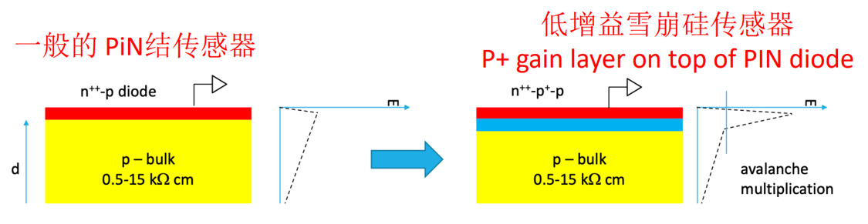
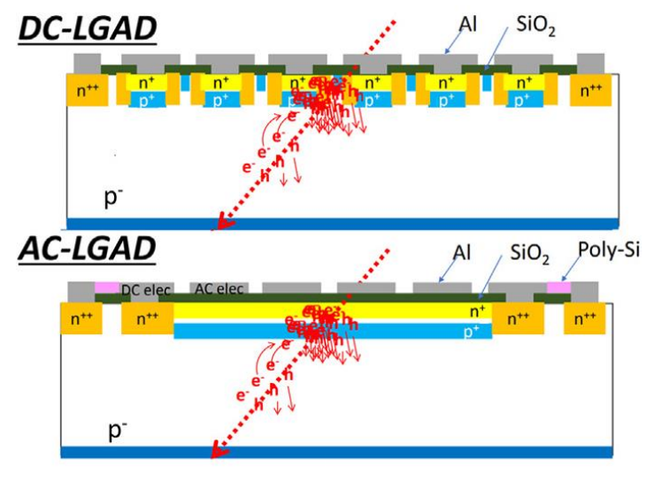
Capacitively-coupled Low Gain Avalanche Detectors (AC-LGAD) 低增益雪崩硅传感器
HGTD project in ATLAS phase-II upgrade
LGAD Advantages:
Large S/N;
Thin PN junction;
Good irradiation hardness
Fast rise time (~500 ps);
Modest gain (~50);
DC-LGAD: large insensitive region
Improved LGAD design
AC-LGAD: Capacitive coupled technology to decrease the insensitive region.

Slide 3
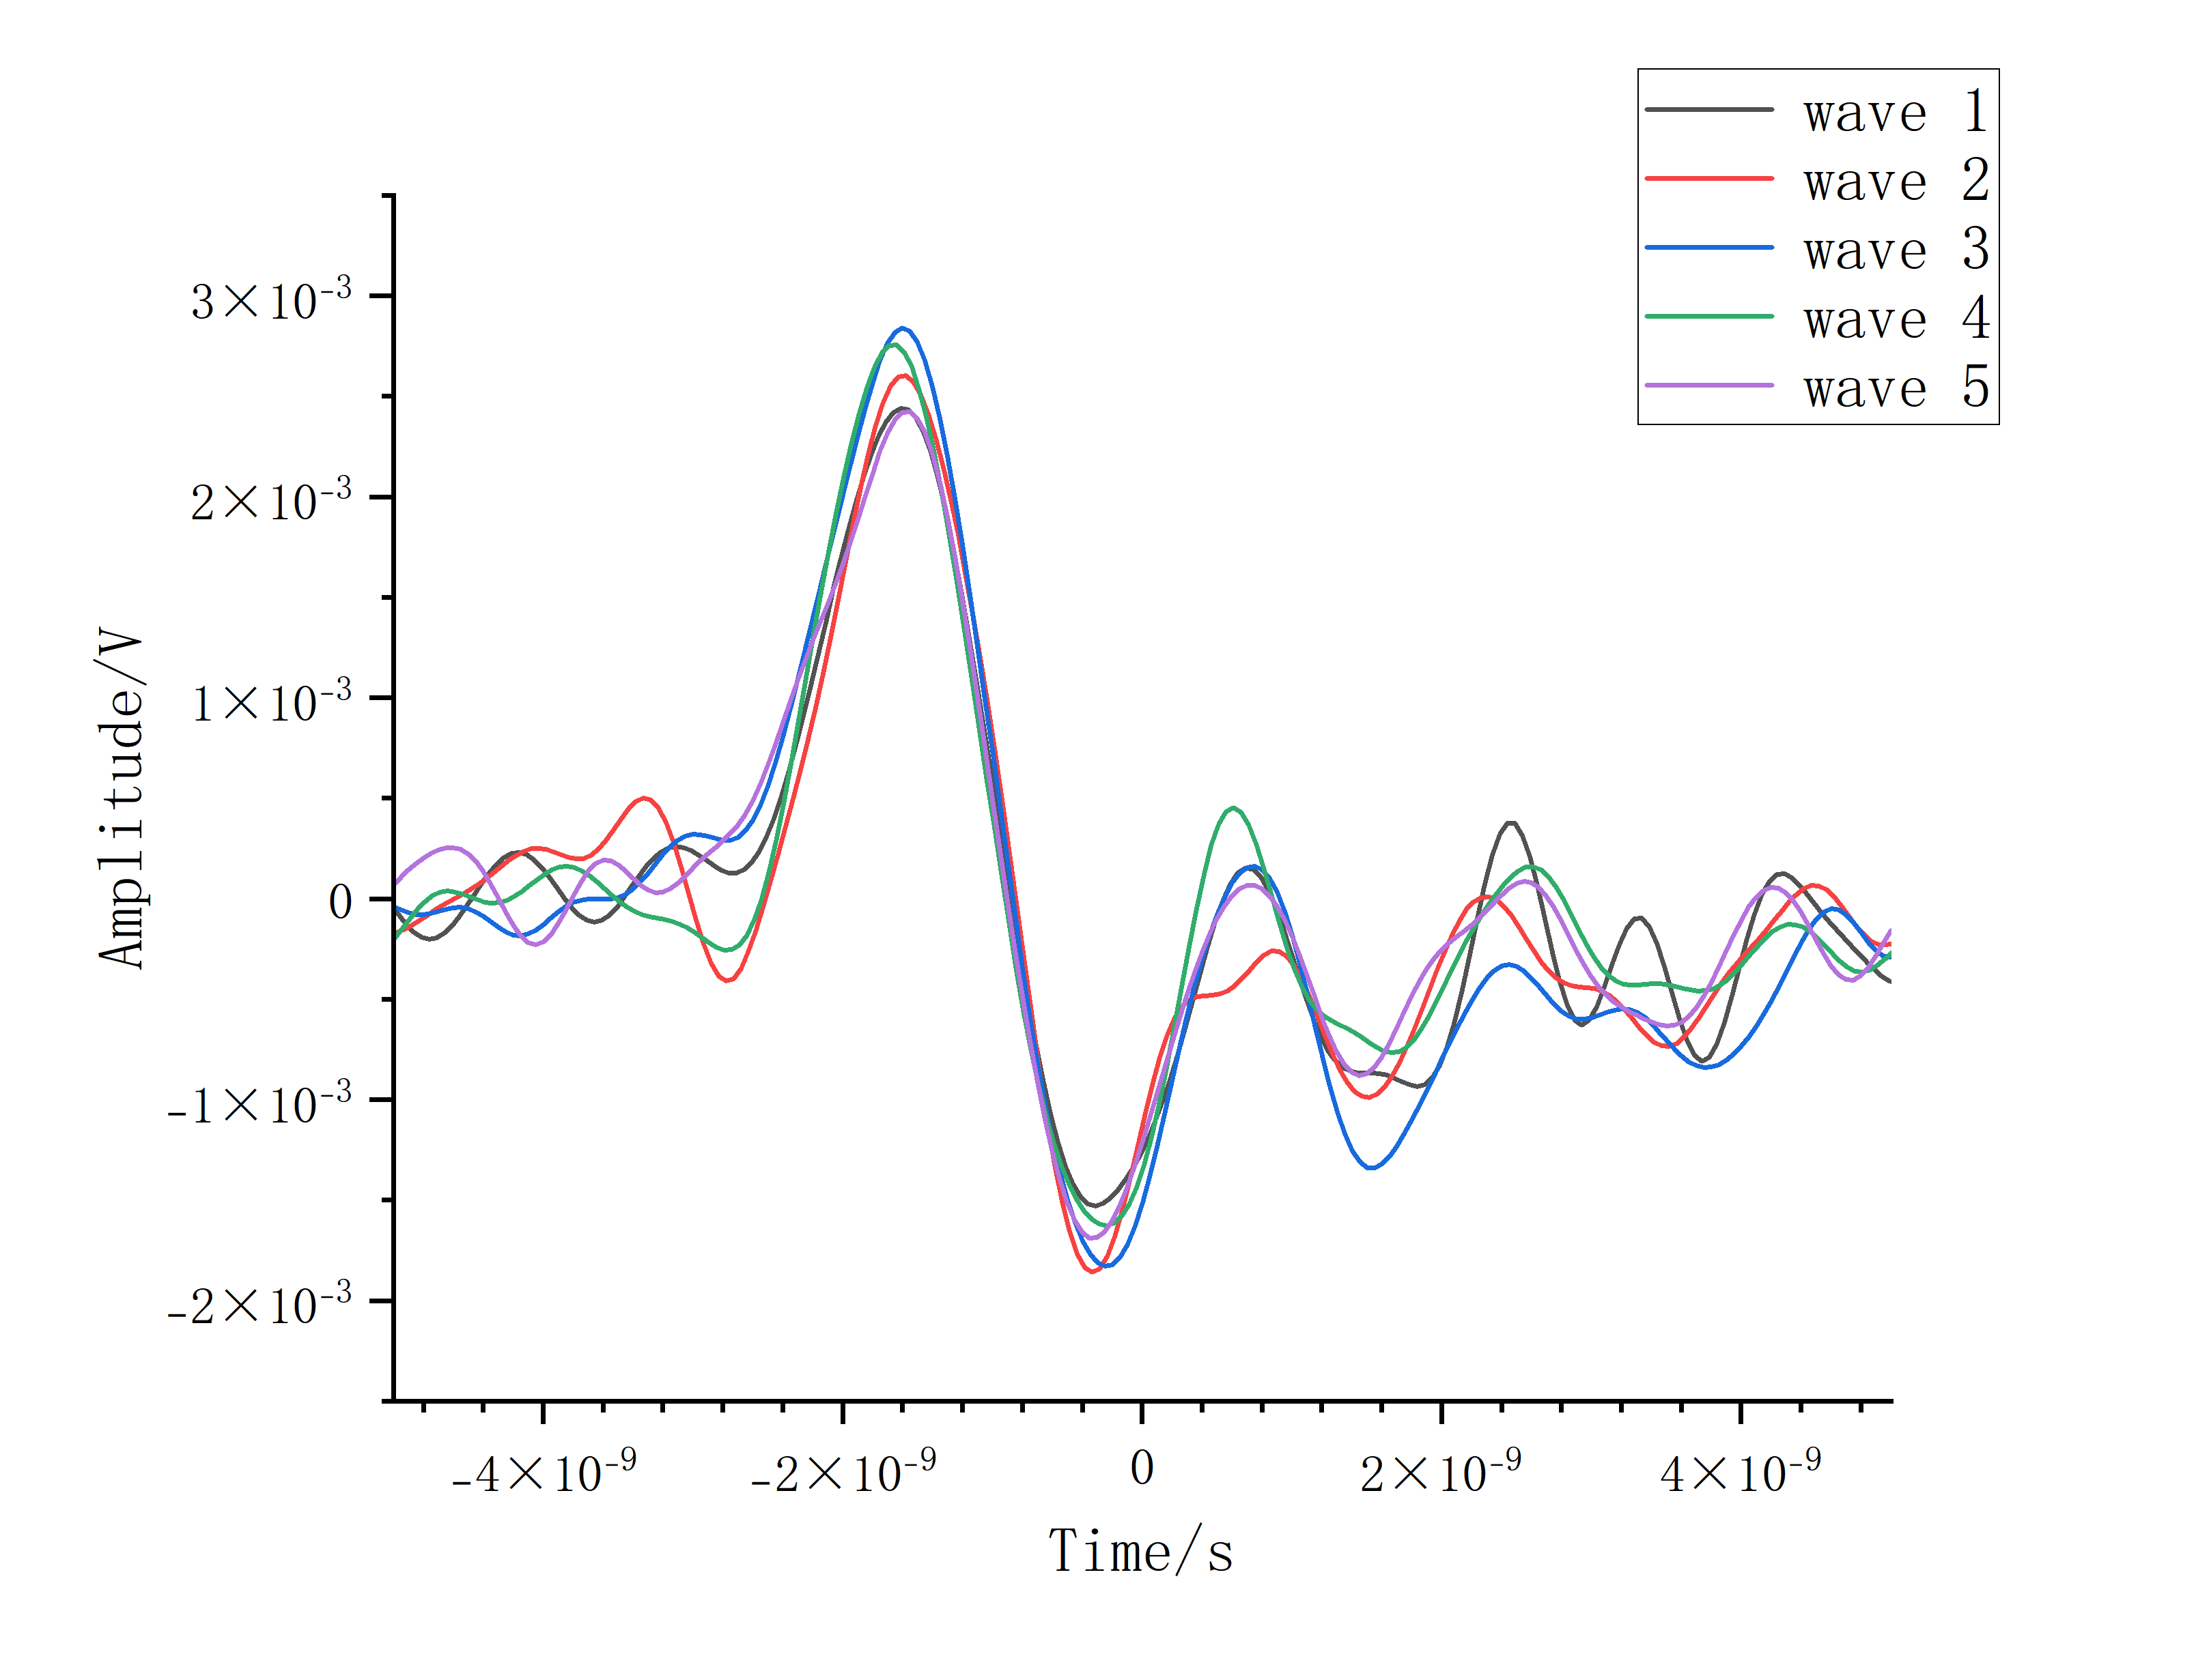
Characteristics of AC-LGAD signal
Characteristics of AC-LGAD output signal
Characteristics of Front End Electronics (FEE)
Short pulse (~2 ns);
Fast rise time (~500 ps);
Small amplitude (<10 mV);
1. Fast response
2. High bandwidth of amplification circuit
3. Large gain

Slide 4
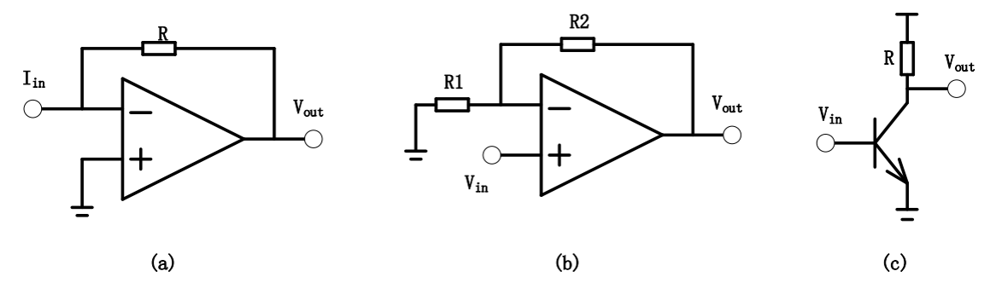
Front-End Readout electronics
Transimpedance Amplifier (TIA): Vout=I_{in}* R ;
Voltage Amplifier (VA): Vout = (1+R₂/R₁)Vin;
Wideband Radio-Frequency Amplifier (RF): fixed gain.
(HGTD-Altiroc);

Slide 5
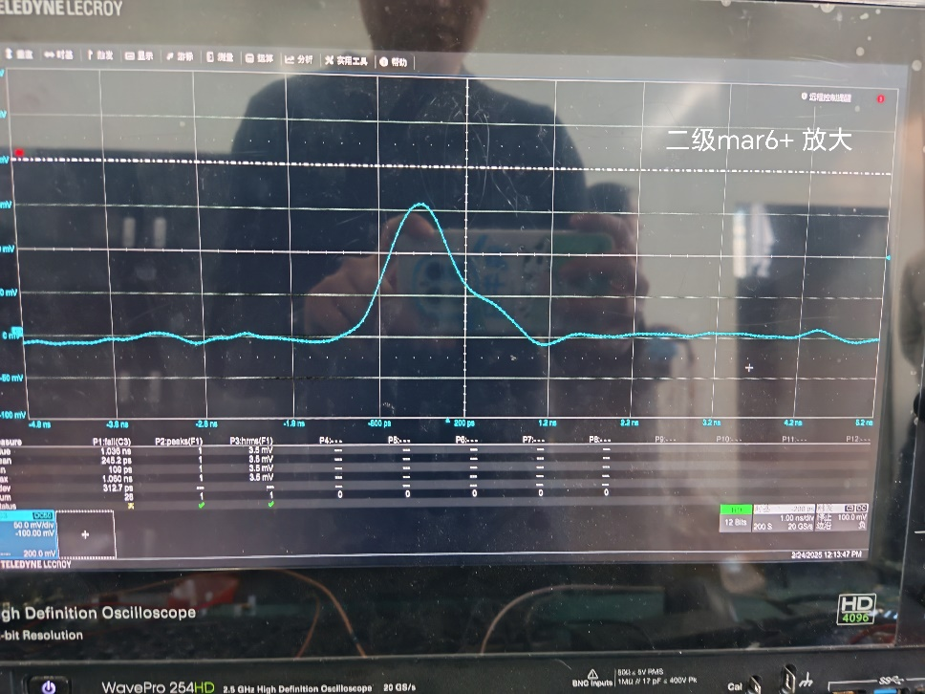
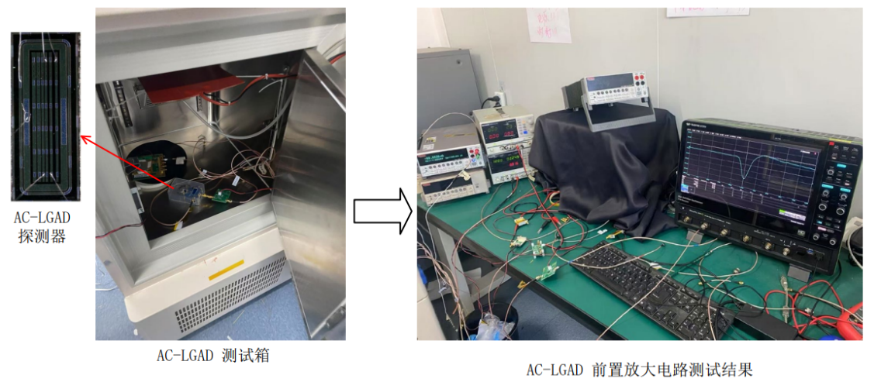
RF Amplifier test in IHEP
PGA-103+ : BandWidth 4GHz，rise time 600ps-800ps；
BGA420 : BandWidth 3GHz，rise time 500-600ps；
BGA427 : BandWidth 3GHz， rise time 400-500ps；
PHA-23LN+ : BandWidth 2GHz， rise time 600ps；
ADL 5536 : BandWidth 1GHz， rise time 700ps-900ps；
MAR-6+/ADL5545 : BandWidth 6GHz， rise time 550ps，pulse width<2ns.
Experimental setup in IHEP.
More than 100 mV after two-stage RF Amp.

Slide 6
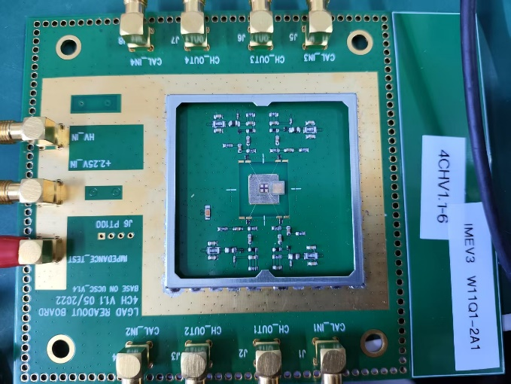
Framework of the FEE
LGAD detector & adapter board
LGAD front-end electronics (FEE)
PC

Slide 7
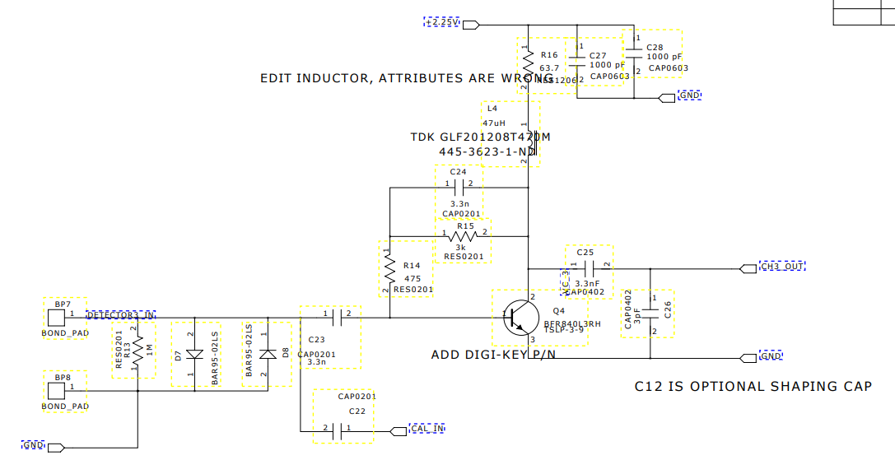
Adapter board
LGAD detector & adapter board
One-stage or two-stage amplifier

Slide 8
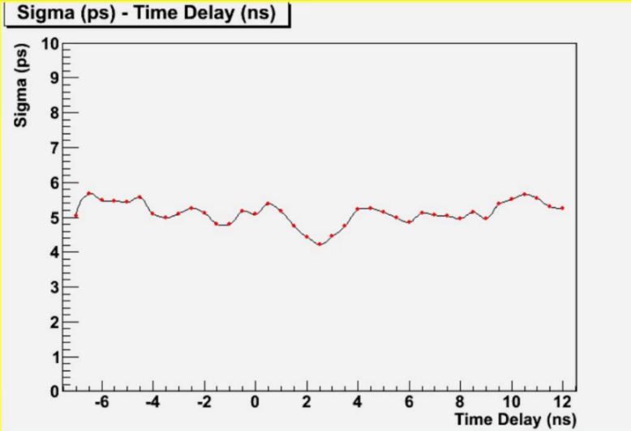
TDL-TDC in FPGA
  FPGA-TDC (Tapped Delay Line,)
  1.Coase time：16-bit counter；
  2.Fine time：Time delay line is implemented CARRY8 primitive.
The resolution of FPGA-based Tappled Delay Line (TDL) TDC in Kintex Ultrascale family is ~6 ps .

Slide 9
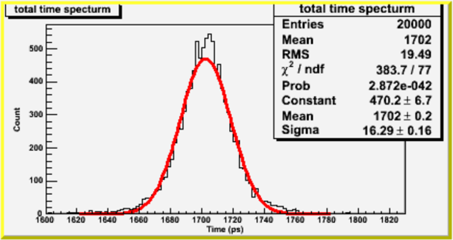
Two-ch FEE Verification
~16 ps
2-ch test system to validate the time resolution measurement:
1. RF: ADL5545->6 GHz with integrated bias control circuit;
2. Ultrafast comparator: ADCMP572 with differential output;
3.Time-to-Digital Converter (TDC): KCU116 Dev-> Tapped delay line (TDL) technology in the FPGA.
Due to analog electronics, the time resolution of one-ch TDC decrease to ~11 ps.

Slide 10
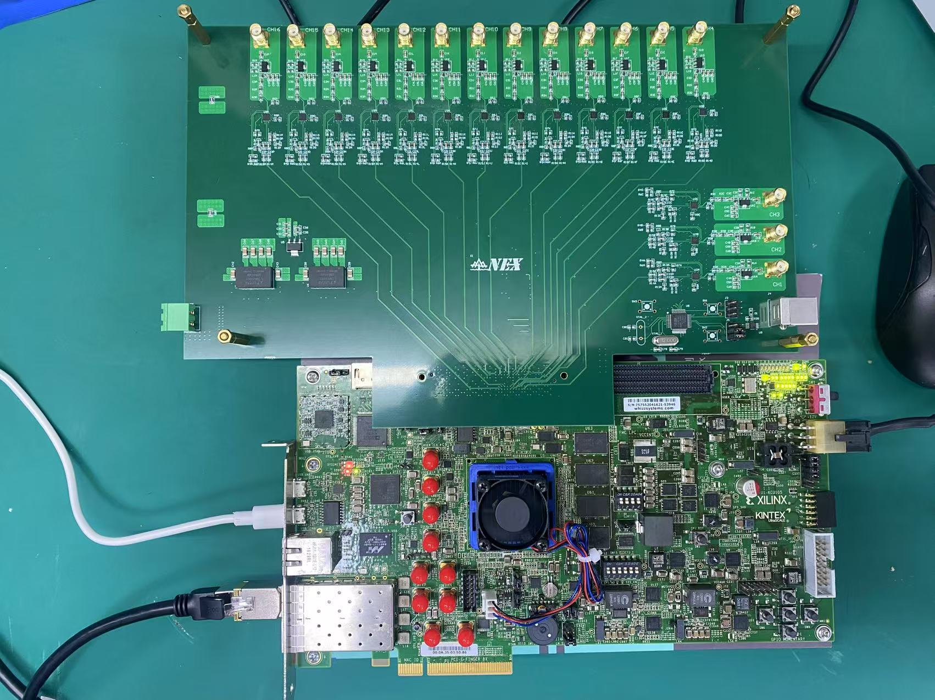
16-ch FEE prototype
16-ch front-end board
KCU116 dev
16-ch front-end board :
1. RF: ADL5545->6 GHz with integrated bias control circuit
2. Comparator: ADCMP572 with differential output;
KCU116 dev : TOT & TOA measurement

Slide 11
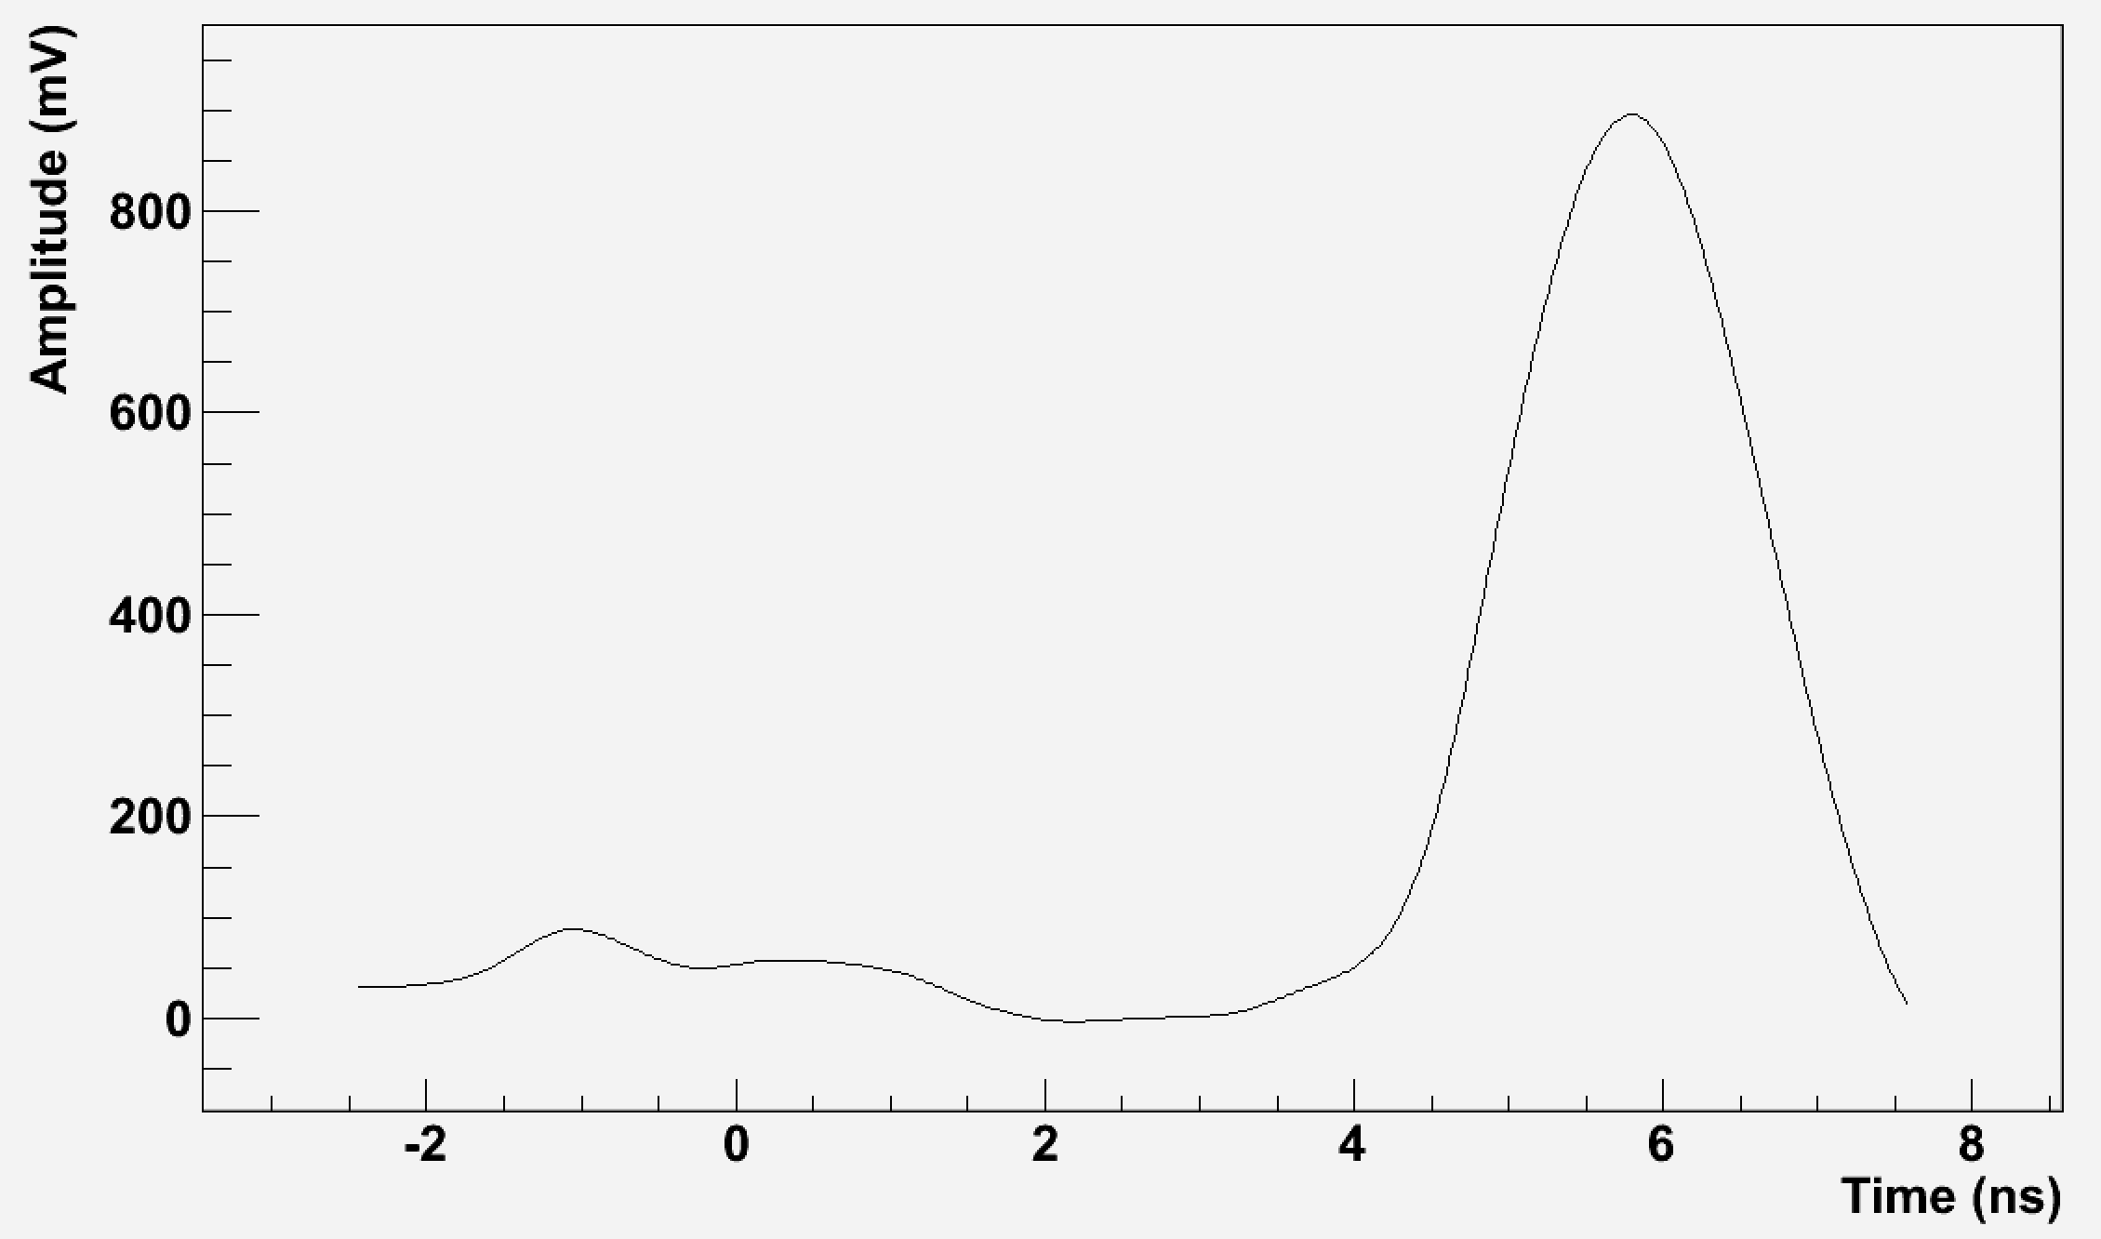
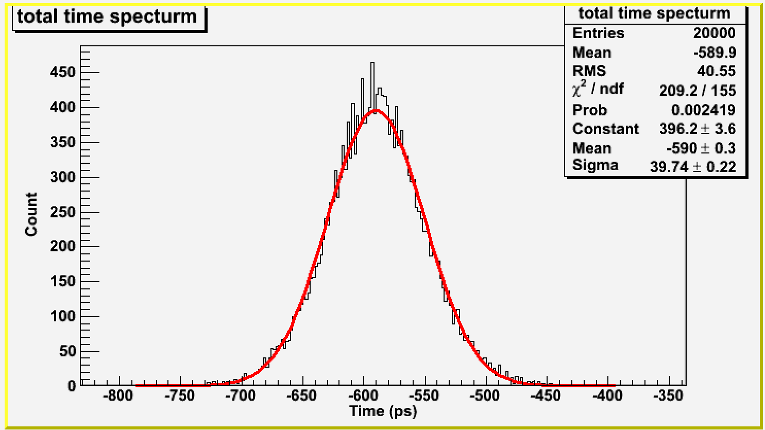
Detector Test
Dark room
Laser
AC-LGAD signal after three-stage amplifiers (~900mV), pulse width ~3 ns
AC-LGAD
Adapter board
FEE
Experimental setup
~40 ps at threshold of 145mV

Slide 12
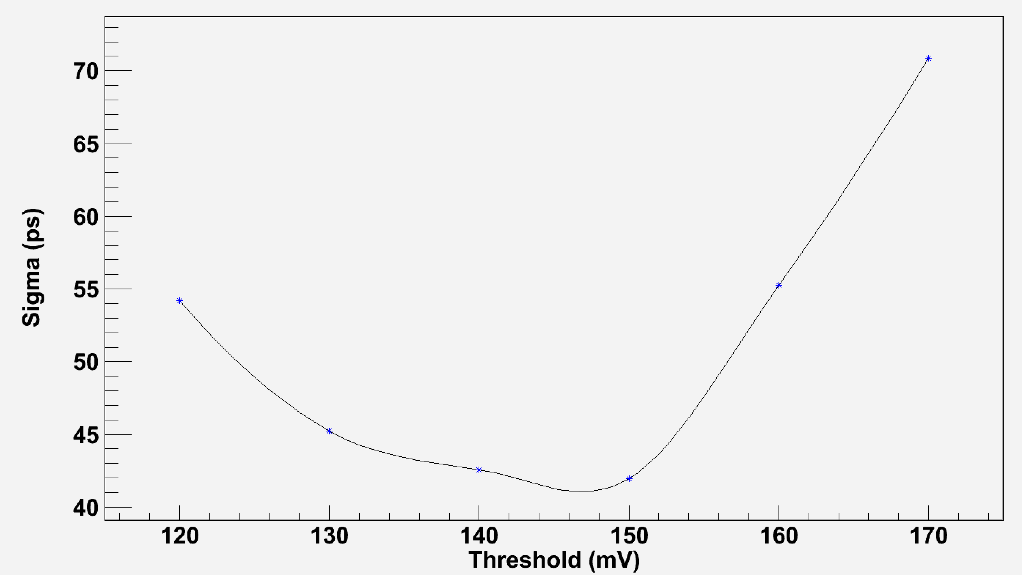
Detector Test
Rise time ~750ps
Resolution vs Threshold

Slide 13
Summary
1. 16-ch FEE was implemented. Some works are ongoing:
    Improve the measurement precision of the TOA;
    Add the TOT measurement;
    Try other types of amps with high BW.
2. Preliminary test results of AC-LGAD detector shows a good time resolution (~40/sqrt(2) for one channel), it could be improved after the TOT calibration in the future.
Thanks for your listening!

