Slide 1
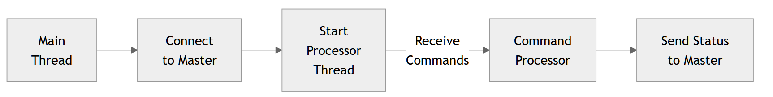
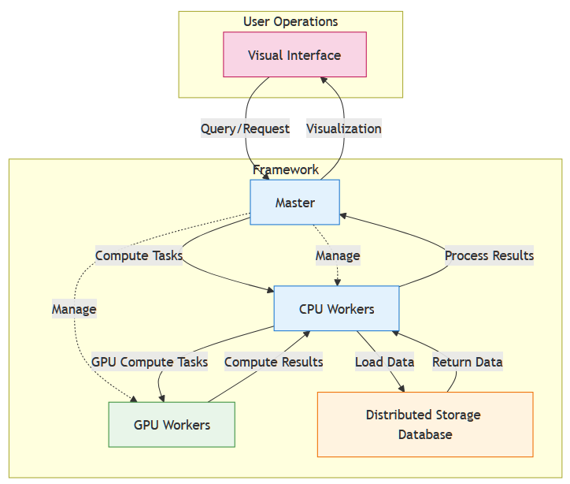
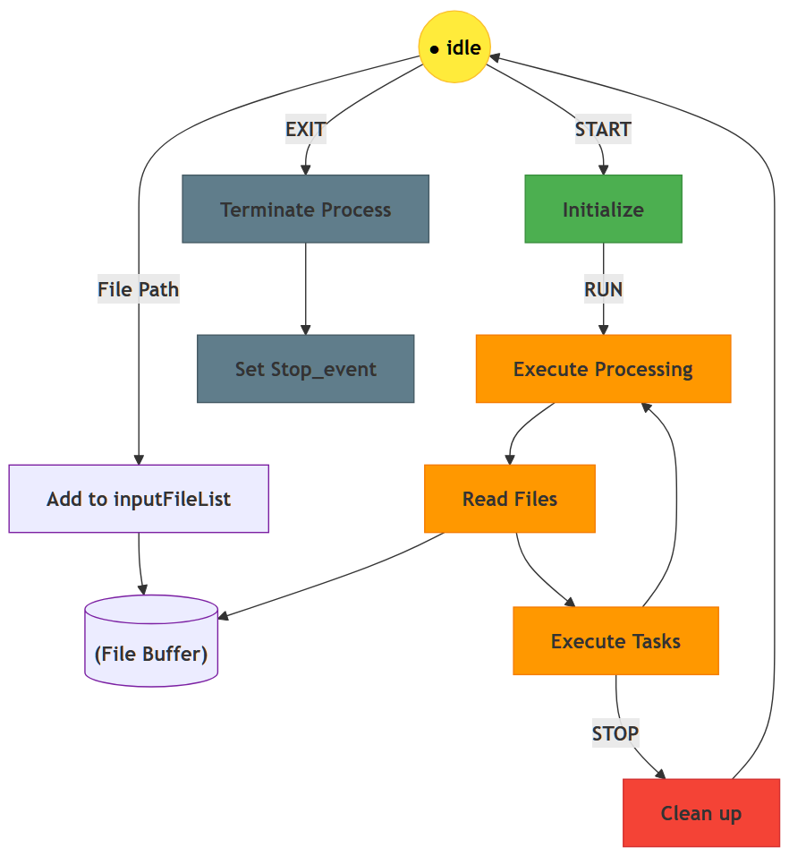
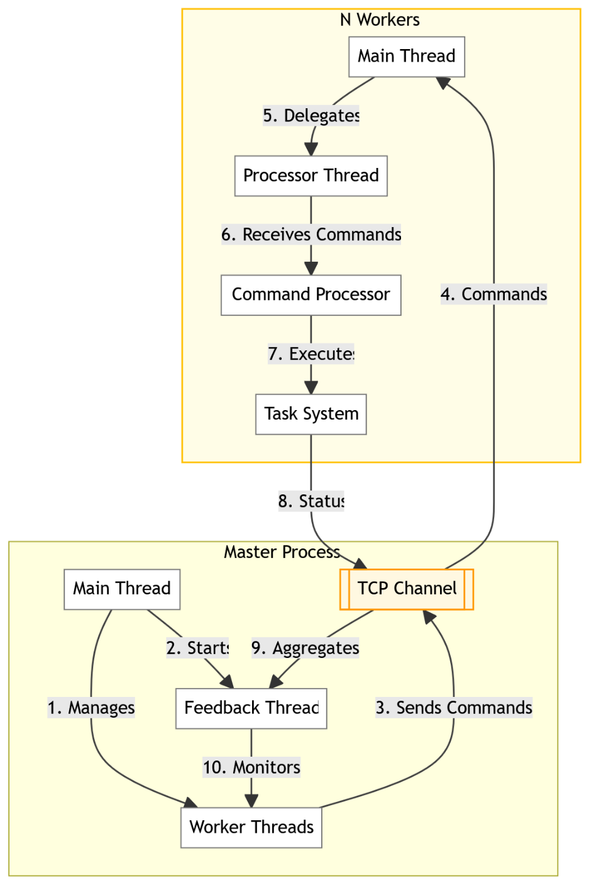
A Concurrent and Distributed Analysis Framework for Large-Scale High-Energy Physics Experiments
Shuzhu Jin¹, Weidong Li¹, Xiaomei Zhang¹, Tao Lin¹, Jiaheng Zou¹
¹Institute of High Energy Physics
Motivation
The upcoming high-energy physics experiments, such as the future CEPC, will generate data at an unprecedented scale, from petabytes to exabytes. This poses a common computational grand challenge: how to process massive datasets efficiently across heterogeneous computing resources. Traditional data processing paradigms often struggle with severe resource under-utilization and performance bottlenecks, particularly due to inefficient I/O operations (e.g., high-latency disk access and network congestion) when handling large-scale datasets. Additionally, these paradigms lack the flexibility to integrate modern machine learning (ML) methods, such as distributed training and real-time inference, which are critical for optimizing complex analysis workflows in hybrid CPU/GPU environments. There is a need for a generic, scalable, and intelligent analysis framework that can dynamically orchestrate tasks and balance loads to fully exploit the potential of modern computing clusters. The concurrent and distributed framework presented here is designed to meet this exact need, holding high applicability for the computational demands of the CEPC project.
Framework Requirements
Implementation of Workers
Accelerate and simplify data analysis process across distributed nodes.
High-Performance Search: Enable rapid event skimming and filtering in large-scale datasets to identify critical physics signatures efficiently.
Task Parallelization: Split selection task across multiple nodes
Self-Balancing Resource Allocation: Intelligent task reassignment to eliminate idle resources.
Modular design: Integrate traditional analysis algorithms or ML methods in event analysis.
One Master will manage several Workers. The Worker starts in an idle state, waiting to establish a connection with the Master. After registering with Master, it will receive commands from Master and execute, send status back to Master. The whole process is as below:
Design Overview
Fig3. Workflow of a worker
The proposed framework is built on MPI (Message Passing Interface) to enable high-performance, distributed computing for large-scale data processing.
Dynamic Task Scheduler (MPI Scheduler)
The entire framework relies on MPI for communication, ensuring low-latency, high-throughput task orchestration.
Implements dynamic task allocation based on workload priorities and resource availability.
Command Processor’s Lifecycle
1. Receiving Commands
The Worker continuously listens for commands from the Master, including:
Task Assignment: Receives specific task descriptions (e.g., which files to process, which algorithms to execute). Worker adds file paths into File Buffer, waits for task execution.
Control Commands: Such as START, PAUSE, or STOP.
CPU Workers: Execute general-purpose computing tasks (e.g., data preprocessing, traditional analysis).
2. Task Execution
Loads required resources (e.g., input files, algorithm configurations) based on the commands. Read files from File Buffer. Regularly updates the Master on task progress, and adjusts task priority or resource allocation based on Master instructions.
GPU Workers: Work as a service.
Accelerate ML workloads (e.g., distributed training, real-time inference) and computationally intensive tasks (e.g., event reconstruction).
3. Termination & Cleanup
After task completion, releases resources and returns to the Idle state, ready for new tasks. If instructed by the Master or finishing all tasks, fully terminates Worker process.
Fig 1. Workflow of the framework
MPI-based Distributed Scheduler
Main thread of MPI-Master:
Initialization: Open TCP port → Wait for workers → Create worker threads for each worker
Maintains the connection between the master and workers based on the backend heartbeat mechanism.
Fig4. Worker State Transition Diagram
GPU Worker (Being implemented)
GPU nodes first register as a service with the Master.
When a CPU worker encounters a computation-intensive task, it requests the Master to schedule an available GPU worker as a service.
The CPU worker then directly submits the task, along with data preprocessed and compressed using real-time algorithms, to the designated GPU worker.
Upon completion, the GPU returns the results directly to the CPU worker for final integration.
Main thread launches two components:
Worker Threads: Multiple threads (1→n) run in parallel to execute core tasks (e.g., Send different commands to external workers).
Feedback Thread: Lives within the Feedback System and manages status monitoring/feedback relay.
Conclusion & Outlook
Feedback system operations:
The Feedback Thread initiates Monitor Status to track Worker Thread progress or external responses.
Monitor Status → Check: feedback received? → If Yes, notify the main thread.
We present a high-performance, scalable, and flexible analysis framework that addresses key computational challenges in modern HEP, ready to empower the data processing workflows of future experiments like CEPC.
Future Work:
Extend to GPU nodes;
Dynamic task allocation/scheduling: When a worker finishes the computational task first and becomes idle, the master should schedule a portion of the computational tasks from other workers to it.
Customize and optimize for CEPC's specific computing model.
Fig 2. Implement of the scheduler
https://indico.ihep.ac.cn/event/25300/ The 2025 International Workshop on the High Energy Circular Electron Positron Collider, Guangzhou, China jinsz@ihep.ac.cn

