Slide 1


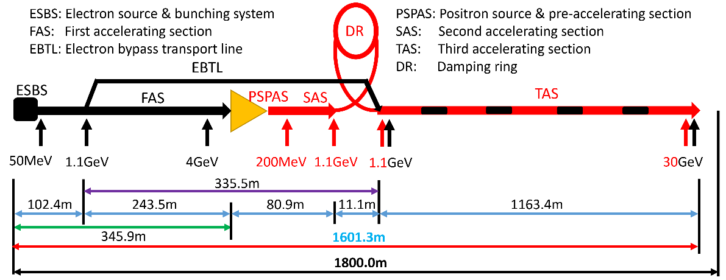
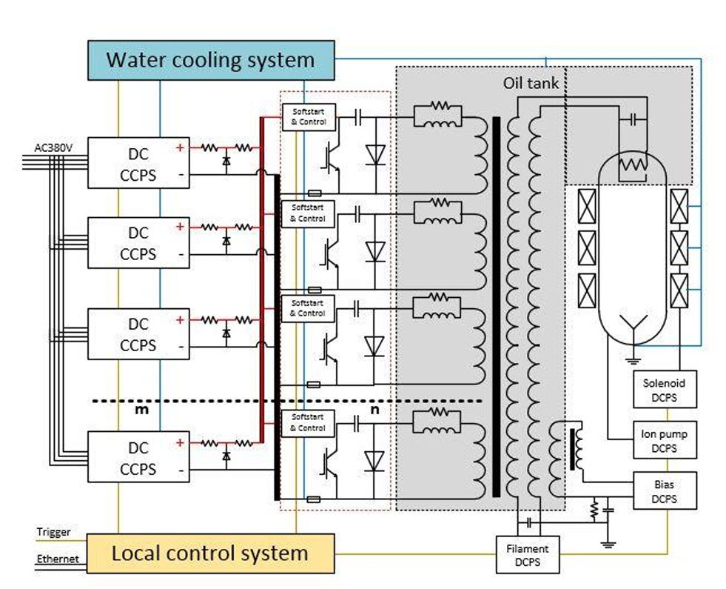
Poster ID: 3
The 2025 International Workshop on the High Energy Circular Electron Positron Collider (CEPC2025), Guangzhou, China, Nov 5-10, 2025
Development of high voltage pulsed modulator for the CEPC C band 80MW Klystron
Fei Li¹ , Dayong He^{1,2} , Jindong Liu^{1,2} , Nan Gan^{1,2}, Yajie Mu¹ , Xiuqian Shi^{1,2} , Zusheng Zhou^{1.2†}
1Institute of High Energy Physics, Chinese Academy of Sciences, Beijing 100049
2University of Chinese Academy of Sciences, Beijing 100049, China
High-voltage pulse modulator is a key device in linear accelerators, serving as the intermediate link that converts power from the power supply into microwave power. According to the CEPC technical design, the linear accelerator requires 236 sets of C-band 80 MW power source systems to supply 5712 MHz/3 μs/100 Hz pulsed power to the accelerating structures. To achieve the target klystron output power of 80 MW, the high-voltage pulse modulator must deliver pulsed voltages of 425 kV, pulsed currents of 425 A, and a minimum output power of 180 MW. The pulse rise and fall times directly determine the modulator's efficiency, while repetition stability critically influences beam quality. The 100 Hz repetition rate imposes stringent requirements on power handling capacity and thermal management. To meet these challenges, a high-voltage pulse modulator based on a solid-state topology has been developed specifically for C-band 80 MW applications. This paper presents the current development progress from several aspects, including the comprehensive circuit calculation of the high-voltage pulse modulator, theoretical analysis and structural design of the pulse transformer, and simulation analysis.
INTRODUCTION
The structural layout of the CEPC Linac is shown in Fig.1. Its RF power source system consists of 33 sets of 80 MW pulsed klystrons operating at 2860 MHz (S-band) and 236 sets of 80 MW pulsed klystrons operating at 5720 MHz (C-band). Among them, each C-band 50 MW klystron supplies power to two 1.8 m accelerating structures, which operate at an accelerating gradient of 45 MV/m. To make the linac more compact, it is proposed to upgrade the C-band 50 MW klystrons to 80 MW klystrons. After the design is completed, a single 80 MW klystron can supply power to four 1.8 m accelerating structures, reducing the overall cost of the linac by approximately 30%. The fabrication of the C-band 80 MW klystrons started in October 2024, and high-power tests will be conducted by the end of 2025. The parameters of the C-band 50 MW/80MW klystron are presented in Table 1.
Table. 1. Parameters of the C-band 50 MW/80MW Klystron
Parameters | 50 MWKlystron | 80MW Klystron
Output Power (MW) | 50 | 80
Beam Voltage (kV) | 350 | 425
Beam Current (A) | 317 | 425
Efficiency (%) | 48 | 47
Gain (dB) | ＞50 | ＞50
Figure. 1. Schematic Structure of the CEPC Linac.
SOLID-STATE MODULATOR
The high-voltage pulse modulator is a key device of the linear accelerator, acting as an intermediate link for converting electrical energy into microwave power. With the rapid iteration of solid-state power electronics technology, solid-state modulators featuring semiconductor devices as the core have demonstrated comprehensive advantages over the traditional PFN pulse power technology: they not only offer higher output stability and a more compact structure but also possess a much longer service life than thyratrons. This solid-state modulator consists of a high-precision direct current (DC) power supply, energy storage capacitors, IGBTs, low-inductance cables, and a matrix pulse transformer, whose schematic diagram is shown in Figure 2.
Table. 2. Parameters of the C-band 80 MW Klystron
Parameters | 50 MWKlystron
Pulse Voltage (kV) | 430
Pulse Current (A) | 440
Repetition Frequency (pps) | 100
Pulse Width (μs) | 3
Pulse Flat-Top Stability (%, within 4 μs) | 1
Pulse Stability (%, over 3000 pulses) | 0.02
Figue.2. Schematic Diagram of the Solid-State Modulator.
For the C-band 5720 MHz/50 MW/100 pps/3 μs klystron load, the design parameters of its solid-state modulator are presented in Table 2. The solid-state modulator for the C-band 80 MW klystron has a pulse top width of 3 μs, a rise time and fall time of approximately 1.8 μs, resulting in a full width at half maximum (FWHM) of 4.4 μs for the pulse, and the average power of the DC power supply unit is 90.8 kW.
To ensure system redundancy, commercial 1,700 V IGBTs are adopted as switches for the discharge units, operating under the conditions of 1,000 V DC and 2,000 A. All discharge units work together, with a total current of 211 kA from 108 units. To control the pulse flatness within 1% over 3 μs, a parallel LR compensation circuit is specifically added to the discharge units. The pulse transformer of the solid-state modulator employs a biconical high-voltage winding to construct the DC current loop for the klystron cathode filament. The high-frequency characteristic (Lδ/Cd)¹/² of the pulse transformer is determined by the leakage inductance Lδ and distributed capacitance Cd, which must be accurately matched to the impedance of the klystron.
REFERENCES
[1] The CEPC Study Group. CEPC Technical Design Report: Accelerator[J]. Radiation Detection Technology and Methods, 2024, 8(1).
[2] I. A. Guzilov, “BAC method of increasing the efficiency in klystrons”, s10th Int. Vacuum Elec. Sources Conf. (IVESC ’14), Saint Petersburg, Russia, July 2014.
[3] R. V. Egorov, I. A. Guzilov, “BAC-klystron: a new genera-tion of klystrons in vacuum electronics”, MOSCOW UNI-VERSITY PHYSICS BULLETIN, 2019, Vol. 74, No. 1, pp 38-42
[4] G. Burt et al., “Particle-in-cell simulation of a core stabiliza-tion method klystron”, IEEE International Vacuum Electronics Conference. (IVEC 2017), London, UK, April, 2017.
[5] IEEE Std 390TM-2007，IEEE Standard for Pulse Transformers.
* Work supported by Yifang Wang’s Science Studio of the Thousand Talents Project
† email address: zhouzs@ihep.ac.cn

