Slide 1


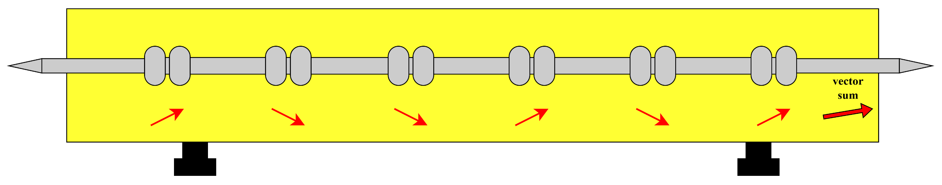
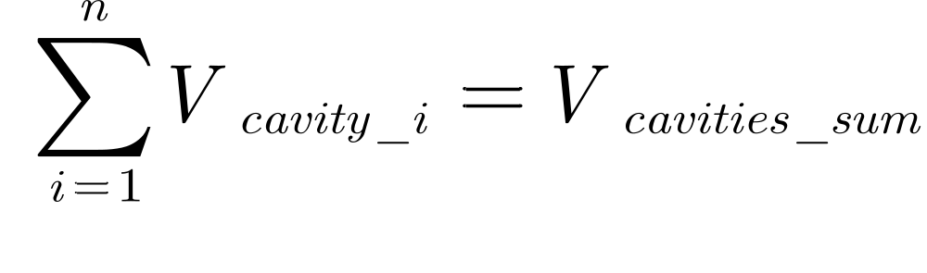
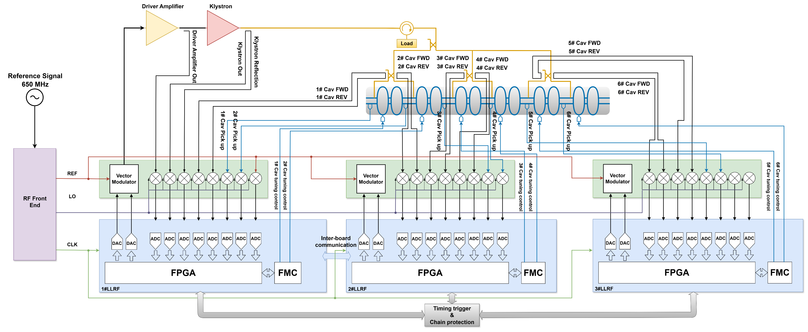
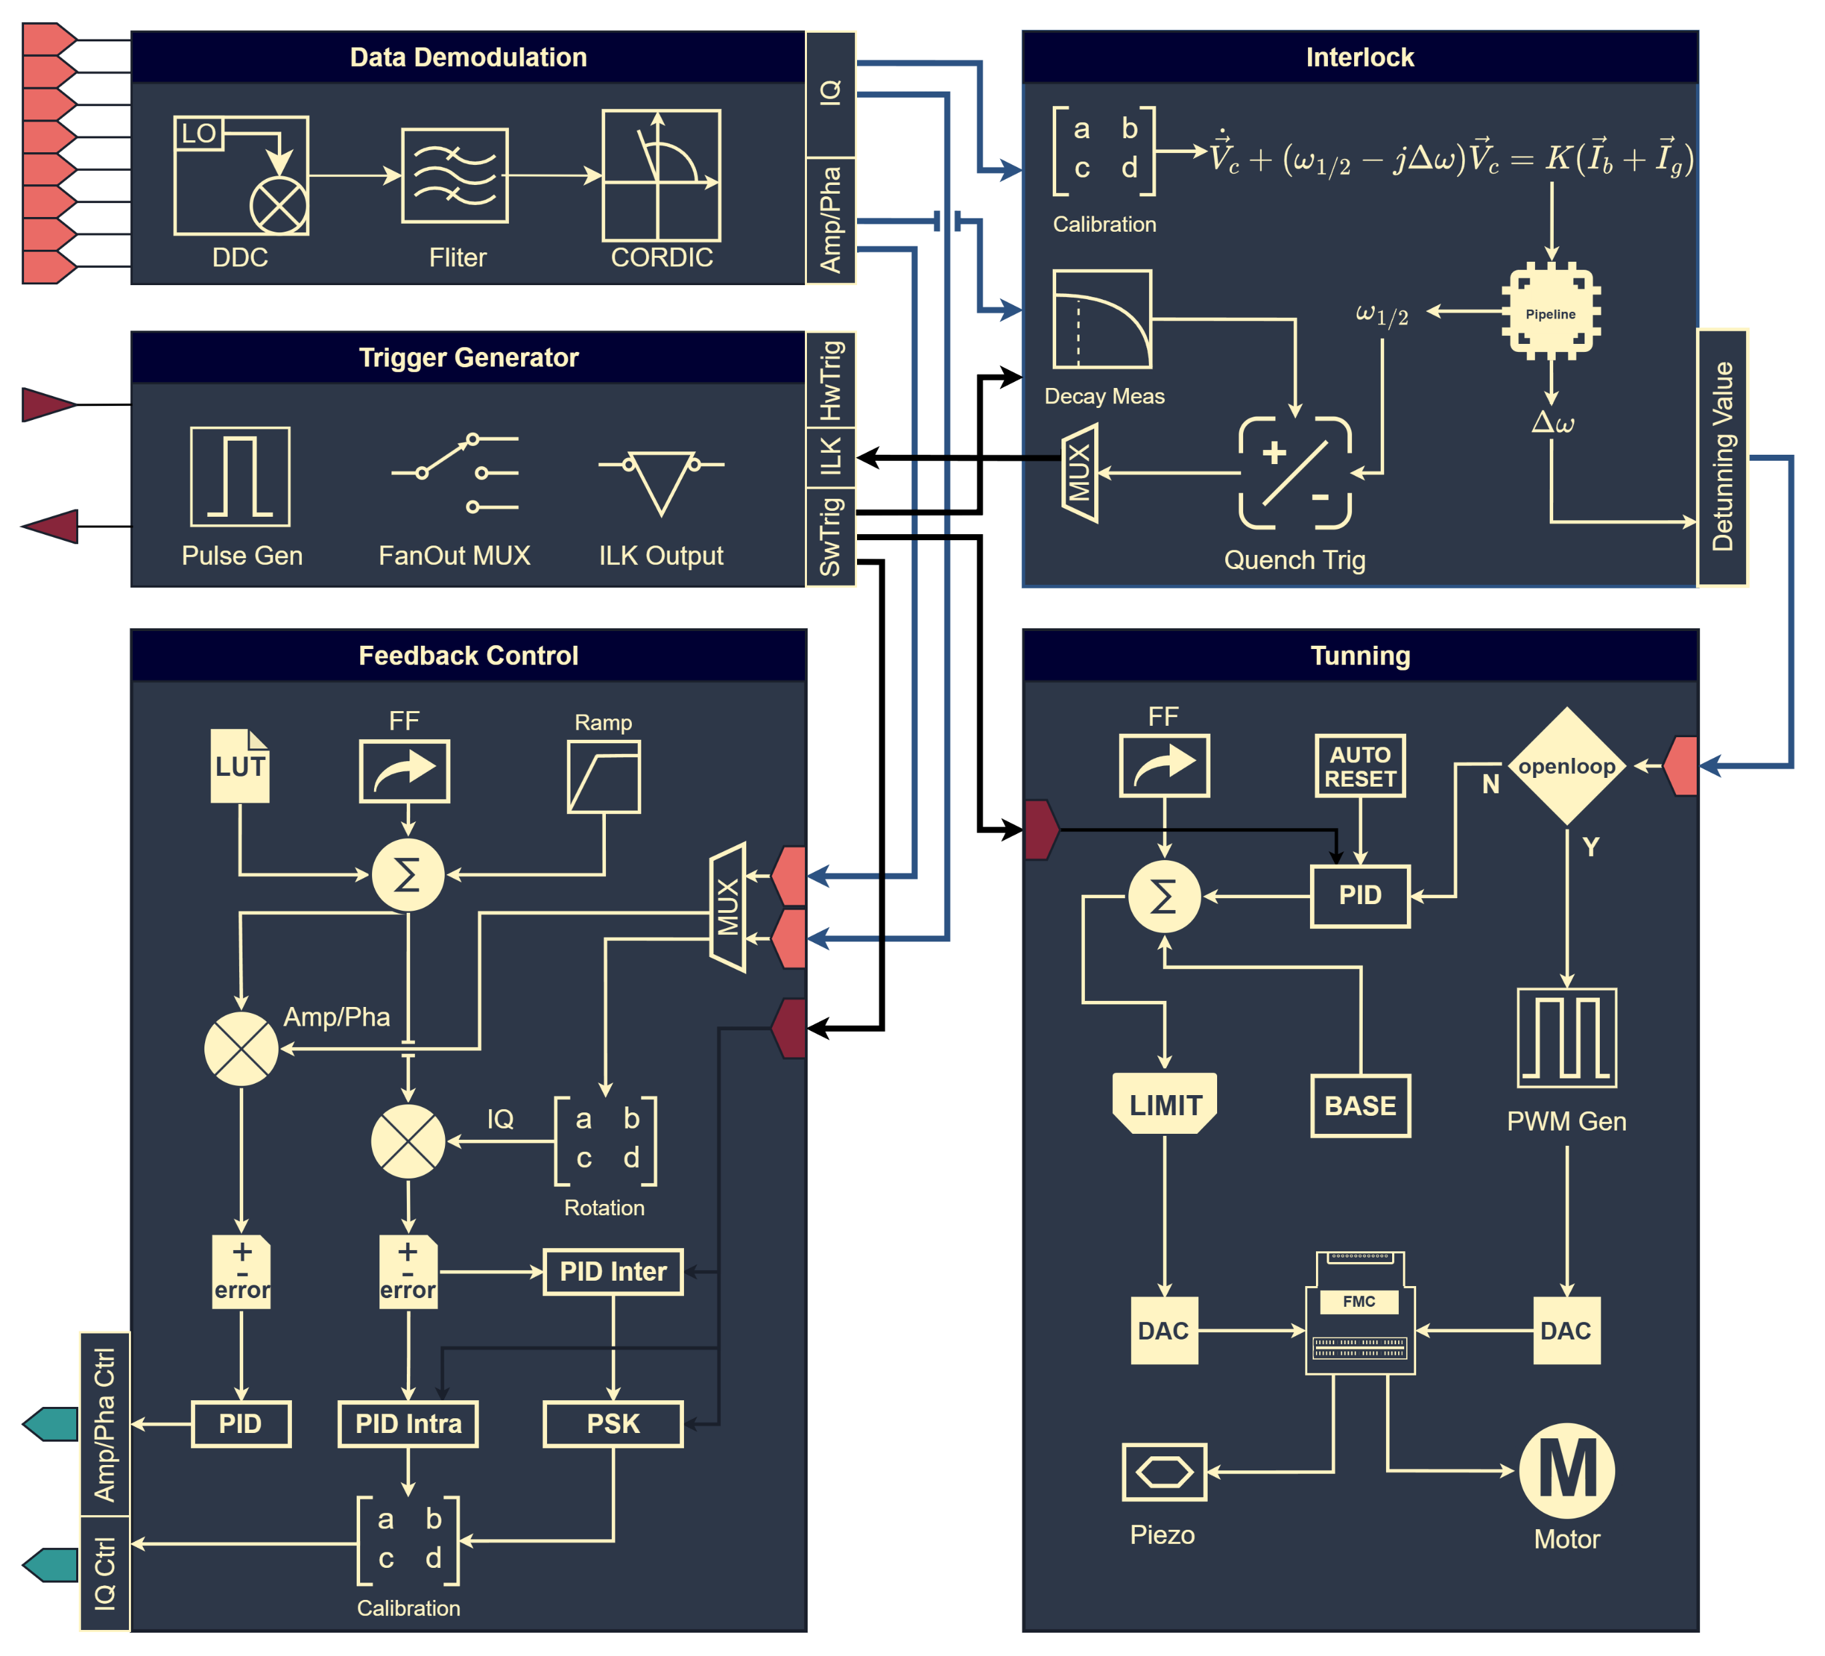
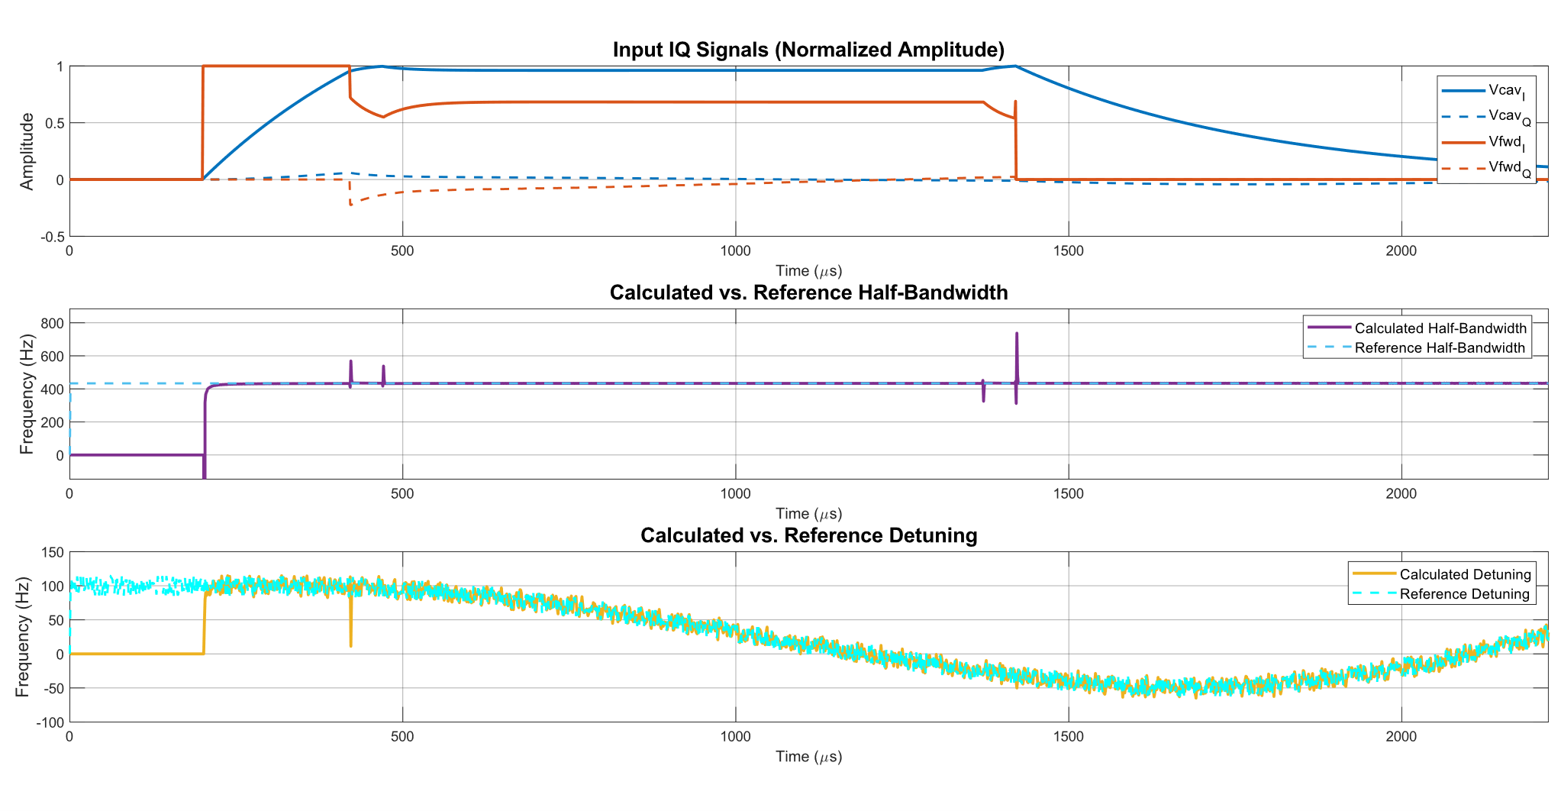
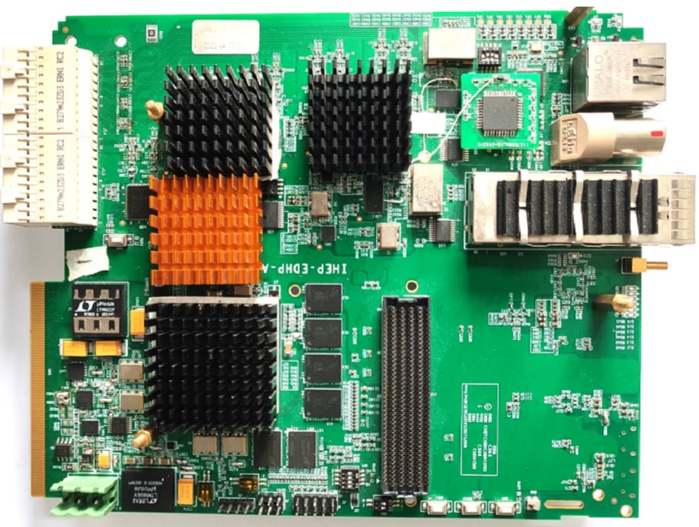
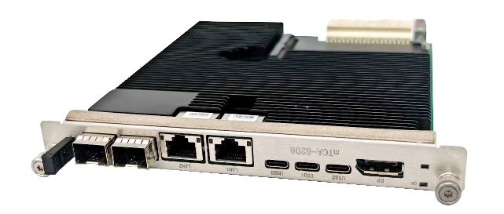
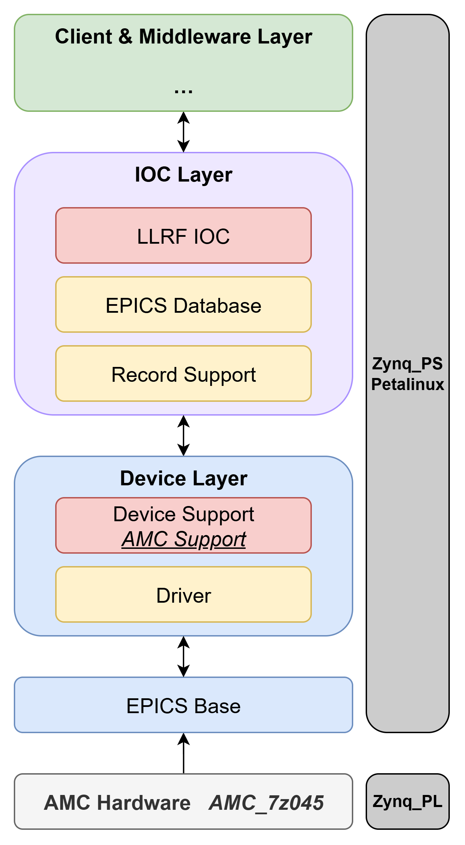
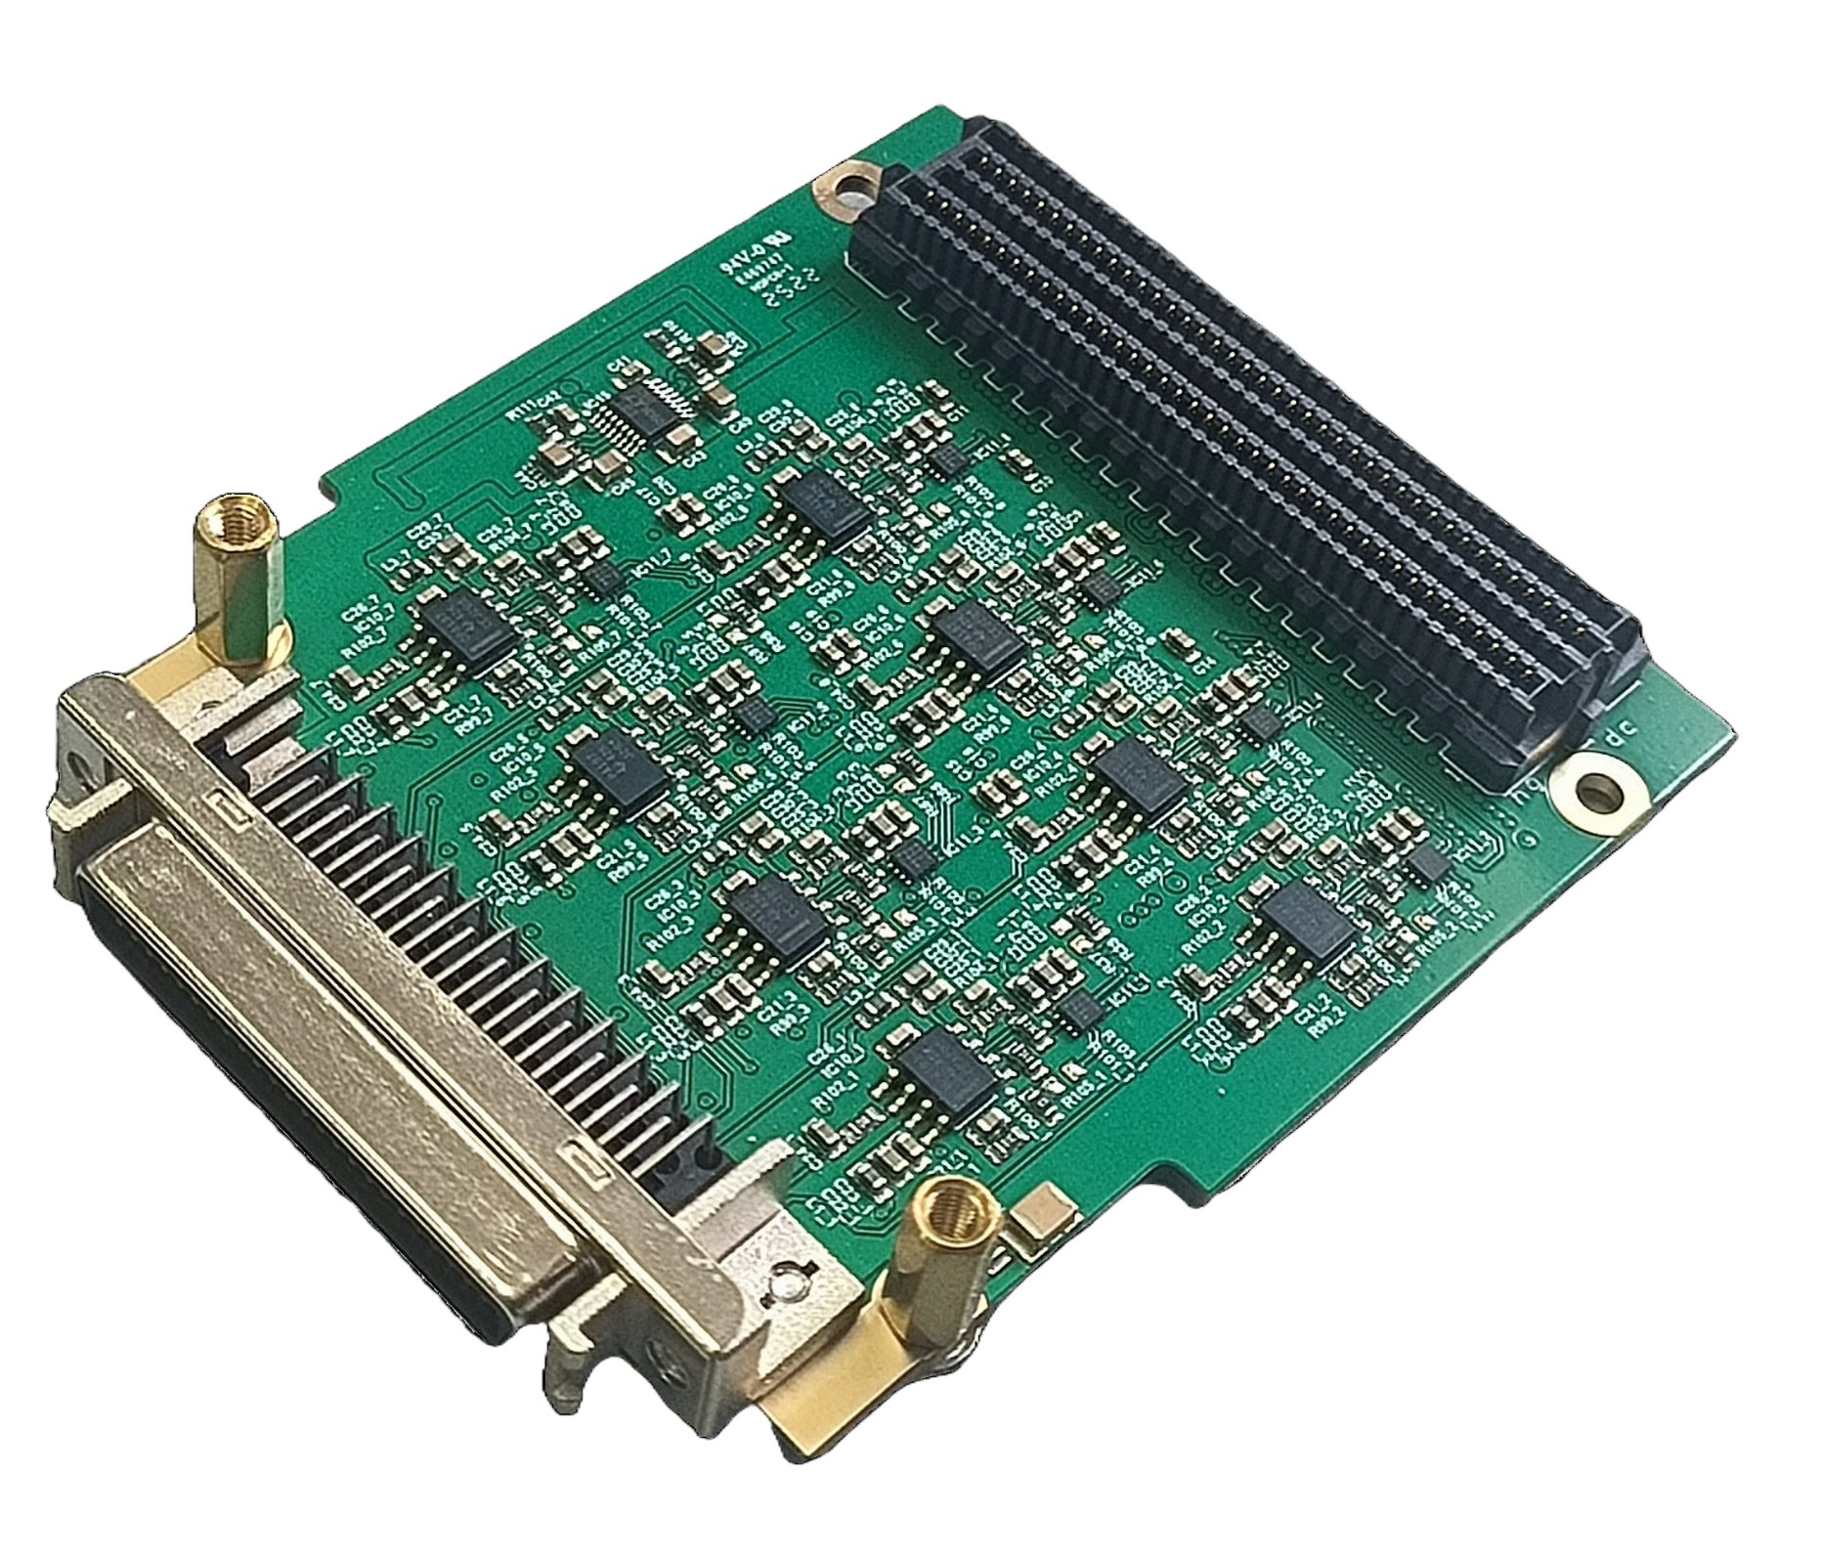
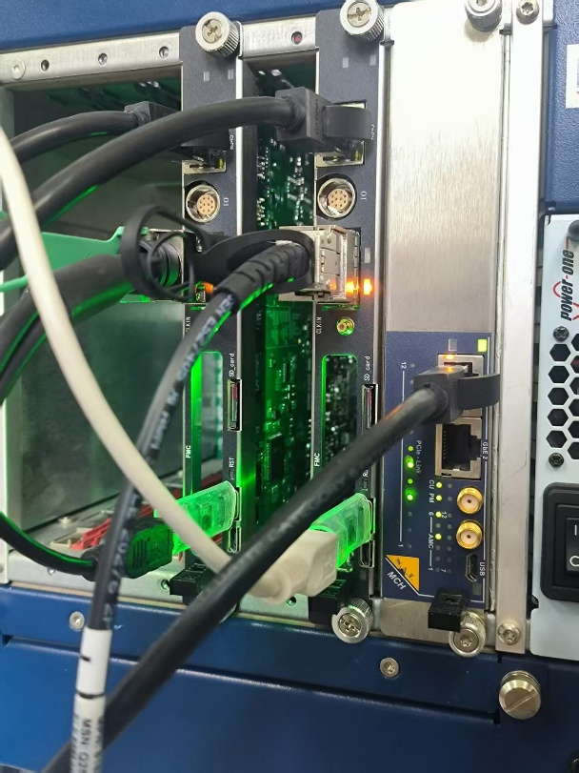
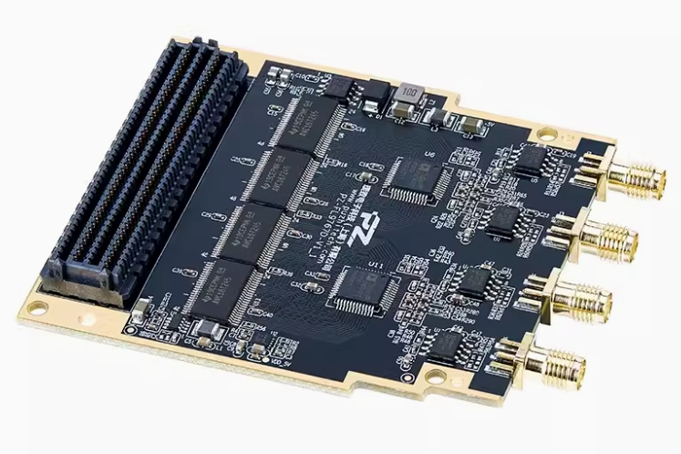
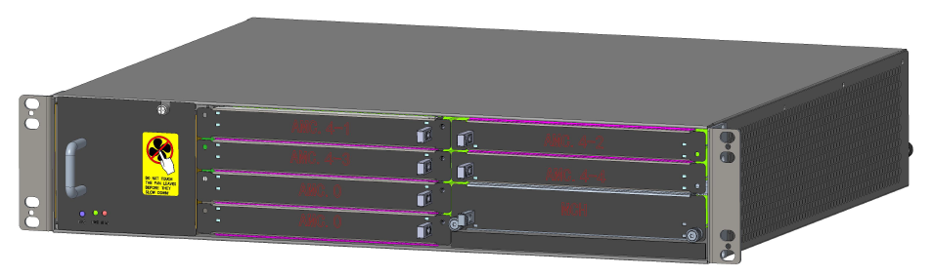
Poster ID: A13
The 2025 International Workshop on the High Energy Circular Electron Positron Collider (CEPC2025), Guangzhou, China, Nov 05-10, 2025
A Low-Level Radio Frequency (LLRF) Control System for Multiple Superconducting Cavities Based on MicroTCA.4*
Wenbin Gao^{1,2}, Nan Gan^{†1,2}, Zusheng Zhou^{1,2}, Jiyuan Zhai^{1,2}, Xinpeng Ma¹
Institute of High Energy Physics, Chinese Academy of Sciences, Beijing 100049, China¹
University of Chinese Academy of Sciences, Beijing 100049, China²
ABSTRACT
This poster presents a domestically developed LLRF control system for simultaneously driving six superconducting cavities with a single klystron. Based on a fully domestic MicroTCA.4 platform, the system employs vector-sum control, IQ sampling, and feedforward-feedback techniques. It ultimately achieves high-precision amplitude, phase, and frequency control for the six cavities, validating a key step for the CEPC project.
VECTOR-SUM CONTROL PRINCIPLE
FIRMWARE OF THE LLRF
Each of the three board cards handles the complete processing for two cavities, including signal demodulation, local vector summation, tuning, and quench detection. These local vector sums are then sent to the main board, which consolidates them into a global vector sum and generates the final feedback signals.
The Vector Sum Control Principle
OVERVIEW OF THE LLRF FOR MULTI-CAVITY
CEPC 650 MHz 6×2-cell superconducting module LLRF system design scheme
The system operates in a master-slave architecture, utilizing a unified vector-sum setpoint for global control, which eliminates per-cavity feedback loops to reduce cost and complexity. The tuning of individual cavities is achieved through a combination of feedforward and feedback control, ensuring precise adjustment.
Firmware Architecture Diagram
DETUNING-CALCULATION FIRMWARE VERIFICATION
SOFTWARE AND HARDWARE PLATFORM
PROGRESS
In Progress
Firmware integration and testing, calibration module development, upper-layer driver optimization, and EPICS applications are currently underway.
Future Plans
By June 2026, a horizontal test platform will be established in Huairou, Beijing for the installation and debugging of the LLRF control system.
REFERENCES
[1] Schilcher, T., Schmueser, P., & Gamp, A. (1998). Vector sum control of pulsed accelerating fields in Lorentz force detuned superconducting cavities.
[2] Brandt, A. (2007). Development of a finite state machine for the automated operation of the LLRF control at FLASH (DESY-THESIS--2007-024). Germany
[3] Hoffmann, Matthias (2008). Development of a multichannel RF field detector for the low-level RF control of the free-electron laser at Hamburg (DESY-THESIS--2008-028). Germany
[4] I. Rutkowski, K. Czuba, D. Makowski, A. Mielczarek, H. Schlarb and F. Ludwig, "Vector Modulator Card for MTCA-Based LLRF Control System for Linear Accelerators," in IEEE Transactions on Nuclear Science, vol. 60, no. 5, pp. 3609-3614, Oct. 2013, doi: 10.1109/TNS.2013.2278372.
[5] Gao, J.(2024). CEPC Technical Design Report: Accelerator. Radiat Detect Technol Methods 8, 1–1105. https://doi.org/10.1007/s41605-024-00463-y
* This work was supported by the National Key Program for ST Research and Development (Grant NO. 2024YFA1610602), Yifang Wang's Science Studio of the Ten Thousand Talents Project, the IHEP Innovation Grant and the National Natural Science Foundation of China (Grant No. 12005240)
† email address: gann@ihep.ac.cn

