Slide 1


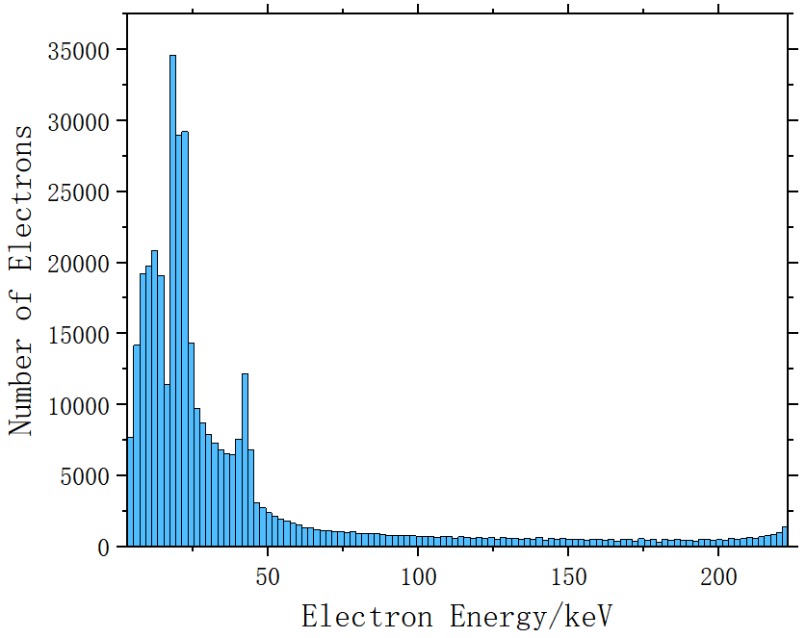
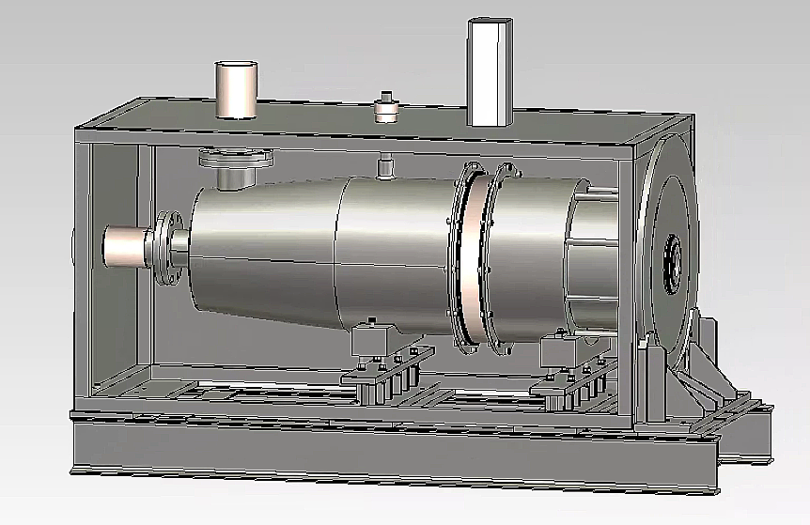
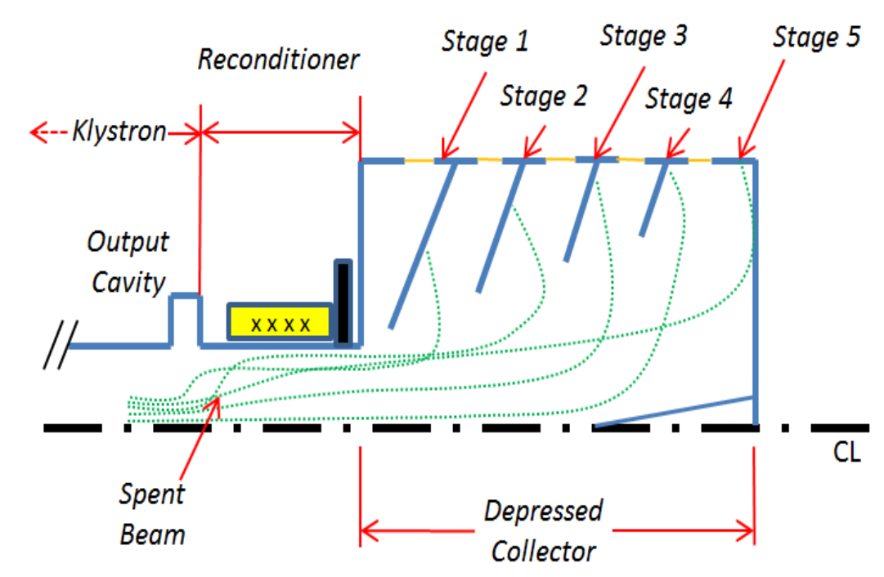
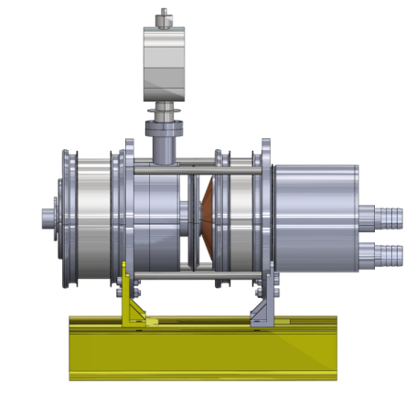
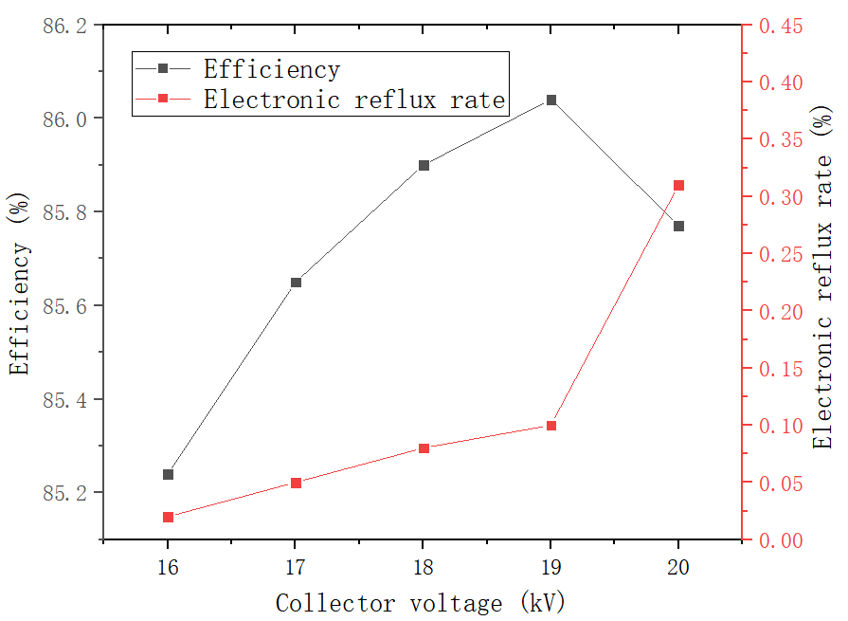
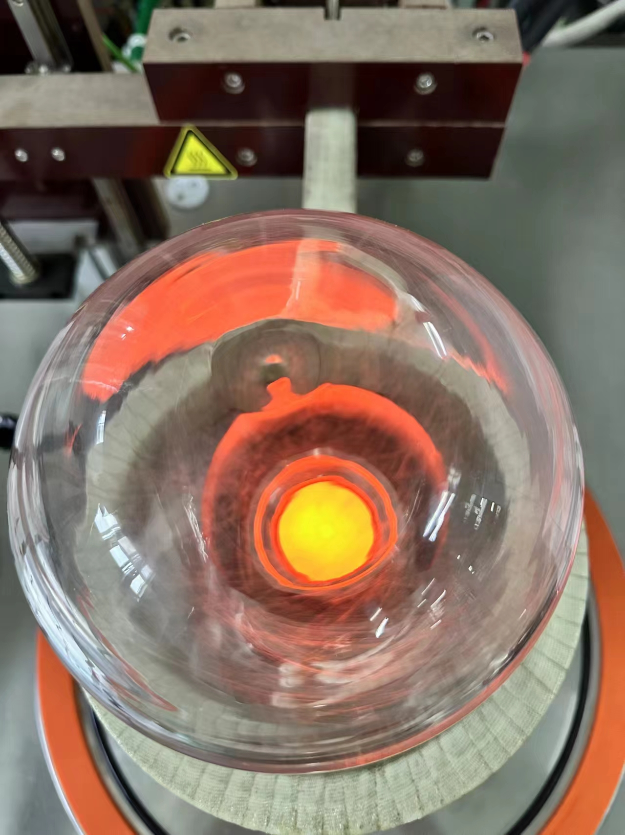
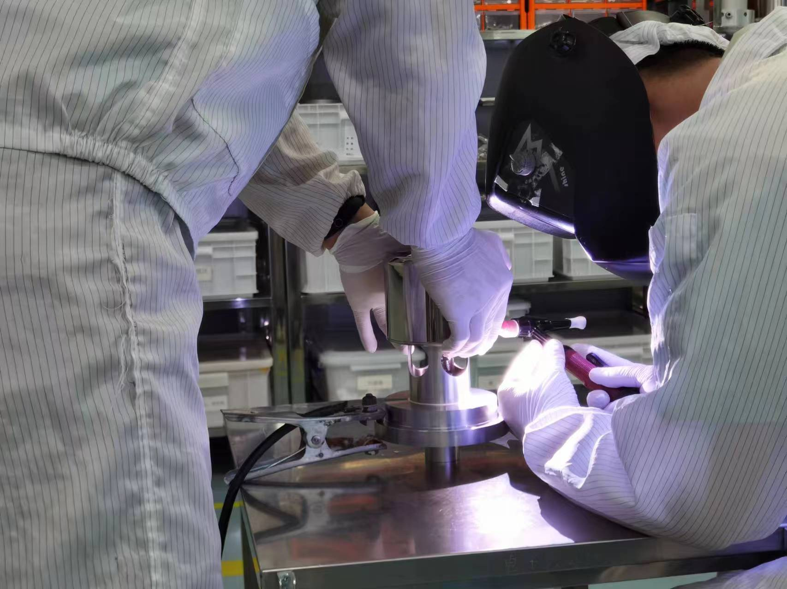
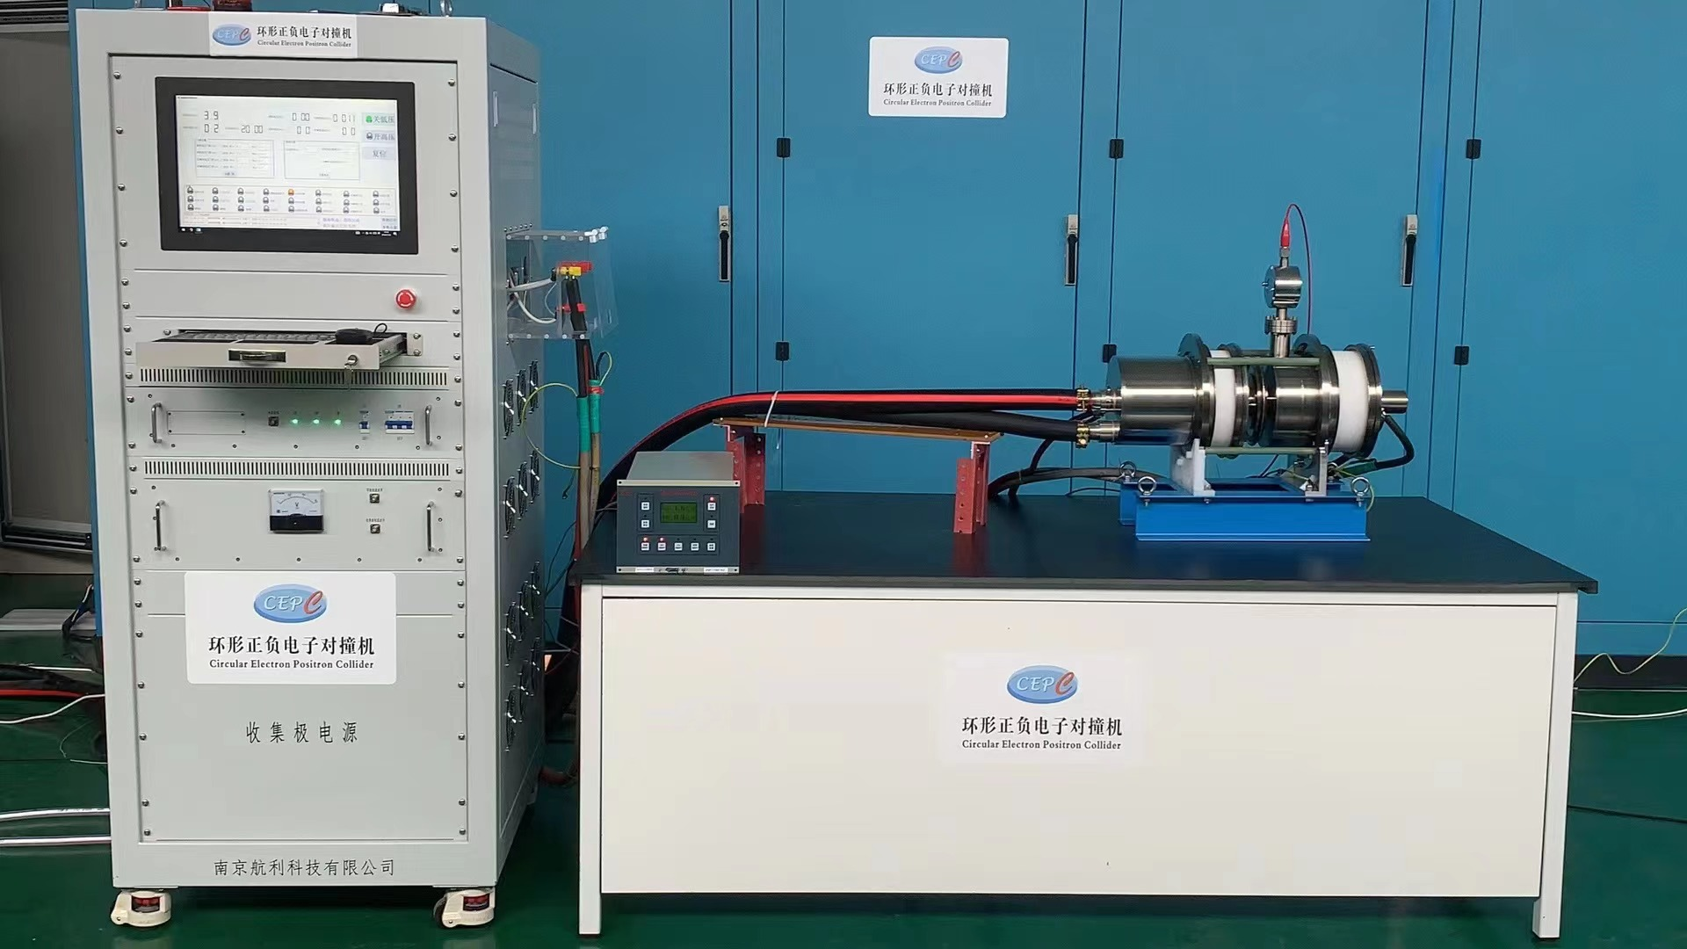
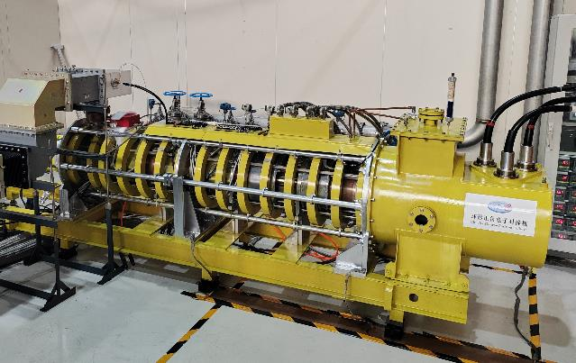
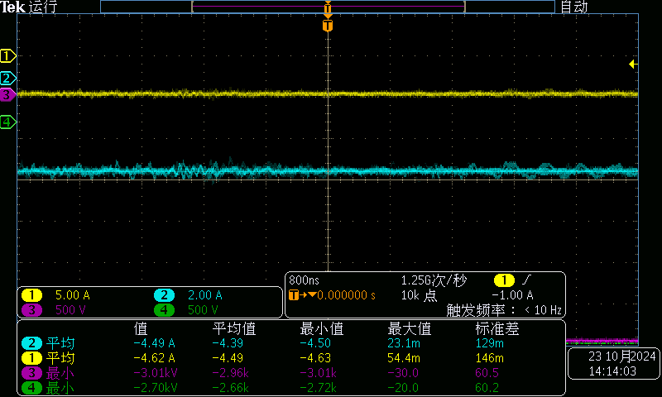
The 2025 International Workshop on the High Energy Circular Electron Positron Collider (CEPC2025), Guangzhou, China, Nov 5-11, 2025
Development of High-Efficiency Energy-Recovery Klystrons*
Yu Liu^{1,2}, Zusheng Zhou^{1.2†}, Ouzheng Xiao², Fei Li¹,Yiao Wang^{1,2}, Han Xiao^{1,2},
Wenbing Gao^{1,2}, Fanyu Wang^{1,2}, Yunlong Chi^{1,2}
1Institute of High Energy Physics, Chinese Academy of Sciences, Beijing 100049
2University of Chinese Academy of Sciences, Beijing 100049, China
Based on the high efficiency klystron scheme of circular electron positron collider (CEPC), the depressed collector design is proposed to improve the overall efficiency of RF power source. The depressed collector technology has been applied in low power microwave electronic vacuum devices such as traveling-wave tube(TWT) and klystron for TV communications. The velocity of electrons entering the klystron collector is scattered, and it is difficult to use the depressed collector to sort the velocity of electrons. This paper presents a simulation study of the depressed collector for the high-efficiency klystron intended for the CEPC, establishes its basic design scheme, and demonstrates through simulation results that its efficiency can exceed 85%.
INTRODUCTION
The depressed collector is an important method to improve the efficiency of microwave tubes by recovering the energy of waste electrons. This technology has been widely used in TWT, and its collector recovery efficiency is more than 70%. Fig. 1 shows the basic principle of an energy recovery device. At present, the application of depressed collector on klystron is mainly used in low power klystron for TV and communication, but there is a little research on depressed collector technology of high power klystron. The fabrication and testing of the Phase I prototype have been successfully completed, marking the conclusion of the preliminary investigation into the energy recovery scheme. In Phase II, the energy recovery configuration specifically designed for the CEPC high-efficiency klystron will be experimentally validated. Simulation results have already demonstrated an efficiency exceeding 85%. Fabrication of the Phase II hardware is now underway, with high-power testing scheduled for August 2026.
The electrode voltage is scanned in CST, and the results are shown in Fig. 9. Simulation results have already demonstrated an efficiency exceeding 85%. Fabrication of the Phase II hardware is now underway, with high-power testing scheduled for August 2026.
Fig.3.Energy distribution of waste electrons
VERIFICATION DEVICE
Before processing the depressed collector klystron, we use the energy recovery verification device to verify the key technology. The basic structure and machining of the verification device are shown in Fig. 4 and 5.
Fig. 8. Structure of the depressed collector.
Fig.1.Depressed collector structure
Fig. 4. Structure of energy recovery verification device
DEPRESSED COLLECTOR PRINCIPLE
Fig. 9. Simulation results
Based on the high efficiency klystron of CEPC, the depressed collector scheme is designed. The high efficiency tube has a saturated output power of 800kW and a design efficiency of more than 75%. The main design parameters of the high-efficiency klystron are shown in Table 1. High-power testing of the klystron was successfully completed in 2024(Fig 2).
SUMMARY AND OUTLOOK
Fig. 5. Mechanical machining
This paper focuses on the high-efficiency CEPC klystron and conducts a theoretical analysis of the collector suppression, determining the electrode parameters. To validate the key technologies of the energy recovery klystron, an energy recovery verification device consisting of an electron gun and a collector was designed and fabricated. After completing the high-power testing, we will proceed with the design of a high-efficiency klystron with a depressed collector, aiming to increase the efficiency from 75% to over 85%.
Table 1: Klystron parameters of CEPC
Operating frequency | 650 MHz
Output power | ≥800 KW
Beam voltage | 113 kV
Beam current | 9.5 A
Beam perveance | 0.25 μP
Efficiency | ≥75%
Fig. 6. Test platform
REFERENCES
After the mechanical machining was completed, we proceeded with the setup of the test platform, as shown in Fig. 6. Testing was completed in November 2024, successfully validating the energy recovery technology(see fig7).
[1]Kosmahl H G. Modern multistage depressed collectors—A review[J]. Proceedings of the IEEE, 1982, 70(11): 1325-1334.
[2]DAYTON J A. System efficiency of a microwave power tube with a multistage depressed collector(Current distribution estimates for microwave power tube with depressed multistage collector)[J]. 1972.
[3]Jiang Y, Teryaev V E, Hirshfield J L. Partially grounded depressed beam collector[J]. IEEE Transactions on Electron Devices, 2015, 62(12): 4265-4270.
[4]Vaughan J R M. Synthesis of the Pierce gun[J]. IEEE Transactions on Electron Devices, 1981, 28(1): 37-41.
[5]Hamme F, Becker U, Hammes P. Simulation of secondary electron emission with CST PARTICLE STUDIOTM[C]//Proc. ICAP. 2006: 160-163.
Fig.2.CEPC P-band high-efficiency klystron
The energy distribution of electrons entering the collector is shown in Fig. 2. The following formula is used to obtain the recovery power of the multi-stage depressed collector:
Fig. 7. Current and voltage waveforms
ENERGY-RECOVERY KLYSTRONS
where Jwaste is the probability density function of electron energy distribution.
In the second phase, we designed a single-stage depressed collector based on the prototype structure. The configuration is shown in Fig 8.
* Work supported by Yifang Wang’s Science Studio of the Thousand Talents Project
† email address: zhouzs@ihep.ac.cn

