Slide 1


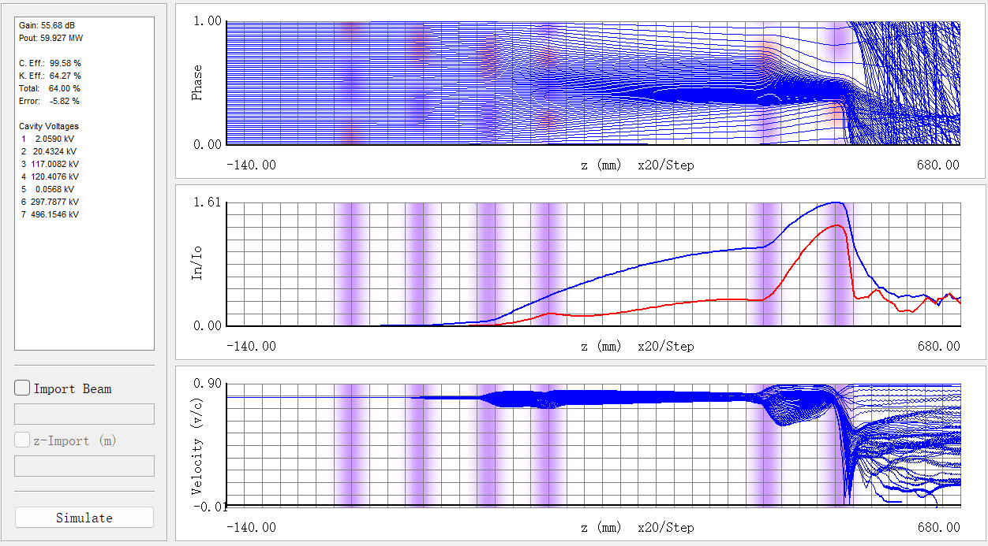
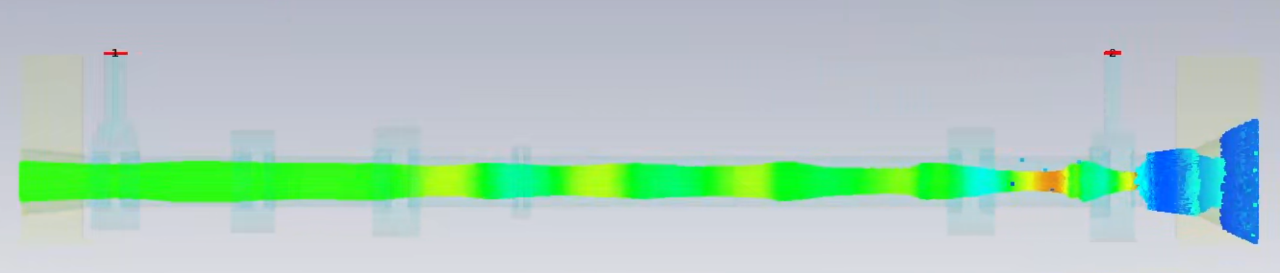
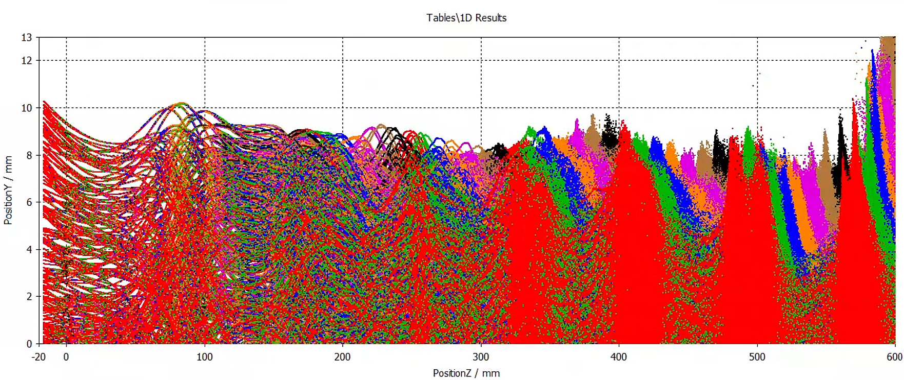
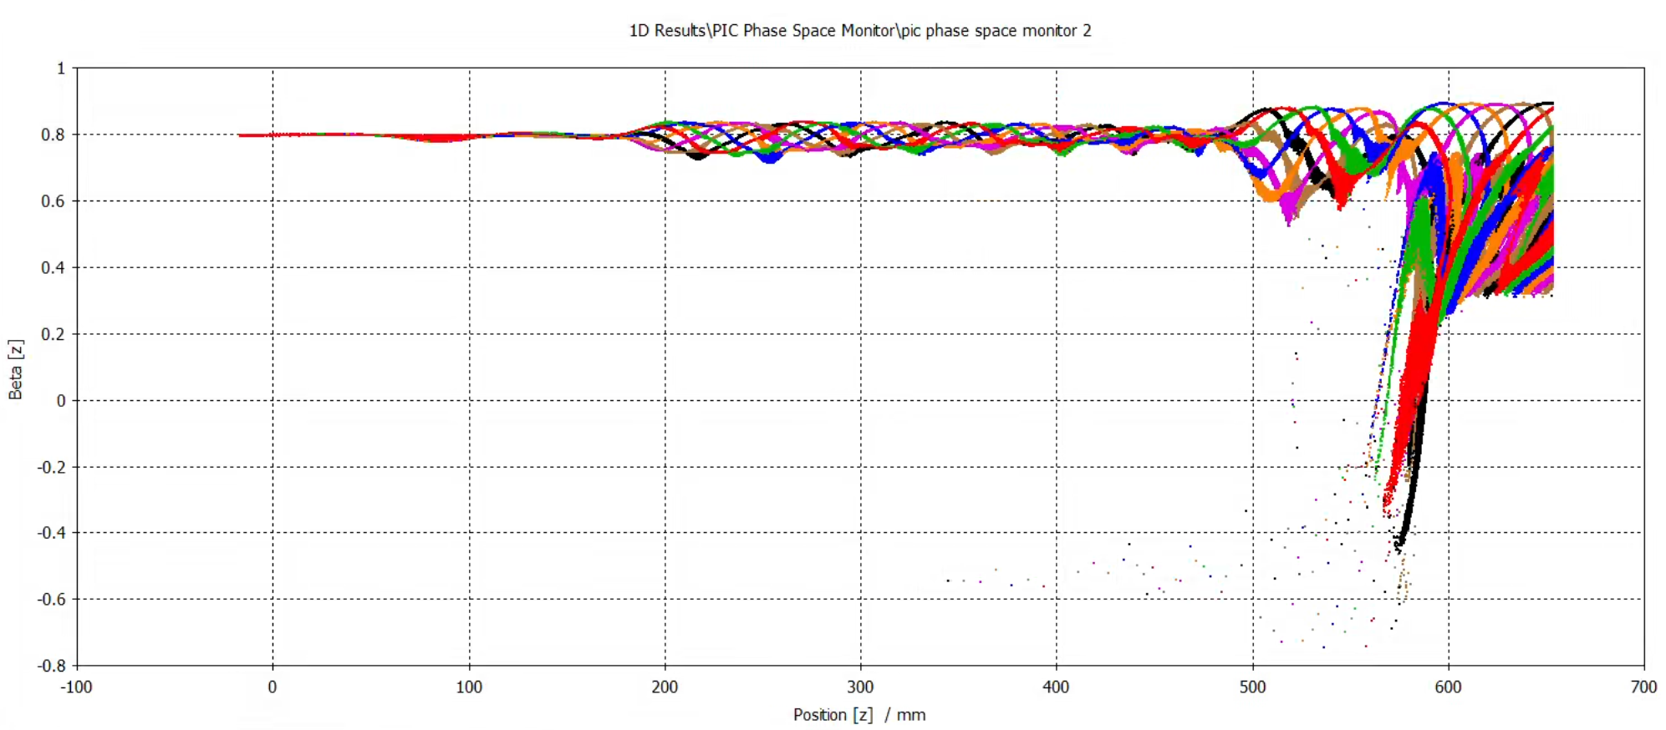
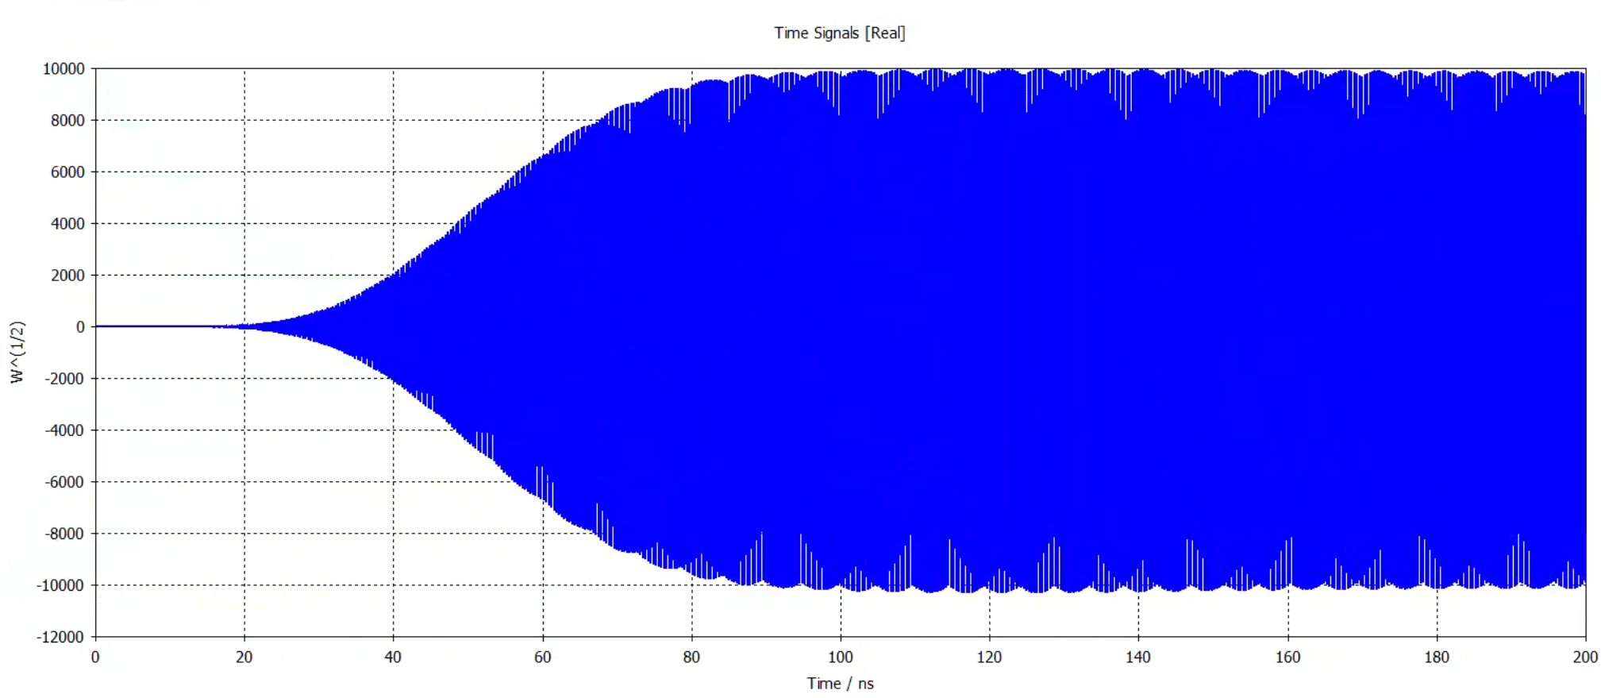
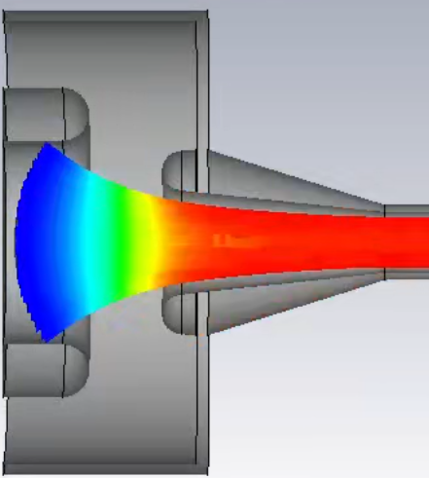
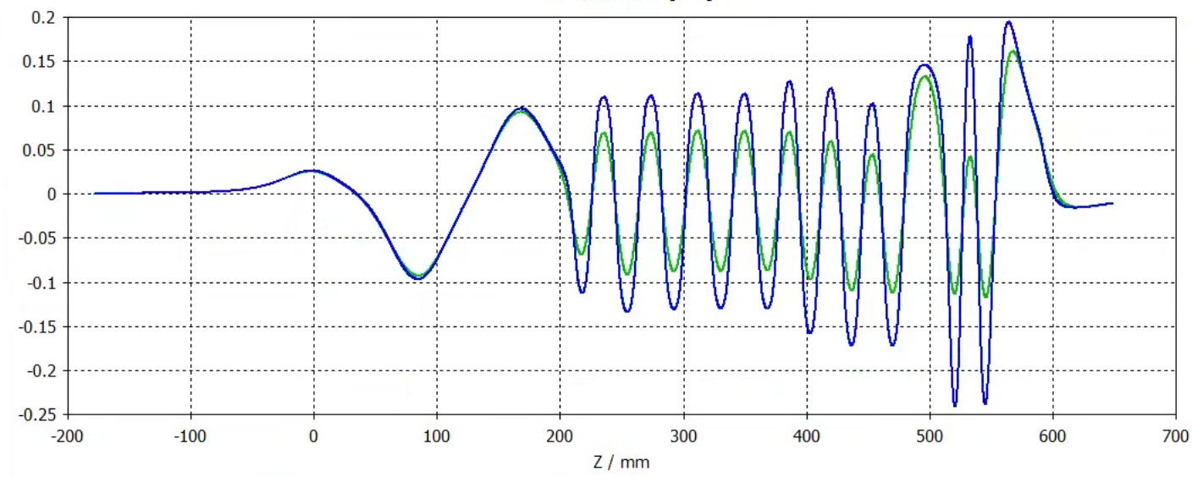
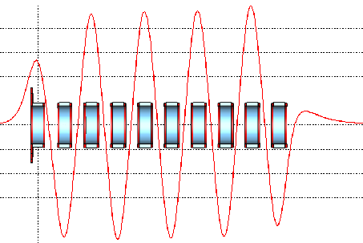
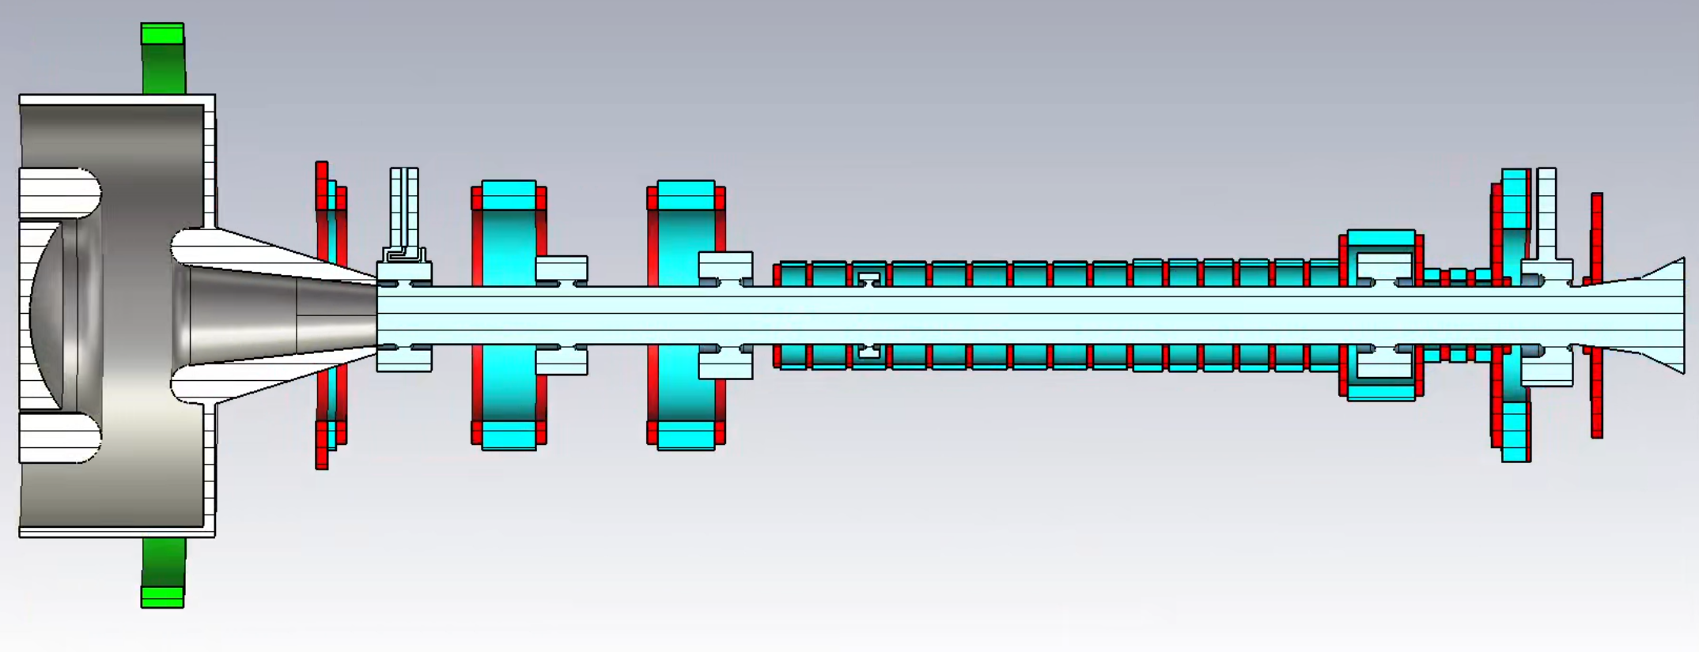
Poster ID: B04 The 2025 International Workshop on the High Energy Circular Electron Positron Collider (CEPC2025), Guangzhou, China, Nov 5-10, 2025
Research on an S-Band 50 MW High-Efficiency Permanent Magnet Klystron†
Han Xiao^{1,2}, Zusheng Zhou^{1,2}*, Ouzheng Xiao¹, Yu Liu^{1,2}, Yiao Wang^{1,2}, Wenbin Gao^{1,2}, Noman Habib^{1,2},
Fanyu Wang^{1,2}, Xiaobo Zhou^{1,2}, Yang Zhao^{1,2},Munawar Iqbal¹, Abid Aleem¹
¹Institute of High Energy Physics, Chinese Academy of Sciences, Beijing 100049, China
²University of Chinese Academy of Sciences, Beijing 100049, China
*email address: zhouzs@ihep.ac.cn
ABSTRACT
Improving klystron efficiency is crucial for reducing the operational costs of particle accelerators. This study presents an S-band 50 MW periodic permanent magnet (PPM) focusing high-efficiency klystron , aiming to minimize energy consumption while maintaining high conversion efficiency. The research addresses the domestic need for localized development of S-band 50 MW klystrons. A key focus is the design of a high-efficiency 50 MW klystron and its corresponding PPM focusing structure. Through precise computer simulations of beam dynamics, the feasibility of the PPM focusing system is validated, achieving both high microwave conversion efficiency and compatible beam focusing. The development of this S-band PPM klystron represents a significant advancement in klystron technology, offering a more efficient and cost-effective solution for high-power applications. This design reduces power consumption without compromising performance, contributing to the broader goals of energy efficiency and cost reduction in accelerator technology.
INTRODUCTION
High power and high efficiency are key research priorities in klystron development. The advancement of large-scale scientific projects—such as the International Linear Collider (ILC), Compact Linear Collider (CLIC), Future Circular Collider (FCC), and Circular Electron Positron Collider (CEPC)—highlights the essential role of high-efficiency klystrons in these initiatives. Improving klystron efficiency relies on effective bunching of peripheral electrons and reduction of velocity dispersion. Common strategies to this end include lowering electrical conductivity and incorporating second harmonic cavities.
Permanent magnet focusing eliminates the need for conventional focusing coils, along with their dedicated power supplies and cooling systems. This not only reduces power consumption but also substantially cuts the klystron's size and weight.
This study introduces a design that integrates high efficiency with permanent magnet focusing, aiming to enhance klystron performance while facilitating system miniaturization.
PERIODIC PERMANENT MAGNET FOCUSING
The Periodic Permanent Magnet (PPM) focusing system is comprised of rings of axially magnetized permanent magnets arranged with alternating polarity. An electron beam can remain focused within this resulting periodic magnetic field, yet its envelope exhibits fluctuation. The amplitude of this fluctuation increases as the beam voltage decreases. Beyond a well-defined threshold, the beam becomes completely divergent. A key advantage of this configuration is its enhanced utilization of the reverse magnetic fields between adjacent magnets, leading to a more compact and lightweight focusing system.
FOUNDATION DESIGN
The design incorporates six cavities, one of which is a second harmonic cavity. Its focusing structure is mainly divided into three sections. The first section has a small fundamental current of the beam and is designed as a long-period magnetic field that is easy to process. At the same time, considering the water cooling space, a large inner diameter magnetic ring is used. In the second section, the pole shoe extends into the vacuum inside the klystron, and considering the cavity size, it is designed as a medium-period medium inner diameter structure. The third section has a large fundamental current and is designed as a short-period small inner diamete structure.
BEAM DYNAMIC
The beam dynamics design was first completed in AJDISK and then rigorously verified and optimized through simulations in CST. The PIC simulations confirm a stable output of 51.2 MW with an efficiency of 53.8%.
Figure 5 Simulation results in AJDISK
Table 1 Main parameters of klystron
Frequency | 2856Mhz
Output power | 50MW
Voltage | 350kV
Current | 272A
Beam radius | 9mm
Drift tube radius | 13.8mm
Efficiency | 53%
Figure 6 Beam trajectory and phase space in CST
ELECTRON OPTICS
In CST simulation, the electron gun current is 272A, the waist radius is 8.86mm, the minimum period length of the focusing structure is 24mm, and the maximum magnetic field along the axis is 1614Gs.
Figure 7 Output power in CST
SUMMARY AND OUTLOOK
Figure 3 The electron gun in CST
This study proposes a design of an S-band 50MW high-efficiency permanent magnet klystron, characterized by a second harmonic cavity and segmented periodic permanent magnet focusing. This configuration has the advantages of high efficiency, simplicity, and compactness. The CST simulation results show that the output power is 51.2MW and the efficiency is 53.8%.
The next step is to optimize the reflux electrons and output power.
Figure 4 Magnetic field distribution
at the axis and beam radius
Figure 1 Periodic permanent magnet focusing structure
REFERENCES
[1] Syratchev, I. (2022). High efficiency klystrons. [PowerPoint slides]. https://indico.cern.ch/event/1138690/contributions/4782684/attachments/2435633/4171251/IFAST_2022_SI.pdf
[2] Matsumoto, H., Shintake, T., Ohkubo, Y., Taoka, H., Ohhashi, K., & Kakuno, K. (2001). High power test of the first C-band (5712 MHz) 50 MW PPM klystron. PACS2001. Proceedings of the 2001 Particle Accelerator Conference (Cat. No.01CH37268), 2, 993-995 vol.2.
[3] Chin, Y.H., Matsumoto, S., Mizuno, H., Morozumi, Y., Ohkawa, T., Ohya, K., Takata, K., Toge, N., Tokumoto, S., Kazakov, S.Y., Larionov, A., & Teryaev, V.E. (2001). X-band PPM klystron development for JLC. PACS2001. Proceedings of the 2001 Particle Accelerator Conference (Cat. No.01CH37268), 5, 3792-3794 vol.5.
[4] Sprehn, D.W., Caryotakis, G., Jongewaard, E.N., & Phillips, R.M. (1999). Periodic permanent magnet development for linear collider X-band klystrons.
[5]CST GmbH, Darmstadt, Germany.
Figure 2 Focusing structure and vacuum inside the klystron
†Work supported by Dr. Yifang Wang’s Science Studio of the Thousand Talents Project

