Slide 1

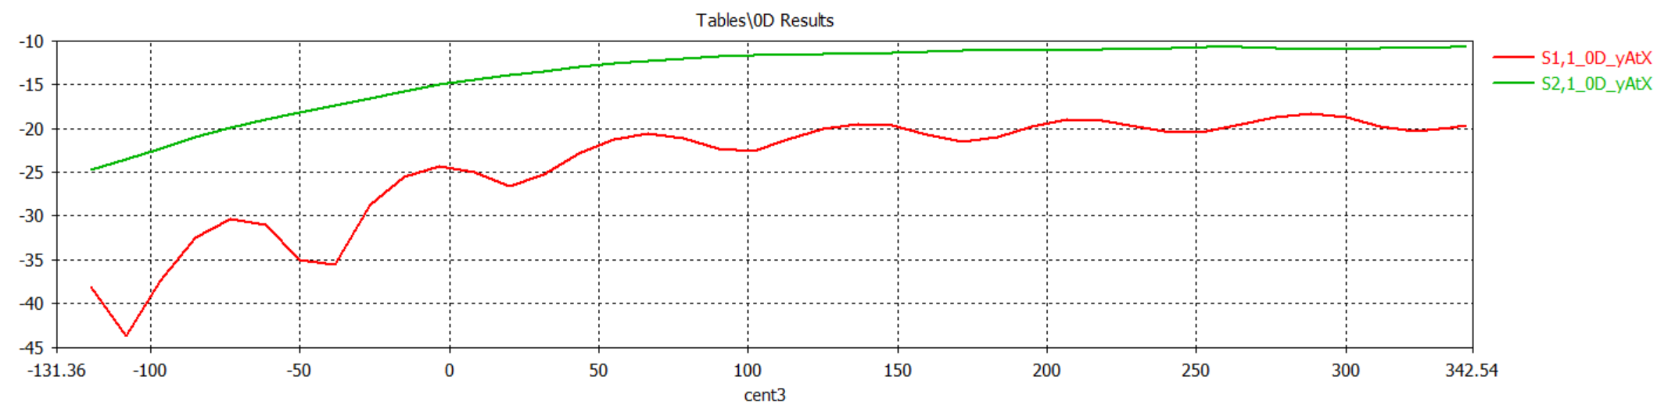
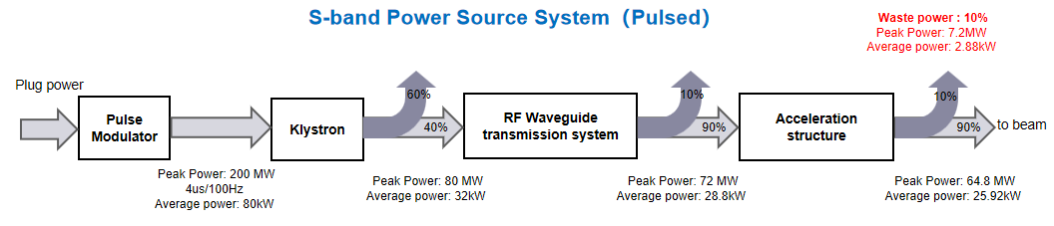
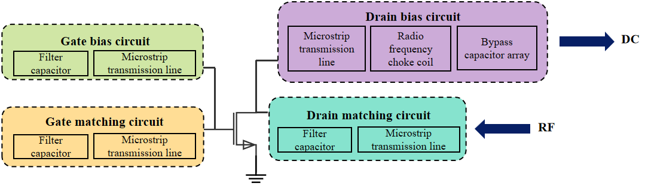
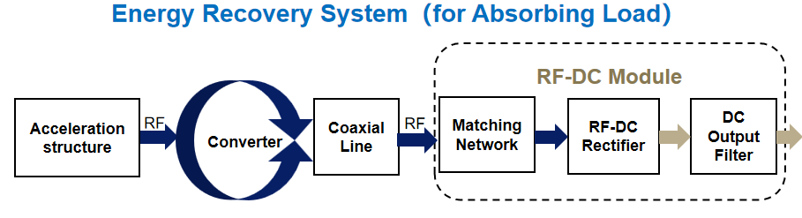
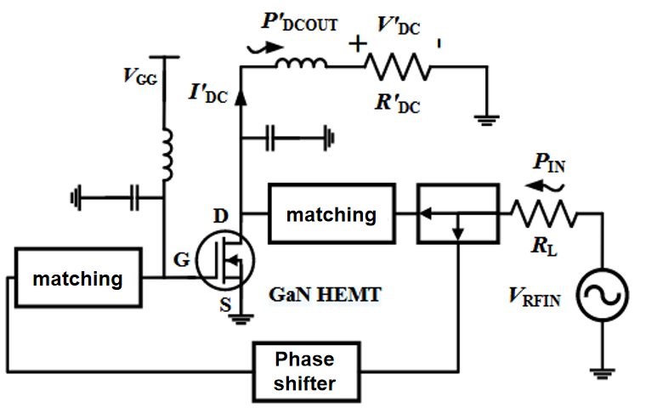
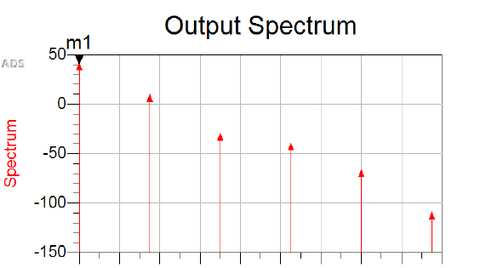
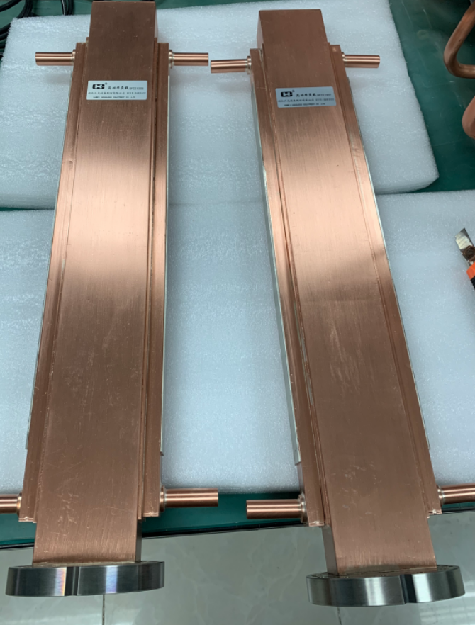
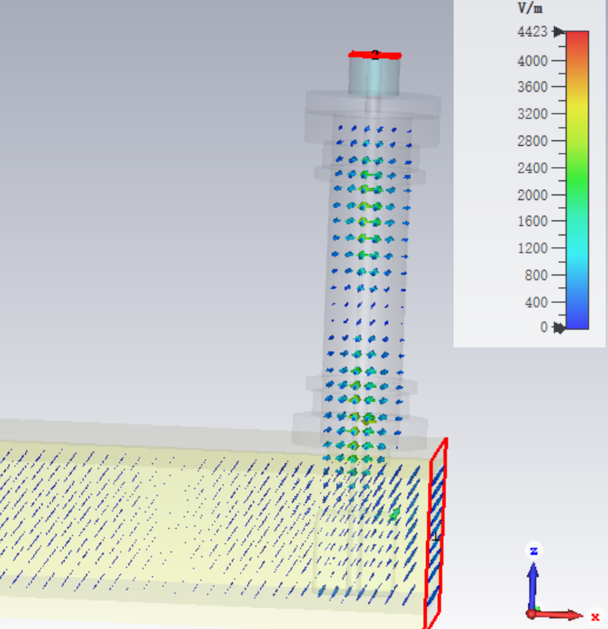
Development of high power energy recovery absorbing load
for large scale accelerators
A-15
Yang Zhao, Xiang He, Jindong Liu, Fei Li, Wenbin Gao, Ouzheng Xiao, Nan Gan, Yongliang Zeng, Zusheng Zhou*
Abstract
CST simulation results demonstrate that microwave extraction across a wide frequency range can be achieved while ensuring no reflected waves return to the accelerating structure.
In large particle accelerators, the RF power system consumes the most energy. Much unused RF energy is wasted as heat in an absorption load. RF-DC rectification offers a solution to recover this energy, but has historically been impractical due to transistor limitations in handling high power/frequency. Recent GaN transistors have overcome these limitations, reviving interest in this method. This work investigates the feasibility of GaN-based RF rectification and its potential for improving energy efficiency in future colliders like the CEPC.Simulation has achieved 500 MW RF power rectification at S-band using a single module.
Rectifier circuit design
The core of the RF rectification circuit design lies in the selection of semiconductor device materials and device types. Both the HEMT based on Gallium Nitride (GaN) material and the LDMOS based on Silicon Carbide (SiC) material possess greater potential for withstanding high-frequency/high-power operation. Therefore, the devices selected for this work are the aforementioned two types.
Upon determination of the semiconductor devices, the design of the rectification circuit topology needs to be undertaken. Both HEMT and LDMOS are field-effect transistors. The principle of transistor rectification is illustrated in the figure.
Microwave circuit design
The energy-recycling load comprises two components: a microwave extraction circuit and an RF rectification circuit. Microwave energy passing through the load is converted into DC power, thereby enabling its secondary utilization.
The circuit structure in the figure below is the schematic diagram of the designed rectification circuit. ADS simulation results demonstrate that when 56 dBm of RF power is fed into the input port of the rectification circuit, 40 dBm of DC power can be obtained at the output port.
The microwave extractor design employs the following configuration: An aperture is created on the broad wall of the original microwave absorbing load. A coupling tab extends through this aperture and connects to a coaxial transmission line. By adjusting the insertion depth of the coupling tab, the amount of extracted microwave power can be regulated.
Conclusion
The results of ADS and CST simulations in this work demonstrate that the unused RF energy in the accelerating structure can be converted into DC power. Although the current conversion efficiency is not high, there remains significant potential for future improvement.

