Slide 1

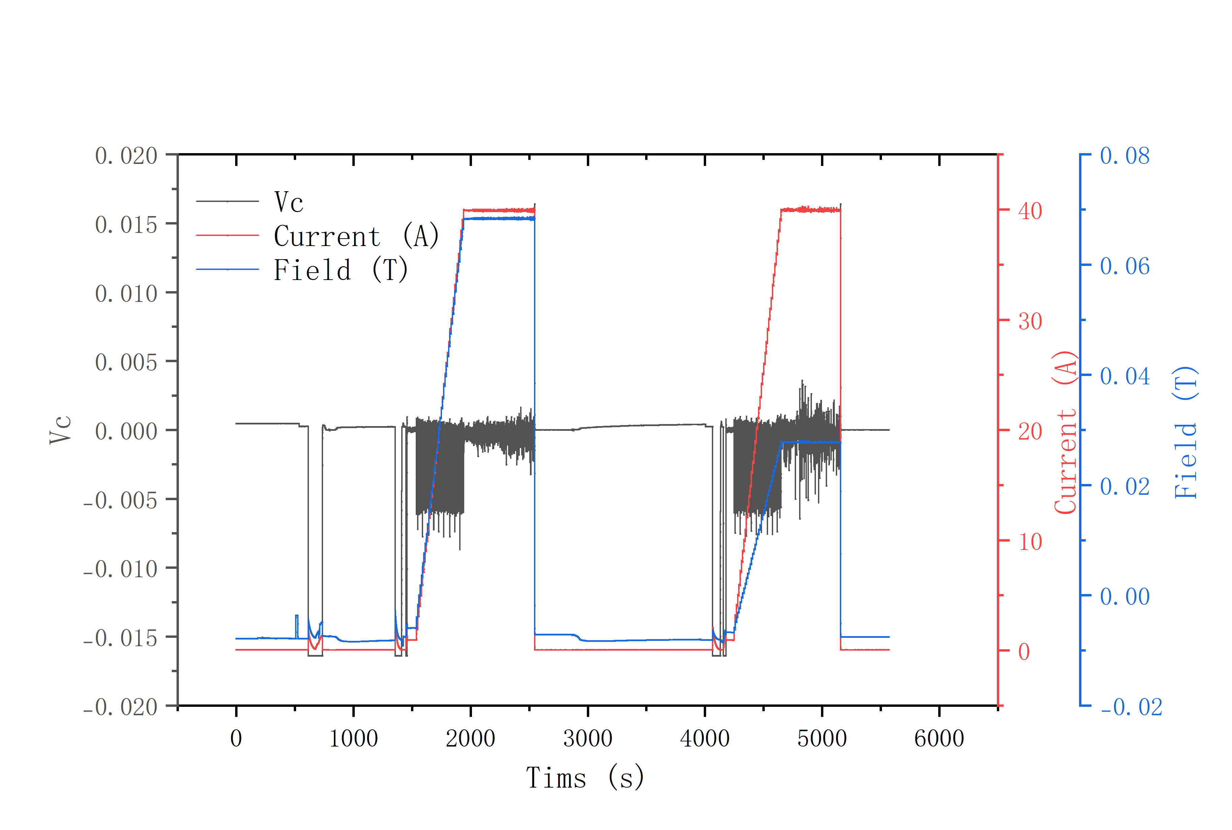
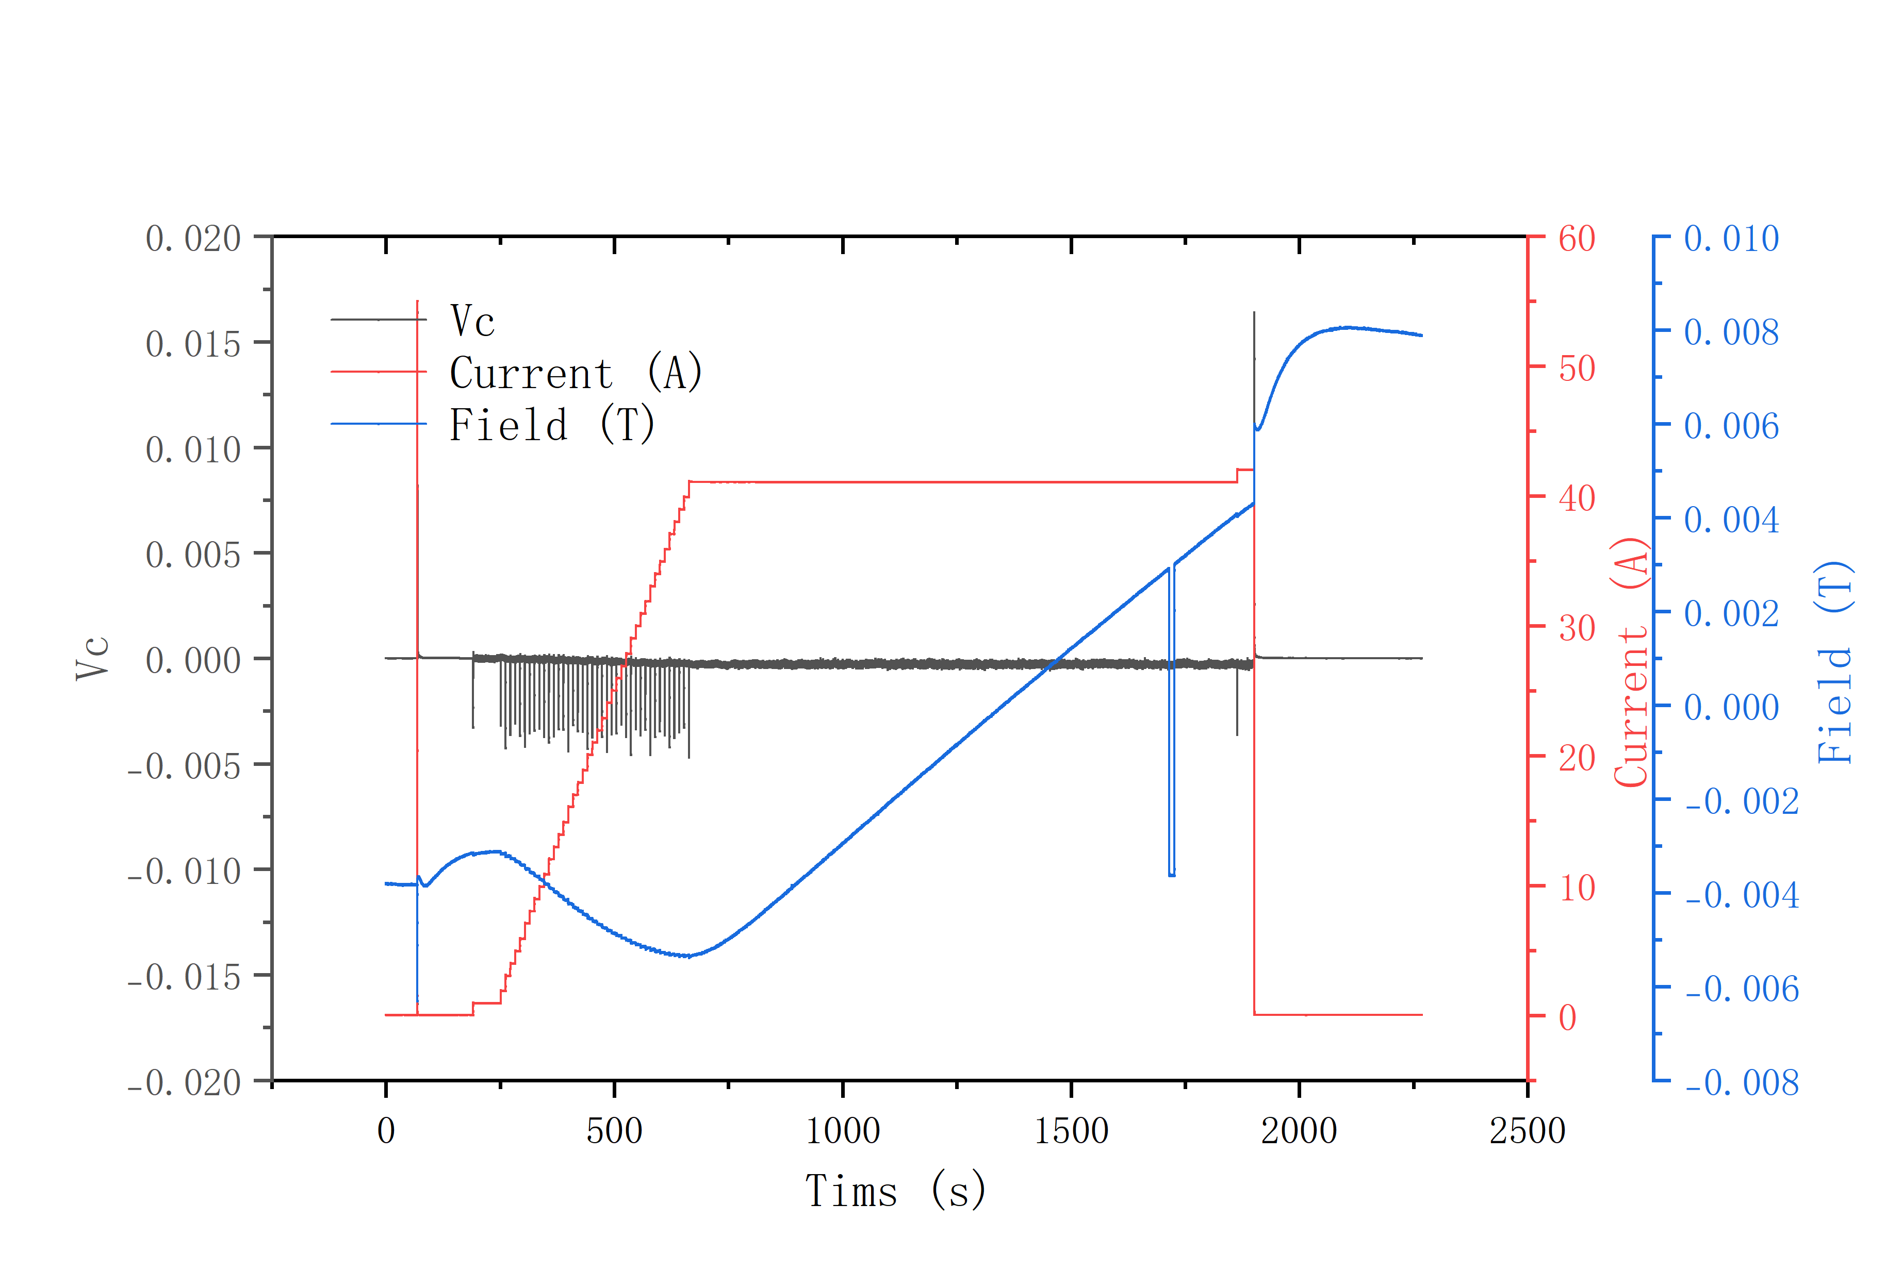
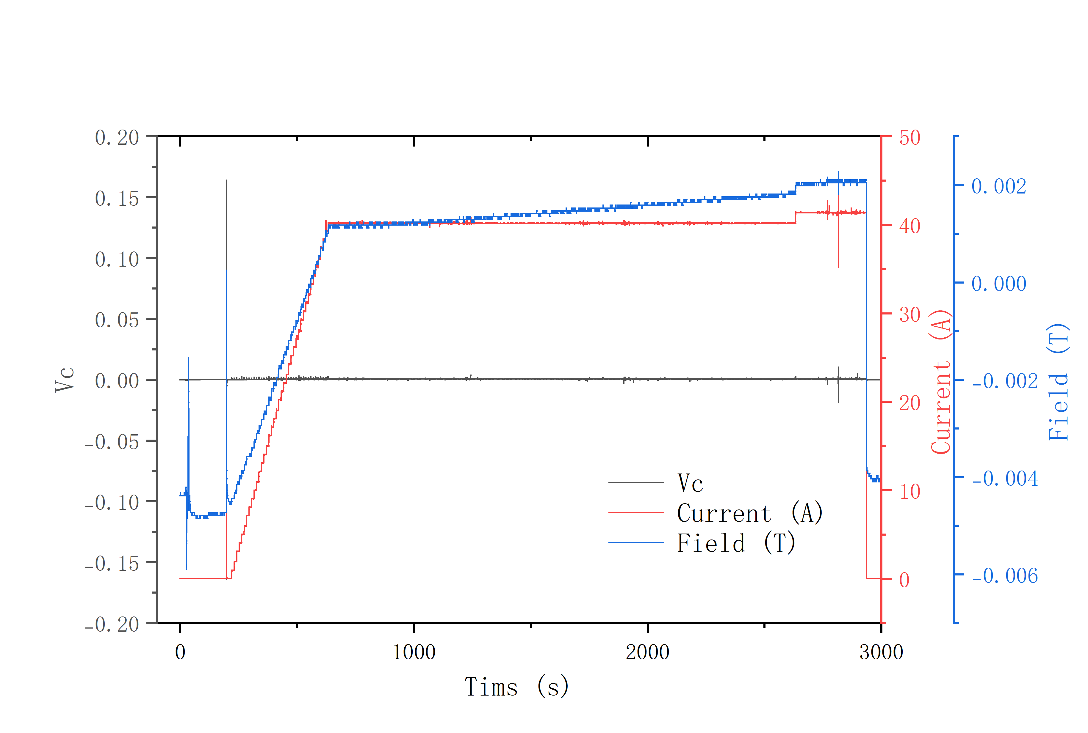
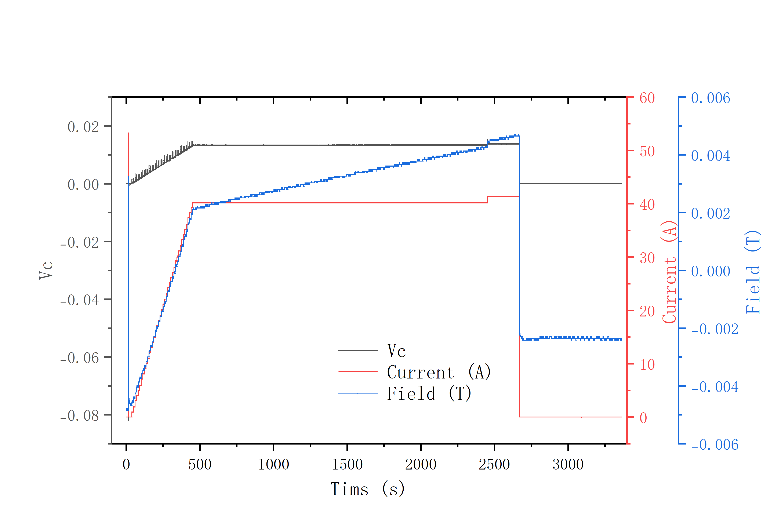
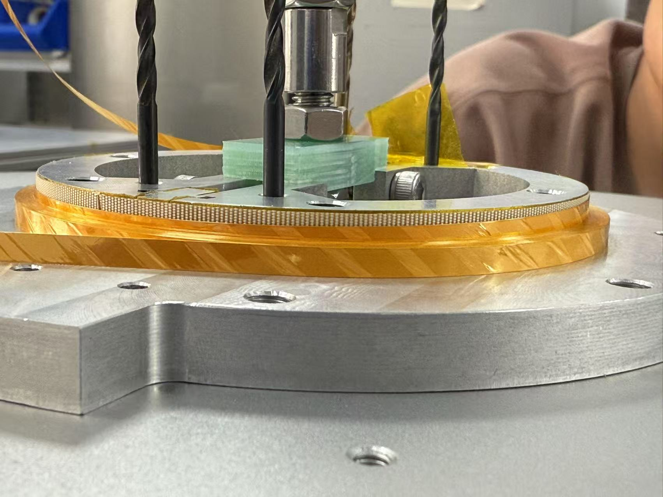
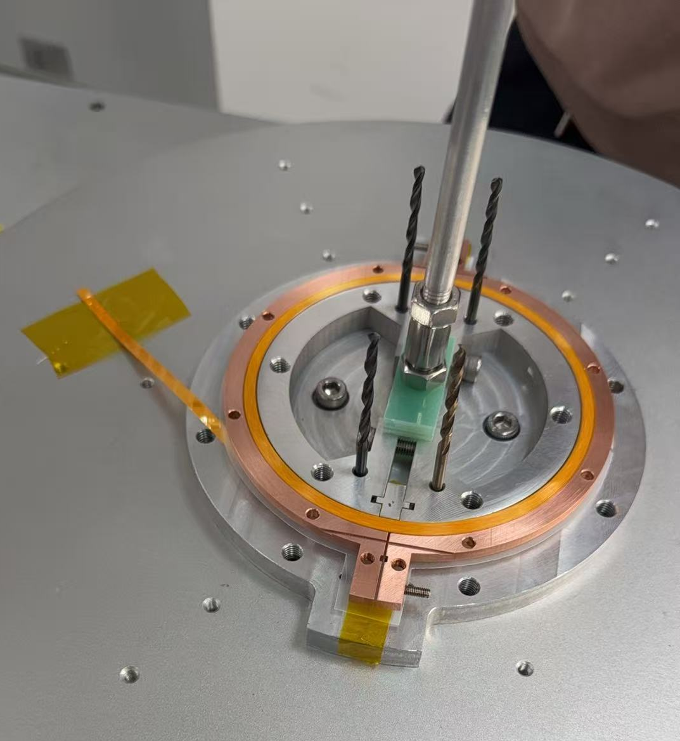
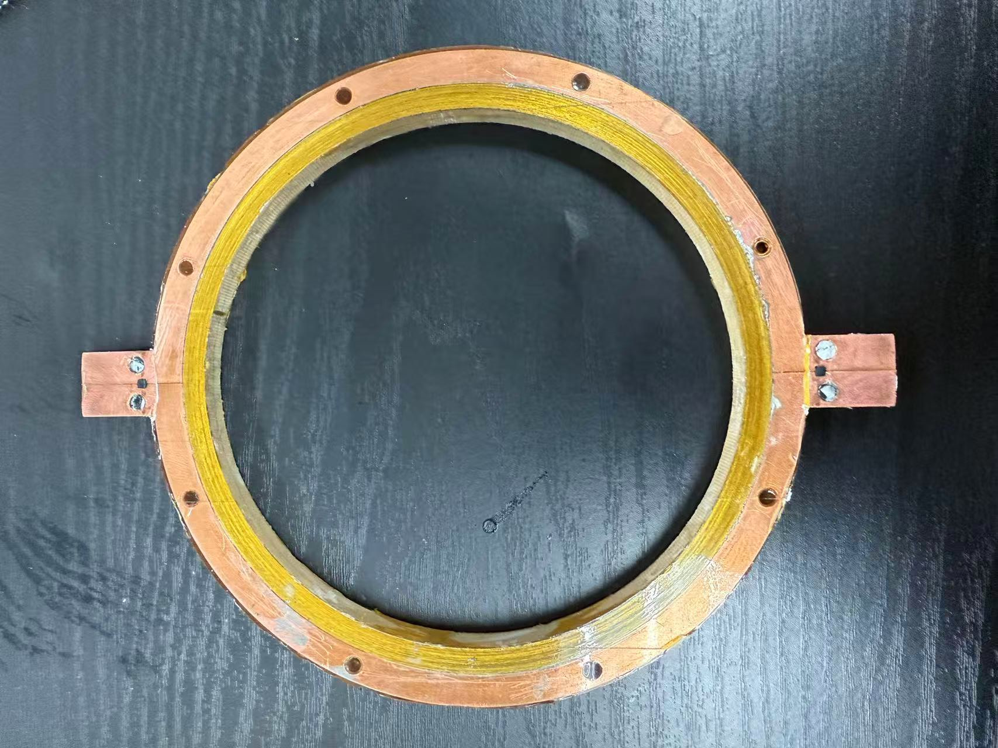
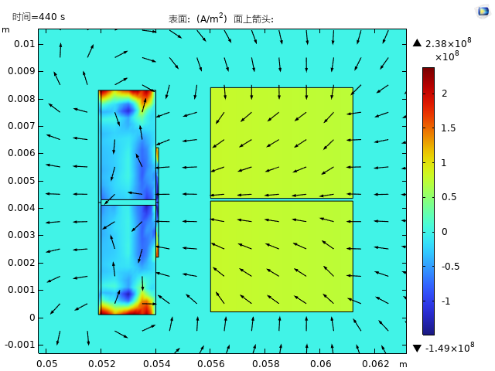
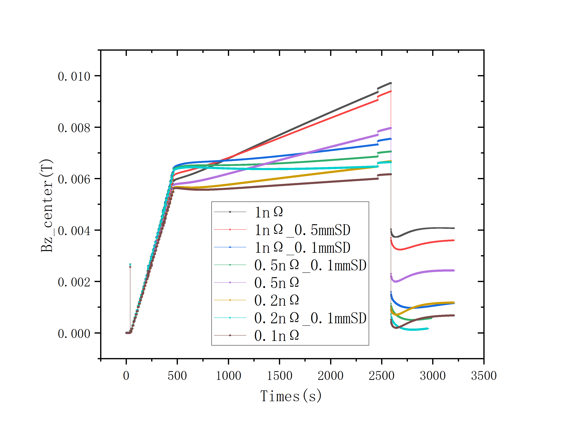
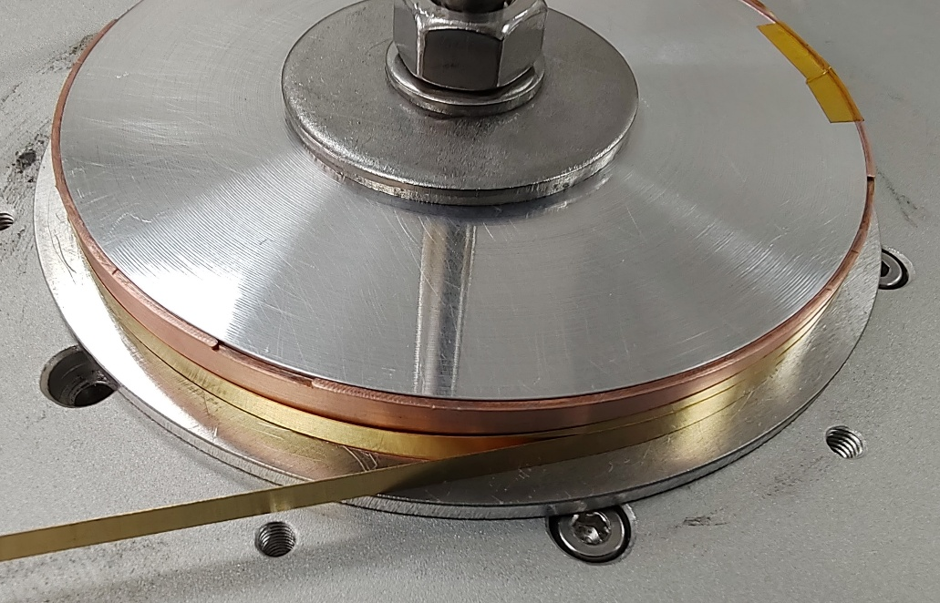
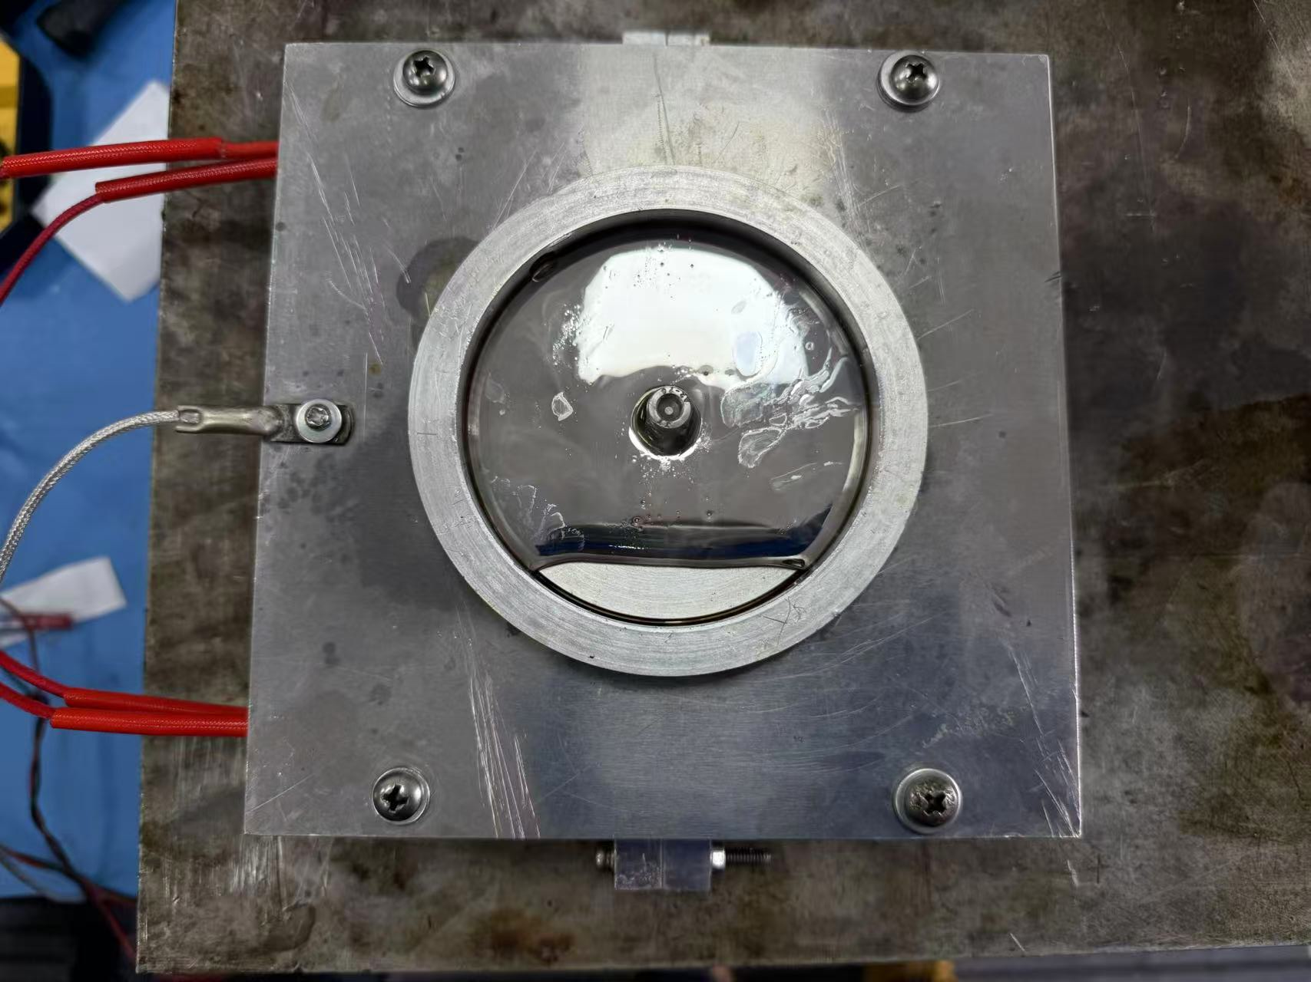
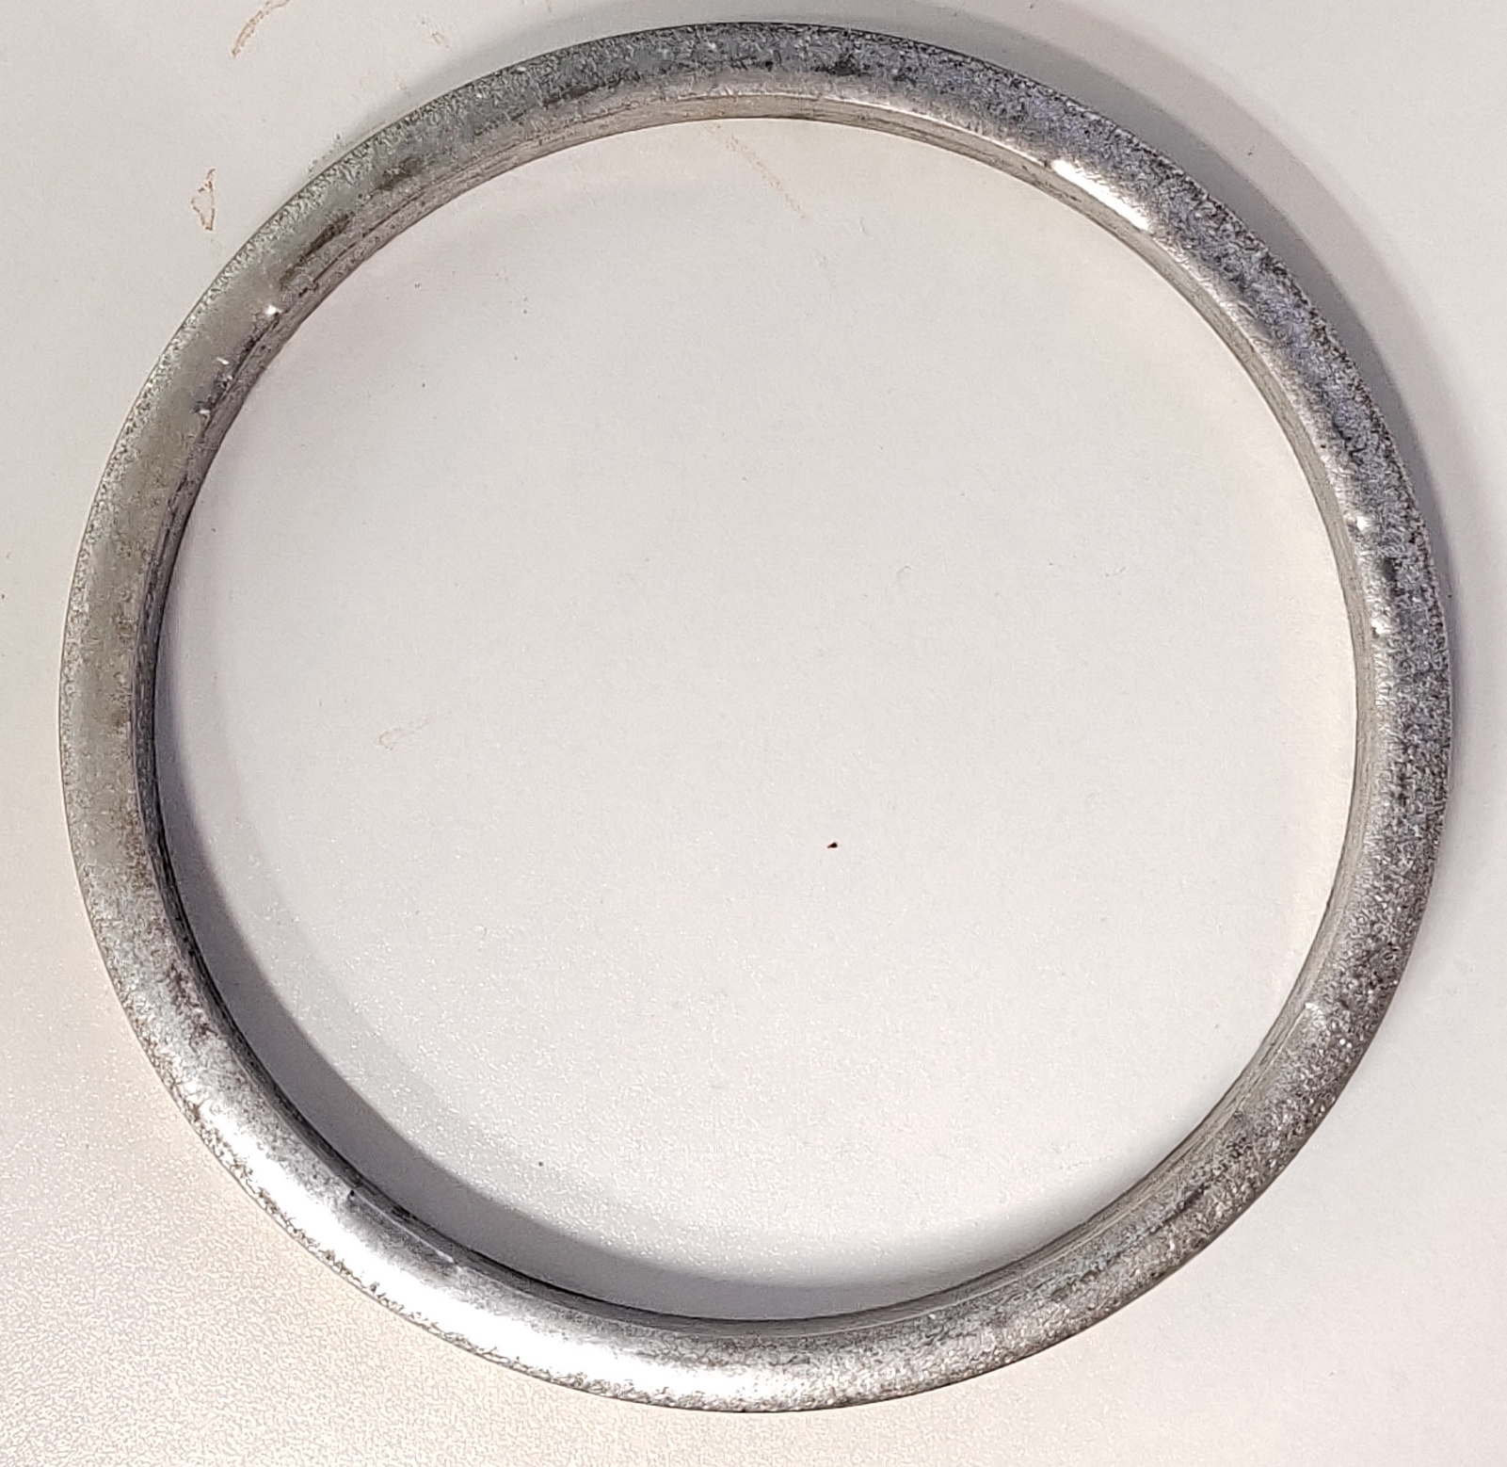
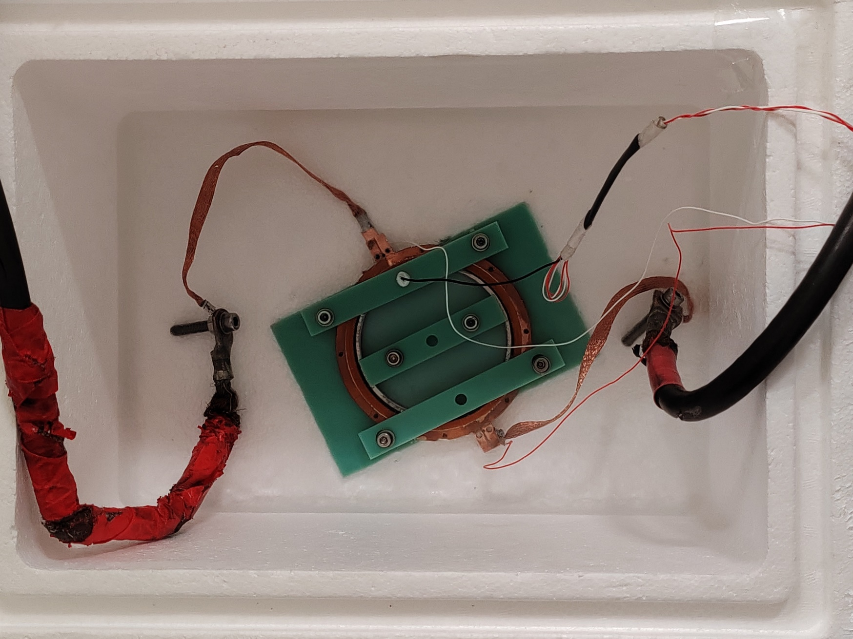
Simulation and Experimental Validation of Inductive Excitation in HTS Flywheel Energy Storage System
Rui Ma ^{1,2}, Juan Wang ¹, Jin Zhou ¹ ，Kai Liao ^{1,2}, Hang Xu ^{1,2}, Rui Kang^{1 *} ，Qingjin Xu^{1 *}
A-10
Institute of High Energy Physics, Chinese Academy of Sciences
2. University of Chinese Academy of Sciences
Abstract
Simulation Analysis
Traditional flywheel energy storage technology is limited by the mechanical strength of materials, resulting in a theoretical upper limit on flywheel rotational speed. To address this bottleneck, IHEP has proposed a new ring-shaped superconducting kinetic energy loading system. This system provides centripetal force through radial electromagnetic force, breaking the speed limitation. An external back-field solenoid coil supplies the magnetic field to the internal flywheel coil, and the flywheel coil is energized through induction excitation. This method of inductive energization effectively reduces the impedance issues caused by current leads under rotational conditions. The flywheel coil is a closed-loop, double-pancake wound, insulation-free coil, solidified with solder, offering both a stable mechanical structure and excellent post-excitation current retention capability.
Three sets of data were collected on the data acquisition instrument: the back-field coil end voltage signal, the back-field coil current signal, and the Hall probe signal.
The Hall probe signal is used to indirectly measure the induced current on the rotating coil.
a
b
Coil Design
To minimize the time delay when powering the back-field, high-temperature superconducting tape wrapped with Kapton is used for winding, and Kapton is used to provide inter-turn insulation.
c
d
Figure a: Magnetic field data measured from a single background coil. The magnetic field is completely linearly related to the current.
Figure b: Magnetic field changes at the edge aperture during three stages: power-on, constant current, and power-off
Figures c and d: Magnetic field changes at the central aperture during three stages: power-on, constant current, and power-off
The rotating coil is wound with copper-plated tape as an uninsulated double pancake. On the outermost layer, 4mm strips are used to weld the double pancake coils together in a manner opposite to the superconducting layer, forming a closed loop.
In the comparison between simulation and experimental results, the main adjustments are made to the two parameters: inter-turn resistance and joint resistance.
In the comparison between experimental data and COMSOL simulation data, the trends are basically consistent, and the joint resistance of the coil without insulation after solder solidification is controlled below 1 nΩ.
Experimental Measurement
Conclusion
This experiment, combining electromagnetic simulation with experimental verification, confirmed the feasibility of the induction excitation method along with solder curing closed-loop and the continuous current-carrying capability of the double pancake coil, laying an important foundation for the innovative design of a new ring-shaped superconducting kinetic energy loading system.
Indirect measurement of induced current at 77K

