Slide 1


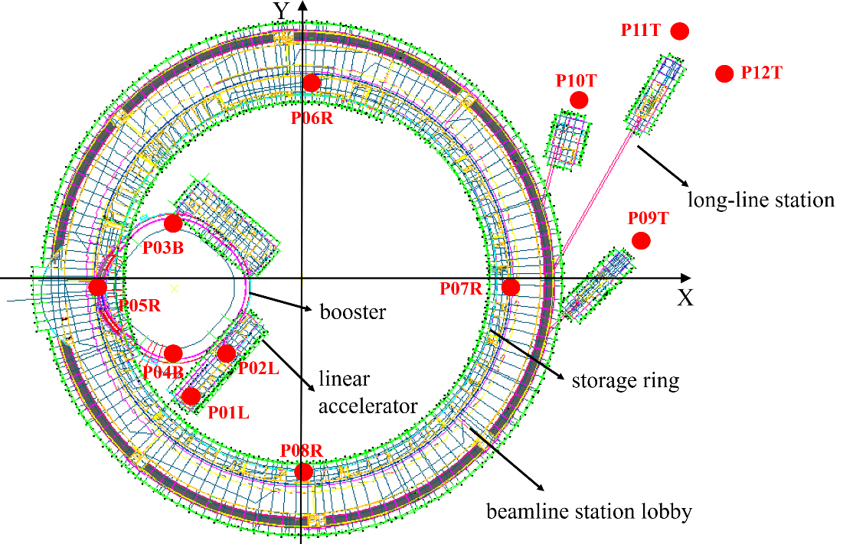
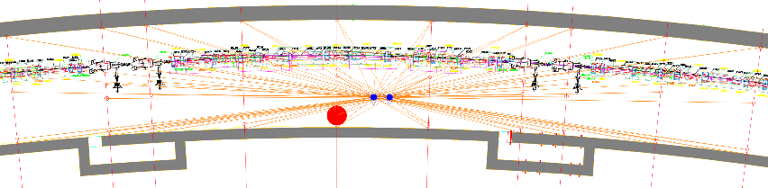
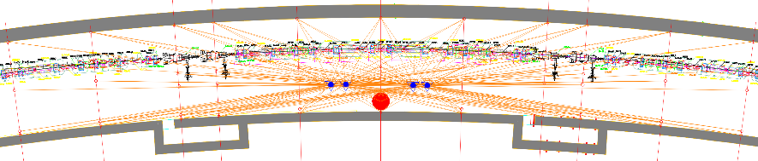
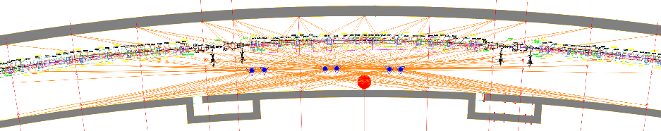
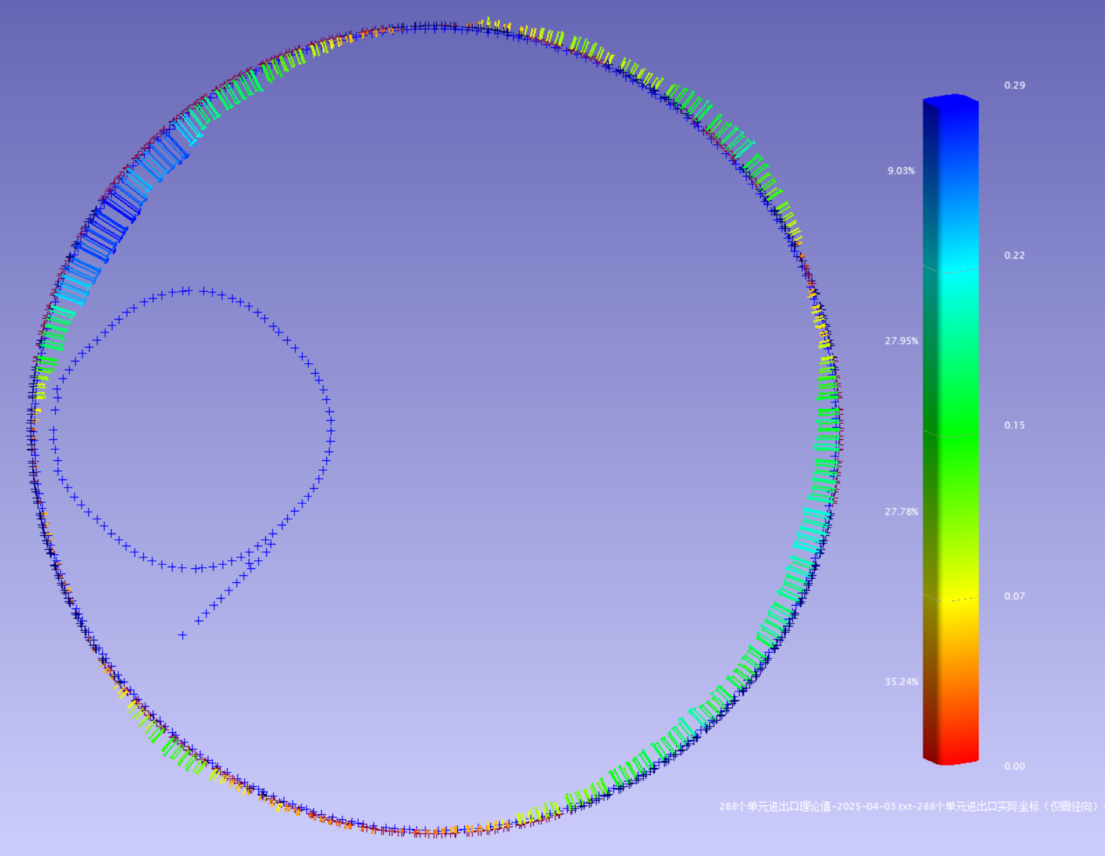
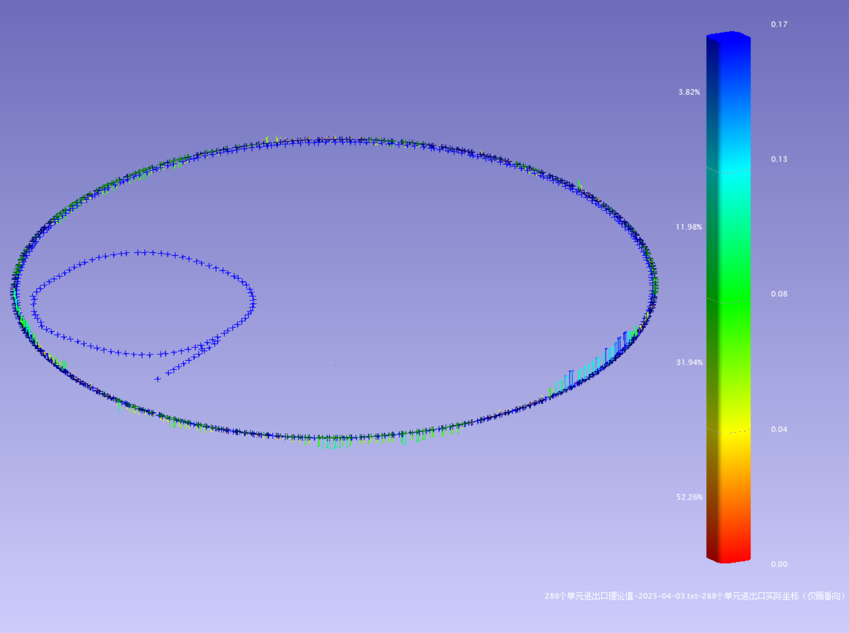
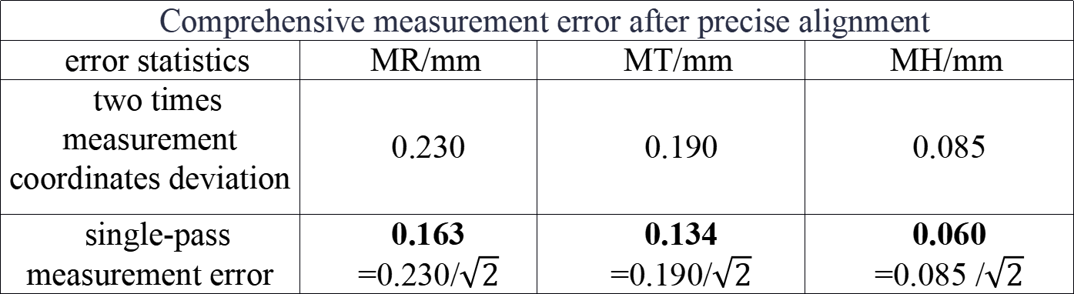
Poster ID :91The 2025 International Workshop on the High Energy Circular Electron Positron Collider (CEPC2025), GuangZhou, China, Nov 5-10, 2025
Analysis of absolute position alignment and absolute position deviation of the high energy photon source storage ring tunnel
Yan Haoyue¹，Dong Lan¹，Wang Xiaolong¹，Wang Tong^{1,2}，Liang Jing^{1,2} ，MaNa^{1,2}，
MenLngling¹，Xuwen Dai¹，Lu Shang¹，Liu Xiaoyang¹，Han Yuanying¹，
Yan Luping¹，Zhang Luyan¹，Li Bo^{1,2}，He Zhenqiang^{1,2}，Ke Zhiyong^{1,2}
1.Institute of High Energy Physics, Chinese Academy of Sciences, Beijing 100049, China
2. Spallation Neutron Source Science Center, Dongguan 523803, China
Abstract: The design emittance of the High Energy Photon Source (HEPS) is ≤ 60 pm·rad, and its brightness reaches 1×10²² phs·s⁻¹·mm⁻²·mrad⁻²·(0.1%bw)⁻¹. This places higher demands on the absolute position accuracy of the storage ring equipment. To achieve the technical indicators of the HEPS and ensure smooth light emission, the accelerator alignment team precisely aligned the equipment of the 1360.4m circumference storage ring to its theoretical design position. The precise alignment of the storage ring ensures the position accuracy of the synchrotron radiation light emission equipment and provides a relatively smooth track under absolute position accuracy control for the efficient operation of the electron beam. In view of the narrow and long space inside the tunnel and the inability to have a wide field of view, to improve the absolute position measurement accuracy, a control network layout scheme based on precise measurement with a laser tracker and a dual-instrument synchronous measurement method were adopted. To reduce the systematic error of the instrument, the laser tracker used the double-sided measurement method for observation. Through displacement adjustment, the final alignment accuracy achieved a maximum deviation of 0.305mm and a standard deviation of 0.136mm for the absolute position of the storage ring unit magnets, both of which are better than the design indicators.
Key words: High Energy Photon Source; control network; laser tracker; alignment; precision analysis
INTRODUCTION
Figure1 HEPS layout and device coordinate system definition
The entire HEPS device consists of a linear accelerator,a booster, a storage ring, and beamline stations.
The storage ring has a circumference of 1,360.4 meters and is divided into 288 sections at intervals of approximately 6 to 8 meters. A total of 1,440 control points form the tunnel network.
For the control network coordinate system of the entire High Energy Photon Source (HEPS) facility, its origin is set at the center of the storage ring. The due north direction is defined as the Y - axis, the X - axis is perpendicular to the Y - axis, and the Z - axis indicates the elevation direction. The definition of the coordinate system for the entire facility is presented in Figure 1.
METHODS
Figure 2 Laser tracker measurement diagram
The comprehensive measurement of the storage ring adopts a dual-instrument parallel comprehensive measurement scheme.
The double-sided measurement method with a laser tracker was adopted for observation, and the observation quantity at each point was doubled.
The observation conditions of the same station, time, weather and measurement points for two rounds of tunnel network measurements have been achieved, minimizing random errors to the greatest extent and significantly improving the
repeatability of the two rounds of measurements.
The planar relative point position accuracy has reached 0.02mm, and the elevation is 0.084mm. The absolute accuracy of the plane has reached 0.2mm, with an elevation of 0.059mm, which is significantly improved compared to the point position accuracy of the third-generation light source and is on par with the point position accuracy of international tunnels.
RESULT
Table 1 Comprehensive measurement error after precise alignment
The displacement method was adopted to precisely and directly adjust the theoretical position of the storage ring.
After the absolute position alignment, a comprehensive measurement was conducted again using two instruments in parallel. The coordinate deviations in the radial, tangential, and vertical directions and the standard deviation of the single measurement are shown in Table 1.
The comprehensive measurement results after the absolute position alignment show that the maximum deviation of the absolute position of the magnet is 0.305 mm and the standard deviation of the absolute position is 0.136 mm, from table 2.
The subsequent test indicators of the high energy photon source all meet or exceed the approved acceptance indicators, and the precise and direct adjustment of the theoretical position of the storage ring meets the accuracy requirements.
Comprehensive measurement error after precise alignment
error statistics | MR/mm | MT/mm | MH/mm
two times measurement coordinates deviation | 0.230 | 0.190 | 0.085
single-pass measurement error | 0.163 =0.230/$\sqrt{2}$ | 0.134 =0.190/$\sqrt{2}$ | 0.060 =0.085 /$\sqrt{2}$
Table 2 Absolute deviation of storage ring devices from theoretical positions
The deviation between the actual position and the theoretical position of the storage ring magnet（only unit points）
deviation statistics | MR/mm | MT/mm | MH/mm
maximum deviation | 0.197 | 0.300 | 0.178
Minimum deviation | -0.305 | -0.163 | -0.129
RMS | 0.136 | 0.056 | 0.061
mean deviation | -0.058 | -0.001 | -0.004
(a) Radial absolute position deviation (b) Vertical absolute position deviation
Figure 3 Absolute position deviation of unit magnets after absolute position alignment of the storage ring
† email address: yanhy@ihep.ac.cn dongl@ihep.ac.cn wxl@ihep.ac.cn

