Slide 1

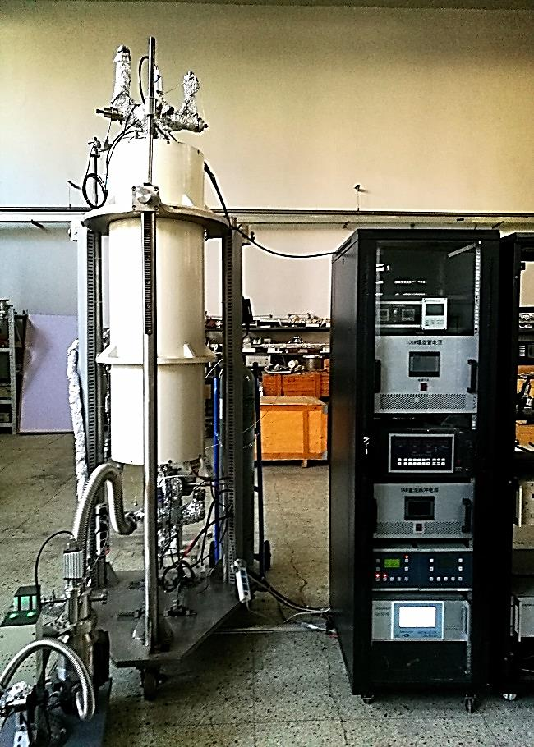
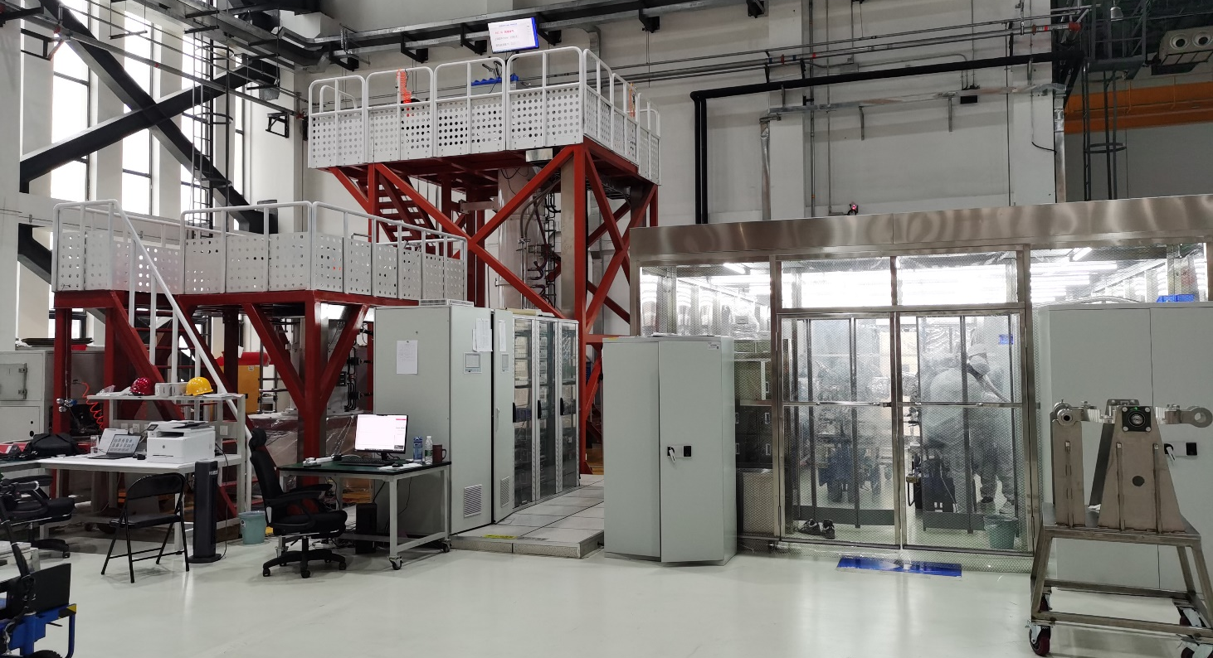
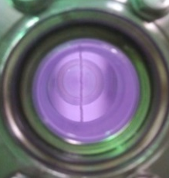
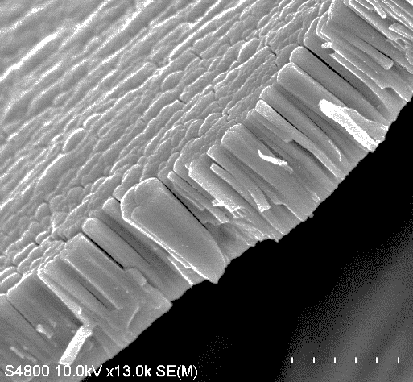
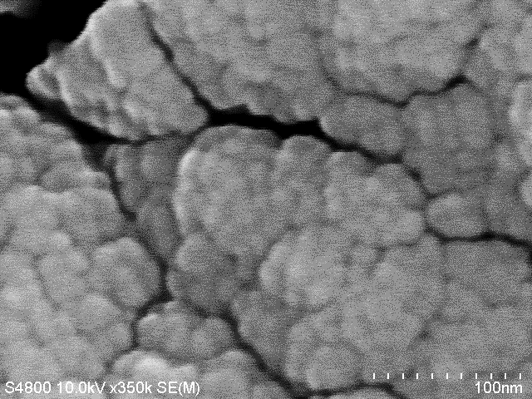
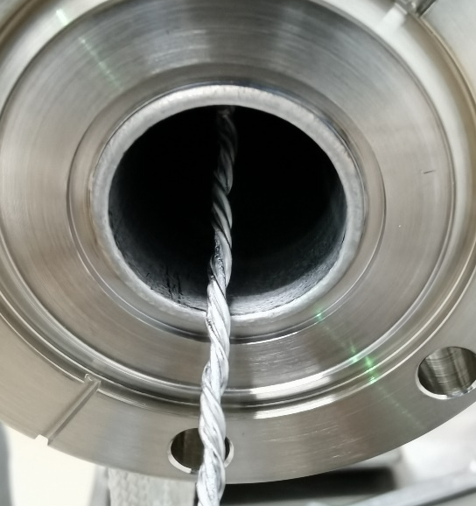
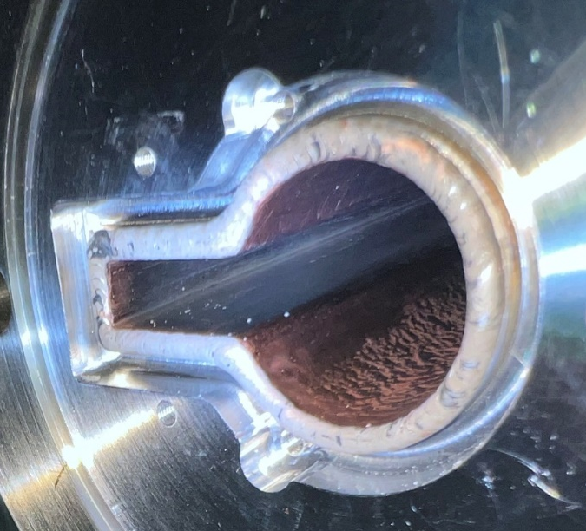
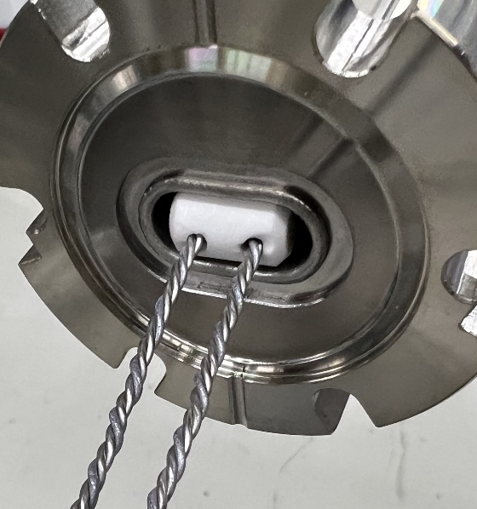
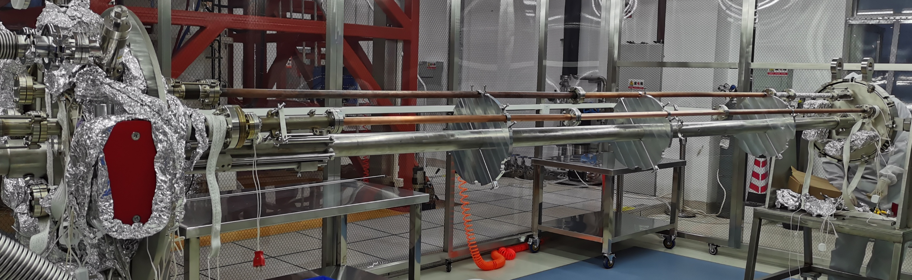
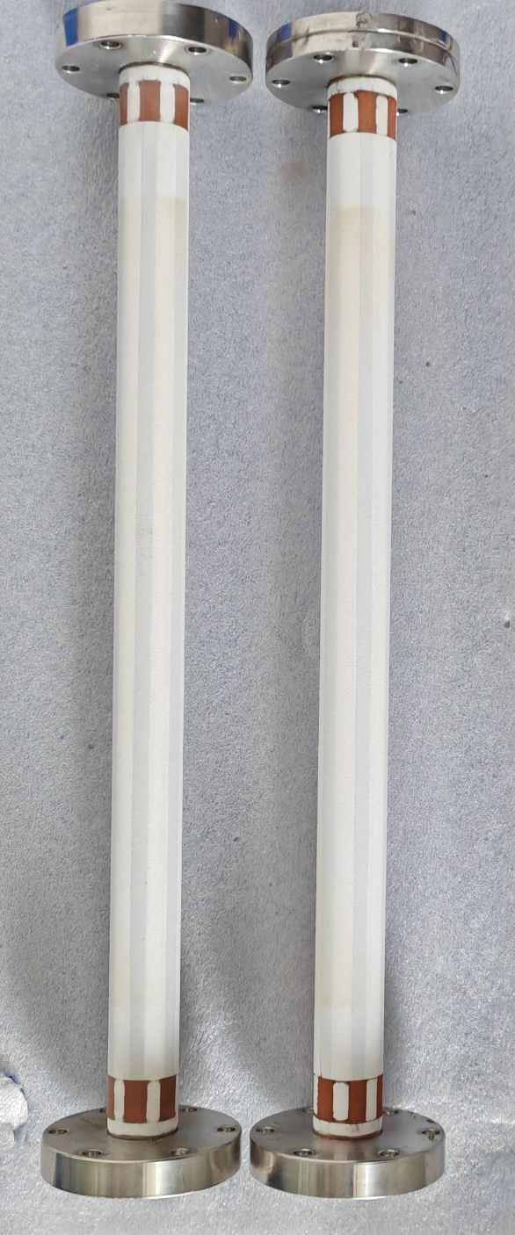
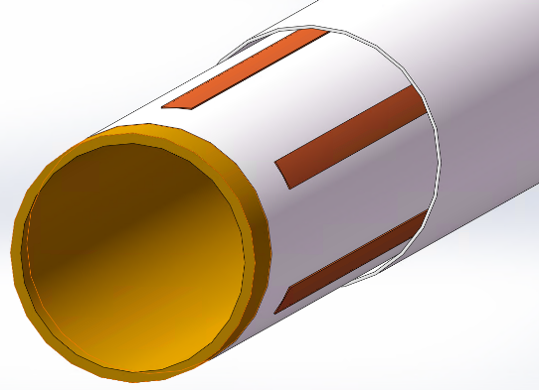
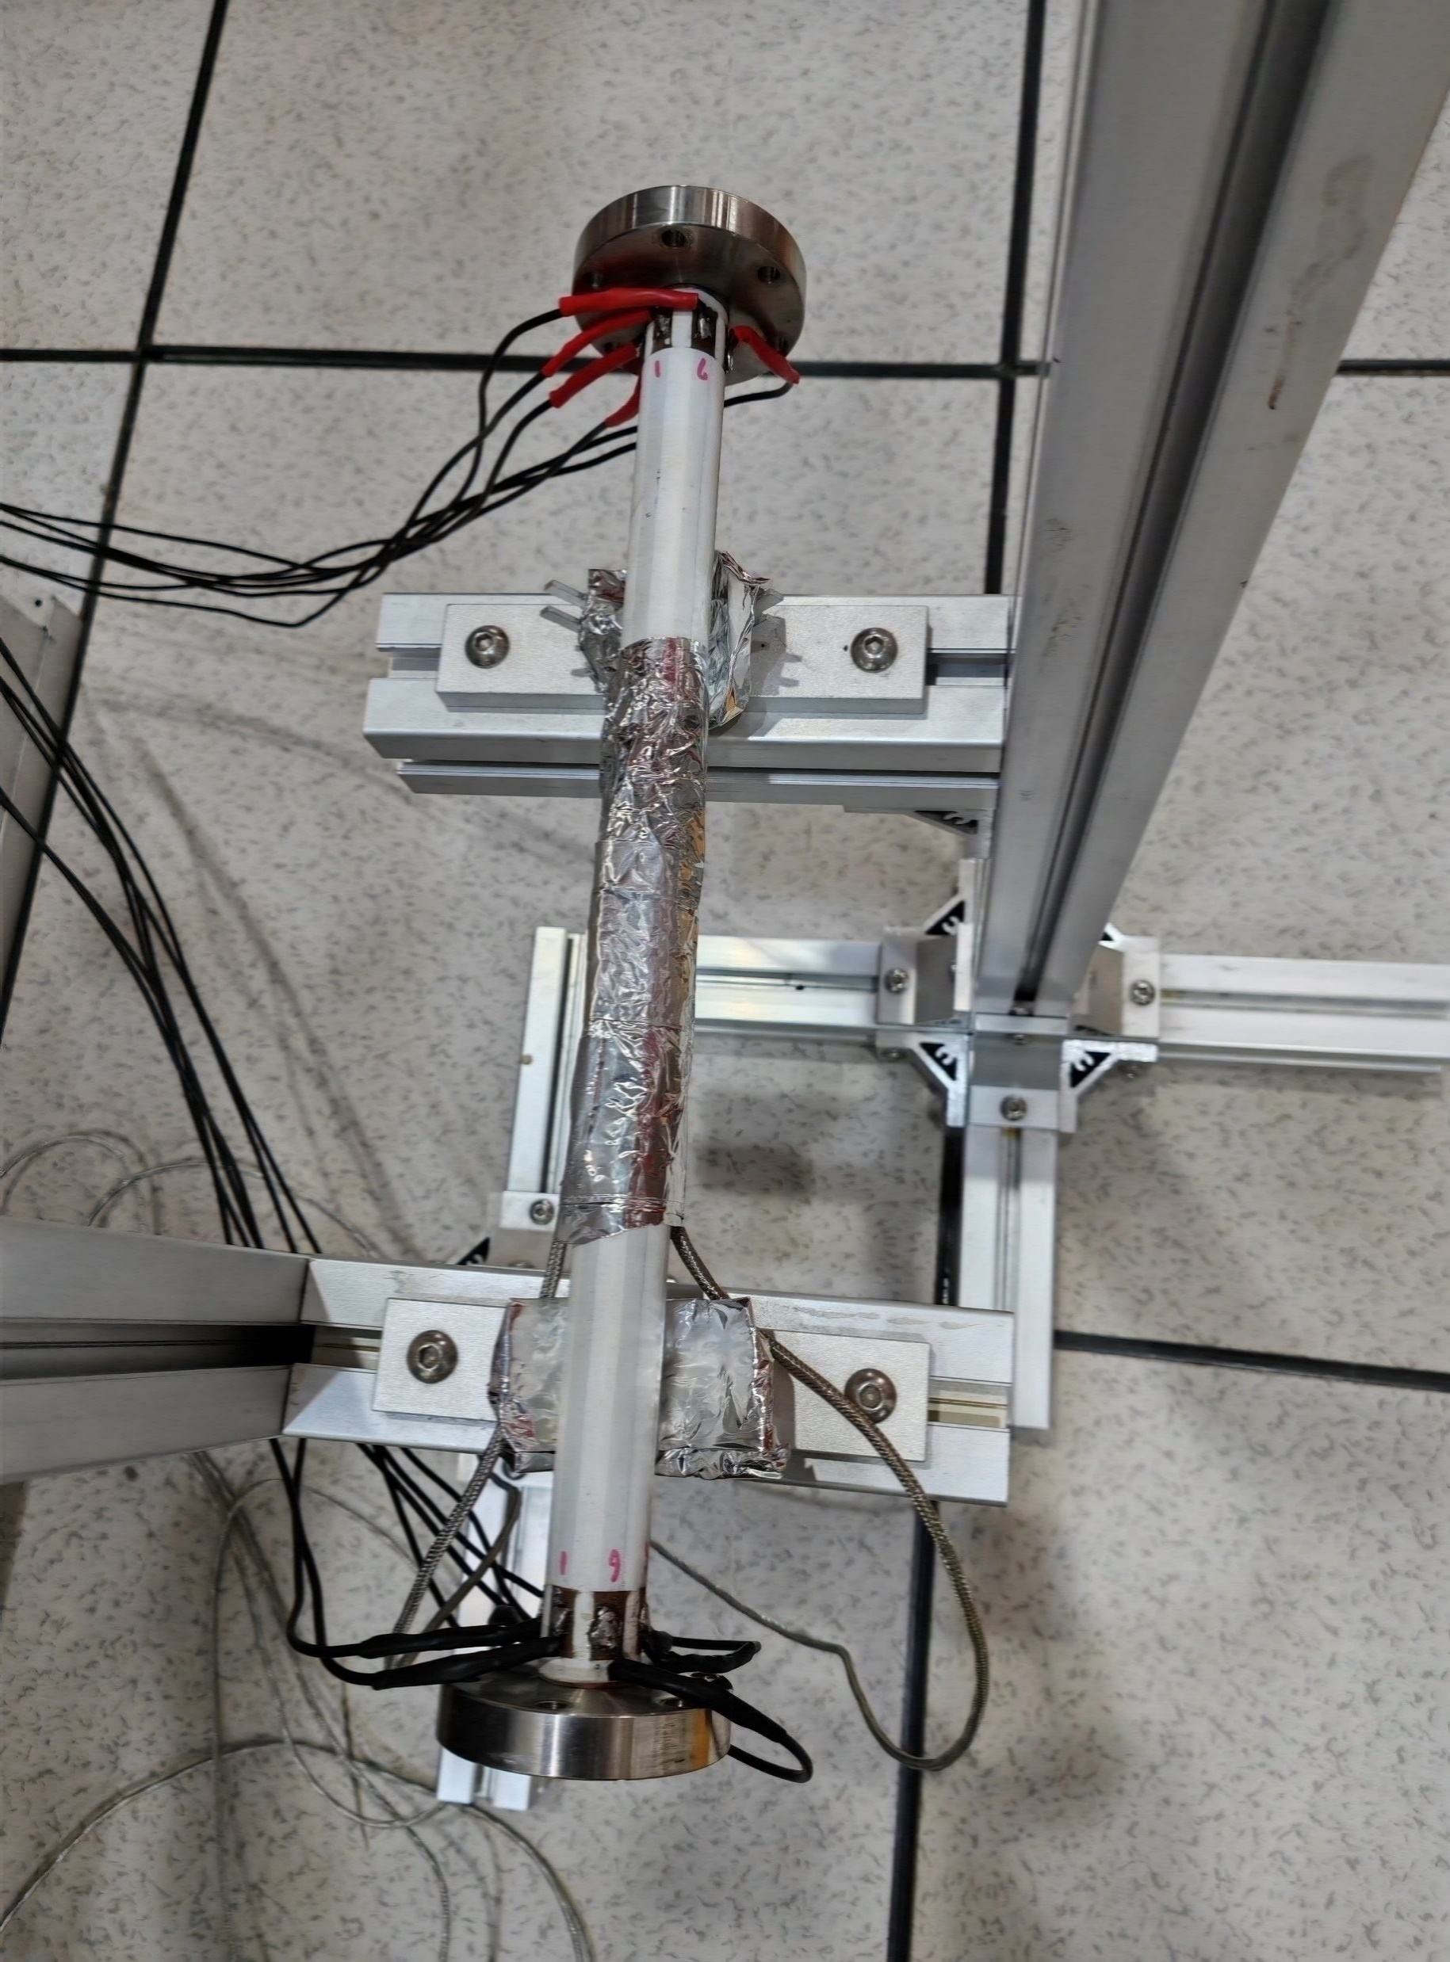
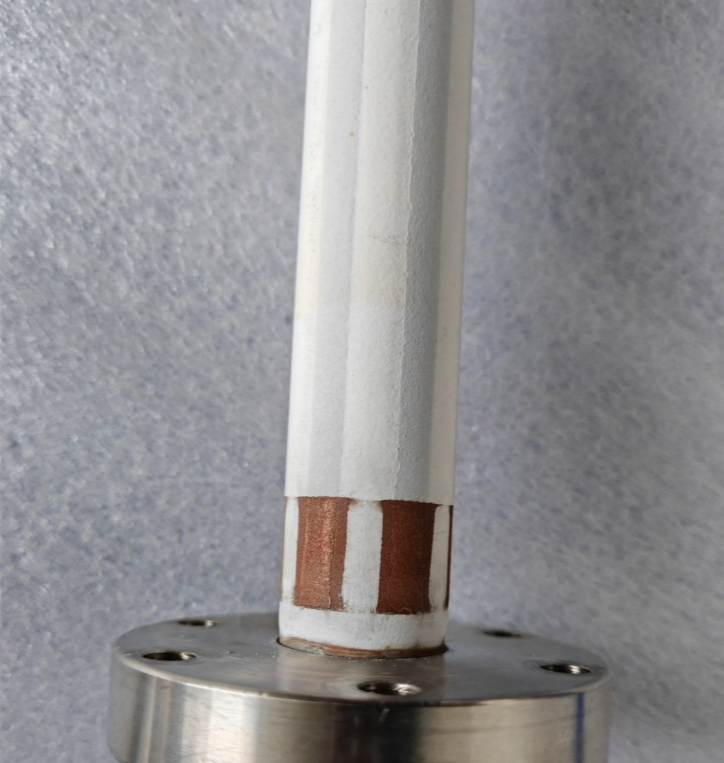
NEG coating and thermal coating spray of vacuum chamber
Yongsheng Ma†, Fei Sun, T Huang, Y. C Yang, D. Z Guo, H. Y Dong, P He
Institute of High Energy Physics, CAS, Beijing, China
Abstract
As the fourth-generation synchrotron radiation light source, vacuum chambers with small apertures were employed for high energy photon source (HEPS), making the performance of Non-evaporable getter (NEG) coating is very crucial for its vacuum system. After years of development, the highly stability of the NEG coating has been achieved. Massive production facilities of NEG coated vacuum chambers have been developed for HEPS in Huairou, Beijing, which based on the NEG coating prototypes. The facilities can achieve simultaneous coating of 16~20 vacuum chambers of HEPS including irregular shaped vacuum chambers. The pumping performance of the NEG coated vacuum chambers has been measured by test facilities. After heated at 200°C for 24 hours, the highest pumping speed of H₂ is about 0.65 l/scm², and the highest capacity of CO is about 1.89×10⁻⁵ mbar·L/cm². The lifetime is more than 20 cycles of air exposure and re-activation. Multilayer thermal coating spray have been studying and preliminary test shows that the heating temperature could reach 300 ℃, and after more than 12 times reheating, the spraying layer also shows a good adhesion.
NEG coating: For the low activation temperature and high pumping speed, surface pumping capacity, the NEG coatings of TiZrV were chosen to vacuum chambers of 4th generation photo source to reach ultra-high vacuum environment and uniform pressure distribution, like MAX IV, Sirius, ESRF-EBS, and also HEPS. The NEG coating also has been employed to suppress the e-cloud of the positron ring, which can cause beam instabilities, heat loads, and pressure increases in the vacuum system.
Non-evaporable getter (NEG) film coatings have been developed at IHEP to provide linear pumping for vacuum chambers of limited conductance and low SEY. Prototypes and massive production facilities were developed. The cathode is made by twisting wires of high-purity (99.95%) titanium, vanadium and zirconium each of 1 mm diameter. The solenoid is powered by a DC power supply, providing a desired magnetic field about 300 G. Film composition, the activation temperature and pumping properties have been investigated in order to optimize the deposition parameters for vacuum applications.
The coating device A: Vacuum chambers are connected in parallel to 6 groups, each group of vacuum chambers length should be lower than 3.5m, outer diame-ter is about 0.47m; A lot of test vacuum chambers have been coated, which shows that NEG film has good adhesion and thickness distribution.
Prototype of NEG coating facility
Massive production facilities of NEG coating
Thermal coating spraying: The baking is the most crucial procedure in achieving ultra-high vacuum. Due to NEG coating reactivation and degassing, to meet the ultra-high vacuum requirement of achieving a dynamic vacuum level of ~10⁻¹⁰ mbar. Multilayer thermal coating will be coated outside of the vacuum chamber which composited by ceramic and conductivity layer, the heating temperature could reach 300℃.
Heating layer
Thickness： 0.5mm
Ceramic layer
N₂
N₂
Convection
Radiation
H₂
H₂
O₂
solution
Conductivity layer
I
MO
O₂
Conduction
Heat
O
Ceramic layer
High
vacuum
or
inert gas
C
H₂O
Cu/ceramic transition layer
CO₂
MC
H₂O
CO
CO₂
Vacuum chamber
Multilayer thermal coating outside of vacuum chamber
Reheating test more than 12 times
* Email: mays@ihep.ac.cn
功率面密度W/cm2

