Slide 1

All-in-one Solution for Signal Cable Systems
CEPC 2025
哈伯思特

Slide 2



Extreme Requirements of CEPC for Connection Systems
How Our Products Meet the Demands
Solution 1: Ensuring Absolute Signal Fidelity
Agenda
Solution 2: Conquering Extreme Physical Environments
Solution 3: Guaranteeing System Power and Maintainability
Our Capabilities and Commitments
Looking Forward to In-depth Cooperation

Slide 3

Extreme Requirements of CEPC for Connection Systems
High Vacuum and Cryogenic (Liquid Helium Temperature) Environment
Intense Radiation Field
Low-level signal readout
High-Current Pulsing and Complex EMI Enviroment
These extreme coditions impose stringent reliability requirements on every single cable and interface within the interconnection system.

Slide 4
How do our products address these challenges?
We can provide a customized portfolio of interconnection system solutions.
For High Vacuum and Cryogenic Temperature Enviroment, we provide Low-temperature resistant, low outgassing cables, and ultra-high vacuum feedthroughs
For Intense Radiation Environment, we provide Radiation-resistant cables with cumulative radiation tolerance of 10^⁶-10^⁷ Gy (K1-grade cable service life: 60 years; K2-grade cable service life: 40 years)
For High Current and Efficient Maintenance Enviroment, we provide Low-inductance cables & Push-Pull plug shielding connectors

Slide 5
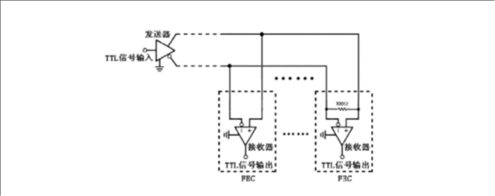
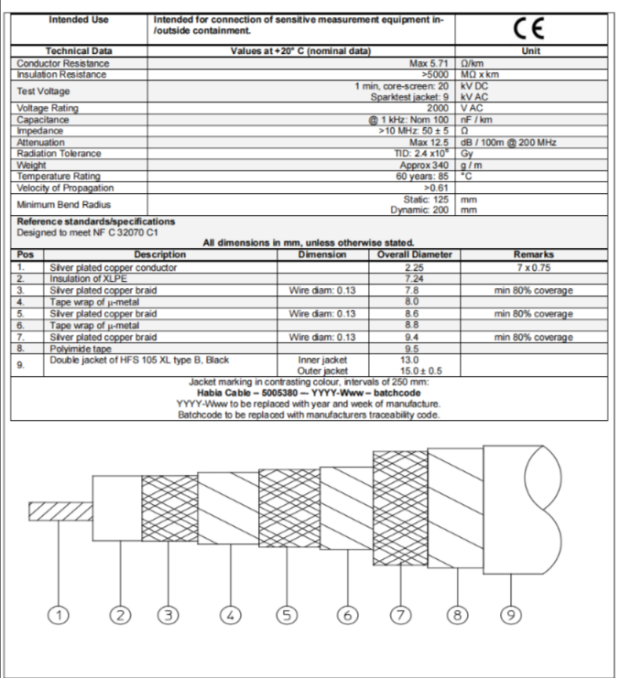
Solution 1: Ensuring Absolute Signal Fidelity
Guarding the "Lifeline" of Detectors
Low-loss cables: Ensuring distortion-free transmission of high-frequency/high-speed signals
Low-noise cables: Maximizing signal-to-noise ratio to capture the weakest particle signals
Core Value: Providing high-fidelity raw data for physical analysis.

Slide 6
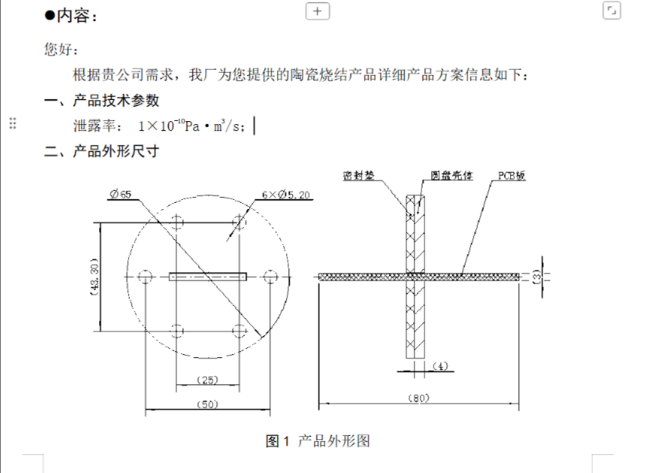
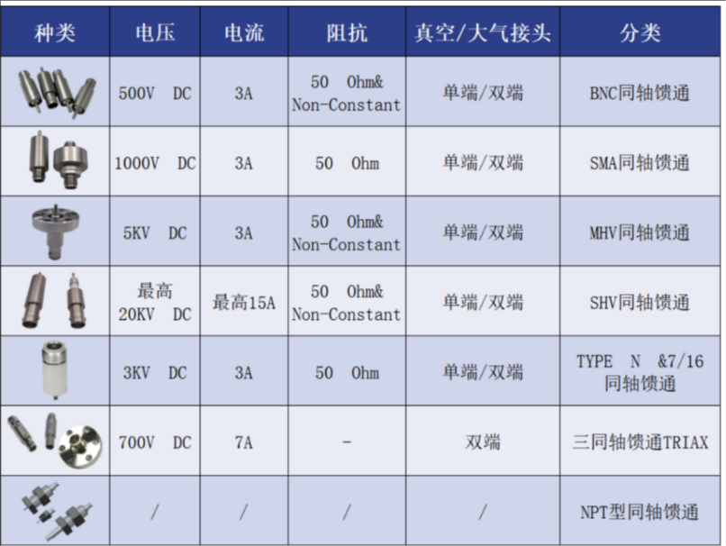
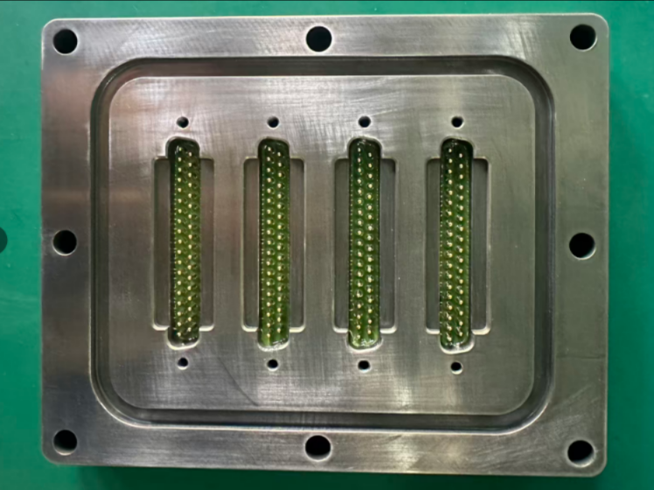
Solution 2: Conquering Extreme Physical Environments
Stable Operation in Vacuum, Low Temperature and Radiation
Custom Vacuum Feedthroughs and Vacuum Cables,Ensuring distortion-free transmission of high-frequency/high-speed signals - Leak Rate: 1×10⁻¹⁰ Pa·m³/s
Core Value: Providing reliable cross-environment barrier connections for key subsystems.

Slide 7
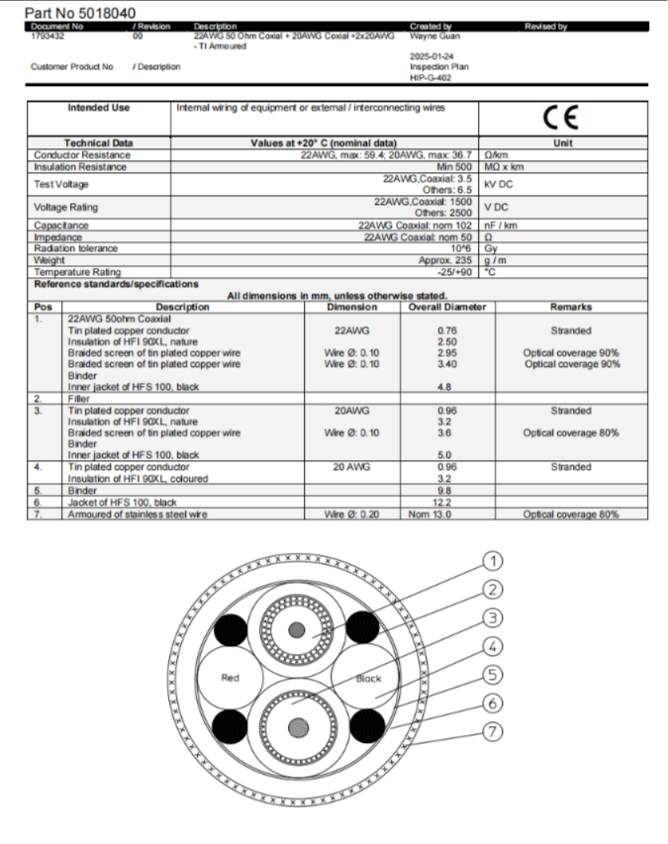
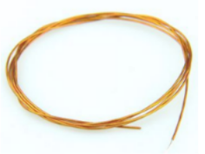
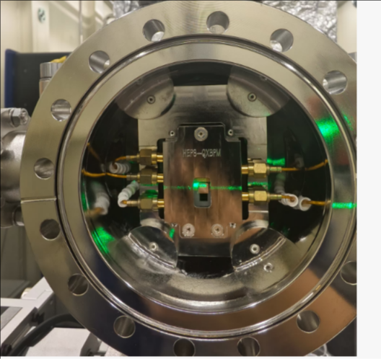
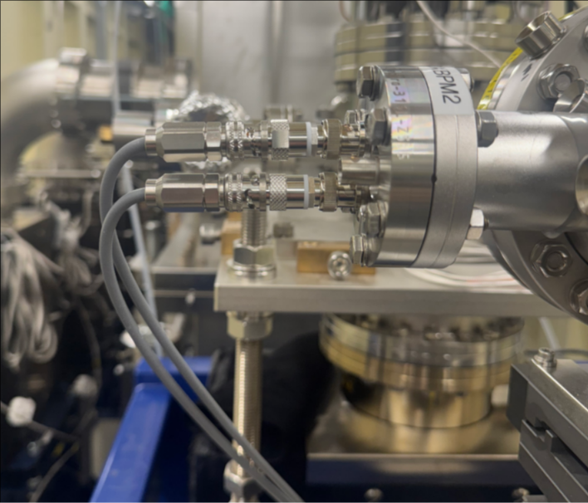
Solution 2: Conquering Extreme Physical Environments
Radiation-Resistant Cables: Cumulative radiation tolerance: 10⁶-10¹⁰ Gy.
Low-outgassing cables
Core Value: Providing reliable cross-environment barrier connections for key subsystems.

Slide 8
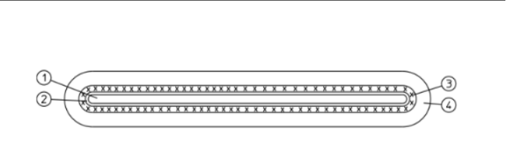
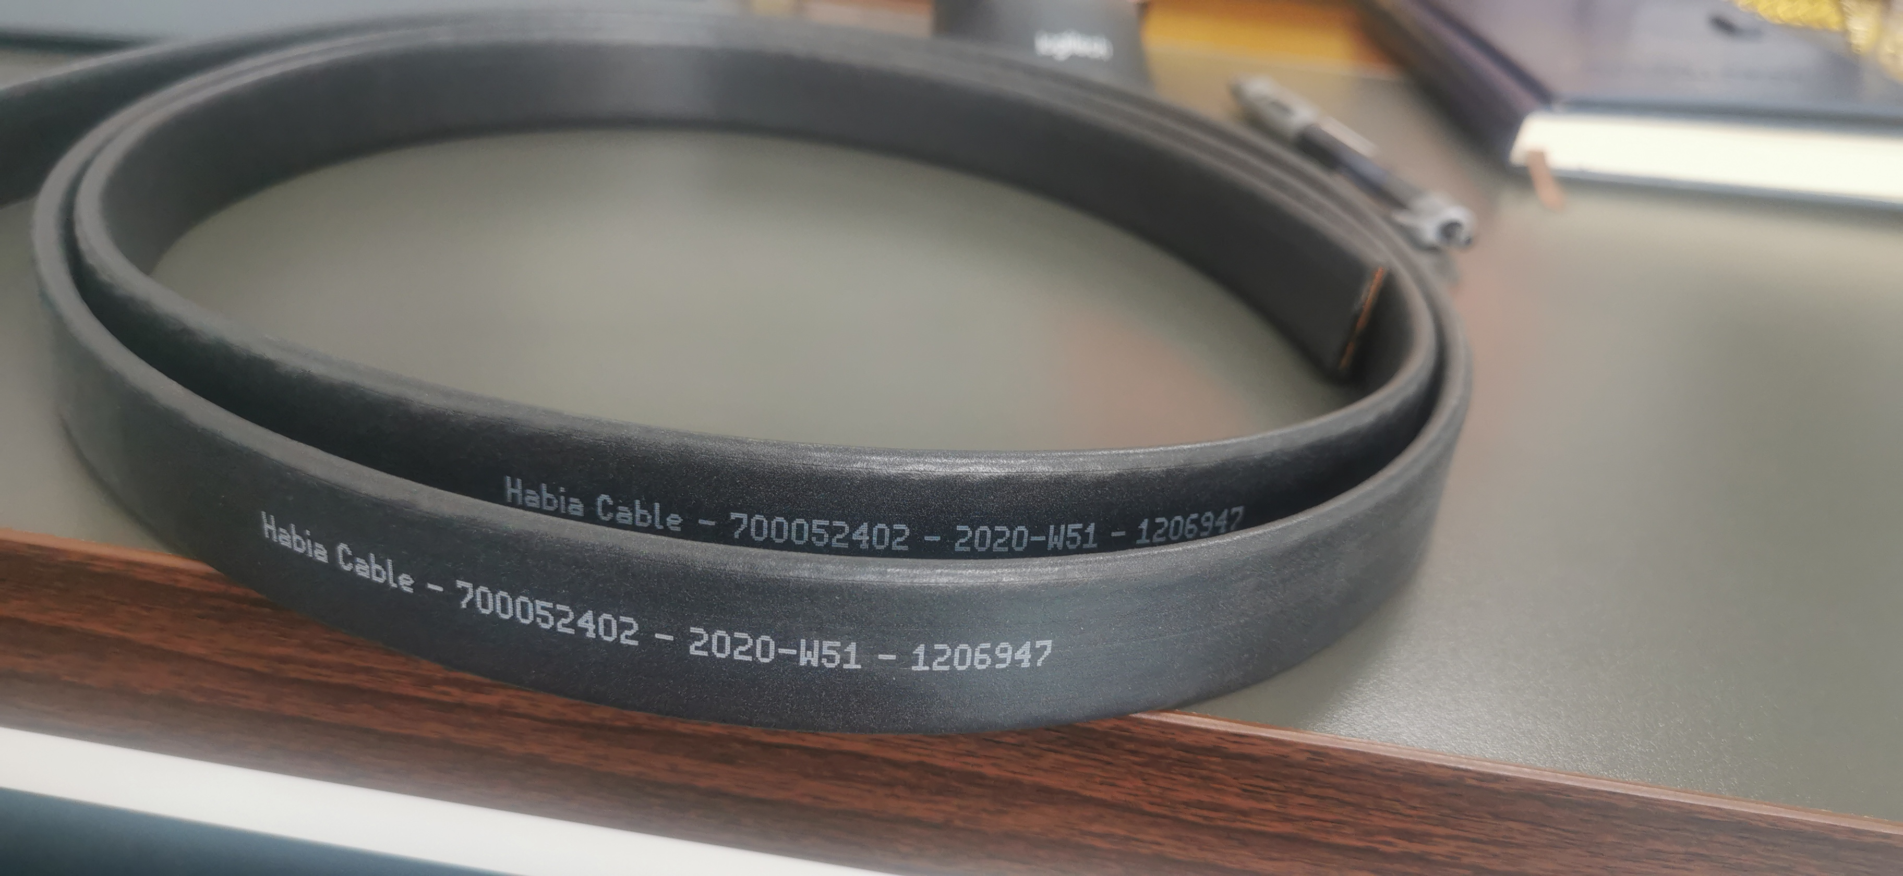
Solution 3: Ensuring System Power & Serviceability
1. Flat bare copper conductor 12.6 mm2 21x0.6
2. Insulation of TWI 205 21.8x1.4 2x66% + 1x50%
3. Braided screen of tin plated copper wire Wire Ø: 0.20 22.7x2.3 Approx. 12.5 mm2
4. Jacket of HFS 100, black Thickness 1.0 Approx. 24.7x4.3
Low-Inductance Cables: Used in pulsed power systems to suppress voltage spikes and protect equipment.
Quick-Lock 360° Shielded Connectors: Push-pull self-latching design, full peripheral EMI shielding, enhancing maintenance efficiency and connection reliability.
Description: Low Inductance Conductor Resistance ：N/A Ω/km
Insulation Resistance ：>1500 MΩ xkm
Test Voltage ：3 kV DC
Sparktest jacket: 5kV AC
Voltage Rating ：1500 V AC
Weight Approx： 330 g / m
Temperature Rating： -40 / +90 °C
Core Current Rating： 2 Amps at 40°C
ambient air temp.
Core Value: Enhance system stability and reduce operational maintenance costs.

Slide 9
Our Capabilities & Commitment
Customization capability: Design and production can be tailored to the specific requirements of each CEPC subsystem.
Quality Certification： ISO9001 Quality Management System
Qualified Supplier For China National Nuclear Corporation
Cooperation Cases：
Institute of High Energy Physics, Chinese Academy of Sciences (IHEP) – High-Energy Light Source Project.
China Institute of Atomic Energy (CIAE) – Proton Accelerator Project, Cyclotron Project, Nuclear Detection Project.
Peking University – Laser Accelerator Project.
Tsinghua University – Engineering Physics Detection Project, Semiconductor Wafer Stage Project.
Institute of Geology and Geophysics, Chinese Academy of Sciences – Deep Earth Project.
Institute of Plasma Physics, Chinese Academy of Sciences (ASIPP) – BEST Project
......

Slide 10
We are committed to becoming CEPC's most reliable connection partner
Guaranteeing Data Quality
Conquering Extreme Environments
Supporting System Stability

Slide 11
Looking Forward to In-depth Cooperation
We look forward to technical docking with the CEPC project team, various detector teams, and accelerator teams.
We can provide detailed technical documentation, sample testing, and customized solutions.
Name：Alice ,Zhang
Position：Sales Manager
Email: Alice-Zhang@Hbosit.cn
Mobile Phone No.：13911865048

Slide 12
Q&A？
Thans for your listening！
Q&A?

