Slide 1
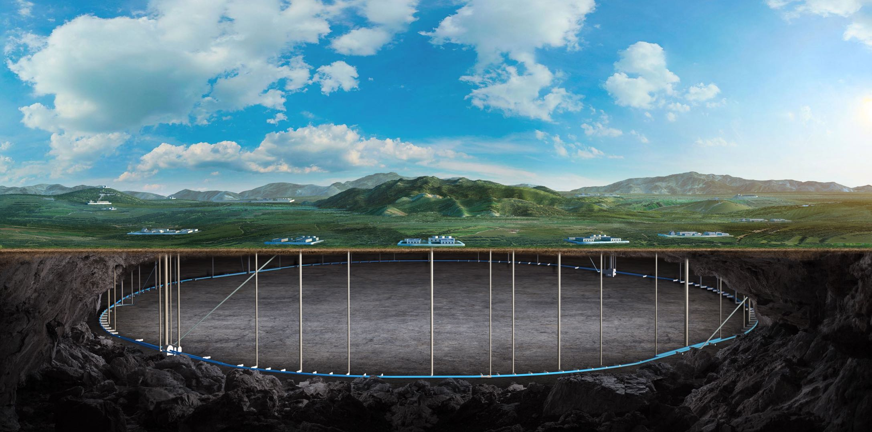
CEPC booster and collider ring magnets development in EDR
Wen Kang、Mei Yang
11, Dec. 2024, IHEP, CEPC Day

Slide 2
Research contents of the magnets in EDR
Dipole-sextupole combined magnet for the Booster
Automatic production line for the Booster dipole magnet
DAD, DAQ and sextupole magnets for the Collider

Slide 3
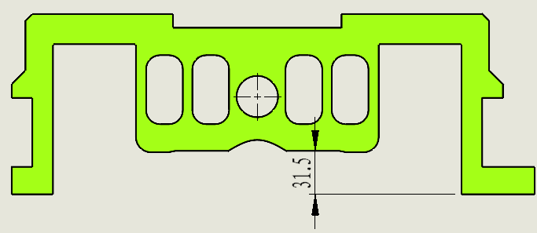
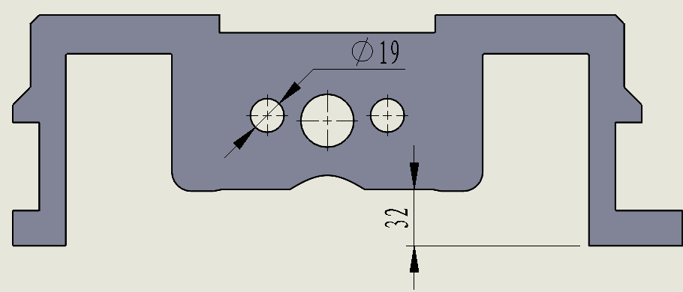
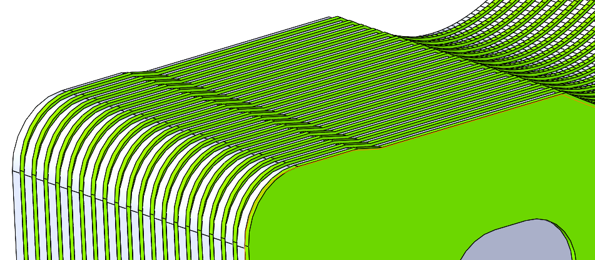
Dipole-sextupole combined magnet for the Booster
Design adjustment
The cores of the magnet are stacked by 1mm thick silicon steel sheets and 2mm thick aluminum or plastic sheets.
Since the precision of stamping 2mm plastic sheet is lower compared to 1mm steel sheet, the size of the plastic sheet is adjusted to be 0.5mm smaller than the steel sheet so that the stamping precision of the plastic sheet can be released.
The four square holes on the plastic sheets are changed to round holes, facilitating the insertion of long rods in the automated production line.
1mm冲片外形
2mm冲片外形
两种冲片叠装效果

Slide 4
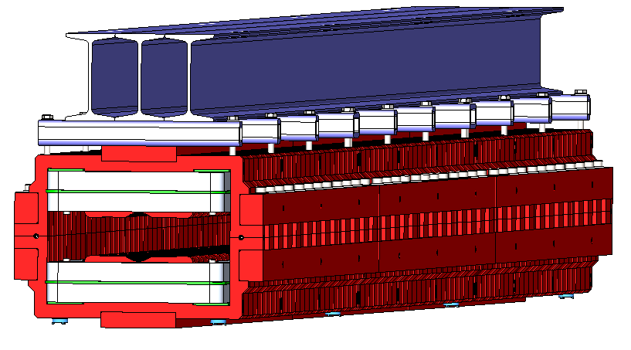
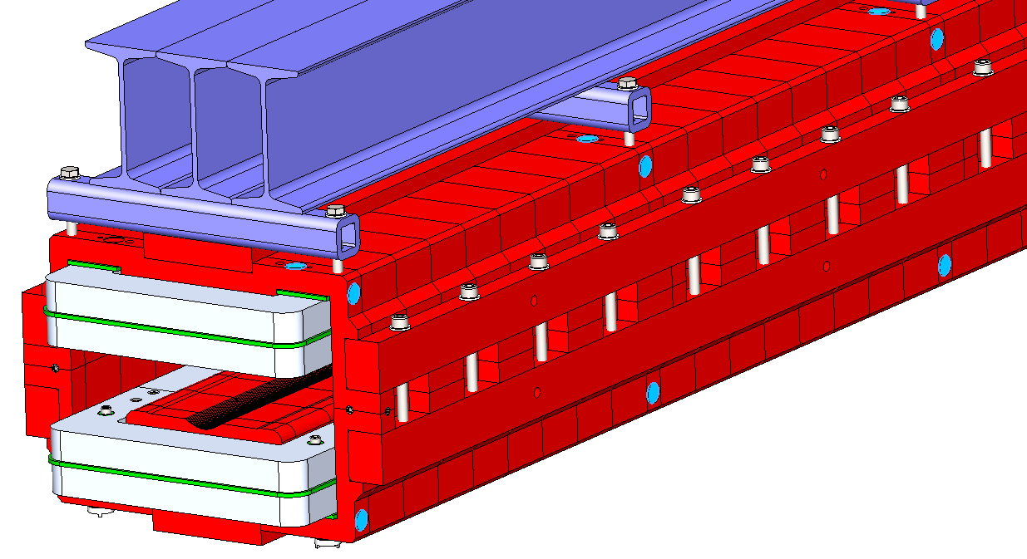
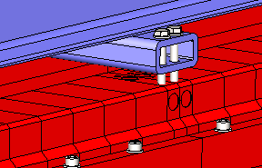
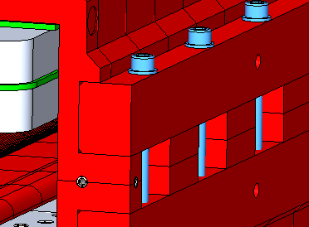
Dipole-sextupole combined magnet for the Booster
Design adjustment
The target mounts are arranged at the bottom as well as on both sides of the magnet for calibration and alignment.
4-φ20 concave surfaces will be produced on sides of all end and middle plates for the magnet center measurement.
The fastening screws for the upper and lower halves of the magnet have been moved outward by 2mm to facilitate screw tightening by automated production line equipment.
准直凹面
靶标座布置
铁芯分段处与骨架连接
紧固螺钉外移

Slide 5
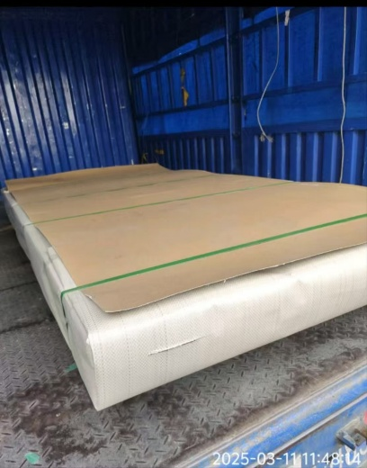
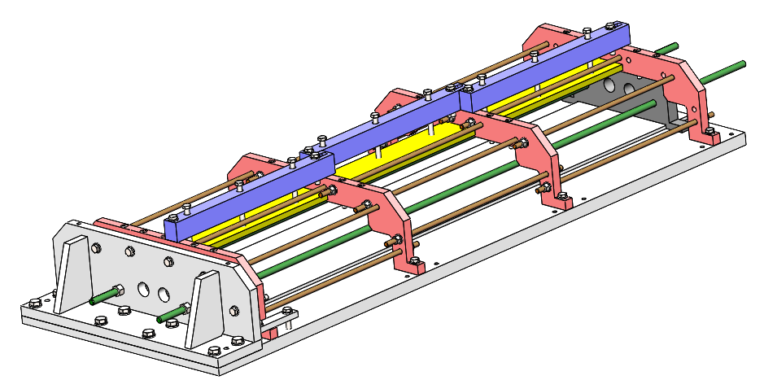
Dipole-sextupole combined magnet for the Booster
Magnet production progress
From Jan. to Feb., three stamping die manufacturers were surveyed, but they said they could not produce high precision 2mm plastic sheets.
After adjusting the size of the plastic sheets, the stamping die started to be produced.
The aluminum and plastic material for the stamping sheets have been ordered.
The design of the lamination stacking mold has been completed and all materials for the mold have been prepared, and processing is underway
铝板
叠装模

Slide 6
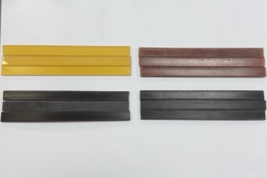
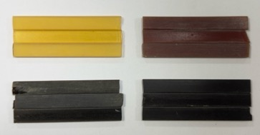
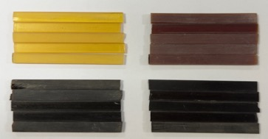
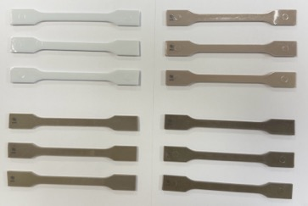
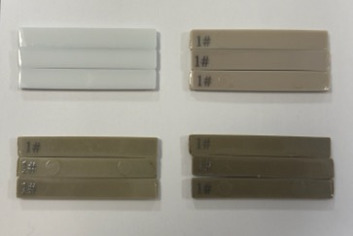
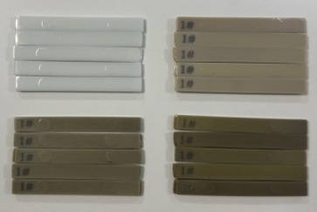
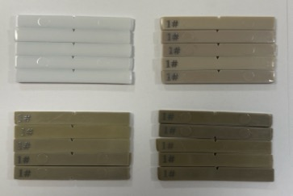
Dipole-sextupole combined magnet for the Booster
High radiation test results
拉伸强度测试
弯曲强度测试
非缺口冲击强度测试
缺口冲击强度测试
0 kGy
1000 kGy
0 kGy
1000 kGy
0 kGy
1000 kGy
环氧树脂
无样条
3000 kGy
5000 kGy
3000 kGy
5000 kGy
3000 kGy
5000 kGy
0 kGy
1000 kGy
0 kGy
1000 kGy
0 kGy
1000 kGy
0 kGy
1000 kGy
PET
3000 kGy
5000 kGy
3000 kGy
5000 kGy
3000 kGy
5000 kGy
3000 kGy
5000 kGy

Slide 7
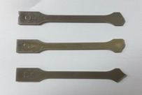
Dipole-sextupole combined magnet for the Booster
1） 拉伸强度测试结果
拉伸强度：衡量材料在拉伸过程中抵抗断裂的能力。
断裂伸长率：反映材料在拉伸过程中的变形能力。
环氧树脂
PET
检测项目 | 0 kGy | 1000 kGy | 3000 kGy | 5000 kGy | 0 kGy | 1000 kGy | 3000 kGy | 5000 kGy
拉伸强度（MPa） | 21.7 | 39.6 | 49.1 | 52.9 | 80.4 | 65.1 | 22.1 | /
断裂伸长率 （%） | 21.80 | 3.75 | 3.12 | 2.91 | 16.97 | 2.54 | 2.29 | /
注：装载样条完毕，未进行拉伸操作，样条即从端口断裂，无法测取有效数据。
随辐照剂量的增加，环氧树脂的拉伸强度不断提高，而PET的拉伸强度却不断降低。

Slide 8
Dipole-sextupole combined magnet for the Booster
2） 弯曲强度测试结果
弯曲强度：衡量材料在弯曲过程中抵抗断裂的能力。
弯曲模量：反映材料在弹性极限内抵抗弯曲变形的能力。
环氧树脂
PET
检测项目 | 0 kGy | 1000 kGy | 3000 kGy | 5000 kGy | 0 kGy | 1000 kGy | 3000 kGy | 5000 kGy
弯曲强度（MPa） | 32.4 | 69.1 | 81.4 | 91.8 | 126.1 | 92.3 | 33.1 | 22.4
弯曲模量 （MPa） | 1015 | 1890 | 2253 | 2394 | 3220 | 3314 | 3516 | 3580
随辐照剂量的增加，环氧树脂的弯曲强度不断提高，而PET的弯曲强度却不断降低。

Slide 9
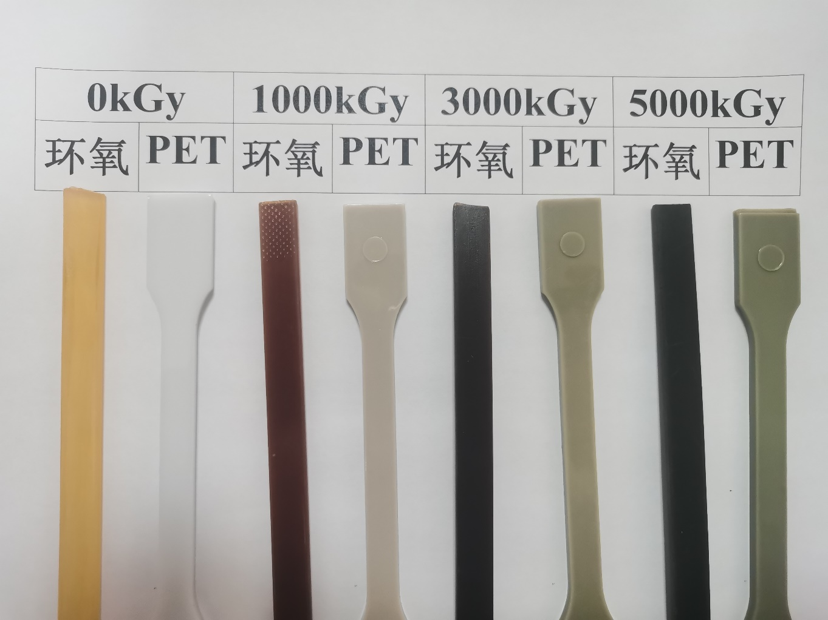
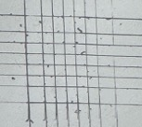
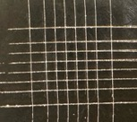
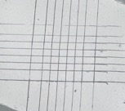
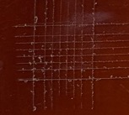
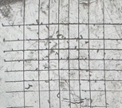
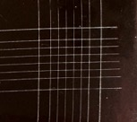
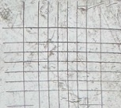
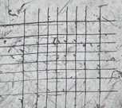
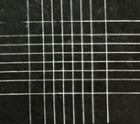
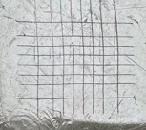
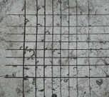
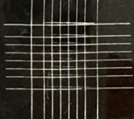
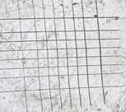
Dipole-sextupole combined magnet for the Booster
3）划格试验测试结果
划格结束
胶带撕离后（样片）
环氧树脂
PET
环氧树脂
PET
0 kGy
1000 kGy
3000 kGy
5000 kGy
二者网格区域均无明显脱落,随辐照剂量的增加，环氧树脂的划格碎屑明显增多。

Slide 10
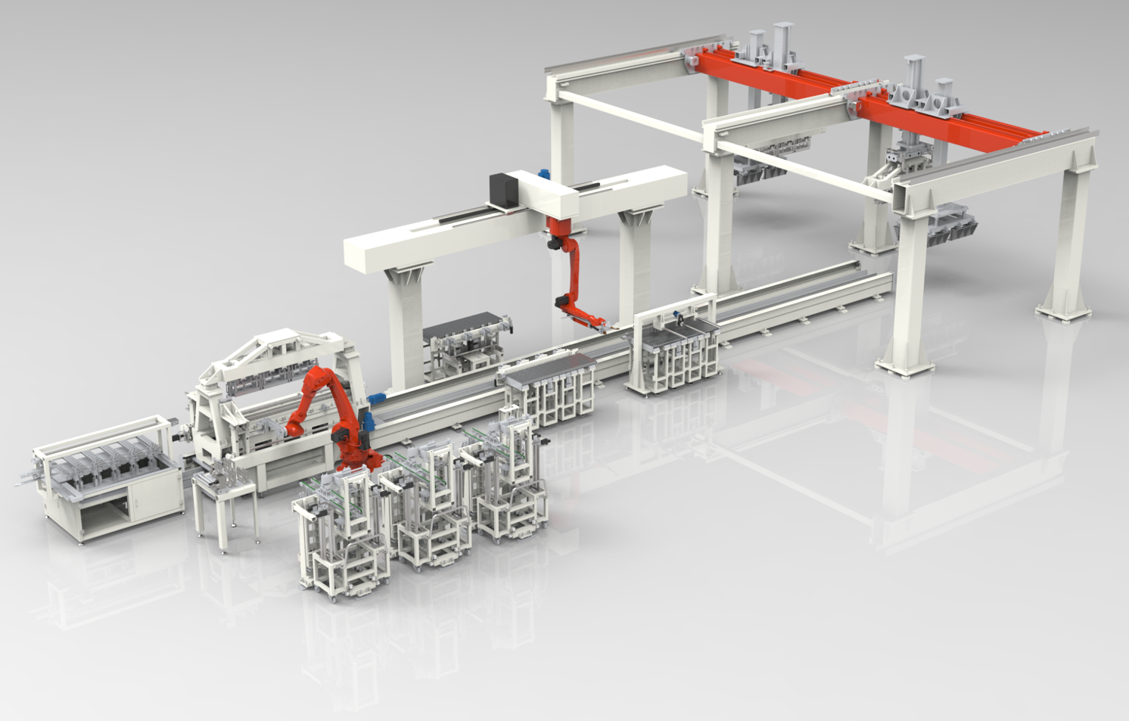
Automatic magnet production line
The review of the production procedures was completed yesterday.
叠装机器人
拉板焊接工作站
叠装夹具及视觉系统
自动叠装平台
拉杆自动装配设备
Automatic stacking of 1/3 length core
端板上料机
冲片掺和机
侧拉板上料机
顶拉板上料机
铁芯单元卸载设备

Slide 11
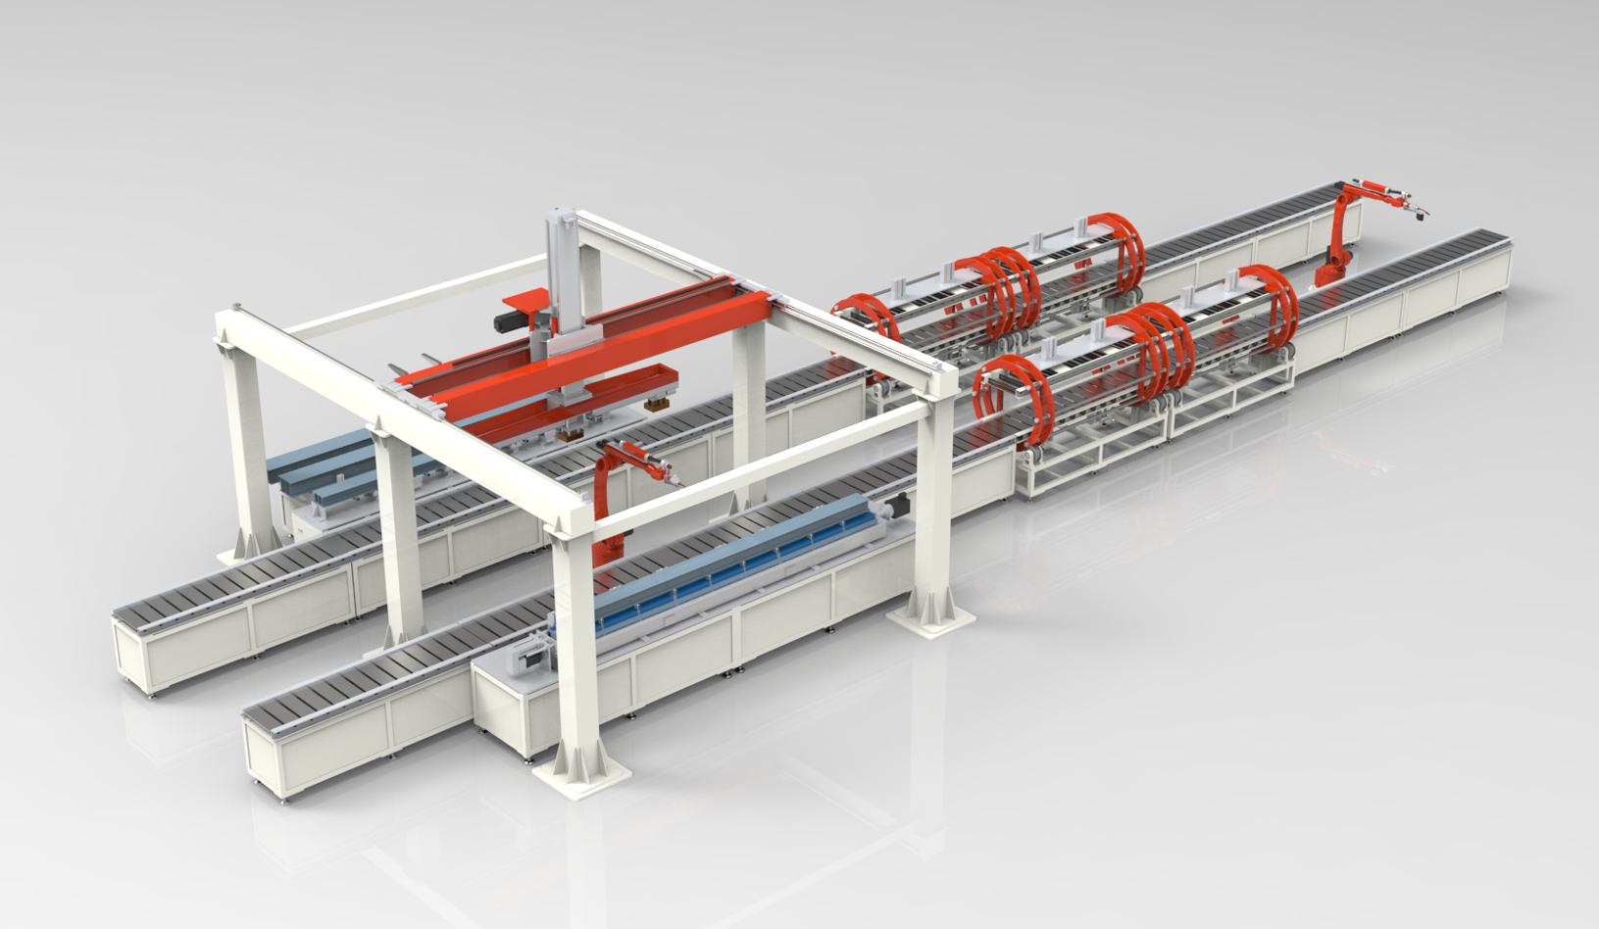
Automatic magnet production line
桁架机器人系统
机器人自动焊接系统
Automatic integration of the three 1/3 length cores
自动上料平台
焊接定位平台
180°自动翻转机

Slide 12
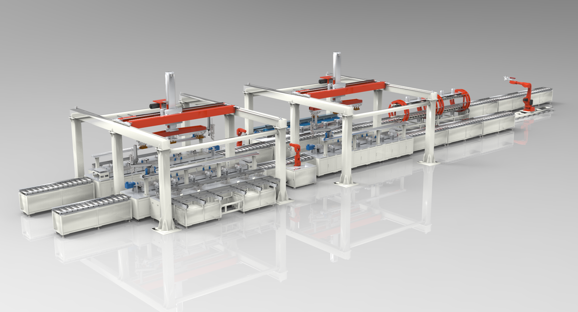
Automatic magnet production line
吊梁自动拆卸设备
合铁检测自动化设备
Automatic assembly of the magnet
线圈装配自动化设备
绝缘检测自动化设备

Slide 13
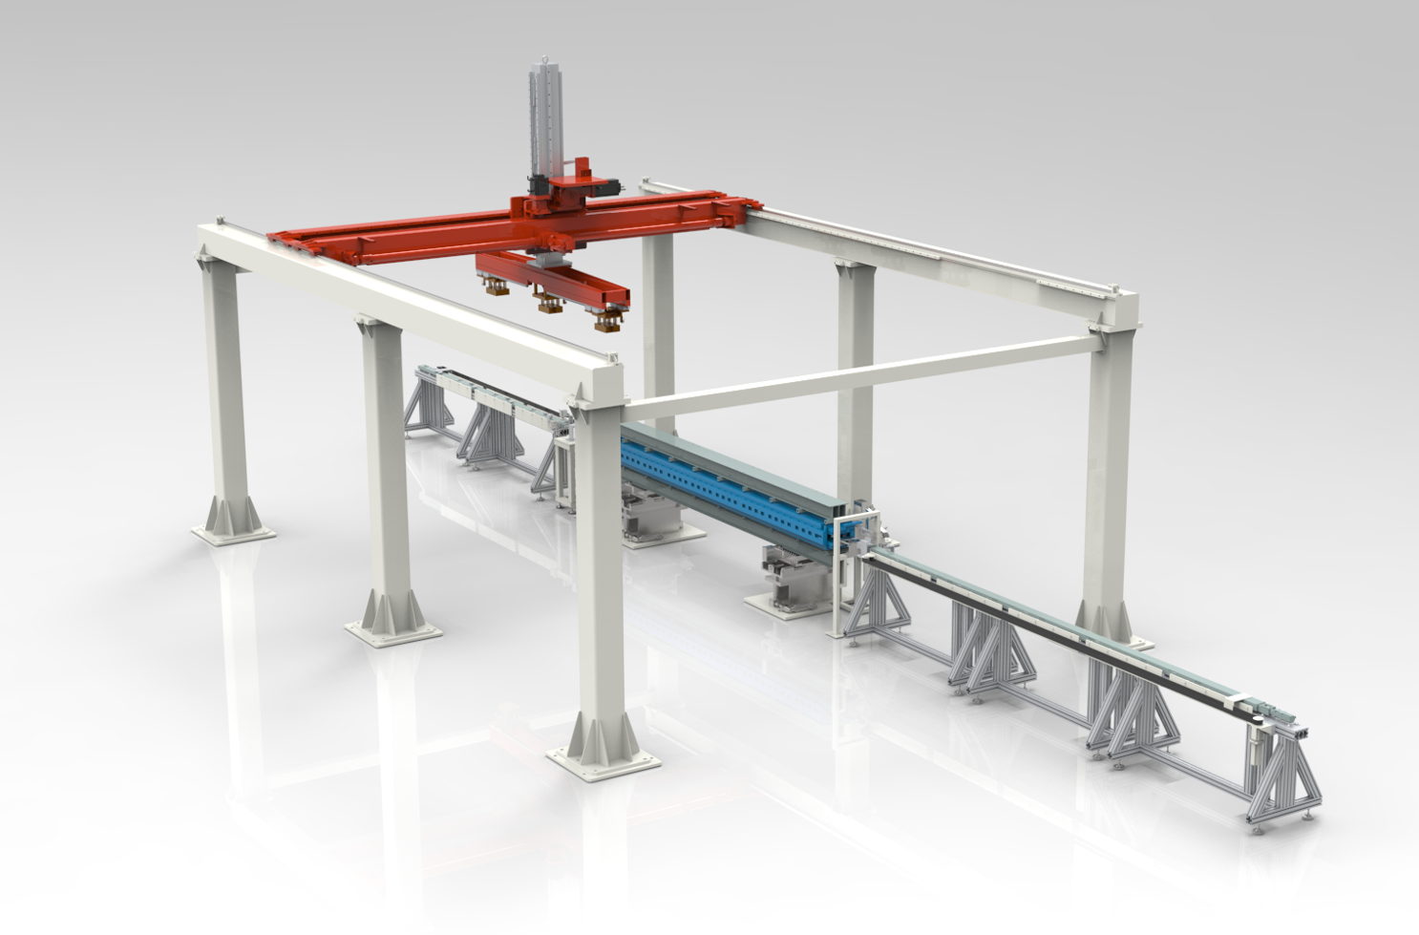
Automatic magnet production line
磁铁自动调整基座
Automatic field measurement
自动接水/电系统
磁测线圈自动装载设备

Slide 14
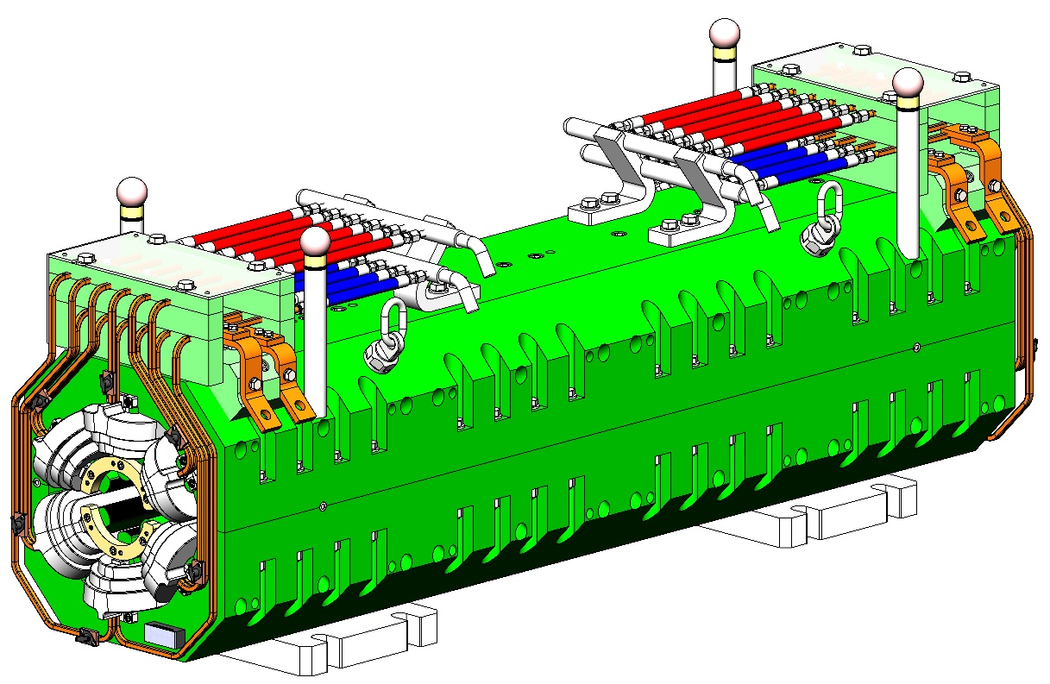
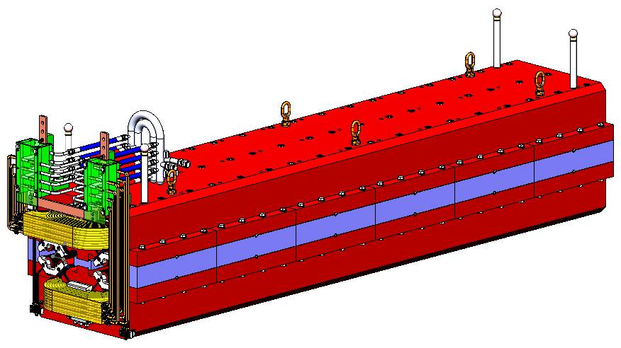
EDR progress in Collide magnets
Finish the mechanical design for DAQ(3m) and sextupole(1.4m)
Complete the physical and mechanical design review
The procurement is continuing

Slide 15
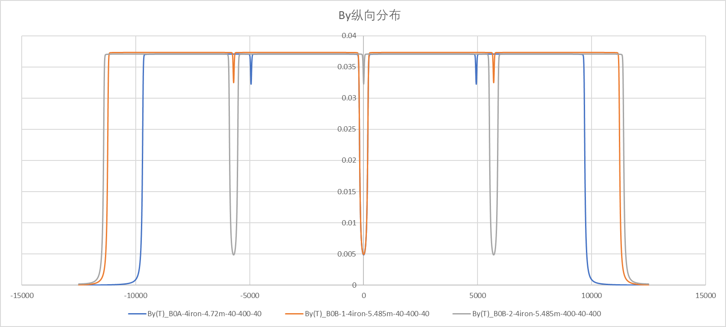
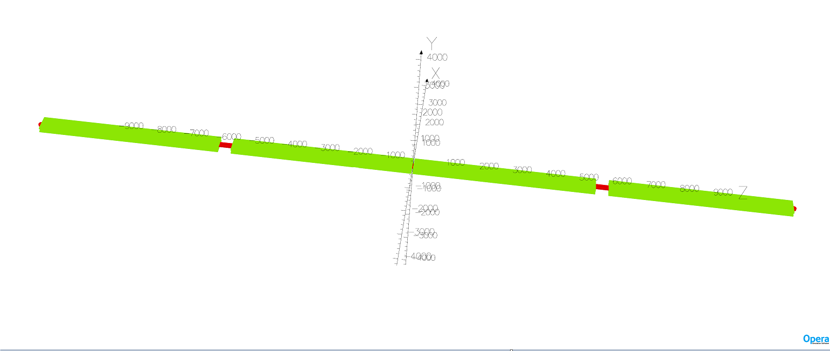
DAD simulation for mockup design
Field simulation of DAD (3 layouts)
B01: 4irons, Liron=4720, 40-400-40; Leff=19.167m
B02: 4irons, Liron=5450, 40-400-40 ; Leff=22.224m
B03: 4irons, Liron=5450, 400-40-400 ; Leff=22.3m

Slide 16
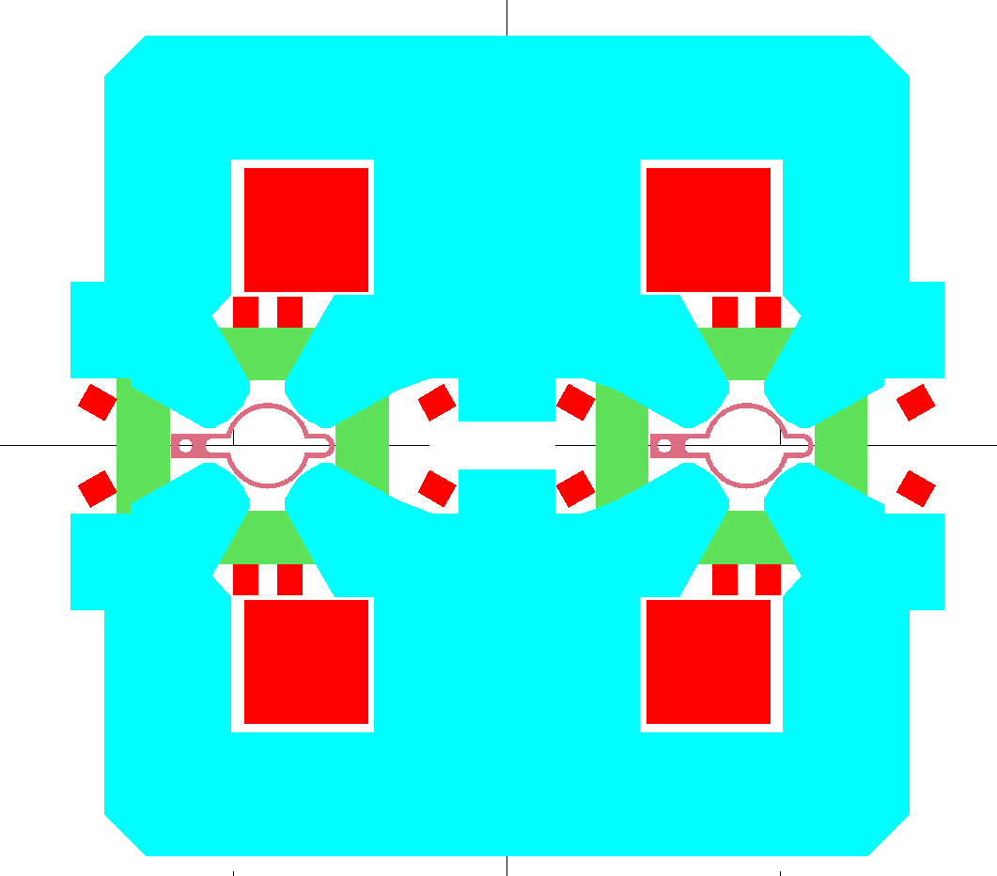
Magnets adjusted to fit VC with antechamber and absorber
VC with antechamber and absorber
Max half width of VC: 70mm
Lead is widened to 38mm from 25mm
DAD
Width of coil is narrowed
The yoke slotted for coil
DAQ
Adjust the position of trim coils
Increase the height of the yoke
Sextupole
Not enough space for lead(w=38mm)
Lead width=38mm
DAD
DAQ
Lead width=38mm

Slide 17
Next plans for collider magnets
Prototype magnets construction
Cooling design for radiation power on lead and iron in DAD and DAQ
Research and design of long magnet measurement

Slide 18
Thank you very much!

