Slide 1
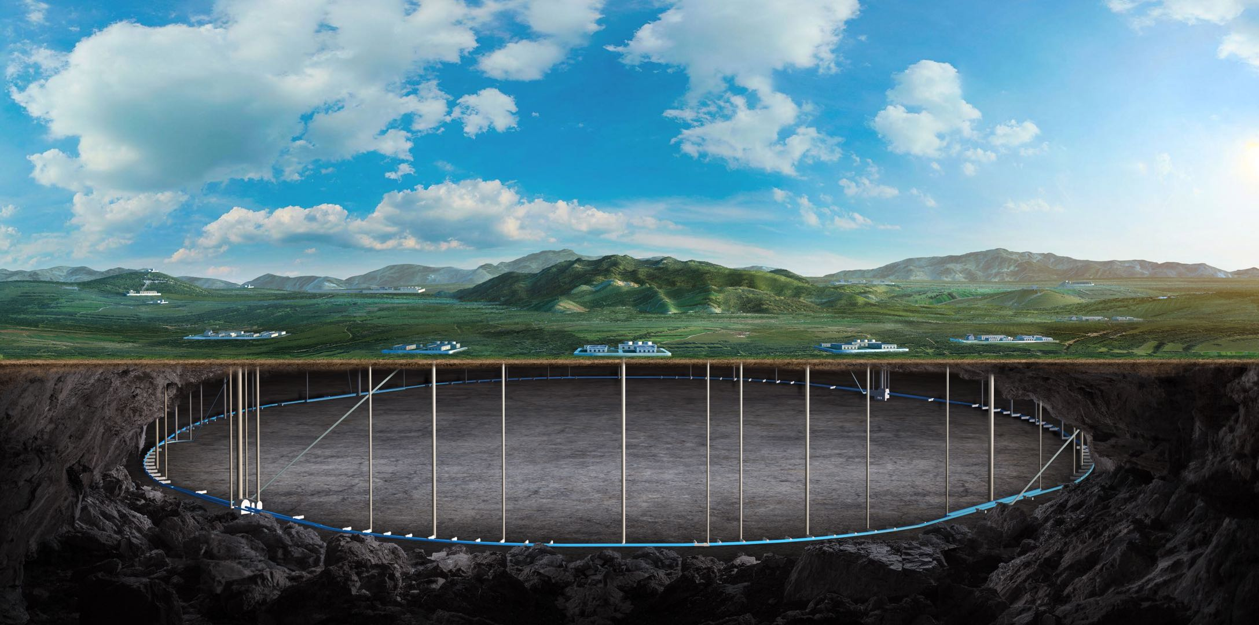
CEPC injection from Linac to booster and from booster to collider ring
(with all components survey and hardware)
Jinhui Chen, Xiaohao Cui, Lei Wang , Huo Lihua , Guanjian Wu
21. March. 2025, CEPC Day

Slide 2
Content
Overview of CEPC Injection & extraction system
Inj.&ext. system survey layout design progress
Septum magnets EDR design update
Kicker systems EDR design update
Summary

Slide 3
Overview of CEPC Injection & extraction system

Slide 4
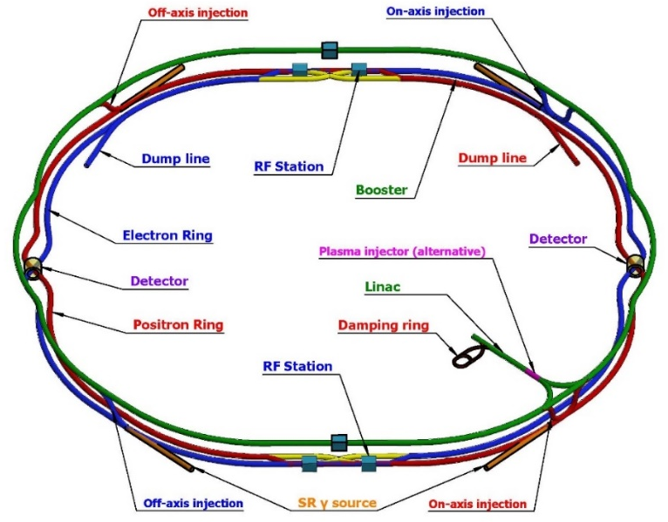
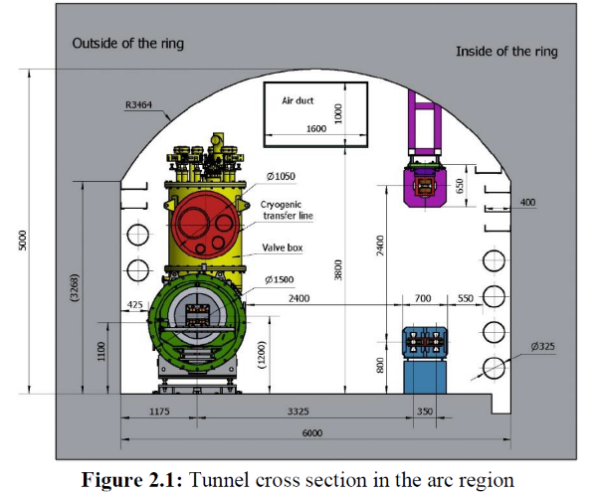
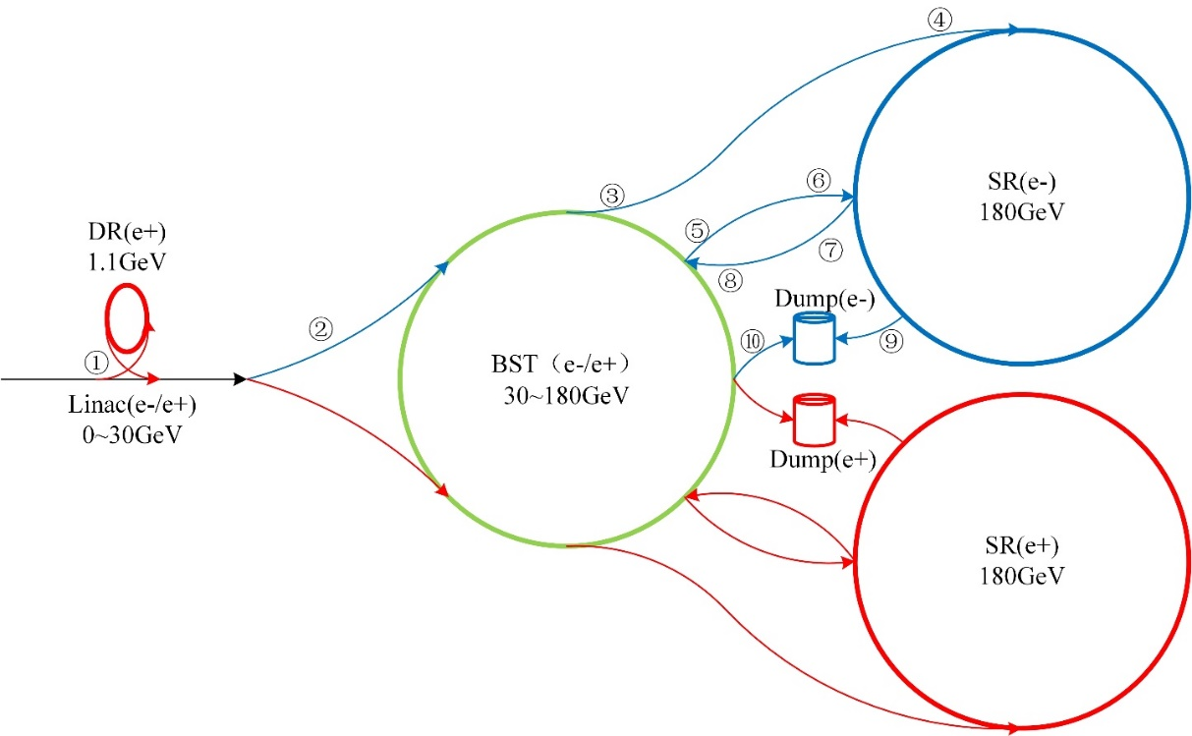
Overview of the inj.&ext. system in CEPC
The CEPC complex consists of 4 circular accelerators：
A damping ring (1.1GeV/147m)
A booster ring (30~120/180GeV/100km)
2 storage rings (120/180GeV/100km)
The 4 rings being linked with 10 injection and extraction sub-systems :
DR injection and Extraction system(e+)
Booster LE injection system (e+,e-)
Booster Extraction system1 (e+,e-)
Collider off-axis injection system (e+,e-)
Booster Extraction system2 (e+,e-)
Booster HE injection system (e+,e-)
Collider swap out injection system (e+,e-)
Collider swap out extraction system (e+,e-)
Collider beam dump system(e+,e-)
Booster beam dump system(e+,e-)
Off-axis injection
(in W, Z and $t\overline{t}$ mode)
On-axis injection
(only in Higgs mode)

Slide 5
Survey layout design progress status
Contributed by Xiaohao Cui etc.

Slide 6
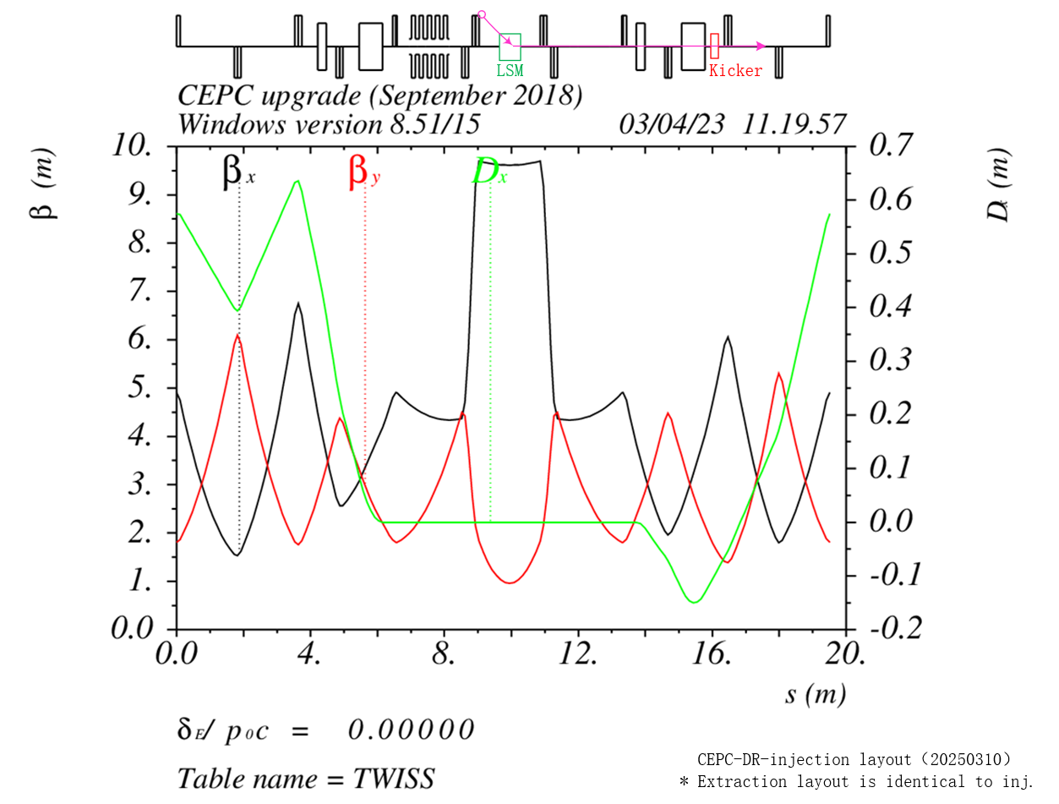
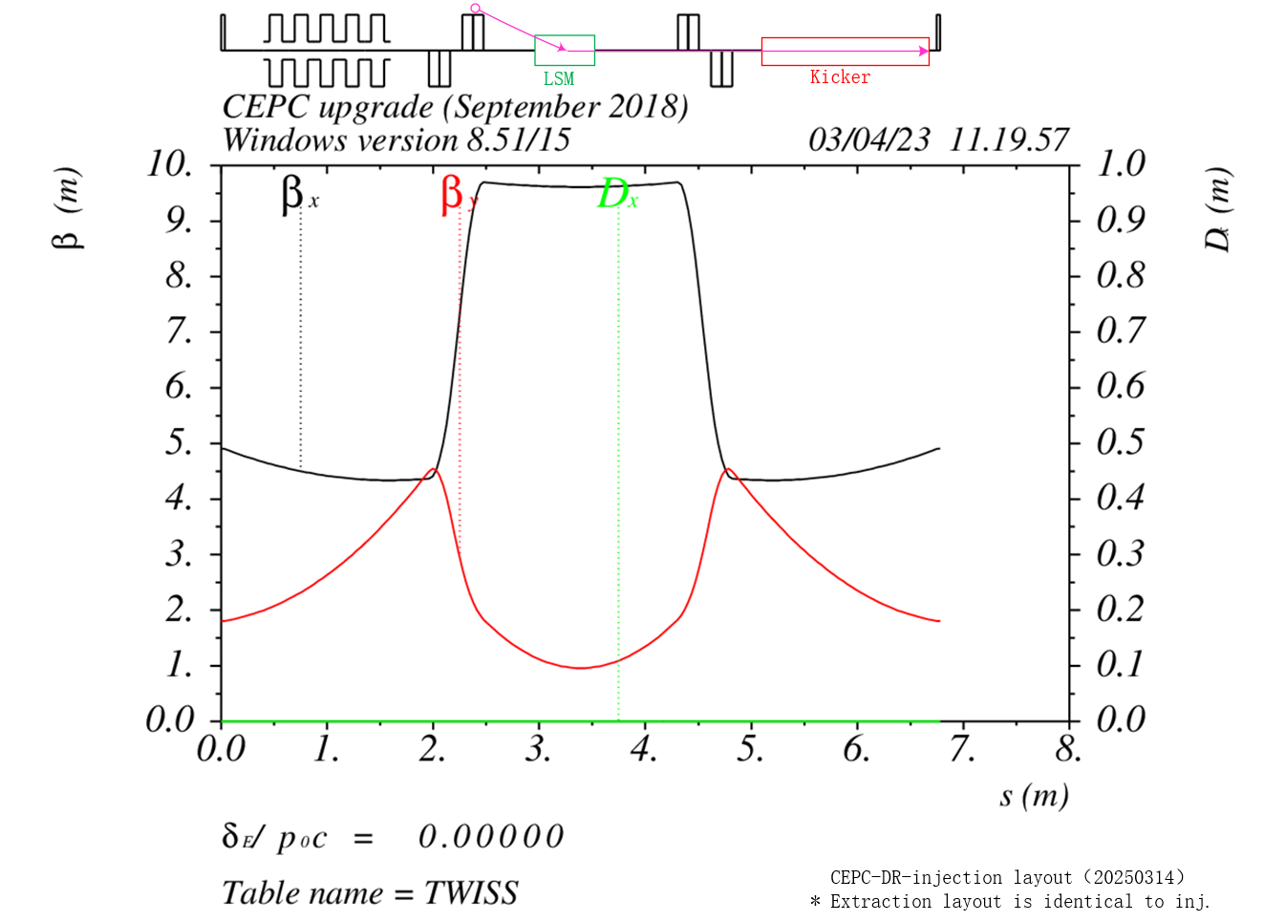
Damping ring inj. & ext. system layout
update

Slide 7
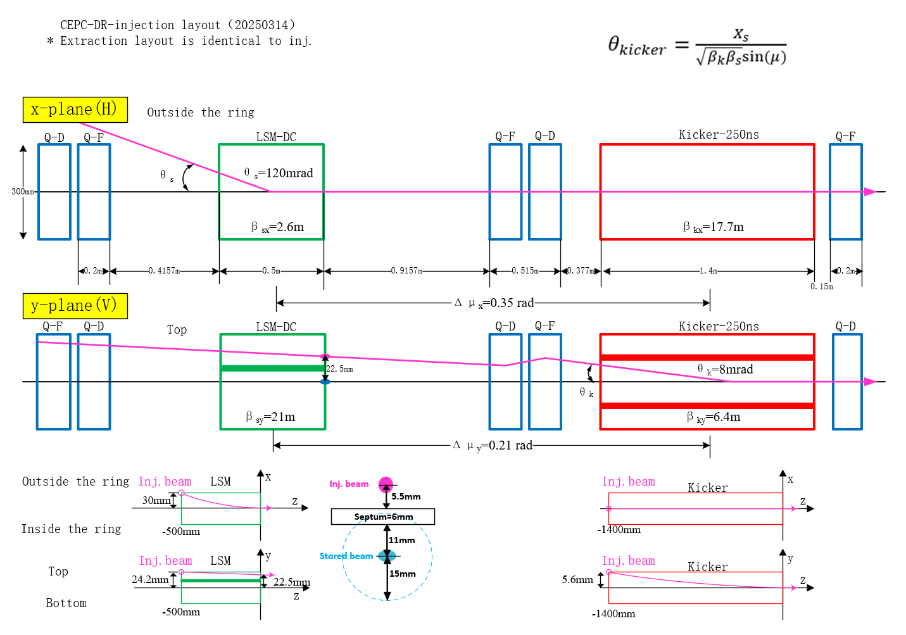
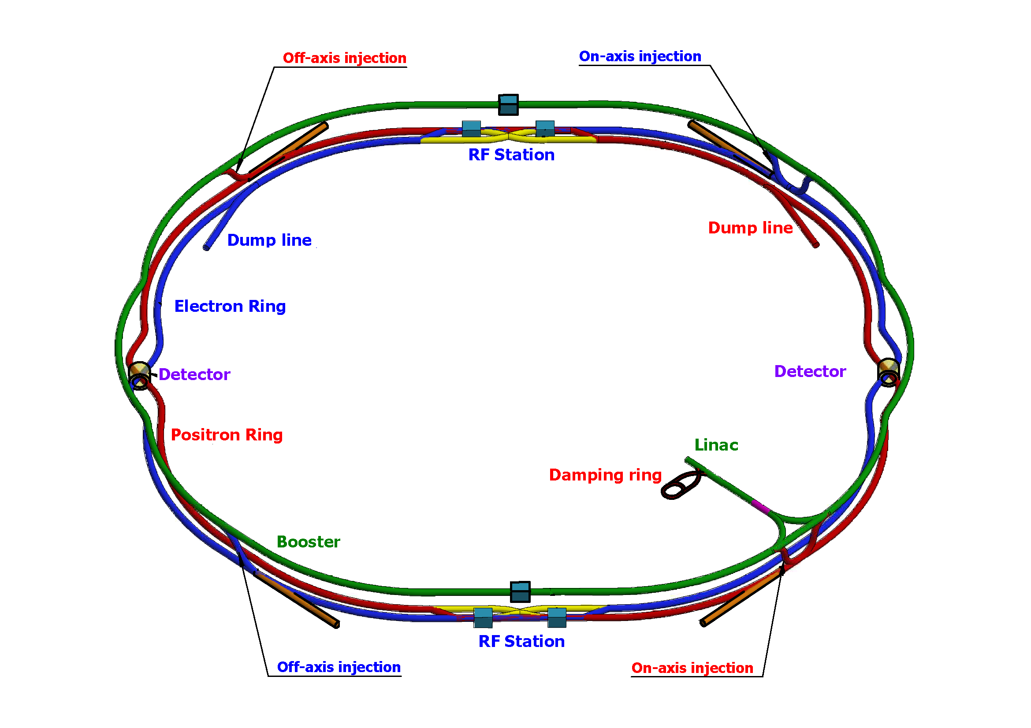
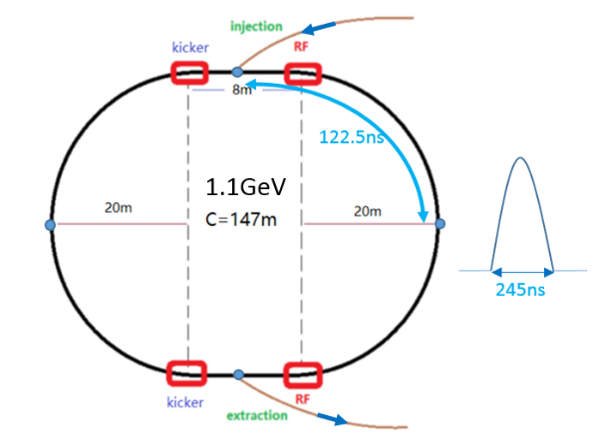
Damping ring inj. & ext. system layout

Slide 8
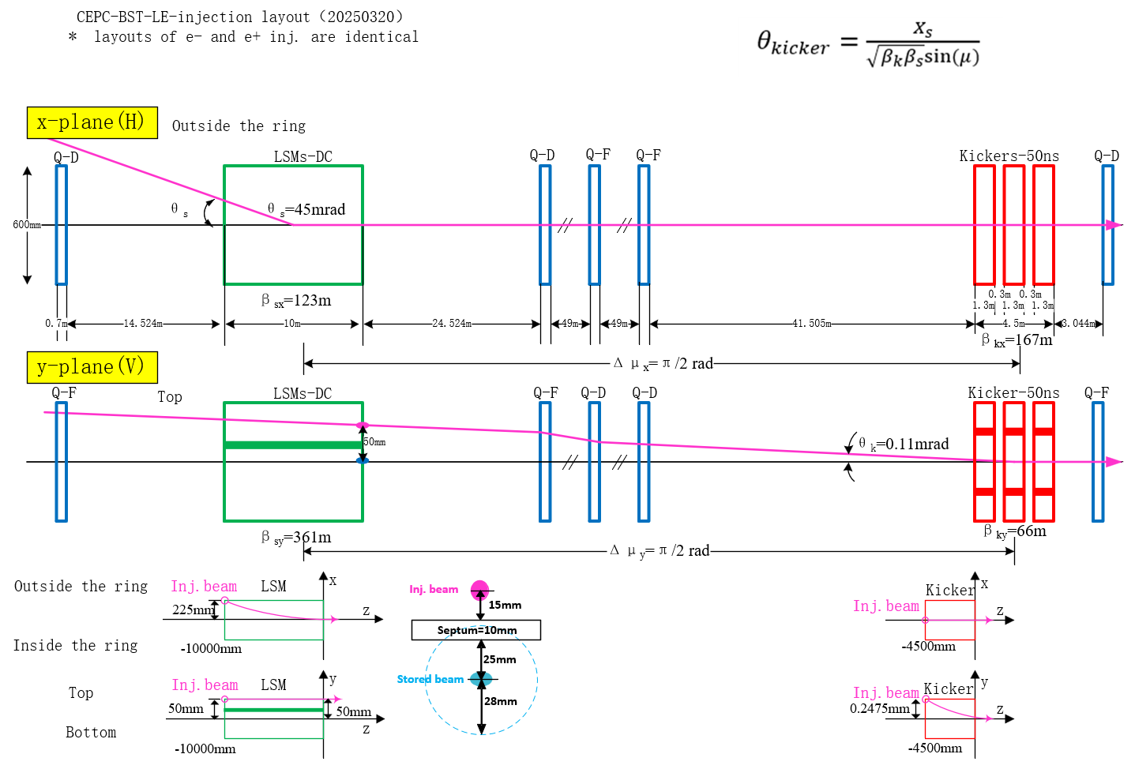
Booster injection from Linac

Slide 9
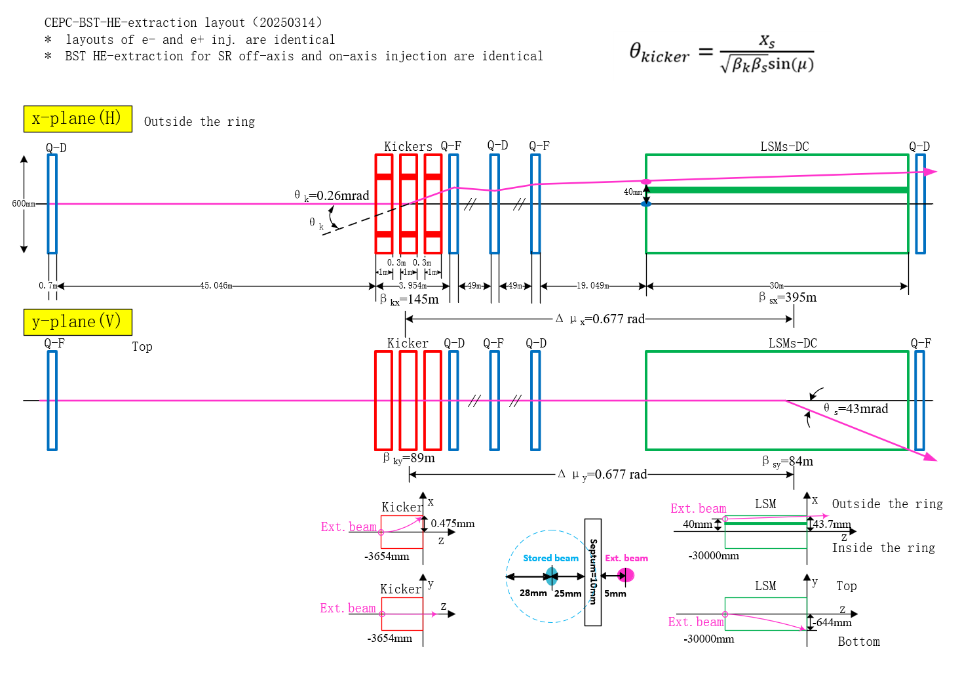
Booster extraction to SR

Slide 10
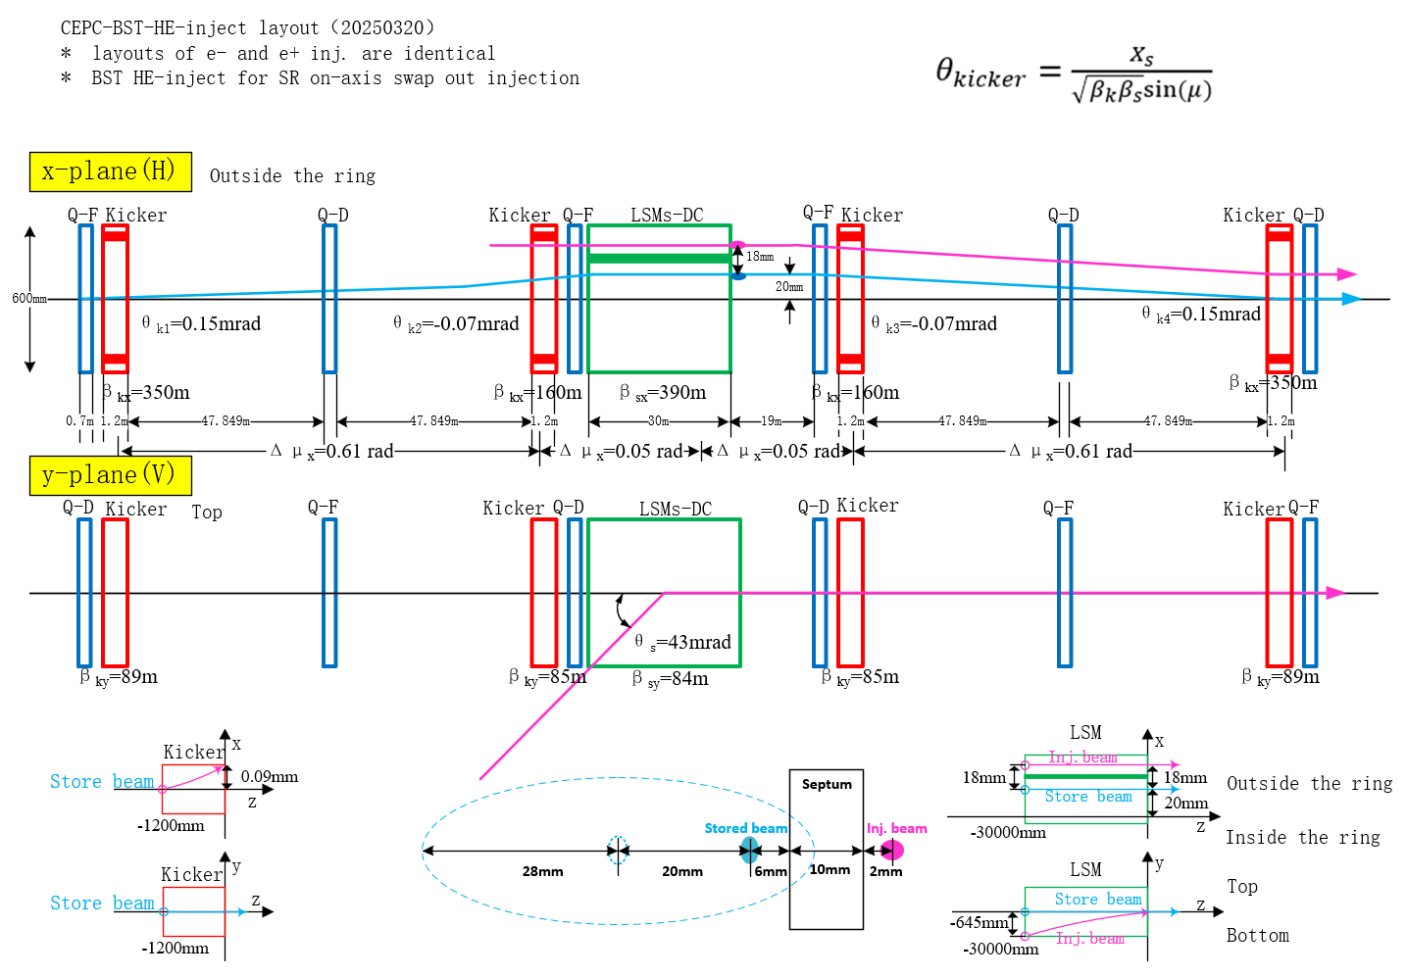
Booster re-injection from SR

Slide 11
Booster HE extraction to dump(未完成)
讨论：BST dump和SR dump共用条件下，BST abort system设计
建议将两个垃圾桶（e+/e-）安置在两个离轴注入区附近，即电子垃圾桶设置在正电子离轴注入区附近，正电子垃圾桶需要移位到电子离轴注入区附近。
以BST电子废束引出为例，增强器离轴引出kicker（delay-line kicker）可以兼做abort kicker，但是还是需要增加1组引出用的Lambertson磁铁将电子束引出至dump输运线上去
BST离轴引出Kicker系统为梯形波脉冲，脉宽在440~2420ns可调。如果要兼做abort kicker，z模式下共150串束流，只能是一串一串引出，最高重复频率为1KHz，共需要150ms时间才能将束流全部引出，此时束流会在环里继续转约500圈（0.33ms/Turn），是否能接受？如果需要增加kicker脉宽的话，脉冲电源的设计难度会相应增加。SR的 abort system同样也有这个情况（ TDR中 abort kicker设计参数和离轴注入kicker的一致）。
增强器在ramping过程中是否也可能启动abort system？如果是，就会比较复杂， BST abort Lambertson以及dump输运线上的铁必须要求和增强器二极磁铁一起同步ramping，kicker的强度也是需要逐次调整，脉冲电源的设计难度就要增加很多。
1kHz
440~2420ns
200ns
200ns
离轴引出kicker波形

Slide 12
Septum magnets EDR design update
Contributed by Lihua Huo

Slide 13
Preliminary mechanical design of LSM for BST LE inj.
Top view
0.4mm
Side view
2442.6mm
8073.8mm

Slide 14
Preliminary mechanical design of LSM for BST HE extraction
引出点
No.6
No.7
No.8

Slide 15
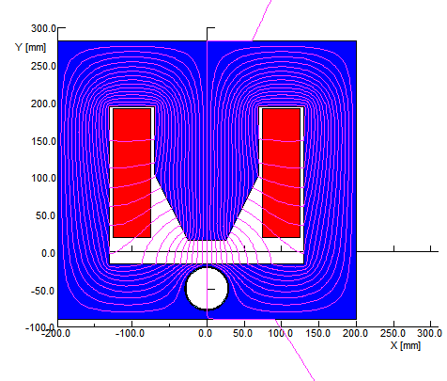
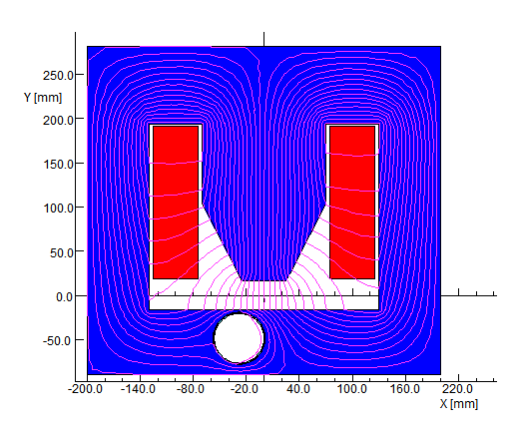
2D simulation for in-air LSM
Total thickness of septum ：5.5mm
Iron septum（DT4）：3mm
Wall thickness of stored beam pipe：1mm
Installation margin of stored beam pipe：0.5mm
Wall thickness of injected beam pipe：1mm
结论：
如果最高场强设计为1T，在此结构下选用的材料均不能满足漏场要求，需要修改屏蔽结构。
如果最高场强设计为0.9T，在此结构下循环束真空盒选择DT4可以满足漏场要求
如果最高场强设计为0.8T，在此结构下循环束真空盒选择材料都可以满足漏场要求
down stream
up stream
将所有真空外LSM的最高场强归一化到0.8T
 | Material of stored beam pipe | Air (Stainless Steel or copper) |  |  | 1J77A |  |  | DT4 |  |  | 1J22
Down stream | Main field By (T) | 0.80 | 0.89 | 0.999 | 0.8007 | 0.900 | 1.011 | 0.8010 | 0.903 | 1.023 | 1.027
 | Leakage field By (T） | 5.06E-04 | 4.69E-03 | 1.51E-02 | 1.07E-06 | 1.53E-03 | 1.10E-02 | 2.52E-05 | 2.76E-04 | 5.94E-03 | 4.46E-03
 | Leakage field Bx (T） | 3.03E-07 | -1.99E-06 | -1.76E-05 | 2.57E-10 | -5.76E-06 | 6.33E-04 | 4.89E-09 | 6.06E-04 | 6.66E-04 | 6.78E-04
 | Leakage field By/main field By | 6.33E-04 | 5.25E-03 | 1.51E-02 | 1.34E-06 | 1.70E-03 | 1.08E-02 | 3.15E-05 | 2.76E-04 | 5.94E-03 | 4.46E-03
Up stream | Main field By (T) | 0.80 | 0.905 | 1.037 | 0.8007 | 0.905 | 1.039 | 0.8010 | 0.905 | 1.040 | 1.040
 | Leakage field By (T） | 5.06E-04 | 8.39E-04 | 5.89E-03 | 1.07E-06 | 3.63E-06 | 1.58E-03 | 2.52E-05 | 2.99E-05 | 4.27E-04 | 2.63E-04
 | Leakage field Bx (T） | 3.03E-07 | 2.45E-04 | -5.83E-03 | 2.57E-10 | 2.13E-06 | -2.22E-03 | 4.89E-09 | -3.37E-04 | -1.25E-03 | -1.10E-03
 | Leakage field By/main field By | 6.33E-04 | 9.26E-04 | 5.68E-03 | 1.34E-06 | 4.01E-06 | 1.52E-03 | 3.15E-05 | 3.30E-05 | 4.11E-04 | 2.53E-04
上表中红色数字为不满足物理要求。

Slide 16
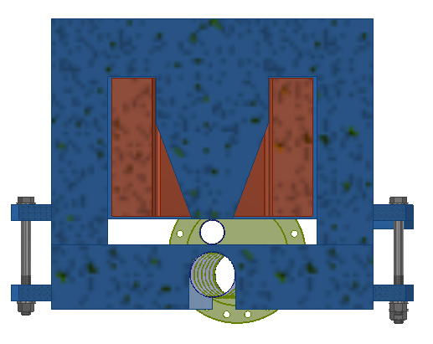
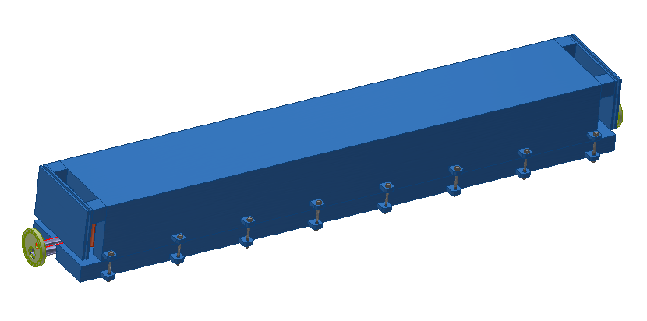
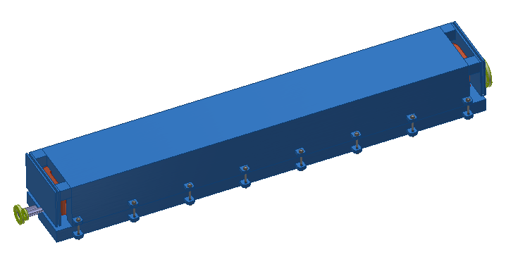
down stream LSM
Preliminary mechanical design of LSM
单台磁铁机械长度统一为2.7米，主要考虑以下几点：
磁铁机床加工制造能力（实心铁+深孔钻）
磁铁装配、准直误差
磁铁单台重量不宜过重
真空管道加工和极限真空
磁铁磁场测量（点测）
400mm
injected beam pipe：Idφ=30mm/
Thickness=0.7mm
360mm
stored beam pipe:
Idφ=56mm
Thickness=1mm
down stream LSM
beam
up stream flange
up stream flange
2500mm
2700mm
beam
UP stream LSM
2940mm

Slide 17
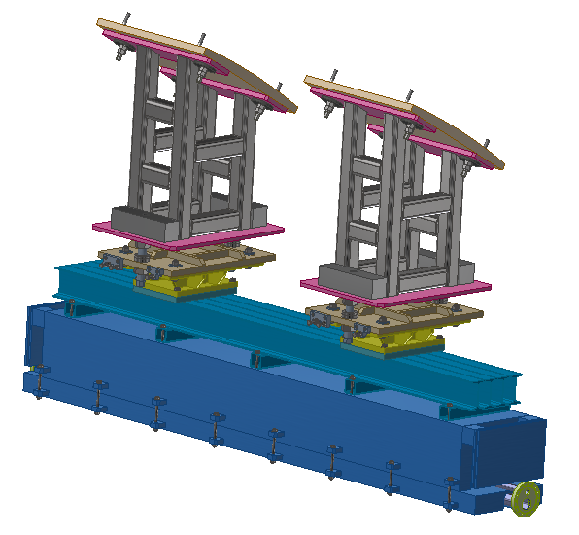
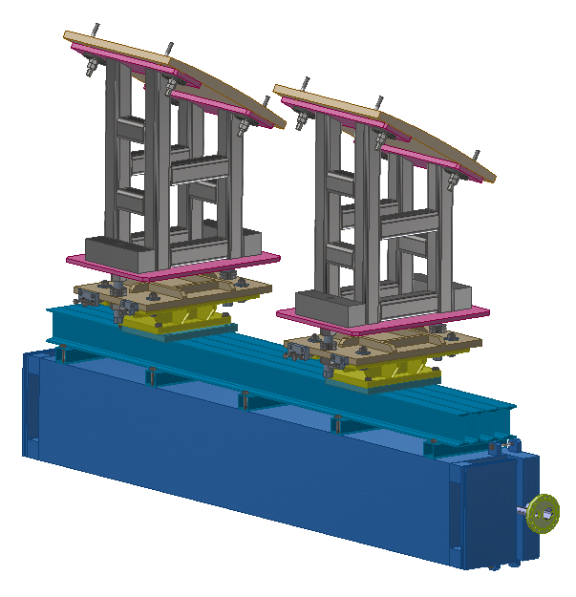
Preliminary mechanical design of LSM support
Horizontal deflection LSM
Vertical deflection LSM
BST LE injection LSM
BST HE inj. & ext. LSM

Slide 18
Kicker system EDR design update
Contributed by Guanjian Wu and Lei Wang

Slide 19
Strip-line kicker for BST LE injection
1300 mm
460 mm
300 mm
300 mm
1300 mm
1300 mm
1300 mm
260 mm
4.5m

Slide 20
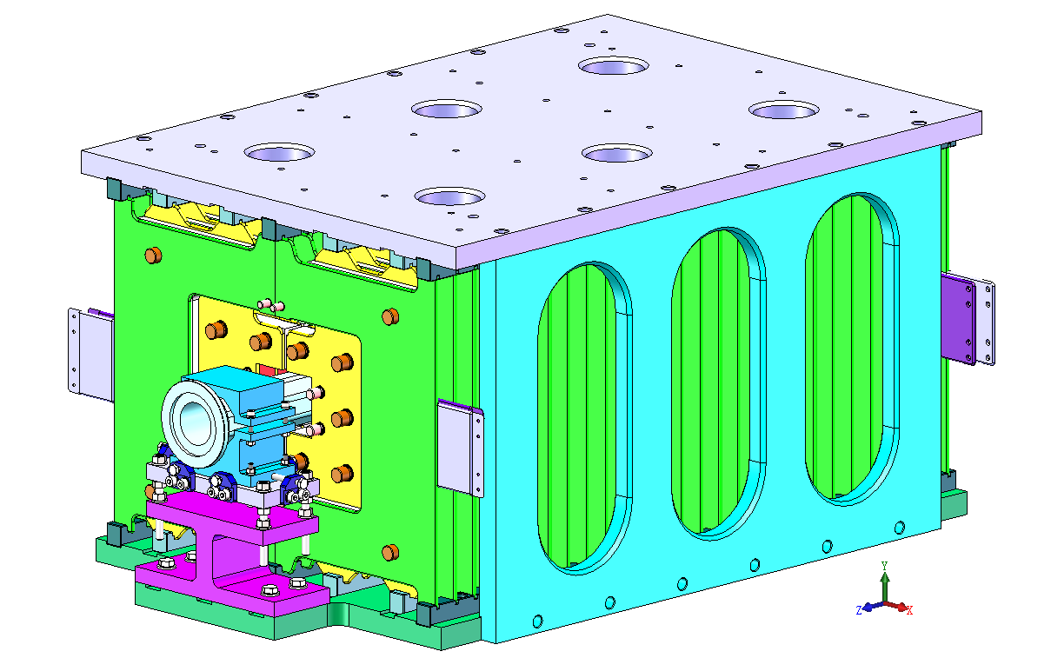
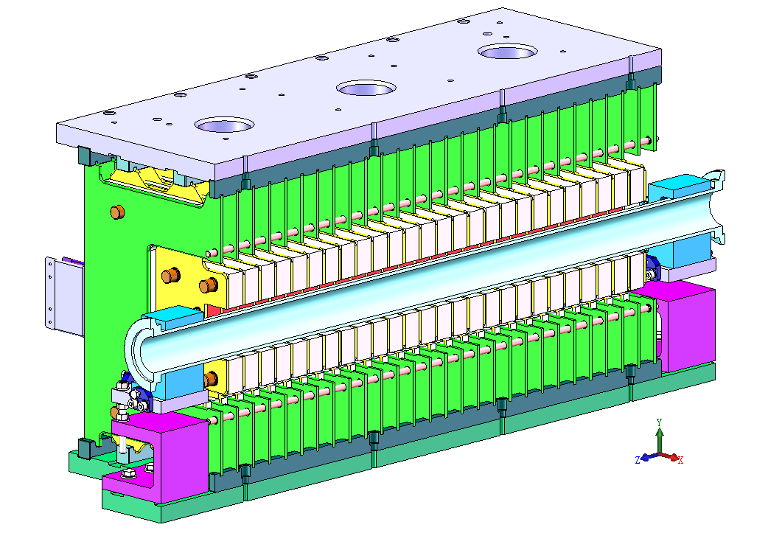
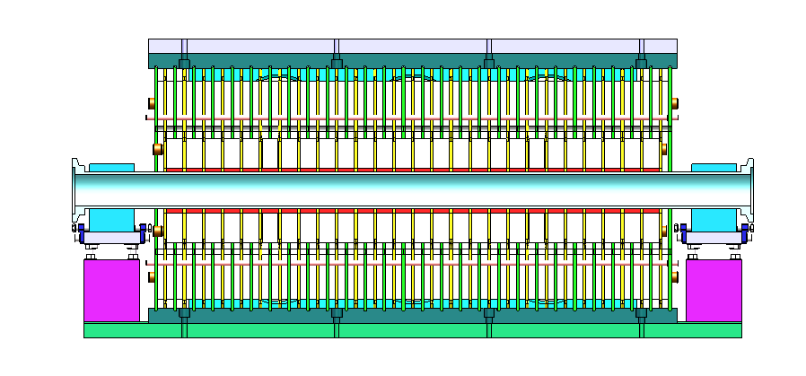
Delay-line kicker design for BST HE extraction（off-axis）
Update: design a new delay-line kicker with ceramic dielectric
Delay-line dipole kicker and pulser Parameter | Value
Aperture of magnet (mm) | 100 × 80
Longitudinal length of magnet cell (mm) | 36
Cell number of magnet | 26
Differential impedance of magnet (Ω) | 12.5
Length of magnet (mm) | 942
Total mechanical Length of magnet (mm) | 1018
Inductance of magnet cell (nH) | 56.6
Total inductance of magnet (nH) | 1471.6
Capacitance of magnet cell (pF) | 362
Total capacitance of magnet (nF) | 9.412
Magnetic strength (Gs) | 425
Exciting current of magnet (A) | 2703
Differential voltage of magnet (V) | +/-16895.5
Pulse waveform | trapezoid
Rise/fall time (ns) | 200
Flat-top width of pulse (ns) | 40~2000 adjustable
Filling time of magnet (ns) | 117.728
Rise/fall time of pulser (ns) | 80
Repetition rate (kHz) | 1
1kHz
440~2420ns
200ns
200ns

Slide 21
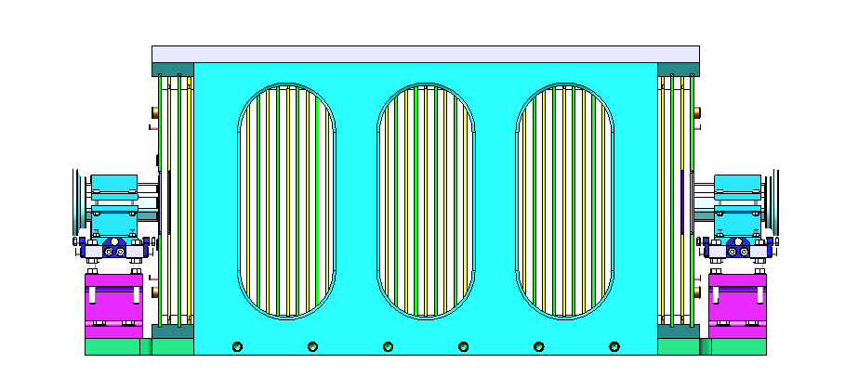
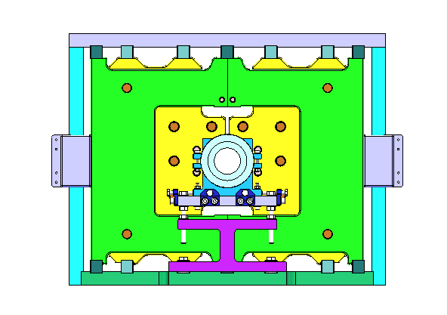
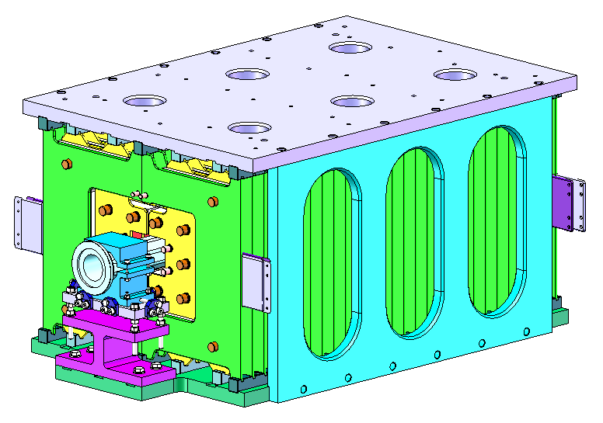
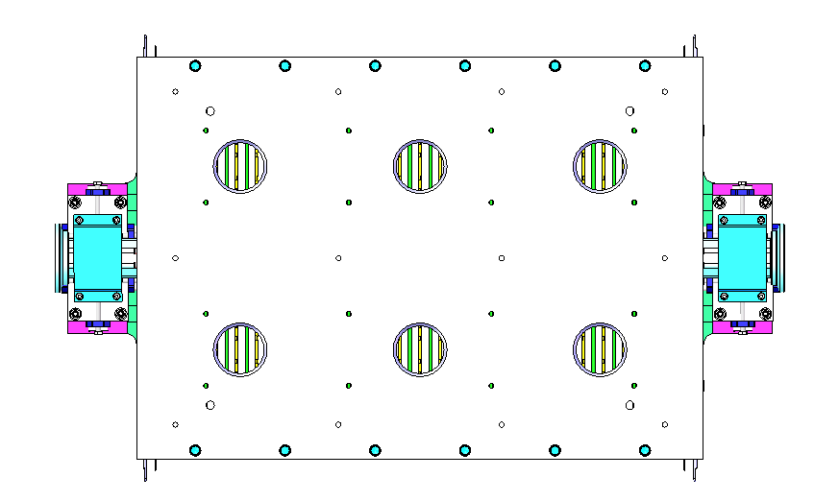
945.1mm
535mm
1216mm
1216mm
1216mm
1216mm
300mm
300mm
4.25m

Slide 22
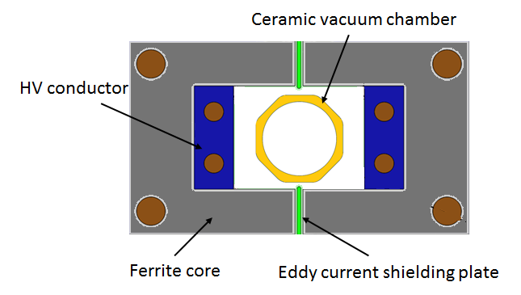
lumped parameter design for BST HE inj. & ext. system（on-axis）
The kicker magnet with ferrite core is preferred due to its higher exciting efficiency.
As For 1.3us half-sine wave kicker system, the lumped parameter type kicker is adopted, because of its simpler structure and lower cost.
Lumped dipole kicker Parameter | Value
Magnetic field B (T) | 0.04
Inner aperture of ceramic vacuum chamber (mm×mm) | 56×56
Ceramic vacuum chamber outer aperture (mm×mm) | 85×66
Magnet aperture w × h (mm×mm) | 100×80
Length of magnet l (m) | 1
Inductance of magnet L (μH) | 1.6
Magnet exercitation current I (kA) | 2.6
Impedance Z (Ω) | 3.7
Voltage of magnet U (kV) | 9.62
Pules bottom width τ (ns) | 1360
Repetition rate（Hz） | 1000
<1360ns,1kHz
200 mm
220 mm
1200 mm
1200mm
300mm
1200mm
300mm
1200mm
4.2m

Slide 23
Summary
The layout designs of injection and extraction systems in the CEPC booster were discussed.
The layout design of CEPC Storage ring inj.&ext. system will be update in next CEPC day.
The in-air Lambertson magnet，strip-line kicker, delay-line kicker，lumped-parameter ferrite-core kicker design for the CEPC booster inj.&ext. system have been updated. The preliminary mechanical designs with dimensions were presented.

Slide 24
END
Thank you for attentions!

Slide 25
Backup

Slide 26
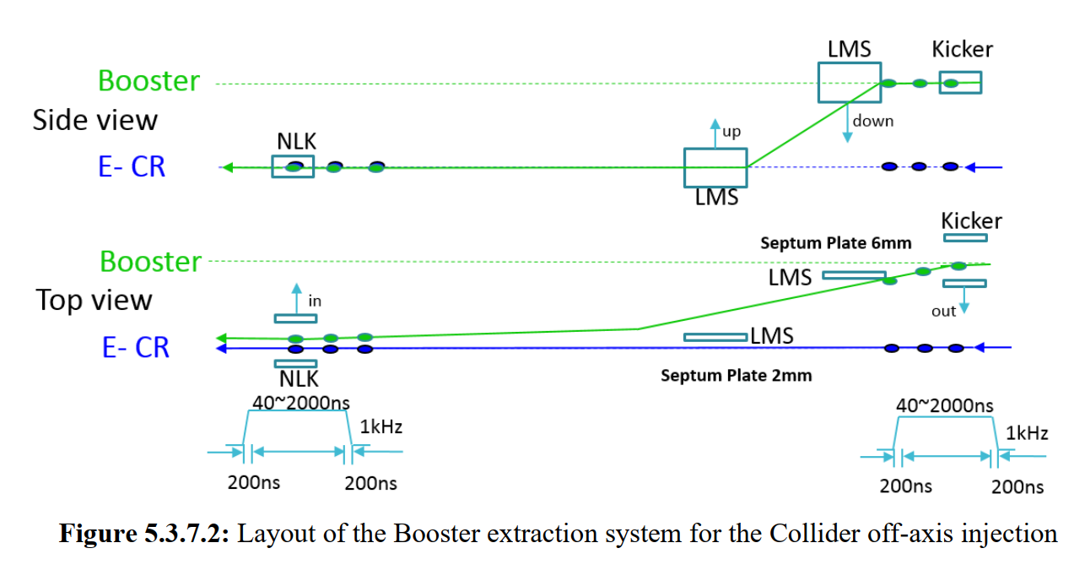

Slide 27
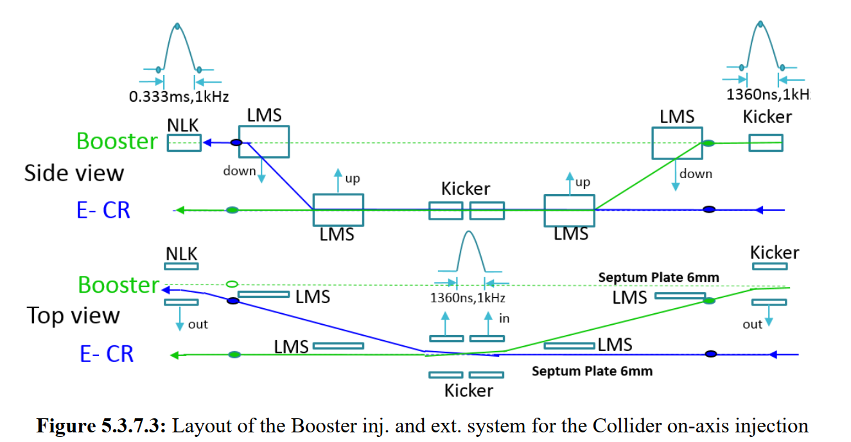

Slide 28
List of all type of hardware
No | Hardware | Type | Typical parameters | Unit | Number | Unit price (10,000 CNY) | Total Price (10,000 CNY)
1 | kicker1 | delay-line dipole kicker | in-air delay-line dipole kicker, horizontal, 0.1mrad, 0.04T·m, L=1m, B=0.04T(H), inc. ion pump | set | 24 | 50 | 1200
2 | kicker pulser1 | trapezoidal wave pulser | PFN, solid-state,440~2400ns, inc. cable | set | 24 | 100 | 2400
3 | kicker2 | ferrite-core dipole kicker | in-air ferrite-core dipole kicker, horizontal,0.2mrad,0.08T·m, L=1m, B=0.04T(H)， inc. ion pump | set | 6 | 33 | 198
4 | kicker pulser2 | half-sine wave pulser | LC, solid-state,1360ns, halfsine, inc. cable | set | 6 | 31 | 186
5 | kicker3 | strip-line kicker | Strip-line kicker, vertical, 46ns, L=1m, inc. ion pump | set | 6 | 28 | 168
6 | kicker pulser3 | DSRD pulser | 46ns, ±12.5kV,DSRD pulser, inc. cable | set | 6 | 67 | 402
7 | kicker4 | slotted-pipe kicker | Slotted-pipe kicker,vertical,250ns,L=0.25m, DR beam pipe φ=30mm, inc. ion pump | set | 2 | 23 | 46
8 | kicker pulser4 | trapezoidal wave pulser | solid-state,inductive adder, 250ns, inc. cable | set | 2 | 40 | 80
9 | dilution kicker | CW full-sine | CW full-sine，L=2m，150Gauss，T=25us, total length=10m | set | 10 | 30 | 300
10 | dilution kicker pulser | CW full-sine | CW full-sine，T=25us | set | 10 | 30 | 300
11 | NLK | NLK | in-air Nonlinear kicker or pulsed sextupole, horizontal, 0.1mrad, 0.04T·m, L=1m, inc. ion pump | set | 2 | 38 | 76
12 | NLK pulser | half-sine wave pulser | LC, solid-state,0.3ms, halfsine, inc. cable | set | 2 | 15 | 30
13 | thin septa | In-vacuum Lambertson | Lambertson,vertical,DC,L=1.75m,B=0.8T,Septum=2mm, mainfield clearance=20*20mm, 13mrad, 5.22T·m,inc. ion pump | set | 28 | 58 | 1624
14 | thick septa1 | In-air Lambertson | Lambertson,vertical,DC,L=1.75m,B=0.8T,Septum=6mm, mainfield clearance=20*20mm, 13mrad, 5.22T·m,inc. ion pump | set | 148 | 25.8 | 3818.4
15 | thick septa2 | In-air Lambertson | Lambertson,horizontal,DC,L=1.2m, B=0.8T, Septum=5.5mm, mainfield clearance=50*50mm, 45mrad, 0.92T-m,inc. ion pump | set | 2 | 22.8 | 45.6
16 | thick septa3 | In-air Lambertson | Lambertson,horizontal,DC,L=0.5m,Septum=3.5mm, DR beam pipe φ=30mm,inc. ion pump | set | 2 | 20.8 | 41.6
17 | septa power supply | DC power supply | DC switch power supply, inc. cable | set | 28 | 12.5 | 350
18 | local control system1 |  | PLC，touch screen，oscilloscope | set | 16 | 10 | 160
19 | local control system2 |  | PLC，touch screen，oscilloscope | set | 2 | 5 | 10
20 | Field measurement devices1 | hall | Hall point measurement system for Lambertson | set | 2 | 160 | 320
21 | Field measurement devices2 | inductive coil measurement | inductive coil measurement system for kicker | set | 1 | 10 | 10
 |  |  |  |  |  | Total cost： | 11765.6
 |  |  |  |  |  | Toal cost with installation fee(3%)： | 12118.568

Slide 29
Two types of Lambertson magnets
To realize thinner septum as possible, 2 novel structures of magnet were proposed:
Magnet pole
Wall of stored beam pipe
+
Wall of injected beam pipe
+
Iron septum
+
installation margins
Installation margin
Septum
thickness
Injected bunch
=
Yoke
half-in-vacuum
(for septum of 2mm)
Stored bunch
Thin septum
(IN-VAC)
Magnet pole
Installation margin
Injected bunch
SS
Half in-vacuum
Quantity:28 sets
Installation margin
Yoke
Magnet pole
Stored bunch
Installation margin
Injected bunch
embedded thin-wall vacuum chamber
(for septum≥3.5mm)
SS
Iron or
VP(FeCoV，1J22)
Thick septum
(IN-AIR)
Yoke
Traditional LSM
Stored bunch
Quantity:152 sets
in-air

Slide 30
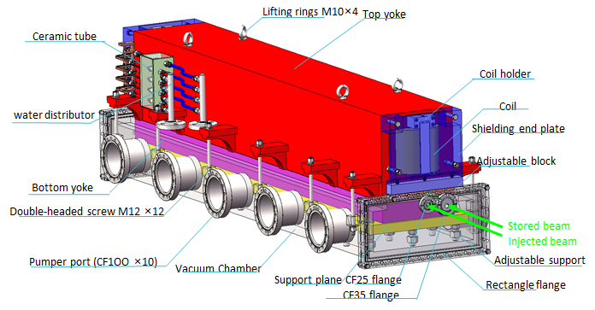
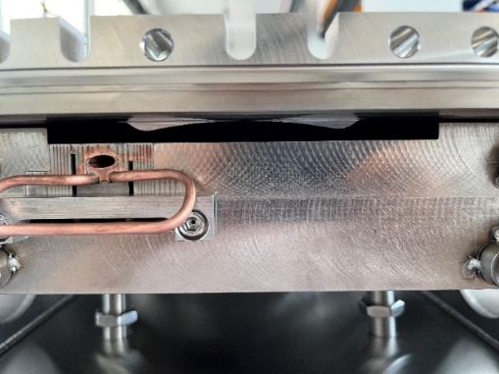
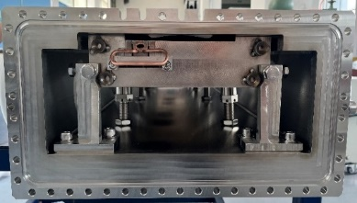
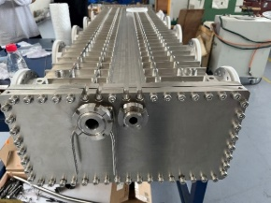
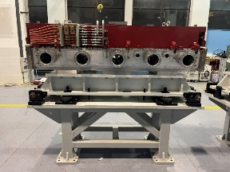
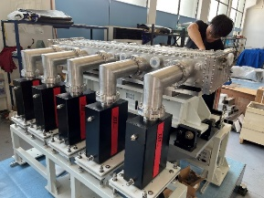
IN-Vacuum LSM
Research status：final magnets for HEPS SR injection will see first beam this year.
FeCoV
2mm
DT4
Cu

Slide 31
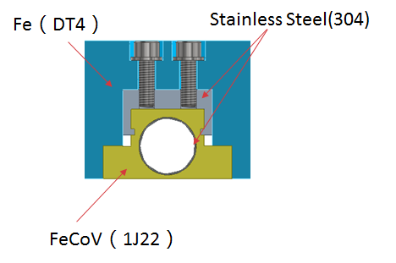
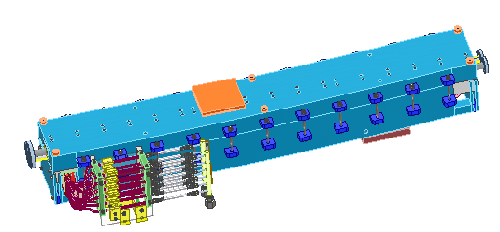
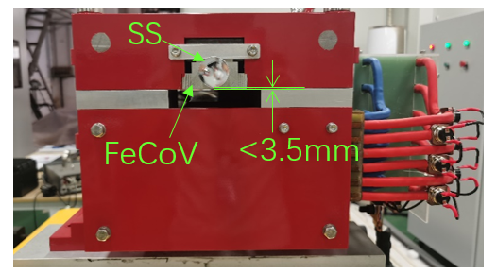
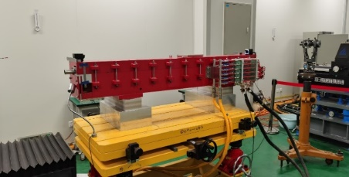
IN-Air LSM
Research status：final magnets for HEPS BST injection was applied in beam commissioning successfully last year.

Slide 32
Design parameters of ferrite core kickers for CEPC
There are 2 kinds of kicker with ferrite core for trapezoid wave and half-sine wave pulsed system.
parameter | Unit | BST-EXT-kicker1/CR-inj-kicker1/dump （for CR off-axis inj.） | BST-EXT-kicker2/CR-inj-kicker2 （for CR on-axis inj.）
Type | - | In-air delay-line dipole kicker | In-air lumped parameter dipole kicker
Deflect direction | - | Horizontal | Horizontal
Beam Energy | GeV | 120 | 120
Deflect angle | mrad | 0.1 | 0.2
Magnetic effective length | m | 1 | 1+1
Magnetic strength | T | 0.04 | 0.04
Integral magnetic strength | T·m | 0.04 | 0.08
Clearance region(H×V) | mm | 56×56 | 56×56
Good field region(H×V) | mm | 50×50 | 50×50
Field uniformity in good field region | - | ±1.5% | ±1.5%
Repetition rate | Hz | 1k | 1k
Amplitude repeatability | - | ±0.5% | ±0.5%
Pulse jitter | ns | ≤5 | ≤5
Bottom width of pulse(5%-5%) | ns | Trapezoid：440~2420 | Half-sine：1360
Tr/Tf(5%-95%) | ns | <200 | <680
40~2000ns
1kHz
200ns
200ns
1360ns,1kHz

Slide 33
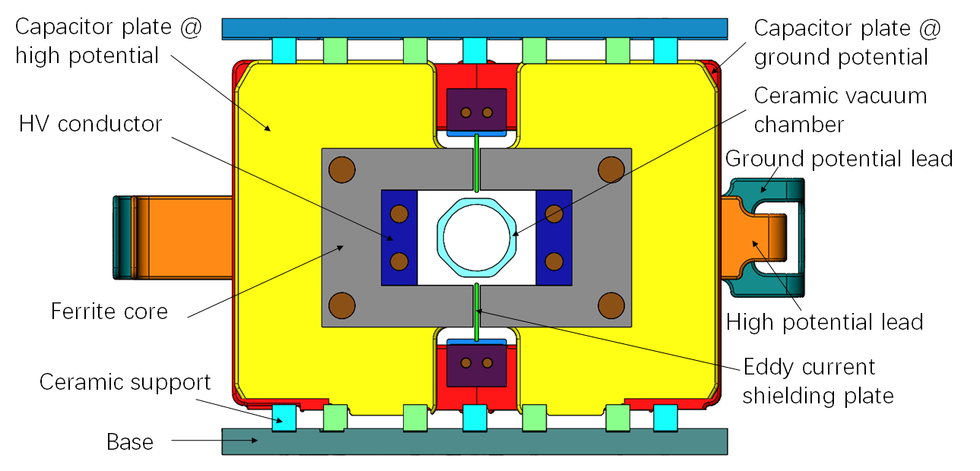
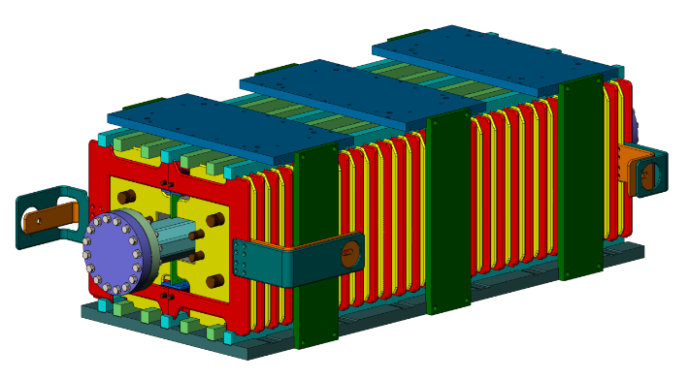
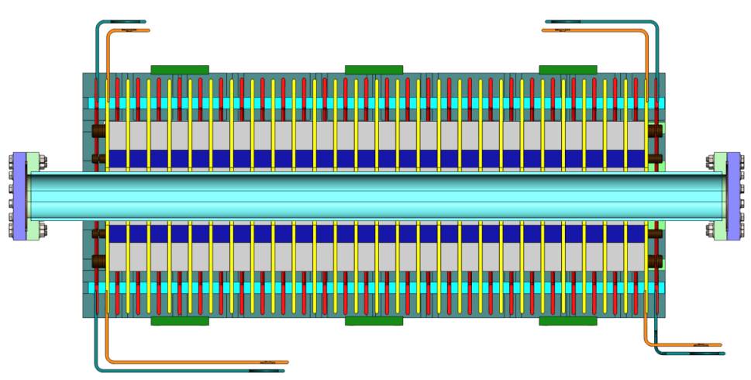
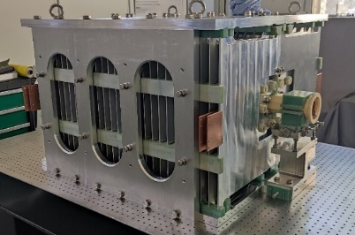
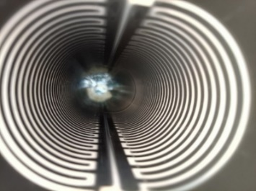
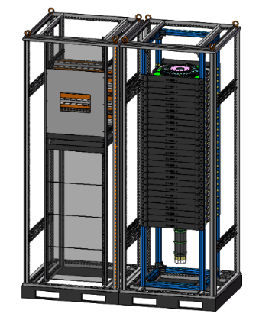
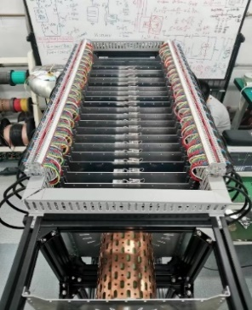
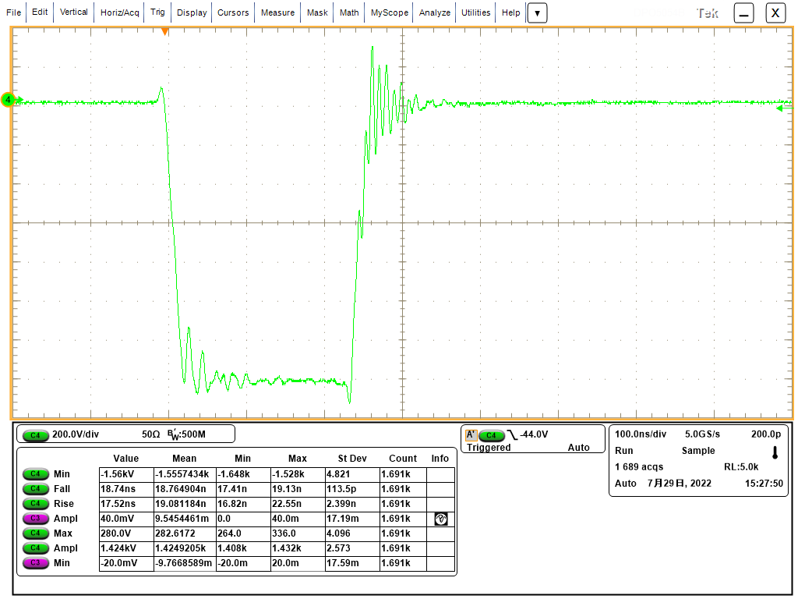
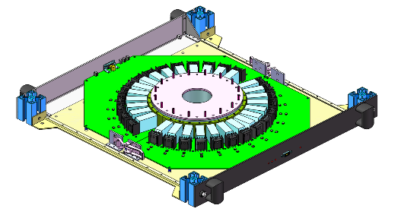
Trapezoid wave kicker system
40~2000ns
1kHz
200ns
200ns
Research status：
A delay-line kicker (NLK) prototype was done. But magnet characteristic impedance is a little high and volume is Large; Beam impedance issue of ceramic vacuum chamber with Ti coating is not clear
A solid-state pulser prototype based on SiC MOSFET was done. But the pulse HV dose not meet CEPC requirement yet.
Delay-line dipole kicker and pulser Parameter | Value
Aperture of magnet (mm) | 100 × 80
Longitudinal length of magnet cell (mm) | 36
Cell number of magnet | 26
Differential impedance of magnet (Ω) | 12.5
Length of magnet (mm) | 942
Total mechanical Length of magnet (mm) | 1018
Inductance of magnet cell (nH) | 56.6
Total inductance of magnet (nH) | 1471.6
Capacitance of magnet cell (pF) | 362
Total capacitance of magnet (nF) | 9.412
Magnetic strength (Gs) | 425
Exciting current of magnet (A) | 2703
Differential voltage of magnet (V) | +/-16895.5
Pulse waveform | trapezoid
Rise/fall time (ns) | 200
Flat-top width of pulse (ns) | 40~2000 adjustable
Filling time of magnet (ns) | 117.728
Rise/fall time of pulser (ns) | 80
Repetition rate (kHz) | 1
Voltage is lower
18-stage@800V：14.2kV into 10Ω

Slide 34
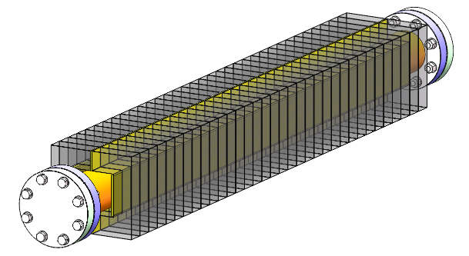
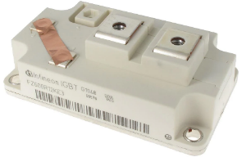
Half-sine wave kicker system
<1360ns,1kHz
Research status：
A novel solid-state pulser circuit is proposed. (LC resonance discharge with inductive-adder based on IGBT and SiC-SBD) .
The IGBT module(FZ600R12KS4: 1.2kV/1200A) is adopted for its higher performance-cost ratio.
Principle verify circuit in condition of 2 stages is being test
Lumped dipole kicker Parameter | Value
Magnetic field B (T) | 0.04
Inner aperture of ceramic vacuum chamber (mm×mm) | 56×56
Ceramic vacuum chamber outer aperture (mm×mm) | 85×66
Magnet aperture w × h (mm×mm) | 100×80
Length of magnet l (m) | 1
Inductance of magnet L (μH) | 1.6
Magnet exercitation current I (kA) | 2.6
Impedance Z (Ω) | 3.7
Voltage of magnet U (kV) | 9.62
Pules bottom width τ (ns) | 1360
Repetition rate（Hz） | 1000
DC=800V
Ip=~1300A，Tw=~400ns

