Slide 1
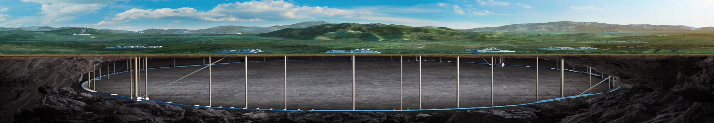


CEPC accelerator survey and mechanical design progresses
Haijing Wang, on behalf of mechanics colleagues
CEPC DAY
2025.3.21

Slide 2
Content
1. Accelerator survey
  1.1 Layout design
  1.2 2D/3D linkage design
2. Mechanical design progresses
  2.1 Tunnel mockup
  2.2 High accuracy automatic adjusting and alignment system
  2.3 Vibration test
3. Summary

Slide 3
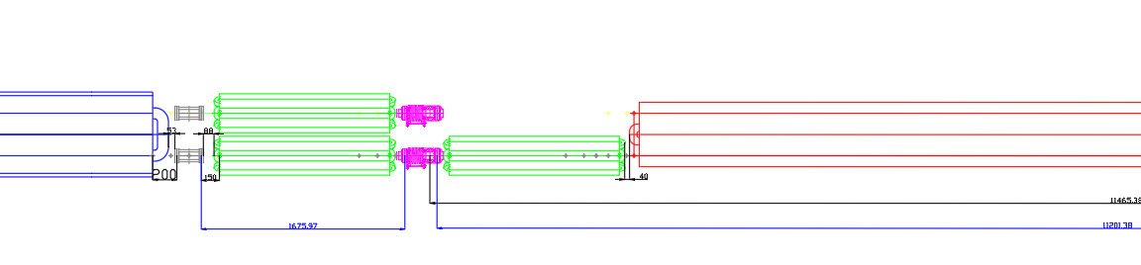
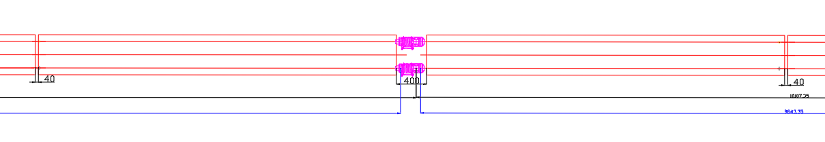
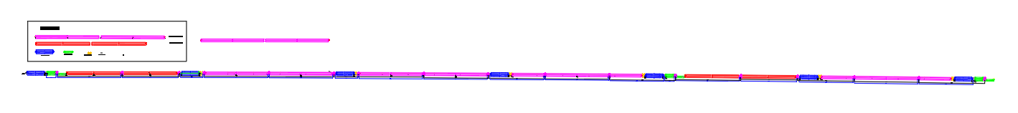
1.1 Layout design
Layout design from EDR beginning to 24.10
Quadrupole
BPM
sextupole
dipole
Vacuum connection part
dipole
Vacuum connection part
dipole
Progress from 24.10 to now
  A updated survey of Collider(25.2.14), Booster (25.3.1), Linac, DR, TLs (25.3.7)
  The realization of 2D/3D linkage design
  Typical section layout of Collider and Booster
  MDI layout updating

Slide 4
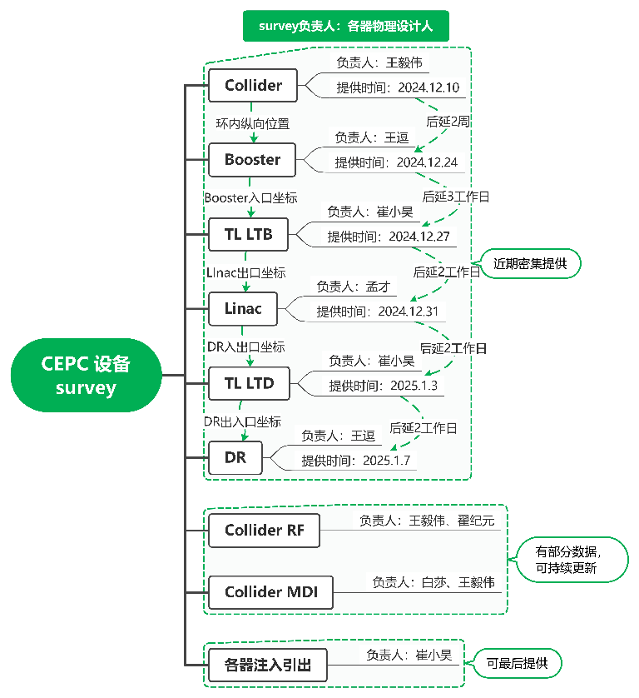
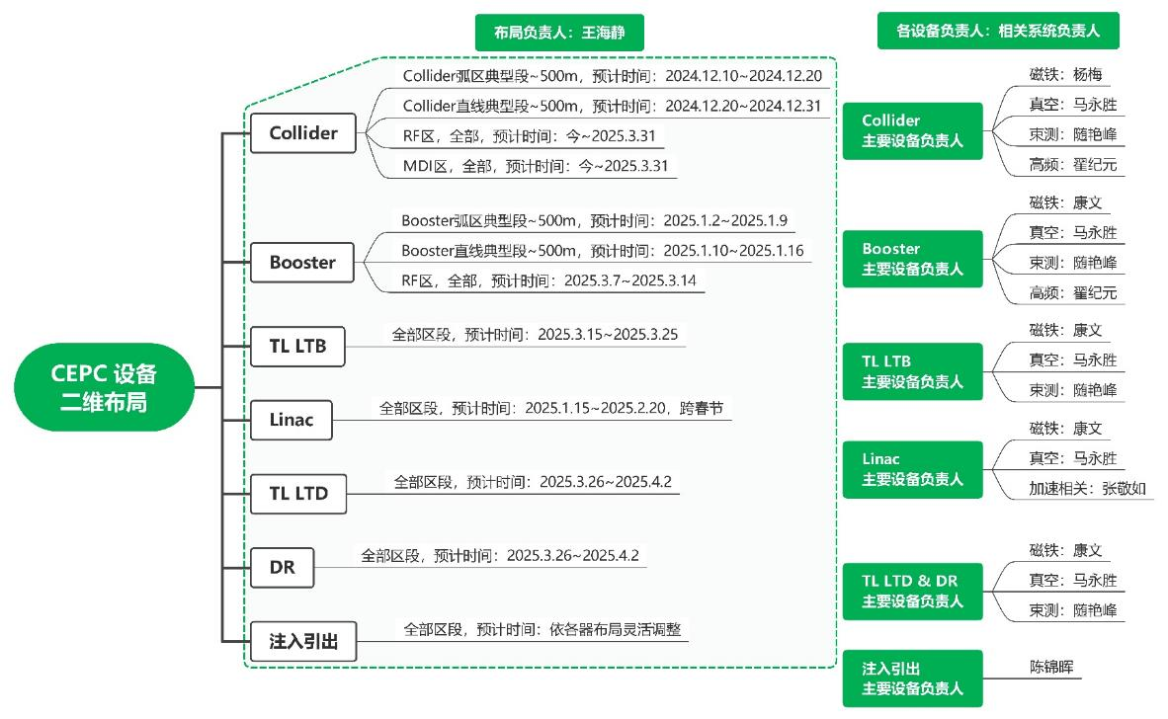
1.1 Layout design
survey checked, √
survey needs to be updated

Slide 5
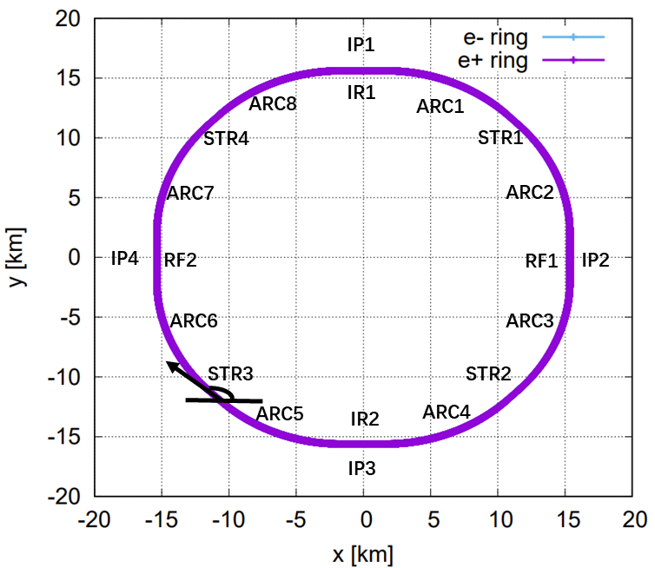
1.1 Layout design
New Collider survey from Yiwei
  Has been delivered to Huadongyuan.
区域 | 长度 [米]
弧区（ARC1/4/5/8） | 10186.200
弧区（ARC2/3/6/7） | 10270.937
对撞区（IR1/IR2） | 3337.132
高频区（RF1/RF2） | 3754.813
短直线节 （STR） | 985.744
全环 | 99,955.418

Slide 6
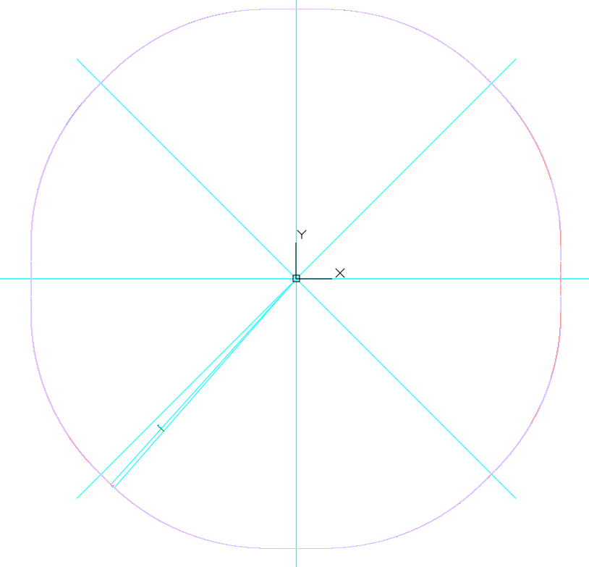
1.1 Layout design
The coordinate origins of all the accelerator has been unified.
The (0,0) point is at the symmetric center of the Collider.
2D and 3D layout are being built simultaneously.
(0,0)
We begin from here

Slide 7
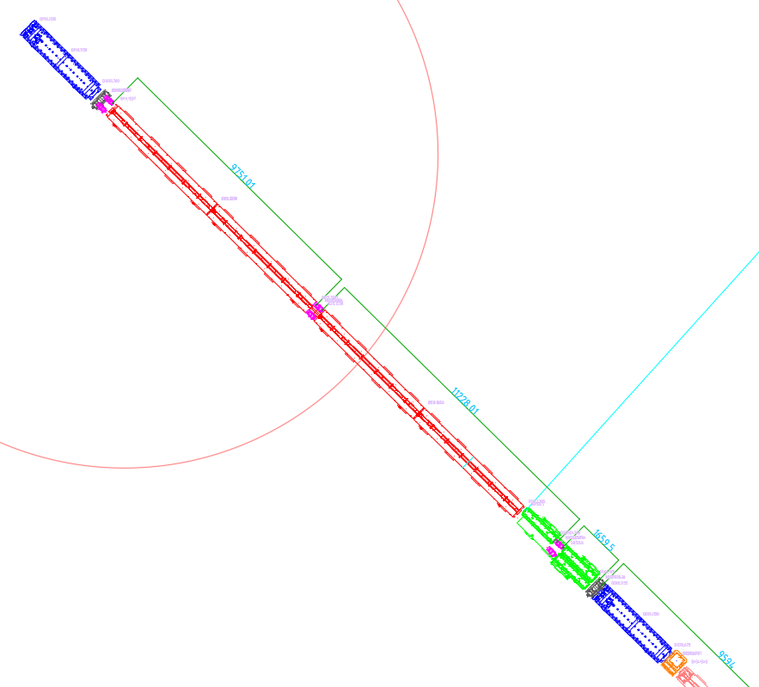
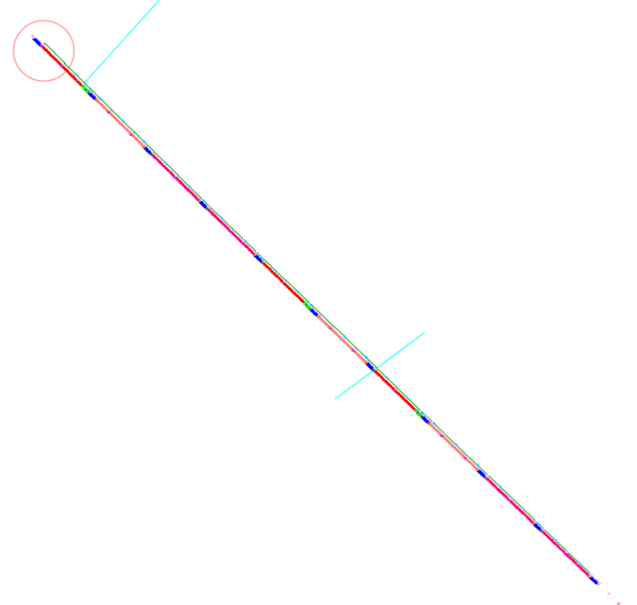
1.1 Layout design
An arc section of 276 m layout has been made.
四极铁
BPM
B01
环内，靠墙
真空连接段
真空连接段
真空连接段
环外，靠过道
BPM
六极铁
四极铁
校正铁

Slide 8
1.1 Layout design
Three vacuum layout has been compared considering the installation of dipoles.
  The compared section is 164 m, a typical cycle period
  Aim: to discuss the feasibility of two dipole cores transported and installed together. (pre-installed outside, less workload in the tunnel)
  The vacuum tube installation, the coils installation, the upper cores of magnets need to be disassembled and reassembled.
Design principles
  Pump distance ≤12.5m
  Number of vacuum tubes as small as possible

Slide 9
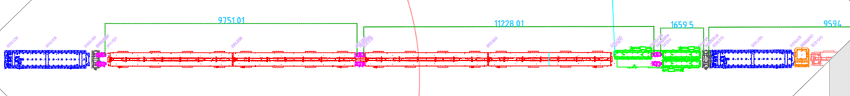
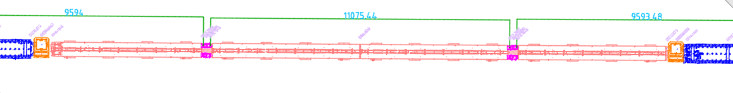
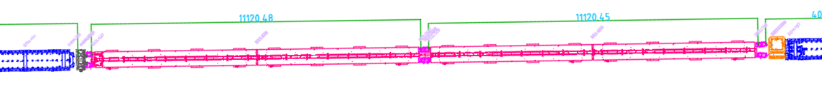
1.1 Layout design
Three vacuum layout has been compared considering the installation of dipoles.
V1: 18 vacuum tubes in one ring, 10 can be pre-installed with magnets

Slide 10
1.1 Layout design
Three vacuum layout has been compared considering the installation of dipoles.
V2: 20 vacuum tubes in one ring, 14 can be pre-installed with magnets

Slide 11
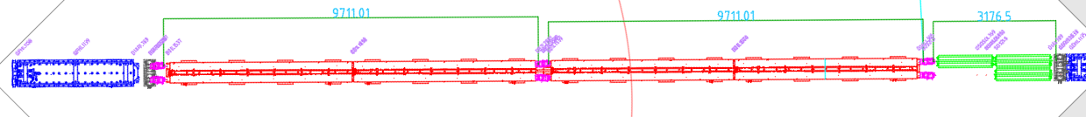
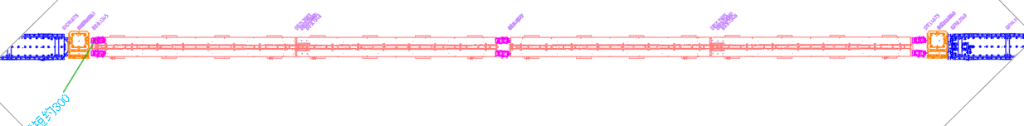
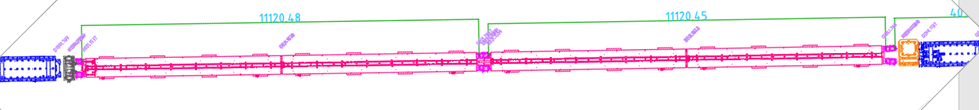
1.1 Layout design
Three vacuum layout has been compared considering the installation of dipoles.
V3: 20 vacuum tubes in one ring, 14 can be pre-installed with magnets

Slide 12
1.1 Layout design
Three vacuum layout has been compared considering the installation of dipoles.
 | V1 | V2 | V3
No. of vacuum tubes | 18 | 20 | 20
No. of vacuum tubes can be pre-installed outside | 10 | 14 | 14
No. of dipole core can be pre-installed outside (total of 24) | 16 | 20 | 24
No. of vacuum connection parts (bellows & pumps) | 16 | 16 | 18
Others |  |  | Dipole length decease ~600mm/164m
Whether pre-install the dipoles has benefits should be discussed further.

Slide 13
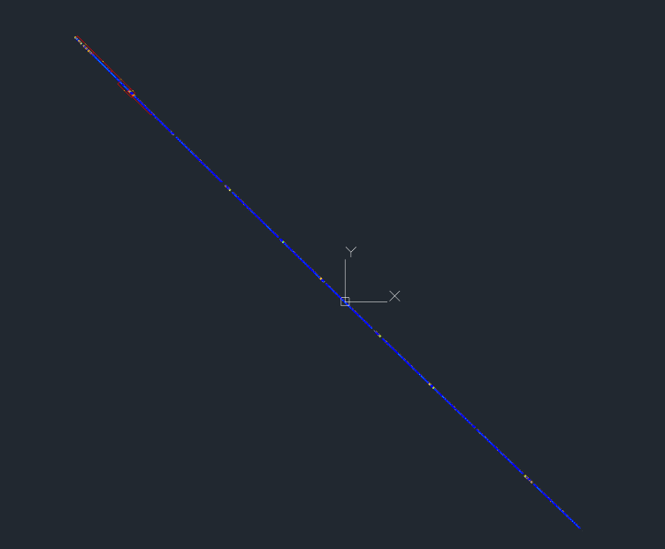
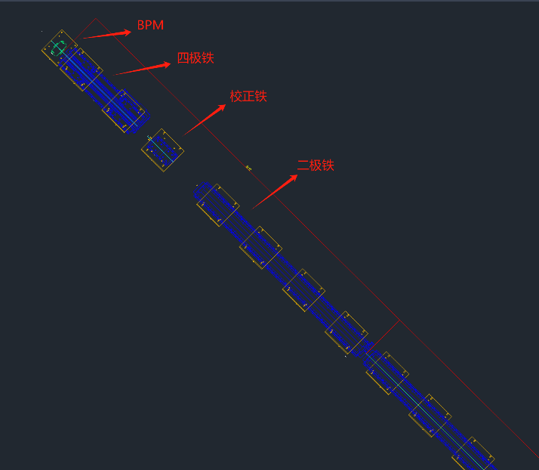
1.1 Layout design
Booster layout
  A preliminary layout has been made, about 256m.
  No real in/out survey point provide, we have discussed with Dou Wang, she will update the survey according to this preliminary version.

Slide 14
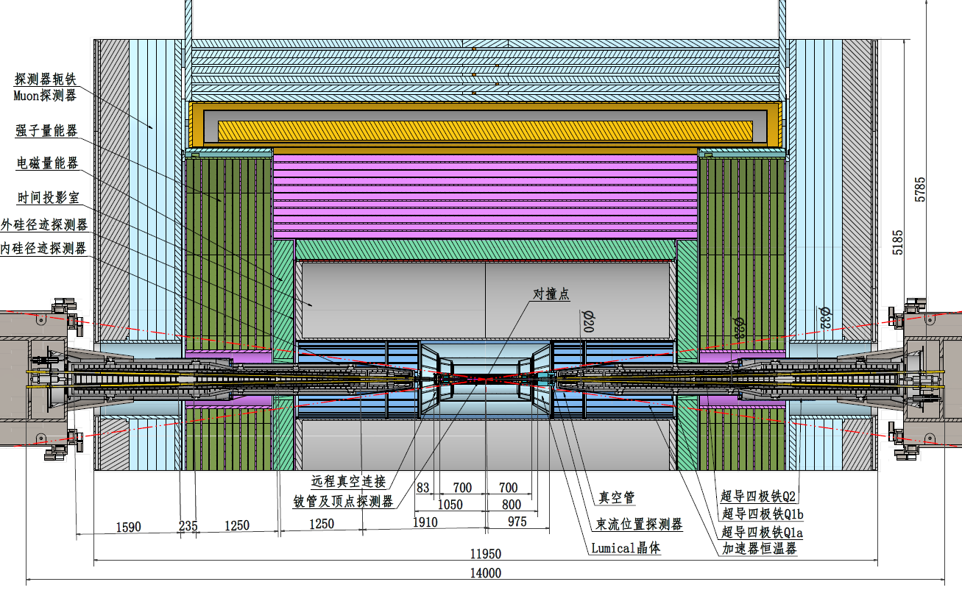
1.1 Layout design
MDI layout

Slide 15
1.2 2D/3D linkage design
The accelerator layouts before CEPC (HEPS\BEPC\CSNS…), the 2D and 3D layouts are designed separately and has no direct linkage
  More workloads
  Easily to have inconsistencies between 2D and 3D layout
We want to make a 2D/3D linkage design for CEPC
  Autodesk soft wares: AutoCAD Mechanical, Autodesk Inventor Professional, Factory Design Utilities, the three should have the same version and language. We use V2024. We have the software until end of 2026.
  We also investigated “中望CAD”. It doesn’t have this usage.
  Other soft wares: we haven’t investigated.

Slide 16
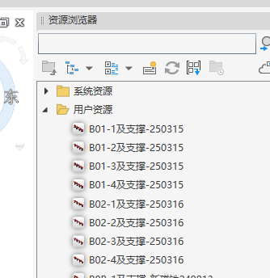
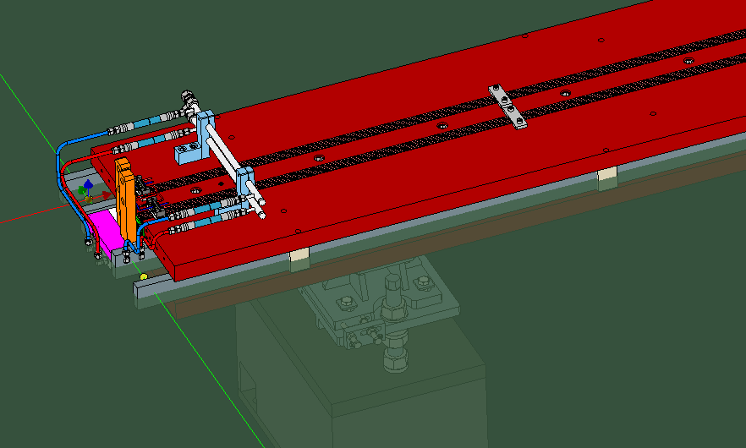
1.2 2D/3D linkage design
  Pre-processing: define a work plane and a plug-in point in 3D environment
  Publish the top view resource to the resource library
  The models in resource library can be loaded in Mechanical CAD (2D drawing). Place the models on the corresponding survey points.
The resource browser
Plug-in point and work plane

Slide 17
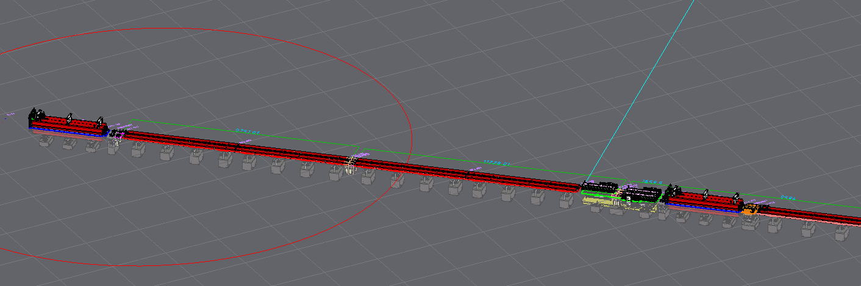
1.2 2D/3D linkage design
  Factory-open in inventor, the 3D assembly of the cell is built automatically.
  If the 3D model is changed or replaced, the 2D model will be updated.
  If the 2D model is replaced or its location is changed, the 3D model will be updated.

Slide 18
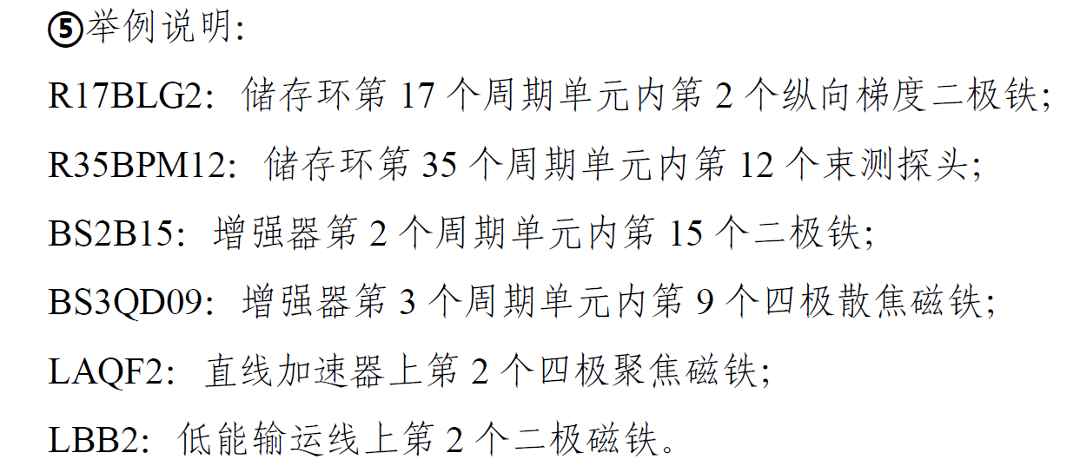
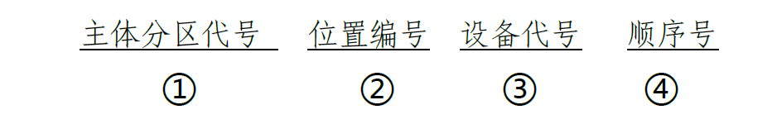
1. Layout design (problems and solutions)
The survey and layout design.
  We need the magnet in/out points, then we can map them to the 3D models. There maybe some discussions and modifications of the survey points (not the survey design). We are pushing it!
  The layout design has strong correlation with the installation, alignment and hardware design, not just a simple work of drawing.→ Two people are working on it, Haijing Wang for Collider and Siyu Chen for injector. We are pushing it!
  How to name the elements?
HEPS 命名规则，由工程经理部制定下发

Slide 19
1. Layout design (problems and solutions)
The 2D/3D linkage design
  The layer properties can be defined. We can make magnets and supports as different resources, and assemble them in 2D drawings, then we can get and export some point information like pedestal installation coordinates. But this make the magnets and supports all appeared in the 2D drawing with no hidden lines →ugly!
  We tried to use BIM to make the model more lighter, but it may hide some important components such as adjusting mechanics. →We are trying to find solutions!
Other problems
  CEPC is such a big project. The layout is big too. Computer lag reduces work efficiency.

Slide 20
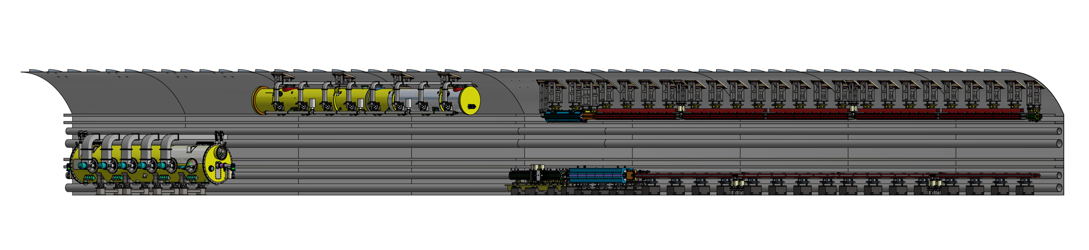
2.1 Tunnel mockup
Progress of displaying models
  Design review: 24.8.16
  Initial draft of bidding documents: 24.10.1
  Pre-bid meeting: 24.12.18
  Now: waiting for putting it on the web for bidding

Slide 21
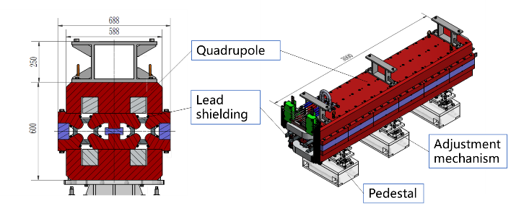
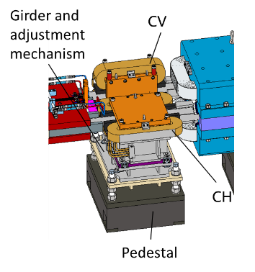
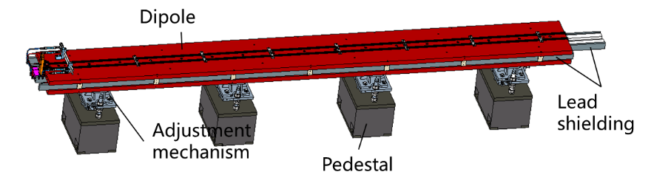
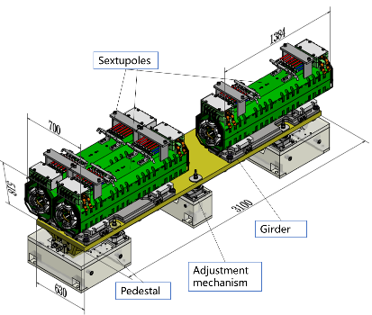
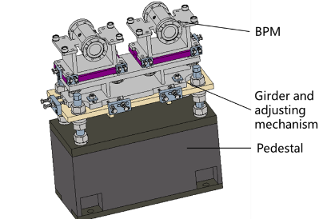
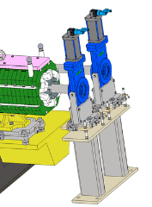
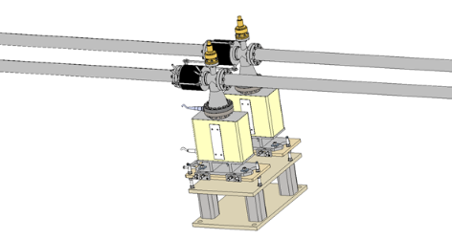
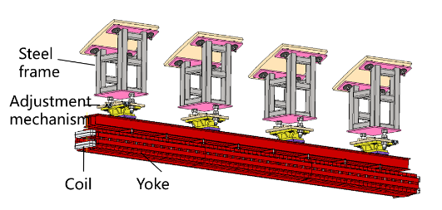
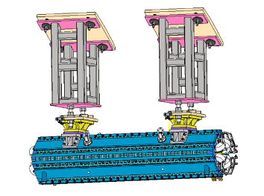
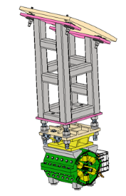
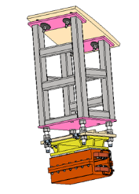
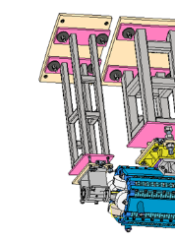
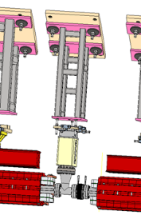
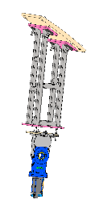
2.1 Tunnel mockup

Slide 22
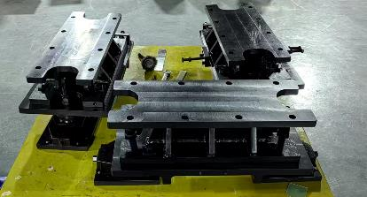
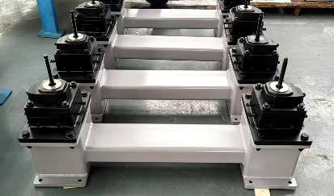
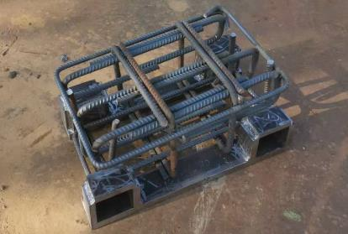
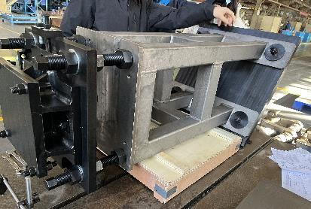
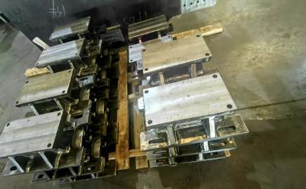
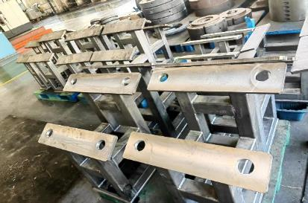
2.1 Tunnel mockup
The supports and adjusting devices of the mockup is under developing.
经费支出118W （mockup支撑及高精度准直实验设备）
  螺杆支撑结构及楔块支撑结构：首台验收，批量中
  基座：养护中
  高精度准直实验设备：预计今年中开始部分验收及整体集成

Slide 23
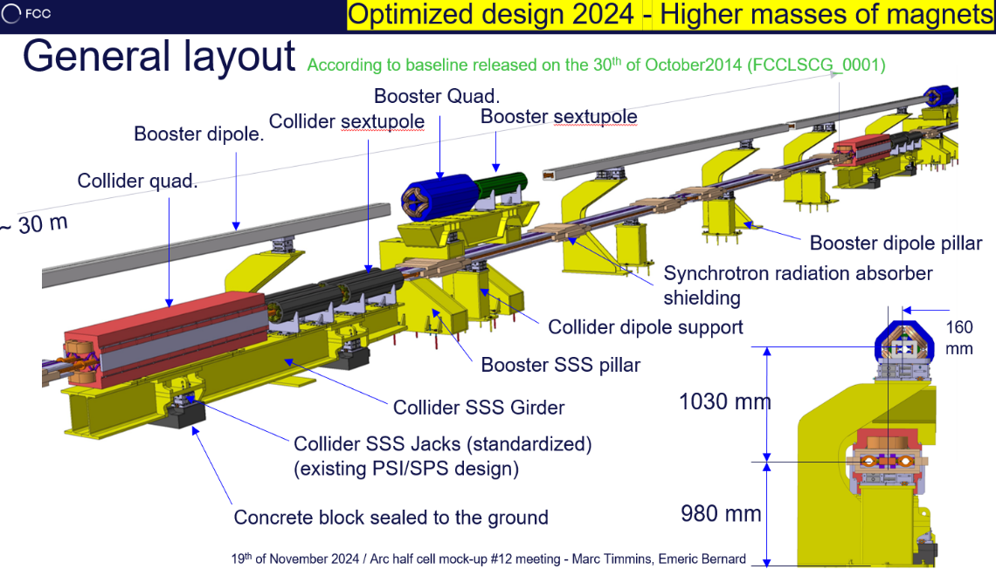
2.1 Tunnel mockup
Comparing with FCC mockup
  The support method of Booster
  Support points of long dipoles. CEPC has four according to the deformation optimization. We think maybe it can be decreased. The magnet colleague (Mei Yang) is assessing it.
  If we use FCC method
    Higher beam height (CEPC 0.8m)
    Wider tunnel
    Easy installation of Booster
    Less worry about tunnel waterproof
Three support schemes of Booster elements for CEPC

Slide 24
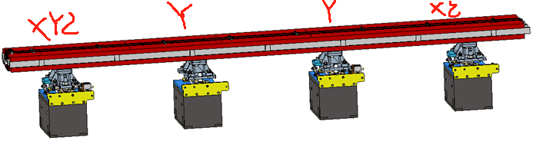
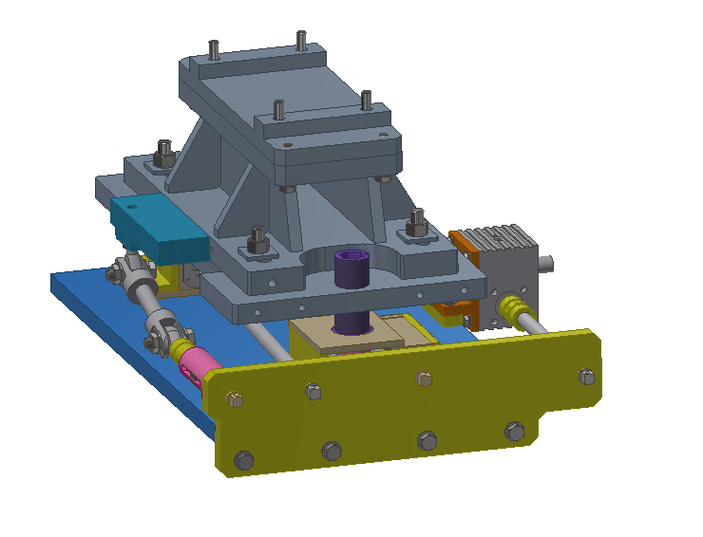
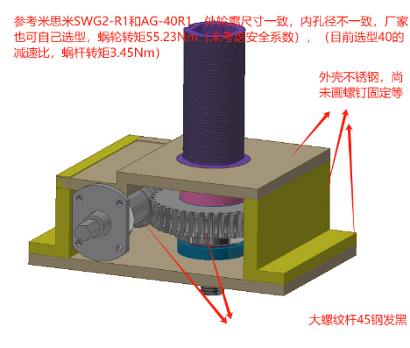
2.2 High accuracy automatic adjusting and alignment system
The preliminary design and inquire for cost has been done for adjusting mechanics for Collider dipoles.
The preliminary design and inquire for cost has been done for adjusting mechanics for Collider dipoles.
Necessary load analyses has been done
目前厂家发回报价：xyz
  聚能 样机23616 批量 25500
  普束 样机38000 批量19000
  工研 样机15000 批量6000元
  计划本年度可以采购之后做样机

Slide 25
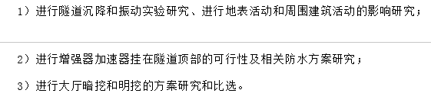

2.3 Vibration test
 | Ground motion requirements, RMS, 1-100 Hz displacement integral
MDI | ≤4 nm
Arc and straight section, and RF section in Collider | ≤25 nm
Booster | ≤25 nm
Linac | ≤50 nm
CEPC振动要求
招标文件提到的振动测试

Slide 26
2.3 Vibration test
We have organized two discussions, and make a test plan.
测试内容 |  | 场地要求 | 当前进展
场址振动性能测试 | 大地振动振幅 | 地勘孔（有要求） | 调研传感器及所需条件
 | 波速及垂向衰减
磁铁+支撑装配体振动性能测试 | Collider对比组 | 怀柔（自备） | 初测场地
 | Collider现场实验 | ≥6*6米或16*2米，接近真实隧道场地 | 提交华东院寻找合适场地
 | Booster现场实验 | ≥6*4米或12*2米，接近真实隧道场地

Slide 27



2.3 Vibration test
Test of the platforms at HEPS (near cryogenic hall)
  The natural frequency of the two platforms
  The two has similar performance（S-N：~17Hz；E-W：14Hz；Vertical：not obvious）
HEPS低温厅外场地

Slide 28


2.3 Vibration test
Test of the platforms at HEPS (near cryogenic hall)
  FEA of the two platforms, assuming the magnets and supports installed.
  The platform have effect on the test results. (magnet & supports ~43Hz, with the platform ~39Hz). But it can be extrapolated with FEA(by experience）
  The area near the site is scheduled for landscaping, which may affect the testing.

Slide 29
2.3 Vibration test
Inquire for cost from other factories
  To achieve an effect similar to that of the HEPS cryogenic hall site, it is desired that the foundation dimensions exceed 10-5-1.5 meters.
  We prefer the first one.
  江阴贝斯特众（HEPS支架厂家）：15.8万，含地基、人工、场地、来回零件运输等。
  舞钢（mockup基座厂家）：22.4万，含地基、人工场地、来回零件运输等。
  HEPS低温厅实验（核二三公司）：18-20万，含场地清理、凿毛、安装设备、搭棚子、人工等

Slide 30



2.3 Vibration test
Test of sensors
  Two of the currently best-performing vibration acquisition sensors for underground applications have been selected.
  CS-60 is better but more expensive. For 941b, we think it can test the vibration of 25 nm ~1-100 Hz, but may not for 4 nm ~1-100 Hz
试验台测试
HEPS场地测试

Slide 31

2.3 Vibration test
Inquire for cost
  含仪器租用及测试，测完后提供数据。
  希望测试点约13个，4个IP各1，每个弧区各2，直线1.
  We prefer CS-60.
 | CS-60 | 941B
测试费用 | 18.5万元 | 11.1万元
所需地勘孔尺寸 | ＞140mm | ＞213mm
主要要求 | 钻井后安装钢管，建议＞6.5mm。金属管最下端10m采用无磁不锈钢管 | 钻井后安装钢管（其他材料亦可），保证井壁光滑，建议＞6.5mm，确保无变形
华东院比选阶段勘察大纲初稿孔尺寸

Slide 32
Summary
A typical arc section layout of over 250 m has been made, both in 2D and 3D, which can be designed with linkage.
The design of high accuracy automatic adjusting system has been preliminary made. The prototype is planned in the near future.
The preparation of the vibration test is on-going.

Slide 33
Thanks for your attention!

