Slide 1



CEPC MDI Design Status and Updates
Sha Bai
On behalf of CEPC MDI group
March. 21, 2025, CEPC Day

Slide 2
Outline
CEPC MDI design update
IARC/IAC/IDRC report Q&A

Slide 3
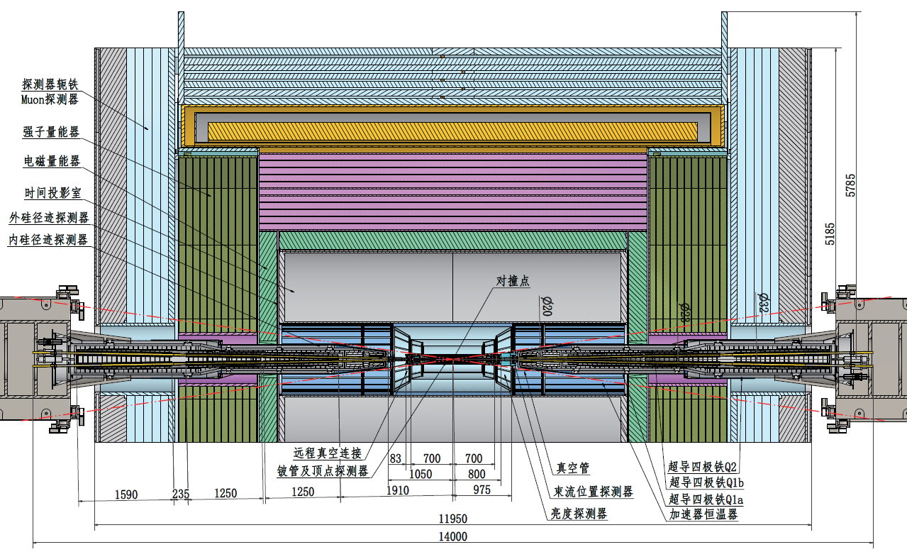
MDI layout
The overall layout of CEPC MDI is self-consistent and interference free.
Lumical is between 800mm~950mm from IP, while IP BPM at 950~1050mm.
Cryostat start point at 1050mm from IP, while anti-solenoid starts at 1130mm to 6200mm from IP.

Slide 4
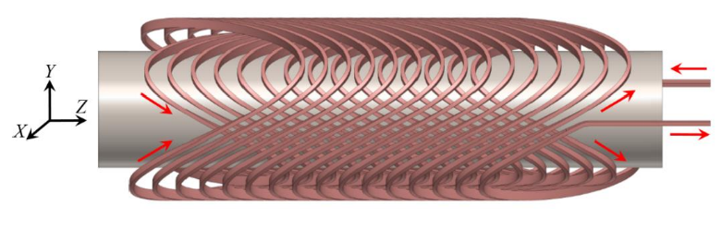
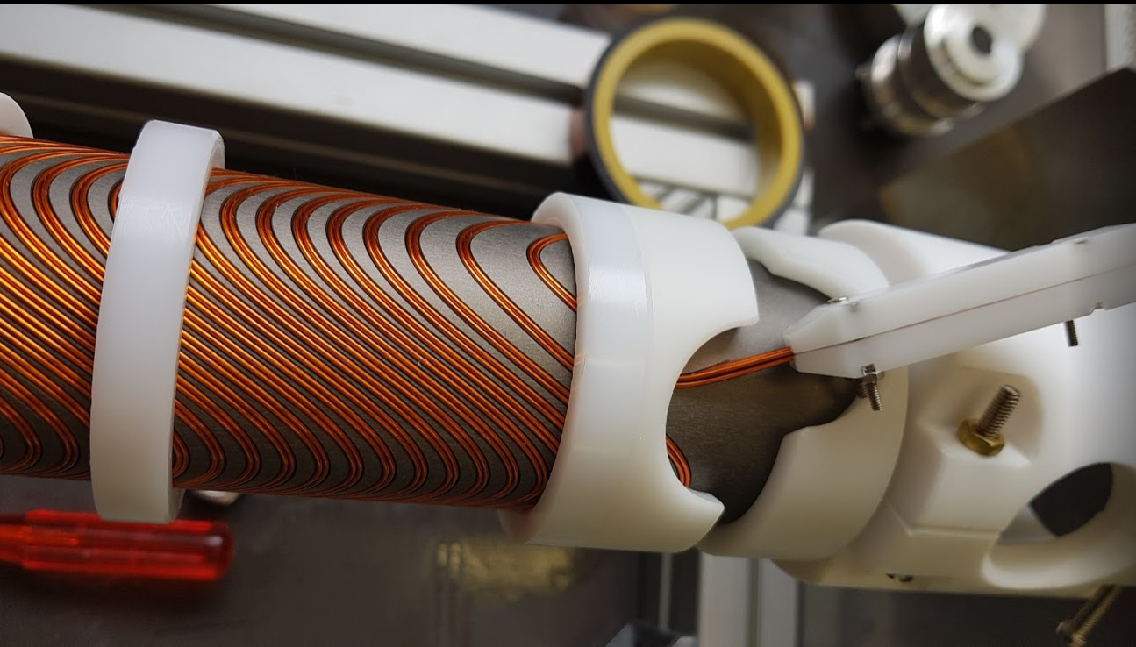
SC magnets
SC quadrupole design adopted CCT type
1) CEPC Interaction Region quadrupole magnets meet basic requirement.
2) Ratio of multipole field to quadrupole field <2×10⁻⁴
3) Integral dipole field at the center of one aperture is zero
Local dipole field at each longitudinal position ≤ 300Gs
The total weight of each set of SC magnets is ~ 0.4 tons.
ITEM | Q1a | Q1b | Q2 | Anti-solenoid
Central field gradient (T/m) | 142.3 | 85.4 | 96.7
Cooling type | LHe | LHe | LHe | LHe
Operating current (A) | 730 | 640 | 710 | 1300
Magnetic storage energy (KJ) | 16.7 | 15.2 | 36.1 | 740
Cross section parameter (mm) | Φ40~61 | Φ52~78 | Φ62~88 | 70 sections
Magnet mechanical length (m) | 1.23 | 1.23 | 1.53 | 5.1
Net weight (Kg) | 25 | 32 | 43 | 302
Total weight of magnets (Kg) |  |  |  | 402
CCT coil
Peak field in coil Q1a/Q1b/Q2: 4.3T/3.8T/4.1T
Within the aperture of anti-solenoid, the maximum magnetic field is 8.2T, and the maximum magnetic field on anti-solenoid coil is 10.9T.
SC magnets corrector coil：dipole coil(Q1a/Q1b/Q2）≤300Gs
Skew quadrupole coil：
 | Q1b | Q2
L(m) | 1.21 | 1.21
K(m⁻¹) | 0.02 | 0.02
G（T/m) | 6.61 | 6.61
IARC report Q&A: Study the requirement of the corrector magnets for quadrupole field alignment and the corrector space in the cryostat

Slide 5
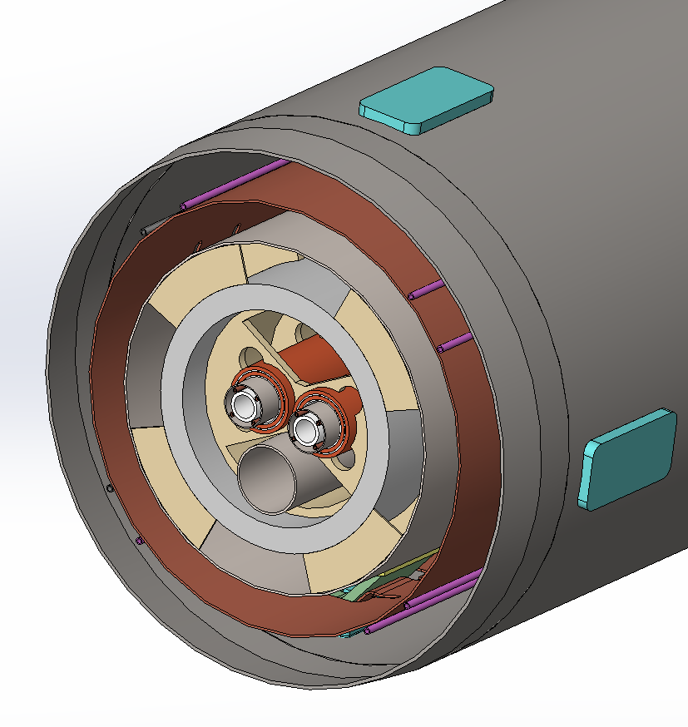
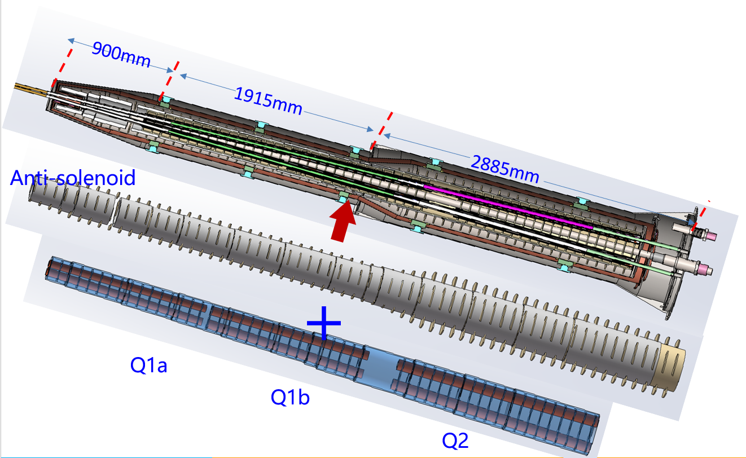
Cryostat
The cryostat is used to provide the cryogenic environment for SC magnets, which is below 5.0 K.
Vacuum
Thermal shield
LHe tank
Support
Anti-solenoid
Q1a
Beam chamber
Items | Weight (kg) | Main materials
Vacuum vessel | 2000 | SS
Helium Vessel | 425 | SS
Thermal shield and pipes | 148 | copper
SC quadrupoles | 100 | Copper & Aluminum
Anti-solenoids | 302 | Copper & Aluminum
Skeleton supports | 92 | Aluminum
Liquid Helium | 90 | Liquid Helium
Total weight | 3157
In the case of SC magnet quenching, approximately 400 kJ of energy are released into cryogenics system within 2 seconds.
Cryostat: a total weight of ~ 2 tons and a total length of ~ 5.75m.

Slide 6
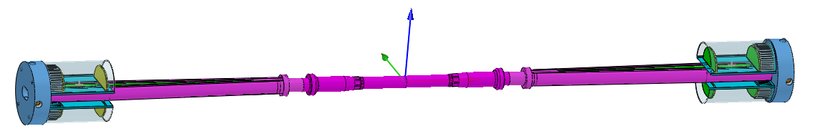
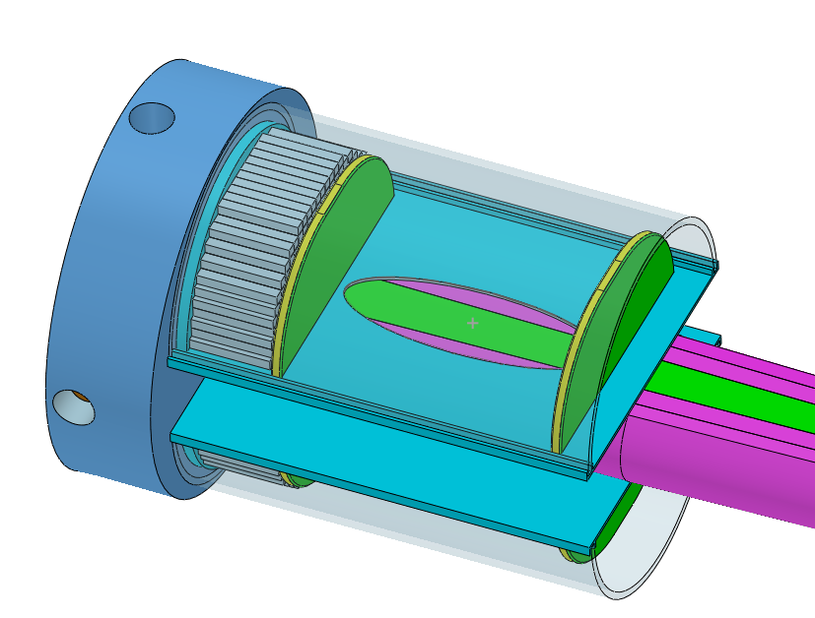
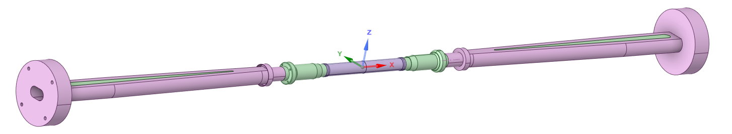
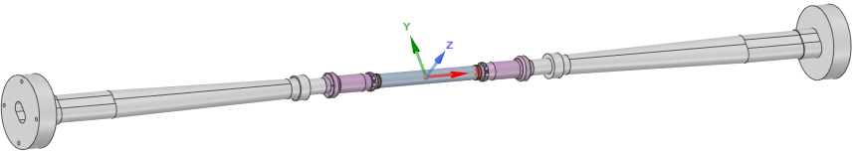
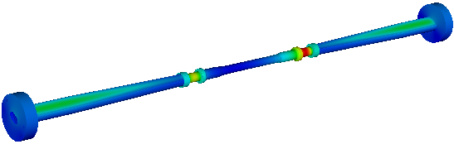

The central beampipe design
Central Be pipe segment: 380mm, the inner diameter: 20mm
The inner Be layer: 0.2mm
Outer Be layer: 0.15mm (to improve the accuracy of vertex)
the cooling gap: 0.35mm, Paraffin
0.2mm, Water
Si wafer
LYSO bars
Highest temperature position
Water is the basic design and Paraffin is alternative choice.
Dynamic temperature/pressure could meet the requirements.
Highest temperature: 26.7℃

Slide 7
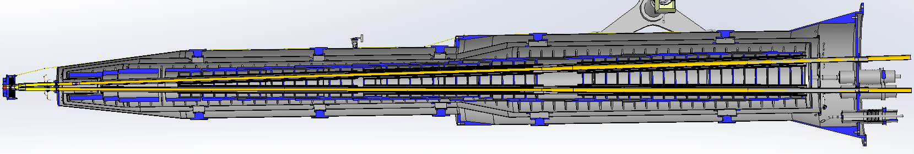
IR vacuum chamber
The total length of MDI vacuum system is about 14m, mainly composed of vacuum chamber, bellows, beryllium pipe, cooling system, support system, etc.
Due to limited space at MDI region, not possible to install a vacuum pump, and NEG coating is chosen.
mode | E (Gev) | Beam lifetime (hours) | Vacuum pressure (Torr)
Higgs | 120 | 10 | 2 × 10⁻⁹
W | 80 | 5 | 1.5 × 10⁻⁹
Z | 45.5 | 3 | 8 × 10⁻¹⁰
tt | 180 | 15 | 1 × 10⁻⁸
From IP(mm) | Shape | Inner diameter(mm) | Material | Marker
0-110 | Circular | 20 | Be
110-180 | Circular | 20 | Al
180-655 | Cone | 20~35 | Al | Taper: 1:70
655-700 | Circular | 35 | Al
700-780 | Circular | 35 | Cu
780-805 | Cone | 35~39 | Cu
805-855 | Race-track | 39~20 double pipe | Cu
Double beam pipe is made of chromium zirconium copper material (Cr-Zr-Cu).
Cr-Zr-Cu has low photon desorption capacity, high thermal conductivity, and can effectively prevent photons from penetrating the vacuum chamber and damaging magnets and other hardware.
Bellows was installed at the connection of vacuum chamber which can compensate for the thermal expansion, contraction, and offset of the vacuum chamber, and provide continuous RF shielding between two connected vacuum chambers to reduce the impedance.
Masks are designed to prevent SR and protect downstream equipments.
Water channels for cooling the SR heat load.
Q1a-Q1b-Q2：20mm-23mm-32mm
Cone+circular beam pipe structure with gradually increasing aperture

Slide 8
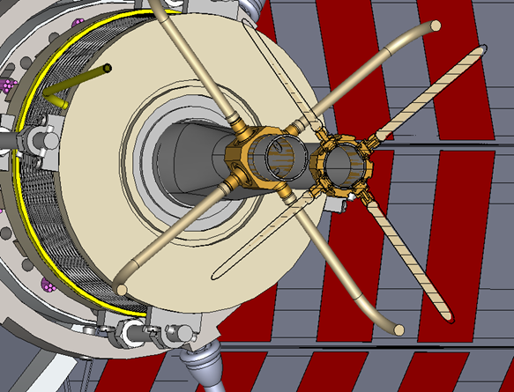
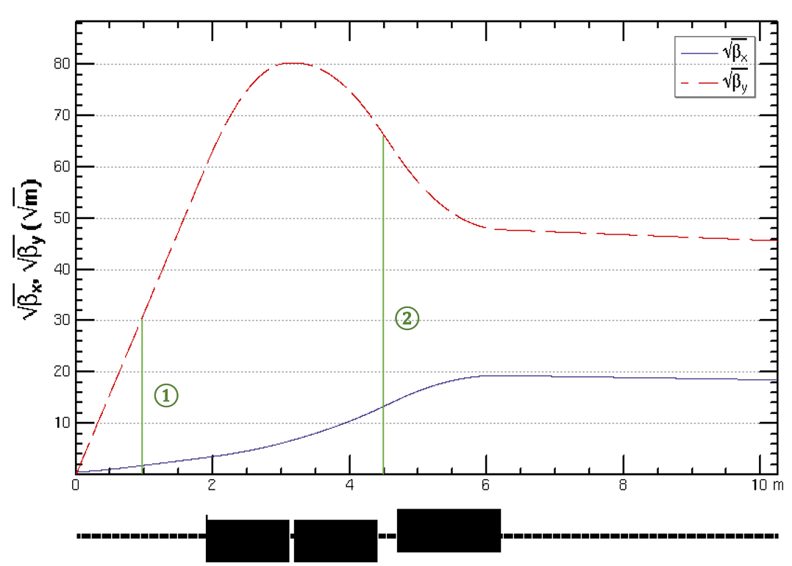
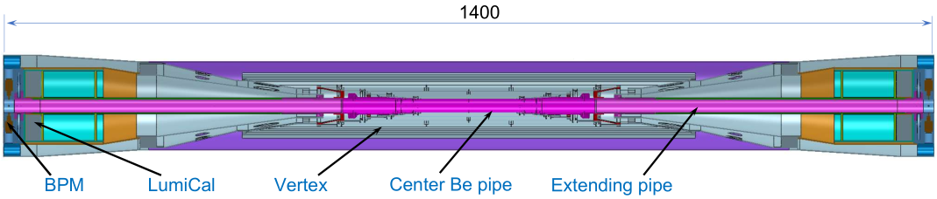
IR BPMs
Considering response time and calibration difficulty, two 4 button electrodes BPM in double pipe and one 2 button electrodes BPM in single pipe at each side of CEPC IR are adopted.
2 button electrodes BPM for measuring the arrival time.
Utilize a pair of BPMs for vertical beam orbit feedback (fast lumi monitor for horizontal), placed at symmetric positions on each side of the IP, located at 950mm~1050mm from IP.
IARC report Q&A: How the signals would be extracted from the BPM between Q1b and Q2 within the cryostat was too briefly discussed to assess its feasibility .
the BPM in cryostat between Q1b and Q2 is cancelled, because the measurement accuracy is sufficient.

Slide 9
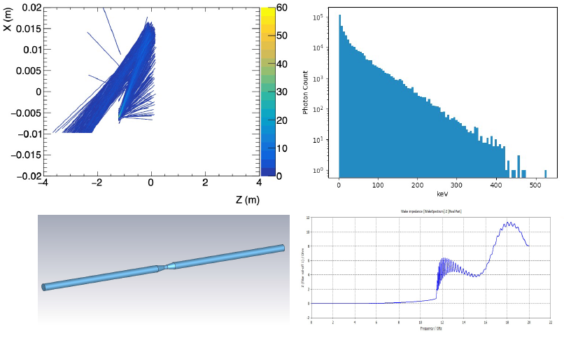
SR mitigation – mask and gold plating
The central beam pipe was carefully designed to avoid the direct hitting of the SR photons.
The masks are implemented to further mitigate the secondaries, the design is still on going.
  Several ways has been attempted, including the shrinking of the incoming beam pipe and different position/material/design of the mask.
Masks design(two masks/IP/ring) :
  Tungsten
  One locates at -1.21m with 5mm height and 10mm long
  The other at -4.3m with 0.6mm height
Shielding Methods | SR Backgrounds Level at VXD
Original | 5795157
-1.9m-4mm | 4512
5um Au | 717973
-1.9m-4mm+5um Au | 3051
-1.9m-4mm+5um Au+-4.3m mask | 465
-1.9m-2mm+5um Au+-4.3m mask | 1022
-1.9m-5mm+5um Au+-4.3m mask | 71
Photons hitting number on Be/BX reduced by 5 orders of magnitude
IDRC report Q&A: Refine the SR masks for the Ref-TDR configuration, incorporating simulations of tip scatterings, bounces within the beam pipe, and SR originating from the beam halo in quadrupoles.

Slide 10
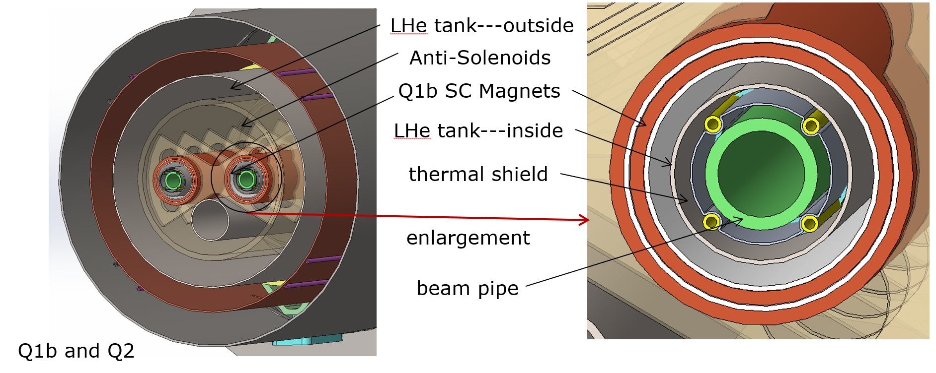
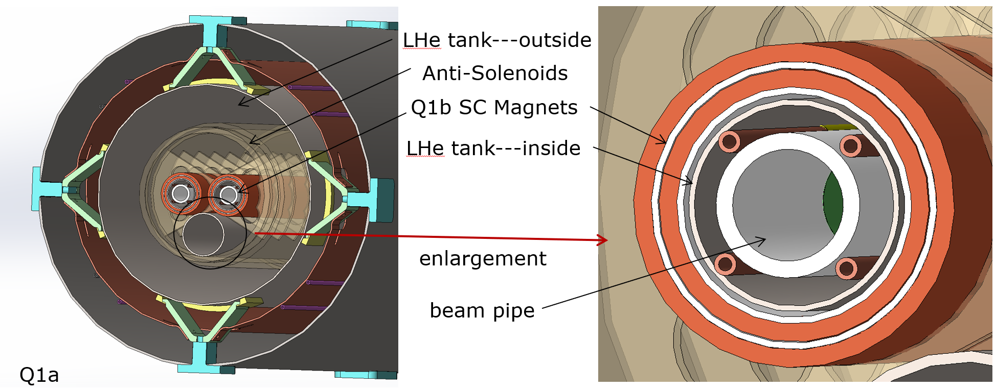
Shielding
To mitigate the beam background, Shielding has been implemented at both ends of the yoke using the 10 cm of paraffin, and also 10mm W in front of the cryostat. It will continue with the optimization of BG and maybe more tungsten shielding inside & outside of the cryostat.
Gold plating on beryllium pipe (~5µm) to mitigate the SR.
Shielding for detector hall
IDRC report Q&A: Explore the feasibility of placing heavy metal masks near the interaction point (IP) to absorb particle showers effectively.
To protect SC magnets: cumulative dose(累积剂量）should be less than 100MGy
To avoid quench of SC magnets: heat load density（热载荷密度） should be less than 100mJ/cm³
Chromium zirconium copper (Cr-Zr-Cu) is chosen for the double beam pipe.

Slide 11
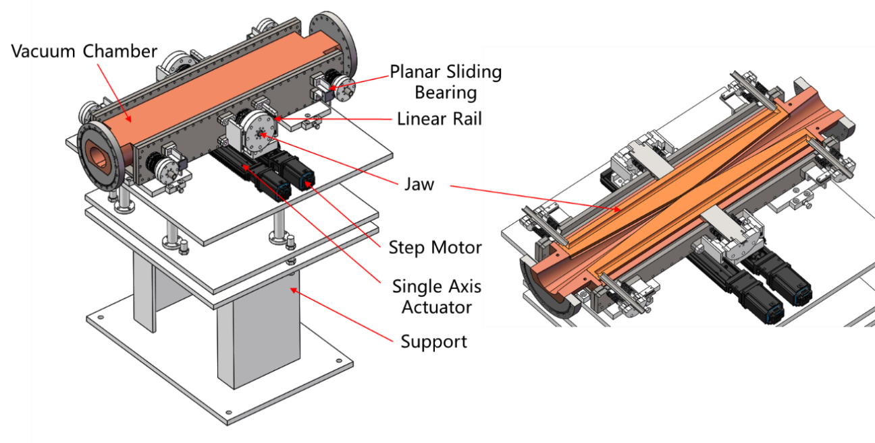
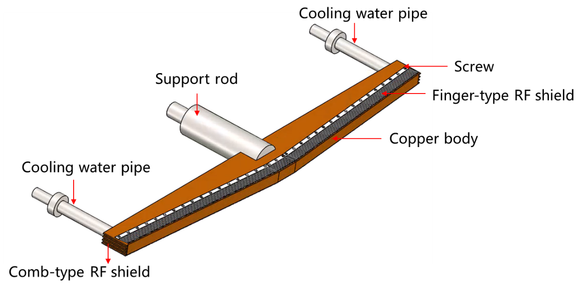
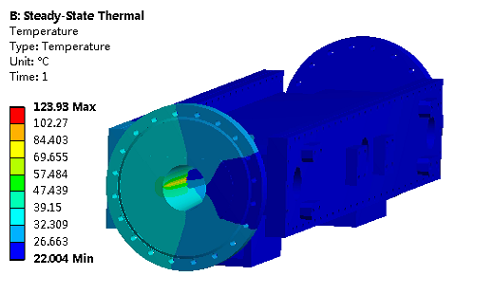
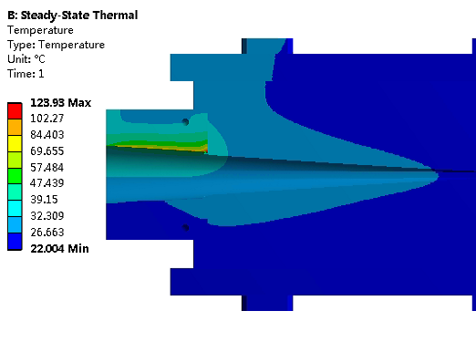
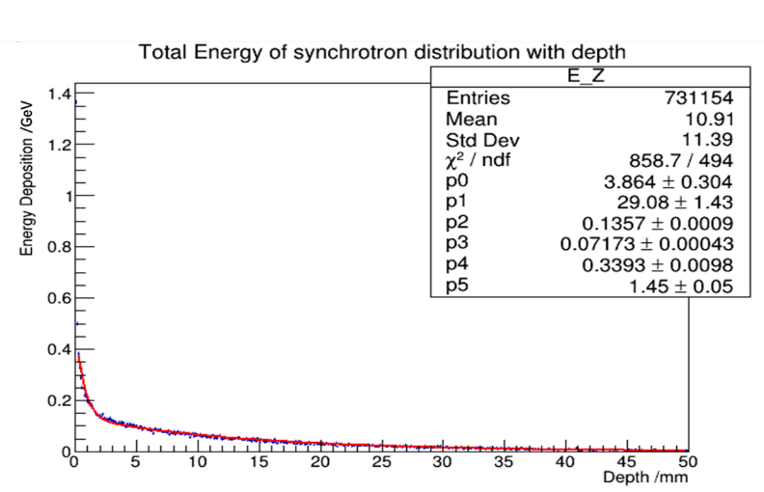
Movable collimators
  Movable collimators are designed for beam background mitigation.
  Jaw and vacuum vessel material: Glidcop Al-15, can endure the SR and HOM power in normal operation.
Structure of the jaw
Highest temperature: 124 ℃

Slide 12
Thermal analyses – Synchrotron radiation
Synchrotron radiation
Region | ttbar |  | Higgs |  | Z
 | SR heat load | SR average power density | SR heat load | SR average power density | SR heat load | SR average power density
0~780mm | 0 | 0 | 0 | 0 | 0 | 0
780mm~805mm | 11.88W | 132W/cm² | 23.04W | 256W/cm² | 11.8W | 131.1W/cm²
805mm~855mm | 27.53W | 152.9W/cm² | 53.39W | 296.6W/cm² | 27.4W | 152.2W/cm²
855mm~1.9m(Q1a entrance） | 2.22W | 0.59W/cm² | 4.32W | 1.15W/cm² | 2.2W | 0.59W/cm²
Q1a（1900-3110）1210 | 1.69W | 0.38Wcm² | 3.28W | 0.75W/cm² | 1.68W | 0.38W/cm²
Q1a~Q1b（3110-3190） | 11.8W | 40.97W/cm² | 22.92W | 79.58W/cm² | 11.75W | 40.8W/cm²
Q1b（3190-4400） | 2.04W | 0.47W/cm² | 3.96W | 0.91W/cm² | 2.03W | 0.47W/cm²
Q1b~Q2(4400-4700) | 36.6W | 33.9W/cm² | 71.04W | 65.8W/cm² | 36.4W | 33.7W/cm²
Q2(4700-6200) | 3.74W | 0.69W/cm² | 7.26W | 1.34W/cm² | 3.72W | 0.69W/cm²
Notes:
标注尺寸

Slide 13
Thermal analyses – HOM & Resistance wall
HOM & Resistance wall
Position | Position Start-end（mm） | material | Length (mm) | Higgs(w) & (w/cm²) | W (w) & (w/cm²) | Z(w) & (w/cm²) | ttbar（w） & (w/cm²)
Be pipe (w) | 0-110 | Be | 110 | 1.46 & 0.021 | 7.230 & 0.105 | 71.558 & 1.35 | 0.401 & 0.005
Be pipe transition(w) | 110-180 | Al | 70 | 0.45 & 0.01 | 2.173 & 0.049 | 21.574 & 0.491 | 0.127 & 0.007
Transition pipe (w) | 180-655 | Al | 475 | 6.99 & 0.017 | 34.48 & 0.085 | 341.562 & 0.83 | 1.958 & 0.005
Transition （w） | 655-700 | Al | 45 | 0.62 & 0.015 | 2.95 & 0.071 | 29.28 & 0.701 | 0.172 & 0.004
RVC bellow（w） | 700-780 | Cu | 80 | 0.52 & 0.007 | 2.532 & 0.034 | 25.002 & 0.337 | 0.14 & 0.002
Transition on Y-crotch | 780-805 | Cu | 25 | 0.16 & 0.007 | 0.785 & 0.032 | 7.822 & 0.316 | 0.05 & 0.002
Y- crotch (w) | 805-855 | Cu | 50 | 0.33 & 0.005 | 1.572 & 0.024 | 15.626 & 0.241 | 0.091 & 0.002
Quadrupole pipe(w) | 855-1100 | Cu | 245 | 1.58 & 0.005 | 7.735 & 0.024 | 75.594& 0.24 | 0.434 & 0.002
Total | 0-1100 | - | 1100 | 12.0 &0.011 | 58.594 &0.056 | 580.46 & 0.56 | 3.331 & 0.003
IARC report Q&A: Carry out a full study, at the highest expected luminosity and current at the Z, of the total heat load close (±1m) to the IP
Notes:
标注尺寸

Slide 14
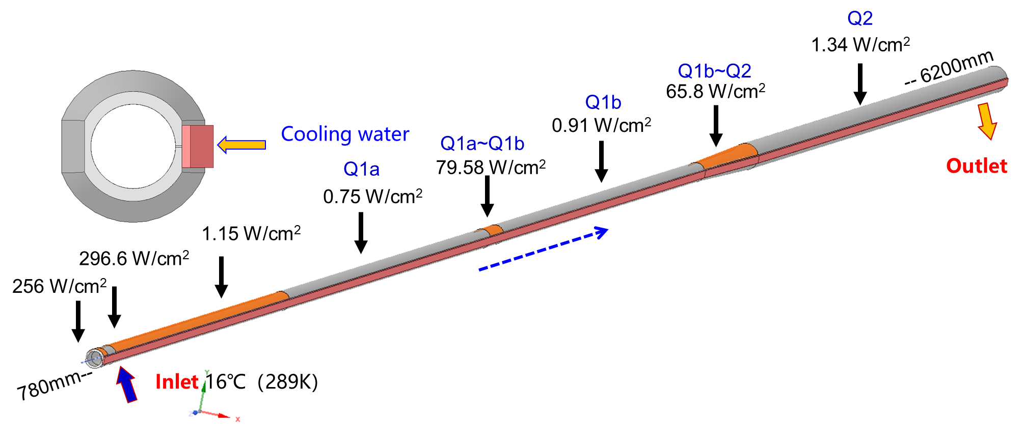
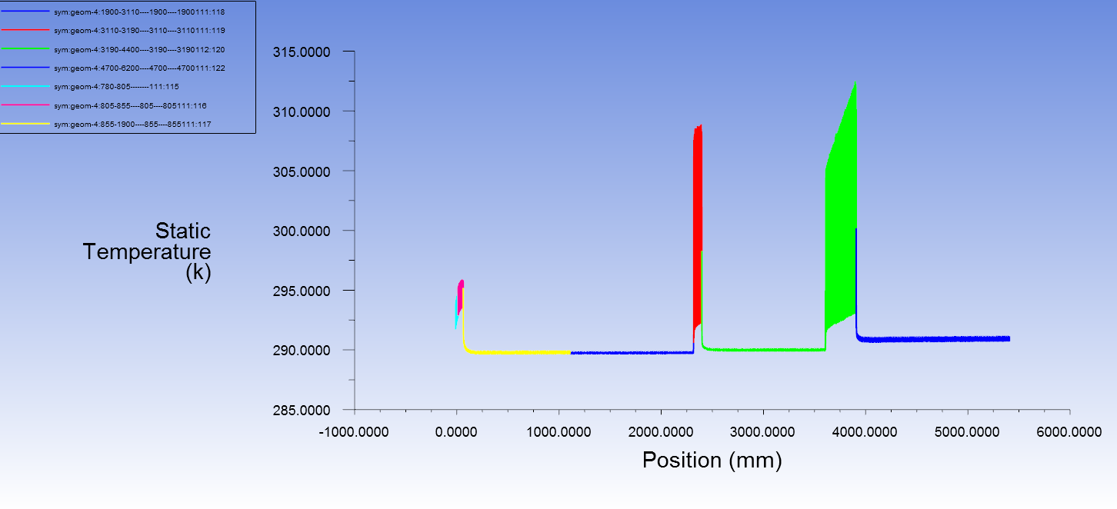
Thermal analyses of IR beam pipe
Thermal analyses of beam pipe at cryostat @Higgs, 30MW
  Total SR power: 189W
  Total HOM power: 12W
  Cooling water temperature: 16 ℃ (289K)
  Maximum temperature on beam pipe: 40 ℃ (313K)
The detailed structure design including the space arrangement is under-going.
IARC report Q&A:
Produce a more detailed plan of the cooling and the support structure of the beam pipe in the area of the cryostat

Slide 15
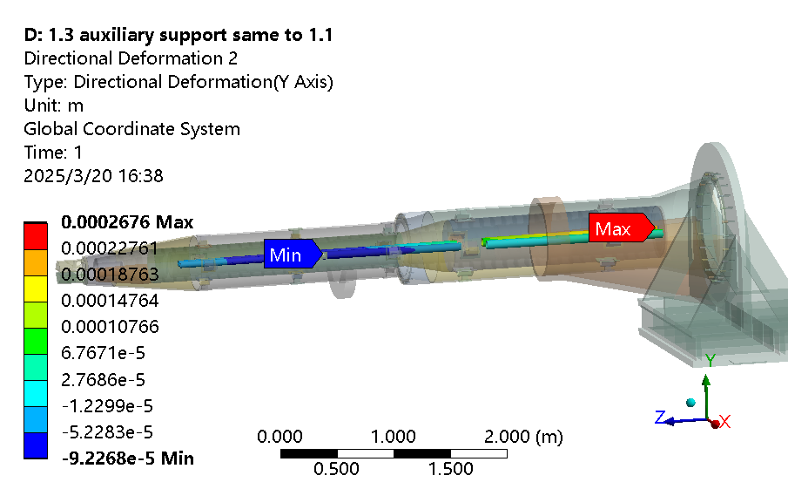
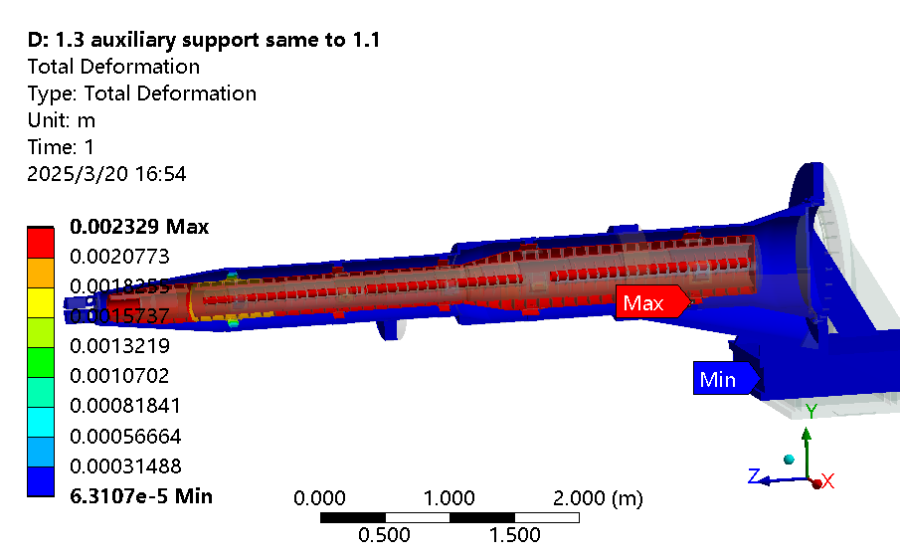
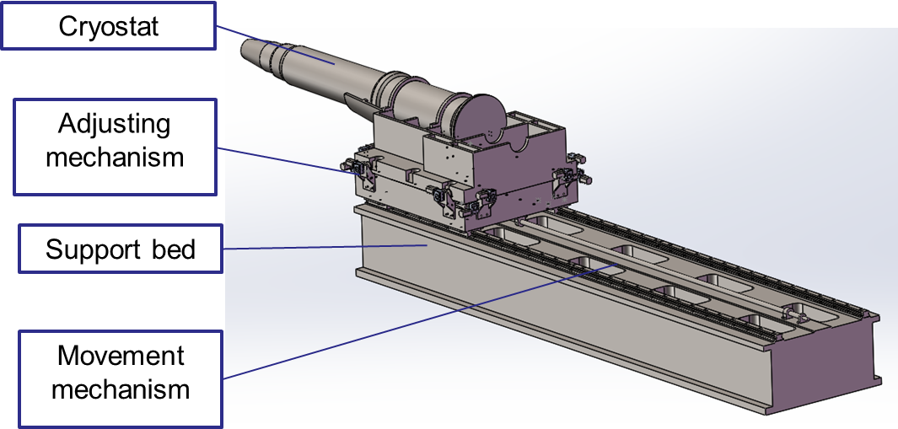
SC magnet support system
Mechanical FEA
  After the optimization of the supports in the cryostat, the total weight of the cryostat and the devices inside is ~3.1 ton.
  The cryostat is about 5.7m long. The cantilever length is ~5.2m.
  The resolution requirement of the adjusting mechanism < 5 μm.
With Lorentz force
Conclusions on mechanical FEA:
  The thicker model with SS vacuum vessel is preferred
  max. uneven deformation: 12 µm (Q1b)
  max. displacement change after applying Lorentz force: 33 µm (Q2)
  1st sensitive modal frequency: 60.9 Hz (The 1st natural frequency is 52.5 Hz, in Z direction). The modal analyses is related to the support connected to detector, but the trend should be unchanged, can be considered qualitative analysis
IARC report Q&A: Study the possible benefits of increasing the cryostat outer diameter and wall thickness

Slide 16
IARC/IAC/IDRC report Q&A

Slide 17
Q&A in IARC
MDI EDR plan and status
Comments:
Pairs of BPMs are planned on both sides of the IP for fast vertical position feedback, in front of the cryostat at 0.9m and between Q1b and Q2 within the cryostat. How the signals would be extracted from the latter was too briefly discussed to assess its feasibility.
Answer: the BPM in cryostat between Q1b and Q2 is cancelled, because the measurement accuracy is sufficient.
Recommendations:
The significant amount of beamstrahlung emitted at the IP during collisions was not discussed and must be considered in detail to ensure safe extraction from the vacuum pipe into a dedicated beam dump, for suitable heat extraction and radiation containment;
Answer: Sure, we've considered it and the design of the dump is ongoing.
The radiation tolerance of detector components should be thoroughly investigated to ensure that the current estimated beam-loss rates in the IR are acceptable;
Answer: Sure, the estimation of beam induced backgrounds level at IR is updating together of the detector. Currently, the level at Higgs mode is acceptable.

Slide 18
Q&A in IARC
MDI EDR plan and status
Beam-loss sensors within the detector, capable of issuing beam-dump request signals in case of excessive radiation, are essential to protect several key detector components. Signals from these sensors should be used with different thresholds for injection and non-injection periods;
Answer: The monitor system would be designed when the detector was fixed.
Check whether the reserved cabling space is sufficient for Vertex Detector (VXD) readout and power-supply cables, as well as cooling pipes, etc. Study the procedure for installation and mounting of detector components near the beam pipe and the insertion of the final-doublet cryostat taking into account the presence of the cabling;
Answer: Sure, this work needs joint effort and would be designed together with detector.
Arrange a focused review on MDI in the coming year, inviting members from both detector and accelerator groups with sufficient expertise and experience to cover all the relevant aspects, which would be very beneficial.
Answer: Thank you, it’s in arrangement.

Slide 19
Q&A in IARC
IR engineering design status
1. Produce a more detailed plan of the cooling and the support structure of the beam pipe in the area of the cryostat;
A: Thanks for the recommendation. We are planning to do this next stage.
2. Study a mitigation strategy in the event that one of the superconducting elements of the IR area quenches;
A: Thanks for the recommendation. After the superconducting magnet quenches, the stress changes. We need to conduct a mechanical analysis to ensure the overall structural safety, while also exploring the possibility of special structures.
3. Assess the effect on luminosity of lack of BPMs close to the final-focus quadrupole magnets;
A: Thanks for the recommendation. Right now there are three BPMs designed per IP per ring. One is a two-button BPM for arriving time, about 0.7 m from IP. Two are four-button BPM for beam position at the Y-chamber locations, about 0.9 m from IP. These three BPMs were showed in the slides.
4. Carry out a full study, at the highest expected luminosity and current at the Z, of the total heat load close (±1m) to the IP, and also of the power deposited in the cryostat system from physics processes (radiative Bhabhas, beam background, etc.);
A: Thanks for the recommendation. We have already calculated the total heat load in high lumi Z, and the deposited power of beam background(RBB, BS, BG, BTH...) on the vaccum chamber is much lower and can be ignored comparing to the synchrotron radiation and impedance.

Slide 20
Q&A in IARC
IR engineering design status
5. Assess whether the length of the cantilevered cryostat can be reduced;
A: Thanks for the recommendation. We never stopped to reduce the cryostat. It is related to the length of the detector yokes and the starting point of the SC magnets inside the cryostats. To avoid modifying these two designs, and to enhance stability of the cryostat, we have recently considered adding an auxiliary support.
6. Study the possible benefits of increasing the cryostat outer diameter and wall thickness, having agreed an outer envelope with the detector group;
A: Thanks for the recommendation. This is included in our next plan of cryostat optimization, and we will discuss it with detector group after some simulation.
7. Study the measurement and alignment strategy of the centre of the quadrupole field with respect to the ideal beamline, in the context of the assembly scheme of the IR components;
A: Thanks for the recommendation. This is planned and will be studied in the EDR stage.
8. Study the requirement of the corrector magnets for quadrupole field alignment and the corrector space in the cryostat;
A: Thanks for the recommendation. The corrector magnets have been roughly discussed but need more detailed design. We hope to achieve phased results during the EDR period.
9. Study the vibrations of the cryostat, taking into account the mechanical connection to the detector.
A: Thanks for the recommendation. We will first add more details of the structure design, and will do the vibration studies such as modal simulation and vibration response simulations. And this will be a very comprehensive work, we hope to have a phased progresss in the EDR period.

Slide 21
Q&A in IDRC
The resulting occupancies and radiation doses in the detectors are found to be acceptable for Higgs operation, though further optimization is required for Z running. Additionally, beam background studies for failure scenarios have been conducted in collaboration with the accelerator group.
Answer: The failure case already been studied in the design of the passive machine protection system with acc. Group.
A collimator was simulated under the assumption that any particle striking it would be fully absorbed without generating secondary particles. However, secondary particles can frequently lead to much higher background estimations. Currently, the SR masks used are those designed for the CDR detector, and they have not yet been optimized for the Reference Detector. A detailed optimization of the SR masks is essential, particularly for photons produced in the final dipoles and final focus quadrupoles. This includes considering effects like scattering at the mask tip and reflections within the beam pipe. To mitigate shower backgrounds caused by stray beam particles, heavy metal masks are often placed near the interaction point (IP), although no such study was discussed in the presentation. Additionally, the significant beamstrahlung generated at the IP during collisions must be carefully managed to ensure proper extraction into a dedicated beam dump, while also providing sufficient heat dissipation and radiation shielding.
Answer: The secondaries generated by collimators has been studied yet and since all the collimators are far away from the IP, there will be no impact on detectors. The SR masks has been updated, and the effects has been studied. The heavy metal shielding outside of the cryo-module have been added. The photon dump is under design.

Slide 22
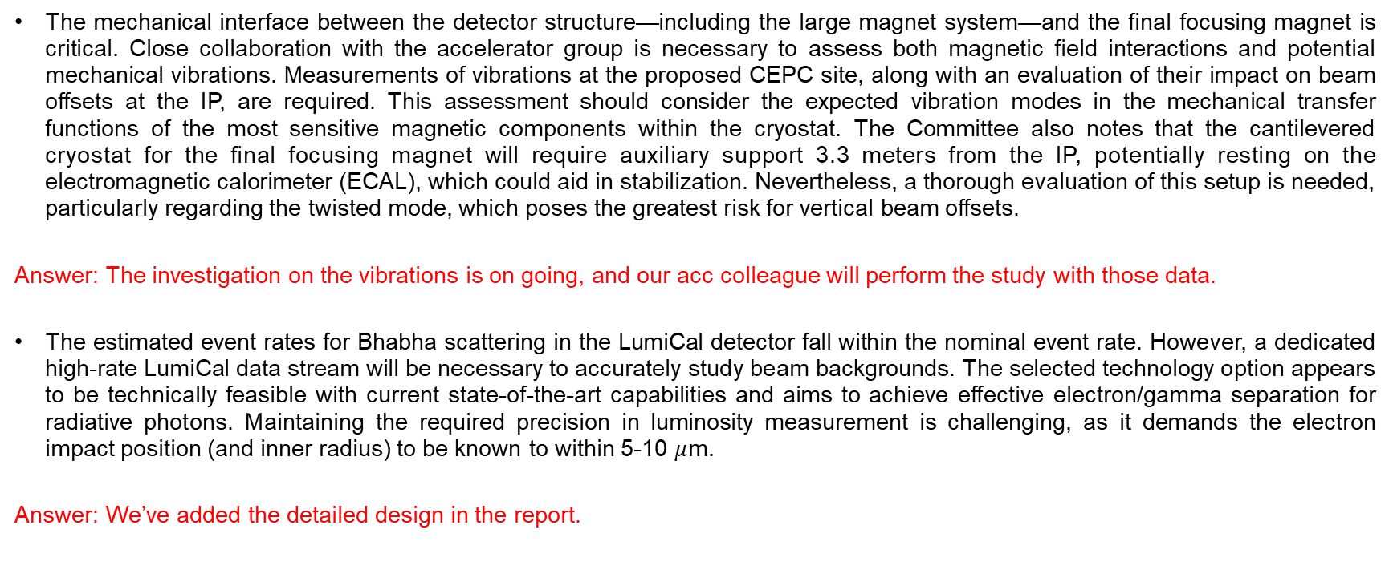
Q&A in IDRC
The mechanical interface between the detector structure—including the large magnet system—and the final focusing magnet is critical. Close collaboration with the accelerator group is necessary to assess both magnetic field interactions and potential mechanical vibrations. Measurements of vibrations at the proposed CEPC site, along with an evaluation of their impact on beam offsets at the IP, are required. This assessment should consider the expected vibration modes in the mechanical transfer functions of the most sensitive magnetic components within the cryostat. The Committee also notes that the cantilevered cryostat for the final focusing magnet will require auxiliary support 3.3 meters from the IP, potentially resting on the electromagnetic calorimeter (ECAL), which could aid in stabilization. Nevertheless, a thorough evaluation of this setup is needed, particularly regarding the twisted mode, which poses the greatest risk for vertical beam offsets.
Answer: The investigation on the vibrations is on going, and our acc colleague will perform the study with those data.
The estimated event rates for Bhabha scattering in the LumiCal detector fall within the nominal event rate. However, a dedicated high-rate LumiCal data stream will be necessary to accurately study beam backgrounds. The selected technology option appears to be technically feasible with current state-of-the-art capabilities and aims to achieve effective electron/gamma separation for radiative photons. Maintaining the required precision in luminosity measurement is challenging, as it demands the electron impact position (and inner radius) to be known to within 5-10 $μ$m.
Answer: We’ve added the detailed design in the report.

Slide 23
Q&A in IDRC
Optimize the collimators using simulations that account for secondary particle interactions.
Answer: The collimators has been updated with the secondaries considered.
Refine the SR masks for the Ref-TDR configuration, incorporating simulations of tip scatterings, bounces within the beam pipe, and SR originating from the beam halo in quadrupoles.
Answer: The SR masks has been updated and included in simulation. The SR originating from beam halo in quadrupoles has been studied together in the simulation.
Explore the feasibility of placing heavy metal masks near the interaction point (IP) to absorb particle showers effectively.
Answer: The heavy metal shielding has been added outside of the cryo-module. The BG level has been mitigated with such shielding.
We encourage continuing the design optimization of the LumiCal detector through simulation studies, with an emphasis on detailed mechanical design. In later stages, beam tests with detector prototypes should be performed.
Answer: The updated design of the lumical has been updated, and the prototypes are on schedule in the EDR phase.
A comprehensive review of the Machine-Detector Interface (MDI) would be highly beneficial. This review should involve experts from both the detector and accelerator teams to ensure all relevant aspects are thoroughly addressed.
Answer: We plan to have such a review in April/May. The review will cover all the MDI related topics from both accelerator and detector side. The preparation of the review is on going.

