Slide 1
CEPC collimator design
Xiaohao Cui
CEPC Day, 2025/03/21

Slide 2
1. Introduction
The energy stored in the beam of CEPC is very high
Machine protection considered for beam destruction
 | Higgs | W | Z | ttbar
Energy (GeV) | 120 | 80 | 45.5 | 180
Bunch Number | 268 | 1297 | 11934 | 35
Bunch Charge (nC) | 20.8 | 21.6 | 22.4 | 32
Energy/bunch (kJ) | 2.5 | 1.73 | 1.02 | 5.76
Energy/beam (MJ) | 0.67 | 2.24 | 12.17 | 0.2

Slide 3
For slow beam loss in the machine (The loss time is larger than several turns, t>1ms), we can use the beam dump system, to extract the unstable beam into the beam dump.
For fast beam loss in the machine, we must have beam collimation system added in the ring for machine protection.

Slide 4
Collimation systems for:
Suppress experimental backgrounds
Global machine protection from unexpected beam loss
Protect important elements, RF cavities, detectors,…

Slide 5
2. Collimators arrangement
Now there are two types of collimators in the ring
MDI collimators -- mainly to reduce the background at IP
Machine protection collimators – mainly to protect the machine against abnormal beam loss.

Slide 6
After some simulation and optimization
19 MDI collimators:
12 machine protection collimators:

Slide 7
MDI collimators with aperture radius 3mm or 4mm
name | Position | Distance to IP/m | Beta function/m | Horizontal Dispersion/m | Phase | BSC/2/m | Range of half width allowed/mm
APTX1 | D1I.1042 | 44669 | 81.64 | 0.15 | 202.79 | 0.00711 | 1.4~7.1 | U
APTX2 | D1I.1046 | 44728 | 89.97 | 0.15 QF | 203.04 | 0.0073 | 1.4~7.3 | U
APTX3 | D1I.2291 | 4969 | 90.04 | 0.15 QF | 425.34 | 0.0073 | 1.4~7.3 | U
APTX4 | D1I.2294 | 4915 | 89.97 | 0.15 QF | 425.59 | 0.0073 | 1.4~7.3 | U
APTX5 | D1O.10 | 1721 | 90.01 | 0.15 QF | 7.00 | 0.0073 | 1.4~7.3
APTX6 | D1O.14 | 1776 | 90.01 | 0.15 QF | 7.25 | 0.0073 | 1.4~7.3
APTX7 | D1O.1262 | 51418 | 90.01 | 0.15 QF | 229.80 | 0.0073 | 1.4~7.3
APTX8 | D1O.1264 | 51469 | 81.62 | 0.15 QF | 230.05 | 0.0073 | 1.4~7.3
APTX9 |  | 19 | 307.40 | 0.006 | 444.85 | 0.01098 | 2.6~10.98 | U
APTY1 | D1I.1051 | 44809 | 90.25 | 0.075 QD | 203.38 | 0.0035 | 0.14~3.5 | U
APTY2 | D1I.1054 | 44864 | 89.78 | 0.077 QD | 203.63 | 0.0035 | 0.14~3.5 | U
APTY3 | D1I.2299 | 4833 | 90.25 | 0.077 QD | 425.99 | 0.0035 | 0.14~3.5 | U
ATPY4 | D1I.2302 | 4778 | 89.78 | 0.077 QD | 426.24 | 0.0035 | 0.14~3.5 | U
APTY5 | D1O.16 | 1826 | 18.77 | 0.15 QF | 7.31 | 0.0035 | 0.14~3.5
APTY6 | D1O.19 | 1881 | 18.56 | 0.15 QF | 7.56 | 0.0035 | 0.14~3.5
APTY7 | D1O.1271 | 51578 | 18.77 | 0.15 QF | 230.42 | 0.0035 | 0.14~3.5
APTY8 | D1O.1274 | 51633 | 18.56 | 0.15 QF | 230.67 | 0.0035 | 0.14~3.5
APTY9 | D1I.1540 | 18307 | 81.95 | 0.079 QD | 364.96 | 0.0035 | 0.14~3.5 | U
APTY10 | D1I.1543 | 18250 | 81.28 | 0.081 QD | 365.21 | 0.0035 | 0.14~3.5 | U

Slide 8
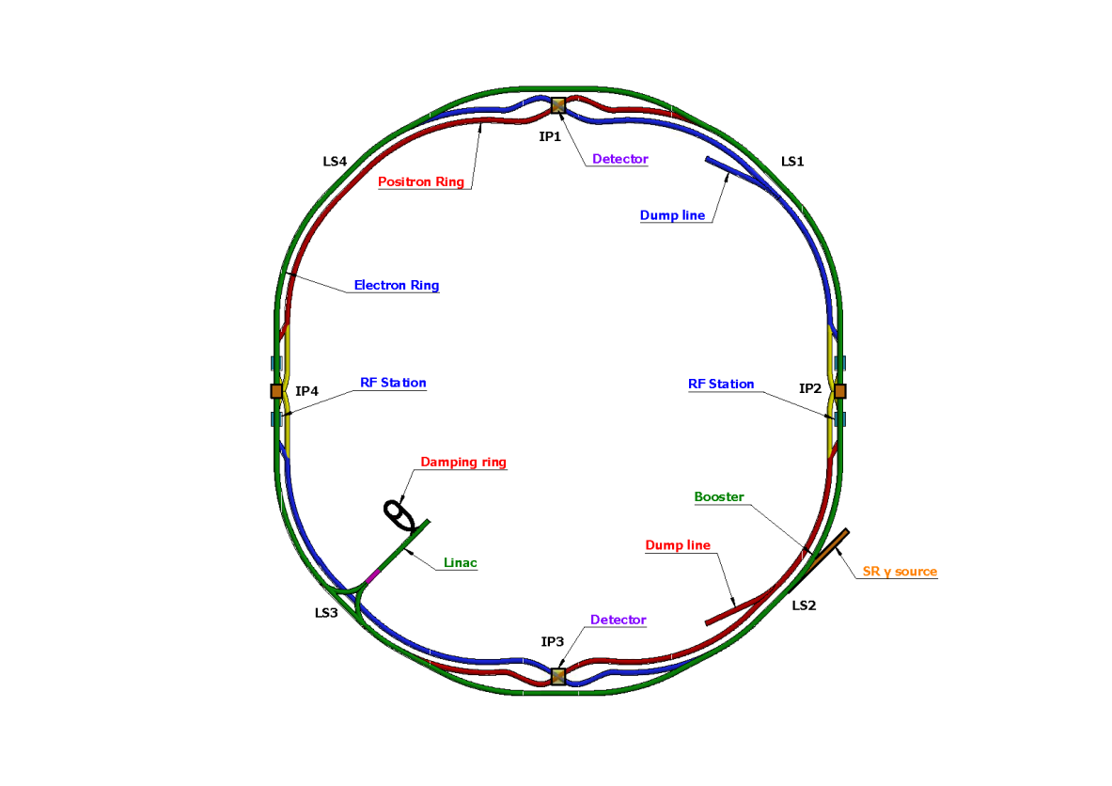
Machine protection collimators： aperture radius 3mm
4 horizontal betatron collimators, installed in the straight sections, are used to block particles with large horizontal betatron oscillations
for H betatron collimator
for momentum collimator
for vertical collimator
4 momentum collimators, installed in the arc sections, are used to block particles with large momentum deviations
4 vertical betatron collimators, installed in the straight sections, are used to block particles with large vertical betatron oscillations
After discussion with Yi Wei Wang, momentum collimators are moved to one side of an arc section。

Slide 9
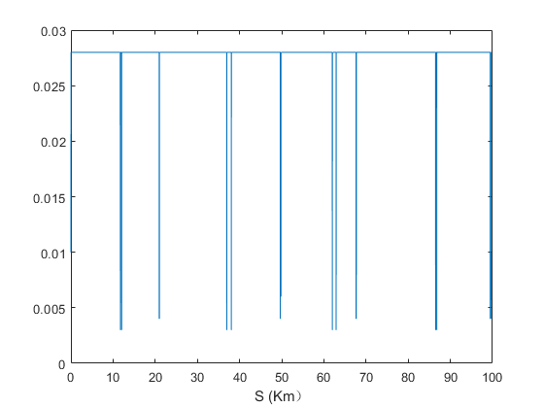
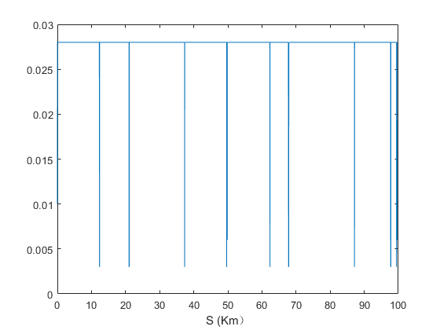
Position of collimators in the ring
X
Y

Slide 10
3. Simulation results
RF failure:
Considering the RF cavity protection scenario, it is assumed that the RF cavity voltage decays exponentially after the protection is triggered, V(t)=V0​⋅e^{−t/τ} with a time constant of 773 µs.

Slide 11
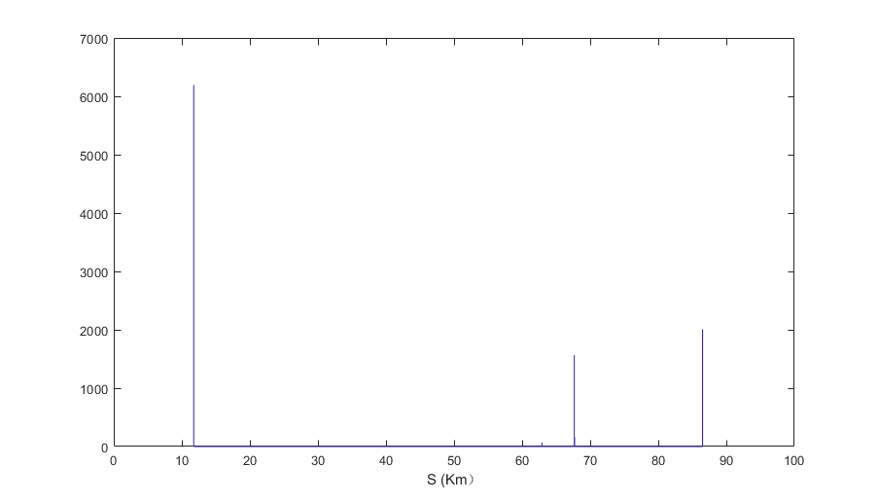
3. Simulation results
RF failure:
Position of particle loss

Slide 12
3. Simulation results
2. Dipole failure
Assume that dipole magnets in one arc section of the ring loses power, and its magnetic field decays exponentially with a time constant of 10ms B(t)=B0​⋅e^{−t/τ}

Slide 13
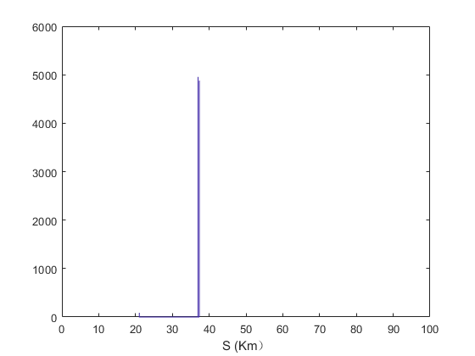
3. Simulation results
2. Dipole failure
Position of particle loss

Slide 14
3. Simulation results
3. Quadrupoles failure
Assume that all quadrupole magnets in the ring loses power, and its magnetic field decays exponentially with a time constant of 10ms B(t)=B0​⋅e^{−t/τ}

Slide 15
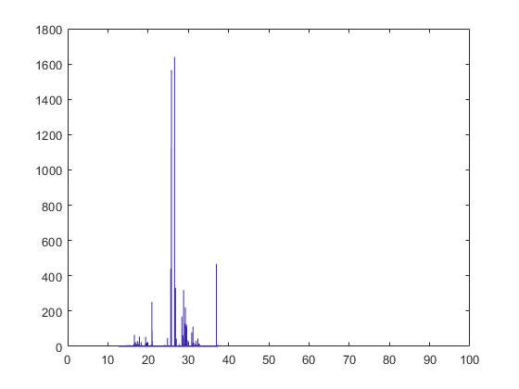
3. Simulation results
3. Quadrupoles failure
Position of particle loss

Slide 16
4. Work to do
Optimize collimator setting and particle loss under quadrupole failure conditions
SAD-Fluka coupling simulation

