Slide 1
Collectivity in Heavy-Ion Collisions at High Baryon Density from STAR BES-II
Li-Ke Liu
for STAR Collaboration
Central China Normal University
The 2nd International Workshop on Physics at High Baryon Density
Notes:
Hello everyone! Good morning, I am Li-Ke Liu from STAR Collaboration. Firstly, Many thanks to the organizer, and I am glad to have this opportunity to share our updates.
Here, I would like to talk about the Collectivity in heavy-ion collisions from STAR BES-II.

Slide 2
Outline
Motivation
Experimental Setup
Results and Discussion
Directed flow (v1) measurements
Elliptic flow (v2) measurements
Summary and outlook
Notes:
My talk is arranged as follows: physics motivation,
And since it’s a experimental talk, I will briefly discuss the Experimental setup, I will focus on the directed flow and elliptic flow measurements.
In the last, I will give a brief summary.

Slide 3
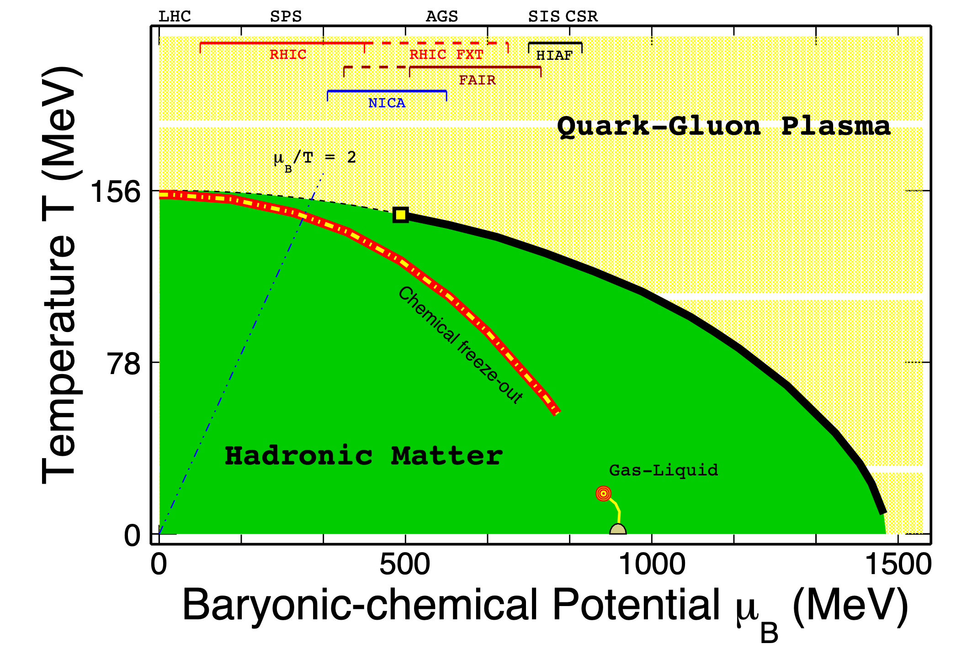
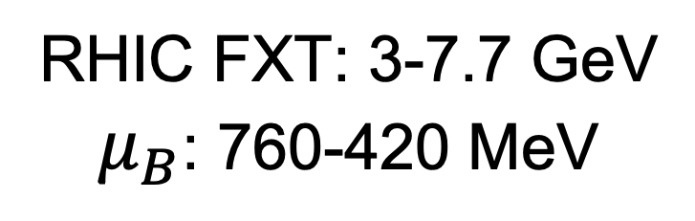
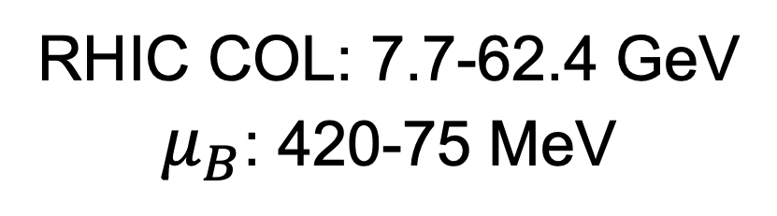
Motivation
LHC, RHIC 200 GeV
TC
RHIC COL: 7.7-62.4 GeV
$μ_{B}$: 420-75 MeV
RHIC FXT: 3-7.7 GeV
$μ_{B}$: 760-420 MeV
RHIC 200 GeV and LHC
Small viscosity, high temperature
Evidence of Quark-Gluon Plasma
Beam energy scan program
Locate the first-order phase boundary
Search for Critical Point
A. Bazavov et al., Phys. Rev. D 85, 054503 (2012); K. Fukushima and C. Sasaki, Prog. Part. Nucl. Phys, 72, 99 (2013)
Notes:
So, Let’s start with motivation
(For each researcher of QCD phase structure, this plot is pretty familiar.)
This plot shows the QCD phase diagram based on our knowledge. Since the quark color confinement, we can’t get the free quark, so the basic idea is to create extremely high temperature and high baryonic chemical potential conditions, to release the quark freedom, by relativistic HIN collisions. The results of nuclear modification factor, flow, and polarization from RHIC top energy and LHC energies indicate a new form of matter with Small viscosity (visgaosity) and high temperature has been built up. Meanwhile, the lattice QCD calculation told us the phase transition in this region is a crossover. (if we want to finally prove the QGP exists, it's important to locate the first-order phase boundary and its endpoint, which motivates the Beam Energy Scan program. Including the collider mode and FXT target mode.

Slide 4
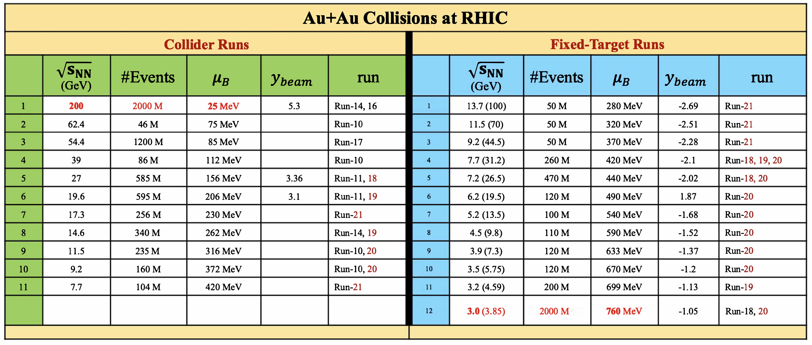

STAR Beam Energy Scan
The widest map of the QCD phase diagram
$$3<\sqrt{s_{NN}}<200 \text{GeV}, 760>μ_{B}>25 \text{MeV}$$
Notes:
As this table shows, the collider runs Cover 200 GeV down to 7.7 GeV, and the FXT mode was developed to decrease the center of mass energy down to 3 GeV. For now, STAR has covered the collision energy from 3-200 GeV, corresponding baryon chemical potential from 760 - 25 MeV. It’s the widest map of the QCD phase diagram,
making it possible to explore the structure of the QCD phase

Slide 5
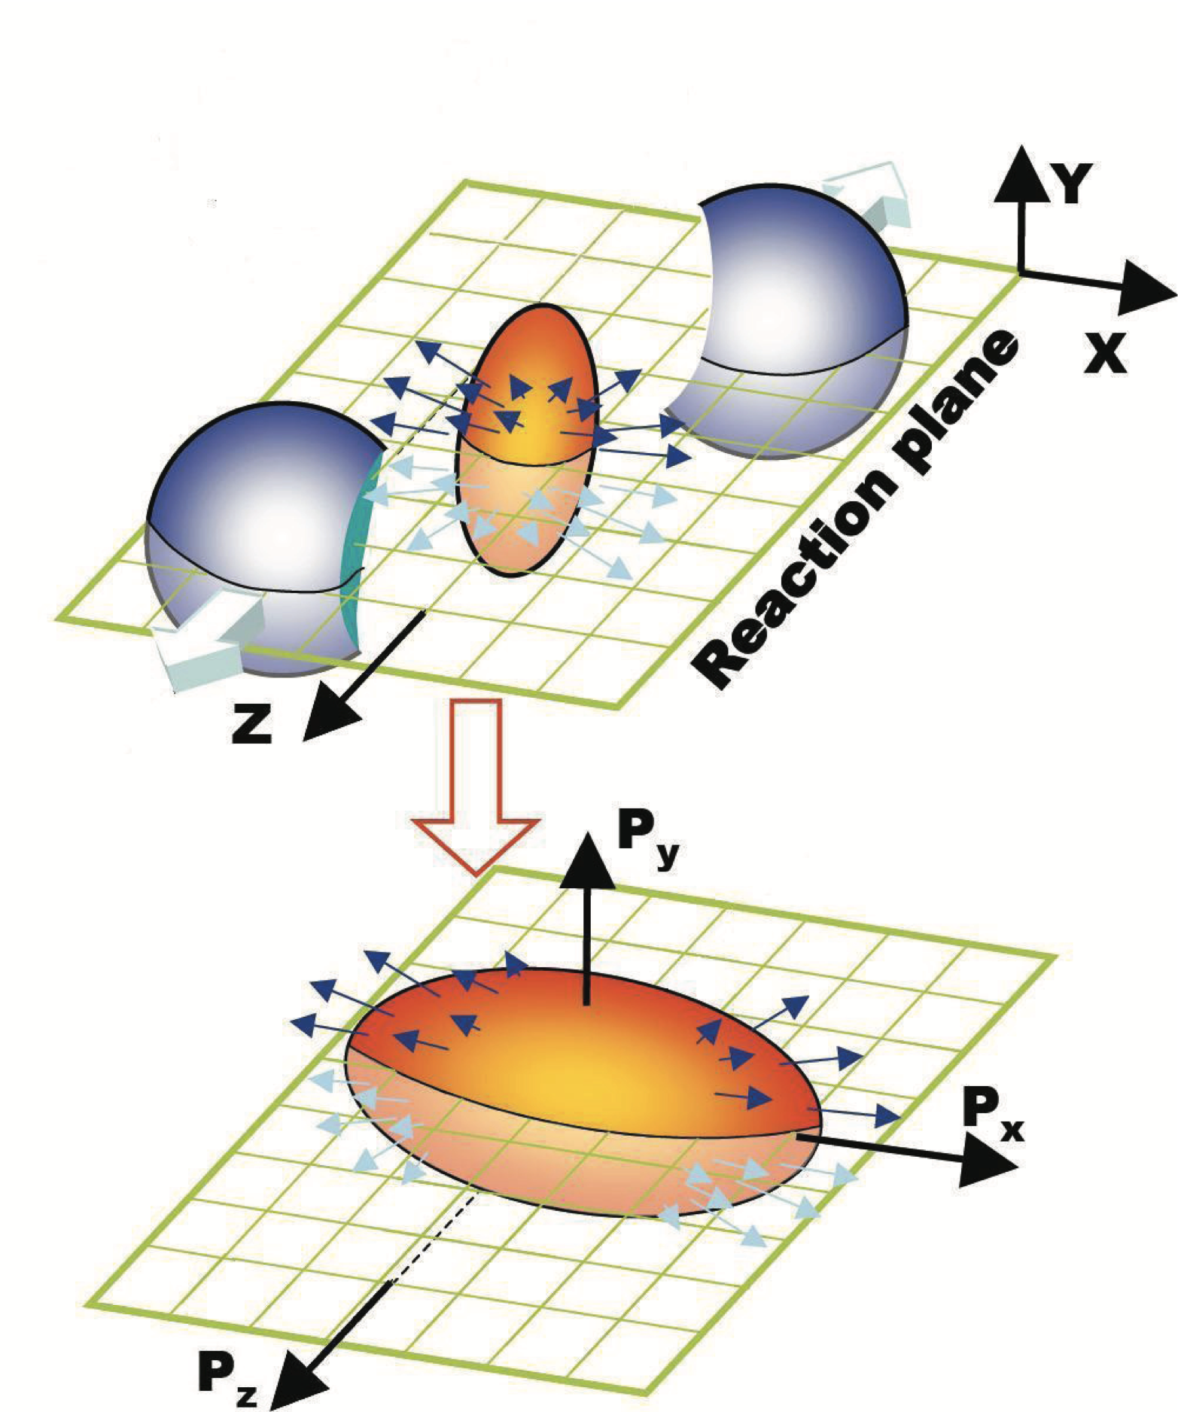
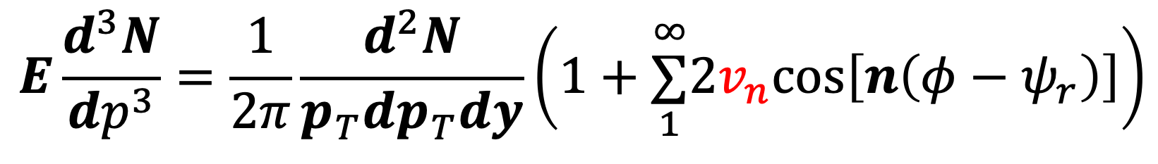
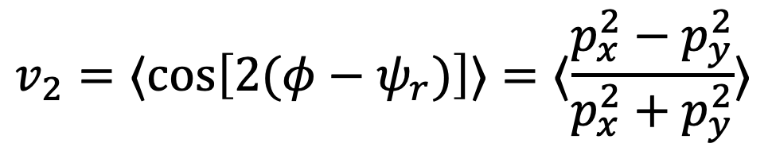
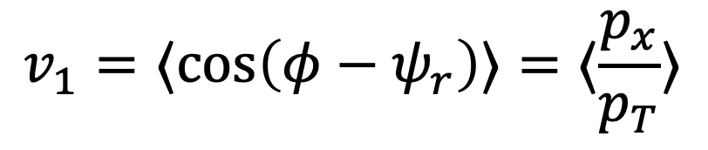
Anisotropic flow
Anisotropies in particle momentum distributions relative to the reaction planes or symmetry planes
Initial spatial anisotropy → Pressure gradient → Momentum space anisotropy
$$E\frac{d^{3}N}{dp^{3}}=\frac{1}{2π}\frac{d^{2}N}{p_{T}dp_{T}dy}\left(1+\overset{∞}{\underset{1}{∑}}2v_{n}cos\left[n\left(φ−ψ_{r}\right)\right]\right)$$
$$v_{1}=⟨cos\left(φ−ψ_{r}\right)⟩=⟨\frac{p_{x}}{p_{T}}⟩$$
directed flow
$$v_{2}=⟨cos\left[2(φ−ψ_{r})\right]⟩=⟨\frac{p_{x}^{2}−p_{y}^{2}}{p_{x}^{2}+p_{y}^{2}}⟩$$
elliptic flow
Equation of State of the medium
Constituent interactions and degree of freedom
A. M. Poskanzer and S. A. Voloshin, Phys. Rev. C 58, 1671 (1998)
P. Danielewicz and R. Lacey, Science 298 (2002)
STAR Collaboration, Phys. Rev. Lett. 118, 212301 (2017)
Notes:
Now, let's talk about the observable. The anisotropic flow is one of the most important final-state observables, which refers to anisotropies in particle momentum distributions relative to the reaction plane. It originates from initial spatial anisotropy and passes by Pressure gradient to the Final state momentum space anisotropy. Generally, we did the Fourier expansion to the (Lorentz-)invariant particle spectrum, v1 is the first-order coefficient, called the directed flow, and the second order called the elliptic flow. Because the spatial asymmetries rapidly decrease with time, flow can develop only in the early stage.
And such significant final-state flow signals mean there are strong constituent interactions. Therefore, we can conclude the flow can reflect the EoS and it’s sensitive to constituent interactions and degree of freedom.

Slide 6
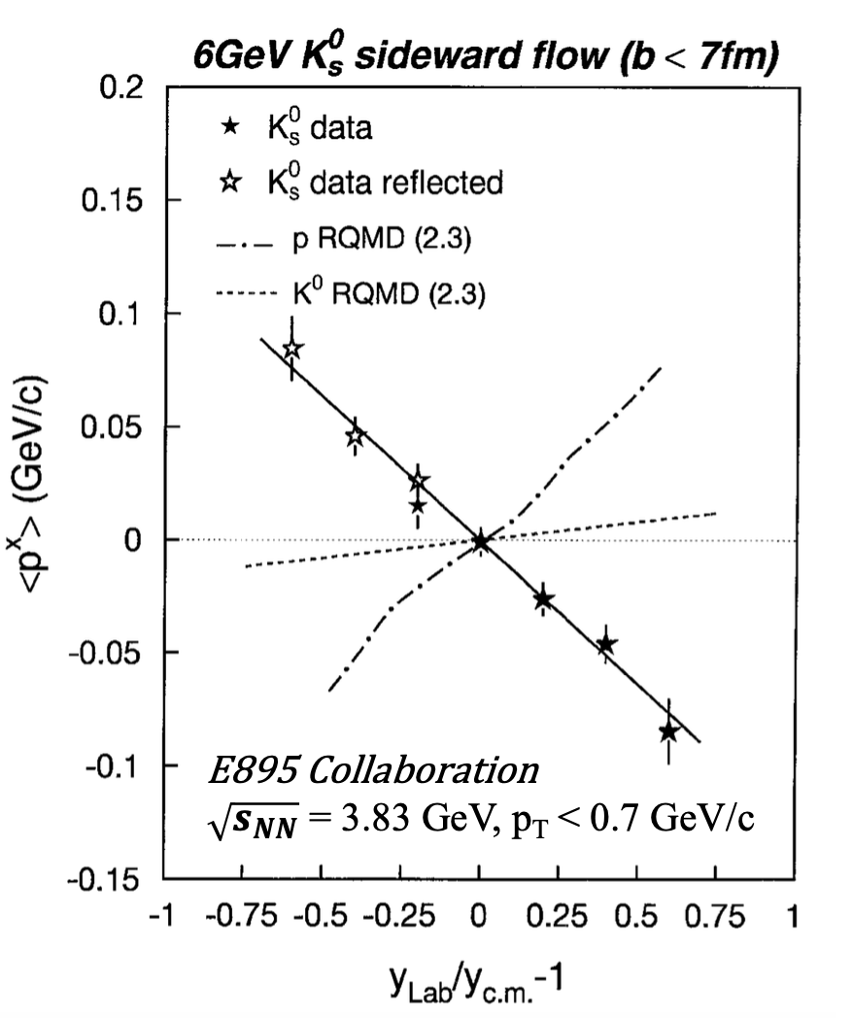
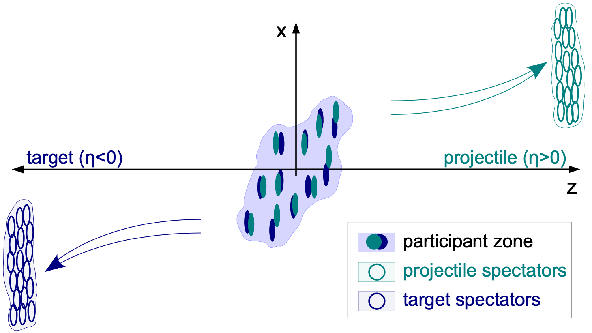
Motivation: Anti-flow of kaons
Figure taken from: Phys. Rev. Lett. 111, 232302 (2013)
E895 Collaboration, Phys. Rev. Lett. 85, 940 (2000)
Bounce-off: Positive flow in positive rapidity
Au+Au 3.83 GeV: anti-flow of kaon at low pT (< 0.7 GeV/c) → Kaon potential?
Notes:
In this talk, we want to answer two questions about Anisotropic flow, as possible. The first one is about directed flow, the left figure shows a Schematic of two nuclei colliding. The positive-Z is the beam direction, and the initial momentum causes the initial shape to tilt (tei (you) t), In this case, the bounce-off expansion would cause the positive v1 in the positive rapidity region. While the directed flow measurement from E895 shows that K0S v1 signal is negative, which is opposite to the normal (bounce-off) expansion, Called the anti-flow, some papers introduce the kaon potential to explain this novel behavior. The question is this: does the (anti-flow of K0S)novel behavior connect to the kaon potential, and is this potential necessary?

Slide 7
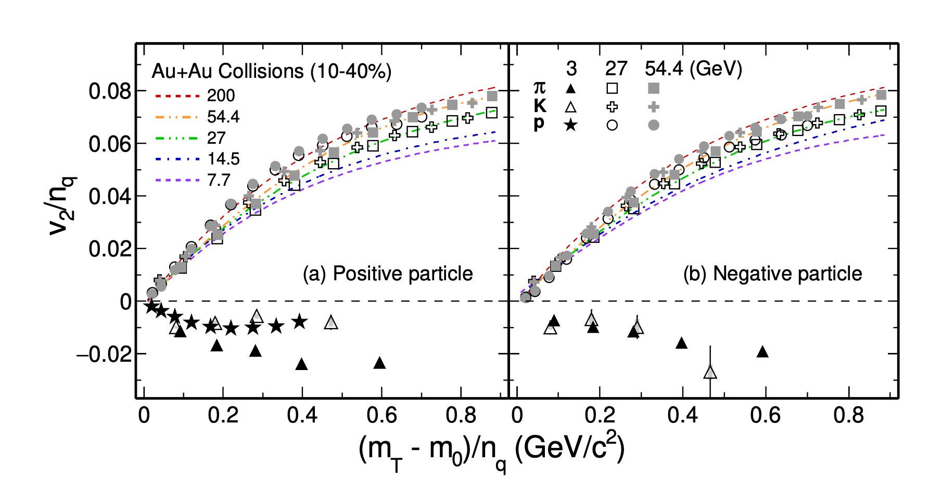
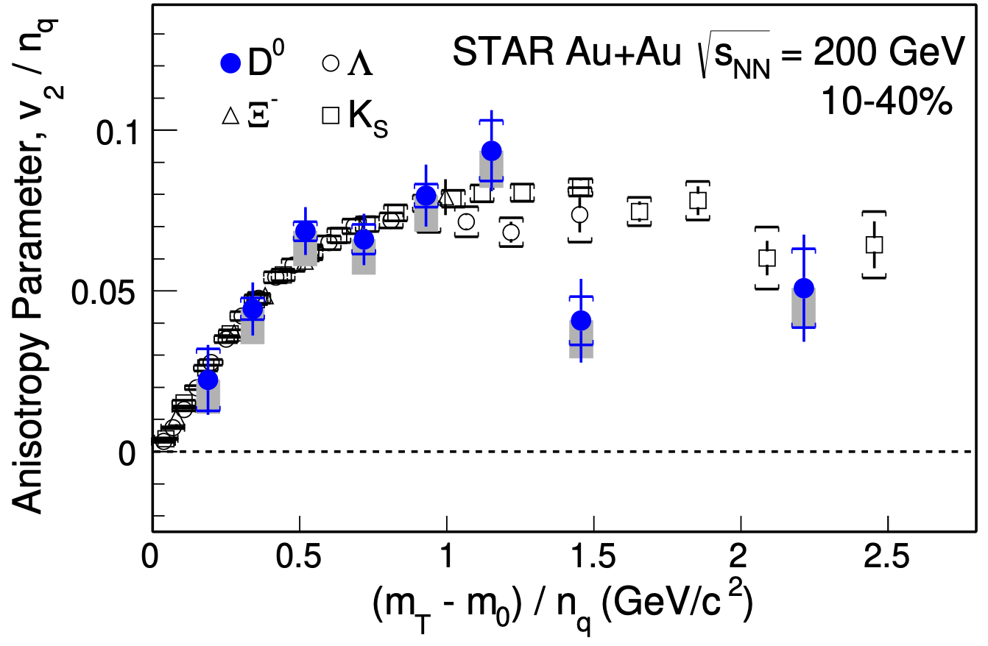
Motivation: Elliptic flow
STAR Collaboration, Phys. Rev. Lett. 118, 212301 (2017)
STAR Collaboration, Phys. Rev. Lett. 110, 142301 (2013)
Phys. Rev. C 93, 14907 (2016), Phys. Lett. B 827, 137003 (2022)
?
Universal Scaling ➞ Parton freedom ➞ indication of sQGP
200 GeV: Partonic collectivity
3 GeV: Hadronic interaction dominates
Change of degree of freedom: 3 → 7.7 GeV?
Notes:
For the elliptic flow, the measurements at RHIC 200 GeV have shown,
if we scaled the v2 and transverse momentum with the number of constituent quarks, particles v2 grouped, even for charm hadrons, which means the behavior does not depend on the hadron’s mass, charge, or spin, only relative to the number of quarks, it indicates a partionic degree of freedom.
From the BES-I measurements, we found that NCQ scaling is in good agreement for collision energies above 7.7 GeV. While, the New results at 3 GeV collisions show that all v2 values are negative and NCQ scaling is absent, indicating the partonic collectivity disappears and hadronic interaction dominates. The measurements between 3.0 and 7.7 GeV, can inform us how the elliptic flow changes and how the degree of freedom changes?

Slide 8
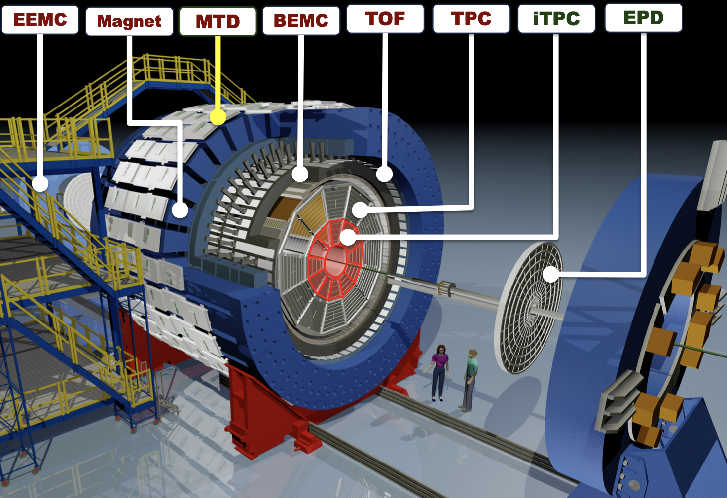
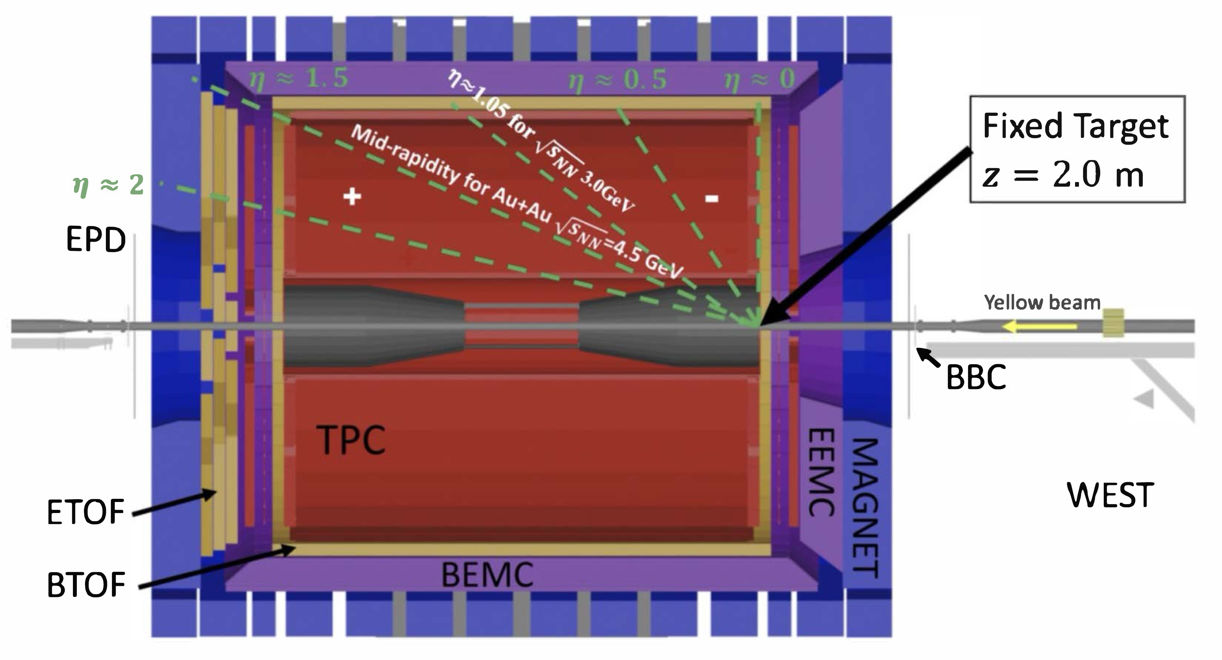
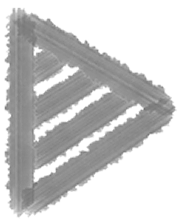
Experimental Setup
STAR Detector Upgrade:
Inner-Time Projection Chamber
Better track quality, |η| < 1 ➞ 1.8
Endcap Time Of Flight
Particle identification
Event Plane Detector
Event plane determination (2.1< |η| < 5.1)
Notes:
Here I would like to introduce the STAR detector. STAR is a large detection system composed of several sub-detectors, with 2𝜋 azimuthal and large mid-rapidity coverage.
In the flow measurement, we mainy use time projection chamber, TOF and EPD.
The FXT setup is shown in the right plot; the yellow line is the beam direction, and the target is located on the right side of the TPC.
For the BES-II, STAR has been upgraded with several subdetectors.
The inner TPC upgrade gives better track quality and
extends the eta coverage from 1 to 1.8.
eTOF newly installed on the left side of TPC, extends the TOF rapidity coverage in the mid-y, and EPD located in the forward rapidity region of the collision, covers a pseudorapidity range from $2.1 < |\eta| < 5.1$.
This design can reduce autocorrelations for the mid-rapidity analysis and determine the event plane of collisions
Compared to the collider mode, the final state particles can fly in the whole TPC region, giving the longer track, thus Better track quality and better vertex precision are reached in FXT mode.

Slide 9
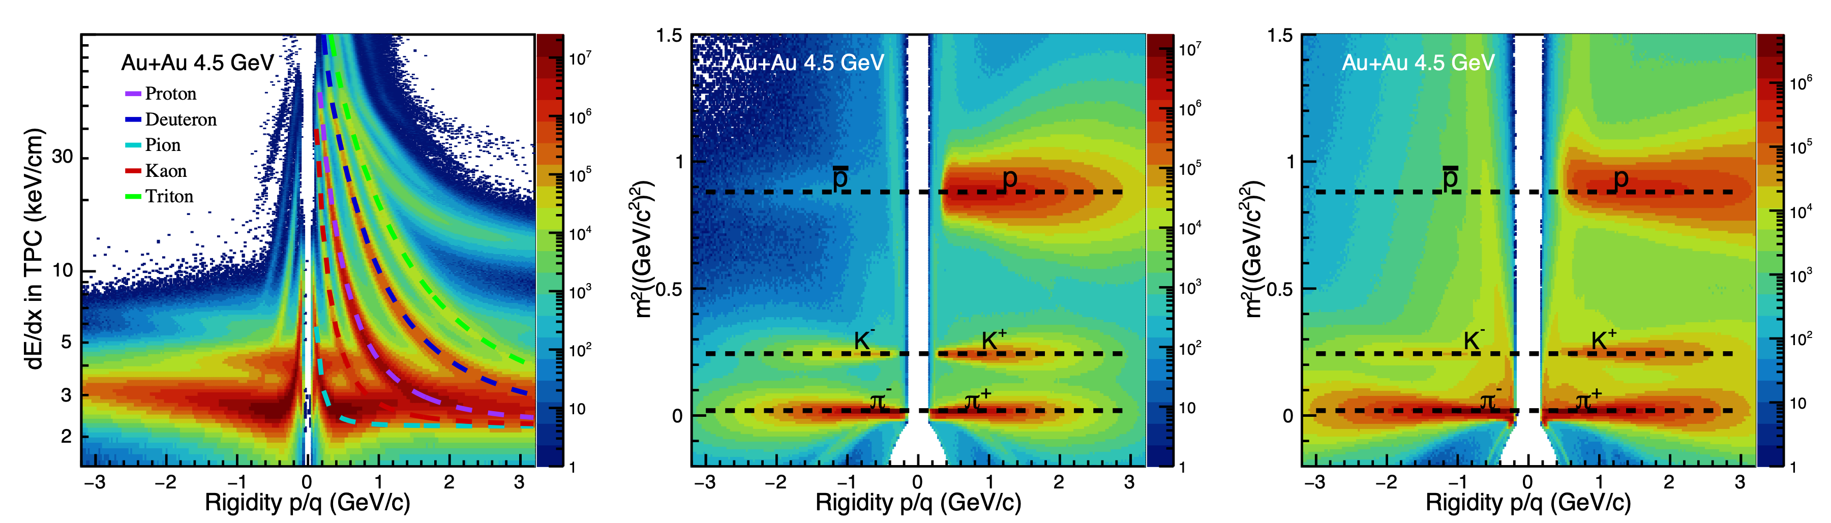
Particle Identification
TPC
bTOF
eTOF
Good particle identification capability based on TPC dE/dx and TOF m²
Notes:
In experiment analysis, the first step is to identify the interested particles. The charged particles are identified using the TPC dE/dx and TOF m2 information. Based on the dE/dx distribution, we can clearly distinguish the bands of pions, kaons, protons, deuterons, and tritons. The TOF can extend the identification to a higher momentum region, with charged particles well separated up to 3 GeV. The eTOF is a new detector, which is borrowed from CBM, as you can see it also performs well in particle identification.

Slide 10
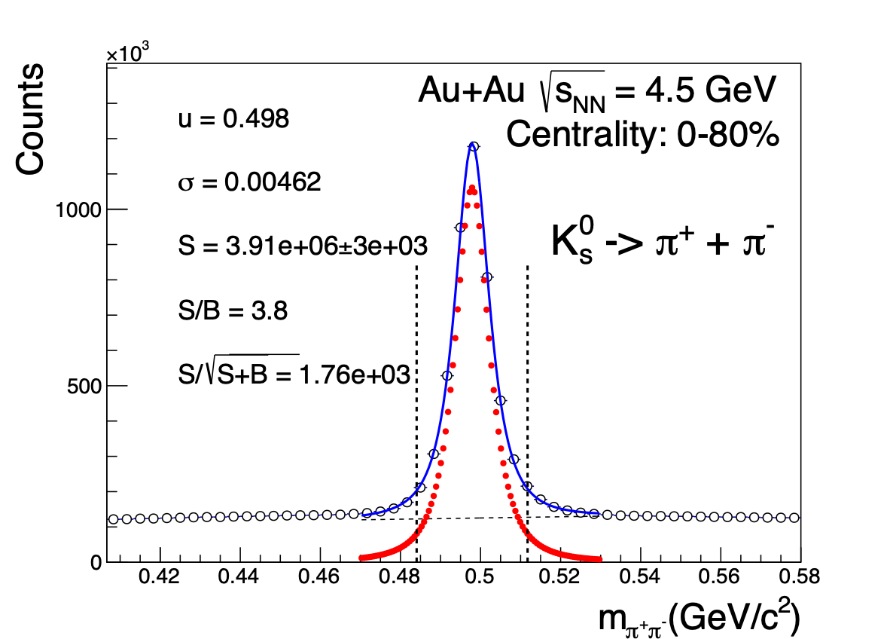
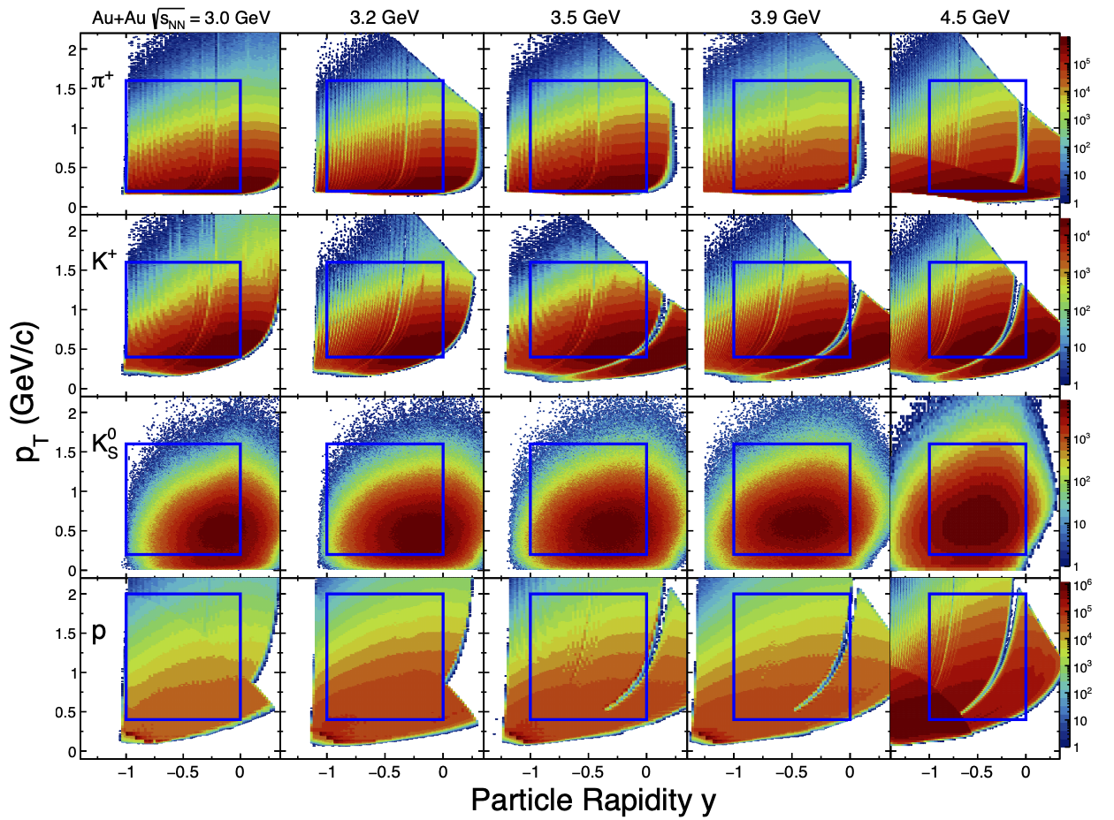
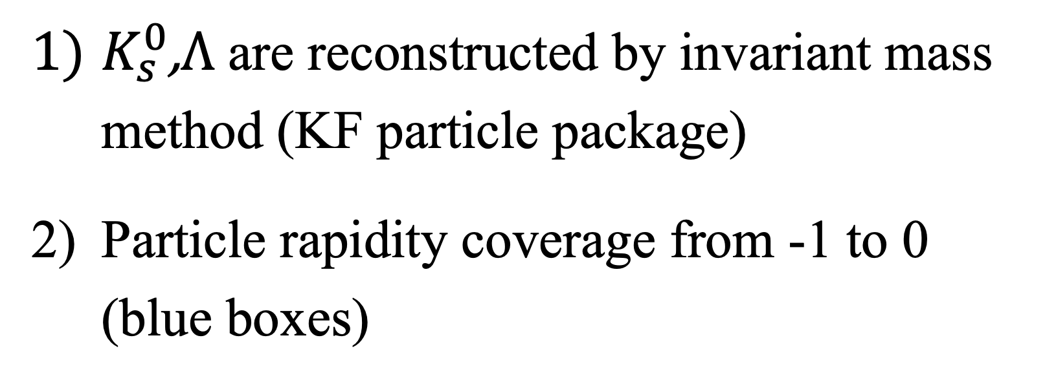
Particle Acceptance
$K_{s}^{0}\text{,}Λ$ are reconstructed by invariant mass method (KF particle package)
Particle rapidity coverage from -1 to 0 (blue boxes)
A. Banerjee, I. Kisel and M. Zyzak, Int. J. Mod. Phys. A 35, 2043003 (2020)
Notes:
The short-lived particles can not be directly detected, which are reconstructed by pairing their daughter tracks. Such as weak decay K0S, can be reconstructed through decay chanel: piPlus and pi Minus. clean signal reached by applying the KF particle package. The right plot shows the acceptance for different particle species from 3 to 4.5 GeV, a good coverage reached from rapidity minus-one to 0 as the blue boxes shown. (Up to now, We have discussed so many experiment details, so let’s see the data!) After that, we can get the flow results by using the Event plane method

Slide 11
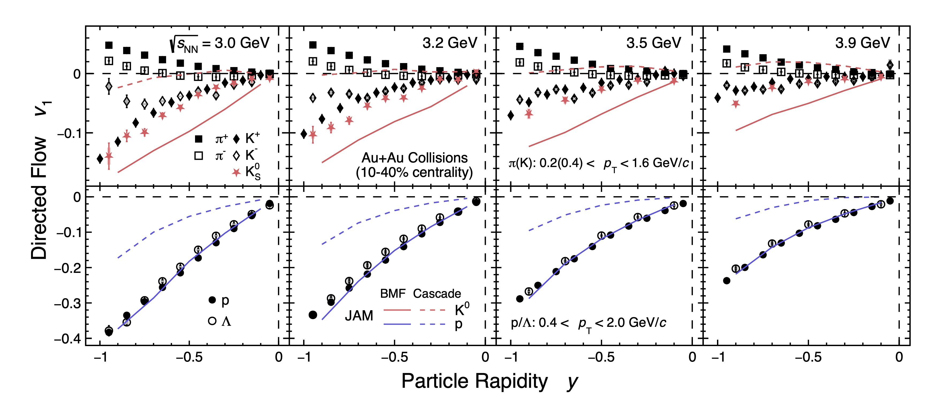
Rapidity dependence of v1
STAR Collaboration, arxiv: 2503.23665
STAR Preliminary
Baryonic Mean Field: p dependent Soft EoS
the nuclear incompressibility K = 210 MeV
Measurements of v1 vs. rapidity for $π^{±},K^{±},K_{S}^{0},p,Λ$ at 3.0, 3.2, 3.5, and 3.9 GeV
Notes:
We have measured the Rapidity dependence of directed flow for pions, kaons, proton and lambda from 3 to 3.9 GeV in the middle central collisions. We also add the model calculation for comparison: JAM cascade, and JAM with baryonic mean field JAM with baryonic mean field better describes the baryons flow than cascade mode,
Indicates the hadronic interaction dominates in such high baryon density region, and it does not work well for meson flow.

Slide 12
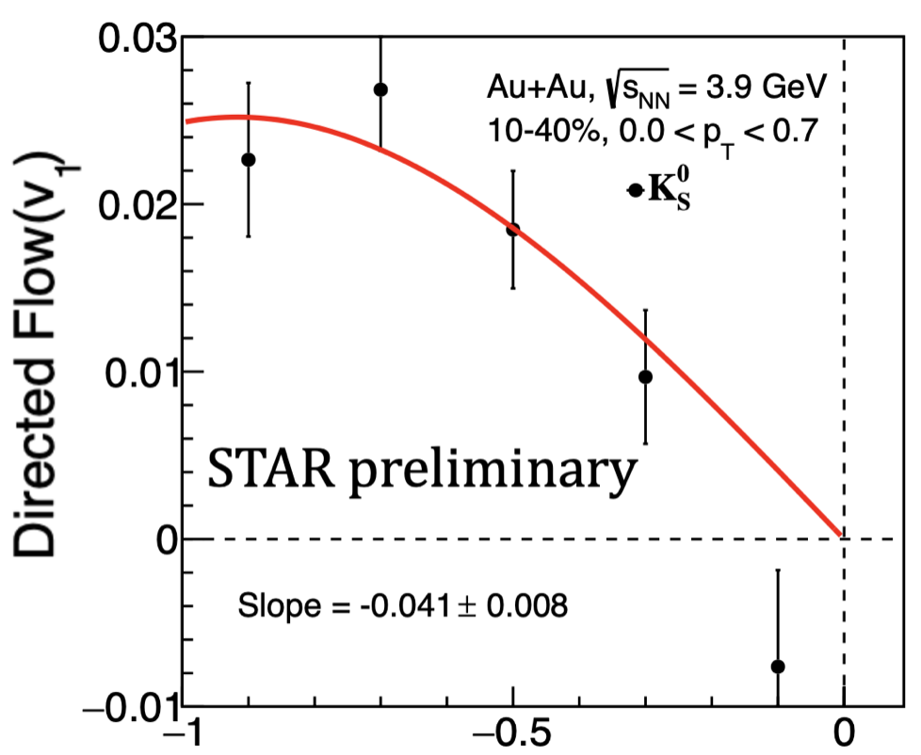
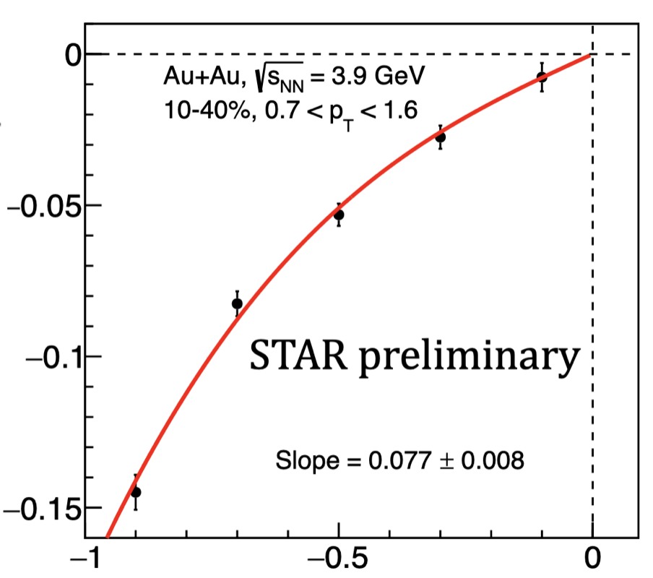

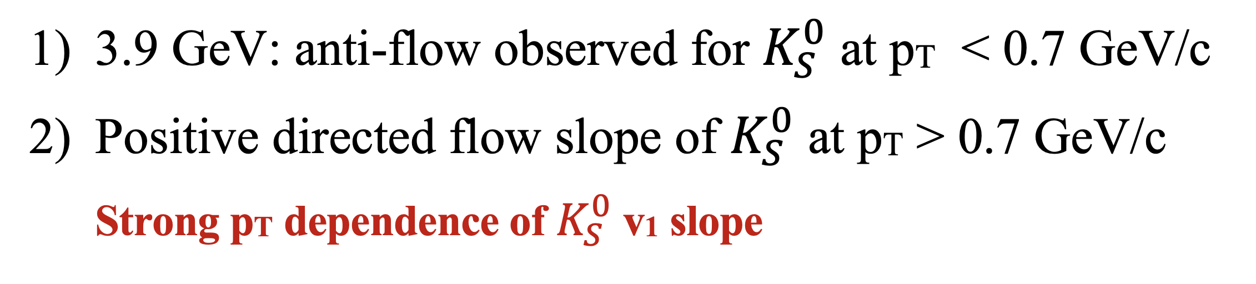
Anti-flow of Kaon
E895 Collaboration, Phys. Rev. Lett. 85, 940 (2000)
STAR Collaboration, arxiv: 2503.23665
Fit Function: y = ax + bx³
3.9 GeV: anti-flow observed for $K_{S}^{0}$ at pT < 0.7 GeV/c
Positive directed flow slope of $K_{S}^{0}$ at pT > 0.7 GeV/c
Strong pT dependence of $K_{S}^{0}$ v1 slope
Notes:
The motivation for the kaon measurement comes from the E895 results published in 2000, which reported a strong antiflow signal of $K^0_S$. They introduced a potential between kaons and nucleons to explain the observed data.
We did the similar v1 measurement at the closest energy, same pt window, pt less than zero point 7 GeV/c, the anti-flow observed for K0S at low pT. While we did the measurements at a higher pt window, the v1 slope becomes positive, and it goes back to the normal expansion.
So, there is a Strong pt dependence of K0S v1 slope.
Thus, we did the further differential measurements, the v1 vs. y measured in the differential pt window. then the v1 slope is extracted as a function of pt.

Slide 13
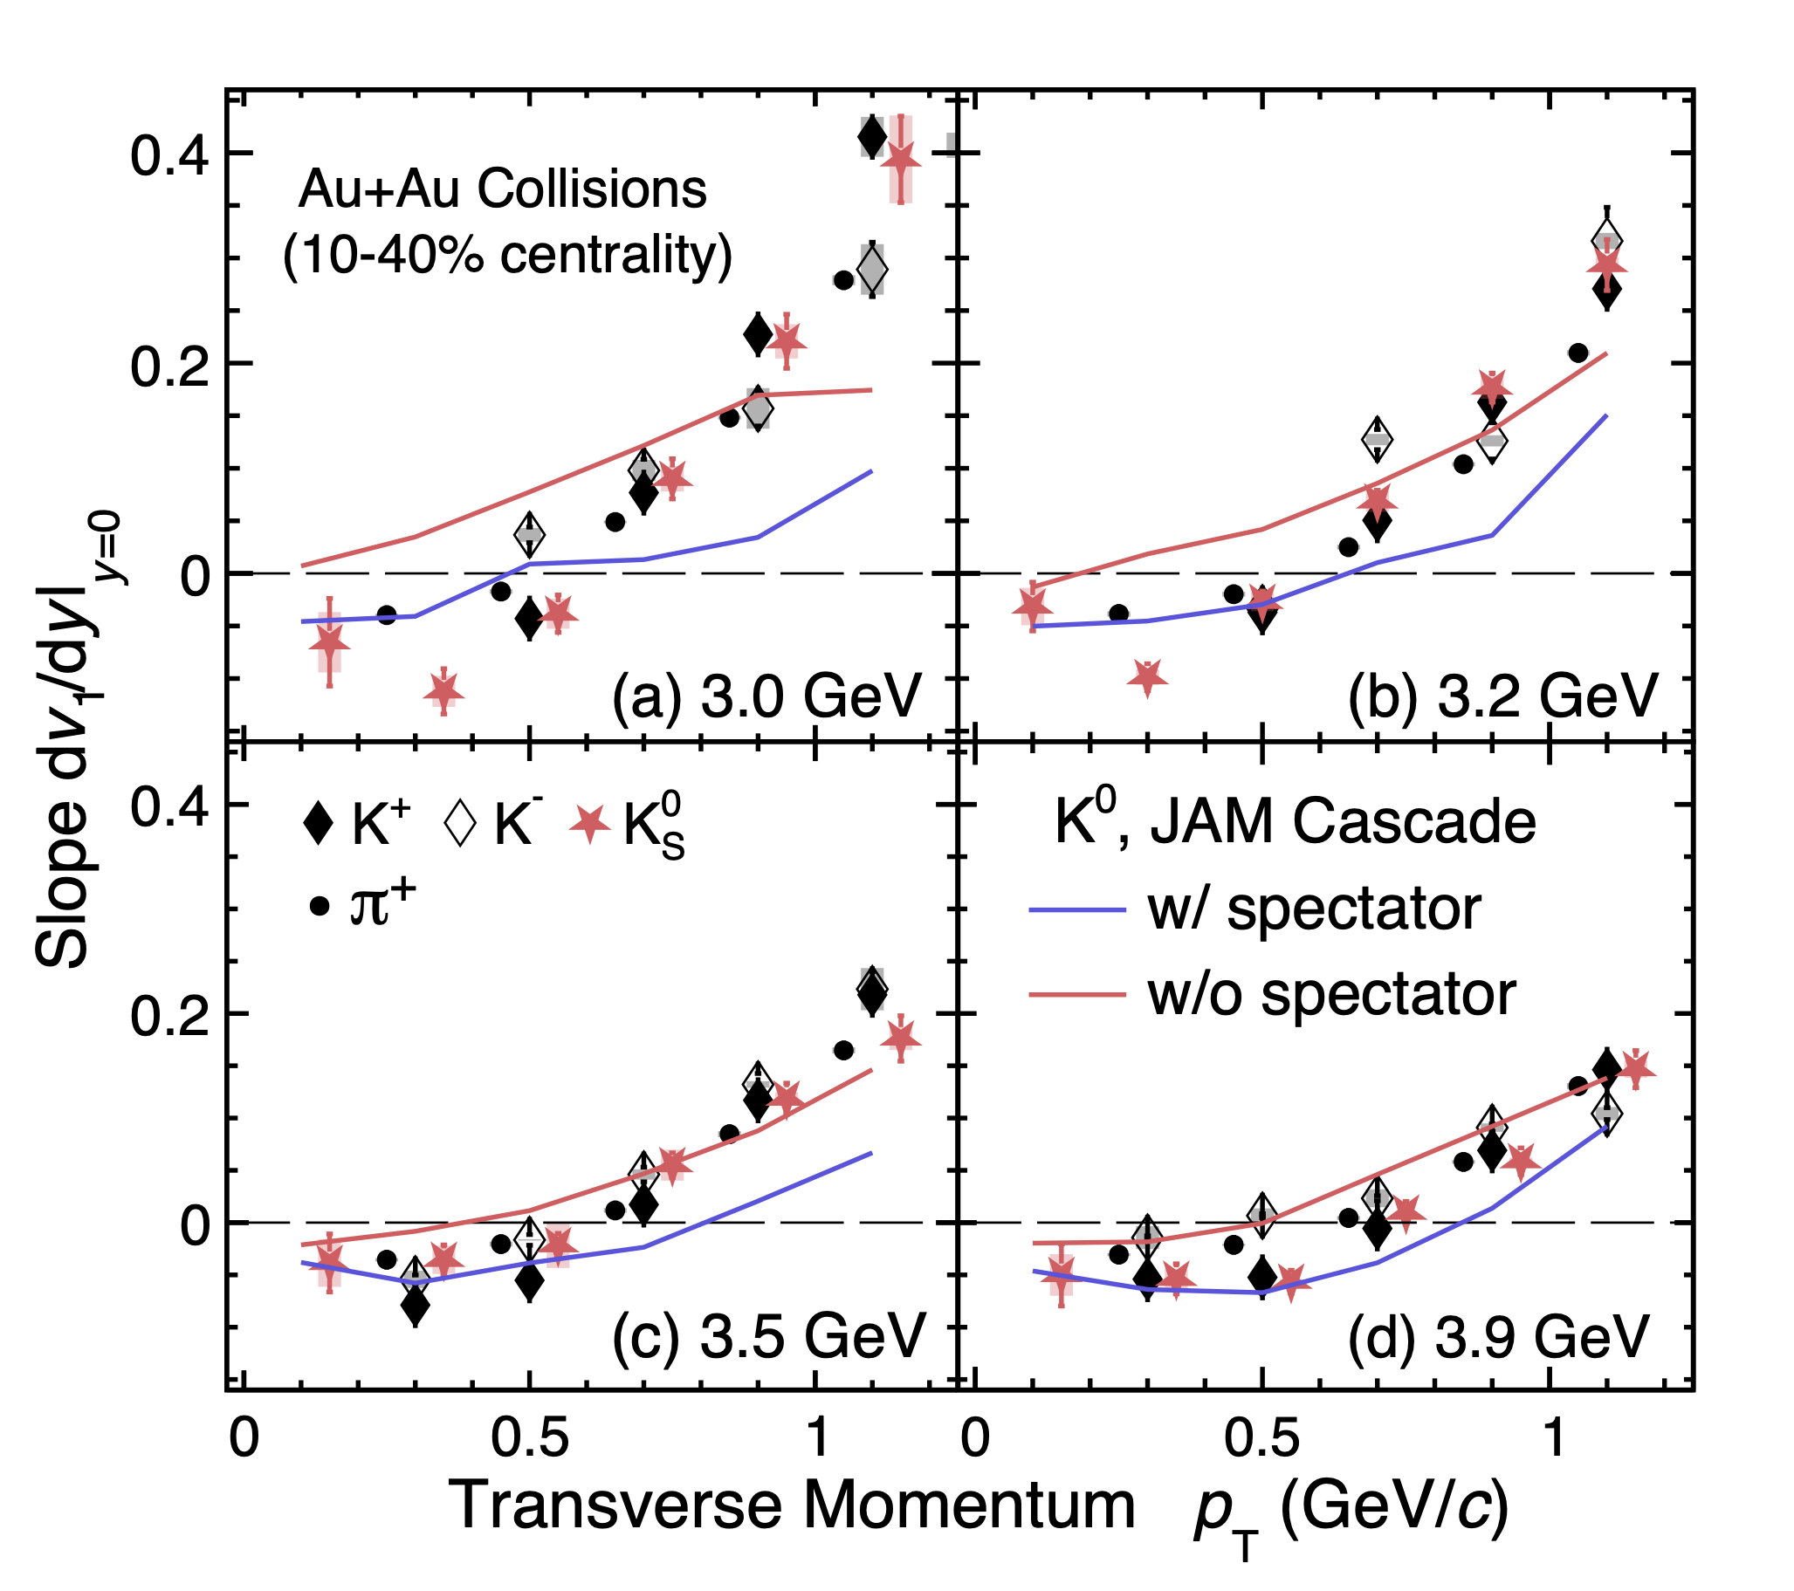
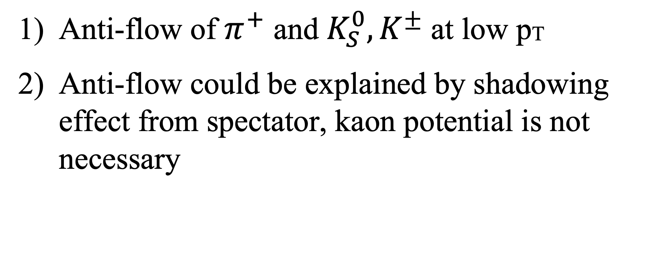
pT dependence of v1 slope
STAR Collaboration, arxiv: 2503.23665
STAR Preliminary
Anti-flow of $π^{+}$ and $K_{S}^{0},K^{±}$ at low pT
Anti-flow could be explained by shadowing effect from spectator, kaon potential is not necessary
Notes:
And summarized in this plot. (This plot shows) the pT dependence of v1 slope, anti-flow of K0S observed at low pt, in these four energies. For comparison, we include the pi^Plus (the black lines), which has historically known it’s anti-flow caused by the spectator shadowing effect. the charged kaons, the open triangular markers, also show the similar trend. We have added the model calculation from JAM. The cascade model with spectator can reproduce the anti-flow at low pT(as the blue line shown). When we remove the spectator effect in the evolution, the calculation can not describe the data. These results suggest Anti-flow could be explained by the shadowing effect from spectator, and kaon potential is not necessary (Possible question: Because the passing time of spectator at low energy collision is close to mean freeze-out time, the normal expansion is blocked by the spectator, and the particle with low transverse momentum can not overcome the blocking, it cause the anti-flow at low pt, while not at high pt)

Slide 14
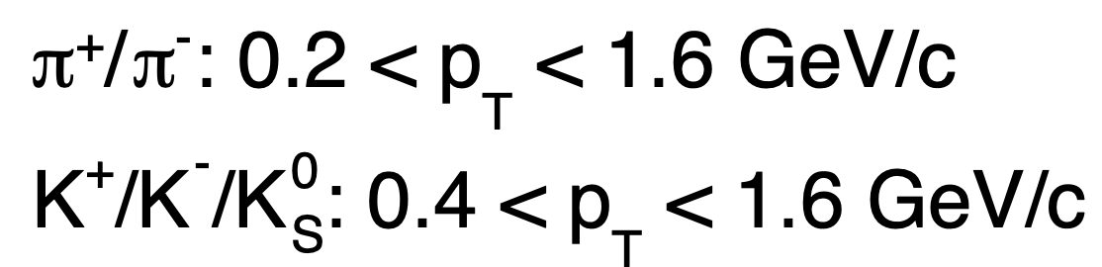
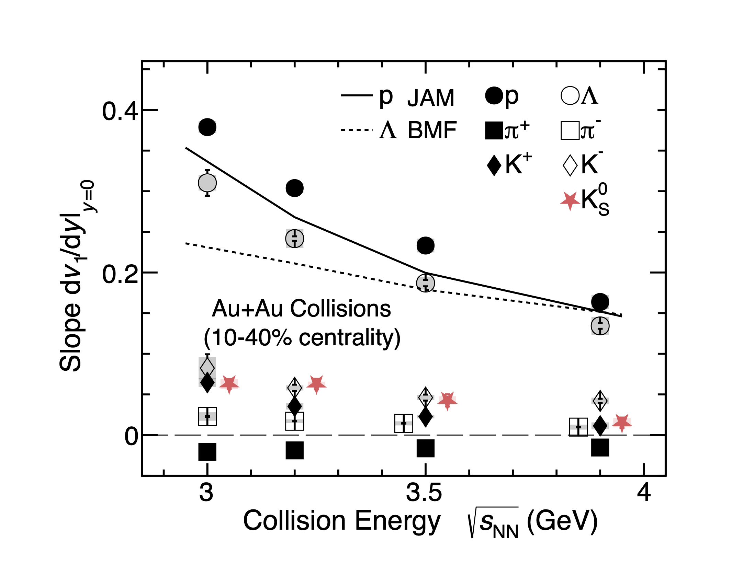
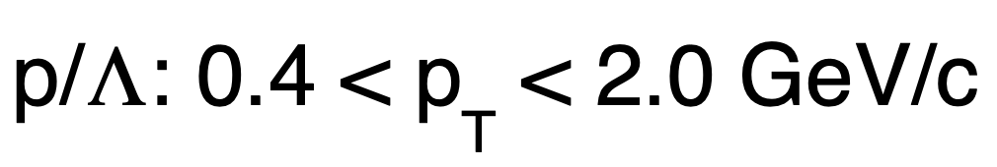
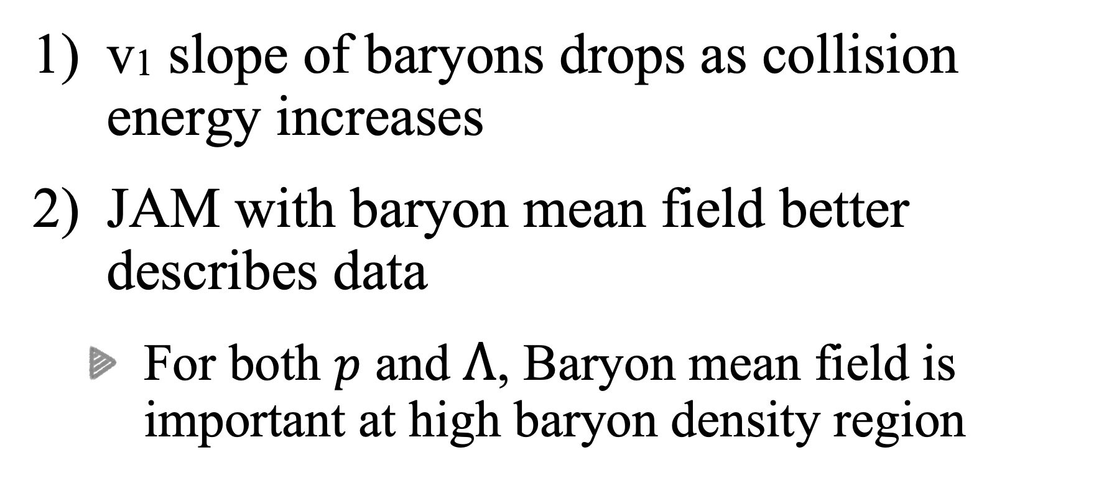
Energy dependence of v1 slope
STAR preliminary
v1 slope of baryons drops as collision energy increases
JAM with baryon mean field better describes data
For both $p$ and $Λ$, Baryon mean field is important at high baryon density region
STAR Collaboration, arxiv: 2503.23665
Notes:
We further study the energy dependence of v1 slope for the identified particles. the v1 slope of baryons drops as collision energy increases, the JAM calculation with baryonic Mean Field well describes the proton data, also the Lambda data is in good agreement. These results suggest that mean field potential plays an important role within these energy region.

Slide 15
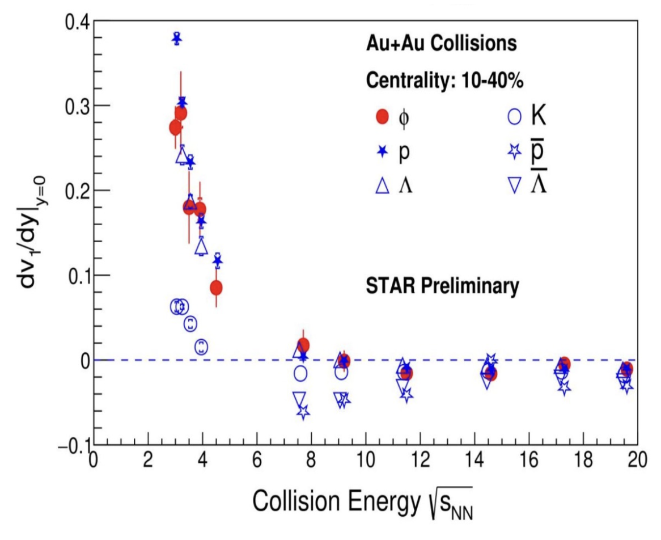
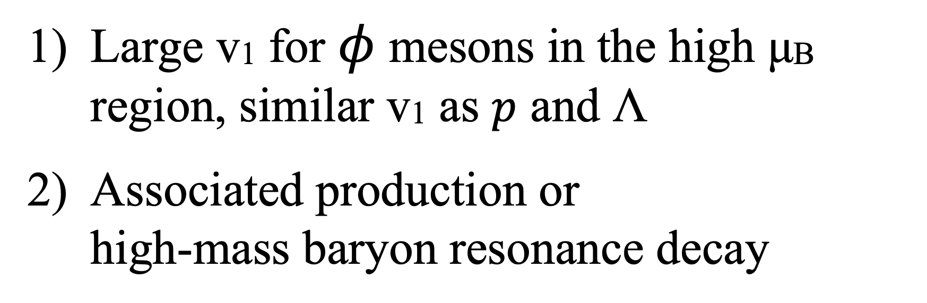
Energy dependence of $φ$ v1
STAR Collaboration, Quark Matter 2025
Large v1 for $φ$ mesons in the high μB region, similar v1 as $p$ and Λ
Associated production or high-mass baryon resonance decay
Notes:
One more interesting result is about the $\phi$ meson.
Because of its smaller hadronic cross section, we would normally expect a small $v_1$ in the high μB region, but unexpectedly, a significant $v_1$ signal was observed below 7.7~GeV ---
similar to that of protons and hyperons, and quite different from other mesons.
This could be due to the associated production dominates the dynamics,
or a decay contribution from high-mass baryon resonancess.

Slide 16
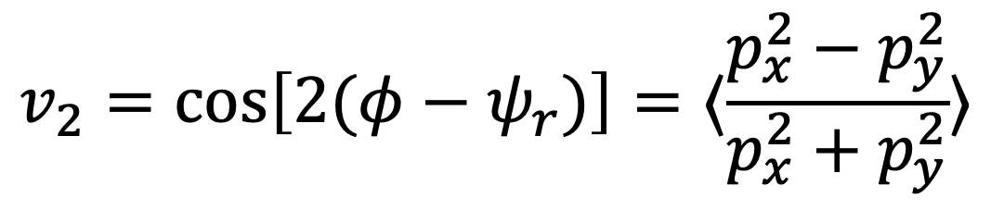
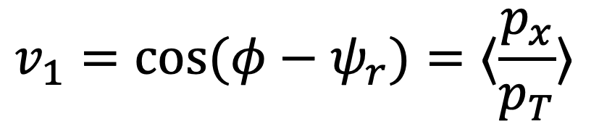
Anisotropic flow
$$v_{1}=cos(φ−ψ_{r})=⟨\frac{p_{x}}{p_{T}}⟩$$
$$v_{2}=cos\left[2(φ−ψ_{r})\right]=⟨\frac{p_{x}^{2}−p_{y}^{2}}{p_{x}^{2}+p_{y}^{2}}⟩$$
v1 reflect asymmetry along X direction
v2 reflect asymmetry on X-Y plane
Notes:
In the previous slides, we talked about the v1 vs. rapidity,
By definition, it can reflect the asymmetry along the x direction. We can further study the X-Y transverse expansion by measuring v2, which reflects the asymmetry on the X-Y plane

Slide 17
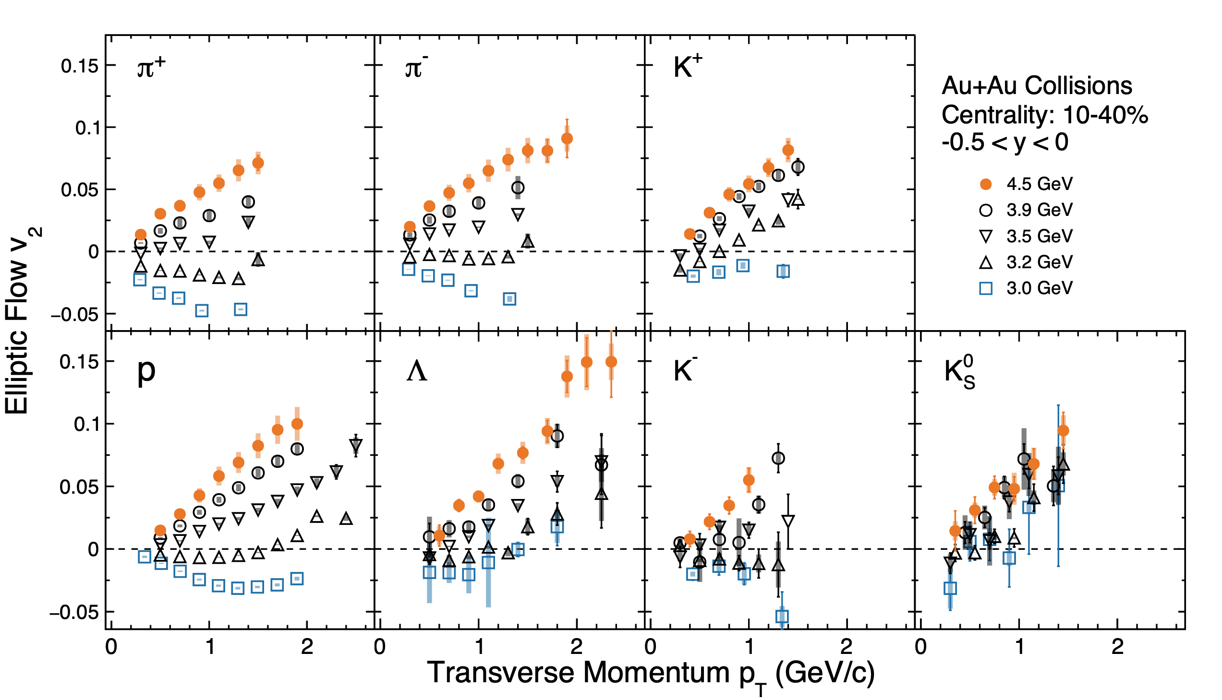
pT dependence of v2 at 3.0 - 4.5 GeV
STAR Collaboration, Phys. Rev. Lett. 135, 072301 (2025)
v2 changes from negative to positive across different hadron species
As collision energy increases, spectator shadowing reduces
Notes:
This plot shows the pt dependence of v2 from 3 to 4.5 GeV.
For each particle species, the five different markers correspond to five energy data points.
We can clearly see v2 changes from negative to positive across different hadron species. As the collision energy increases, the passing time of nuclear spectators is reduced, and the shadowing effect is diminished.

Slide 18
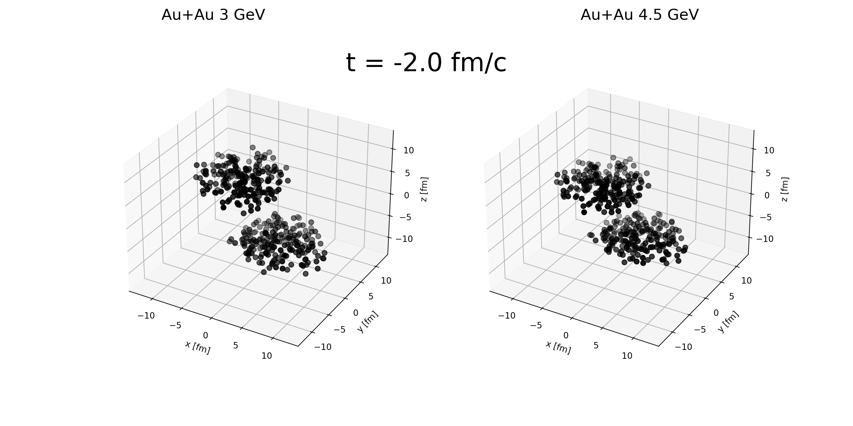
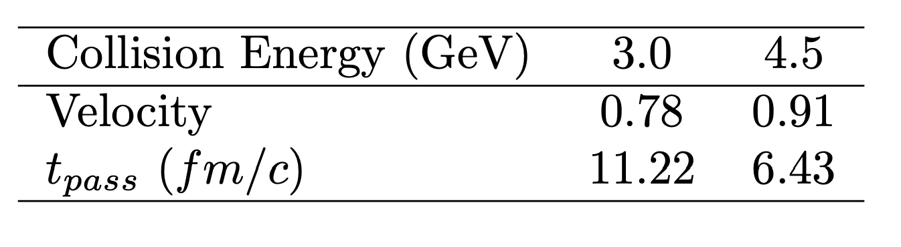
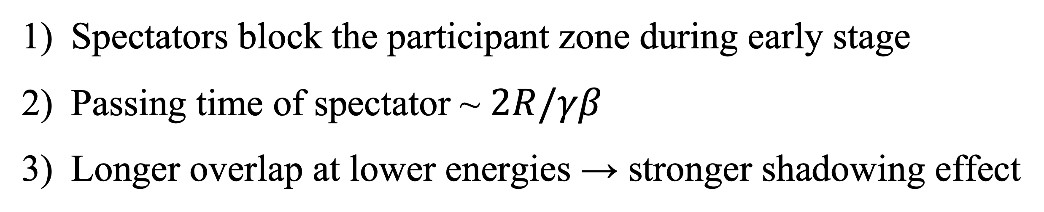
Spectator shadowing effect
Spectators block the participant zone during early stage
Passing time of spectator ~ $2R/γβ$
Longer overlap at lower energies → stronger shadowing effect
Notes:
The shadowing effect can be explained by this picture,
The z-axis is the beam direction. The collisions start at zero fermi
At 3.0 GeV, due to weaker Lorentz contraction, fewer nucleons overlap compared to 4.5 GeV at the moment.
Around six fermi, the spectators at 4.5 GeV have mostly passed the overlap zone, while the 3.0 GeV system just reaches maximum compression.
This shows that the in-plane expansion is strongly suppressed at low energy.
Finally, around 11 fermi, the spectators at 3.0 GeV have just moved away, whereas the 4.5 GeV system has almost finished expanding. Longer overlap at lower energies → stronger shadowing effect, which results in a significantly different $v_2$ behavior.

Slide 19
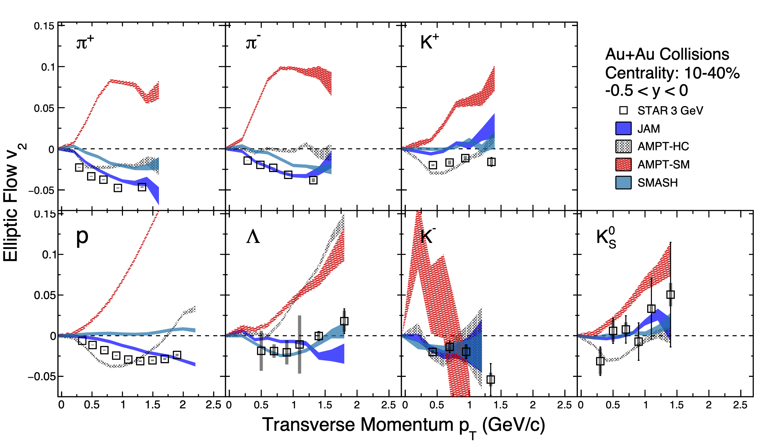
Data-model comparsion: 3 GeV
L.K. Liu, S.S. Shi, arxiv: 2508.21577
STAR Collaboration, Phys. Rev. Lett. 135, 072301 (2025)
Hadronic models fit 3.0 GeV data, while AMPT-SM fails as spectator shadowing missed
Hadrons dominate the medium’s DOF, large cross sections & short mean-free paths
Notes:
Calculations from different models are represented by the bands, The hadronic transport models JAM, AMPT-hadron cascade mode, and SMASH.
hadronic transport models fit v2 data,
while the multi-phase transport model AMPT-SM (red band) predicts the opposite sign of $v_2$,

Slide 20
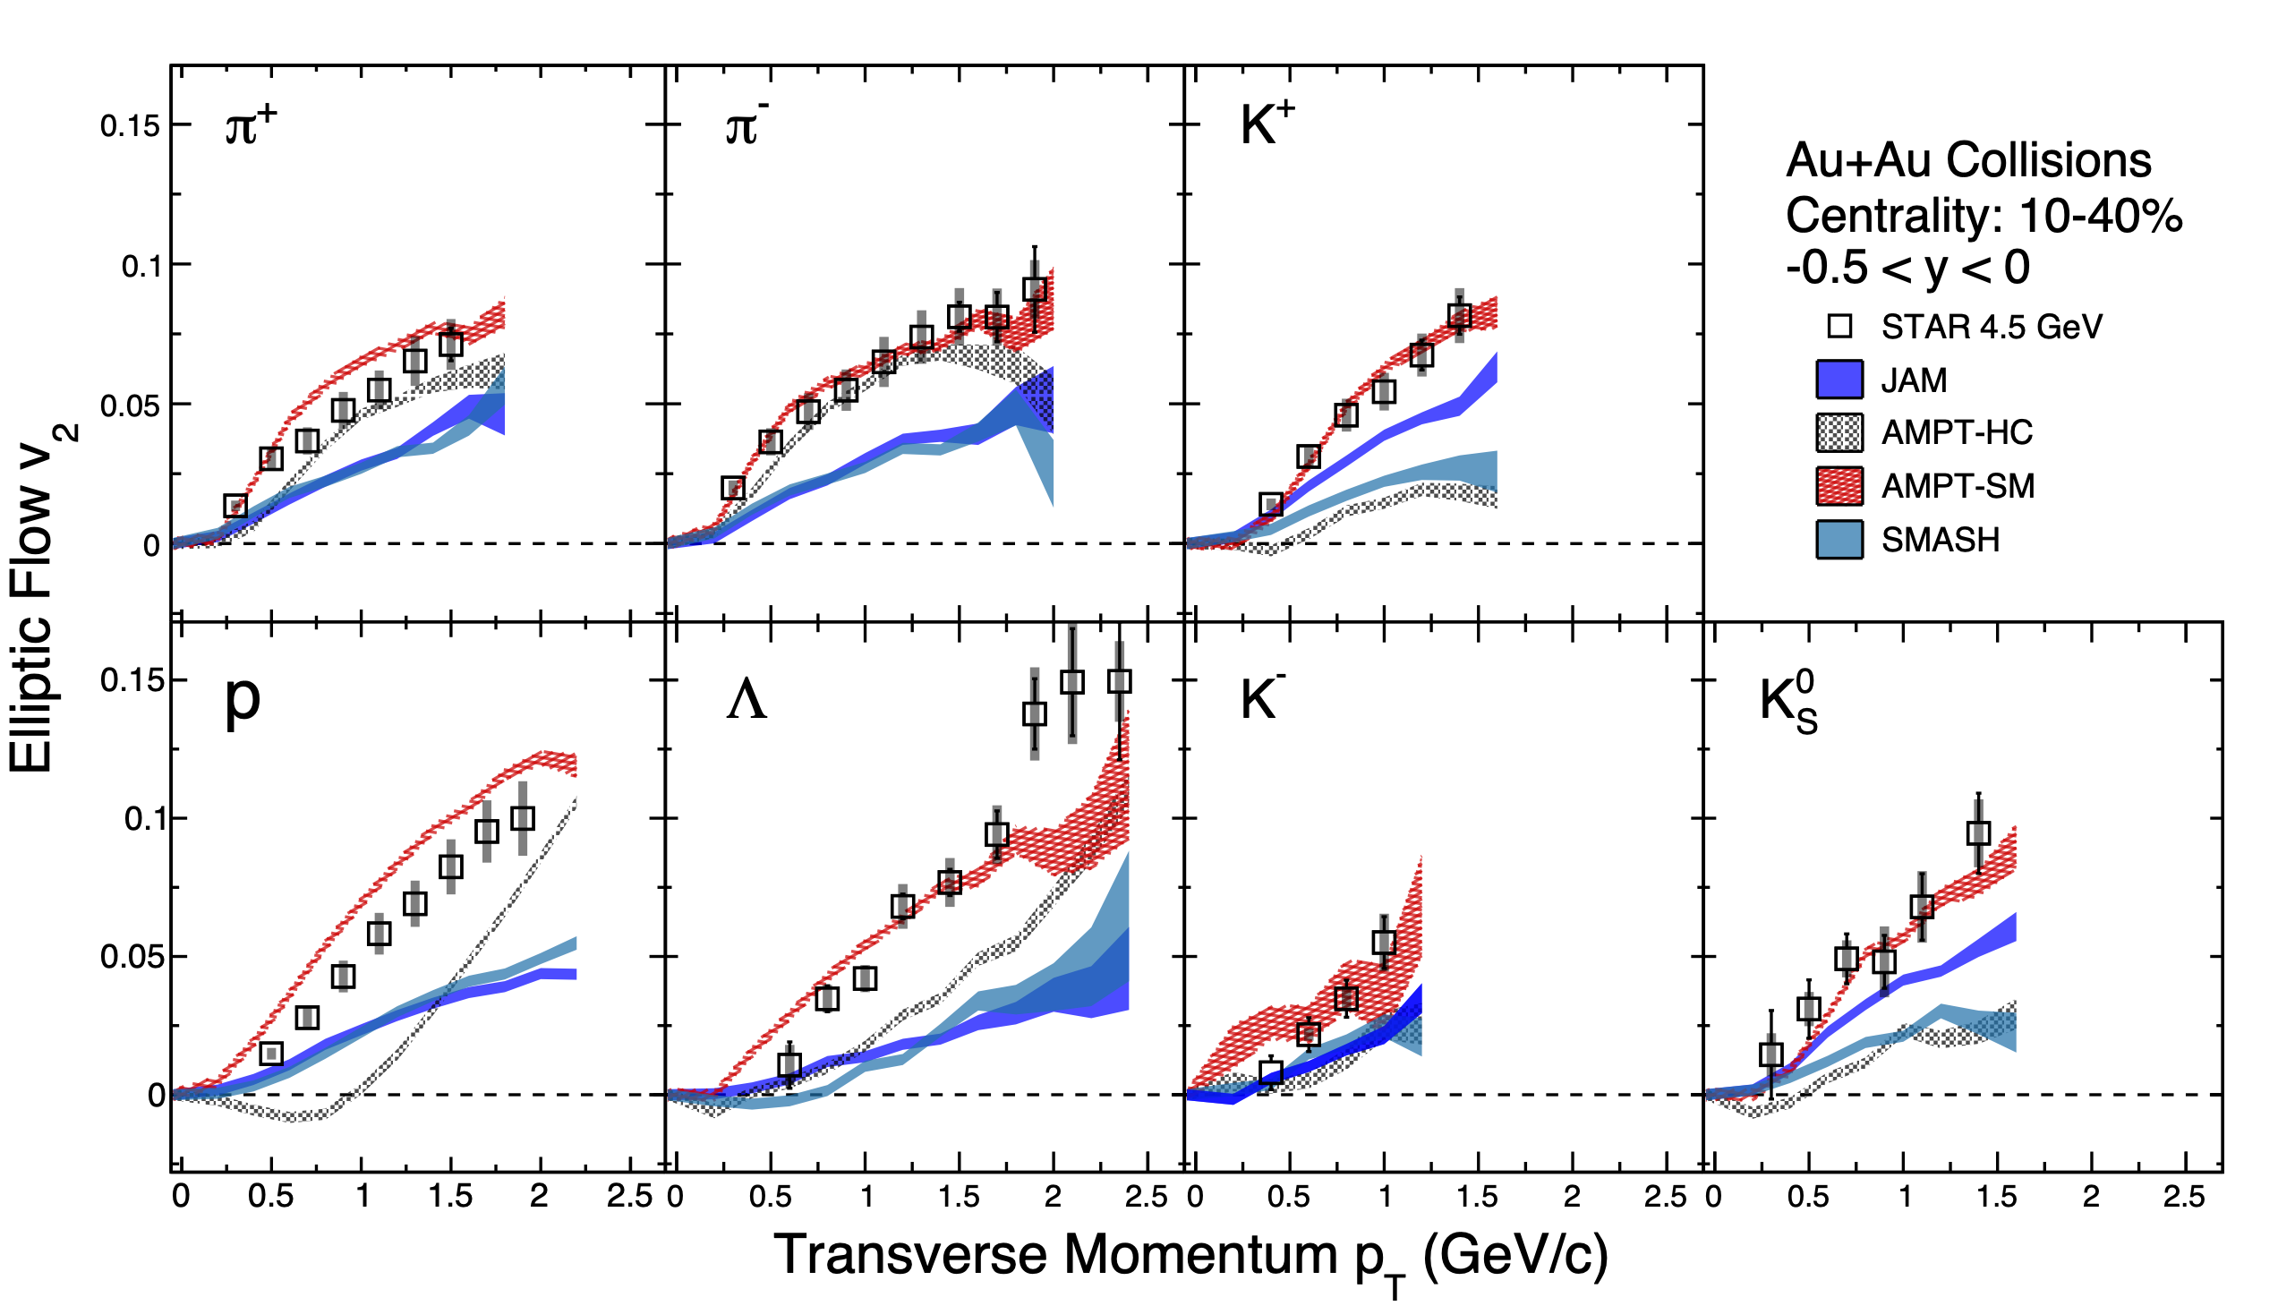
Data-model comparsion: 4.5 GeV
L.K. Liu, S.S. Shi, arxiv: 2508.21577
STAR Collaboration, Phys. Rev. Lett. 135, 072301 (2025)
AMPT-SM matches 4.5 GeV data, while hadronic models underestimate
Emergence of partonic DOF, smaller partonic cross sections & longer mean-free paths
Notes:
Hadronic transport models generally underestimate the $v_2$ data, in contrast, the AMPT-SM model, which incorporates partonic interactions, provides a better description of the $v_2$ data.
This indicates that parton interactions and coalescence play an important role in generating this significant $v_2$ signal,
reflecting the emergence of partonic degrees of freedom, where interactions are governed by smaller partonic cross sections and longer mean-free paths.

Slide 21
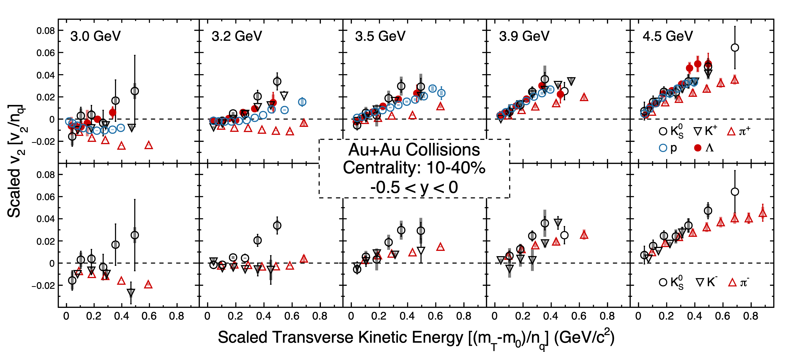
NCQ scaling of v2 at 3 - 4.5 GeV
STAR Collaboration, Phys. Rev. Lett. 135, 072301 (2025)
NCQ scaling completely breaks below 3.2 GeV
NCQ scaling restores gradually from 3.2 to 4.5 GeV
Notes:
In order to demonstrate the NCQ scaling properties, we further scaled the v2 with Number of constituent quark, also for x-axis (the transverse kinetic energy) from 3 to 4.5 GeV. And The upper one is for the particles group, and the lower one is for the anti-particles group. So, Firstly, at 3.0 and 3.2 GeV, NCQ scaling completely breaks, with each particle species exhibiting a different trend. That means the degree of freedom should be dominate by Hadronic interactions(level). With the energy increasing, we can clearing see the evolution of NCQ scaling, the NCQ scaling becomes better gradually from 3 to 4.5 GeV both for particles and anti-particles. Suggest the partonic collectivity built up.
This signals a shift from hadronic to partonic dominance.

Slide 22
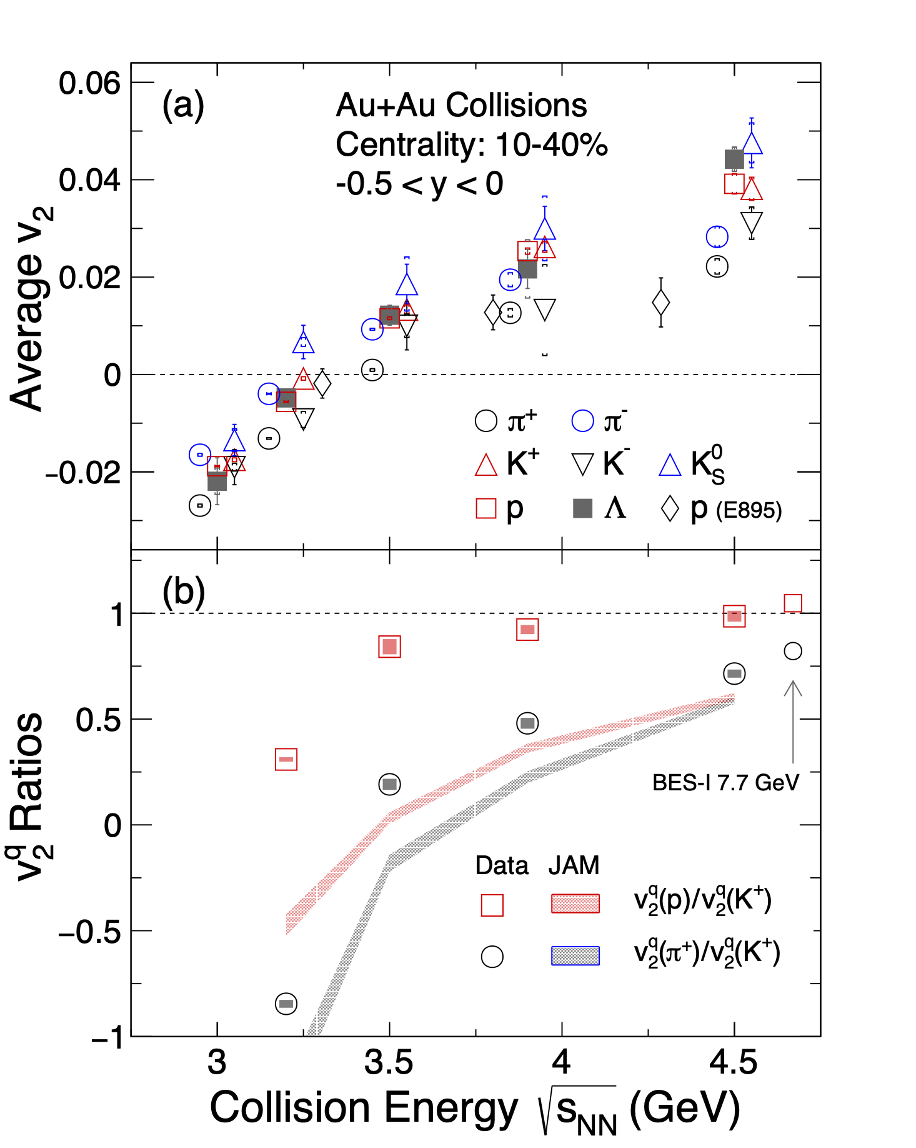
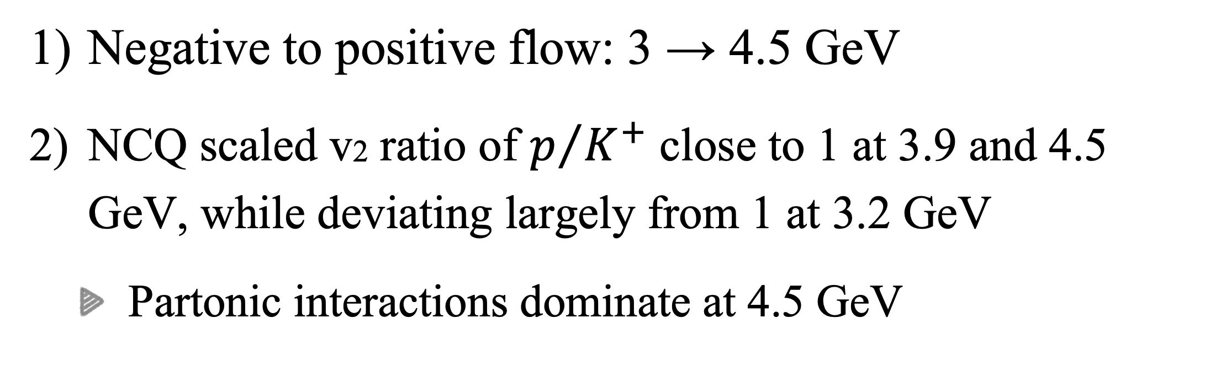
Energy dependence of $⟨v_{2}⟩$
STAR Collaboration, Phys. Rev. Lett. 135, 072301 (2025)
In-plane expansion
Out of plane
Negative to positive flow: 3 → 4.5 GeV
NCQ scaled v2 ratio of $p/{K^{+}}$ close to 1 at 3.9 and 4.5 GeV, while deviating largely from 1 at 3.2 GeV
Partonic interactions dominate at 4.5 GeV
STAR Collaboration, Phys. Rev. C 88, 14902 (2013), Phys. Rev. C 103, 34908 (2021)
Notes:
We further investigate the pT integrated v2 as a function of collision energy, the pT integrated v2 changes from negative to positive flow from 3 to 4.5 GeV.
The out of plane expansion to in-plane expansion, and it passing zero depends on different particle species. In order to quantify the trend of NCQ scaling with collision energy, the lower panel shows the NCQ scaled v2 ratio for these particles as a function of collision energy at ET /nq = 0.4 GeV, similar story as the previous plot. NCQ scaled v2 ratio of p/K+ largely deviate from 1 at 3.2 GeV, and close to 1 at 3.9 and 4.5 GeV, similar with BES-I 7.7 GeV ratio (7.7 GeV ratio is follow the trend).
Indicating the Partonic interactions become more important at 4.5 GeV

Slide 23
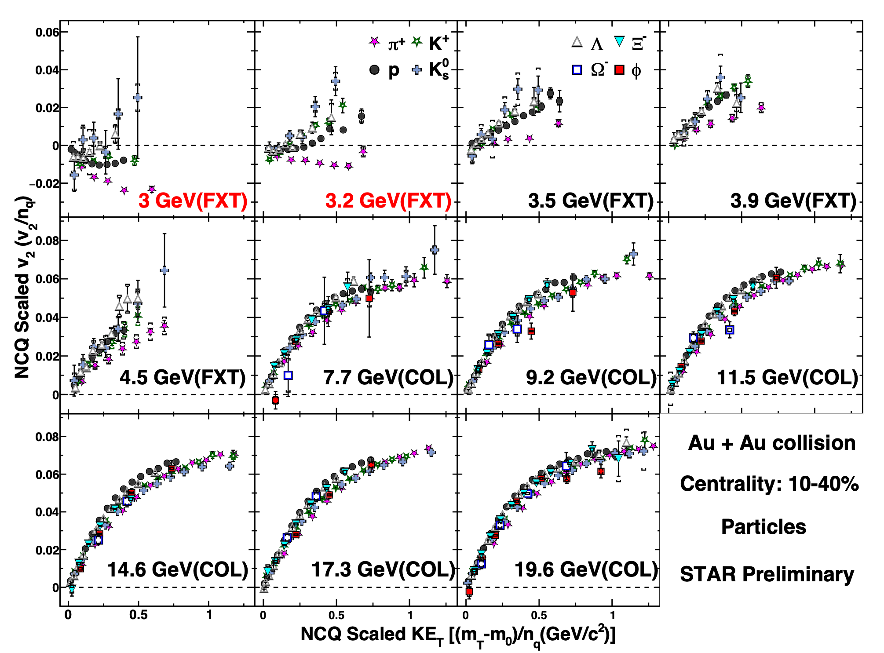
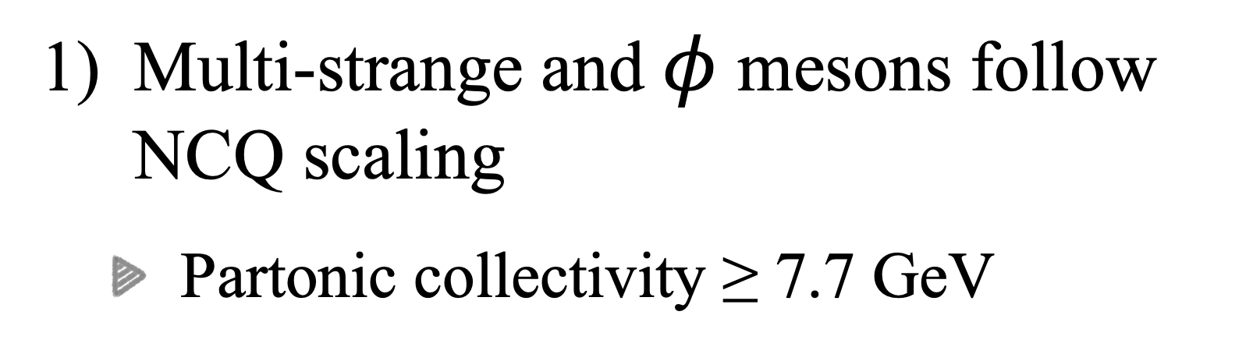
NCQ scaling from 3 - 19.6 GeV
STAR Collaboration, Quark Matter 2025
Multi-strange and $φ$ mesons follow NCQ scaling
Partonic collectivity ≥ 7.7 GeV
Notes:
For higher collision energy, we focus on Multi-strange hadrons and phi mesons.
These findings provide strong evidence that partonic degrees of freedom dominate in Au+Au collisions above 7.7 GeV. They also give us a solid baseline to study partonic collectivity at intermediate energies.

Slide 24
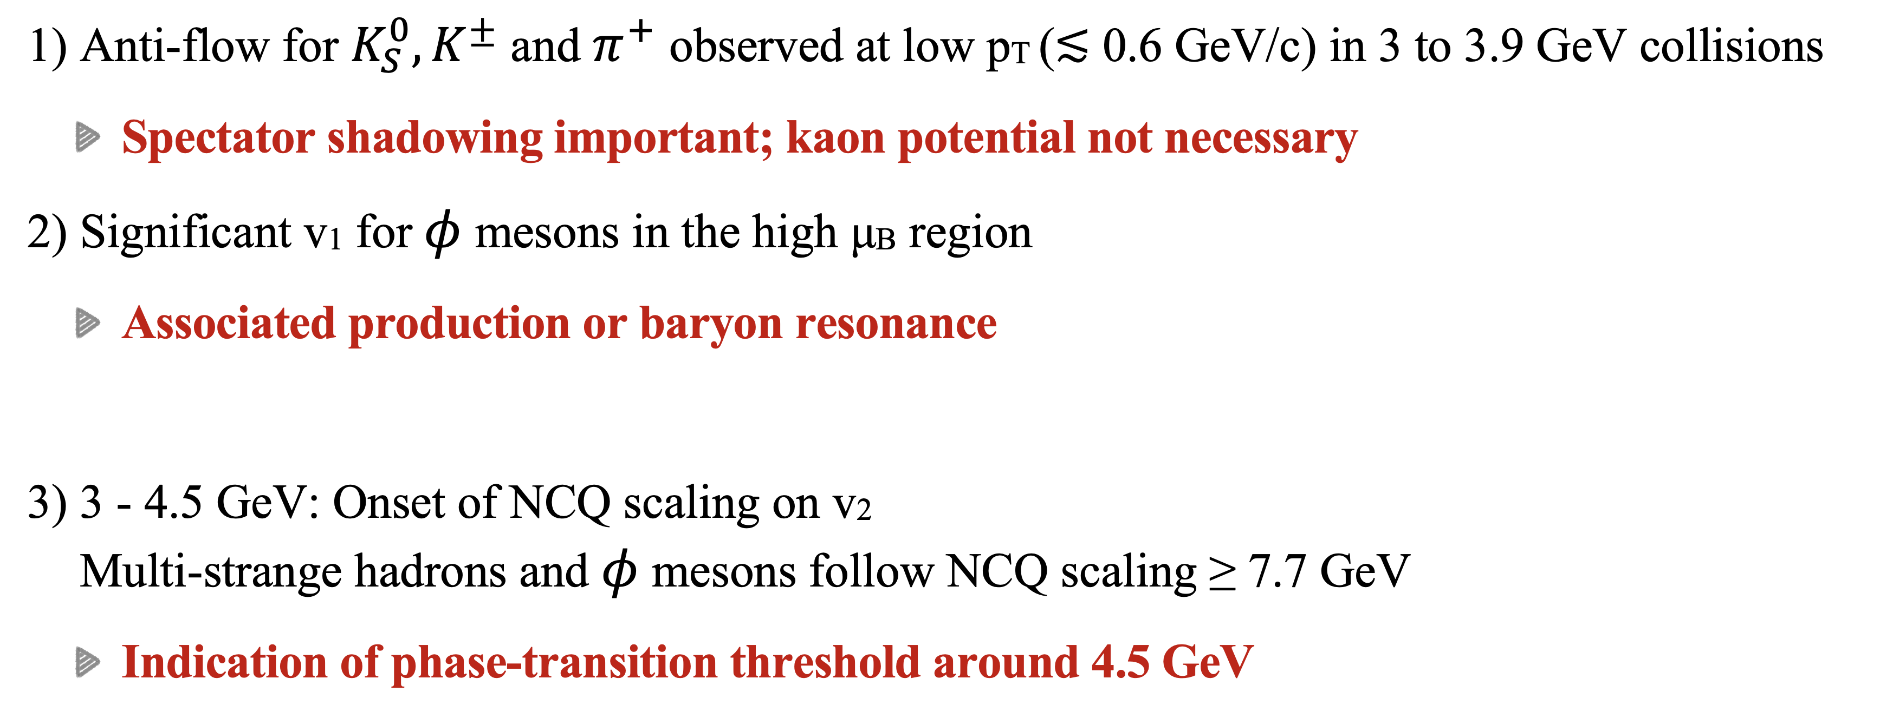
Summary
Anti-flow for $K_{S}^{0},K^{±}$ and $π^{+}$ observed at low pT (≲ 0.6 GeV/c) in 3 to 3.9 GeV collisions
Spectator shadowing important; kaon potential not necessary
Significant v1 for $φ$ mesons in the high μB region
Associated production or baryon resonance
3 - 4.5 GeV: Onset of NCQ scaling on v2 Multi-strange hadrons and $φ$ mesons follow NCQ scaling ≥ 7.7 GeV
Indication of phase-transition threshold around 4.5 GeV
Notes:
Let me give a brief summary, In this talk, We present flow measurements for the identified particles from 3 to 4.5 GeV.
There are two key points. For directed flow: the anti-flow for K0S, charged kaons and pi+ was observed at low pT (≲ 0.6 GeV/c). Combined with previous knowledge and JAM calculation. These results told us shadowing effect is important, and the kaon potential is not necessary. For elliptic flow, NCQ scaling breaks below 3.2 GeV, and gradually restores from 3.0 to 4.5 GeV. It indicates shadowing effect diminishes as the energy increases. And Partonic interactions become more important at 4.5 GeV

Slide 25
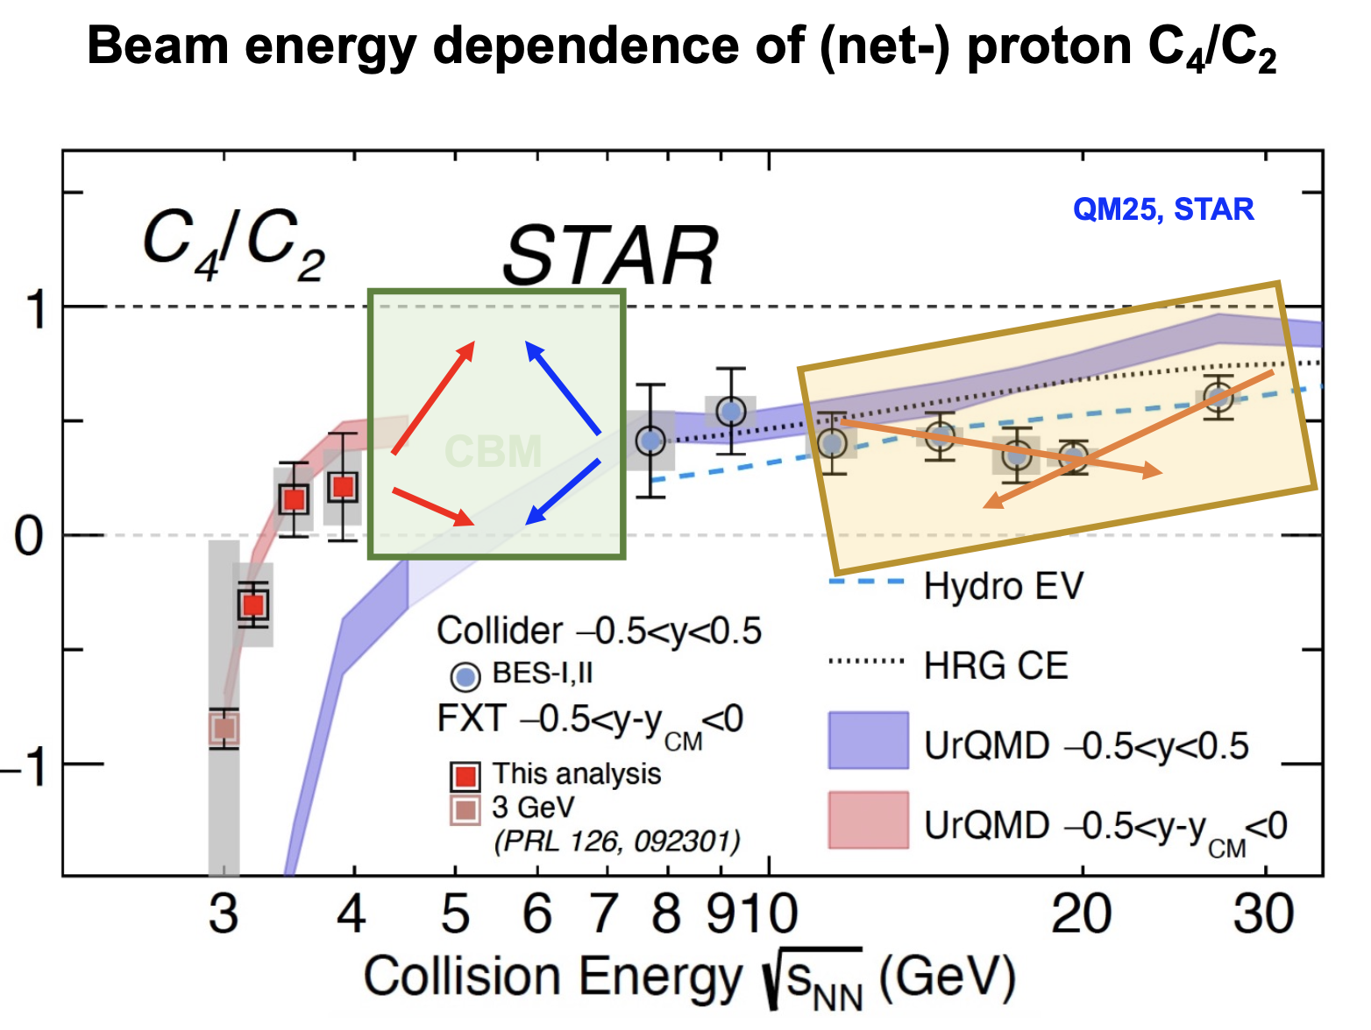
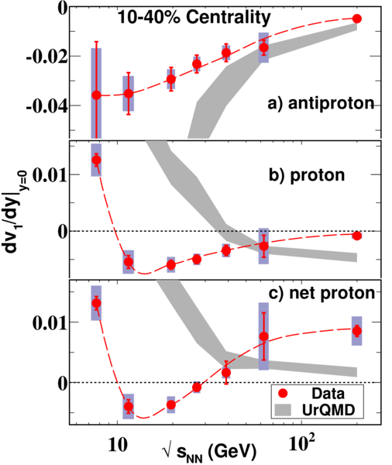
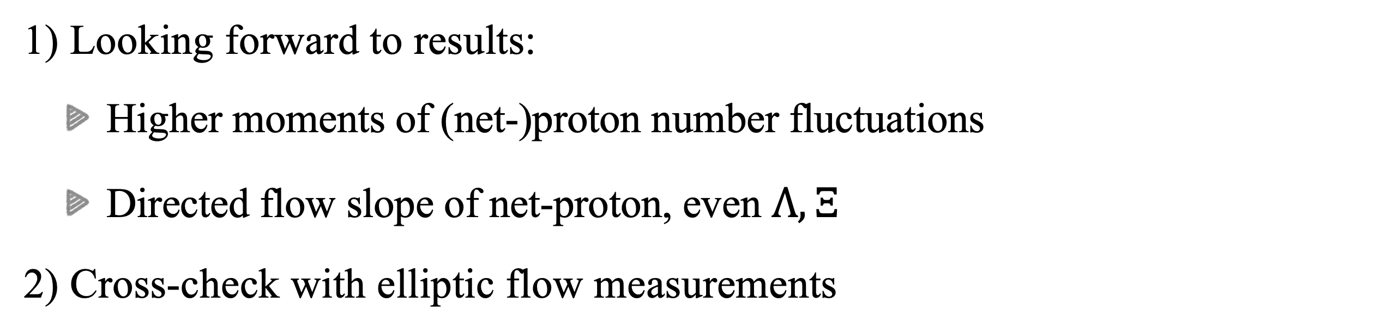
Outlook: Future Measurements
STAR Collaboration, Phys. Rev. Lett. 112 162301 (2014)
Looking forward to results:
Higher moments of (net-)proton number fluctuations
Directed flow slope of net-proton, even $Λ, Ξ^{}$
Cross-check with elliptic flow measurements

Slide 26
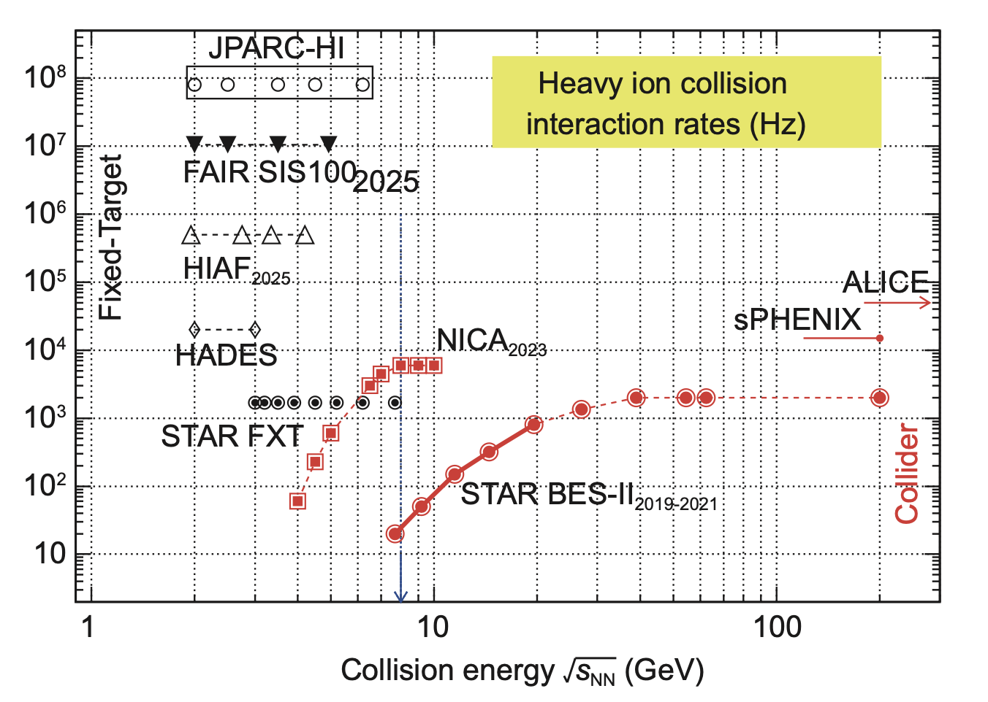
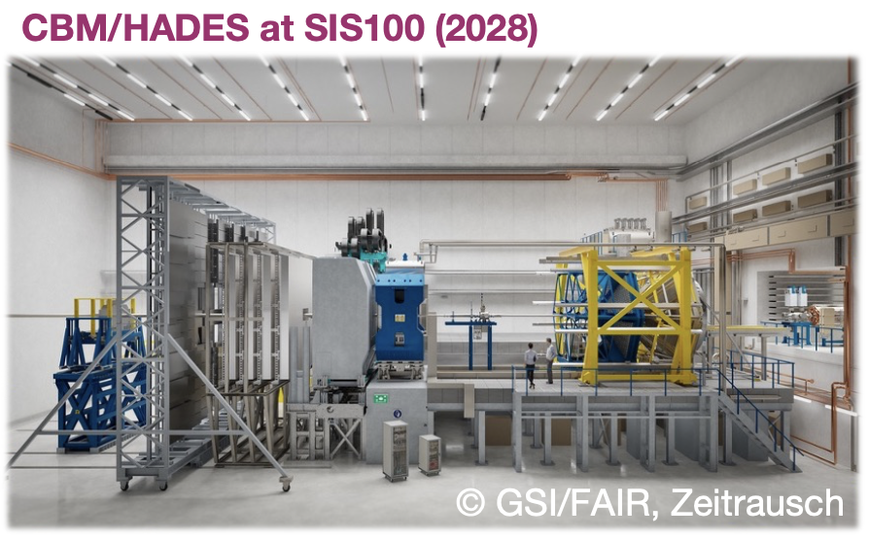


Outlook: Future Experiments
Future experiments: high interaction rates
FAIR-CBM, 2.7 — 4.9 GeV
JINR-NICA, 4 — 11 GeV
HIRFL/HIAF-CEE, 2.1 — 3.3 GeV
Interaction rates (Hz)
MPD at NICA
Notes:
For the next-generation experiments, high interaction rates are reached as the left plot shows,
. It can provide important guidance for exploring the QCD phase diagram.
Yeah, that’s all from my side, thank you very much for your attention!

Slide 27

Backup: NCQ scaling of antiparticles
STAR Collaboration, Quark Matter 2025
Better scaling observed for antiparticles
Notes:
The results around 4.5 GeV show that the NCQ scaling of light and strange hadrons starts to recover, which indicates that partonic interactions begin to dominate in this energy region.
However, measurements of multi-strange hadrons and the $\phi$ meson are still missing at these energies.
At 7.7 GeV and above, we have comprehensive measurements for light, strange, multi-strange, and $\phi$ mesons, all showing consistent partonic collectivity.
Therefore, we can say that 4.5 GeV marks the onset of partonic interactions, while 7.7 GeV and above correspond to the established QGP phase.

Slide 28





Backup: Spectator shadowing effect
Passing time of spectator ~ $2R/γβ$
Expansion suppressed by spectator at 3 GeV, significantly reduced at 4.5 GeV

