Slide 1
Manifestation of scale symmetry in dense nuclear meduim ---peak of sound velocity and pseudoconformal structure
Yong-Liang Ma
Nanjing University
Physics at High Baryon Density (PHD2025),
Wuhan, Oct. 16-18, 2025

Slide 2
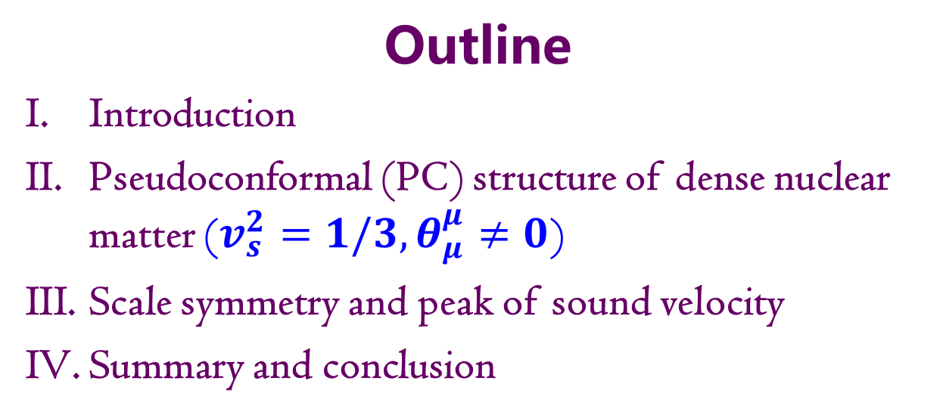
Outline
Introduction
Pseudoconformal (PC) structure of dense nuclear matter ($v_{s}^{2}=1/3, θ_{μ}^{μ}≠0$)
Scale symmetry and peak of sound velocity
Summary and conclusion

Slide 3

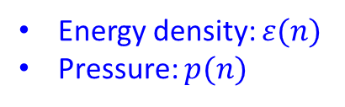
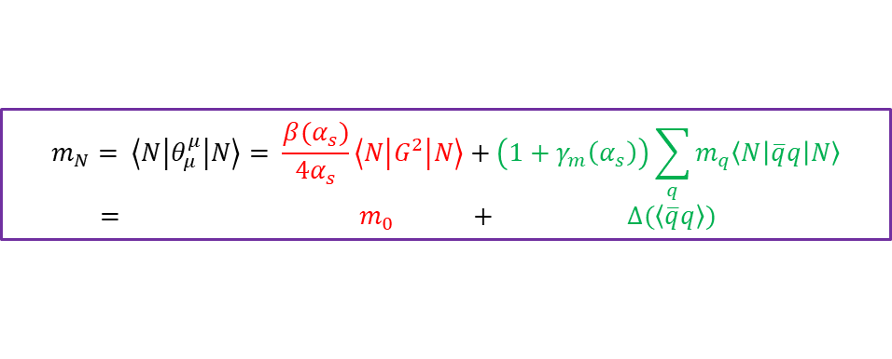
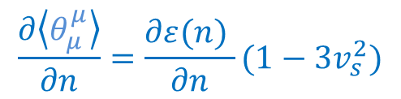
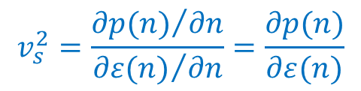
I. Introduction
Scale symmetry in medium is drawing more and more attentions.
Trace of energy momentum tensor
$θ_{μ}^{μ}(n)=ε\left(n\right)−3p(n)$
Energy density: $ε(n)$
Pressure: $p(n)$
$$\frac{∂\left\langle θ_{μ}^{μ}\right\rangle }{∂n}=\frac{∂ε(n) }{∂n}(1−3v_{s}^{2})$$
$$v_{s}^{2}=\frac{{∂p(n)}/{∂n}}{{∂ε(n)}/{∂n}}=\frac{∂p(n)}{∂ε(n)}$$
Stiffness of EOS, behaviour of SV, interaction among quasiparticles！
$$m_{N}= \left\langle N\left|θ_{μ}^{μ}\right|N\right\rangle = \frac{β(α_{s})}{4α_{s}}\left\langle N\left|G^{2}\right|N\right\rangle +\left(1+γ_{m}\left(α_{s}\right)\right)\sum_{q}{m_{q}\left\langle N\left|\overline{q}q\right|N\right\rangle }$$
$= m_{0} + ∆(\left\langle \overline{q}q\right\rangle )$
Origin of nucleon mass:

Slide 4
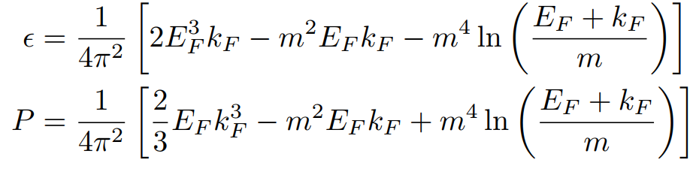
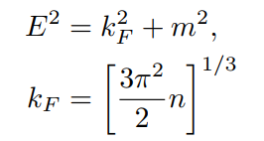

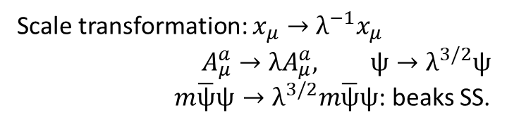
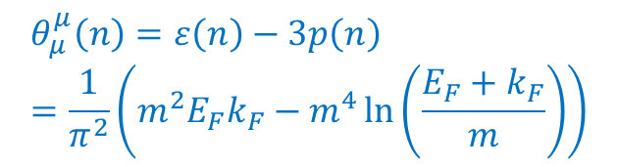
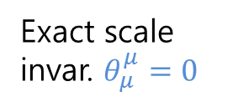
I. Introduction
An example: Cold non-interaction fermion matter:
$$θ_{μ}^{μ}\left(n\right)=ε\left(n\right)−3p\left(n\right)=\frac{1}{π^{2}}\left(m^{2}E_{F}k_{F}−m^{4}\ln\left(\frac{E_{F}+k_{F}}{m}\right)\right)$$
$$m=0$$
Exact scale invar. $θ_{μ}^{μ}=0$
Scale transformation: $x_{μ}→λ^{−1}x_{μ}$
$$A_{μ}^{a}→λA_{μ}^{a}, ψ→λ^{3/2}ψ$$
$m\overline{ψ}ψ→λ^{3/2}m\overline{ψ}ψ$: beaks SS.
Scale symmetry is broken by fermion mass
Notes:
TEMT mstar, PCM

Slide 5






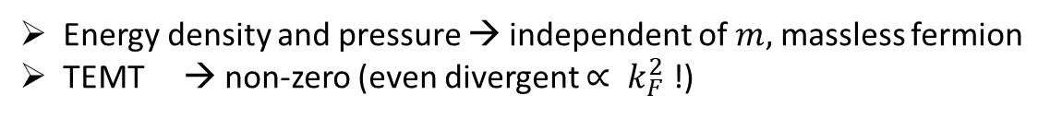
I. Introduction
An example: Cold non-interaction fermion matter:
Extreme high density regime, $k_{F}≫m$
Energy density and pressure → independent of $m,$ massless fermion
TEMT → non-zero (even divergent $∝ k_{F}^{2}$ !)
Can we talk about conformality?
Notes:
Check 一下此式

Slide 6
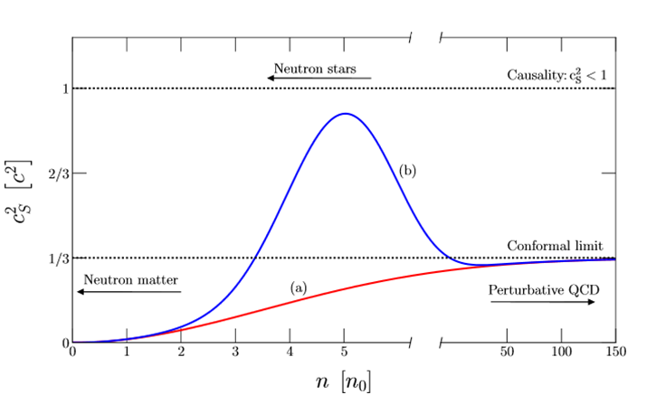
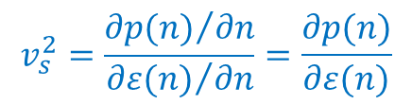
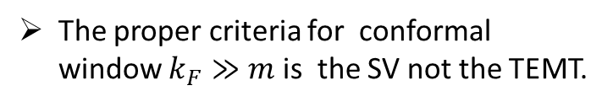
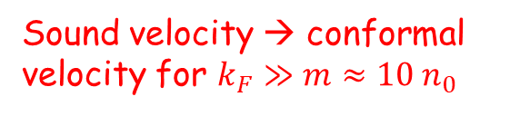
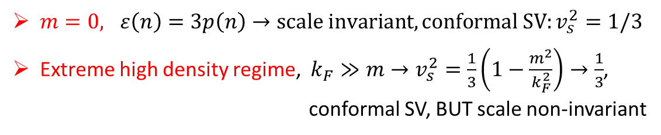
I. Introduction
An example: Cold non-interaction fermion matter:
Sound velocity:
$$v_{s}^{2}=\frac{{∂p(n)}/{∂n}}{{∂ε(n)}/{∂n}}=\frac{∂p(n)}{∂ε(n)}$$
$m=0, ε\left(n\right)=3p\left(n\right)→scale invariant, conformal SV:v_{s}^{2}=1/3$
Extreme high density regime, $k_{F}≫m→v_{s}^{2}=\frac{1}{3}\left(1−\frac{m^{2}}{k_{F}^{2}}\right)→\frac{1}{3}$,
conformal SV, BUT scale non-invariant
Sound velocity → conformal velocity for $k_{F}≫m≈10 n_{0}$
S. Reddy et al, 2018
The proper criteria for conformal window $k_{F}≫m$is the SV not the TEMT.
Notes:
Check 一下此式

Slide 7
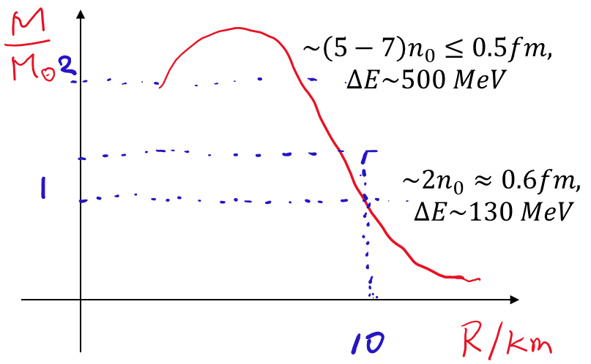
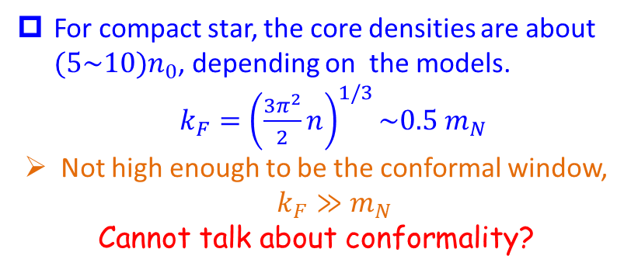
I. Introduction
Compact star matter (strongly correlated matter):
For compact star, the core densities are about $(5\sim 10)n_{0}$, depending on the models.
$k_{F}={\left(\frac{3π^{2}}{2}n\right)}^{1/3}\sim 0.5 m_{N}$
Not high enough to be the conformal window, $k_{F}≫m_{N}$
Cannot talk about conformality?
It is a criterion relevant to the non-interacting massive fermions, cannot be simply imposed on the strongly interacting fermionic matter at the core of compact star. A conformal window may appear in a different context.
H. K. Lee, symmetry 16 (2024), 1598
Notes:
Check 一下此式

Slide 8



I. Introduction
Effective Lagrangian for interacting nucleon $N$
Symmetries implemented
Chiral symmetry: pseudo scalar mesons, pion $π$
Chiral symmetry: pseudo scalar mesons, pion 𝜋
Hidden local symmetry: vector mesons, $ρ, ω$
Hidden local symmetry: vector mesons, 𝜌, 𝜔
Scale symmetry: dilaton, $χ$
Scale symmetry: dilaton, χ
EFT of QCD, real QCD in the sense of power counting.
Trace anomaly in effective models：
anomaly match
Trace anomaly in QCD
Trace anomaly EFT
$$θ_{μ}^{μ}=\frac{β(g)}{2g}G_{μv}G^{μv}∝χ^{4}$$
Dilaton compensator;
A source of scalar meson in EFT
$$δ_{D}V(χ) ∝χ^{4}$$

Slide 9
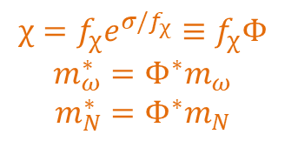
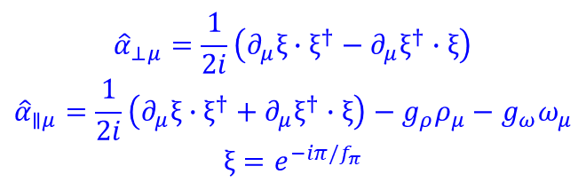
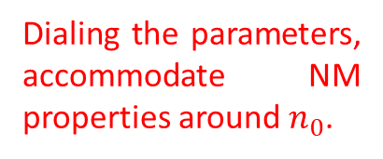
II. PC structure of dense nuclear matter
$$χ=f_{χ}e^{σ/f_{χ}}≡f_{χ}Φ$$
$$m_{ω}^{∗}=Φ^{∗}m_{ω}$$
$$m_{N}^{∗}=Φ^{∗}m_{N}$$
$${\hat{α}}_{⊥μ}=\frac{1}{2i}\left(∂_{μ}ξ∙ξ^{†}−∂_{μ}ξ^{†}∙ξ\right)$$
$${\hat{α}}_{∥μ}=\frac{1}{2i}\left(∂_{μ}ξ∙ξ^{†}+∂_{μ}ξ^{†}∙ξ\right)−g_{ρ}ρ_{μ}−g_{ω}ω_{μ}$$
$$ξ=e^{−iπ/f_{π}}$$
Trace anomaly
Dialing the parameters, accommodate NM properties around $n_{0}$.
W. G. Paeng, T. T. S. Kuo, H. K. Lee, YLM, M. Rho, arXiv: 1704.02775.

Slide 10
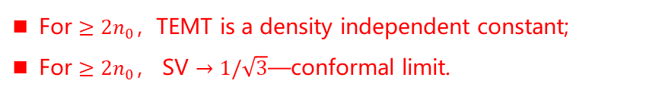
II. PC structure of dense nuclear matter
W. G. Paeng, T. T. S. Kuo, H. K. Lee, YLM, M. Rho, arXiv: 1704.02775.
Peak due to topology change
Relevant to the core of NS
For $≥2n_{0}$，TEMT is a density independent constant;
For $≥2n_{0}$， SV $→1/\sqrt{3}$—conformal limit.
Pseudoconformal structure
A feature not observed before.

Slide 11
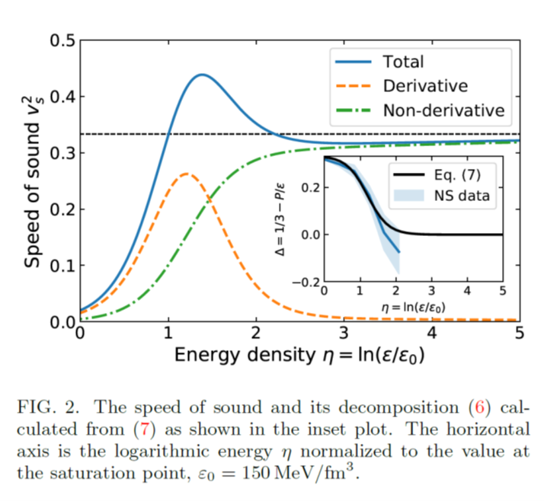
II. PC structure of dense nuclear matter
The PCM changed the previous understanding of the EoS：
The model where the sound velocity saturating the conformal limit at asymptotic density, cannot predicted the maximum value of the NS mass satisfying the observation of the massive NSs.
Predicted in more models
Quark-hadron crossover
Quarkyonic matter
Quarkyonic matter
S. Reddy et al, 2018
Kapusta & Welle, 2103.16633
Zhao & Lattimer, 2004.08293
Margueron et al, 2103.10209
Fujimoto, et al, 2207.06753

Slide 12
II. PC structure of dense nuclear matter
Agrees with the empirical values of the nuclear matter properties quite well.
YLM & M. Rho, 2006.14173 v1
Notes:
其他参考文献？

Slide 13
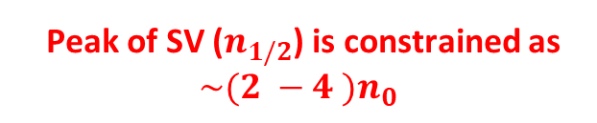
II. PC structure of dense nuclear matter
Peak of SV ($n_{1/2}$) is constrained as $\sim (2 −4 )n_{0}$
Notes:
其他参考文献？

Slide 14
II. PC structure of dense nuclear matter
Notes:
其他参考文献？

Slide 15

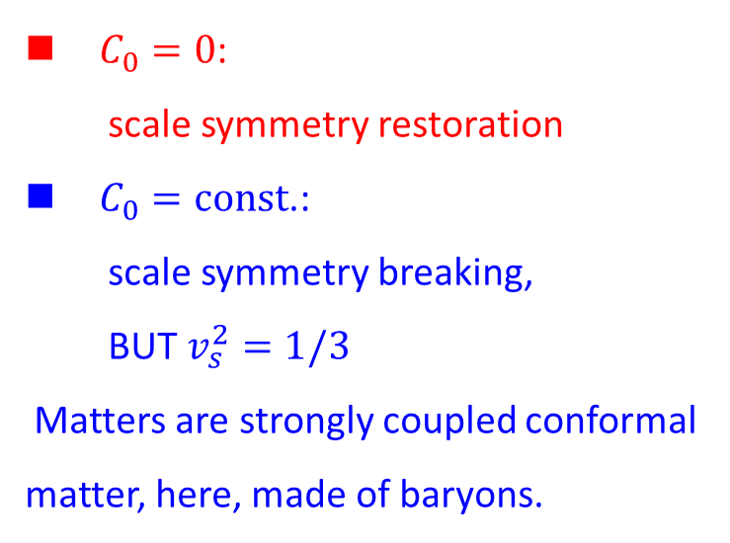

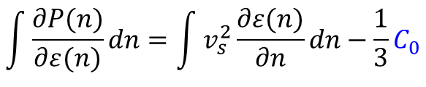




II. PC structure of dense nuclear matter
$$v_{s}^{2}=\frac{∂P(n)}{∂ε(n)}/\frac{∂ε(n)}{∂n}$$
$C_{0}=0$:
scale symmetry restoration
$C_{0}=const$.:
scale symmetry breaking,
BUT $v_{s}^{2}=1/3$
Matters are strongly coupled conformal matter, here, made of baryons.
$$\int{\frac{∂P(n)}{∂ε(n)}}dn=\int{v_{s}^{2}}\frac{∂ε(n)}{∂n}dn−\frac{1}{3}C_{0}$$
Const. SV
$$P\left(n\right)=v_{s}^{2}ε(n)−\frac{1}{3}C_{0}$$
PCM for DM $T_{μ}^{μ}≠0; v_{s}→1/\sqrt{3}$
$$v_{s}^{2}=1/3$$
$$ε\left(n\right)−3P\left(n\right)=C_{0}$$
ideal liquid
$$θ_{μ}^{μ}\left(n\right)=ε\left(n\right)−3p\left(n\right)=C_{0}$$
YLM & M. Rho, 2006.14173
YLM & W. C. Yang, 2301.02105

Slide 16
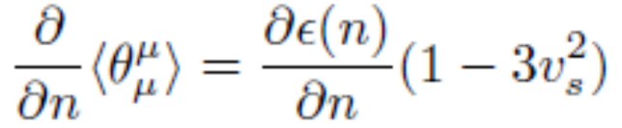
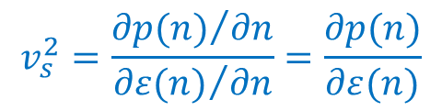


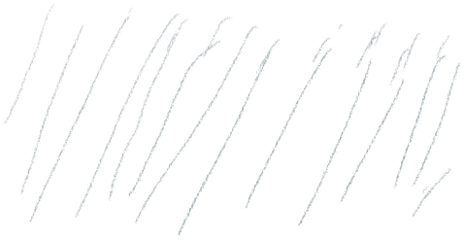




III. Scale symmetry and peak of SV
$$v_{s}^{2}=\frac{{∂p(n)}/{∂n}}{{∂ε(n)}/{∂n}}=\frac{∂p(n)}{∂ε(n)}$$
$$v_{s}^{2}$$
1
At least one peak
pQCD region
$$1/3$$
$$\sim 2n_{0}$$
$$\sim 10 n_{0}$$
$$\sim 100n_{0}$$

Slide 17
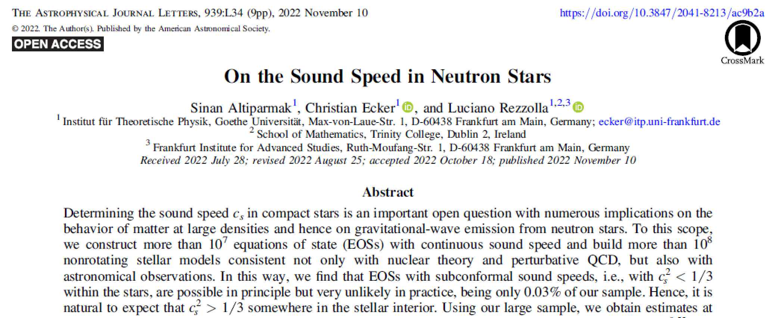
III. Scale symmetry and peak of SV

Slide 18
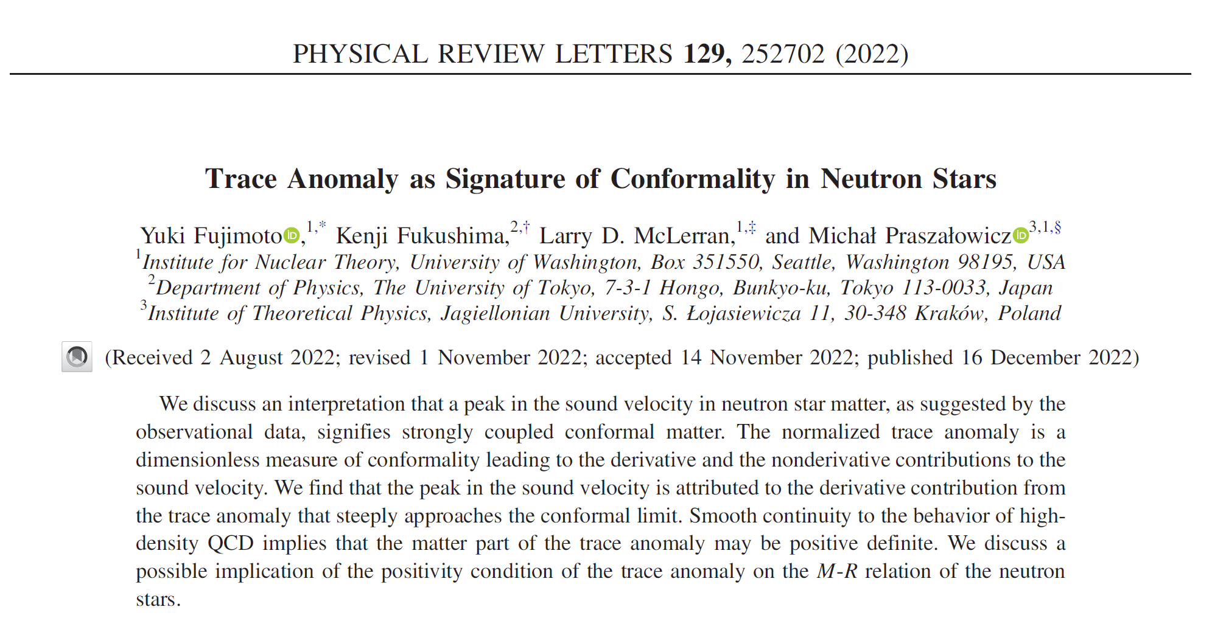


Slide 19
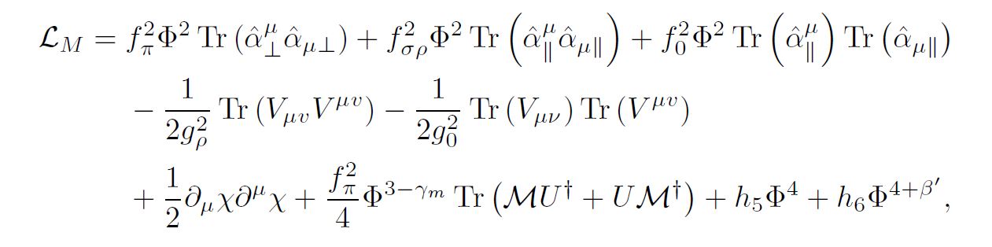
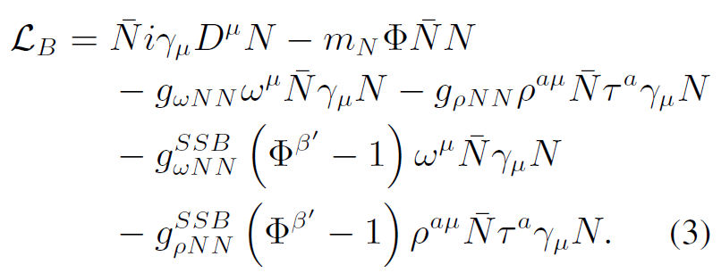
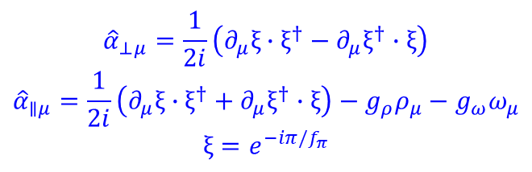
III. Scale symmetry and peak of SV
$${\hat{α}}_{⊥μ}=\frac{1}{2i}\left(∂_{μ}ξ∙ξ^{†}−∂_{μ}ξ^{†}∙ξ\right)$$
$${\hat{α}}_{∥μ}=\frac{1}{2i}\left(∂_{μ}ξ∙ξ^{†}+∂_{μ}ξ^{†}∙ξ\right)−g_{ρ}ρ_{μ}−g_{ω}ω_{μ}$$
$$ξ=e^{−iπ/f_{π}}$$
L. Q. Zhang, Y. Ma and YLM, 2410.04142; 2412.19023.

Slide 20
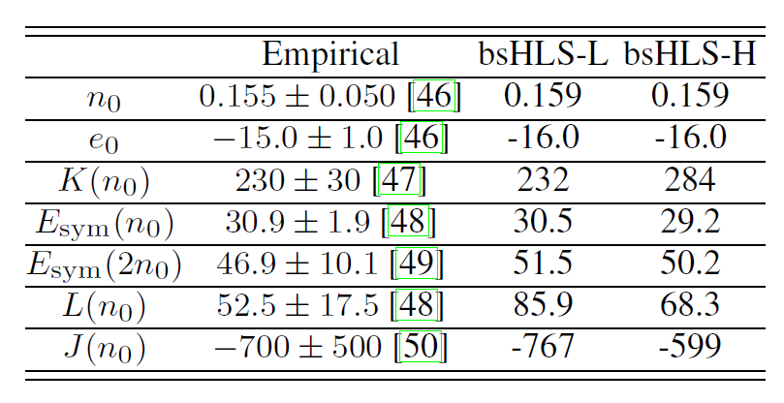
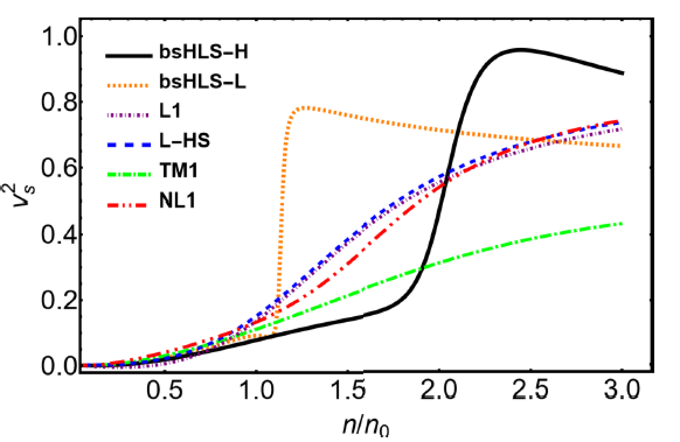
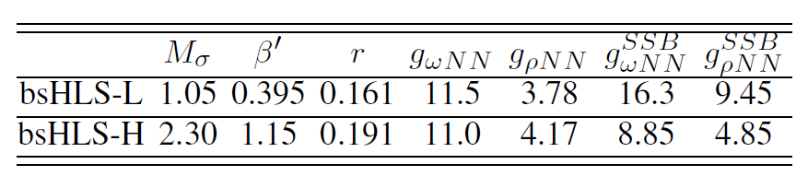

III. Scale symmetry and peak of SV
Self-consistent mean field calculation
Peak of SV, not far from $n_{0}$
Linear model
The peak in the SV is due to the nonlinear realization of scale symmetry, NOT observed in Walecka-typy models!

Slide 21
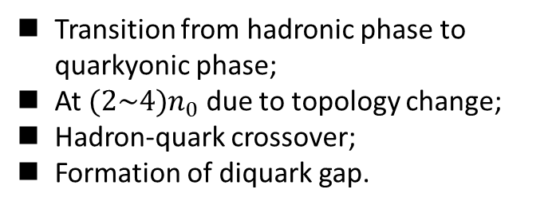
III. Scale symmetry and peak of SV
Hippert, et al. , 2105.04535
Emerges in the transition from a phase with broken chiral symmetry to one with gapped Fermi surface with the condensation of diquarks and dibaryons.
Transition from hadronic phase to quarkyonic phase;
At $(2\sim 4)n_{0}$ due to topology change;
Hadron-quark crossover;
Formation of diquark gap.
Hadronic phase
L. McLerran and S. Reddy, PRL122 (2019), 122701.
T. Zhao and J. M. Lattimer, PRD102 (2020), 023021.
YLM and M. Rho, PRD99 (2019), 014034; PPNP113 (2020), 103791;
G. Baym, S. Furusawa, et al., APJ 885 (2019), 42;
M. Leonhardt, M. Pospiech, et al., PRL125 (2020), 142502 (2020).
Chiral-scale EFT, NO phase transition/configuration change!

Slide 22
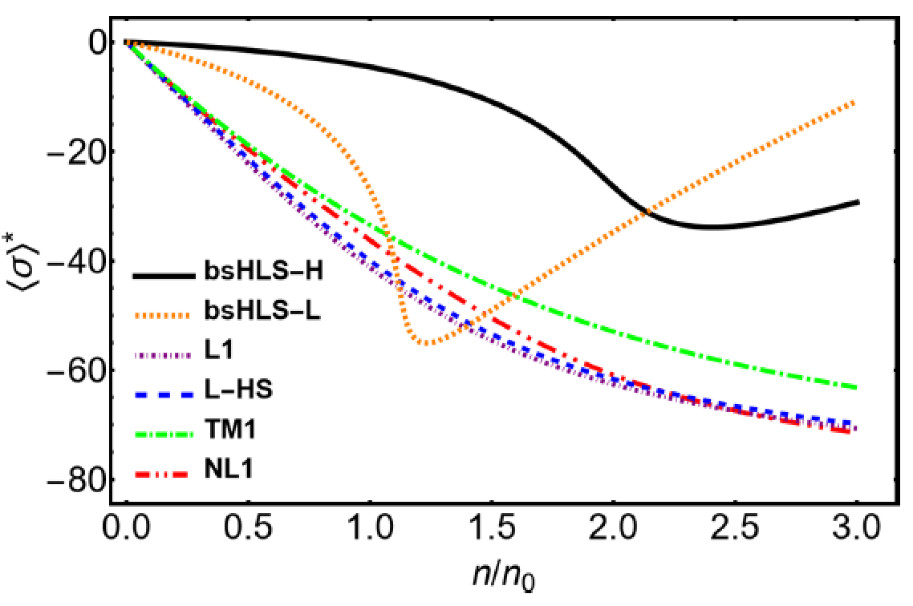
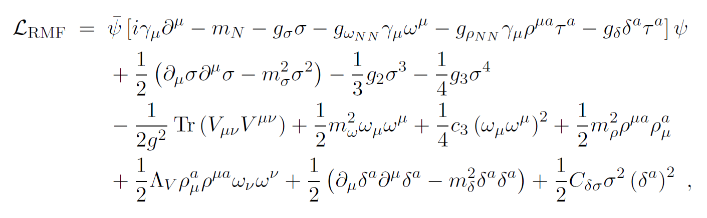
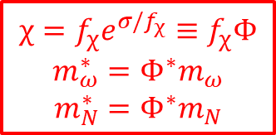
III. Scale symmetry and peak of SV
Why in Chiral-scale EFT?
Scale symmetry is first partially restored with density, but then stops after a critical denity.
Also found in skyrmion crystal approach.
Long-Qi Shao, YLM, arXiv:2202.09957
$$χ=f_{χ}e^{σ/f_{χ}}≡f_{χ}Φ$$
$$m_{ω}^{∗}=Φ^{∗}m_{ω}$$
$$m_{N}^{∗}=Φ^{∗}m_{N}$$

Slide 23
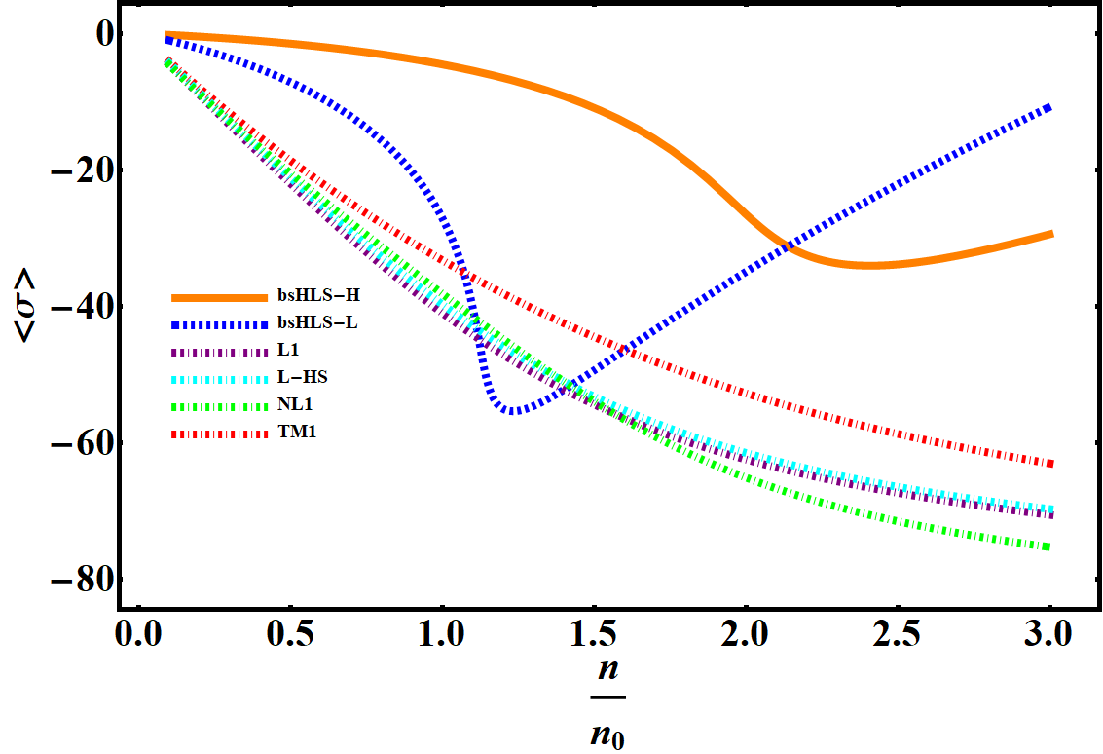
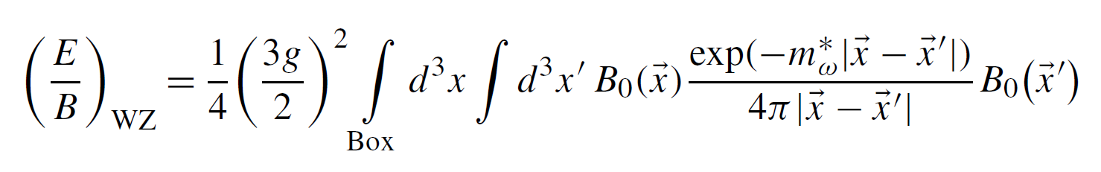
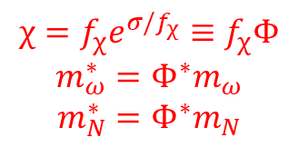
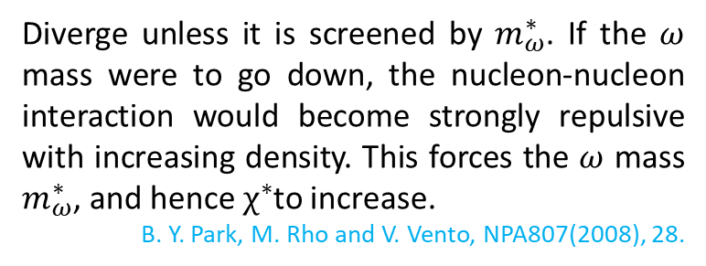
III. Scale symmetry and peak of SV
Why in Chiral-scale EFT?
Scale symmetry is first partially restored with density, but then stops after a critical denity.
Also found in skyrmion crystal approach.
Long-Qi Shao, YLM, arXiv:2202.09957
The nonlinear realization of scale symmetry gives a natural explanation of the peak in the SV, WITHOUT retrospect to phase transition/configuration change!
Diverge unless it is screened by $m_{ω}^{∗}$. If the $ω$ mass were to go down, the nucleon-nucleon interaction would become strongly repulsive with increasing density. This forces the $ω$ mass $m_{ω}^{∗}$, and hence $χ^{∗}$to increase.
B. Y. Park, M. Rho and V. Vento, NPA807(2008), 28.
$$χ=f_{χ}e^{σ/f_{χ}}≡f_{χ}Φ$$
$$m_{ω}^{∗}=Φ^{∗}m_{ω}$$
$$m_{N}^{∗}=Φ^{∗}m_{N}$$

Slide 24
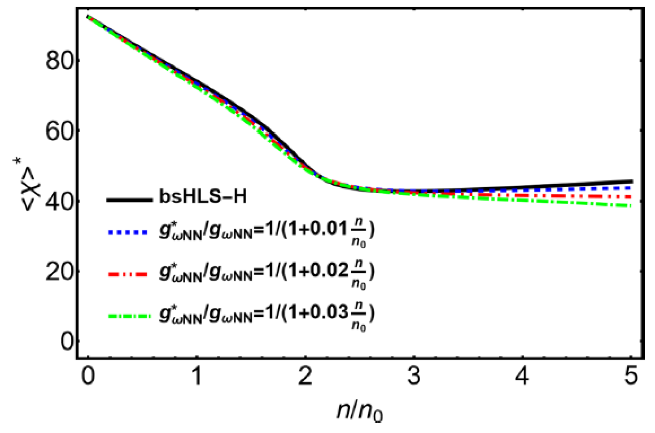
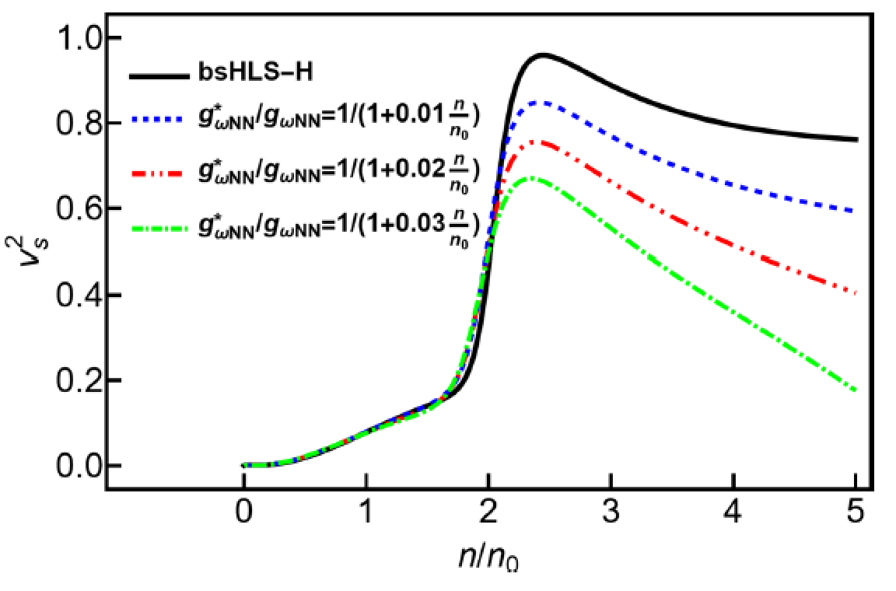

III. Scale symmetry and peak of SV
A scaled $ω−N−N$ coupling:
Correction to LOSS is significant for the restoration of SS!
Locations are locked

Slide 25
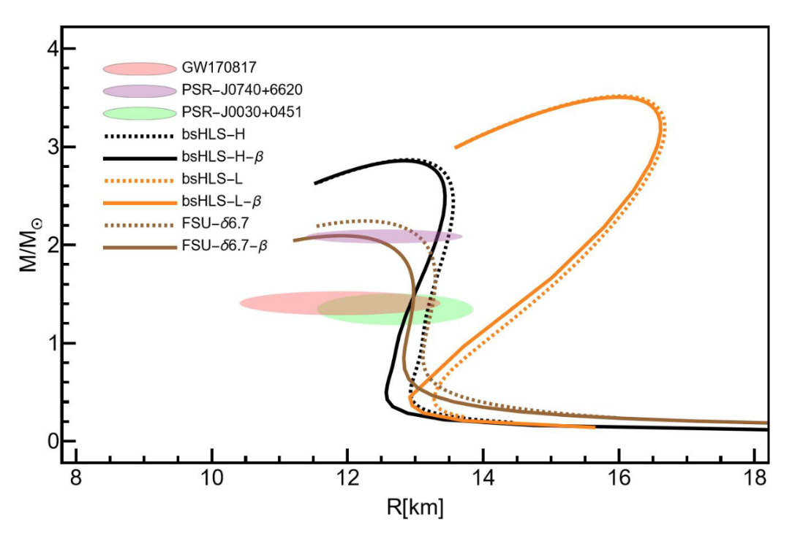
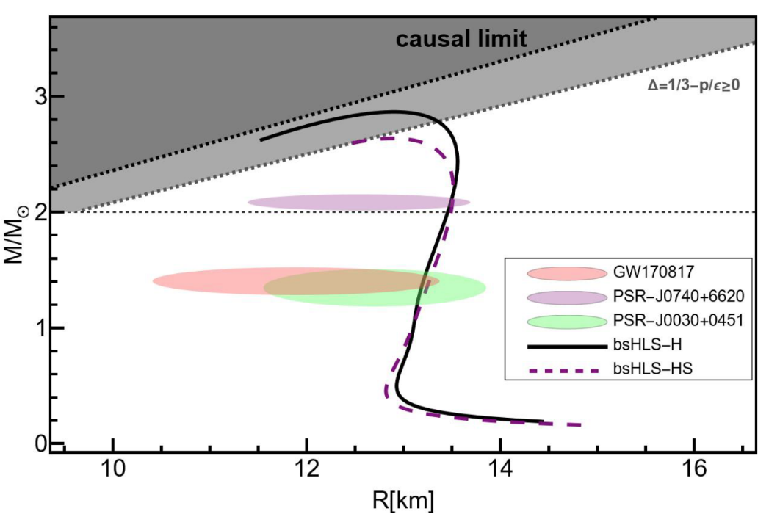
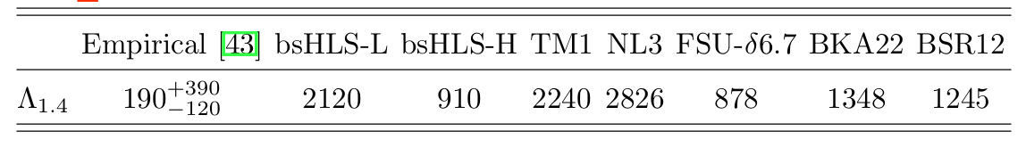
III. Scale symmetry and peak of SV
Confront with NS observations and GW detections
Without considering beta equilibrium.

Slide 26
IV. Summary and discussion
The nonlinear realization of scale symmetry provides a mechanism for generating the peak of SV in nuclear matter, NOT the hadron-quark transition or other configuration change;
The SV can saturates the conformal limit in the core of massive stars, BUT matter is not conformal---pseudoconformal. Conformal SV may not be due to the deconfinement phase transition;
The predictions of the theory agree with all the observations obtained so far. Cannot be excluded.

Slide 27



IV. Summary and discussion
PC requires $m=0$? NO!
If (nearly) non-interaction quasi-fermion matter:
$$θ_{μ}^{∗μ}\left(n\right)=ε\left(n\right)−3p\left(n\right)=\frac{1}{π^{2}}\left(m^{∗2}E_{F}k_{F}−m^{∗4}\ln\left(\frac{E_{F}+k_{F}}{m^{∗}}\right)\right)$$
$$\frac{∂θ_{μ}^{∗μ}\left(n\right)}{∂n}=0 →constrain m^{∗}\left(n\right)!$$

Slide 28





IV. Summary and discussion
G-T transition of heavy nuclei
(YM & M. Rho, 2020)
$$\left\langle T_{μ}^{μ}\right\rangle \sim \left\langle χ\right\rangle \sim m_{N}$$
$${\left\langle T_{μ}^{μ}\right\rangle }^{∗}/\left\langle T_{μ}^{μ}\right\rangle$$
Chiral invariant mass of hadron
Quark matter
pQCD region
Peak of SV
$$\frac{∂\left\langle T_{μ}^{μ}\right\rangle }{∂n_{B}}=\frac{∂ε(n)}{∂n}\left(1−3v_{s}^{2}\right)=0$$
Scale symmetry is hidden. Pseudoconformal
YLM, M. Rho, et al, 15’~22’
$$\sim 2n_{0}$$
$$\sim 10 n_{0}$$
$$\sim 100n_{0}$$
Scale symmetry is broken
Scale invariant.

Slide 29
Acknowledgement:
M. Harada (Nagoya), T. Kuo (Stony Brook), H. K. Lee (Hanyang), Y. L. Li (Jilin), Yao Ma (Nanjing), W. G. Paeng (Hanyang), B. Y. Park (Daejon), M. Rho (Saclay), L. Q. Zhang (Nanjing), ……

Slide 30
Thank you for your attention!

Slide 31



IV. Summary and discussion
Nucleon mass includes a large of chiral invariant component. Gluon/Dilaton condensate.
$$m_{N}= \left\langle N\left|θ_{μ}^{μ}\right|N\right\rangle = \frac{β(α_{s})}{4α_{s}}\left\langle N\left|G^{2}\right|N\right\rangle +\left(1+γ_{m}\left(α_{s}\right)\right)\sum_{q}{m_{q}\left\langle N\left|\overline{q}q\right|N\right\rangle }$$
$= m_{0} + ∆(\left\langle \overline{q}q\right\rangle )$
Origin of nucleon mass:

Slide 32





I. Introduction
Symmetry and symmetry breaking play dominant roles in particle and nuclear physics.
Scale symmetry in medium is drawing more and more attentions.
Scale symmetry and scale symmetry breaking:
Scale transformation: $x_{μ}→λ^{−1}x_{μ}$
$$A_{μ}^{a}→λA_{μ}^{a}, ψ→λ^{3/2}ψ$$
Invariant at classical level;
Broken by quantum correction:
$∂_{μ}J_{D}^{μ}=T_{μ}^{μ}=\frac{β(α_{s})}{2α_{s}}G_{μv}^{a}G^{aμv}+\left(1+γ_{m}\right)m\overline{q}q$

Slide 33

I. Introduction
Trace anomaly in QCD
$∂_{μ}D^{μ}= \frac{β(α_{s})}{4α_{s}}Tr (G_{μv}G^{μv})$
A possible way to introduce a scalar meson.

Slide 34

I. Introduction
$f_{0}(500)$ is a pNGB arising from (noted $m_{f_{0}} ≅ m_{K}$). The SB of SS associated + an explicit breaking of SI.
Assumption: There is an Nonperturbative IR fixed point in the running QCD coupling constant $α_{s}$.
EB of SI: Departure of $α_{s}$ from IRFP + current quark mass.
Crewther and Tunstall , PRD91(2015), 034016, e-Print: 1312.3319
Provides an approach to include scalar meson in ChPT.

Slide 35



I. Introduction
The QCD Running Coupling, A. Deur, e-Print: 2502.06535 [hep-ph].
The absence of $Q^{2}$-dependence of $α_{s}$ in the IR, i.e., the vanishing QCD β-function, is variously named the freezing of $α_{s}$, the conformal window of QCD, or the $Q^{2}=0$ fixed point.

Slide 36



IV. Summary and discussion
Pseudoconformal, also hQCD models (soliton matter);
Deviate from QCD. Corrections from $O\left(\frac{1}{N_{c}}\right)$ ?
J. S. Wang, L. K. Yang, et al., 2508.18659
Notes:
其他参考文献？

Slide 37
I. Introduction
潮汐形变？观测的一致性。
2017PC文章，解释PC，与以往观点的不同。
区分Walecka模型的sigma与dilaton中的sigma
声速的行为，统计分析。

