Slide 1
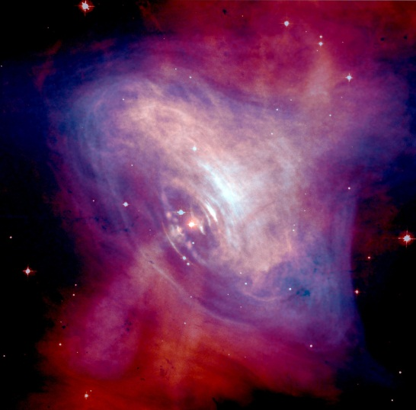
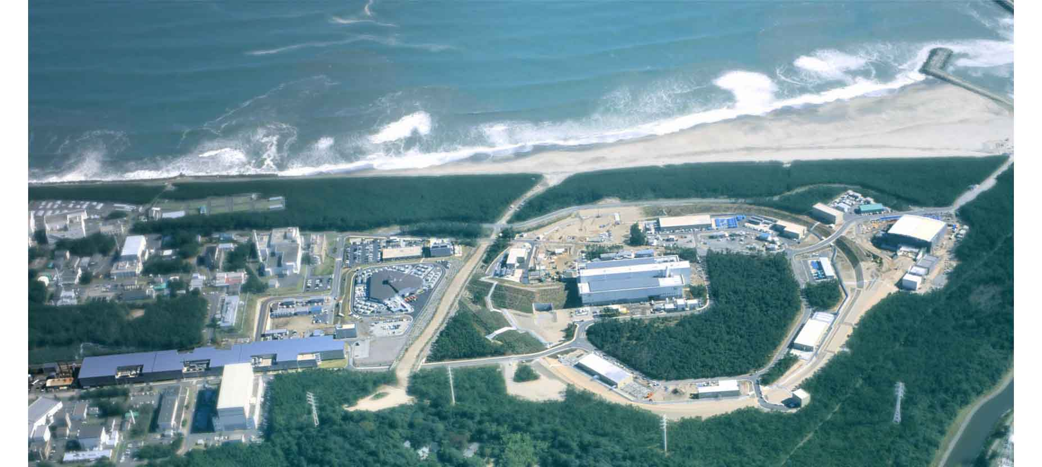
2025. 10. 17
PHD2025@Wuhan
Study of high-density matter in neutron stars via hypernuclear experiments
Hiro Tamura (田村 裕和）
Tohoku University (東北大学）
Japan Atomic Energy Agency

Slide 2
2025. 10. 17
PHD2025@Wuhan
Study of high-density matter in neutron stars via hypernuclear experiments
Contents
1. Introduction
---How to investigate high density matter in NS
2. Present status of hypernuclear experiments
2.1 Light Λ hypernuclei
2.2 Ξ hypernuclei
2.3 Hyperon-nucleon scattering
3. Study of ΛNN force from hypernuclei
4. Summary

Slide 3
1. Introduction
---How to investigate high density matter in NS

Slide 4

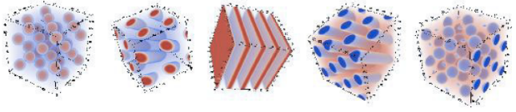

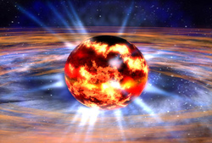
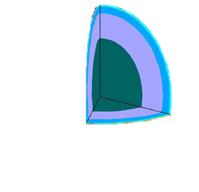
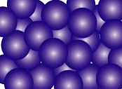

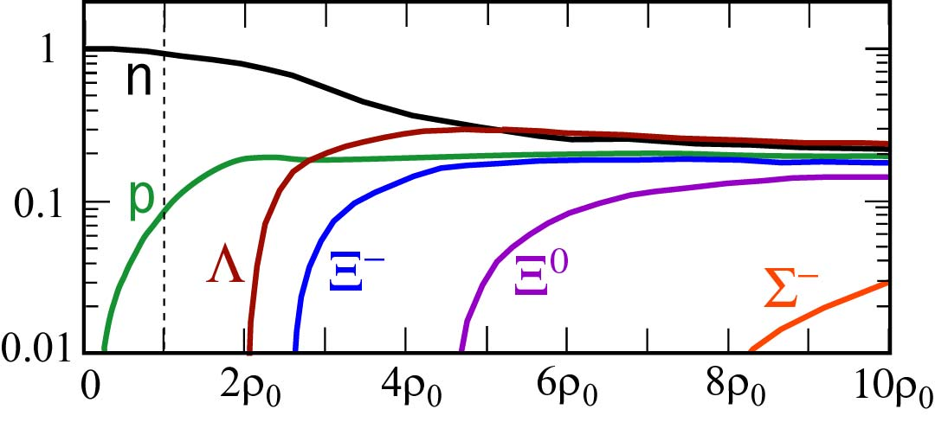

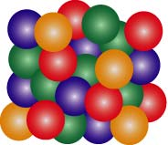
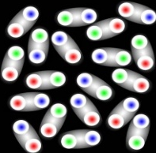
4
Mystery of matter in neutron stars
Outer crust
Neutron-rich
nuclei
Inner crust
Pasta nuclei
Outer core
Neutron Matter
n
C. Ishizuka et al., J.Phys.G 35 (2008) 085201
EOSY: U_{Λ}= -30 MeV, U_{Σ} = +30 MeV, U_{Ξ} = -15 MeV
assumptions based on experimental suggestions
Inner core
Hyperon Matter
(Strange Hadronic Matter)
d
p
n
baryon fraction
?
Λ
Ξ
?
Inner core
Deconfined
Quark Matter
??
ρ （density）
Sensitive to YN, YY interactions
Hyperons (Λ, Ξ⁻) should appear at ρ ~ 2-3 ρ₀

Slide 5
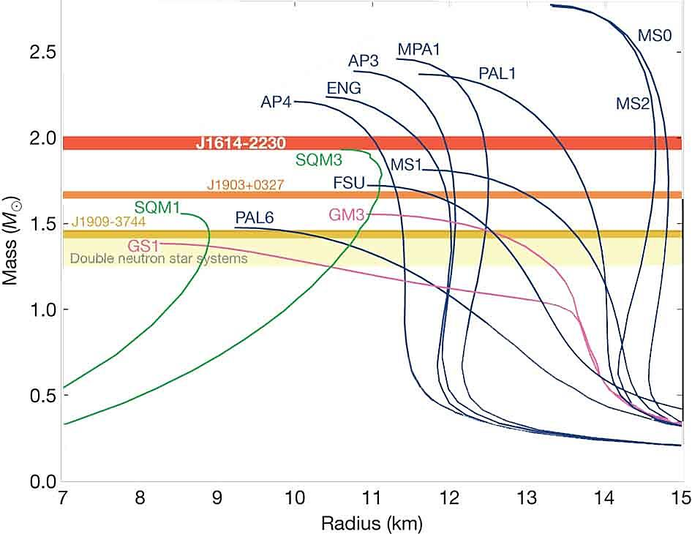
5
Hyperon Puzzle
EOS’s with hyperons are too soft to support massive NS’s of >1.5 M_{sun}.
2.0 M_{sun} neutron stars are observed.
Present nuclear physics has almost no predictive power for > ρ₀
1.97±0.04 M_{sun}
J1614-2230 (2010)
Ignore hyperons
Repulsive three-body force in NNN.
Also in YNN, YYN, YYY ?
2.01±0.04 M_{sun}
J0348-0432 (2013)
M
but no clear experimental evidence
2.14±0.10 M_{sun}
J0740-6620 (2020)
Deconfined quark matter?
+Hyperons
NS mass
Quark matter begins to appear at ~2ρ₀ ?
-> repulsive
Quark matter
T
170 MeV
crossover
NS radius (km)
?
Determine YN forces and YNN 3BFs
Crossover?
?
NS can be described in the hadron level or not
ρ₀
a few ρ₀
ρ

Slide 6
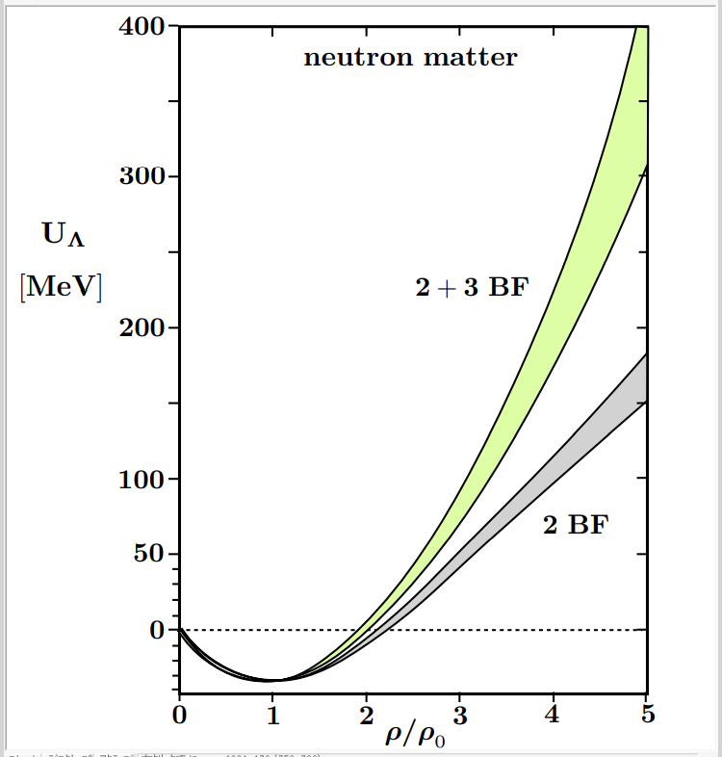
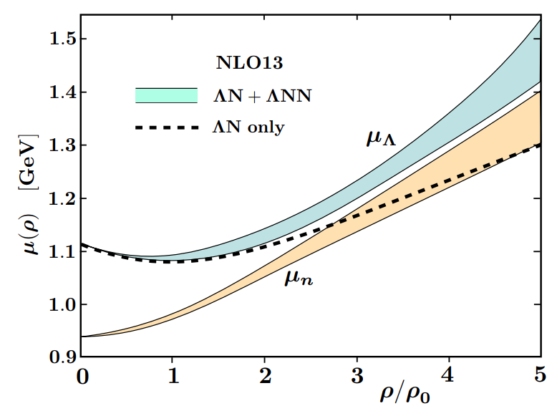
6
EoS from Chiral EFT force (NLO13)
Chiral EFT nuclear force is being extended to BB forces via SU(3)f (Haidenbauer et al.)
D.Gerstung , N. Kaiser, W. Weise,
Eur. Phys. J. A (2020) 56:175.
“Decuplet saturation” approx.
Single particle potential of Λ
Chemical potential of neutron and Λ
If this interaction is correct, Λ’s do not appear and the hyperon puzzle is solved.
But this interaction is based on very poor ΛN scattering data, and 3BF is assumed.
=> We should determine realistic ΛN and ΛNN forces.

Slide 7
Strategy for solving the hyperon puzzle
7
High quality
ΛN,ΣN scattering data
ΛN, ΣN, ΛΛ, ΞN, ...
Femtoscopy data
Precise light Λ
Hypernuclear data
@J-PARC, JLab, SPring-8,..
@STAR, ALICE,...
@J-PARC, STAR,ALICE,…
Calc. of hypernuclear Structure
YN/YY int. in free space
SU(3)_{f} chiral EFT / Meson-exch. models
⇒ “Realistic” YN/YY models
Lattice QCD
ΞN, ΛΛ hypernuclear data
(K,K)@J-PARC
Λd scattering
Λd, ΛNN Femtoscopy
Precise B_{Λ} data of
various Λ hypernuclei
Calc. of hypernuclear Structure
YN/YY int. in nuclear matter
=YNN 3B int. (chiral EFT framework)
(e,e’K)@JLab ; (π,K)@J-PARC
Observational data of NS
Understanding
high density matter in NS
Realistic EOS
・Ｘrays (NICER, XRISM..)
・Gravitational Waves

Slide 8
2. Present status of hypernuclear experiments
2.1 Light hypernuclei

Slide 9
9
Hypertriton (³_{Λ}H): benchmark for YN interaction
p
³_{Λ}H
Not
converged yet
New data after 2018
n
Λ
Experiment | Reaction | Method | τ (³_{Λ}H) [ps] | B_{Λ}(³_{Λ}H) [keV]
STAR | HI (Au+Au) √s=3GeV | decay length inv. mass | 221±15±19 | 0.41±0.12±0.11
ALICE | HI (Pb+Pb) √s=5TeV | decay length inv. mass | 253±11±6 | 0.102±0.063 ±0.067
HADES | HI (Ag+Ag) √s=2.55GeV | decay length | 239±23±18 | -
WASA-FRS | HI (⁶Li+¹²C) 2GeVA | decay length | under analysis | under analysis
J-PARC E73 | ^{3,4}He(K⁻,π⁰) | decay π⁻ timing | Under analysis | -
J-PARC E07 | K⁻ on emulsion | decay energy | - | 0.23±0.11 ±0.05
MAMI | ⁷Li(e,K⁺) | decay π⁻ momentum | - | New data coming
~ 15 fm
We long believed:
B_{Λ}~ 130 keV (old emulsion)
=> radius ~(2μB_{Λ})^{-1/2} ~ 15 fm
=> τ ~ τ_{Λ(free)} (263 ps)
Previous data of τ, much shorter than τ_{Λ} (free), look inconsistent with the small B_{Λ}.
Hypertriton’s B_{Λ} is an important benchmark for ΛN interaction in free space (but with a little effect of ΛNN 3BF.

Slide 10
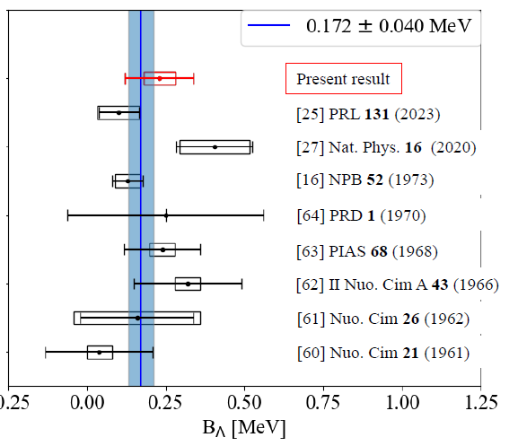
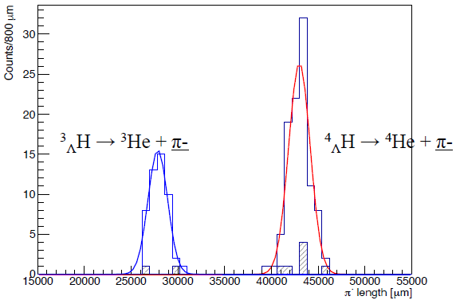
A new hypertriton B_{Λ} value from emulsion
10
J-PARC E07 emulsion irradiated by K- beam was analyzed using machine learning to find ³_{Λ}H -> ³He π⁻ events.
π⁻ ’s range was converted to the π⁻ energy, where the systematic error was reduced down to 50 keV.
A. Kasagi et al., PTEP2025, 083D01
New emulsion
ALICE
STAR
Old emulsion
(averaged)
Pion range
J-PARC E07 data

Slide 11
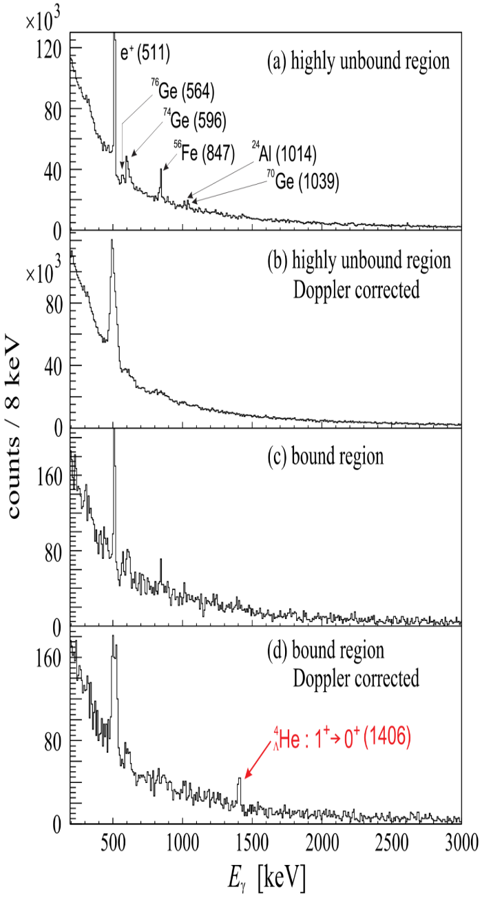
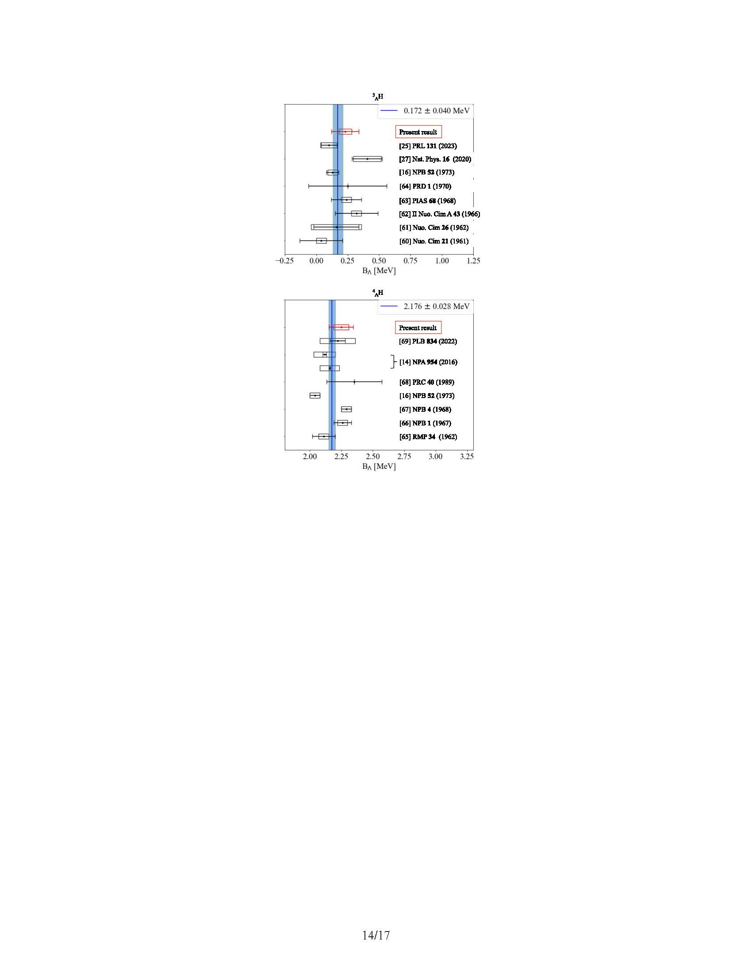
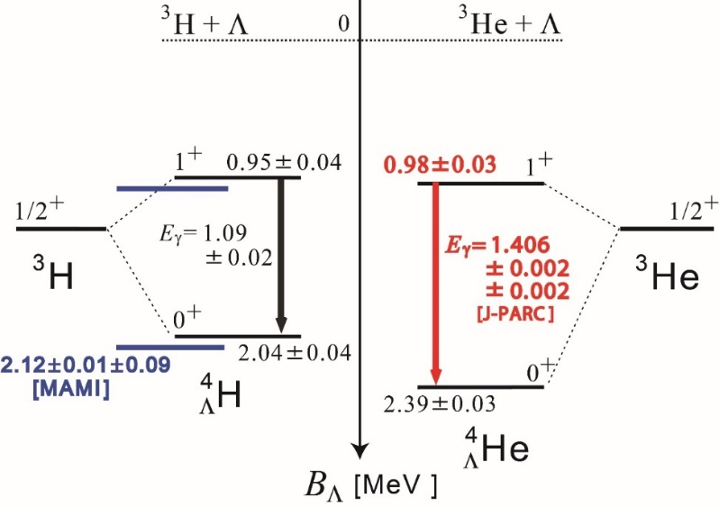
Charge Symmetry Breaking (CSB) in A=4 Λ hypernuclei
11
Bedjidian et al.
PLB 83 (1979) 252 etc.
T.O. Yamamoto et al.,
PRL 115 (2015) 222501
J-PARC E07 emulsion
STAR
MAMI
Old
emulsion
A large CSB (Λp ≠ Λn) is confirmed from γ-ray data only.
2.176±0.028
Λ
⁴_{Λ}H
⁴_{Λ}He
p
n
A. Kasagi et al., PTEP2025, 083D01
c.f. B_{Λ}(⁴_{Λ}He(0⁺)) - B_{Λ} (⁴_{Λ}H(0⁺)) = 320 keV >> B(³H)-B(³He) ~70 keV (w/o Coulomb)
Not understood yet theoretically.
Old low-quality data
Precise data will be measure
at J-PARC (E63). Run from Nov. 2025.
CSB comes from u/d quark mass difference
=> Touchstone of our understanding of BB force from quark level.
CSB for heavier hypernuclei will be a key to solve this problem. => J-PARC + JLab

Slide 12
2.2 Ξ hypernuclei

Slide 13
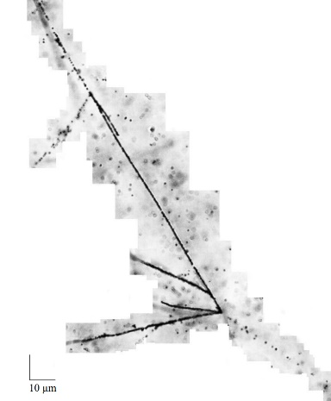
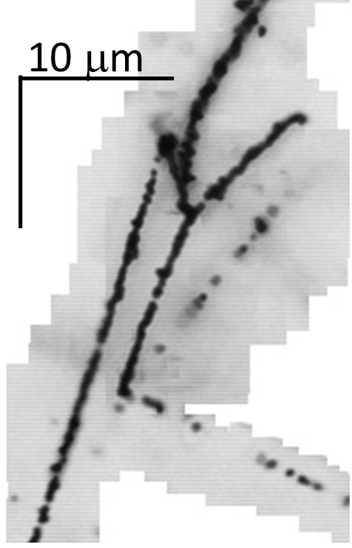
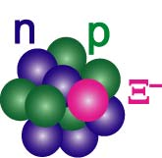
13
Ξ-hypernuclei in emulsion (J-PARC E07)
Ξ⁻ plays important role in NS, but ΞN interaction was unknown.
K⁻ + “p” -> Ξ⁻ + K⁺, Ξ⁻ stopped in emulsion, captured by C, N, O nuclei.
IBUKI event
IRRAWADDY event
M. Yoshimoto et al.,
PTEP 2021, 073D02
S. H. Hayakawa,
PRL 126 (2021) 062501
Ξ⁻
⁴He
Ξ⁻ + ¹⁴N →¹⁵_{Ξ}C
⁵_{Λ}He
First precise
determination of B_{Ξ}
⁵_{Λ}He
Ξ⁻
⁵_{Λ}He
Ξ⁻ p → Λ Λ
¹⁰_{Λ}Be
20μm
¹⁵_{Ξ}C -> ⁵_{Λ}He + ⁵_{Λ}He + ⁴He + n
¹⁵_{Ξ}C -> ¹⁰_{Λ}Be + ⁵_{Λ}He
= 1.27 ± 0.21 MeV
= 6.27 ± 0.27 MeV

Slide 14
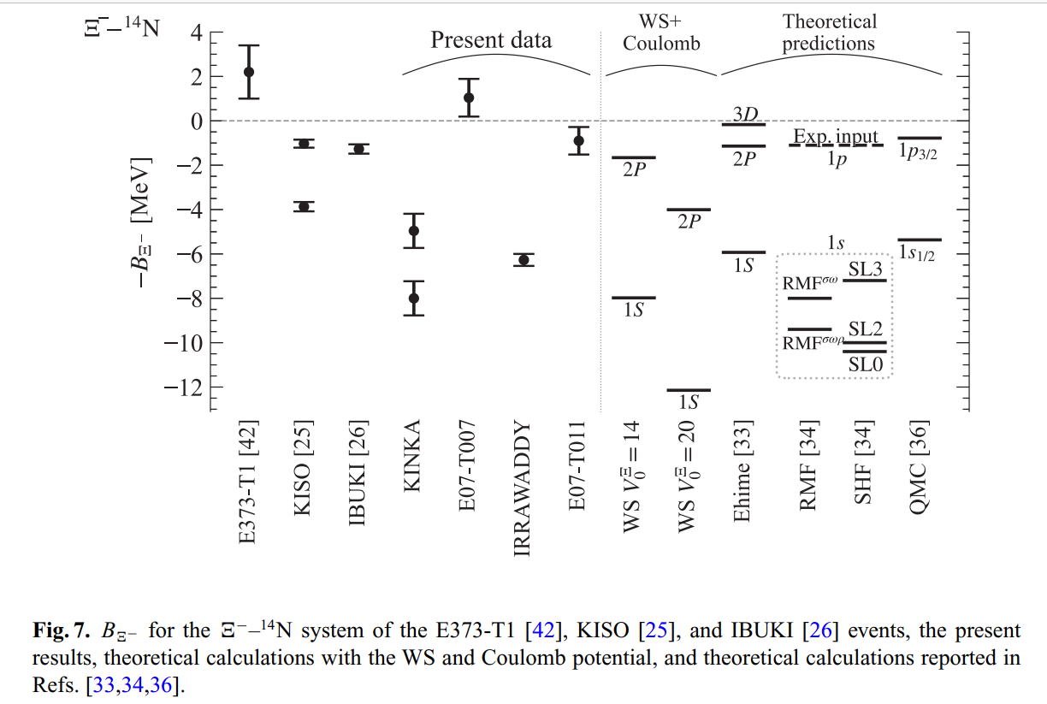
14
Observation of p- and s(?)-states Ξ hypernuclei
M. Yoshimoto et al., Prog. Theor. Exp. Phys. 2021, 073D02
¹⁵_{Ξ}C
Coulomb
p_{Ξ}
p_{Ξ}
?
2P
or
Ξ⁻
s_{Ξ}
or
s_{Ξ}
1S
Ξ⁻
Emulsion data
Nuclear force
Attractive ΞN interaction confirmed.
ΞN→ΛΛ strength very small?
Why stopped Ξ⁻ goes down to 1S orbit? (Theoretically, it should be absorbed at 3D/2P)
Ξ⁻ atomic X-ray measurement necessary -> J-PARC E96

Slide 15
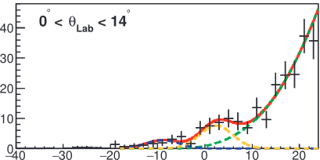
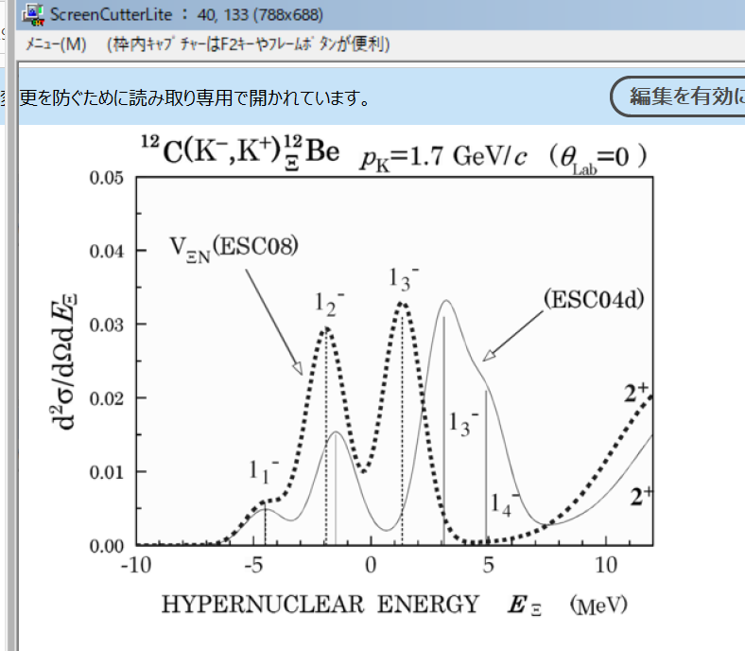
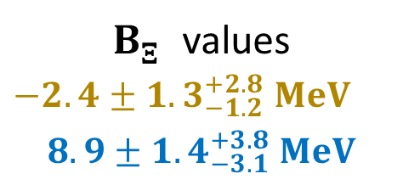
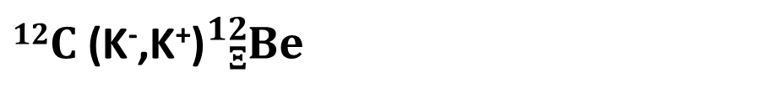

$12C$ (K⁻,K⁺)${}_{Ξ}^{12}{Be}$ missing-mass spectroscopy
(J-PARC E05)
15
Resolution: 14 MeV(FWHM) @BNL → 8 MeV@J-PARC E05
$12C$ (K⁻,K⁺)${}_{Ξ}^{12}{Be}$
Y. Ichikawa et al., PTEP 2024 (2024) 091D01
Y. Ichikawa et al. PTEP 2024, 091D01
Scat. K⁺
Fit with 2 Gaussian peaks
Assuming a narrow ΞN→ΛΛ width
First observation of
Ξ-hypernuclear peaks
dσ/dΩ [(nb/sr)/MeV]
QF
$B_{Ξ}^{}$ values
$$−2.4±{1.3}_{−1.2}^{+2.8} MeV$$
$$8.9±{1.4}_{−3.1}^{+3.8} MeV$$
－B_{Ξ} [MeV]
−B_{Ξ} [MeV]
DWIA calc.
ESC08
ESC04d
Better resolution necessary
to identify states
J-PARC E70
w/ a new spectrometer
T.Motoba, S.Sugimoto
NPA835 (2019) 223
Beam K⁻

Slide 16
2.3 Hyperon-nucleon scattering

Slide 17
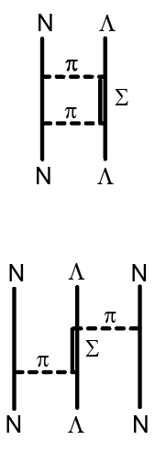
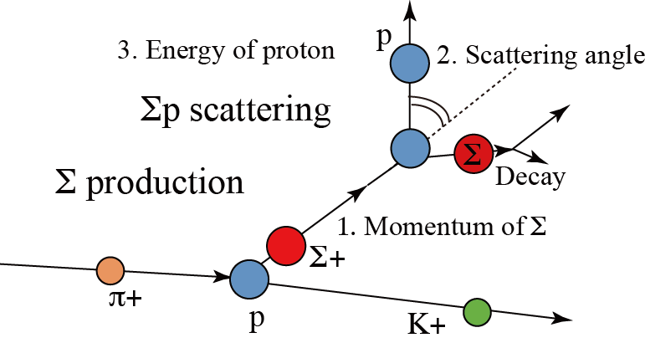
YN interaction
17
Λp, Σ±p scattering data with bubble chambers (1960s)
YN interaction
models
(Nijmegen
NSC, ESC)
<~ 0.30 GeV/c, poor quality, σ, no dσ/dΩ for Λp
Λ hypernuclei (+ Σ hypernuclei): B_{Y} + level scheme (1960-)
But, YN int. in nuclei is significantly different from YN. Int in free space
N
Λ
N
N
High quality YN scattering experiments
+ femtoscopy data
=> “Realistic YN interaction” is necessary
N
Λ
N
N
Σ±p scattering （J-PARC E40）
Dedicated “fast” detector system, CATCH
(scint. fiber + SiPM + fast DAQ)
CATCH detector
BGO calorimeter
p
E_{p}
p_{Σ}
Σ
θ
Cylindrical
Fiber Tracker
π
dσ/dΩ
for 0.44-0.80 GeV/c
(important for NS)
π
n
K⁺
π⁺
π⁺
Liq H2 target
400 mm

Slide 18
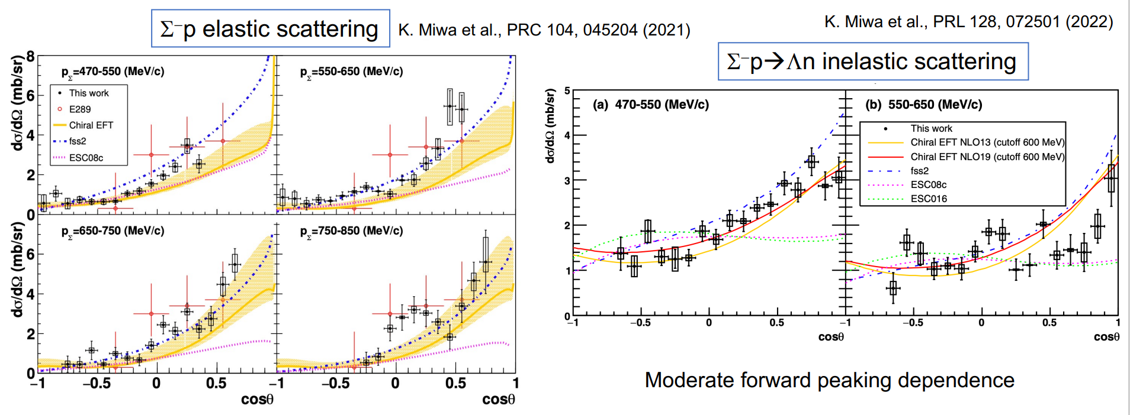
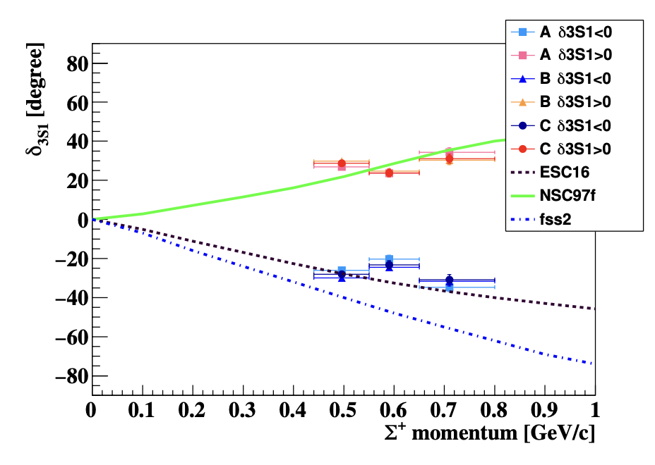
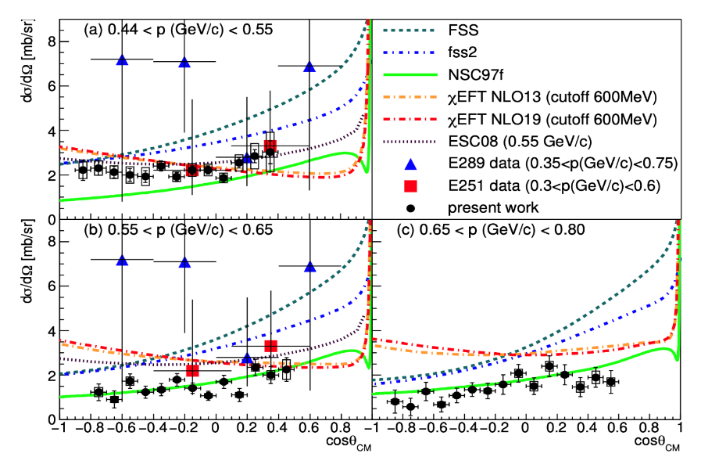
Σ±p scattering results
18
Σ⁻ p→ Λ n
Σ⁻ p elastic
T. Nanamura et al., PTEP.2022 093D01
Chiral EFT BB force is being revised based on those data.
pn ¹S₀
NSC97f
Σ⁺ p elastic
The first YN phase shift data
phase shift
Σ⁺-p (spin=1)
Σ⁺
u
p
u
d
Σ⁺p ³S₁
ESC16
s
u
u
fss2
Strong repulsion
by quark Pauli ??

Slide 19

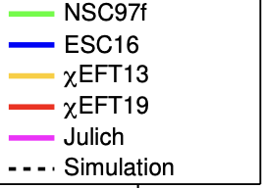
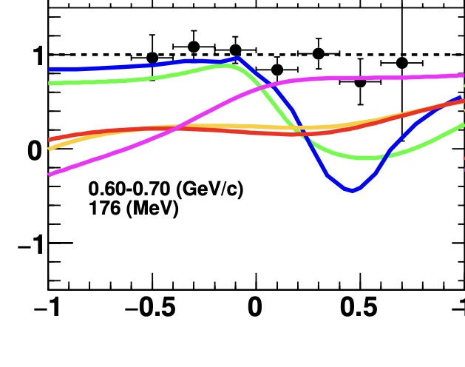
Present and future : Λp scattering
19
Slide from Miwa
w/ γ beams @Spring-8
w/ K- beam@J-PARC HEFex (K1.1 line) (E86)
Momentum tagged Λ via γp→K⁺Λ reaction
Measure spin observables with polarized Λ beam from p(π⁻, K⁰) reaction
YN scattering detector system (CATCH)
Polarization can be measured from angular distribution of p
p
Λ spin can be automatically polarized
Λ
Liq. H2 target
Decay
Production
π⁻
recoil proton
Λ
Liquid H₂
Fiber detector
Scattering
BGO calorimeter
p
Left-Right asymmetry
Polarization change
Depolarization
Analyzing power
ΛN LS force and spin-spin force will be determined
Simulation
Simulation
1.4-2.4 GeV
Backward Compton gamma
Essential constraint to determine spin-dependent ΛN interaction

Slide 20
3. Study of ΛNN force
from hypernuclei

Slide 21
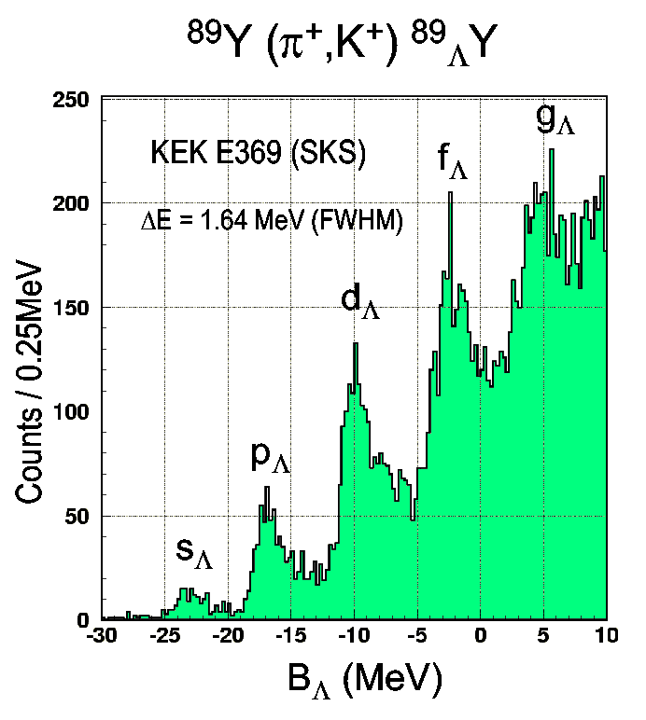
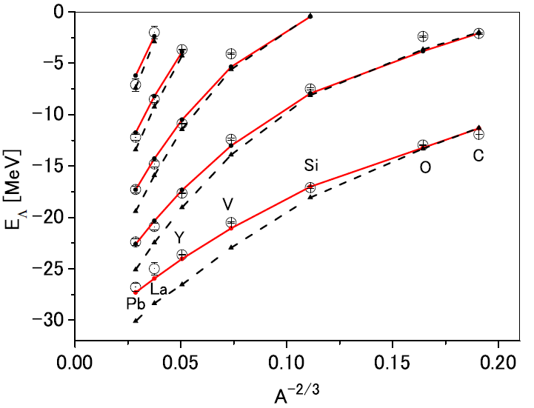
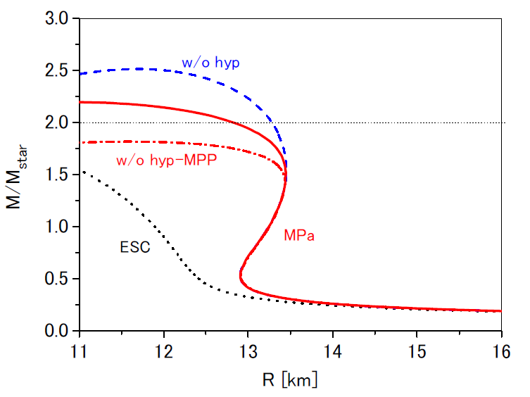
21
How to investigate YNN force?
Study density-dependence of Λ’s single particle energies
PRC64 (2001) 044302
Yamamoto, Furumoto, Rijken et al. PRC90 (2014) 045805
NN + YN + NNN repulsion
g_{Λ}
f_{Λ}
d_{Λ}
p_{Λ}
MPa
NN + YN +
universal repulsion in
NNN+YNN+...
s_{Λ}
~1 MeV accuracy
NN+ NNN repulsion
MPa
determined from HI collision data
-B_{Λ} [MeV]
ECS08 only
ESC08 only
NN+YN, no 3B repulsion
Density dependence of ΛN int. (=ΛNN force effect) appear

Slide 22
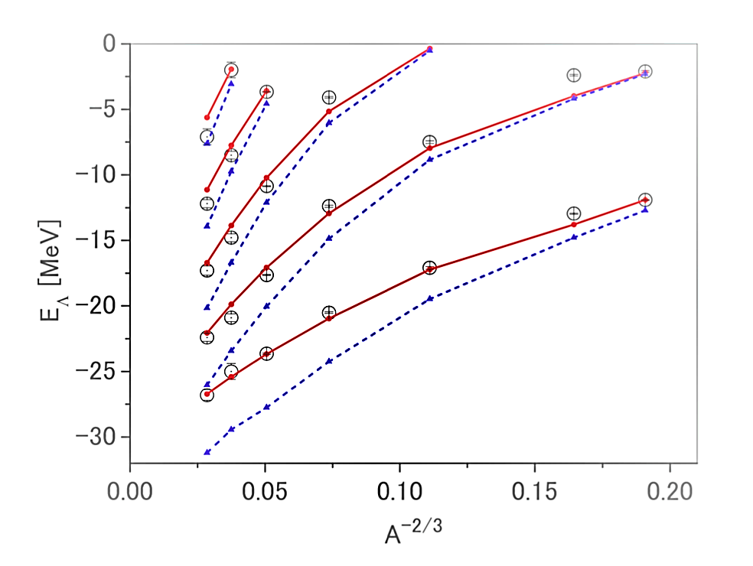
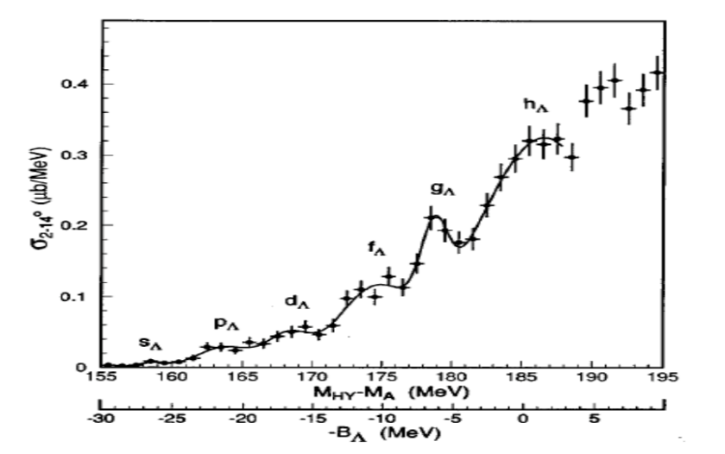
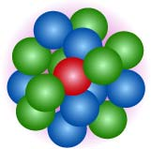
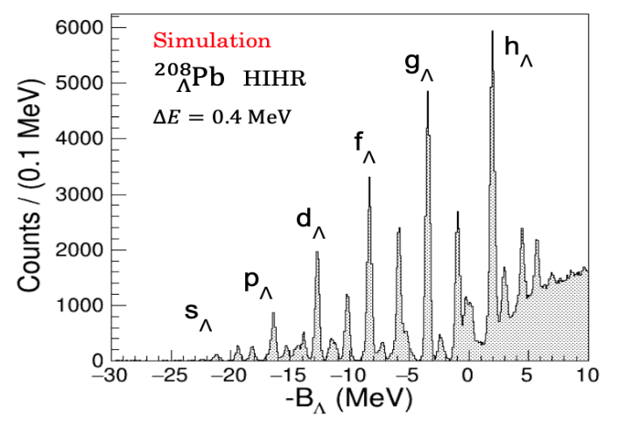
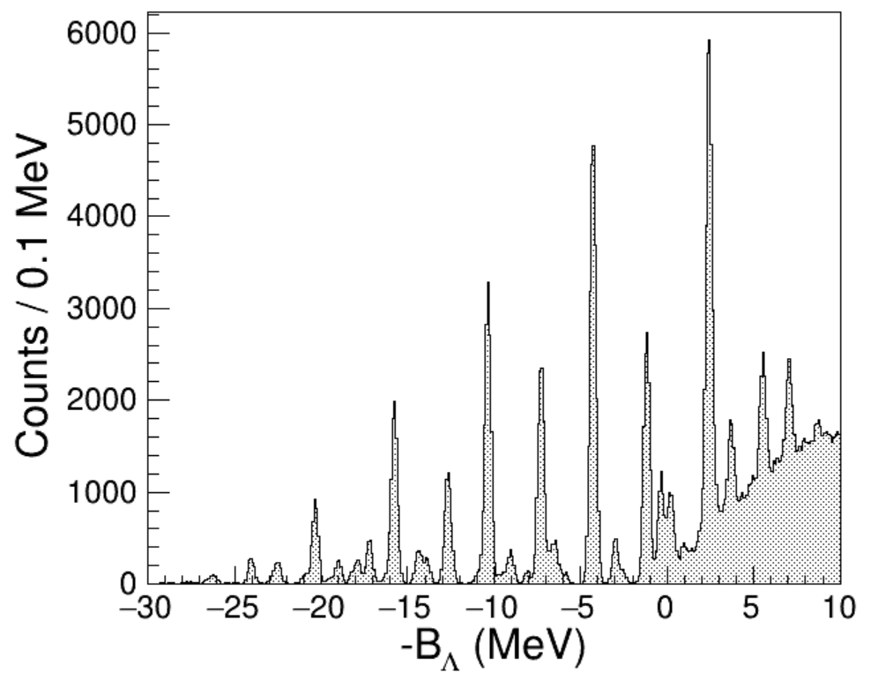
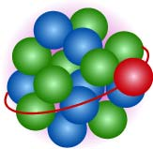
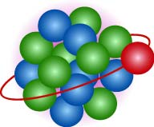
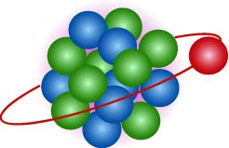
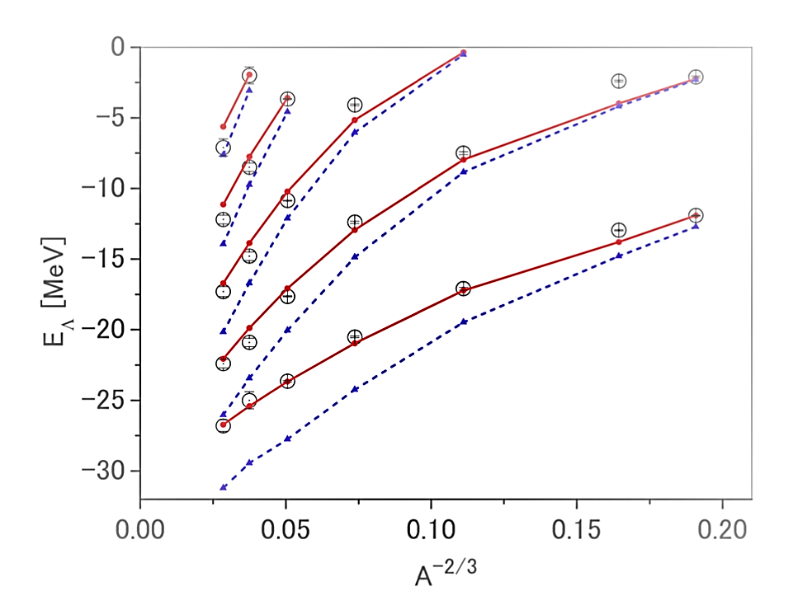
22
How to investigate YNN force?
Study density-dependence of Λ’s single particle energies
Λ is distinguishable from nucleons. No Pauli from nucleons.
We know the local density where the Λ is located.
Different mass numbers, orbitals -> probe different densities
Realistic YN interaction
determined in free space necessary
Pb
M.M. Nagels et al. PRC99, 044003 (2019)
²⁰⁸_{Λ}Pb
w/o ΛNN int.
ΔE ~ 2.2 MeV
w/ ΛNN int.
Nijmegen ESC16
s_{Λ}
p_{Λ}
g_{Λ}
d_{Λ}
f_{Λ}
Measure precise B_{Λ} data with ~0.1 MeV accuracy

Slide 23
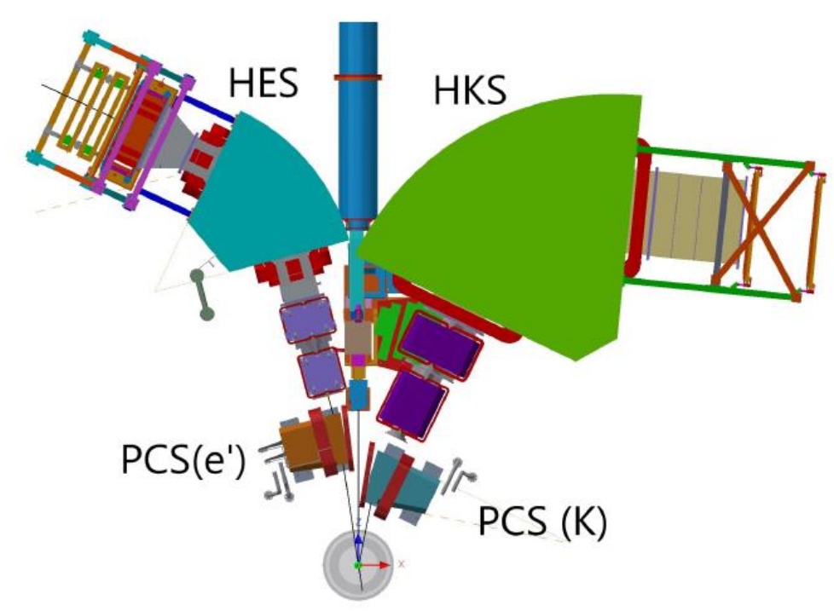
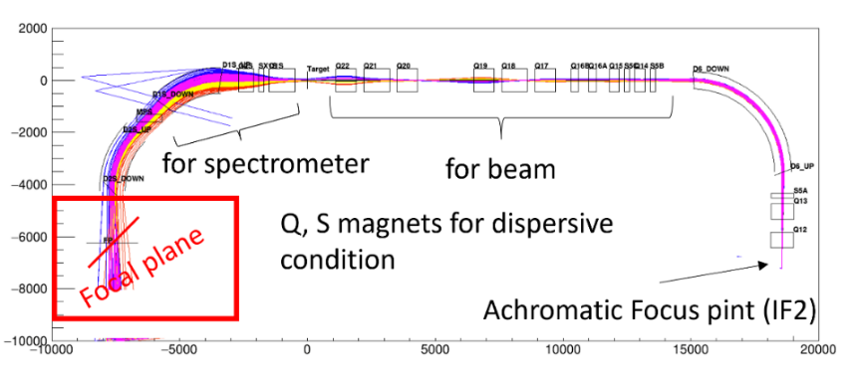
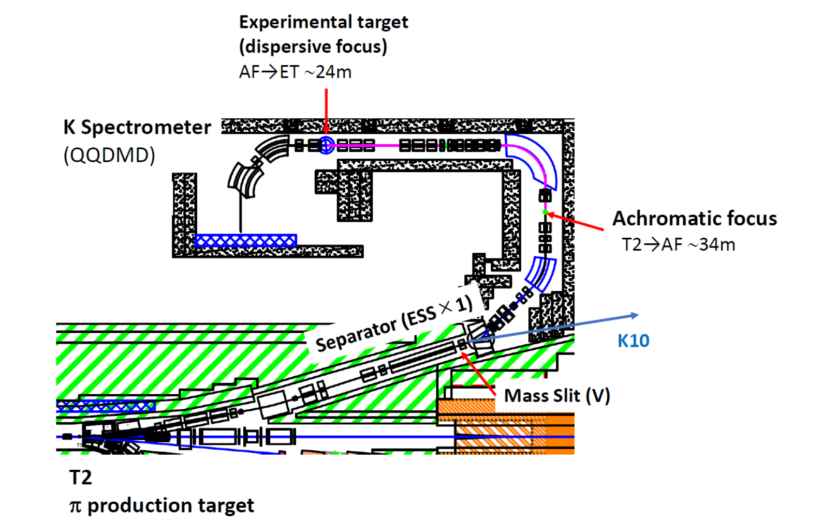
23
𝑒⁻
Experimental Plans
JLab @Hall C
𝐾⁺
E12-15-008: ^{40,48}Ca(𝑒,𝑒’𝐾⁺) ^{40,48}_{Λ}K
E12-18-013: ²⁰⁸Pb (𝑒,𝑒’𝐾⁺) ²⁰⁸_{Λ}Tl
T=1 ΛNN force => Λnn force in NS
J-PARC @HIHR line
at the extended Hadron Facility
HIHR
P84: (π⁺,𝐾⁺) ...¹²_{Λ}C, ²⁸_{Λ}Si, ⁴⁰_{Λ}Ca,
⁵¹_{Λ}V, ⁸⁹_{Λ}Y, ¹³⁹_{Λ}La, ²⁰⁸_{Λ}Pb
Pion intensity > 2x10⁸/spill
Dispersion matching
ΔM < 400 keV (FWHM)
ΔM ~ 0.3 MeV FWHM
Δp/p = 1/10000
Together with ΛΝ scattering exp. (E86 @K1.1),
those B_{Λ} values give info. on ΛΝΝ strength.

Slide 24
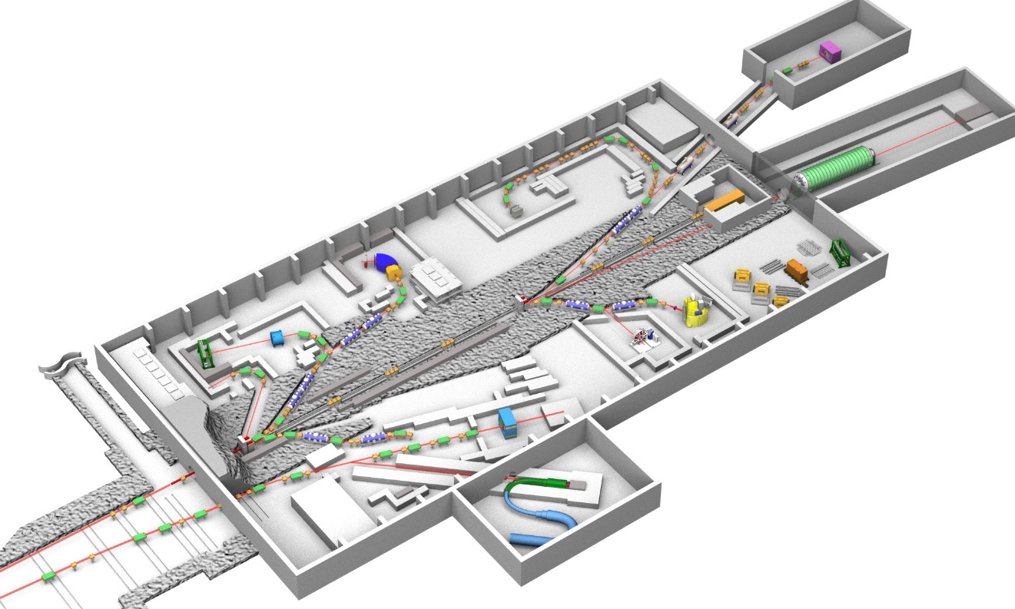
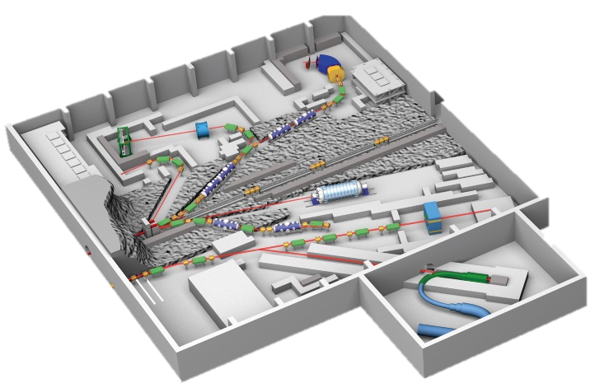
Hadron Experimental Facility extension Project
24
K. Aoki et al., arXiv: 2110.04462 [nucl-ex] (2021);
F. Sakuma et al., EPJ Web Conf. 271 (2022) 11001
High-p charged separated line
High-intensity high-resolution line
K10
Extended HEF
(2029～)
Precise spectroscopy of Λ hypernuclei
HIHR
higher intensity neutral line
Present HEF
(2009～)
KL2
K1.8
T2
K1.8BR
KL
Low-p charged
separated line
30 GeV
primary
proton beam
Test-BL
K1.1/K1.1BR
T1
Λp scattering
High-p (π20)
High-p
COMET
Extended hall
High-p charged line

Slide 25
25
Summary
Strangeness Nuclear Physics plays important role to study high-density matter in neutron stars.
Experimental status, particularly at J-PARC, is reviewed.
・ Precise light hypernuclear data (³_{Λ}H and ⁴_{Λ}H/⁴_{Λ}He) still necessary.
・ Attractive Ξ-N interaction with a narrow ΞN-ΛΛ coupling is found.
・ High quality YN scattering experiments are in procress.
3. ΛNN interaction will be clarified via precise Λ hypernuclear spectroscopy
and Λp scattering at HIHR/K1.1 beam lines in the J-PARC extended Facility.

Slide 26
Backup

Slide 27
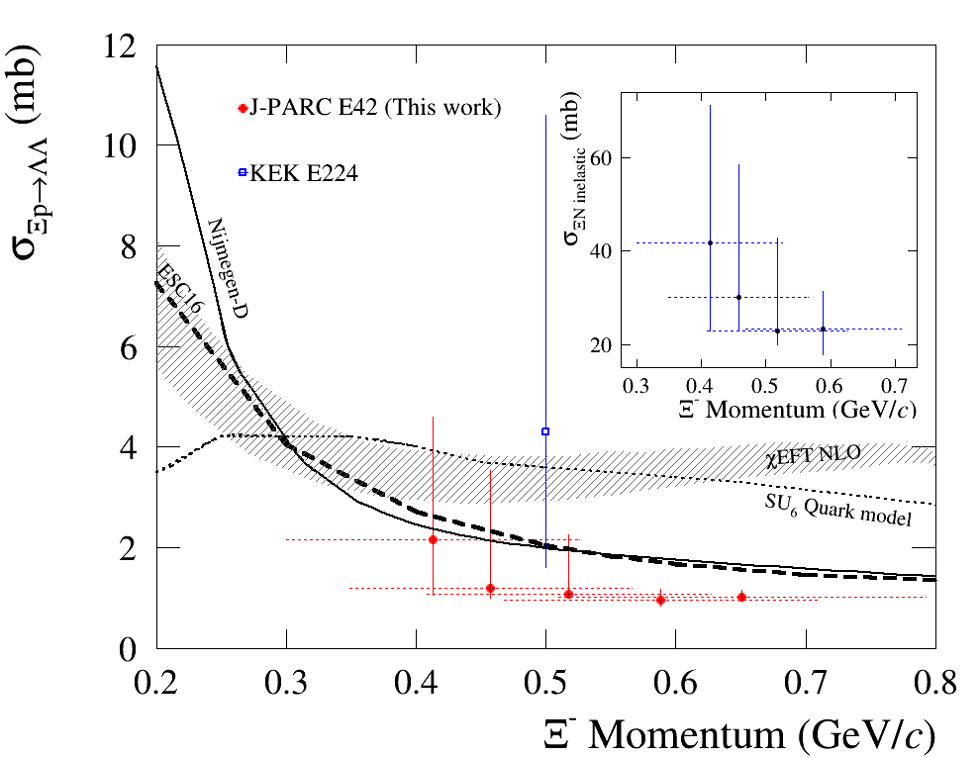

H-dibaryon search and study of ΞN interaction
(J-PARC E42)
¹²C (K⁻,K⁺)
K⁻ p → Ξ⁻ K
Ξ⁻ escape / Ξ⁻ p→ΛΛ
W.S. Jung et al., Prog. Theor. Exp. Phys. 2025, in press.
Ξ⁻ p inelastic
TPC for high-rate operation
~ 30 mb
Ξ⁻ p→ΛΛ
~ 1.1 mb → Γ_{Ξ} ≲ 0.7 MeV
Very weak ΞN-ΛΛ coupling

