Slide 1
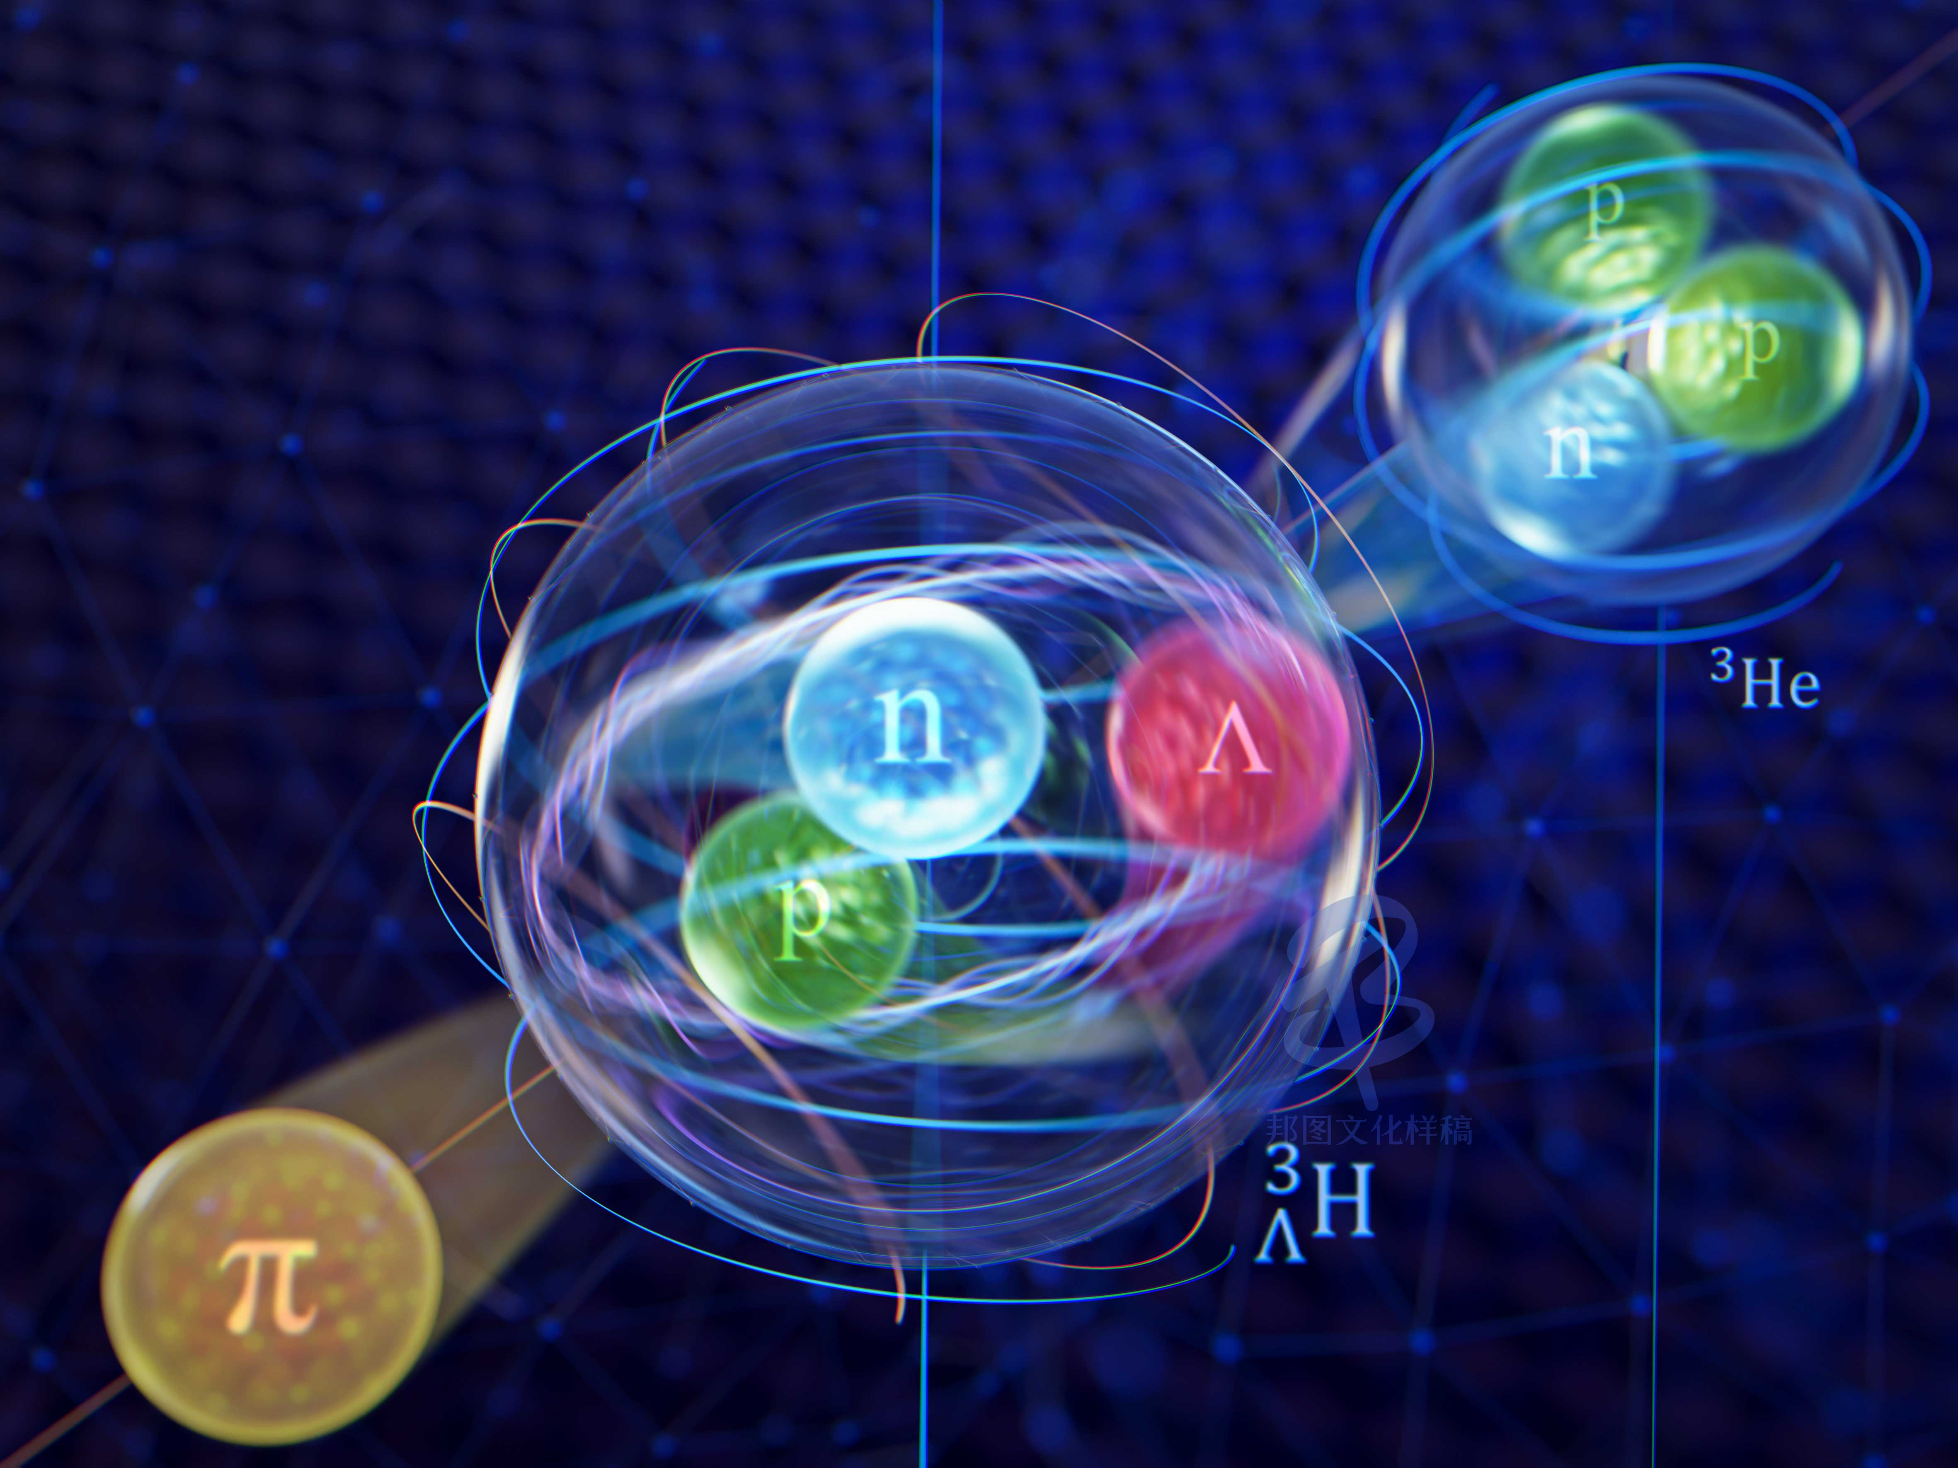
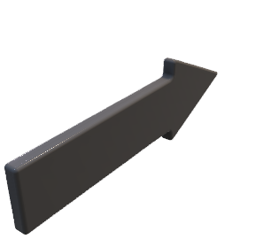













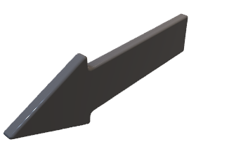

The 2nd International Workshop on Physics at High Baryon Density
Global Proton Spin Polarization at High Baryon Densities
KaiJia Sun
kjsun@fudan.edu.cn
Fudan Univ.
2025-10-17
WuHan
In collaboration with Lie-Wen Chen, Jin-Hui Chen, Che Ming Ko, Dai-Neng Liu, Yun-Peng Zheng, Yu-Gang Ma

Slide 2
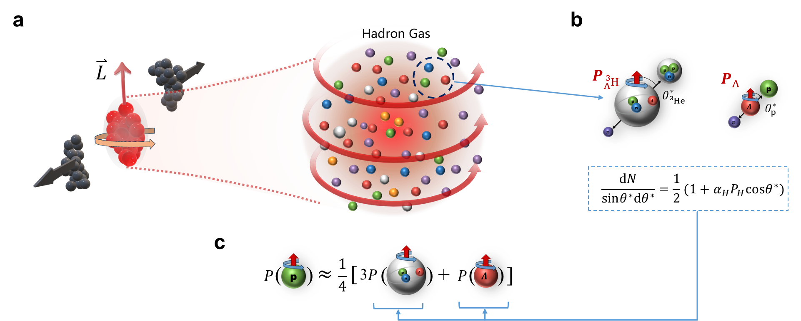
Dai-Neng Liu et al., arXiv:2508.12193 (2025)

Slide 3
Outline
Proton spin polarization in heavy-ion collisions
2. Decoding proton spin polarization from hypertriton polarization
3. Global spin polarization of Li-4
4. Summary and outlook
Kai-Jia Sun et al., Phys. Rev. Lett. 134, 022301 (2025)
Dai-Neng Liu et al., arXiv:2508.12193 (2025)
Yun-Peng Zheng et al., arXiv:2509.15286 (2025)

Slide 4
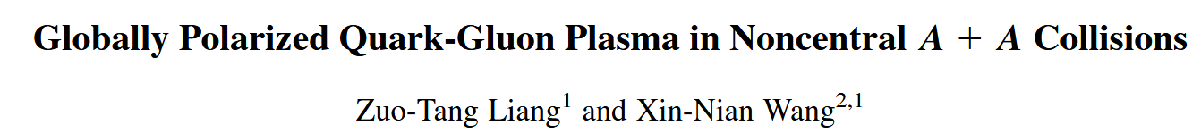
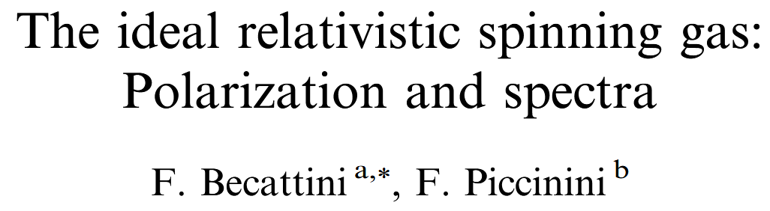
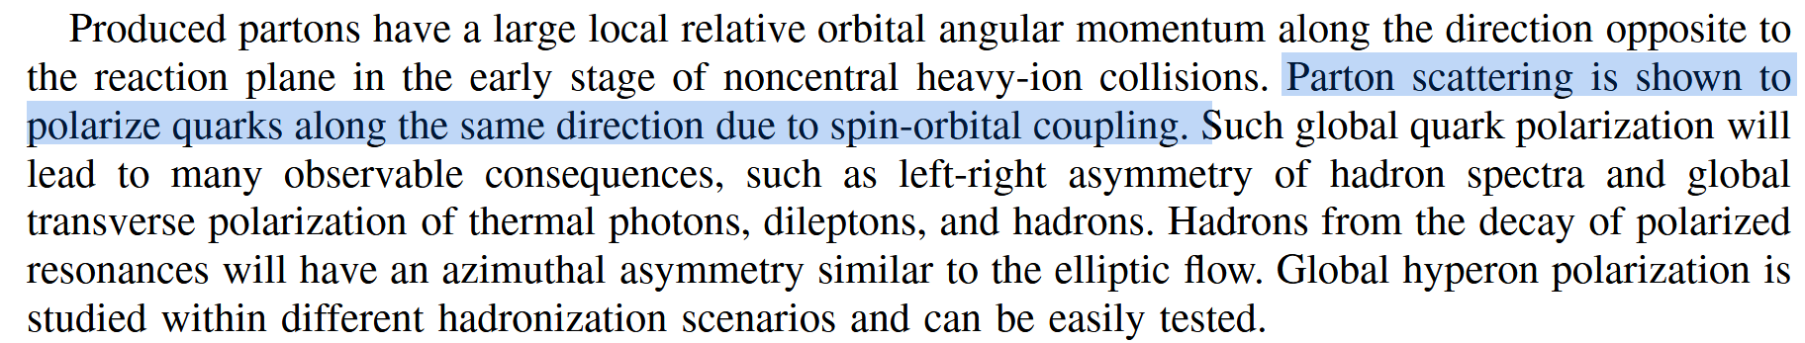
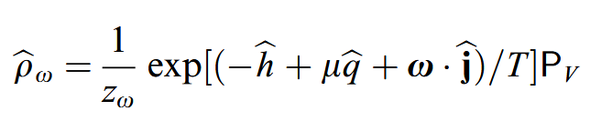
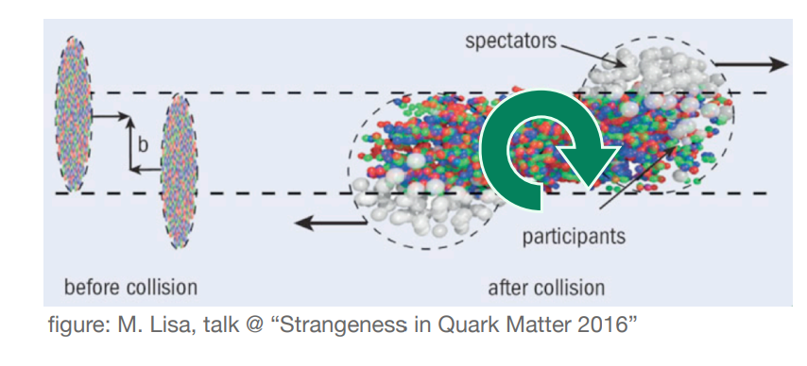
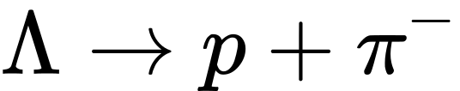
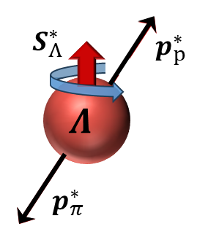
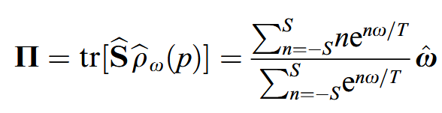
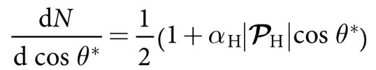




1. Spin polarization of hyperons in heavy-ion collisions
(1)
Spin polarization of Lambda hyperon
Z. T. Liang and X. N. Wang PRL 94, 102301 (2005)
F. Becattini, F. Piccinini, Annals of Physics 323, 2452 (2008)
$$θ^{∗}$$
Vorticity
Spin polarization
$$Λ$$
$$Λ$$
Decay constant

Slide 5
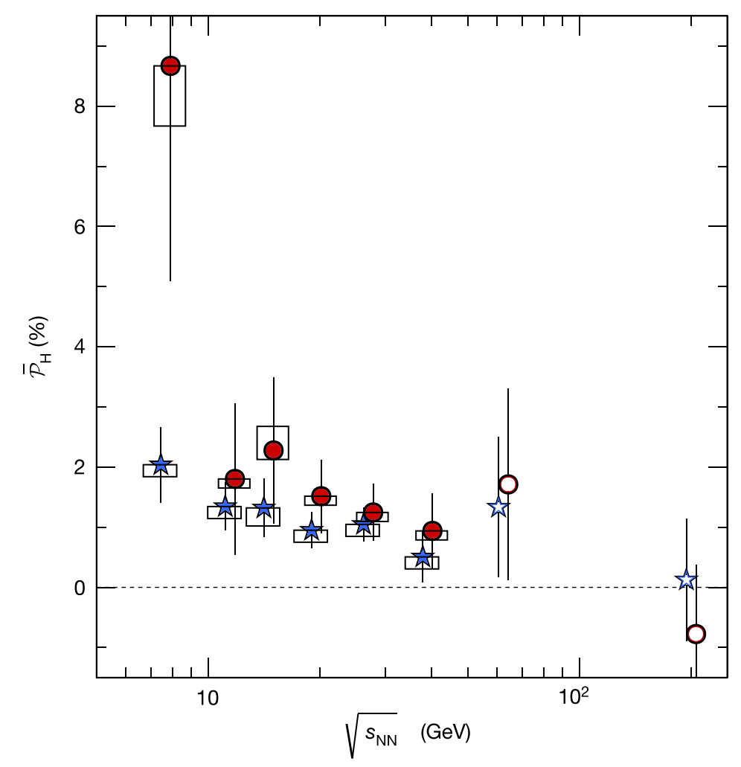
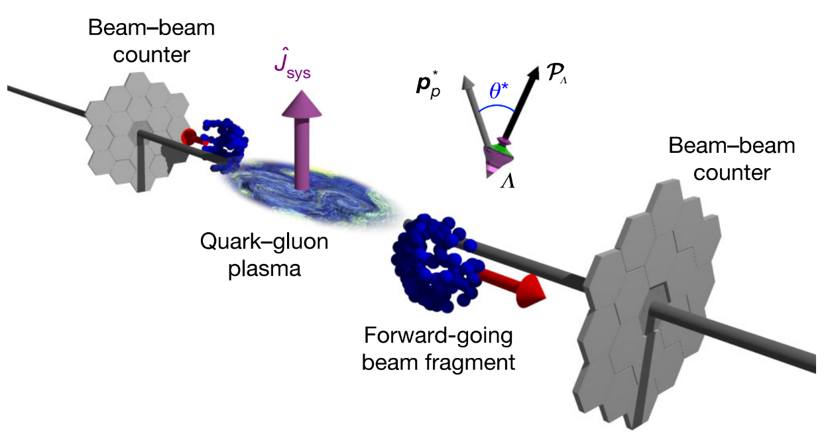
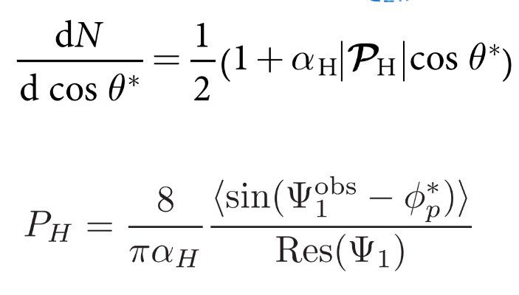
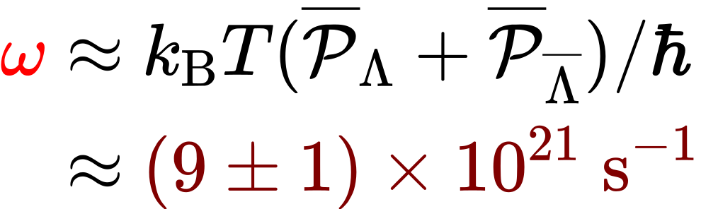
1 . Spin polarization of hyperons and vorticity of QGP
(2)
STAR, Nature 548, 62 (2017)
Spin polarization of Lambda hyperon
Vorticity of QGP
Z. T. Liang and X. N. Wang PRL 94, 102301 (2005)
F. Becattini, F. Piccinini, and J. Rizzo, PRC 77, 024906 (2008)
F. Becattini, M. Buzzegoli, T. Niida, S. Pu, and A. Tang, Int.J.Mod.Phys.E 33 (2024) 06, 2430006

Slide 6
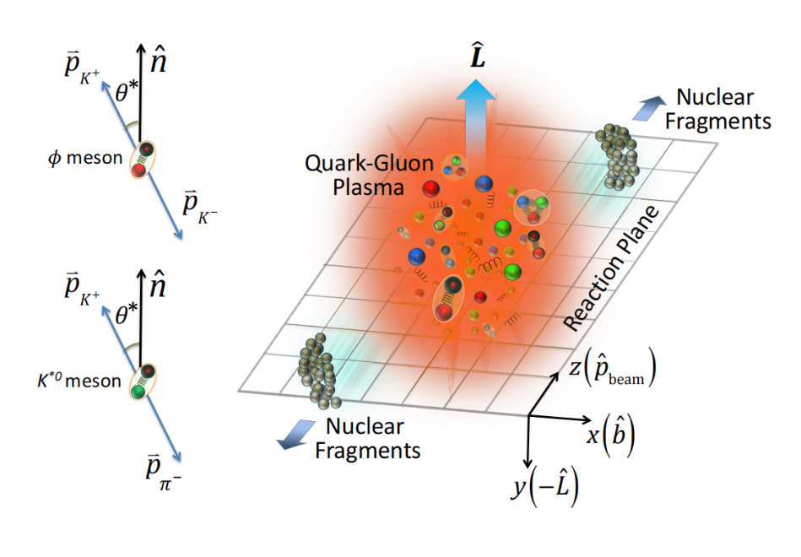
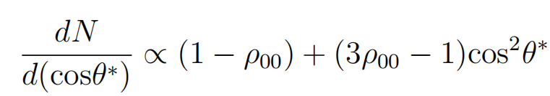
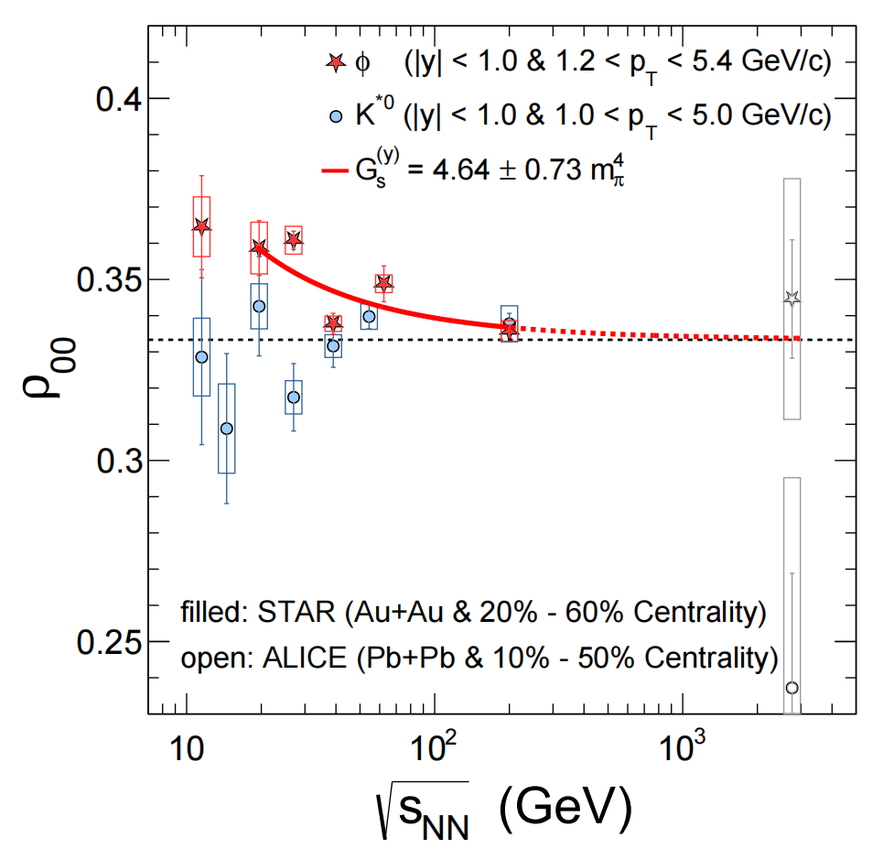
1 . Spin alignments of vector mesons and strong force field
(3)
STAR, Nature 614, 7947 (2023)
Spin alignment of vector mesons
Fluctuation/correlation of strong force field
X. L. Sheng et al., PRL 131, 042304 (2023)
Quark-antiquark spin correlation
J. P. Lv et al., Phys.Rev.D 109 (2024) 11, 114003
In-medium meson spectral property
Y. L. Yin, W. B. Dong, J. Y. Pang, S. Pu, and Q. Wang, Phys. Rev. C 110 (2024) 2, 024905
F. Li and S. Liu, arXiv:2206.11890
Local spin density fluctuation
Kun Xu and M. Huang, Phys. Rev. D 110, 094034 (2024)
Gluon polarization
H. A. Ahmed, Y. Chen, and M. Huang, Phys. Rev. D 111, 086006 (2025)

Slide 7
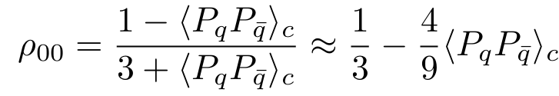
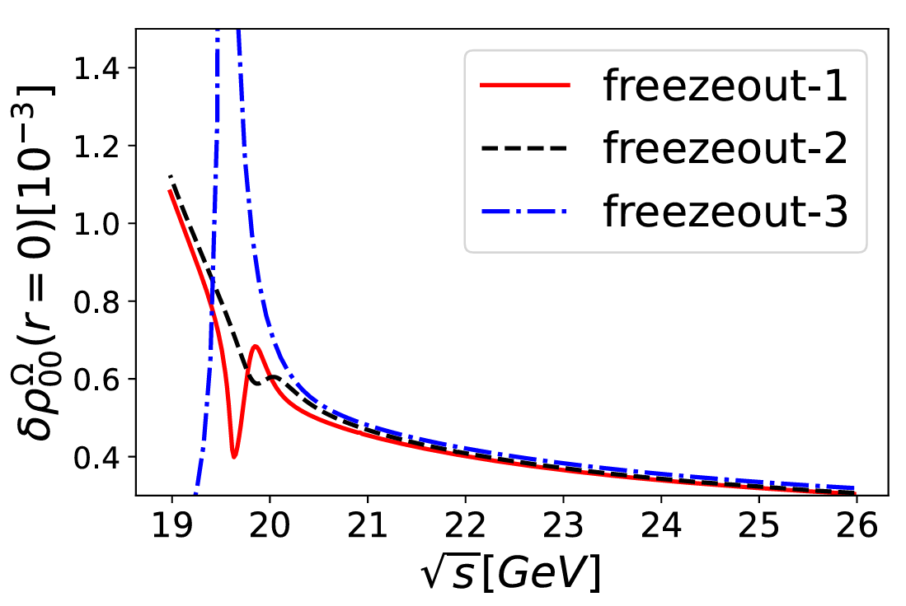
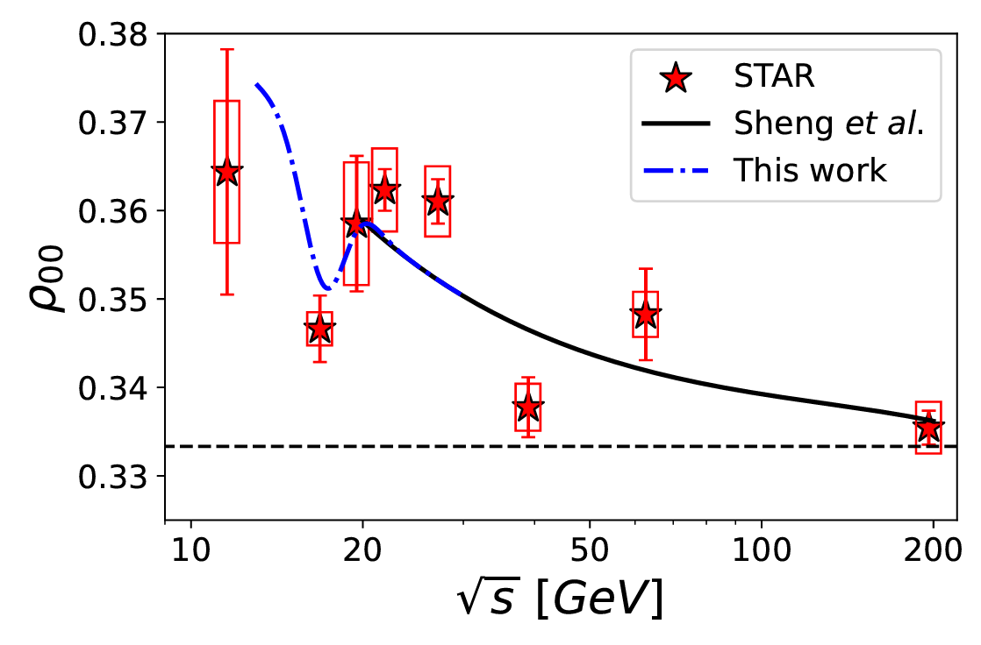
1 . Spin alignment/correlation and QCD critical point
(4)
K. Xu and M. Huang, Phys. Rev. D. 110, 094034 (2024)
H. L. Chen, W. J. Fu, X. G. Huang, and G. L. Ma, Phys. Rev. Lett. 135, 032302 (2025)
A pronounced peak in quark spin correlations near the CEP, primarily driven by the rapid variation of the order parameter within the crossover region. This observation serves as a distinctive signature of approaching the CEP.

Slide 8

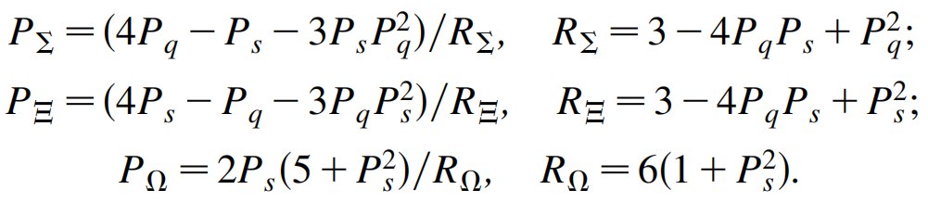

1 . Spin polarization of proton and light quarks
(5)
SU(6) quark coalescence model
Z. T. Liang and X. N. Wang PRL 94, 102301 (2005)
Hyperon polarization is dominated by the spin polarization of the strange quark
Proton spin polarization is a good probe to the spin dynamics of light quarks

Slide 9
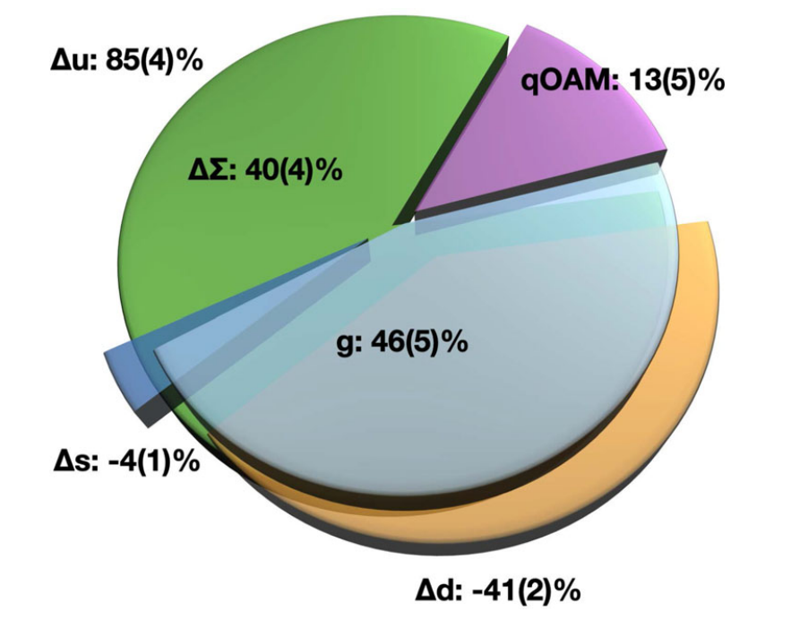
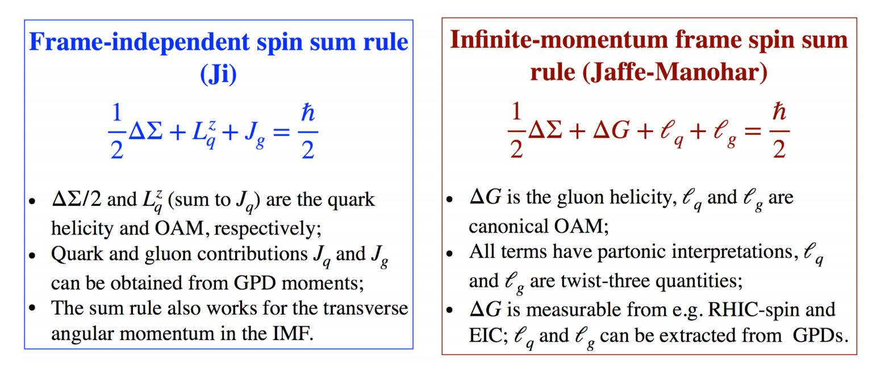
1 . Proton spin puzzle
(6)
LQCD tells us that only about 40% of proton spin comes from quarks
X. D. Ji, F. Yuan, and Y. Zhao, Nature Rev. Phys. 3 (2021) 1, 27-38
Gluon polarization also contributes to the polarization of proton

Slide 10
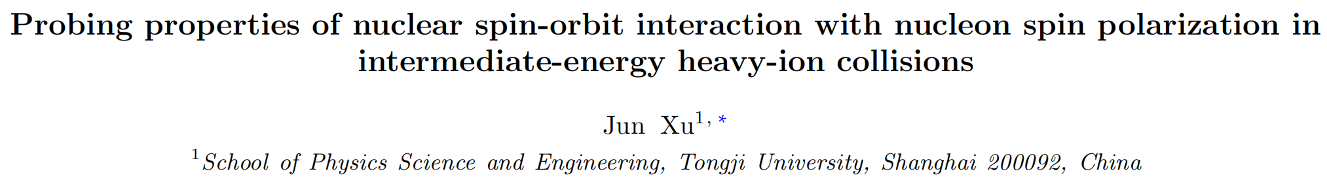
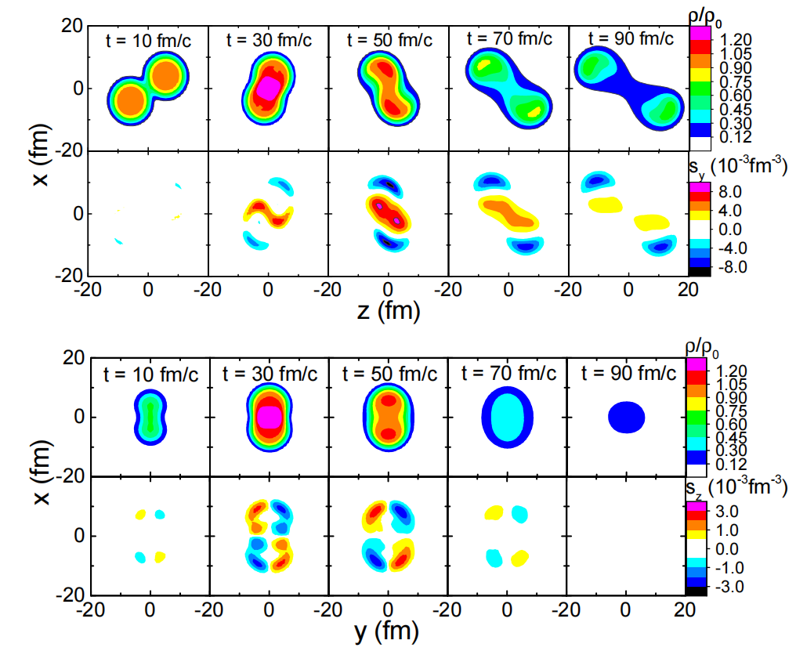
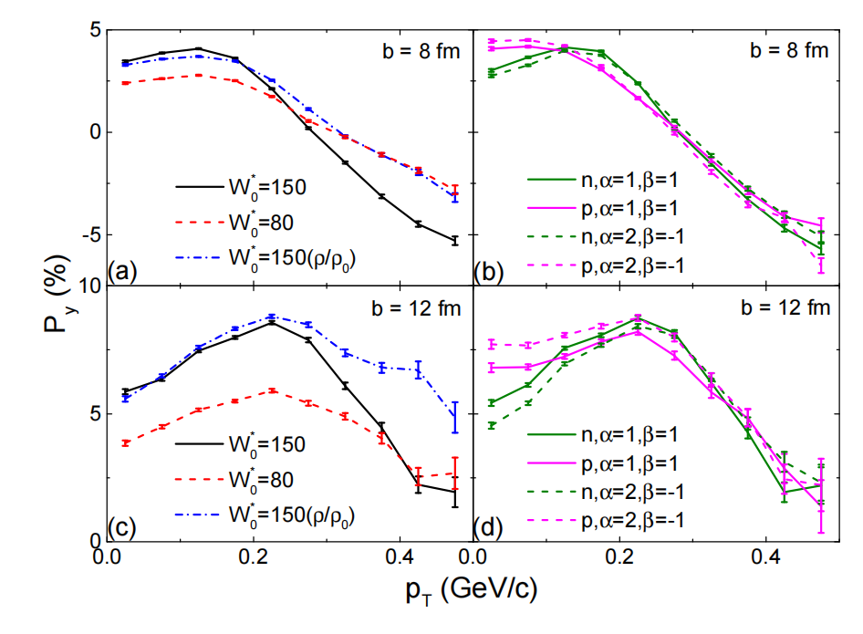
1 . Proton spin polarization in intermediate collision energies
(7)

Slide 11
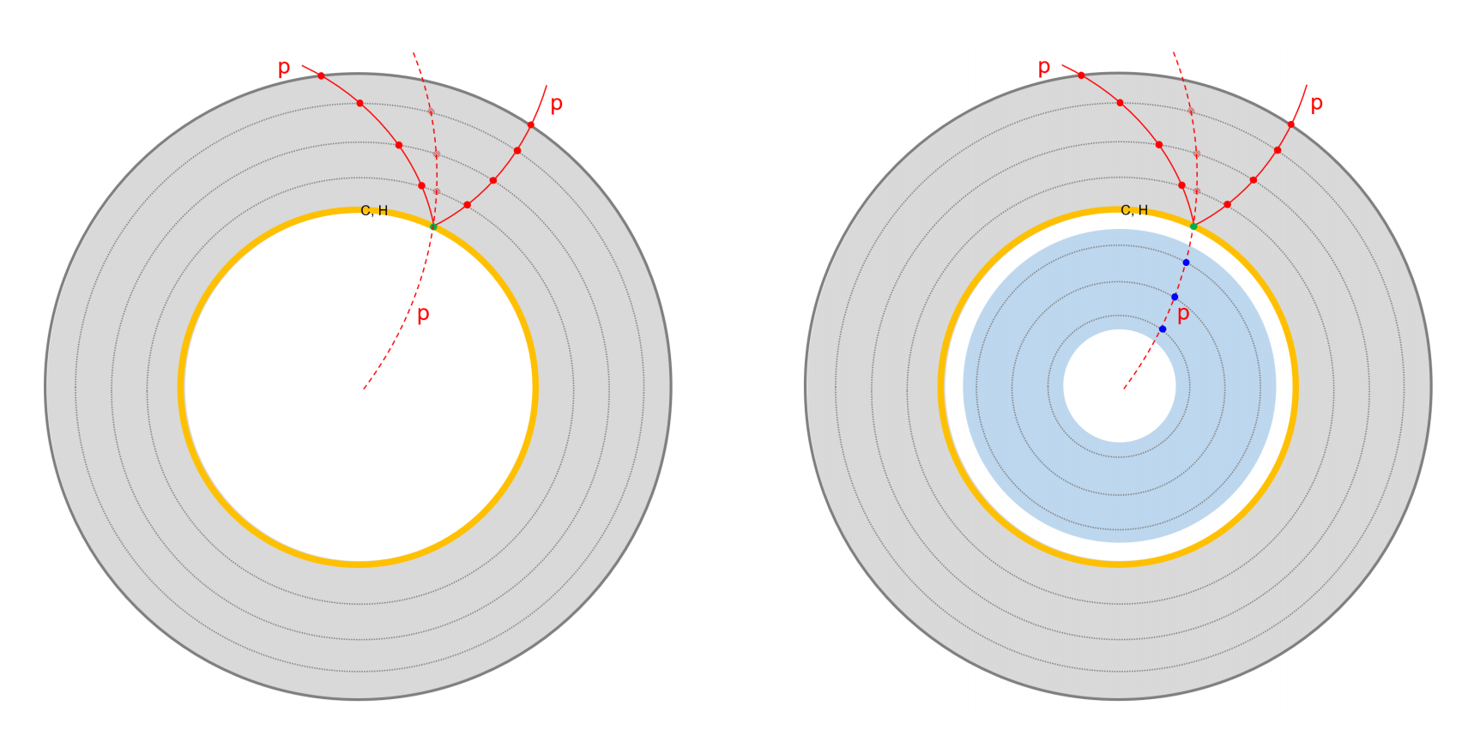
1 . Challenge and opportunity in measuring proton polarization
(8)
Proton is a stable particle, making conventional polarization measurement based on particle decay infeasible!
Phys. Rev. D 112 (2025) 3, L031502

Slide 12
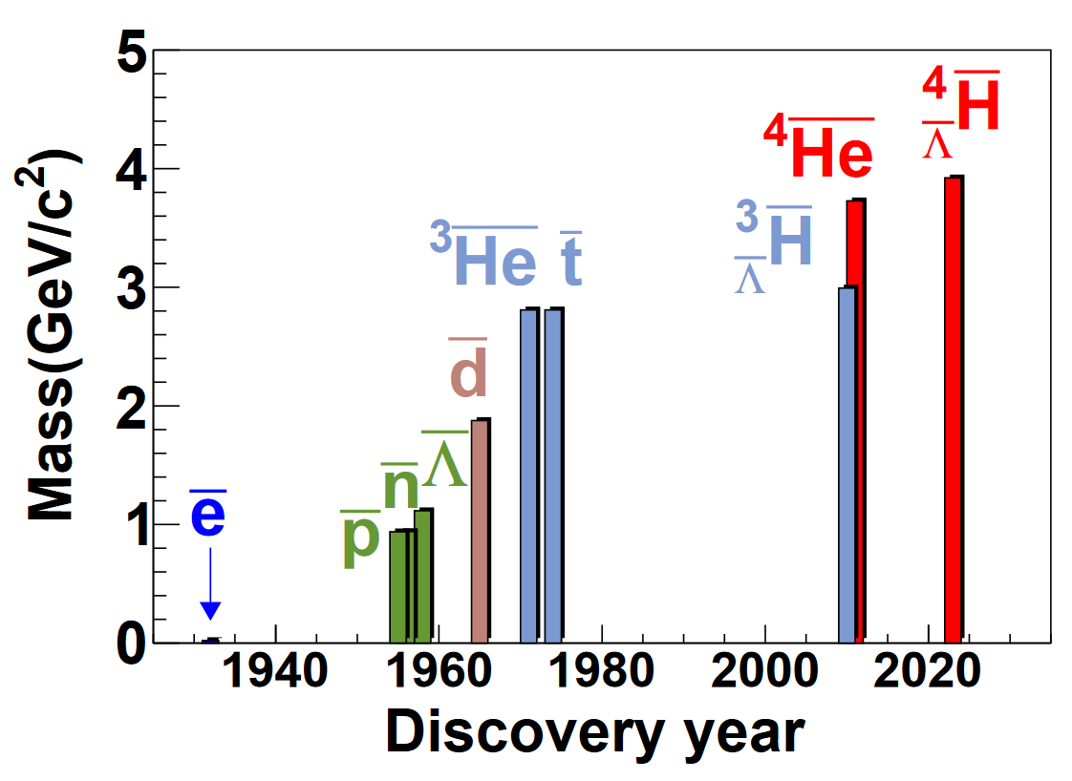
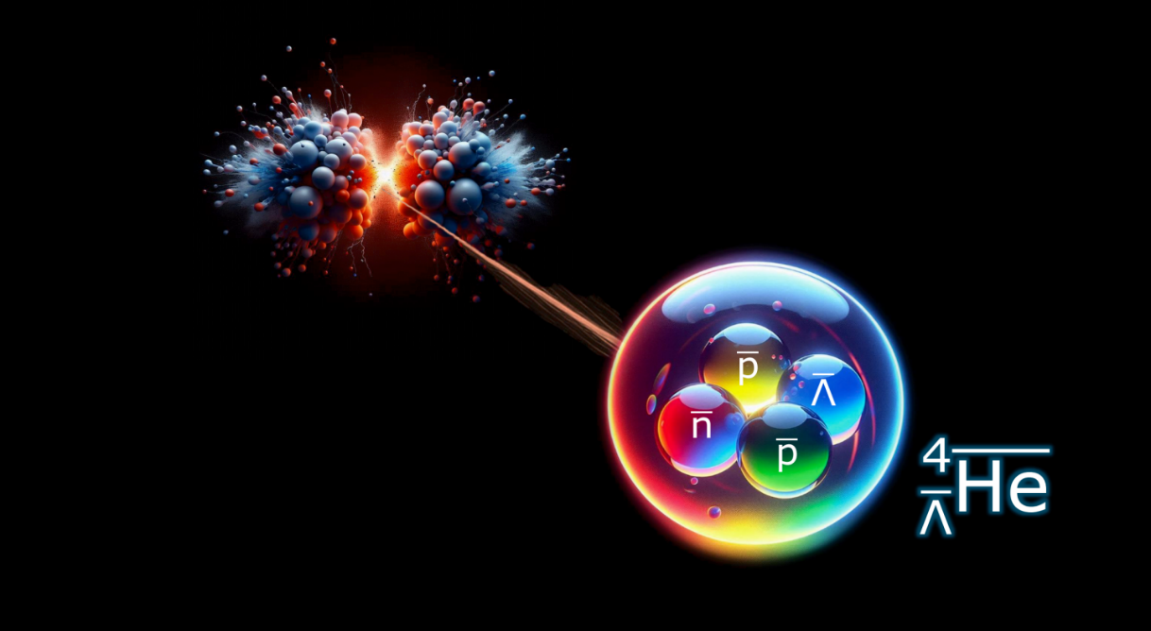

















2 . From polarization of hadrons to light (hyper)nuclei
(9)
K. J. Sun et al., Phys. Rev. Lett. 134, 022301 (2025)
K. J. Sun, R. Wang, C. M. Ko, Y. G. Ma, C. Shen, Nature Commun. 15, 1074 (2024)
STAR, Nature 632, 8027 (2024)
E. Jobst, M. Puccio, and S. Kundu https://repository.cern/records/w44qe-33g73
R.-J. Liu and J. Xu, Phys. Rev. C 109, 014615 (2024).
Stable (anti-)nuclei
Elementary hadrons
$$p(uud)$$
$$d(np)$$
$${}_{}^{3}{He}(npp)$$
$$\overline{p}(\overline{u}\overline{u}\overline{d})$$
$$\overline{d}(\overline{n}\overline{p})$$
$${}_{}^{3}{\overline{He}}(\overline{n}\overline{p}\overline{p})$$
$$Λ(uds)$$
$$Ξ(uss)$$
$$Ω(sss)$$
…
$$φ(s\overline{s})$$
$$K^{∗0}(d\overline{s})$$
$$ρ^{+}(u\overline{d})$$
Unstable (anti-)(hyper-)nuclei
ALICE, Phys. Rev. Lett. 134 (2025) 16, 162301
$$J/ψ(c\overline{c})$$
…
$${}_{Λ}^{3}{H(npΛ)}$$
$${}_{}^{4}{Li(nppp)}$$
$${}_{\overline{Λ}}^{3}{\overline{H}(\overline{n}\overline{p}\overline{Λ})}$$
$${}_{}^{4}{\overline{Li}(\overline{n}\overline{p}\overline{p}\overline{p})}$$
…

Slide 13
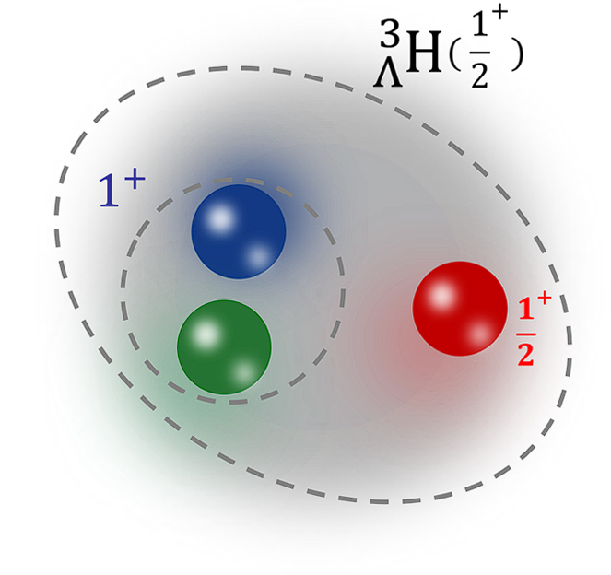
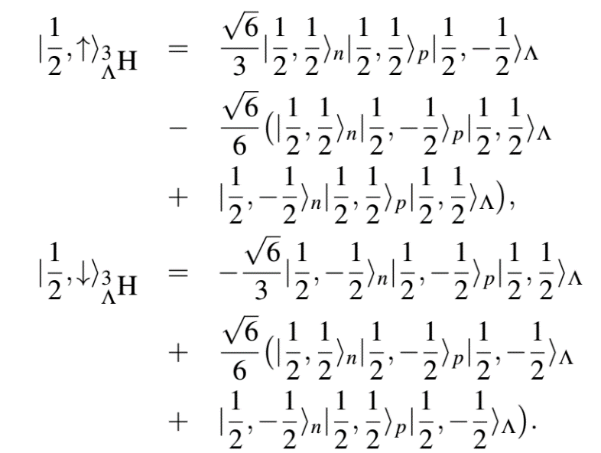
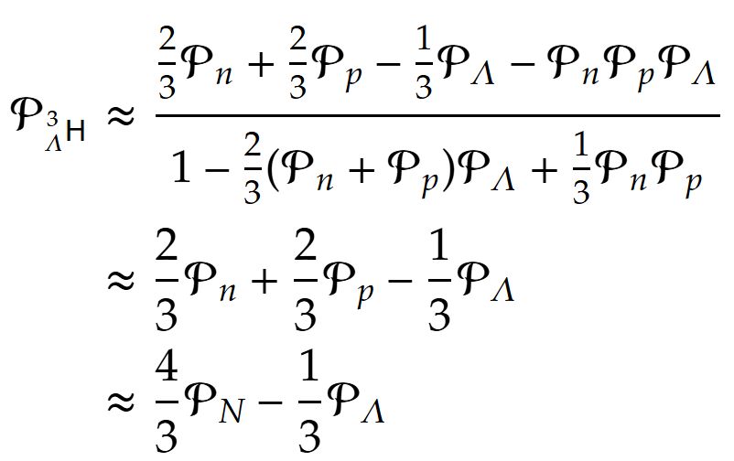

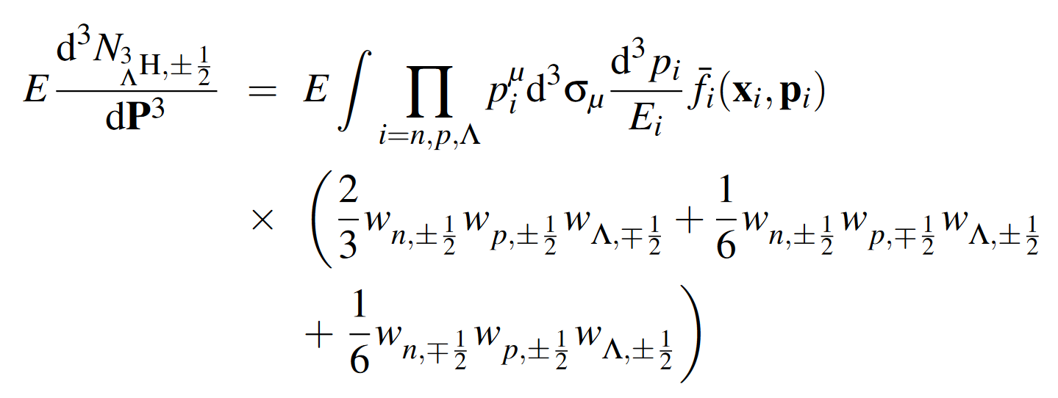
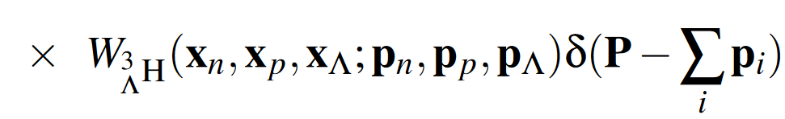
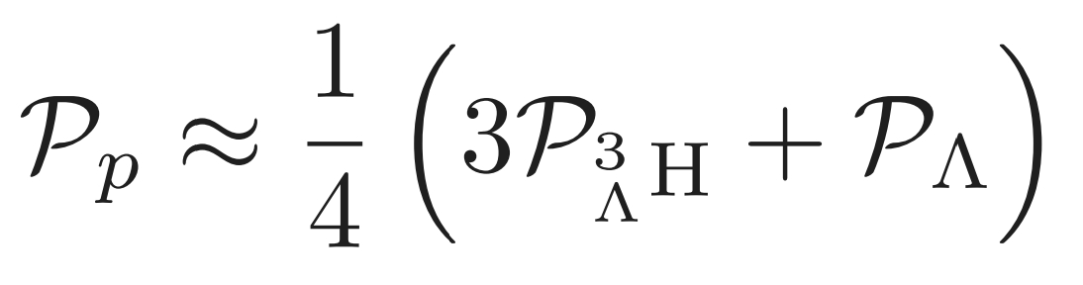
2 . Polarization of hypertriton and proton
(10)
Kai-Jia Sun et al., Phys. Rev. Lett. 134, 022301 (2025)
Spin wavefunction
Coalescence model for hypertriton production (without baryon spin correlation)

Slide 14
2 . Decoding proton spin polarization from hypertriton production
(11)
Dai-Neng Liu et al., arXiv:2508.12193 (2025)

Slide 15
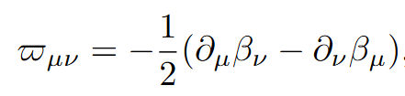


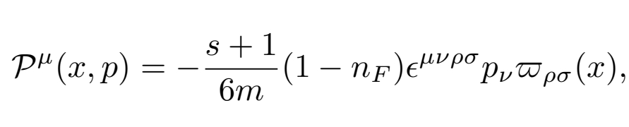






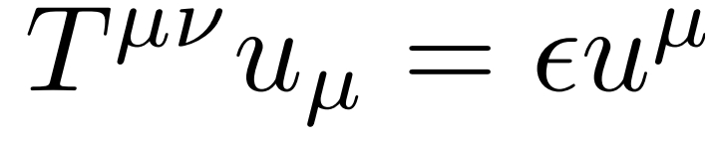
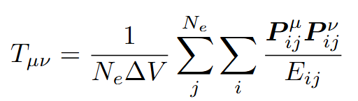
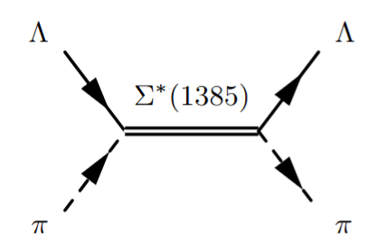
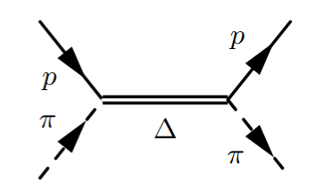
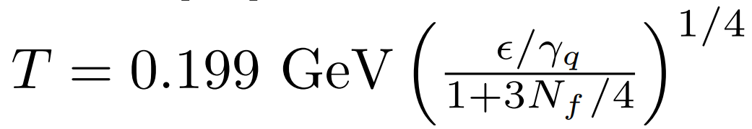
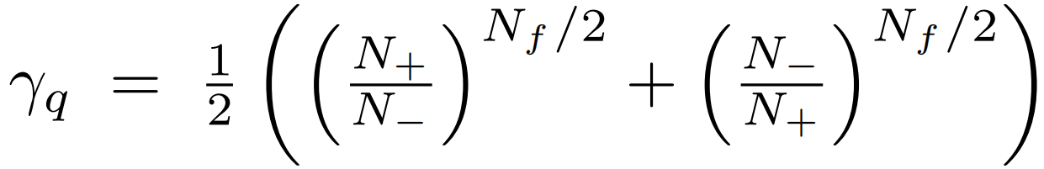
2 . Model setup
(12)
Thermal vorticity
HIJING
AuAu 7.7-200GeV, 20-50%, b=8fm
Spin polarization vector of single pariticle
AMPT
ZPC
QC
Eigen equation
Fiuld energy-momentum tensor
ART
Scattering
Decay
|y|<1
Coalescence
Temperature
Hypertriton

Slide 16
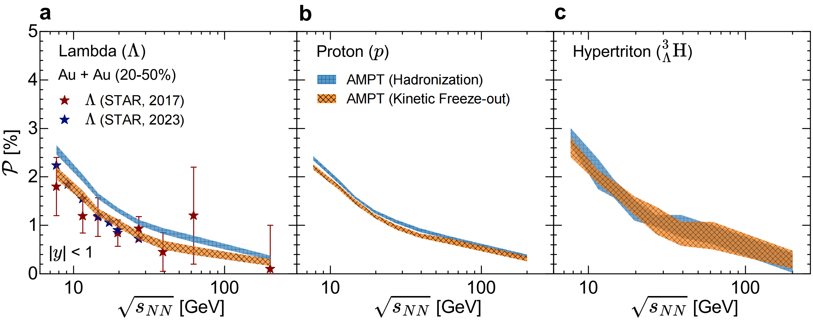
2 . Results
(13)

Slide 17
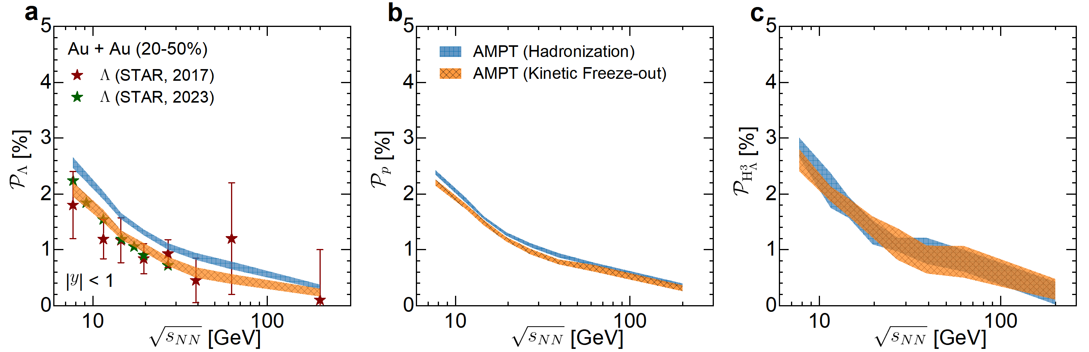
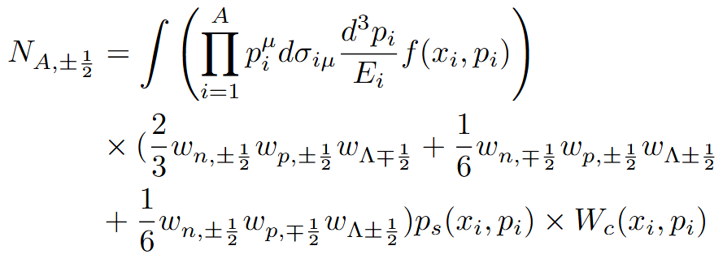

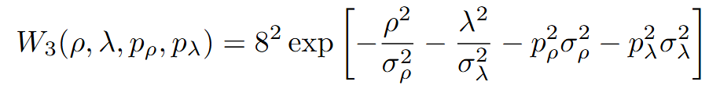


2 . Hypertriton polarization
(14)
Spin-dependent Coalescence model

Slide 18

2 . Decoding proton spin polarization
(15)

Slide 19


















2 . Measurements
(16)
Parity-violating weak decay
Λ hyperons
Hypertriton
BESIII, Phys. Rev. Lett. 129, 131801 (2022).
The transition matrix
The angular distribution
H denotes $Λ$ and $\overline{Λ}$
Sign flip !

Slide 20


3 . Spin alignment of Li-4
(17)
Yun-Peng Zheng et al., arXiv:2509. 15286 (2025)

Slide 21



3 . Spin alignment of Li-4
(18)
Yun-Peng Zheng et al., arXiv:2509. 15286 (2025)
New

Slide 22
4 . Summary and outlook
(19)
(Anti-)hypertriton is globally polarized in non-central heavy-ion collisions.
Combining measurements of Lambda and hypertriton polarizations provides a novel route to unravel the proton spin polarization.

Slide 23



4 . Summary and outlook
(20)
A. Andronic et al., Phys. Lett. B 697, 203-207 (2011)
FAIR/CBM (2.3-5.3 GeV)
HIAF/CEE (2.1-4.5 GeV)
NICA/MPD (4-11 GeV)
J-PARC-HI (2-6.2 GeV)

Slide 24
backup

Slide 25

结合能和寿命
ALICE, PRL 131, 102302 (2023)
Y. G. Ma, Nucl. Sci. Tech. 3497 (2023)
J. Chen et al., Phys. Rep. 760, 1 (2018);P. Braun-Munzinger and B. Donigus NPA987, 144 (2019)

Slide 26

3 . Spin alignment of Li-4
(17)
Yun-Peng Zheng et al., arXiv:2509. 15286 (2025)
New

Slide 27



总结&展望
(25)
E. Jobst, M. Puccio, and S. Kundu, https://repository.cern/records/w44qe-33g73
ALICE Run2 Pb-Pb @ 5.02TeV

Slide 28



模型设置-强子化阶段
(11)
HIJING
AuAu 7.7-200GeV, 20-50%, b=8fm
Spin polarization vector of single pariticle
AMPT
ZPC
in the c.m. frame by a Lorentz boost
QC
ART
Scatter
Decay
|y|<1
Hadronization
Hypertriton

Slide 29





模型设置-强子散射和衰变
(12)
Xia, Li, Huang, Huang, Phys.Rev.C 100, 014913 (2019)
HIJING
AuAu 7.7-200GeV, 20-50%, b=8fm
AMPT
ZPC
QC
Decay from mother particles
ART
Scatter
Decay
|y|<1
Single particle
feed-down
Hypertriton

Slide 30







模型设置-强子散射和衰变
(13)
Cross section
HIJING
AuAu 7.7-200GeV, 20-50%, b=8fm
Γ = 36 MeV
AMPT
ZPC
QC
ART
Scatter
Decay
|y|<1
To form a resonance
Hypertriton

Slide 31






利用超核测量质子自旋极化
(10)
STAR, PRC 97, 054909 (2018)
Favors spin 1/2
Favors spin 3/2

Slide 32
利用超核测量质子自旋极化
(11)
Kai-Jia Sun et al., Phys. Rev. Lett. 134, 022301 (2025)
Spin wavefunction
Coalescence model for hypertriton production (without baryon spin correlation)

Slide 33
超子和超核极化测量
(12)
Parity-violating weak decay
Λ hyperons
Hypertriton
BESIII, Phys. Rev. Lett. 129, 131801 (2022).
The transition matrix
The angular distribution
H denotes $Λ$ and $\overline{Λ}$
Sign flip !

Slide 34




奇异‘晕’核-（反物质）超氚核
D. Lonardoni et al., Phys.Rev.Lett. 114 (2015) 9, 092301
$${}_{Λ}^{3}H$$
J. Chen et al., Phys. Rep. 760, 1 (2018);
P. Braun-Munzinger and B. Donigus NPA987, 144 (2019)
D. N. Liu et al. Phys. Lett. B 855, 138855 (2024)

Slide 35

（反）超氚的自旋 ?
Spin triplet
Spin singlet
Spin triplet

Slide 36











超核产生的并合模型
Coalescence Model
$$A_{P}$$
Density Matrix Formulation
(sudden approximation)
$$Deuteron$$
$$n$$
$$p$$
$$N_{A}=Tr\left({\hat{ρ}}_{s}{\hat{ρ}}_{A}\right)$$
${=g}_{c}∫dΓ ρ_{s}\left({\{x}_{i},p_{i}\} \right){×W}_{A}(\{x_{i},p_{i}\})$
$${}_{Λ}^{3}H$$
Wigner function of light cluster
$$R$$
$$A_{T}$$
Overlap between source distribution function and Wigner function of light nuclei
R. Scheibl and U. W. Heinz, PRC59. 1585(1999)
F. Bellini et al., PRC99,054905(2019)
K. J. Sun, C. M. Ko and B. D$\ddot{o}$nigus, PLB 792, 132 (2019)
Zhen Zhang and Che Ming Ko, PLB 780, 191-195 (2018)
K. Blum, M. Takimoto, PRC 99, 044913 (2019)
Hui-Gan Chen and Zhao-Qing Feng, PLB 824, 136849 (2022)

Slide 37







（反）超氚的极化和波函数自旋结构
Different polarization and decay patterns!

Slide 38




（反）超氚的极化和波函数自旋结构
The measurement of hypertriton polarization provides a novel method to uniquely determine its internal spin structure

