Slide 1



CEPC vertex Detector
Zhijun Liang

Slide 2
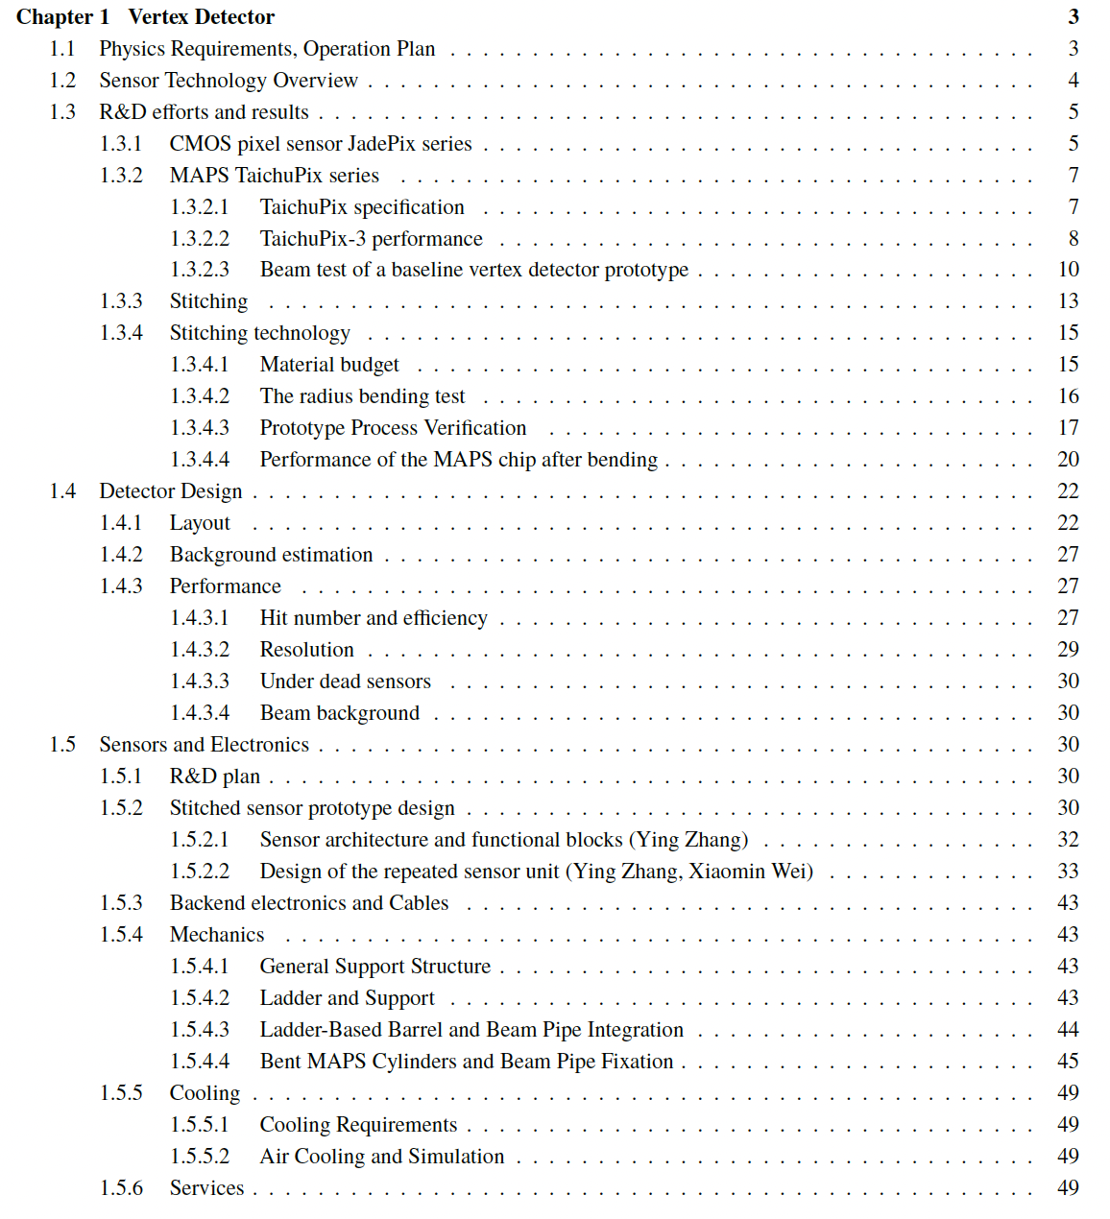
COST review
More than 50 pages ready (85%)
Introduction part (ready)
R & D part
  Jadepix/Taichu (1st draft ready)
  Stitching (just upload)
Detector design
  Physics Layout (1st draft ready)
  Stitching design (1st draft ready)
  Mechanics (1st draft ready)
https://latex.ihep.ac.cn/project/6745179fef5108a66841008a

Slide 3
Feedback from Yifang
Introduction: missing why we choose 65nm ? Power issue ?
R & D: missing general overview, roadmap, missing ref to ALICE …
R & D: vertex prototype description was scattered in many sections
  Should put them together around 4.3.3
Design : Taichu3 → Taichu or Taichu Serial
Add roadmap for future development
Design section, There are too many details
  should remove some of the content
Performance should move to after Mechanics

Slide 4
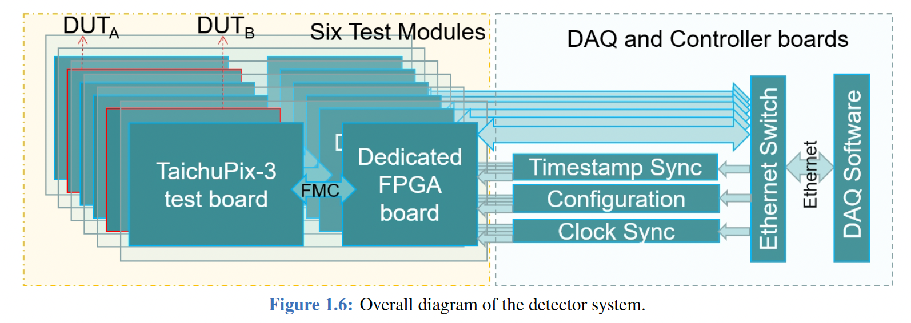
Figure issue
TaichuPix-3 → TaichuPix or other name for future chip

Slide 5
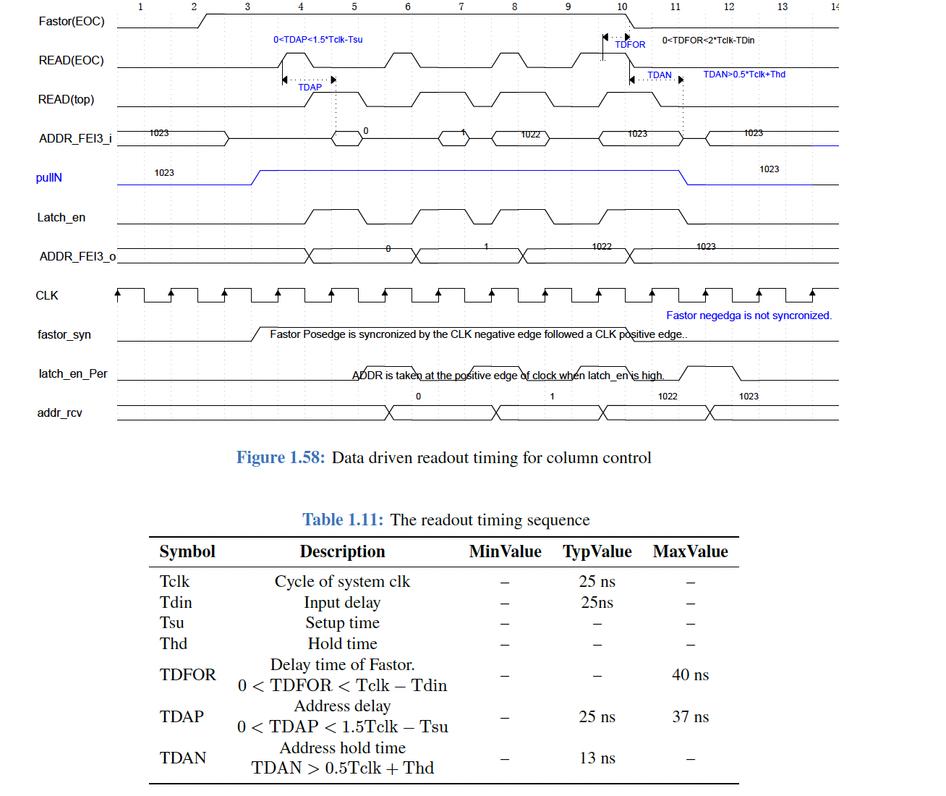
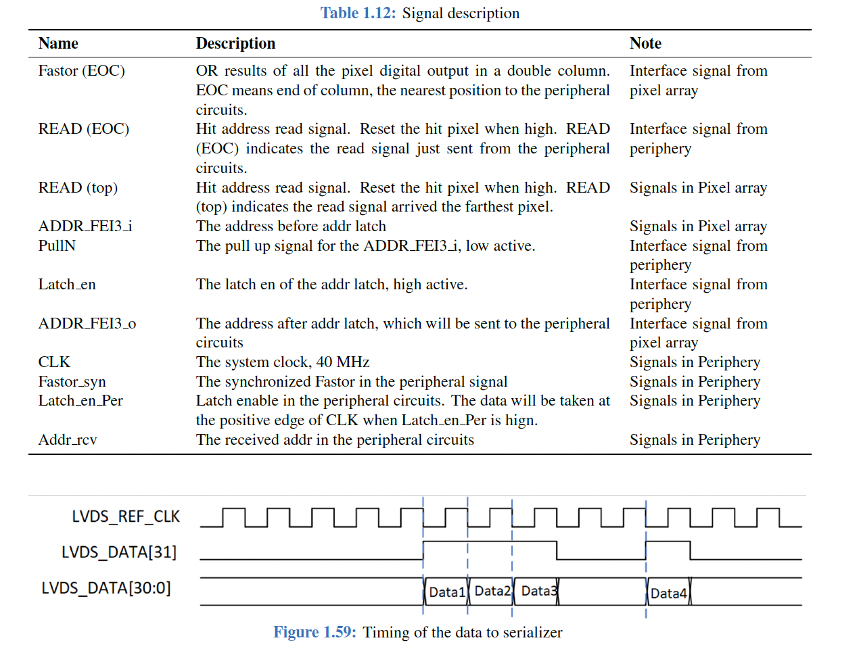
Figure
Too details, Suggest to remove
Appendpix

Slide 6
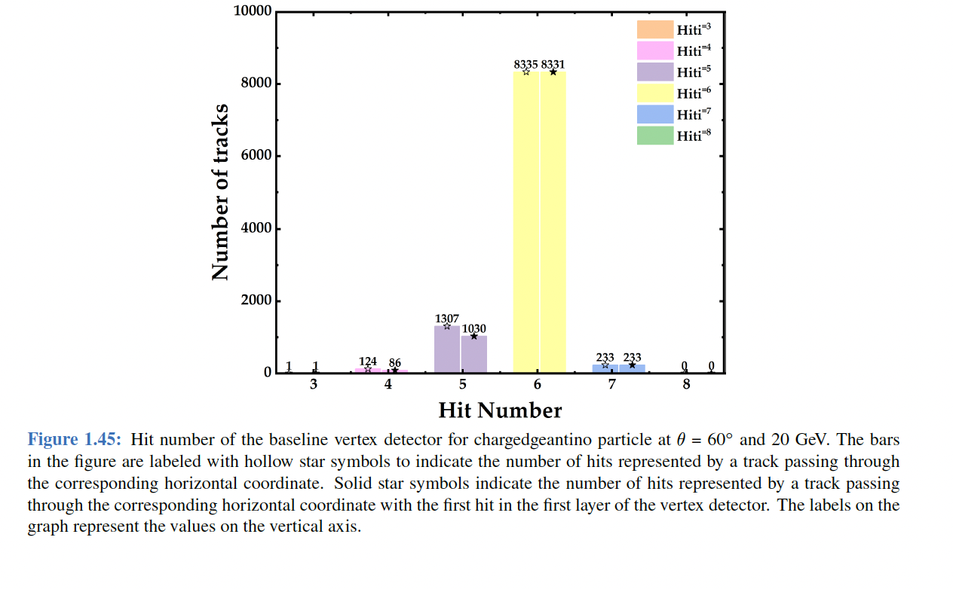
Figure
Absolute number has no meaning, fraction
Hit efficiency, track efficiency, alignment

Slide 7
Cost estimation

