Slide 1

CEPC Trk & PID meeting
H_recoil Status Report
Yuji Li(Fudan university)

Slide 2


Status
In this formula, the width of Z/H should be measured as a constant with H invisible events.
We use a chi square method to find the best lepton pair.
Clear relation between Z boson momenta and H recoil.
Clean Signal Inputs: /cefs/higgs/liugeliang/CEPC/202501/Production/E240_e2e2Hinvi, /cefs/higgs/liugeliang/CEPC/202501/Production/E240_e1e1Hinvi

Slide 3
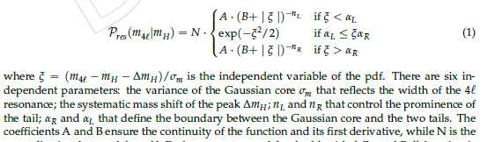
Lepton Selection
Status: Muon system is not well defined, and electron reconstruction is not corresponding to Z peak from Geliang’s report. Before the improvement of Ecal, we will disscuss muon only.
Lepton selection is performed by GenMatching.(DeltaR<0.1)
Z, H resonance is fitted with TwosidedCB. (unbinned fit)

Slide 4
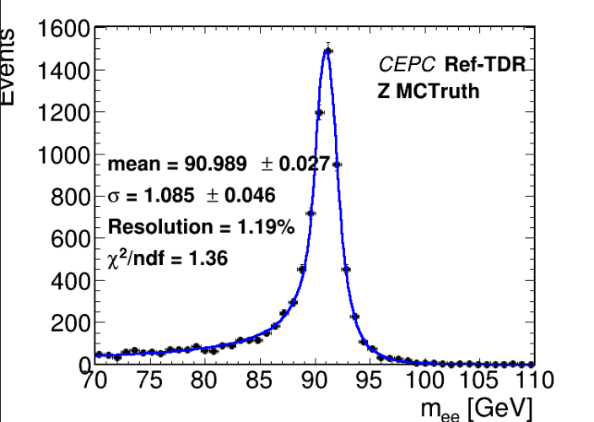
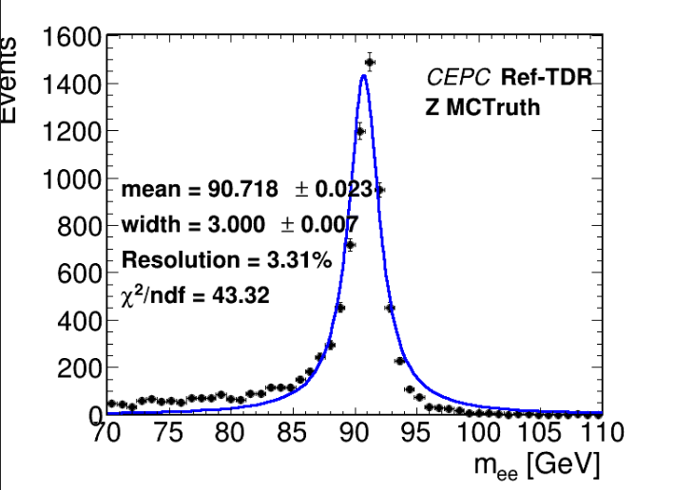
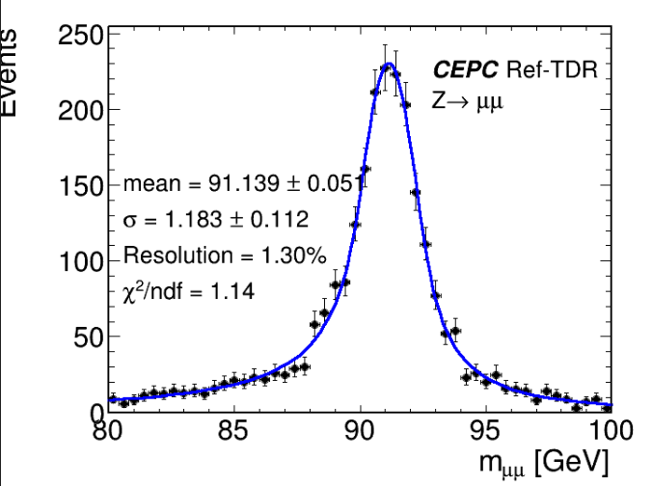
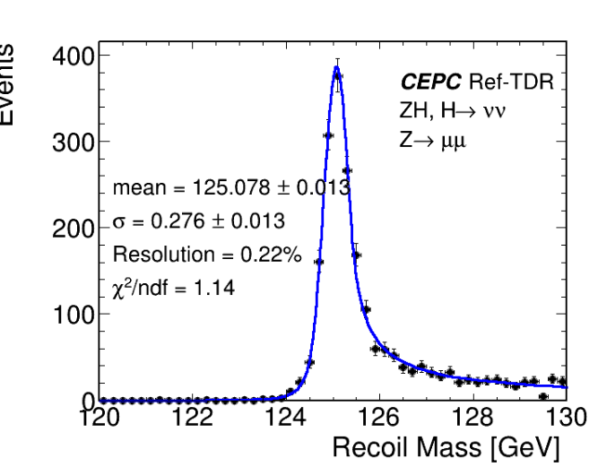
Results (Fitting with TwosidedCB)
BW checking

Slide 5
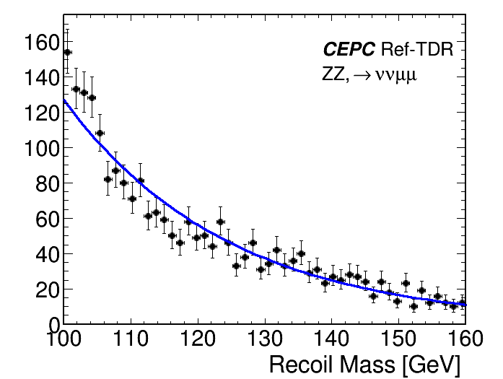
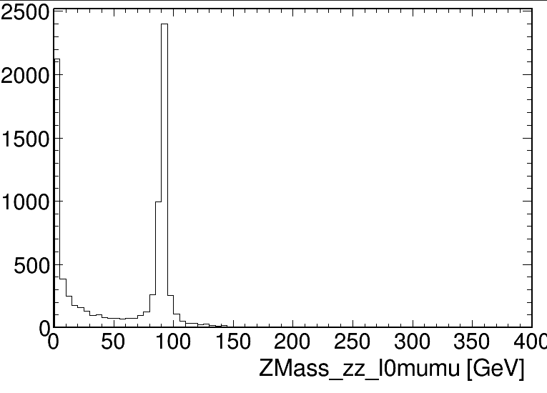
BKG Samples: eeToZZTo2l2nu
Fitted by exponential

Slide 6
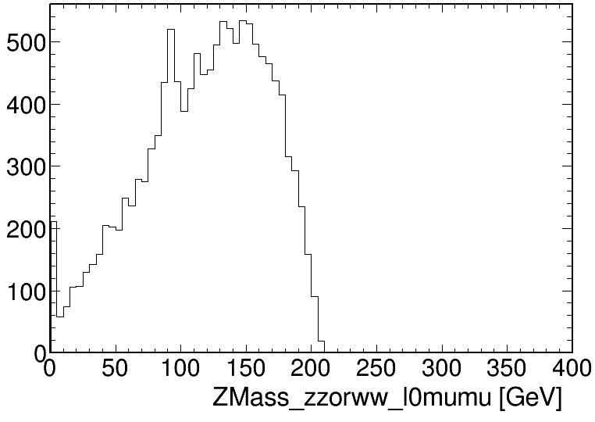
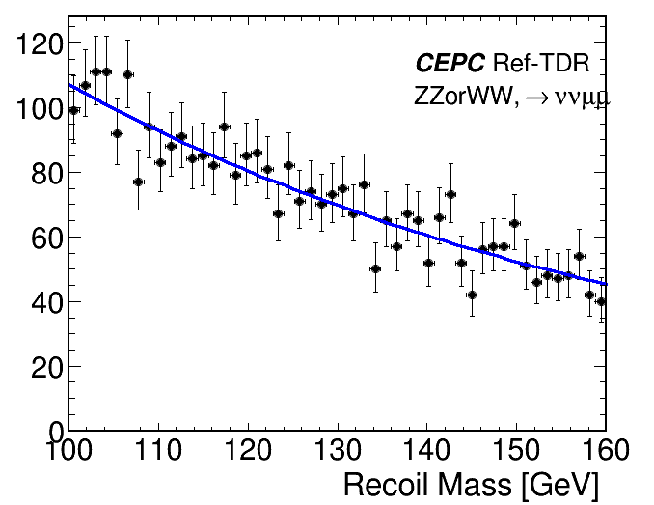
BKG Samples: eeToZZ(WW)To2l2nu
Fitted by exponential

Slide 7
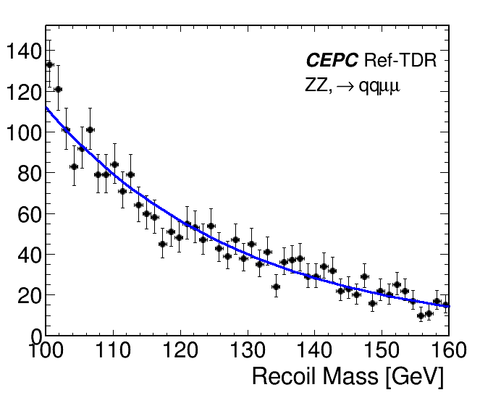
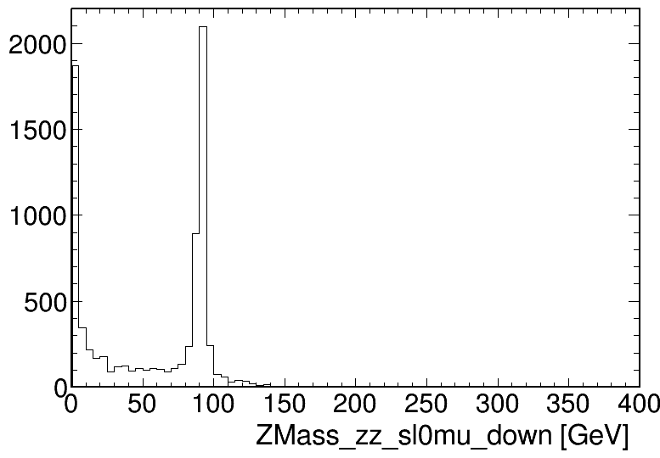
BKG Samples: eeToZZTo2l2q
Fitted by exponential

Slide 8
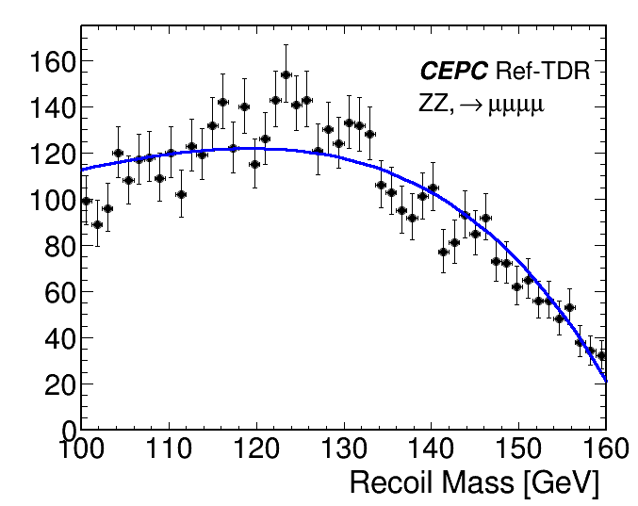
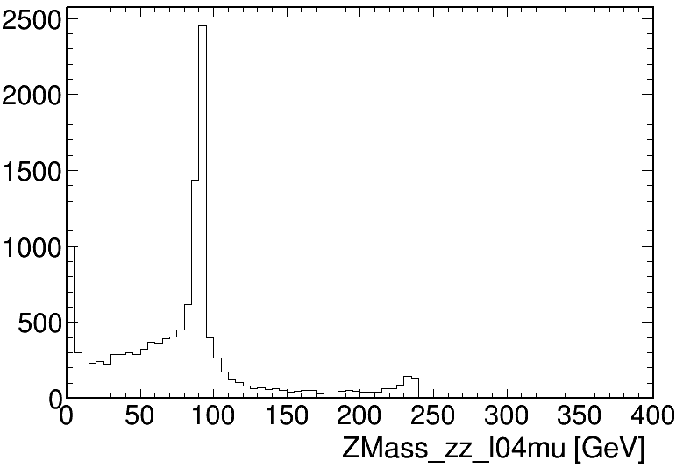
BKG Samples: eeToZZ4L
Fitted by polynomial

Slide 9
Summay and plans
The shape in H invisible decay is corresponding with kaili & Geliang’s study.
Bkg samples includes eeWW and eeZZ with suitable final states are checked for a proper fitting functions, and the optimazations of event selections will be taken care with signal and bkg efficiencies.
We are lacking of ee->Zgamma samples as another dominant bkg.
Final fit of H recoil shape will be performed including bkg shapes.

