Slide 1
isospin-sum rule test
Parameter:
$$\frac{τ_{B^{0}}}{τ_{B^{+}}}=0.9310±0.0043±0.0030$$
$$\frac{τ_{B^{0}}}{τ_{B^{+}}}=0.9273±0.0033(from PDG)$$
I_Kpi = 0.0224 ± 0.1591 (stat) ± 0.0423 (sys)
I_Kpi = 0.0025 ± 0.1564 (stat) ± 0.0422 (sys)
I_Kpi = 0.0136 ± 0.1566 (stat) ± 0.0422 (sys)

Slide 2
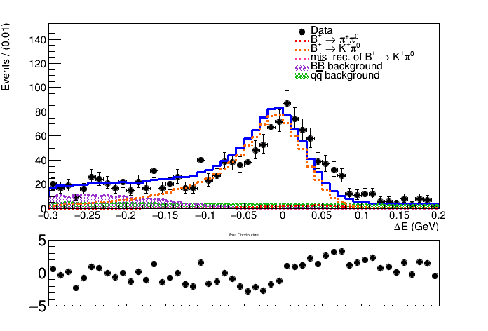
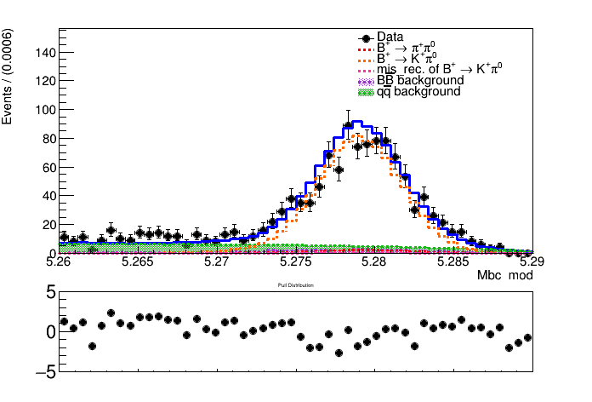
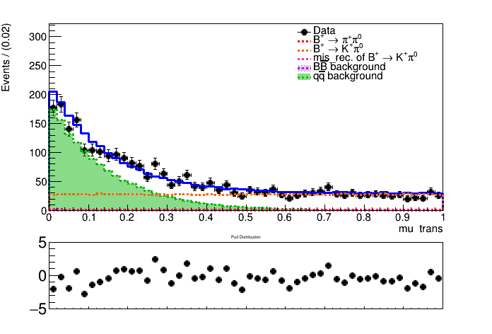
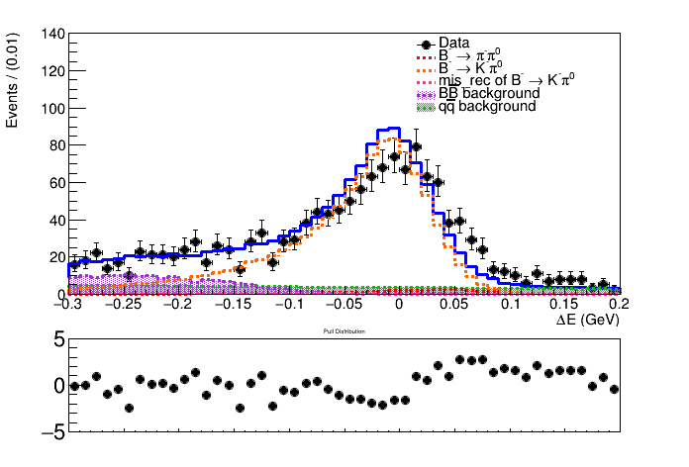
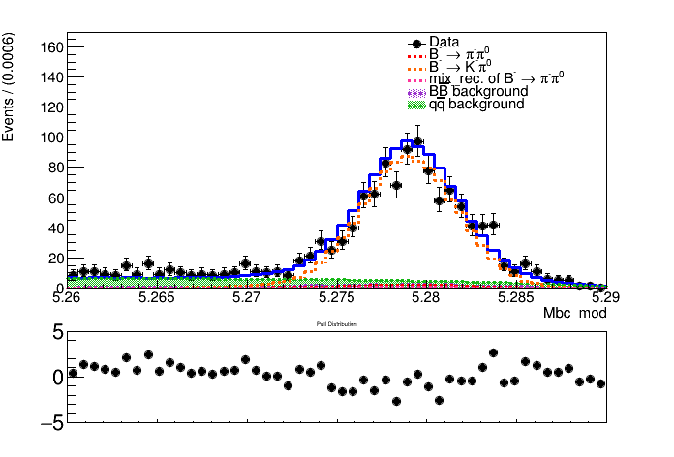
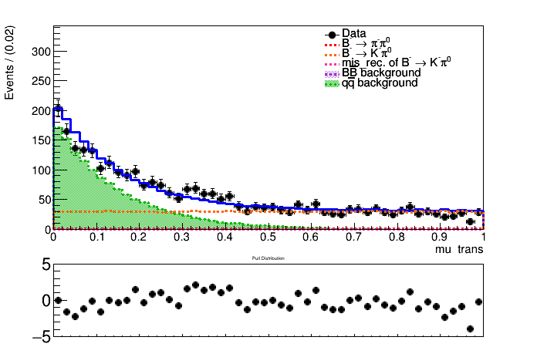
Simultaneously fit to belle and belle2 sample
Belle kpi fitting plots

Slide 3
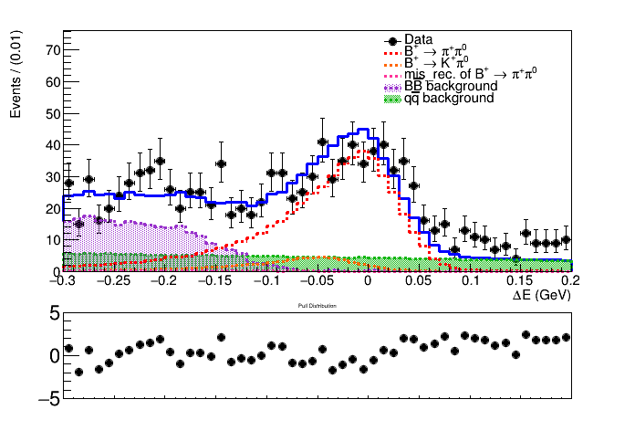
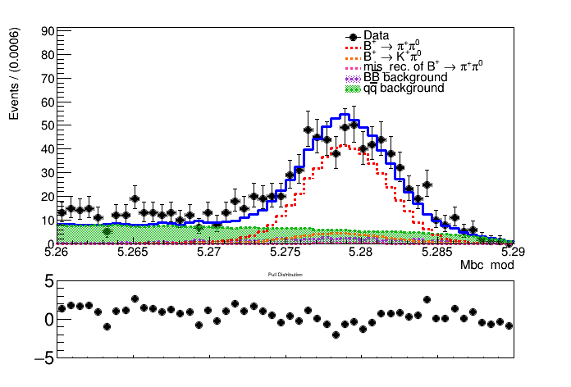
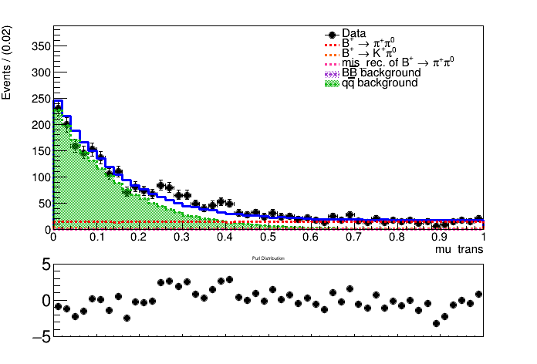
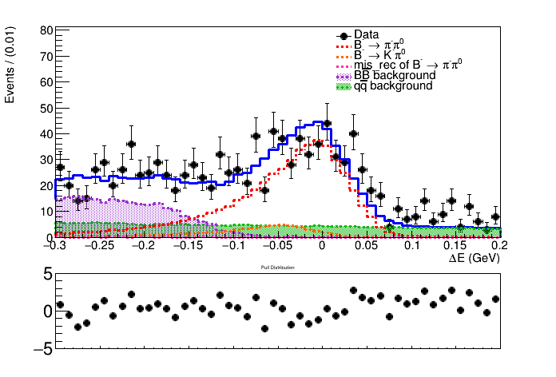
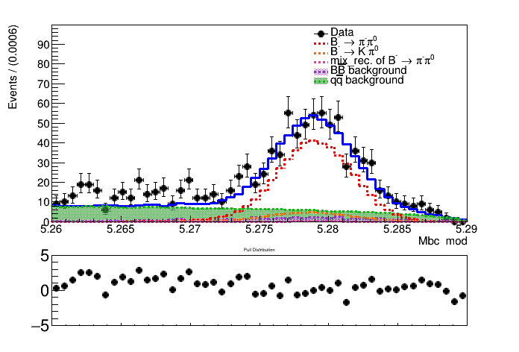
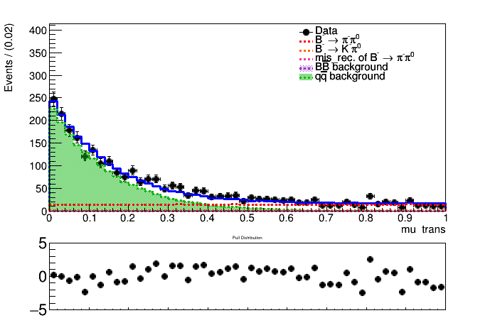
Simultaneously fit to belle and belle2 sample
Belle pipi fitting plots

Slide 4
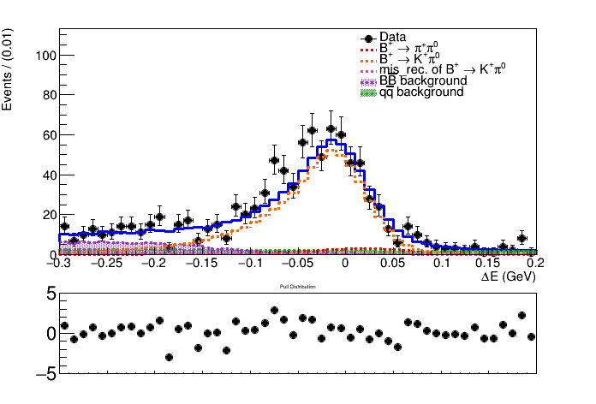
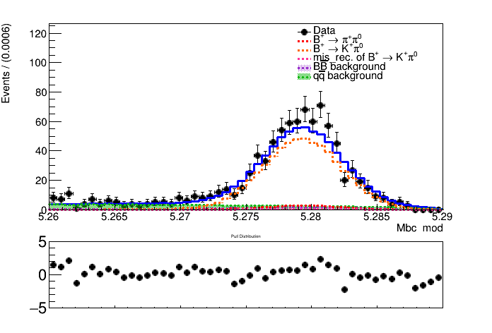
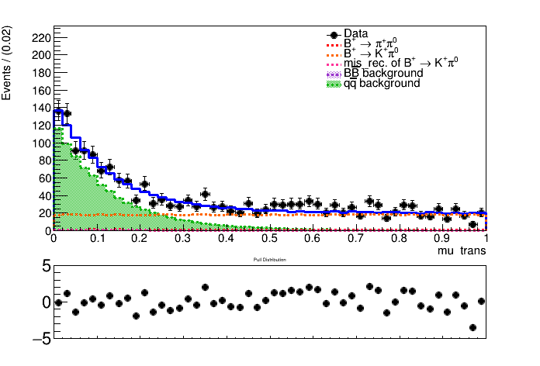
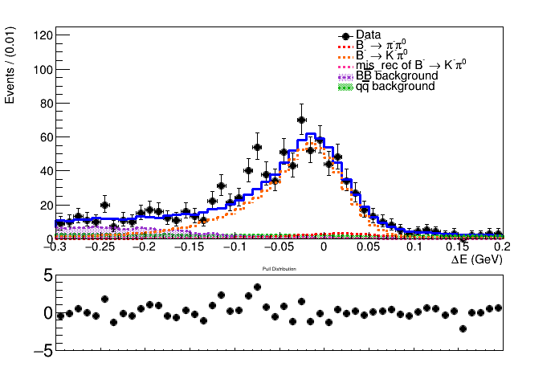
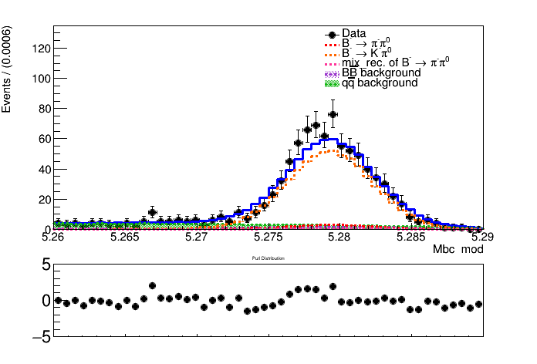
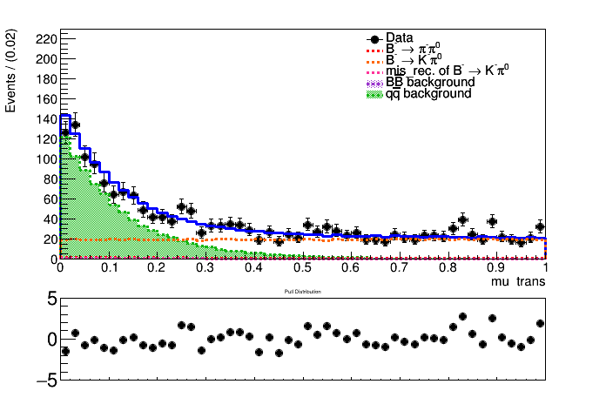
Simultaneously fit to belle and belle2 sample
Belle2 kpi fitting plots

Slide 5
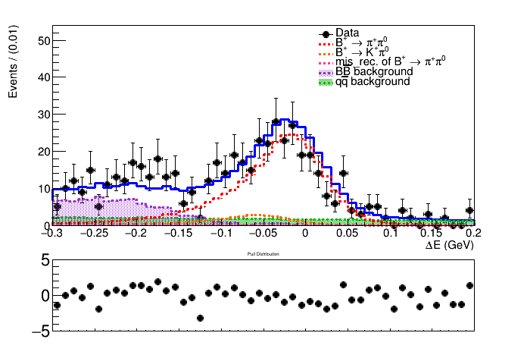
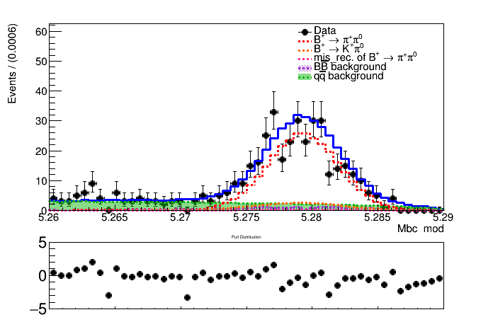
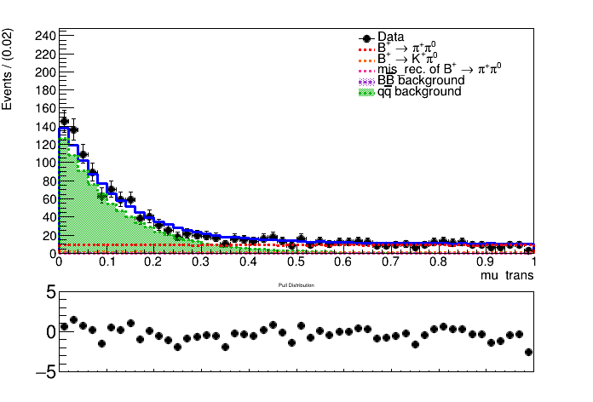
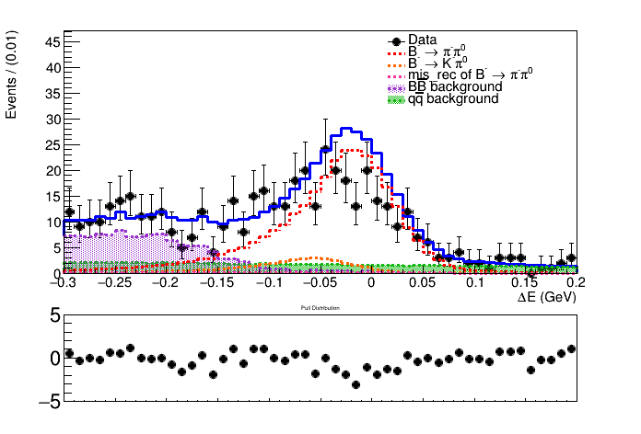
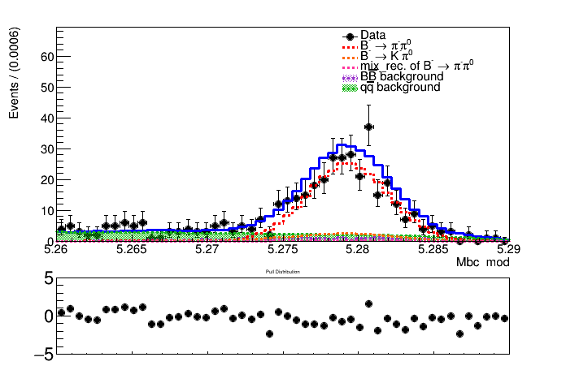
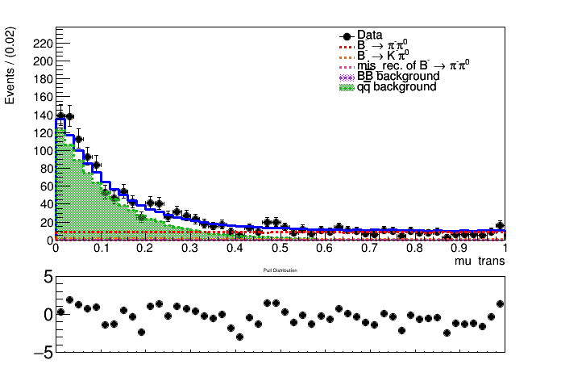
Simultaneously fit to belle and belle2 sample
Belle2 pipi fitting plots

Slide 6
 | $$Type$$ | $$A_{CP}(B^{+}→K^{+}π^{0})$$ | $$Br(B^{+}→K^{+}π^{0})$$ | $$A_{CP}(B^{+}→π^{+}π^{0})$$ | $$Br(B^{+}→π^{+}π^{0})$$
$$my measurement$$ | $$b1 \& b2(MC)$$ 771/fb+515/fb | $$0.027±0.015$$ | $$(13.20±0.20)×{10}^{−6}$$ | $$−0.010±0.028$$ | $$(5.31±0.15)×{10}^{−6}$$
$$improvement$$ |  | $$17\%↑$$ | $$17\%↑$$ | $$18\%↑$$ | $$21\%↑$$
$$my measurement$$ | $$b1 \& b2(Data)$$ 771/fb+365/fb | $$0.037±0.017$$ | $$(13.07±0.22)×{10}^{−6}$$ | $$−0.009±0.027$$ | $$(6.56±0.18)×{10}^{−6}$$
$$improvement$$ |  | $$6\%↑$$ | $$8\%↑$$ | $$20\%↑$$ | $$5\%↑$$
$$previous results$$ | $$b1 \& b2(Data)$$ 771/fb+365/fb | $$0.029±0.018$$ | $$(13.25±0.24)×{10}^{−6}$$ | $$−0.017±0.034$$ | $$(5.47±0.19)×{10}^{−6}$$
$$PDG$$ |  | $$0.030±0.013$$ | $$(12.9±0.5)×{10}^{−6}$$ | $$0.03±0.04$$ | $$(5.5±0.4)×{10}^{−6}$$
$$belle published$$ | $$b1 (Data)$$ 771/fb | $$0.043±0.024$$ | $$(12.62±0.31)×{10}^{−6}$$ | $$0.025±0.043$$ | $$(5.86±0.26)×{10}^{−6}$$
$$belle2 published$$ | $$b2(Data)$$ 365/fb | $$0.013±0.027$$ | $$(14.21±0.38)×{10}^{−6}$$ | $$−0.082±0.054$$ | $$(5.02±0.28)×{10}^{−6}$$

Slide 7
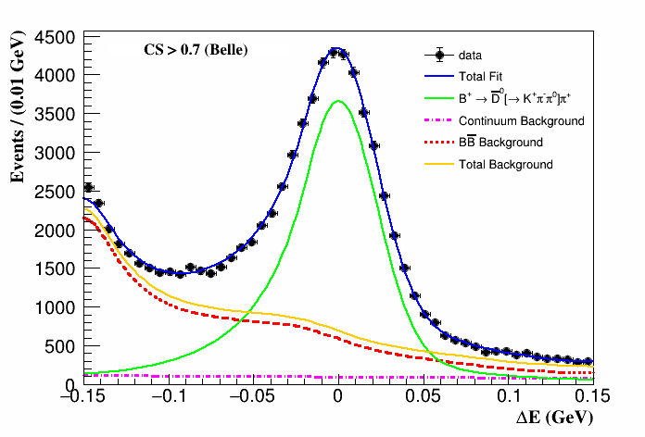
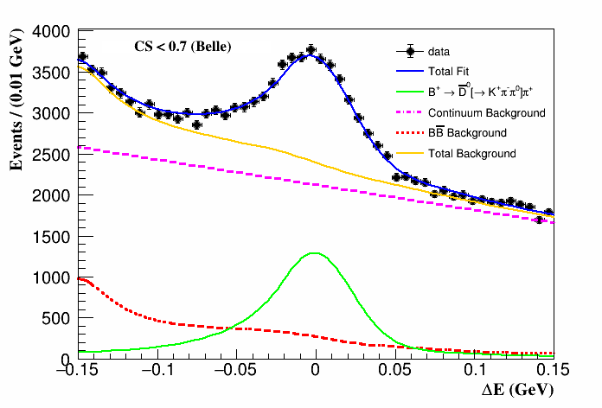
Control Sample
$$B^{+}→\overline{D}(→K^{+}π^{−}π^{0})π^{+}$$
$$efficiency$$ | $$K^{+}π^{0} BDT[\%]$$ | $$π^{+}π^{0} BDT[\%]$$
$$data$$ | $$72.108±0.596$$ | $$to be done$$
$$simulation$$ | $$73.189±0.086$$ | $$to be done$$
$$Ratio$$ | $$98.522±0.822$$ | $$to be done$$

Slide 8
Control Sample
$$B^{+}→\overline{D}(→K^{+}π^{−}π^{0})π^{+}$$
Br(BtoDpi) = (4.06 ± 0.05)e-03
Br(BtoDpi) = (4.61 ± 0.10)e-03(pdg)
$$efficiency$$ | $$belle$$ | $$belle2$$
$$eff$$ | $$9.76$$ | $$7.69$$
$$scf$$ | $$15.2$$ | $$5.41$$

Slide 9
Belle PID
$For KaonID$
kaonid eff corr = 0.994976
kaonid eff uncertainty = 0.0152306
$For PionID$
kaonid eff corr = 0.993511
kaonid eff uncertainty = 0.0064029

