Slide 1
Group Meeting
邹世明
2025/02/28

Slide 2
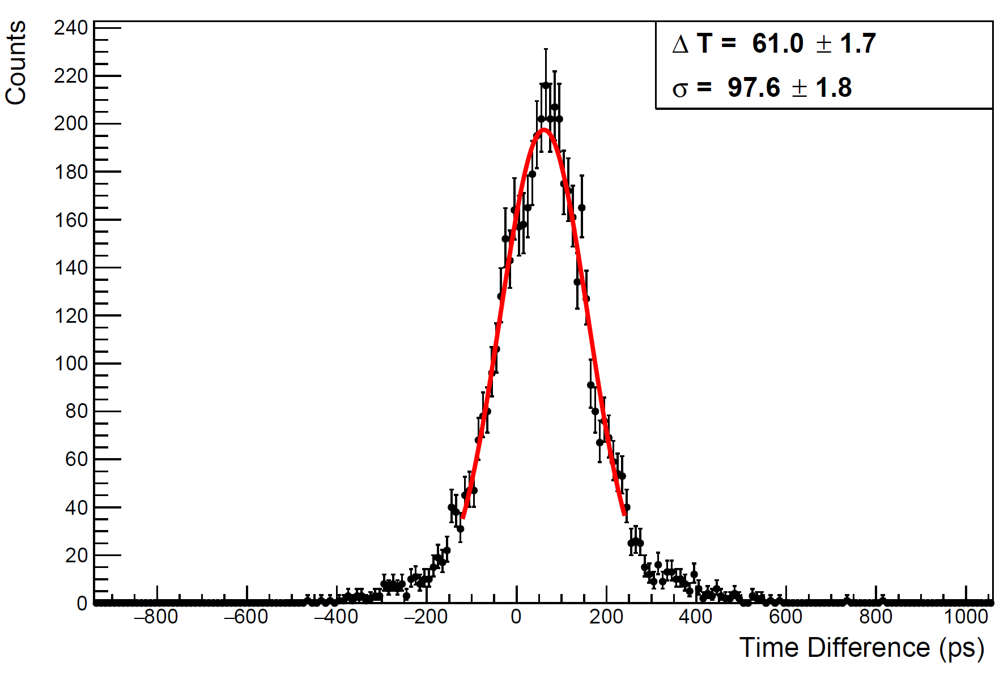
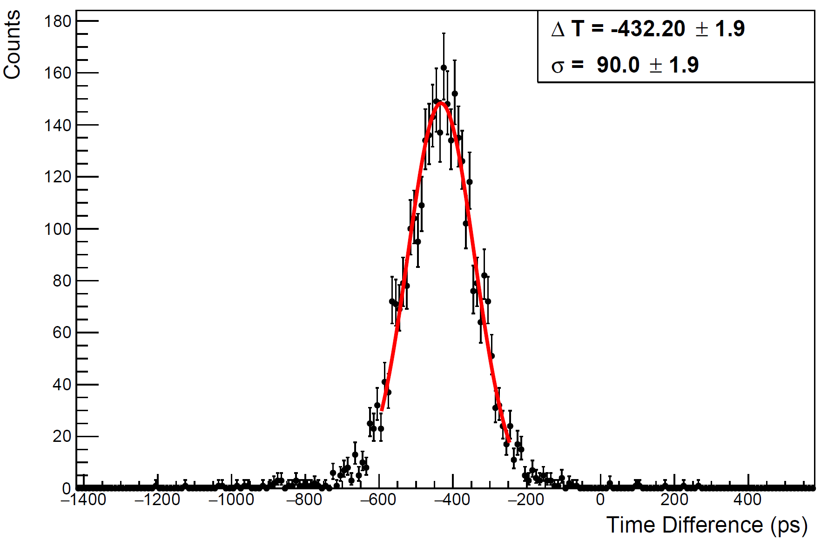
STCF Trigger
Aluminum foil
Without aluminum foil
MPPC_4S
MPPC_4S
$$\frac{T_{1}+T_{2}+T_{3}+T_{4}}{4}−\frac{T_{5}+T_{6}+T_{7}+T_{8}}{4}$$
$$\frac{T_{1}+T_{2}+T_{3}+T_{4}}{4}−\frac{T_{5}+T_{6}+T_{7}+T_{8}}{4}$$

Slide 3
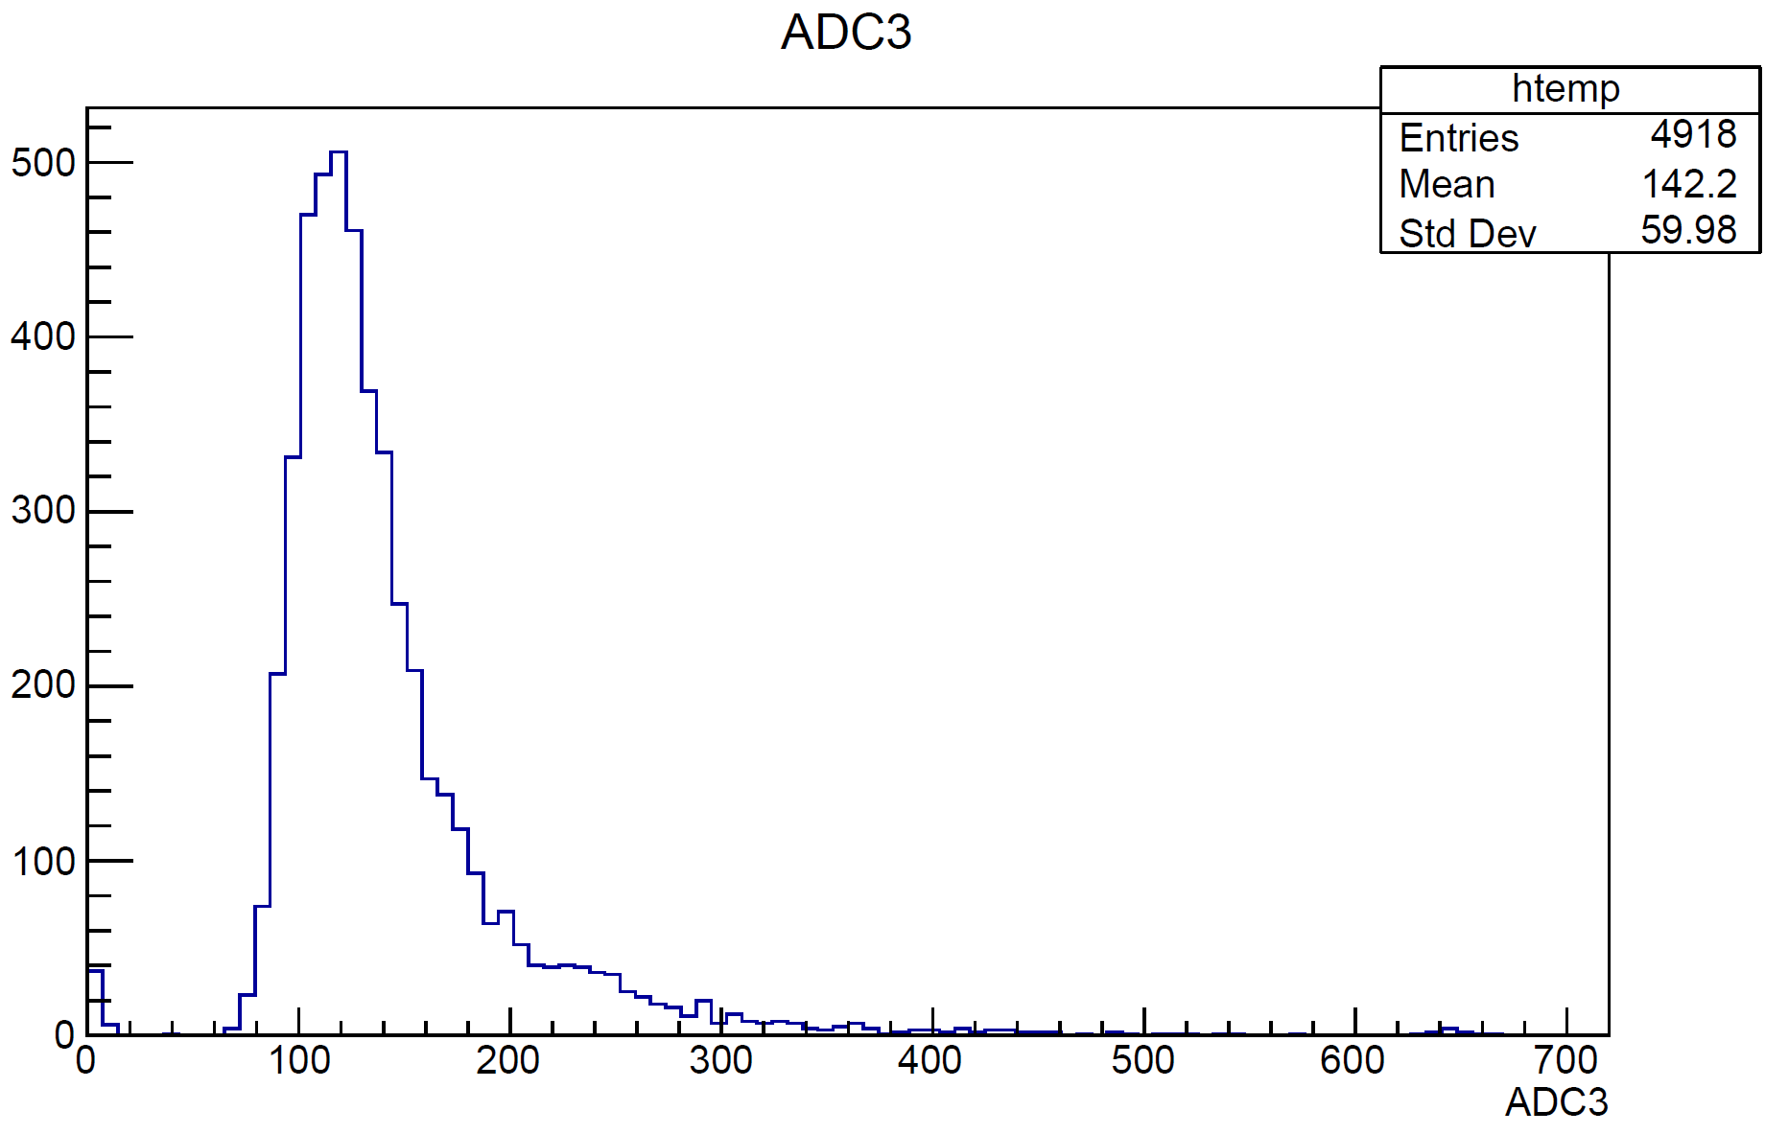
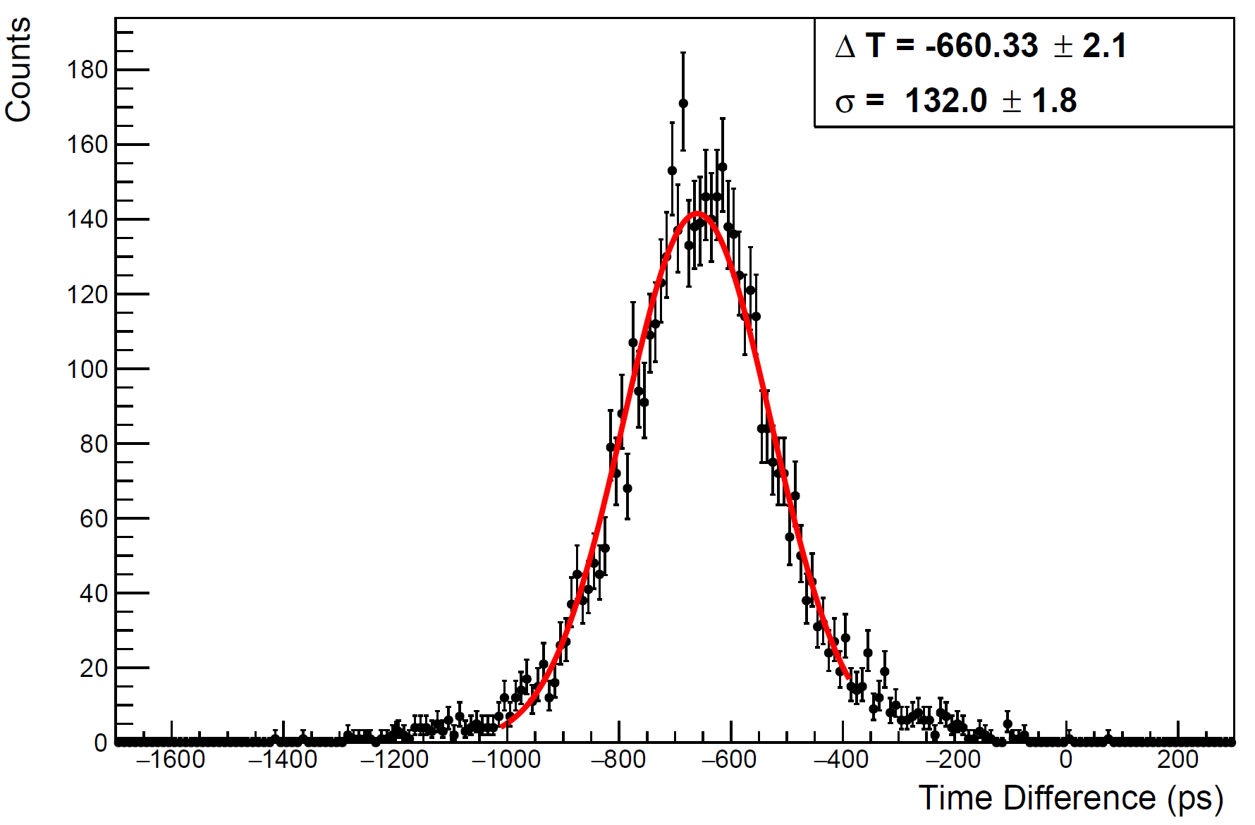
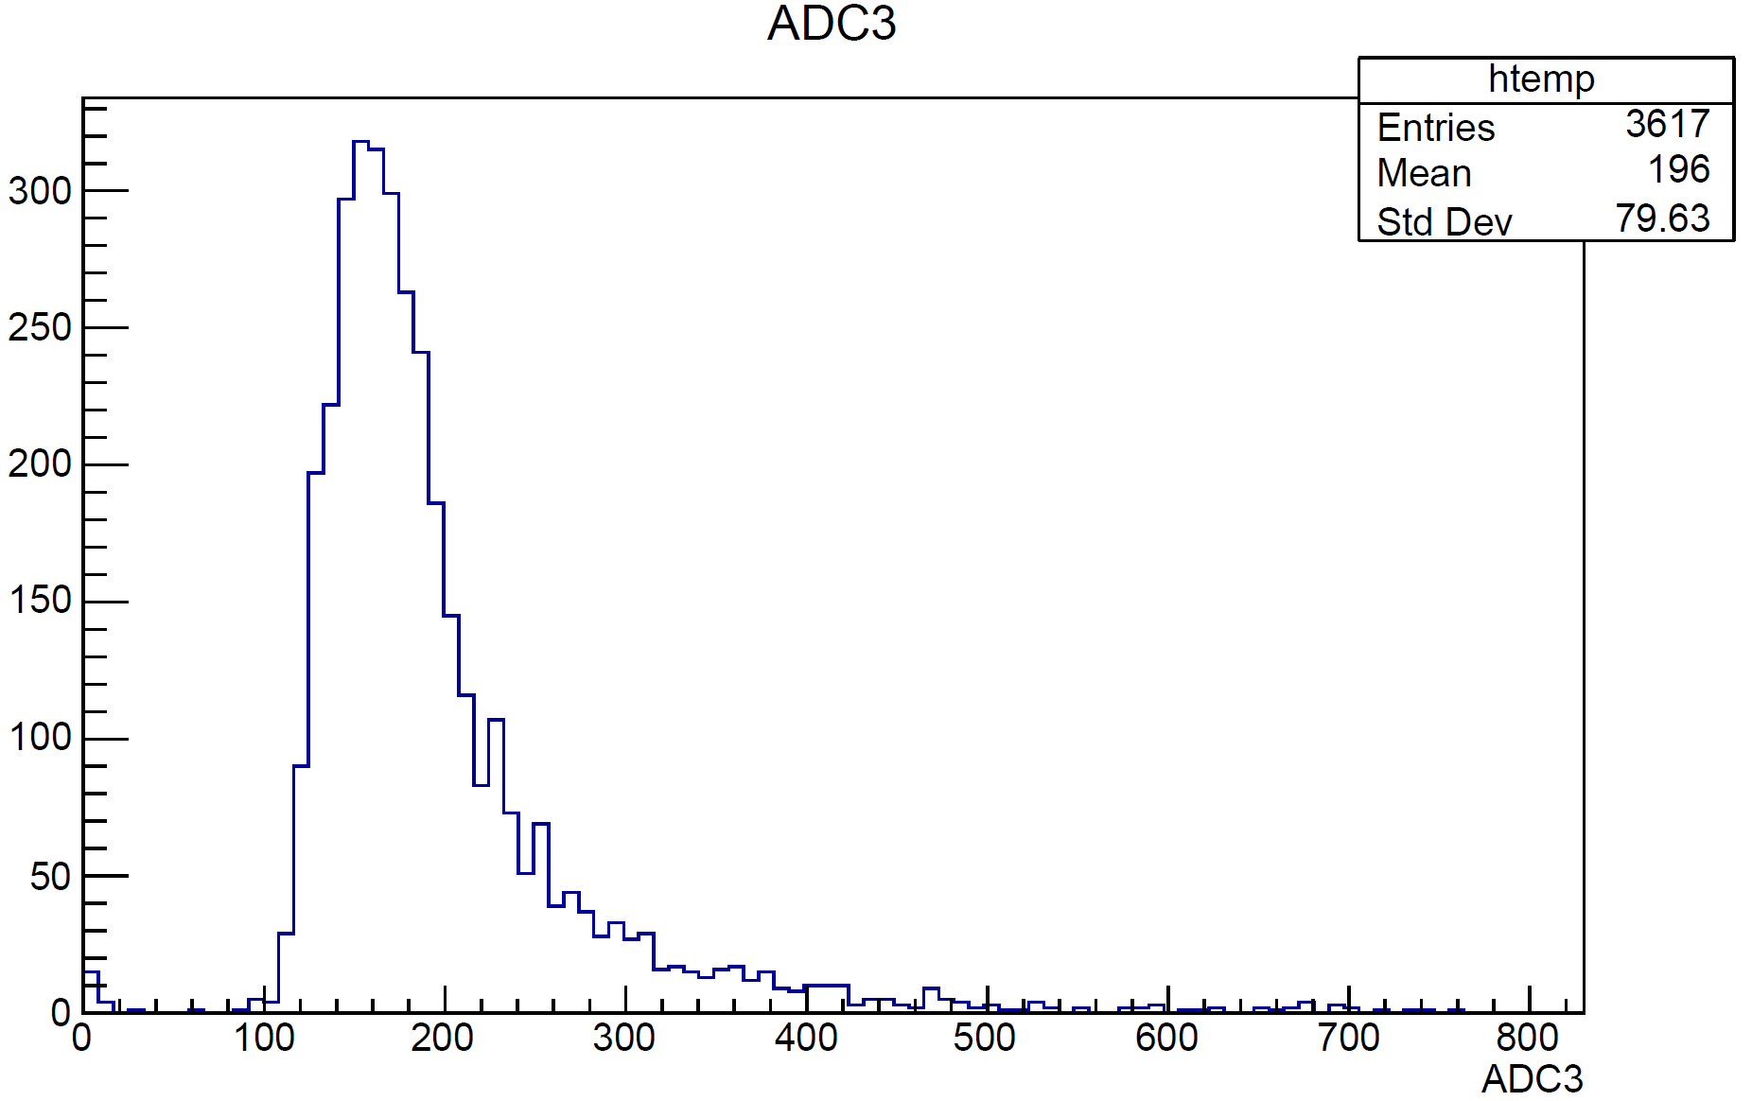
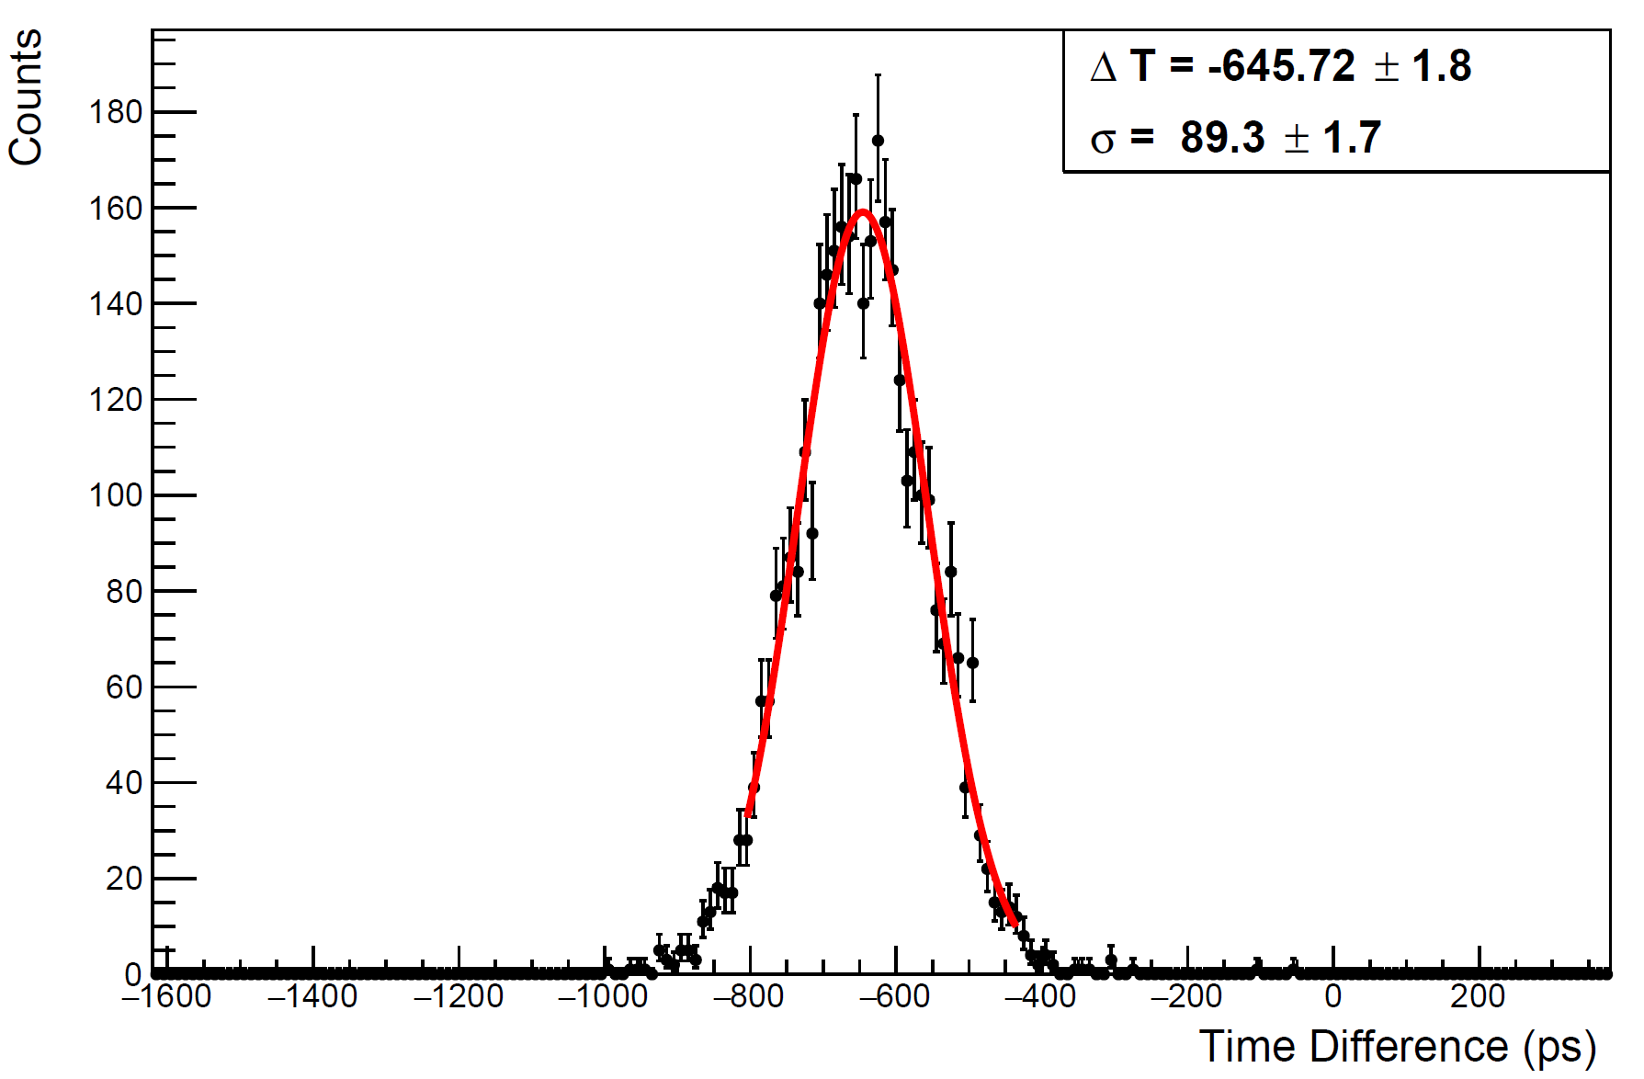
STCF Trigger
$$\frac{T_{1}+T_{2}+T_{3}+T_{4}}{4}−\frac{T_{5}+T_{6}+T_{7}+T_{8}}{4}$$
Trigger
MPPC_4S
Trigger
MPPC_4S

Slide 4
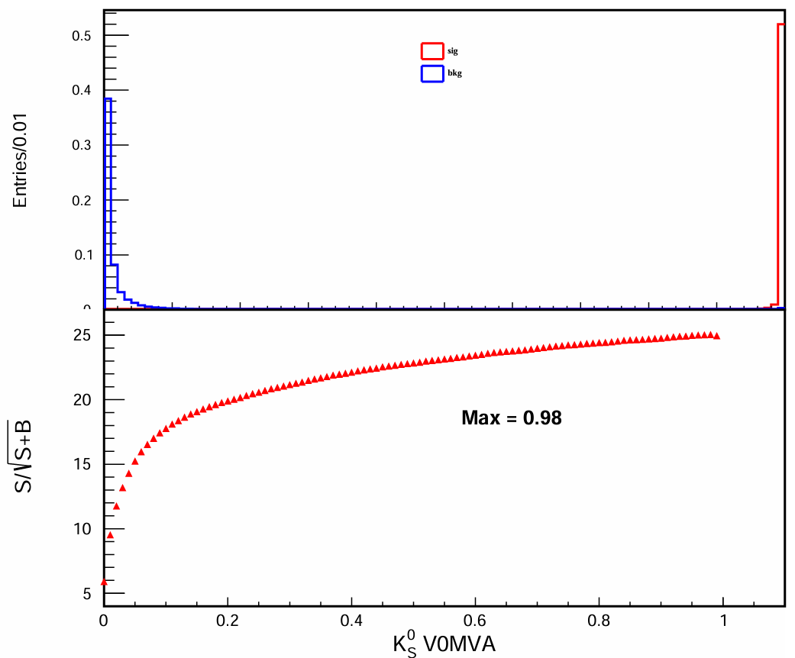
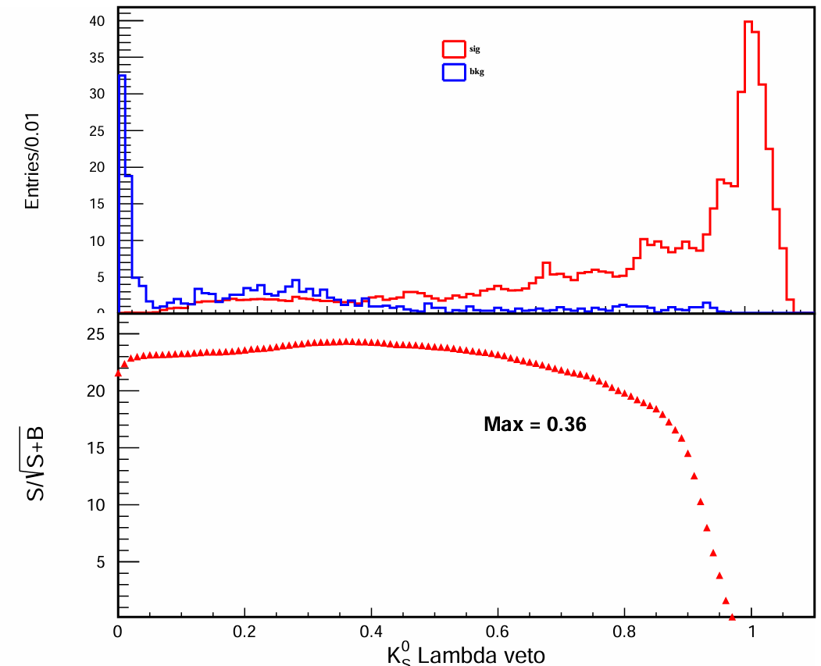
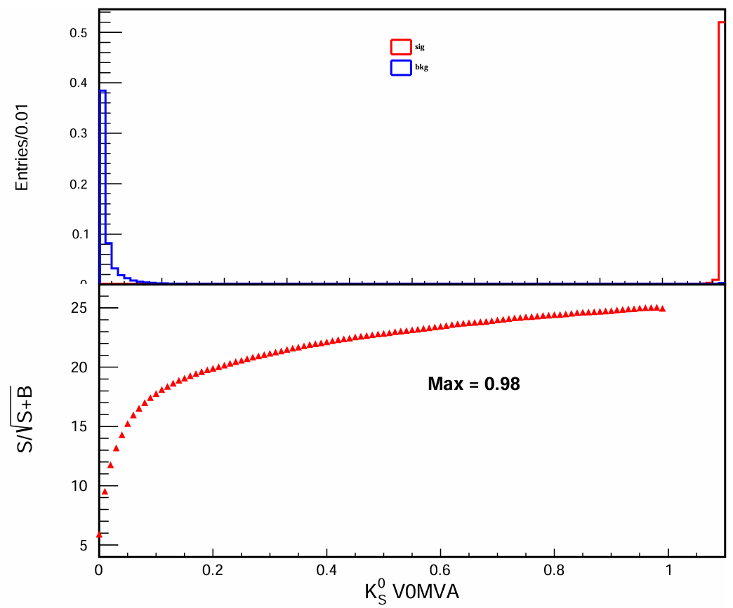
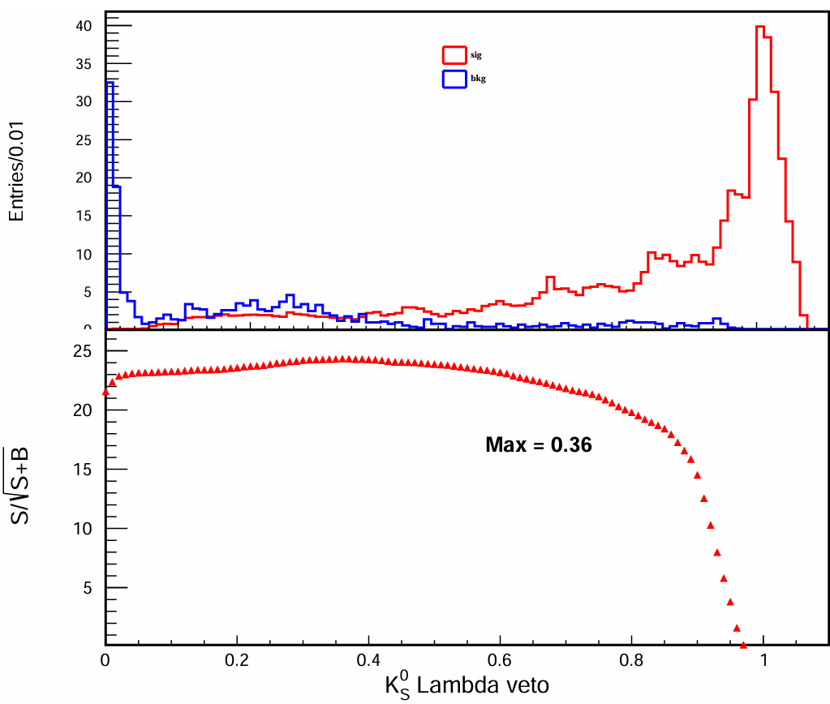
ksSelector
V0 selector > 0.98
Lambda veto> 0.36
Select V0 particles: V0MVA>0.98
Lambda Veto: Lambda veto>0.36

Slide 5
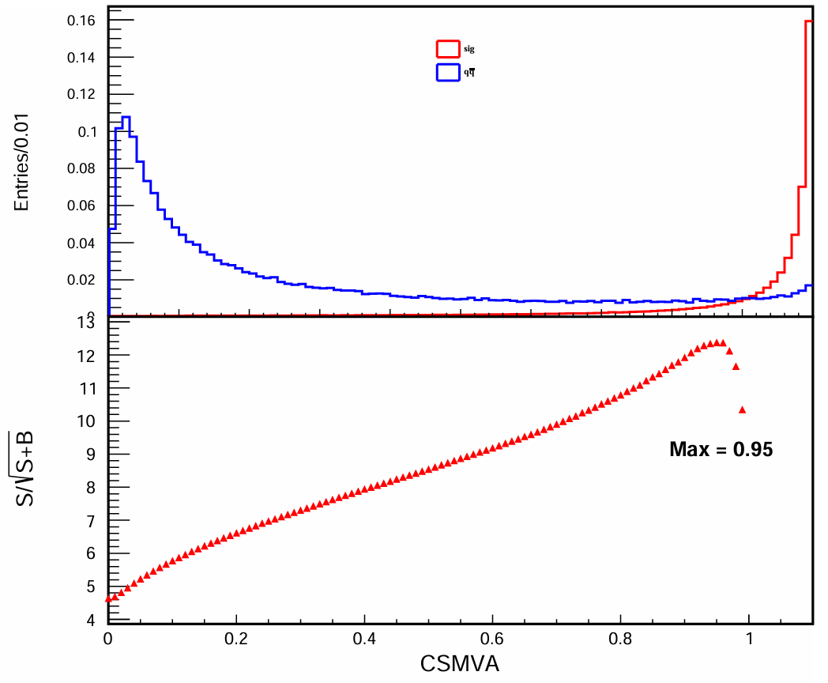
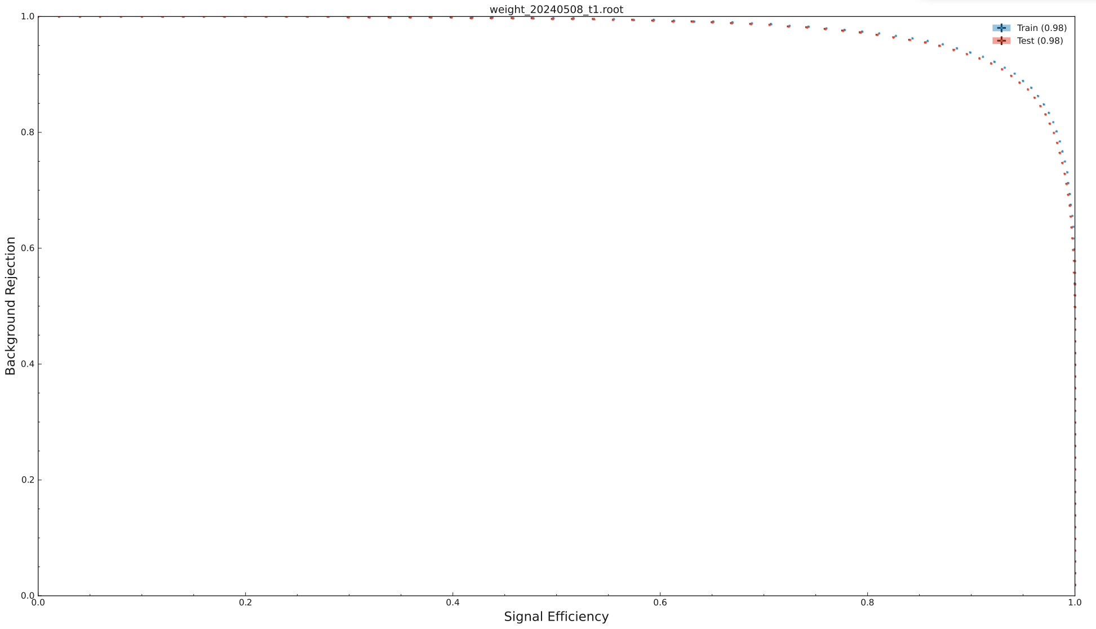
Continuum Suppression
CSMVA>0.96

Slide 6
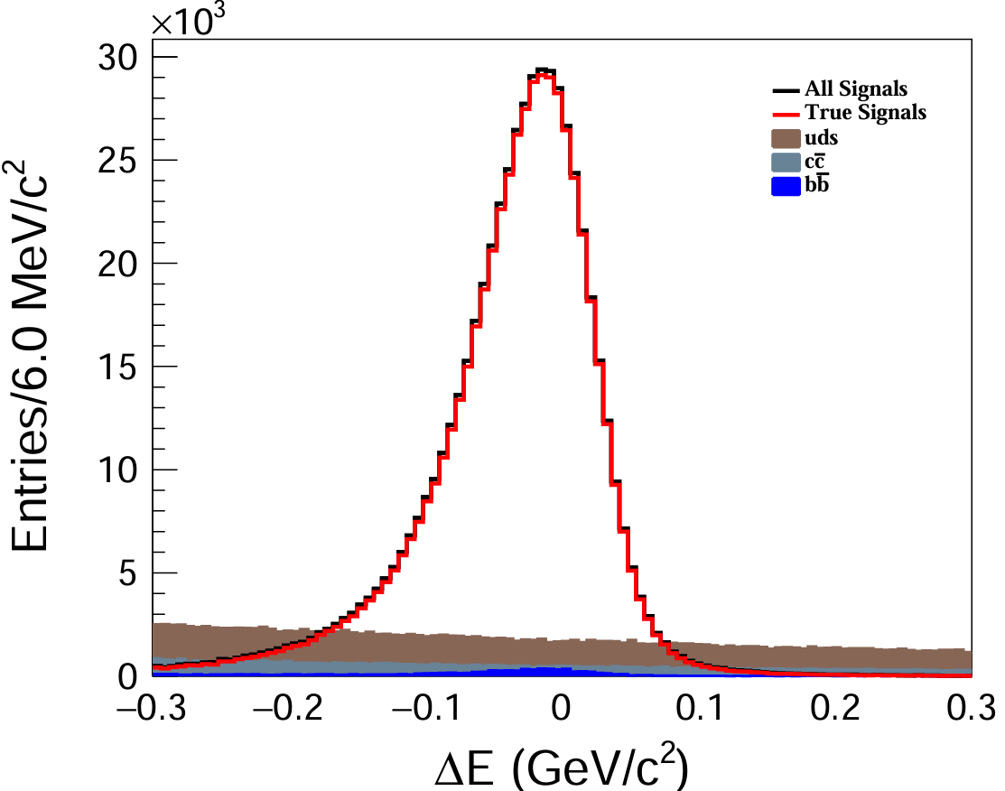
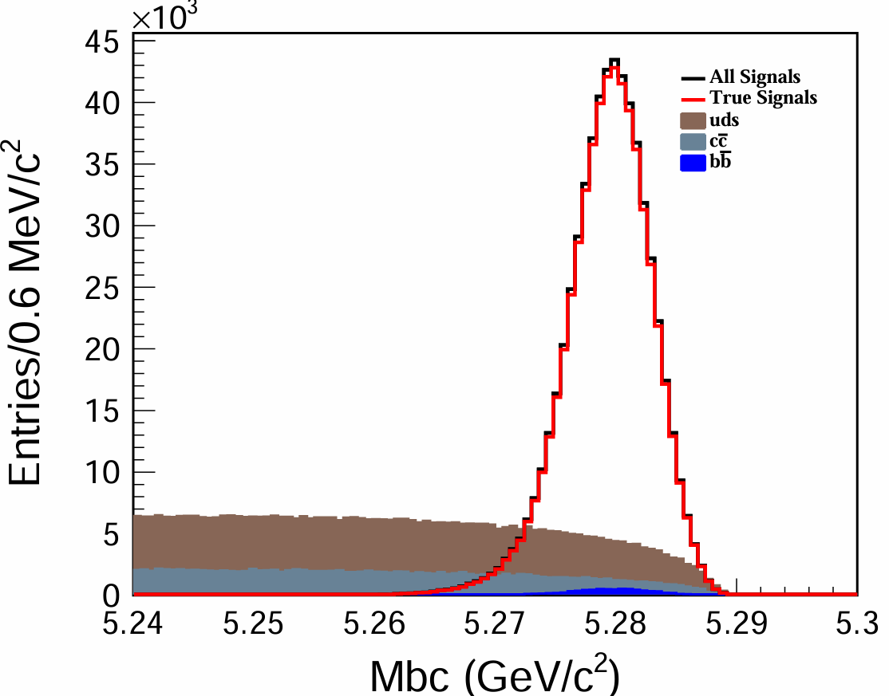
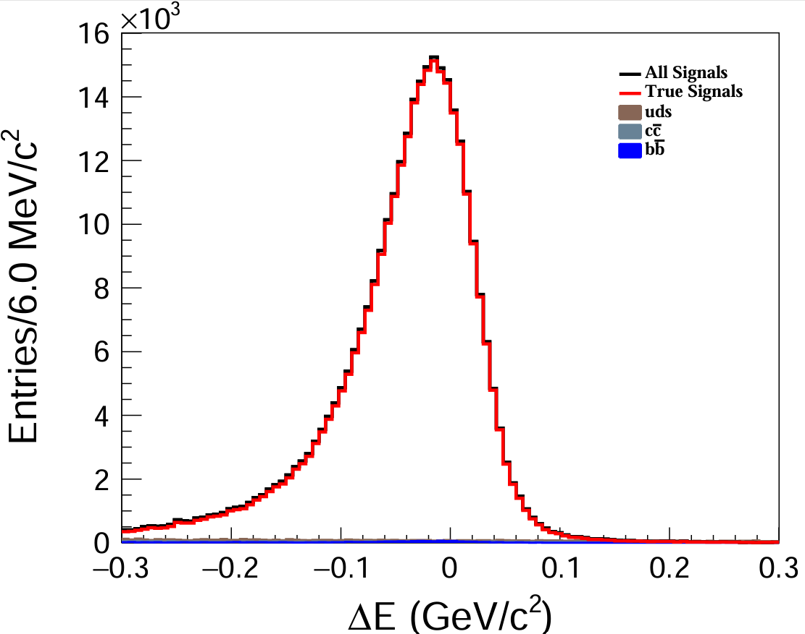
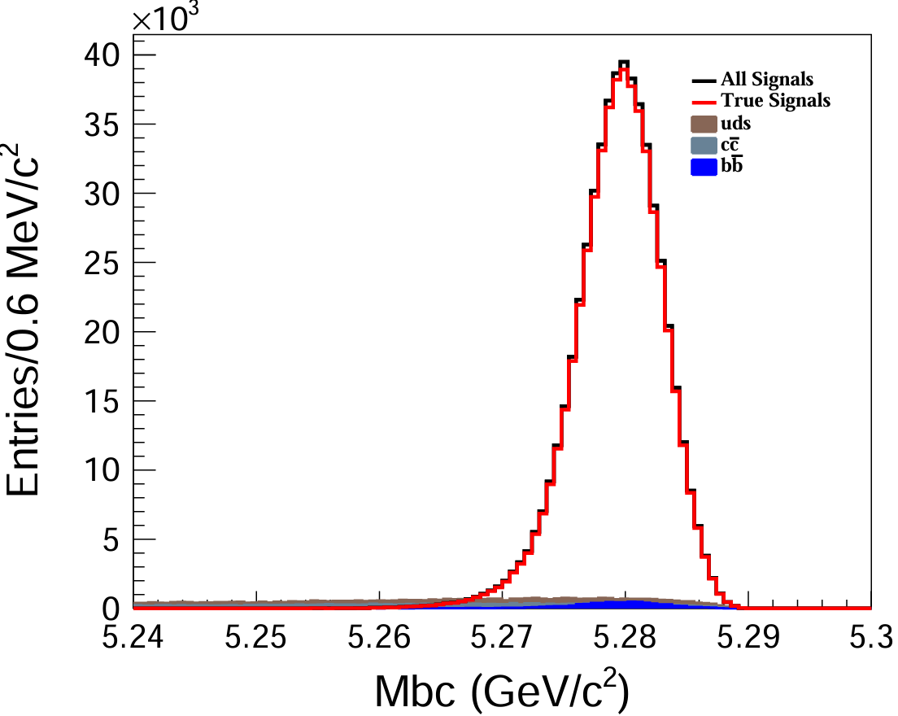
Mbc & $ΔE$ after CS selection
Before CS cut
Aftere CS cut

Slide 7
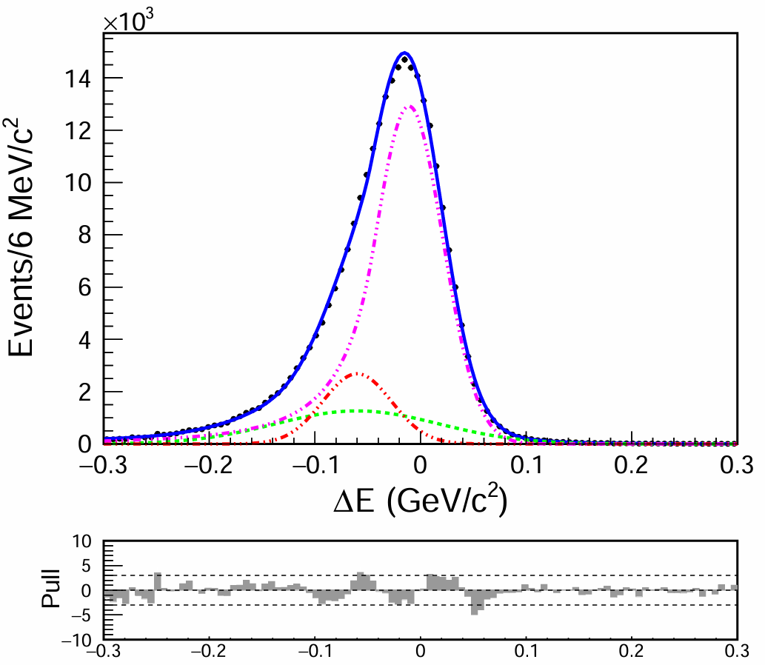
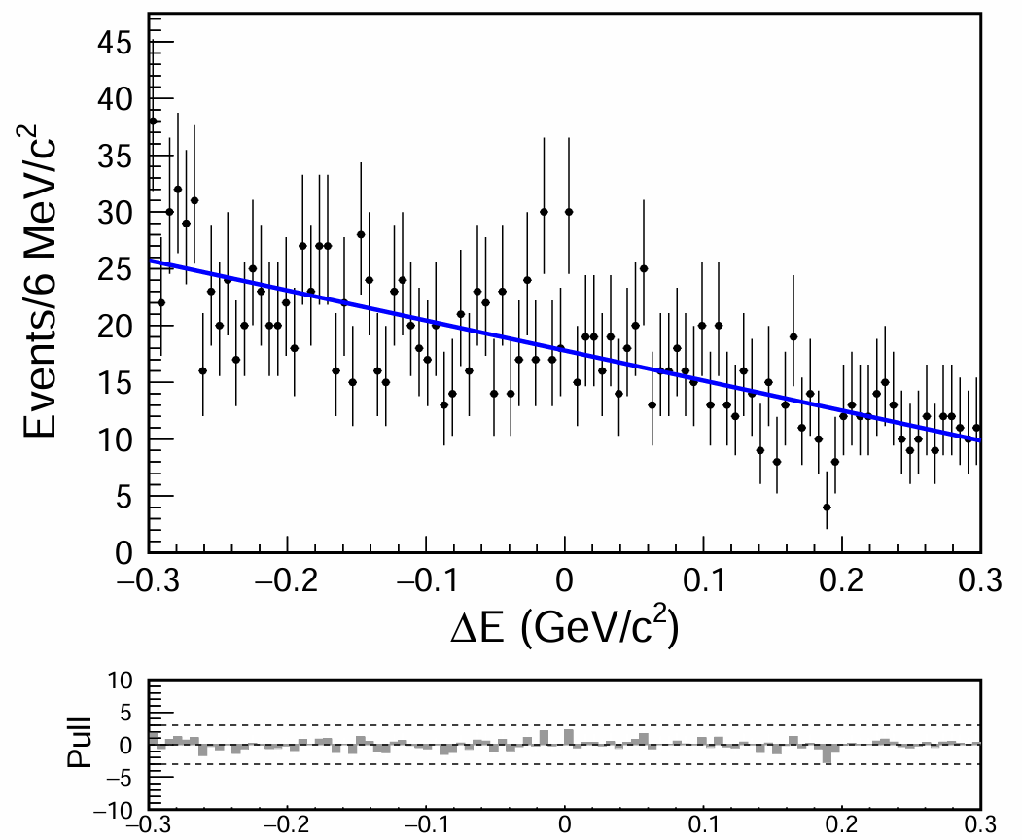
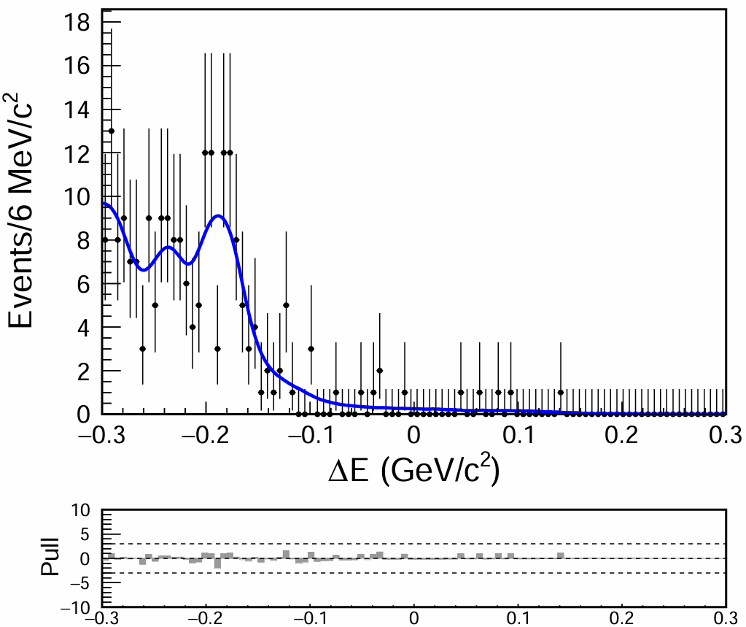
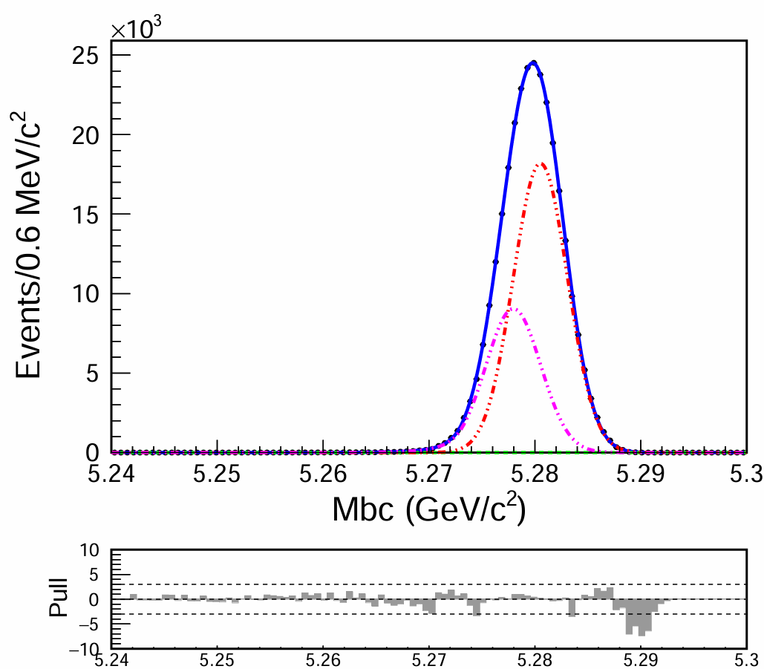
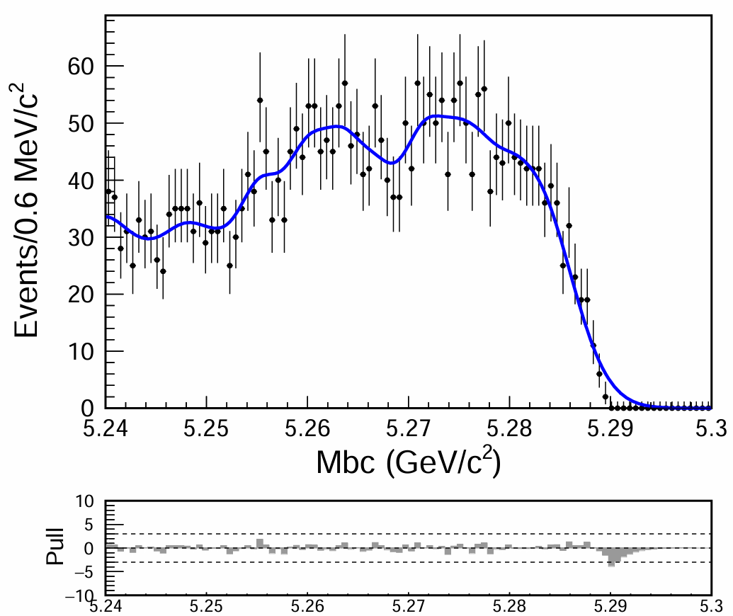
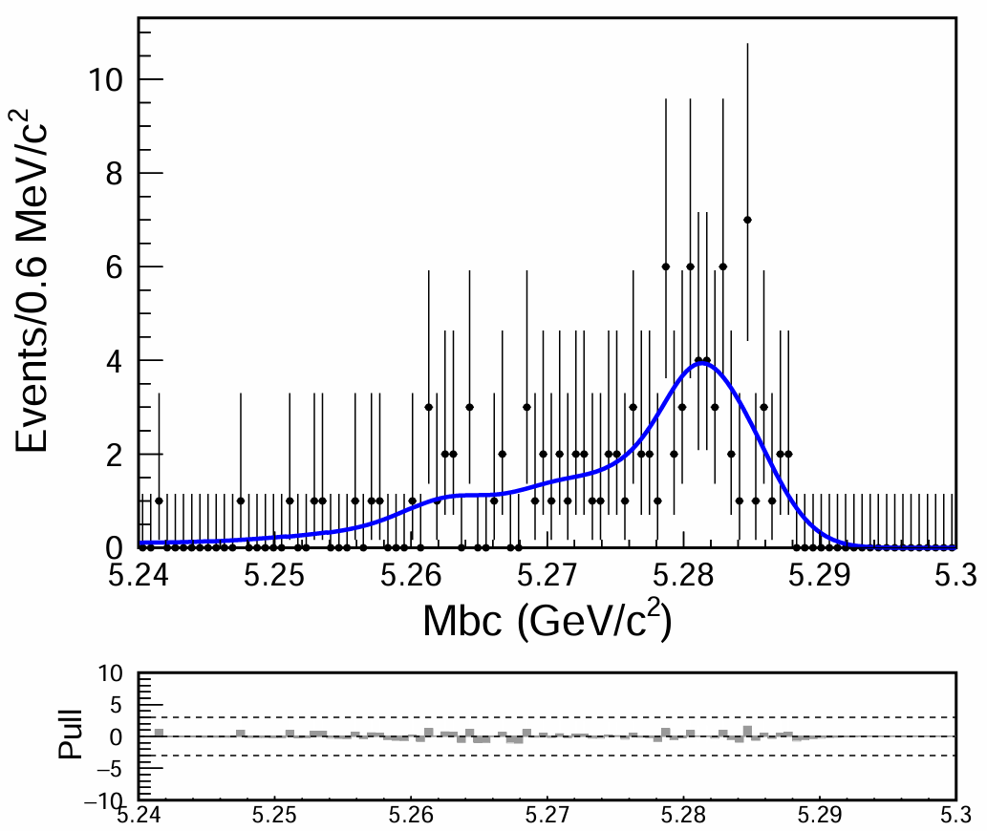
Fit for different components
Signal
$$q\overline{q}$$
$$b\overline{b}$$
1D poly
Kernel PDF
2 Gaussian + 1 CB
$$q\overline{q}$$
1 Gaussian + 1 CB
Kernel PDF
Kernel PDF

Slide 8
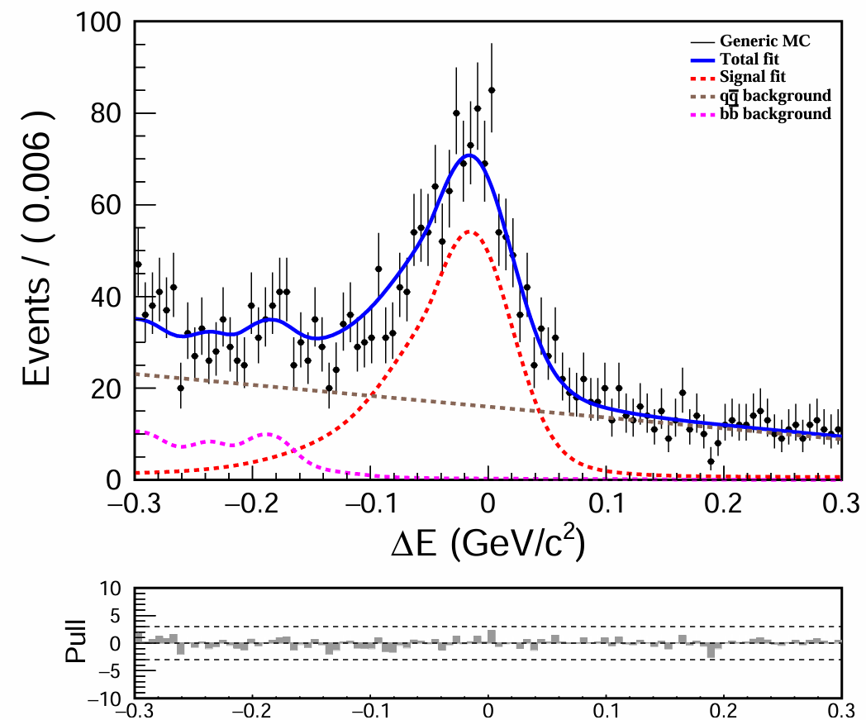
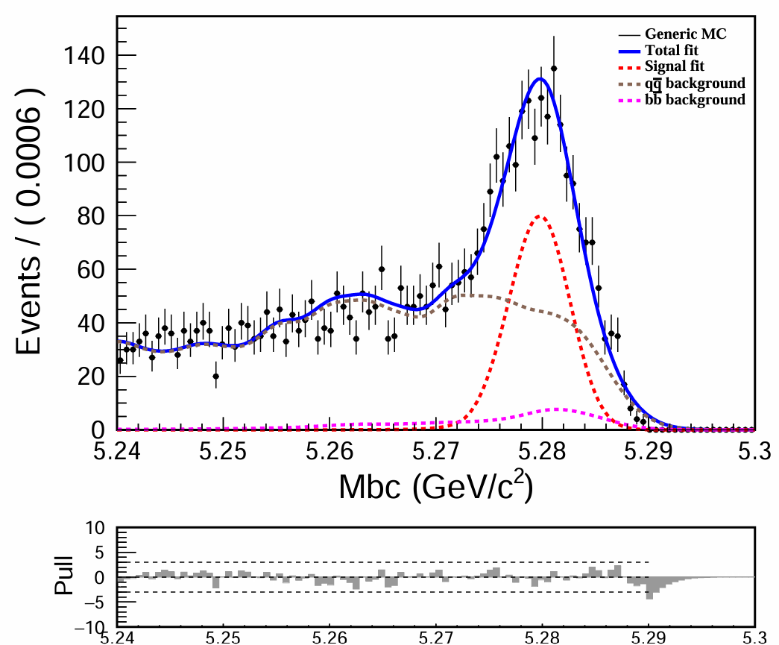
1D fit
Input Branching fraction: $9.6×{10}^{−6}$
$$Nsig=924;eff=14.1\%$$
$$B\left(B^{0}→K^{0}π^{0}\right)= \frac{Nsig}{N\left(B\overline{B}\right)⋅ε⋅B(K^{0}→{K_{s}}/{K_{L})}}=$$
$$(8.5±0.2)×{10}^{−6}$$
$$Nsig=957;eff=14.7\%$$
$$B\left(B^{0}→K^{0}π^{0}\right)= \frac{Nsig}{N\left(B\overline{B}\right)⋅ε⋅B(K^{0}→{K_{s}}/{K_{L})}}=$$
$$(8.4±0.2)×{10}^{−6}$$
Next to do: BCS

