Slide 1


Tutorials of Physics Analyses on CEPC ref-TDR
Geliang Liu (刘格良)
Mar. 4th, 2025
Notes:
5pm Friday

Slide 2
Outlines
CEPCSW
Physics analyses for ref-Detector TDR
Sample production
Event selection
Statistical model and inferences

Slide 3
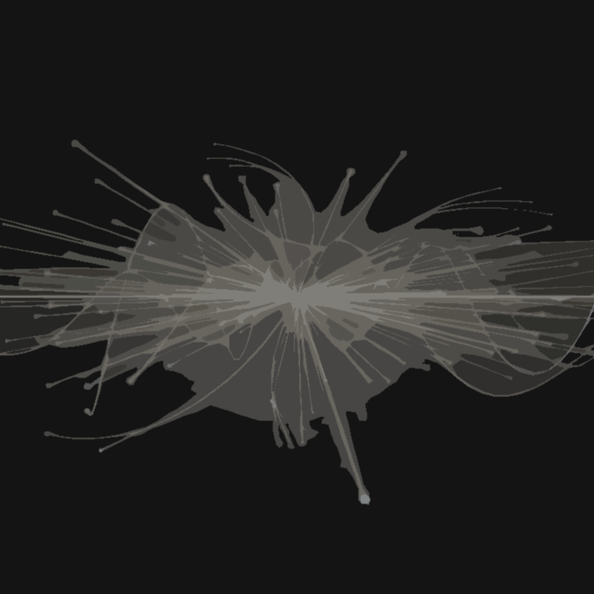
1
CEPCSW
Offline software prototype

Slide 4
Introduction to CEPCSW
An offline software prototype for CEPC ref-detector
  Available on “IHEP gitlab”: https://code.ihep.ac.cn/cepc/CEPCSW
Functions
  Perform full simulation of the CEPC ref-detector Perform offline event reconstruction
  Perform physics analyses, accompanied with tools you are familiar with
Structure
  Detector: detector geometry
  Generator: simulate physics processes
  Simulation: simulate detector responses
  Digitization: digitize the analog signals
  Reconstruction: particle flow algorithm, particle ID
  Analysis: analyze data after event reconstruction
  Examples: simple examples to get familiar
Framework
  Based on key4hep: Turnkey Software for Future Colliders
  Gaudi framework to build data processing application
  Let’s keep it short and easy:
    Write the algorithm in C++ which contains how you would like to process the data
    Build the algorithm as a module with cmake
    Use a python script to call and run the module
    Get the output

Slide 5
Let’s get start
Beforhand
  ssh -XY username@lxlogin.ihep.ac.cn
  cd /cefs/higgs/username/
  Don’t forget to create a SSH key and put it in your account on code.ihep.ac.cn and github
Installation
  The version for this tutorial based on 25.1.2 and updates of Fangyi:
    git clone git@code.ihep.ac.cn:glliu/CEPCSW.git
    cd CEPCSW
    git checkout CyberPFA-5.0.2-dev
  A new official version (25.3.0) has been available
Build
  source setup.sh
  ./build.sh
  source setup.sh
  Every time you change something, don’t forget to run ./build.sh
Example
  Run the python script: ./run.sh Examples/options/helloalg.py
  Very simple: print out an int number

Slide 6
Physics Analyses for CEPC ref-Detector TDR
2

Slide 7
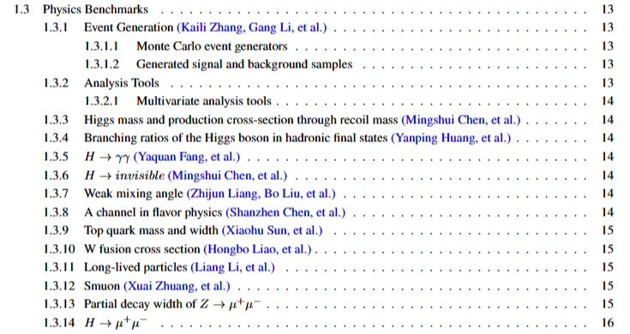
Physics performance
Detector performances
  Tracking / vertexing / PID / jet clustering / jet flavor tagging
Inputs
Proof
Physics performances
  Analyses of physics benchmarks
  Proof of detector performances
    H→qq: jet clustering / flavor tagging
    H→γγ: ECAL energy measurements
    H→invisible: overall PFA performances
  Ability to measure/search for important physics
    Higgs boson recoil mass: inclusive measurements; pure measurement on gZZ
    Z / top precise measurements
    ......
Output

Slide 8
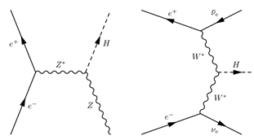

Focus: Higgs boson invisible decay
Higgs boson production
  Higgs strahlung: ee→Z*→ZH (dominant)
  W fusion: ee→$ν_{e}ν_{e}$H (sub-dominant)
Previous studies
Invisible decays
  ee→Z(→ee/μμ/qq)H(→invisible)
  In the SM: H→ZZ*→4v
    BR(H→4v)=0.106%
  BSM: H→sparticles / dark matter / LLPs, ...
Exps | Data | Results | Publication
ATLAS | LHC Run 2 | UL on BR(H→inv): 10% | JHEP08(2022)104
CMS | LHC Run 2 | UL on BR(H→inv): 10% | PRD 105 (2022) 092007
ILC | 250, 350, 500 GeV; 250, 350, 500 fb-1 | UL on BR(H→inv): 0.26% | arXiv:1909.07537
FCC-ee | 240+365 GeV; 10.8+3 ab-1 | 3.9 σ on BR(H→ZZ→4v) | Presentation
CEPC | 240 GeV, 5.6 ab-1 | UL on BR(H→inv): 0.26% | Chinese Phys. C 44 123001

Slide 9
3
Sample Production
What you need first to do analyses

Slide 10
Steps (See Kaili’s tutorial)
WhizardAis 1.95 for hard processes; Pythia for hardonization
See the tutorial in https://code.ihep.ac.cn/zhangkl/whizardais
Simulation
Detector response simulated by Geant 4
cd Reconstruction/RecPFACyber/script/;
Digitization
Digitization of ECAL and HCAL information
./run.sh digi.py
Physics process
Tracking
Reconstruction
./run.sh sim.py
Digitization of vertex detector, tracker
./run.sh tracking.py
Particle flow algorithm to reconstruct objects (PFO)
./run.sh rec.py
No need to run ourselves
Particle identification (work in progress)
stdhep
sim.root
dig.root
trk.root
rec.root

Slide 11
Job submission
Download the package
  git clone git@code.ihep.ac.cn:glliu/cepcsw_tutorial.git
  cd cepcsw_tutorial
  git checkout master
Understand what this is doing
  check jobs/CEPC_Hinvi.sh
    Take the inputs of stdhep from Kaili (each file 1000 events, split into 5 jobs; iFile defines N_Files to be read)
    Five steps: sim → digi → trk → rec → tre (TTree production, to read rec.root, introduced later)
    Write sh files to source CEPCSW environment and run the job
    Use hep_sub to submit jobs
  Modify yourself:
    Change CurrPath to the folder you want to save the samples
    Change the CEPCSW environment to your own path
Job launching
  cd /path/to/your/CEPCSW/repository; source setup.sh
  cd /path/to/your/cepc_tutorial/jobs
  source CEPC_Hinvi.sh
  Check job status: hep_q –g higgs –u username
WARNING !!!
  Do NOT direct run!
  Make sure you made the changes!
  Make sure iFile=1 for check first!

Slide 12
Available samples
stdhep (hard process + hadronization):
  Produced by Kaili
  On lxlogin: /cefs/higgs/zhangkl/stdhep/
  No need to produce ourselves
Full simulated and reconstructed samples:
  I have produced some for both Higgs boson invisible decays and backgrounds
  Under git@code.ihep.ac.cn:glliu/CEPCSW.git
  On lxlogin: /cefs/higgs/liugeliang/CEPC/202501/Production
    Hinvi/: signal samples
    4fermions/, 2fermions/: 4-fermion and 2-fermion-final-state background samples
    HX/: inclusive Higgs boson decays (another background)
  With limited statistics
    Production en masse after new CEPCSW release
Sample name conventions
  For explanation: /cefs/higgs/zhangkl/stdhep/cepc_sample_note_latest.pdf

Slide 13

How to read samples
Output of reconstruction
  In the repository for each process: Combined/rec*root are the output from reconstruction.
  As a TTree, and can be directly read.
  A more convenient way is to read it in the format of edm4hep: documentation
Example
  https://code.ihep.ac.cn/glliu/CEPCSW/-/blob/CyberPFA-5.0.2-dev/Analysis/MissingET
Understand the python script
  cd Analysis/MissingET/
  Check MissingET.py
  Input files:
  Input collections from the files:
  Inherit the algorithm:
  Output:

Slide 14
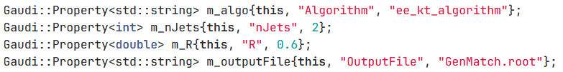
How to read samples
Understand the algorithm
  https://code.ihep.ac.cn/glliu/CEPCSW/-/blob/CyberPFA-5.0.2-dev/Analysis/MissingET/src/:
  Input collections:
  Interferable properties:
  What the algorithm does: compute/save some properties of simulation events in a new TTree and ROOT file.
    MissingET.cpp#L195-277: loop over PFOs and compute/save their 4-momentum/isolation/charge/PID information..., as well as the visible 4-momentum.
    MissingET.cpp#L279-396: jet clustering (ee-kt algorithm with Njet=2), and compute variables related to jet-substructure.
    MissingET.cpp#L398-466: loop over MC particles and save their 4-momentum/charge/flavor/status...
Try yourself
  ./run.sh Analysis/MissingET/MissingET.py
  Check the output!

Slide 15
4
Event selection
Improve the sensitivity

Slide 16
Jupyter-notebook
Feel free to choose your own tool/language to do analyses
Let’s use jupyter-notebook for this tutorial
On lxlogin
  ssh -XY username@lxlogin.ihep.ac.cn -L 8888:localhost: 8888
  Change 8888 to your favorite number
  cd /path/to/your/CEPCSW/repository/
  source setup.sh
  export JUPYTER_DATA_DIR=$(mktemp -d)
  export JUPYTER_CONFIG_DIR=$(mktemp -d)
  jupyter-notebook --port 8888 (don’t forget to change the number)
  You should be able to open the link it generates, starting with http://localhost:8888/?token=......
  If it doesn’t work, restart your terminal, and change to a new port number.
Notebooks for tutorials
  Go to Analysis/HiggsInvisible/
  MissingET.ipynb: draw some plots of key variables in the Higgs boson invisible decay.
  LeptonID.ipynb: studies of temperary solutions for lepton identification.
  EventSelection.ipynb: perform event selection of the invisible decay analysis and build the statistical model.

Slide 17
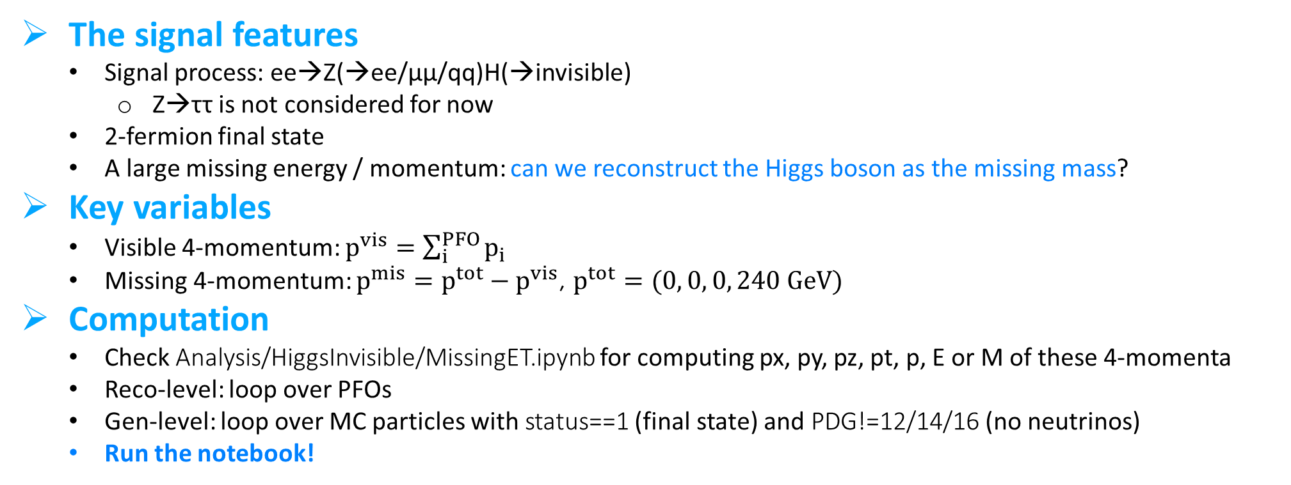
Understand the signal
The signal features
  Signal process: ee→Z(→ee/μμ/qq)H(→invisible)
    Z→ττ is not considered for now
  2-fermion final state
  A large missing energy / momentum: can we reconstruct the Higgs boson as the missing mass?
Key variables
  Visible 4-momentum: $p^{vis}=\sum_{i}^{PFO}{p_{i}}$
  Missing 4-momentum: $p^{mis}=p^{tot}−p^{vis}$, $p^{tot}=(0, 0, 0, 240 GeV)$
Computation
  Check Analysis/HiggsInvisible/MissingET.ipynb for computing px, py, pz, pt, p, E or M of these 4-momenta
  Reco-level: loop over PFOs
  Gen-level: loop over MC particles with status==1 (final state) and PDG!=12/14/16 (no neutrinos)
  Run the notebook!

Slide 18
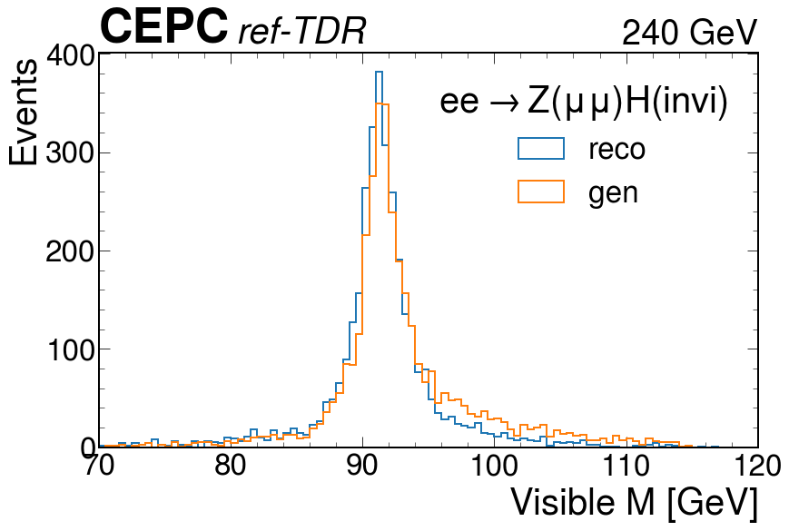
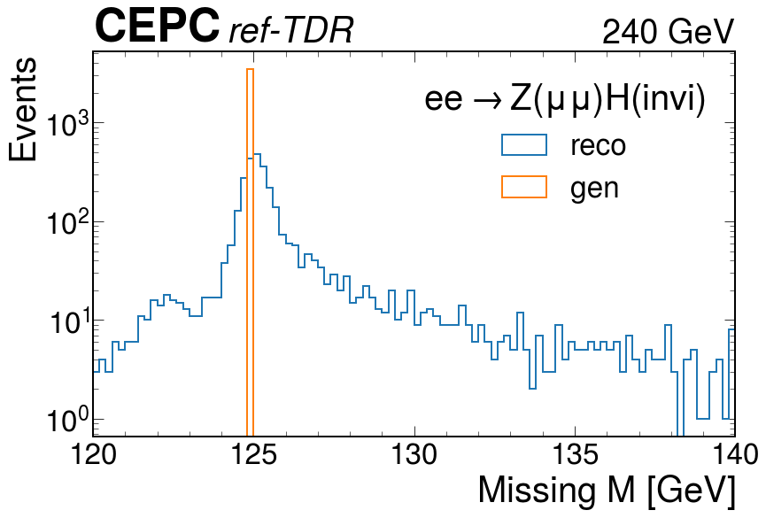
Understand the signal
What you may get (take μμ final state as an example)
  The visible mass is around 91 GeV, while the missing mass is around 125 GeV.
  Check other variables and other signals!

Slide 19
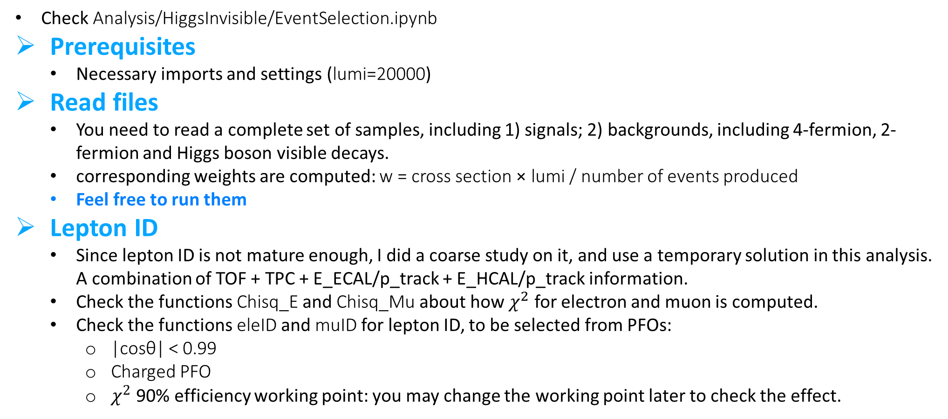
Baseline selection
Check Analysis/HiggsInvisible/EventSelection.ipynb
Prerequisites
  Necessary imports and settings (lumi=20000)
Read files
  You need to read a complete set of samples, including 1) signals; 2) backgrounds, including 4-fermion, 2-fermion and Higgs boson visible decays.
  corresponding weights are computed: w = cross section × lumi / number of events produced
  Feel free to run them
Lepton ID
  Since lepton ID is not mature enough, I did a coarse study on it, and use a temporary solution in this analysis. A combination of TOF + TPC + E_ECAL/p_track + E_HCAL/p_track information.
  Check the functions Chisq_E and Chisq_Mu about how $χ^{2}$ for electron and muon is computed.
  Check the functions eleID and muID for lepton ID, to be selected from PFOs:
    |cosθ| < 0.99
    Charged PFO
    $χ^{2}$ 90% efficiency working point: you may change the working point later to check the effect.

Slide 20
Baseline selection
Baseline selection: ee μμ
  For the μμ selection, require exactly 2 muons passing muon ID, with opposite charge.
  For the ee selection, require exactly 2 electrons passing electron ID, with opposite charge.
Variables: ee μμ
  A number of variables are computed and saved in numpy arrays which may be used for further selection.
  Include: lepton pt / p; number of charged / neutral PFOs; ΔR, Δφ of the two leptons; di-lepton 4-momentum and their recoil; visible and missing 4-momentum; ID score and isolation.
  Fill in variables: you may try only the signals, but it takes very long time.
  Skip to Read variables from saved outputs: outputs saved in EventSection/, which can be directly read.
  Make plots: for each variable and final state, make a plot composing all backgrounds stacked, and each signal separated.
    Used to check their distributions, and how discriminating between signals and backgrounds.
Baseline selection: qq
  No such selection. The jet clustering algorithm always clusters two jets.
Variables : qq
  Additional variables are computed: jet thrust, energy correlation functions (ECF), N-subjettinesses.

Slide 21
Kinematic selection
Kinematic selection
  Check function KelSel: different selection criteria are applied to multiple variables in different final states.
  Obtained from Chinese Phys. C 44 123001: H→invisible with CEPC CDR detector.
    Selections to be optimized; but before doing it yourself, it is worth using the selections in previous analyses as starting points.
  Print yields: you may compute the yields and selection efficiencies. Compare with Chinese Phys. C 44 123001.
  Plots after kinematic selection: similar plots after kinematic selection. Check the effects!

Slide 22
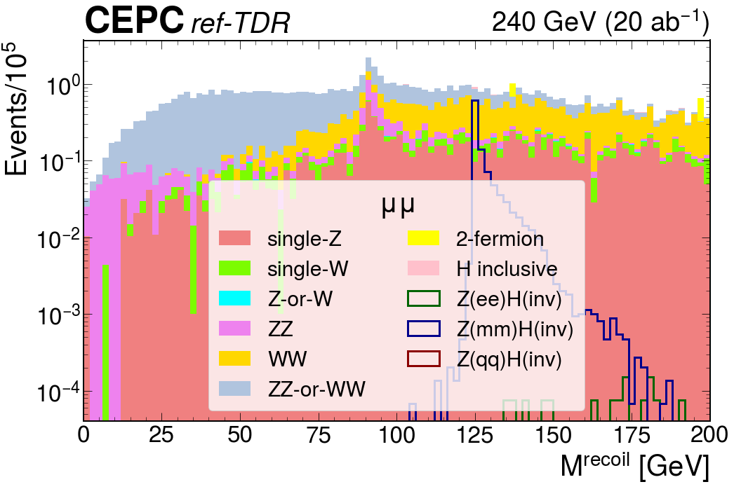
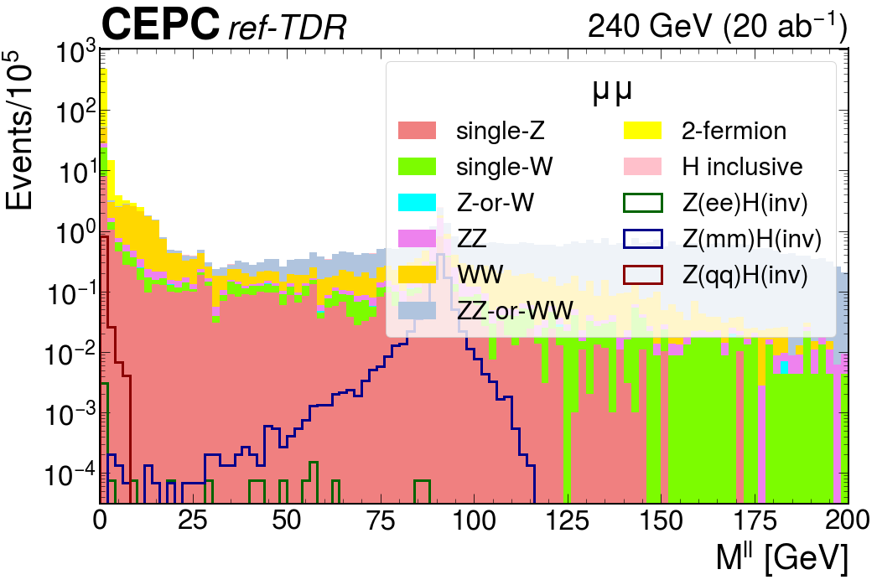
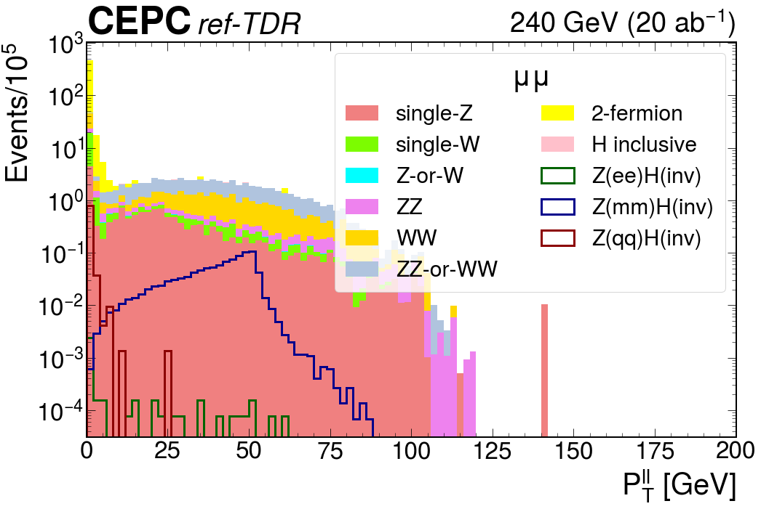
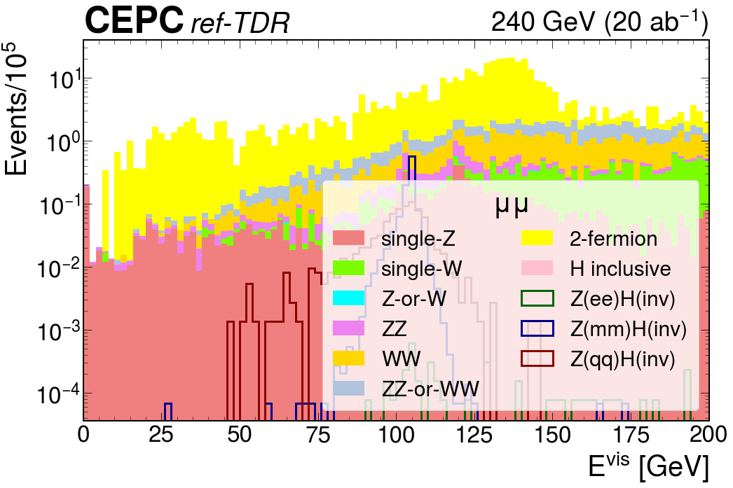
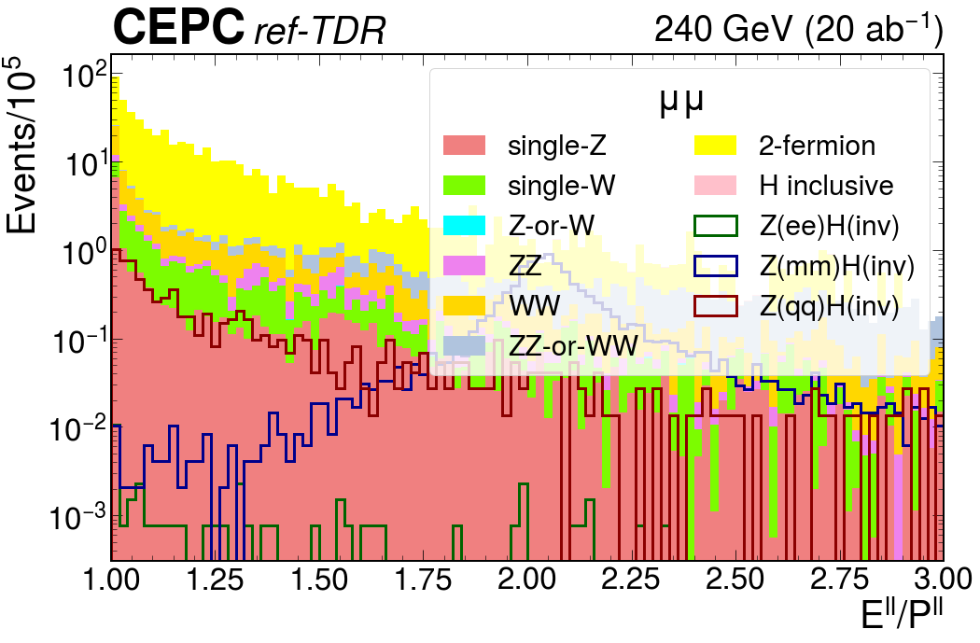
Kinematic selection: μμ
[120, 150] GeV
[85, 97] GeV
[12, +∞] GeV
[102, 107] GeV
[0, 2.4]
[0, 2.4]

Slide 23
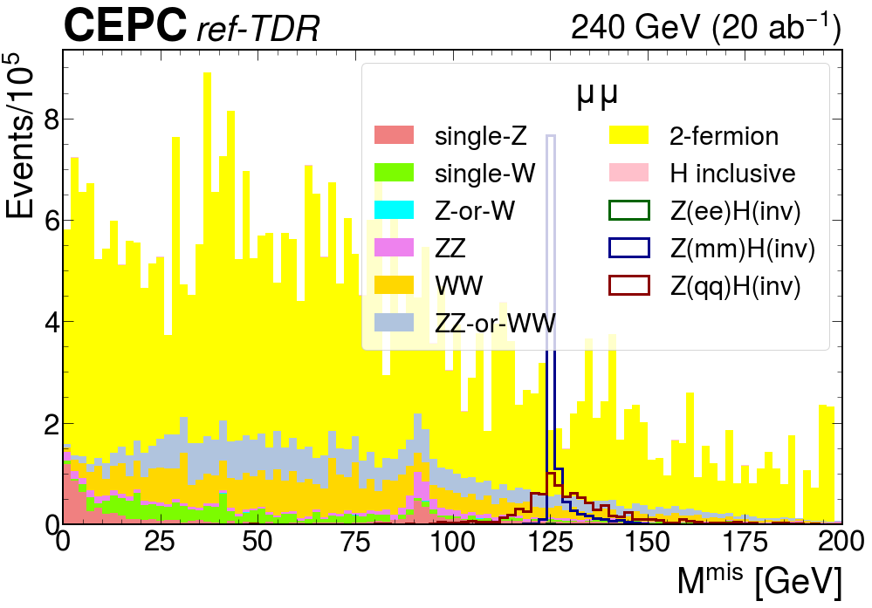
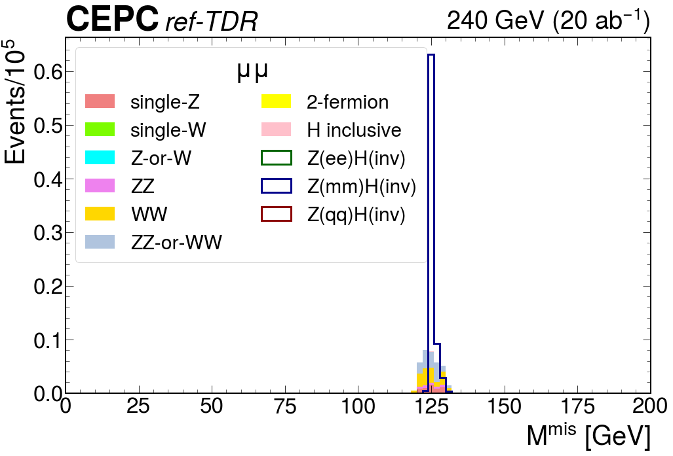
Kinematic selection: μμ
μμ final state
Process | eeH | mmH | qqH | sz | sw | szw | zz | ww | zzww | 2f | Hincl | All bkg
Total yield | 140800 | 135400 | 2736200 | 32403400 | 69705000 | 4989600 | 22819400 | 181522200 | 73003000 | 1082137200 | 4073200 | 1470653000
Base sel | 406 | 106555 | 85917 | 1558339 | 1893099 | 14293 | 791039 | 4331596 | 3576077 | 44002567 | 34049 | 56201059
Kin sel | 0 | 76004 | 0 | 5358 | 0 | 0 | 2188 | 12917 | 13525 | 0 | 47 | 34035
eff (%) | 0.000 | 56.133 | 0.000 | 0.017 | 0.000 | 0.000 | 0.010 | 0.007 | 0.019 | 0.000 | 0.001 | 0.002
eff CDR (%) | - | 59.17 | - | 0.01 | 0.00 | 0.00 | 0.01 | 0.01 | 0.02 | 0.000 | 0.00 | 0.00

Slide 24
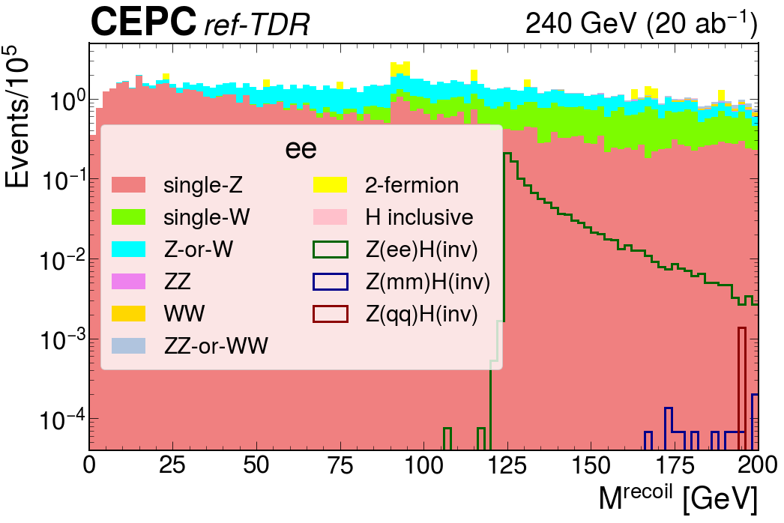
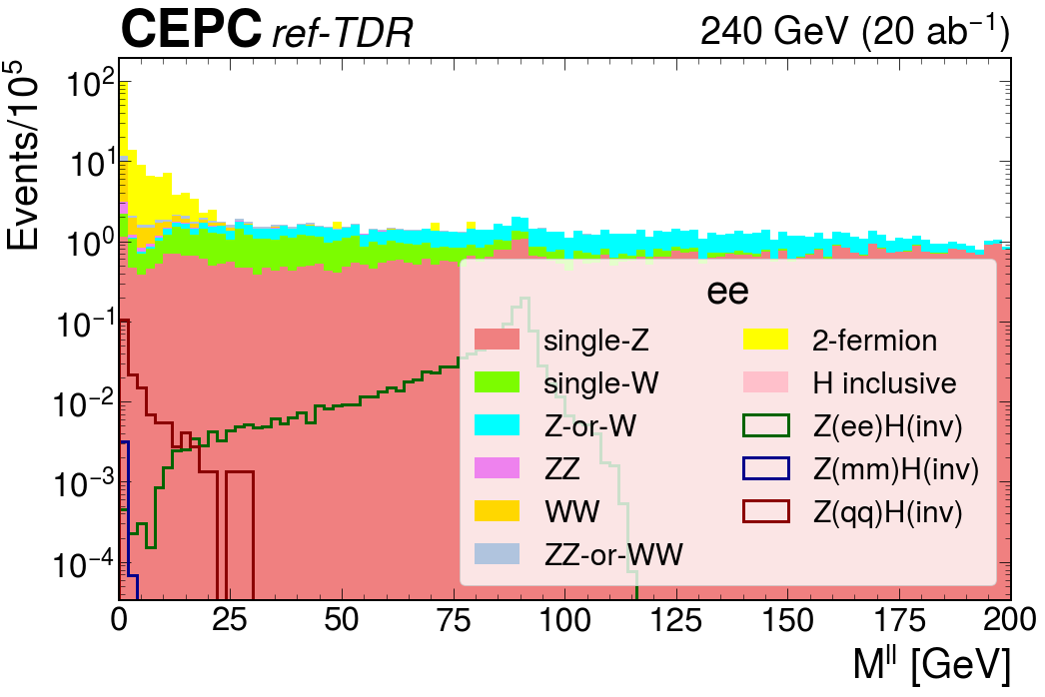
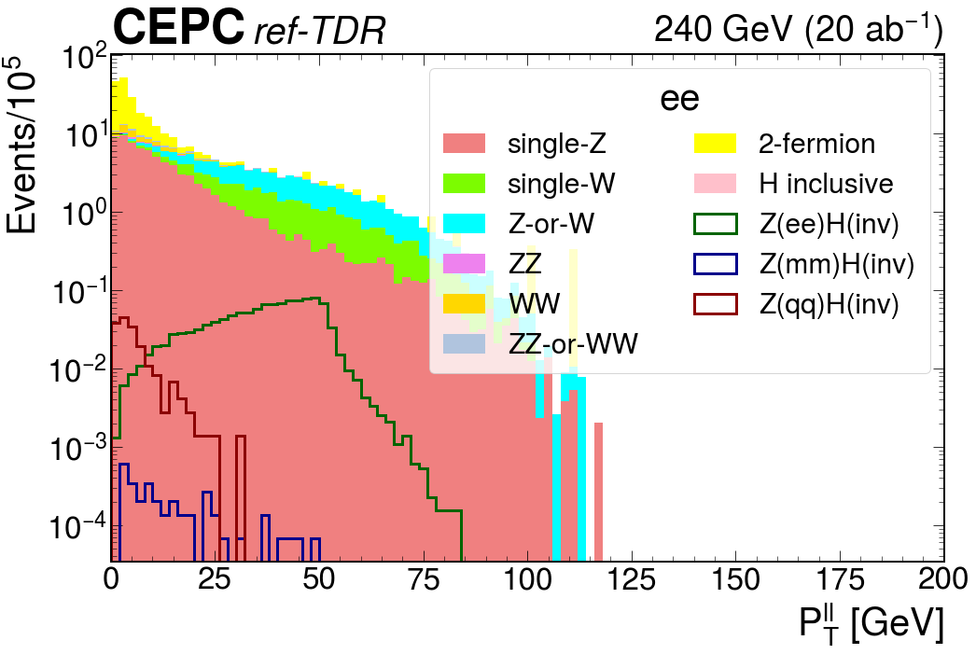
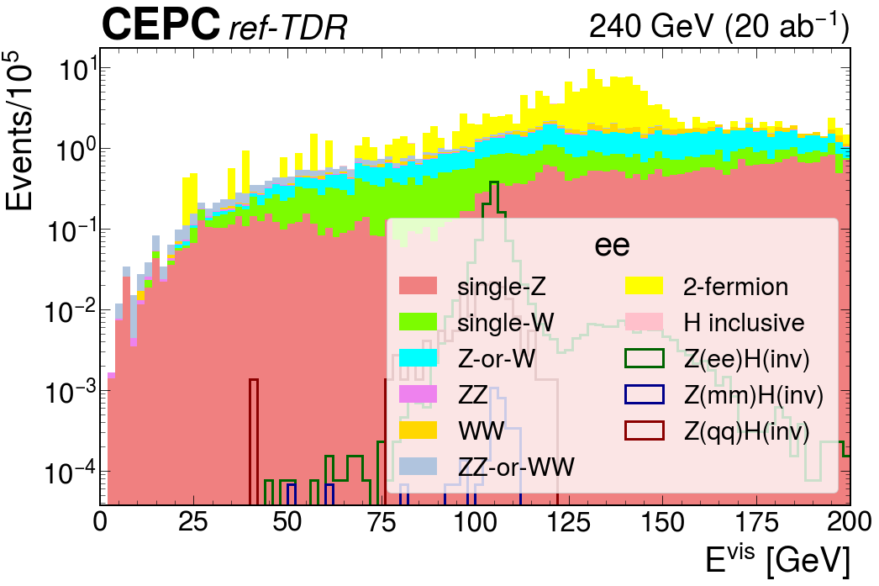
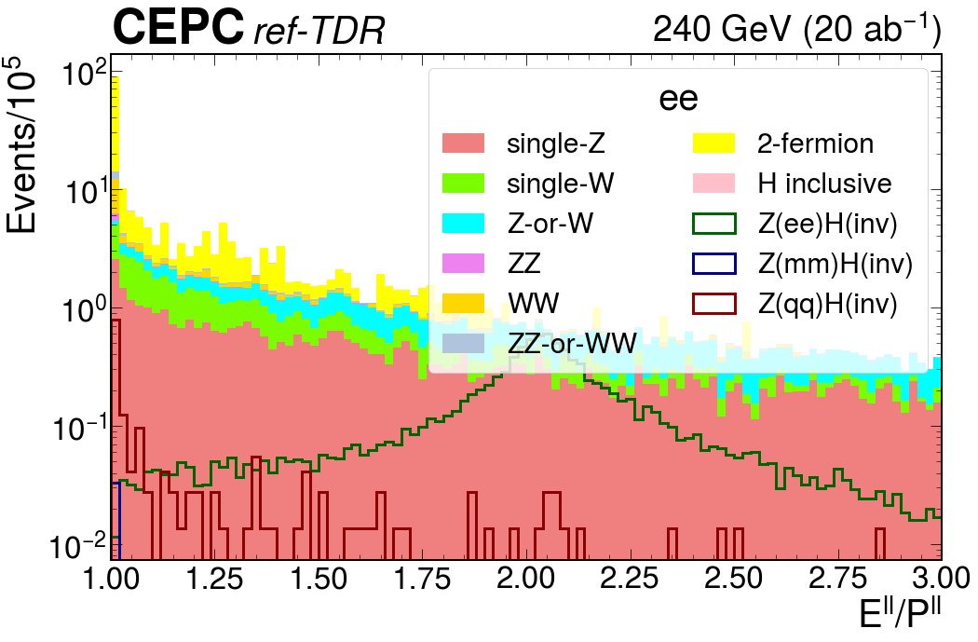
Kinematic selection: ee
[120, 170] GeV
[71, 99] GeV
[12, 55] GeV
[101, 107] GeV
[1.8, 2.4]

Slide 25
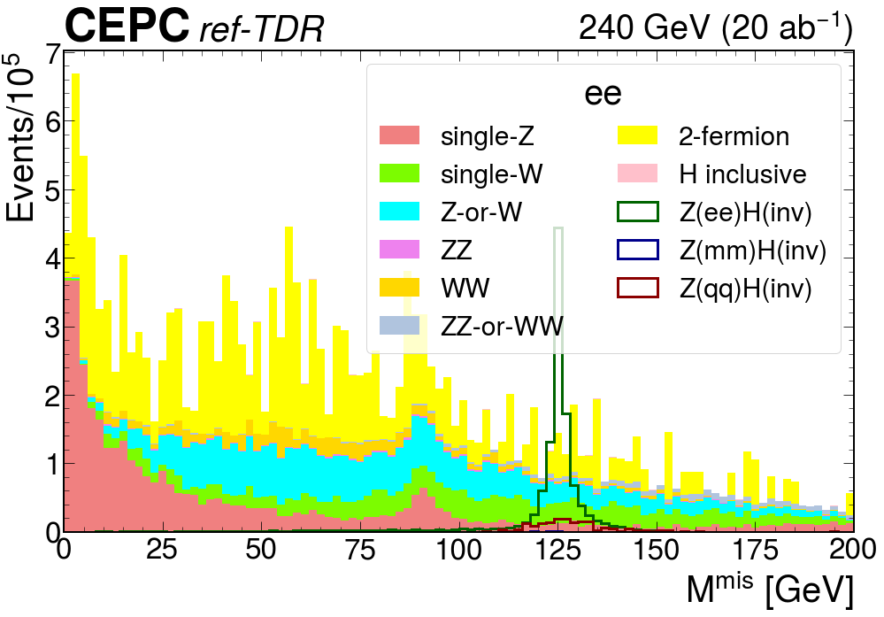
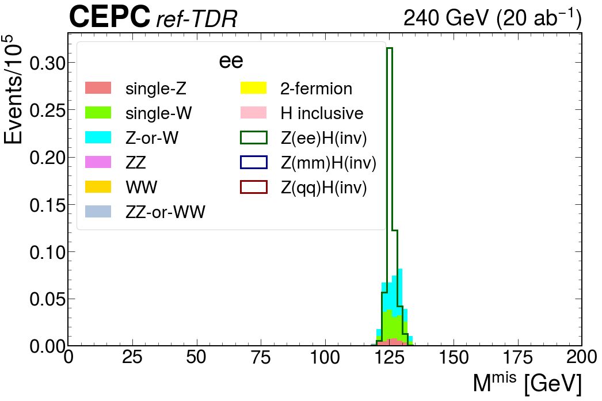
Kinematic selection: ee
Process | eeH | mmH | qqH | sz | sw | szw | zz | ww | zzww | 2f | Hincl | All bkg
Total yield | 140800 | 135400 | 2736200 | 32403400 | 69705000 | 4989600 | 22819400 | 181522200 | 73003000 | 1082137200 | 4073200 | 1470653000
Base sel | 118165 | 333 | 17785 | 7595862 | 2750212 | 4080038 | 161423 | 1092489 | 451954 | 12614069 | 23692 | 28769739
Kin sel | 55517 | 0 | 0 | 3449 | 14227 | 17931 | 0 | 0 | 211 | 0 | 54 | 35872
eff (%) | 39.429 | 0.000 | 0.000 | 0.011 | 0.020 | 0.359 | 0.000 | 0.000 | 0.000 | 0.000 | 0.001 | 0.002
eff CDR (%) | 35.34 | - | - | 0.01 | 0.01 | 0.43 | 0.00 | 0.00 | 0.00 | 0.000 | 0.00 | 0.00

Slide 26
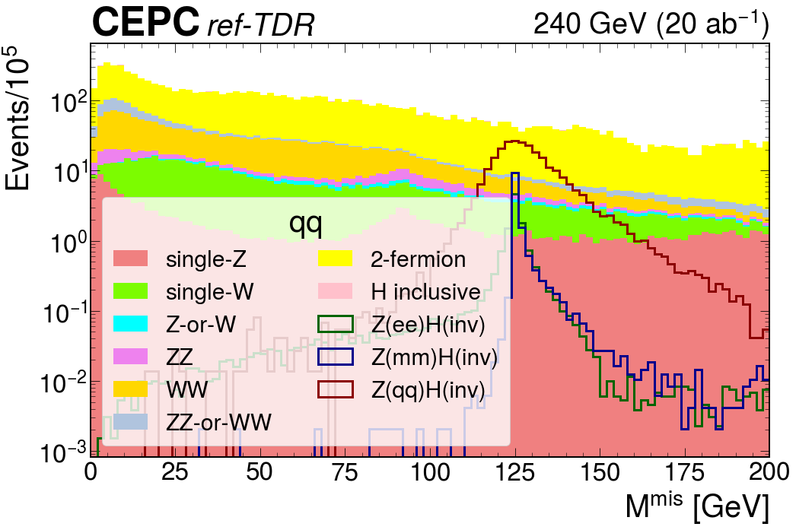
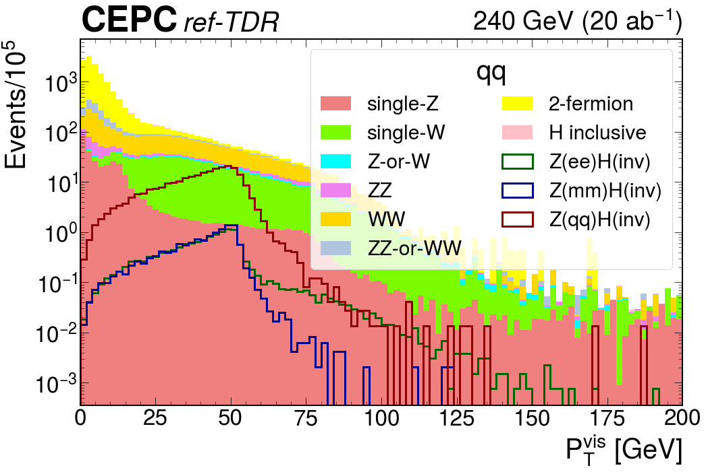
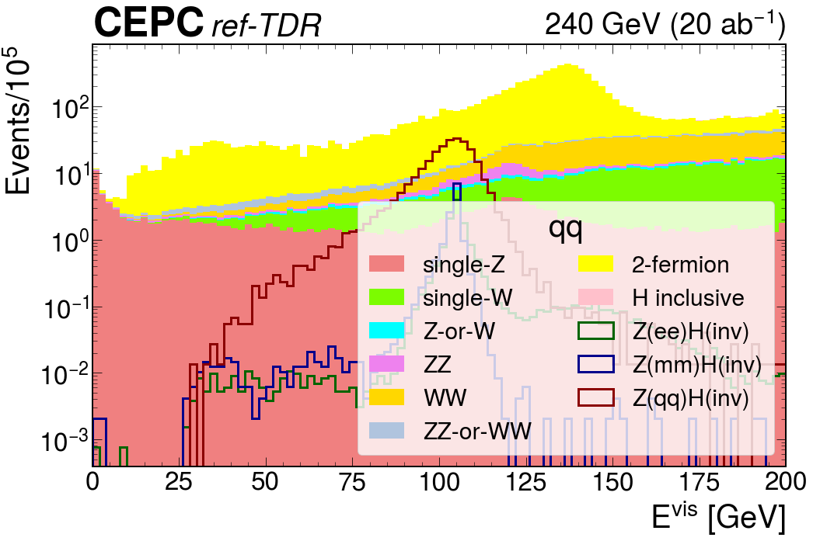
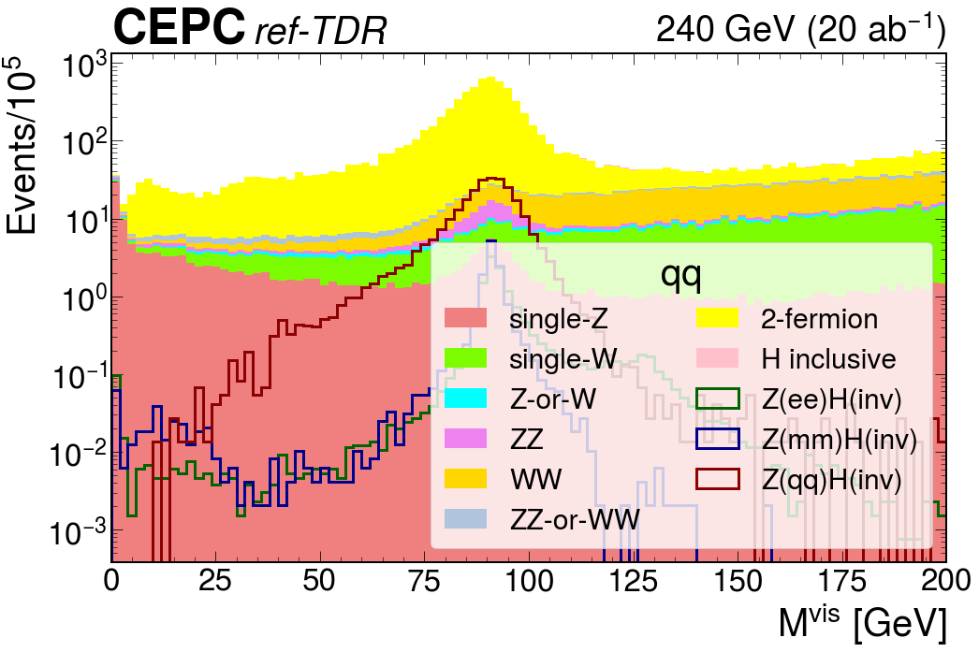
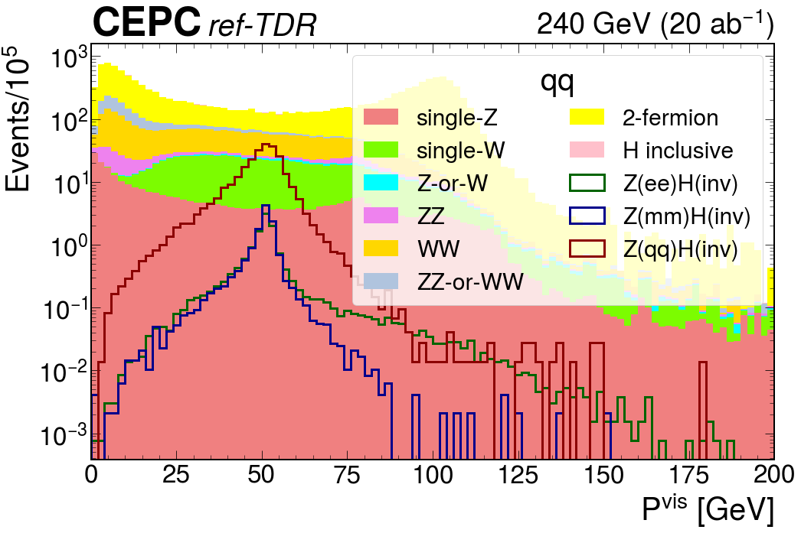
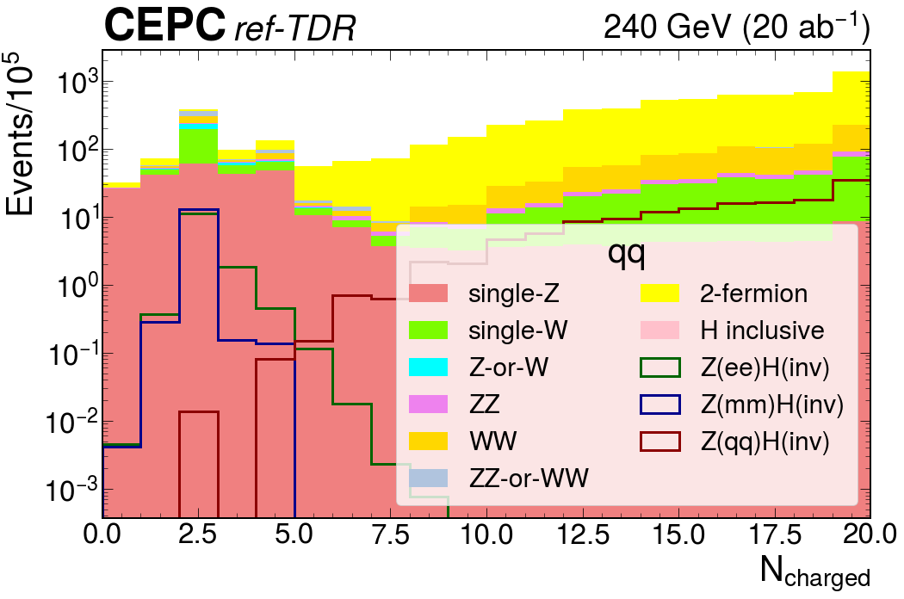
Kinematic selection: qq
[100, 150] GeV
[18, 60] GeV
[90, 117] GeV
[85, 102] GeV
[30, 58] GeV
[0, 2.4]
(5, +∞]

Slide 27
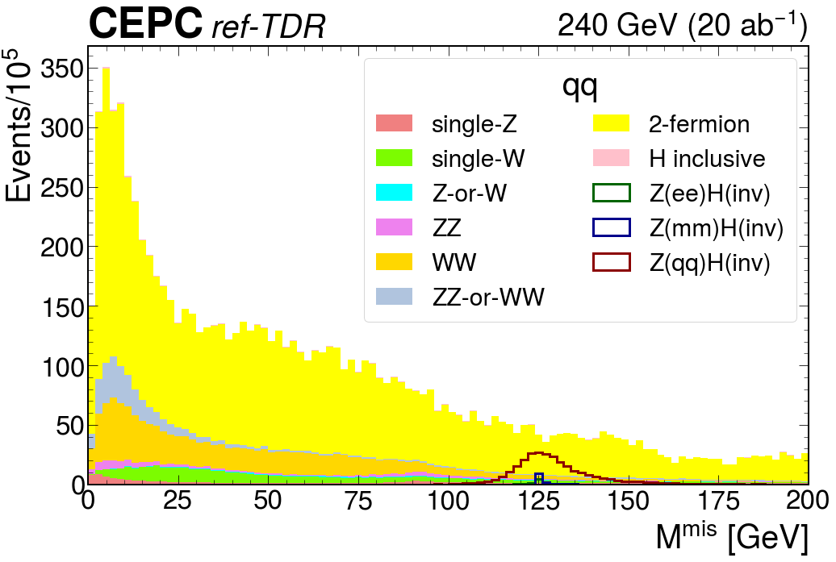
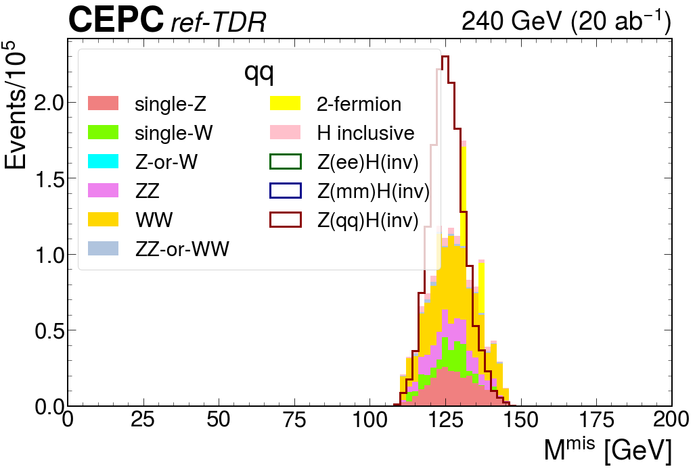
Kinematic selection: qq
Process | eeH | mmH | qqH | sz | sw | szw | zz | ww | zzww | 2f | Hincl | All bkg
Total yield | 140800 | 135400 | 2736200 | 32403400 | 69705000 | 4989600 | 22819400 | 181522200 | 73003000 | 1082137200 | 4073200 | 140800
Kin sel | 23 | 0 | 1626945 | 244397 | 128022 | 0 | 182434 | 601706 | 20246 | 97783 | 55033 | 23
eff (%) | 0.0163 | 0.000 | 59.460 | 0.754 | 0.184 | 0.000 | 0.800 | 0.332 | 0.028 | 0.009 | 1.351 | 0.0
eff CDR (%) | - | - | 60.81 | 0.66 | 0.06 | 0.00 | 0.64 | 0.21 | 0.02 | 0.00 | 0.97 | 0.03

Slide 28
5
Statistical Model and inferences
Obtain the results

Slide 29
Discriminating variable
You will need to fit on a certain variable to compute the results you want.
It should have strong separation power between signals and backgrounds.
  Typically, a score from multivariate analysis, or a mass variable (if resolution is good).
In this tutorial, we choose the missing mass.
  For signals, it is concentrated around 125 GeV.
  For backgrounds, it is mostly flat, or concentrated somewhere else.

Slide 30
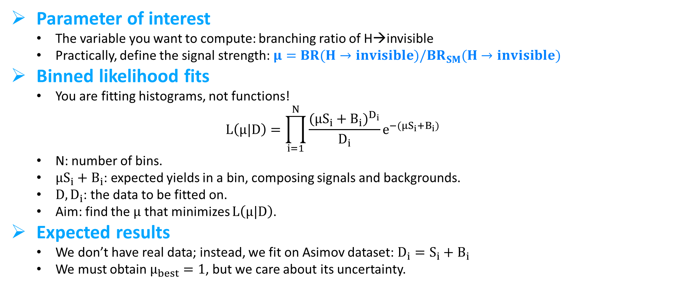
Statistical model
Parameter of interest
  The variable you want to compute: branching ratio of H→invisible
  Practically, define the signal strength: $μ=BR(H→invisible)/BR_{SM}(H→invisible)$
Binned likelihood fits
  You are fitting histograms, not functions!
  $$L\left(μ|D\right)=\prod_{i=1}^{N}{\frac{{{({μS}_{i}+B}_{i})}^{D_{i}}}{D_{i}}e^{−{({μS}_{i}+B}_{i})}}$$
  N: number of bins.
  ${{μS}_{i}+B}_{i}$: expected yields in a bin, composing signals and backgrounds.
  $D, D_{i}$: the data to be fitted on.
  Aim: find the $μ$ that minimizes $L\left(μ|D\right)$.
Expected results
  We don’t have real data; instead, we fit on Asimov dataset: $D_{i}={S_{i}+B}_{i}$
  We must obtain $μ_{best}=1$, but we care about its uncertainty.
Note: no systematic uncertainties are considered yet !!!

Slide 31
The CMS Combine tool
Introduction
  A compact tool for statistical analyses, with multiple usages.
  Open source, with an official publication: Comput Softw Big Sci 8, 19 (2024)
  Tutorial: https://cms-analysis.github.io/HiggsAnalysis-CombinedLimit/
  Again, feel free to choose the tool you are familiar with.
Installation
ssh -XY username@lxlogin.ihep.ac.cn
cd /cefs/higgs/username/
Note: do not enter a CEPCSW environment !!!
CMS environment:
  source /cvmfs/cms.cern.ch/cmsset_default.sh
  cmsrel CMSSW_14_1_0_pre4
  cd CMSSW_14_1_0_pre4/src
  cmsenv
  git clone https://github.com/cms-analysis/HiggsAnalysis-CombinedLimit.git HiggsAnalysis/CombinedLimit
  cd HiggsAnalysis/CombinedLimit
  git fetch origin
  git checkout v10.1.0
  cd -
Supplements
  git clone https://github.com/cms-analysis/CombineHarvester.git CombineHarvester
Compile
  scramv1 b clean
  scramv1 b –j 4

Slide 32
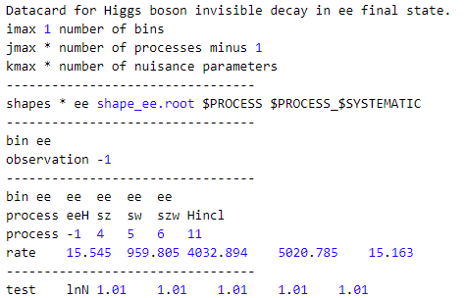
Prepare for datacards
  Go to the last section of Analysis/HiggsInvisible/EventSelection.ipynb
  Make sure your datacard folder exists.
  Fill in the histograms (TH1F) of missing mass for each process in each final state (channel).
  Compute the yield.
  Write in datacards in txt, and shapes in ROOT format, for each channel.
Datacards
Statement, not necessary
Number of channels
Number of processes - 1
For syst uncertainties
The file you put the histograms, and their names.
Name of channels
Name of processes
Label of processes: signal <= 0, backgrounds > 0
Yields: should be compatible with the integral of histograms
Syst uncertainty templates

Slide 33
Run combine
cd /path/to/your/CMSSW/repository
cmsenv
cd /path/to/your/datacard/folder/
combineCards.py dc*txt > combine.txt
  Combine datacards in different channels into one single datacard.
text2workspace.py combine.txt -o workspace.root -m 125 --X-allow-no-background
  Convert the datacards into a RooWorkspace, containing the complete statistical model.
combine -M MultiDimFit workspace.root -t -1 --algo=singles --X-rtd TMCSO_AdaptivePseudoAsimov -m 125 --expectSignal=1 --freezeParameters test
  You will get a fitted result with up and down uncertainty at 68% confidence level.
combine -M AsymptoticLimits workspace.root --run expected -m 125 --cminDefaultMinimizerStrategy=0 --cminFallback Minuit2,0:0.01 --cminFallback Minuit,0:0.001 --minosAlgo=stepping --freezeParameters test --expectSignal 1
  You will get the upper limit at 95% confidence level.
To compute results in each channel, directly run from text2workspace.py to each datacard.
Can be difficult to understand, but once you are able to run them, let’s understand them little by little!

Slide 34
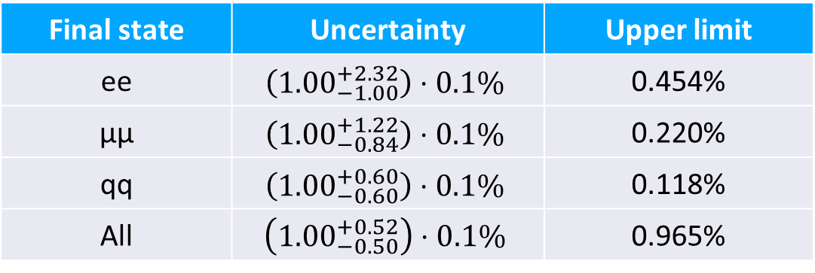
Results
After running all steps, you should be able to get the following results, assuming data of 20 ab-1.
Final state | Uncertainty | Upper limit
ee | $$\left({1.00}_{−1.00}^{+2.32}\right)⋅0.1\%$$ | 0.454%
μμ | $$\left({1.00}_{−0.84}^{+1.22}\right)⋅0.1\%$$ | 0.220%
qq | $$\left({1.00}_{−0.60}^{+0.60}\right)⋅0.1\%$$ | 0.118%
All | $$\left({1.00}_{−0.50}^{+0.52}\right)⋅0.1\%$$ | 0.965%

Slide 35
6
Conclusion

Slide 36
Conclusion
The physics analysis at CEPC ref-detector follows similar procedures as other experiments
  Produce your samples
  Study the features of signals
  Design the event selection criteria
  Build the statistical model
  Compute the result
There can be some specific features
  Unique particle identification
  Design event selection based on detector efficiency and resolution of CEPC ref-detector.
  ......
The tutorial
  Play with the materials provided in the tutorial!
  In all steps: make sure you won’t write to my (liugeliang) folder, thanks! : )

Slide 37
Following steps
For H→invisible studies
  Selection criteria are not optimized: isolation? Jet substructure? Tau reconstruction? Vertex information?
  Discriminating variable needs to be checked: is missing mass the best one? Do we want to use machine learning?
  Details to be checked: contributions from other Higgs boson decays,
For physics analyses in general
  Just begins, a lot of works are needed for different topics.
    Other Higgs boson decay channels.
    Z→μμ studies.
  Performances of physics objects waiting to be checked under the new release.

