Slide 1
Physics analysis at CEPC --- view points of an analyzer
LI Gang
ligang@ihep.ac.cn
IH

Slide 2
Physics at CEPC
Precision and systematical study of Higgs, W, and Z boson, as well as flavor physics with Z decays
WHZ physics (most are exclusive)
Flavor physics (inclusive analysis)

Slide 3
CEPC detector
PFA detector : excellent jet energy resolution achieved with PFA reconstruction
New features
PID capabilities with dN/dx and ToF; K/pi separation up to 20 GeV
Very good photon energy resolution: <3%

Slide 4
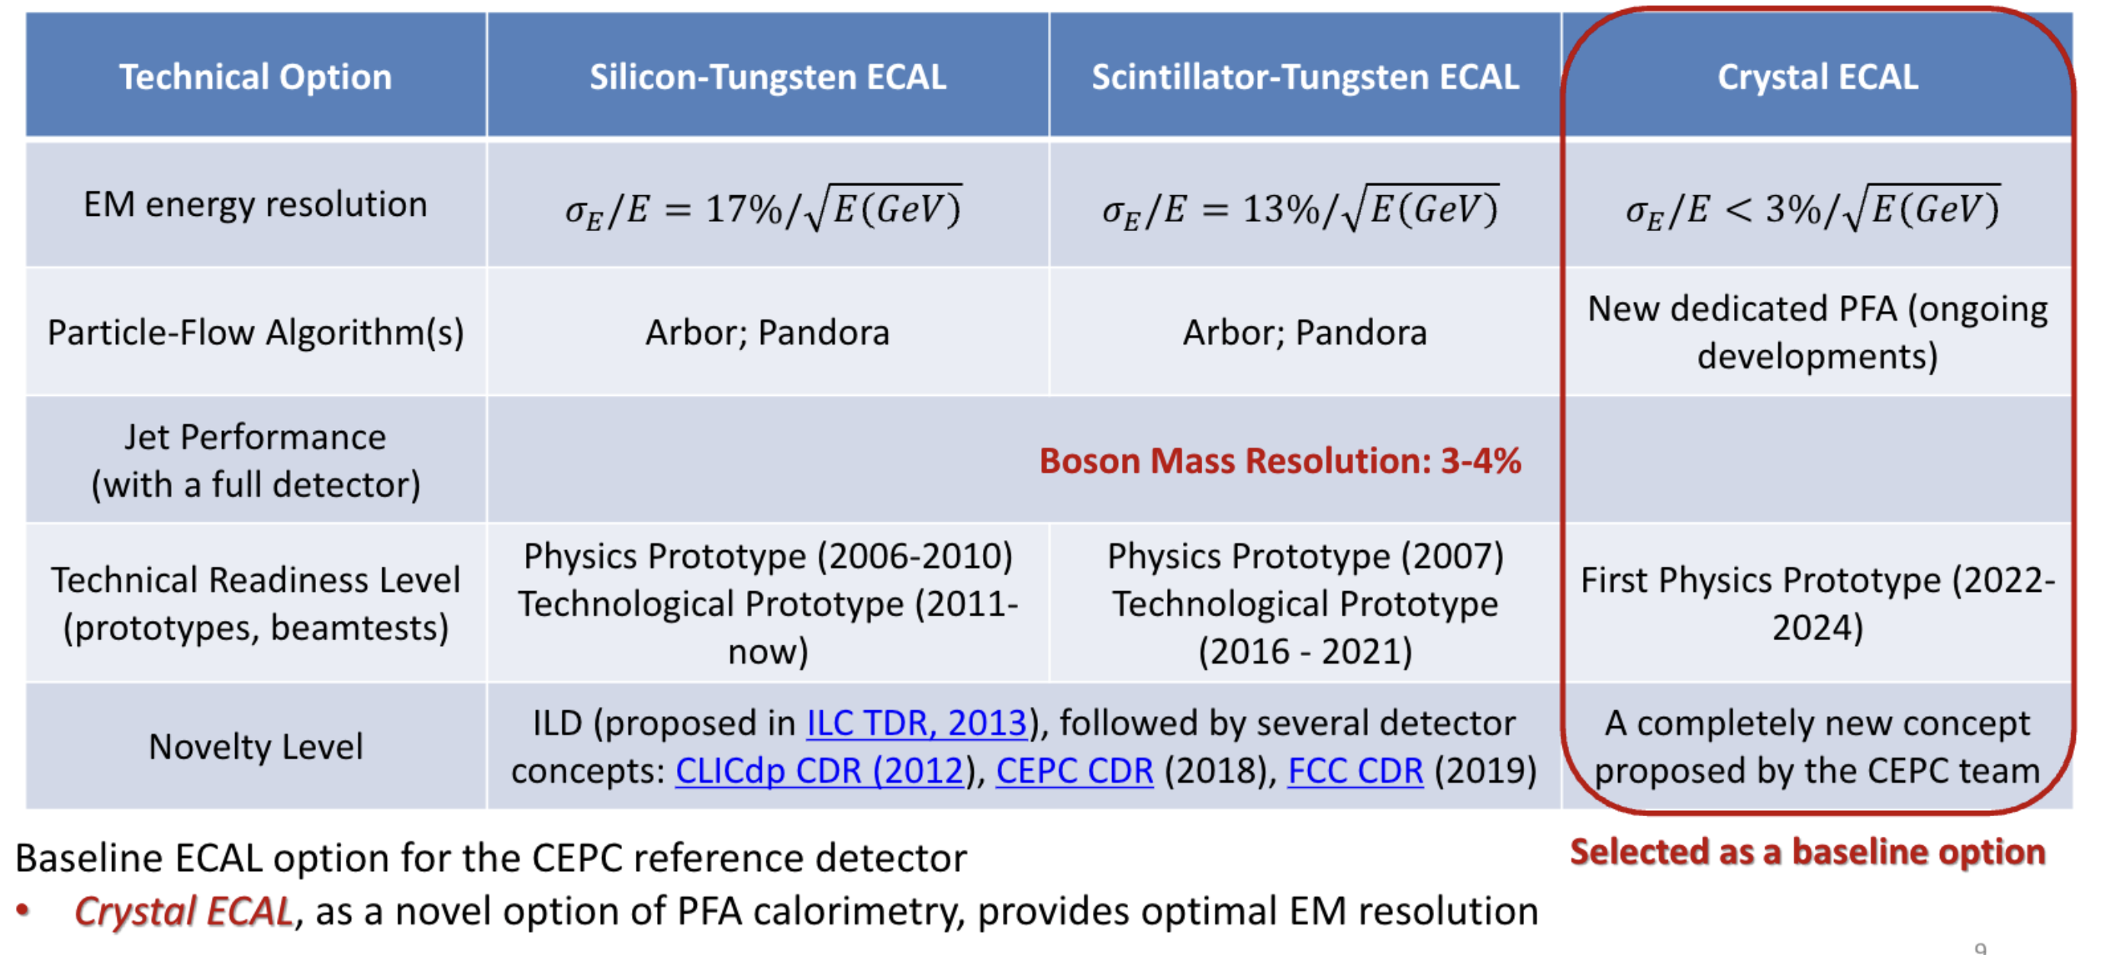
Technology options of ECAL

Slide 5
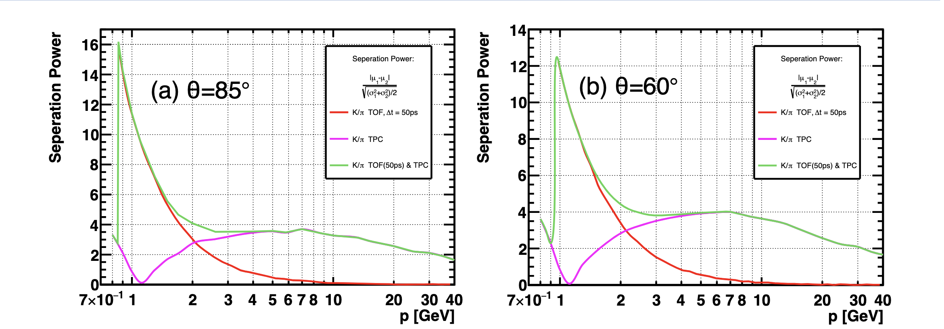
Particle Identification

Slide 6
Typical performances
Parameters | Performance | Comments
Jet energy resolution | < 4% | ~ 8% at LHC experiments
EM energy resolution | < 3% | >10% with Sampling ones
Mass resolution (recoil in μμH) | < 300 MeV
Mass resolution (Higgs→γγ) | < 1 GeV | ~ 2 GeV with Sampling ones
Mass resolution (π⁰→γγ) | ~ 10 MeV

Slide 7
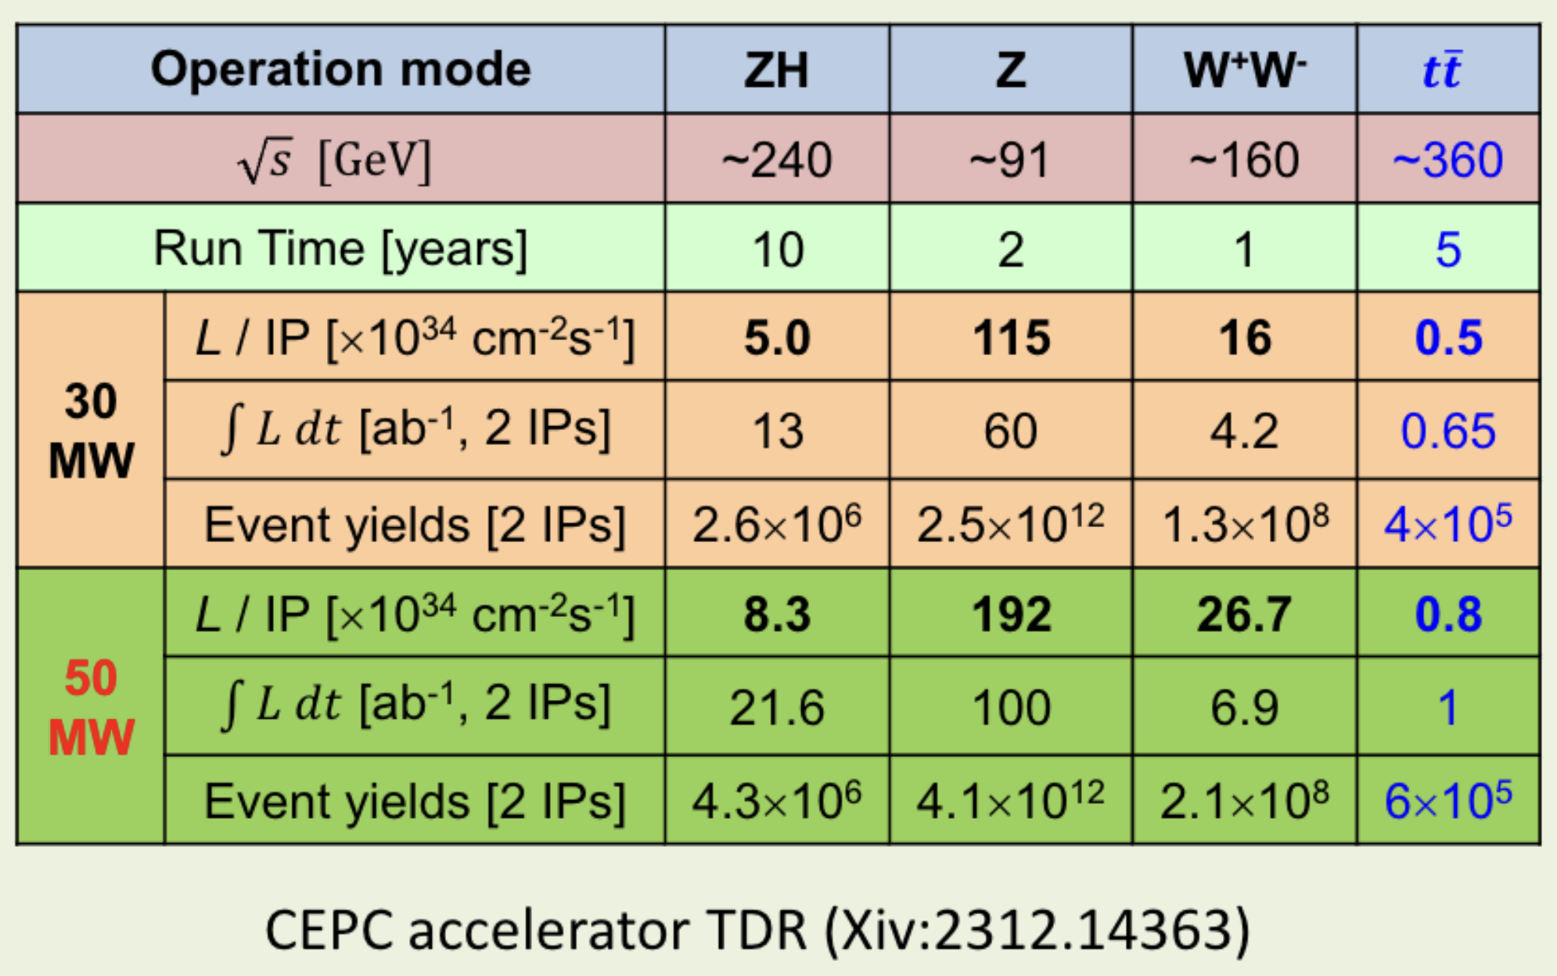
CEPC operation scenario
4 M Higgs, 10¹² Z, 10⁸ WW pair, 0.6M tt pair

Slide 8
Physics analysis at e+e- colliders: 1st dimension
Exclusive and inclusive
Exclusive analysis dominant
More constrain (information) available
Avoid information loss

Slide 9
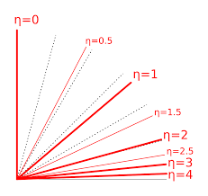
Physics analysis at e+e- colliders: 2nd dimension
3D information, not only transverse
P_{t}
E_{t}
Missing X_{t}
Use cos(θ) instead of η
Forget about them !

Slide 10
Physics analysis at e+e- colliders: 3rd dimension
Reconstruct and analysis simultaneously
Why?
efficiency
Jets too soft
For example : μ⁺μ⁻ + di-jet
~50 particles in an signal event: fast to process
4 GeV/particle: every particle need to be used
The best way: selection muon pair first, then perform the jet clustering in exclusive mode with the rest particles
Testing all combinations with reconstructed results

Slide 11
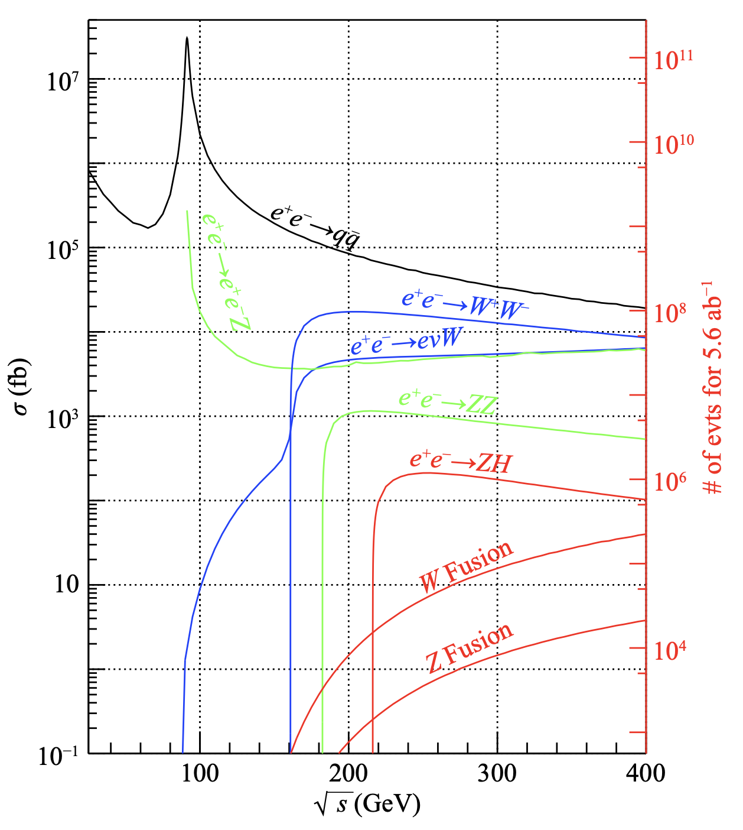
Feature 1: clean
High S/N ratio: O(0.001)
But less ~4 M Higgs
Avoid eff. loss
Higgs signal (~0.2pb)
2fermion backgrounds
( ~ 50pb )
4fermion backgrounds
( ~ 30 pb)

Slide 12
Feature 2: high (trigger) efficiency
Even triggerless
Pile-up free(240 GeV and 360 GeV)
low background
High hermeticity : an complete event without fake particles
|cos θ| up to 0.98

Slide 13
Feature 3: kinematic constrain
Very powerful to improve (mass) resolution
Provide an extra feature for suppress backgrounds
Package: MarlinKinFit

Slide 14
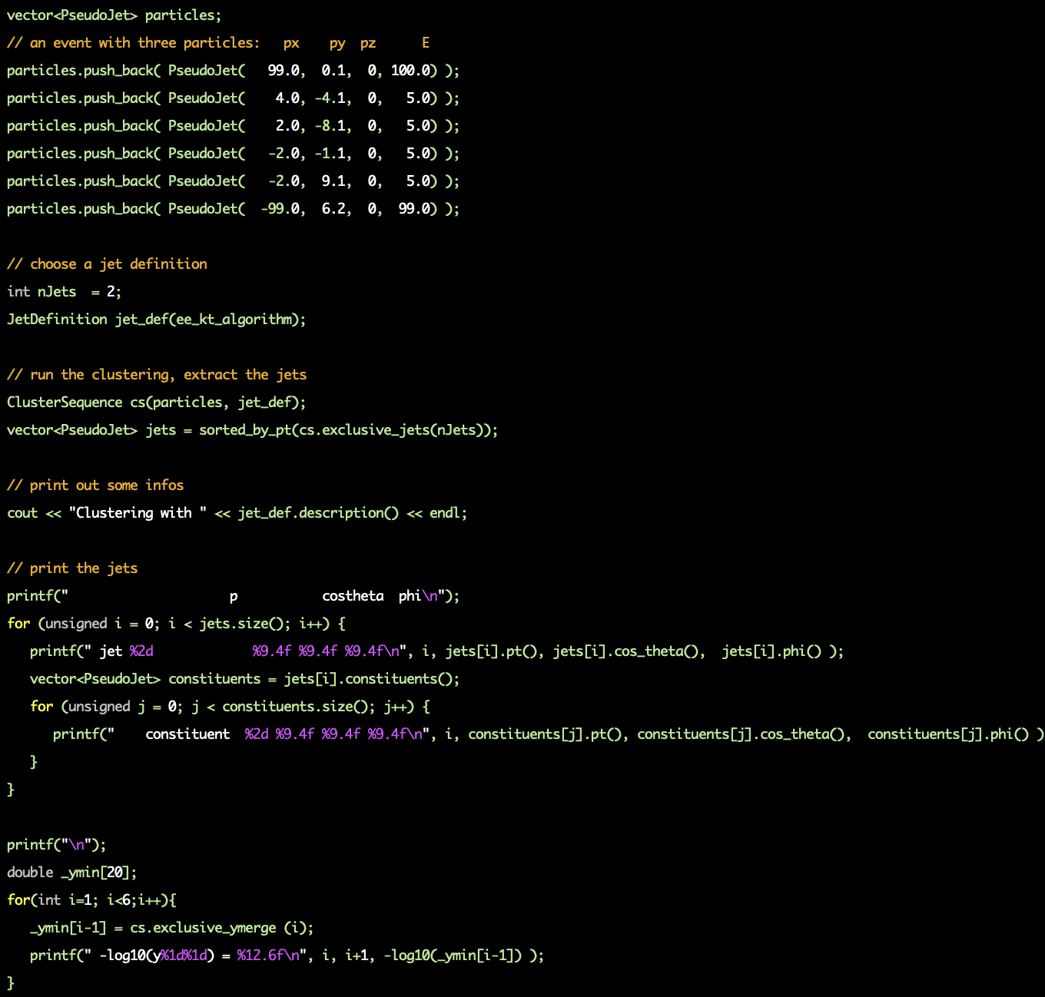
Feature 4: use ee-kt exclusively
Exclusive: each particle is useful in an event
Analysis specific jet-clustering
Or you will lose efficiency

Slide 15
An example
e+e- → μ+μ-H
Model independent measurement
Only the muons from Z decay used

Slide 16
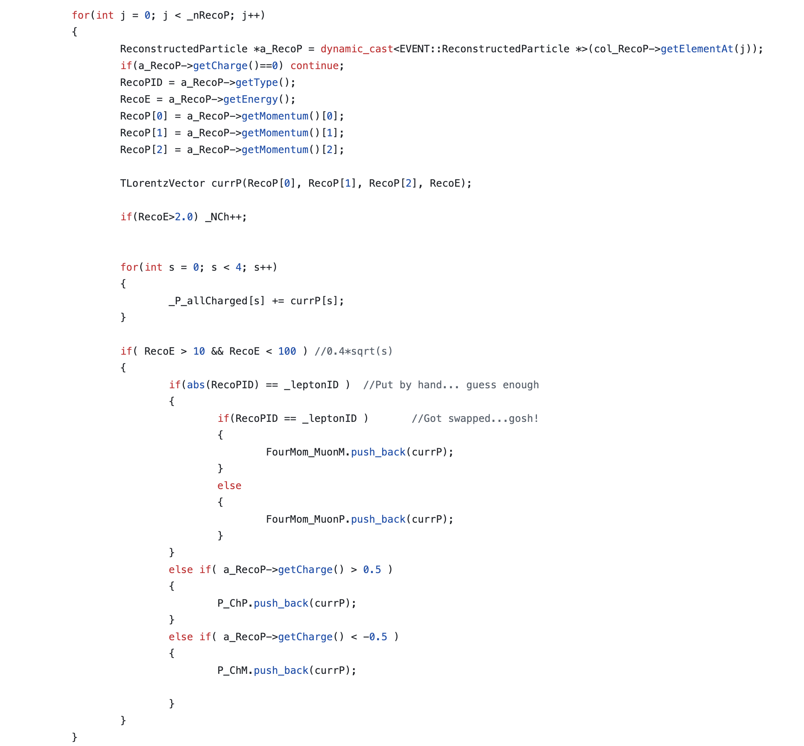
Muon candidates

Slide 17
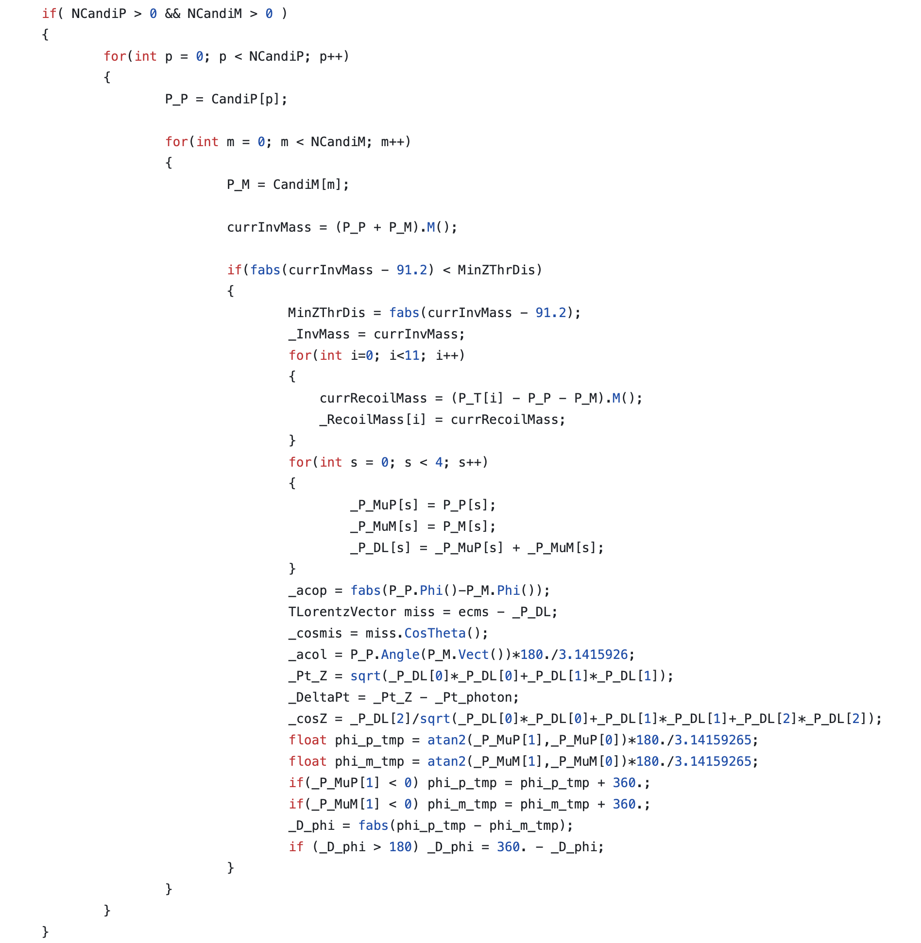
Muon pair

Slide 18
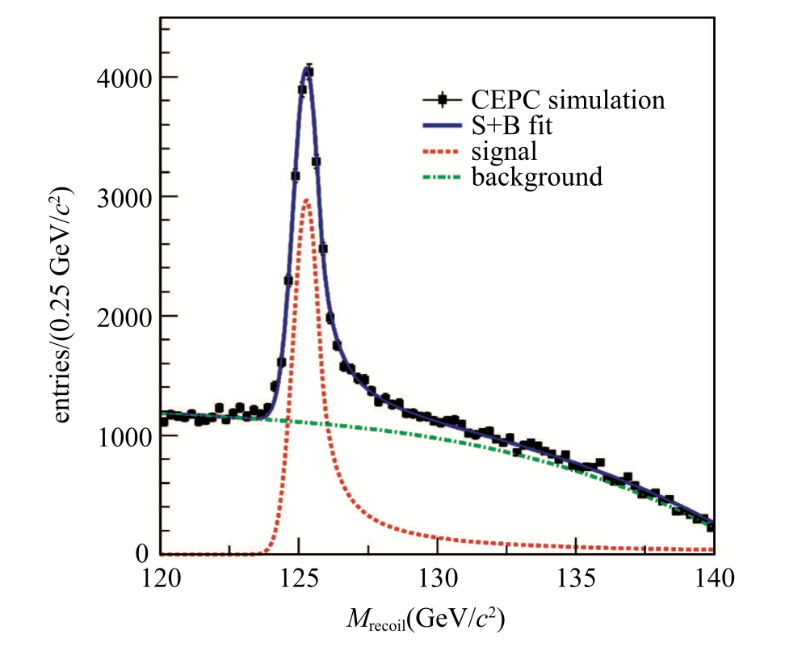
Recoil mass

Slide 19
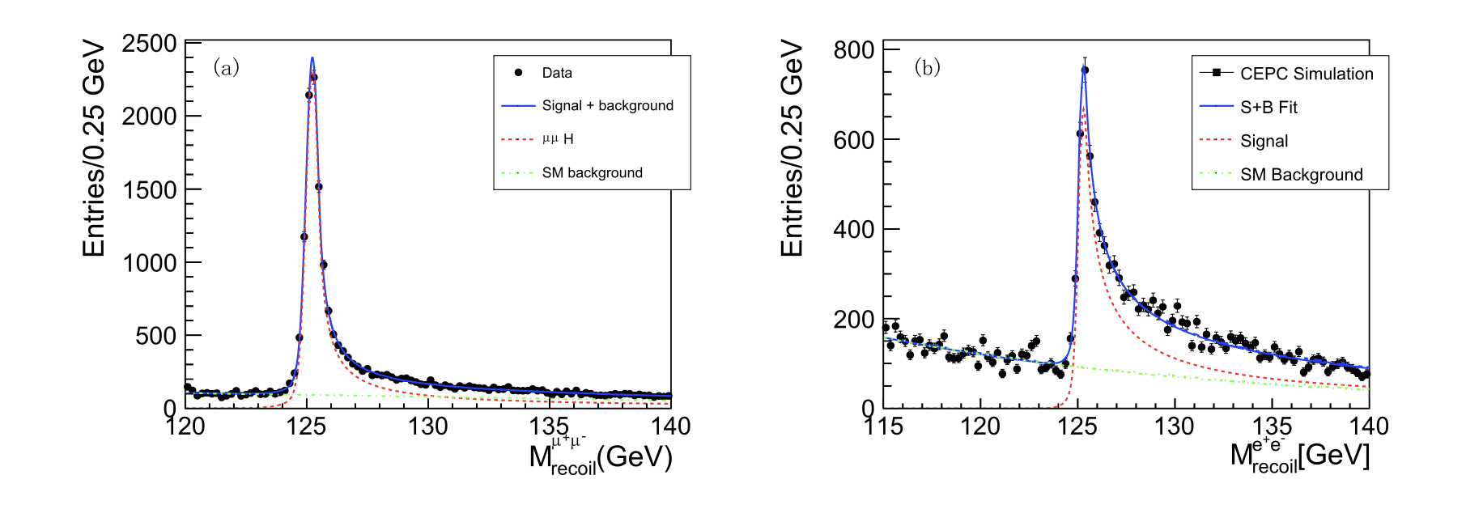
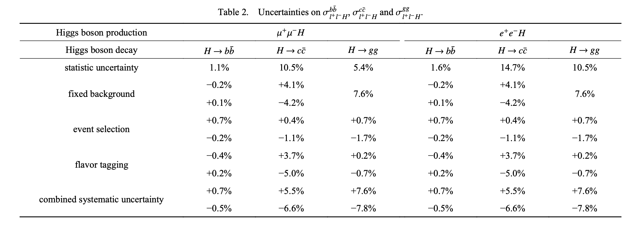
Another example
e+e- → μ+μ-H, Higgs →di-jet

Slide 20
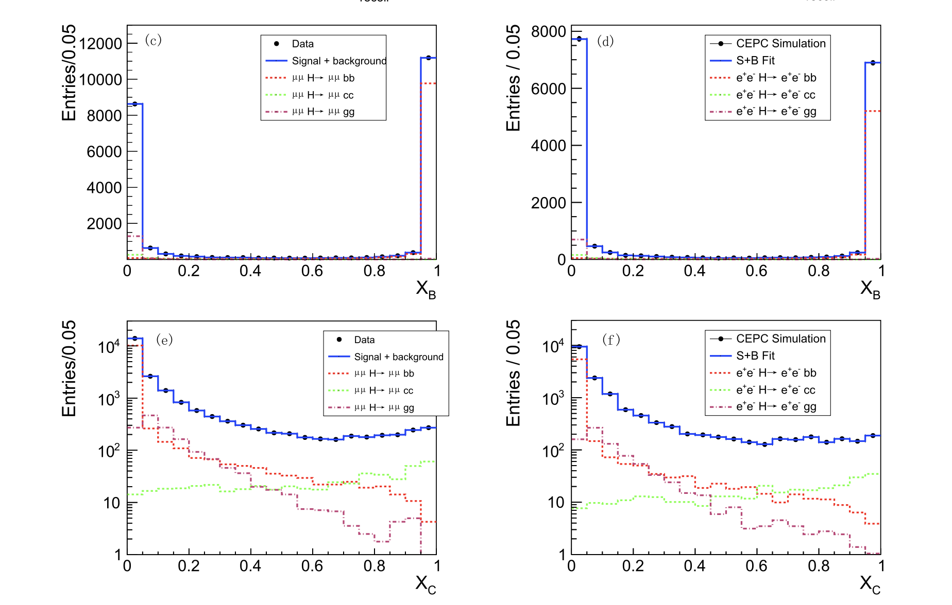
Another example
e+e- → μ+μ-H, Higgs →di-jet

Slide 21
Another example
e+e- → μ+μ-H, Higgs →di-jet

Slide 22
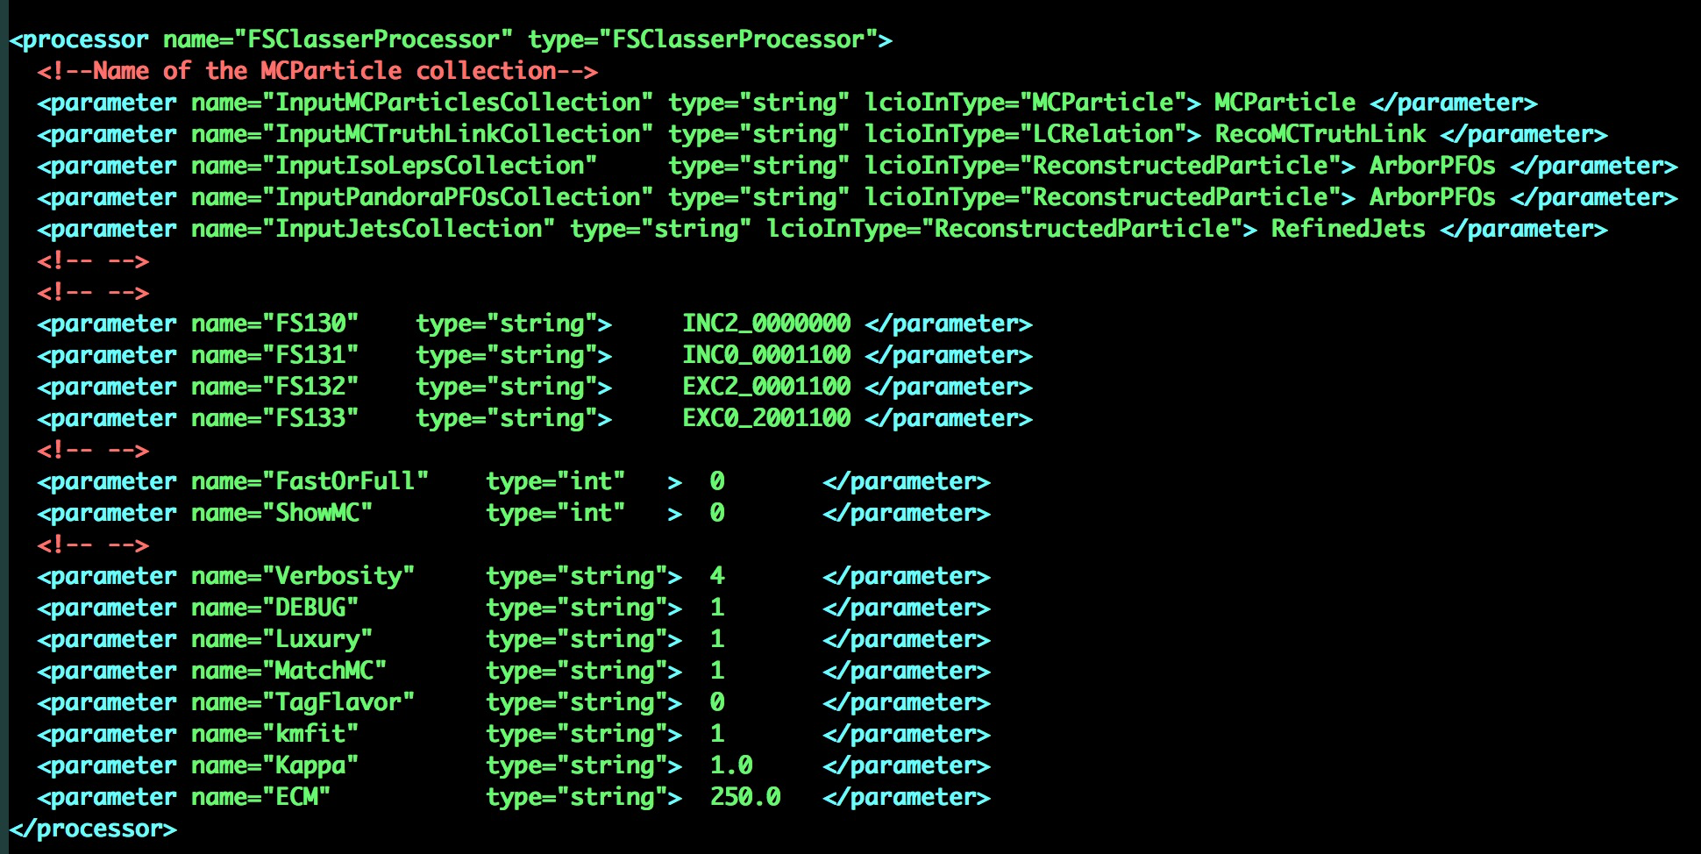
Job options

Slide 23
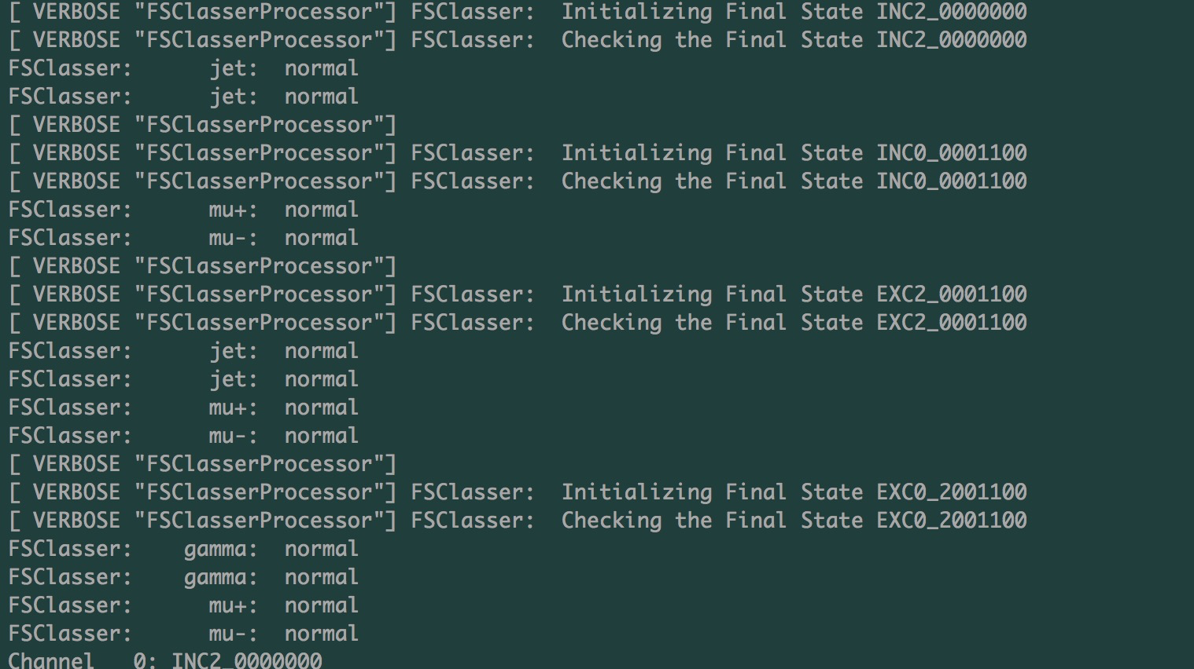
Information on screen
Marlin FS_example.xml

Slide 24
Summary
Analysis at e+e- colliders
Get used to do (some) reconstruction by yourself, tuning it according to your analysis
Try to use all particles in an event
Try to use kinematic fit
Using p and cos(θ) instead of pt and eta, respectively

Slide 25
Backups

Slide 26
Overview of data-analysis
Two stages:
Pre-selection and Ntuple production
Root script – plots and numerical results
First state
Particle Objects
MC particles – used for comparison
Reconstructed particles (tracks, clusters, jets ) → event
Combination of objects → candidate events
Fill ntuples for the next stage in root …

Slide 27
Overview of data-analysis (cont’d )
Data
Ntuple
Plots/results
Root
Root
CEPCSW

Slide 28
Overview of data-analysis (cont’d )
Jets
tracks
clusters
leptons
e/μ/τ
photons
τ finder
Missing particles
Feed all types of particle object to the combination engine for further processing
ee+X, μμ+X, jj+ee, jj+μμ …

Slide 29
Abstract of tasks
Class FSParticle → all types of (reconstructed) particles
Class FSinfo → all kinds of combination
Class NTupleHelper → service of ntuple
Class MCTruthHelper → service of MC truth
Class FSCut → preliminary cuts

Slide 30
Final state classification
Main processor
FSInfo
Reconstructed particles/MC particles
Ntuple/MC truth
PFOs/Jets/MC particles as input
Arbor/Pandora
Jet clustering/flavortag/MCTL …
Top level
Event level
PFO/jet level

Slide 31
Structure of code
CEPCSW algorithm
FSClasser
Combination
FSInfo
FSParticle
FSCut
FSNtuple
MCtruth

Slide 32
Structure of main program
Prepare particle lists
e,μ, γ
Jet, τ
Combination the particle list as the request
Events, Ntuple,
MC truth
Loop over all combinations: calculate variables and fill ntuple
Simple cuts
Kinematic fit
Fill ntuples

Slide 33
Class FSPaticle
Data
PID/Mass/charge/ 4-momentum, p, pT …
Flavor/vertex
Matched MC object

Slide 34
FSInfo
Data
Combination of a list of particles/jets
the associated MC truth/ Ntuple
Cuts
Steers

