Slide 1
Hadrons from a Multi-Phase Transport Model
Zi-Wei Lin (林子威)
East Carolina University (ECU)
The Hadronic Interaction Workshop at CUHK, Hong Kong, 3/2025

Slide 2
Outline
A Multi-phase Transport (AMPT) Model
A baryon stopping puzzle
Some results of p+O collisions from AMPT
Summary

Slide 3
1) A Multi-phase Transport (AMPT) Model
Transport models based on the Boltzmann equation have been developed to study and simulate high energy nuclear collisions.
They include
ART, HSD, UrQMD, SMASH (hadron transport)
ZPC, MPC (elastic parton transport)
AMPT (elastic parton transport + hadron transport)
PACIAE (2-body parton transport + hadron transport)
BAMPS (2-body plus 2 ↔ 3 parton transport)
PHSD (off-shell parton transport + hadron transport)
...
There are also event generators without final state rescatterings:
PYTHIA, HIJING, ...

Slide 4
A multi-phase transport (AMPT) model
aims to provide a kinetic description of all essential stages
of relativistic heavy ion collisions:
A+B
Initial condition
Source codes since 1st release (2004)
are available at
https://myweb.ecu.edu/linz/ampt/
ZWL, Che-Ming Ko, Bao-An Li, Bin Zhang & Subrata Pal, Phys Rev C (2005);
ZWL & Liang Zheng, mini-review at
Nucl Sci Tech (2021)
Parton Cascade
Hadronization
Hadron Cascade
As a result, the model is well suited to describe non-equilibrium dynamics
Final particles

Slide 5
Structure of AMPT v1.xx (AMPT-default)
A+B
HIJING1.0:
minijet partons (hard), excited strings (soft), spectator nucleons
Generate parton space-time
ZPC (parton cascade)
Partons freeze out
Hadronization (Lund string fragmentation)
Extended ART (hadron cascade)
Hadrons freeze out (at a global cut-off time);
then strong-decay all remaining resonances
Final particles

Slide 6
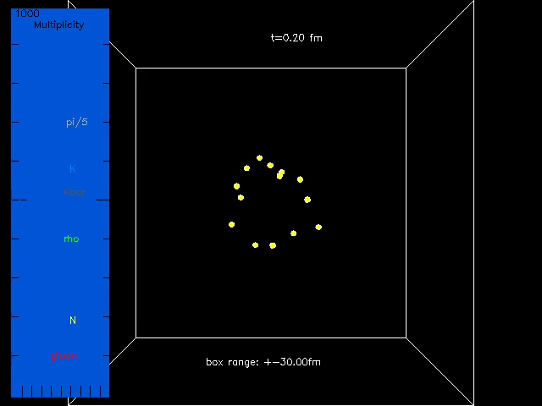
A central Au+Au event at $\sqrt{s_{NN}}=200$ GeV from AMPT-default
60fm-long box;
shows only
formed particles.
◉
Beam axis
1st frame:
right after the
primary collision,
only spectator
nucleons are formed.
At middle right:
a rho decays
at 7.0 fm/c.
At lower right:
a K*bar is
produced
at 16.6 fm/c
& vanishes
at 20.8fm/c.

Slide 7
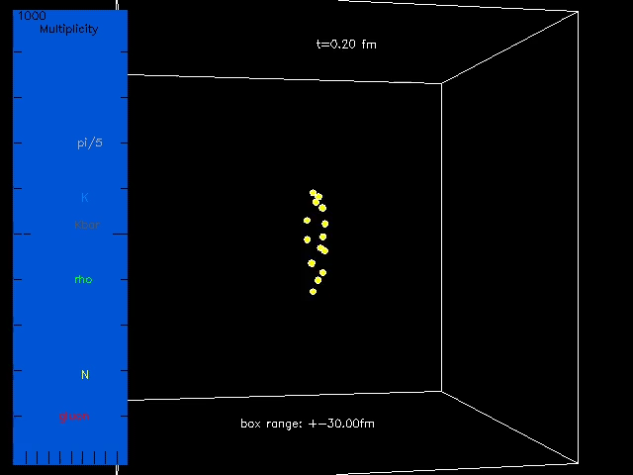
The same Au+Au event from AMPT-default
Side view:
Beam axes
Dynamics is
time-dilated at large rapidities:
for example, see
hadronization
of gluons
Notes:
Color: gluon (2 red), q (2 red), qbar (5 cyan);
pi (15 gray), k (11 light blue), kbar (14 dark gray), K*/K*bar (6 magenta), rho (3 deep green), omega/phi/eta/allOthers (1 white),
p/n (7 yellow), pbar/nbar (12 violet), Delta/N*/Lambda/Sigma & bar (12 violet).

Slide 8
String Melting version of AMPT
If we use the Bjorken formula to estimate
the initial energy density in heavy ion collisions:
~ 2.5 6 20 GeV/fm³
SPS RHIC LHC
>>critical energy density
for QCD phase transition:
ε_{c} ~ O(1/2) GeV/fm³
Nuclear radius
Proper formation time, taken as 1 fm/c
➔At high-enough energies,
hadronic matter such as strings cannot exist at early times,
they should be represented by a dense partonic matter
➔ the string melting version of AMPT ZWL & Ko, PRC (2002)

Slide 9
Structure of AMPT v2.xx (AMPT-String Melting)
A+B
HIJING1.0:
minijet partons (hard), excited strings (soft), spectator nucleons
Generate parton space-time
Strings melt to q & qbar by decomposing initial hadrons
ZPC (parton cascade)
Partons freeze out
Hadronization (Quark Coalescence)
Extended ART (hadron cascade)
Hadrons freeze out (at a global cut-off time);
then strong-decay all remaining resonances
Final particles

Slide 10
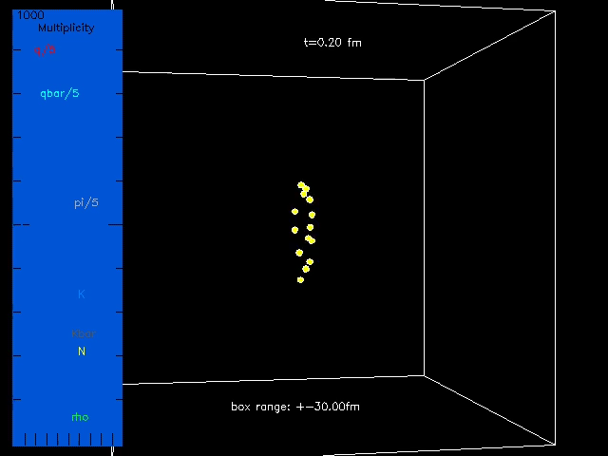
The same Au+Au event from AMPT-String Melting
Side view:
Beam axes
Middle region
(near mid-rapidity):
coalescence of
q (red) and
qbar (cyan)
occurs earlier
Notes:
Color: gluon (2 red), q (2 red), qbar (5 cyan); pi (15 gray), k (11 light blue), kbar (14 dark gray), K*/K*bar (6 magenta), rho (3 deep green), omega/phi/eta/allOthers (1 white), p/n (7 yellow), pbar/nbar (12 violet), Delta/N*/Lambda/Sigma & bar (12 violet).
% Look at bottom middle: an anti-strange meson (turns out to be K*bar) is created ~3.8 fm/c, then decayed to a Kbar and a pion at ~10.6 fm/c.
You can see rho decays on middle to left, a white object decays to pions at top middle.

Slide 11
Components of AMPT
HIJING1.0 Two component model (soft strings + hard minijets)
ZPC parton cascade (elastic collisions only)
Hadronization Lund string fragmentation (AMPT- default)
or
Quark coalescence (AMPT-String Melting)
Extended ART Hadron cascade,
including secondary interactions for
All other particles with PYTHIA flavor codes have no secondary interactions,
but they will be produced (from HIJING or quark coalescence),
e.g.
Each hadron has an explicit isospin/charge.
Notes:
Hadrons formed via coalescence do not include eta’ in pseudoscalar mesons, Sigma* or Xi* in decuplet baryons.

Slide 12
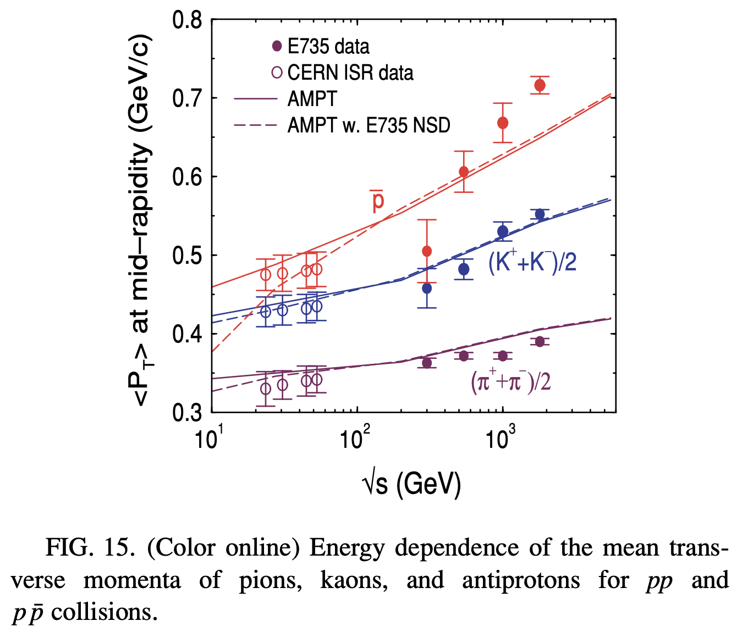
Selected earlier results: particle yields
AMPT-default for
p+p or p+pbar collisions:
AMPT-default for central
Au+Au or Pb+Pb collisions:
ZWL et al. PRC 72 (2005)
Notes:
Present status

Slide 13
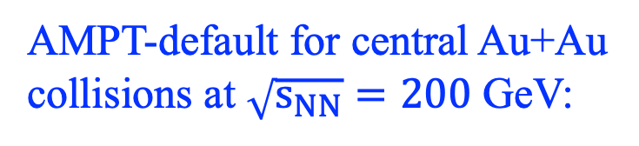
Selected earlier results: p_{T} spectra
AMPT-default for central Au+Au
collisions at $\sqrt{s_{NN}}=200$ GeV:
FSI
=Final State Interactions:
lead to
more transverse flow
and a harder p_{T} spectrum
ZWL et al. PRC 72 (2005)
Notes:
Present status

Slide 14
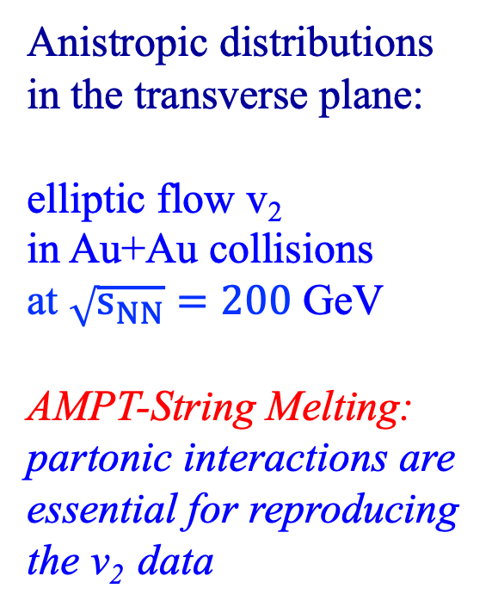
Selected earlier results: v₂
Anistropic distributions
in the transverse plane:
elliptic flow v₂
in Au+Au collisions
at $\sqrt{s_{NN}}=200$ GeV
AMPT-String Melting:
partonic interactions are
essential for reproducing
the v₂ data
ZWL & Ko, PRC 65 (2002);
ZWL et al. PRC 72 (2005)

Slide 15


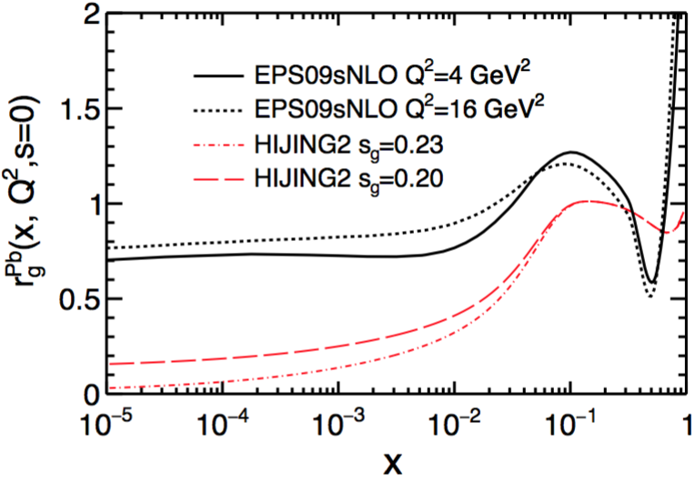
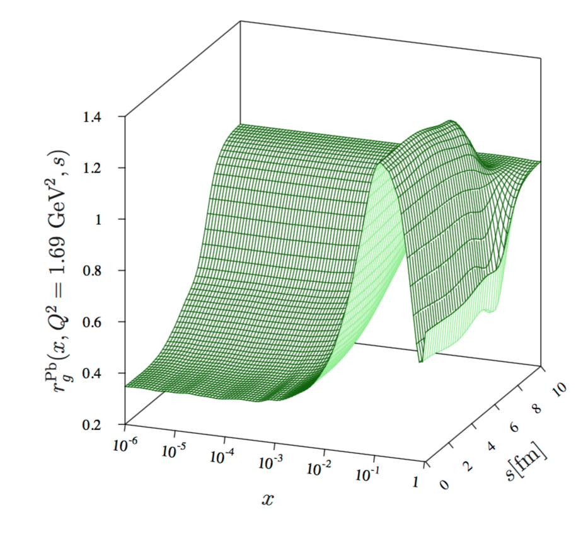
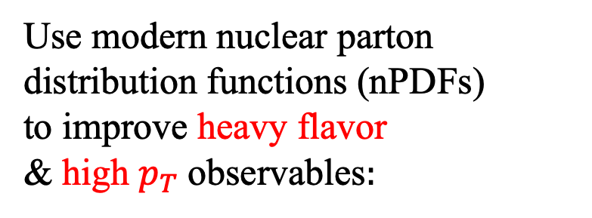
Improvement with modern PDFs of nuclei
Use modern nuclear parton distribution functions (nPDFs)
to improve heavy flavor
& high $p_{T}$observables$:$
C. Zhang et al., PRC 99 (2019)
Here we use
CTEQ6.1M PDFs for free nucleon;
EPS09s: spatial-dependent nuclear shadowing, has Q² evolution.
Nuclear Shadowing for Pb:

Slide 16
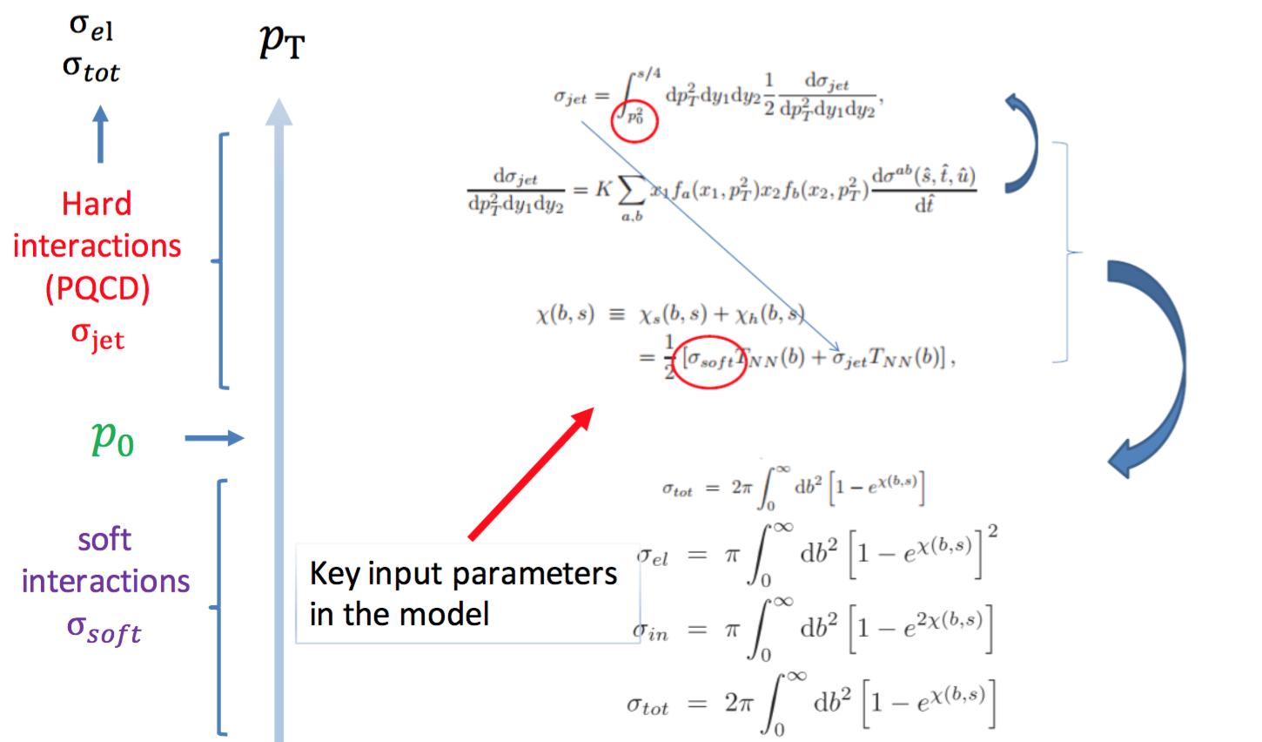
Improvement with modern PDFs of nuclei
Initial condition from the HIJING1.0 model:

Slide 17
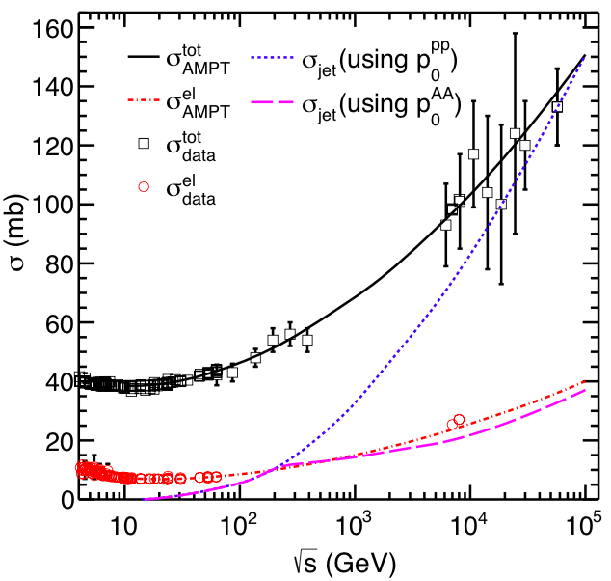
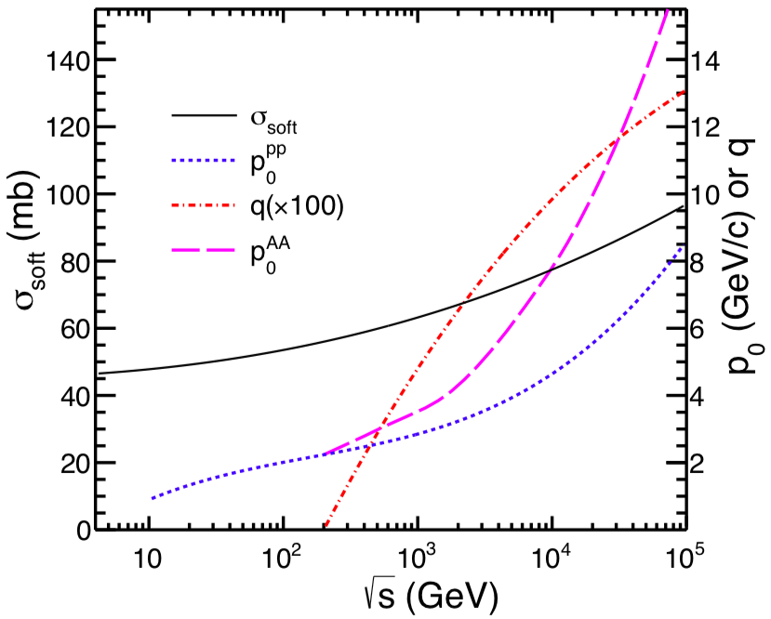
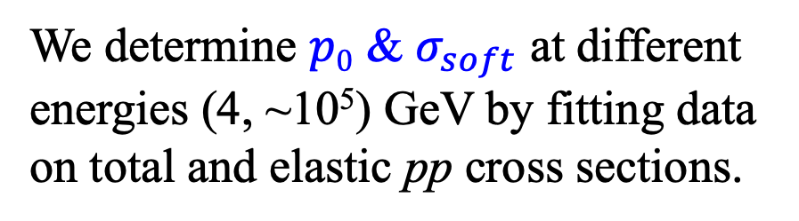
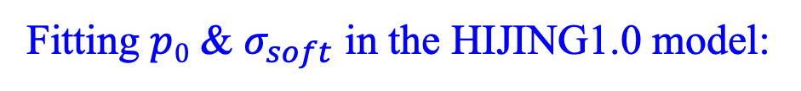
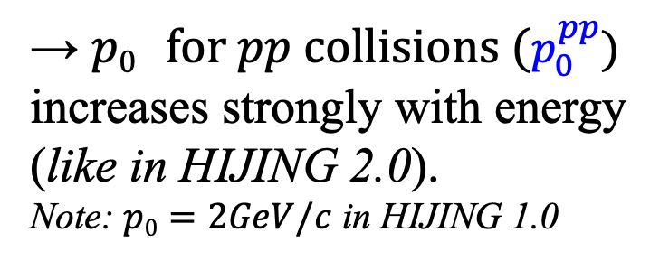
Improvement with modern PDFs of nuclei
Fitting $p0$ & $σ_{soft}$ in the HIJING1.0 model:
We determine $p0$ & $σ_{soft}$ at different energies (4, ~10⁵) GeV by fitting data on total and elastic pp cross sections.
→ $p0 for pp collisions (p_{0}^{pp})$
increases strongly with energy
(like in HIJING 2.0).
Note: $p0=2GeV/c$ in HIJING 1.0

Slide 18
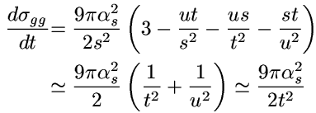
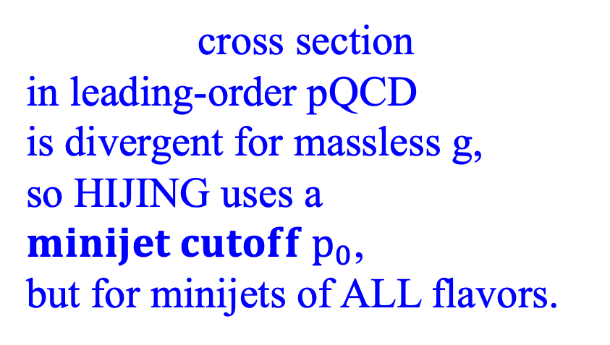
Improvement of heavy flavor productions
L. Zheng et al., PRC 101 (2020)
cross section
in leading-order pQCD
is divergent for massless g,
so HIJING uses a $minijet cutoff p_{0}$,
but for minijets of ALL flavors.
But heavy flavor production may NOT be subject to this cutoff
due to heavy quark mass >> Λ_{QCD} (e.g. in FONLL)
$g+g→Q+\overline{Q},$ $q+\overline{q}→Q+\overline{Q},$
1) So we now remove the p₀ cut on HF productions
in the two-component model HIJING & AMPT.

Slide 19
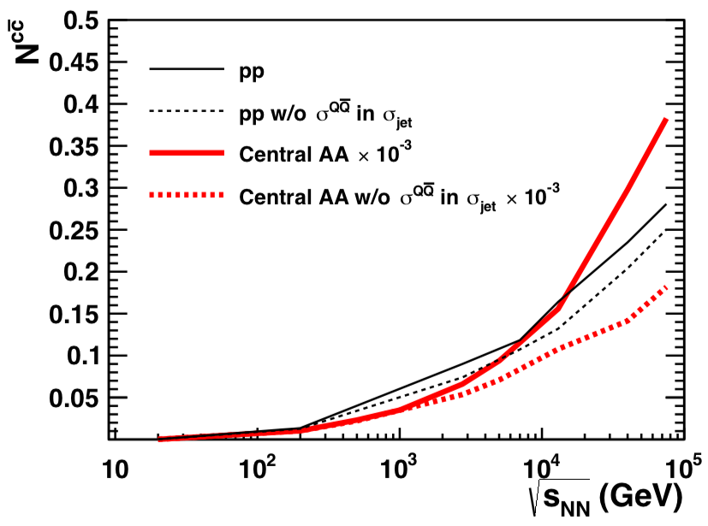
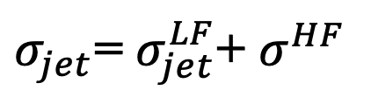
Improvement of heavy flavor productions
σ_{jet} in the HIJING model
currently only includes light flavor (LF: u/d/s) minijets,
then HF & LF minijets are generated according to
their relative cross sections.
2) We now include HF in σ_{jet}:
sizable effect above a few TeV.
3) We also make correction
of factor of ½
for certain σ_{jet} channels
$σ_{jet}$= $σ_{jet}^{LF}$+ $σ^{HF}$
L. Zheng et al., PRC 101 (2020)
Notes:
since $σ^{HF}$ can be a sizable fraction of $σ_{jet}$ at high energies (given the high p₀ cut for LF minijets).

Slide 20
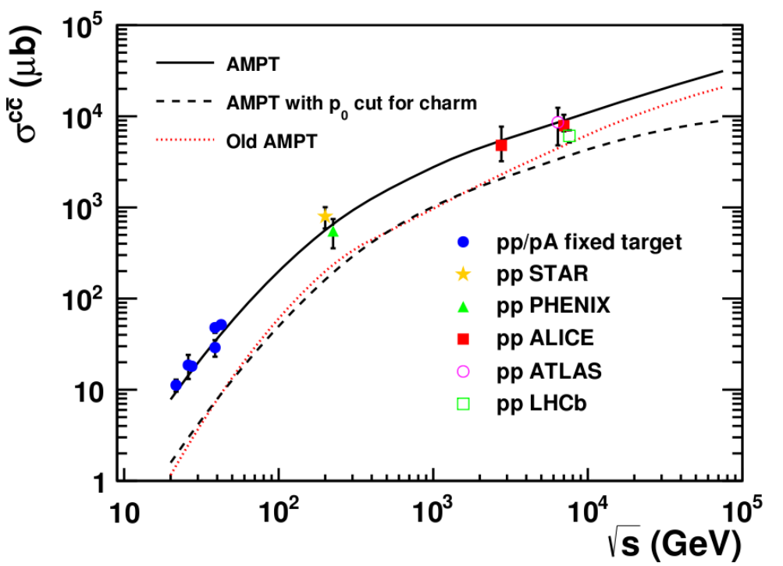
Improvement of heavy flavor productions
Charm quark yields in pp collisions:
Old/public AMPT charm yield << data
Removing p₀ greatly enhances charm yield
Updated AMPT model well describes the world data

Slide 21
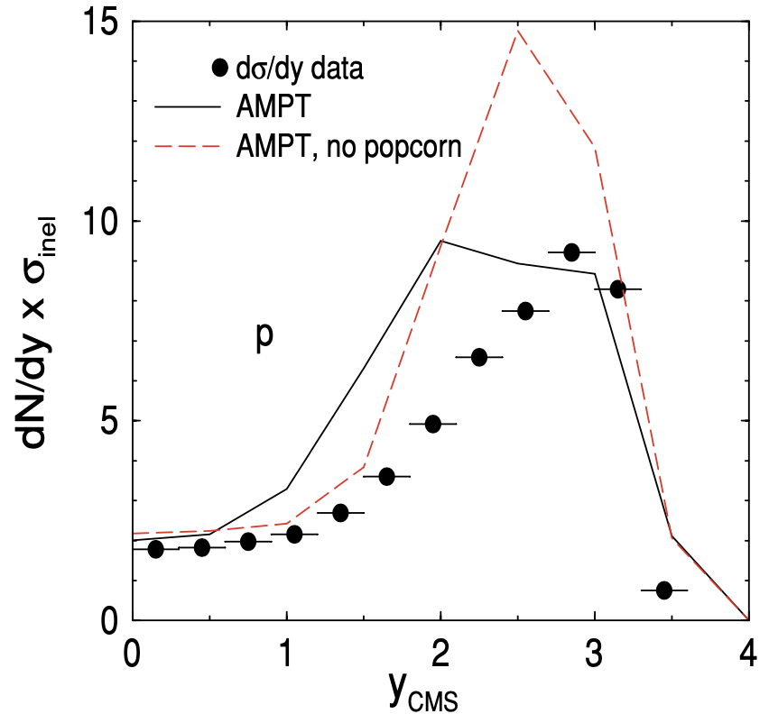
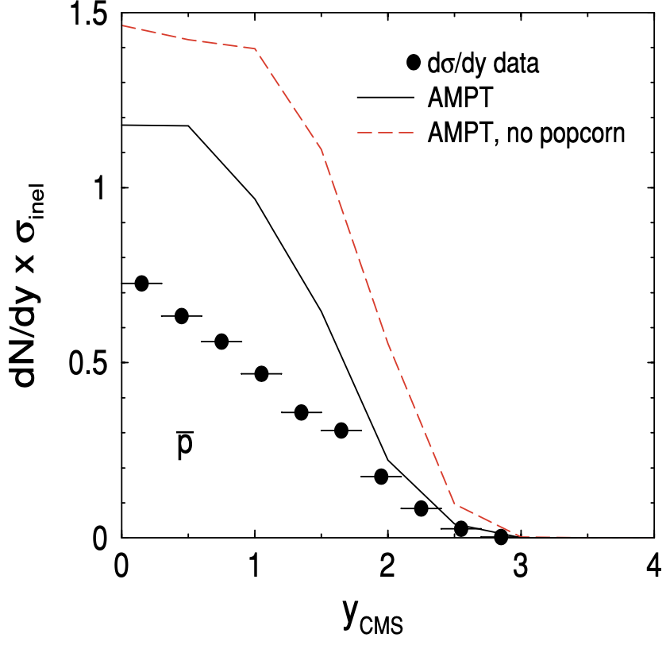
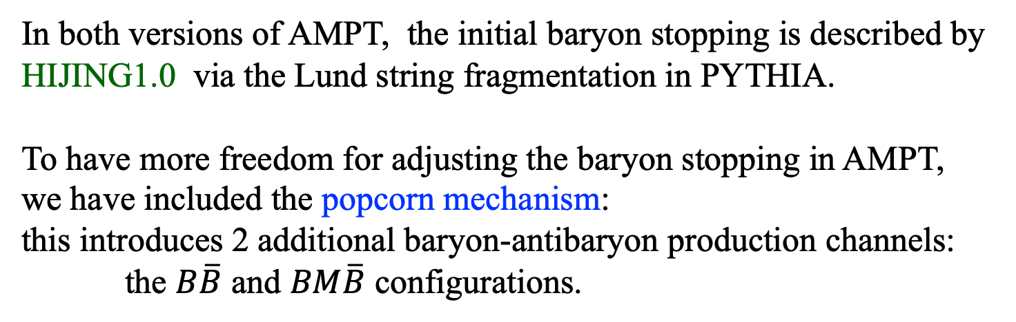
2) A baryon stopping puzzle
In both versions of AMPT, the initial baryon stopping is described by HIJING1.0 via the Lund string fragmentation in PYTHIA.
To have more freedom for adjusting the baryon stopping in AMPT,
we have included the popcorn mechanism:
this introduces 2 additional baryon-antibaryon production channels:
the $B\overline{B}$ and $BM\overline{B}$ configurations.
ZWL et al. PRC 72 (2005)
pp collisions at P_{lab} = 400 GeV/c
The popcorn mechanism can help but is often not enough.

Slide 22
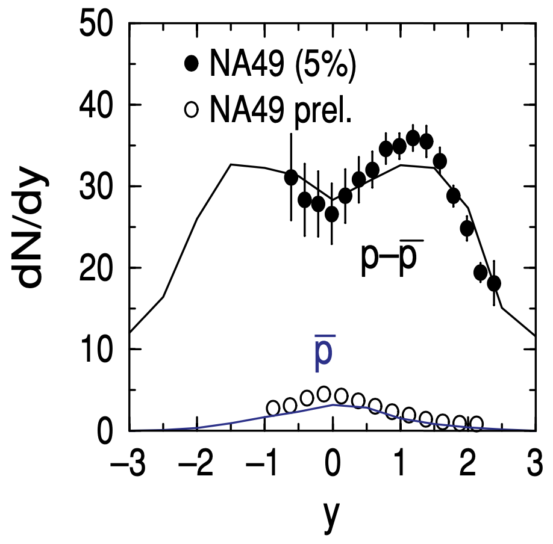
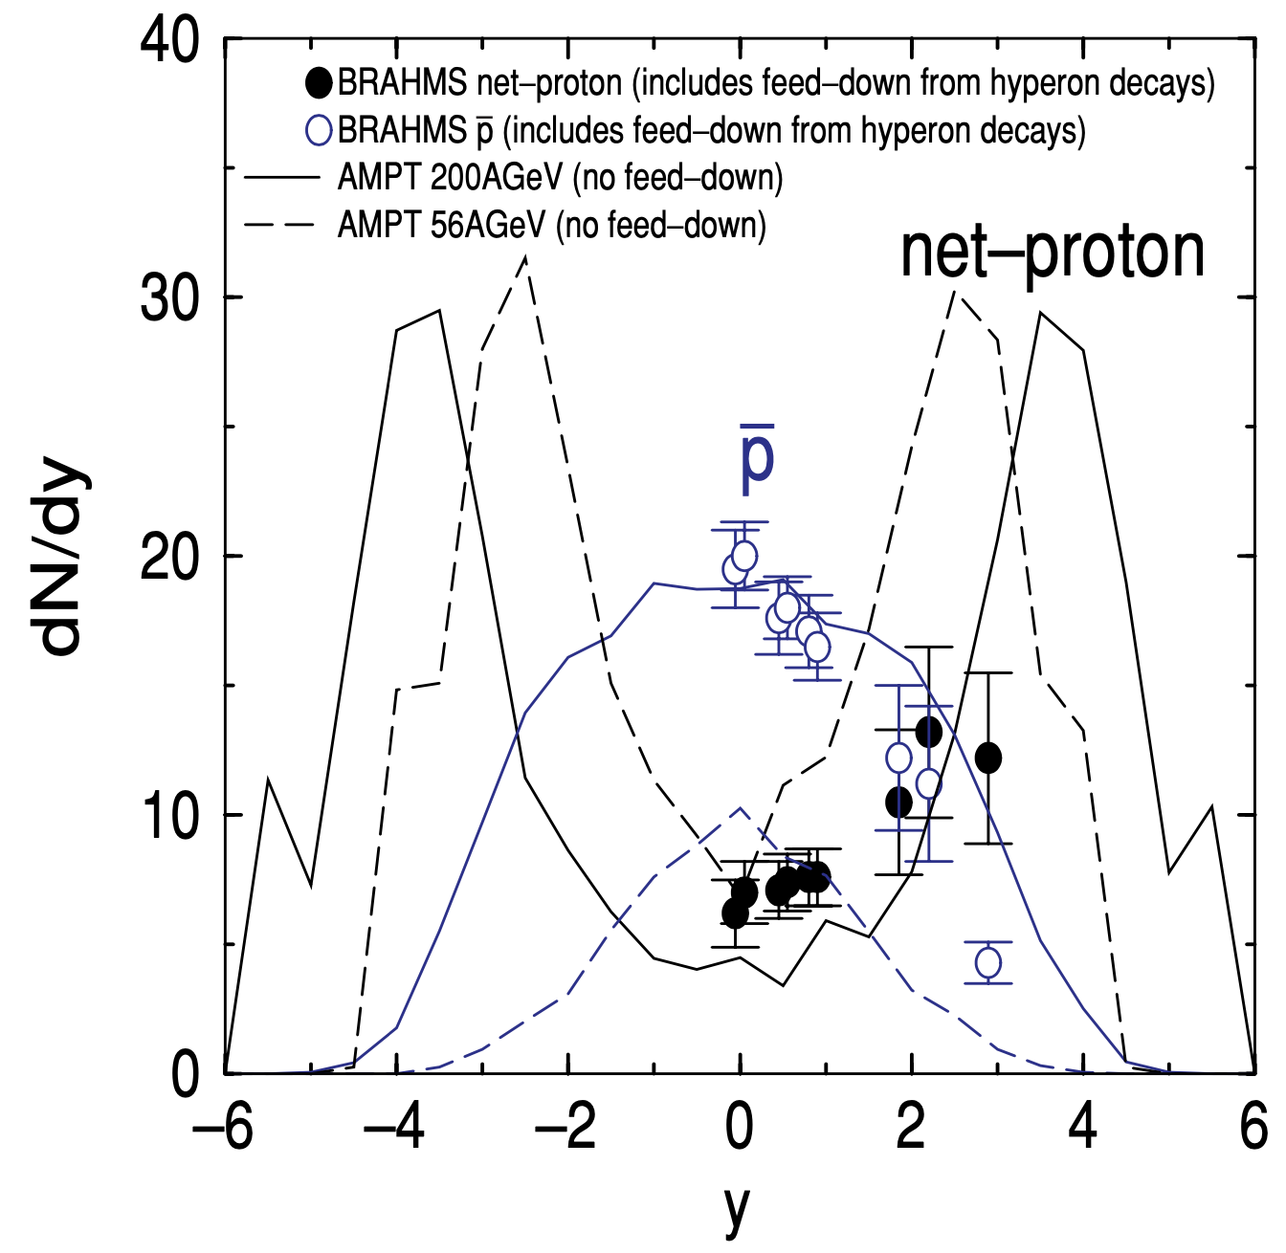
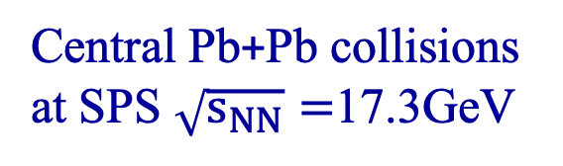
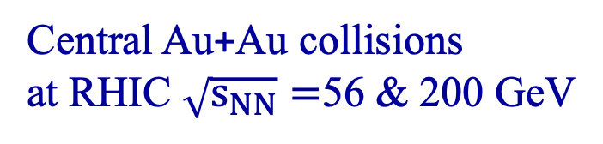
2) A baryon stopping puzzle
Baryon stopping in the AMPT-default model
for heavy ion collisions are often reasonable,
but good comparisons at large rapidities are limited.
Central Pb+Pb collisions
at SPS $\sqrt{s_{NN}}=$17.3GeV
Central Au+Au collisions
at RHIC $\sqrt{s_{NN}}=$56 & 200 GeV

Slide 23
2) A baryon stopping puzzle
Results from AMPT-String Melting
for minimum-bias Zr+Zr collisions:
B
⇢
B
Q
N_{B} or B: net-baryon number.
N_{Q} or Q: net-electric charge number.
ZWL at the Baryon Dynamics workshop, Jan 2024.
Notes:
AMPT version CC-v25t7fu: has charge conservation and “Moved (anti)baryon coalescence in front of meson coalescence” (similar to new coalescence)

Slide 24
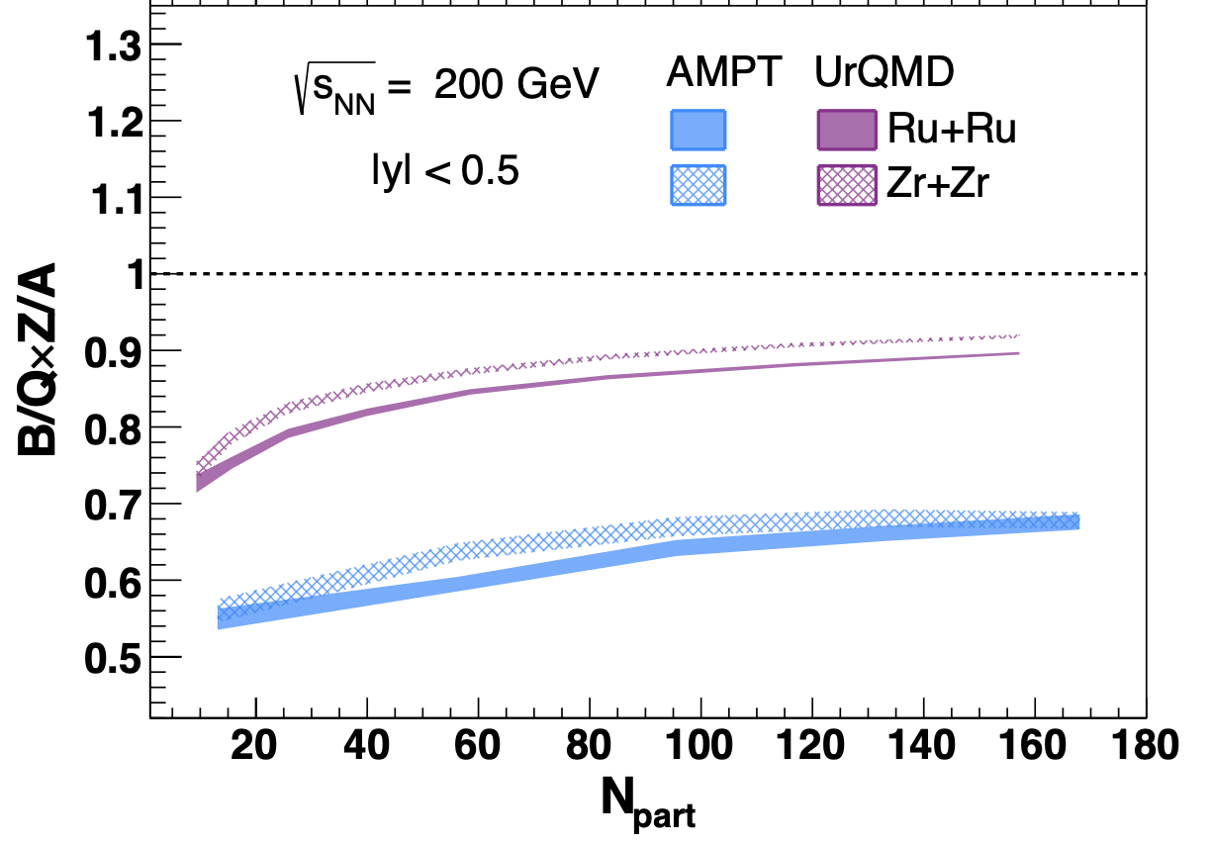
2) A baryon stopping puzzle
Ratio B/Q*Z/A has been proposed
to study baryon stopping.
Z. Xu, RBRC workshop on Physics Opportunities from isobar run (2022)
Both AMPT & UrQMD models give B/Q*Z/A < 1
at mid-rapidity, for every centrality of isobar collisions:
Lewis et al.,
EPJC 84 (2024)
More UrQMD results in
Lv et al., CPC 48 (2024)

Slide 25
2) A baryon stopping puzzle
Rongrong Ma at the Baryon Dynamics workshop, Jan 2024.
For isobar collisions ⁹⁶Ru relative to ⁹⁶Zr
at mid-rapidity:
models give
B/ΔQ*ΔZ/A < 1.
Preliminary data > 1.
The gluon junction, a Y-shaped gauge-invariant configuration
connecting three quarks, has long been suggested to be the carrier
of baryon number; in contrast to the usual picture (where q carries 1/3 B).
The gluon junction, as a new mechanism of baryon transport,
should increase B stopping relative to Q stopping.
Rossi and Veneziano, NPB123 (1977); Kharzeev, PLB378 (1996).
Lewis et al., EPJC 84 (2024)

Slide 26



3) Some results of p+O collisions from AMPT
for minimum bias collisions at these two energies:
RHIC
LHC
170 GeV & 9.9 TeV
$$\sqrt{s_{NN}} (GeV)$$
~15,400
~52,200,000
$$E_{LAB}(GeV)$$
~1.54 x10¹³
~5.22 x10¹⁶
$$E_{LAB}(eV)$$
“The Large High Altitude Air Shower Observatory (LHAASO)
can detect cosmic rays with energies ranging from
around 10¹¹ eV to 10¹⁷ eV (100 PeV).”

Slide 27
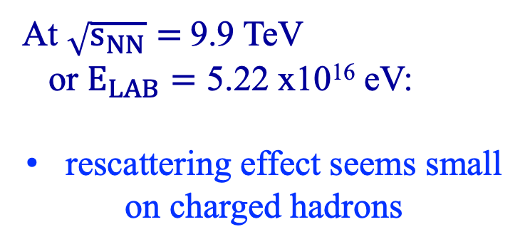
3) Some results of p+O collisions from AMPT
At $\sqrt{s_{NN}}=$9.9 TeV
or $E_{LAB}=\text{5.22 }\text{x}\text{1016}$ eV:
rescattering effect seems small
on charged hadrons
protons dominate at large y
around yBeam (18.5 here),
pions also contribute
there are even some pions
with y > yBeam

Slide 28
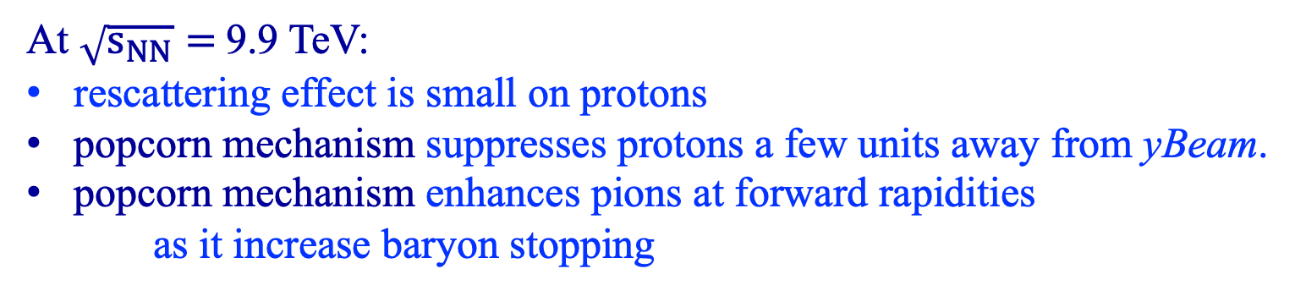
3) Some results of p+O collisions from AMPT
At $\sqrt{s_{NN}}=$9.9 TeV:
rescattering effect is small on protons
popcorn mechanism suppresses protons a few units away from yBeam.
popcorn mechanism enhances pions at forward rapidities
as it increase baryon stopping

Slide 29
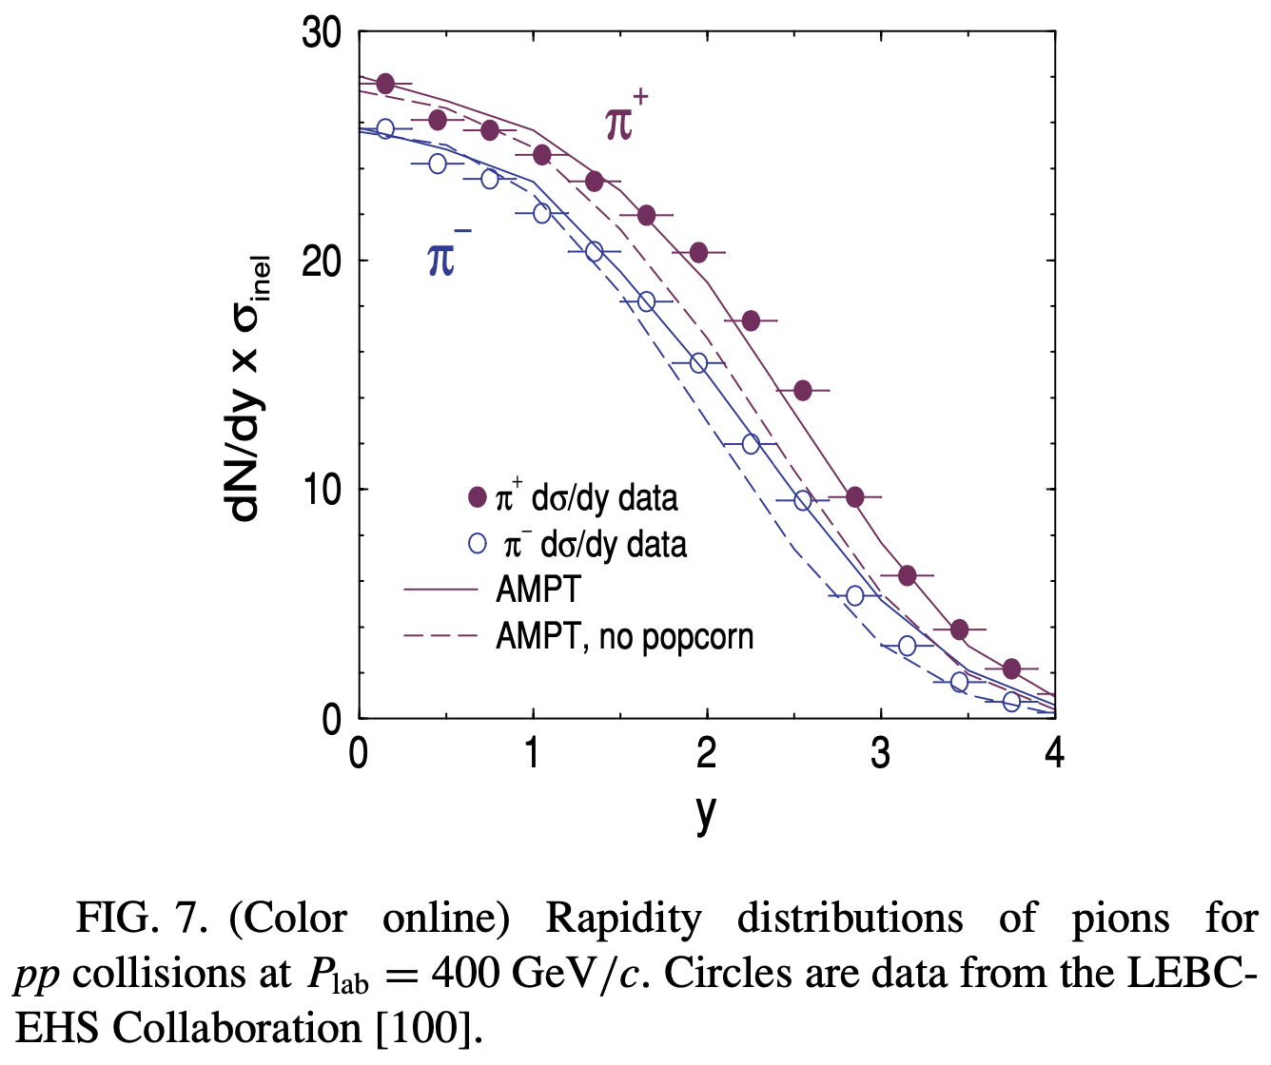
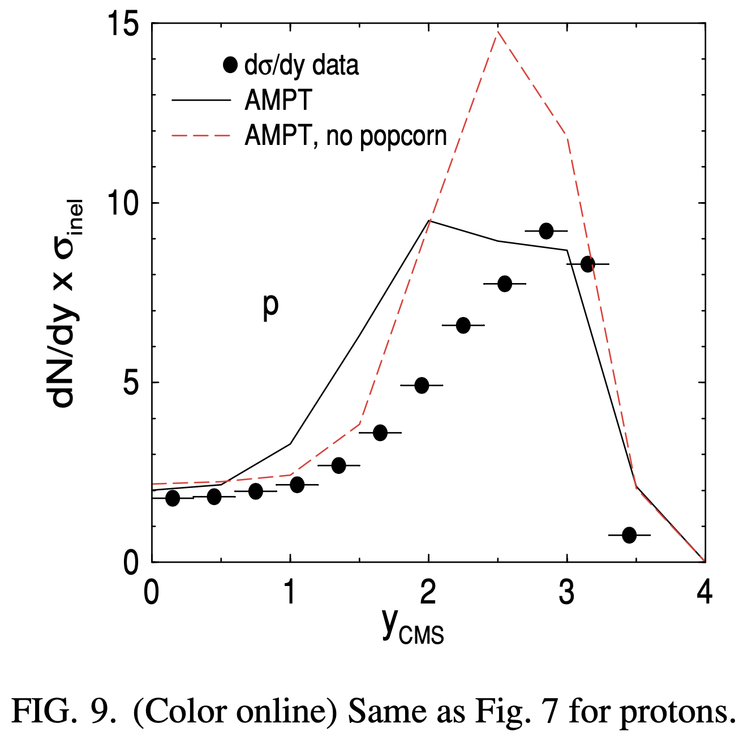
3) Some results of p+O collisions from AMPT
ZWL et al, PRC 72 (2005)
These features were observed before for p+p collisions at lower energies:
popcorn mechanism suppresses protons a few units below yBeam.
popcorn mechanism enhances pions at forward rapidities
as it increase baryon stopping

Slide 30
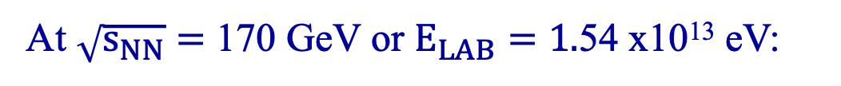
3) Some results of p+O collisions from AMPT
At $\sqrt{s_{NN}}=$ 170 GeV or $E_{LAB}=\text{1.}\text{5}\text{4} \text{x}\text{1013}$ eV:
Anti-protons
~ protons at mid-rapidity (yBeam/2)
much lower at forward rapidities
At forward rapidities:
protons dominate at large y
around yBeam (10.4 here),
pions also contribute
even some pions with y>yBeam

Slide 31
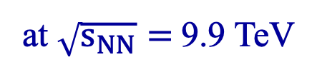
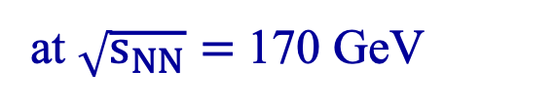
3) Some results of p+O collisions from AMPT
at $\sqrt{s_{NN}}=$9.9 TeV
At forward rapidities:
results are qualitatively similar
at the two energies;
consistent with limiting fragmentation
or scaling with (y-yBeam)
at $\sqrt{s_{NN}}=$ 170 GeV

Slide 32
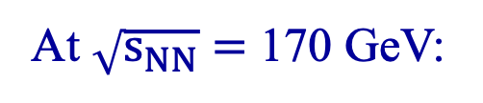
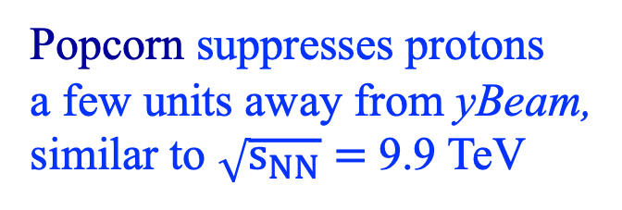
3) Some results of p+O collisions from AMPT
At $\sqrt{s_{NN}}=$ 170 GeV:
Similar proton results from:
calculations in CMS or LAB frame
AMPT-default & String Melting,
showing little effect from
parton or hadron rescatterings
Popcorn suppresses protons
a few units away from yBeam,
similar to $\sqrt{s_{NN}}=$9.9 TeV

Slide 33
4) Summary
The AMPT model provides a kinetic description of nuclear collisions
including p+p, p+A, and A+A collisions
Rescattering effect seems small for particle yields in p+O collisions
Baryon stopping due to the popcorn mechanism (or gluon junction)
typically suppresses protons but enhances pions are forward rapidities
Understanding baryon stopping remains a challenge.
With recent focus on high baryon density nuclear physics,
we expect better understanding of baryon stopping/transport
and better description of forward productions.

