Slide 1
Microscopic Parton and Hadron Transport Model PACIAE
Dai-Mei Zhou (Central China Normal University)
On behalf of PACIAE group:
An-ke Lei, Qiang Wang (CCNU);
Yu-liang Yan, Ben-hao Sa (China institute of atomic energy);
Zhi-lei She ( Wuhan Textile University);
Hua Zheng, Wen-chao Zhang (Shaanxi Normal University)
Comput. Phys. Commun. 183 (2012) 333-346
Phys. Rev. C 108 (2023) 6, 064909
Comput. Phys. Commun. 310 (2025) 109520
March 20, 2025, Hongkong workshop

Slide 2
OUTLINE
I. PACIAE history brief review
II. p-p (h-h) collision in PACIAE
III. A-A collision in PACIAE
IV. Recent results
1. Ordinary observables
2. Heavy flavor production
3. Exotic hadron production
V. Summary & outlook

Slide 3
PACIAE, a parton and hadron cascade model to describe the high-energy
lepton-lepton, lepton-hardon, lepton-nucleus, hadron-hadron, hardon-nucleus and nucleus-nucleus collisions, based on PYTHIA

Slide 4
I. PACIAE history brief review
LUCIAE
Firecracker
FRITIOF
CPC 73 (1992) 71
~1992
Final hadronic rescattering
PRC 48 (1993) 2995
Z. Phys. C 70 (1996) 499
Final hadronic rescattering
JETSET 7.4
PYTHIA 5.7
CPC 82 (1994) 74
~1996
JPCIAE
PRC 59 (1999) 2728
extending to A-A
Partonic & Hadronic rescsttering
~2006
PACIAE1.0
PYTHIA 6
CPC 135
(2001) 238
extending to A-A
PRC 75 (2007) 054912
Several new physics added
~2023
PACIAE 3.0
PRC 108 (2023) 064909
CPC 178 (2008) 852
CPC 191 (2015) 159
~2024
PACIAE 4.0
PYTHIA 8
CPC 310 (2025) 109520
SciPost Phys.Codeb. 2022 (2022) 8

Slide 5
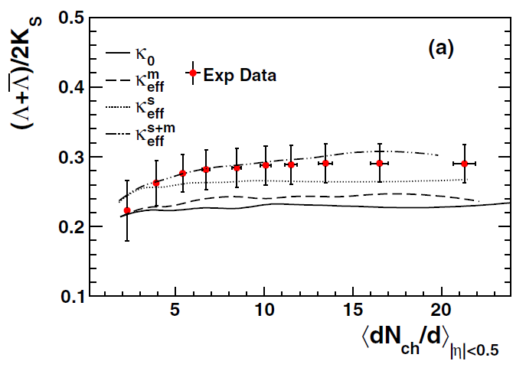
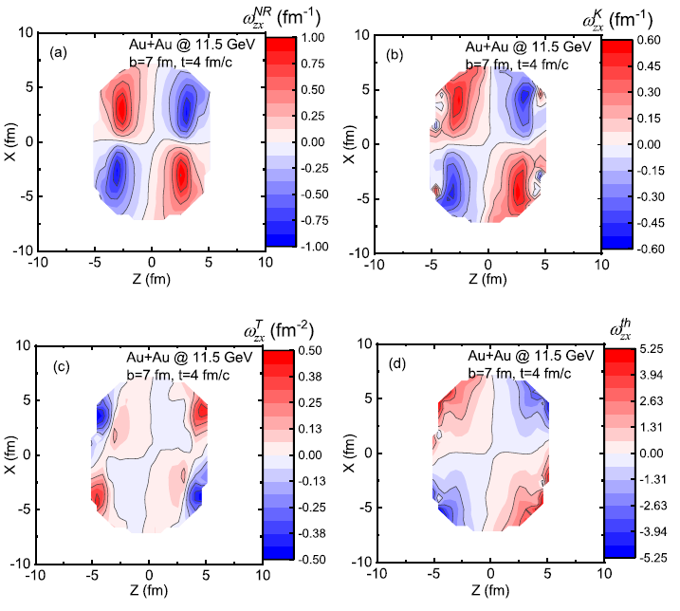
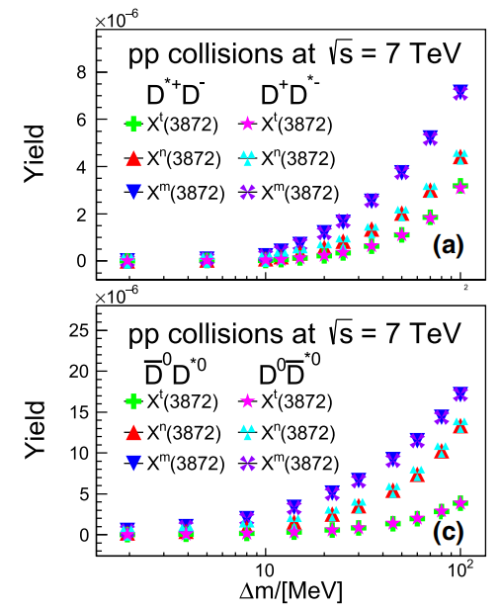
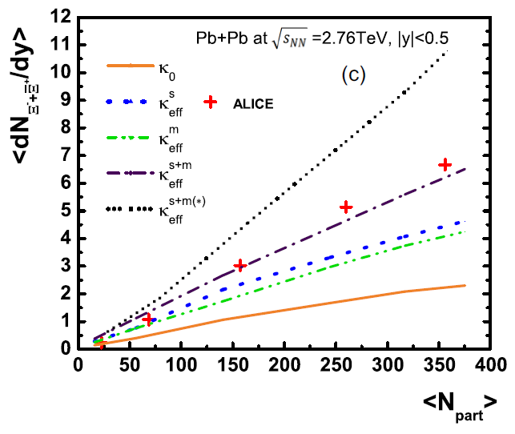
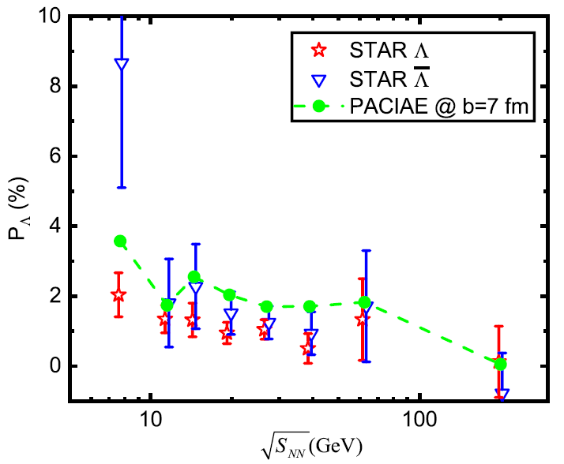
Examples of past results
Strangeness suppression
Vorticity and Λ polarization
Exotic states X(3872)
PRC 102 (2020) 044903
PRC 104 (2021) 054903
Eur. Phys. J. C (2021) 81:784

Slide 6
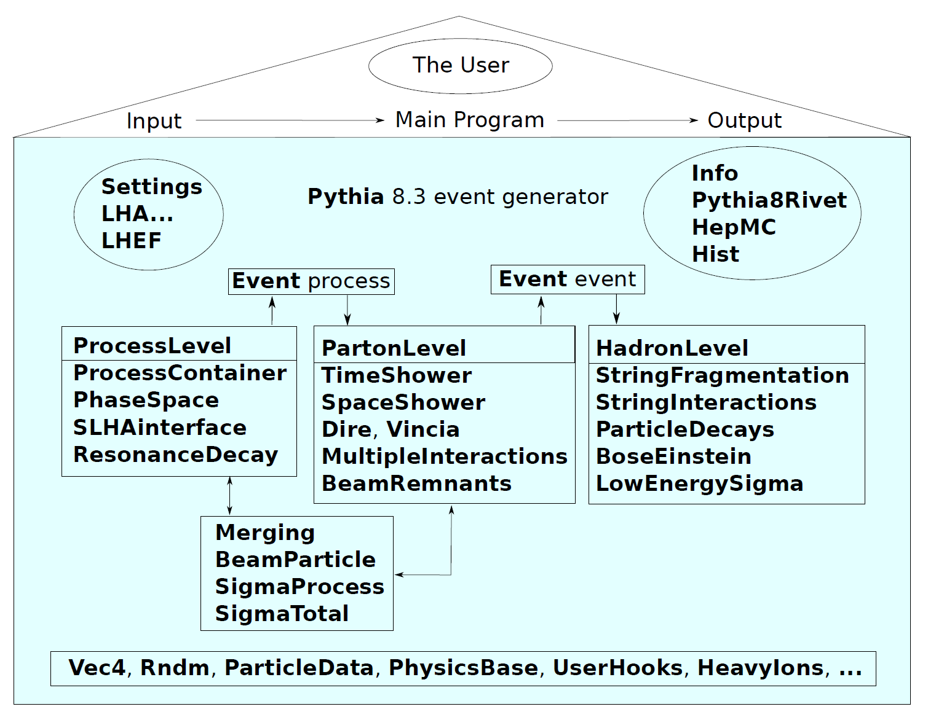
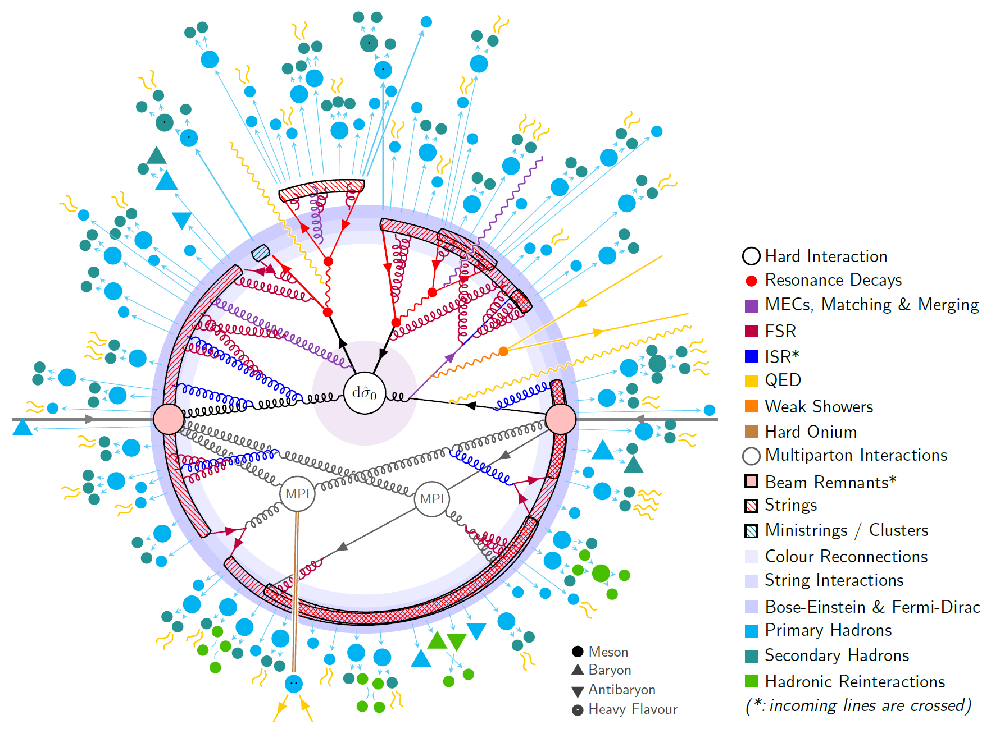
PYTHIA 8 structure and $pp→t\overline{t}$ event
PYTHIA 8 (C++) with more physics and features beyond PYTHIA 6 (Fortran 77).
SciPost Phys.Codeb. 2022 (2022) 8
Simplified picture of the PYTHIA 8.3 structure
Schematic structure of a $pp→t\overline{t}$ event

Slide 7
Why interfacing to PYTHIA 8 ?
Most of physics are redealed in PYTHIA 8 referring to PYTHIA 6,
such as:
（1）Color Reconnection (CR)
（2）Multiparton Interactions (MPI)
（3）Better handling of the beam remnant
...

Slide 8
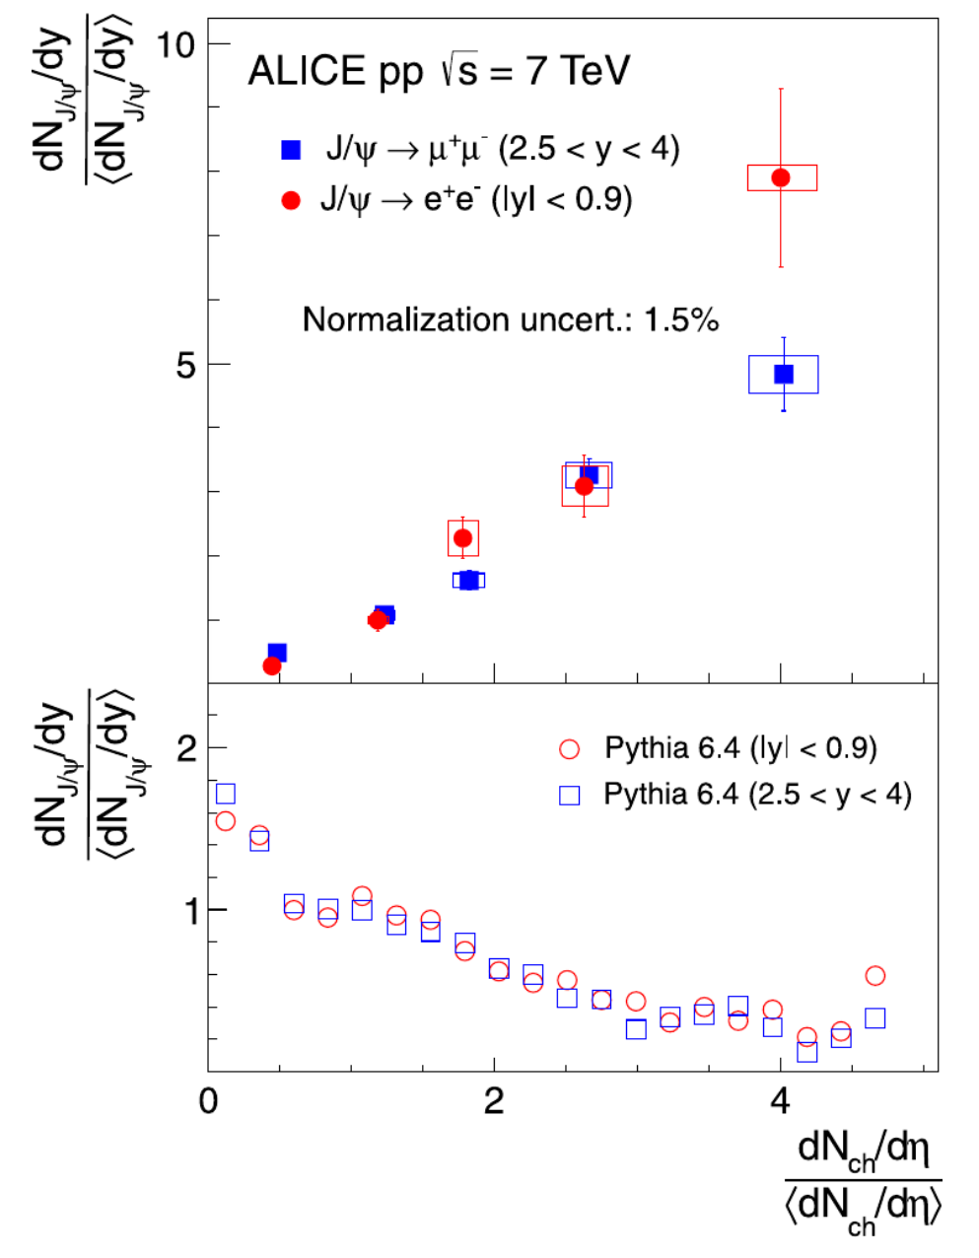
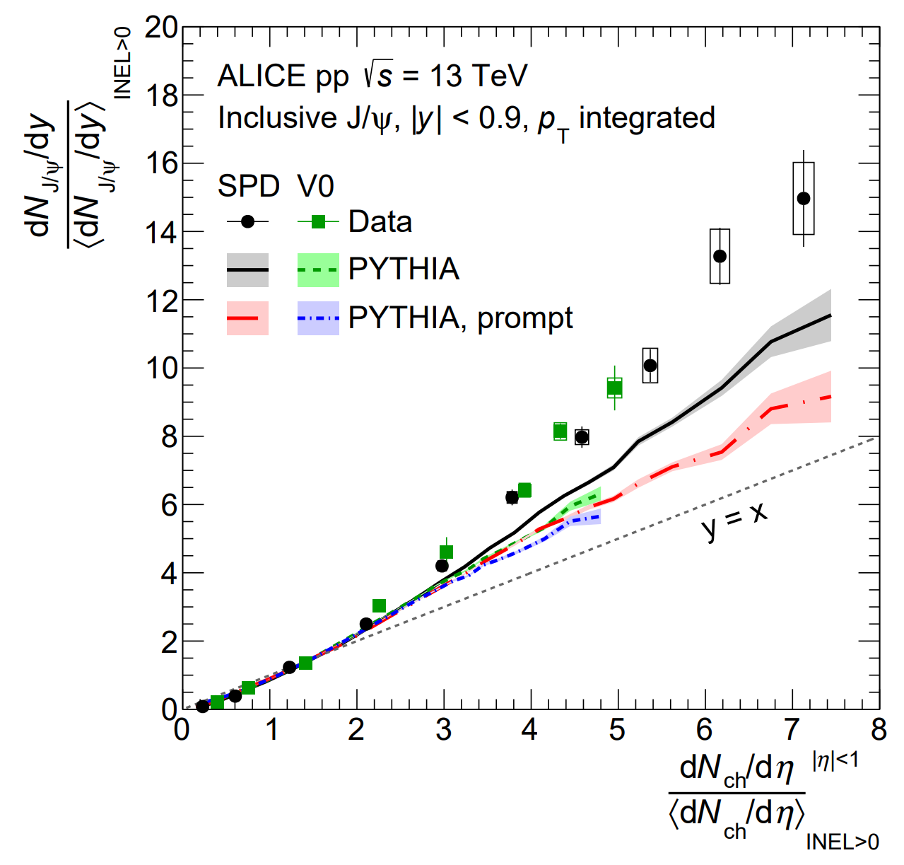
Why interfacing to PYTHIA 8 ?
Expermental results favor PYTHIA 8 : Multiparton interactions (MPI) .
8.2
PLB 712 (2012) 165-175
PLB 810 (2020) 135758
×

PYTHIA 6
PYTHIA 8

Slide 9
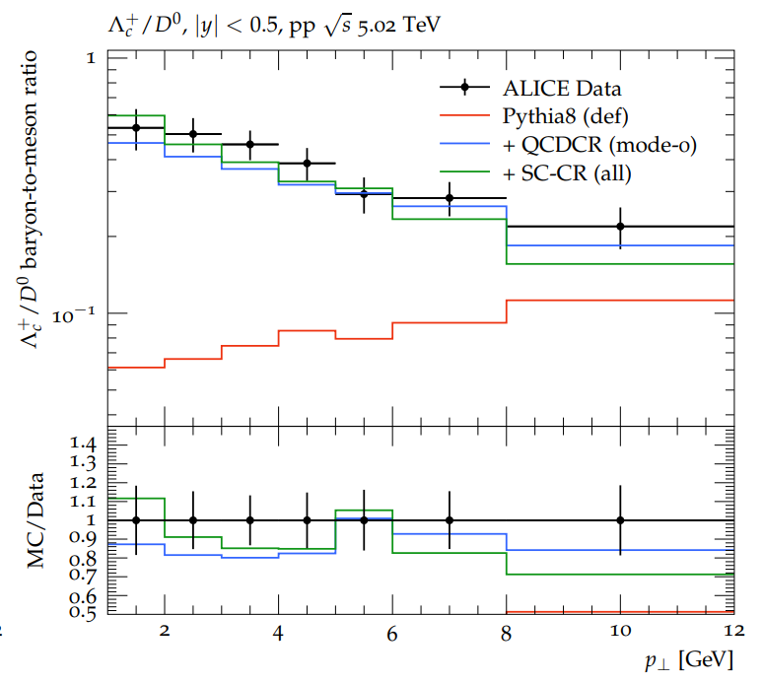
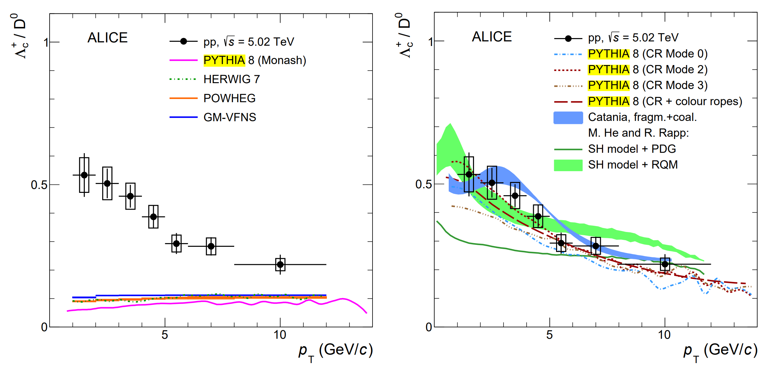
Why interfacing to PYTHIA 8 ?
Expermental results favor PYTHIA 8 : Color reconnection (CR) .
PRL 127 (2021) 202301
PRC 104 (2021) 054905

Eur. Phys. J. C 84 (2024) 3, 231
×
PRL 127 (2021) 20, 202301

Slide 10
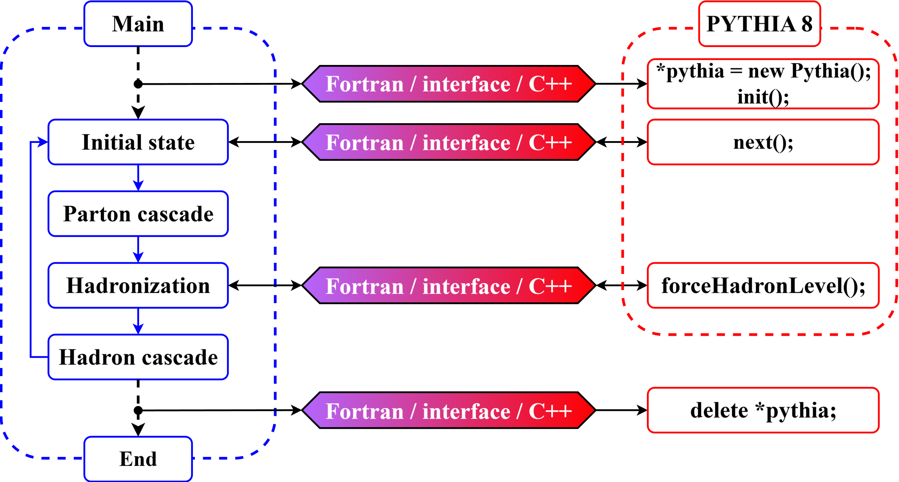
Why interfacing to PYTHIA 8 ?
Interfacing structure
(C++)
The grogram flow of PACIAE 4.0
CPC 310 (2025) 109520
(Fortan-C++)
Open-source: https://github.com/ArcsaberHep/PACIAE4

Slide 11
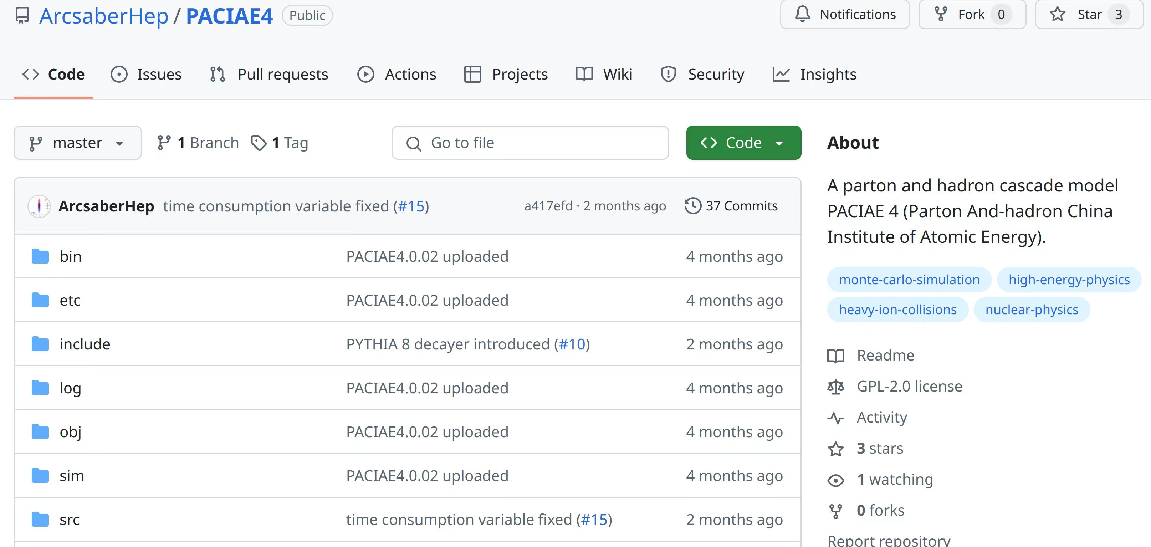
Open-source: https://github.com/ArcsaberHep/PACIAE4

Slide 12
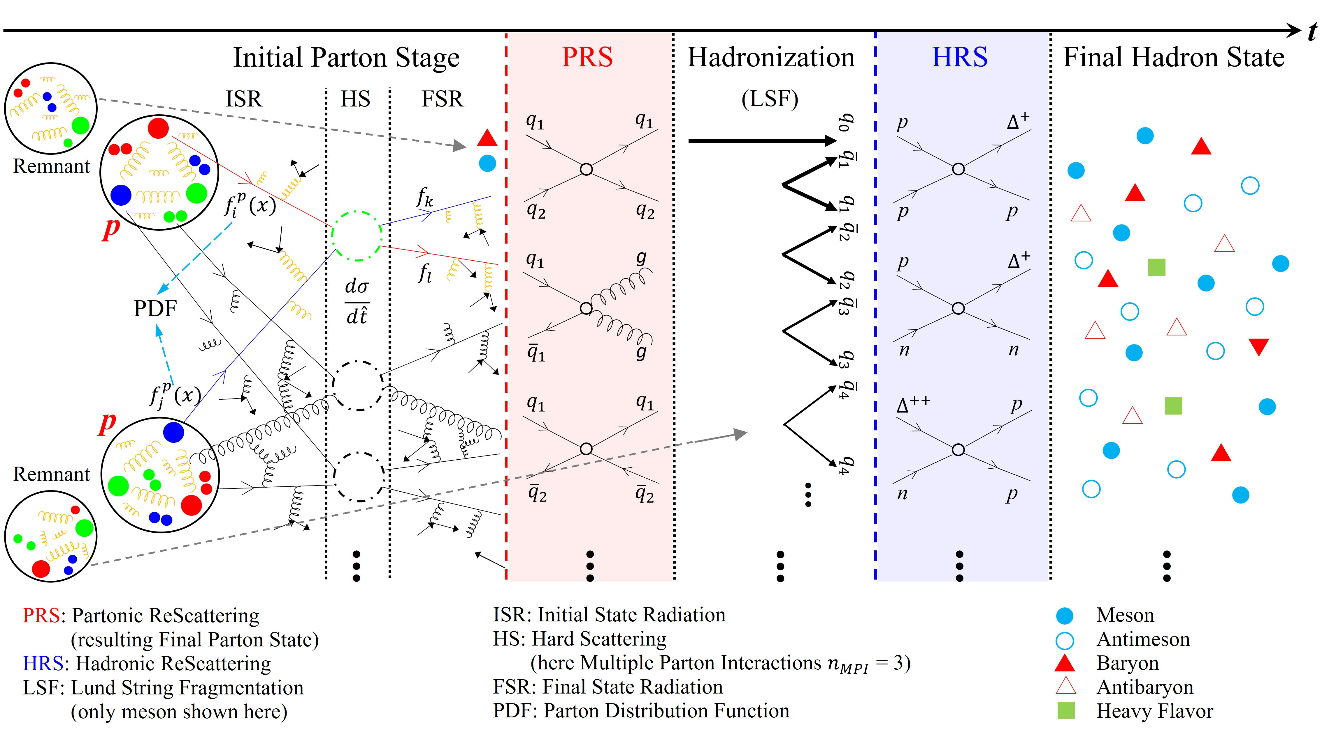
II. p-p(h-h) collision in PACIAE
partonic initialization
partonic rescatterring
hadronization
hadronic rescatterring

Slide 13
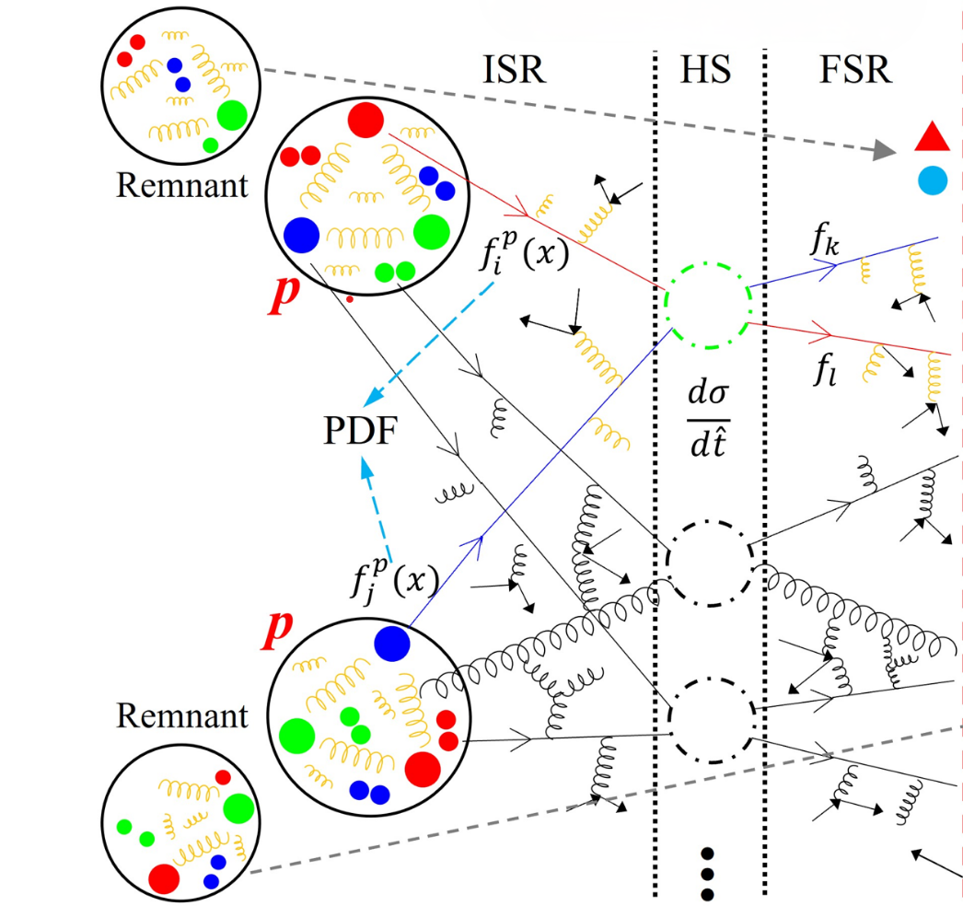
A. Partonic initialization：
Hard scattering partons (hard)
Initial & final state radiations
Multiparton interactions (MPI)
Beam remnant (Underlying Event)
PYTHIA
Call PYTHIA with string fragmentation switched-off

Slide 14
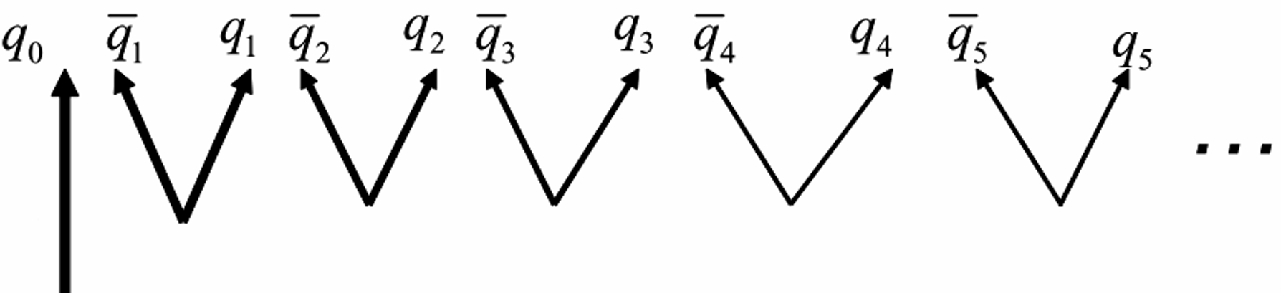
Another mode of initial partonic state
Pure quark/anti-quark initial state
(A). Gluon splitting: $g→q\overline{q}$
Altarelli–Parisi form:
(B). Quark deexcitation: $q_{0}→q_{1}{\overline{q}}_{1}+q_{0}$
Lund-like form:

Slide 15
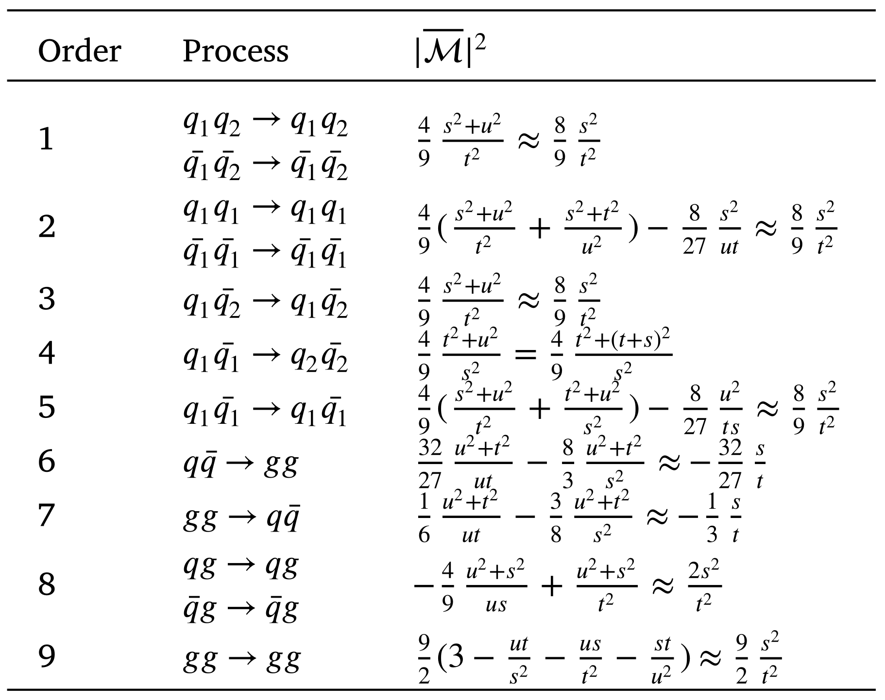
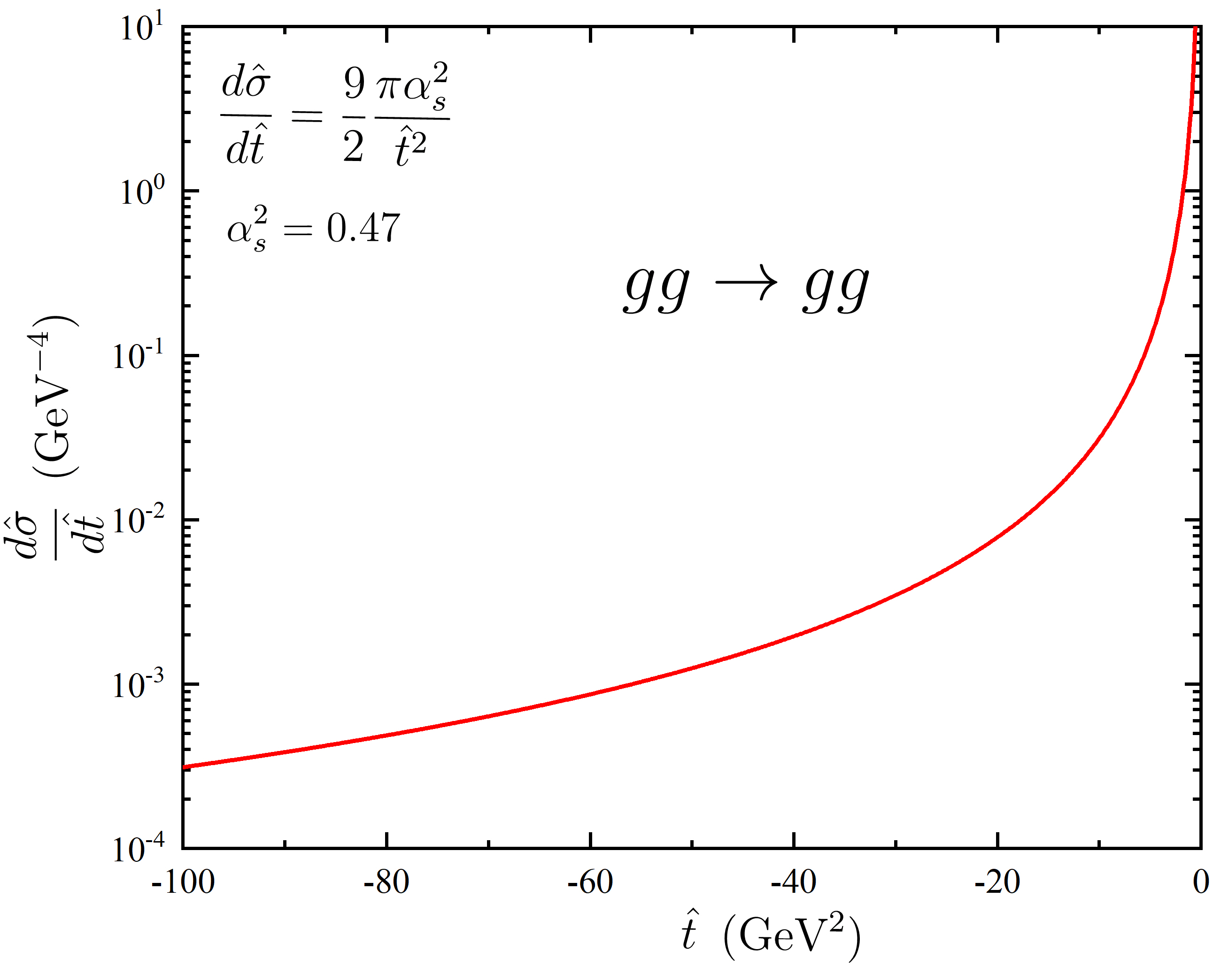
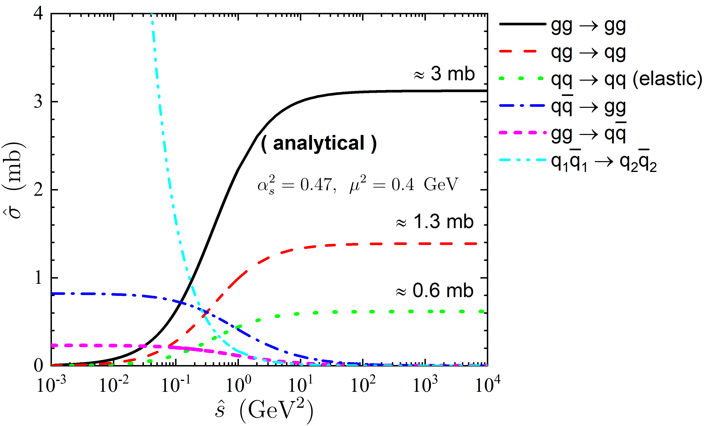
B. Parton cascade: rescattering
1. Binary parton-parton scatterings
1) LO-pQCD cross sections:
with the small angle approximation.
CPC 310 (2025) 109520

Slide 16
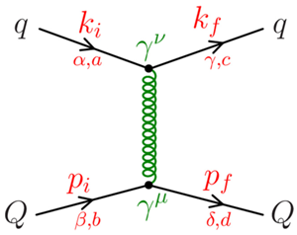
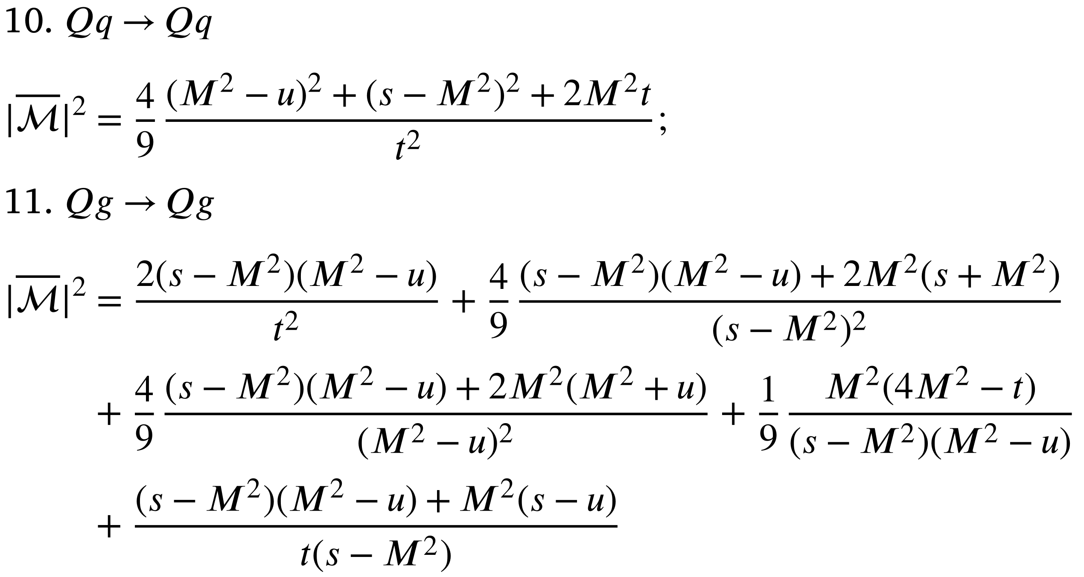
B. Parton cascade: rescattering
2) Mass correction to heavy quarks:
Fig: PRC 89 (2014) 054901

Slide 17
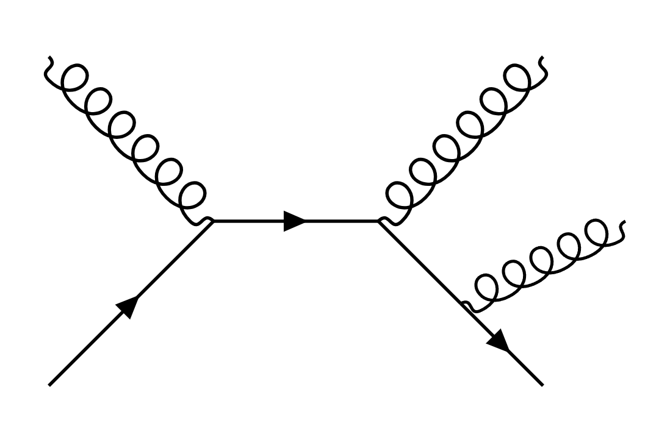
B. Parton cascade: medium-induced radiation
The medium-induced radiation using the time-like shower approach.
The simple collinear parton splitting is employed.
Assume the outging final states from a parton-parton rescattering would radiate one or more partons with QCD branchings:
$$q→qg, g→gg, g→q\overline{q}$$
recoiler
No-branching probability is determined
by Sudakov factor:
shower
radiator

Slide 18
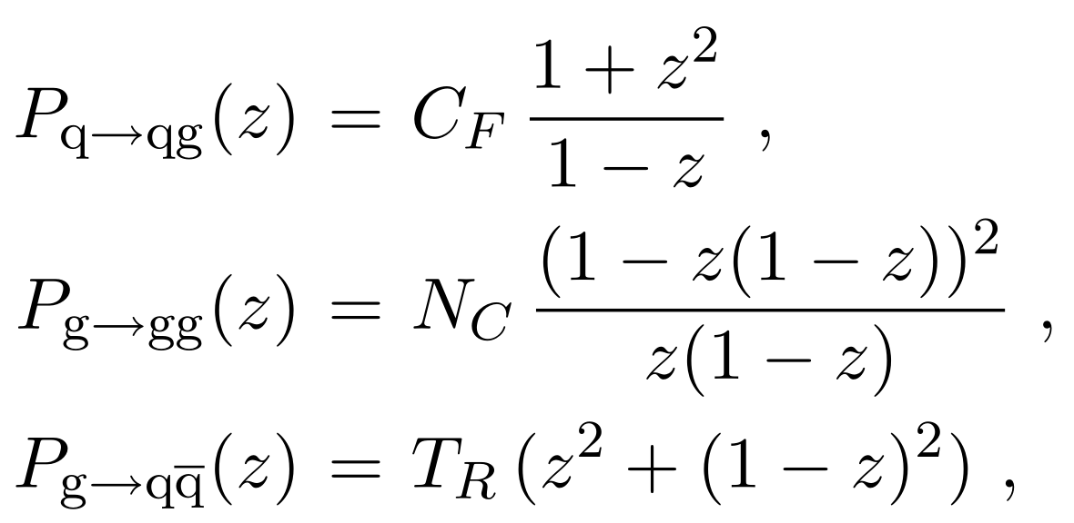
B. Parton cascade: medium-induced radiation
Splitting kernels, Altarelli–Parisi splitting functions:
Dead-cone effect？
Landau–Pomeranchuk–Migdal (LPM) effect？

Slide 19
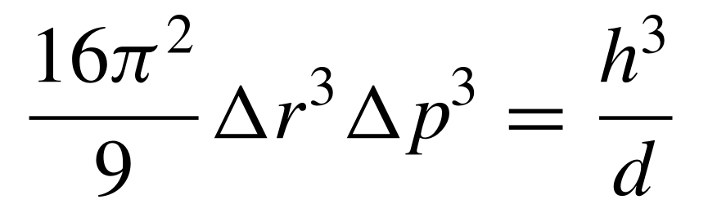
C. Hadronization
1. String Fragmentation model (SFM)
1) Recover strings and diquarks & junctions
2) Fragmented by PYTHIA 8
Lund fragmentation function:
2. Coalescence model (Coal)
1) Three $q\left(\overline{q}\right)$ are combined into a baryon (anti-baryon), $q\overline{q}$ to a meson randomly.
2) Only primary mesons (pseudoscalar spin-0 and vector spin-1) and
baryons (octet spin-1/2 and decuplet spin-3/2).
3) The phase-space constraint is optional:

Slide 20
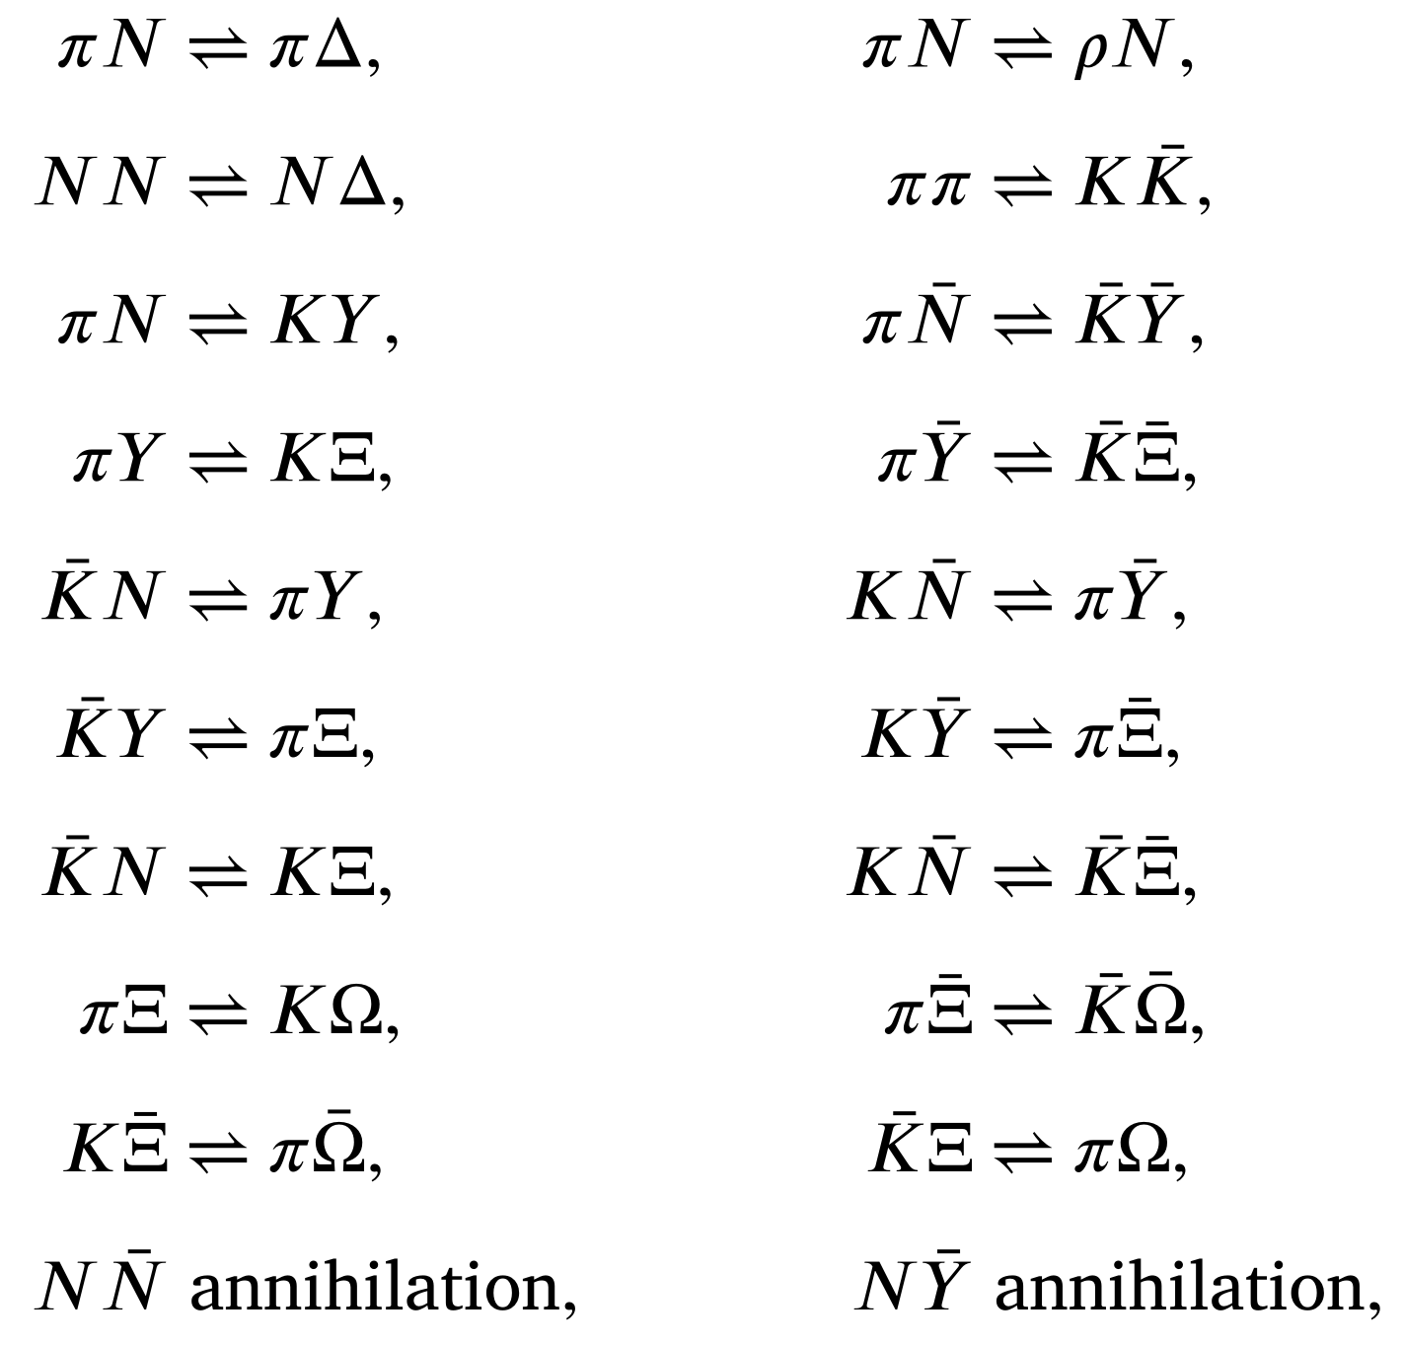
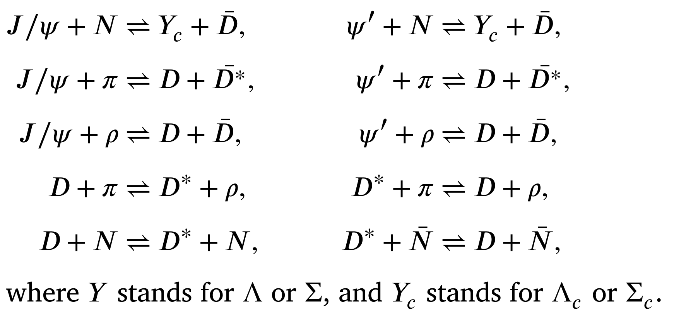
D. Hadron cascade: rescattering & decay
1. $2→2$ hadron-hadron rescatterings
Cross sections:( Additive Quark Model):
π, K, p, n, ρ(ω), Δ, Λ, Σ, Ξ, Ω, J/ψ, D
$$σ^{AB}=σ^{NN}C_{AB}$$
$$C_{AB}=\frac{n_{eff}^{A}n_{eff}^{B}}{n_{eff}^{N_{1}}n_{eff}^{N_{2}}}$$
$$n_{eff}=n_{d}+n_{u}+{0.6 n}_{s}+0.2n_{c}+0.07n_{b}$$
$n_{eff}:$effective valence quark number

Slide 21
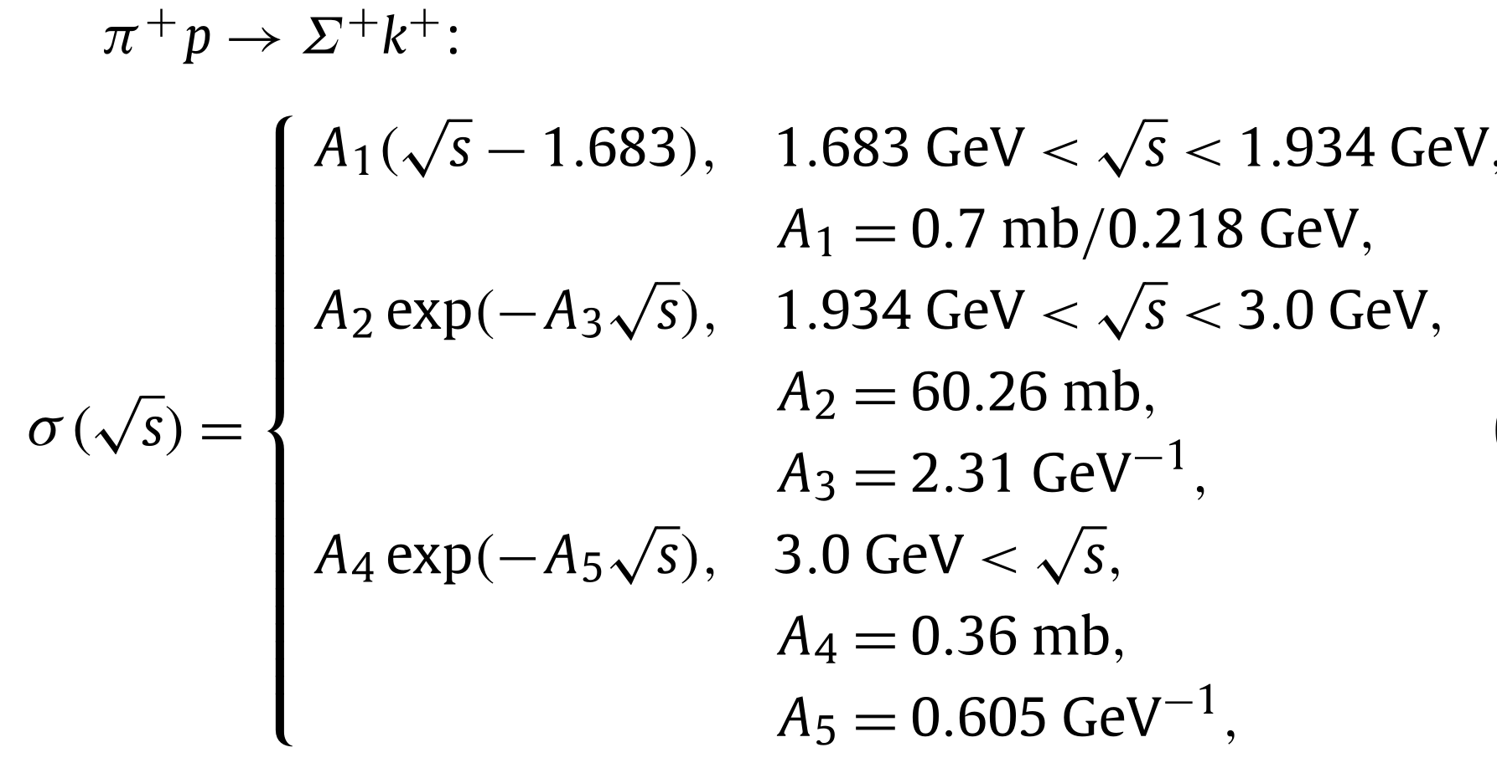
D. Hadron cascade: rescattering & decay
Cross sections:
1) Experimental inspired parameterizations
of total cross section are adopted
2) Some constant assumptions
3) Additive Quark Model (AQM):
$n_{eff}:$effective valence quark number
2. Decay of unstable particle: PYTHIA 8 decayer
By default, only the particles with the mean proper lifetime greater
than $1 \text{cm}\text{/}c={10}^{13}\text{fm}\text{/}c$ are recognized as stable.

Slide 22
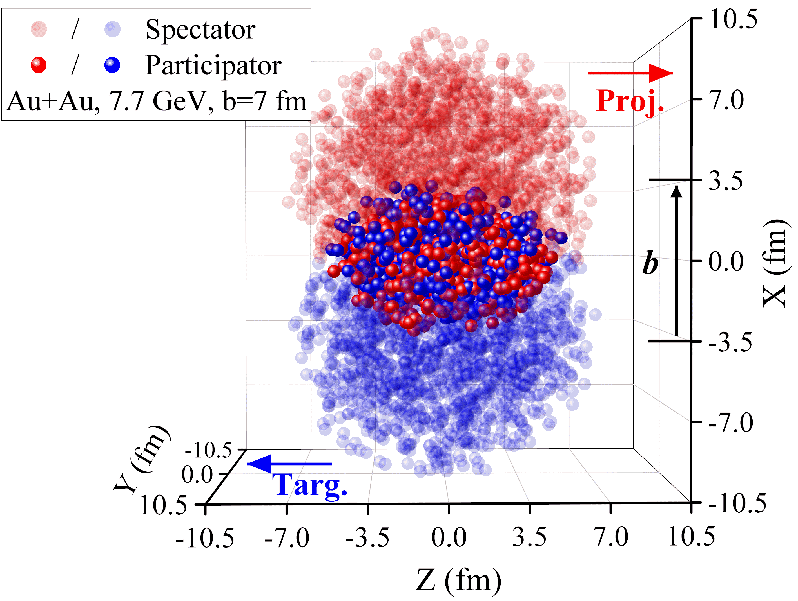
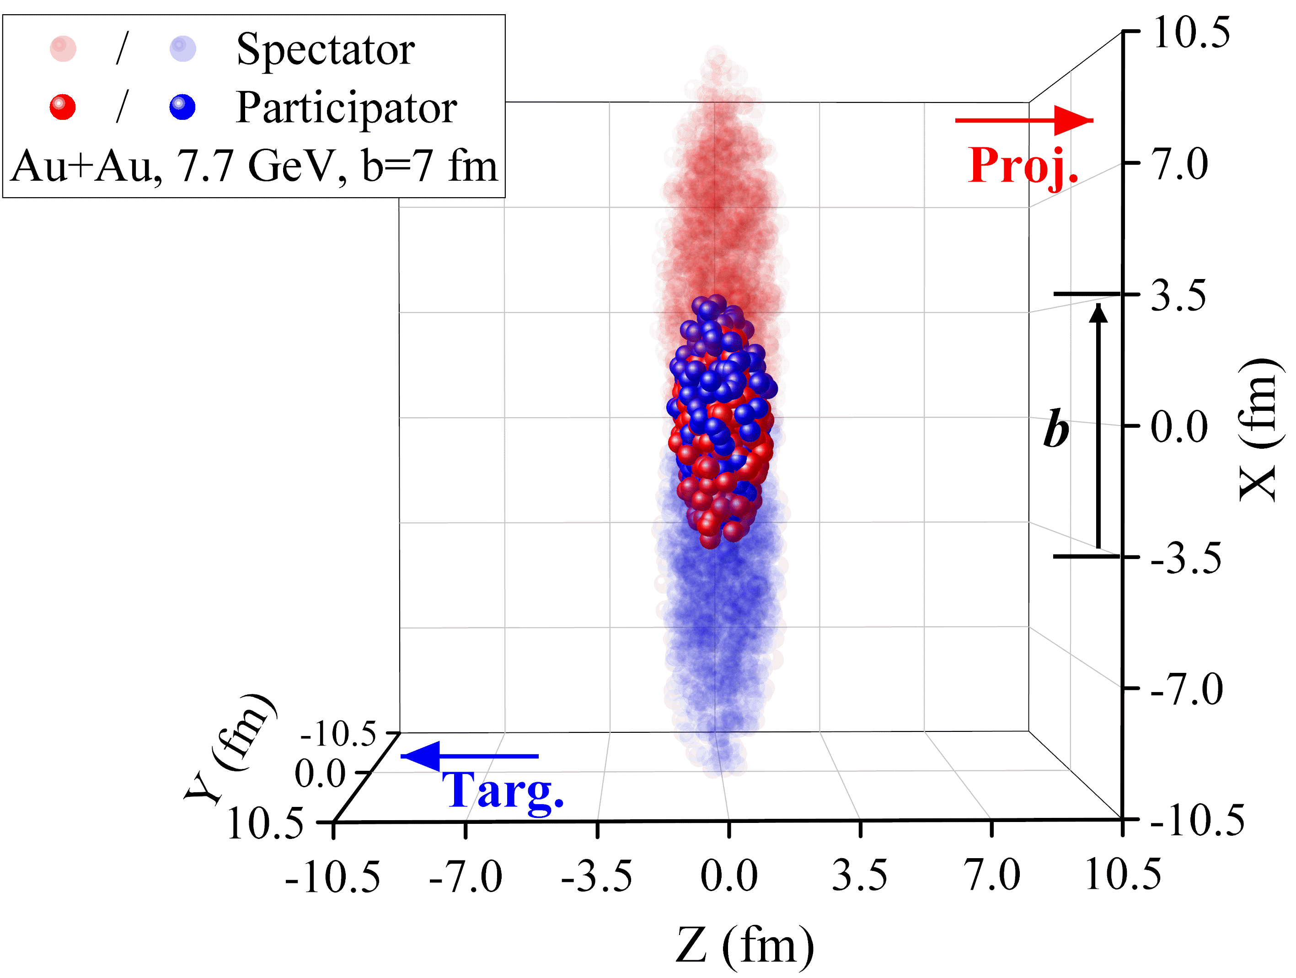
III. A-A(B) collision in PACIAE
A nucleus-nucleus (A A) collision is the cumulative superposition of NN (hh) collisions. That means: one has to update nucleon (N) or hardon (h) list & the collision time list after each N-N (h-h) collision, detailed as follows:
(1) Initial nucleon spatial distribution
One first distributes the nucleons in its own nucleus sphere by the Woods-Saxon distribution (for radius $r$)
The uniform distribution in 4$π$ solid angle (for direction)
The time origin is set at the moment of two centers of the projectile and target spheres have the same coordinates of z = 0

Slide 23
III. A-A(B) collision in PACIAE
(2) Initial nucleon mumentum distribution
The initial momentum of each nucleon in the projectile nucleus (Proj.)
$p_{x}=p_{y}=0, p_{z}=p_{beam}$
in the target nucleus (Targ.)
$p_{x}=p_{y}=0, p_{z}=−p_{beam}$
Hadron list
particle order
four-coordinate and four-momentum
hadron 1
hadron 2
hadron 3
$$x,y,z,t; p_{x},p_{y},p_{z},E_{1}$$
$x,y,z,t; p_{x},p_{y},p_{z},E_{2}$
$$x,y,z,t; p_{x},p_{y},p_{z},E_{3}$$
...
...

Slide 24
A-A collision in PACIAE
Collision time list
We assume the particle trajectory in the velocity field of a nuclear collision system is a straight line, calculate the collision time $t_{ij}$
nn (hh) collision happens if their least approaching distance
collision order
collision pair
collision time
1
2
3
hadron i and j hadron k and l
hadron m and n
col. time for ij
col. time for kl
col. time for mn
...
...
...

Slide 25
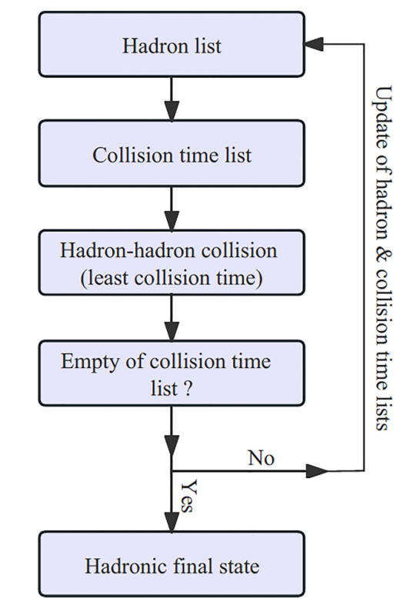
A-A collision in PACIAE
(3) Executing a NN (hh) collision with least
collision time
(4) Update of hadron list
(5) Update of hadron collision time list
(6) Repeat the loop composed of (3), (4), & (5) until the empty of the collision time list.

Slide 26
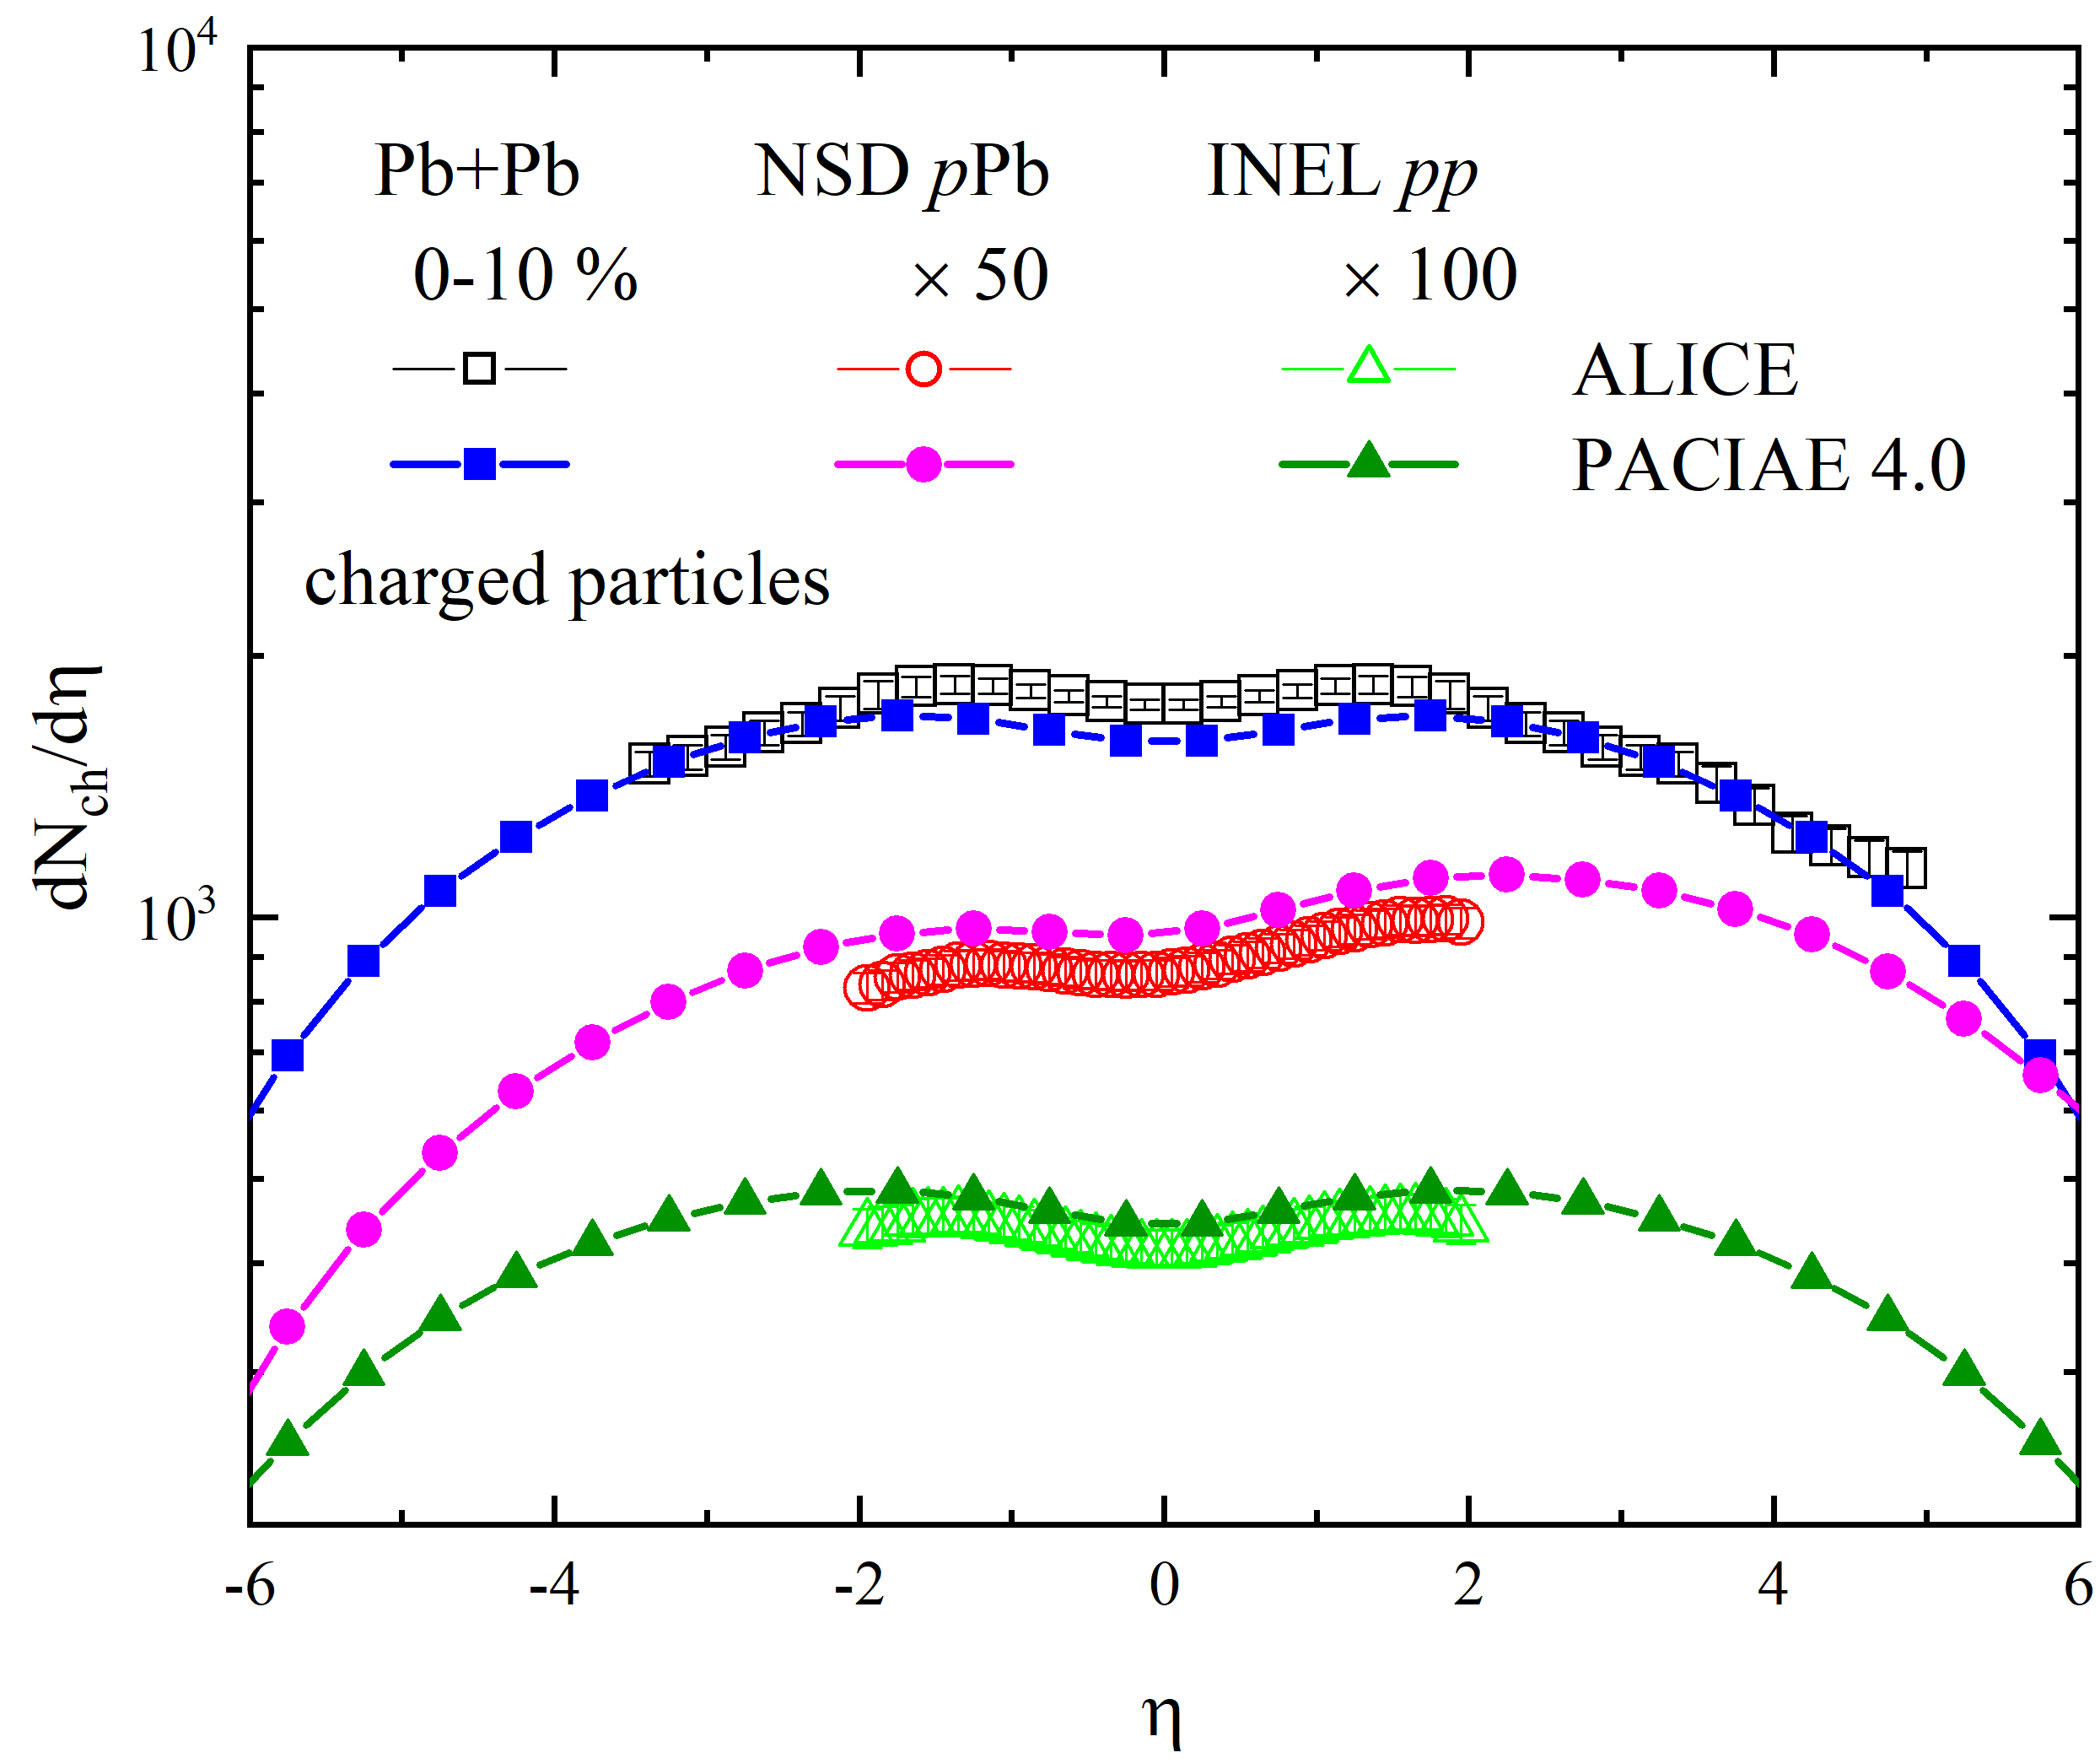
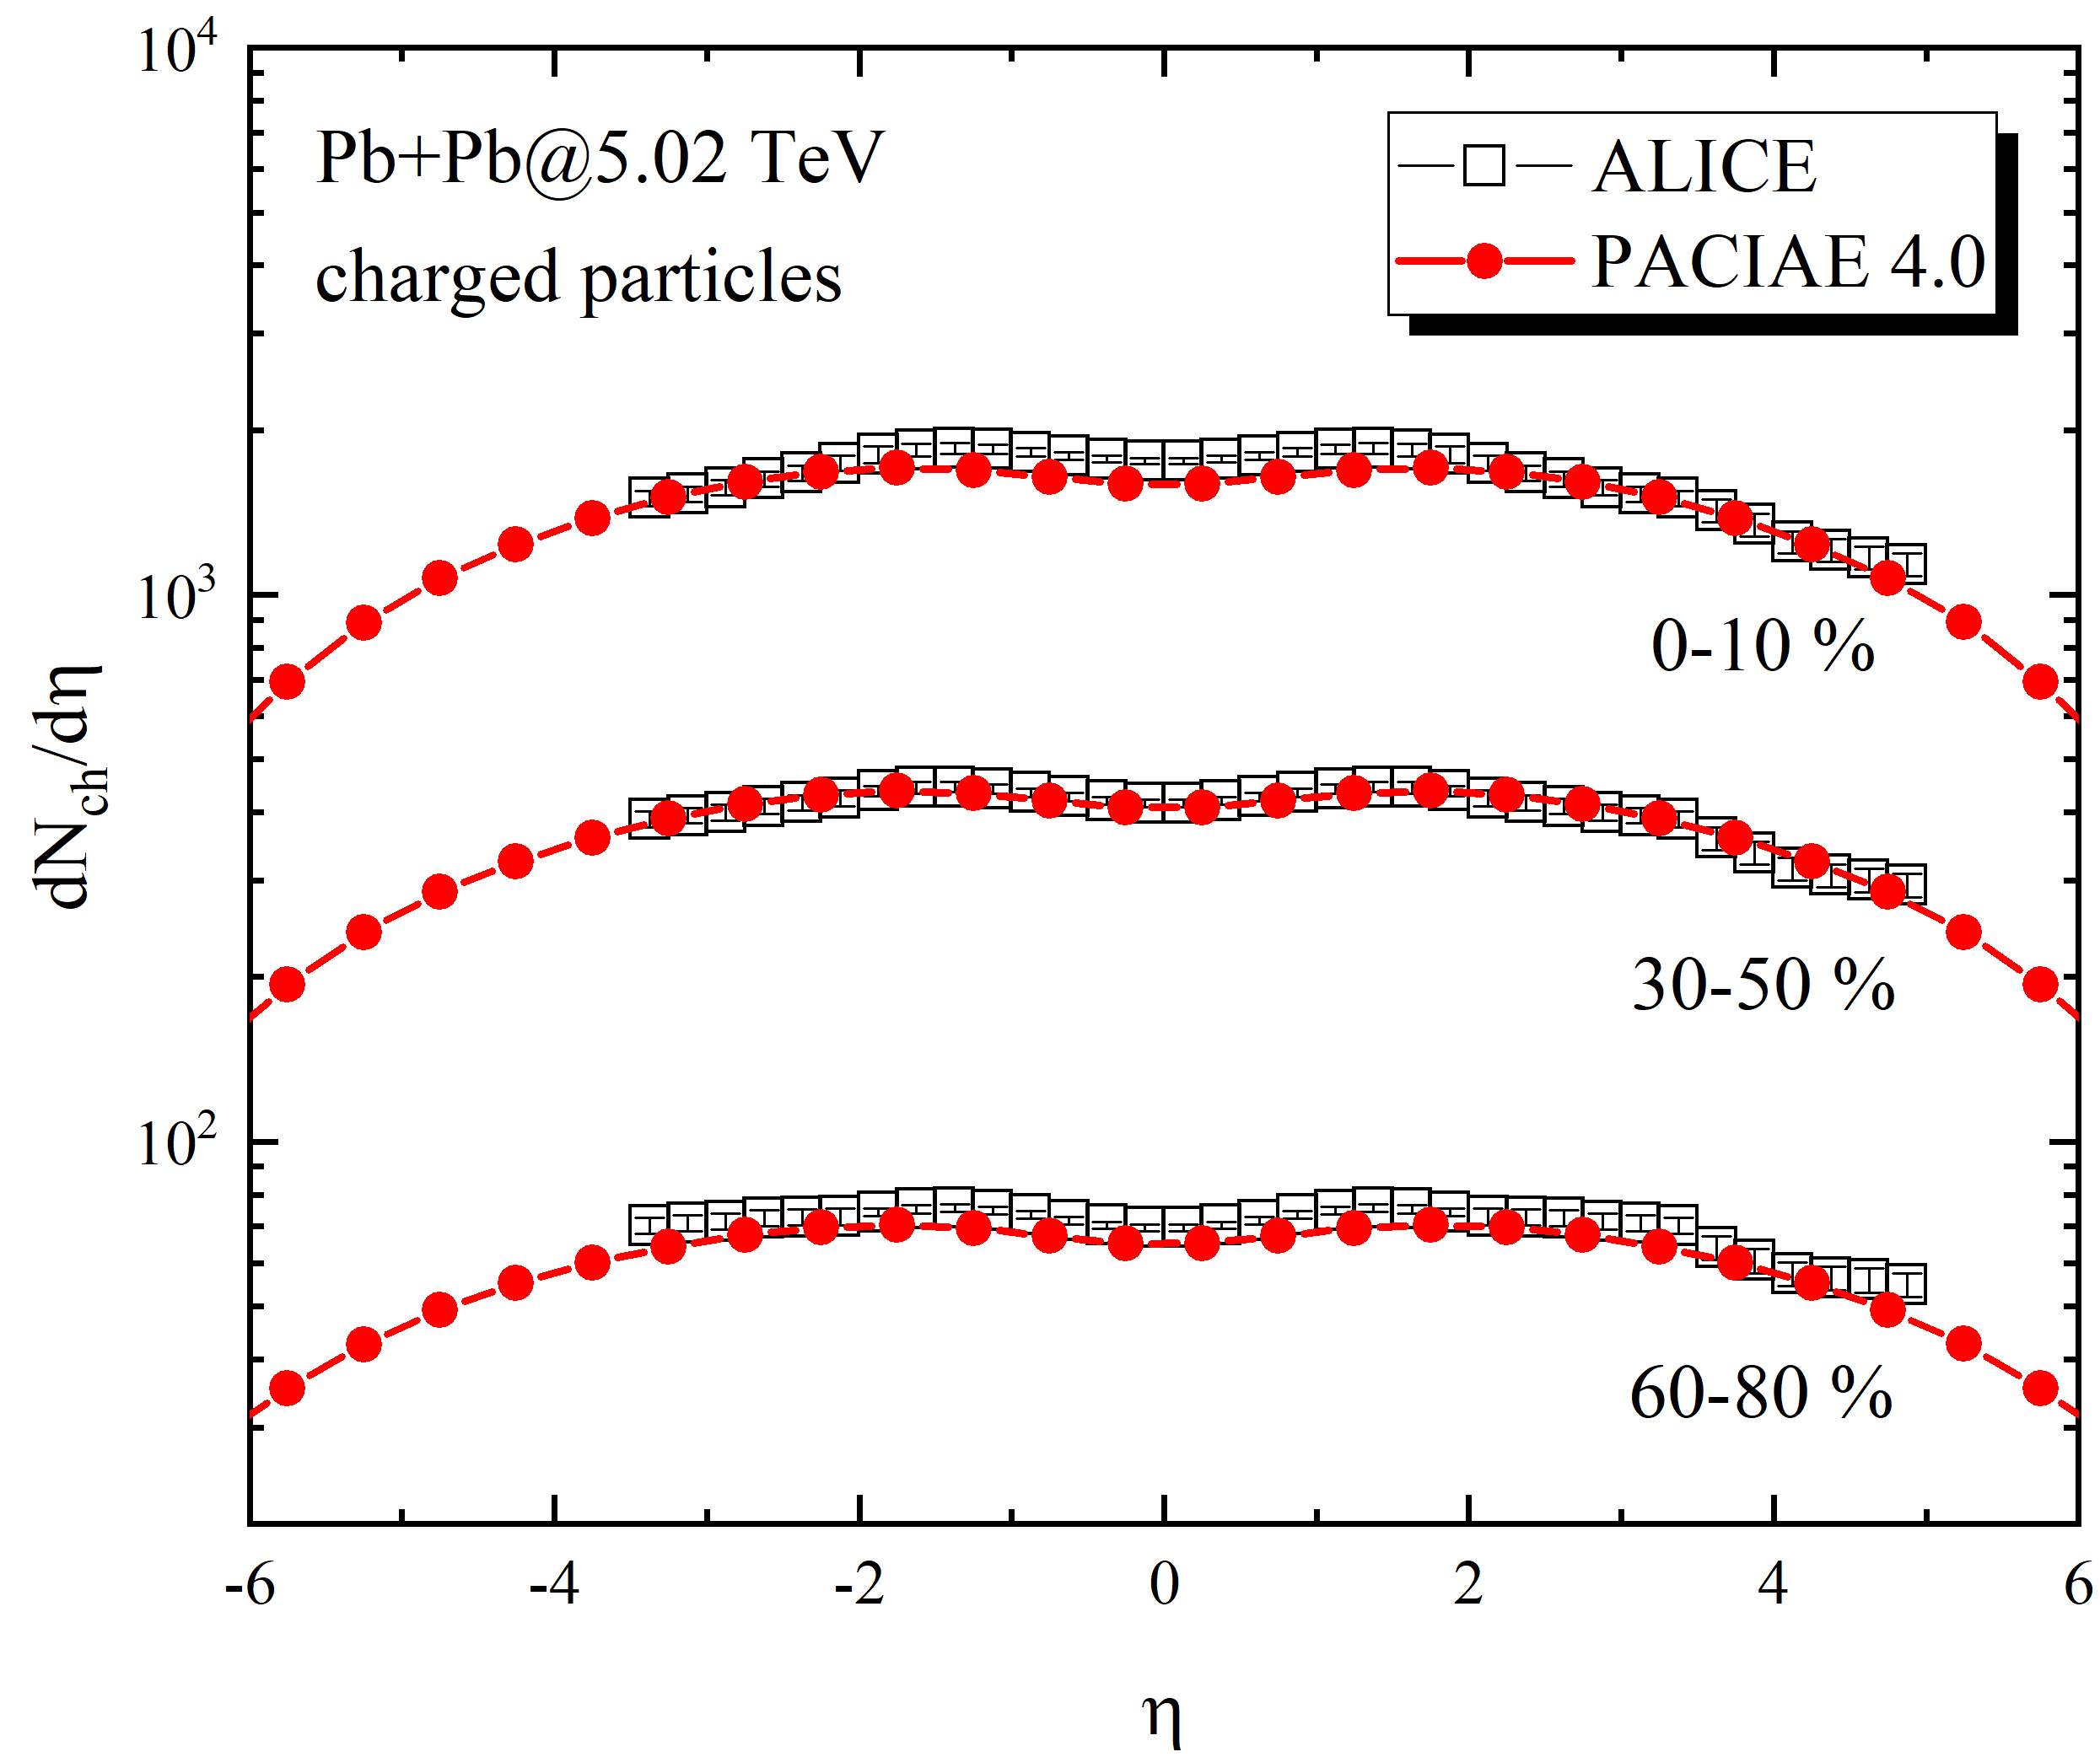
IV. Recent results: 1. basic observables

Slide 27
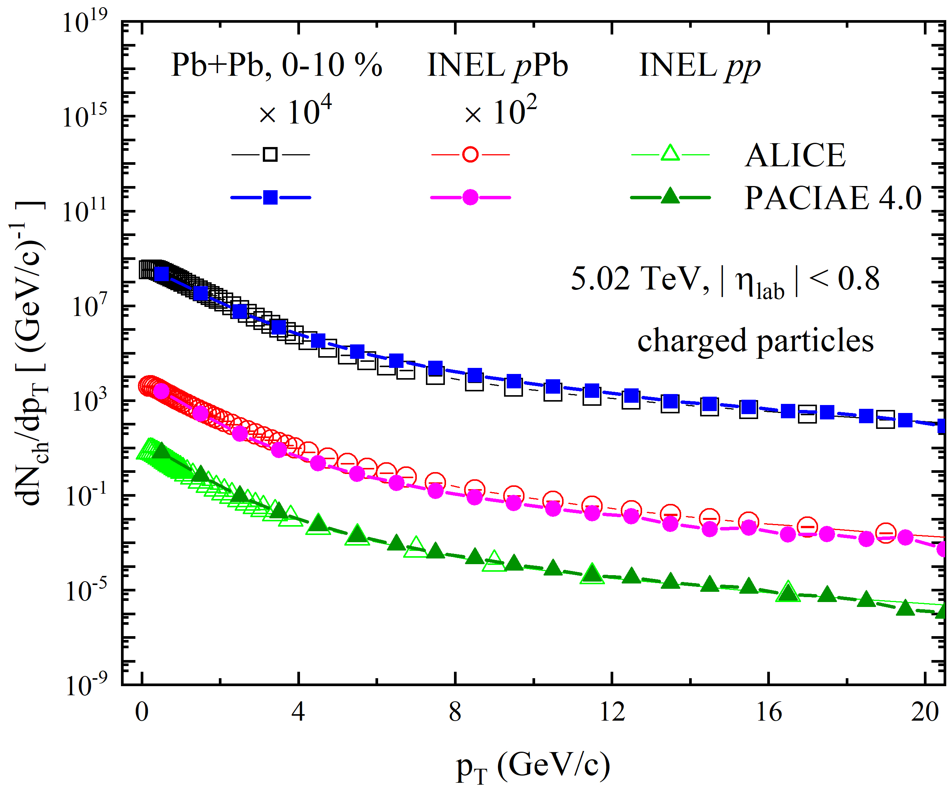
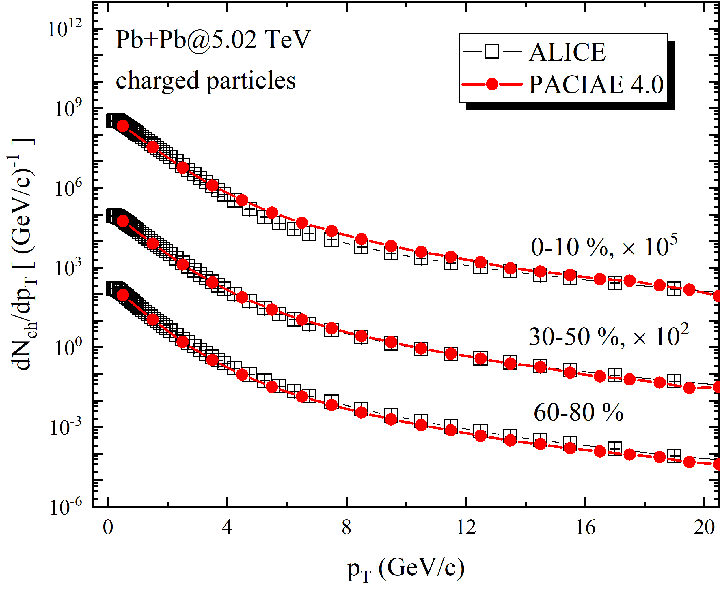
IV. Recent results: 1. basic observables

Slide 28
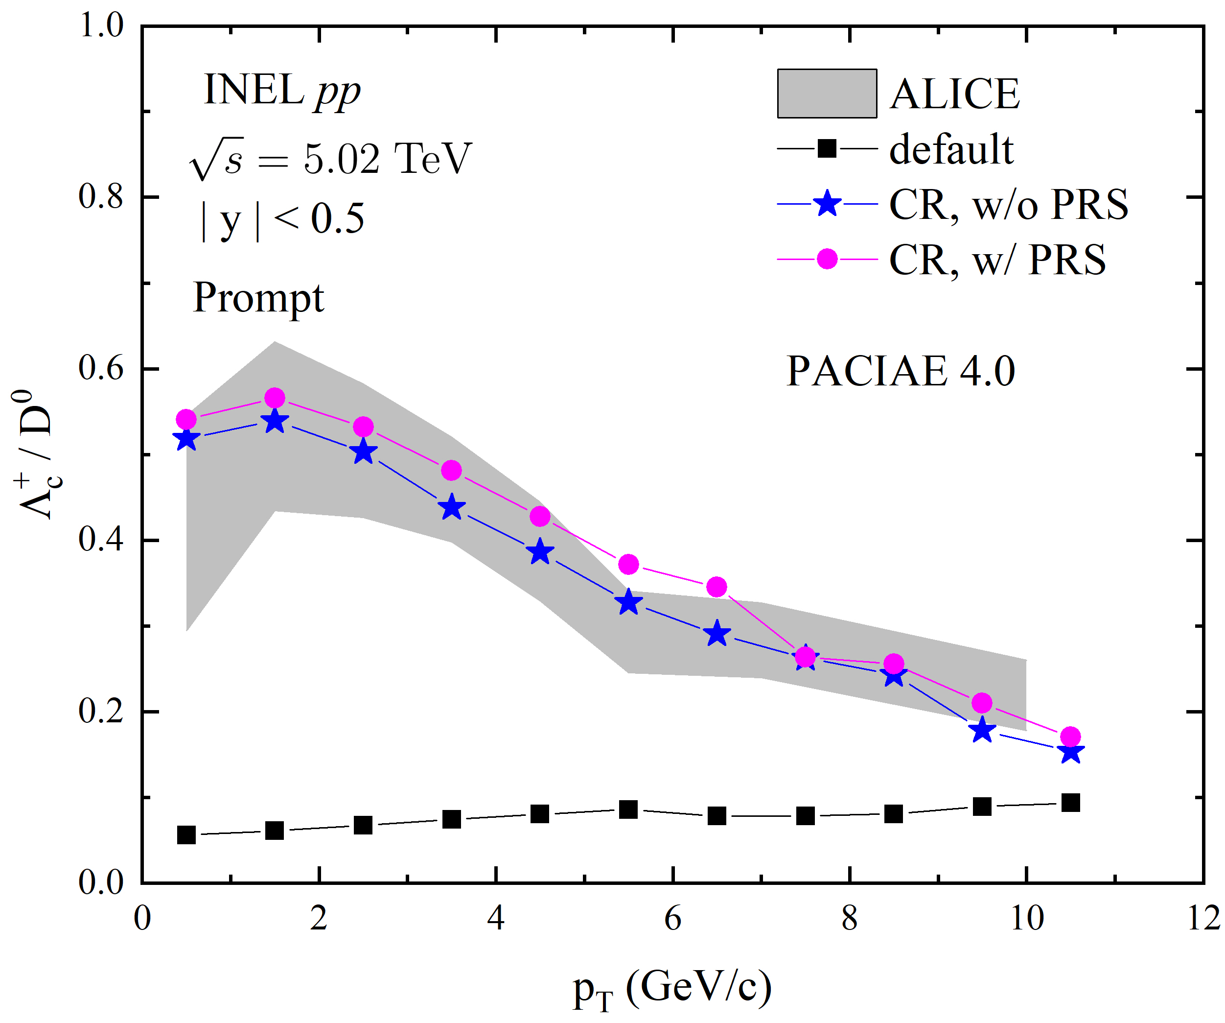
IV. Recent results: 2. heavy flavor production
PACIAE + Color Reconnection (CR), open-heavy hadron production
Lightest heavy baryon and meson
Prompt $Λ_{c}\text{/}D^{0}$
$$Λ_{c}:u, d, c; D^{0}:c, \overline{u}$$
dipoles $→$ junction topology, i.e. baryon
Fig: JHEP 07 (2024) 238
PRS enhances the ratio due to the
mass variation of strings.

Slide 29
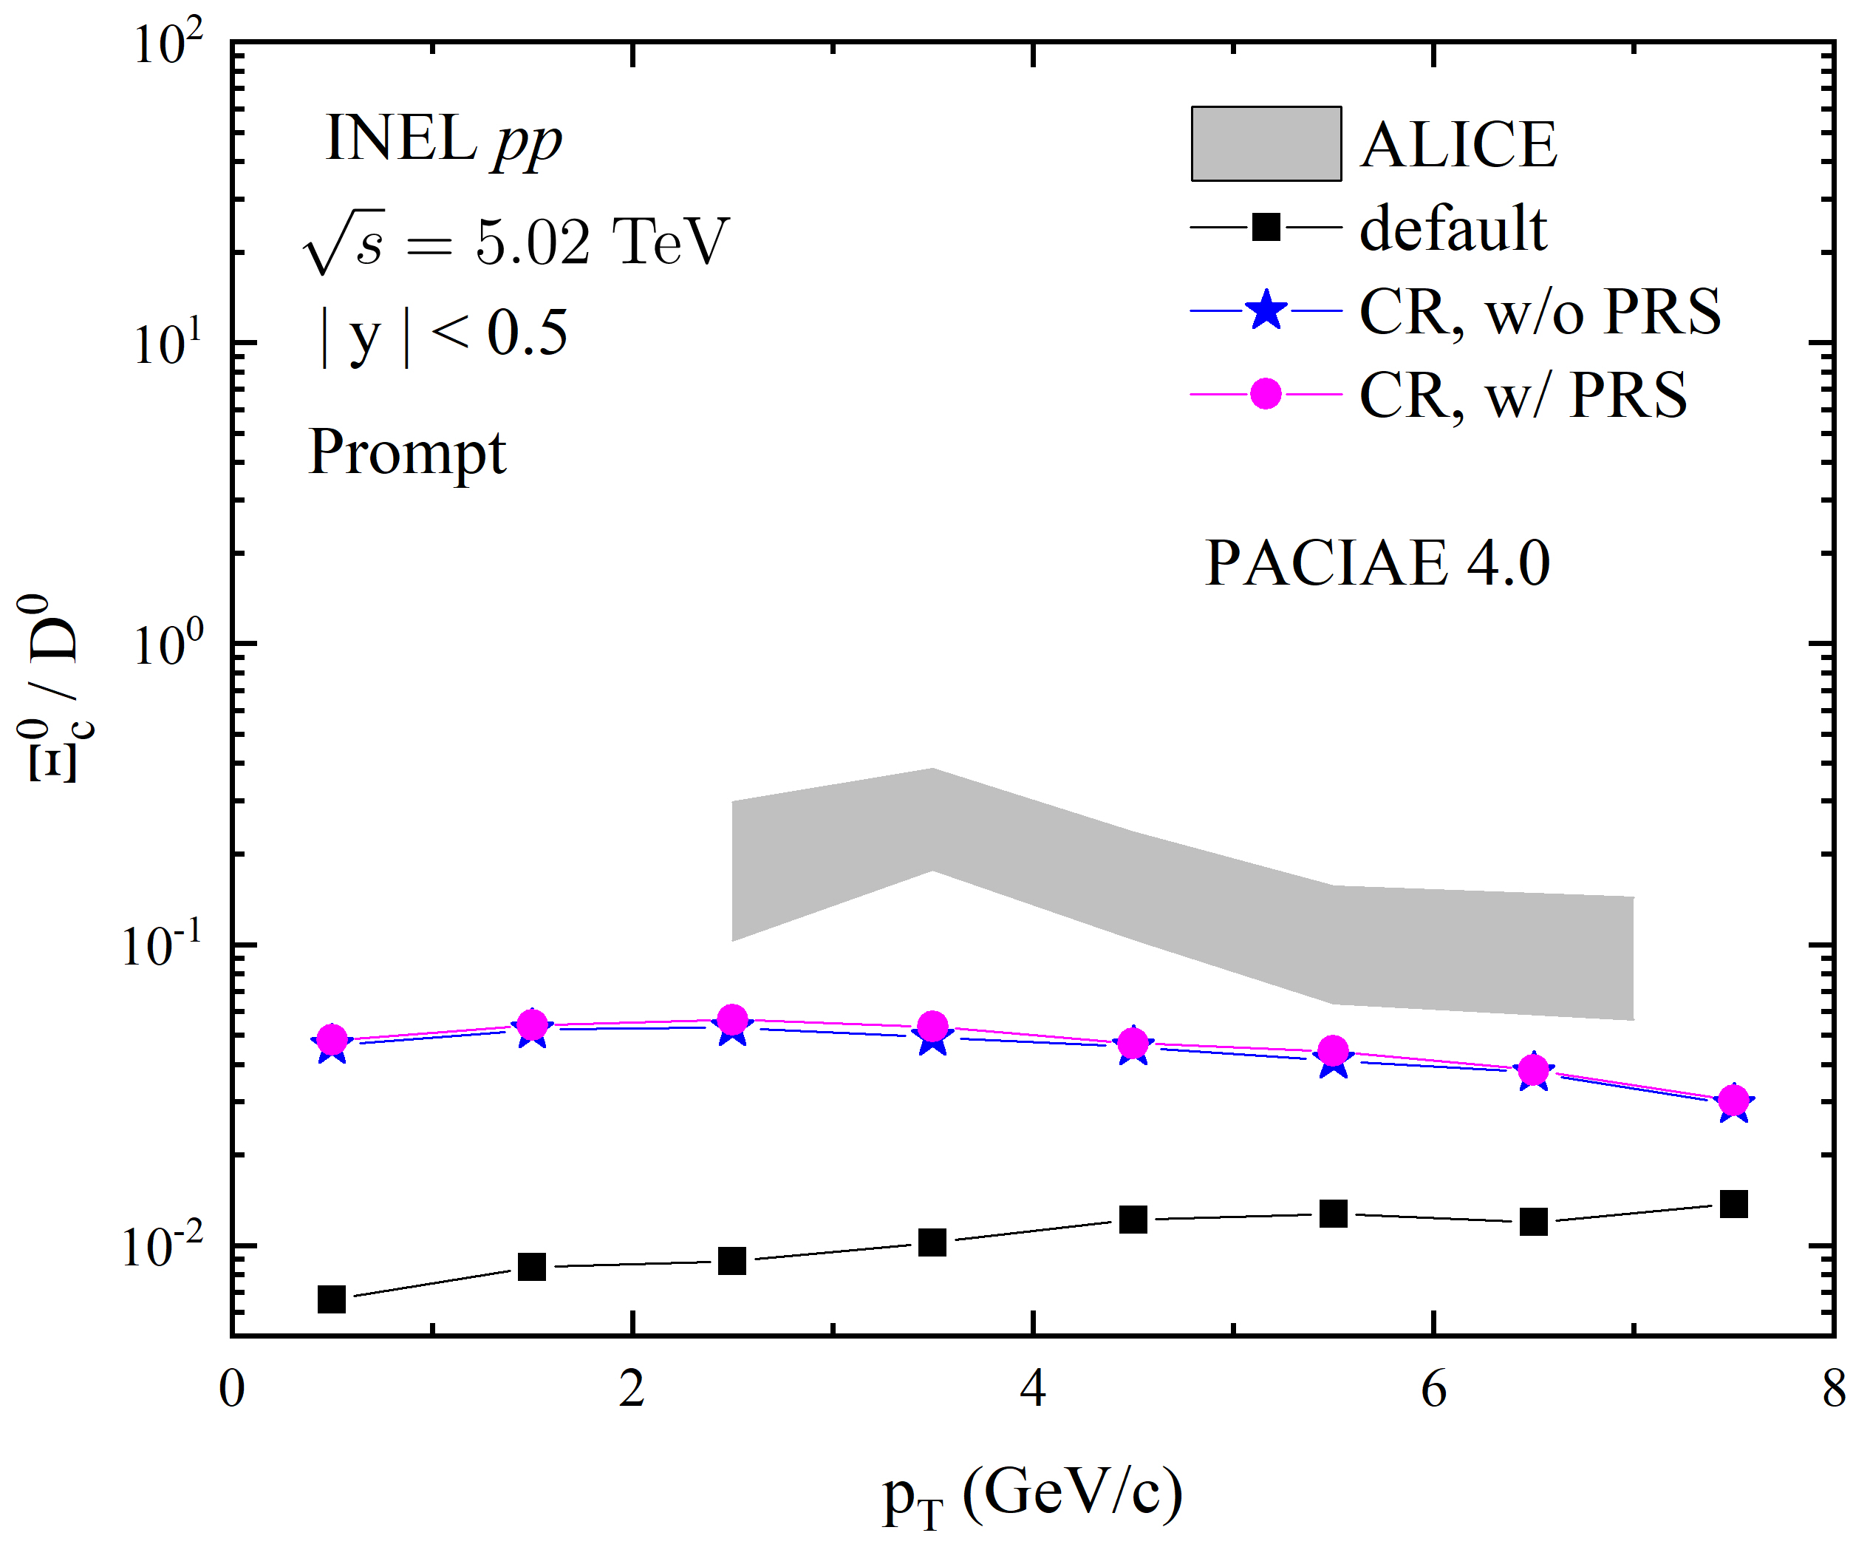
IV. Recent results: 2. heavy flavor production
PACIAE + Color Reconnection (CR), open-heavy hadron production
Prompt $Ξ_{c}^{0}\text{/}D^{0}$
Strange-charm
$$Ξ_{c}^{0}:s,d,c; D^{0}:c, \overline{u}$$
PRS enhances the ratio.
However, all of them fail to describe
this ratio.

Slide 30
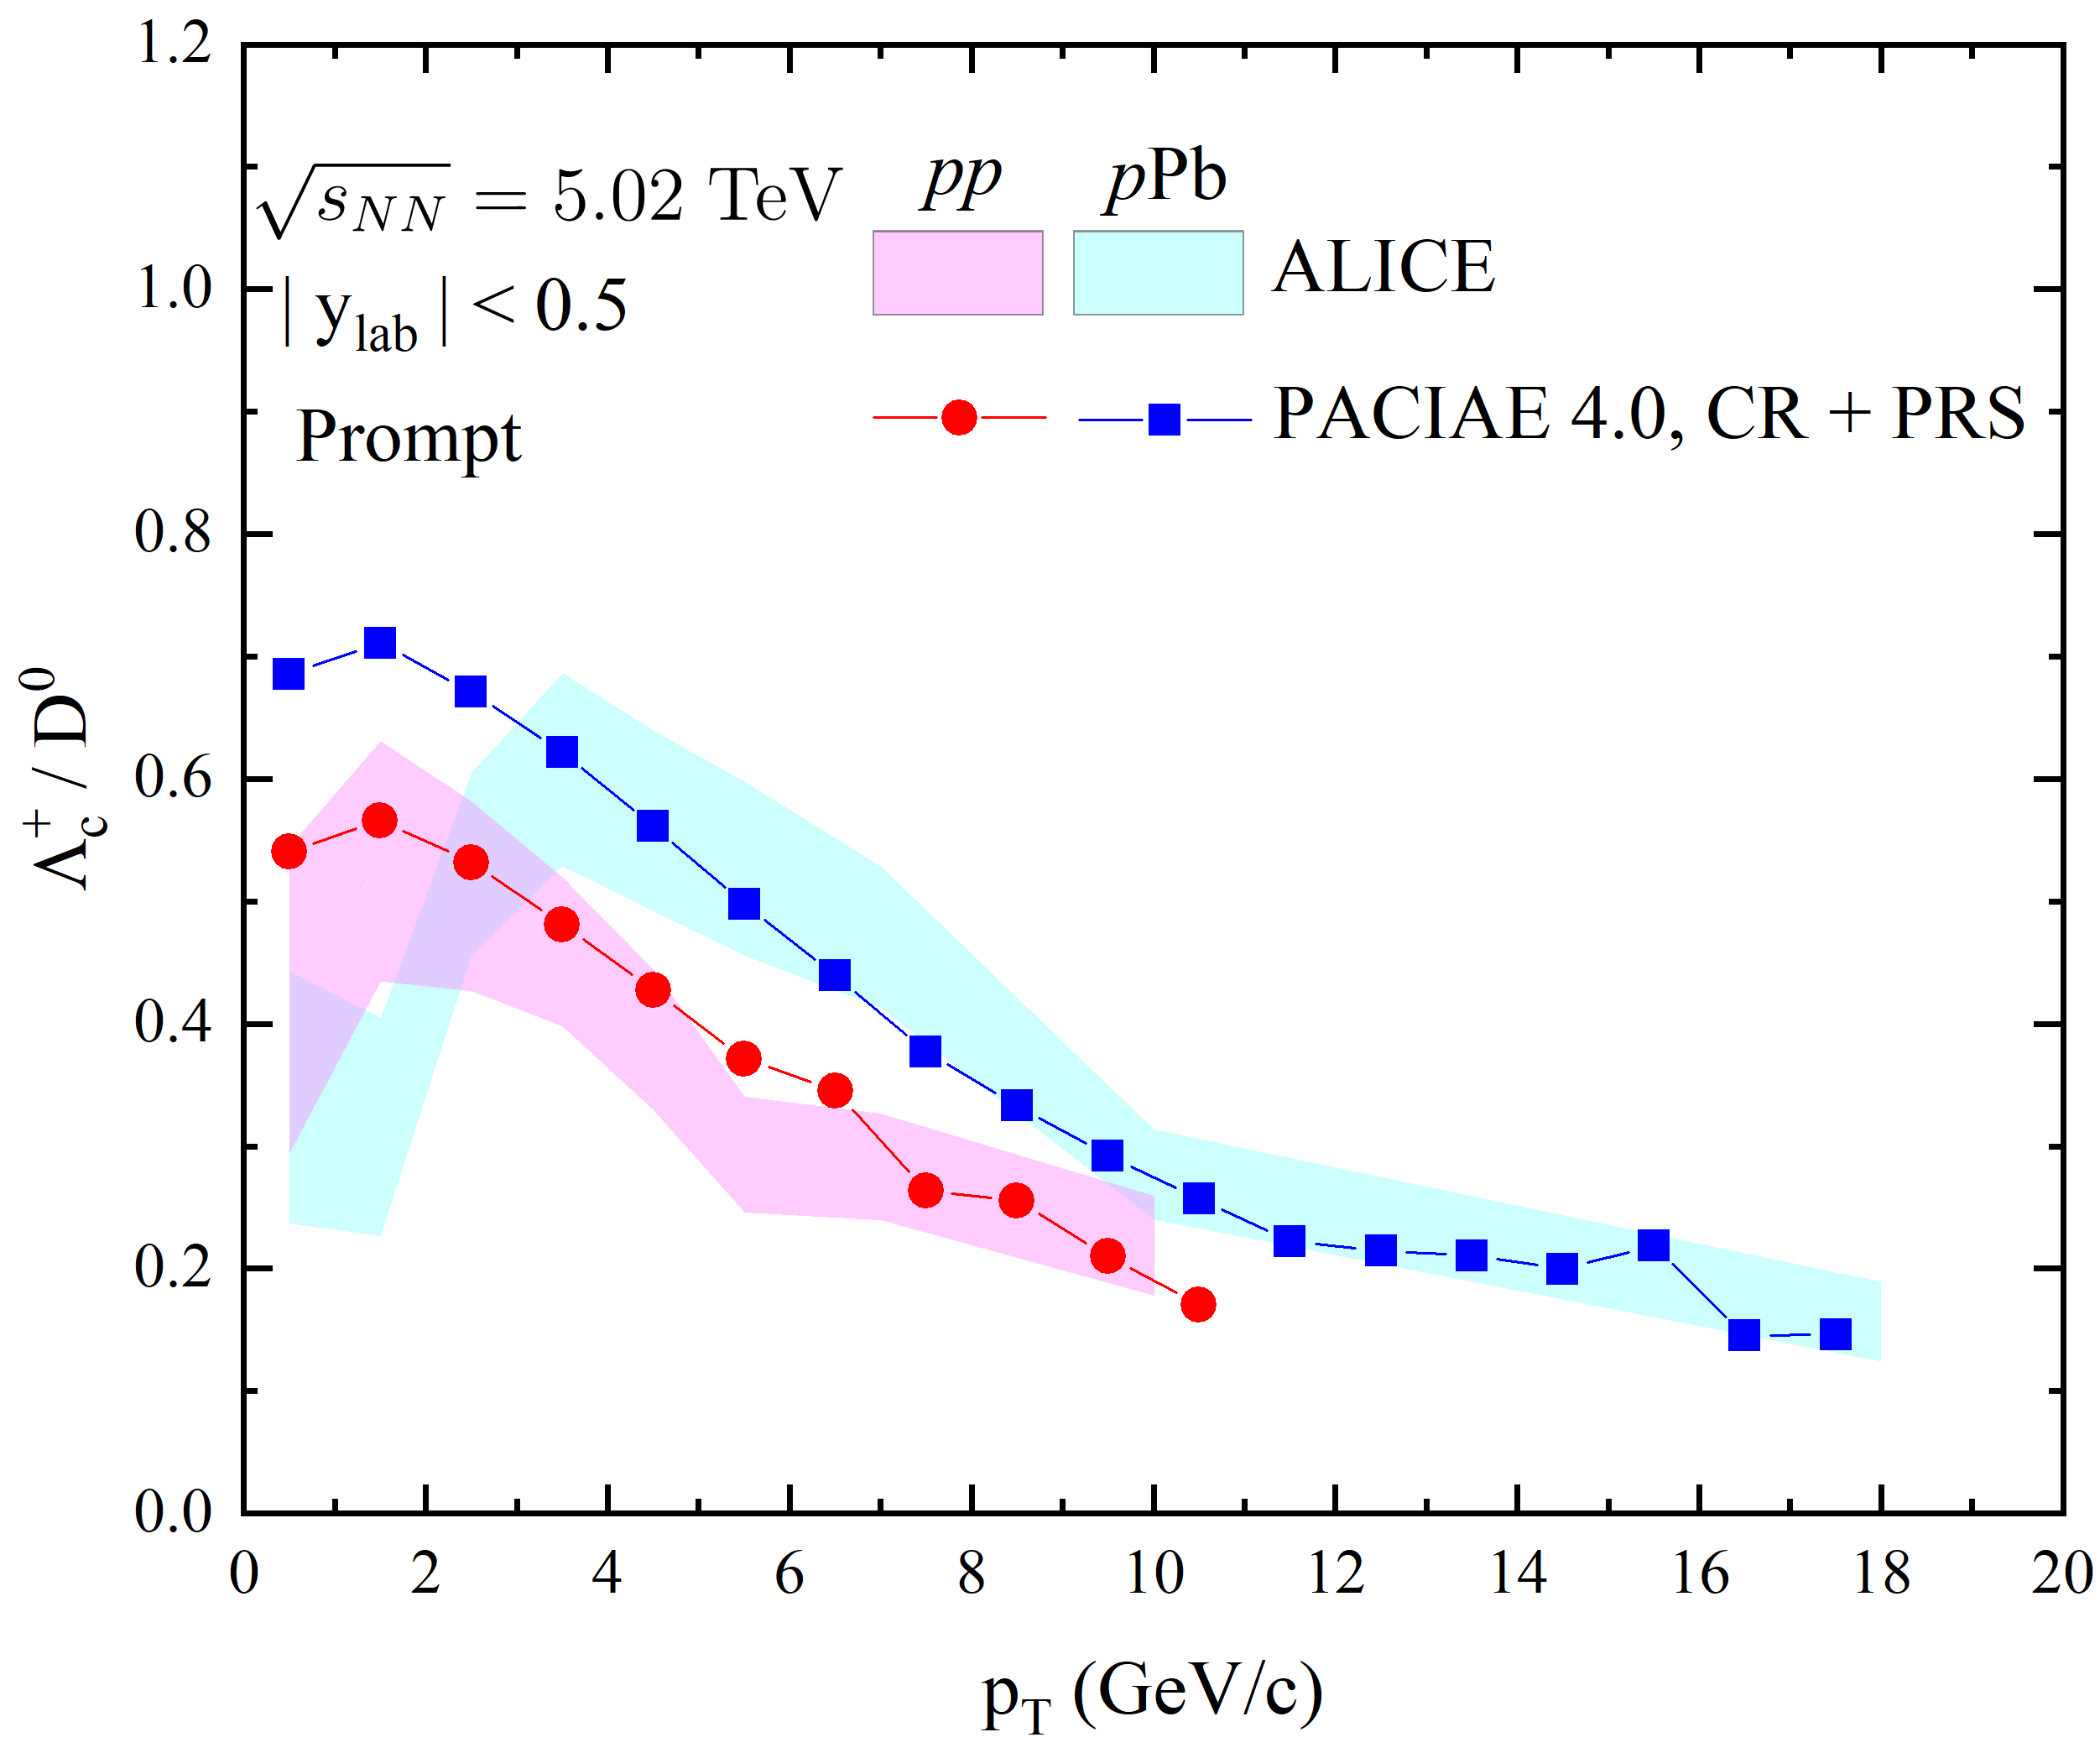
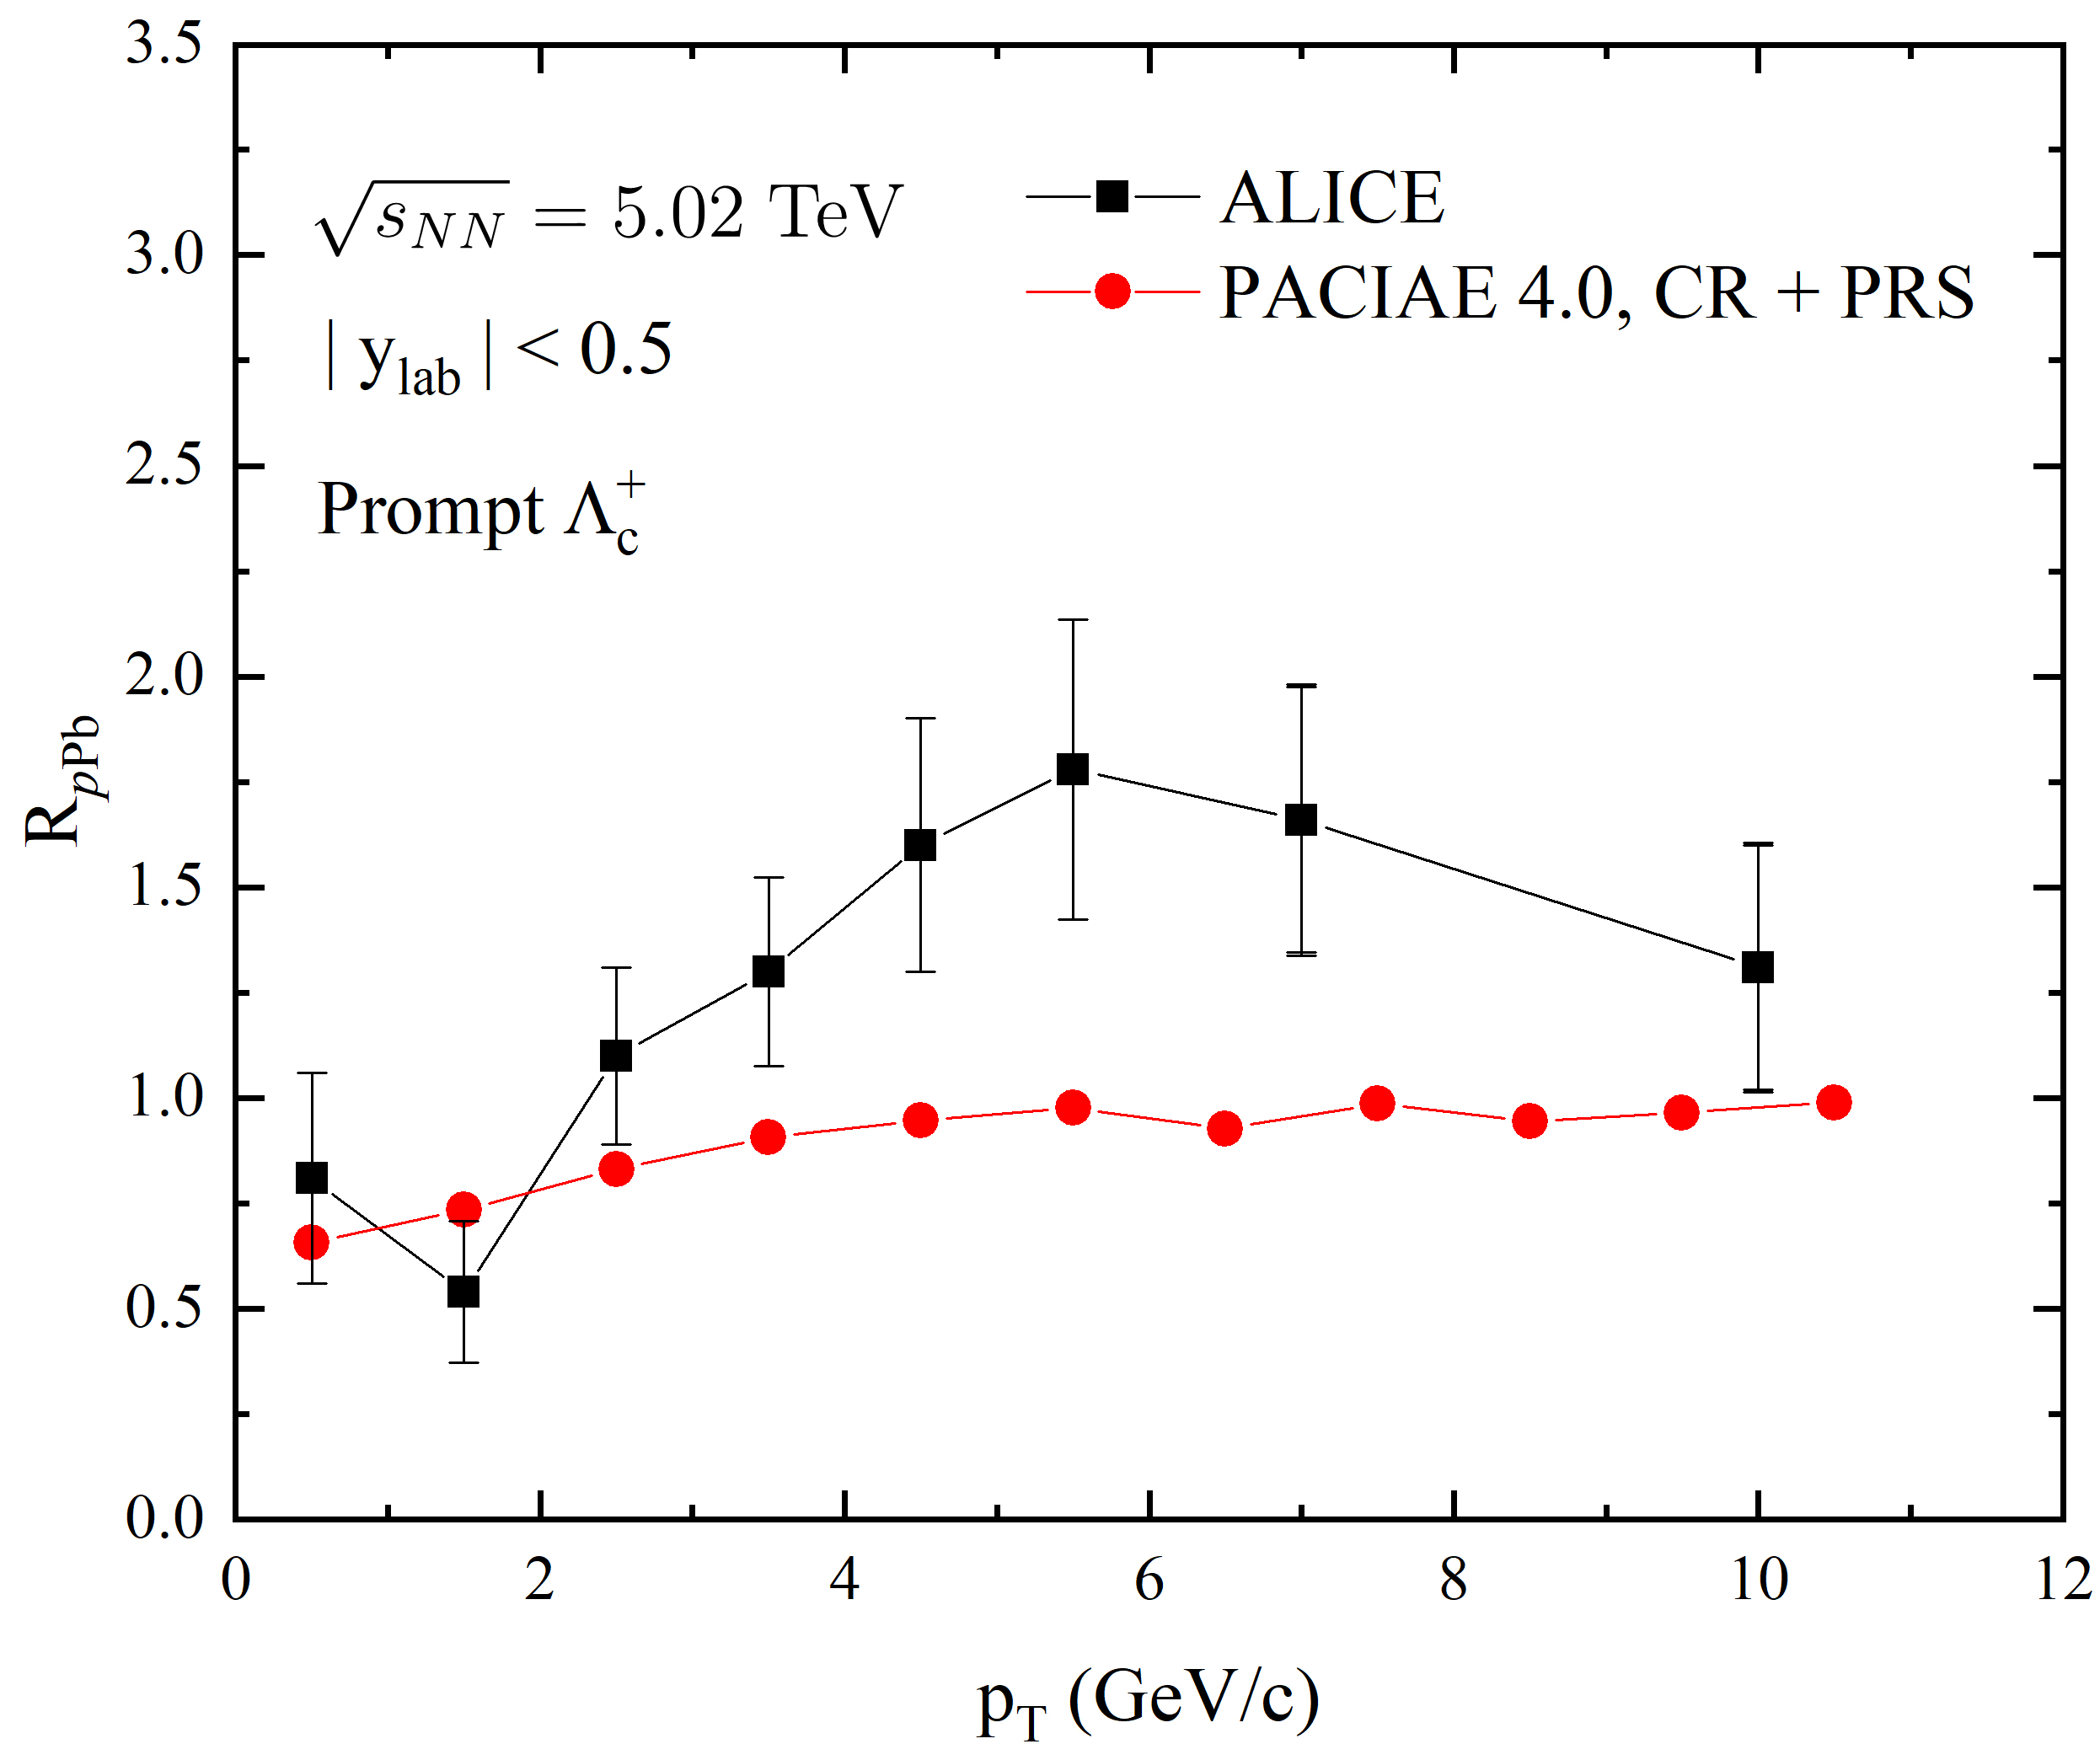
IV. Recent results: 2. heavy flavor production
pPb system:
The low $p_{T}$ behavior of heavy baryon-to-meson ratio?
Nuclear modification factor?
Need further improvements.

Slide 31
IV. Recent results: 3. exotic hardon production
Conventional hadrons are composed from 2 (meson)
or 3 (baryon) quarks
Naive Quark model:

Slide 32
IV. Recent results: 3. exotic hardon production
QCD allows hadrons with Nquark ≠2, 3, Exotic States:
Phys. Rep. 389, 61 (2004)；Phys. Rep. 454, 1 (2007)；Prog. Part. Nucl. Phys. 63, 74 (2009).

Slide 33
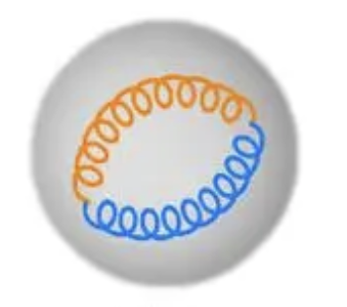
IV. Recent results: 3. exotic hardon production
PACIAE + DCPC (Dynamically Constrained Phase-space Coalescence model)
Yields of N-particle clusters, based on quantum statistical mechanics:
$Y_{N}=\int{⋅⋅⋅\int^{ }{\frac{d\vec{q_{1}}d\vec{p_{1}}⋅⋅⋅d\vec{q_{N}}d\vec{p_{N}}}{h^{3N}}}}$
with phase-space constraints (positions and mass)
For the two-gluon glueball (for example),
$$Y_{glueball}=\frac{1}{2!}\int{⋅⋅⋅\int^{ }{δ_{12}\frac{d{\vec{q}}_{1}d{\vec{p}}_{1}⋅⋅⋅d{\vec{q}}_{2}d{\vec{p}}_{2}}{h^{6}}}}$$
$$δ_{12}=\left\{\begin{aligned}1. {if 1=g, 2=g′ \atop m_{X(2370)}−Δm<m_{inv}<m_{X(2370)}−Δm, R≤1fm} \\ 0. otherwise\end{aligned}\right.$$
$Δm=Γ/2$, R is the radius of the cluster.

Slide 34
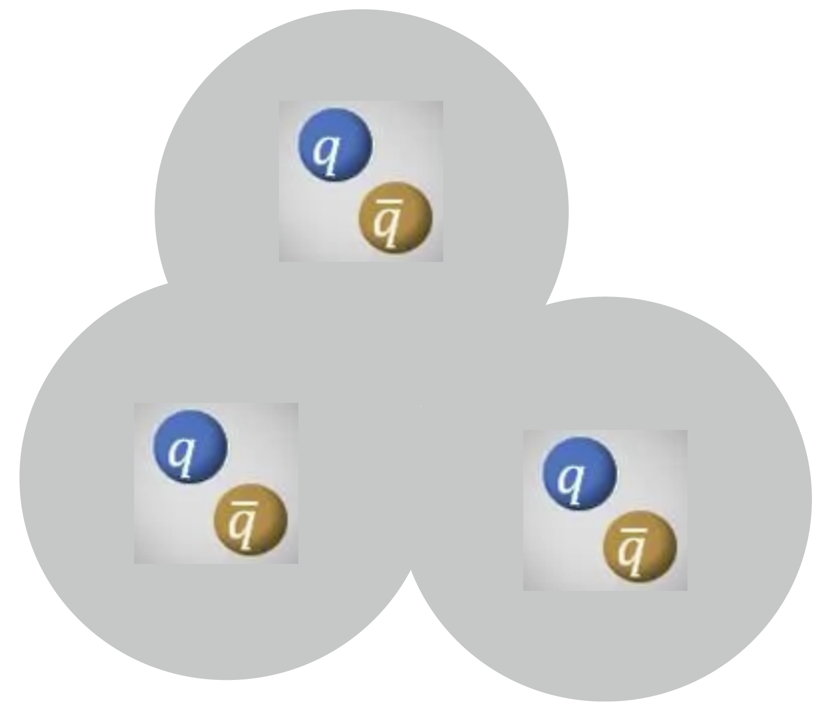
IV. Recent results: 3. exotic hardon production
For the molecule state, its yield reads as
$$Y_{molecule}=\int{⋅⋅⋅\int^{ }{δ_{123}\frac{d{\vec{q}}_{1}d{\vec{p}}_{1}d{\vec{q}}_{2}d{\vec{p}}_{2}d{\vec{q}}_{3}d{\vec{p}}_{3}}{h^{9}}}}$$
$$δ_{123}=\left\{\begin{aligned}1. {if 1=π^{+}, 2=π^{−}, 3=η′ \atop 3m_{π^{−}}<m_{inv}<3m_{η′}, 1fm≤R≤10fm} \\ 0. otherwise\end{aligned}\right.$$

Slide 35
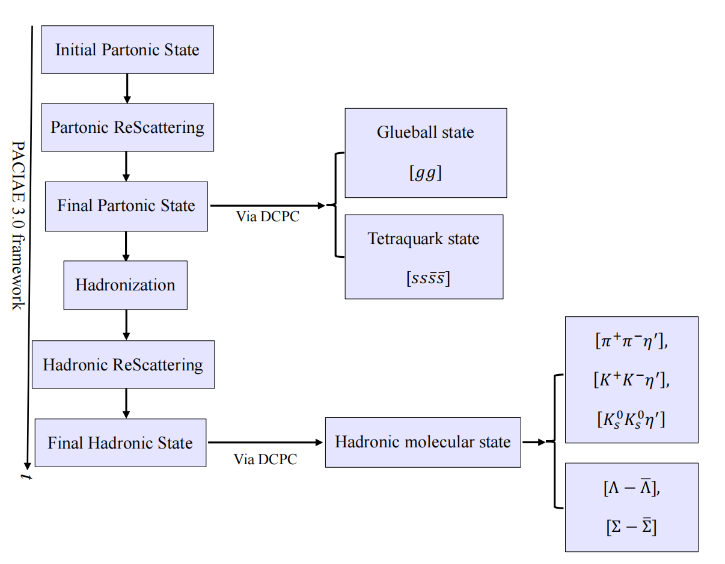
IV. Recent results: 3. exotic hardon production
In our work, glueball-like state and loose hadronic molecule-state of X(2370) are assumed to be coalesced in PFS and HFS, respectively.

Slide 36
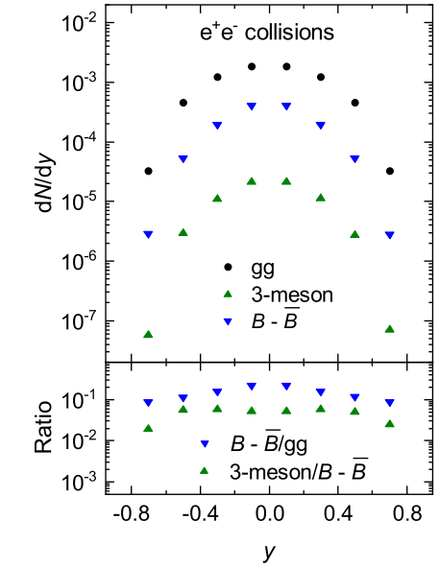
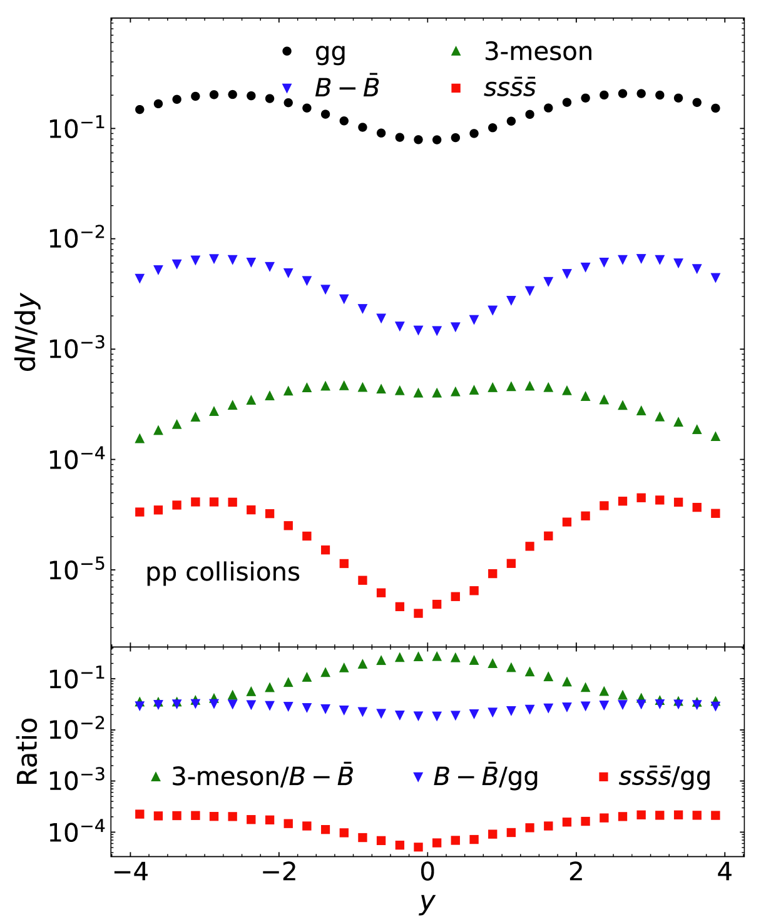
IV. Recent results: 3. exotic hardon production
Phys.Rev.D 110 (2024) 5, 054046

Slide 37
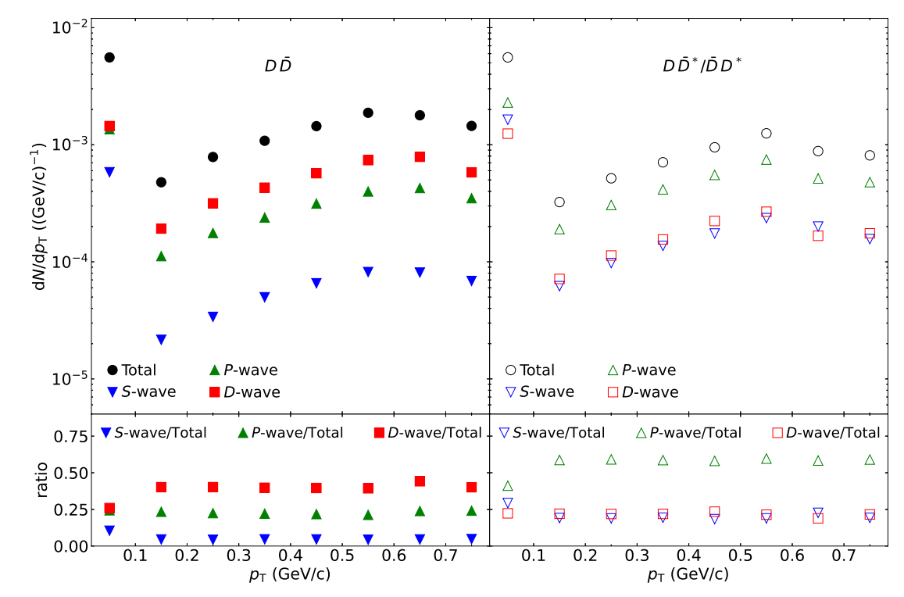
IV. Recent results: 3. exotic hardon production
Deciphering the G(3900) quantum numbers $J^{PC}$ in $e^{+}e^{−}$collisions
$$l^{∗}=x_{1}^{∗}×p_{1}^{∗}+x_{2}^{∗}×p_{2}^{∗}$$
$$l^{∗2}= L\left(L+1\right)ℏ^{2}$$
$$L=round\left(\frac{−1+\sqrt{1+4l^{∗2}/ℏ^{2}}}{2}\right)$$
$$P=(+1){\left(−1\right)}^{L}={\left(−1\right)}^{L}$$
$$C={\left(−1\right)}^{L+S}$$
https://arxiv.org/pdf/2502.16822

Slide 38
V. Summary & outlook : Summary
1. PACIAE model is a microscopic transport model incorporating the parton and hadron cascades to describe the high-energy elementary particle collisions as well as high energy nuclear collisions;
2. PACIAE has been upgraded to PACIAE4.0, in which PYTHIA 8 is interfaced in. More features and physics are available;
3. The pseudorapidity density distributions and the transverse momentum spectra of charged particles are very well described by PACIAE 4.0 in p-p, p-Pb and Pb-Pb collisions ;
4. The study of heavy-flavor production is succesful preliminary. Further study is on-going. The partonic rescattring shows an enhancement of the heavy baryons;
5. The production of exotic states X(2370), G(3900), etc. has been studied with the frame of PACIAE + DCPC.

Slide 39
V. Summary & outlook : outlook
1. Heavy flavor production studied further;
2. exotic hadron production & properties in p-A and A-A collisions
3. Dibaryon & dimeson production & properties;
.......

Slide 40
Thanks !

Slide 41
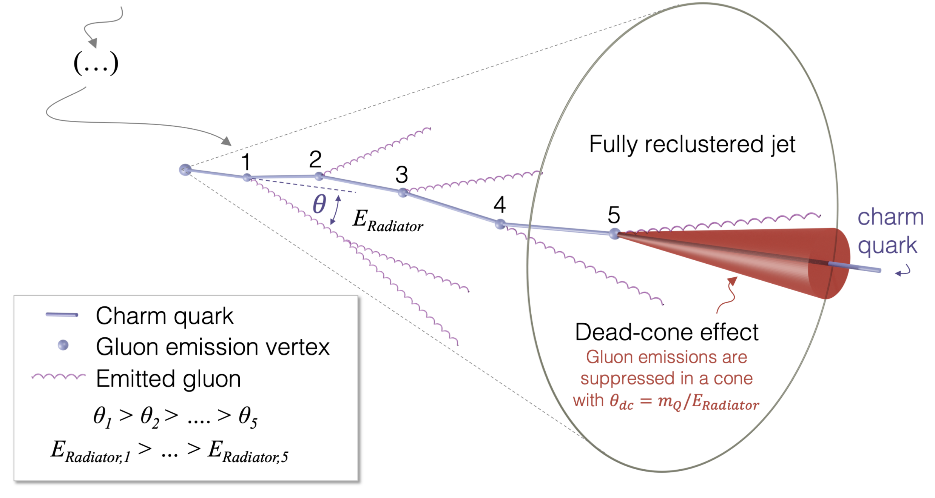
B. Parton cascade: medium-induced radiation
2) Dead-cone effect: radiation from an emitter of mass $m$ and energy $E$ is suppressed at angular scales smaller than $m/E$.
$$θ_{dead}=\frac{m}{E}$$
Fig. ALICE Nature 2022

Slide 42
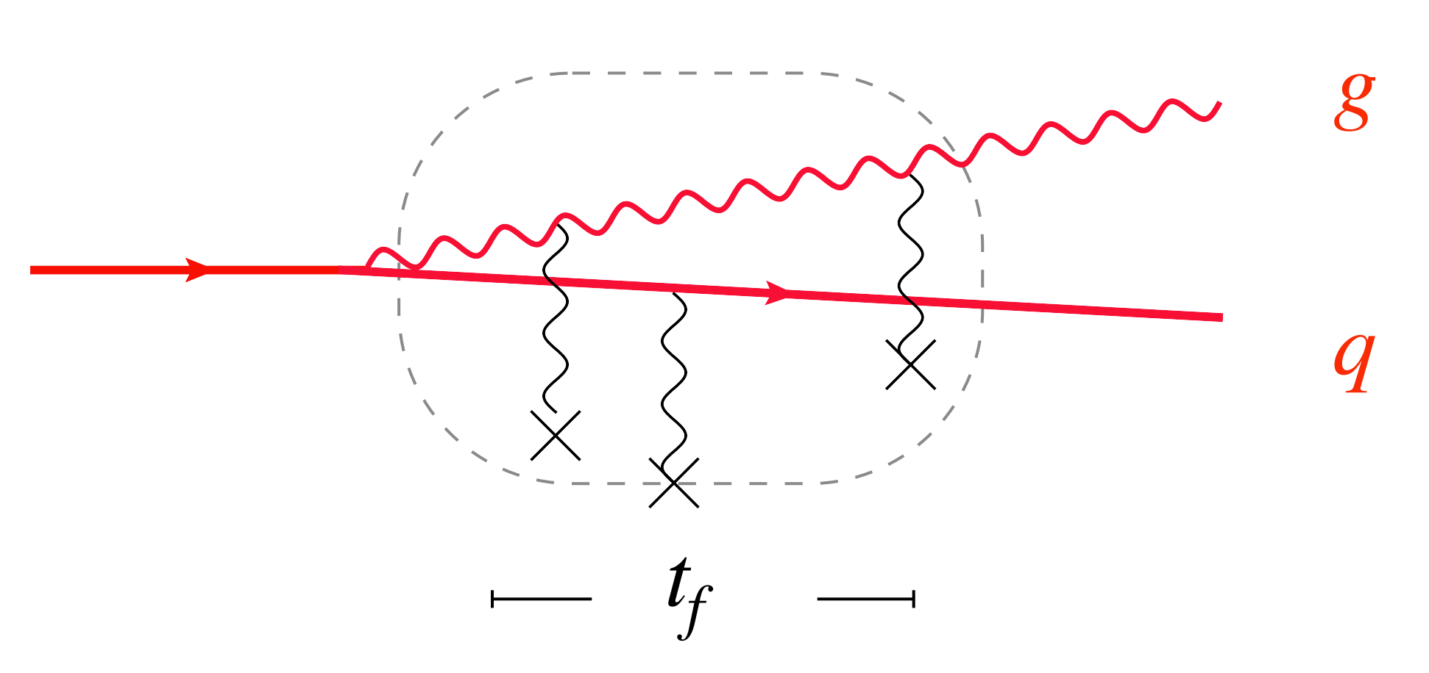
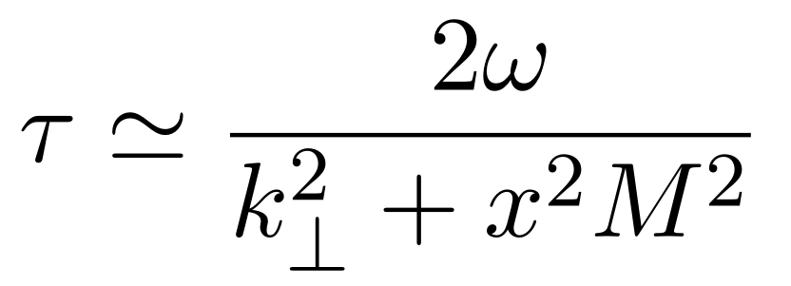
B. Parton cascade: medium-induced radiation
3) Landau–Pomeranchuk–Migdal (LPM) effect: suppression of the radiation due to the coherence of multiple scatterings.
Formation time of a gluon with the energy $ω$,
transverse momentum $k_{⊥}$,
momentum fraction $x$ of the emitter with mass $M$：
Fig. Y. Mehtar-Tani

