Slide 1
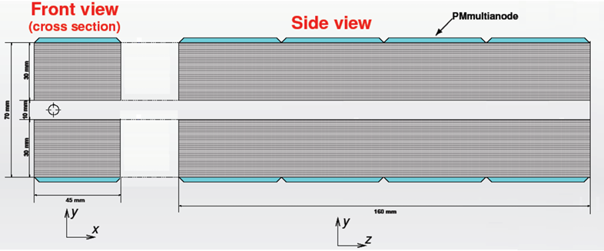
Two Photon and ZDD
Wang Yilun (Nanjing University) Wan Jiawei(Nanjing University)
Zhang Lei (Nanjing University)

Slide 2
Contents
Introduction
TwoGam Generator & Cuts
Results
Conclusion

Slide 3
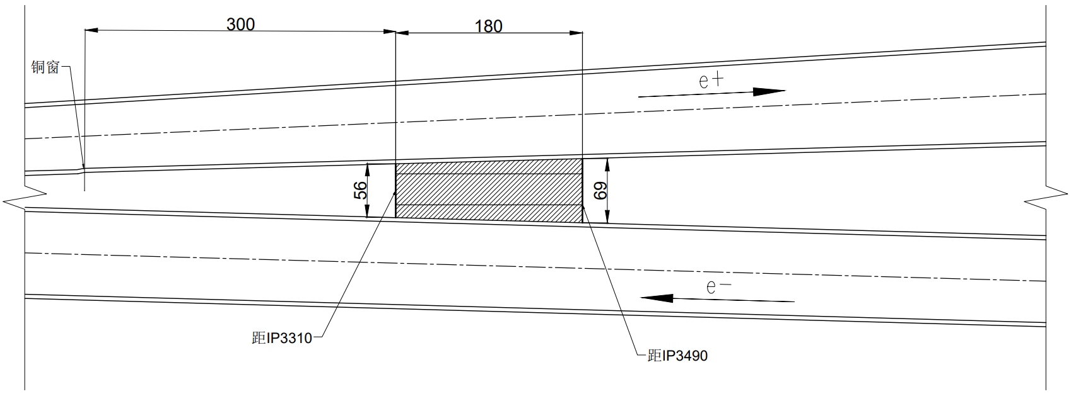
Introduction
Beam Center
Detector Center
Distance from beam to detector center
$$\sim 70 mm$$
Notes:
根据万家威提供的信息，探测器中心离束流中心距离,也就是图中红色箭头标出的距离，约为 70 mm，因此在有磁场的情况下，可以近似将探测器中心放在质心系下离束流中心70mm的位置

Slide 4
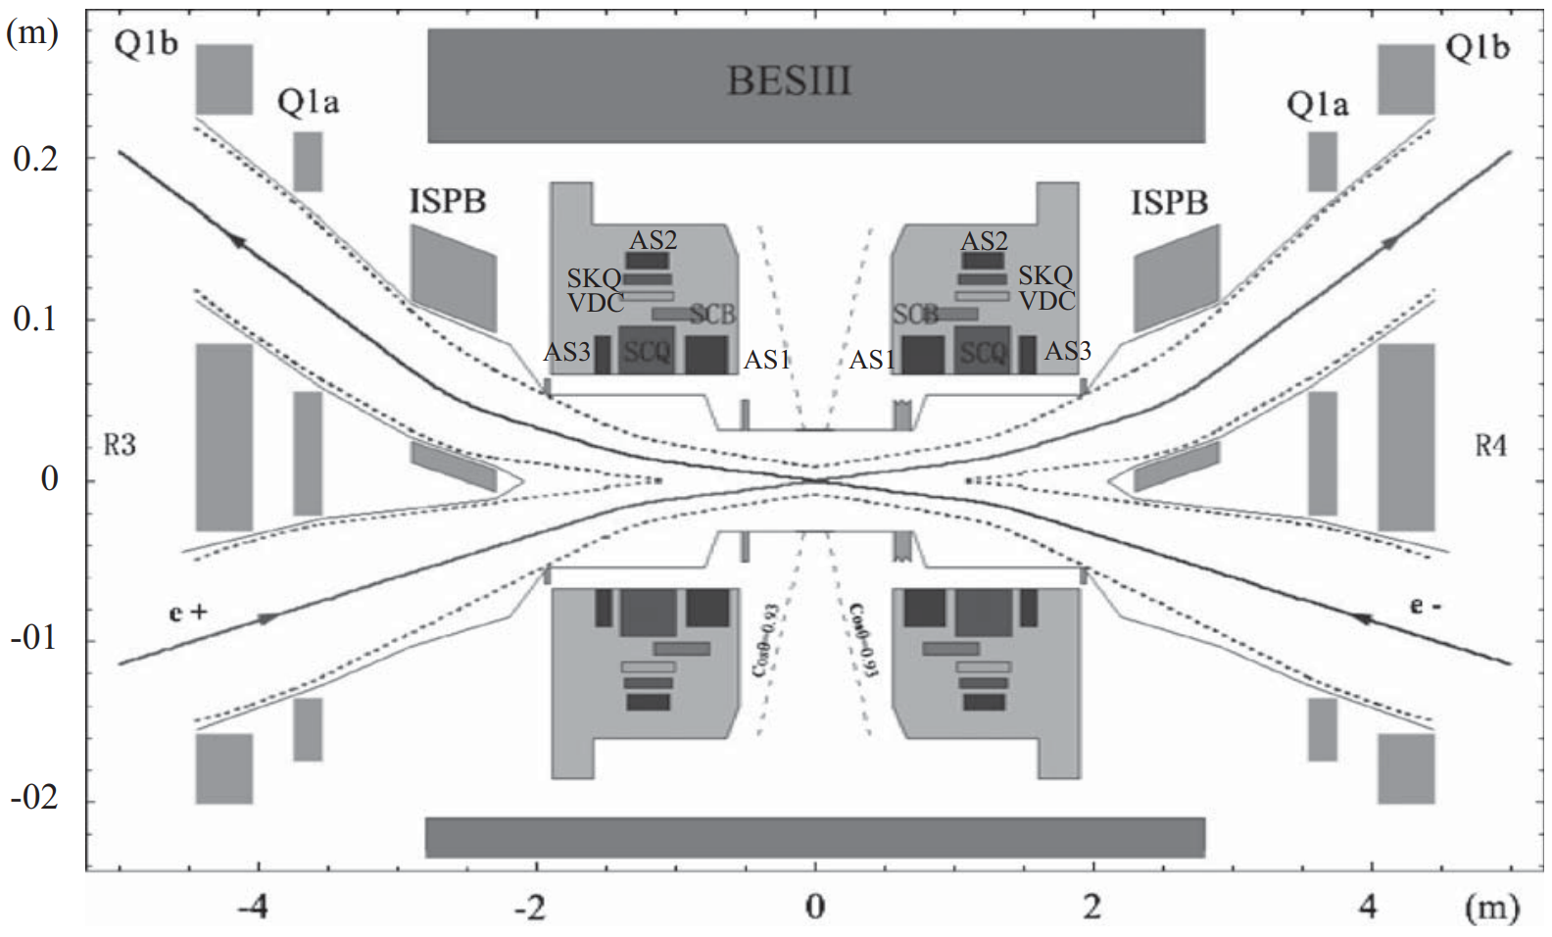
Introduction
Categorize the events by detected electron and positron
If one of the scattered $e^{±}$ is detected, it’s called single tag
If both scattered $e^{±}$ is detected, it’s called double tag
The $π^{0}, η, η^{′}$ are detected by central detector
For double tag, both the electron and positron requires $p_{x}>0$
Notes:
根据探测到的正负电子，将事例分为single tag 和double tag，而双光子产生的pi0等粒子由主探测器探测。由于ZDD位于束流管同一侧，要探测到double tag事例，需要散射的正负电子x方向动量均大于0，如图中箭头所示，因此事例数会非常少。

Slide 5
TwoGam Generator
Environment : BOSS 7.0.9
Generator : TwoGam (BesTwoGam)
$\sqrt{s}=4.68 GeV$
Limit the invariant mass of $γ^{∗}γ^{∗}$ to $π^{0}, η$ or $η^{′}$, to simulate the generation of these particles, and analyse the distribution of the scattered electron and positron
The hits with $x<0$ are taken to $x>0$, doubling the effective generated events
The particles with $p_{z}<0$ are also considered, so that the results includes both the forward and backward detector
Using process $e^{+}+e^{−}→e^{+}+e^{−}+e^{+}+e^{−}$ to simulate the generation of $π^{0}$, since the invariant mass of $π^{0}$ is lower than $μμ$
The radiation switch of the generator is turned off, will not radiate an extra photon
Notes:
使用BOSS709环境下的BesTwoGam，质心能量为4.68 GeV，对双光子体系的不变质量分别限制在pi0， eta和eta prime的不变质量附近，以研究在产生这些粒子的情况下，散射的正负电子的分布。将x<0的事例，也就是左侧的事例对称到右边来，这样相当于产生子产生了两倍的事例数。同时，pz<0的粒子，也被对称到z>0的探测器上，所以之后结果是包含两侧的探测器的。对于产生pi0的过程，由于pi0的不变质量低于mu子，只能使用ee到eeee的过程。产生子的辐射开关关闭，不会产生额外的光子

Slide 6
TwoGam Generator &
$π^{0} e^{+}+e^{−}→e^{+}+e^{−}+e^{+}+e^{−}$
Generator config
$w2min=0.0156 GeV^{2}≈({0.1249 GeV)}^{2}$
$(M_{π^{0}}≈0.13957 GeV)$
Cut $(GeV)$
$0.13957−0.01<M_{ee}<0.13957+0.01$
Detector range $(mm)$
$47.5<x<92.5$
$5<\left|y\right|<35$
$z=3310$
$η e^{+}+e^{−}→e^{+}+e^{−}+μ^{+}+μ^{−}$
$w2min=0.289 GeV^{2}≈{(0.5376 GeV)}^{2}$
$(M_{η}≈0.54786 GeV)$
$0.54786−0.01<M_{μμ}<0.54786+0.01$
$η^{′} e^{+}+e^{−}→e^{+}+e^{−}+μ^{+}+μ^{−}$
$w2min=0. 896 GeV^{2}≈{(0. 9466 GeV)}^{2}$
$(M_{η^{′}}≈0.95778 GeV)$
$0.95778−0.01<M_{μμ}<0.95778+0.01$
$$π^{0}$$
Notes:
例如对于pi0，其不变质量约为 0.13957 GeV，于是选择双光子体系不变质量为0.13957+-0.01 GeV 范围内的事例，进而设置产生子时就将不变质量下限设为略低于0.13957-0.01GeV，也就是0.1249GeV。实际上产生子的参数为不变质量的平方，w^2，也就是0.0156GeV^2。其他过程也同理，

Slide 7
Results

Slide 8
$π^{0}$ Result
$$π^{0}$$ | Number of Events | % | %
Total | $$6×{10}^{5} (12×{10}^{5})$$ | $$100$$ | -
Invariant Mass Cut | $$44645$$ | $$3.72$$ | $$100$$
Single Tag | $$258$$ | $$0.0215$$ | $$0.578$$
Double Tag | $$1$$ | $$0.000083$$ | $$0.00224$$
Notes:
首先是pi0的结果，等效120万个事例中，不变质量截断后剩余44645个事例，其中single tag258个，double tag只有一个，分别占比%0.578和%0.00224，即两侧的探测器能single tag到%0.578的事例

Slide 9
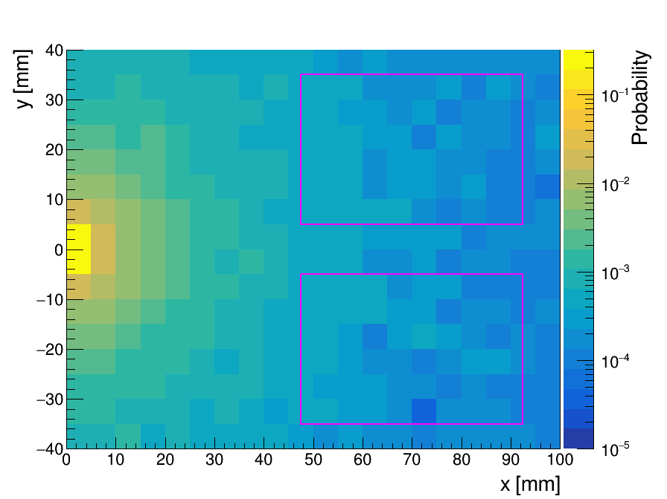
$π^{0}$ Result
Notes:
粒子击中分布如图所示，品红色框为探测器位置

Slide 10
$η$ Result
$$η$$ | Number of Events | % | %
Total | $$7×{10}^{5} (14×{10}^{5})$$ | $$100$$ | -
Invariant Mass Cut | $$41485$$ | $$2.96$$ | $$100$$
Single Tag | $$258$$ | $$0.0184$$ | $$0.622$$
Double Tag | $$3$$ | $$0.000214$$ | $$0.00723$$
($2×{10}^{5}$ more events to fill histogram)
Notes:
接着是eta的结果，因为等效120万个事例没有填充满直方图，增加了20万个事例。Single tag占比 %0.622，double tag占比 %0.00723

Slide 11
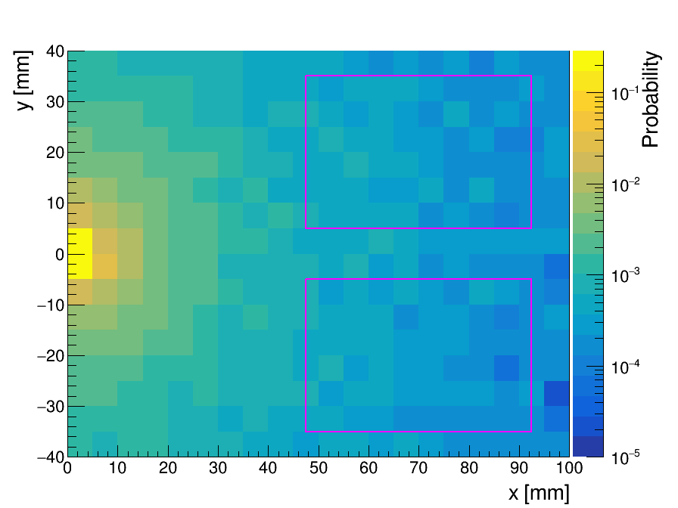
$η$ Result
Notes:
击中分布如图所示

Slide 12
$η′$ Result
$$η^{′}$$ | Number of Events | % | %
Total | $$6×{10}^{5} (12×{10}^{5})$$ | $$100$$ | -
Invariant Mass Cut | $$32864$$ | $$2.74$$ | $$100$$
Single Tag | $$259$$ | $$0.0216$$ | $$0.788$$
Double Tag | $$4$$ | $$0.000333$$ | $$0.0122$$
Notes:
最后是eta prime的结果，single tag 占比 %0.788，double tag % 0.0122

Slide 13
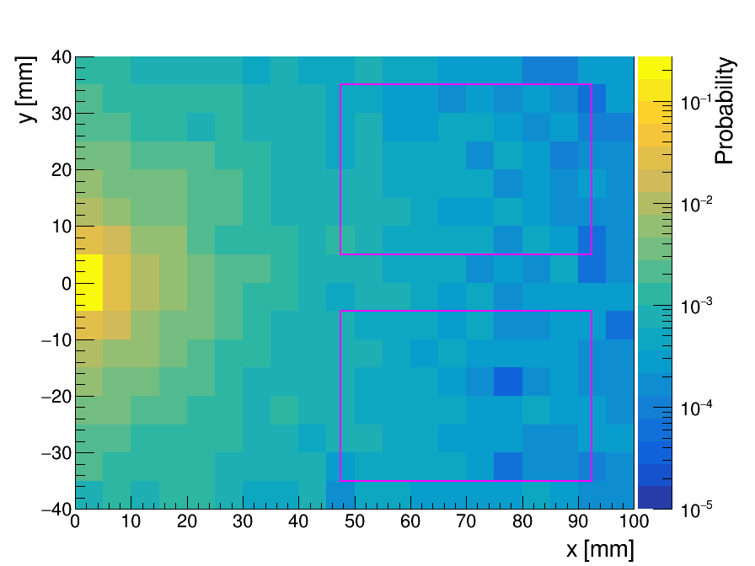
$η′$ Result
Notes:
分布如图所示

Slide 14
Conclusion
With magnetic field, the center of ZDD can be roughly placed at
$x=70 mm$
TwoGam Generator is used to simulate the scattered $e^{±}$, in $π^{0}, η, η^{′}$ scenarios
The relative cross section for both sides is calculated, for single tag,
$π^{0} 0.578\%, η 0.622\%, η^{′} 0.788\%$
Higher invariant mass of the two photon system gives higher relative cross section
Double tag events are very rare
The distributions of scattered $e^{±}$ at $z=3310 mm$ are drawn.
Notes:
总结，在有磁场的情况下，可以看作ZDD的中心位于x=70mm，z=3310mm的位置。使用bestwogam产生子模拟在产生pi0，eta和eta prime的情况下散射电子的分布。计算了三种情况下的相对截面，两侧探测器single tag事例之和分别是pi0 %0.578, eta %0.622, eta prime %0.788。可以看出不变质量越高的双光子体系，击中探测器的正负电子比例越高。Double tag 事例非常罕见。绘制了散射的正负电子在z=3310mm处的分布。

