Slide 1
Motivation
Examination of T/CP Invariance in the $e^{+}e^{−}→^{+}^{−}$Reaction at BESIII
R value:
1997, T. Ohshima et al. Test R value and give MC.
2001, Belle cooperation, test R value base on 4.1 $fb^{−1}$ data, ${|δ}_{eμ}|<0.018$ under 90% confidence.
Electric Dipole Moment(EDM):
1991, D. Atwood and A. Soni, $e^{+}e^{−}→t\overline{t}$
1998, L3 cooperation, $e^{+}e^{−}→τ^{+}τ^{−}γ$, no new physics.
2000, ARGUS cooperation, $e^{+}e^{−}→τ^{+}τ^{−}$, same with LEP.
2003, Belle cooperation, $e^{+}e^{−}→τ^{+}τ^{−}$, give result under 95% confidence.
2022, Belle cooperation, new data and more than 2003, give result under 95% confidence.
2024, super tau-charm, $e^{+}e^{−}→τ^{+}τ^{−}$, MC result.
Test EDM need four momentum of $τ$, not suit do in pure lepton decay.

Slide 2
Result
The result from data
$$\tilde{R}=R_{μ^{+}e^{−}}^{T}∙R_{e^{+}μ^{−}}^{T}=R_{μ^{+}e^{−}}^{CP}∙R_{e^{+}μ^{−}}^{CP}=1+4δ$$
$\tilde{R}=1.0205$ and $δ=0.0051$
$δ$ is the CP violation part.
Even accounting for systematic errors, the results will most likely be better than before.

Slide 3
CLFV
Show semi-blind data on new physics group meeting.
Prepare memo!

Slide 4
Examination of T/CP Invariance in the $e^{+}e^{−}→^{+}^{−}$Reaction at BESIII
Yunhe Yang¹, Ziyu Zhang¹, Zhiyong Wang³, Aiqiang Guo², Chunxu Yu¹
¹NanKai University
²Institute of Modern Physics, Chinese Academy of Sciences
³Institute of High Energy Physics

Slide 5
Outline
Motivation
MC sample
Event selection
Further selection
Background analysis
<A> and R

Slide 6
Motivation
CPV is a key to understand the preponderance of matter over antimatter in our universe.
CPV in Collider Physics:
1964, AGS, $\frac{Br(K_{2}^{0}→π^{+}π^{−})}{Br(K_{2}^{0}→ALL)}=(2.0±0.4)×{10}^{−3}$
DAΦNE (KLOE, 𝜙 peak): Br(𝜙 → K+K-) = 49.2%
e+e- @1019.4 MeV Br(𝜙 → K0K0-bar) = 33.8%
KEKB/BELLE, PEP-II/BABAR Tevatron (D0/CDF) LHC (ATLAS/CMS)
e+e- @10.58 GeV, ץ(4S) pp-bar @1.98 TeV pp @14 TeV
CKM says: no CPV should not occur in the leptonic sector, which must be tested!

Slide 7
Motivation
BESIII VS BELLE

Slide 8
MC sample
BOSS version: 7.0.9
Data:
Inclusive MC: 2300M
Signal MC: $1×{10}^{6}$
MC sample | Generated Model
$$τ^{+}→e^{+}ν_{e}{\overline{ν}}_{τ}$$ $τ^{−}→μ^{−}{\overline{ν}}_{μ}ν_{τ}$ | PHOTOS TAULNUNU
$$τ^{+}→e^{+}ν_{e}{\overline{ν}}_{τ}$$ $τ^{−}→μ^{−}{\overline{ν}}_{μ}ν_{τ}$ | PHOTOS TAULNUNU

Slide 9
Event selection
Good Charged Choose
$\left|V_{r}\right|<1.0cm, \left|V_{Z}\right|<10cm, \left|cosθ\right|<0.93, N_{total}=2$
Good Photon Choose
$N_{γ}=0, dang≥{10}^{◦}, 0≤TDC≤700ns$
$Barrel EMC: \left|cosθ\right|≤0.8, E_{γ}≥25MeV$
$Endcap EMC: 0.86≤\left|cosθ\right|≤0.92, E_{γ}≥50MeV$
PID
$For e: P_{e}>0.001, P_{e}>P_{μ}, P_{e}>P_{π}, P_{e}>P_{K}, P_{e}>P_{p}, n_{e}=1$
$For muon: P_{μ}>0.001, P_{μ}>P_{e}, P_{μ}>P_{π}, P_{μ}>P_{K}, P_{μ}>P_{p}, n_{μ}=1$
Vertex fit

Slide 10
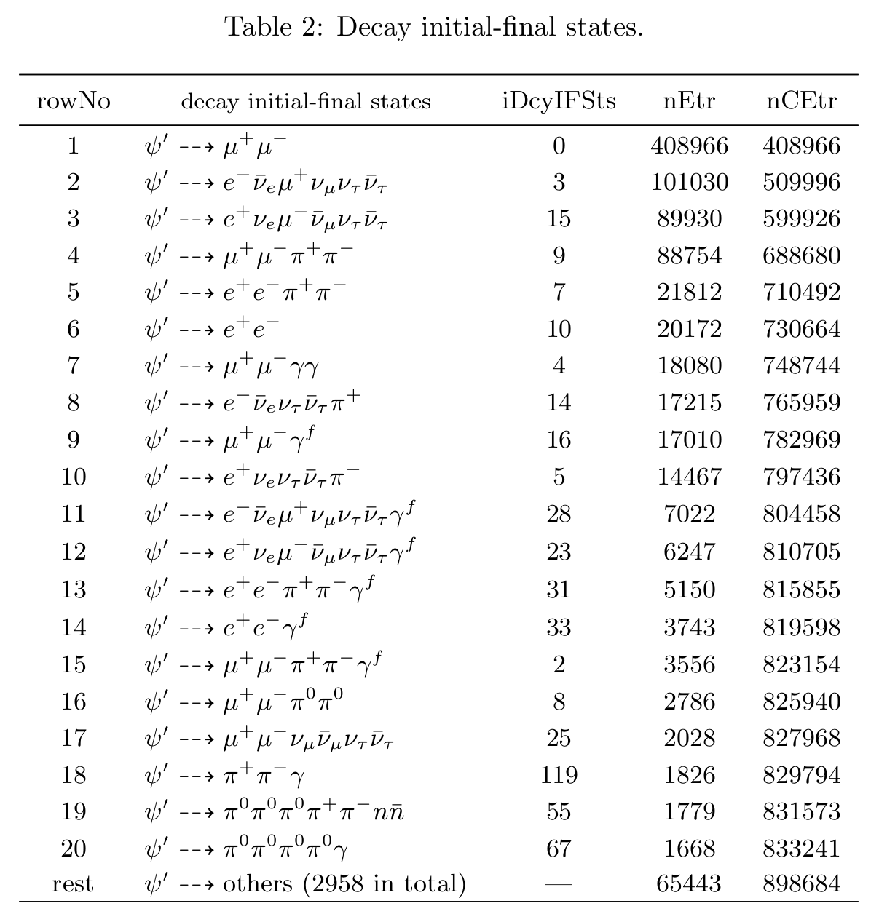
Further selection
$ψ\left(2S\right)→μ^{+}μ^{−}$
$ψ\left(2S\right)→e^{+}e^{−}$
$ψ\left(2S\right)→π^{+}π^{−}J/ψ→μ^{+}μ^{−}π^{+}π^{−}$
$ψ\left(2S\right)→π^{+}π^{−}J/ψ→e^{+}e^{−}π^{+}π^{−}$
$ψ\left(2S\right)→τ^{+}τ^{−}→e^{+}π^{−}3ν+c.c.$
$ψ\left(2S\right)→ηJ/{ψ→}μ^{+}μ^{−}γγ$
……
Need to give more cut!

Slide 11
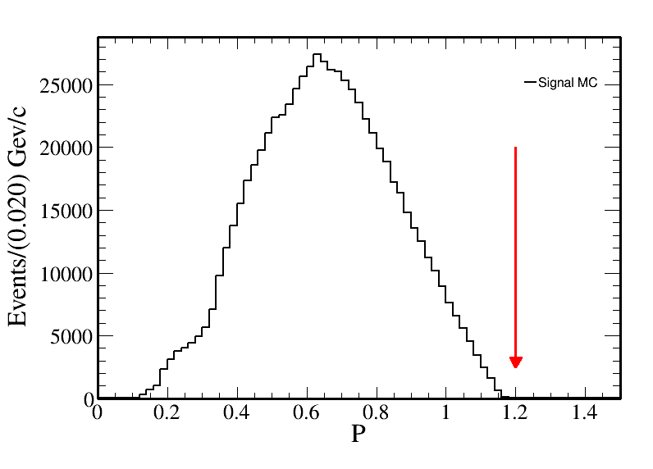
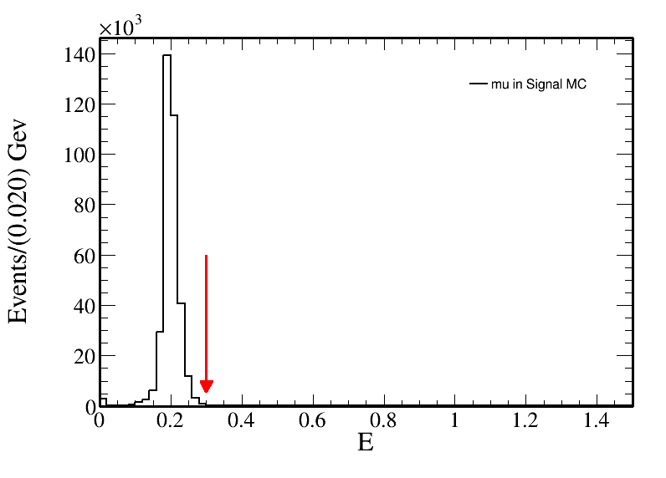
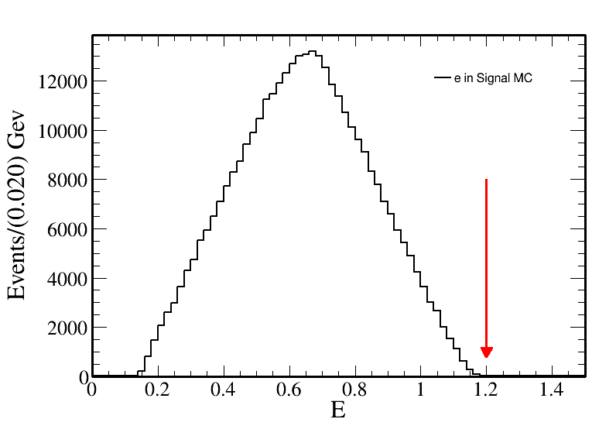
Further selection
For electron and muon:
Momentum in MDC: $P<1.2$
The energy in EMC: $E_{e}<1.2$
The energy in EMC: $E_{μ}<0.3$

Slide 12
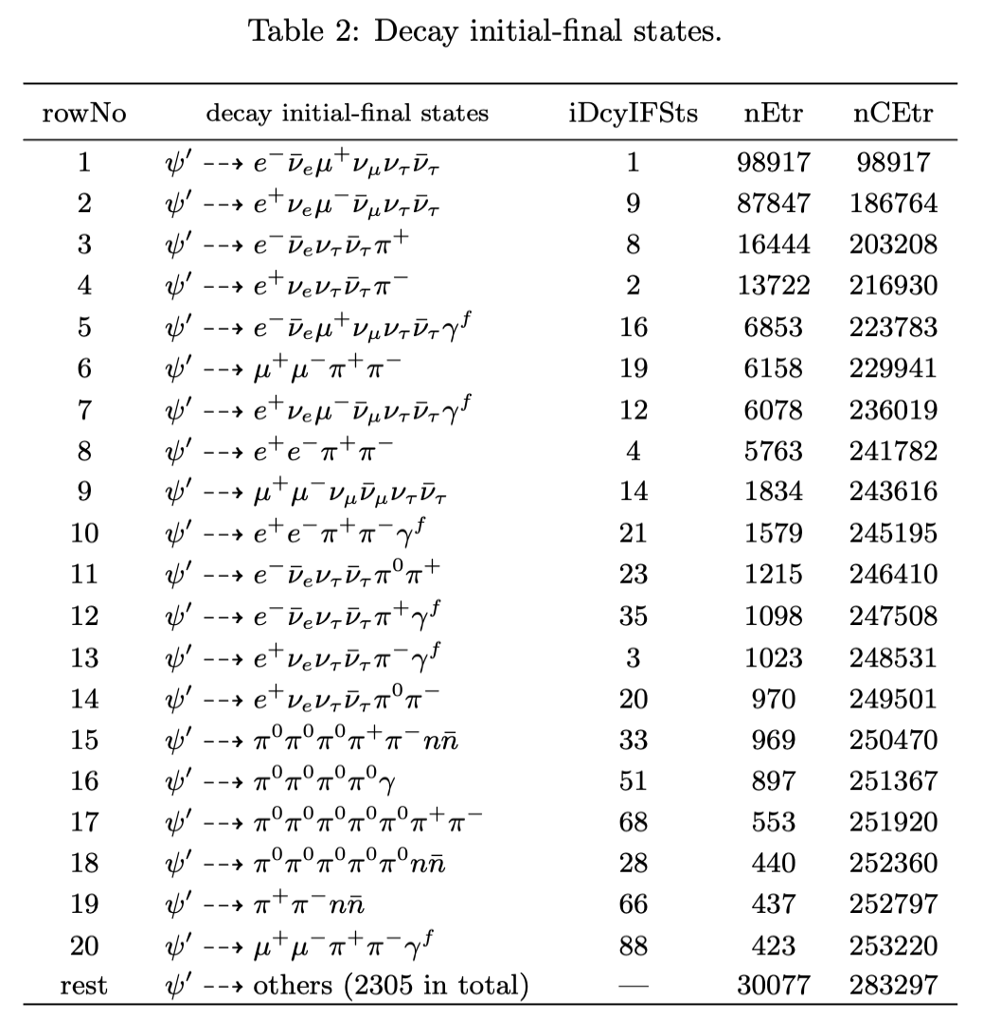
Further selection
Muon and Pion, need MUC information.
Electron, Muon
Need ep-ratio information

Slide 13
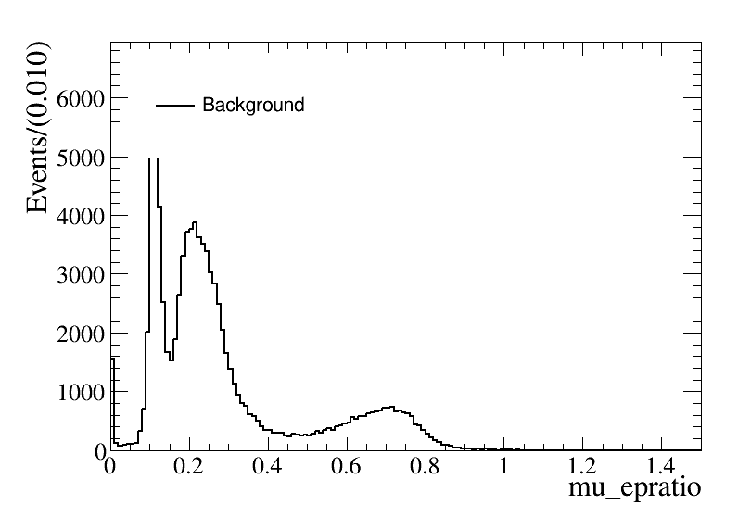
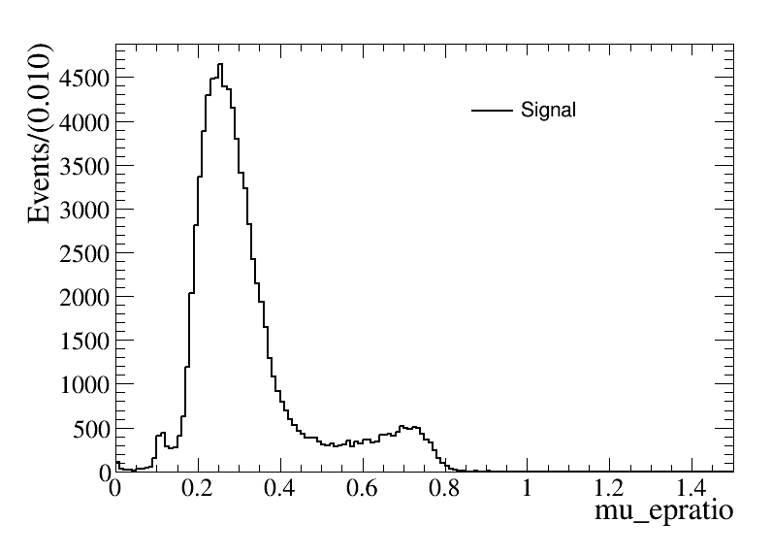
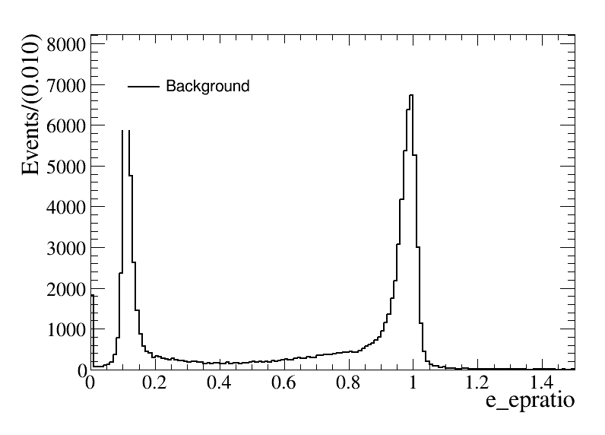
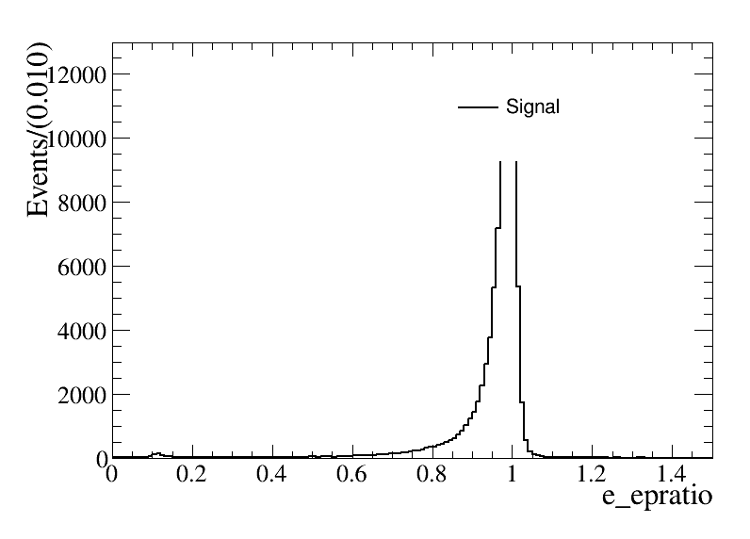
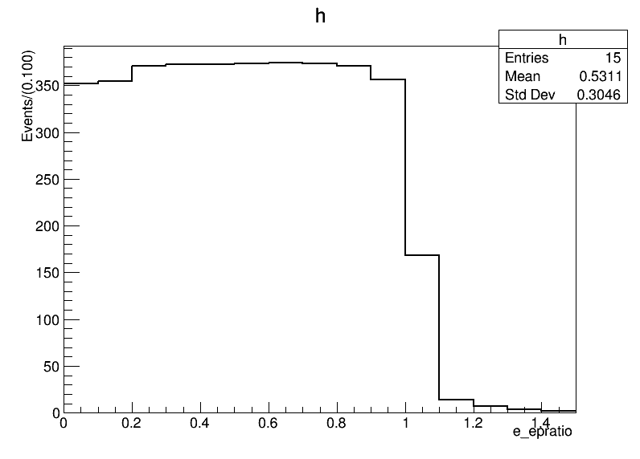
Further selection
For electron:
$FOM=S/{\sqrt{S+B}}$
$E/P>0.6$

Slide 14
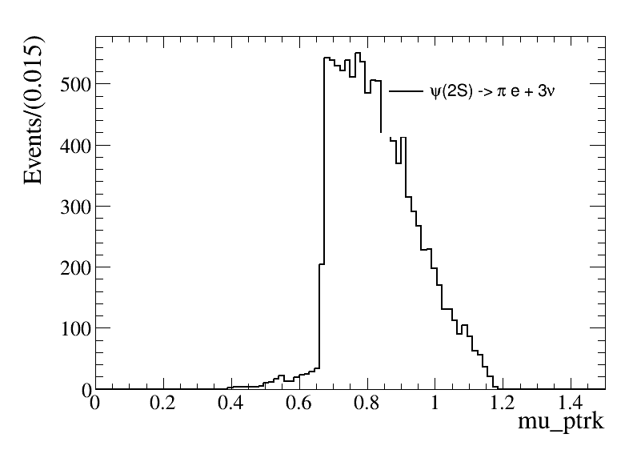
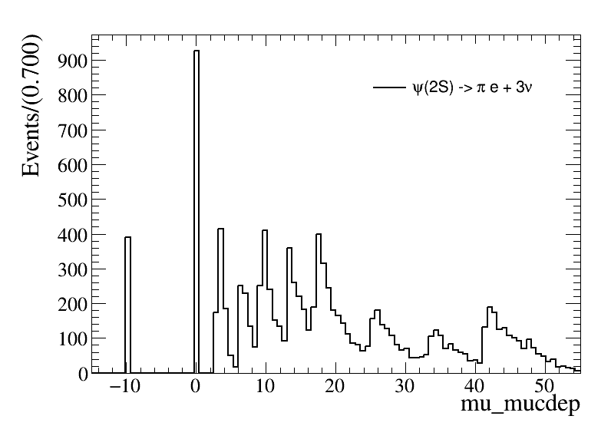
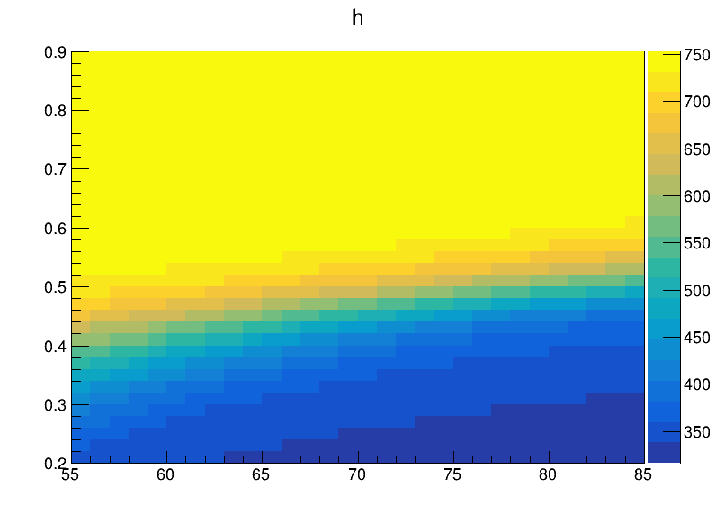
Further selection
Use the relationship between P and depth in the MUC
$FOM=S/{\sqrt{S+B}}$
$MUC_{depth}>83×(P−0.56)$

Slide 15
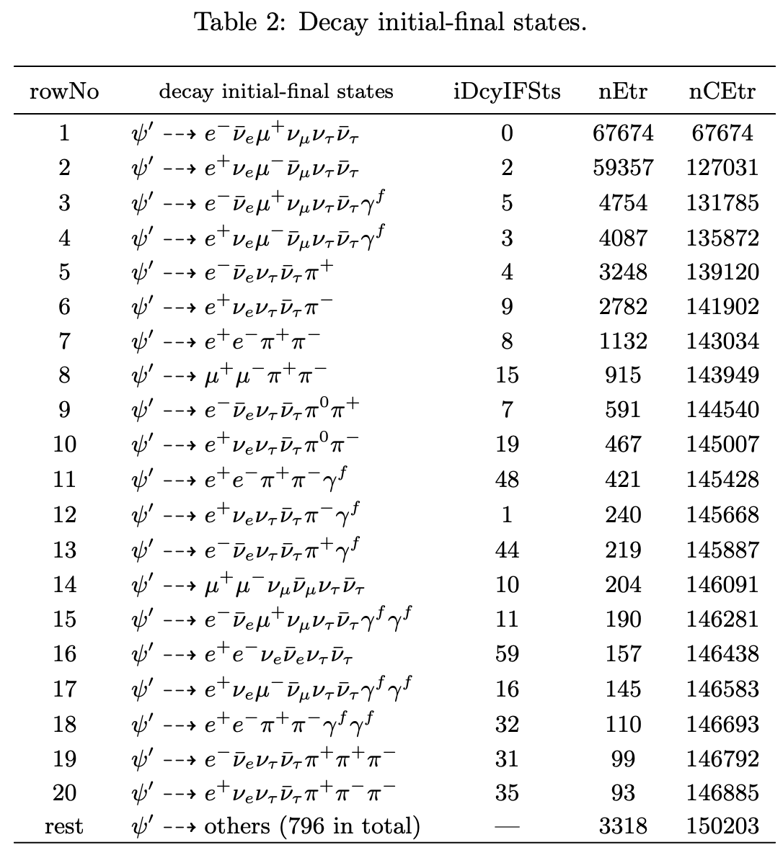
Further selection
The left background
Need the miss mass and miss $cosθ$
$M_{miss}=\left(P4_{ψ\left(2S\right)}−P4_{ll}\right)∙m()$
$cosθ_{miss}=\frac{−{\left(p_{1}+p_{2}\right)}_{z}}{|p_{1}+p_{2}|}$

Slide 16
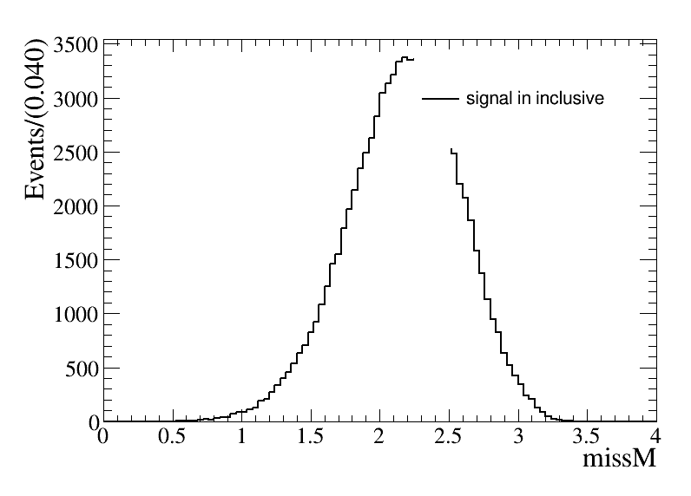
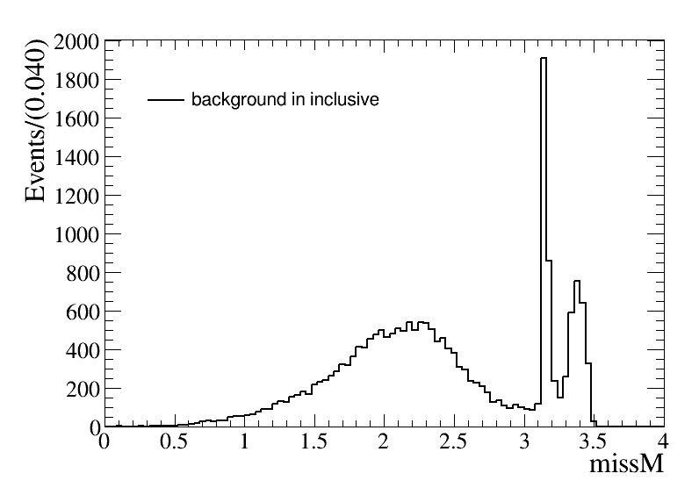
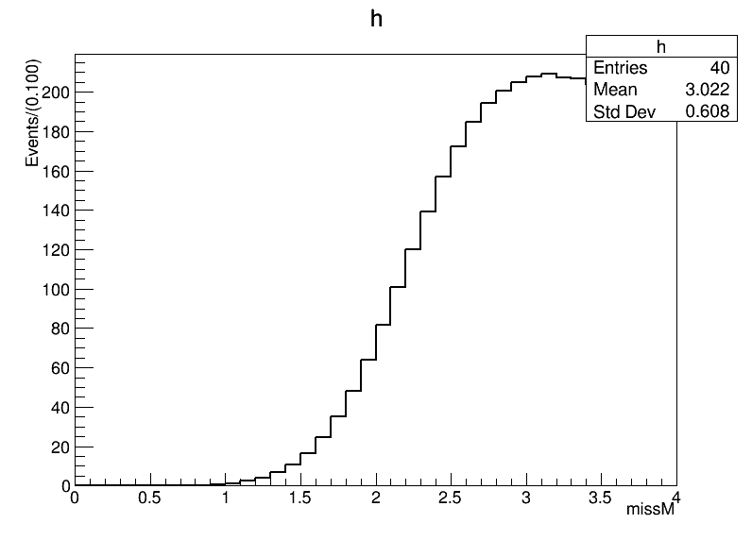
Further selection
$M_{miss}=\left(P4_{ψ\left(2S\right)}−P4_{ll}\right)∙m()$
The missing mass: $M_{miss}<3.05$

Slide 17
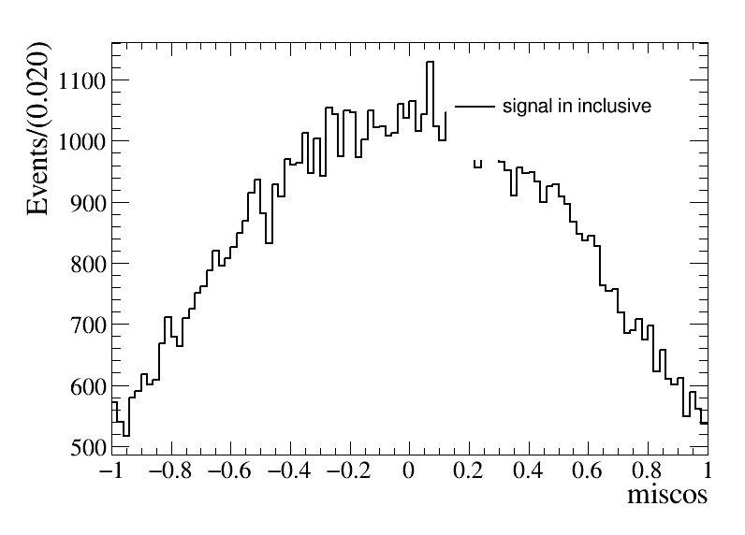
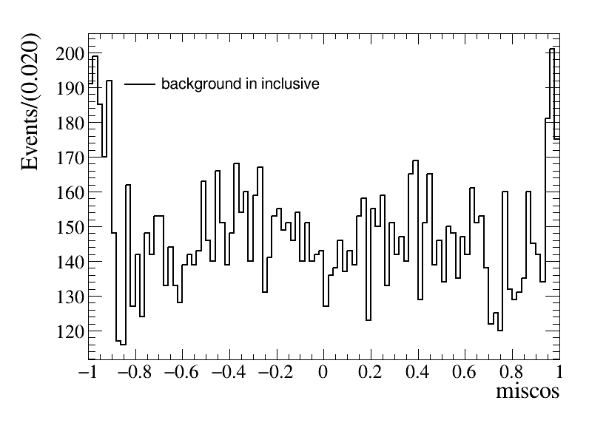
Further selection
$cosθ_{miss}=\frac{−{\left(p_{1}+p_{2}\right)}_{z}}{|p_{1}+p_{2}|}$
The missing $cosθ$: $|cosθ_{miss}|<0.8$

Slide 18
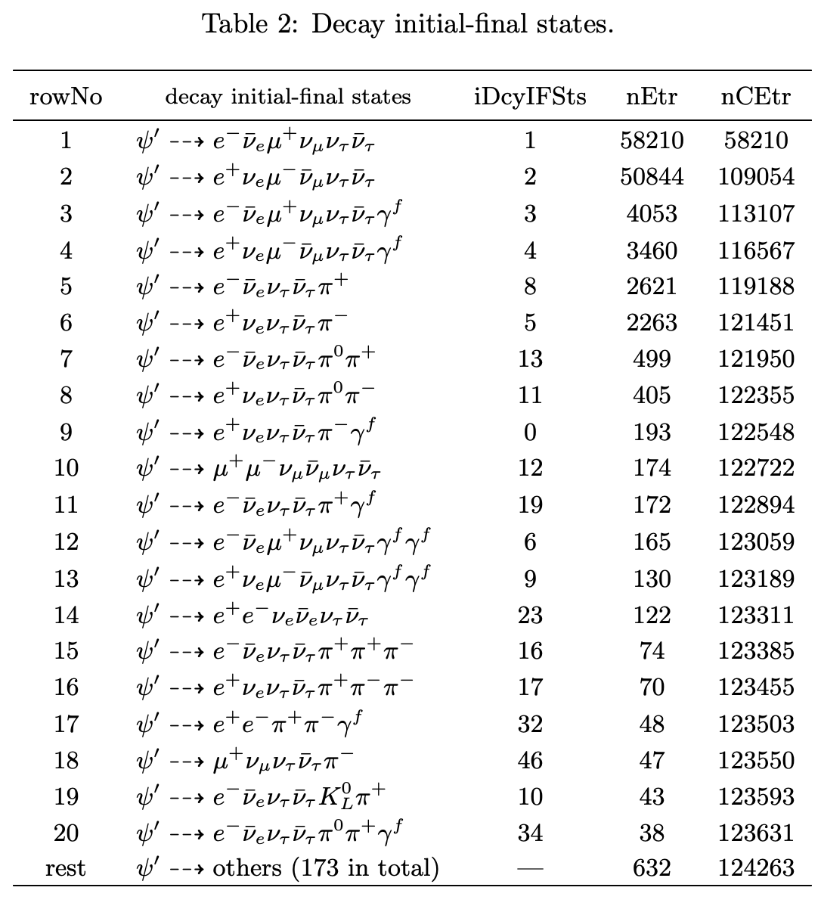
Background analysis
Main background
$ψ\left(2S\right)→τ^{+}τ^{−}→e^{+}π^{−}3ν+c.c.$
The number of background events is about 7696 in total, about 6.10% to inclusive MC.

Slide 19
Cut flow
Events selection | Signal MC | Inclusive MC
Total number | 1000000 (100.0%) | $23×{10}^{8}$
Charge choose | 826526 (82.65%, 82.65%) | $4.09×{10}^{8}$
Photon choose | 678673 (67.87%, 82.11%) | $3.77×{10}^{7}$
PID | 460925 (46.09%, 67.92%) | $9.01×{10}^{5}$
Vertex fit | 460397 (46.04%, 99.89%) | $8.99×{10}^{5}$
$$P<1.2$$ $$E_{e}<1.2,E_{μ}<0.3$$ | 457213(45.72%, 99.31%) | 283297
$$E/P_{e}>0.6$$ | 446268 (45.73%, 97.61%) | 239404
$$depth_{MDC}>0$$ $$depth_{MDC}>83×(P−0.56)$$ | 315751(31.58%, 70.75%) | 150203
$$M_{miss}<3.05$$ $$|cosθ_{miss}|<0.8$$ | 271213(27.12%, 85.41%) | 124263
Final Efficiency | 27.12%

Slide 20
Data Vs MC

Slide 21
Data Vs MC

Slide 22
Result
The result from data
$$\tilde{R}=R_{μ^{+}e^{−}}^{T}∙R_{e^{+}μ^{−}}^{T}=R_{μ^{+}e^{−}}^{CP}∙R_{e^{+}μ^{−}}^{CP}=1+4δ$$
$\tilde{R}=1.0205$ and $δ=0.0051$
$δ$ is the CP violation part

Slide 23
Systematic uncertainty
Event selection
For good charge track choose
The tracking eﬃciency uncertainties for electron and muon charged tracks are 0.5% and 0.2%.
Total uncertainty on tracking eﬃciency is 1.0% conservatively.
For good photon choose
Data-MC difference of photon selection eﬀiciencies is assigned as 0.2%.
For PID
Data-MC difference of MDC tracking eﬀiciencies is assigned as 1% per charged particle in analysis.
References：
M. Ablikim et. al. (BESIII Collaboration), Phys. Rev. D 92 112008 (2015).
M. Ablikim et. al. (BESIII Collaboration), Phys. Rev. Lett. 122, 071802 (2019).
B.X. Zhang et. al. https://docbes3.ihep.ac.cn/cgi-bin/DocDB/ShowDocument?docid=1174

Slide 24
Systematic uncertainty
Vertex fit
Fit is studied by correcting the track helix parameters to reduce the difference between data and MC.
The systematic uncertainty can be calculated by: ${ε_{1}−ε_{2}}/{2ε_{1}}$, where $ε_{1}$ is the efficiency with correction and $ε_{2}$ is the efficiency without correction.
The systematic uncertainty of 4C kinematic fit and vertex fit are calculated as 0%.
Signal window | Use correction | No correction
Final events | 460397 | 460397
Selection efficiency(%) | 46.04% | 46.04%
Uncertainty(%) | 0%

Slide 25
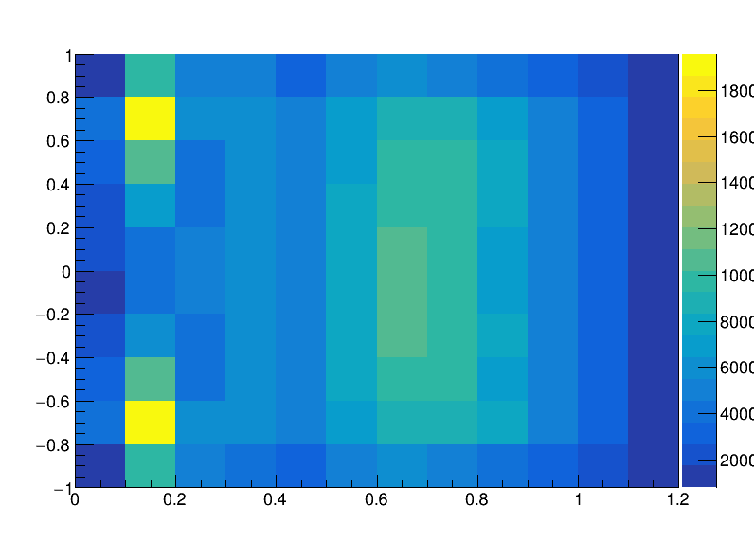
Systematic uncertainty
P, E and E-P ratio cut

Slide 26
Systematic uncertainty
$π$ and $μ$ cut

Slide 27
Systematic uncertainty
$M_{miss}$ and $cosθ_{miss}$ cut

