Slide 1
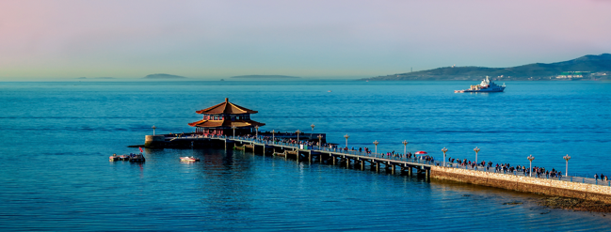
Thoughts and facts about a recent long stay in China
I. Laktineh
16th France-China Particle Physics Network/Laboratory workshop (FCPPN/L 2025) @ Shandong University -Qingdao

Slide 2
Introduction
I have started my collaboration with Chinese groups in 2008
I have hosted Chinese postdocs, PhD students and several collaborators
The topics of my collaborations have been (M)RPC, calorimetry, muon tomography, neutron detection, electronics readout and most recently photodetection.
In 2013 I invited my colleagues in Tsinghua university (Pr. Y. Wang) to join us in the iRPC proposal for the CMS upgrade project.
In 2014, with Pr. Ran Han contributed to the CEPC CDR in proposing SDHCAL.
In 2016 and in 2020 I invited my Chinese collaborators (Pr. H. Yang) to join in the European projects of AIDA200 and AIDAInnova.
In 2018, I was honoured to replace (Pr. M. Davier) as the co-chair of the FCPPL steering board.
In 2021, I was proposed as a 200-talent professor at SDU by (Pr. M. Wang and Pr. L. Zhang)
In 2023, with the initiation of the DRDx in which I took some responsibilities, the collaboration with Chinese groups became stronger and larger including Pr. J. Liu (DRD1), Pr. S. Qian and Pr. P. Chen (DRD4)
In all of these collaborations, FCPPL was an excellent framework that allowed me to appreciate not only the high scientific qualities of my collaborators but also their extraordinary friendship.

Slide 3
Why this visit
During the FCPPL meeting in Bordeaux, I told Eric about my desire to spend more time in China to strengthen my collaboration and establish new ones but also to answer a question that I was asking myself: “in case CEPC is approved, will it be easy to come to live here to participate to the big adventure?”
Eric suggested to discuss with Pr. Gang Chen who has obtained funding from MOST to invite French physicists
to visit China for this very purpose.
Usually the teaching duties prevent me from spending long periods of time abroad but by chance due to some modifications in my teaching schedule, spring period was free….
I contacted Pr. Gang Chen, asking if there is still a possibility for me to visit China and spend some time to work with my collaborators. The answer was immediate. YOU ARE WELCOME.
Usually, at least in France, the administrative way to organize a visit of a foreigner visitor is paved with hurdles. It seems that the rules are really different in China and in particular when you have Ms Jingjy Zhao taking care of the organisation. This lady is the proof that behind big institutions there are always a great staff.
What takes days for others, takes minutes and sometimes seconds for M. Zhao.

Slide 4
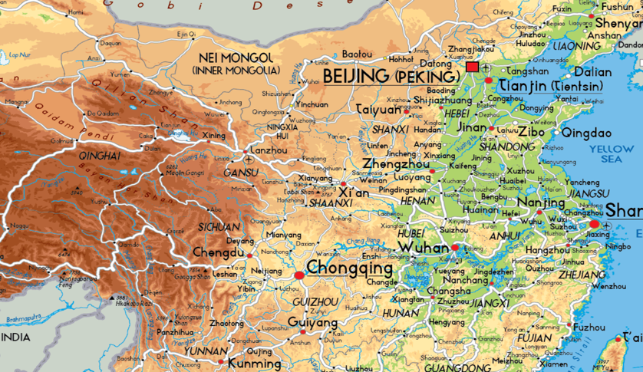
The trip

Slide 5
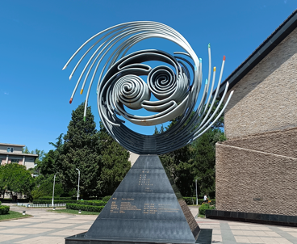
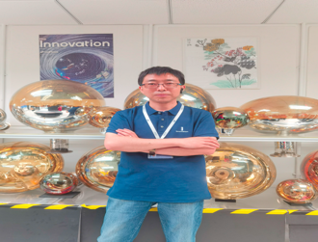
First step : Beijing
FCPPN
Discussion with Pr. Gang Chen
CEPC
Discussion with Pr. Jie Gao
Discussion with Pr. Yon Liu
Discussion with Pr. Joao Guimaraes Da Costas
Discussion with Pr. Manqi Ruan
Discussion with Pr. Yifang Wang (international ambassador of CNRS for 2025)
Seminar on SDHCAL status: present and future
DRD4
Discussion and visit of the photo-detection lab of Pr. Sen Qian
and initiation of a new collaboration on MCP-PMT simulation and
a possible future collaboration on hadron calorimetry.

Slide 6
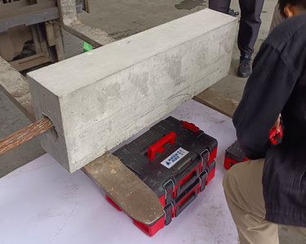
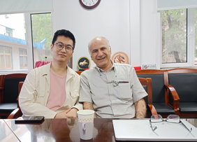
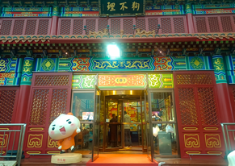
Second Step: Tianjin
Muon tomography
Visit with Pr. Ran Han team to a bridge construction company to
test muon tomography capability to detect bridge fabrication defaults thanks to a free and natural source “ the cosmic muons “.
Followed by a discussion with applied mathematicians at Nankai University on
Inversion techniques
PICMIC
Discussion with Yue Zhao (one of the most talented
young researchers in micro-electronics) and a pilar of the
PICMIc project
The last verification of the PICMIC1 ASIC was successfully
achieved a few hours before to go for a diner in a very special restaurent
Scintillator plans

Slide 7
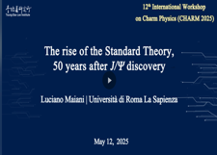
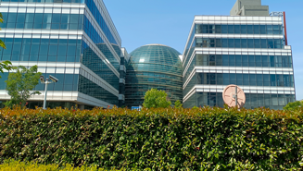
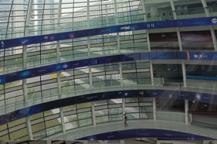
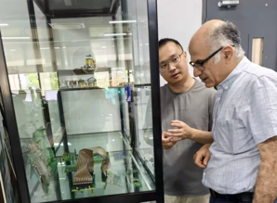
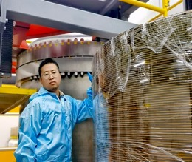
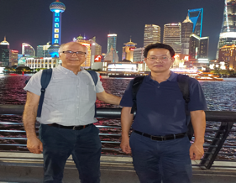
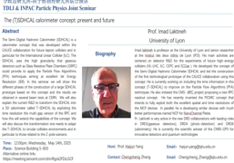
Third Step: Shanghai
12th international Charm Conference @ TDL Institute. A lot of activities in the
Charm sector either experimentally or theoretically
The architecture of TDLI building is really great.
Seminar on T-SDHCAL (with delicious pizzas offered ahead
of the seminar to all participants…)
Visit to a few SJTU labs (muon lab, T-SDHCAL, PandaX)
Work with Pr. Haijun Yang team on the next step of our collaboration on TSDHCAL
and a visit to Shanghai wonderful Bund of Shanghai.
Weihao Wu
Shoabo Wang

Slide 8
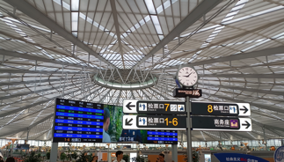
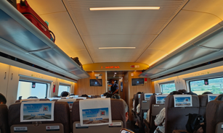
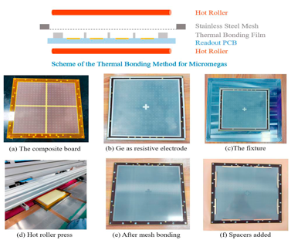
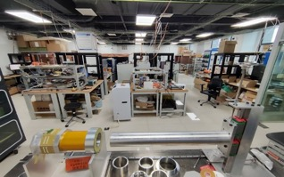
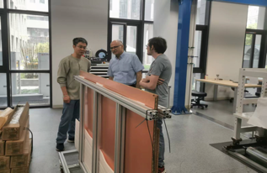
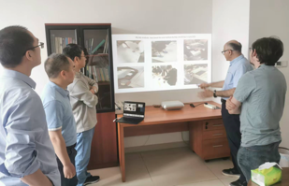
Fourth step: Hefei
Let’s take the train from Shanghai to Hefei..
USTC is a wonderful place for detector development:
Gaseous detectors ( in particular the development of picosecond concept)
and calorimetry (AHCAL) and timing electronics among others
A very brilliant physicist Jianbei Liu with whom I had a lot of discussion and ideas exchange.
Visit of the different extraordinary facilities after my seminar on SDHCAL

Slide 9
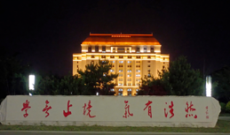
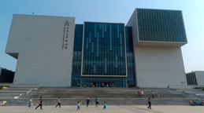
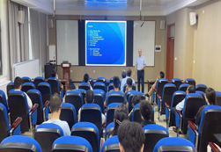
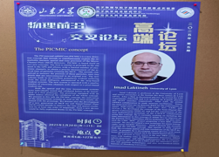
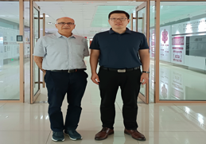
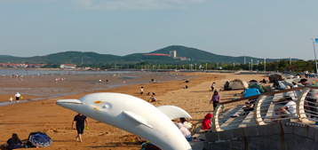
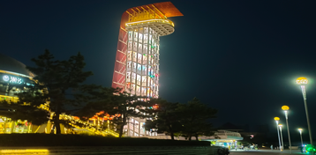
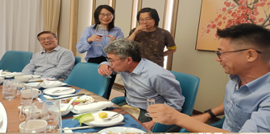
Fifth step: Qingdao
Qingdao is my second university and I feel there at home.
Three lectures on gaseous detectors
A seminar on PICMIC in which Qingdao is an essential partner (Pr. Liang Zhang)
Discussion with Pr. Chengguang Zhu on a new way of using using graphene
in future TPC to prevent IBF.
Qingdao is not only a wonderful place with excellent physicists. It is a very friendly place
and Pr. Meng Wang is the master piece of this enticing environment and in SDU they have also a wonderful person Ms L. Zhang

Slide 10
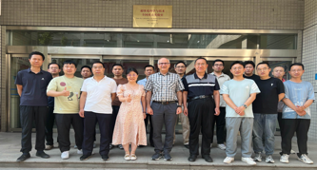
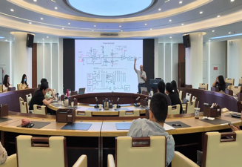
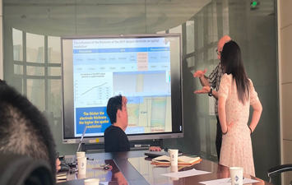
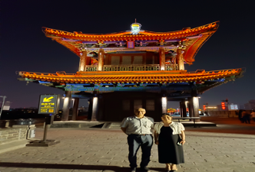
Sixth step : Xi’an
Why Xi’an?
We contacted Xi’an group three years ago to ask for their help to simulate for us the behaviour of electron cloud in the NCP we proposed….. They kindly accepted and helped.
Our collaboration started in this strange way and now within DRD4, Xi’an under the leadership of Pr. Ping Chen
(a talented physicist and a great leader) and Lyon groups are real partners.
Visit of the MCP-PMT lab (remarkable development on Streak Cameras)
Work meetings on the simulation and behaviour of MCP and NCP
Seminar on the PICMIC concept
Visit to Attosecond lab
Visit to the one of the most interesting cities in the world….

Slide 11

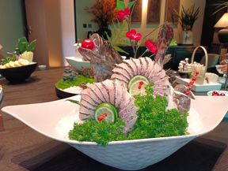
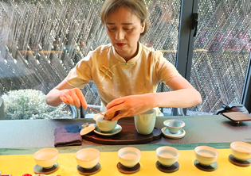
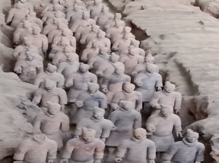
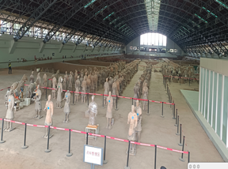
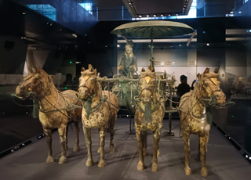
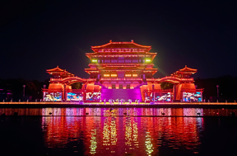

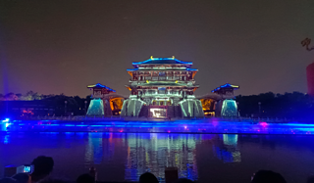
How not to fall in love with Xi’an?
Excellent food
Extraordinary history
Light city

Slide 12
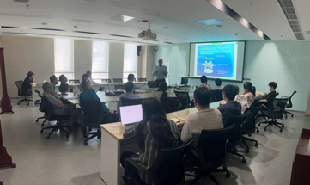
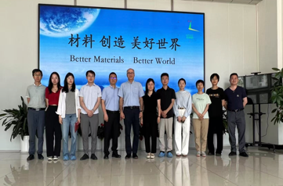
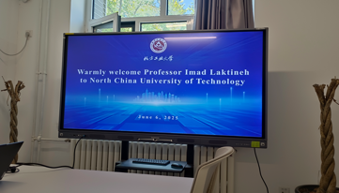
Seventh step : Beijing
IHEP:
Discussion on the Stereo Crystal Ecal proposed by Pr. Huaqiao zhang
Visit to the HGCAL lab (remarkable work)
Seminar on PICMIC concept
Discussion on ILD& CEPC
Discussion with Jingbo Ye on the timing electronics for PICMIC
Discussion with Huirong Qi on the IFB problem of the TPC
Visit to CBMA with Pr. Ping Chen
Presentation of the Lyon team activities and initiation of several
collaborations on MCP and associated topics
Visit to the North China University of technology
with Pr. Ran Han to discuss the use of robots in muon tomography projects

Slide 13
Conclusion
China is an extraordinary place with wonderful people and a great history
The quality of research conducted in many of the laboratories I visited is of a world-class level. If you are young and motivated then China is a great option.
French and Chinese groups have many things to win in working together and FCPPN is the right framework.
Personally, this experience was a wonderful one and I would encourage my French colleagues to come and spend more time working with Chinese partners.
Many thanks for Pr. Gang Chen to give me this opportunity and many thanks for all my colleagues and collaborators for their hospitality and your extraordinary kindness and help
I will be happy to be back more and more in particular now that I started to learn Chinese

Slide 14
我爱中国

