Slide 1
Development of Pixel Detectors and ASICs collaboration between CPPM & IHEP
Mujin Li – IHEP,
Institute of High Energy Physics, Chinese Academy of Sciences
FCPPN/L 2025, 21 July
The France China Particle Physics Network/ Laboratory Workshop, Shandong University (Qingdao)
On behalf of the Electronic Group of Experimental Physics Division, IHEP

Slide 2
Outline
Collaboration History
Recent：ITER XRCS
  Introduction of ITER XRCS
  System Specification
  ASIC Design
Future Collaboration Possibility : From IHEP Side
  Photon Source Detector: BPIX and HYLITE
  HEP Detector: TaichuPix and LGAD
  Prospect

Slide 3
Outline
Collaboration History
Recent：ITER XRCS
  Introduction of ITER XRCS
  System Specification
  ASIC Design
Future Collaboration Possibility: From IHEP Side
  Photon Source Detector: BPIX and HYLITE
  HEP Detector: TaichuPix and LGAD
  Prospect

Slide 4
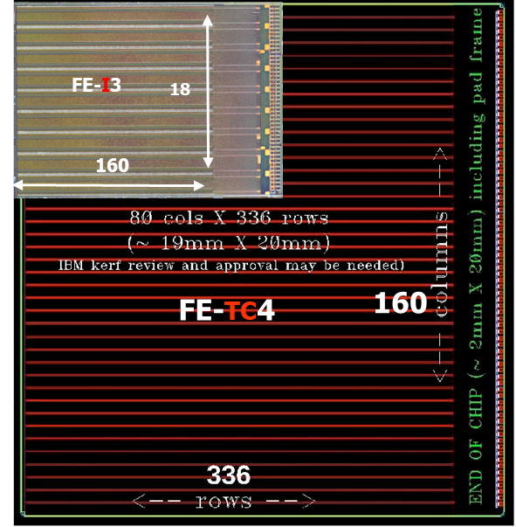
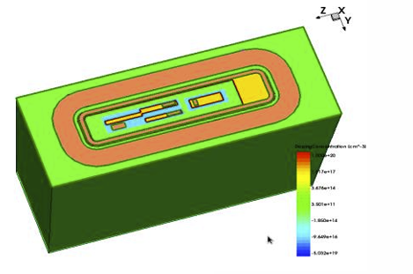
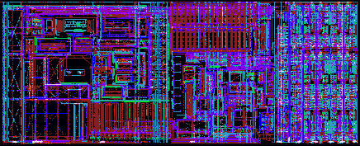
Collaboration History
A long history of communication and collaboration between CPPM and IHEP for about 15 years.
Thanks to the efforts of Pf. Marlon Barbero, Pf. Patrick Pangaud, Pf. Wang Zheng and Pf. Wei Wei, a good relationship has been set up and maintained between the two electronic groups.
ATLAS CPPM / ACC project in 2011: Wei Wei、Wang Na.
HVCMOS Sensor Design based on LF 150 nm technology in 2019: Zhao Mei.
…
The FE-TC4 ATLAS full-scale chip, 2011
FEC4_P3, 2D Chartered, 2011
LF-Monopix TCAD, 2019

Slide 5
Outline
Collaboration History
Recent：ITER XRCS
  Introduction of ITER XRCS
  System Specification
  ASIC Design
Future Collaboration Possibility: From IHEP Side
  Photon Source Detector: BPIX and HYLITE
  HEP Detector: TaichuPix and LGAD
  Prospect

Slide 6
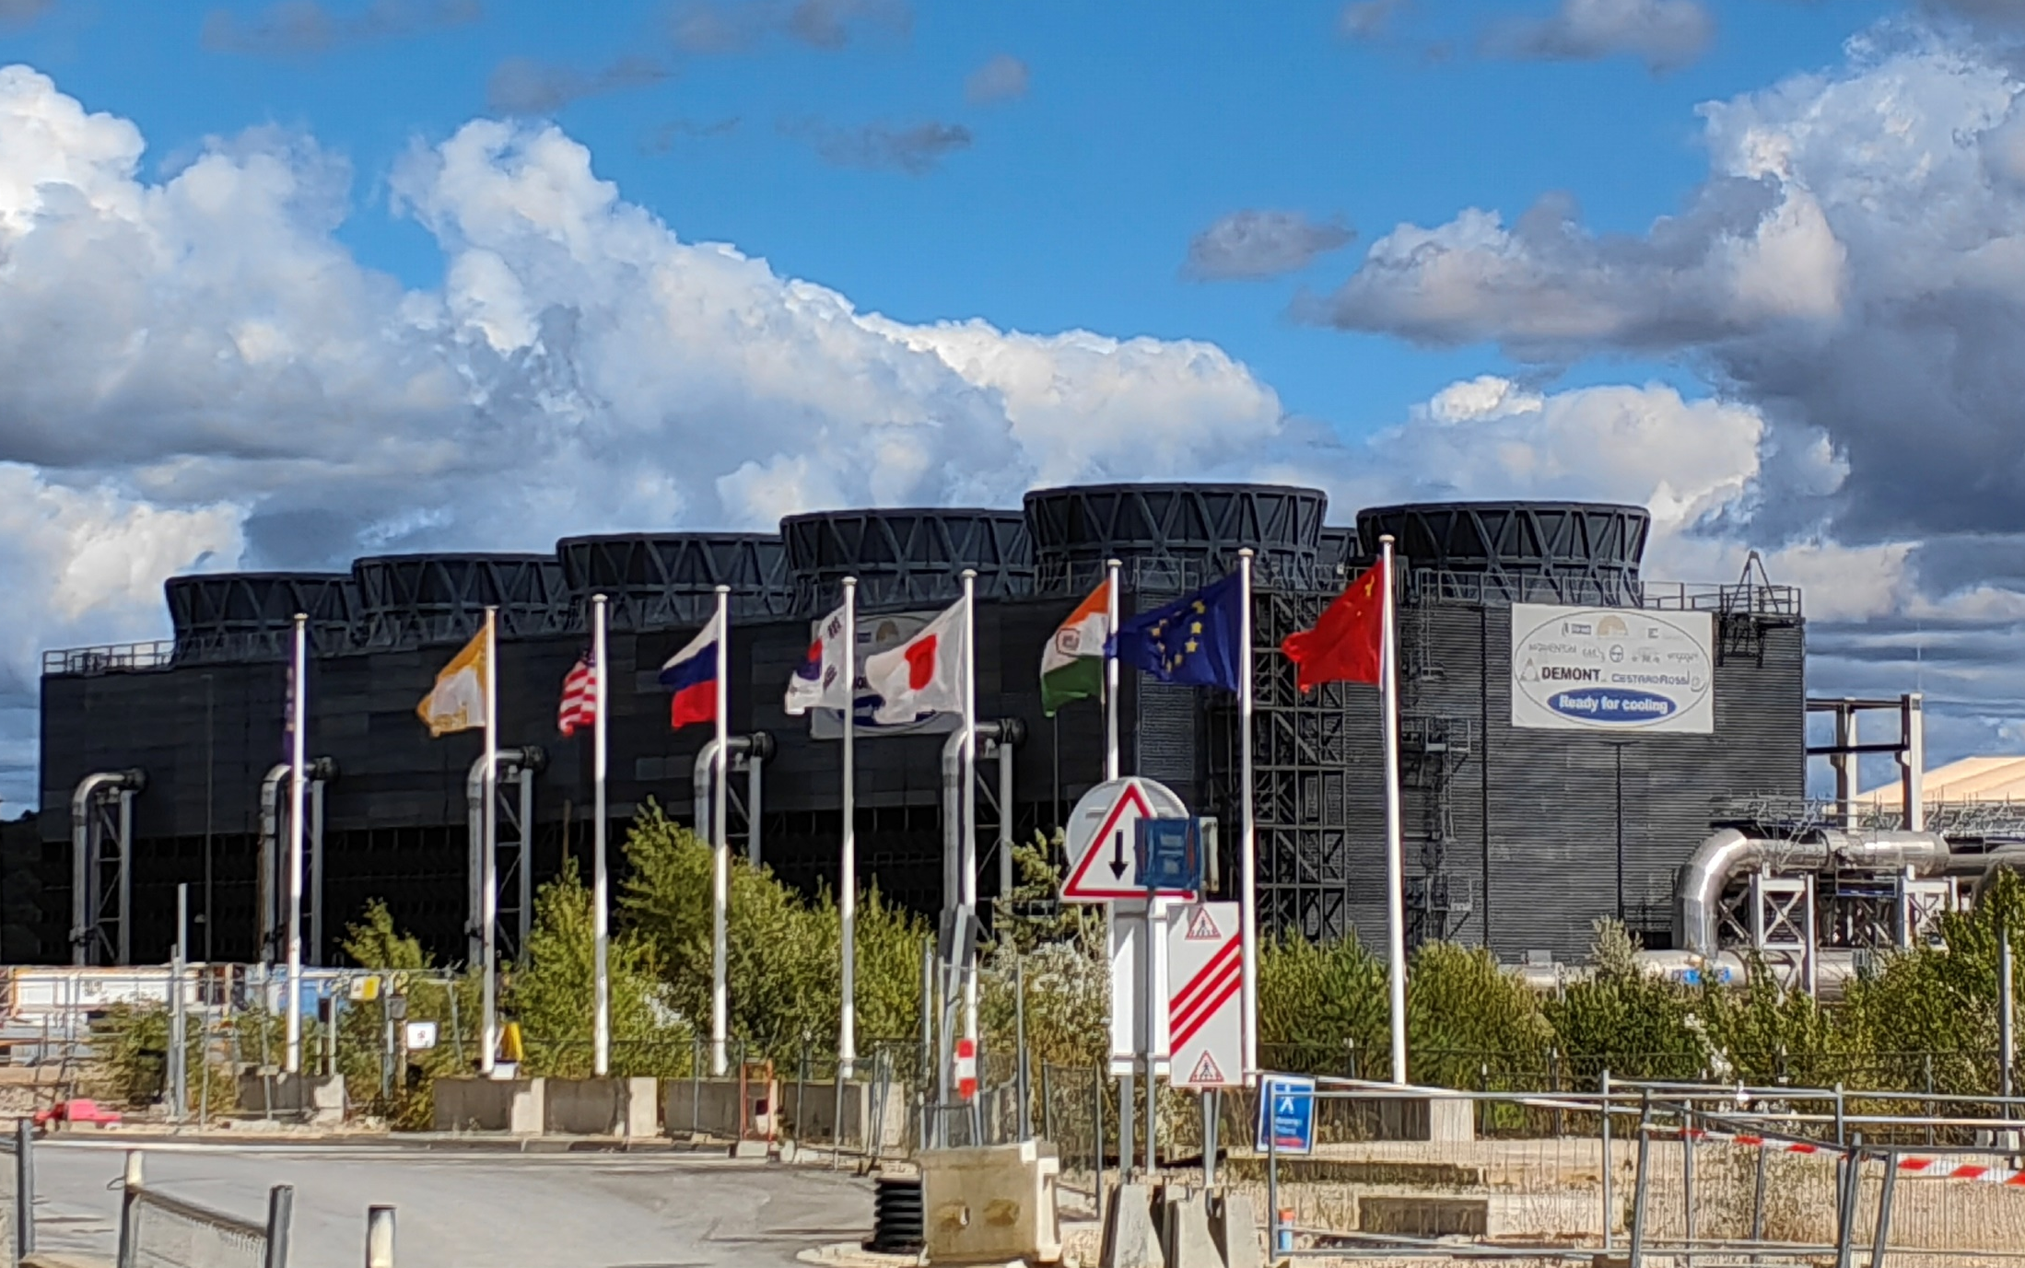
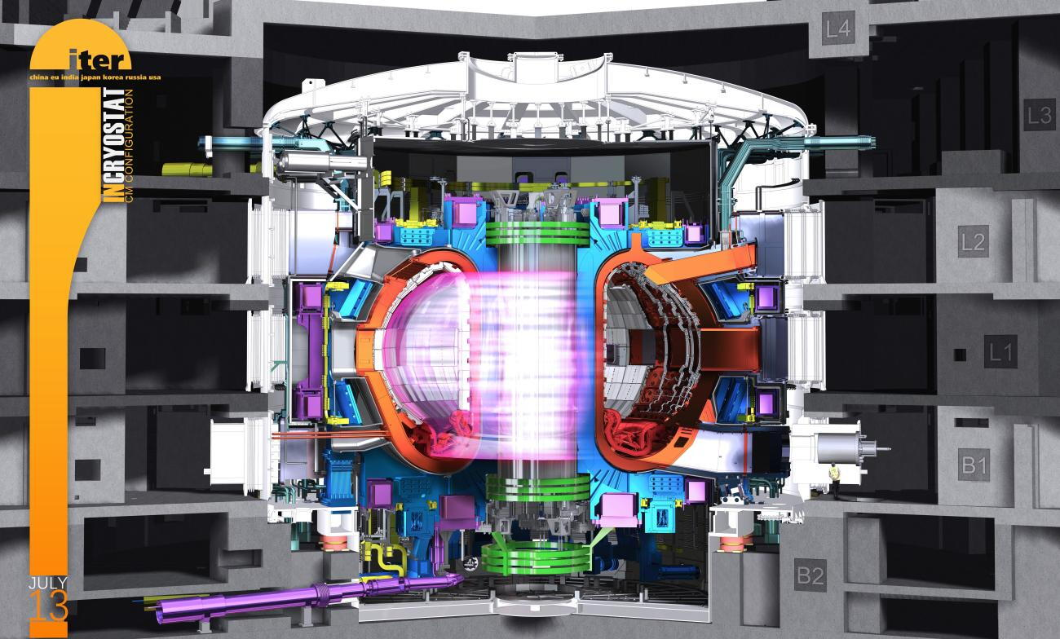
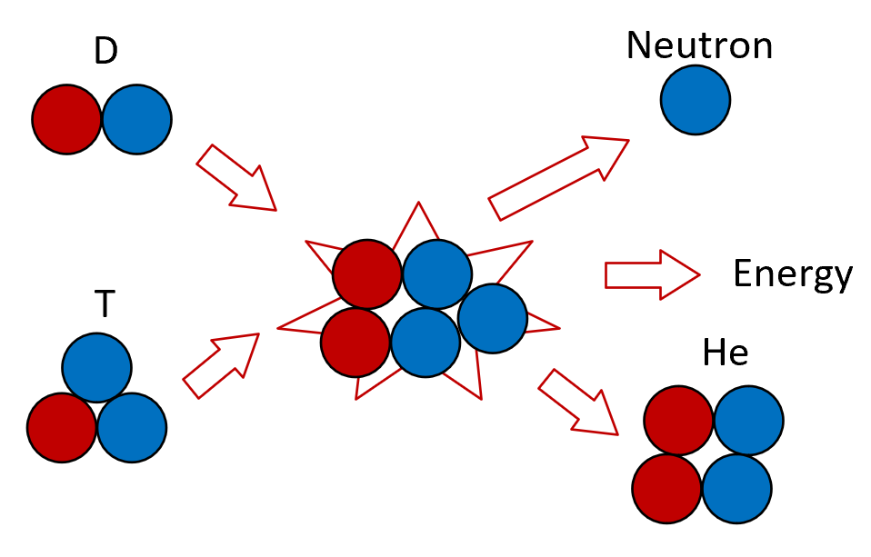
Recent cooperation: ITER XRCS
ITER 7 Cooperators：CN, EU, IN, JA, KO, RF, US
Diagnose system：“Multi-messenger”（Visible/UV/X-ray/neutron…）
XRCS: X-Ray Crystal Spectrometer: Temperature and rotate speed of plasma, first wall material…
Pixel Detector design started at 2024.9.
Main contributors: Patrick Pangaud, Marlon Barbero, Mujin Li, Danwei Xu and Wei Wei
ITER Location
ITER: International Thermonuclear Experimental Reactor
port plugs
D-T Fusion Process
Ref: Raphael TIEULENT, TWEPP2023, Sardinia Italy, October 2023
ITER Vacuum and Port Plugs

Slide 7
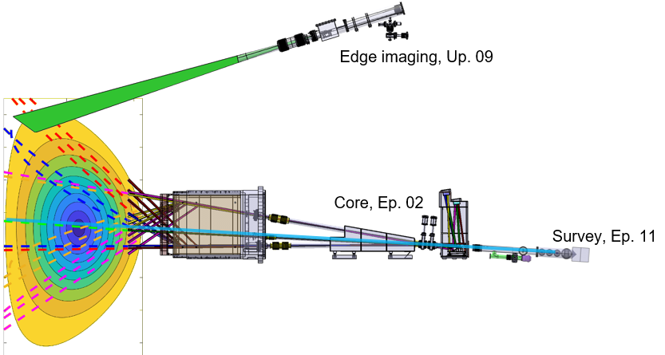
Specifications of ITER XRCS Pixel Detector
XRCS：Core/Edge/Survey：Different Detection Energy
  Core & Edge：Single-photon resolution @ 3 keV
Detector Panel Neutron Flux：10⁶ / s·cm²
  Separated front-end and back-end
Panel Size：180 mm × 85 mm
Vacuum： UHV (10⁻⁵~10⁻⁶ pa)
Magnet：0.2 T
Run-time control latency：<10 ms
Maximum Counting Rate：10⁷ counts/s/mm²
Red, Green-1 and Magenta Sights: Xe44+ (2.5525Å) and Xe47+ (2.5572Å) from 0a to 0.85a
Blue and Yellow sights: Xe51+ 2.1899Å for 0~0.55a
Green-2 View: W64+ (1.354Å) passing through plasma center
Sub-system | XRCS Core | XRCS Survey | XRCS Edge
Wavelength (Å) | 2.555 (4.852keV) 2.189 (5.663keV) 1.354 (9.156keV) | 1-100 (0.12keV - 12keV) | 3.97 (3.12keV) 3.73 (3.32keV)
Ref: Zhifeng Cheng, ITER Spectroscopic Diagnostics and Atomic Data Needs, 2023 Vienna

Slide 8
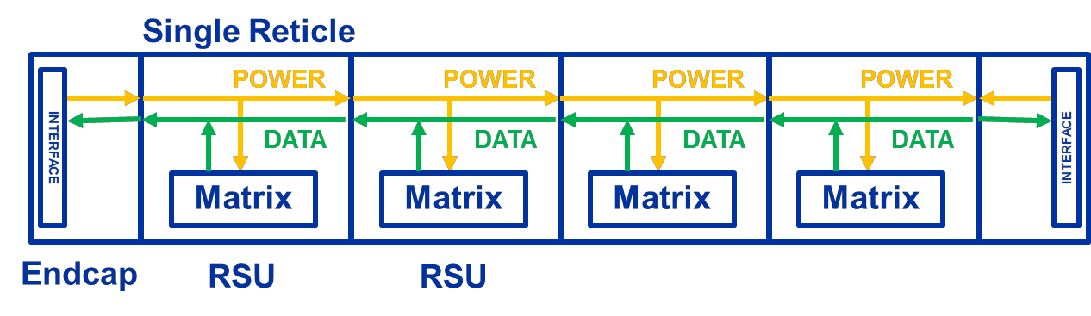
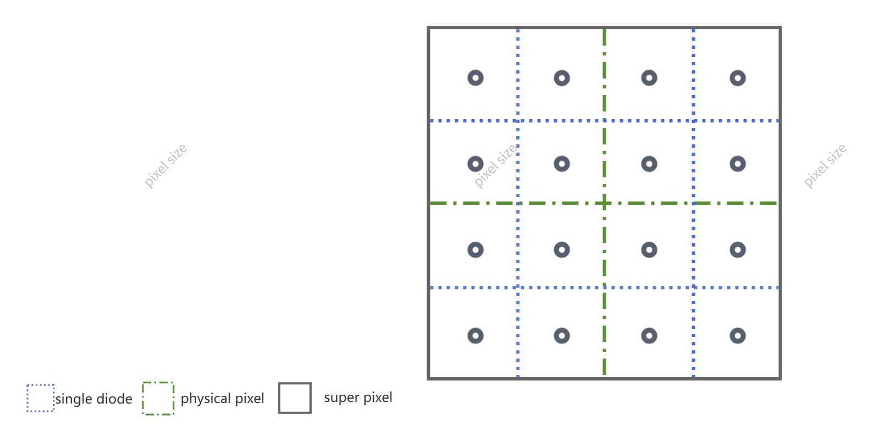
Architecture
Mujin Li, Wei Wei, Patrick Pangaud,
Marlon Barbero, Danwei Xu
Single-photon resolution @ 3keV
  MAPS + photon-counting
  C_{in} < 1 fF / diode
  Energy of threshold: 1.5 keV -> ENC < 40 e-
Large-area panel and less dead zone
  Stitching
Pixel Size: 100 μm × 100 μm
  Physical pixel：25 μm × 25 μm
  16 diodes per pixel
High flux of neutron
  Double threshold to reject neutron hits
Latency: < 10 ms
  Frame rate>100 Hz -> 200 Hz
  Two Counters/pixel，ping-pang
Stitching Structure
CIS Process Cross Section
Pixels Scale Illustration

Slide 9
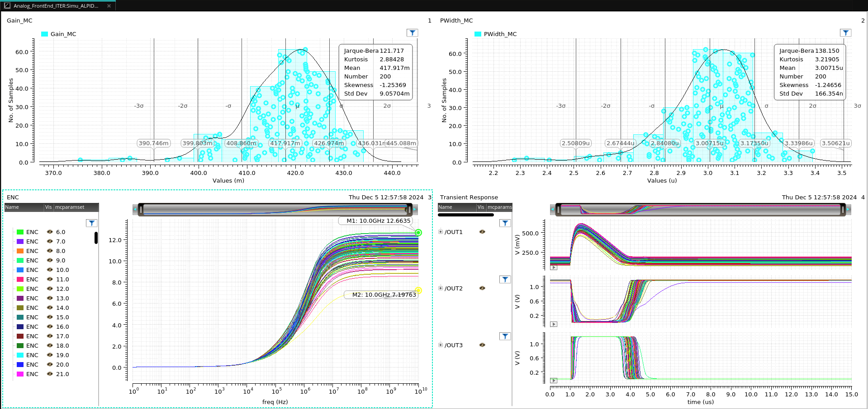
CSA + Analog Sum
Classical CSA structure
  4 diodes/CSA，PEX and modeling of the input network
Double threshold, de-offset discriminator
  Depth of the counter: 9-bits (10-bits with ovf bit)
  4 counters/pixel
Arriving time difference: 10 ns maximum
Power Consumption：~7.5 μW
ENC: < 33 e-
Analog Sum Scheme
Noise and Transient Simulations of 15 corners

Slide 10
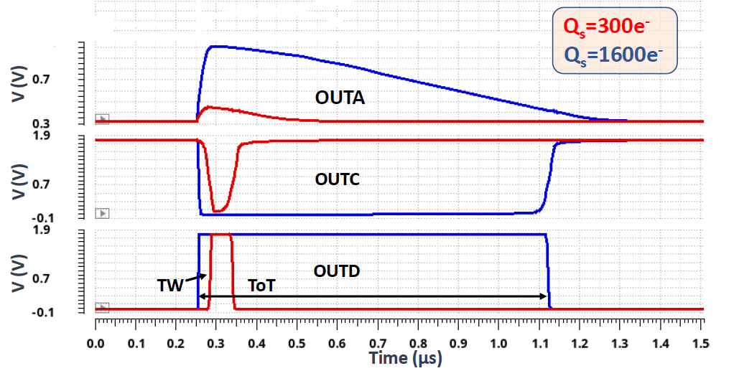
ALPIDE-like front-end + Digital Sum
ALPDE-like(TJ-Monopix1) TOT
Ref: Konstantinos Moustakas, PHD thesis, 2021
Cannot take advantage of low C_{in} by adopting CSA
ALPIDE-like front-end
  Low noise, compact
How to achieve double threshold?
  Low threshold: ALPIDE charge threshold
  High threshold: TOT（Digital threshold）
  Set different threshold by different counting depth and clock frequency
Digital Sum Structure

Slide 11
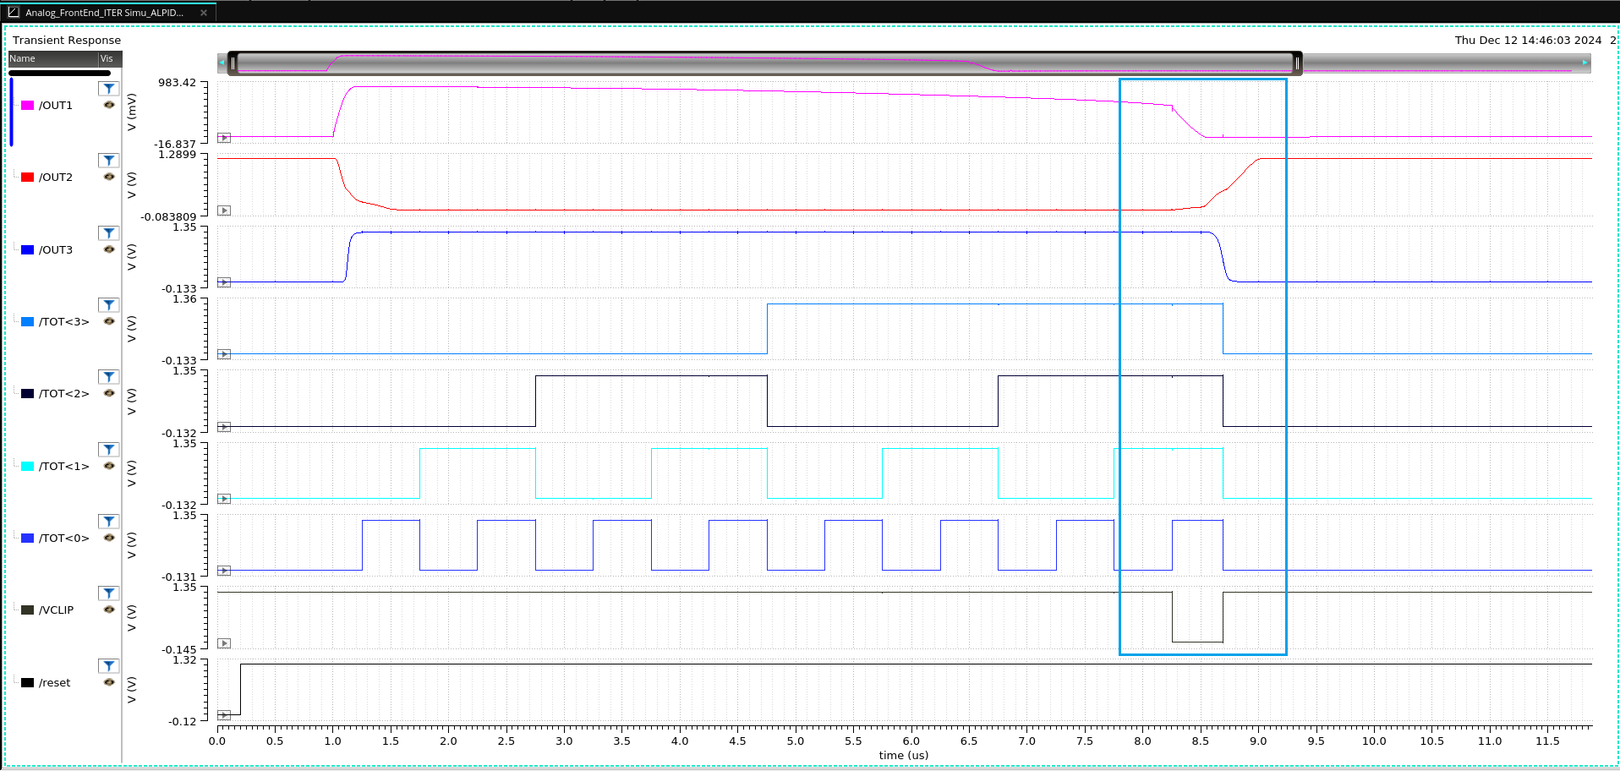
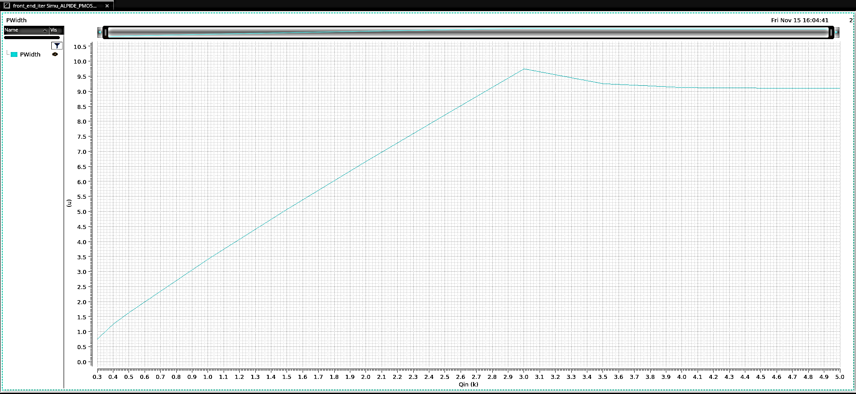
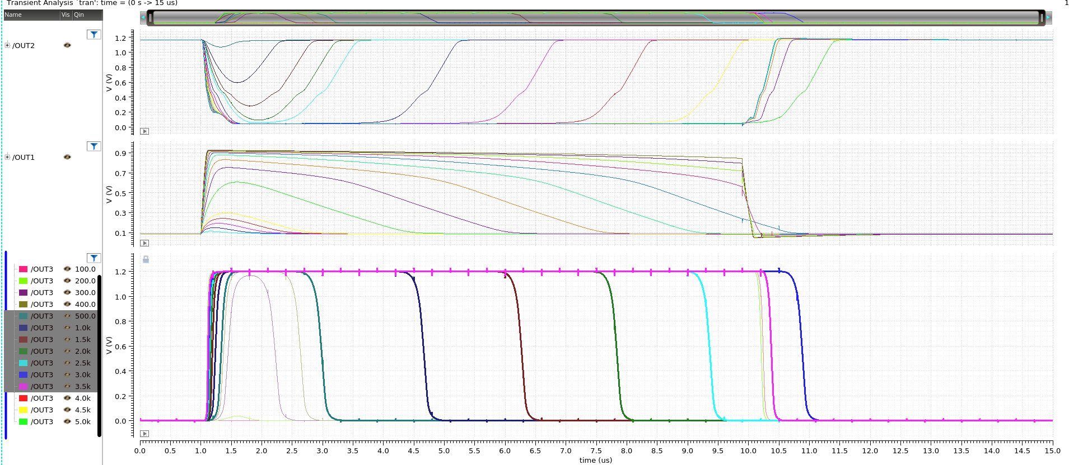
ALPIDE-like front-end + Digital Sum
TOT and Arbitration Logic
Qin-TOT Linearity (300e-~5ke-)
SPEC | Mean | Standard Deviation
Charge Gain/ (mV/ke-) | 417.9 | 9.057
Pulse width/us | 3.007 | 0.166
Power consumption: ~7 μW
ENC Monte Carlo (Qin=800 e-):
  maximum: 12.66 e-
  minimum: 7.20 e-
Qin 800e-~3000e- Transient Simulation

Slide 12
Outline
Collaboration History
Recent：ITER XRCS
  Introduction of ITER XRCS
  System Specification
  ASIC Design
Future Collaboration Possibility: From IHEP Side
  Photon Source Detector: BPIX and HYLITE
  HEP Detector: TaichuPix and LGAD
  Prospect

Slide 13
Pixel Detector in EPDEG, IHEP
Pixel Detectors
Light Source
HEP
Photon-
Counting
Charge
Integration
Sensors
MAPS

Slide 14
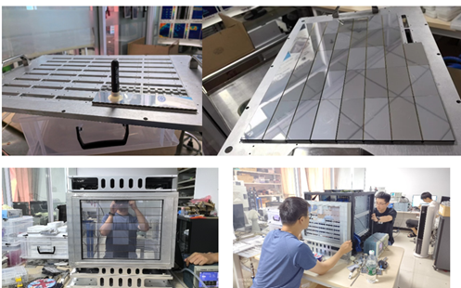
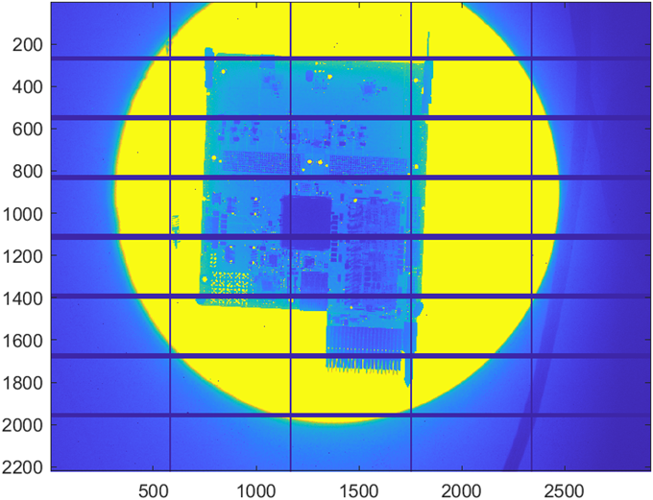
Light Source Detector: BPIX
A photon-counting pixel detector for synchrotron radiation end stations (HEPS).
New BPIX-40: A 6M system assembled for the HEPS beamline BA.
A series of detectors in different dimensions (2M/1M …) are also scheduled
Specs | BPIX-20 | BPIX-40
Pixel size | 150 μm×150 μm | 140 μm×140 μm
Pixel Array | 104×72 | 128×96
Threshold | 1 | 2
Gain | Fixed | 2 bits tunable
Counting rate | > 2Mcps | > 2Mcps @ Med gain
Frame rate | 1.2kHz | 2kHz
Counting Depth | 20 bit | 14 bit
Detector Module | 2×4 (208×288) | 2×6 (256×576)
Module Gap | 3mm by TSV | 2.7mm by WB
6M BPIX-40 pixel detector
6M pixel detector Imaging Test

Slide 15
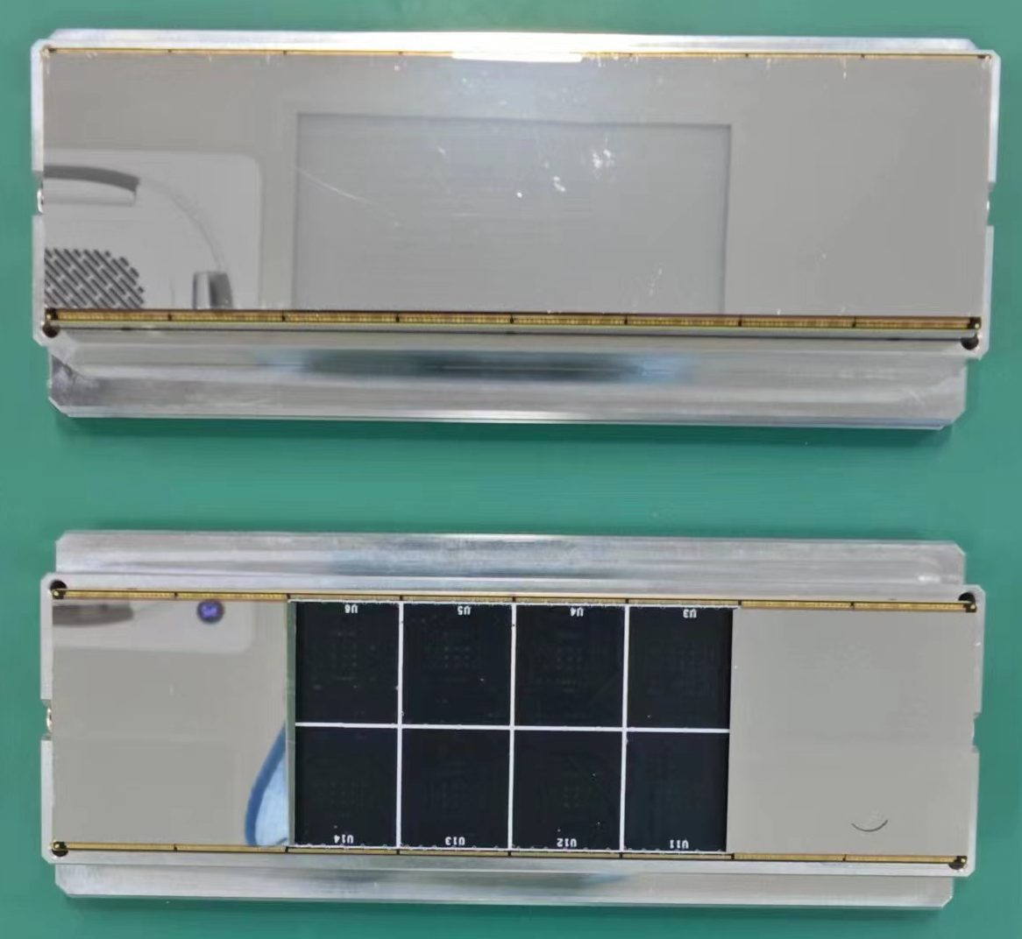
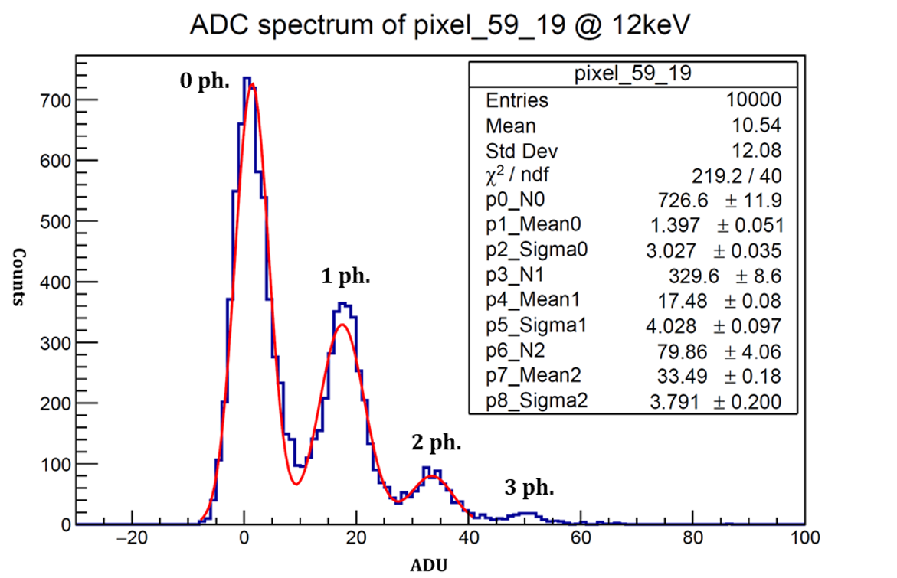
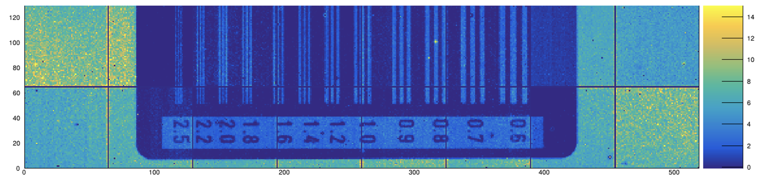
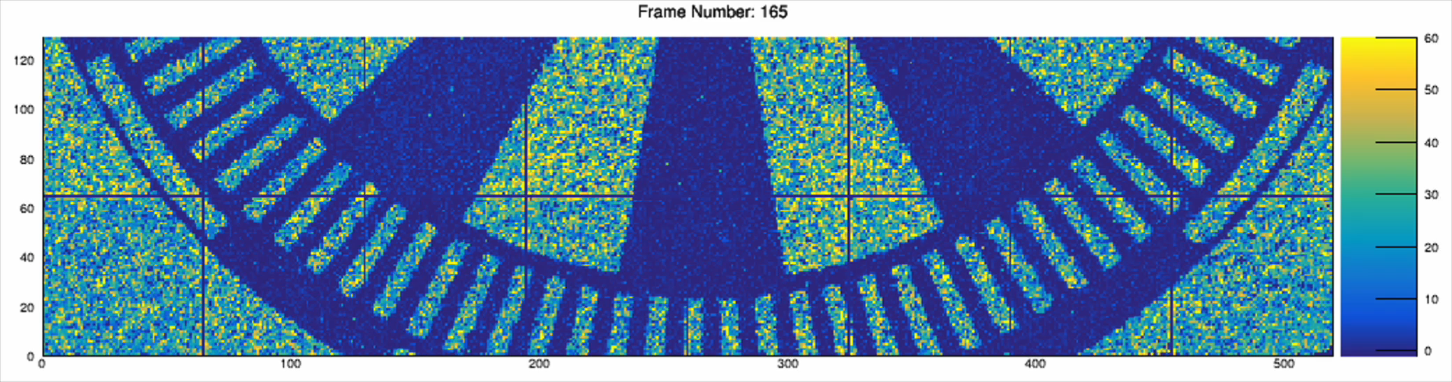
Light Source Detector: HYLITE
A charge-integration pixel detector for XFEL (SHINE) with large dynamic ranges and high frame rates.
Cooperation of 4 institute/university
The 200-μm edition has been fully tested and performs well.
The 100-μm edition is under manufacturing.
The Detector Module
Energy calibration @ 12keV
Specs | SL1 | SL0
Sensor | 500 μm silicon PIN | /
Pixel Size | 100μm×100μm | 200μm×200μm
Array Size | 128×128 | 64×64
Dynamic Range | 1~10000 ph./pulse/pixel @12 keV | /
Frame Rate | 10 kHz (continuous readout) | 1 kHz
Detector Scale | A 4M pixel detector in vaccum, quadrant movable | 2×8 ASIC module
1 kHz Frame Rate Test

Slide 16
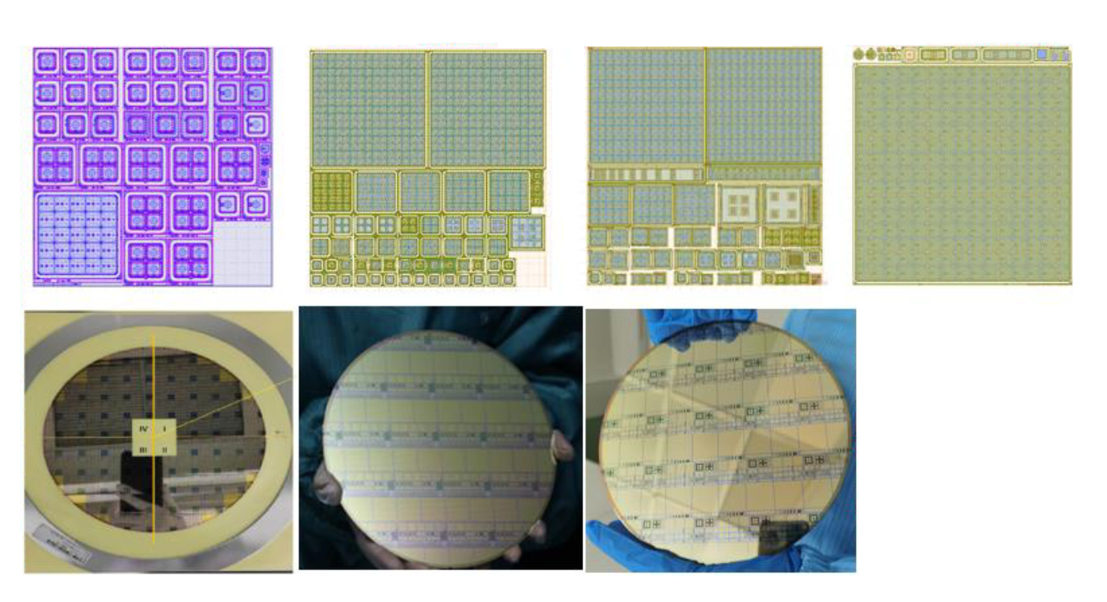
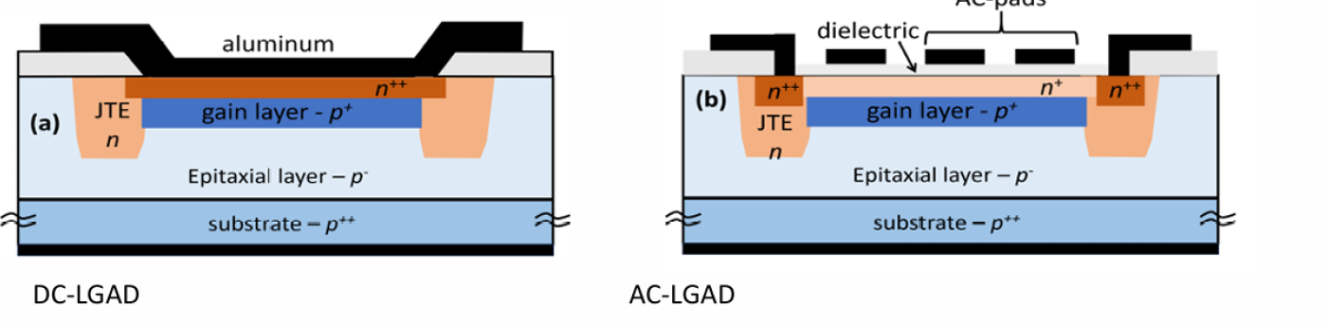
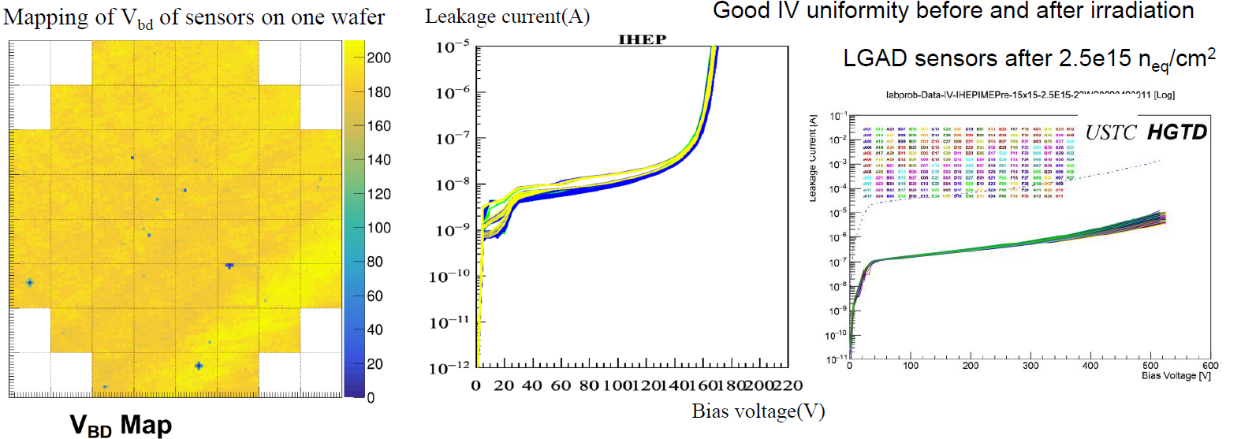
HEP: LGAD
IHEP-IMEv1(2020.9)
IHEP-IMEv2(2021.5)
IHEP-IMEv3(2022.5)
Pre-Production(2023.3)
Main contributor: Zhao Mei
For ATLAS HGTD: 100 % procurement share
Breakdown voltage deviation for 225 pads is less than 5%.
Beam Test at DESY and CERN:
  Collected charge: more than 15 fC charge before irradiation and >4 fC charge after.
  Timing resolution: better than 35 ps before and after irradiation.
Performance fulfills HGTD requirement.
IHEP-IME LGAD Development History
Good IV Uniformity before and after Irradiation
Notes:
2.5 ✕ 10^15 n eq /cm 2

Slide 17
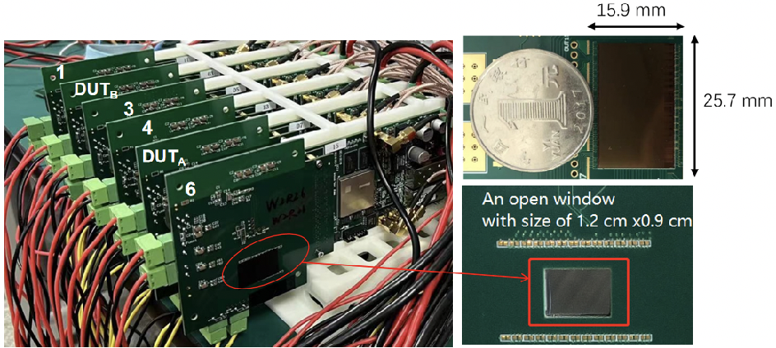
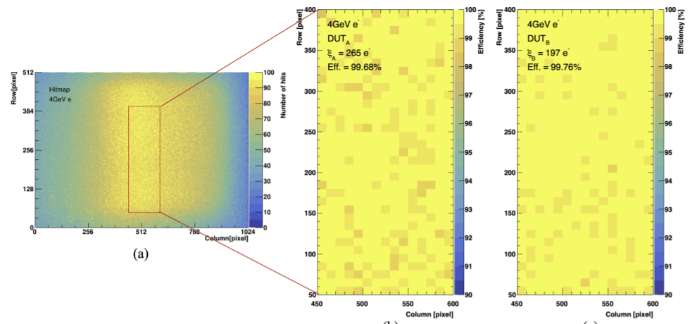
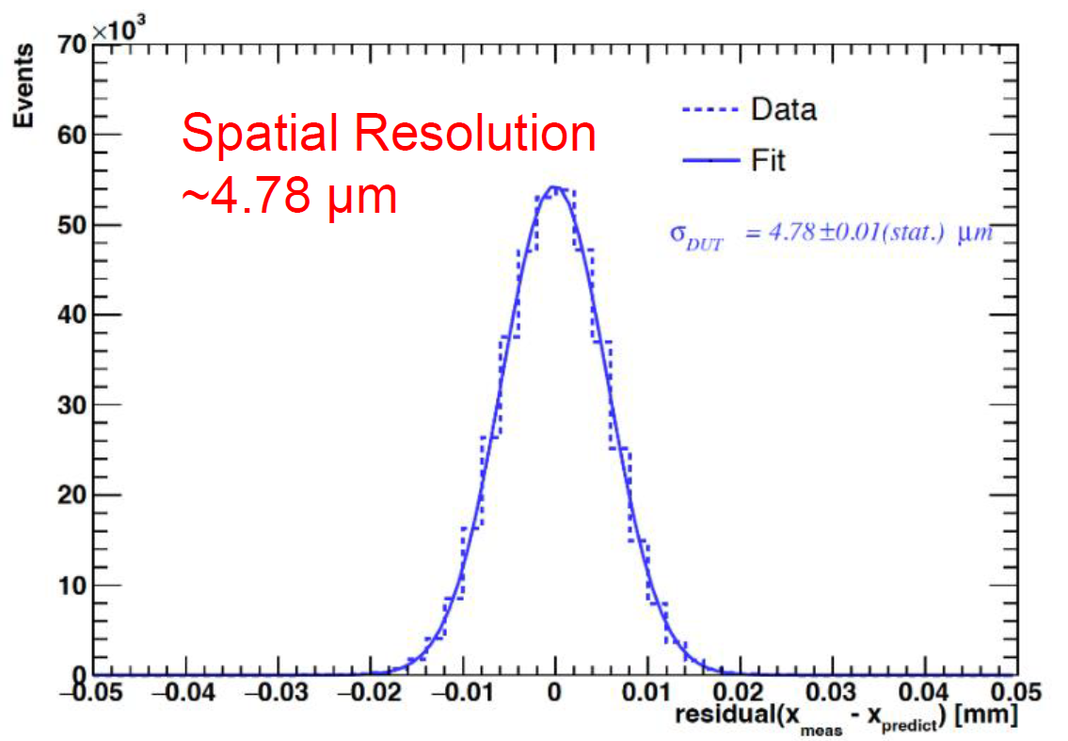
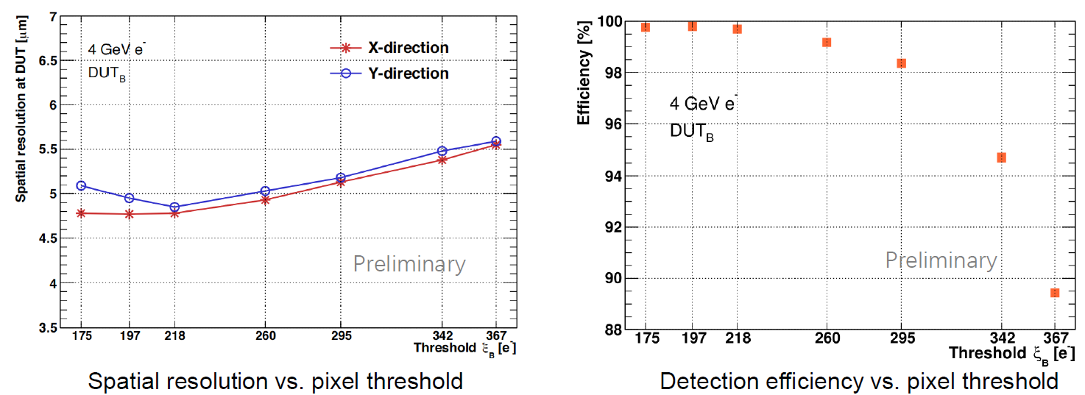
HEP: TaichuPix
For CEPC Vertex
Pixel Size: 25 μm × 25 μm
  Continuously active front-end, in-pixel discrimination
  Fast-readout digital circuits
Column-drain readout for pixel matrix
  Priority based data-driven readout
  Readout time: 50 ns for each pixel
2-level FIFO scheme
Trigger-less & Trigger mode compatible
  Trigger-less: 3.84 Gbps data interface
  Trigger: data coincidence by time stamp, only matched event will be readout
Spatial Resolution: <5μm
Detection Efficiency: >99.5%
Stitching Prototype is developing based on TaichuPix3
6-laiyer TaichuPix-3 Telescope
Vertex Ladder Prototype based on TaichuPix-3
TaichuPix-3 Hitmap and Detection Efficiency
TaichuPix-3 Spatial Resolution
Notes:
99.5% at threshold with best resolution

Slide 18
Outline
Collaboration History
Recent：ITER XRCS
  Introduction of ITER XRCS
  System Specification
  ASIC Design
Future Collaboration Possibility: From IHEP Side
  Photon Source Detector: BPIX and HYLITE
  HEP Detector: TaichuPix and LGAD
  Prospect

Slide 19
Prospect
There are many possibilities for cooperation between IHEP and CPPM based on our project basics:
Photon Detector: The demand of soft-Xray pixel array detector based on CMOS is growing. Two main technical paths: MAPS and LGAD.
  MAPS: Low C_{in} lead to low noise. Both of us have the design experience.
  LGAD: Sensor with gain. PSI’s main research direction.
HEP:
  CEPC Vertex development. TaichuPix is open to international cooperation.
  Tracker: HVCMOS
More communication and cooperation will decrease misunderstanding and benefit both of us!

Slide 20
Thank you!

Slide 21
Back Up Slides

Slide 22
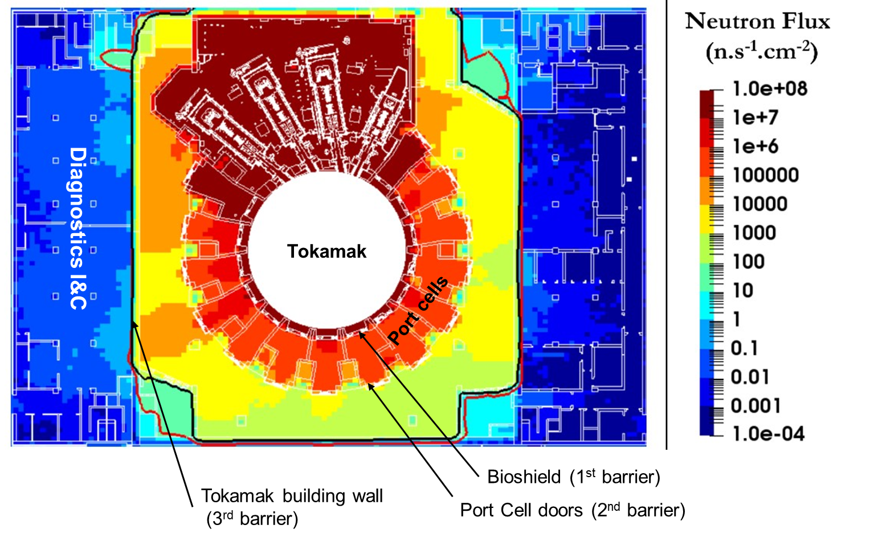
ITER Neutron Flux
Ref: Raphael TIEULENT, TWEPP2023, Sardinia Italy, October 2023

Slide 23
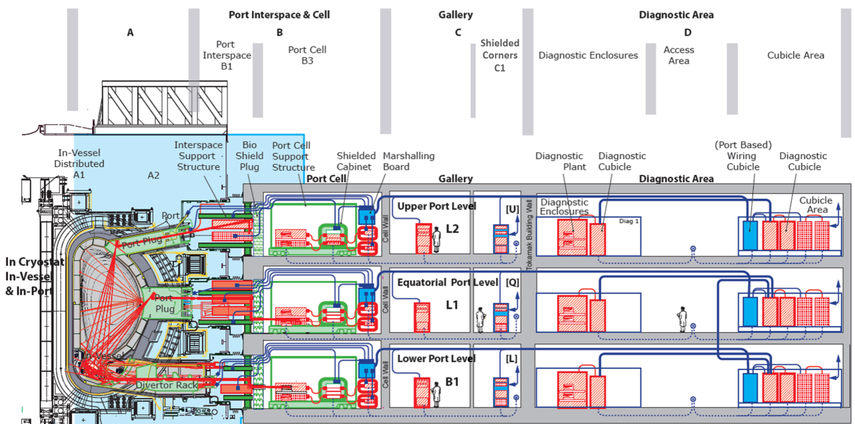
ITER and Diagnose System
port plugs
In-vacuum
Ref: Raphael TIEULENT, TWEPP2023, Sardinia Italy, October 2023
Notes:
ITER has 26 diagnostic ports which house about 50 diagnostic systems，1/3 of the systems are spectrometric

Slide 24
CSA-Pixel Structure

Slide 25
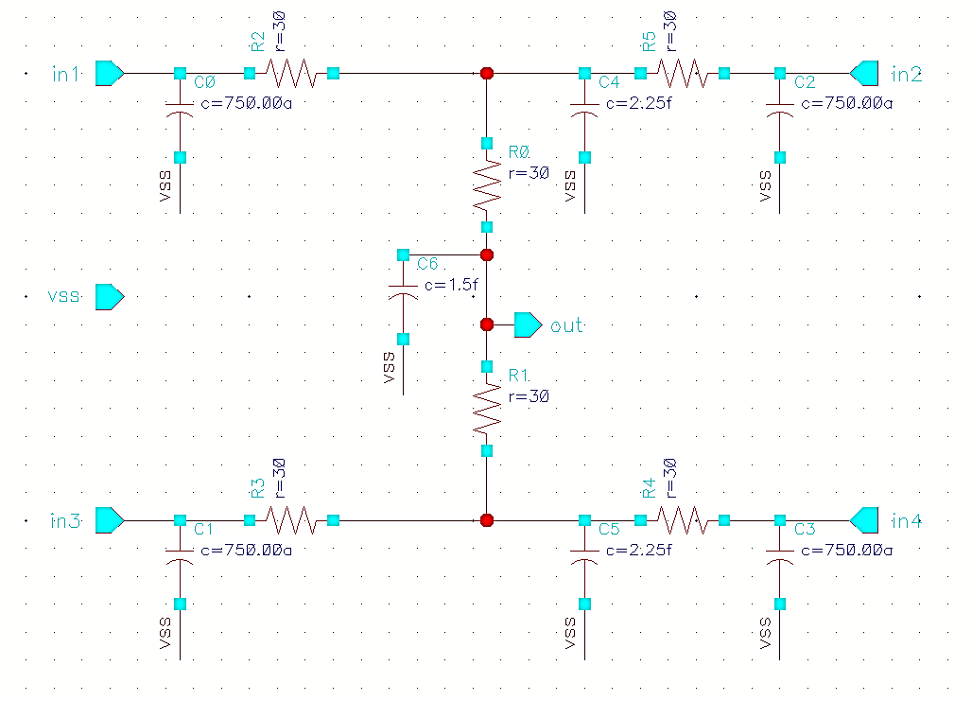
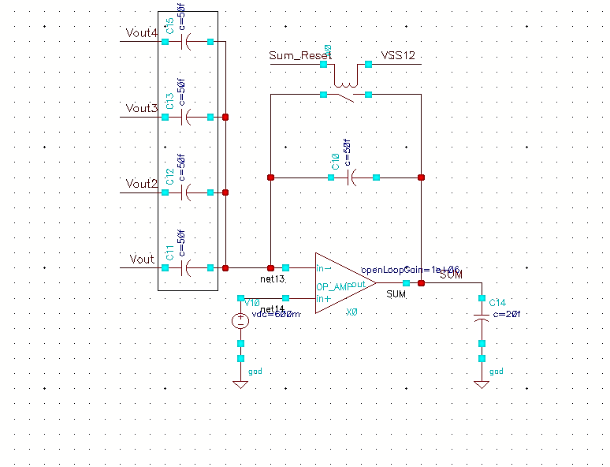
CSA + Analog Sum
Charge spatial distribution
Analog sum circuit
CSA input network model
Classical CSA structure
  4 diodes/CSA，PEX and modeling of the input network
Double threshold, de-offset discriminator
  Depth of the counter: 9-bits
  4 counters/pixel
Arriving time difference: 10 ns maximum
Power Consumption：~7.5 μW
Analog sum scheme
Notes:
每50um内两个甄别器+两个计数器（面积紧张功耗偏高）、过阈问题
TCAD is important

Slide 26
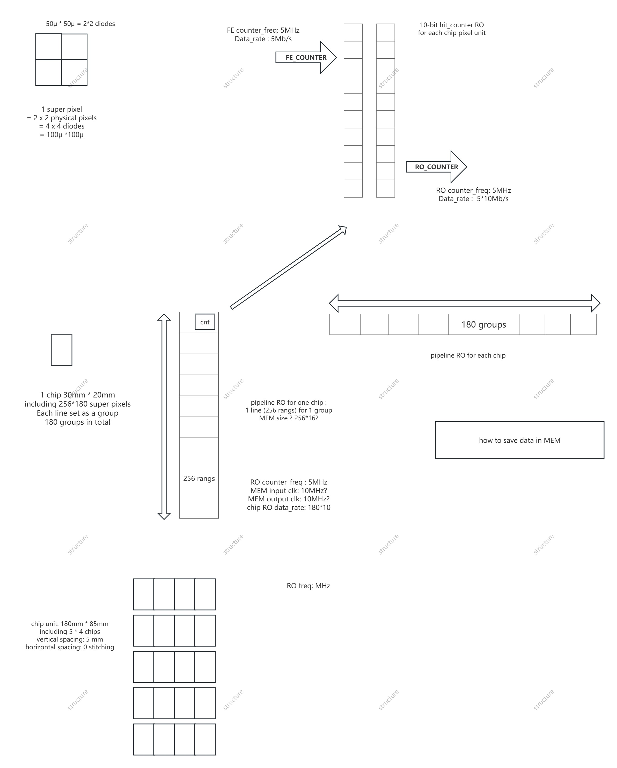
Architecture
Frame Rate : 200Hz Count Rate : 10⁵ cps/pixel(for 1 super pixel)
Chip Size : 30 mm×20 mm Super Pixel Numbers : 256 × 180
Set 256 (each line) as a group, 180 groups in total
Module size : 180 mm x 85 mm. Totally includes 5×4 chips for one module
Main clk : ~160 MHz, Output data_rate for one module is 5~10 Gb/s

Slide 27
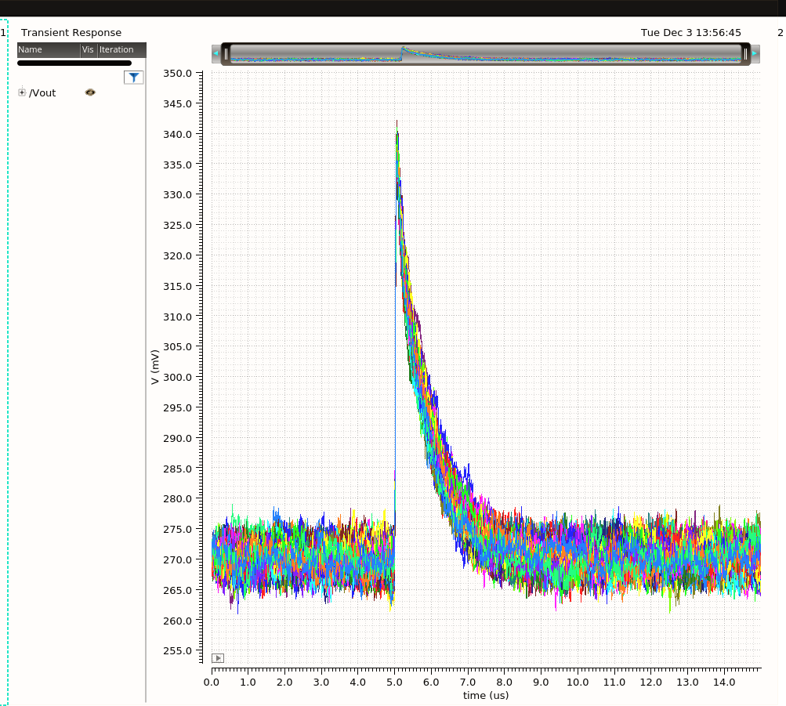
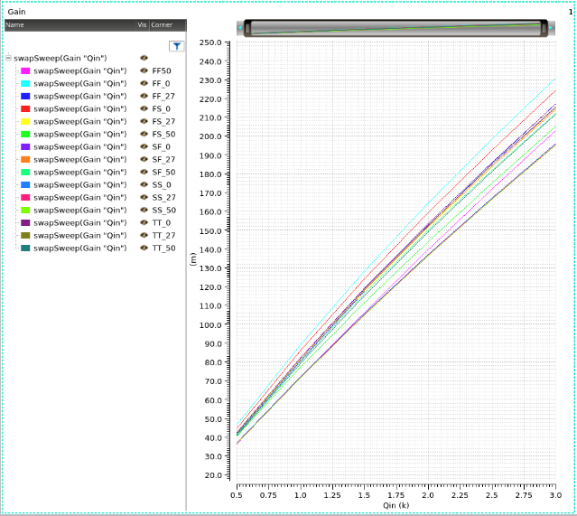
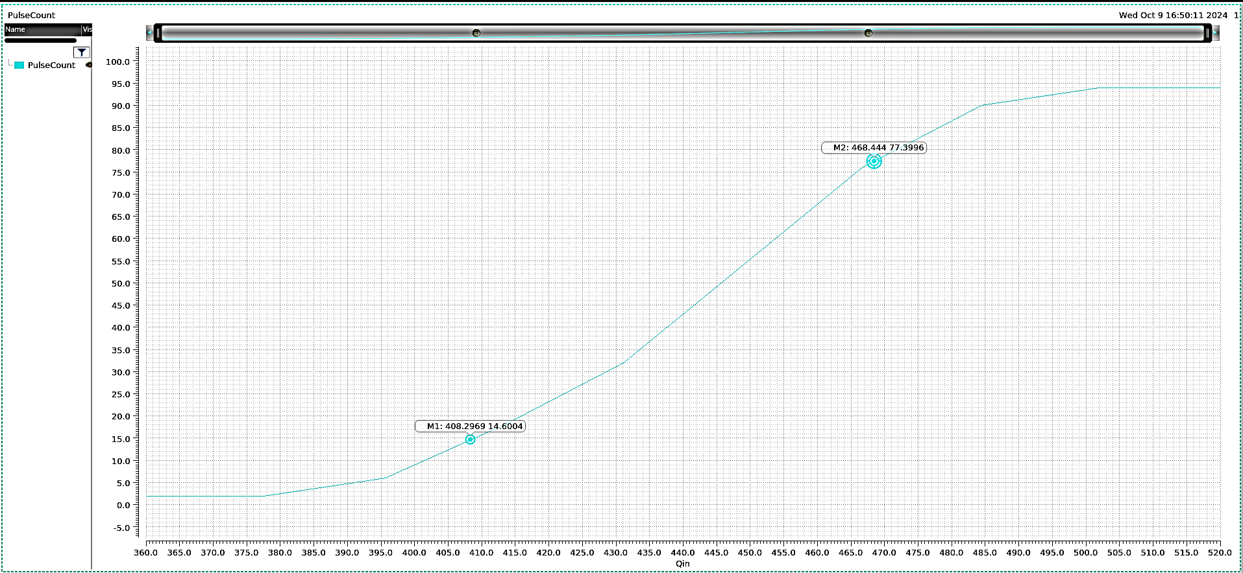
CSA + Analog Sum
Qin=800e- transient noise simulation
Qin=800e-~3000e- Energy Linearity Simulation
S-Curve
Spec | Mean | Std
Gain/ (mV/ke-) | 81.45 | 6.43
Phase Margin | 84.23 | 2.41
Spec | Maximum | Minimum
ENC/e- | 32.50 | 21.53
Baseline/mV | 313.88 | 203.87
Noise and transient 15 corners
Simulation results of gain and noise

