Slide 1
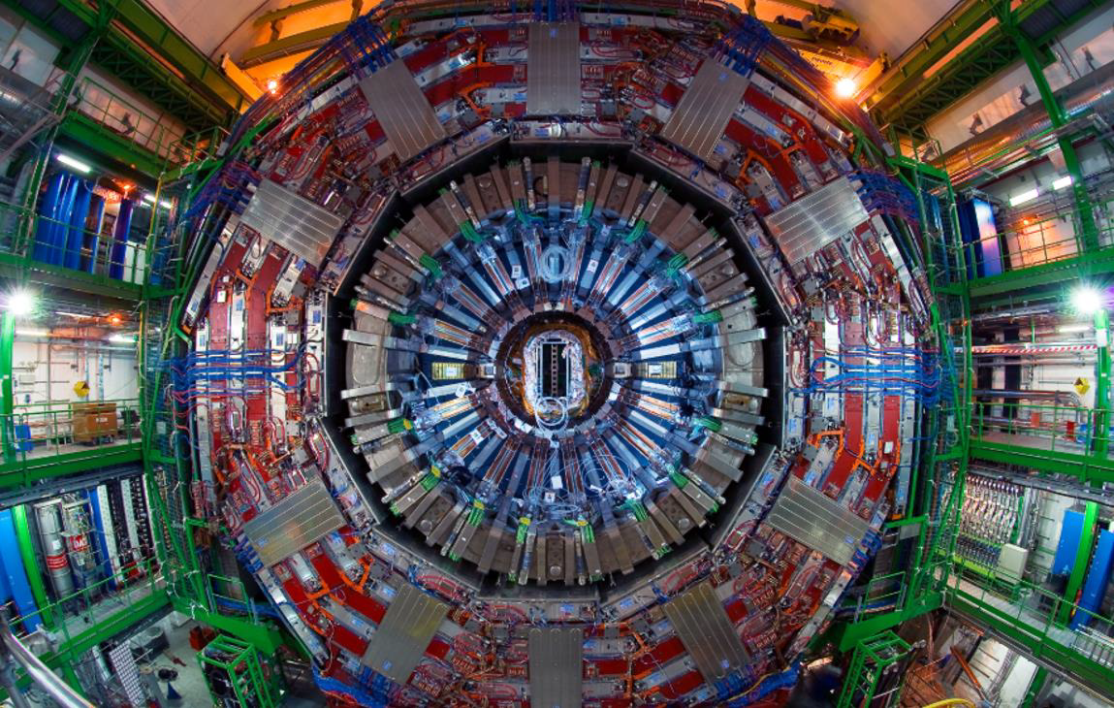






The CMS FCPPN/L Projects
Suzanne GASCON-SHOTKIN
IP2I Lyon (IN2P3-CNRS)/Université Claude Bernard Lyon 1
with Claude CHARLOT (LLR Palaiseau), Guoming CHEN (IHEP/CAS Beijing), Junquan TAO (IHEP/CAS Beijing), Qiang LI (PKU)
Learn more about CMS Highlights in IP2I postdoc Jie Xiao’s talk!
FCCPN/L 2025
Haitian Grand Theatre Hotel, Qingdao
July 21, 2025

Slide 2

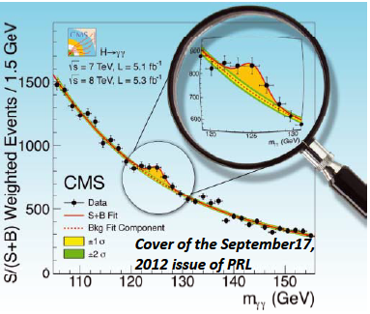
CMS in FCPPL/N: 18 years of exchanging people + ideas
IHEP-IP2I: Collaboration started in 2007 (one of the longest-lived in FCPPL),
Virtually all aspects touching photons in CMS: ECAL calibration/performance (learn more from IHEP Student Tianyu Cao’s presentation), photon identification, direct photon measurements, discovery of a Higgs boson/measurement of properties, theoretical interpretations
Current focus: Standard Model Higgs boson measurements through the H◊γγ channel, HH searches and searches for a second, low-mass (<125 GeV) Higgs boson in the γγ channel.
Since 2007, FCPPL-financed exchanges have benefitted over 20 people (IHEP and IP2I postdocs and doctoral students), some for multiple visits
Making possible significant contributions to ~45 CMS published papers/public results
And support for 2 co-PhD theses financed by prestigious scholarships (CSC, Eiffel)
2024-2025 team: IP2I : Suzanne GASCON-SHOTKIN, Maxime GOUZEVITCH, Jie XIAO, Jessy DANIEL, Elise JOURD’HUY, Benjamin MASSSOTEAU, Christian VEROLLET, Alejandro SALINAS IHEP Beijing : Guoming CHEN, Mingshui CHEN, Junquan TAO, Jin WANG, Fabio IEMMI, Chu WANG, Shaowei SONG, Zhenxuan ZHANG
Other sources of financing : ANR ‘HIGGSENLIGHTENED’ project (S. Gascon IP2I PI) for PhD scholarship +1 yr postdoc; China CSC (2021 2025) and MoST (2023.11 2028.10)
JINST 16 P05014 (2021)
Phys. Lett. B 716 (2012)
Notes:
• [16] “Performance of the CMS electromagnetic calorimeter in pp collisions at √s = 13 TeV”, CMS Collaboration, JINST 19 (2024) P09004

Slide 3
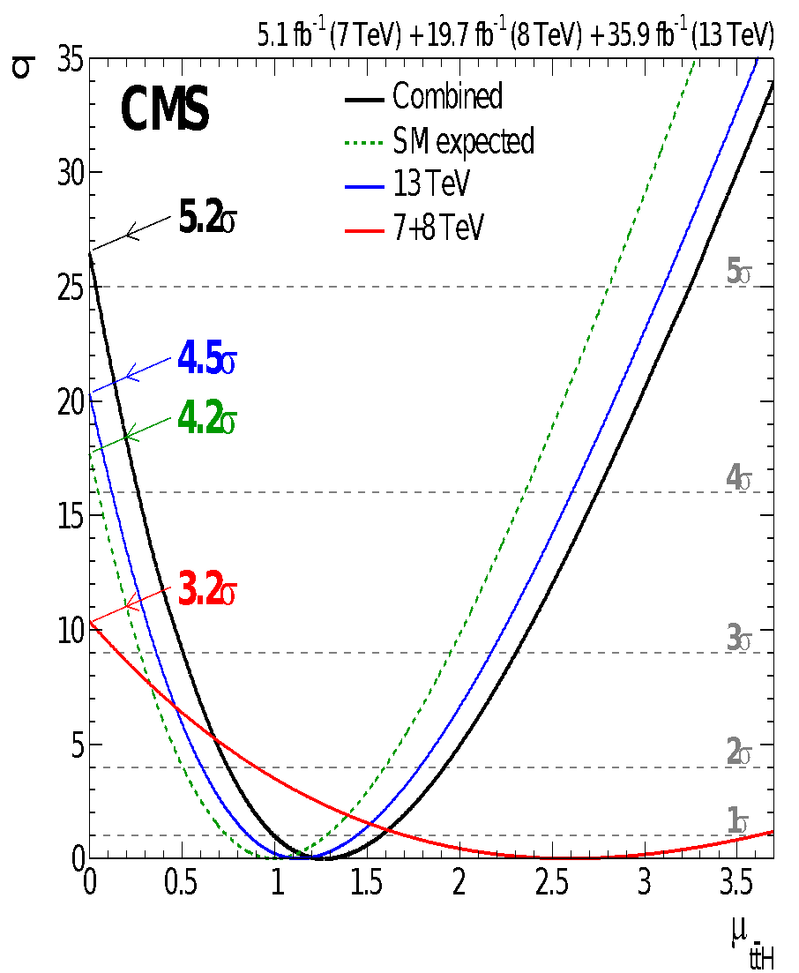
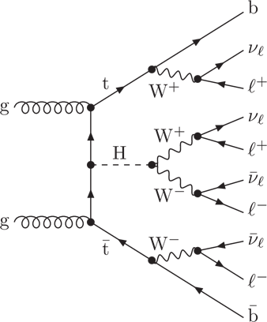
CMS in FCPPL/N: 18 years of exchanging people + ideas
PKU-IPHC-IP2I: Collaboration started in 2015 as PKU-IPHC, then added IP2I in 2017
Focus: Matrix Element and deep learning techniques for top-Higgs and WW/ZZ scattering leading to 6 published papers/public results
Main results: ttbarH observation, Phys. Rev. Lett. 120, 231801 (2018); Full Run 2, Eur. Phys. J. C 81 (2021) 378, direct measurement of the top-Higgs coupling
Published two phenomenology studies: “Polarization Fraction Measurement in same sign WW scattering using Deep Learning”, Phys. Rev. D 99, 033004 (2019),“Polarization fraction measurement in ZZ scattering using Deep Learning”, Phys. Rev. D 100, 116010 (2019)
Collaboration suspended in 2020-2021 but could be re-activated in the future
ttH multilepton
PRL 120.231801 (2018)
WW scattering
ZZ scattering
PRD 99, 033004 (2019)
PRD 100, 116010 (2019)

Slide 4
CMS in FCPPL: 18 years of exchanging people+ ideas
PKU-LLR: Collaboration started in 2020. Focused on EW production of VBS ZZ, making significant contributions to 1 CMS published paper and 1 phenomenology paper; now measurement of the Zγ production cross section and nTGC
PLB 812 (2020) 135992
IHEP, PKU, IP2I and IPHC have hosted FCPPL workshop, regularly contribute members of scientific committee

Slide 5
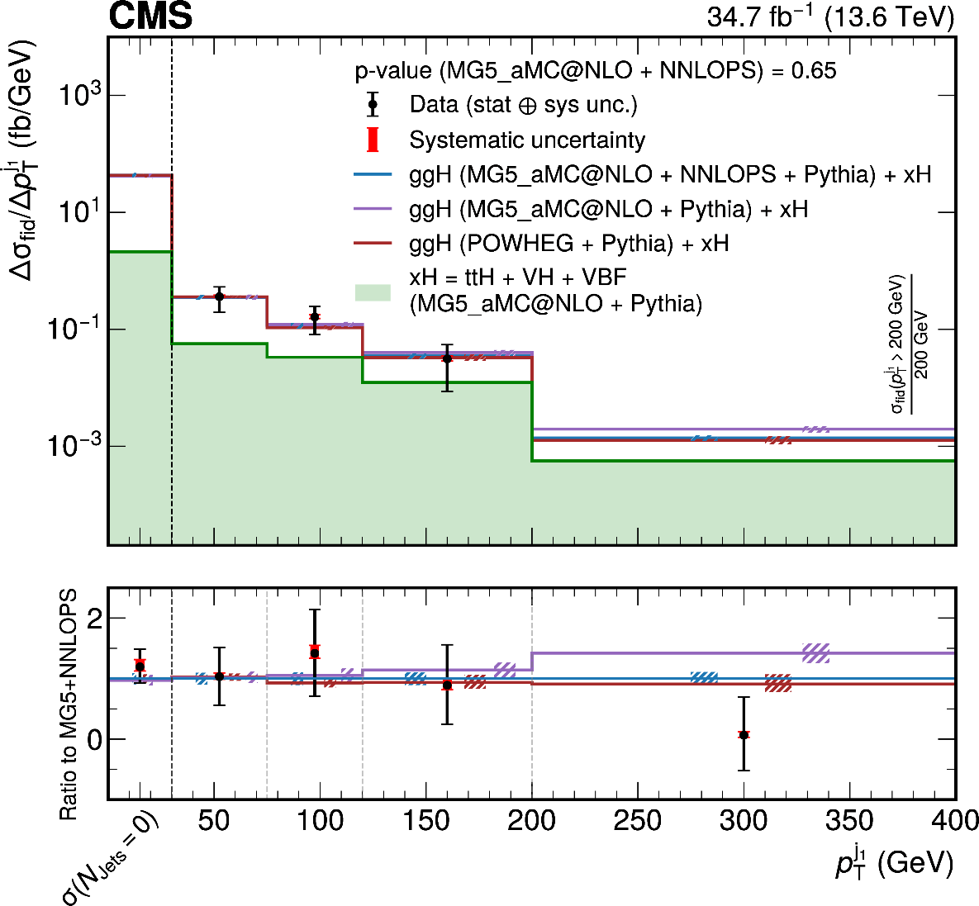

IHEP-IP2I: Run2+3 H→γγ measurements: Progress and plans
arXiv:2504.17755
Major contributions to all H➔measurements: High-level trigger development and maintenance, photon ID MVA development, electron veto efficiency, Z→μμγ validation, sub/chief editor of CMS notes
H➔γγ inclusive and differential cross sections at √s=13.6 TeV (Run 3 2022!) submitted to JHEP
Full Run 2 Higgs + charm submitted to JHEP, preliminary result of search for anomalous couplings
Learn more about it from Junquan Tao’s talk!
Ongoing analyses and future plans:
  Full Run 2 mass measurement
  Run2/3: gg→γγ/gg→H→γγ interference: mass shift/cross section reduction to constrain H width, measure spin (BSM?)

Slide 6
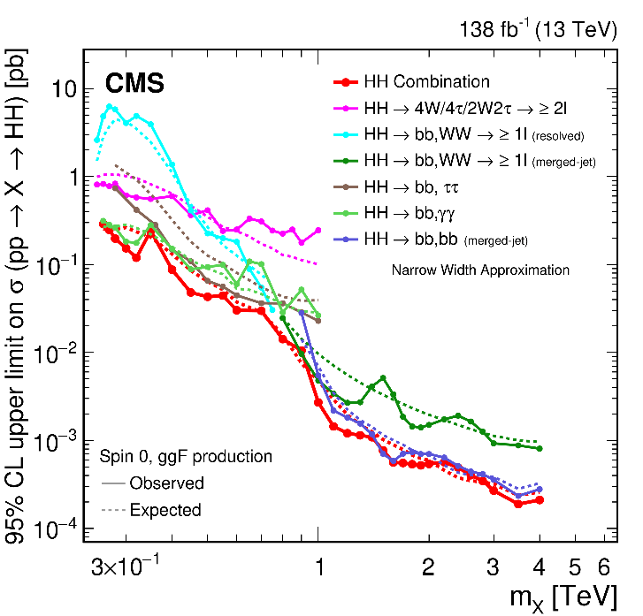
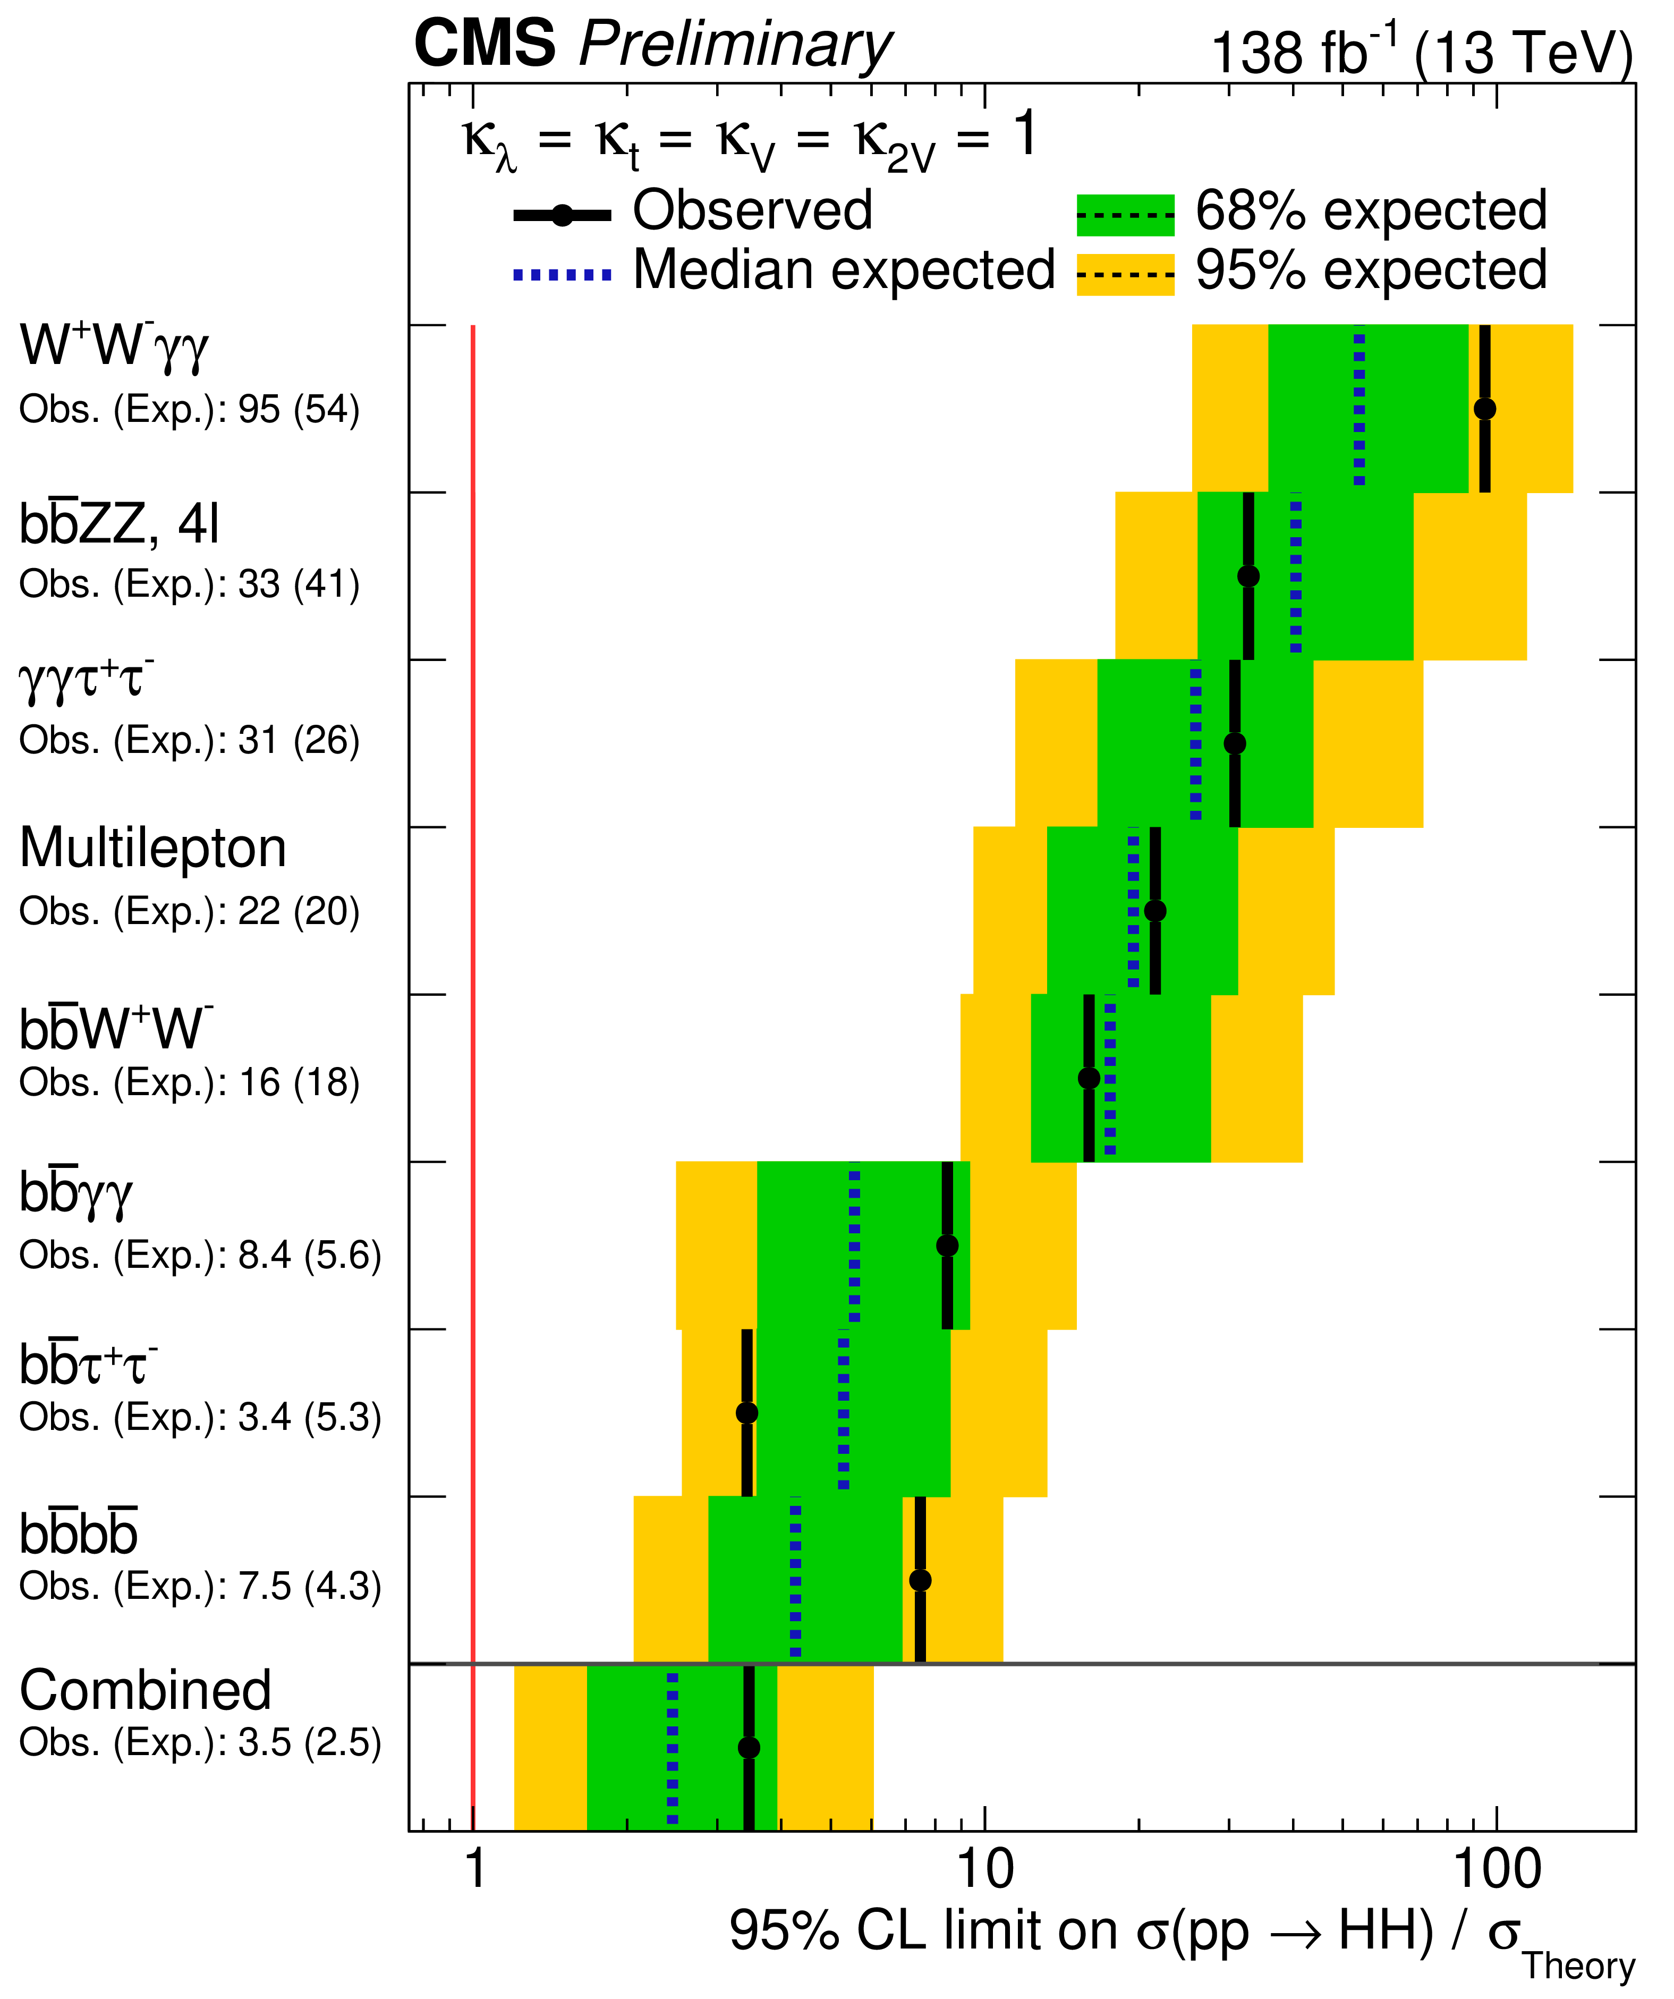

IHEP-IPNL 2025: Run 2 + 3 HH searches, progress and plans
Phys. Rpt. 1115 (2025) 368
CMS-PAS-HIG-20-011
Initiators of HH searches in CMS
New publications/public results:
  Full Run 2 resonant search for X➔HH/YH➔bbγγ : JHEP 05 (2024) 316
  Full Run 2 Combinations:
    Single- and Di-Higgs analyses, κ_{λ} constrained to 1.4 <κ_{λ}< 7.8 PLB 861 (2025) 139210
    Resonant X→HH/YH Phys. Rpt. 1115 (2025) 368
    Preliminary non-resonant with sensitivity 3.5 (2.5) X SM
Learn more about it in IHEP student Shaowei Song’s talk!
Ongoing analyses and future plans:
  Resonant X→HH/HY→WWγγ and high-mass X→HH/HY→bbγγ searches with Run 2 data (not undertaken previously in CMS!)
  Non-resonant HH→bbγγ analysis with Run 3 data
IP2I Postdoc Jie Xiao and Student Elise Jourd’huy’s 1-month stays at IHEP in 2024 financed by FCPPL grant to project ‘CMSHIGPHO’

Slide 7
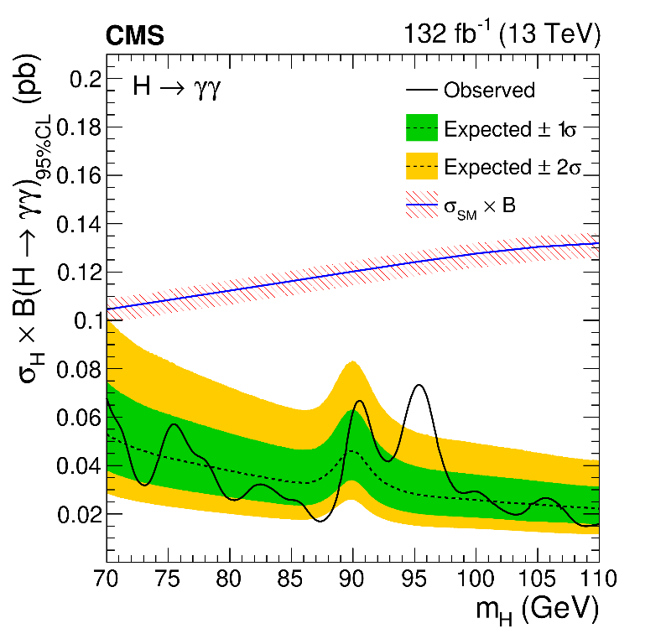
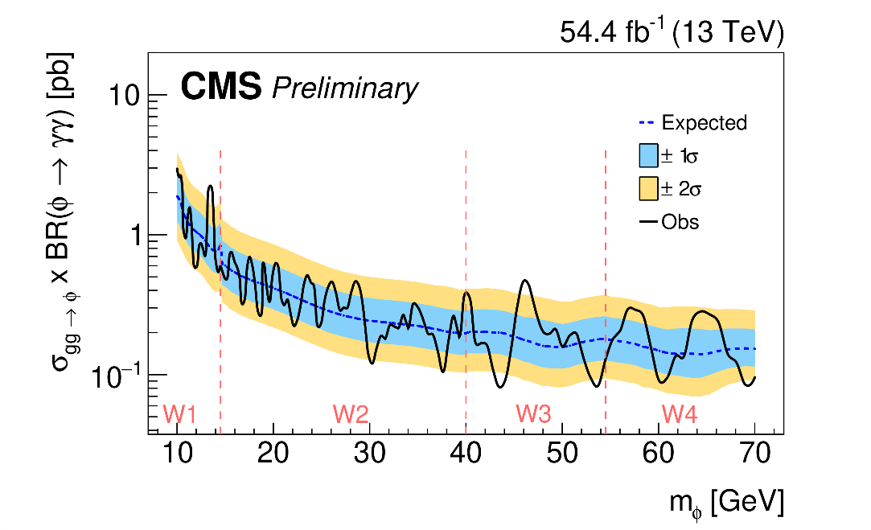

IHEP-IP2I 2025: Run 2 Low-mass (70<m_{γγ} <110 GeV) and Very-low-mass
(10<m_{γγ} <70 GeV) H→γγ search and interpretations
Low-mass (70<m_{γγ} <110 GeV) case: Initiators and leaders in CMS: any 2nd Higgs boson→unequivocal proof of BSM
Full Run 2 results published in PLB, January 2025! 2.9σ observed at m~95.4 GeV, not excluded by ATLAS Full Run 2 result
Contributions to Very-low-mass (10<m_{γγ} <70 GeV) case, inherits heavily from low-mass case: Preliminary result: March 2025!
Phys. Lett. B 860 (2025) 139067
JHEP 01 (2025) 053
Find out more about it in IP2I student Benjamin Massoteau’s talk!
IHEP Student Tianyu Cao’s 1-month stay at IP2I in 2024 was financed by FCPPL grant to project ‘CMSHIGPHO’
CMS-PAS-HIG-24-014
Notes:
Fix animation, replace with published versions and ATLAS published reference

Slide 8
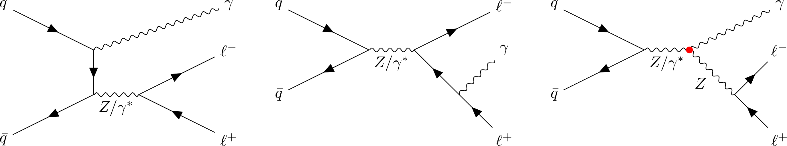
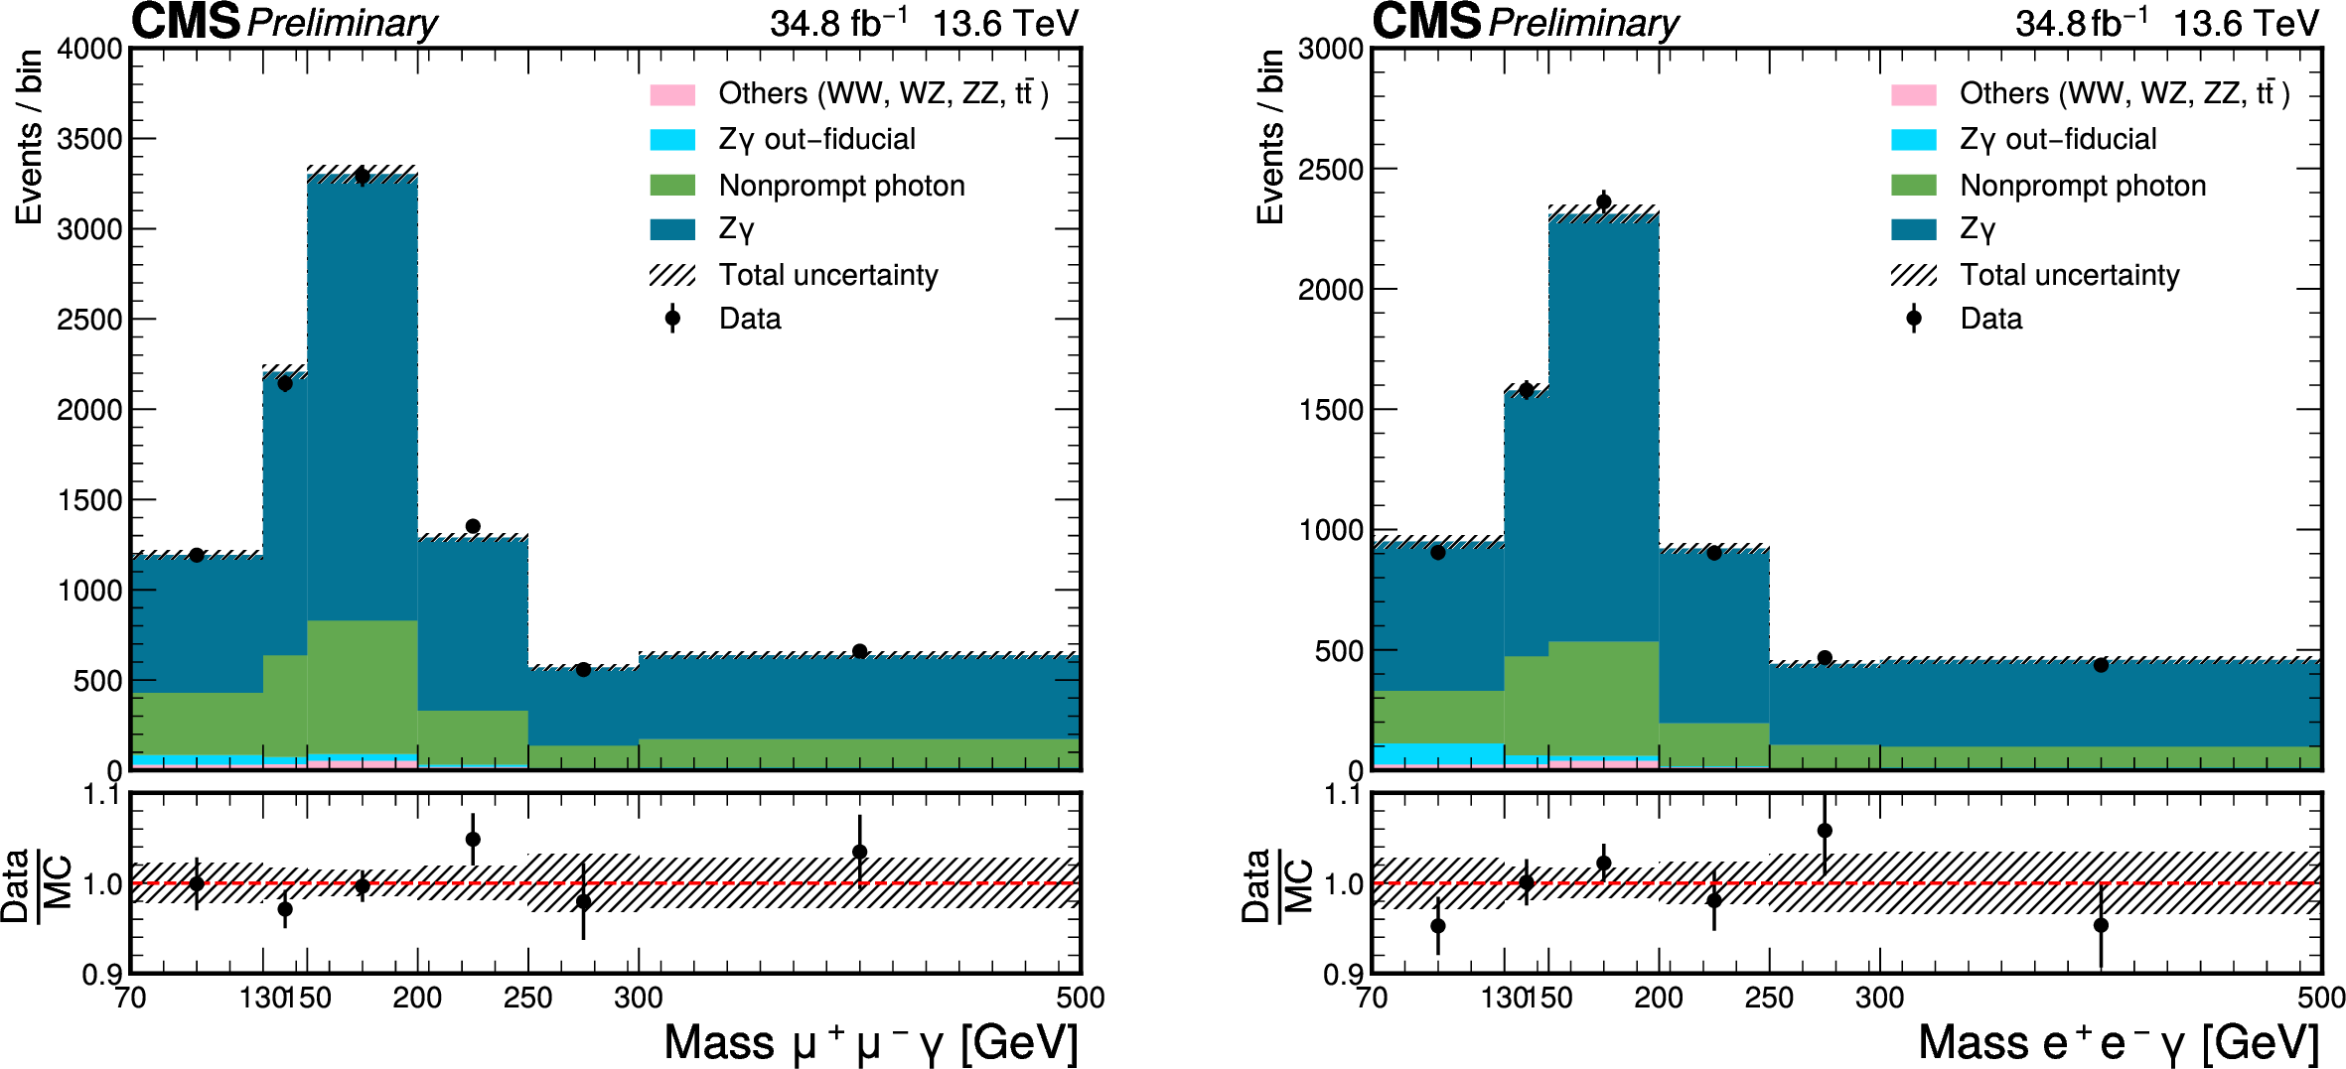

PKU-LLR 2025: Run3 Zγ Cross section and Search for nTGCs with SMEFT
CMS-PAS-SMP-24-002
Measurement of Zγ production with leptonic final states at √s=13.6 TeV (Run 3 2022!). Public preliminary result in March 2025!
Main participants: Tianyu Mu (PKU), Zhe Guan (PKU), Andrew Levin (PKU), Qiang Li (PKU), Claude Charlot (LLR)
Imminent paper (internal CMS review complete) to include comparison of Neutral Triple Gauge Couplings (nTGC) parameter limits between Vertex parametrization (Degrande, Gounaris et al) and Gauge symmetry preserving (Ellis, He, Xiao) models
Learn more about it in PKU student Tianyu Mu’s talk!
Tianyu’s 2-month stay at LLR in 2024 was financed by the FCPPL project ‘MultiBoson’, and will spend another year at LLR, financed by a CSC grant
Notes:
J. Ellis, H.-J. He, and R.-Q. Xiao, “Probing neutral triple gauge couplings at the LHC and
267 future hadron colliders”, Phys. Rev. D 107 (2023), no. 3, 035005,
268 doi:10.1103/PhysRevD.107.035005, arXiv:2206.11676.

Slide 9
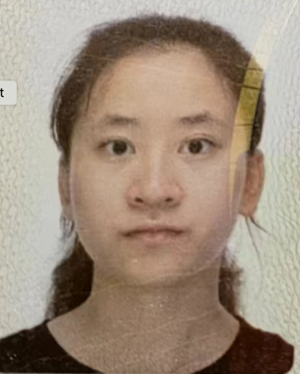
PKU-LLR 2025 in progress: Run2 + 3 HH→WWZZ and Run 2 VBS
In progress: Search for HH→WWZZ and pp→WWZZ in Runs 2 + 3
  Main participants: Ruobing Jiang (PKU), Tianyu Mu (PKU), Qiang Li (PKU), Claude Charlot (LLR), collaboration with Latvia and Split
  Study on-shell pp→WWZZ and pp→HVV backgrounds
In progress: Search for same-sign WWγ VBS process in Run 2: 1st VBS measurement with 3 final-state gauge bosons
  Main participants: Ruobing Jiang (PKU), Tianyu Mu (PKU), Qiang Li (PKU), Claude Charlot (LLR),
PKU Student Ruobing Jiang will spend 1.5 years at LLR, financed by a CSC grant starting in 2026

Slide 10
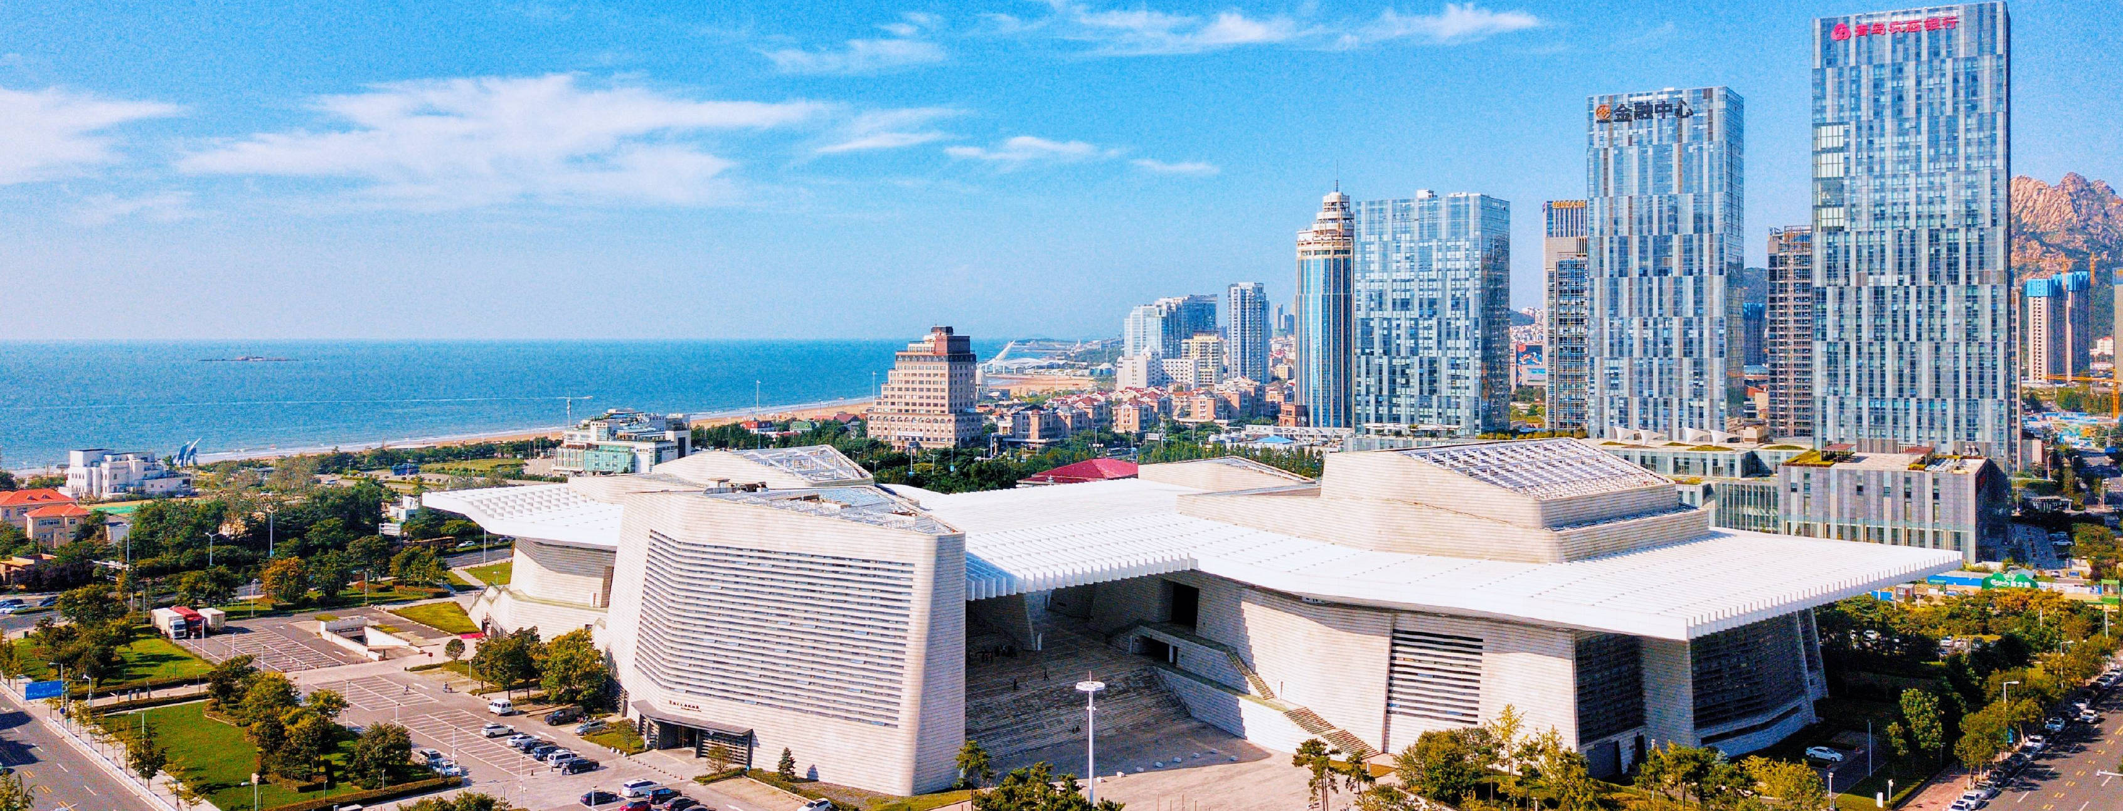

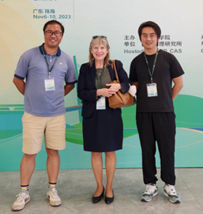
Acknowledgements
THANKS to the FCPPL and to the local organizers!
We are looking forward to your continued support!
For many more years!
Zhuhai, 2023

Slide 11
Backup

Slide 12
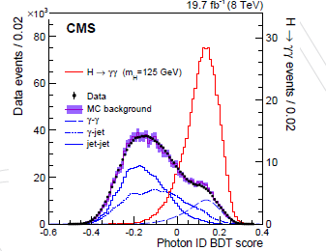
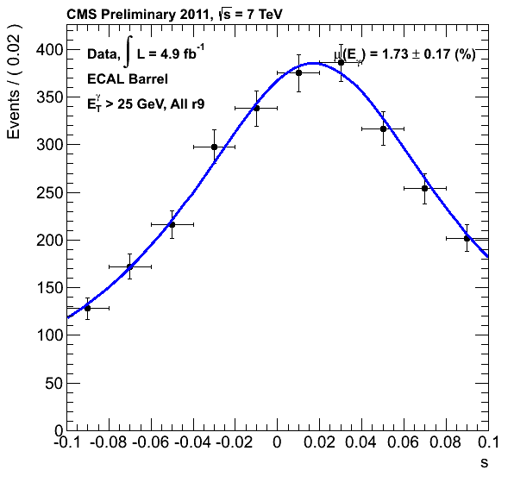
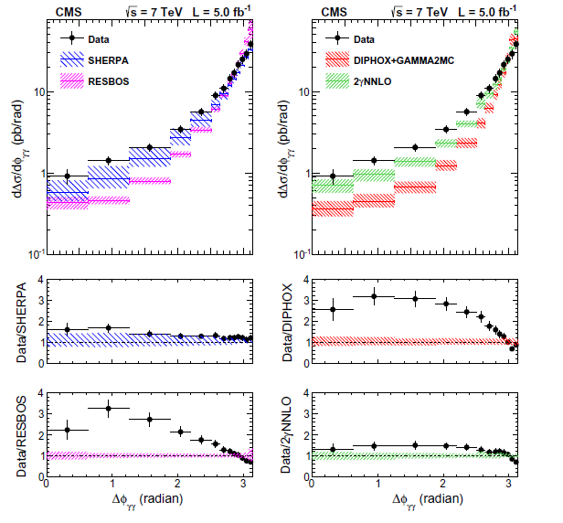
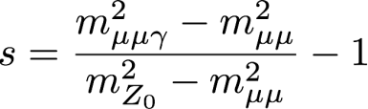
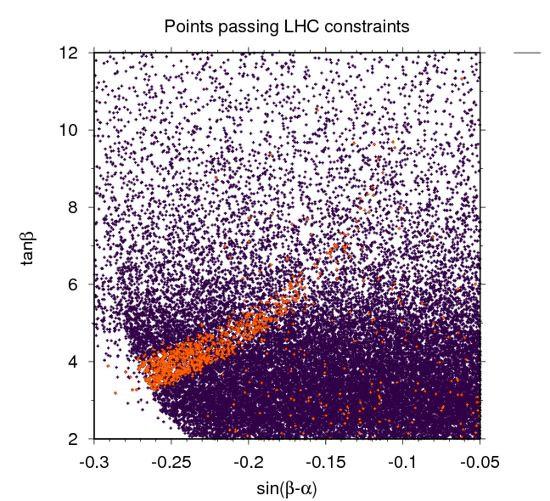
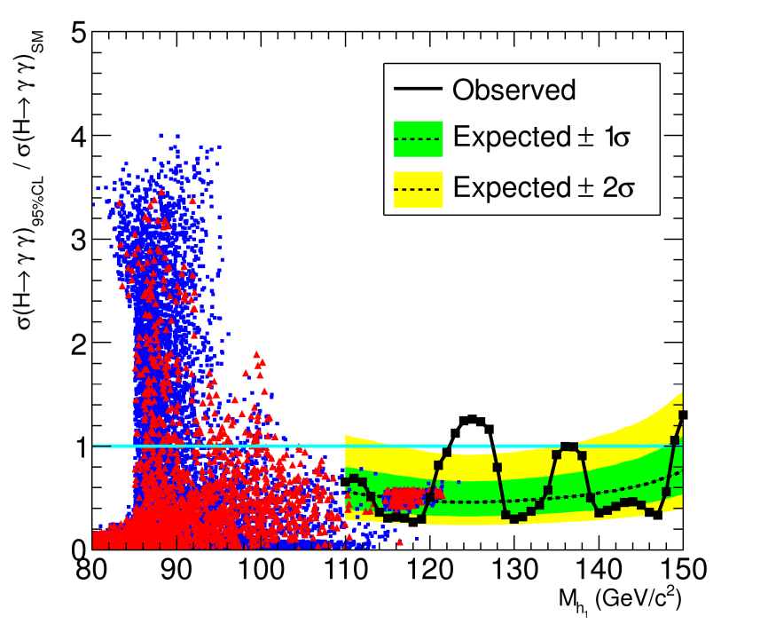
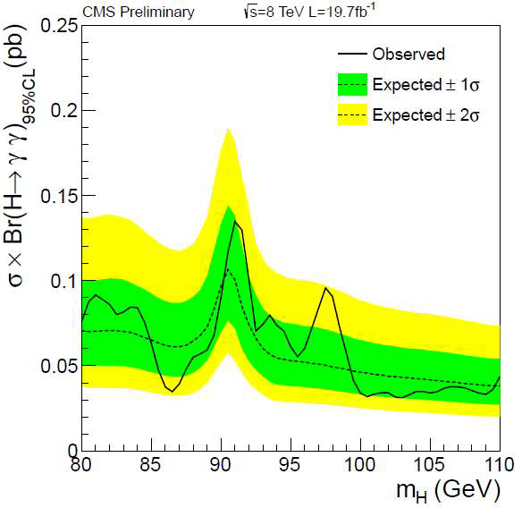
IHEP-IP2I: 16 years of important results on photons and Higgs bosons: Run 1 (2007-2016)
γγ + X differential cross section measurement (2010-…)
γ/π⁰ discrimination for photon ID (2008-…)
.
Cluster/Photon commissioning, Runs 1&2 (2008-…)
.
Photon energy scale extraction with Z→μμγ (2007-…) .
Eur.Phys.J. C74 (2014) 3129
EPJ C 74 (2014) 3076
CMS-PAS-EGM-10-005
σ_{ϕ}/σ_{η}
CMS-DP-2012/024
Phys. Lett. B 716 (2012)
JHEP12 (2016) 068
CMS-PAS-HIG-14-037
Chinese Phys. C 38 073101
Discovery and measurement of a Higgs boson (2012-…)
.
Feasibility study for a 2nd lighter Higgs boson (2013-…)
.
2HDM interpretation w/Th: Search for a 2nd lighter Higgs boson, 8 TeV data (2016) (orange excluded)
Search for a 2nd lighter Higgs boson in 8 TeV data (2013-...…)
Notes:
, correct animation,

Slide 13
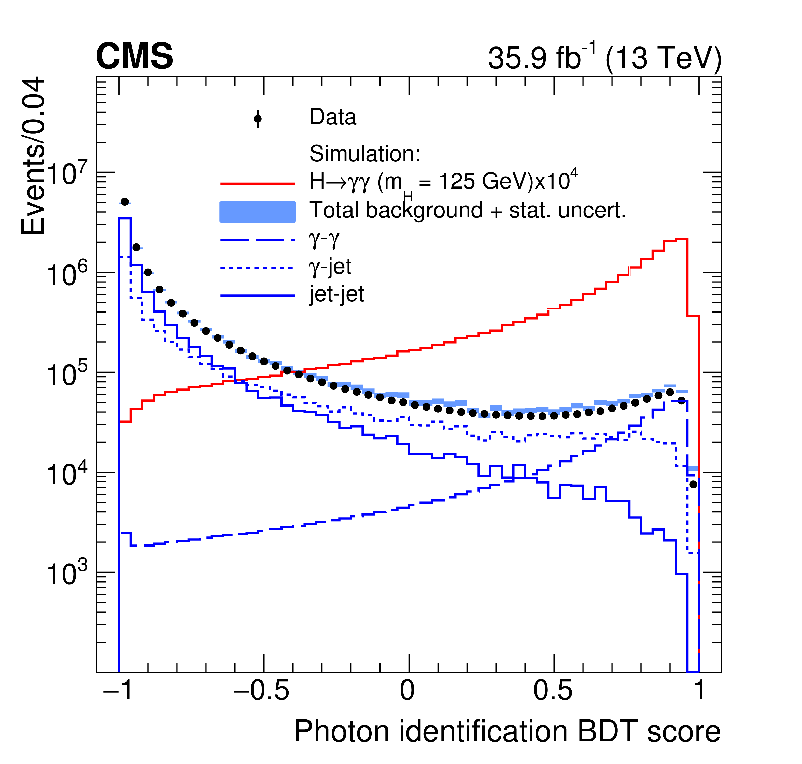
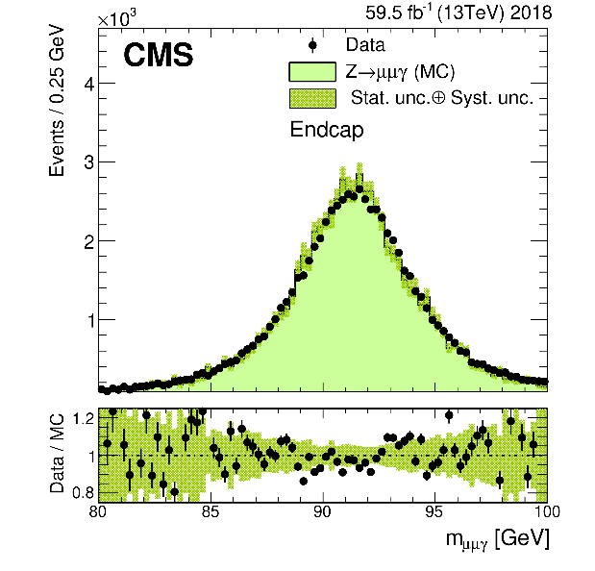
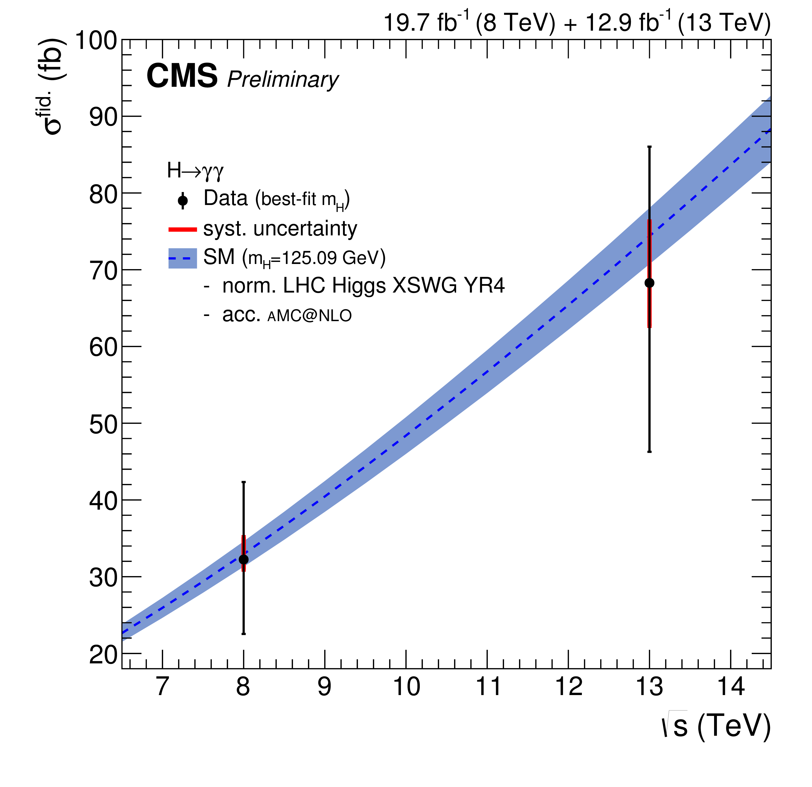
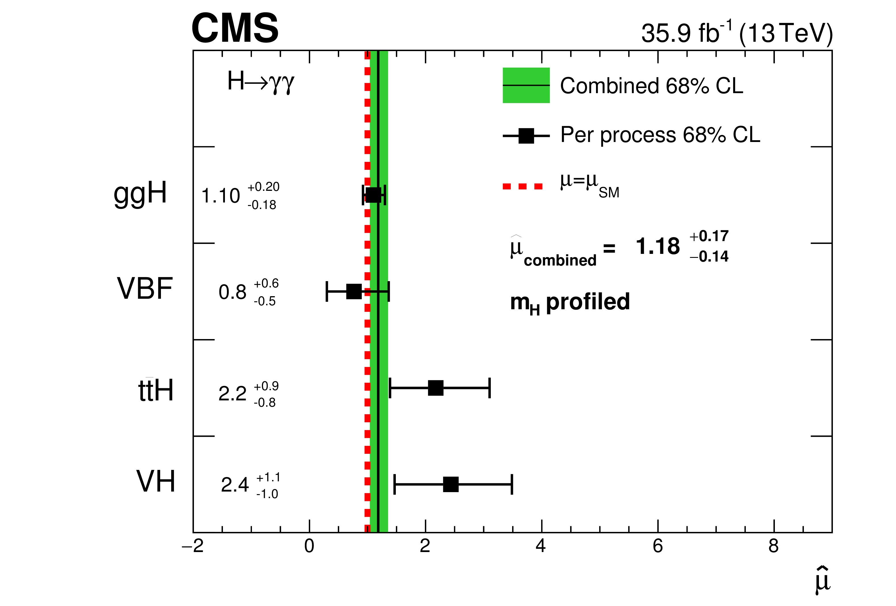
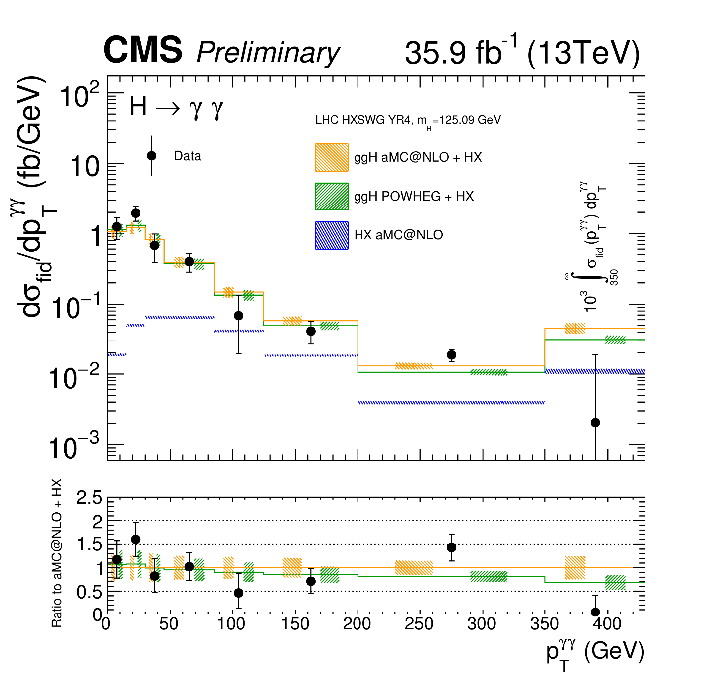
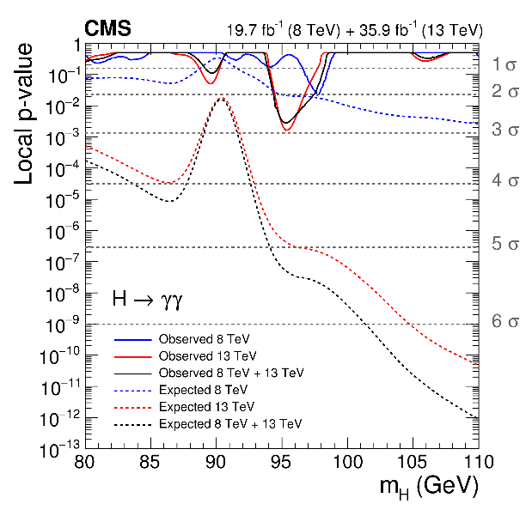
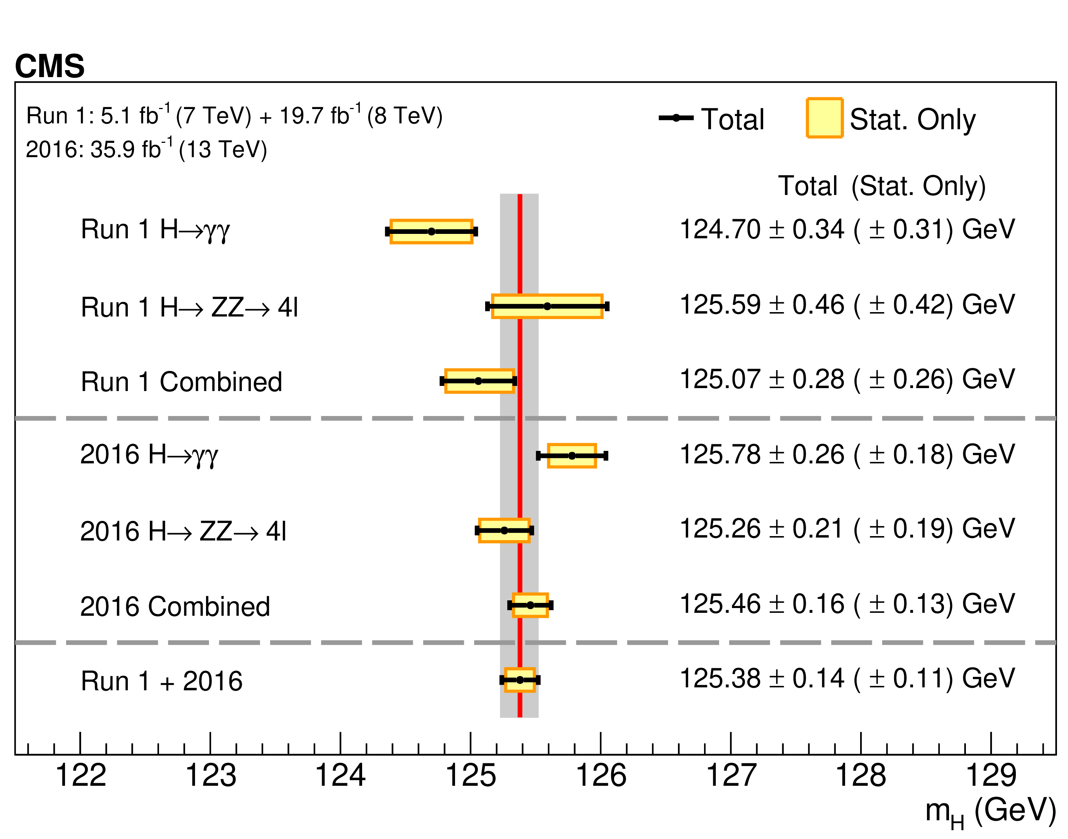
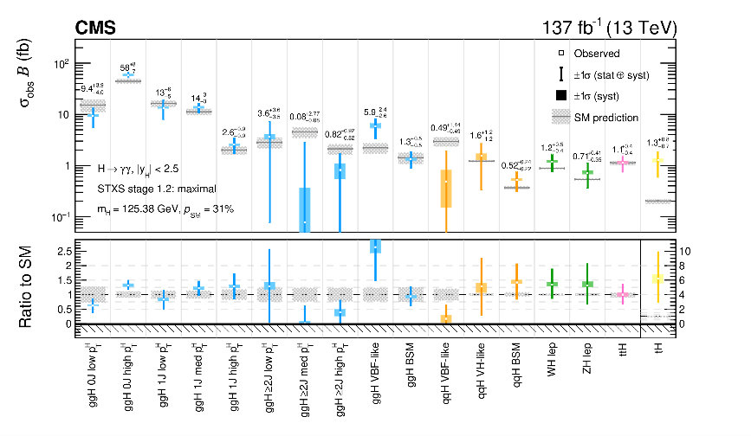
IHEP-IPNL: 16 years of important results on photons and Higgs bosons: Run 2 (2013-...)
Photon energy scale extraction with Z→μμγ (2007-…) .
γ/π⁰ discrimination for photon ID (2008-…)
.
ReDiscovery and measurement of a Higgs boson (2015-…)
.
CMS-PAS-HIG-16-020
JHEP 11 (2018) 185
JHEP 11 (2018) 185
JINST 16 (2021) P05014
PLB 793 (2019) 320
PLB 805 (2020) 135425
JHEP 07 (2021) 027
CMS-PAS-HIG-17-015
Mass measurement with 13 TeV 2016 data (2020-...…)
Strengths, couplings, STXS with Full Run 2 data (2019-...…)
Fiducial and differential cross section measurements (2016-…)
.
Search for a 2nd lighter Higgs boson in 8+13 TeV data (2013-…)
Notes:
correct animation,

