Slide 1
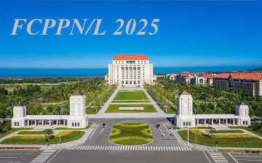




Search for a standard model-like Higgs boson in the mass range between 70 and 110 GeV in the diphoton final state in proton-proton collisions with CMS at √s=13 TeV
Benjamin Massoteau, IP2I – Lyon,
Université Claude Bernard Lyon 1
On Behalf of the CMS Collaboration

Slide 2
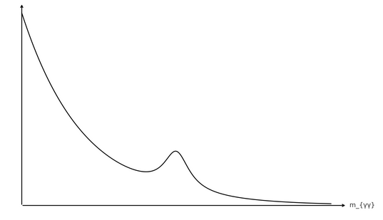
Outline
Results based on
Phys. Lett. B 860 (2025) 139067
Motivation for low mass diphoton resonance searches
Analysis Strategy
Signal and Background modeling
Full Run 2 Results
Summary

Slide 3
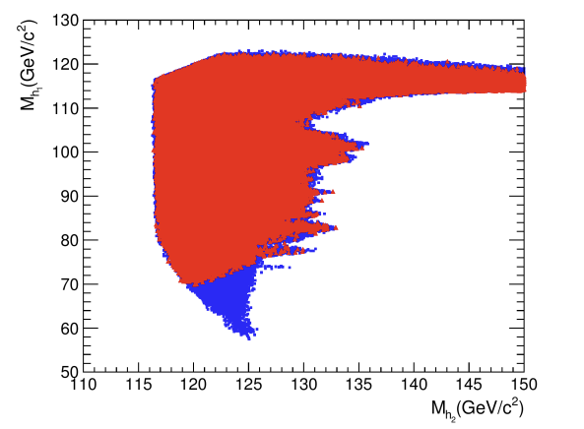
Motivation
Theoretical Motivation : Many BSM models allow the existence of a low mass resonance with m < 125 GeV, lower than the Higgs boson discovered in 2012
Example in NMSSM
Blue : Case I = Ωh² < 0.1102
Red : Case II = 0.1102 < Ωh² < 0.1272
Where Ωh² is the relic density
M_{h1}(GeV/c²)
h₁ : lightest NMSSM scalar Higgs
boson
h₂ : Next to lightest scalar Higgs boson (with a mass around 125 geV)
In this model, even after tighter cosmological constraints, a second Higgs boson with 70 GeV<M_{h1}<120 GeV is still allowed in the case of M_{h2}~125 GeV
M_{h2}(GeV/c²)
J. Fan et. al
2014 Chinese Phys. C 38 073101

Slide 4


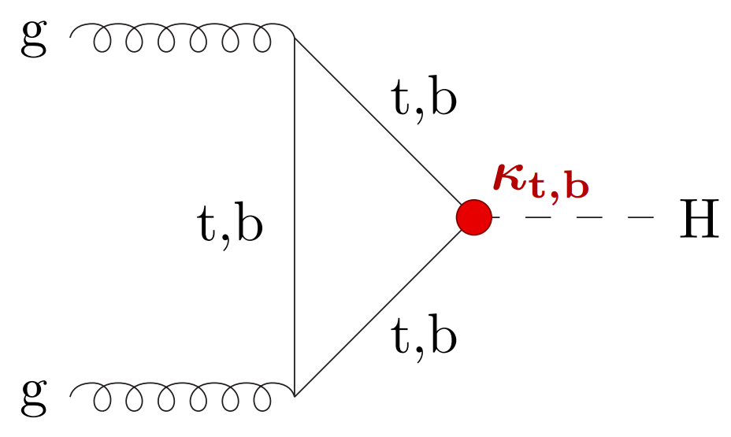
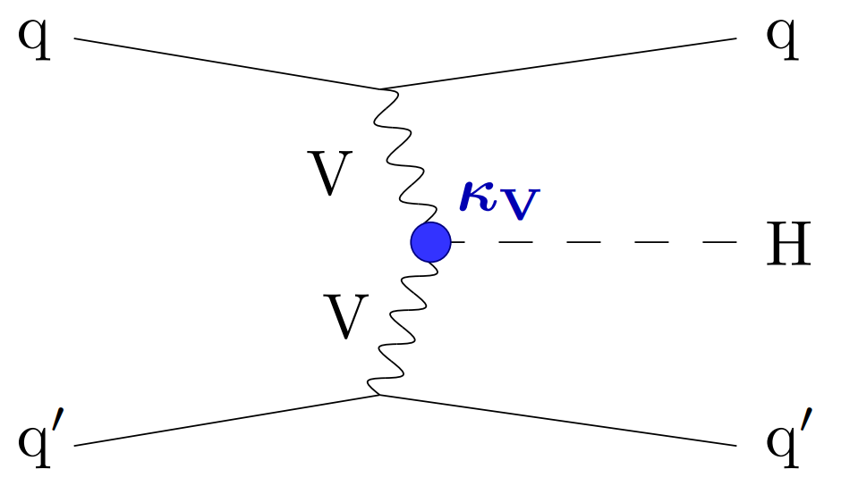


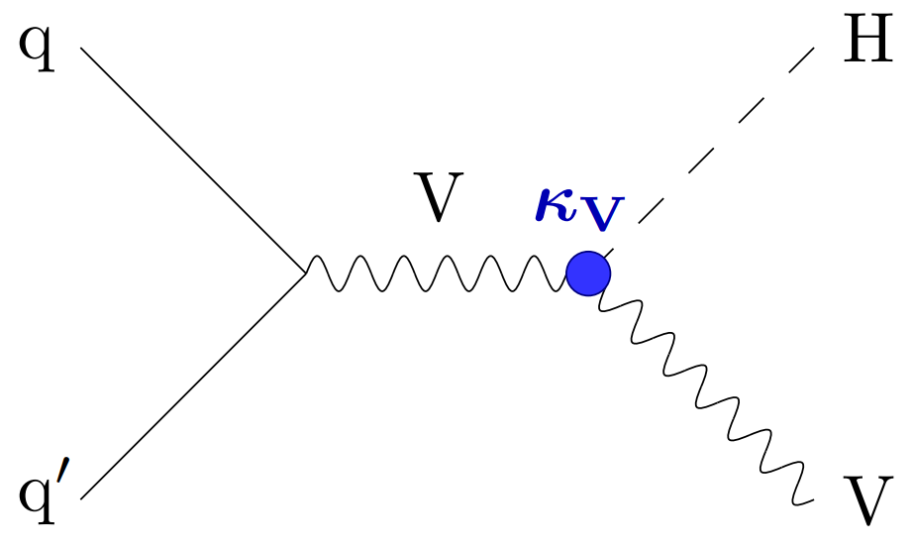
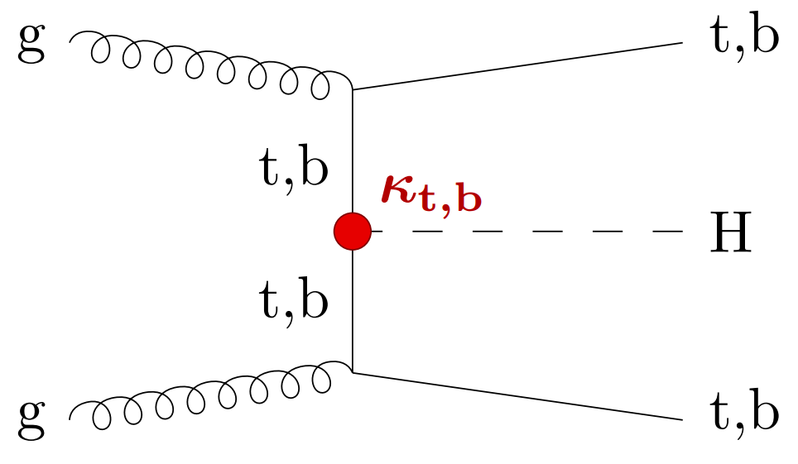
Analysis Strategy
Full Run2 data
Corresponding luminosity 132 fb-1
Main production modes included in signal model
ggH, VBF, VH, and ttH
Relative branching fractions of the different production modes assumed to be the same as in the SM
Extract signal events by fitting to the diphoton invariant mass
Signal search region: 70-110 GeV
Background fitting range: 65-120 GeV
Background components
Irreducible direct γγ production
Reducible γ+jet,jet+jet, Drell-Yan (DY) Z→ee events

Slide 5
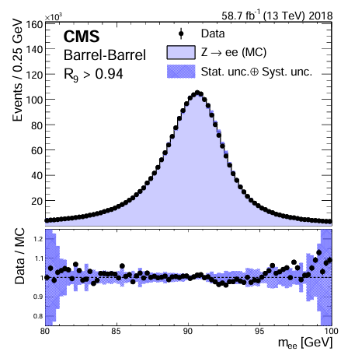
Analysis Strategy
Share many elements from the SM H-> γγ Run 2 analysis
Photon reconstruction and correction
Vertex ID
Signal and Background modeling techniques
Dedicated optimizations for low mass H->γγ full Run 2
New dedicated triggers and dedicated pre-selections
  Stricter isolation and shower shape requirements, allowing photon pt requirements of {30, 18} GeV and little mass requirement
Reoptimized photon ID
Diphoton candidate BDT classifier using kinematic variables retrained for low-mass case
Dedicated VBF event class in 2017 & 2018
Data reanalyzed with improved calibration for 2016
Reinforced DY suppression strategy
JINST 16 P05014 (2021)

Slide 6
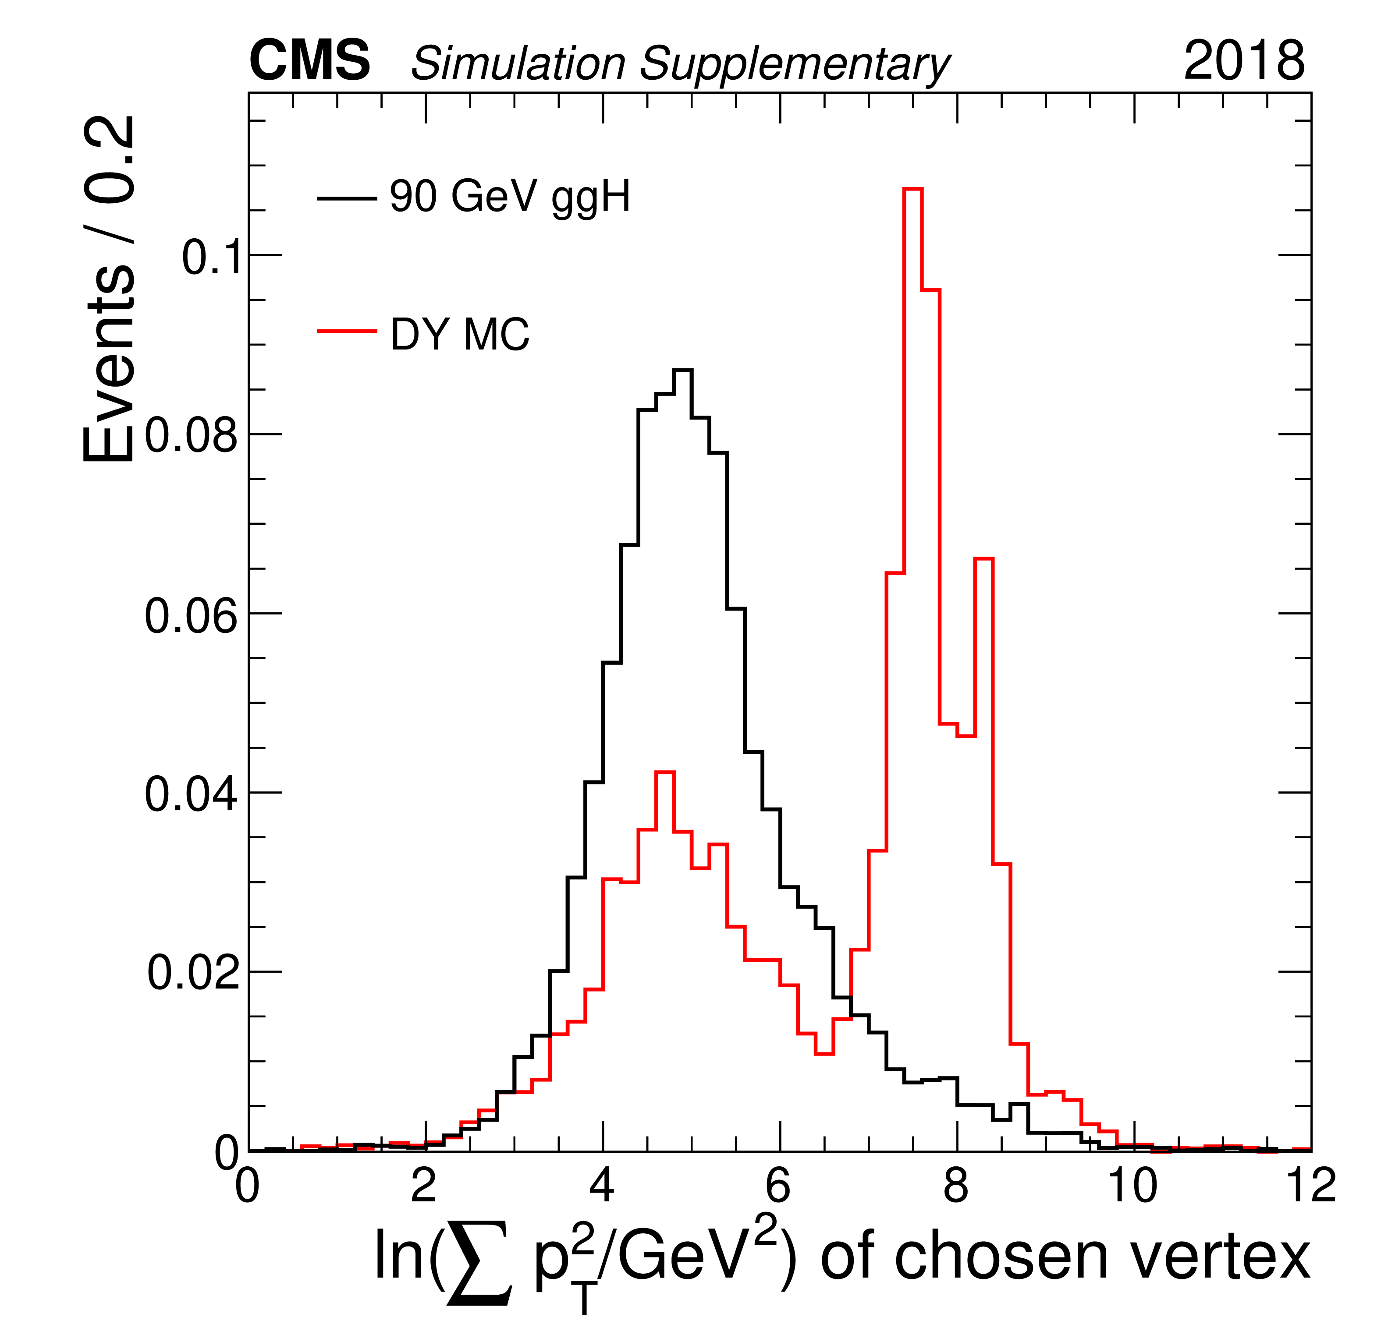
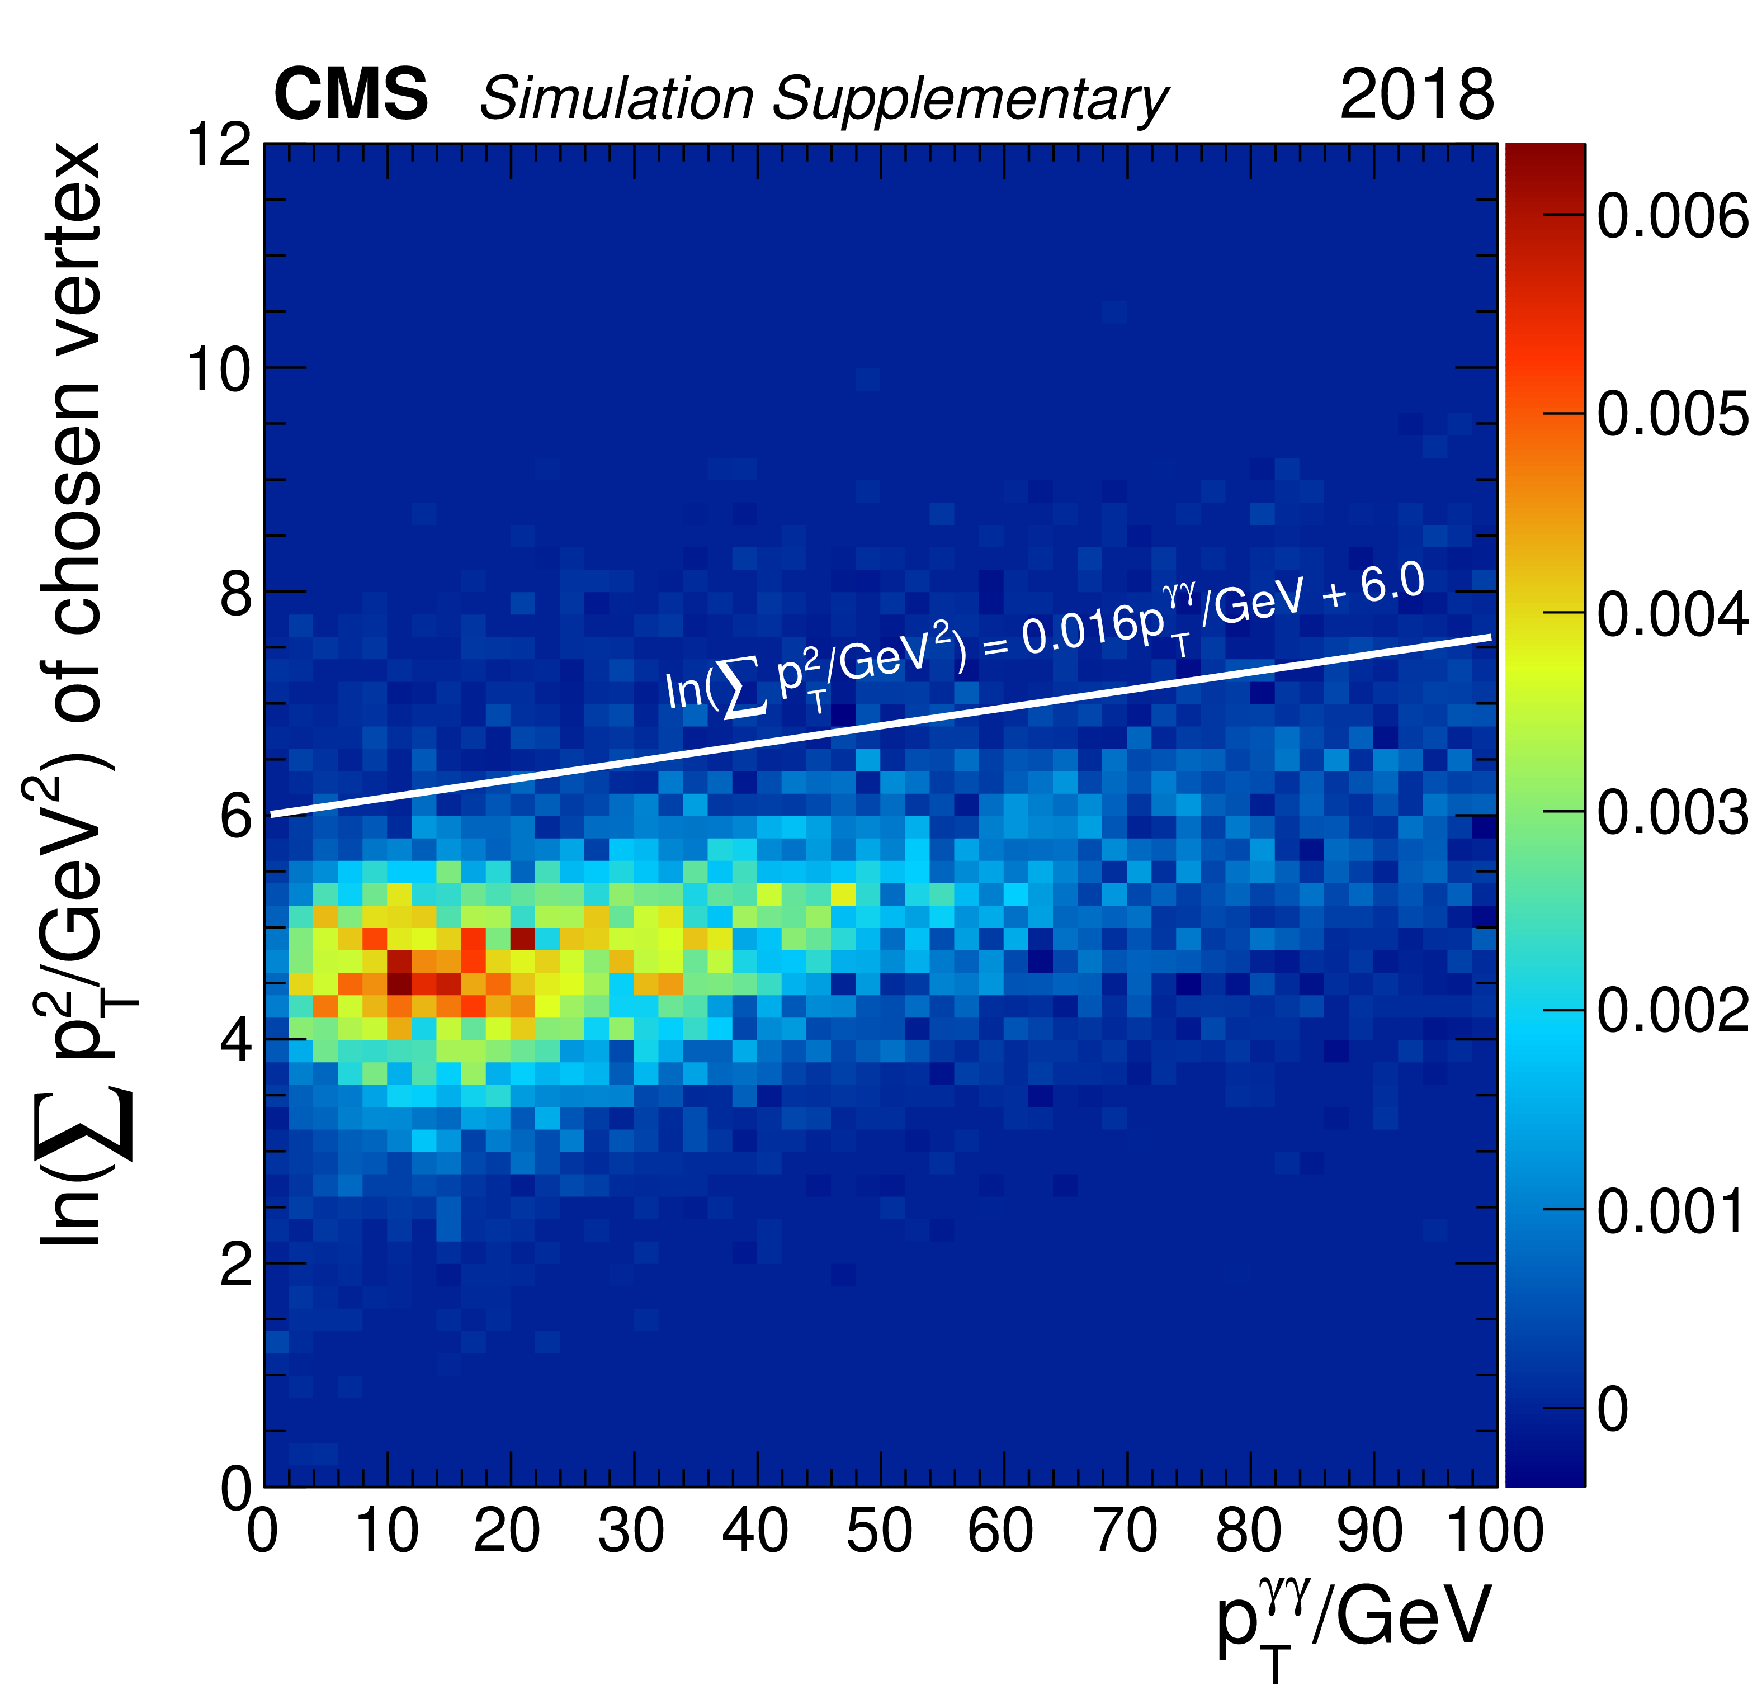
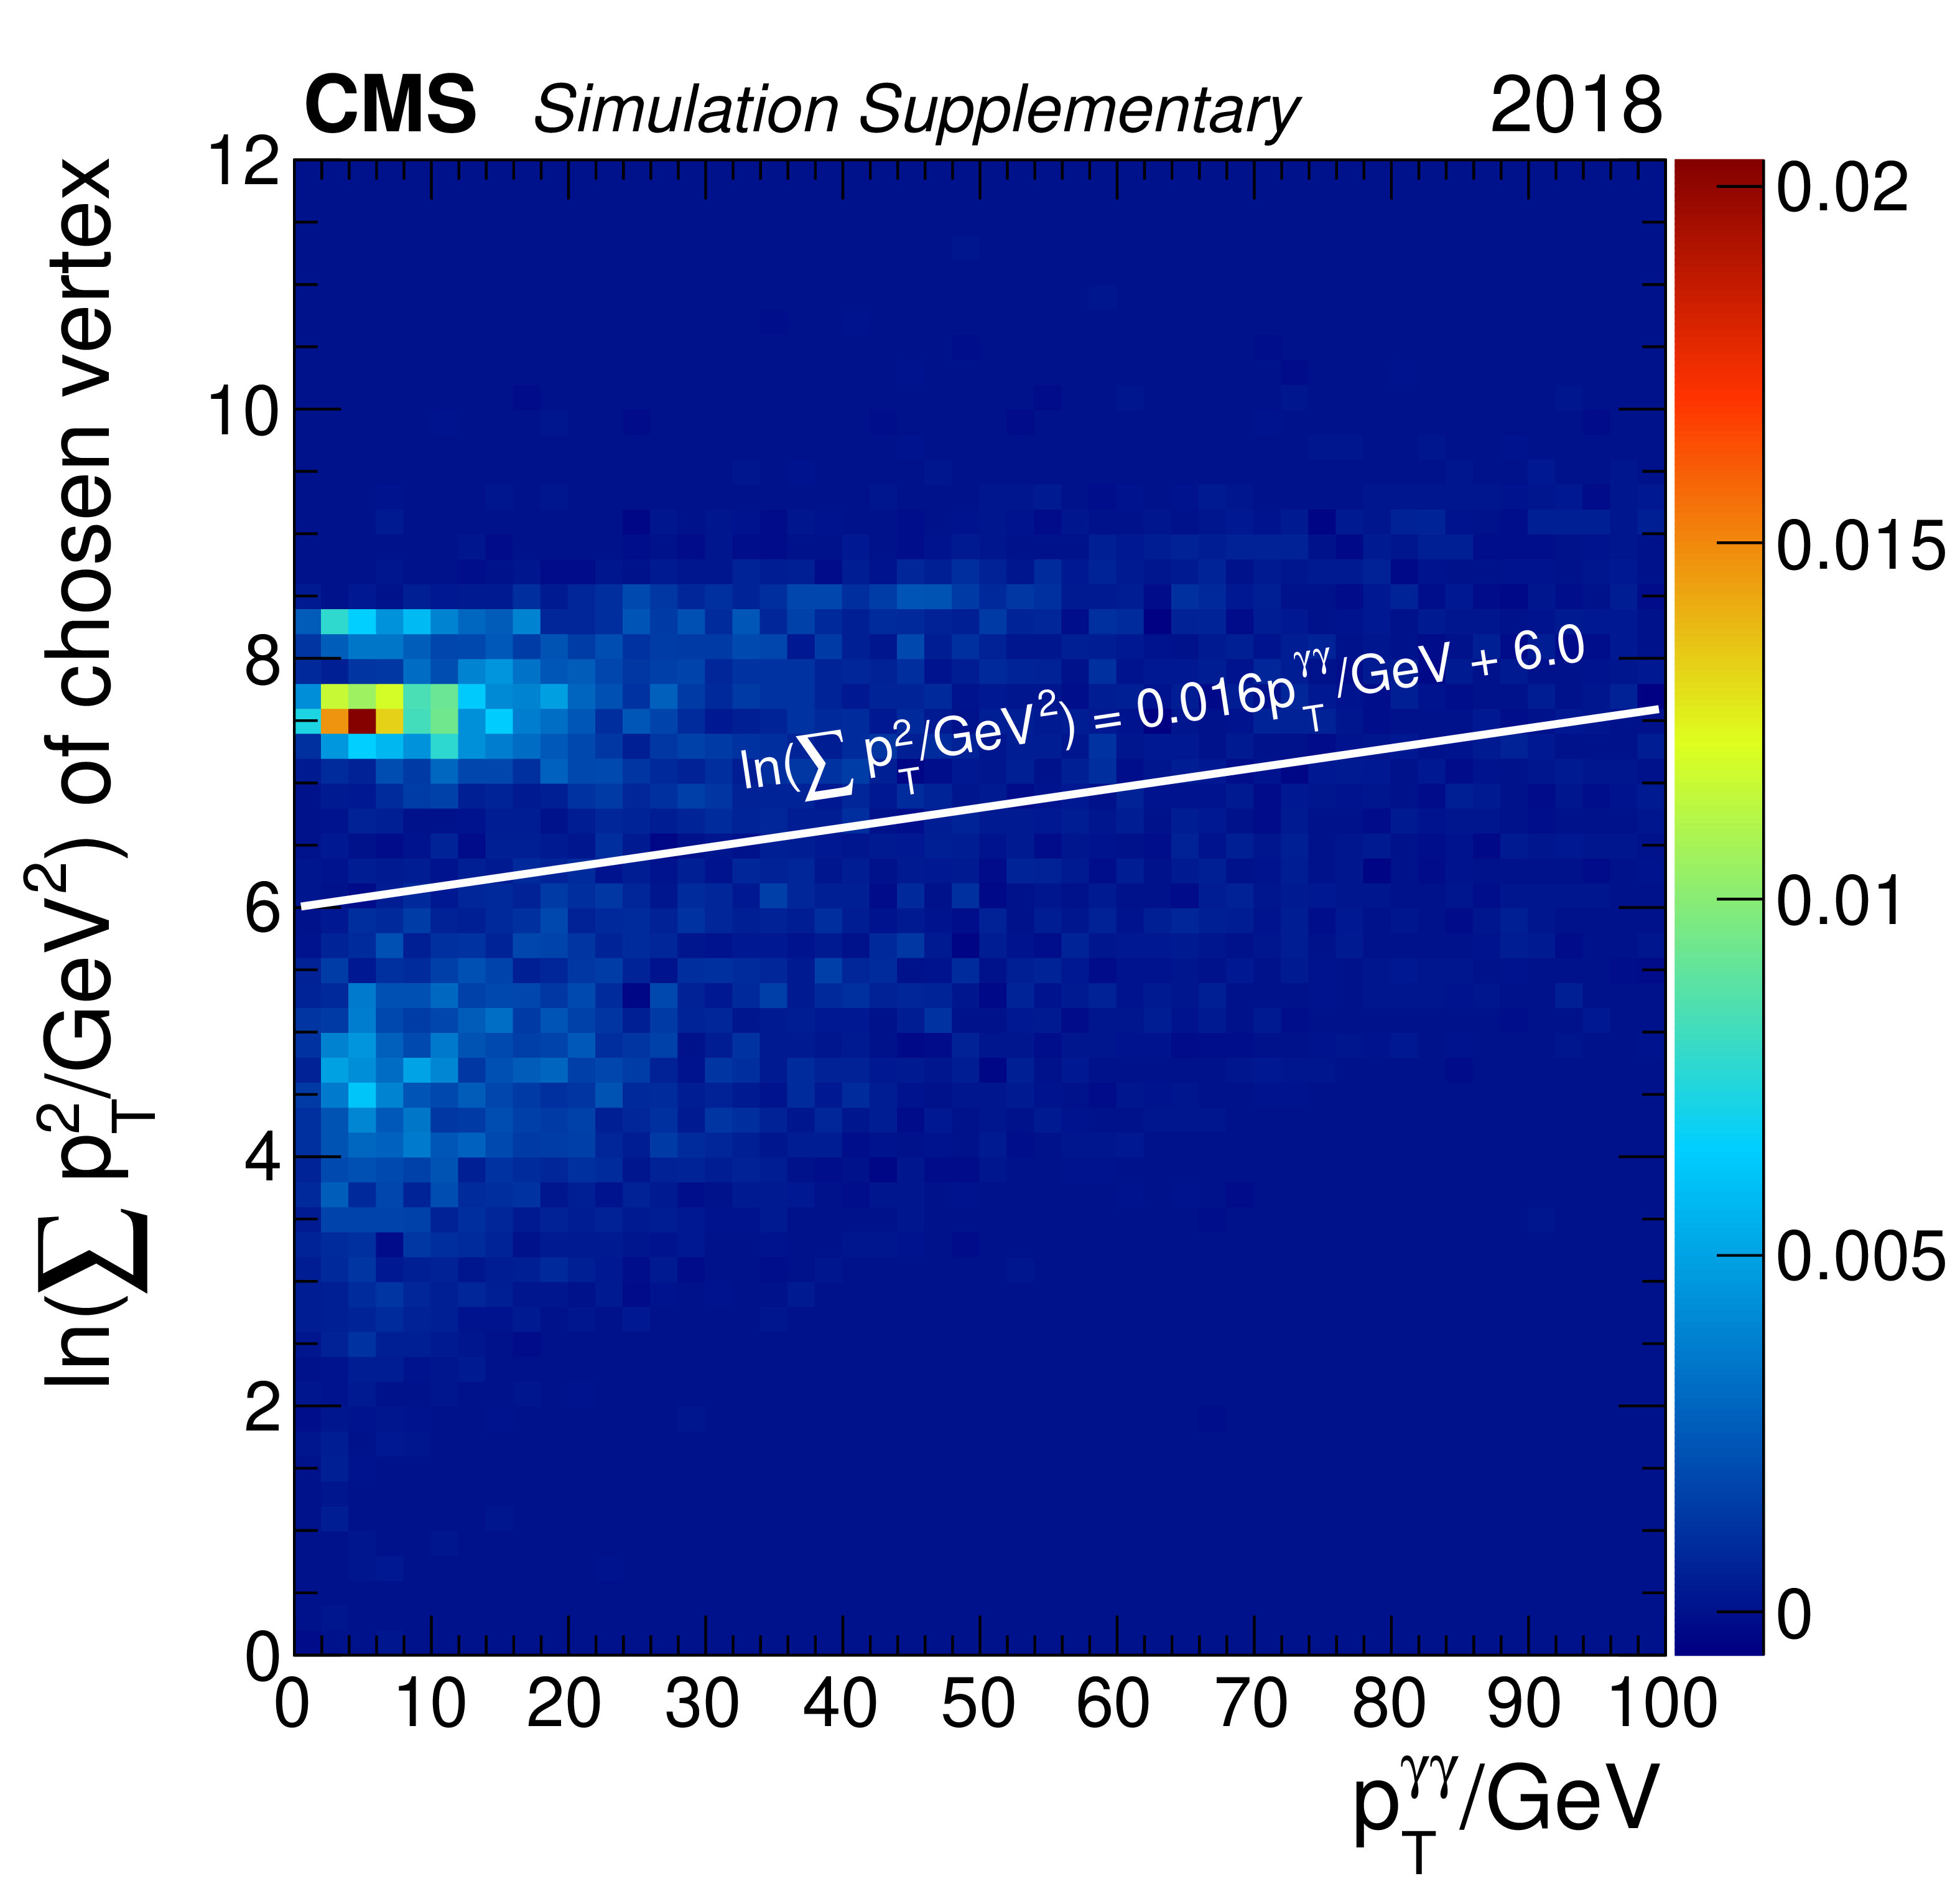
Analysis Strategy : DY suppression
Phys. Lett. B 860 (2025) 139067
Electron-veto without pixel detector hits
  Already used in the analysis of 2016 data combined with 2012 PLB 793 (2019) 320
Additional selections :
  Rejection of photon candidates also reconstructed as electrons
  log(Σp_{T}²)<=0.016*p_{T}^{γγ} + 6.0 : Maximum value of log Σp_{T}²
Classification based on diphoton candidate BDT :
  3 inclusive event classes for 2016
  3 inclusive event classes + 1 class targeting VBF process for 2017 and 2018
DY

Slide 7
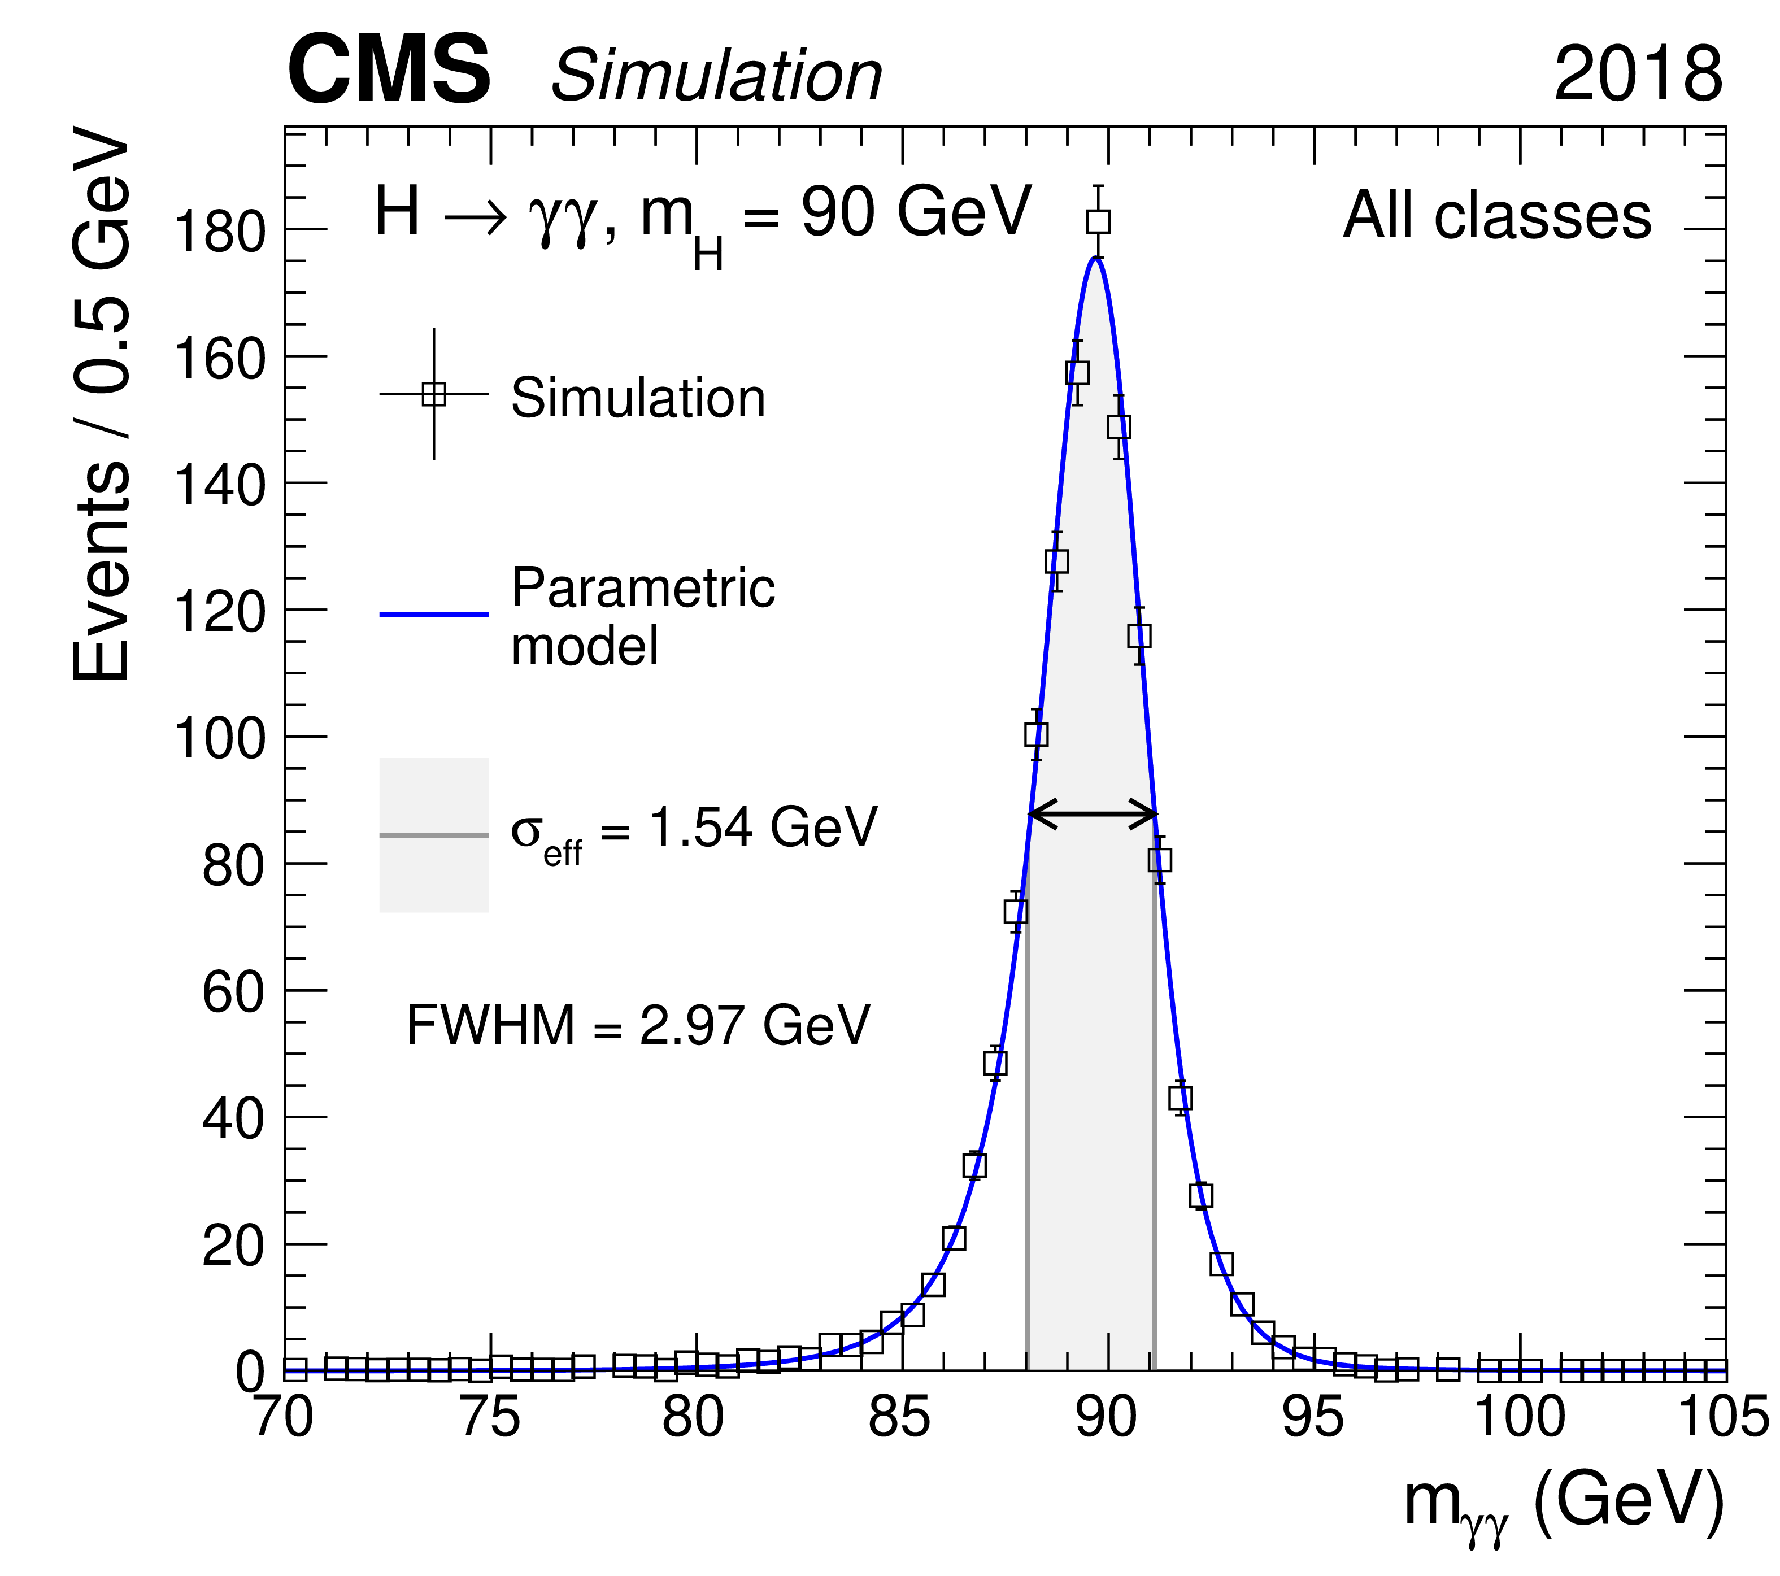
Signal modeling
A parametric model corresponding to a sum of Gaussians is used to model the signal
All production modes (ggH, VBF, WH, ZH, ttH) from 70 GeV to 110GeV with a 5 GeV granularity
Different production modes weighted by SM-like Higgs boson cross sections evaluated at 70 < m_{H} < 110

Slide 8
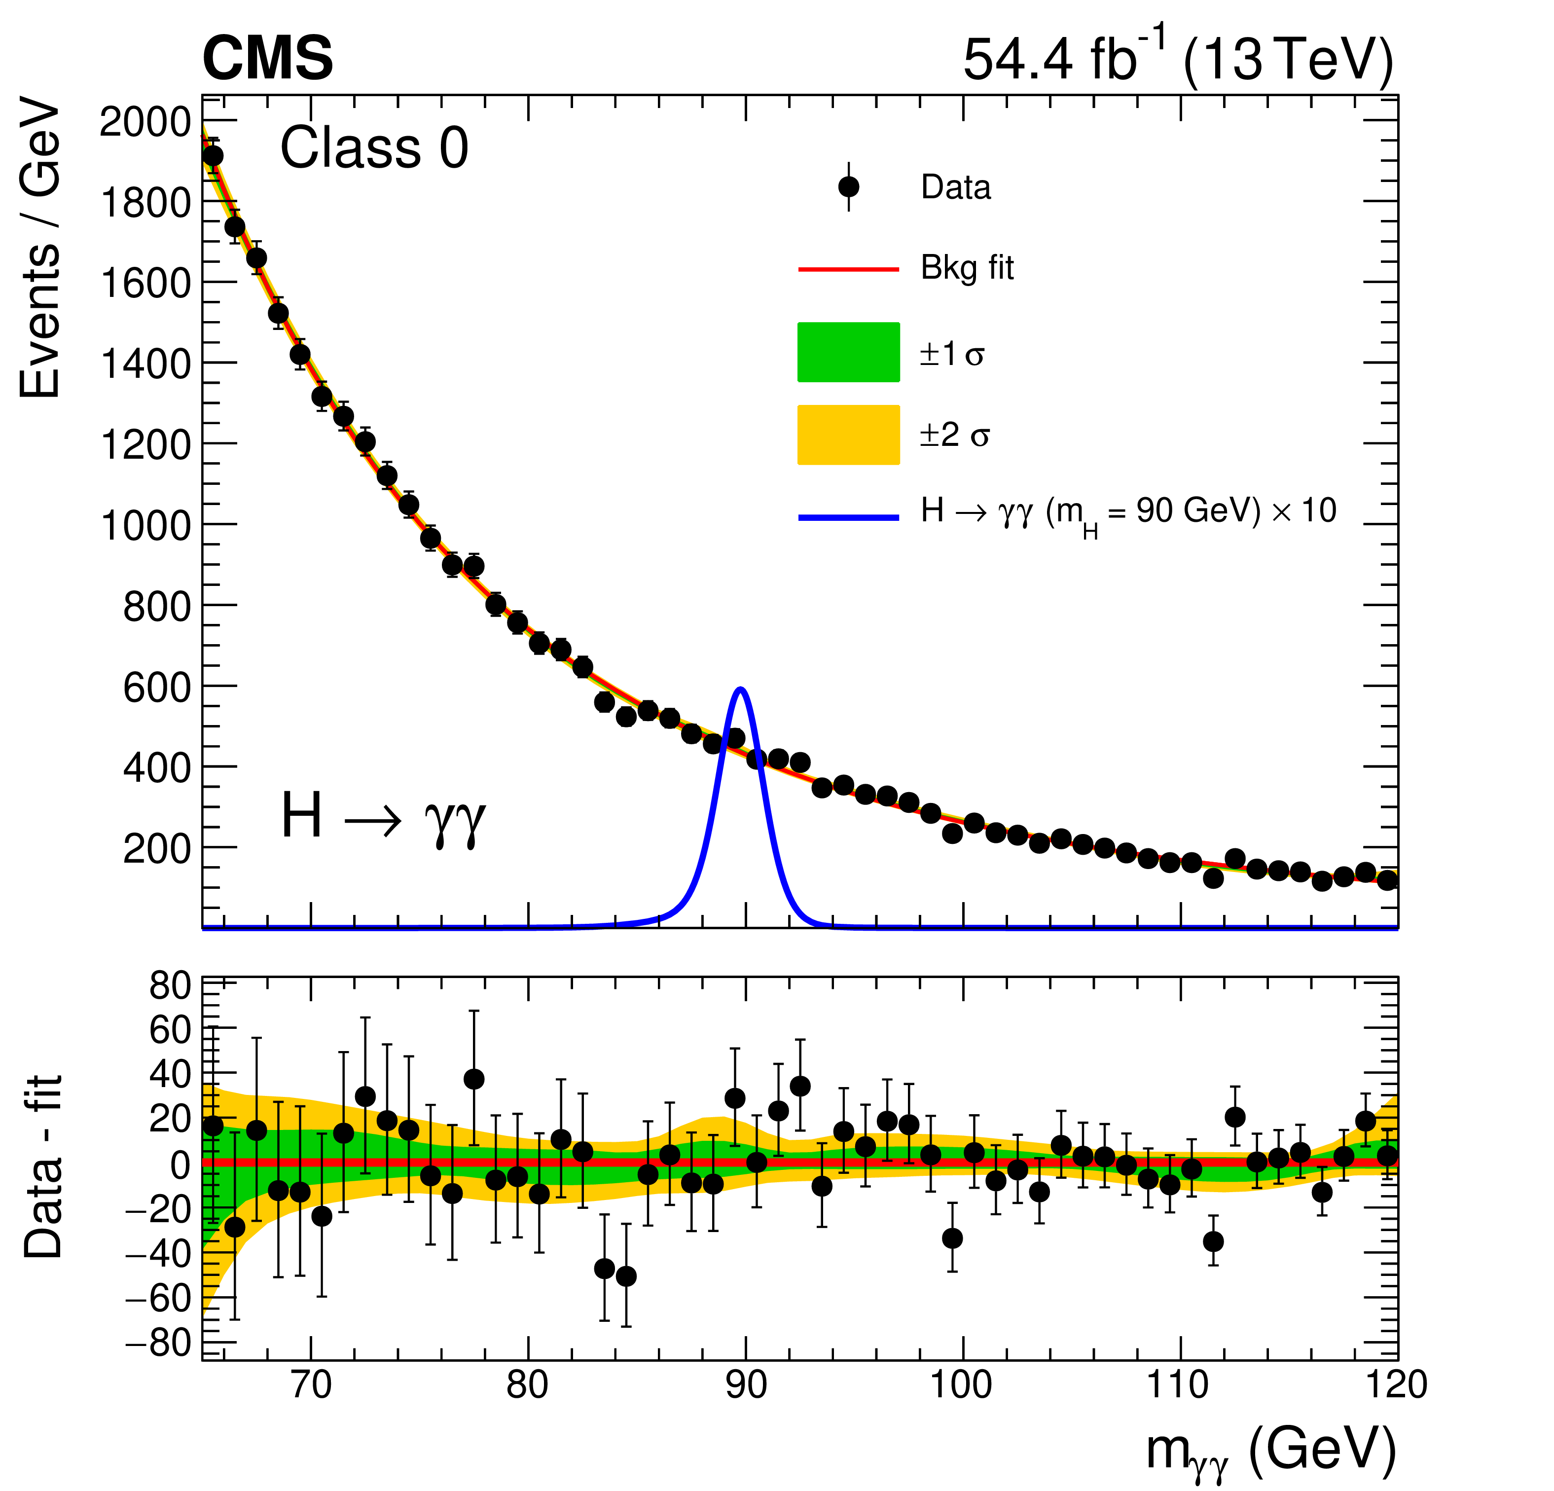
Background modeling
Relic Drell-Yan Z->ee contribution :
  Estimated by fitting doubly-misidentified MC Drell-Yan events with a double-sided Crystal Ball (DCB) function + an exponential
Total background model
  Built from fit to the diphoton mass spectrum (65-120 GeV) of data
  Sum of two components using the 'envelope' (discrete profiling) method
    Continuous analytic functions from four families (Power law, Exponential, Laurent, Bernstein) for the continuum background
    DCB+exponential (normalization floating) function
    for Z→ee contribution
  Envelope method chooses function orders and estimates associated systematic uncertainties

Slide 9
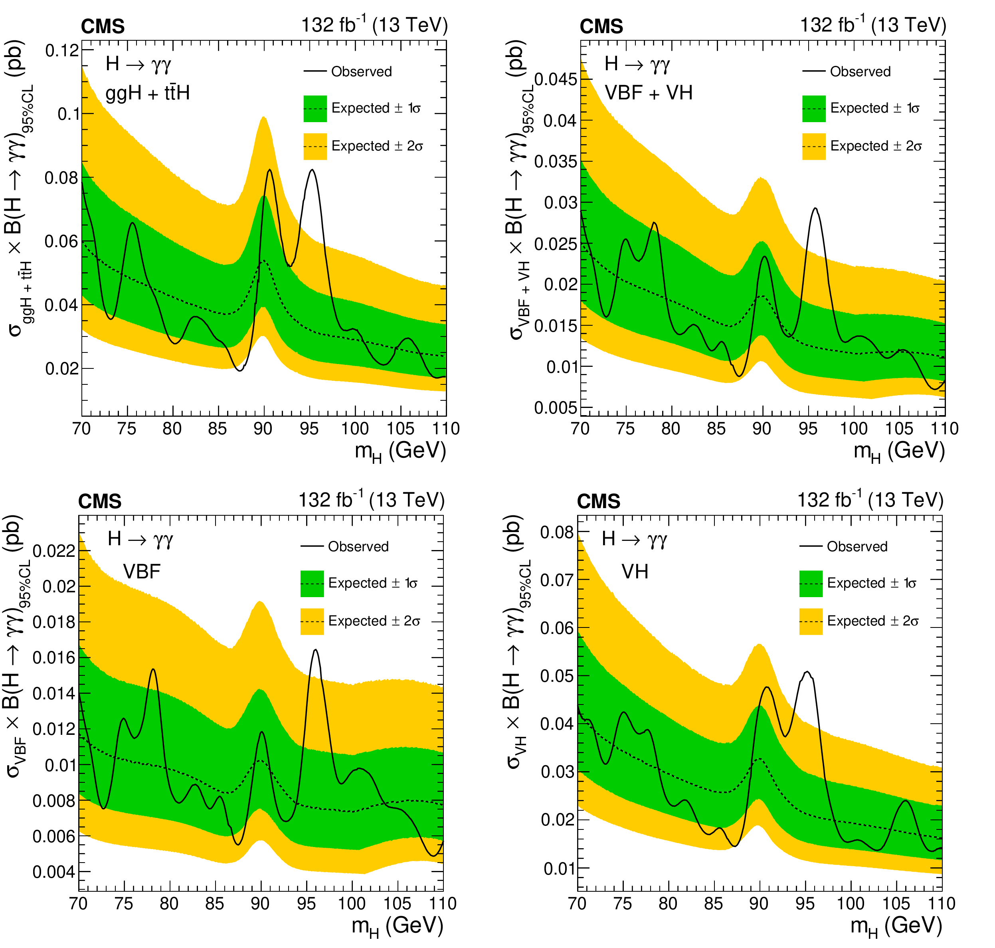
Full Run 2 Results : Limit by production mode

Slide 10
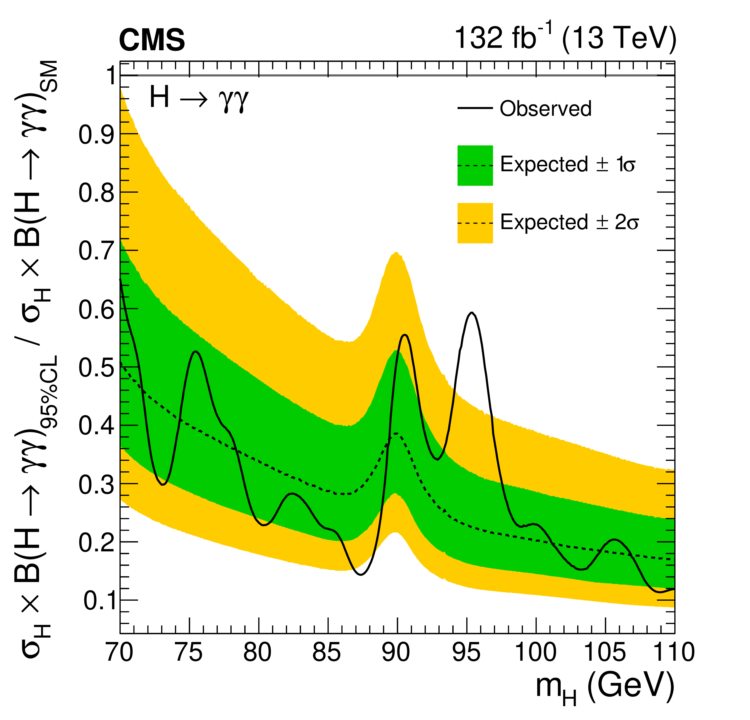
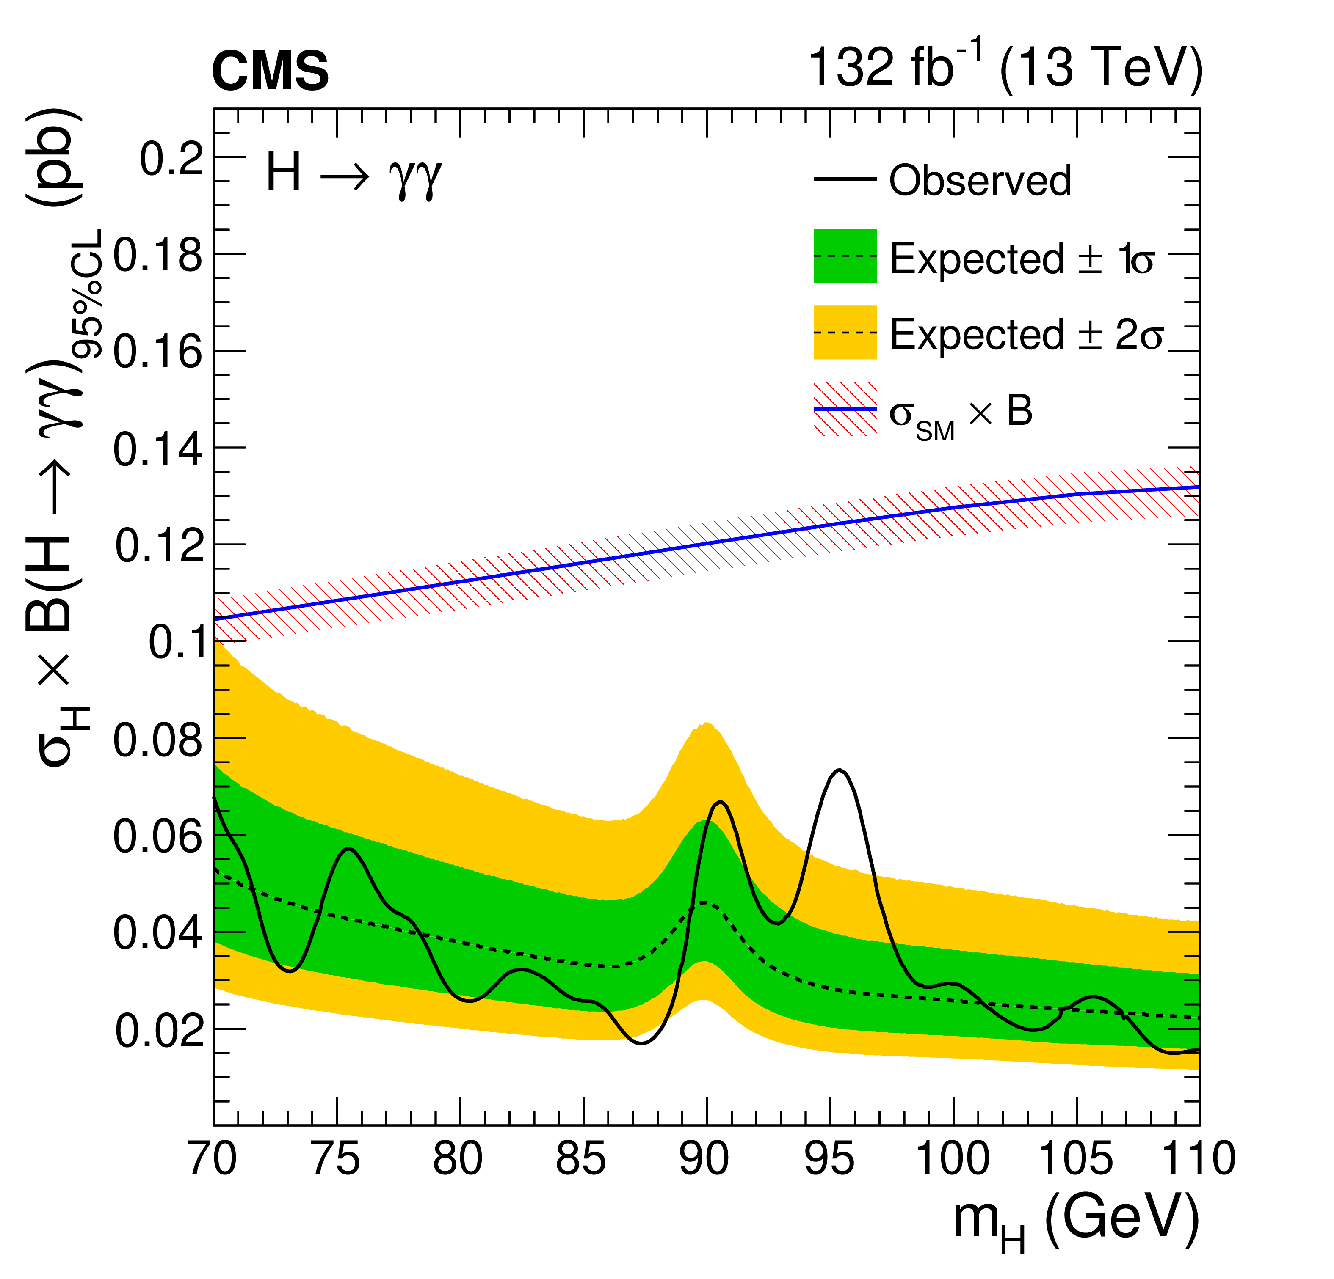
Full Run 2 Results : inclusive limit
95% CL upper limits on σ×BR normalized to SM prediction
Absolute 95% CL upper limits on σ×BR

Slide 11
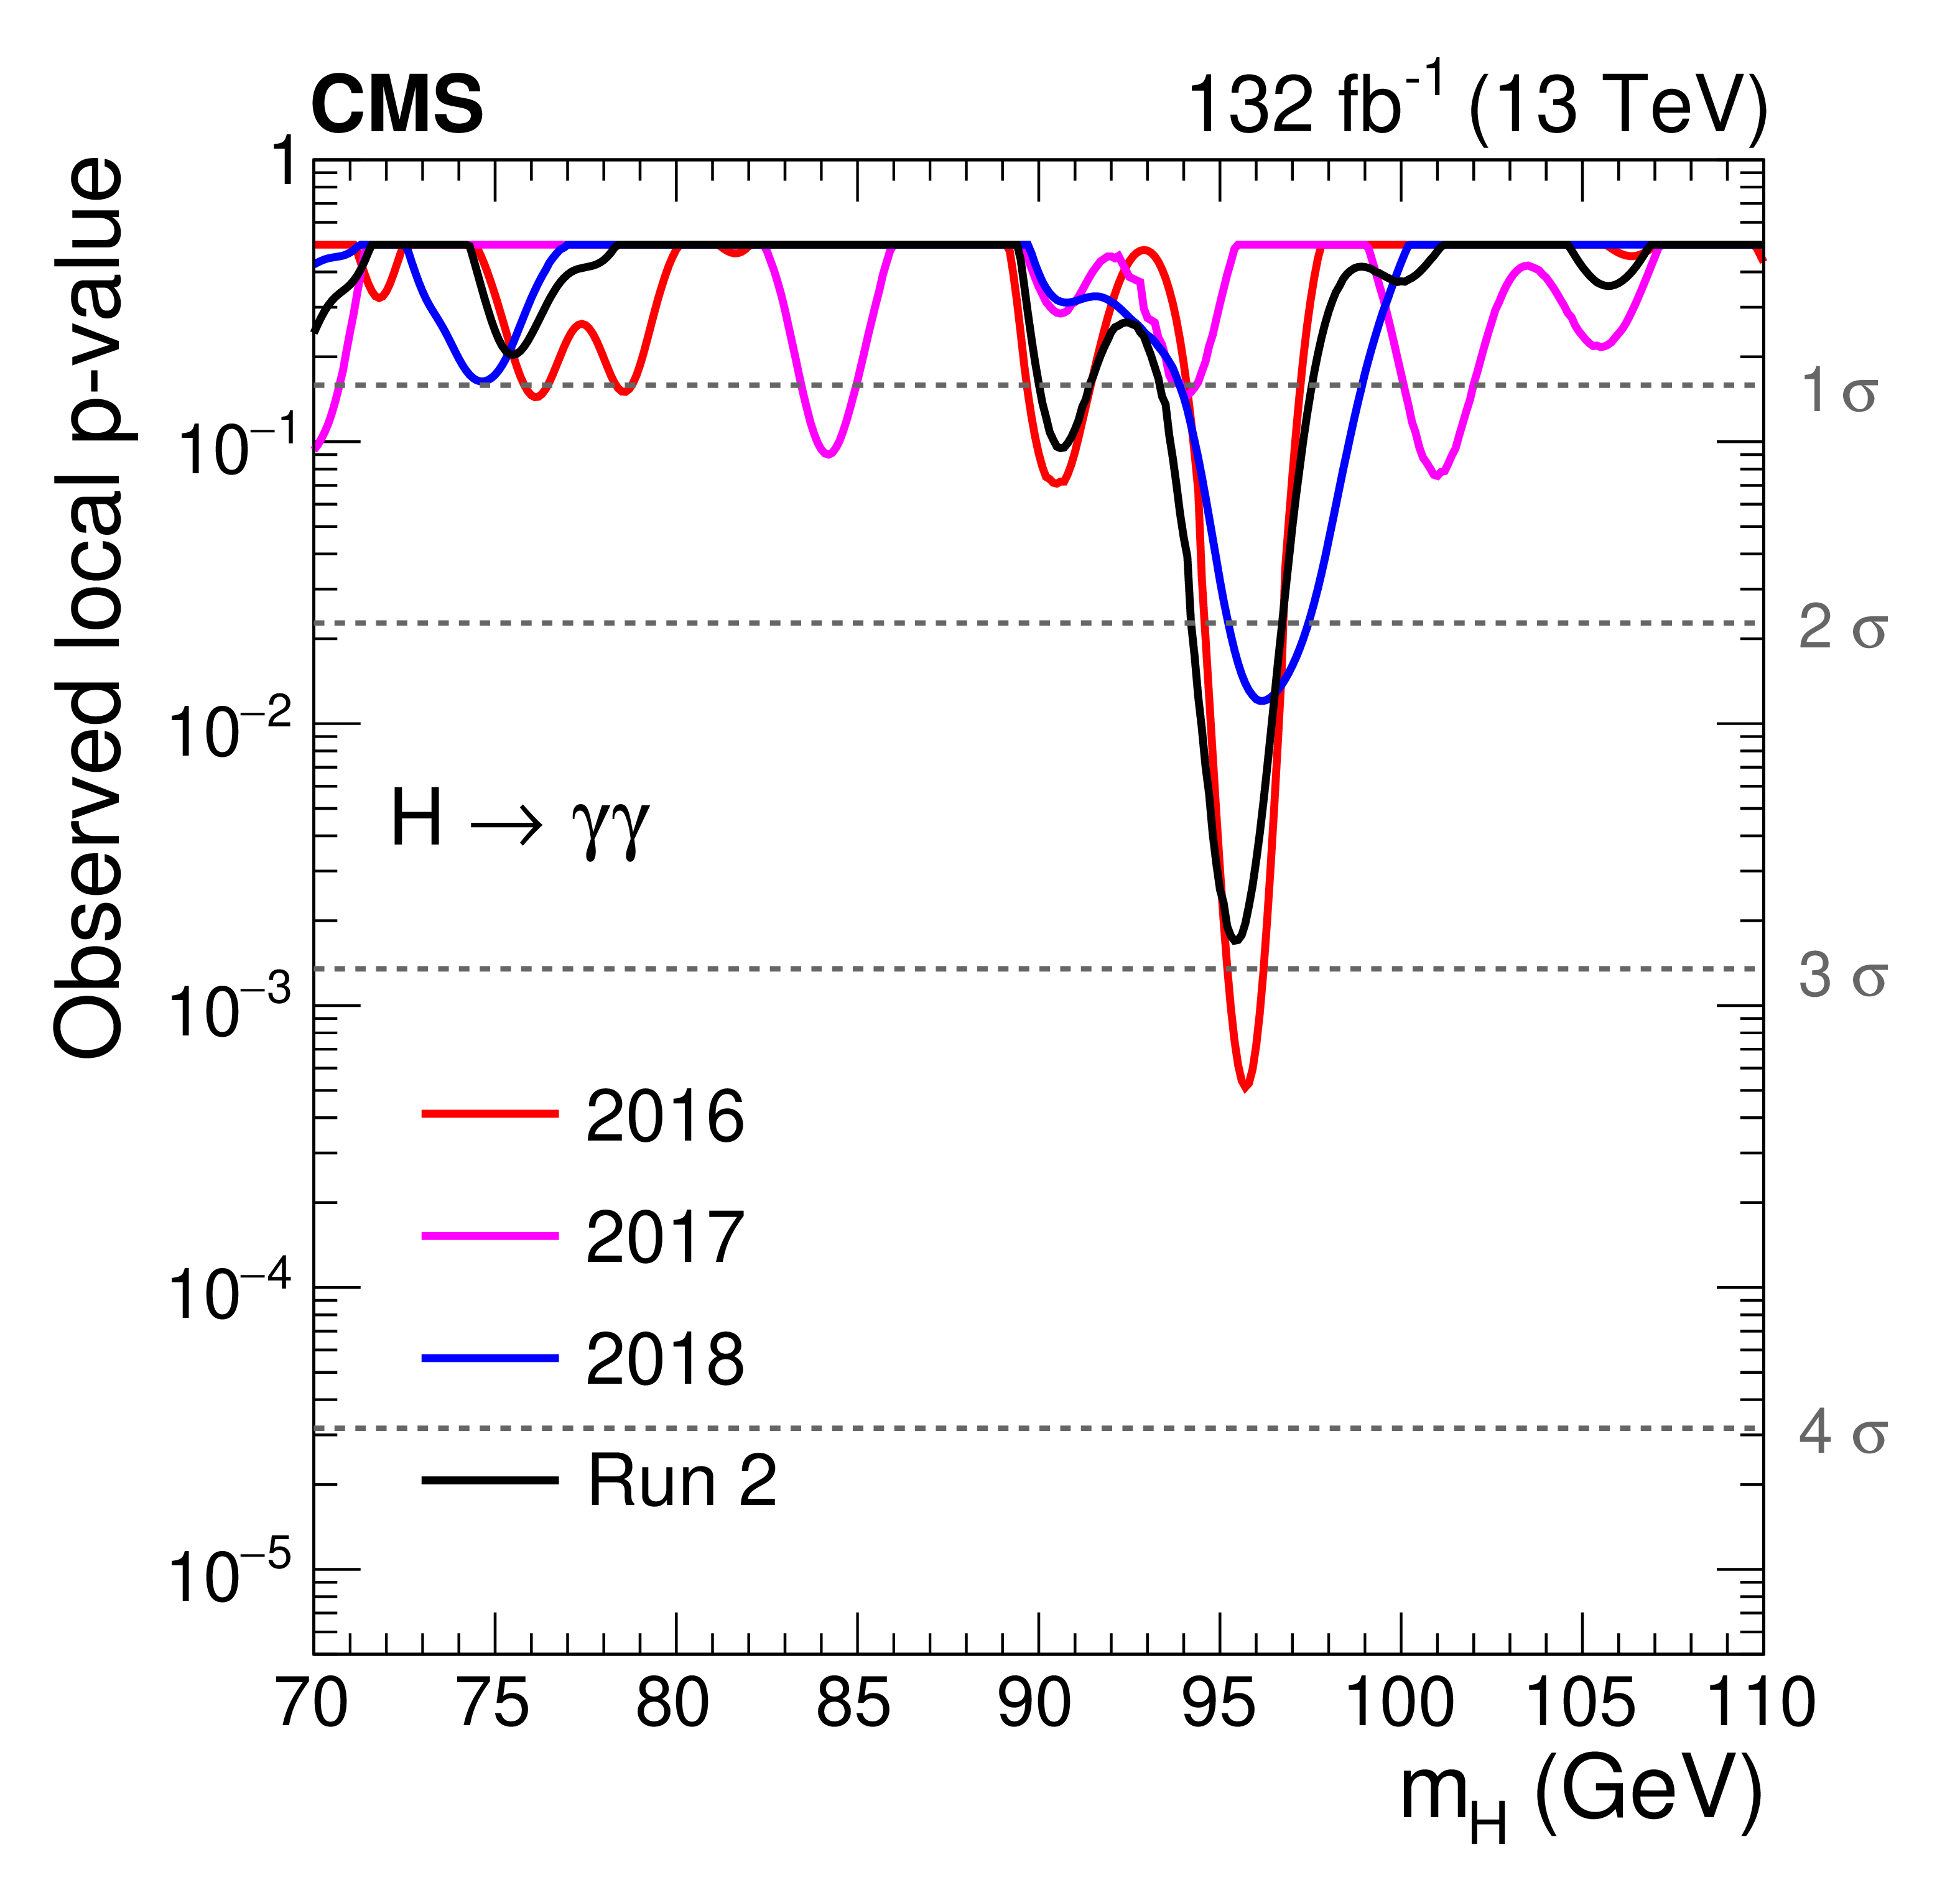
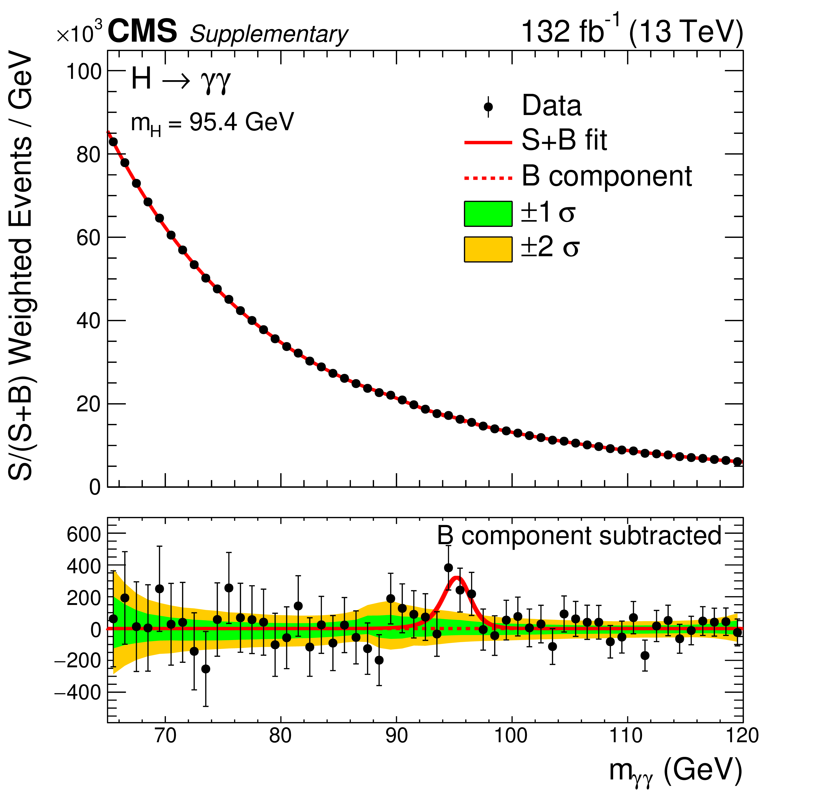
Full Run 2 results : inclusive significance
Observed p-values for 2016,2017,2018 and the combination
Modest excess with ~2.9σ local (1.3σ global) significance at m_{γγ} = 95.4 GeV
m_{γγ} distribution with Signal+Background model fit
The mass hypothesis here is m_{H} = 95.4 GeV
Each event is weighted by the ratio S/(S+B) for its event class

Slide 12
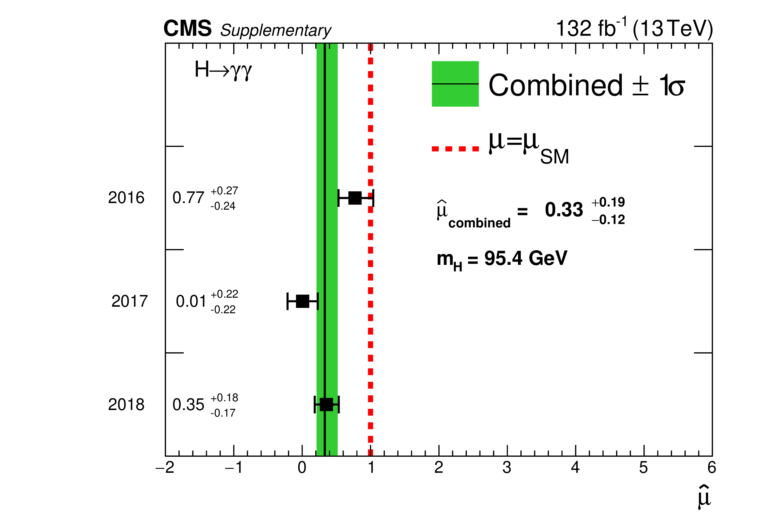
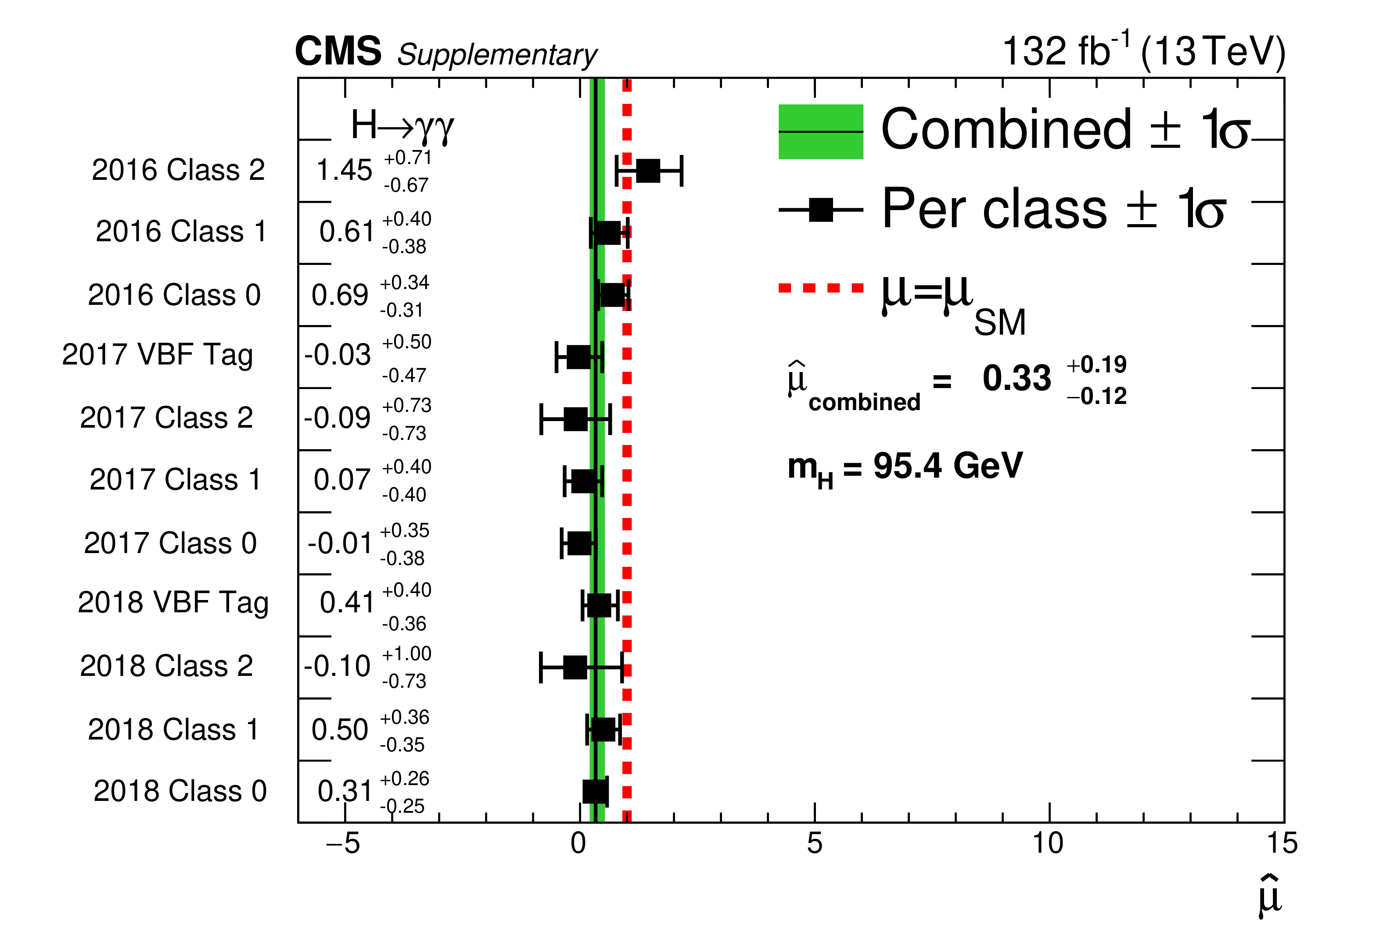
Signal Strengh µ for each year and classes

Slide 13
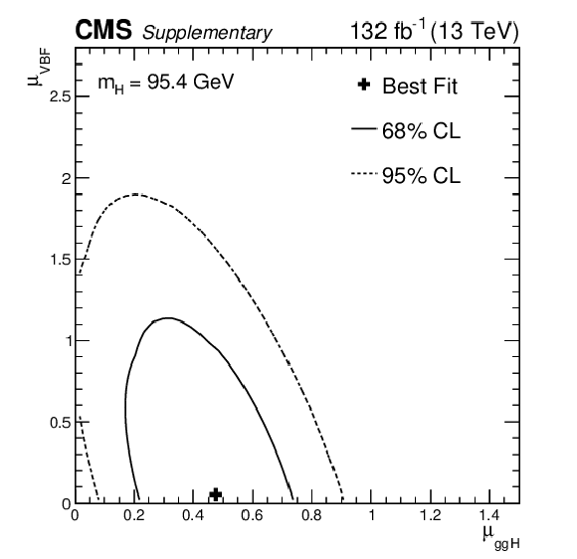
Maximum likelihood estimates
Maximum likelihood estimates, and 68 and 95% confidence level contours obtained from scans of the signal likelihood as a function of μ_{ggH} versus μ_{VBF} for mH = 95.4 GeV, when considering only ggH and VBF production modes.
The best-fit result is (μ_{ggH}, μ_{VBF}) = (0.47, 0.05).

Slide 14
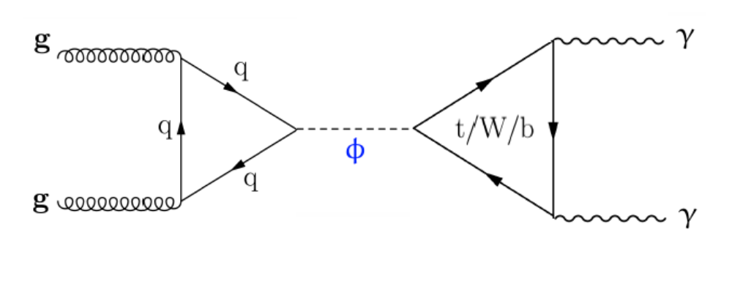
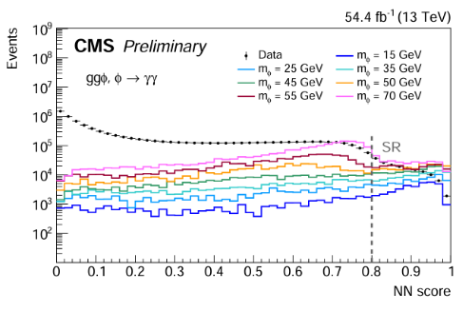
Search for [10,70] GeV H->γγ
CMS-PAG-HIG-24-014
Motivated by GeV-scale Axion-like particles (ALPs), and performed using 2018 data without any diphoton mass cut in the trigger
Many elements (such as trigger efficiencies, pre-selections) inherited from the Run2 low-mass H→γγ analysis as introduced in previous slides
A neural network (NN) is employed to enhance the selection of events with a high sig-to-bkg ratio and good mass resolution
  Variable inputs include photon kinematics and diphoton features along with discrete mass hypothesis
  Signal region (SR) : NN score>0.8 with highest sensitivity

Slide 15
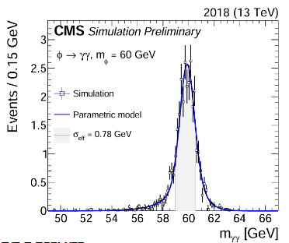
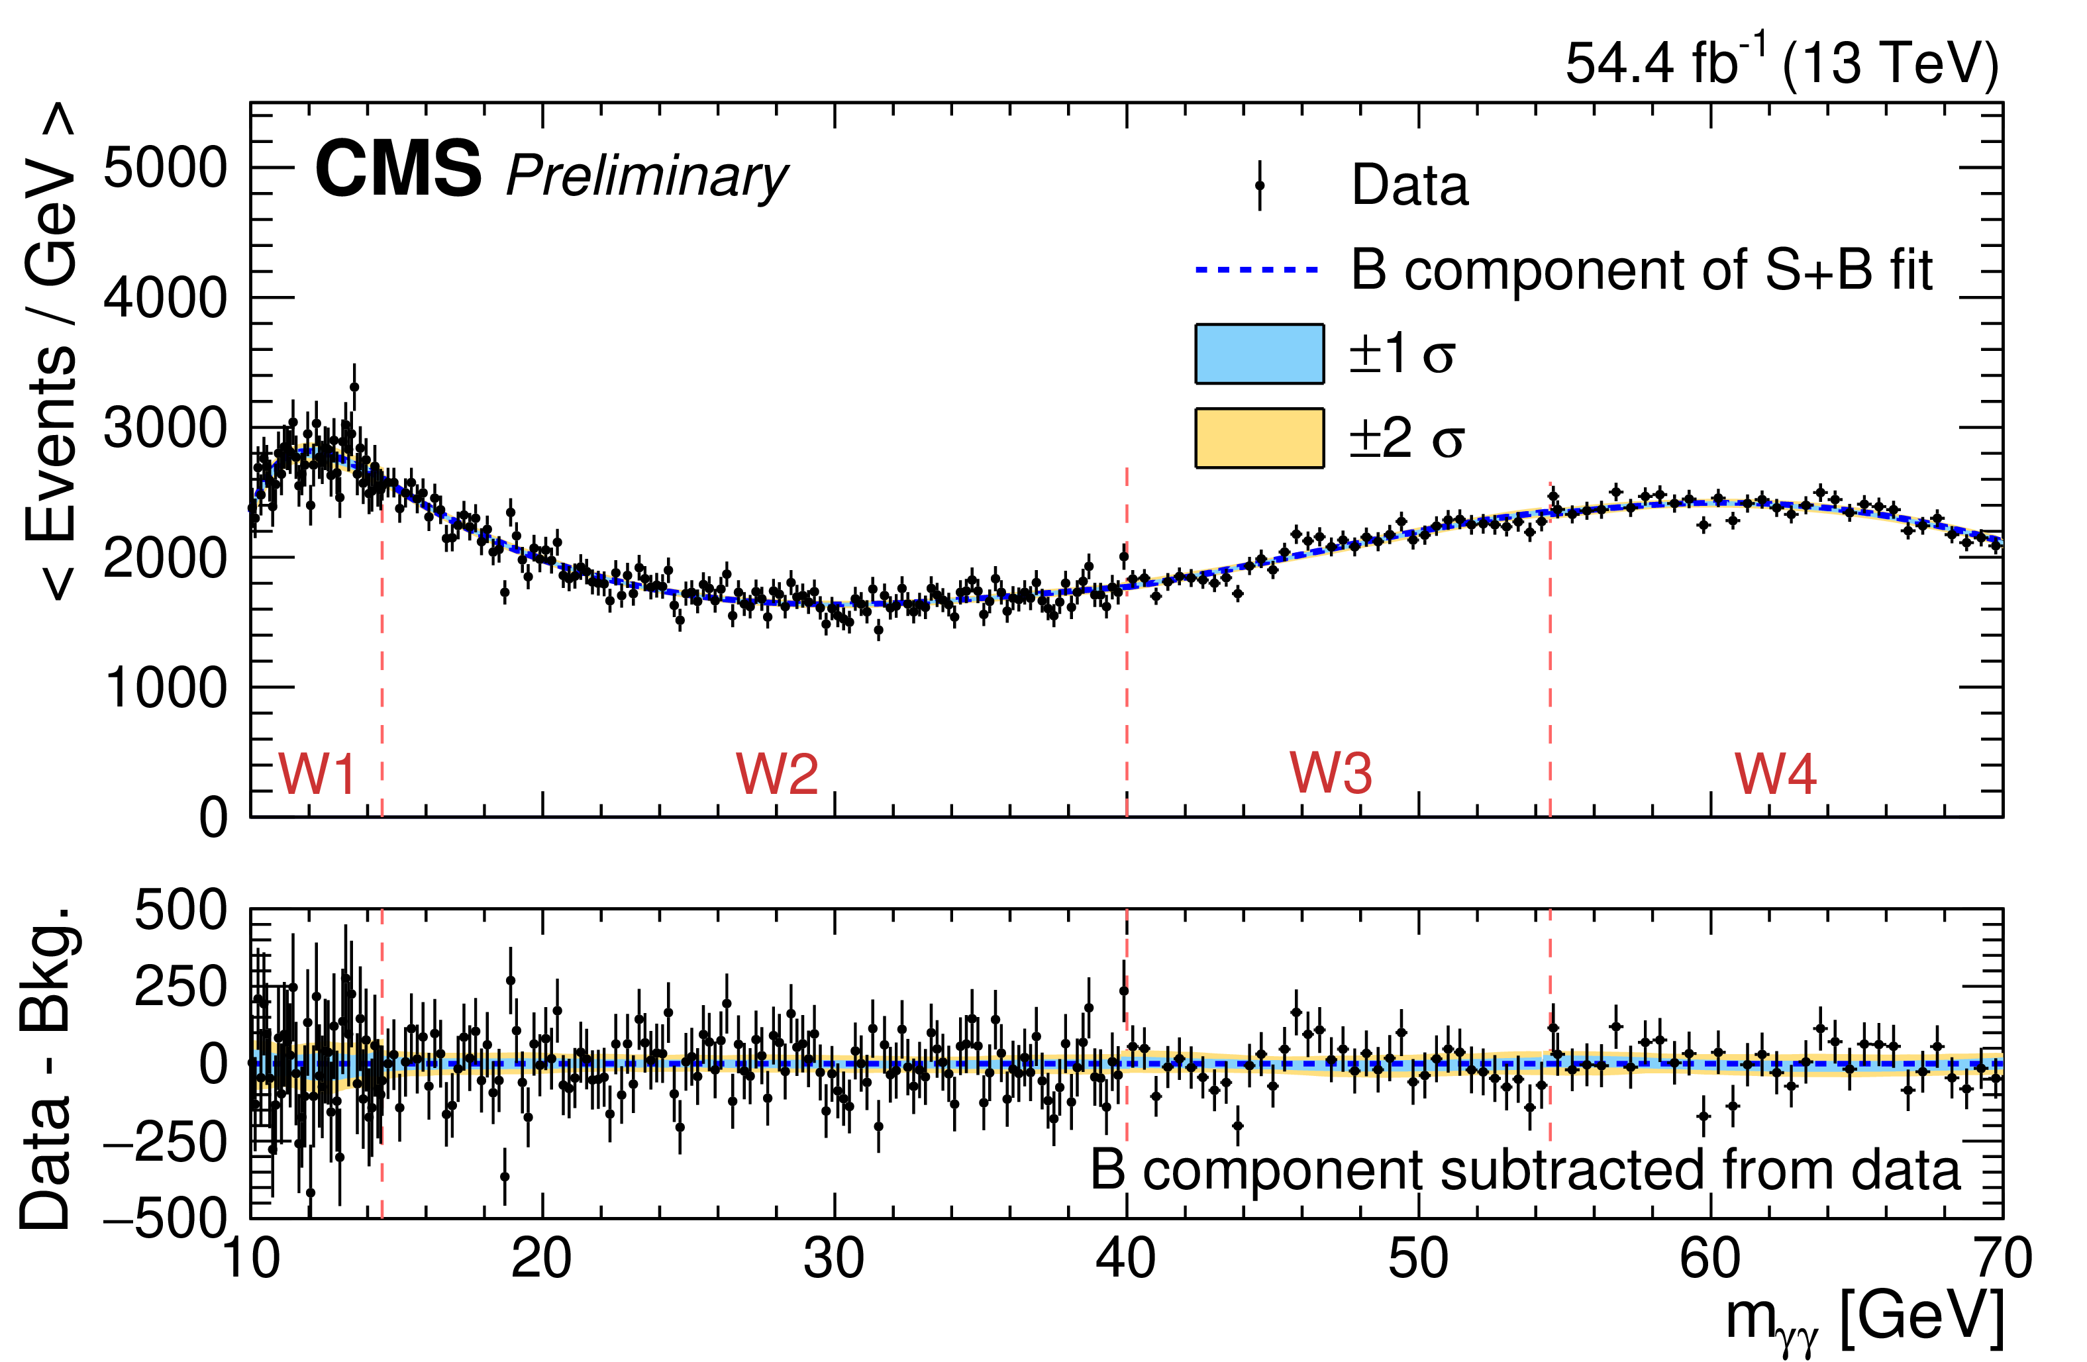

Search for [10,70] GeV H->γγ
Signal model : Double Crystal ball + Gaussian
Background model : mass spectrum divided into 4 sub ranges.
Discrete profiling method applied in each one.
Two distinct turn-on features :
  ~50GeV : Driven by photon p_{T} threshold
  ~12GeV : arising from the photon isolation criteria starting to be inefficient for close-by objects from highly boosted diphoton candidates

Slide 16
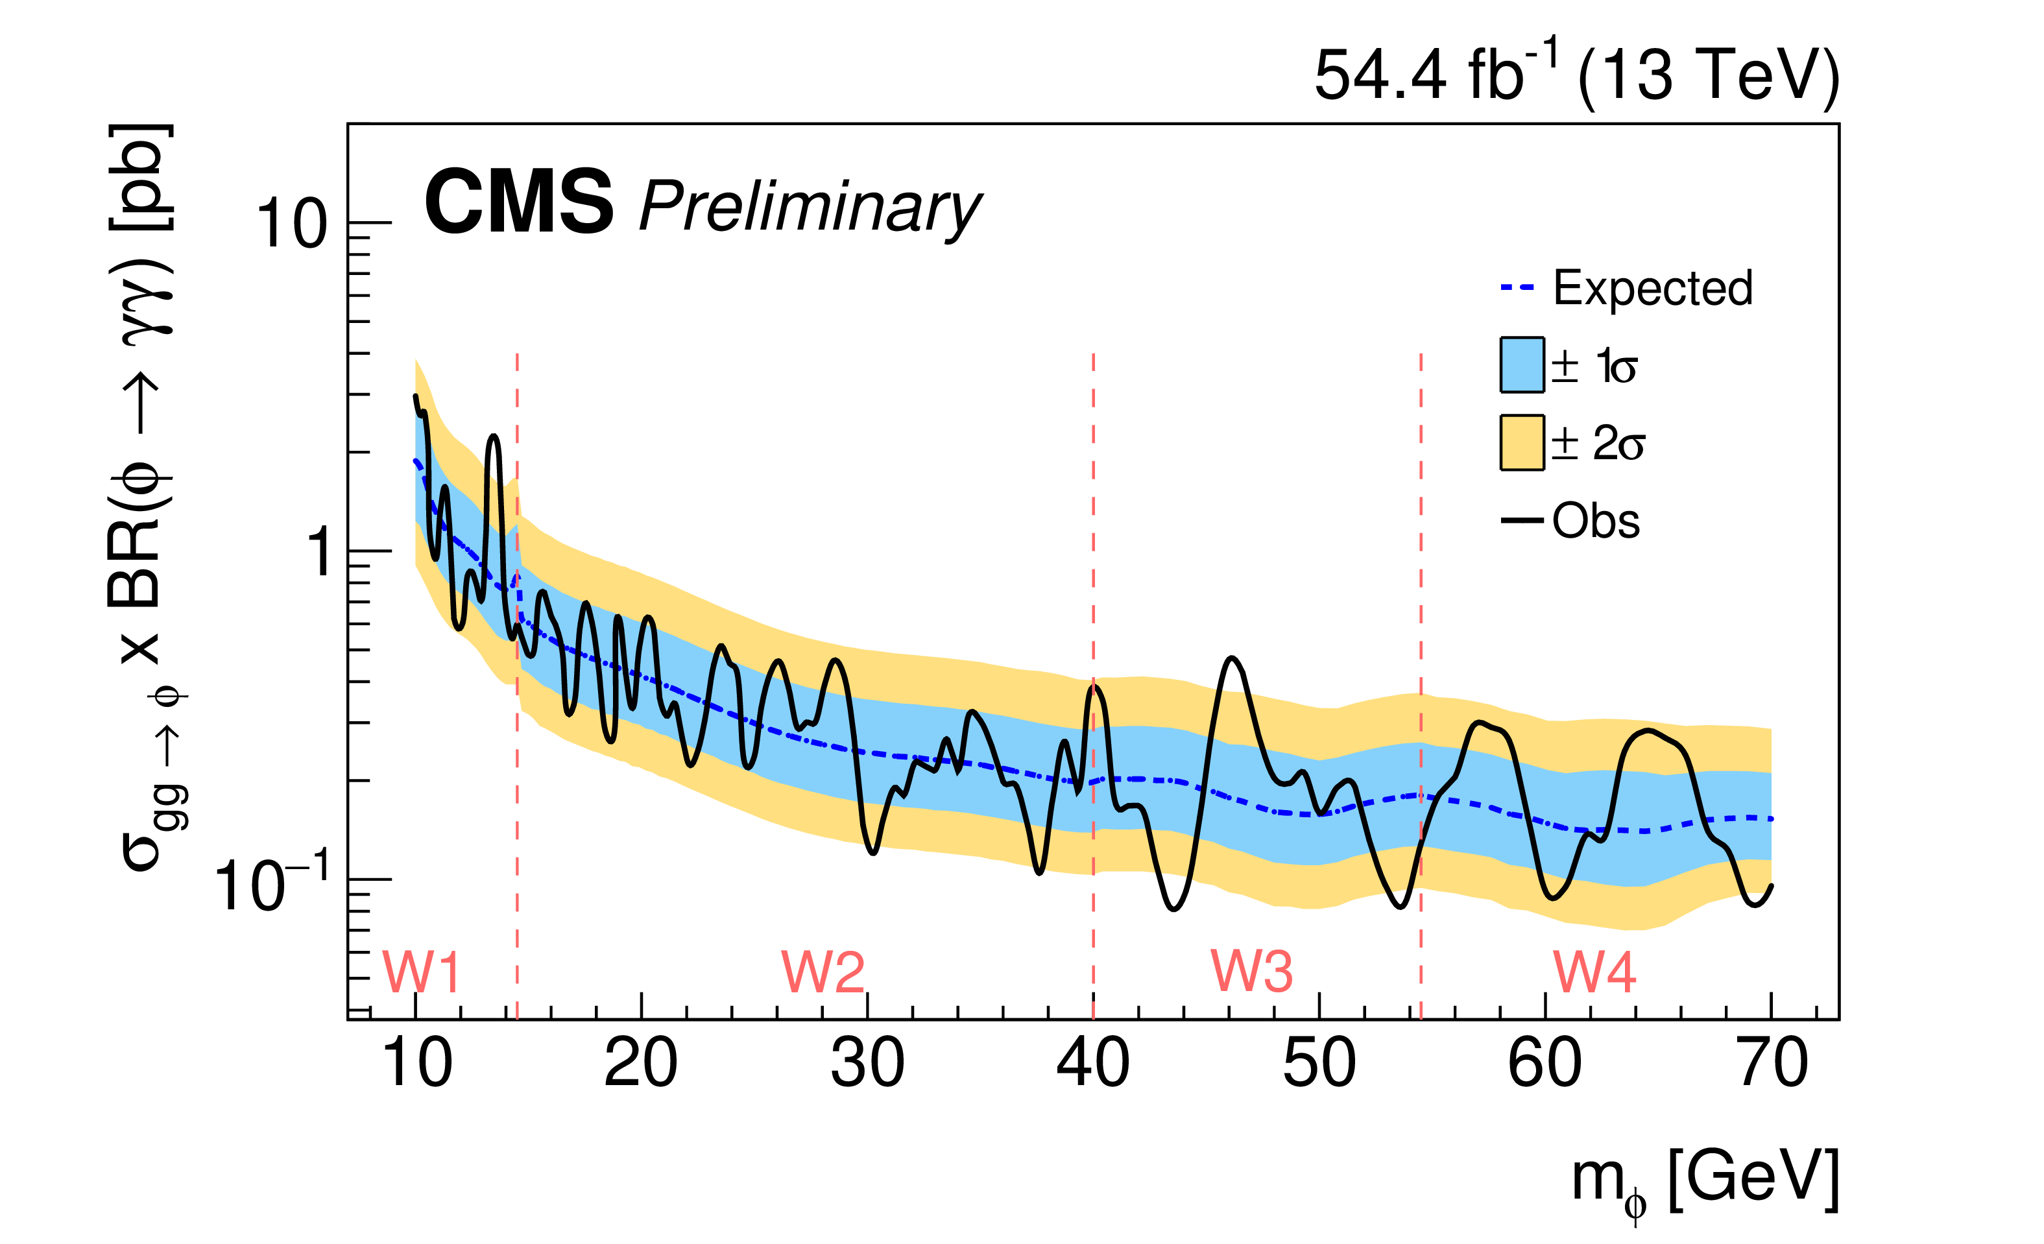
Results of search for [10,70] GeV H->γγ
Most significant excess at 13.6 GeV with
3.47σ (1.9σ) local (global) significance

Slide 17
Summary
Results of search for a standard model-like Higgs boson in the mass range between 70 and 110 GeV in the diphoton final state at 13 TeV with full Run 2 data and search for a narrow ressonance at between 10 and 70 GeV decaying to pair a photon has been presented
Published in PLB : Phys. Lett. B 860 (2025) 139067
No evidence for the existence of a new Higgs Boson so far :
At 95.4 GeV, for all the classes and combined production modes
  Local excess significance : 2.9σ.
  Global excess significance : 1.3σ
At 13.6 GeV :
  Local excess significance : 3.47σ
  Global excess significance : 1.9σ

Slide 18
Thanks for your attention !

