Slide 1
16th Workshop of the France-China Particle Physics Network/Laboratory (FCPPN/L 2025)
Experimental Progress on High-Average-Power Optical Enhancement Cavity
Yan ZHAO
PhD student
Accelerator Lab, Tsinghua University, Beijing, China
Notes:
Hello, I'm from the accelerator lab at Tsinghua University. I report on experimental progress on high average power optical enhancement cavity.

Slide 2
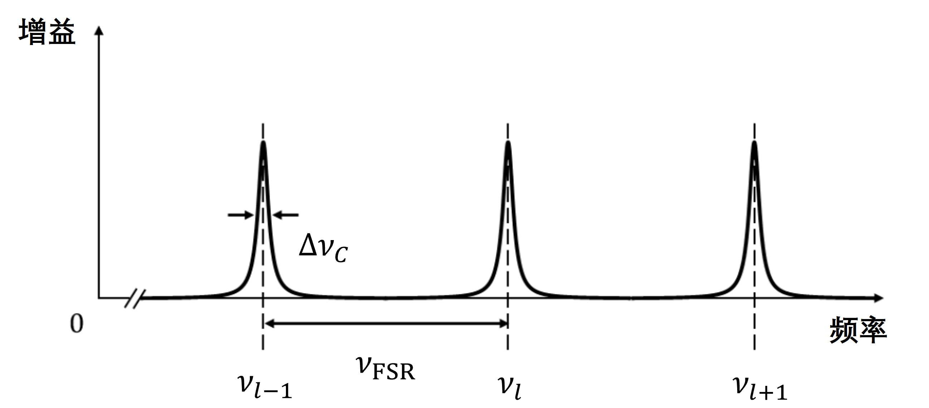
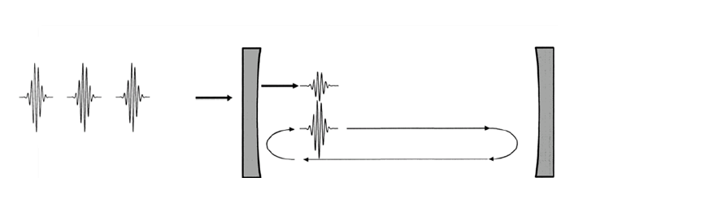
Optical Enhancement Cavity(OEC)
OEC is a technological way to obtain high average power lasers;
It is based on the resonance enhancement principle to realize the accumulated amplification of injected laser light;
The resonance frequency of the cavity forms a frequency comb，and the frequency comb of the incident laser should coincide with it as much as possible.
Optical amplification in the cavity maintains the good properties of the injected laser light, such as good beam quality, low phase noise, and high repetition frequency;
Gain
L_{cav}
Injected laser pulses
Intra-cavity pulses
c
accumulation
FSR=
2 Lcav
Frequency
Frep
Mirror 1
Mirror 2
Figure 2 Schematic of the frequency comb of the OEC
Figure 1 Schematic of OEC principle
Notes:
Here are some introductions to optical enhancement cavity or OEC for short. OEC is a technology for obtaining high average power lasers. It allows the injected laser power to accumulate in the cavity through resonance enhancement. The resonance frequency of the cavity forms a frequency comb. In order to obtain a larger effective gain, the frequency comb of the injected laser should coincide with OEC‘s frequency comb as much as possible. Optical amplification in the cavity maintains the good properties of the injected laser, such as good beam quality, low phase noise and high repetition frequency.
By virtue of stably storing lasers with high power, high repetition frequency, high beam quality, and high phase stability inside the cavity , OEC shows broad application prospects in advanced light sources, fusion energy, precision probes, and other cutting-edge application fields.

Slide 3
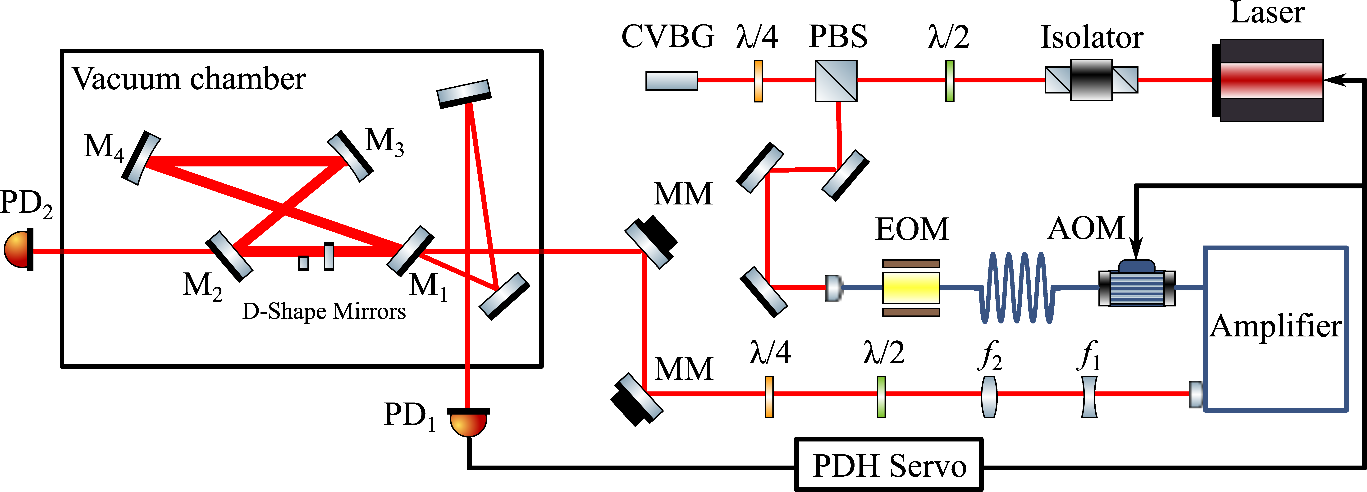
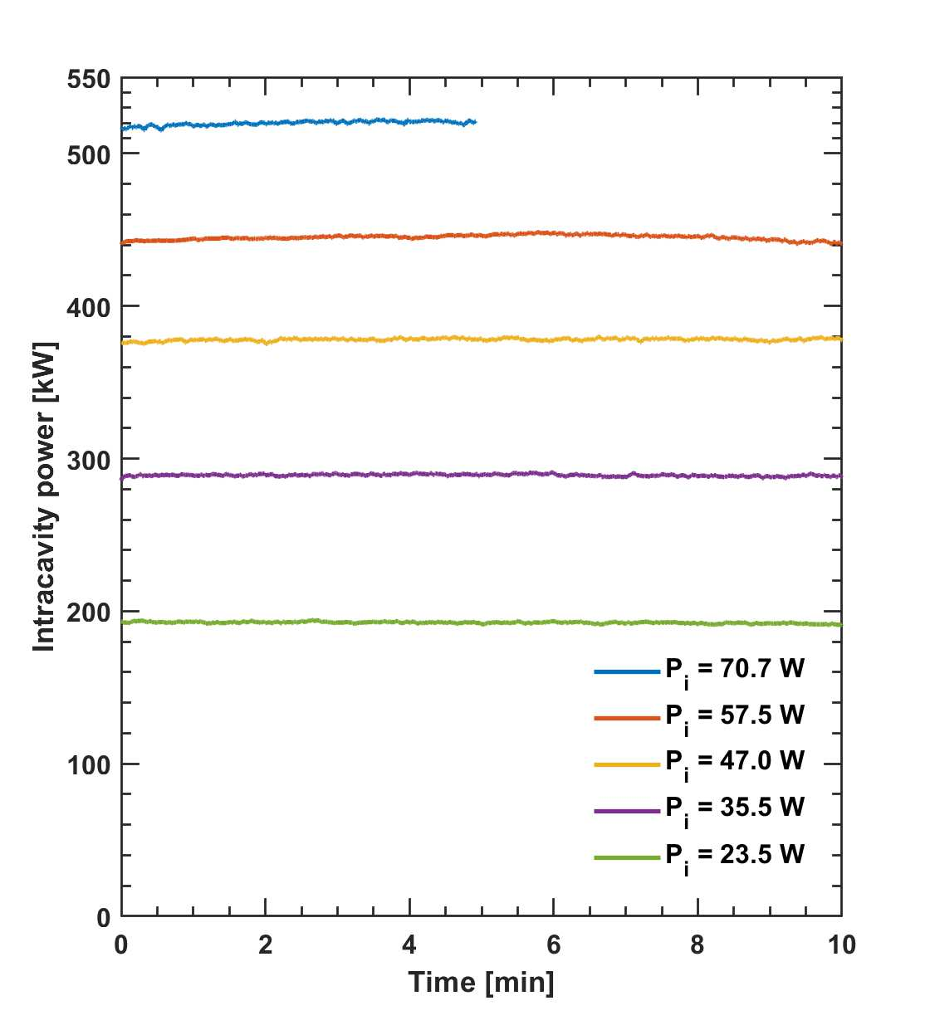
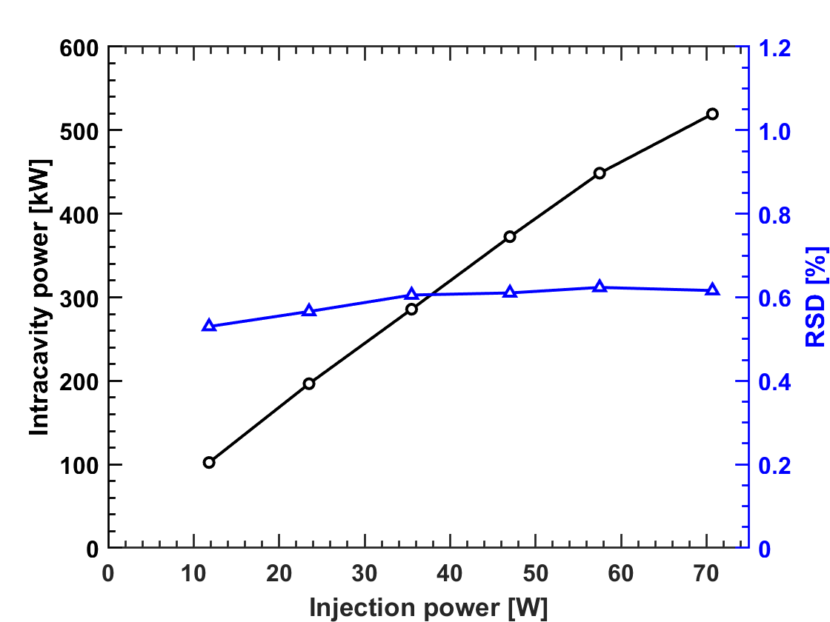
Experimental Progress of high average power pulsed OEC
The laser oscillator generates 200 fs pulses of Fourier-transform limited bandwidth at 1030 nm with a pulse repetition rate of 160 MHz and 150 mW average power.
Figure 3 Schematic of the Bow-tie type four-mirror OEC experimental setup
Ten minutes of experimental testing at different injection power (Above 70 W of amplifier, to protect the hardware equipment, the test time was changed to 5 minutes );
RSD shows fluctuations of around 0.6%.
Figure 4 Experimental measurements of intracavity power as a function of time for various values of injection power Pi.
Figure 5 Experimental measurements of the average intra-cavity
power and its standard deviation relative to its average (RSD) as a
function of injection power. Lines are drawn as a guide for the eye.
Lu X Y, et al. Stable 500 kW average power of infrared light in a finesse 35,000 enhancement cavity[J]. Applied Physics Letters, 2024, 124(25).
Notes:
Next, I'll describe the progress made on high-average-power OEC experiments, including pulsed and continuous wave OEC. The experimental progress on high-average-power pulsed OEC is obtained by a PhD student in our lab together with researchers from IJClab, France, in their lab. This is a schematic of the bow-tie type four-mirror pulsed OEC experimental setup. The system consists of injection laser, OEC, feedback control and signal diagnostics. The laser oscillator generates 200 fs pulses at 1030 nm with a pulse repetition rate of 160 MHz and 150 mW average power and the output power of the amplifier can be greater than 70W. In the high average power optical cavity experiments, the injected laser power was gradually and slowly increased, and the system was adjusted to optimize the stability of the cavity power and locking at different injected powers, followed by a 10-minute average power data recording. The cavity locking duration was shortened to 5 minutes to protect the hardware when the injected laser power was greater than 70W. As shown in Fig. 4, stable locking of the 520 kW average power was achieved at 70.7 W injected power. The effective gain is 7355. No loss of lock was observed in the experiments under all power conditions, and the system maintains excellent stability and can be operated for a longer period of time with high average power. Figure 5 shows the experimental measurements of the average intracavity power and its RSD under different injection powers. The results show that the stability is high.

Slide 4
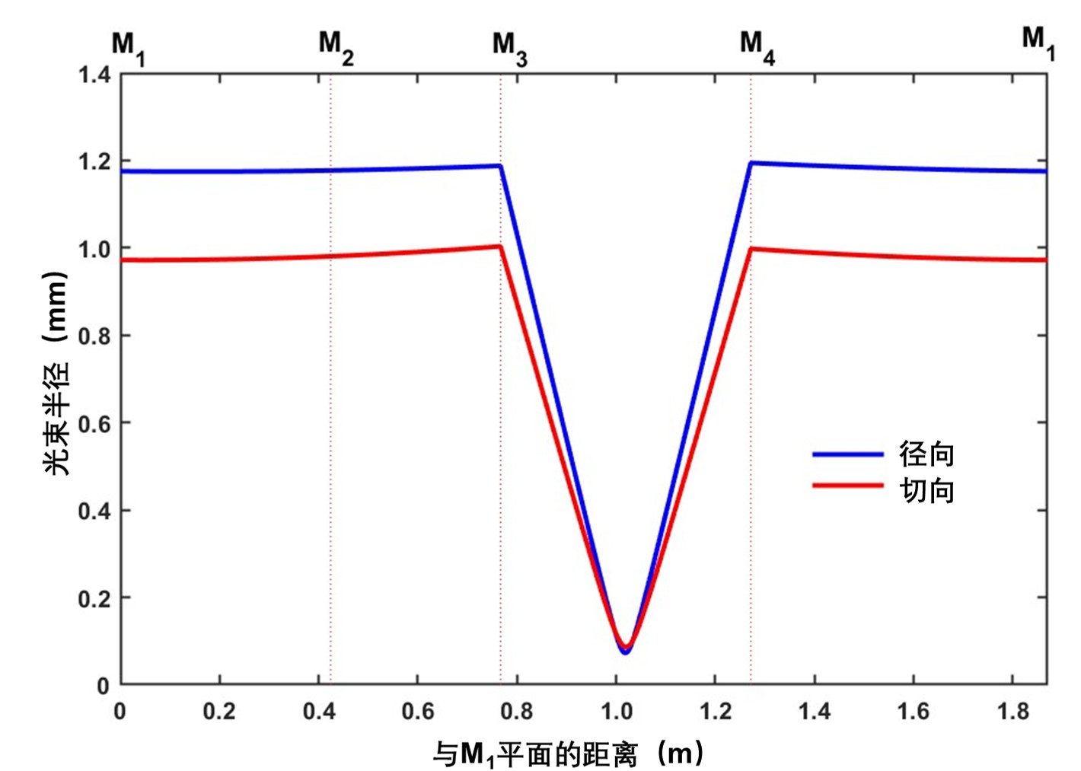
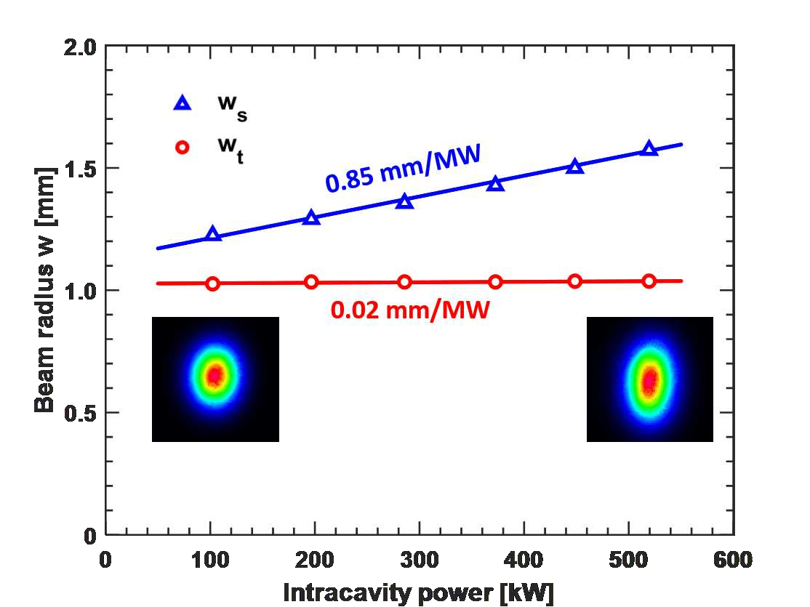
Experimental Progress of high average power pulsed OEC
There is a tight focusing waist between M3,M4, and a well-collimated section of Gaussian beam between M1,M2;
At an average intracavity power of 520 kW, the average power density at the center of the cavity mirror surface was approximately 22 MW/cm2 and the peak power density was approximately 0.8 GW/cm2;
The beam size increases significantly in the sagittal plane but hardly increases in the tangential plane with increasing power in the cavity.
Beam radius (mm)
radial
tangential
Distance from the plane of M1 (m)
Figure 7 Increase in the sagittal (ws) and tangential (wt) beam radius on cavity mode versus the intracavity power. The straight lines are linear fits. The beam profile snapshots taken at 102 kW and 520 kW are shown in the insets.
Figure 6 Variation of beam radial (blue) and tangential (red) radii with distance from 𝑀1 position
Lu X Y, et al. Stable 500 kW average power of infrared light in a finesse 35,000 enhancement cavity[J]. Applied Physics Letters, 2024, 124(25).
Notes:
The evolution of the intracavity laser beam size in the intracavity cycle is shown in Fig. 6. The Bow-tie type four-mirror OEC consists of two plane mirrors M1,M2 and two concave mirrors M3,M4. The mirrors are placed so that there is a tight focusing waist between M3,M4, and a well-collimated section of Gaussian beam between M1,M2. The transverse mode of the optical cavity was measured by mounting a CCD camera behind M2 . Figure 7 shows the variation of the cavity mode radius with the circulating power in the cavity. The light spots detected at an average power of 102 kW and 520 kW in the cavity are shown in the inset. From Fig.7, it can be noticed that the spot ellipticity increases with increasing power in the cavity. In particular, the beam size increases significantly in the sagittal plane but hardly increases in the tangential plane. The sensitivity of the mode size to the intracavity power is mainly related to the extent to which the OEC conformation approaches the instability region as well as to the cavity mirror thermal deformation.

Slide 5
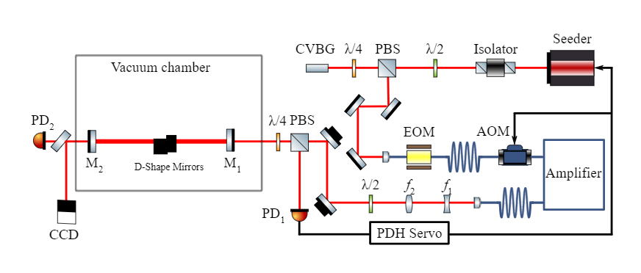
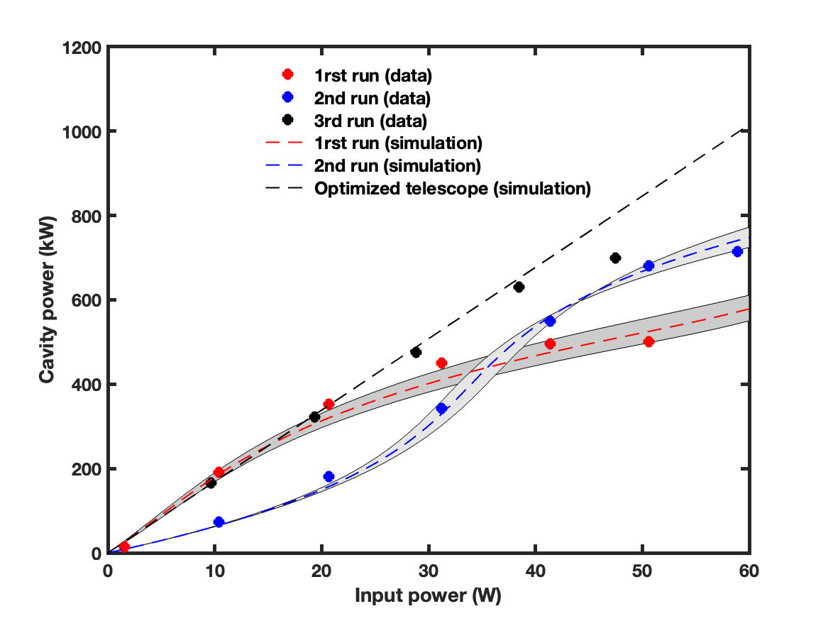
Experimental Progress of high average power pulsed OEC
Three rounds of high-average-power OEC experiments were conducted with different telescope designs.
Figure 8 Schematic of the two-mirror OEC experimental setup
The laser oscillator generates 218 fs pulses at 1030 nm with a pulse repetition rate of 216.6 MHz and 160 mW average power.
Figure 9 The average power stacked in the OEC as a function of the seed, input, average power.
Lu X Y, Chiche R, Dupraz K, et al. 710 kw stable average power in a 45,000 finesse two-mirror optical cavity[J]. Optics Letters, 2024, 49(23)
Notes:
This is a schematic of the two-mirror pulsed OEC experimental setup. Under the same mirror parameters, compared with the four-mirror cavity, the two-mirror cavity reduces the total loss due to the reduced number of mirrors, which improves the finesse and gain of the cavity. However, the two-mirror conformation is more sensitive to cavity thermal effects and mode matching. The laser oscillator generates 218 fs pulses at 1030 nm with a pulse repetition rate of 216.6 MHz and 160 mW average power. Figure 9 shows 3 rounds of high power experiments. In the first run, the design of the telescope used for pattern matching was based on a cold cavity at low power and the telescope is fixed during the experiments. At higher intracavity power, the gain decreases more due to the thermal effects of the cavity mirrors, and the intracavity power remains saturated around 500kW. In the second run, a matched telescope is designed for a hot cavity with a high average power of 700 kW in the cavity based on a beam transport simulation that takes thermal effects into account and the telescope is fixed during the experiments. This telescope performs better at higher powers, At an injected power of 58.9 W, the average power in the cavity is as high as 714 kW, and operates at this power for 15 minutes without loss of lock. In the third run, the telescope is adjusted dynamically as the injected power increases. The gain of the cavity is still degraded at high power due to the demanding requirements for the optimal position of the telescope at high power, as well as other thermal effects that cannot be compensated for by optimizing the telescope.

Slide 6
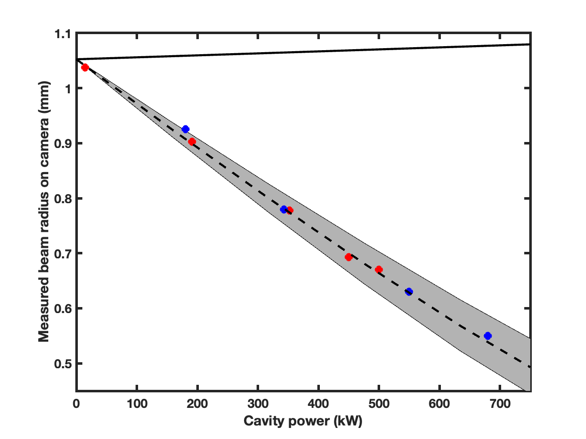
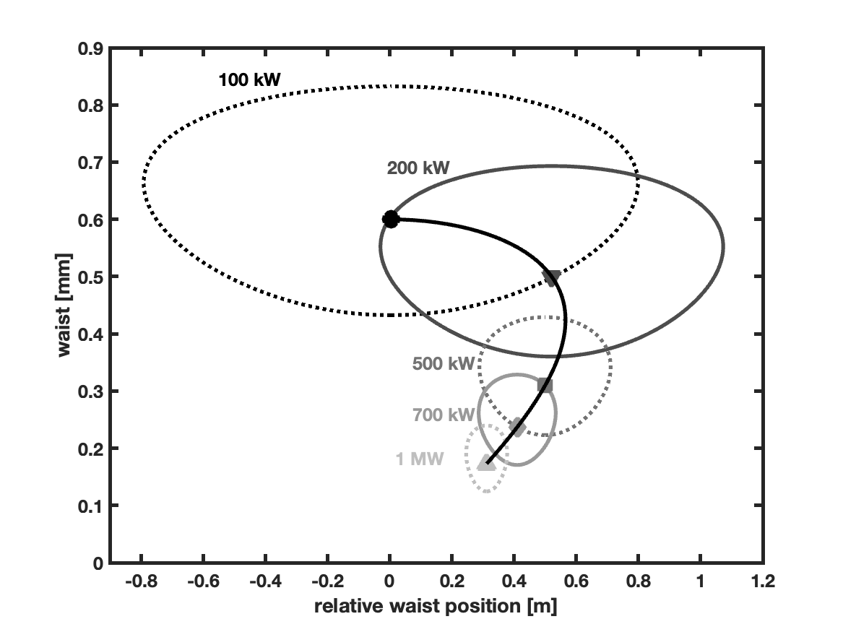
Experimental Progress of high average power pulsed OEC
In general, the measured spot should be slightly larger as the injected power increases, due to thermal expansion of the mirrors;
The smaller spot is caused by the thermal lensing effect due to the thermal absorption of the coating of the cavity mirrors.
Figure 10 The beam radius, measured on a camera 67 cm downstream the output mirror, as a function of the average power in the OEC. Points in red and blue show measurements made during the first and second run. The black solid line is the expected beam radius on the camera only accounting for the change of ROC of the mirrors due to thermal loading of the OEC. The dashed line further accounts for thermal lensing in the bulk of M2. The grey band represents a variation of the coating absorption by about 10%.
Figure 11 Simulation of the optimum waist size versus optimum waist position relative to the input mirror of the input laser beam accounting for thermal lensing in the OEC input mirror. Encircled regions corresponding to geometrical coupling in excess of 90%
Lu X Y, Chiche R, Dupraz K, et al. 710 kw stable average power in a 45,000 finesse two-mirror optical cavity[J]. Optics Letters, 2024, 49(23)
Notes:
In the two-mirror cavity experiment, they measured the spot size with a CCD after M2, as shown in Fig. 10. In general, the measured spot should be slightly larger as the injected power increases, due to thermal expansion of the mirrors. In contrast, the smaller spot shown in the figure is caused by the thermal lens effect due to the absorption of the coating of the cavity mirrors. Although the thermal lens effect of M2 does not affect the beam in the cavity, the thermal lens effect of M1, which is the input mirror, affects the mode matching of the beam in the cavity. Therefore, in order to counteract the negative effect of the thermal lens effect of M1, it is necessary to change the placement of the telescope at each cavity power, that is, to change the beam waist size and position of the laser beam injected into the cavity, as shown in Fig. 11 At high power, the adjustment of the telescope can be very demanding in order to make the degree of mode matching compared to low power case.

Slide 7
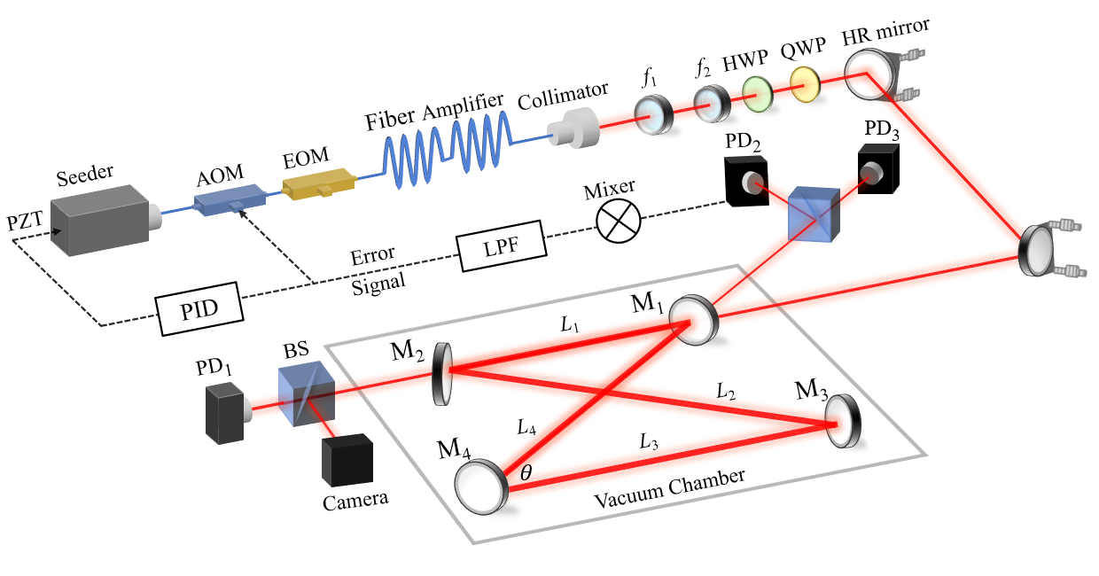
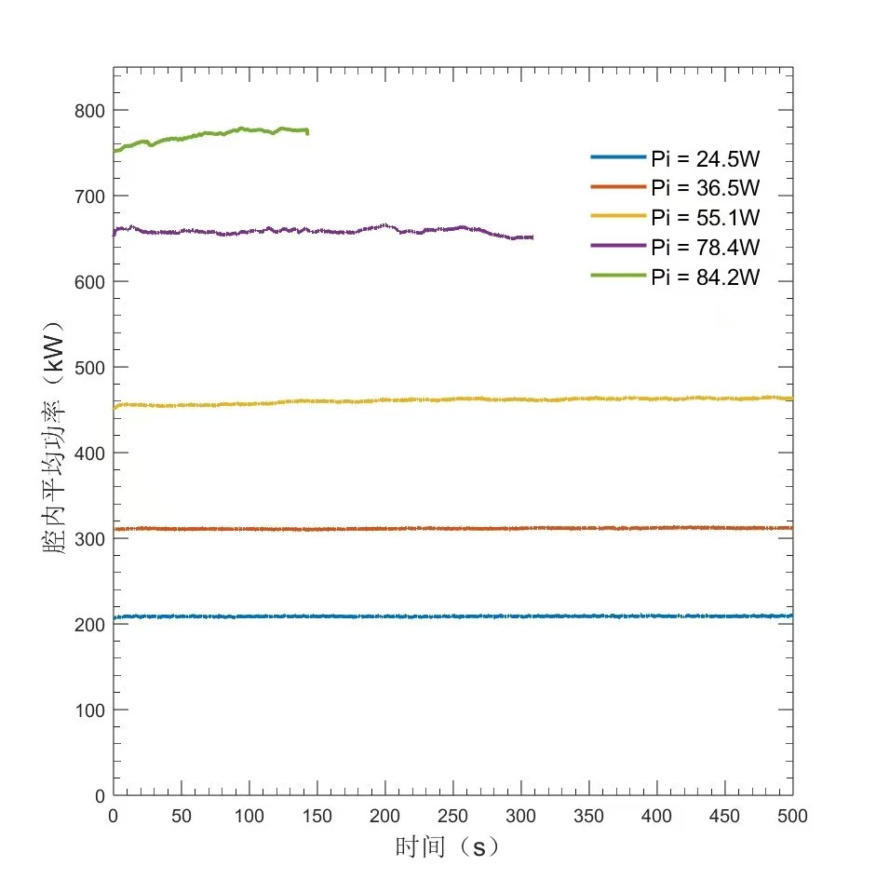
Experimental Progress of high power CW OEC
Intracavity power (kW)
Figure 12 Schematic of the Bow-tie type four-mirror CW OEC experimental setup
The seed oscillator operates at a wavelength of 1064 nm, with a linewidth of about 3 kHz and an output power of 90 mW. The amplifier has a maximum output power of about 130 W;
At an injection power of 84.2 kW, the power in the cavity reaches 750 kW.
time (s)
Figure 13 Intracavity power at different injection powers Pi
Notes:
Next is the experimental progress of high-power continuous-wave OEC. We built a four-mirror cavity experiment platform. The seed oscillator operates at a wavelength of 1064 nm, with a linewidth of about 3 kHz and an output power of 90 mW. The amplifier has a maximum output power of about 130 W. After optimizing the optical path and the collimation of the optical cavity as well as the feedback system, we did several rounds of high-power OEC experiments. Figure 13 shows the power in the cavity at different injection powers. At an injection power of 84.2 kW, the power in the cavity reaches 750 kW.

Slide 8
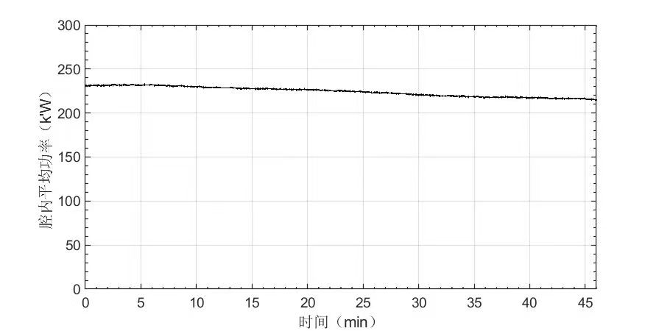
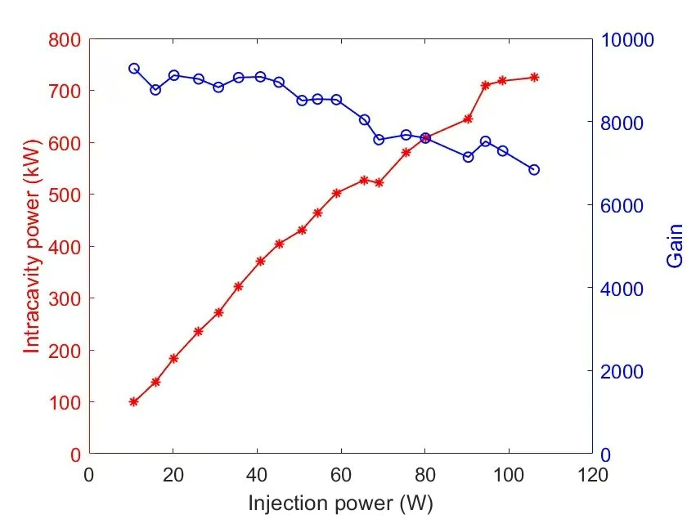
Experimental Progress of high power CW OEC
In the cavity power 230kW, the system can do more than forty minutes of stable operation without losing locks；
The effective gain decreases continuously when the injection power increases;
the gain drop is caused by the thermal lens effect of the laser isolator installed on the optical path at high power.
Intracavity power (kW)
time (min)
Figure 14 Long-term stable operation with Intracavity power greater than 200kW
Figure 15 Variation curves of intracavity power and effective gain with injected power (with isolator)
Notes:
The OEC system locking stability is good. As shown in Fig. 14, in the cavity power 230kW, the system can do more than forty minutes of stable operation without losing locks. Fig. 15 shows the intracavity power and effective gain at different injection powers in a high-power OEC experiment. It can be seen that the effective gain decreases continuously when the injection power increases. This limits the maximum intracavity power we can achieve in the experiment. After investigating, we found that the gain drop is caused by the thermal lens effect of the laser isolator installed on the optical path at high power.

Slide 9
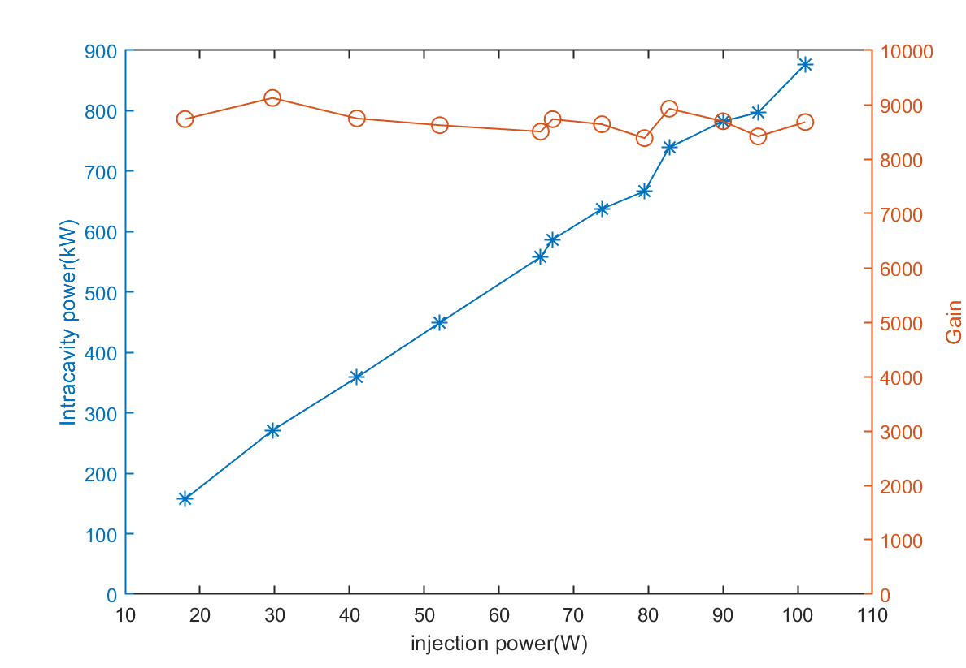
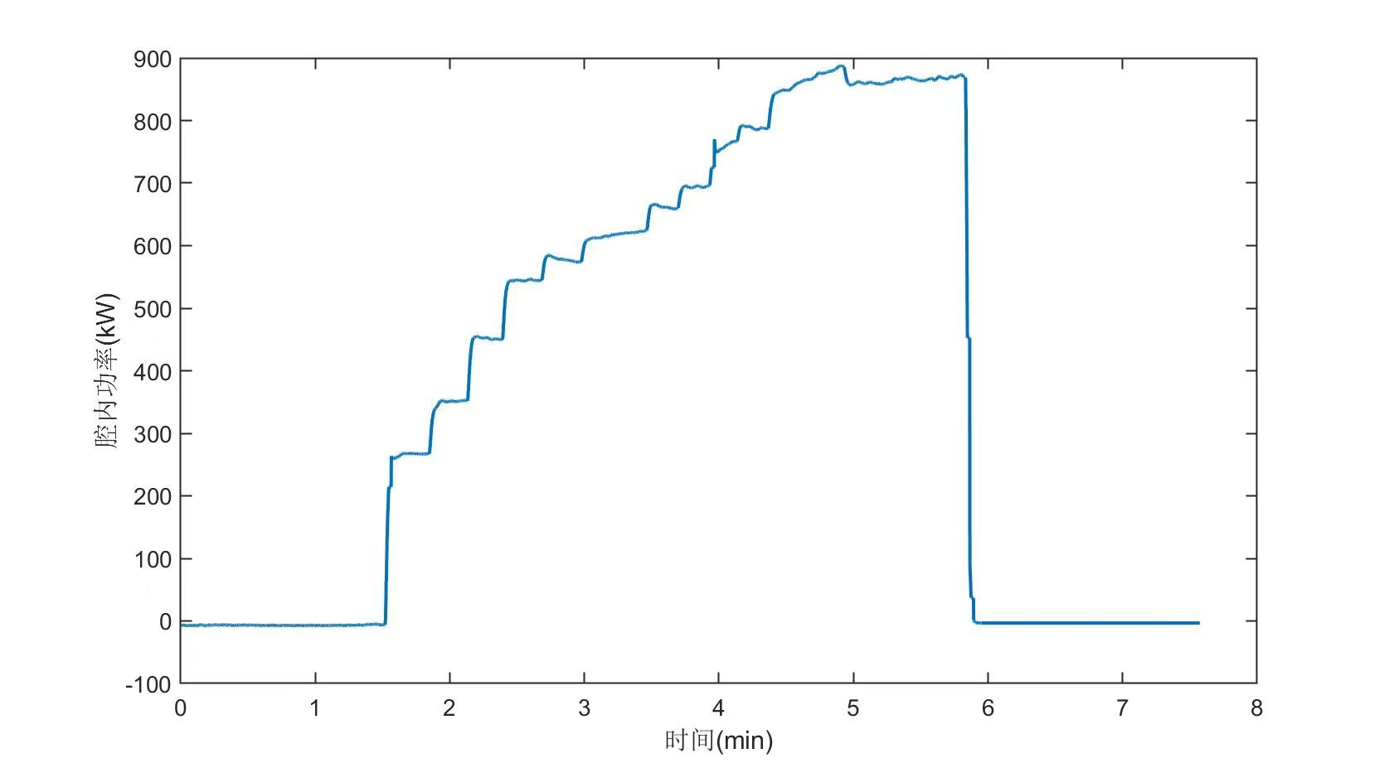
Experimental Progress of high power CW OEC
There is no tendency for the effective gain to decrease as the injection power increases；
The gain stays around 9000, and we reach an intracavity power of 876 kW with 101 W of injected laser;
Backlighting in the optical path can be strong at high powers.
Intracavity power (kW)
time (min)
Figure 16 Variation curves of intracavity power and effective gain with injected power (without isolator)
Figure 17 Experimental results of stepped increase of injected power to measure maximum intracavity storage power
Notes:
Therefore, we removed the laser isolator and performed a round of high power experiment, although this resulted in a strong optical feedback. Figure 16 shows the intracavity power and effective gain at different injection powers without the laser isolator. This time we see that there is no tendency for the effective gain to decrease as the injection power increases. The gain stays around 9000, and we reach an intracavity power of 876 kW with 101 W of injected laser. However, the strong optical feedback prevents us from continuing to increase the output power of the amplifier. Figure 17 shows our stepwise increase in injected power to measure the intracavity power.

Slide 10
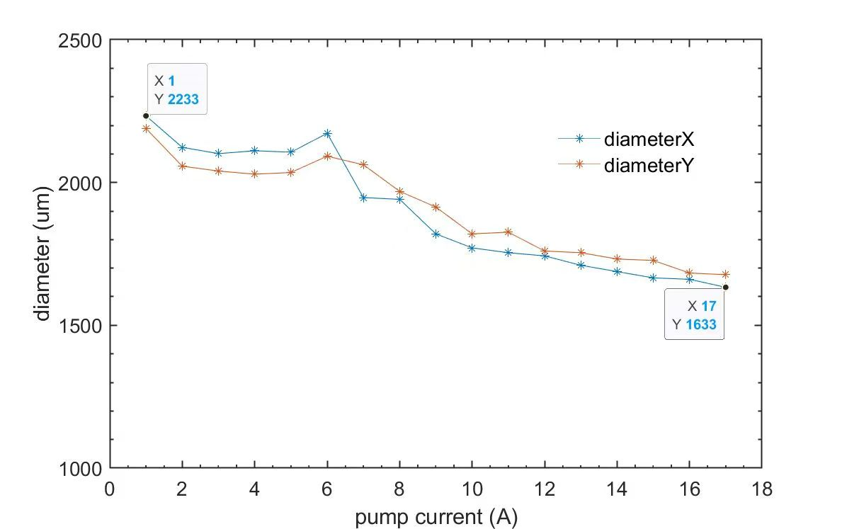
Next steps in high power CW OEC experiments
It is still necessary to use the isolator in the later experiments；
As the amplifier output power increases, the spot behind the isolator is getting smaller;
Purchase laser isolators with less significant thermal lensing effects；
Add concave lenses behind the isolator to counteract the thermal lensing effect of the isolator at high power；
Next Impact Cavity Power 1MW.
Figure18 Variation of spot diameter at M1 with amplifier current (with isolator)
Notes:
Although removing the isolator in the experiment can avoid the decrease of the gain of the cavity at high power, the strong optical feedback is a great risk to the safety of the instrument and personnel. Therefore, it is still necessary to use the isolator in the later experiments. We measured the spot size behind the isolator at different amplifier current settings, as shown in Fig. 18. As the amplifier output power increases, the spot behind the isolator is getting smaller. The isolator has a more obvious thermal lens effect. In the next experiments, we will try to purchase laser isolators with less significant thermal lens effects, or add concave lens behind the isolator to counteract the thermal lens effect at high power. We hope to achieve the goal of 1 MW of intracavity power.
This is my report, thanks.

