Slide 1





Collaboration on luminosity and injection related beam loss monitoring at SuperKEKB and beyond
Philip Bambade, Sandry Wallon IJCLab – Orsay
Meng Li IJCLab – Orsay and IHEP – Beijing
Dou Wang, Jie Gao, Sha Bai, Yiwei Yang, Haoju Shi, IHEP – Beijing
Yunyun Fan, Xiyuan Zhang,…
Acknowledgements: Naoko Iida, Yoshihiro Funakoshi, Yukiyoshi Ohnishi, Hiroyuki Nakayama, Hiroshi Kaji, Kenta Uno, Taichiro Koga, Sadaharu Uehara (KEK – Tsukuba)
FCPPN/L annual workshop July 20-25, 2025 Qingdao - China

Slide 2
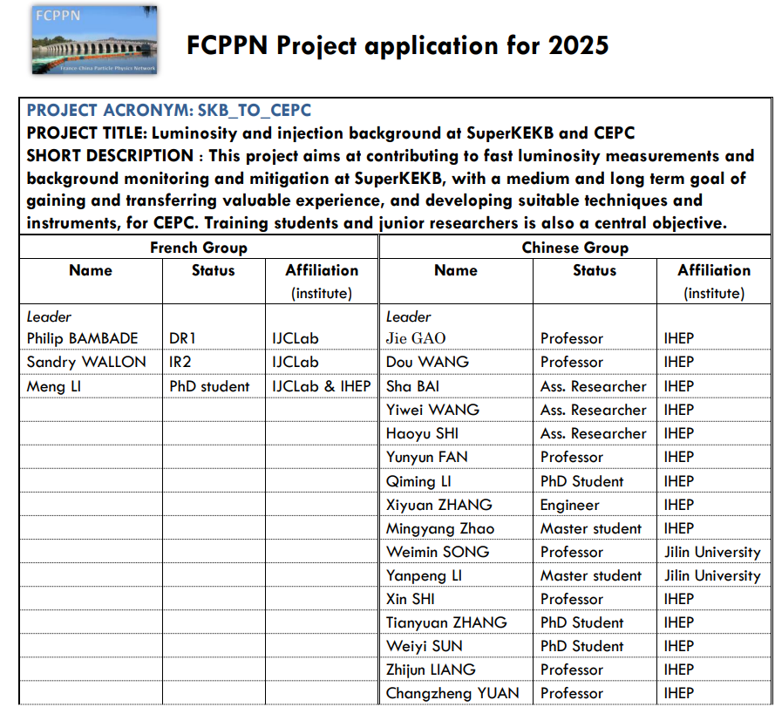
CONTEXT
IJCLab/LAL and IHEP collaborate in FCPPL since 2007 on ILC, ATF2 and SuperKEKB
PhDs of Sha Bai (2010), Shan Liu (2015), Renjun Yang (2018), Chengguo Pang (2019)
Many joint papers with Prof. Jie Gao and his group, especially Dou Wang and Yiwei Wang
SuperKEKB experience ➔ test / validate concepts and techniques for future CEPC / FCCee
FCPPN/L 2025 project application
Injection-related backgrounds at SuperKEKB
Fast luminosity monitor at SuperKEKB (LumiBelle2)
IP luminosity feedback and preliminary design considerations for luminosity monitoring at CEPC
2

Slide 3
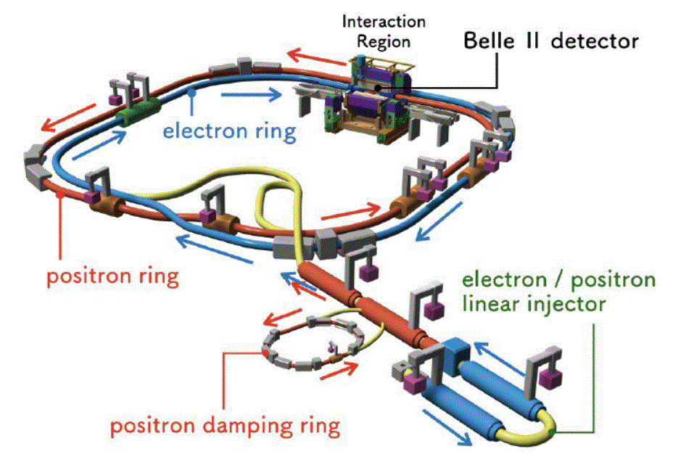
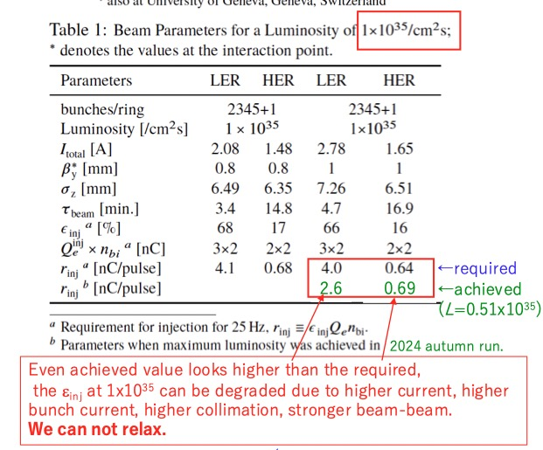

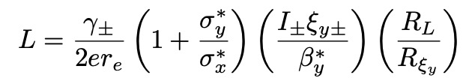
SuperKEKB top-up injection / requirements
N. Iida
high currents → reduced lifetimes → tried during 2024c run
High luminosity
→ Injection may strongly limit higher luminosity
Small $β_{y}^{∗}$ → reduced DA → tried 0.8mm during 2022ab run
3

Slide 4
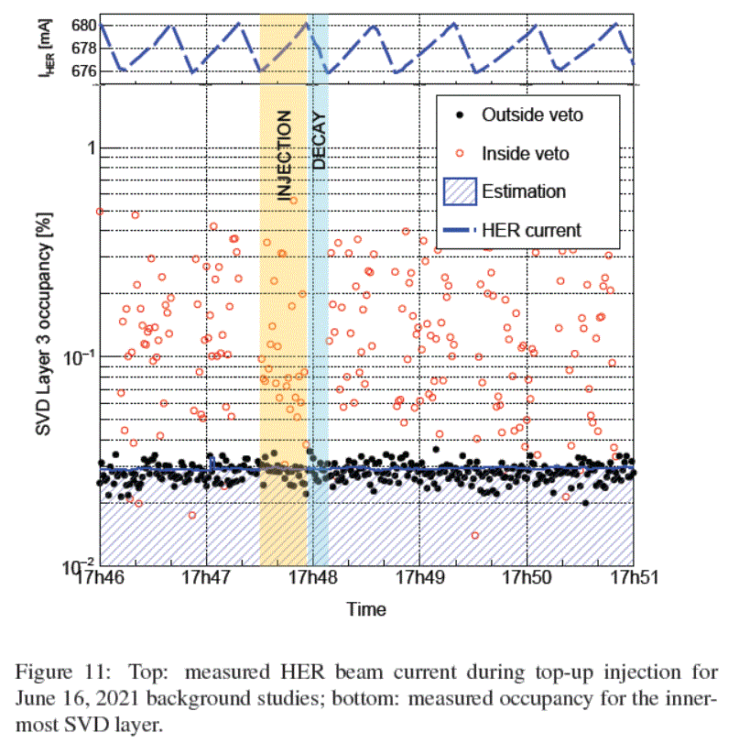
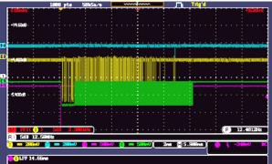
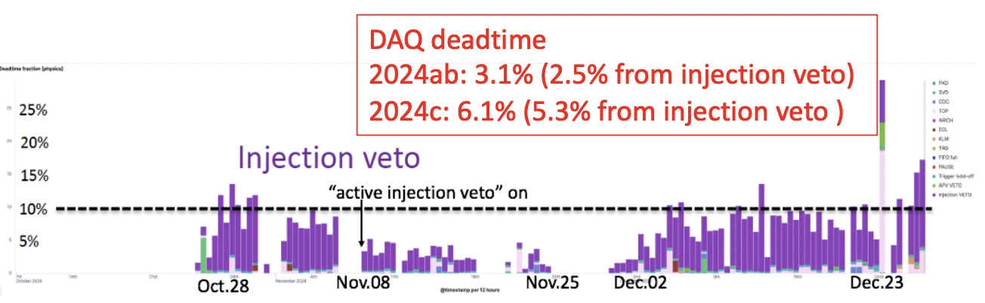
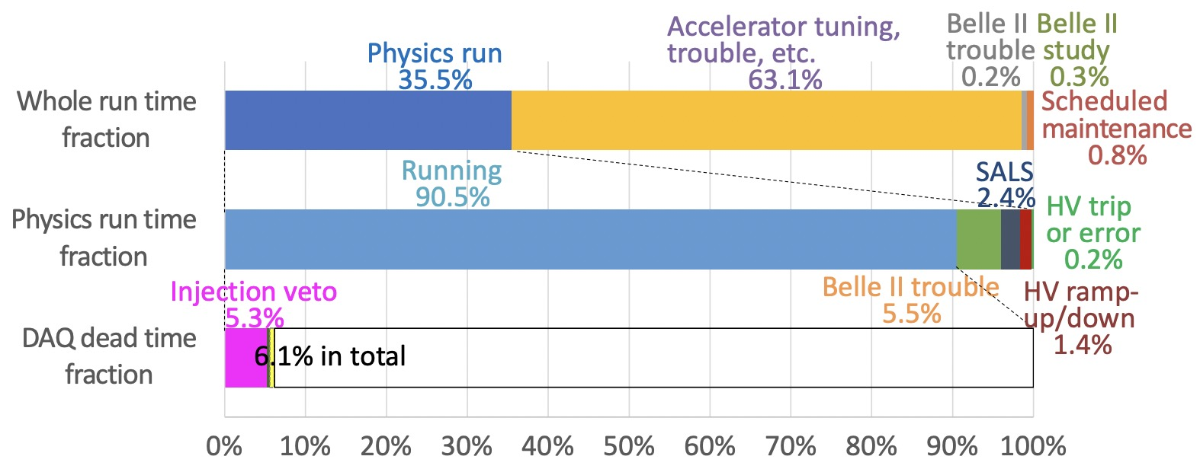
Injection BG and BelleII DAQ
Huge background appear just after beam injection
-Belle II BG level is high every turn(10us) when the injected beam pass through Belle II
-It was not expected that BG duration continues more than 10ms (At belle, it was ~3ms)
To avoid DAQ crash, trigger is vetoed for a while after injection (injection veto)
-by beam injection, instantaneous trigger rate ~100kHz and DAQ crashes
-injection veto causes large DAQ deadtime of 5~15% → it is important to minimize BG duration for data taking efficiency
Injection-related issues are expected to become more severe as the beam intensity increases.
K. Uno
-ECLBG –Injection Veto
～10ms
SVD first layer occupancy
ECLTRG injectionBG duration
Detailed injection-related beam loss and background simulation is essential for improving injection efficiency and BG
-study the time structure of injection losses and their dependence on machine parameters
4

Slide 5
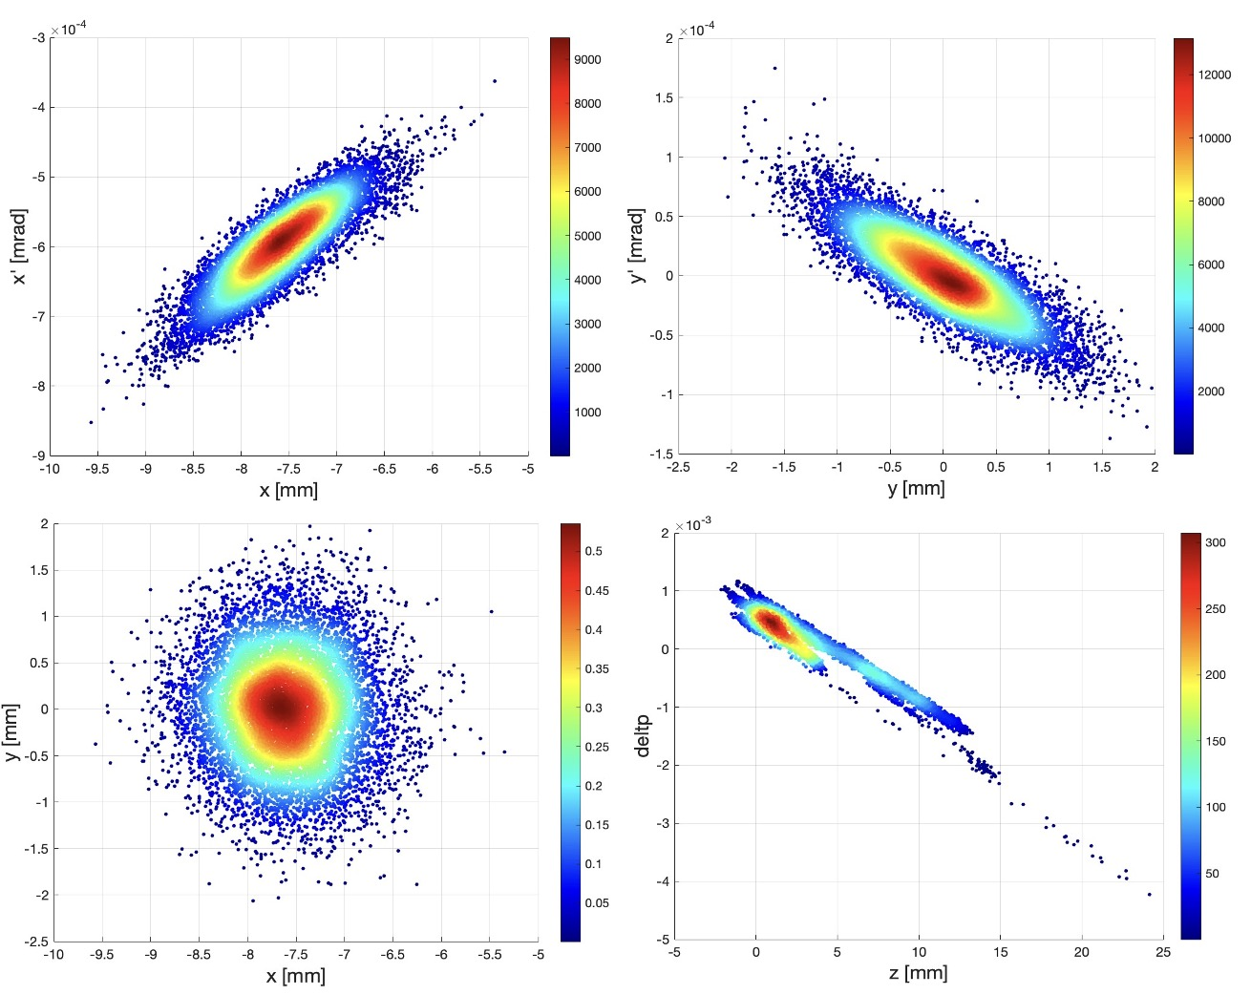
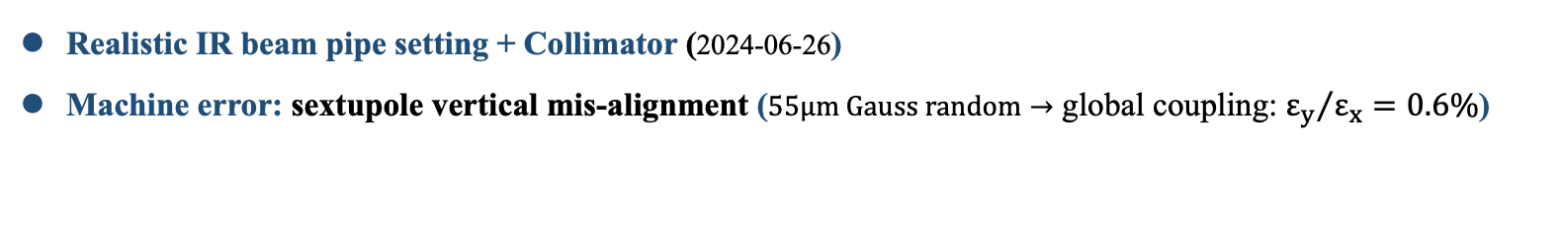
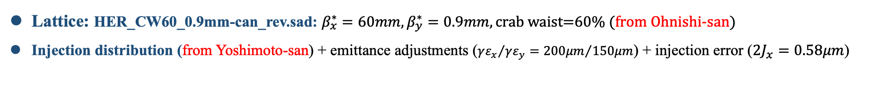
Injection simulation based on realistic operation settings
Lattice: HER_CW60_0.9mm-can_rev.sad: $β_{x}^{∗}=60mm, β_{y}^{∗}=0.9mm, \text{crab} \text{waist}\text{=60\%}$ (from Ohnishi-san)
Injection distribution (from Yoshimoto-san) + emittance adjustments (${γε_{x}}/{γε_{y}={200μm}/{150μm}}$) + injection error (${2J}_{x}=0.58μm$)
Beam-beam(weak-strong model)
$N_{p}=3.31×{10}^{10}→I_{b}=0.5mA→ξ_{y}=0.017, ξ_{x}=0.010$ (based on 2024-6-27 operation emittance and bunch current)
Realistic IR beam pipe setting + Collimator (2024-06-26)
Machine error: sextupole vertical mis-alignment ($55μm Gauss random→$ global coupling: ${ε_{y}}/{ε_{x}=0.6\%}$)
manufactory error from cancel coils(correct leakage field from QC1P in the LER)
Bunch-by-bunch feedback(damping time=0.5ms) $→$ Gaussian stored beam also included
5

Slide 6
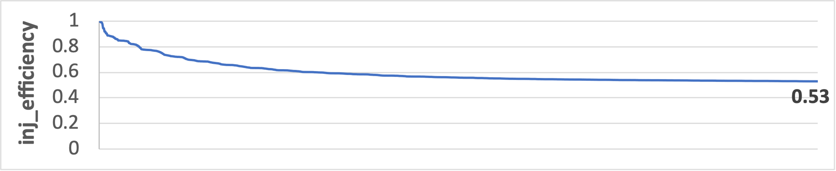
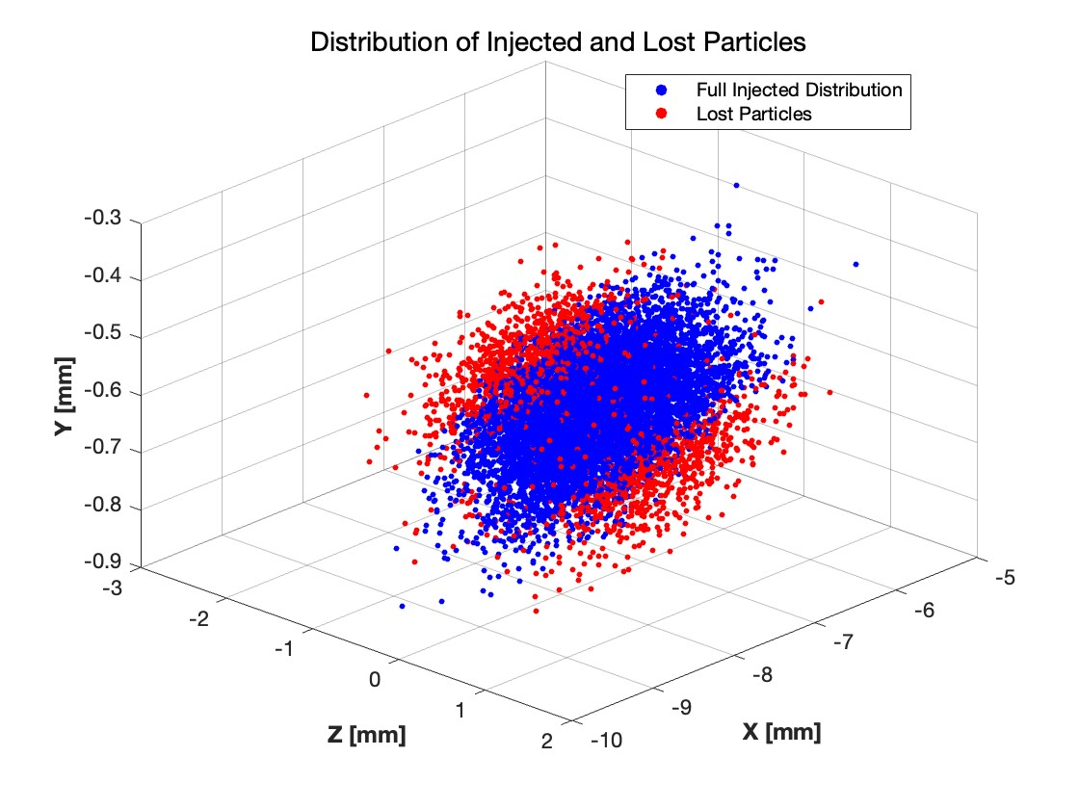
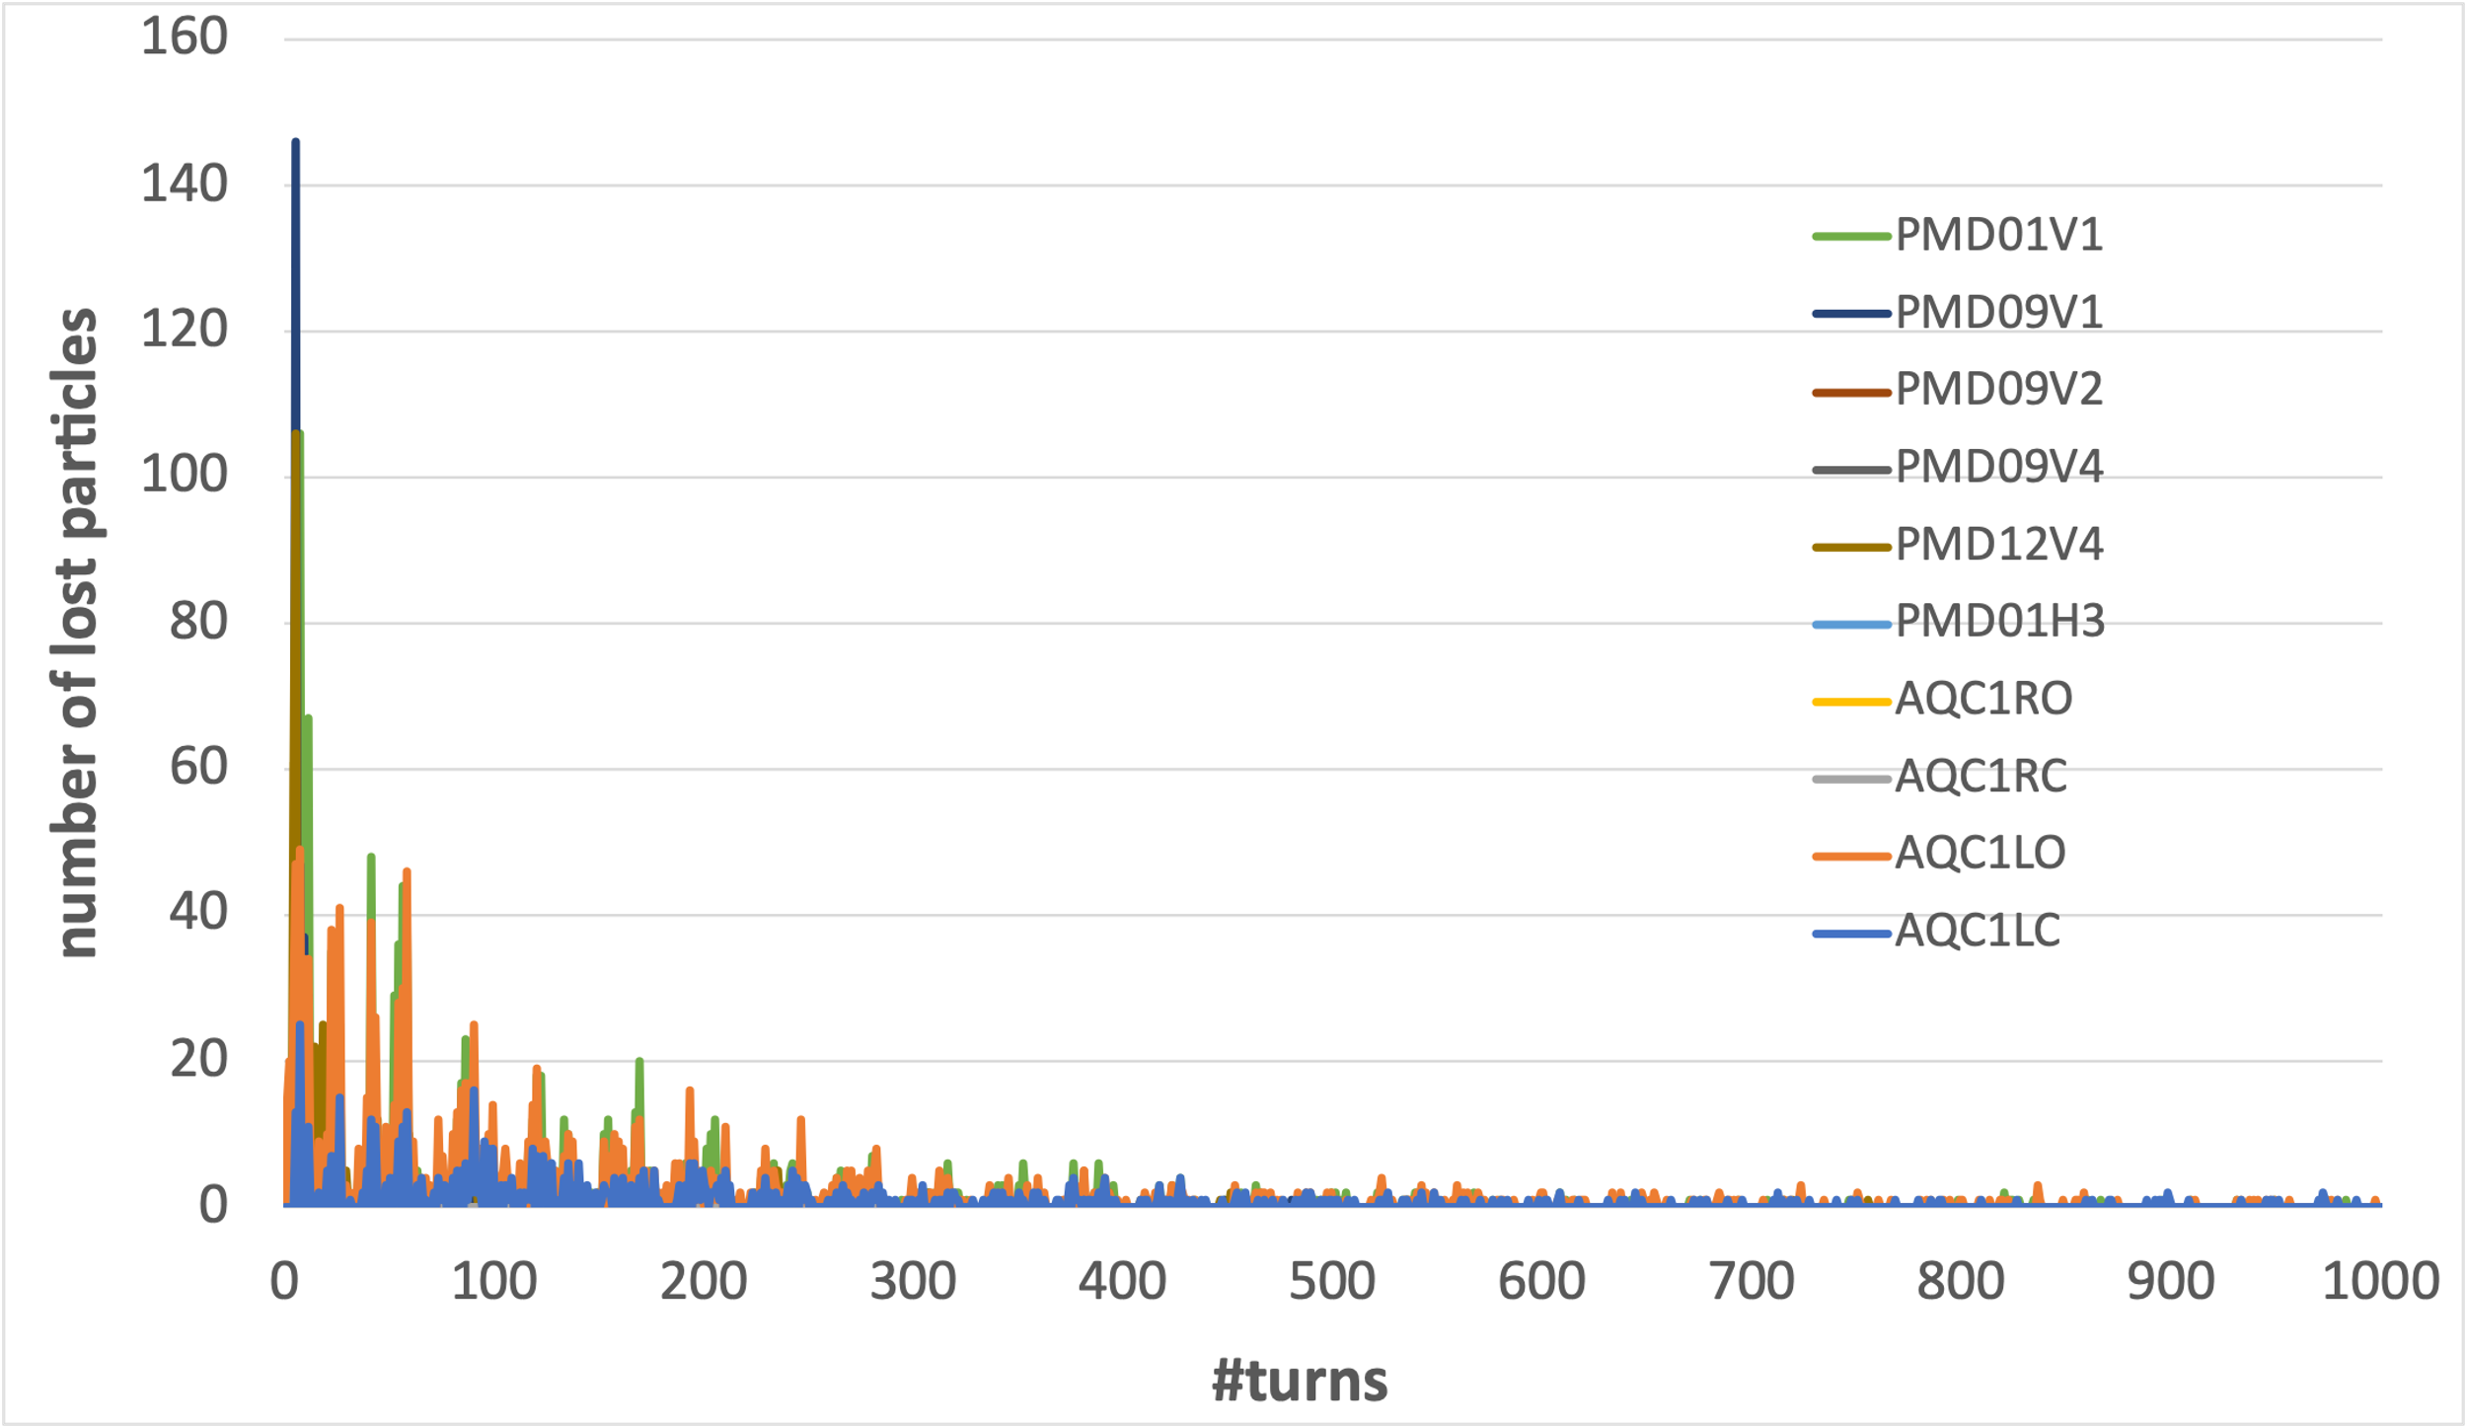
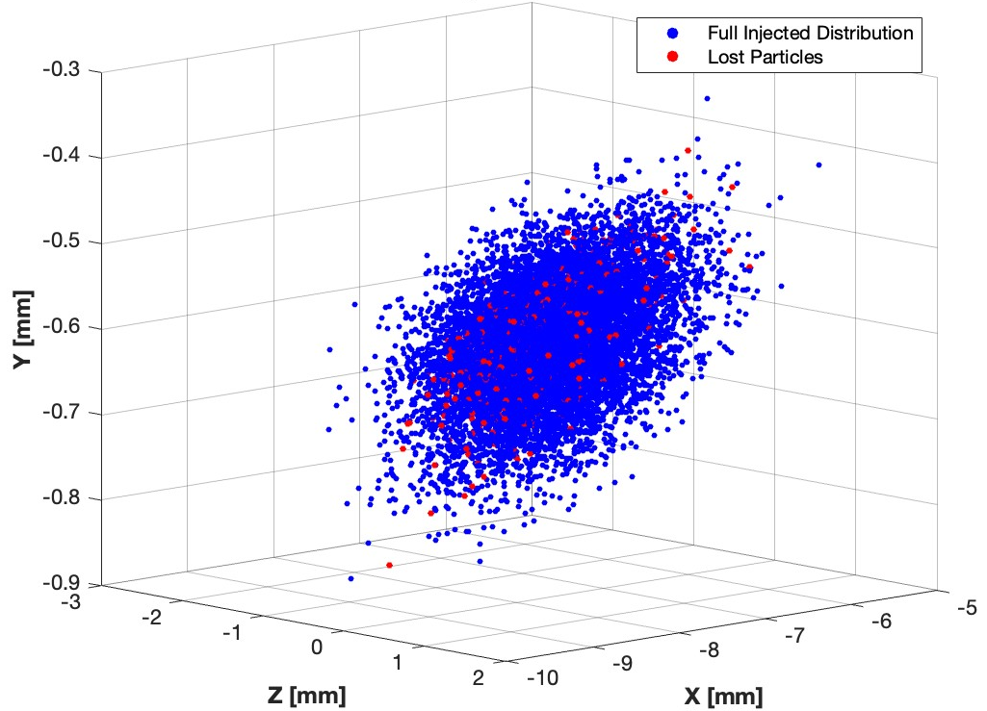
Injection efficiency and beam loss
A: Large rapid beam loss
A: Large rapid beam loss
originate from the edge of bunch
B: Small continuous beam loss
B: Small continuous beam loss
There are 2 different types of beam loss:
1) large and fast beam loss in the first 100 turns(30%) →injection efficiency
2) small and continuous beam loss until 1000 turns(10%) →injection BG duration
originate from the beam core
6

Slide 7
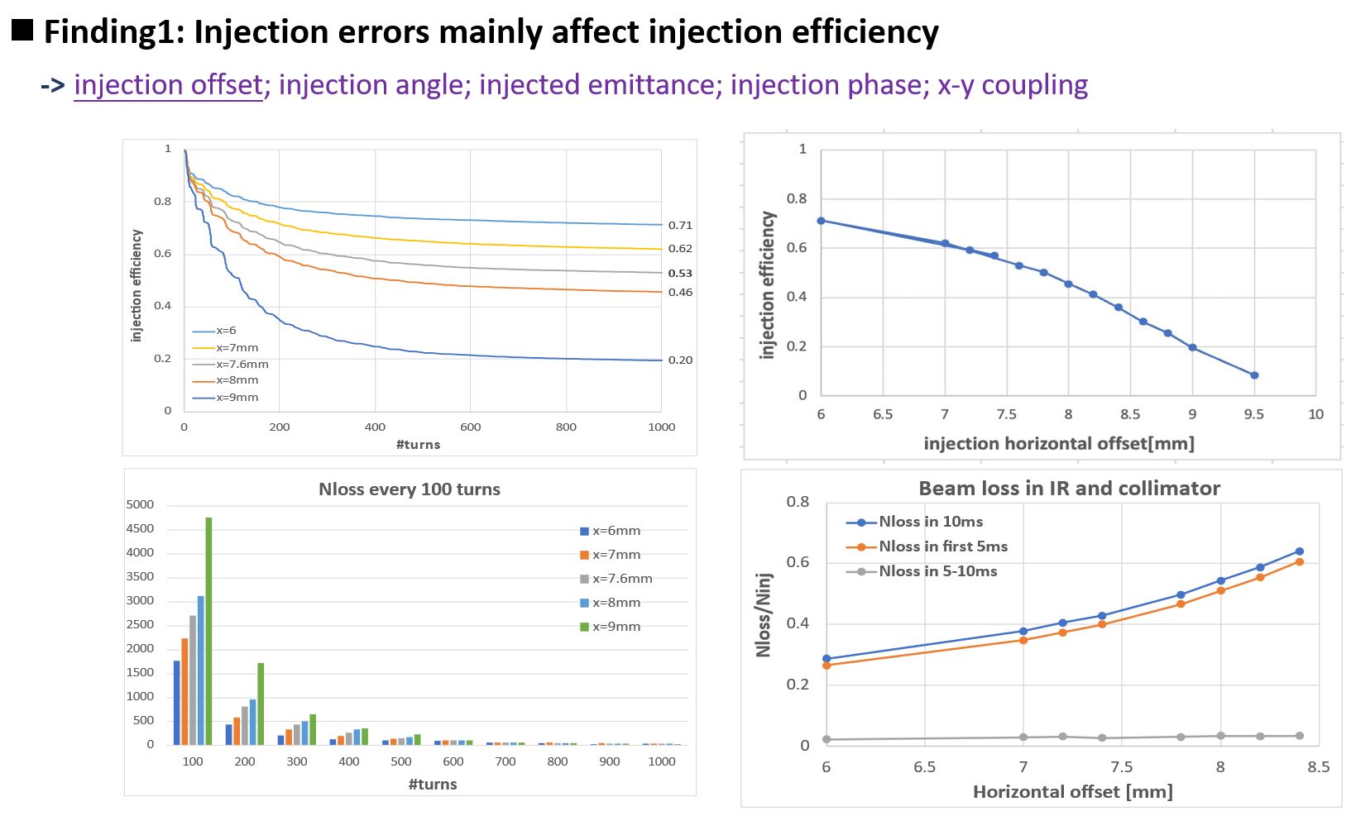
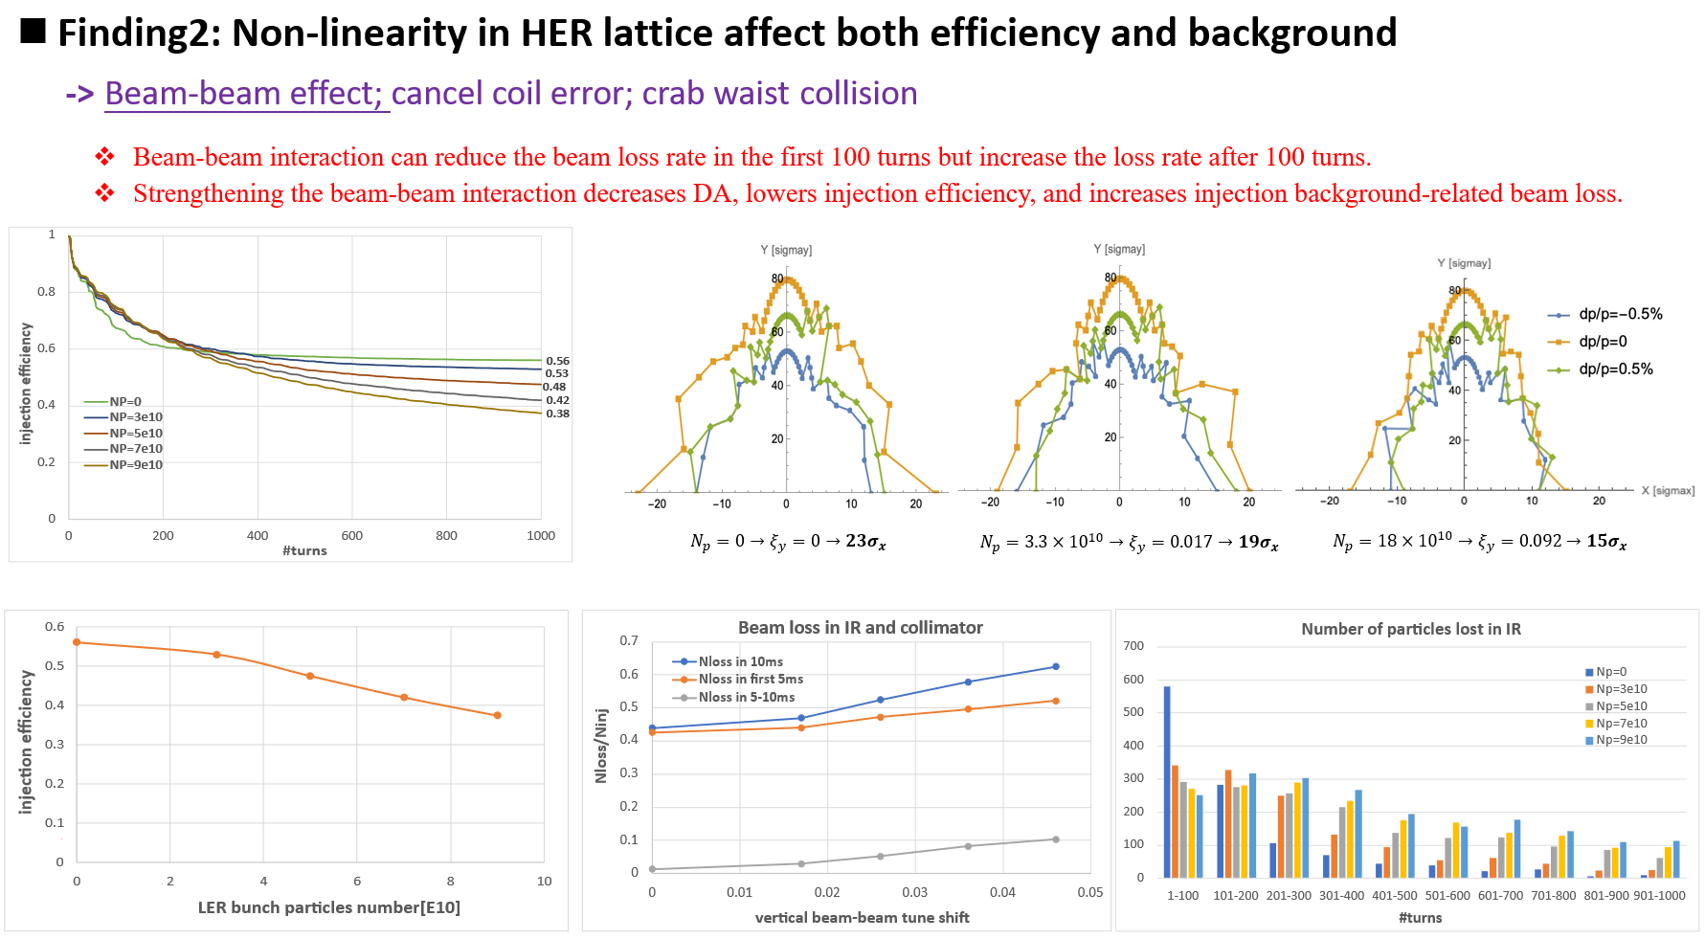
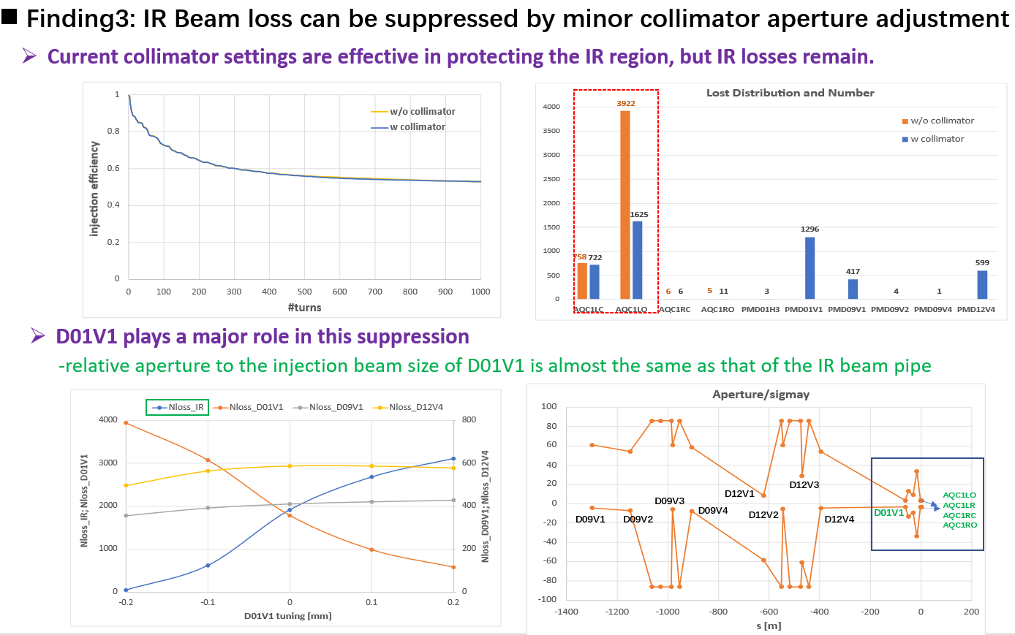
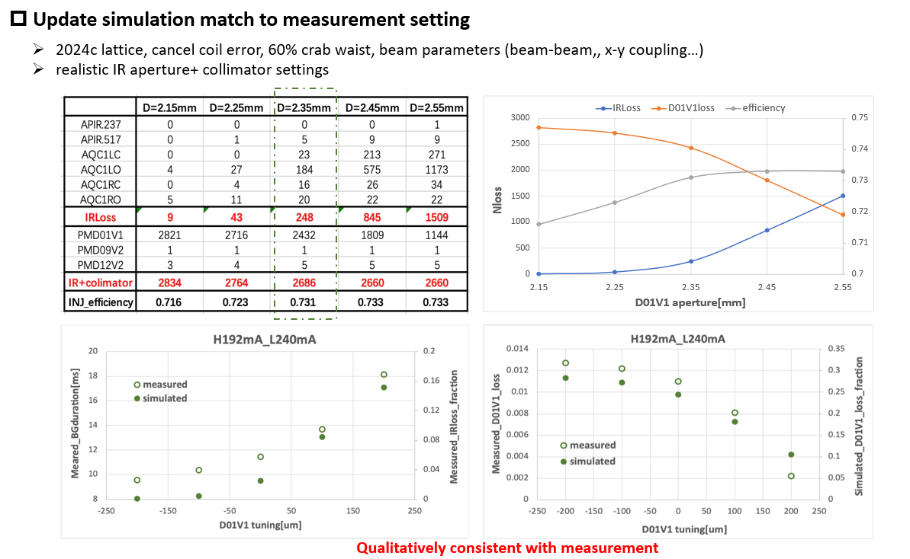
Simulations of injected beam losses and related backgrounds@ SuperKERB
7

Slide 8
Main findings from HER simulation
A detailed simulation of injected beam losses and related backgrounds was developed
Ø Injection errors mainly affect injection efficiency
-> injection offset; injection angle; injected emittance; injection phase; x-y coupling
Ø Non-linear factors affect both injection efficiency and background
-> Beam-beam effect; cancel coil error; crab waist collision
Ø IR Beam loss can be suppressed by minor collimator aperture adjustment
-> D01V1 plays a major role
p validation experiments were conducted based on the main findings from simulations
-> Injection tolerance measurement ( with N. Iida, Y. Ohnishi)
-> Beam-beam study related to injection BG (with Y. Funakoshi, H. Kaji, T. Koga, U. Bela)
-> Collimator study related to injection BG (with K. Uno, R. Ueki, H. Kaji, T. Koga, U. Bela)
Ø The data show good qualitative agreement with the simulation results.
8

Slide 9
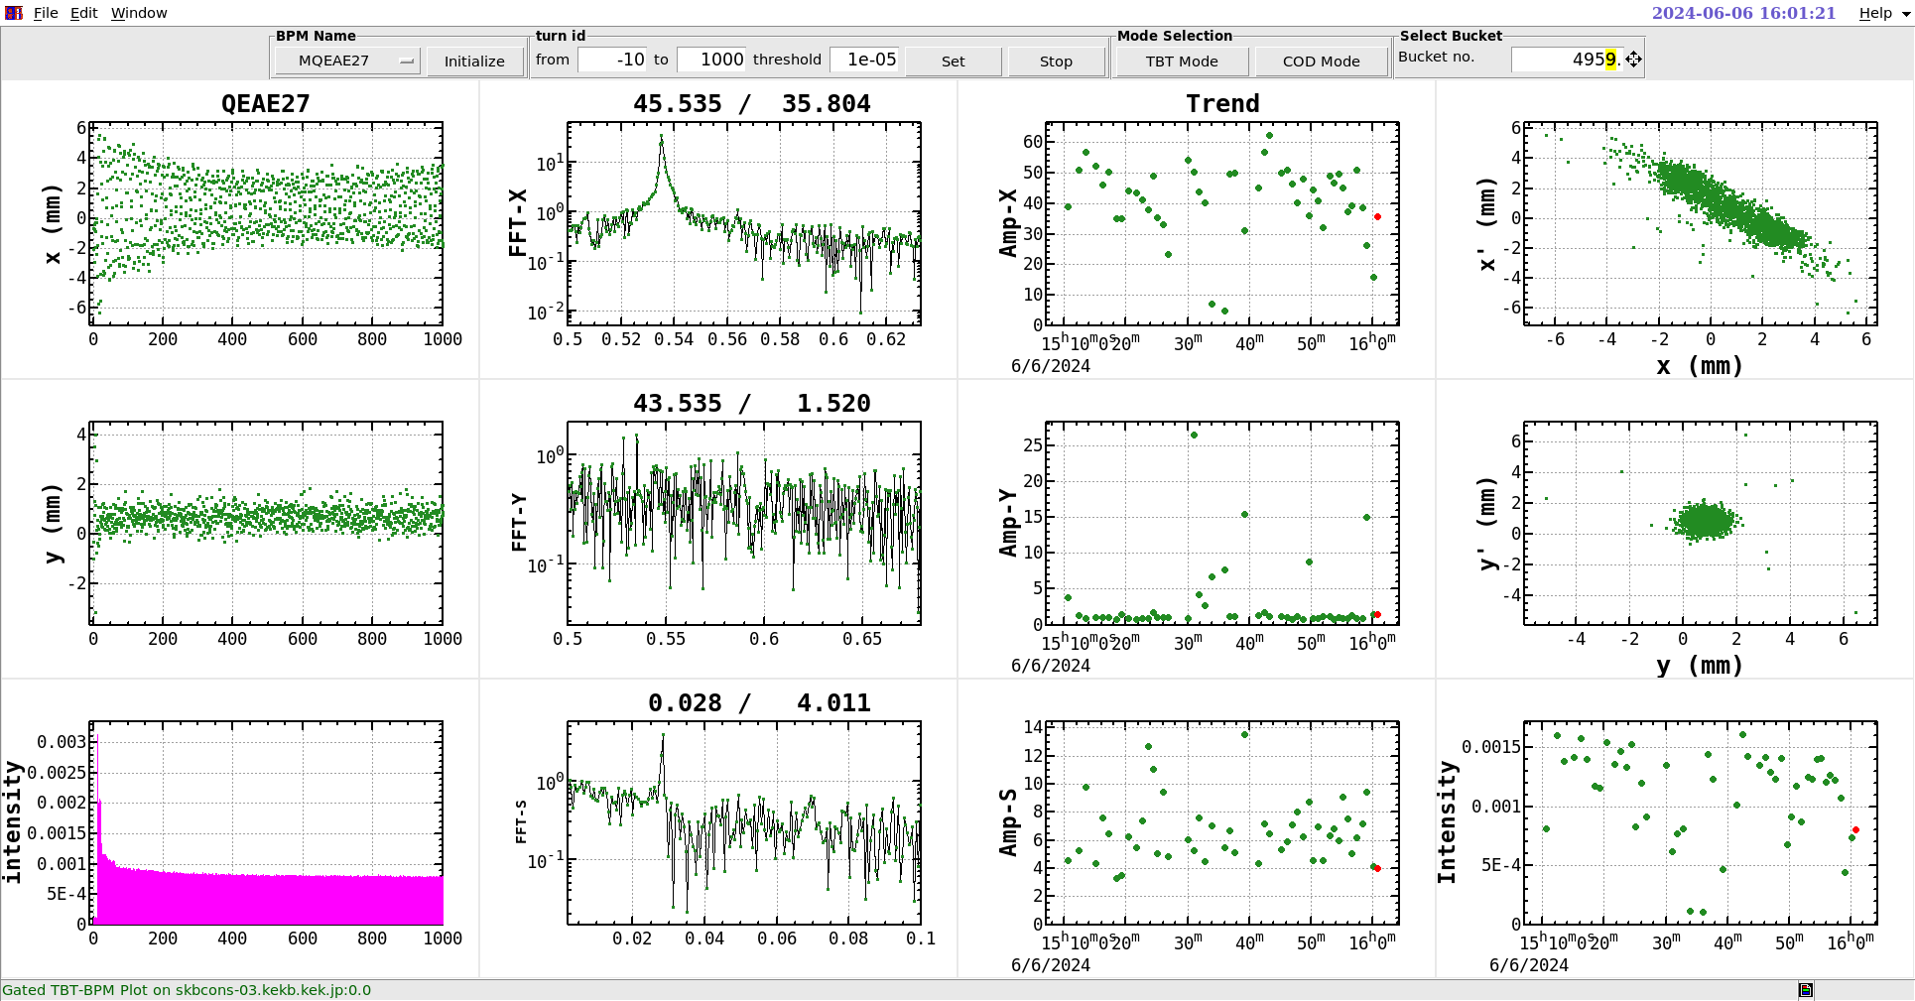
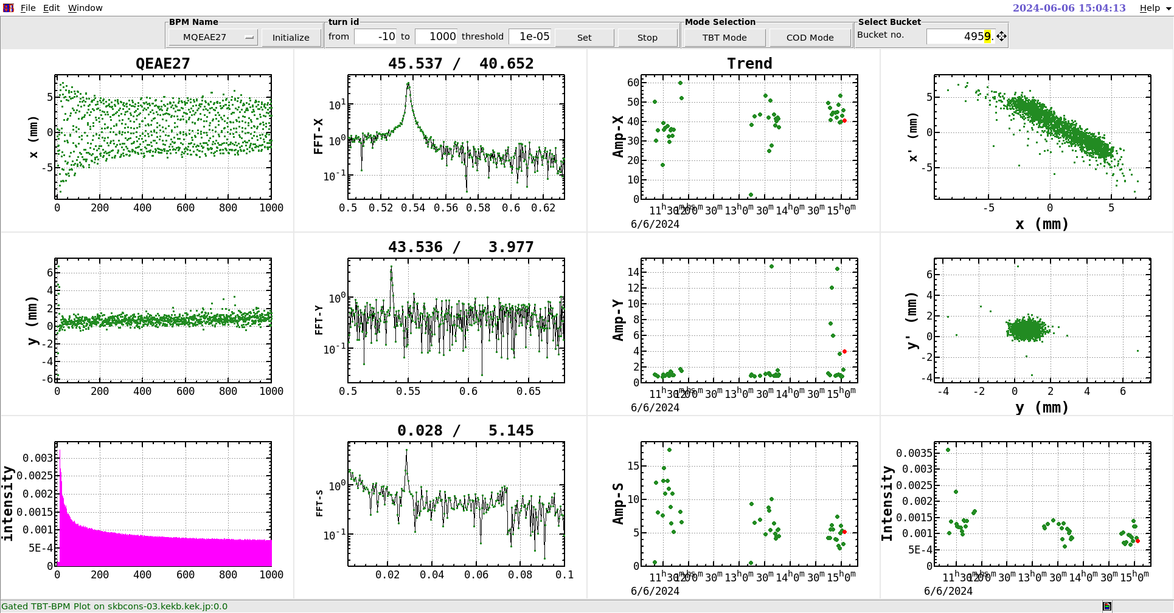
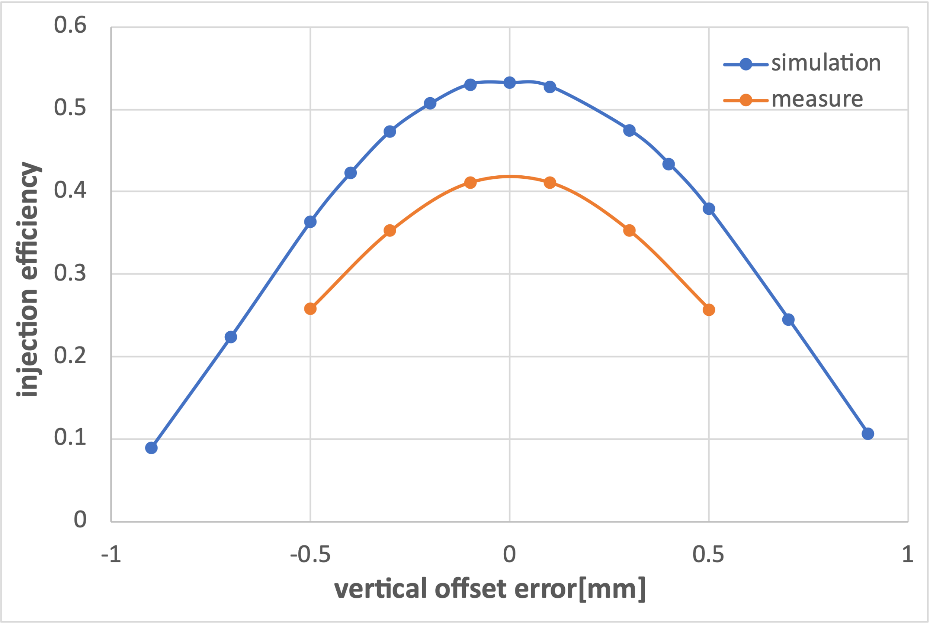
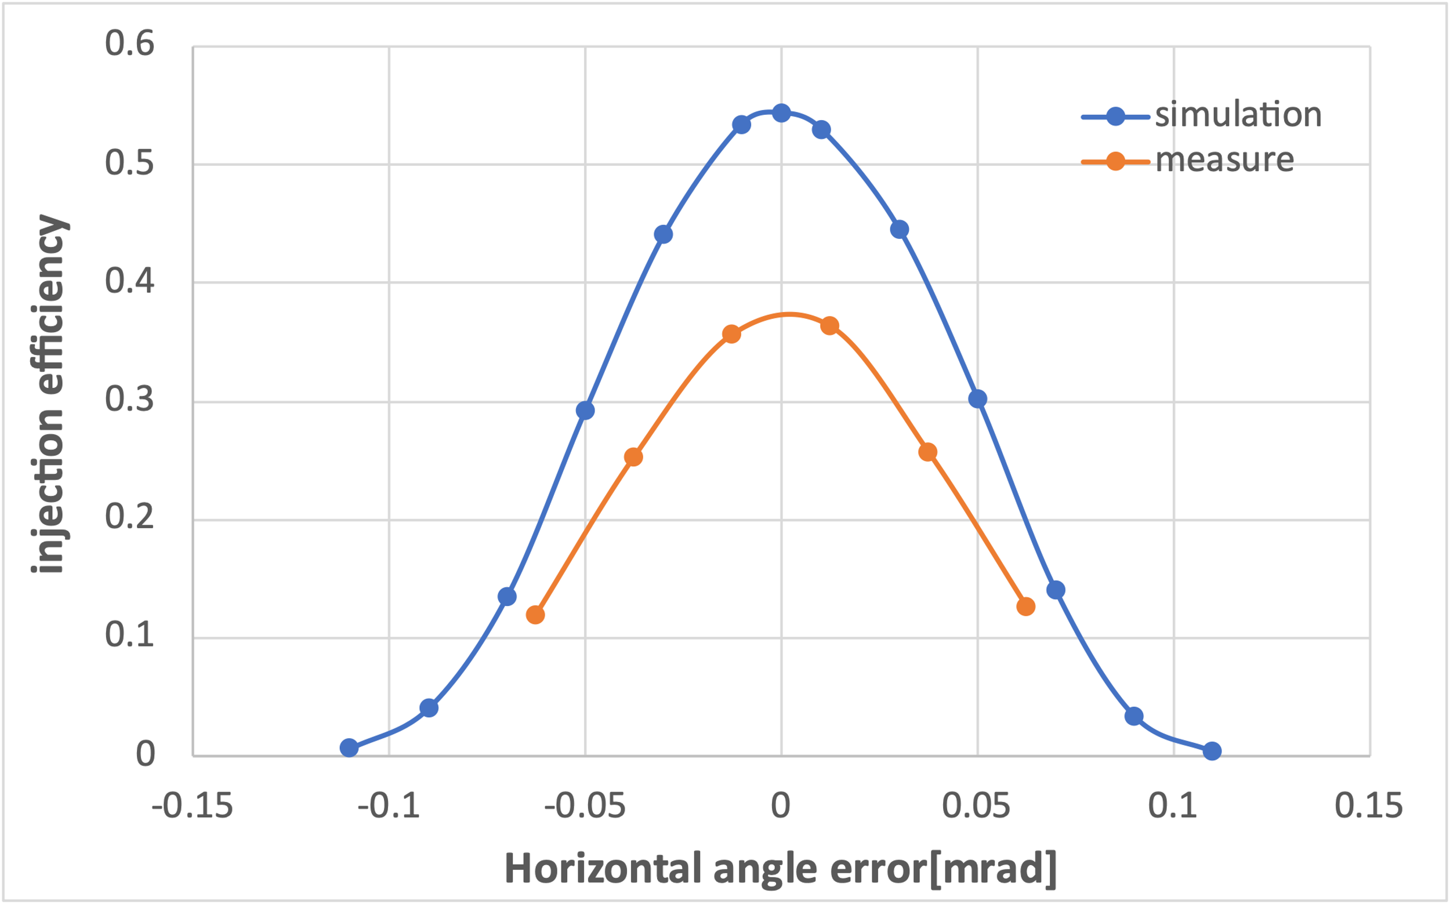
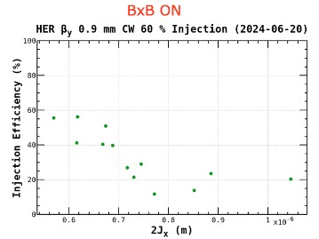
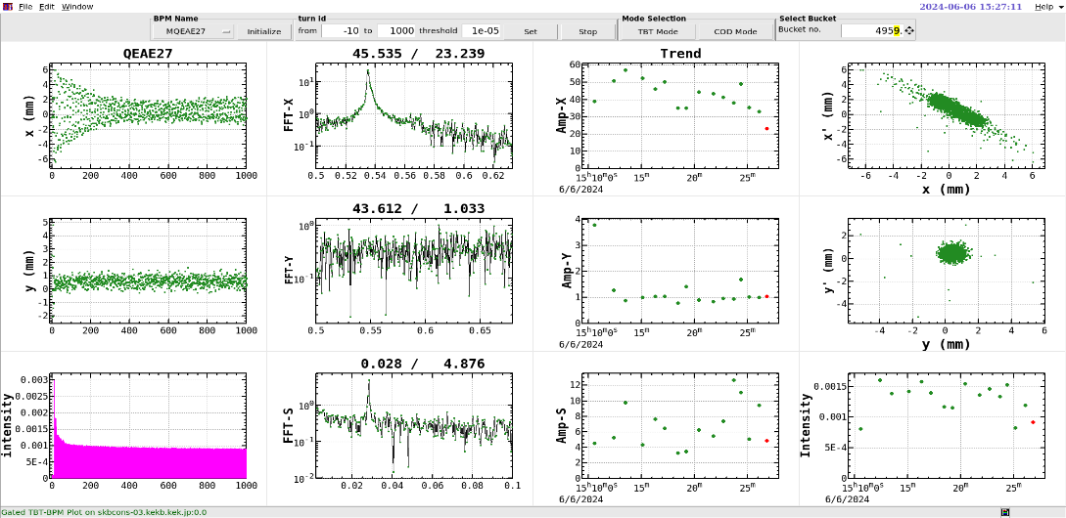
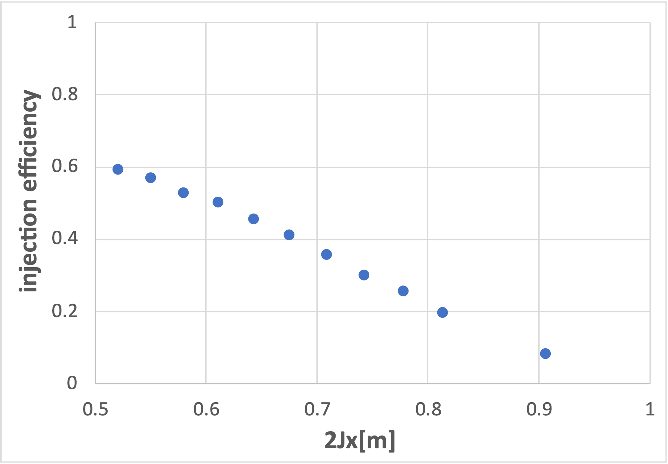
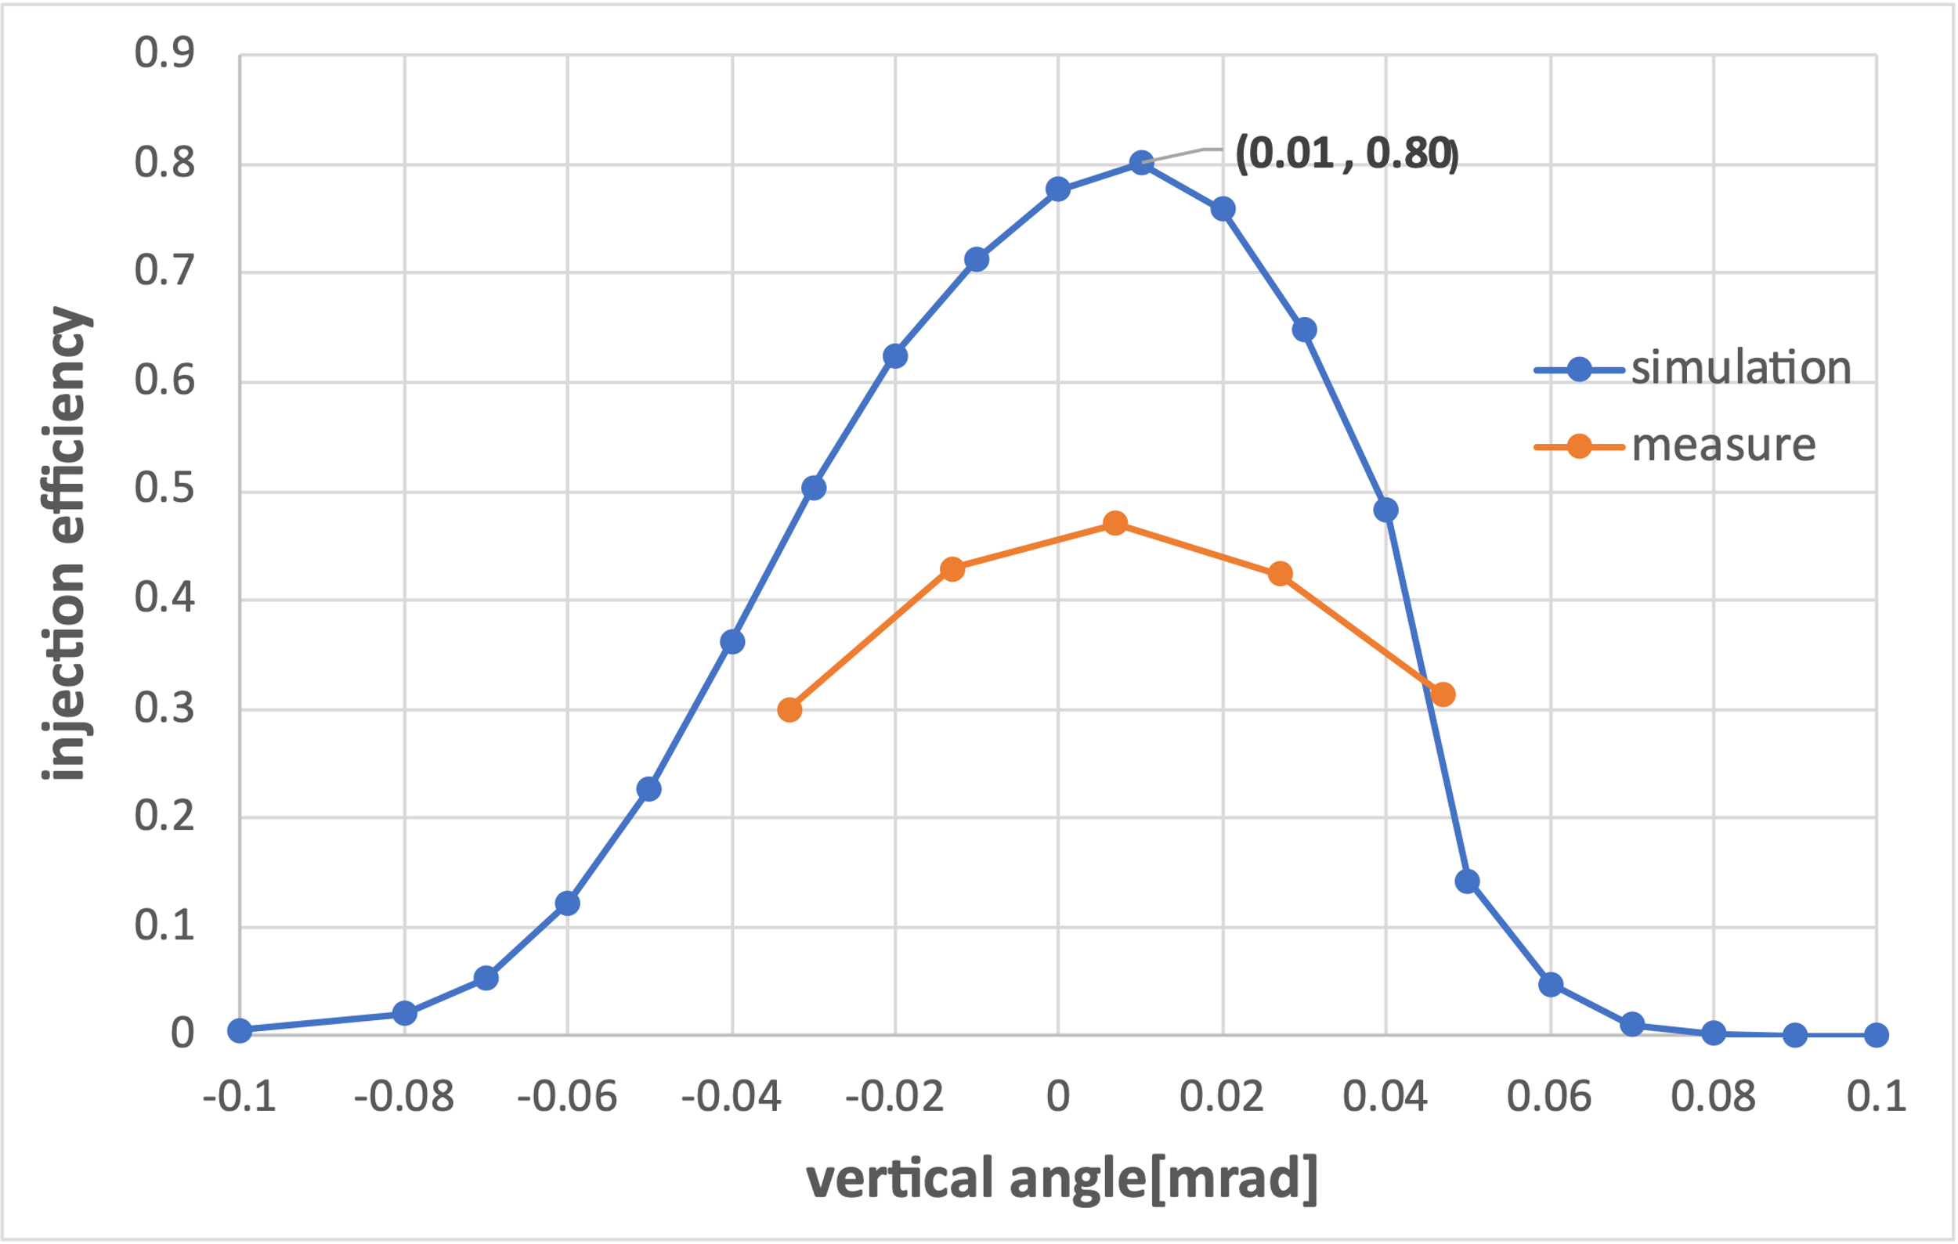
Injection tolerance measurement (2024-06-06)
Vertical Position Scan[mm]:$−0.06→−1.06$
Septum Angle Scan[mrad]:$2.94→3.06$
Septum Position Scan[mm]:$45.1→46.1$
Vertical Angle Scan[mrad]: $0.014→−0.054$
from Onishi-san
The trend of injection efficiency with respect to the variation in error is consistent, but the simulated values are higher than the measured values.
9

Slide 10
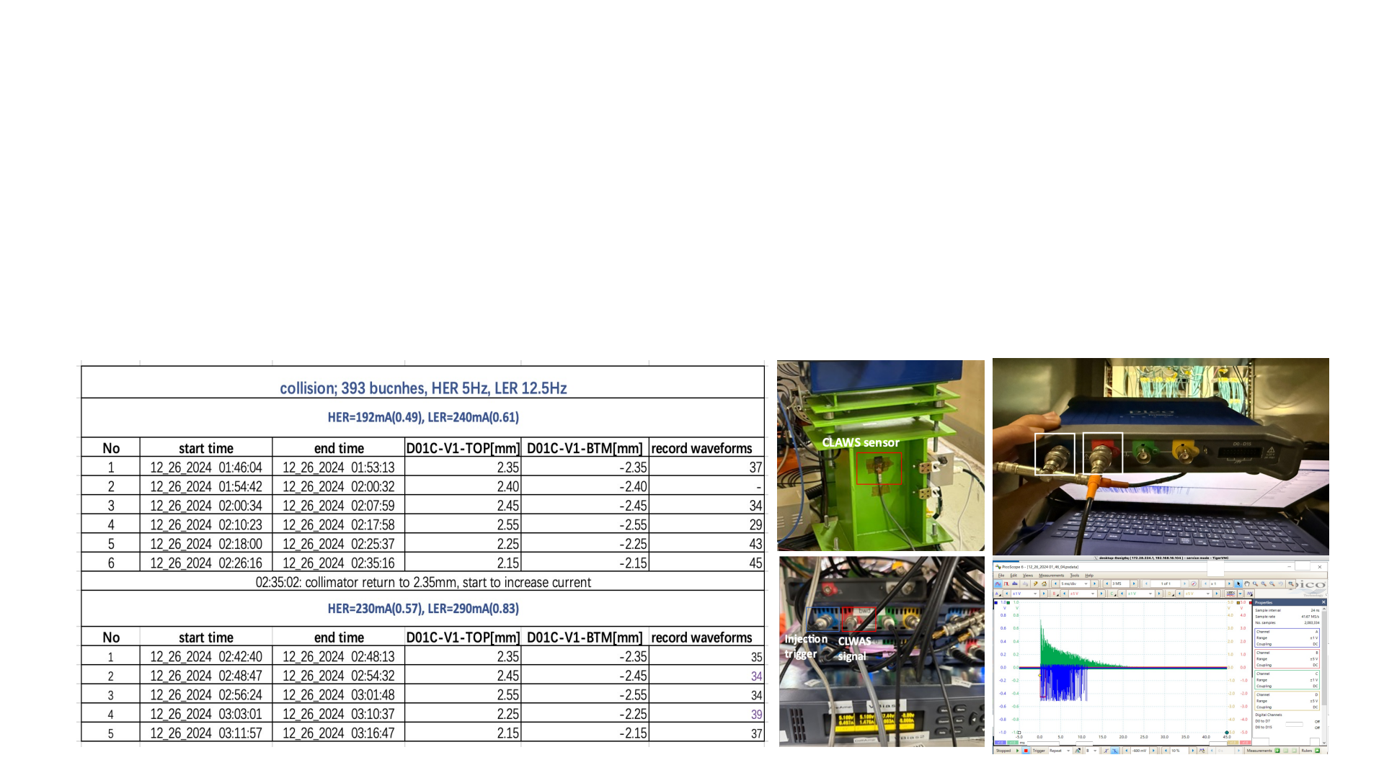
Collimator and beam-beam measurement (2024-12-26)
p Tuning the collimator D01V1 and recording the injection related beam loss and background
Take data with collimator D01V1 position: original, ±100um, ±200um under two different beam current cases
-> LER:240mA, HER:192mA, 393 bunches (corresponds to 1.4A and 1.1A with 2346 bunches) ->current best operation condition
-> LER:290mA, HER:230mA, 393 bunches (corresponds to 1.7A and 1.4A with 2346 bunches)-> a little future
p Data recording
-> injection efficiency -> TbT monitor
-> beam loss pattern -> CLAWS at D01V1; CsI scintillator + PMT& EMT at D09V3, D12V1
-> injection background duration -> ECLTRG
ECL trigger
signal
Injection
trigger
10

Slide 11
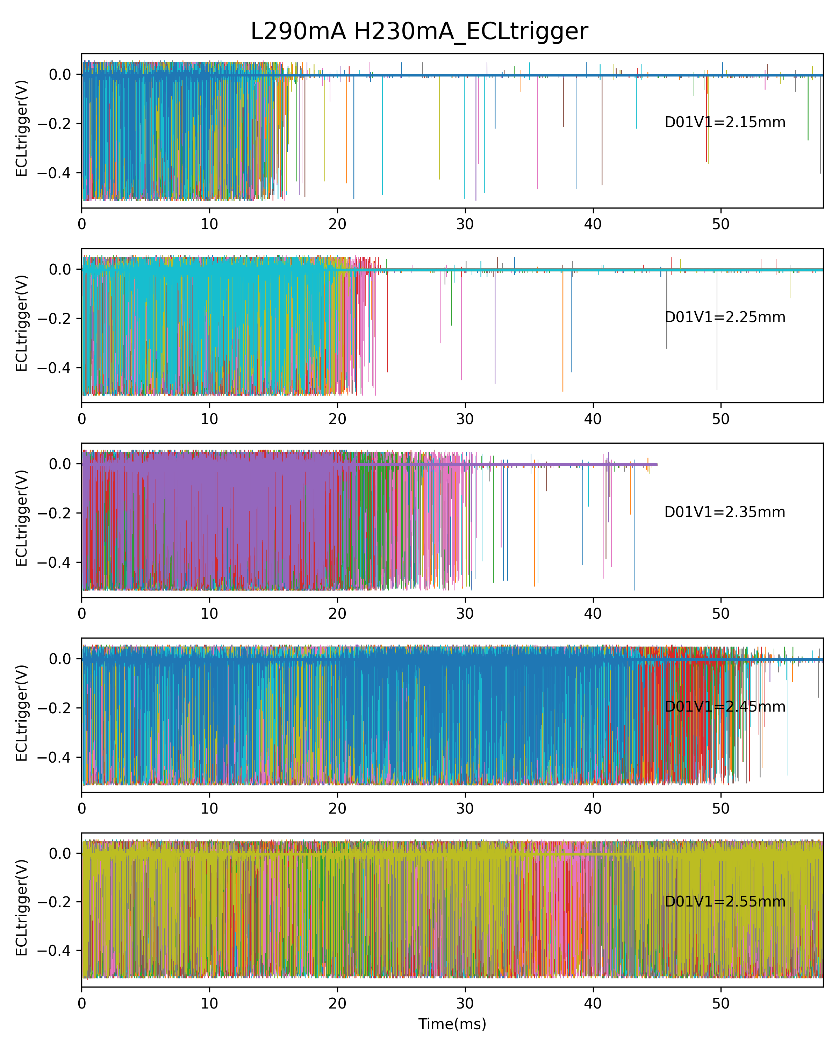
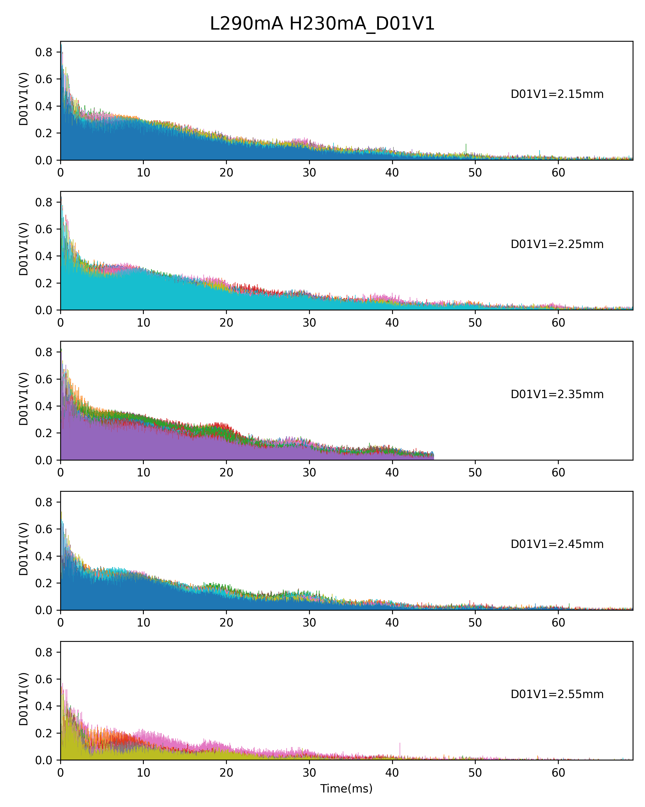
Preliminary analysis
--The injection BG is very sensitive to collimator D01V1 aperture
( close 200um )
( close 100um )
Experiment setting
( open 100um )
( open 200um )
11

Slide 12
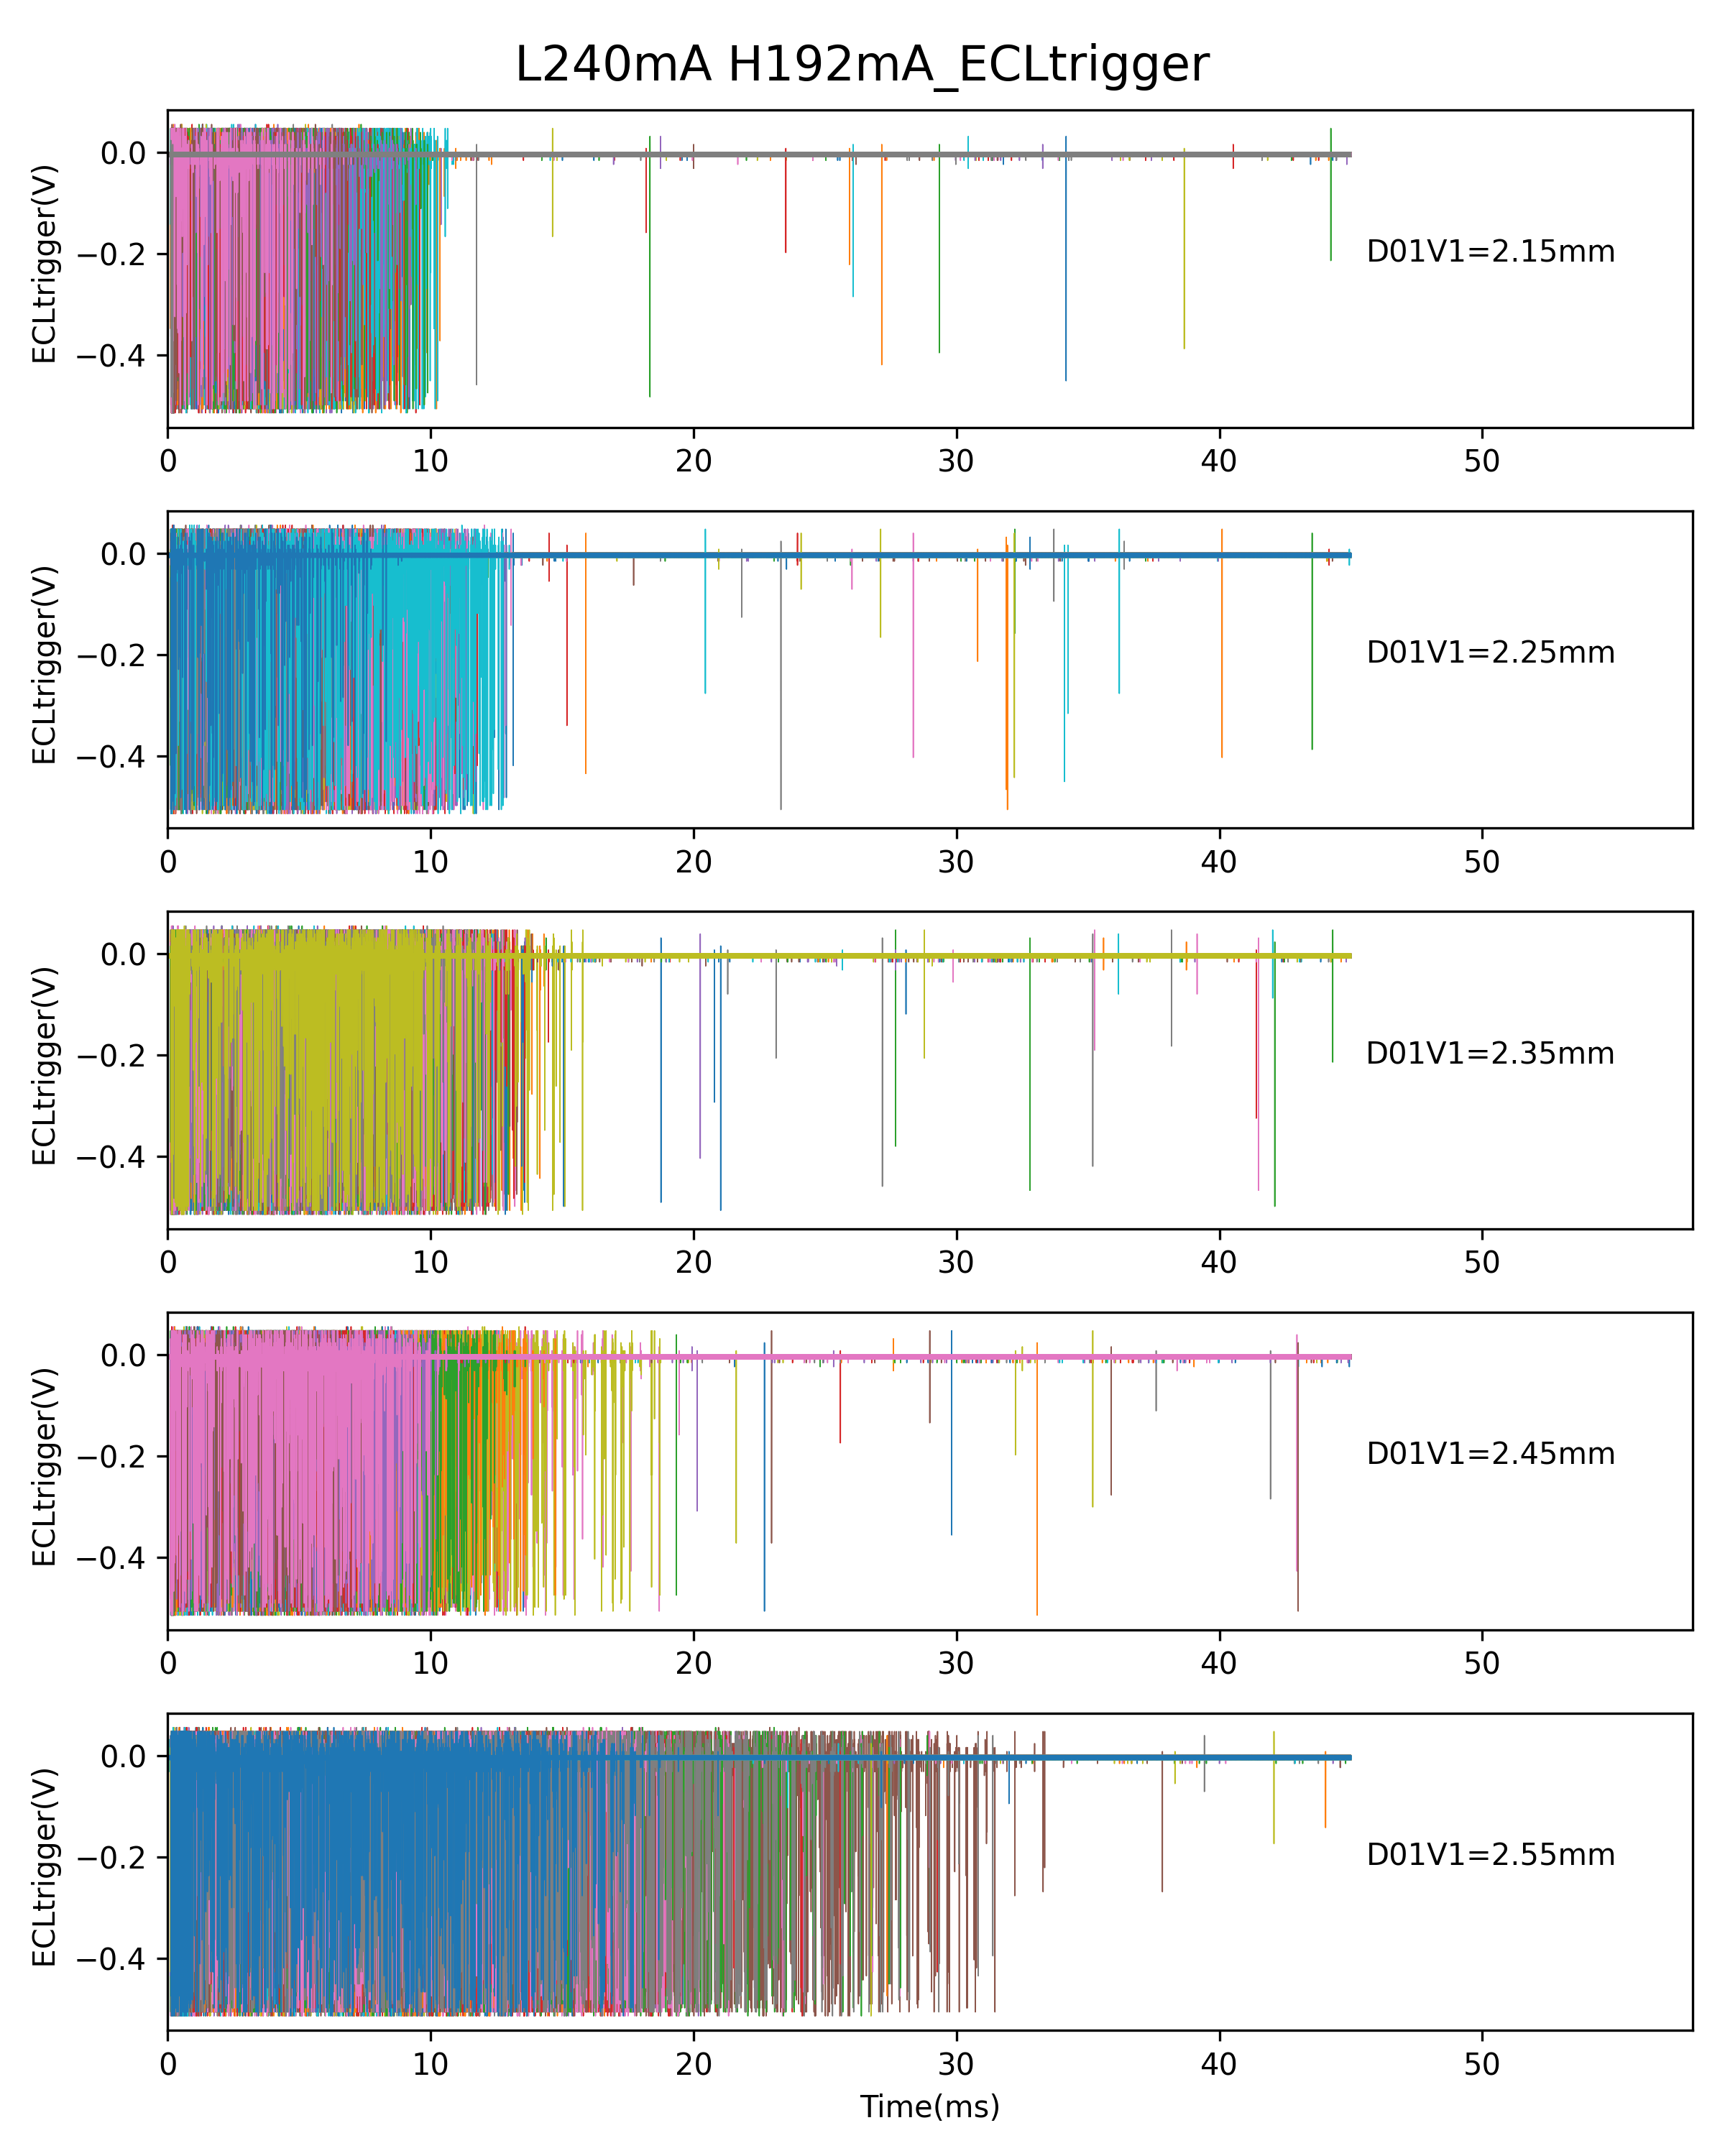
Preliminary analysis
--The injection BG is very sensitive to bunch current(beam-beam strength)
14
( close 200um )
( close 100um )
Experiment setting
( open 100um )
( open 200um )
12

Slide 13
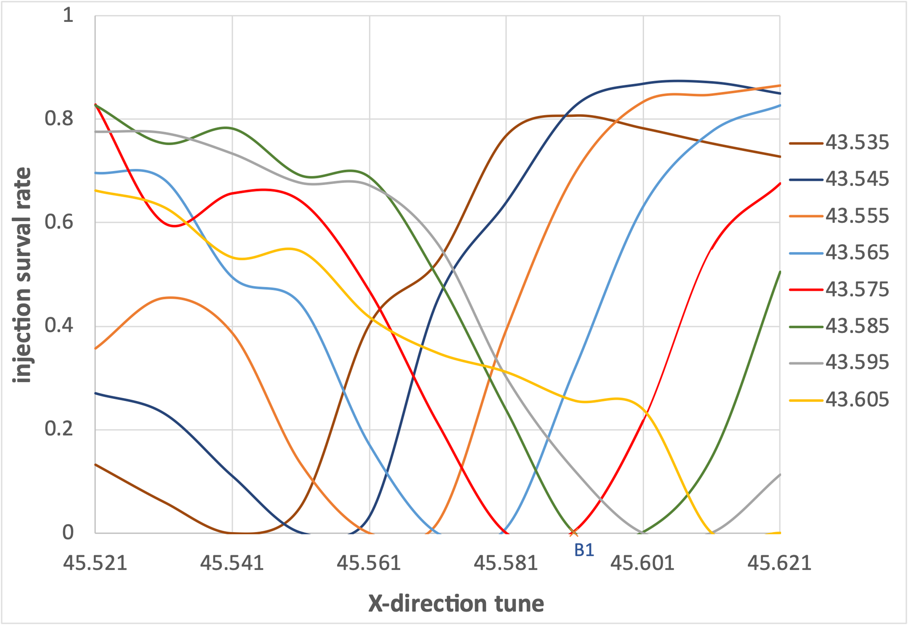
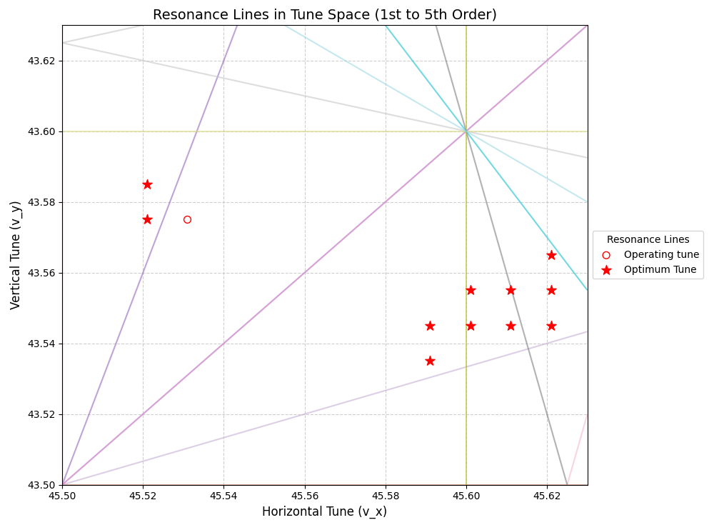
Tune Scan Study of Injection Efficiency
Operating point(45. 531,43. 575), 60%
5
Optimum tune(eff>80%)
5
5
5
5
5
5
4
2
4
5
Some tunes with higher injection efficiency were found in the resonance-free region: located far from the 2nd order resonance lines, above the 4th order resonance lines, and between the 5th order resonance lines.
The results are consistent with the simulation by Yasuhiro Yamamoto.
13

Slide 14
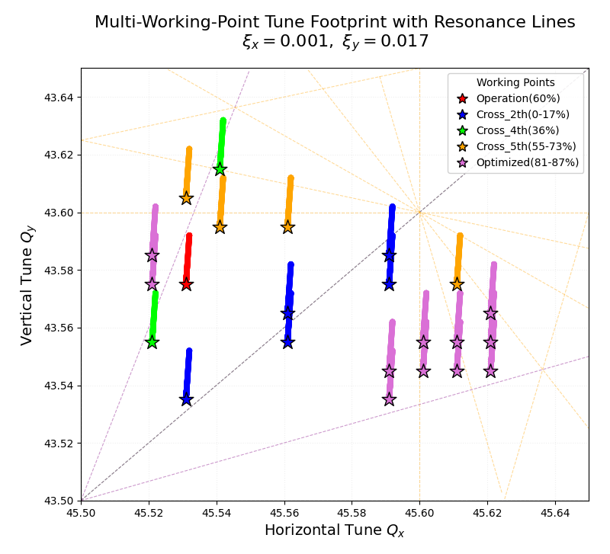
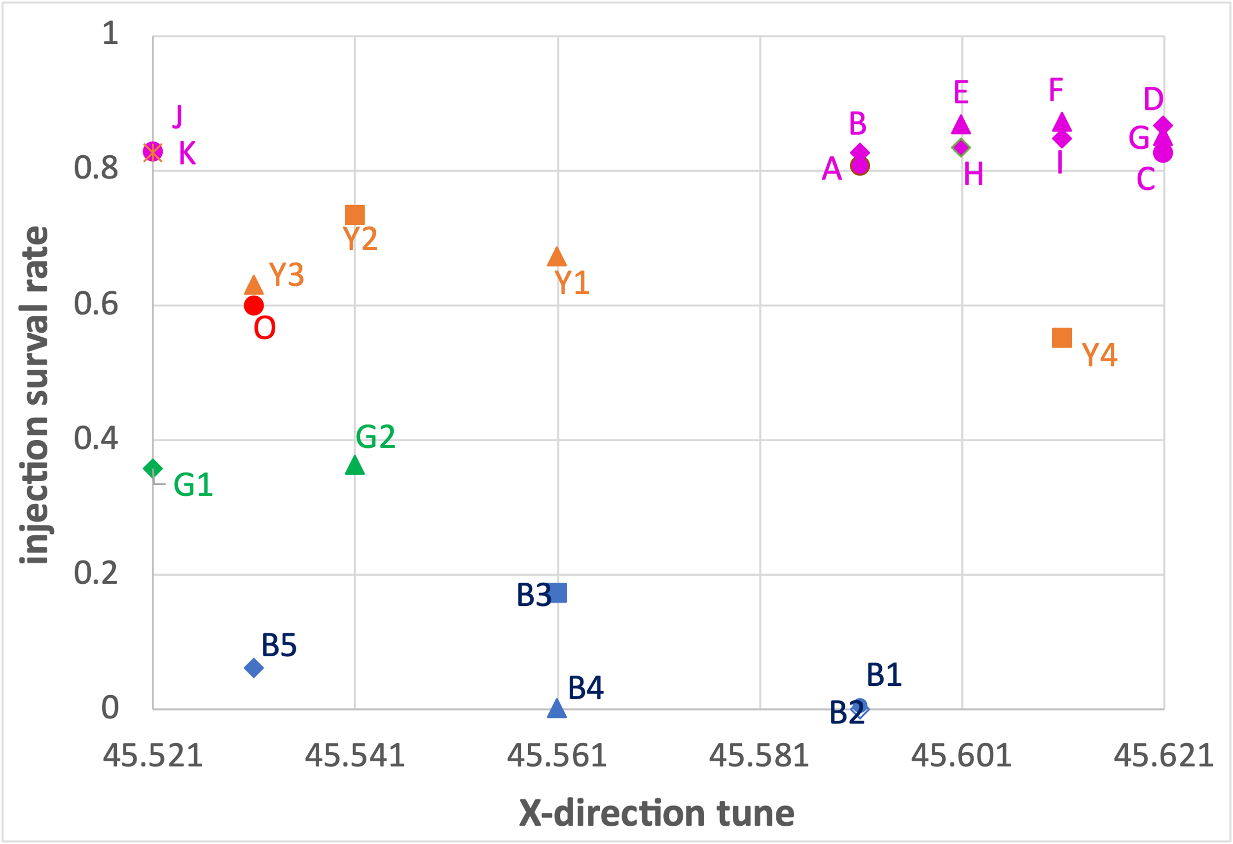
Tune Scan Study of Injection Efficiency
Beam-beam interaction introduces tune shifts as functions of the oscillation amplitudes: $Δν\left(α\right)=ξ\frac{1−e^{−α}I_{0}(α)}{α}$
At vanishing amplitudes, $Δν→ξ$; for very large amplitudes, $Δν→0$
5
5
5
5
G2
5
Y3
5
Y2
Y1
5
K
B2
J
O
B1
Y4
B3
D
G1
B4
F
5
E
G
B
H
I
C
B5
A
4
2
4
4th order resonance and below are dangerous for injection, while 5th order resonance lines may be weaker and have less impact on injection.
14

Slide 15
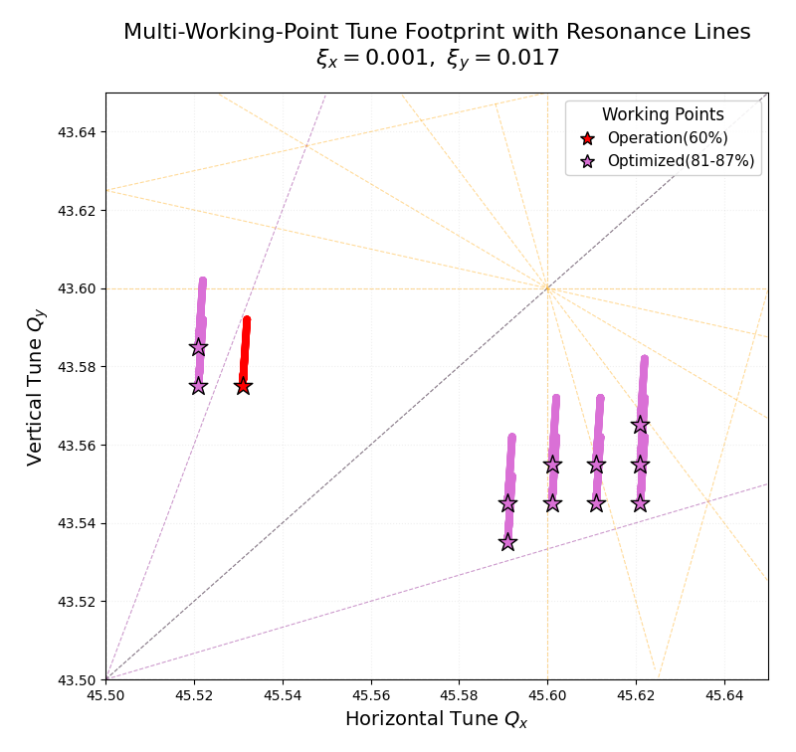
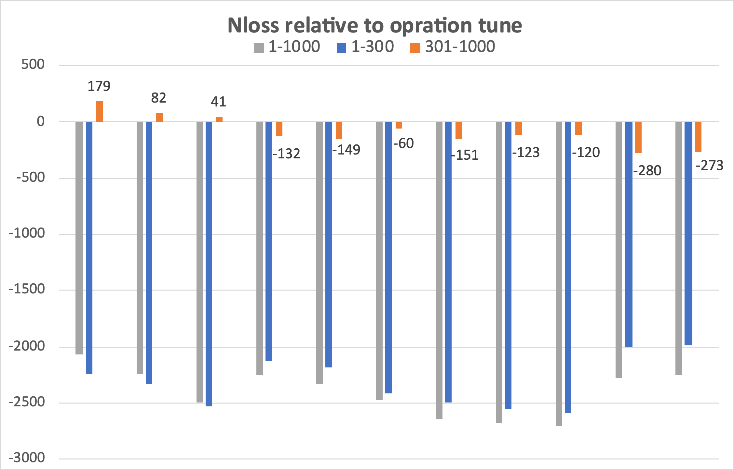
Optimum tunes improve both efficiency and related background
Operation tune | INJ_Effi | Nloss(1-300) | Nloss(301-1000)
(45.531, 43.575) | 0.60 | 3558 | 435
K
J
O
D
E
F
G
B
H
I
C
A
A
B
C
D
E
F
G
H
I
J
K
INJ_Effi
0.81
0.82
0.85
0.83
0.83
0.85
0.87
0.87
0.87
0.83
0.83
A, B, C: Improve injection efficiency(20%); but also increase long duration beam loss between 300-1000turns.
D-K: Improve injection efficiency(~25%) and reduce long duration beam loss (15-60%) compared to current operation tune. Especially tunes G(with highest efficiency) and J, K (with largest reduction of long duration beam loss) reduce beam loss every turn.
15

Slide 16
LumiBelle2 fast luminosity monitor for SuperKEB
Designed and installed in 2016
Fully commissioned in 2018
Operated continuously in 2019-2021
Restarted after maintenance & upgrade in 2023-2024
Reminder of basic function, specs and design
Current setup
Preliminary study of 2024 data…
Philip Bambade IJCLab (Orsay)
Sandry Wallon IJCLab (Orsay)
Meng Li IJCLab (Orsay) and IHEP (Beijing)
Sadaharu Uehara KEK ➔ ZDLM
Hiroyuki Nakayama KEK
Yoshihiro Funakoshi KEK
Mika Masuzawa KEK
16

Slide 17
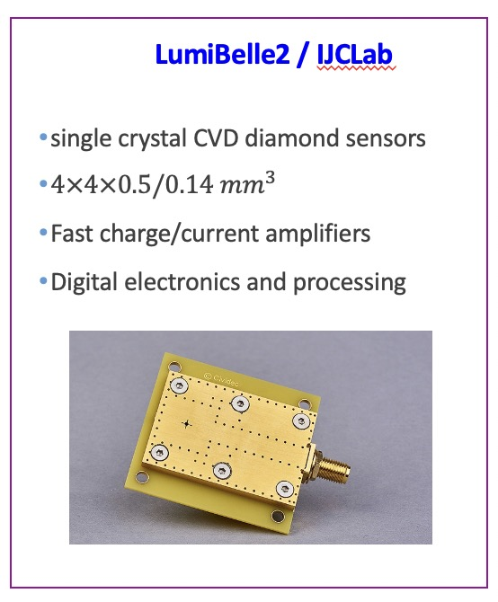
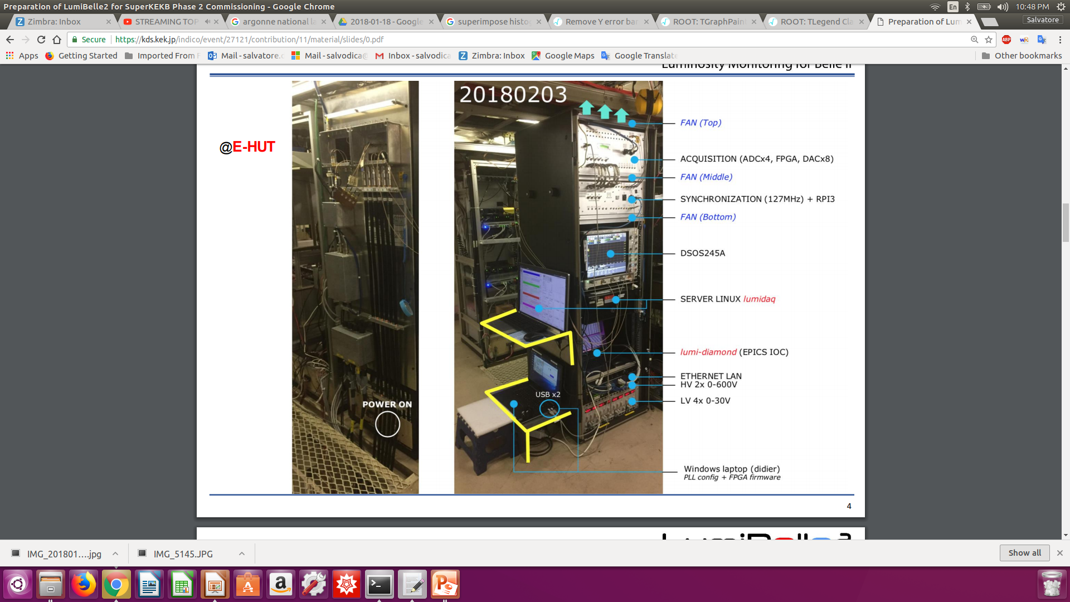
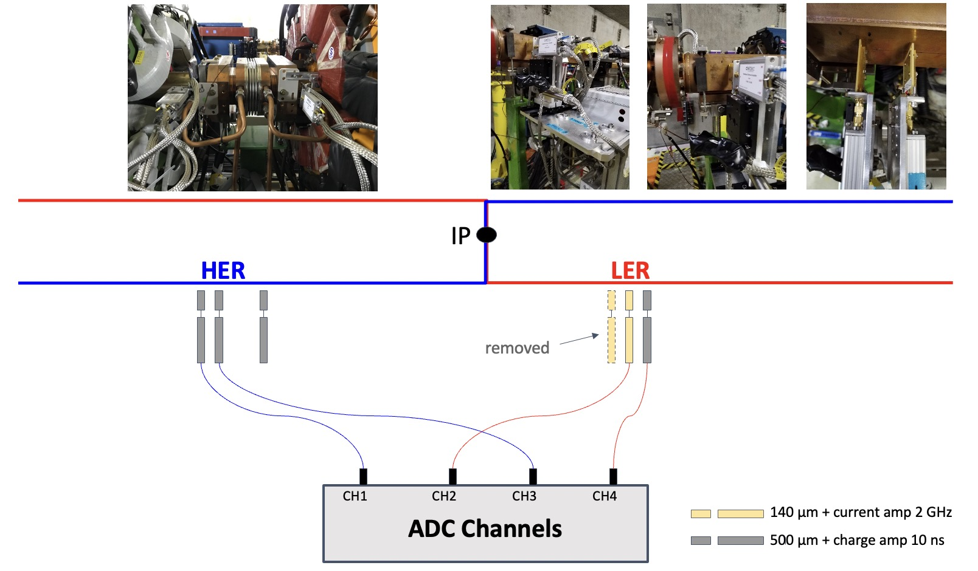
LumiBelle2 fast luminosity monitor at SuperKEKB
-> Developed a fast luminosity monitor LumiBelle2 based on sCVD diamond detectors
-> Fast luminosity measurement and feedback(1% relative precision@1kHz )
-> Bunch by bunch luminosity diagnostic(1% relative precision@1Hz)
-> IP vertical beam size measurement + tuning at very low currents
-> Maintain optimum collision conditions & maximize luminosity
30 m
10 m
17

Slide 18
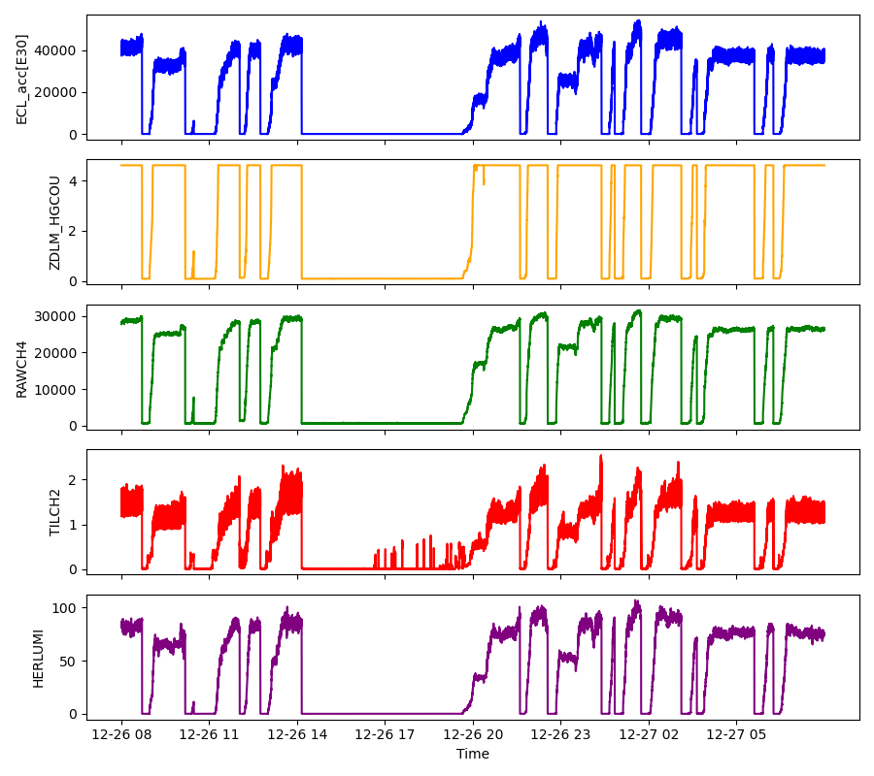
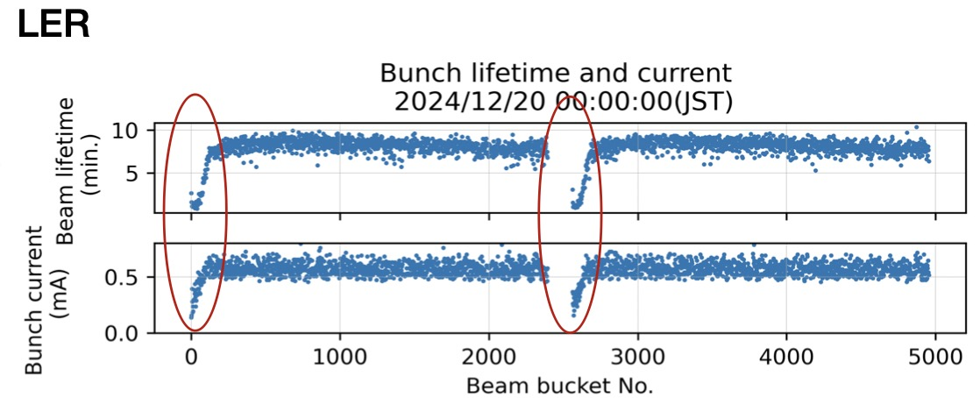
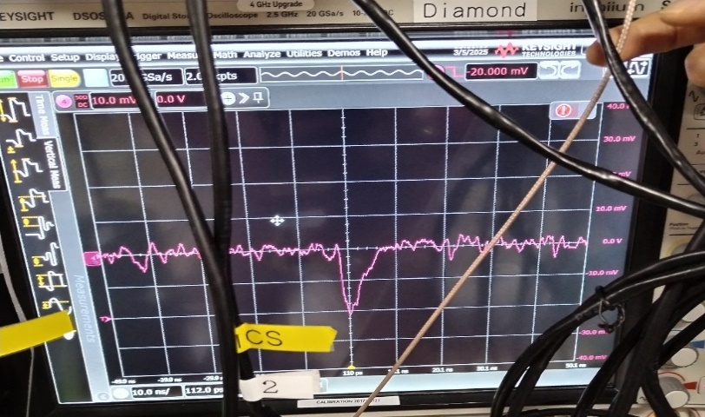
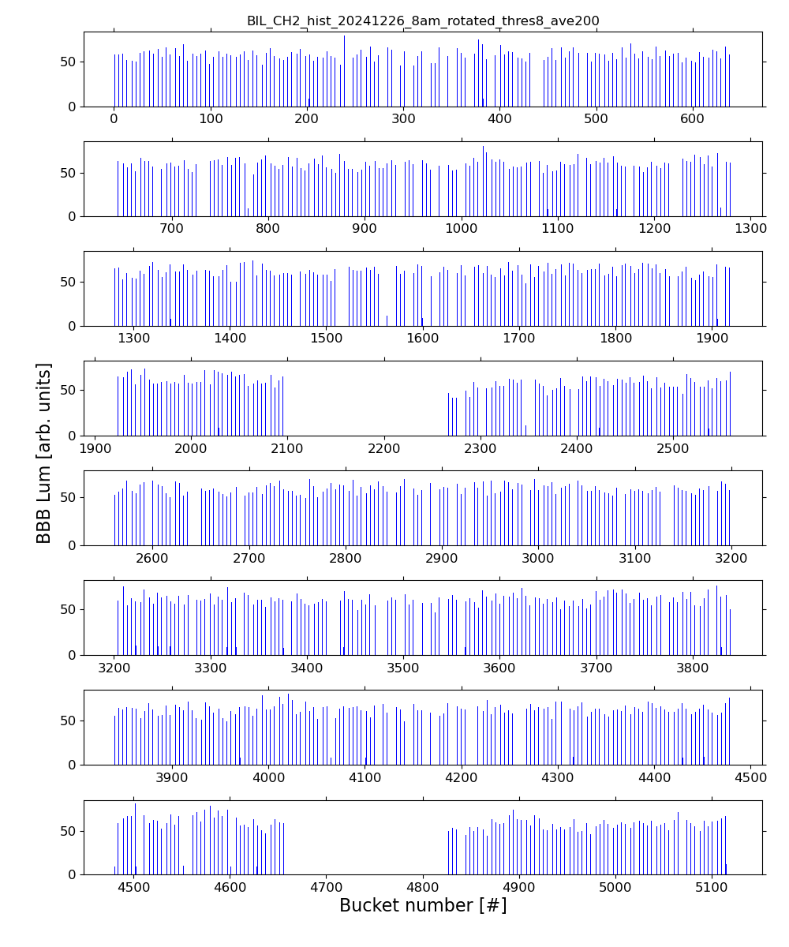
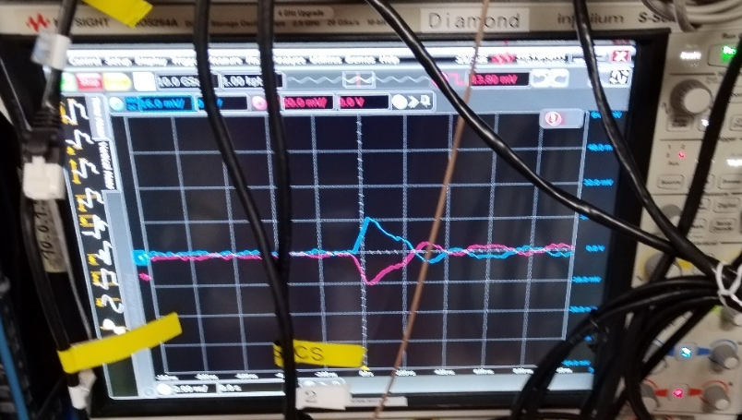
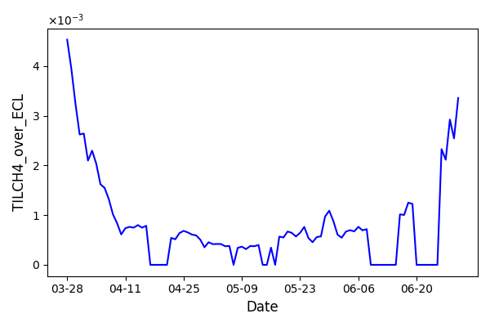
LumiBelle2 fast luminosity monitor at SuperKEKB
In 2024, the LumiBelle2 was operated successfully at KEK
Conducted data analysis based on 2024 run to estimate the performance of Diamond sensors
- Internal data handling/archiving software instability
- Sensor sensitivity drift in one diamond detector
Observe variation of B-by-B lifetimes (Dec. 2024) -> B-by-B luminosity data for machine tuning required by SuperKEKB
Tests of LGAD sensors in LumiBelle2 (Feb. 2025) -> radiation hardened version from IHEP-Beijing used in ATLAS HGTD
Check of 500μm diamond herd42 with C2HV0235 amplifier
Trigger level -20mV
sensitivity@500um diamond
Test of LGAD sensor from IHEP with C2HV0235 amplifier and RF splitter / inverter
Trigger level 13.8mV
18

Slide 19
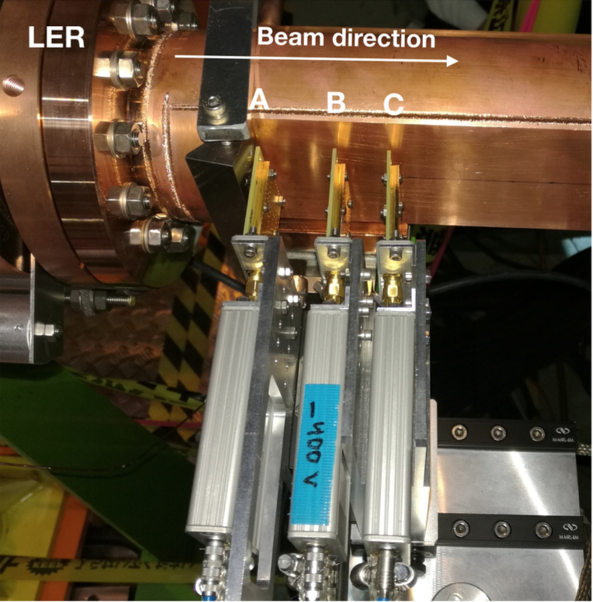
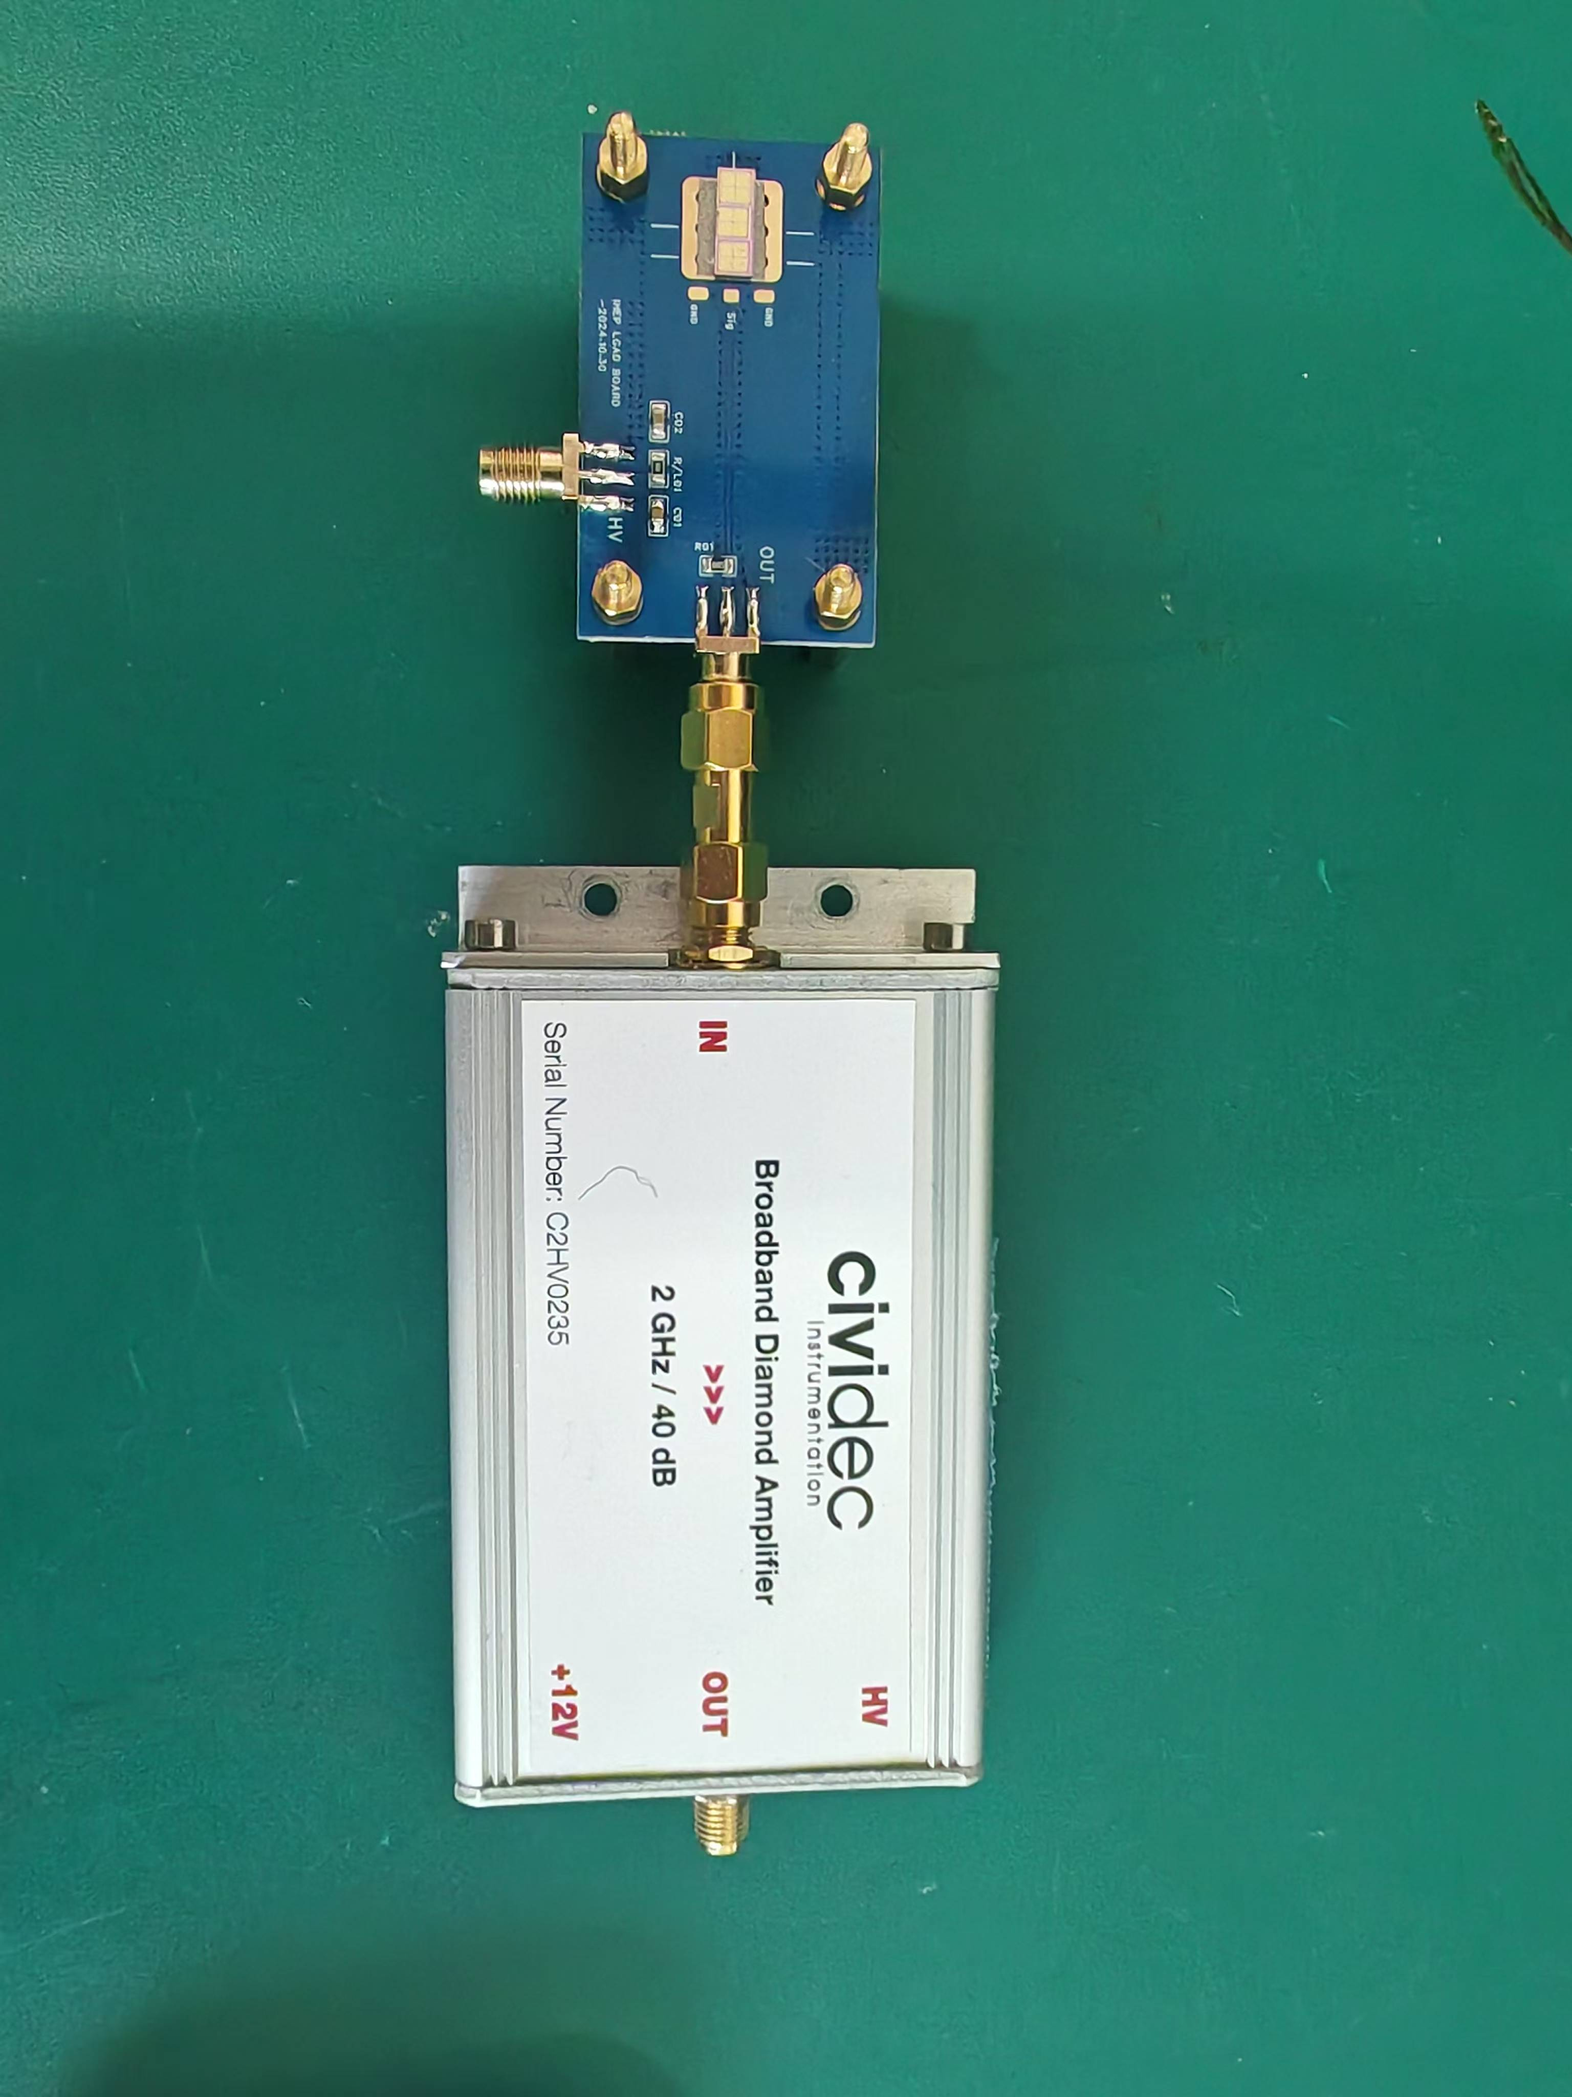
Upgrade LumiBelle2 SuperKEKB fast luminosity monitor with radiation-hard LGAD sensors produced by IHEP-IME for ATLAS HGTD
→ install LGAD with PCB
4 mm x 4 mm LGAD/ 6.5 mm x 6.5 mm LGAD in the LER and HER of Belle II next November
→ use together with existing sCVD diamond sensors during 2025-2026 SuperKEKB operation
sCVD diamond sensors => 4 mm x 4 mm pads
LGAD sensors => 1.3 mm x 1.3 mm pads
→ combine many LGAD sensors to cover large area for enough statistical precision
19

Slide 20
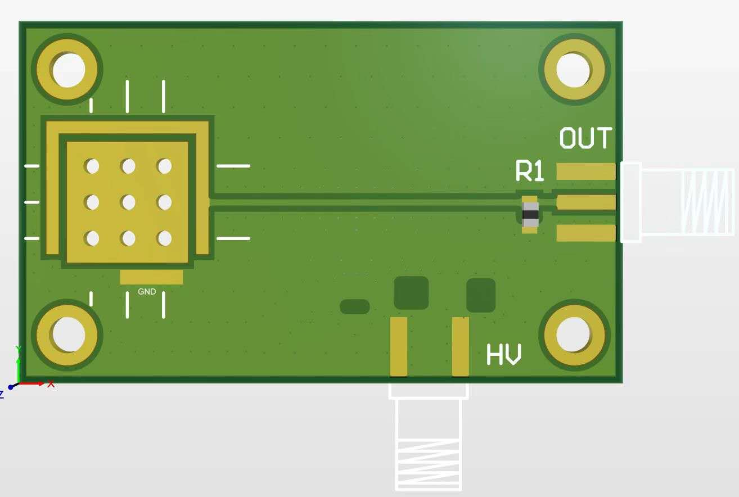
Wire bonding scheme for combining up to 25 LGAD sensors to same readout channel
Avoid increasing the capacitance
→ new wire bonding scheme
20

Slide 21
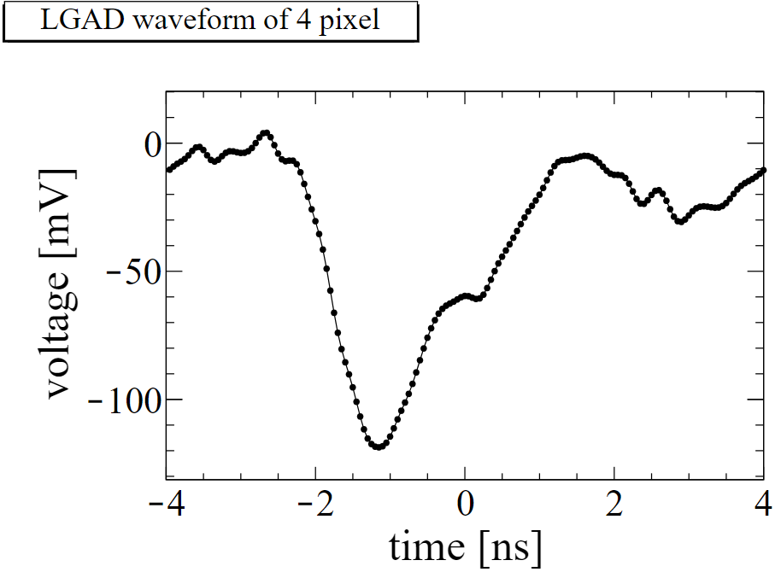

Beta Test for the LGAD with 40dB CIVIDEC amplifier (borrowed from LumiBelle2)
Features of LGAD samples
IHEP-IME LGAD with radiation hardness
2x2 array LGAD
1 pixel： 1.3 mm x 1.3 mm
PCB with HV input and low frequency filter circuit
signal waveform
Bonding 2x2 sensors
21

Slide 22


Beta Test results
Peak distribution for the MIP signal of 2x2 array LGAD
MPV signal peak ： ～ 100 mV
Noise ：< 7 mV
No increase of the capacitance
Good S/N ratio！
22

Slide 23







Preliminary Design Considerations for IP Luminosity Feedback System at CEPC
We considered two possible methods for the IP orbit feedback system at CEPC——similar to SuperKEKB.
Beam-beam deflection driven method
Luminosity driven system
Based on the measurement of the beam orbit around the IP.
The offset at the IP is too small to be accurately measured, but this small offset can be converted into a large offset due to the mutual electromagnetic deflection as the beams propagate forward and collide. By measuring this offset with BPMs upstream and downstream of the IP, we can estimate the offset at the IP and the sign. If accuracy of BPM is precise enough, we may maintain the optimum collision with almost no luminosity loss. We usually prioritize this method for this reason.
Based on measurements of the luminosity. Due to the lumi- nosity being a symmetrical function of offset, we can only know the offset between two beams, but cannot easily know its sign. And some other effects ( beam size and intensity) may also cause luminosity changes at relatively low frequency. To solve this problem, we should introduce a dithering with certain frequency, and then luminosity will change with same frequency, we can extract orbit shifts and correct them.
$${∆y}_{±}^{′}=−\frac{r_{e}N_{∓}}{γ_{±}σ_{y∓}^{∗}\left({\tilde{σ}}_{x∓}^{∗}+σ_{y∓}^{∗}\right)}{∆y}_{IP}$$
$${∆y}_{BPM}=\sqrt{β^{∗}β_{BPM}}∆y^{′}$$
The design of luminosity feedback system depends on the Designed machine parameters, Position and resolution of the IP BPMs, Ground motion of the construction site.
23

Slide 24


Position and requirements of fast luminosity monitor for CEPC
Three potential locations were considered: before, inside, and after the first bending magnet.
IP
1
2
3
Aiming for a precision of about 2% in 1 ms
24

Slide 25


25

Slide 26






Design for CEPC fast luminosity monitor detector based on 4H-SiC
Motivation: Ultra-Precise Luminosity Monitoring
  Higgs-mode luminosity target: 5×10³⁴ cm⁻²s⁻¹
  Demands real-time beam feedback for horizontal stabilization via luminosity-driven dithering system
Simulation workflow
  Energy deposition of Bhabha electron events from GEANT4
  Electrical field & weighting field from DEVSIM
  Current signal from Cal current in RASER (RAdiation SEmiconductoR)
Detector Layout Optimization
  Position: 10m downstream from IP; double sides
  Geometry: >1 X 3 cm² ensures 2% precision
Luminosity Monitoring
  TSC (Total Sample Current) correlates linearly with luminosity
  Relative precision ∝ 1/√L
Energy deposition
Carrier Drift & Diffusion
Shockley–Ramo theorem
Independent development
Electrical field & weighting field
https://raser.team
26

Slide 27



Geometric design and simulation
Distribution of secondary particles
  Symmetric distribution in the vertical direction
  Spatial dispersion of secondary particles along the beam direction
  Reduced position-signal response correlation
27

Slide 28




Geometric design and simulation
Detector Parameters
  4H-SiC pixel units (5×5 mm²)
  Active Region：Doping concentration 5.2×10¹³ cm⁻³
  Thickness：100 μm
Positioning & Size Optimization
  Location: Peak secondary particle flux P1(−31 mm, 0, 230 mm)/ P2(31 mm, 0, 230 mm)
  Beam direction Length: 1 cm (capture efficiency: 1.8% γ / 1.6% e⁻)
  Vertical Length: 1~5 cm
Signal Noise Management
  Current Thresholds (0.05–5 μA)
Detector Performance Requirements
  Design Target: 2% precision @ 1kHz
  2500 e⁻ → 2% theoretical limit
Vertical length must be ≥3cm
Current threshold must be ≤1μA
* A paper is almost ready for publication.
28

Slide 29






Collaboration meetings at IHEP
(September 13-14, 2024)
29

Slide 30
Conclusions and outlook
Injection-related beam loss and background simulation/measurement in HER @ SuperKEKB
-- A more realistic simulation mechanism for injection-related beam loss has been developed
-- Verification experiments have been conducted based on its main findings
-- Qualitative agreement is observed between simulation and experimental data
-- Tune affect both injection efficiency and related background
-- Further investigation of injection-related beam loss and background…
→ Tune scan, Further non-linearity in optics, tip-scattering, Assessment for higher luminosity, Connection with GEANT4 detector simulation, More validation experiments, LER simulation…
LumiBelle2 activity
-- LumiBelle2 Continuously used for SuperKEKB to measure IP beam size & offsets
→ essential at SuperKEKB, CEPC, FCCee, …
-- Issue of radiation → LGAD sensors with Carbon implantation from IHEP/Atlas/HGTD
-- LumiBelle2 operated by IJCLab partly remotely and with local help at KEK
→ recent prospect of strong FCCee + CEPC interest
CEPC fast luminosity feedback studies
-- Collaboration meeting @ IHEP September 13-14, 2024
-- RDTM paper published on conceptual design
-- Promising full simulation study of fast luminosity monitor for CEPC based on 4H-SiC
-- Detail full simulation study of CEPC fast lumi. monitor publication is preparing (follow up of Meng’s study)
-- More work is on going…
30

Slide 31
Thanks for your attention!
Welcome to suggestions and comments!

Slide 32
Back up

Slide 33


The SuperKEKB/Belle II project
 | Electron | Positron
Energy (GeV) | 7 | 4
Current (A) | 3.6 | 2.6
SuperKEKB (Electron-Positron Collider)
C.M.S. Energy: √s = 10.58 GeV
Luminosity: L → 8 x 10³⁵ cm^{– 2}s^{–1} （Luminosity Frontier Machine）
Achieved in 2024 : L = 5.1 x 10³⁴ cm⁻² s⁻¹
Belle-II
Main Ring
Injector Linac
Belle II (General purpose detector)
Vertex detectors: Pixel Vertex Detector (PXD),
Silicon strip Vertex Detector (SVD)
Tracking: Central Drift Chamber (CDC)
Calorimeter: Electromagnetic CaLorimeter (ECL)
Particle ID: Aerogel Ring Image CHerenkov detector (ARICH)
K-Long and Muon detector (KLM)
Time-Of-Propagation counter (TOP)
Damping Ring

Slide 34
KEKB ↔ SuperKEKB parameters
× 1/20 β_{y}
σ_{y} ≈ 50-60 nm
(similar as ILC/ATF2)
× 2-3 beam currents
similar beam-beam strength
(tune-shift)
→ up to × 40 peak luminosity

Slide 35
Nanobeam collision scheme
Opportunities
Very small β_{y} avoids “hour-glass” limitation (effective bunch length ≈ depth of field of the optics)
Collide more charge @ tiny vertical beam size with similar beam-beam tune-shift strength parameter
Challenges
1. Optical aberrations near IP must be cancelled to achieve / maintain tiny beam spots
2. Control beam-beam tune-shift with more complex IP beam-beam dynamics + optical aberrations
3. Continuously inject intense beams in strongly demagnified IP optics → injection backgrounds… beam tails…
× 1/20 β_{y}
× 2-3 beam currents
× 1/20 σ_{y}

Slide 36




Fast & slow beam position variations at IP require feedback corrections
Beam-beam deflection for fast vertical motion
Luminosity feedback by “dithering” for slower horizontal motion
Δy at IP= ∼ 5nm ∼ 1/10σ_{y}*
BPM
Δy at BPM= ∼ 1.3μm
Vertical vibration ∼ 25-100 Hz
Sampling (BPMs) ∼ 32 kHz
IP
BPM
↔
Horizontal motion ∼ few Hz
Modulation freq. f₀ ∼ 79 Hz
Sampling (lumi. meas.) ∼ 1 kHz
- minimize f₀ output component
- dithering × lumi. signal → phase
2×f₀
Luminosity
↔
f₀
x
Dithering coil x 12
DITHERING
LUMINOSITY

Slide 37
Luminosity related observables
1) Bhabha scattering measured in very forward Belle II calorimeter
- cross section precisely known + detector calibration → absolute measurement
- statistical precision needs averaging
2) Single bremsstrahlung ↔ radiative Bhabha process at zero scattering angle
- cross section not precisely computed
→ effective photon approximation
- beam size and collision offset dependencies
→ QED large impact parameter effects
→ experimental acceptance distorted by beam-beam deflection
- very high cross section (0.15-0.2 barn) → OK for fast / high precision monitoring
3) Beamstrahlung
- optical detection at large angles (SuperKEKB)
- high photon rate detection (SLC, FCCee, CEPC)
- rates / asymmetries / polarization dependences on beam sizes → indirect reconstruction
Notes:
LGSO (Lu2-xGdxSiO5)

Slide 38
Fast luminosity monitoring specifications
“Dithering” feedback
Correct for few Hz horizontal motion
79 Hz orbit “dithering” + luminosity sampling @ 1 kHz → reconstruct baseline freq. + 2nd harmonic
Efficient separation from other “slow” variations
1% relative precision @ 1 kHz sufficient (cf. C.-G. Pang et al., J.Phys.Conf.Ser. 1067 (2018) no.7, 072023)
Provide analog signal as input to lock-in amplifier
Bunch by bunch luminosity diagnostic
Nominally 4 ns bunch separation → need short signal pulses, ideally < 4 ns
1% or better relative precision @ 1 Hz
IP vertical beam size measurement + tuning at very low currents
Single beam orbit + optics corrections in two rings
Vertical e+ and e- beam size optical tuning → suppress local aberrations in nanobeam final focus
Control of beam-beam blowup → find best spot in tune diagram
Very low current → avoid confusion from beam-beam induced blowup
Dynamic range L ≈ 10³² → 10³⁶ cm⁻² s⁻¹
Non luminosity scaling contamination < 1% (e.g. beam gas bremsstrahlung and Touschek losses)
Manage radiation damage at highest luminosity
Notes:
LGSO (Lu2-xGdxSiO5)

Slide 39










Bhabha process at vanishing scattering angle
a.k.a. Single Bremsstrahlung
Dima El Khechen et al., PRAB 22, 062801 (2019)
Large cross section $σ≈0.15−0.2 barn$ for $E \left(γ\right)>1\% E \left(beam\right)$
    1) 𝑒+ rate in LER 10 m after IP (part of energy spectrum near E(𝑒+) ≈ 3.5 GeV after large bend)
    2) 𝛾 rate in HER 30 m after IP (part of 0.1-0.3 mrad IP beam angular spread due to geometry)
$$E (e^{−})=7GeV$$
$$E (e^{−})=7GeV$$
$$E (e^{+})$$
𝑒+
$$E (e^{+})=4GeV$$
$$E (γ)$$
$$L∝\frac{dN}{dt}$$
Only relative luminosity → with certain conditions…
Acceptance depends on choice of sensor / location
Also some variation with beam parameters…
𝜎_{Bhabha@zero-degree} not precisely computed in QED
➔ OK for usage on “short” enough time-scales
➔ care for beam parameter dependence
𝛾
Notes:
LGSO (Lu2-xGdxSiO5)

Slide 40





Two complementary techniques for fast luminosity measurements
- compare / collaborate / mutually supporting
- share simulation, mechanics, some data…
- since 2012
LumiBelle2 / IJCLab
ZDLM (Zero Degree Luminosity Monitor) / KEK
single crystal CVD diamond sensors
$4×4×0.5/0.14 mm^{3}$
Fast charge/current amplifiers
Digital electronics and processing
Cherenkov and scintillator detectors
$15×15×64 mm^{3}$ LGSO non-organic scintillator and ES-crystal (quartz)
Photomultipliers
Analog & digital processing
Notes:
LGSO (Lu2-xGdxSiO5)

Slide 41






Implementation in LER and HER
Cheng Guo Pang et al., Nucl.Instrum.Meth. A931 (2019) 225-235
POSITRON RING (measure e+)
Optimal position found at 10 m behind IP using SAD
Over-bent Bhabha positrons → vacuum chamber
Special beam pipe with window + Tungsten radiator
Start-to-end simulation (GuineaPig++, SAD, GEANT4)
IP
0.4
ELECTRON RING (measure $γ$)
28 m
Photon ray-tracing in detailed vacuum chamber geometry + GEANT4
Original position at 30 m (2018)
New optimal position found at 28 m with ≈ 10 times higher rate
IP
X(m)
0
loss position distribution
Notes:
Radiation length of Tungsten is 0.3504 cm

Slide 42




IP
HER
LER
Removed
(radiation damage)
present setup
CH1
CH2
CH3
CH4
ADC Channels
140 μm + current amp 2 GHz
500 μm + charge amp 10 ns

Slide 43



LumiBelle2 signal processing
E-HUT F-8
2 / 10 ns FWHM signals from 140 / 500 μm with 2 GHz current / low noise charge amp sampled every 1 ns
Synchronized to RF clock → continuous monitoring, averaging at 1 kHz and 1 Hz (bunch by bunch and all bunches together)
Luminosity proportional to amplitude of signal peaks
  ADC is AC-coupled → record difference between peak and baseline → “TIL” & “BIL”
  Raw sum of all samples also ∝ luminosity and recorded → “RAWSUM”
  Number of peaks also recorded (constant fraction discriminator) → “COUNT”
➔ EPICS broadcasting @ 1 Hz ➔ “1 Hz, 1 KHz, bunch-by-bunch, bunch-current” data streams transferred daily for archiving

Slide 44






Simulation of signal formation and DAQ

Slide 45


Setting up and optimizing beam collision with LumiBelle2
Initial scanning of IP beam offset to enable Regularly optimizing IP beam offset
collisions at very beginning of the run… to maximize luminosity…

Slide 46



Minimising electron and positron IP beam sizes with LumiBelle2…
→ Machine learning effort for optimizing tuning process…

Slide 47

Introdcution to LGAD
LGAD (Low-Gain Avalanche Diode)
Silicon detector with low gain 10-50（compared with APD and SIPM）
Signal width：1 ns, Time resolution ~ 30ps
Radiation hardness：10¹⁵ ~10¹⁶n_{eq}/cm²
Conventional PN sensor
LGAD sensor
n++
n++
p+
p
p
Gain layer

Slide 48

LGAD sensors pre-production at IHEP
In May 2023, IHEP-IME sensor was chosen for the ATLAS HGTD project.
  First time the silicon sensor designed and produced by China was chosen for an LHC experiment
The production plan:
  IHEP-IME: 90% (66% from CERN tendering+24% in-kind contribution): ~8 m²
Pre-production LGAD sensors from China
IHEP-IME Pre-production

Slide 49


Estimate the performance of the beam-beam deflection at CEPC
Consider the case where the offset at IP is 10% of the beam size caused by ground motion and the luminosity loss is about 1% . The beam-beam angular deflection can be estimated based on the CEPC TDR parameters and the distance from the IP to the IP BPM of about 0.9m.
For the vertical orbit feedback system, this method may work, since the offset is sizable compared to typical expected BPM resolution(0.2um).
But for horizontal the beam-beam deflection is too weak, makes it difficult to measure such a small beam deflection. The luminosity driven method will be used for the horizontal orbit feedback.
*…

Slide 50

Horizontal IP orbit feedback & fast luminosity monitor design
Generating the Bhabha particles through the program( BBBREM or GUINEA-PIG)
Tracking scattered positrons up to 100 meters downstream of the IP using the SAD code and calculate the loss map to identify a possible position for placing a luminosity detector
fraction of scattered electrons hitting the beam pipe is close to the required value
radiative Bhabha process at zero degree dominates over other particle loss processes
ensure that the Bhabha event rate at this position is minimally affected by beam-beam deflection
Detailed simulation in Geant4 to estimate the signal in the detector and radiation dose simulation
Considering / selecting the detector technology (e.g., Cerenkov, array of pin diodes,etc...)

Slide 51





Position of fast luminosity monitor for CEPC
The low-energy scattered electrons from the IP first go through three quadrupole magnets, 33m dirft, 51m bending magnet..
The scattered Bhabha electrons primarily get lost after the three quadrupoles and on the first dipole magnet. Due to the drift section behind the dipole magnet is shorter, the number of lost in this section is relatively low.
1
2
3
Three potential locations were considered: before, inside, and after the first bending magnet

Slide 52



Primary electron tracking
Primary Electron Losses(PEL) areas
  10 meters from the IP
  Dimension~ 5X20cm²
Distribution of primary electrons
  Symmetric distribution in the vertical direction
  Uniform distribution along the beam direction

Slide 53





Detector performance simulation
  Current signal response within 0.1ms
    Nominal luminosity L₀ (5×10³⁴ cm⁻²s⁻¹) & 10% L₀
    Signal peak count decreases significantly
    Average amplitude reduces to 76%
  Signal response vs luminosity
    TSC ∝ Actual luminosity L/L₀
    Relative precision ∝ 1/√L
L₀
10% L₀
  Real-time luminosity monitoring
  Beam alignment verification

Slide 54



Advantages of 4H-SiC Applications
Secondary Particle ratio
  Photons ~ 87.67%
  Electron ~ 7.19%
Prioritize photon-resistant materials
Optimize shielding for γ-ray dominated environment
High bond energy
  Si-C bond: 4.6 eV (vs. Si-Si: 2.3 eV)
Elevated displacement threshold
  SiC 20–35 eV (vs. Si 12–15 eV )
Gamma irradiation
[1] DOI: 10.1109/TNS.2020.3029730
[2] https://doi.org/10.1016/j.nima.2005.01.059
Significantly reduces γ and electron-induced atomic displacement

Slide 55


