Slide 1

Investigations on the polarized positron beams for future circular colliders
Xiaoping Li (IHEP，Beijing) & Iryna Chaikovska (IJCLab, Orsay)

Slide 2
Content
Positron Source in BEPCII/FCC-ee/CEPC
Generation of polarized positron beams
  Polarized positron production from circularly polarized gamma photons
  Polarized positron production from polarized electrons
France-China Cooperation in R&D for PPS
  Progress from IJCLab
  Progress from IHEP
Summary

Slide 3
Content
Positron Source in BEPCII/FCC-ee/CEPC
Generation of polarized positron beams
  Polarized positron production from circularly polarized gamma photons
  Polarized positron production from polarized electrons
France-China Cooperation in R&D for PPS
  Progress from IJCLab
  Progress from IHEP
Summary

Slide 4
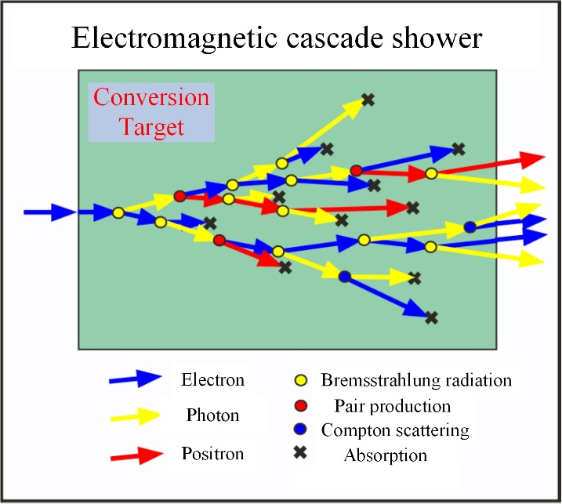
Positron Source in BEPCII/FCC-ee/CEPC
Introduction to Positron Source
  Positrons are a type of elementary particle with a positive charge/Anti-particles of electrons
  Positrons are unstable particles, they collide with electrons and transform into two photons
  Positron source is an essential part of an electron-positron collider (Linear & Circular)
  In high energy accelerators, positrons are typically generated through the electromagnetic cascade shower process when a high-energy electron beams incident on a conversion target
A typical conventional positron source scheme

Slide 5
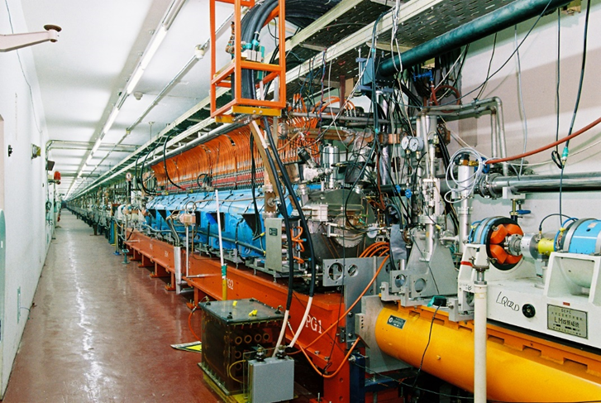
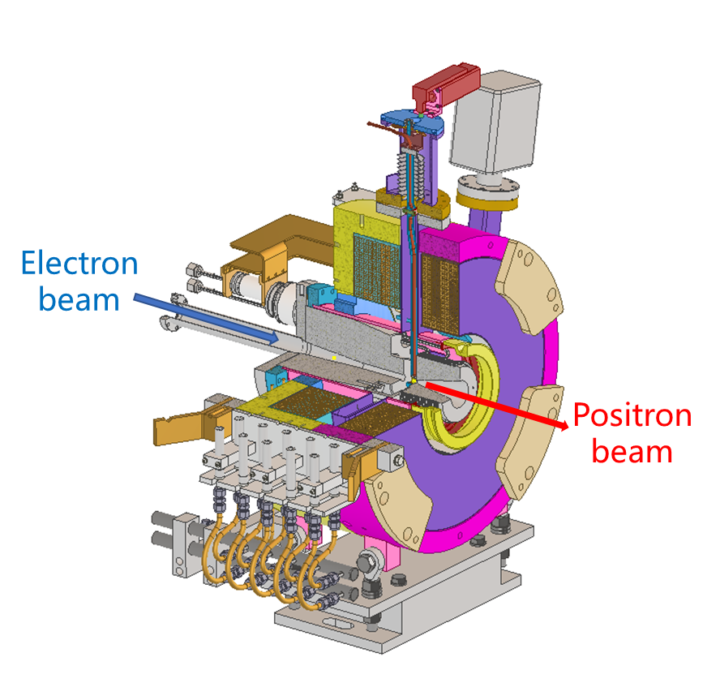
Positron Source in BEPCII/FCC-ee/CEPC
Positron Source in BEPCII/FCC-ee/CEPC
  All these facilities adopt conventional positron source schemes with mature technology
Parameters | BEPCII | FCC-ee | CEPC
Electron energy（GeV） | 0.240 | 2.86 | 4
Electron bunch charge（nC） | 6 | 3.8 | 10
Repetition rate（Hz） | 50Hz | 100 Hz | 100 Hz
Electron beam size（mm） | 2.5 | 1.0 | 0.5
Conversion Target | Tungsten | Tungsten | Tungsten
Target thickness（mm） | 8 | 15 | 15
Power deposition（kW） | 0.013 | 1.0 | 0.78
Capture system | AMD | AMD | AMD
Peak pulse magnetic field | 4.5T→0.5T | 12T(HTS) | 6.0T→0.5T
Capture aperture（mm） | 18 | 60 | 25
Accelerating gradient | 12MV/m | 13.3MV/m | 22MV/m
RF frequency（MHz） | 2856 | 2000 | 2860
Positron Yield | ~0.014 | ~1.05 | ~0.55
BEPCII positron source
FCC-ee positron source
CEPC positron source

Slide 6
Content
Positron Source in BEPCII/FCC-ee/CEPC
Generation of polarized positron beams
  Polarized positron production from circularly polarized gamma photons
  Polarized positron production from polarized electrons
France-China Cooperation in R&D for PPS
  Progress from IJCLab
  Progress from IHEP
Summary

Slide 7
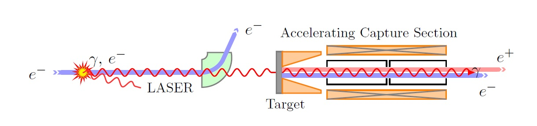
Generation of polarized positron beams
Polarized positron production from circularly polarized gamma photons
  One effective method for generating polarized positrons is to directly use high-energy gamma photons to incident on the conversion target (low Z and thin target)
  Positrons are generated through the pair production process
  When the incident high-energy gamma photon beam has circular polarization, it can generate longitudinally polarized positrons
ILC baseline design
150GeV electron beam
147m helical undulator
Polarization:~30%
Undulator based polarized positron source
Alternative scheme for ILC and CLIC
Bunch charge VS polarization
Compton ring and laser stacking cavity
Positron accumulator ring
Inverse Compton scattering based polarized positron source
“Polarized positron sources for the future linear colliders” Iryna Chaikovska

Slide 8
Generation of polarized positron beams
Polarized positron production from polarized electrons
  Another way to obtain polarized positrons is to use a highly polarized electron beam directly incident on the conversion target
  Only selecting the high energy tail of the produced positrons
  This part of positrons can preserve the initial primary beam polarization
  Low positron yield means low bunch charge
“Polarized positron source design study at JLab”
Sami Habet
Electron beam：120MeV
Electron beam polarization：90%
Positron beam polarization：~60%
Yield：0.01% e⁺/e⁻
Polarized positron source is a big challenge for future colliders
CeBAF facility at JLab

Slide 9
Content
Positron Source in BEPCII/FCC-ee/CEPC
Generation of polarized positron beams
  Polarized positron production from circularly polarized gamma photons
  Polarized positron production from polarized electrons
France-China Cooperation in R&D for PPS
  Progress from IJCLab
  Progress from IHEP
Summary

Slide 10
France-China Cooperation in R&D for PPS
A FCPPN Project for 2025
Actually, the cooperation between France and China focusing on positron sources can be traced back to 15 years ago, joint training of graduate students on advanced positron generation technologies.
Project Title
  Polarized Positrons for Next Generation Circular Colliders (POLAR-P)
Team member
  IJCLab: Iryna Chaikovska (Leader), Viktor. Mytrochenko, Yuting Wang, Fahad Alharthi
  IHEP: Xiaoping Li (Leader), Zhe Duan, Cai Meng, Dou Wang, Huan Wang, Yuxin Liu
Research goal
  Focuses on designing advanced polarized positron injectors to meet the technical requirements for next-generation lepton colliders, including FCC and CEPC.
  Test of suitable simulation tools with spin-tracking capabilities
More to come
  Personnel exchange & joint training of graduate students

Slide 11
France-China Cooperation in R&D for PPS
Progress from IJCLab
Polarized Positrons for Next Generation Circular Colliders
PROJECT ACRONYM: POLAR-P
Y. Wang, I. Chaikovska, F. Alharthi, R. Chehab, V. Mytrochenko,
Laboratoire de Physique des 2 Infinis Irène Joliot-Curie (IJCLab)
CNRS, Université Paris-Saclay

Slide 12
France-China Cooperation in R&D for PPS
FCC-ee Energy Calibration and Beam Polarization
Progress from IJCLab
Future Circular Collider Feasibility Study Report Volume 2, DOI:10.17181/CERN.EBAY.7W4X
Paolo Craievich, FCC week 2025
Jorg Wenninger, FCC week 2025
Kurt Aulenbacher, FCC week 2025
https://indico.cern.ch/event/1398060/
Motivation and challenge
FCC-ee aims to explore physics beyond the Standard Model through ultra-precise measurements of electroweak observables (Z, W bosons).
Achieving this precision requires high-accuracy beam energy calibration, done via resonant depolarization using non-colliding polarized pilot bunches.
Electron polarization is efficient and well-developed, with polarization levels up to ~85% achievable.
Positron polarization, however, is a major challenge:
  At injection level, more than 20% polarized beams to enable resonant depolarization measurements at Z-pole.
  Generation methods should be further investigated.
  For resonant depolarization, the beam polarization (initially longitudinal) must be rotated into the vertical plane before entering the damping ring.

Slide 13
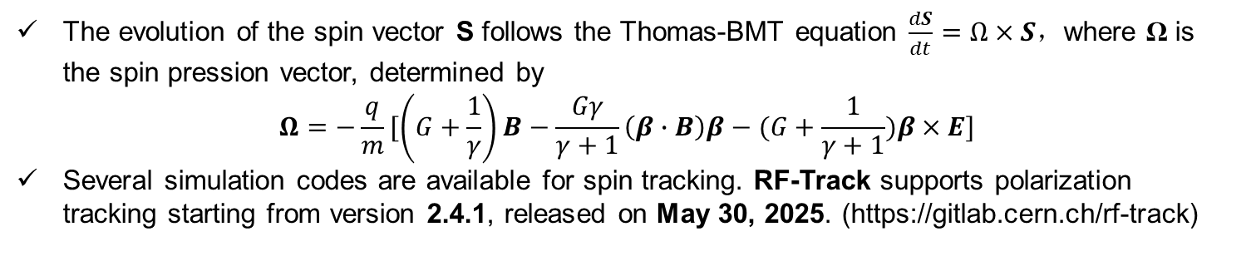
France-China Cooperation in R&D for PPS
Progress from IJCLab
Spin evolution
The evolution of the spin vector S follows the Thomas-BMT equation $\frac{dS}{dt}=Ω×S$，where Ω is the spin pression vector, determined by
$$Ω=−\frac{q}{m}[\left(G+\frac{1}{γ}\right)B−\frac{Gγ}{γ+1}\left(β∙B\right)β−(G+\frac{1}{γ+1})β×E]$$
Several simulation codes are available for spin tracking. RF-Track supports polarization tracking starting from version 2.4.1, released on May 30, 2025. (https://gitlab.cern.ch/rf-track)
Simulation code | Strengths | Limitations
Bmad | - Precise Thomas–BMT spin tracking - Works with 3D field maps - Supports both LINAC and rings | - Limited GUI Modeling complex LINACs with real 3D RF + solenoid fields requires more manual setup
Elegant | - Lightweight and fast - SDDS-based spin tracking - Widely used in accelerators | - Limited spin modeling - Not suitable for field-map-based tracking
GPT | - Supports 3D field maps - Spin tracking plugin available - Good visualization | - Commercial license - Slower for large beams
RF-Track | Modern Python interface - Accurate spin dynamics outstanding flexibility and rapid simulation speed | - Still evolving

Slide 14
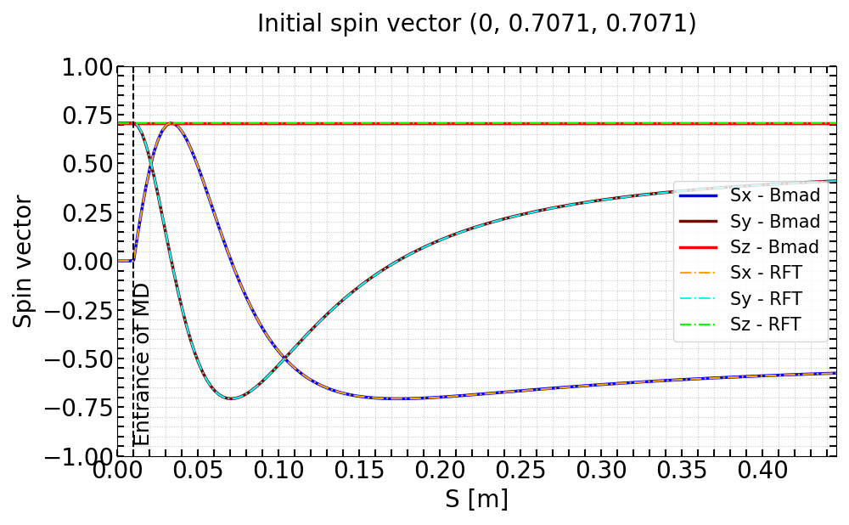
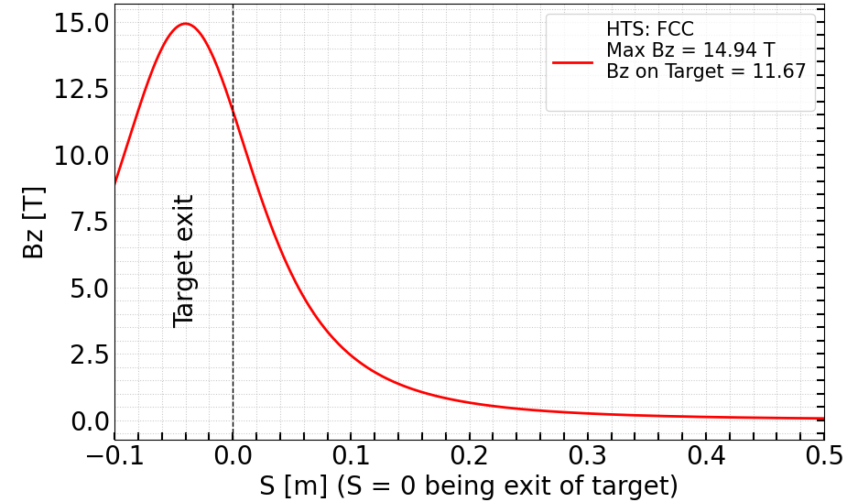
France-China Cooperation in R&D for PPS
Progress from IJCLab
Spin evolution
Taking a 45 MeV electron with an initial spin vector of (0, 0.7071, 0.7071) as an example, its trajectory through the HTS solenoid, based on the measured field map, is simulated.
A benchmark comparison between RF-Track and Bmad shows excellent agreement. The transverse spin components undergo a flip, while the longitudinal component remains conserved throughout the HTS solenoid.

Slide 15
France-China Cooperation in R&D for PPS
Progress from IJCLab
Summary
Several different tools can be used for spin tracking. The simulation framework based on RF-Track is now ready, and full spin tracking simulations are starting.
Benchmarking with different codes, such as Bmad, is essential. Single-particle spin tracking demonstrates excellent agreement between Bmad and RF-Track.

Slide 16
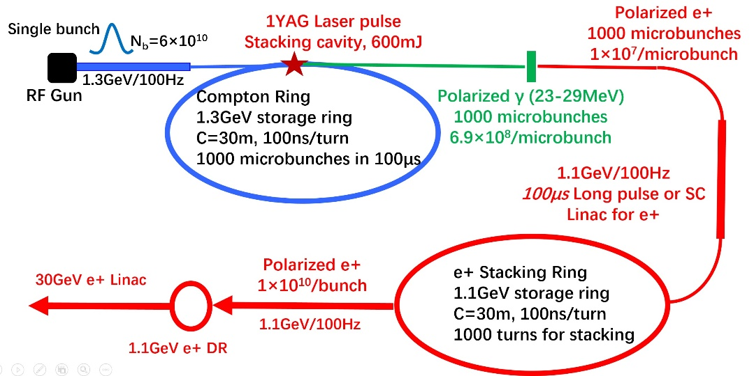
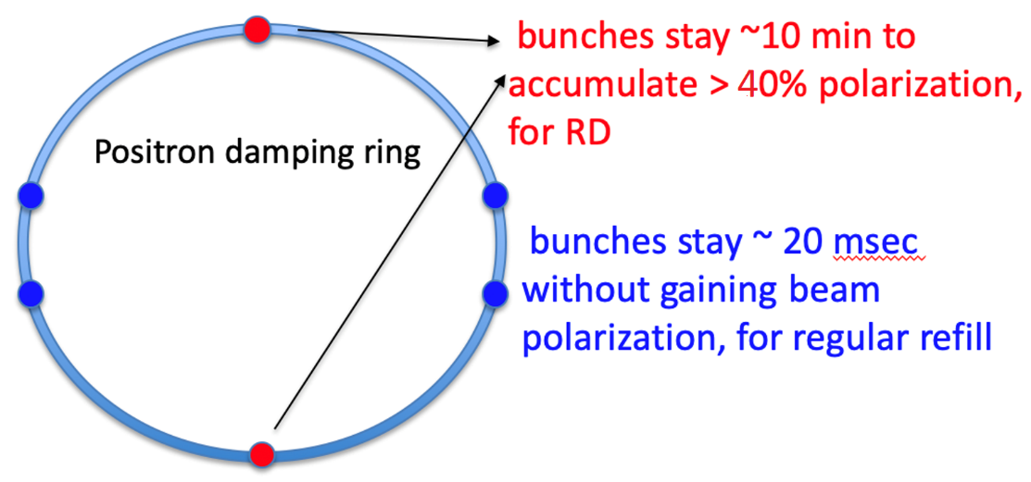
France-China Cooperation in R&D for PPS
Progress from IHEP
1. Polarized positrons generation for CEPC
  Preliminary design study based on a Compton Ring and a Stacking Ring for the generation of polarized positrons
    It can be a potential solution to generate polarized positrons in CEPC
    Up to now, just a conceptual consideration (requires a lot of further simulation works in future)
  Using the self-polarization to generate polarized e+ beams in DR (Zhe DUAN)
    Need a higher energy in DR around 2GeV and a strong dipole strength
    Current research shows that extracted beam polarization @ 10min ~ 44%
Notes:
.

Slide 17
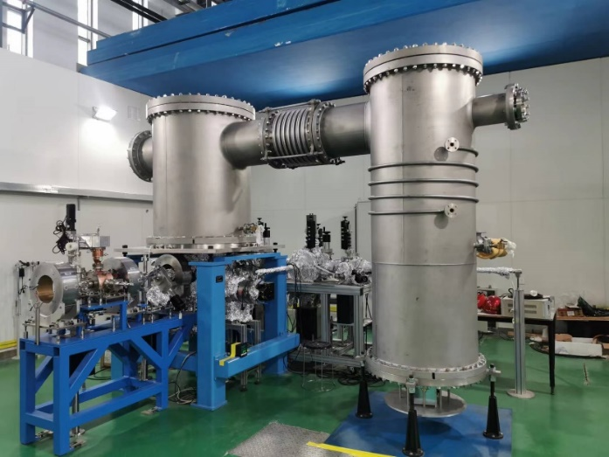
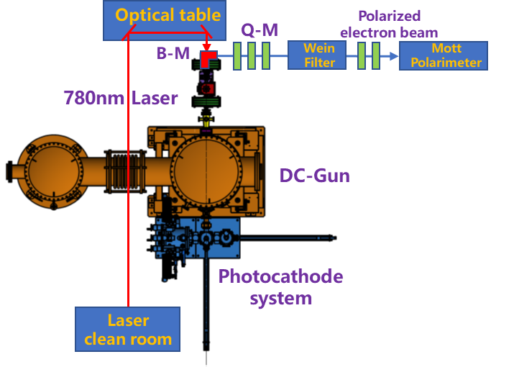
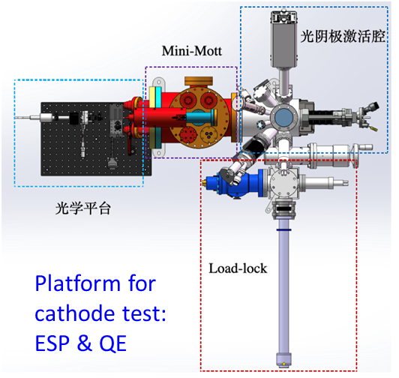
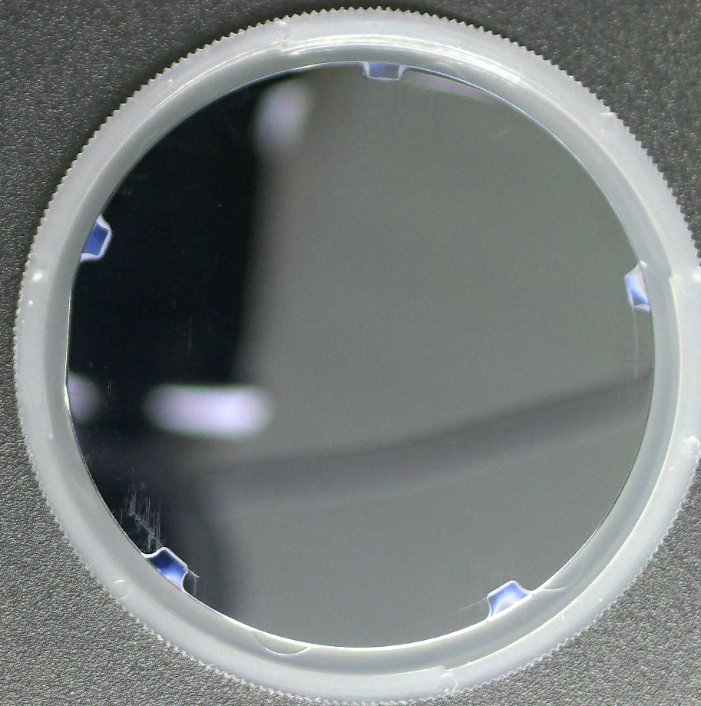
France-China Cooperation in R&D for PPS
Progress from IHEP
2. High bunch charge and high polarization electron source R&D
  Based on a photocathode dc electron gun developed at IHEP
    Extremely high vacuum in the gun (10⁻¹⁰Pa) to ensure the use of superlattice GaAs photocathode
    Can work stably at 400kV DC high voltage, which helps to obtain high bunch charge
  Domestic R&D on superlattice GaAs photocathode (Goal: polarization ≥ 85%, QE ≥ 0.8% )
    Design a platform for superlattice GaAs photocathode performance test, now is under processing
    Recently, growth of the first superlattice wafer has been completed in a MBE system
Polarized electron source R&D based on a dc electron gun
Superlattice GaAs photocathode R&D

Slide 18
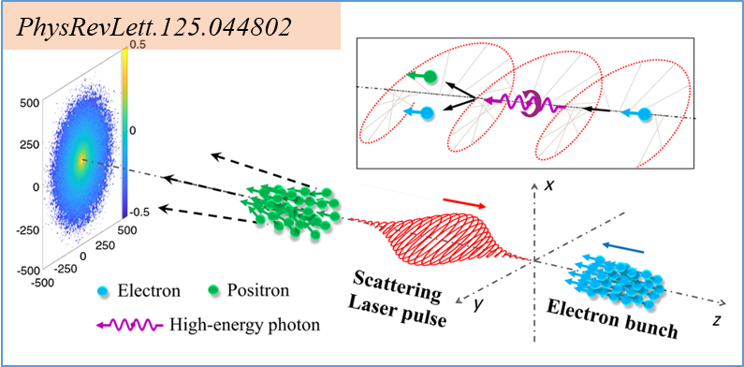
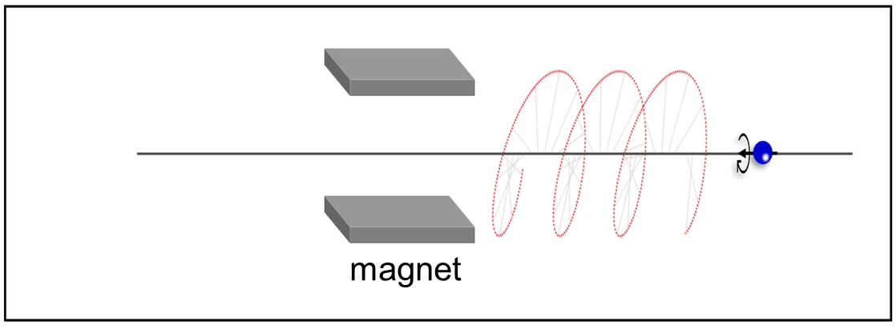
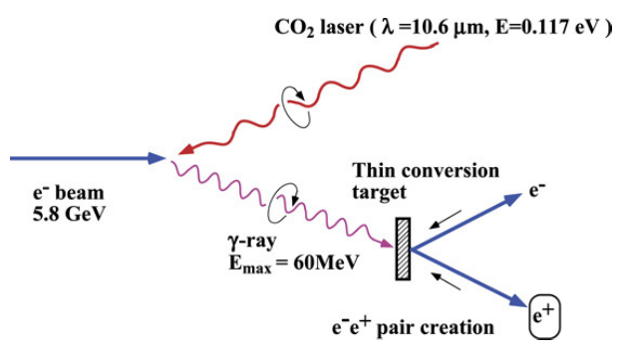
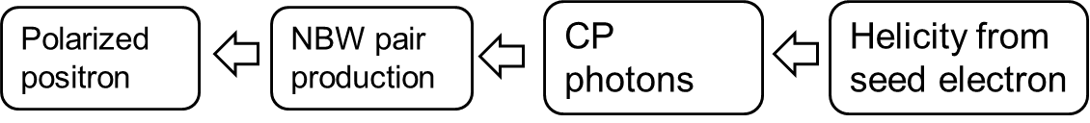
France-China Cooperation in R&D for PPS
Progress from Xi’an Jiaotong University （Prof. Yanfei LI）
3. A novel consideration of generating polarized positrons
  Traditional method: A circularly polarized gamma-ray beam, incident on a high-Z target, generates a polarized positron beam under the influence of the Coulomb field.
  Our method: Laser field replaces the high-Z target, effectively avoiding the influence of Coulomb scattering.
Scenarios of generation of a LSP positron beam: an ultra-intense laser pulse head-on colliding with a counter-propagating LSP electron beam.
Longitudinal polarization (helicity) is transferred from electron to photon during NCS (nonlinear Compton scattering)
Polarization is transferred from high-energy photon to positron through NBW (nonlinear Breit-Wheeler) process
Polarized positron beams suffer from Coulomb scattering, resulting in large angular spread and low yield.
Notes:
.

Slide 19
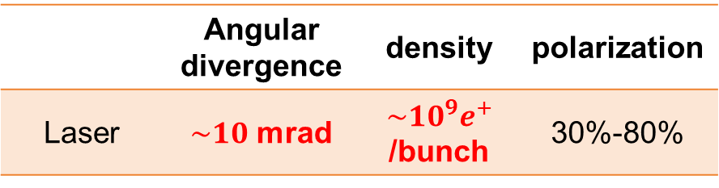
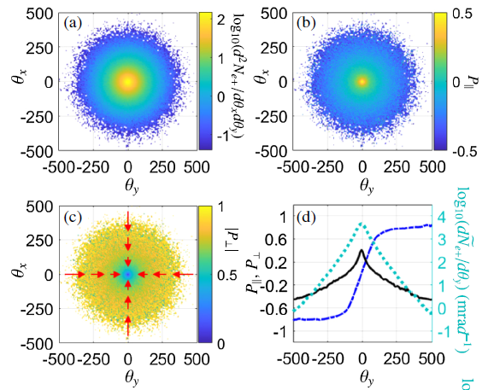
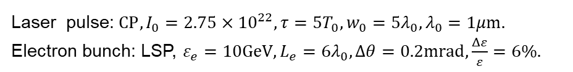
France-China Cooperation in R&D for PPS
Progress from Xi’an Jiaotong University （Prof. Yanfei LI）
A novel consideration of generating polarized positrons
  In a feasible scheme adopting a seed electron beam with polarization degree 80%, density 10⁸/bunch and kinetic energy 10 GeV, a high-quality positron beam can be generated with a polarization degree of 40%, an angle range of 5mrad, a density of 10⁶/bunch and an average energy of 1.4 GeV.
  Given a possible ultrahigh-charge (tens∼100 nC) of electron beams, a positron beam density of 10⁹–10¹⁰/bunch is foreseeable.
  Will continue to do research as an alternative polarized positron generation scheme for CEPC
Simulation parameters
Laser pulse: $CP, I_{0}=2.75×{10}^{22}, τ=5T_{0}, w_{0}=5λ_{0}, λ_{0}=1μm.$
Electron bunch: LSP, $ε_{e}=10GeV, L_{e}=6λ_{0}, Δθ=0.2mrad,\frac{Δε}{ε}=6\%.$
A new potential approach to obtain polarized positrons with high beam quality!
Notes:
.

Slide 20
Content
Positron Source in BEPCII/FCC-ee/CEPC
Generation of polarized positron beams
  Polarized positron production from circularly polarized gamma photons
  Polarized positron production from polarized electrons
France-China Cooperation in R&D for PPS
  Progress from IJCLab
  Progress from IHEP
Summary

Slide 21
Summary
Introduction of Positron source in an electron positron collider.
The method of generating polarized positrons and its challenge for future colliders
A FCPPN Project already started in 2025, the main research goal is Polarized Positrons for Next Generation Circular Colliders (POLAR-P)
Introduced progress from both sides, including Simulation tools upgrade, preliminary study on the generation of polarized positrons and electrons for CEPC, a novel consideration on generating polarized positrons, etc

Slide 22

Thank you for your attention!

