Slide 1


Circular Electron Positron Collider
Polarization Studies for CEPC
Zhe Duan (IHEP) and Aurélien Martens (IJCLab)
On behalf of CEPC Polarization Working Group
July 22th 2025, 16th FCPPN/L Workshop, Qingdao, email: duanz@ihep.ac.cn

Slide 2
Outline
Overview of beam polarization studies for CEPC
Laser-Compton polarimeter @ BEPCII (collaboration with IJCLab team)
Concepts of longitudinal polarization at BEPCII
Summary

Slide 3
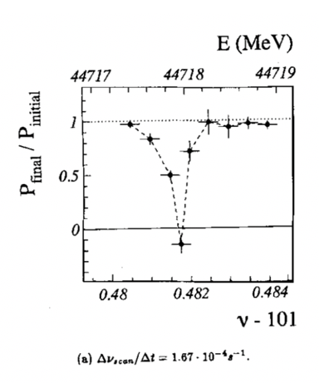
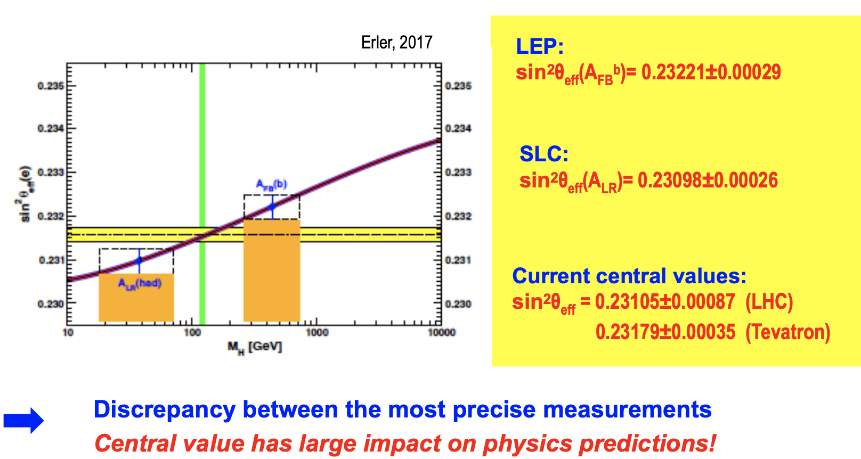
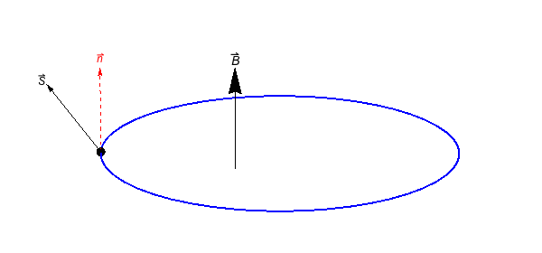
Physics motivation of polarized beams
Precision beam energy calibration @ Z, W (~100keV) in CEPC/FCC-ee
  resonant depolarization with vertically polarized beams
Precision measurement of weak mixing angle @ Z
  Longitudinally polarized colliding beams for measuring A_{LR}
  could resolve the tension between A_{FB} & A_{LR}, by measuring both in the same experiement
CPV with polarized beams in e+e- → HZ. H → ττ etc
ECFA meeting on e+e- to ZH angular measurements
Polarized beam applications @ ILC,
arXiv:2105.09691, 2111.06687, 2202.07385
IP/detector
depolarizer
polarimeter
L. Arnaudon, et al., Z. Phys. C 66, 45-62 (1995).
G. Moortgat-Pick’s talk on CEPC Workshop EU @ Marseille, 2024 April

Slide 4
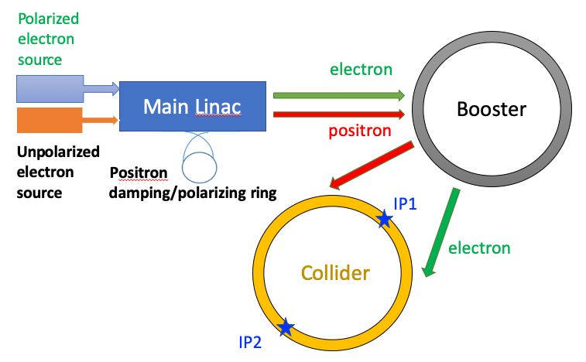
Injecting polarized beams
Polarized source
  Polarized electron gun w/ superlattice GaAs cathode (>85% polarization)
  Positron damping/polarizing ring(>20% polarization, sufficient for RD)
Linac & Transport lines
  non-interleaved H & V bendings
  negligible polarization loss
Booster
  free from intrinsic spin resonances
  polarization can be well maintained for Z & W
T. Chen, Z. Duan, D. H. Ji, D. Wang, Phys. Rev. Accel. Beams, 26, 051003 (2023).
Similar scheme is one key topic in the FCC-ee pre-TDR phase
Z. Duan, Polarized lepton injector for CEPC, FCC Week 2024
J. Wenninger, Injecting polarized beams , FCC Week 2025

Slide 5
Injecting polarized beams
Polarized source
  Polarized electron gun w/ superlattice GaAs cathode (>85% polarization)
  Positron damping/polarizing ring(>20% polarization, sufficient for RD)
Linac & Transport lines
  non-interleaved H & V bendings
  negligible polarization loss
Booster
  free from intrinsic spin resonances
  polarization can be well maintained for Z & W
T. Chen, Z. Duan, D. H. Ji, D. Wang, Phys. Rev. Accel. Beams, 26, 051003 (2023).
Collider
  solenoid spin rotators @ 45.6 GeV
  ~70% longitudinal polarization for e-
W. Xia et al., Investigation of spin rotators in CEPC at the Z-pole,
Radiat. Det. Tech. Meth. 6:490 (2022).

Slide 6
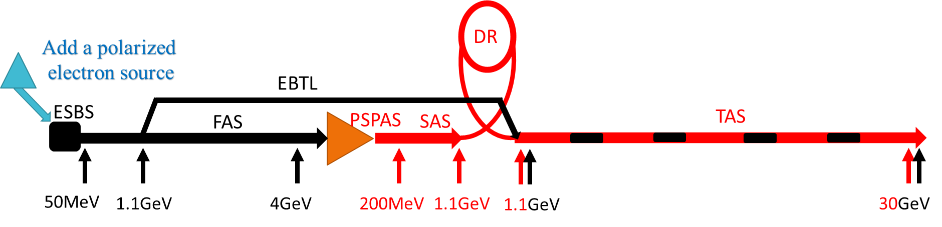
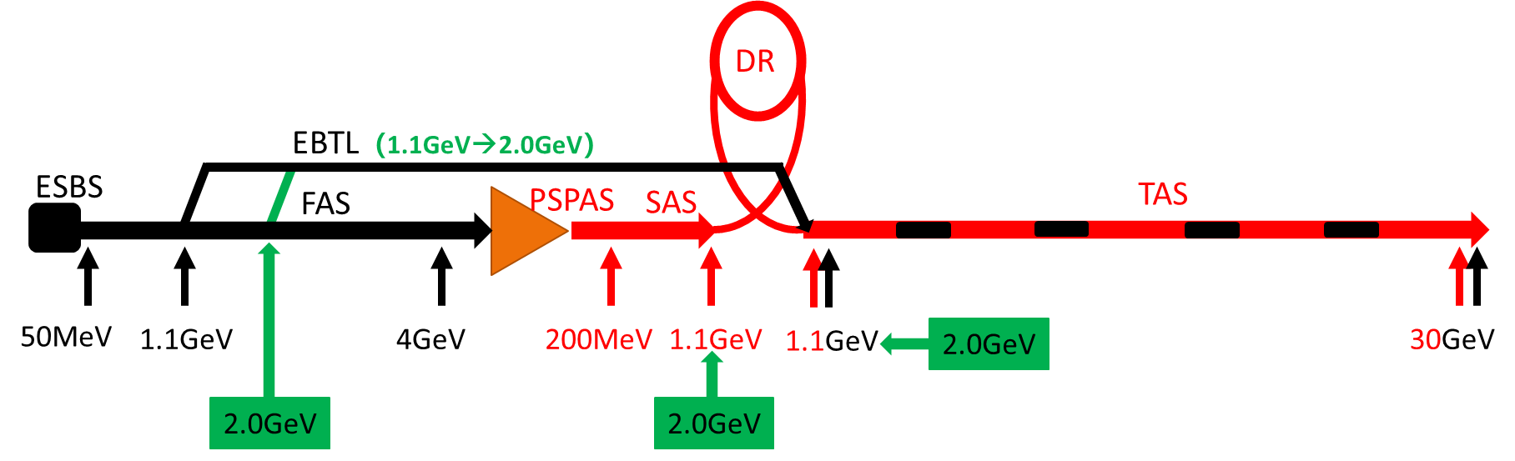
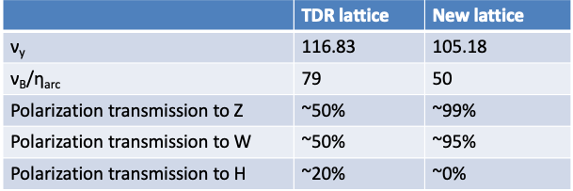
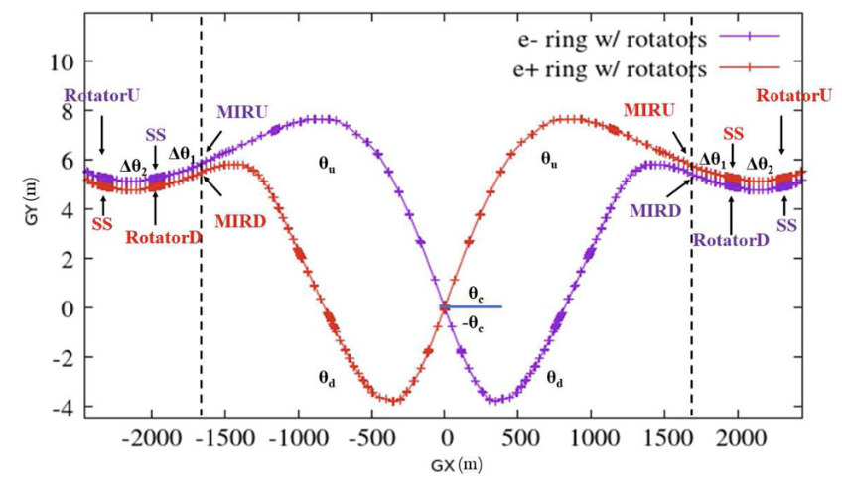
Recent design updates
Polarized beams incorporated into the linac
Improved polarization transmission in the booster
  avoid spin resonance crossing
  no change in layout or hardware specs
Spin rotators inserted into the TDR collider lattice
  total length of 4 rotators ~ 1.6 km (previously 2.8 km)
  ring circumference kept at 99.913km
  minor reduction in length & angle of dipoles
e- linac
e+ linac
Booster lattice with improved polarization transmission
Spin rotators near one interaction region

Slide 7
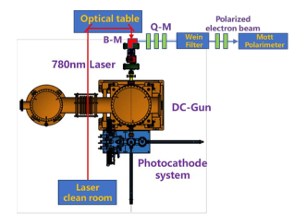
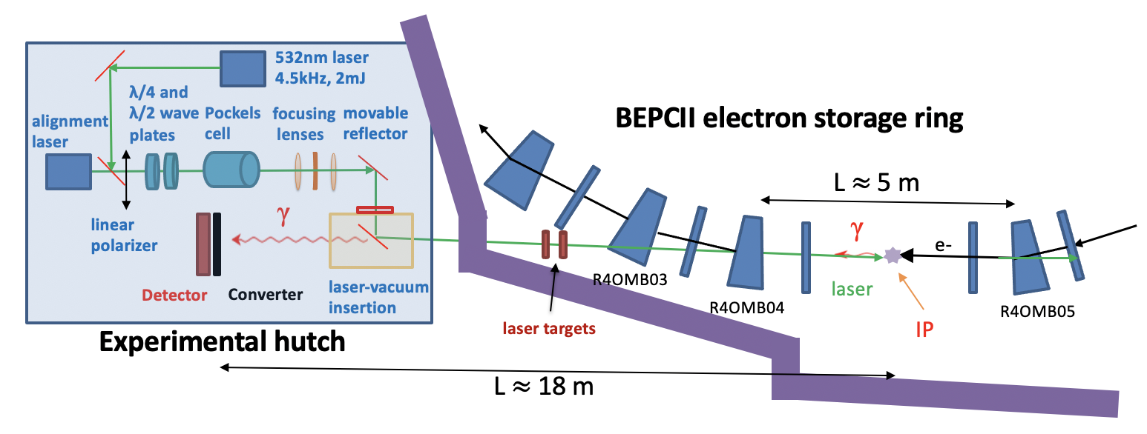
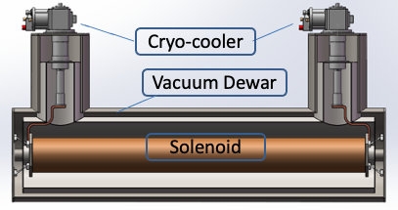
Beam polarization R&D in the CEPC EDR phase
Key aspects | Figure of merit | R&D goal
Design study | > 50% polarization | improve pol e- design, study pol e+ scheme
Polarized e- source | polarization > 85% | polarized DC gun @ PAPS, polarization > 85%
Compton polarimeter | 3D measurements ~ 0.1% | vertical polarization @ BEPCII, ~1%
Resonant depolarization | ~10⁻⁶ for Z & W | demonstration @ BEPCII
Solenoid spin rotator | Solenid field ~ 1000 T.m per IP (@ Z-pole) | HTS SC solenoid, B ~ 12 T, BL > 10 T.m beam test @ a future test facility
Hardware R&D and beam tests
Enable
Experimental studies
Verify
Physics design
Polarized electron source
Compton polarimeter
Solenoid spin rotator

Slide 8
Outline
Overview of beam polarization studies for CEPC
Laser-Compton polarimeter @ BEPCII (collaboration with IJCLab team)
Concepts of longitudinal polarization at BEPCII
Summary

Slide 9
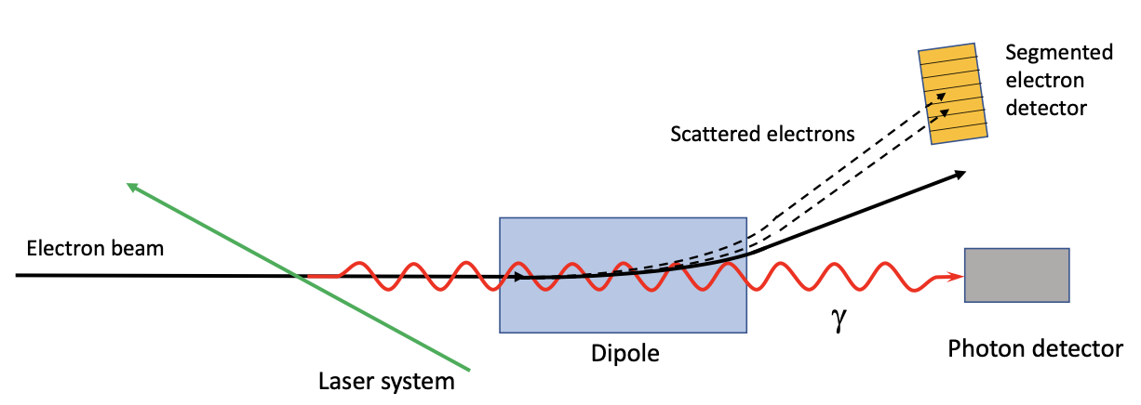
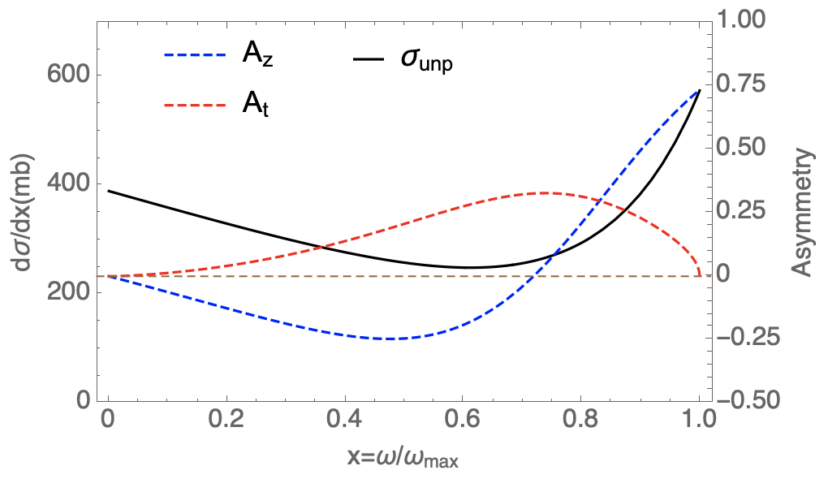

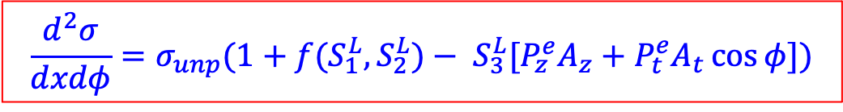
Compton polarimeter: principle
Muchnoi, FCC-ee polarimeter, arXiv:1803.09595
linear
polarization
circular polarization (helicity adjustable)
E_{b}=45.6 GeV, λ_{laser}=515 nm
$$\frac{d^{2}σ}{dxdφ}=σ_{unp}(1+f(S_{1}^{L},S_{2}^{L})− S_{3}^{L}[P_{z}^{e}A_{z}+P_{t}^{e}A_{t}\cos{φ}])$$
Left-right (Counting rate) asymmetry
Up-down (Spatial distribution) asymmetry
${{(S}_{1}^{L})}^{2}+{{(S}_{2}^{L})}^{2}$+ ${{(S}_{3}^{L})}^{2}≤$1
scattered γ energy/Compton edge

Slide 10
Compton polarimeter: requirements and status
Requirements of 3D Compton polarimeter for CEPC/FCC-ee
  vertical polarimeter for pilot bunches (RD): ~1%/~10s
  longitudinal polarimeter for colliding bunches: ~0.1%
  Coverage of Z, W and Higgs energies
  7 * 24 robust operation
Type | Scattered γ | Scattered e-
Transverse | Calorimeter or pixelized detector | Pixelized detector
Longitudinal | Calorimeter
Accelerator implementation | 😀 | ~100m drift for spectrometer
Background | SR & bremstrahlung | 😀
Intrinsic issues | Limited resolution for calorimeter Sys. error due to converter for PD | only measure 2 components
Polarimeter | Direction | Type | Energy (GeV) | Systematic Uncertainty
CERN LEP | Vertical | γ | 46 | 5%
HERA LPOL | Longitudinal | γ | 27 | 1.6%
HERA TPOL | Vertical | γ | 27 | 2.9%
SLD @ SLAC | Longitudinal | e | 45.6 | 0.5%
JLAB Hall A | Longitudinal | γ, e | 1-6 | 1-3%
JLAB Hall C | Longitudinal | γ, e | 1.1 | 0.6%
the above list of polarimeters is not exhaustible

Slide 11


FCPPN/L grant since 2024: Future Collider Compton Polarimeter
Team member
  IJCLab: A. Martens (Leader), F. Zomer, D. Nutarelli, F. Mawas, J. Tamazirt etc
  IHEP: Z. Duan (Leader), Zhijun Liang, Guangyi Tang, Dechong Zhu, Mengyu Su etc
Research goal
  demonstrate a Compton polarimeter at BEPCII
  design & analysis of Compton polarimeters for FCC-ee/CEPC
Personnel exchanges
  April 2024: visit of Zhe Duan to IJCLab
  December 2024: visit of Aurelien Martens to IHEP
Bi-weekly Zoom meeting, joint training of graduate students

Slide 12
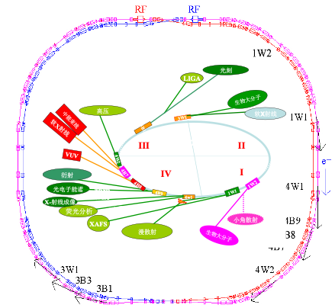
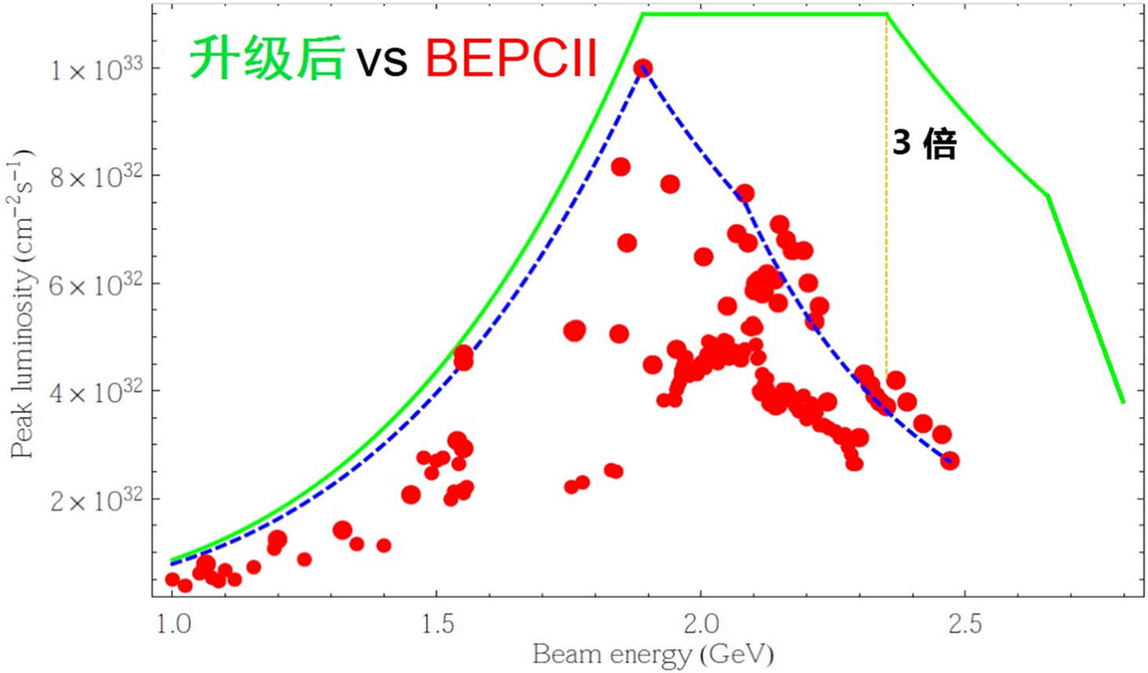
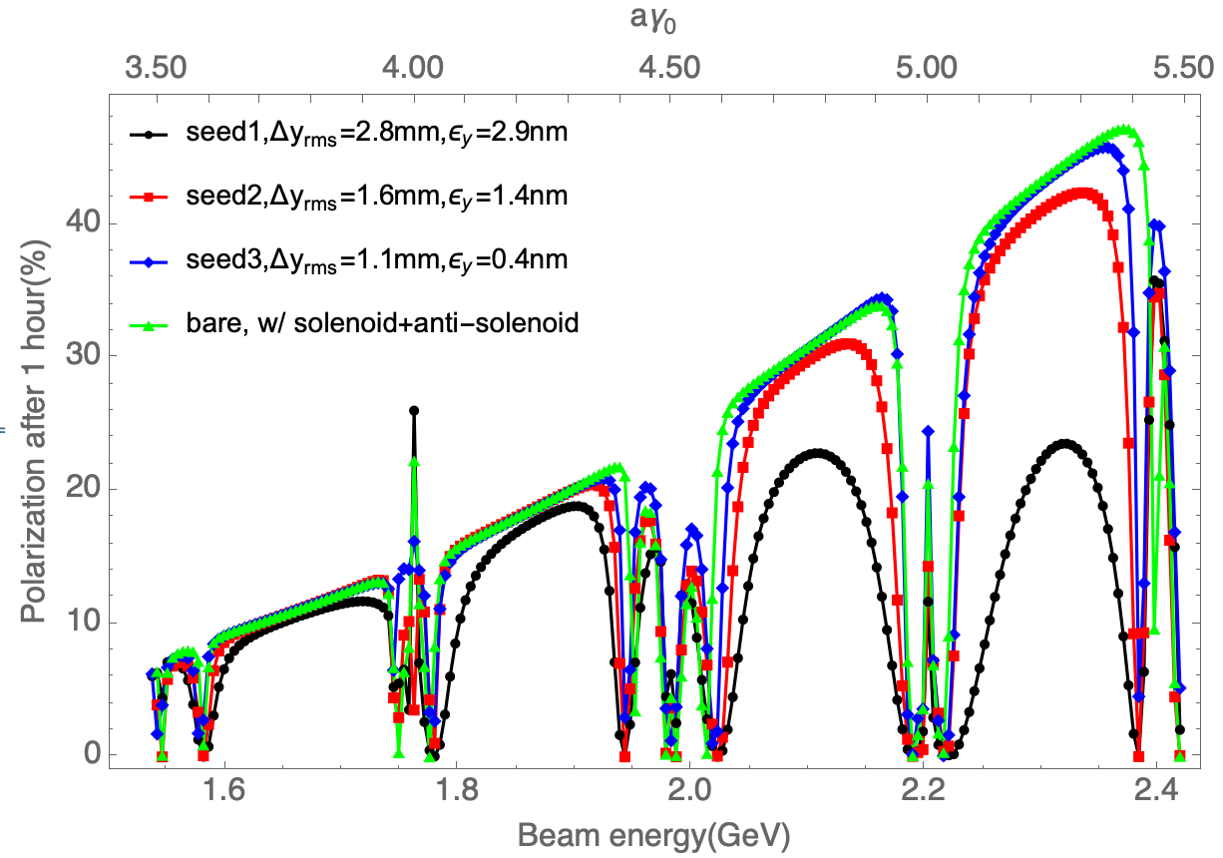
BEPCII-U and beam polarization
BEPCII-U (2025-2030), upgrade to higher luminosity (x3 @ 2.35 GeV) & higher energy (up to 2.8 GeV)
Home-developed SCQ, SRF; CGEM detector (italy)
e- beam is spontaneously vertical polarized due to spin flip in synchrotron radiation
Simulations show a sizable polarization in routine operation condition
Vertical polarization 1 hour after injection
SR commissioning
Colliding beams at 1.84 GeV
Start tunnel installation
2024.7
2025.1
2025.5
Linac resumes operation

Slide 13
Prospects of a Compton polarimeter @ BEPCII
Experimental studies to address
How to precisely measure beam polarization?
How to precisely calibrate beam energy?
How to mitigate depolarization effects in storage ring?
Aspects | R&D item
Compton polarimeter | laser polarization measurement/control, silicon pixel detector
Resonant depolarization | Operation scenarios, error analysis, colliding bunches & pilot bunches
Depolarization mechanism | Rich data of parameter dependence, beam-beam depolarization
Polarization tuning/optimization | spin matching, machine learning techniques

Slide 14
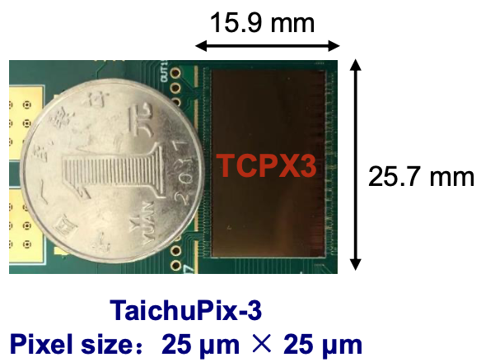
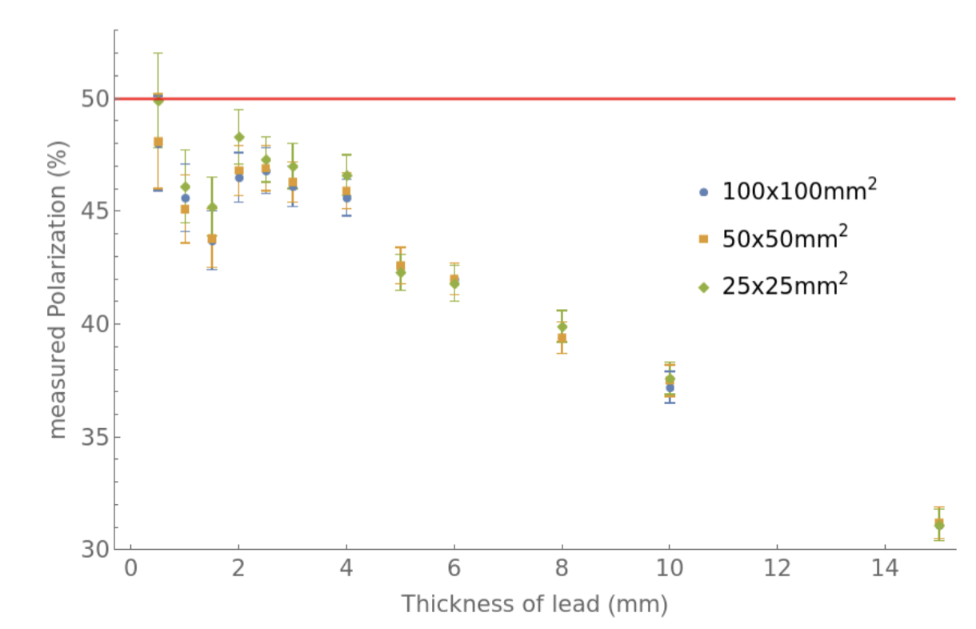
Compton polarimeter @ BEPCII
CEPC vertex detector prototype
Location | beamline and experimental hall of 4W2 wiggler
Laser | 532nm, 4.5 kHz, 2 mJ, 1 ns, flippable circular polarization
Observable | Vertical asymmetry of backscattered γ (up to 180 MeV)
Detector | lead preshower + silicon pixel detector
Signal | backscattered γ ~ 20kHz/mA/W
Background | bremsstruhlung γ ~ 1kHz/mA
Assume 50% vertical polarization
MC simulation
Measured polarization (%)
~1% stats uncertainty in ~ 20 sec
Thickness of lead (mm)
14
14

Slide 15
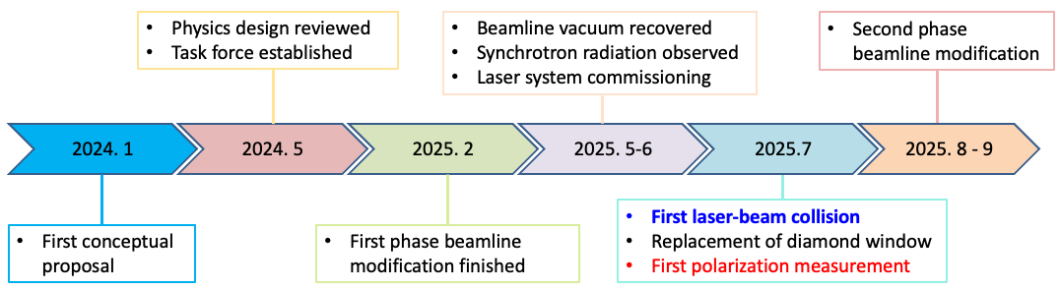
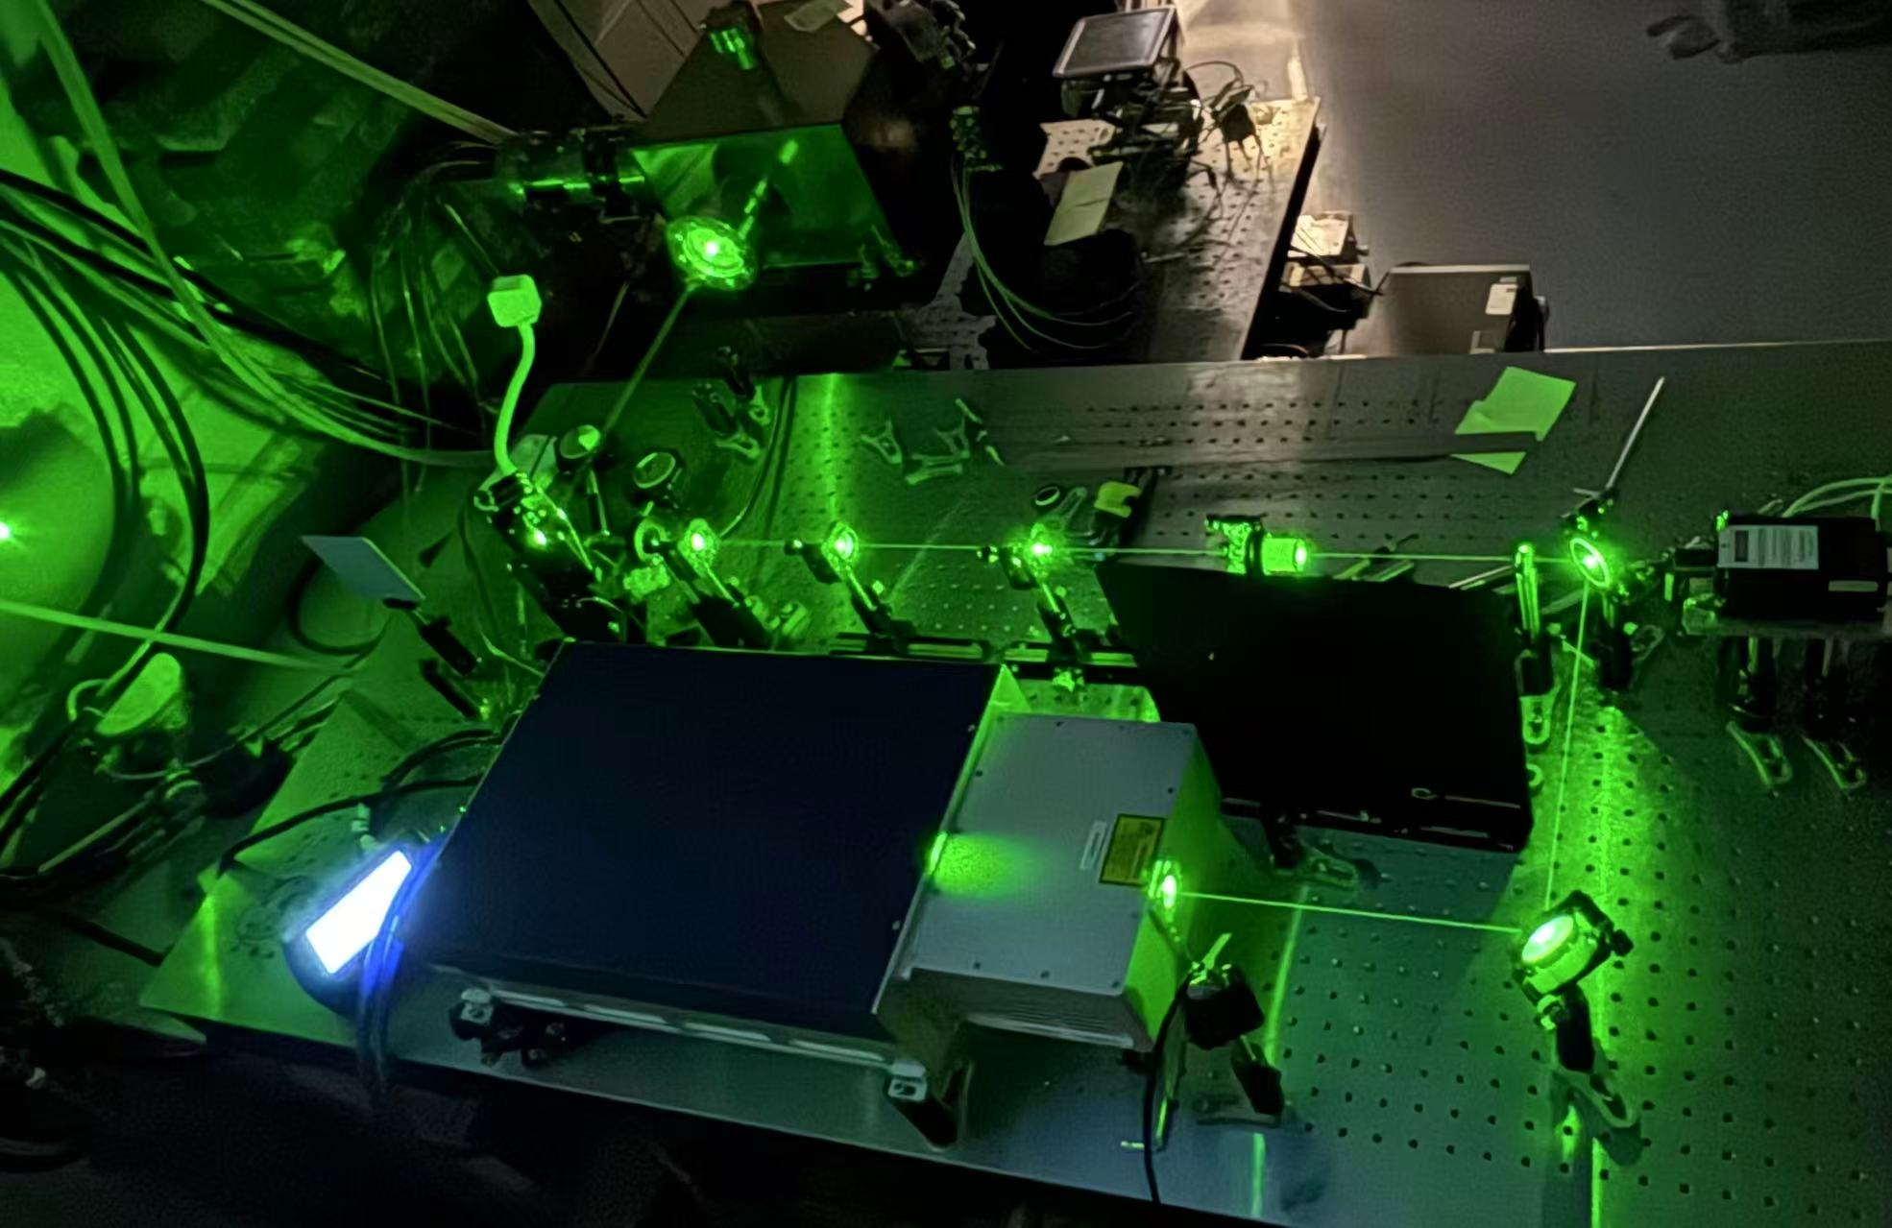
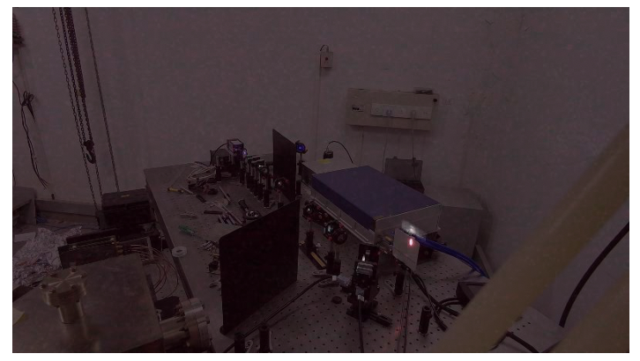
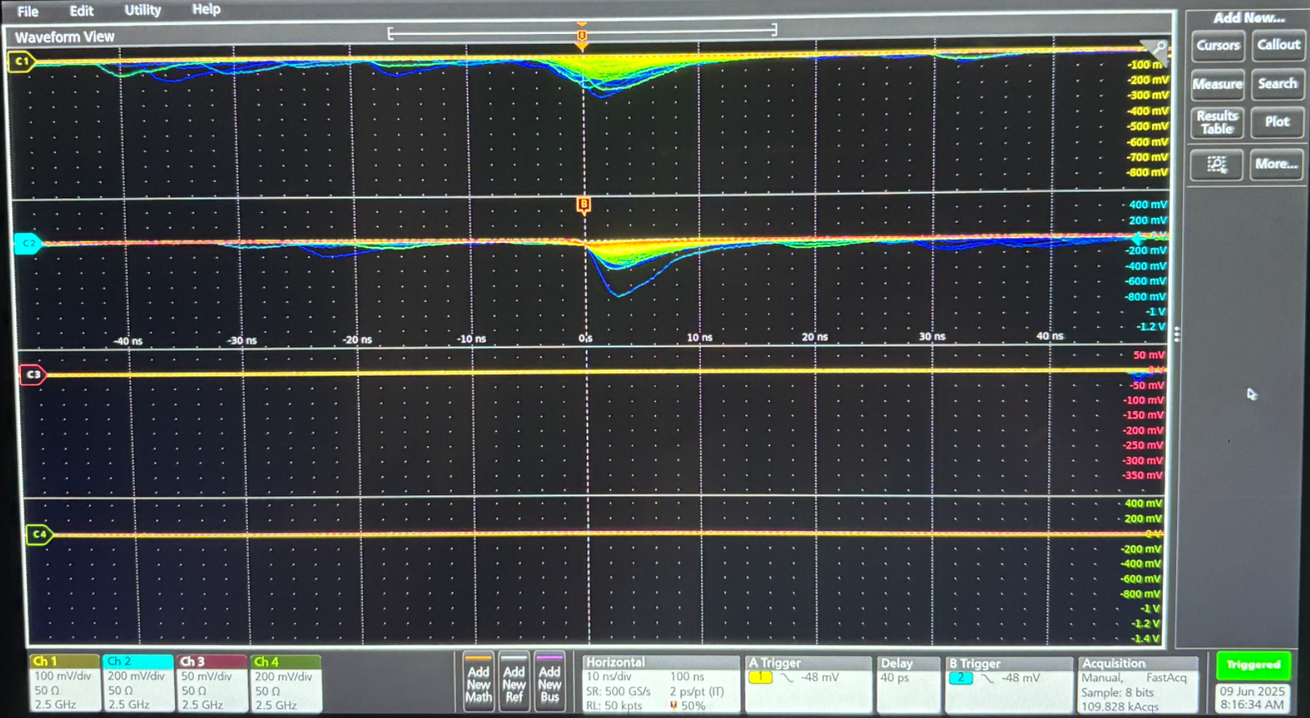
Overall progress
Visible light part of synchrotron radiation from the reflector mirror
Background measured by lead preshower + scintilator + PMT
Laser optics

Slide 16
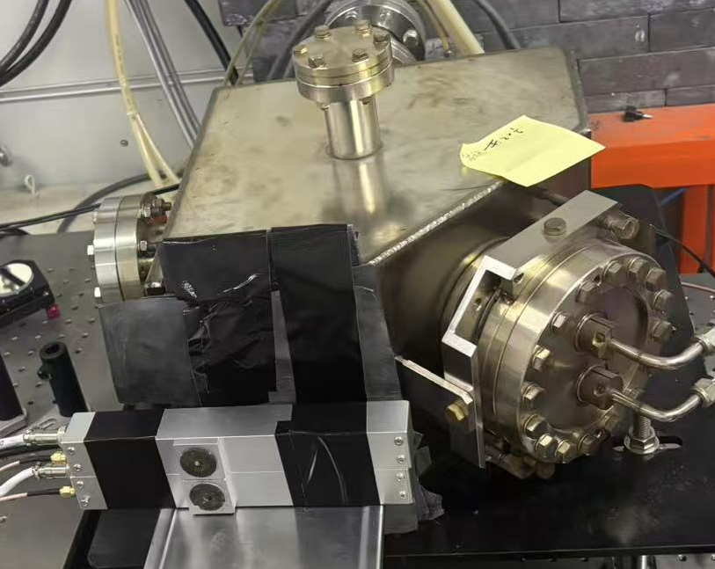
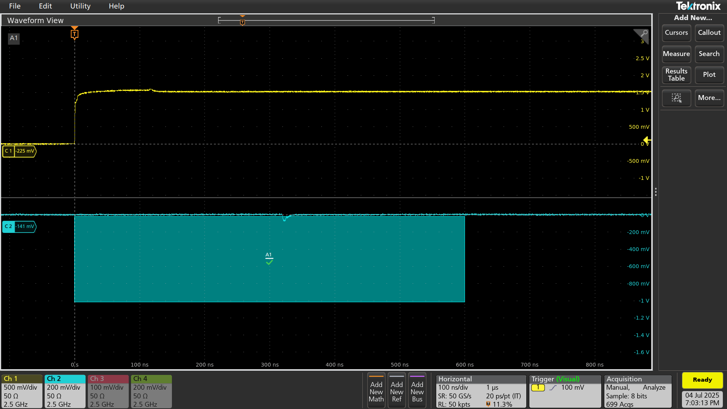
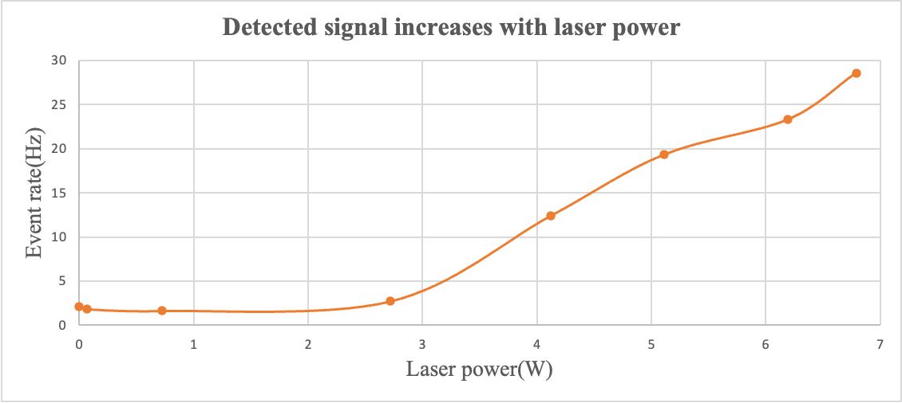
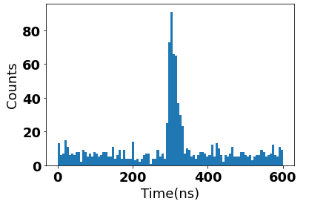
Detection of laser-electron collision signal on July 5th
~5mm lead + glass scintilator + PMT, connected to oscilloscope
Causality between laser and backscattered γ signal
Event rate increases with laser power in a narrow temporal window
laser Qout
internal trigger at 4.5kHz
a 600ns window
Temporal distribution of detected peaks of 1000 triggered waveforms

Slide 17
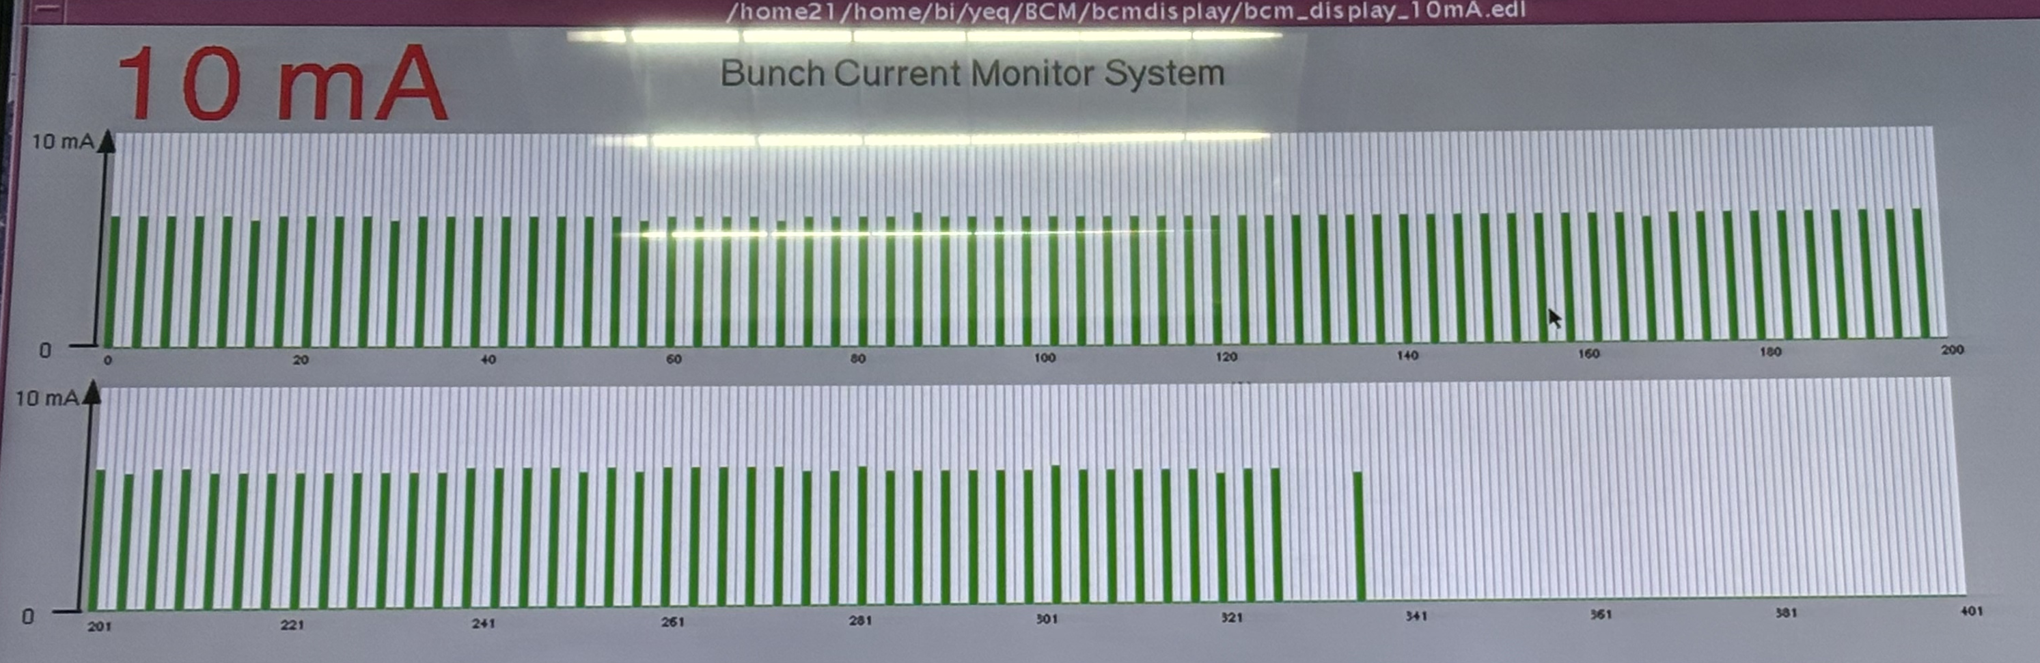
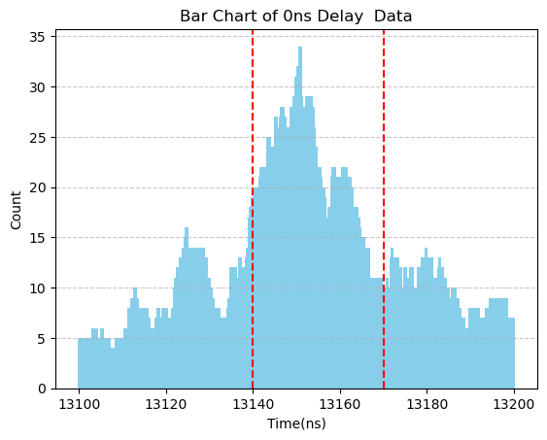
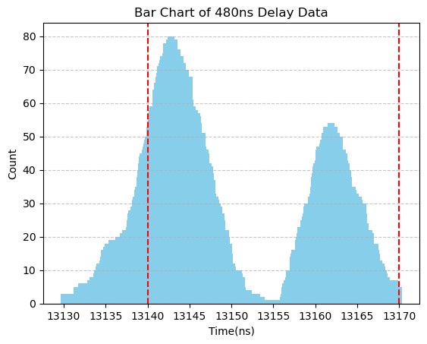
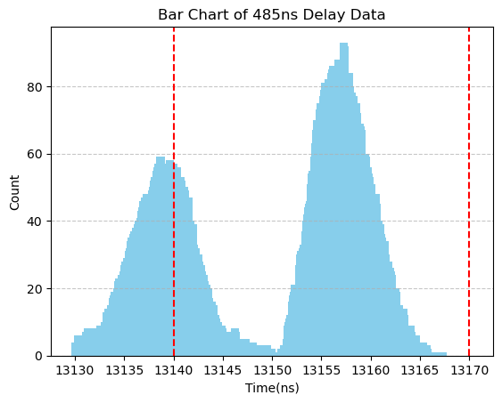
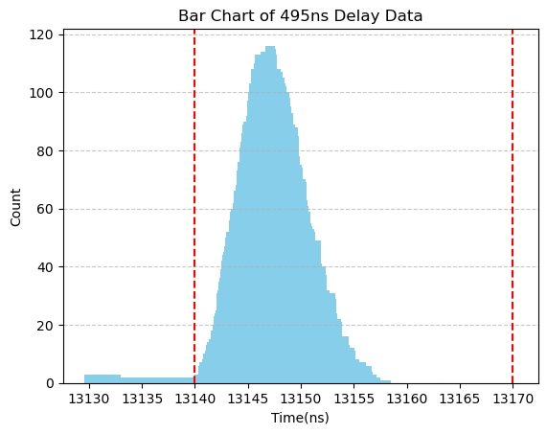
Commissioning of the timing system
Timing system sends 4.508kHz trigger to laser, in synchronization with ring RF frequency
Laser is now synchronized with one pilot bunch
BEPCII e- Ring Bunch current Monitor
6ns bunch spacing, ~108 colliding bunches
18ns gap
delay
delay + 480ns
delay + 485ns
delay + 495ns

Slide 18
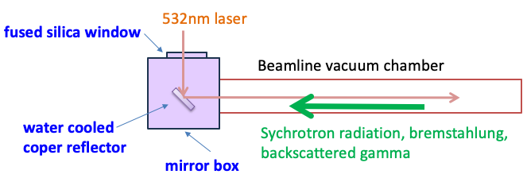
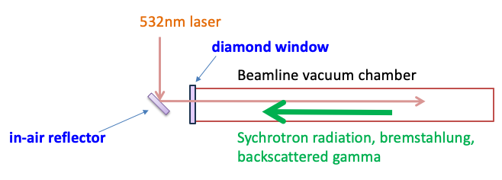
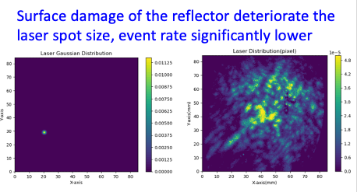

Resolving the issue of laser-vacuum insertion
Event rate significantly lower than expectation, due to the imperfect in-vacuum reflector
Mitigation: replace the mirror box with a diamond window and an in-air reflector on July 15th
borrowed from BEMS (BINP & IHEP)
Employ a single crystal diamond window with water cooling to seal the vacuum

Slide 19
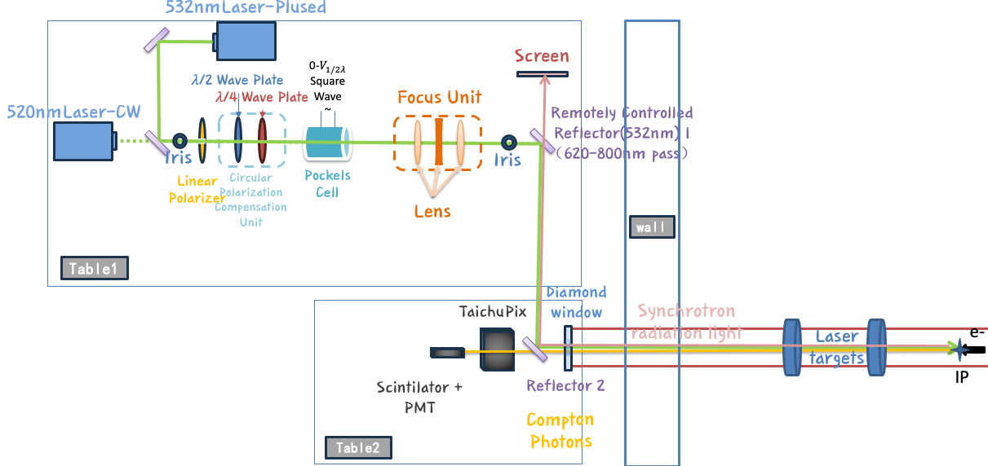
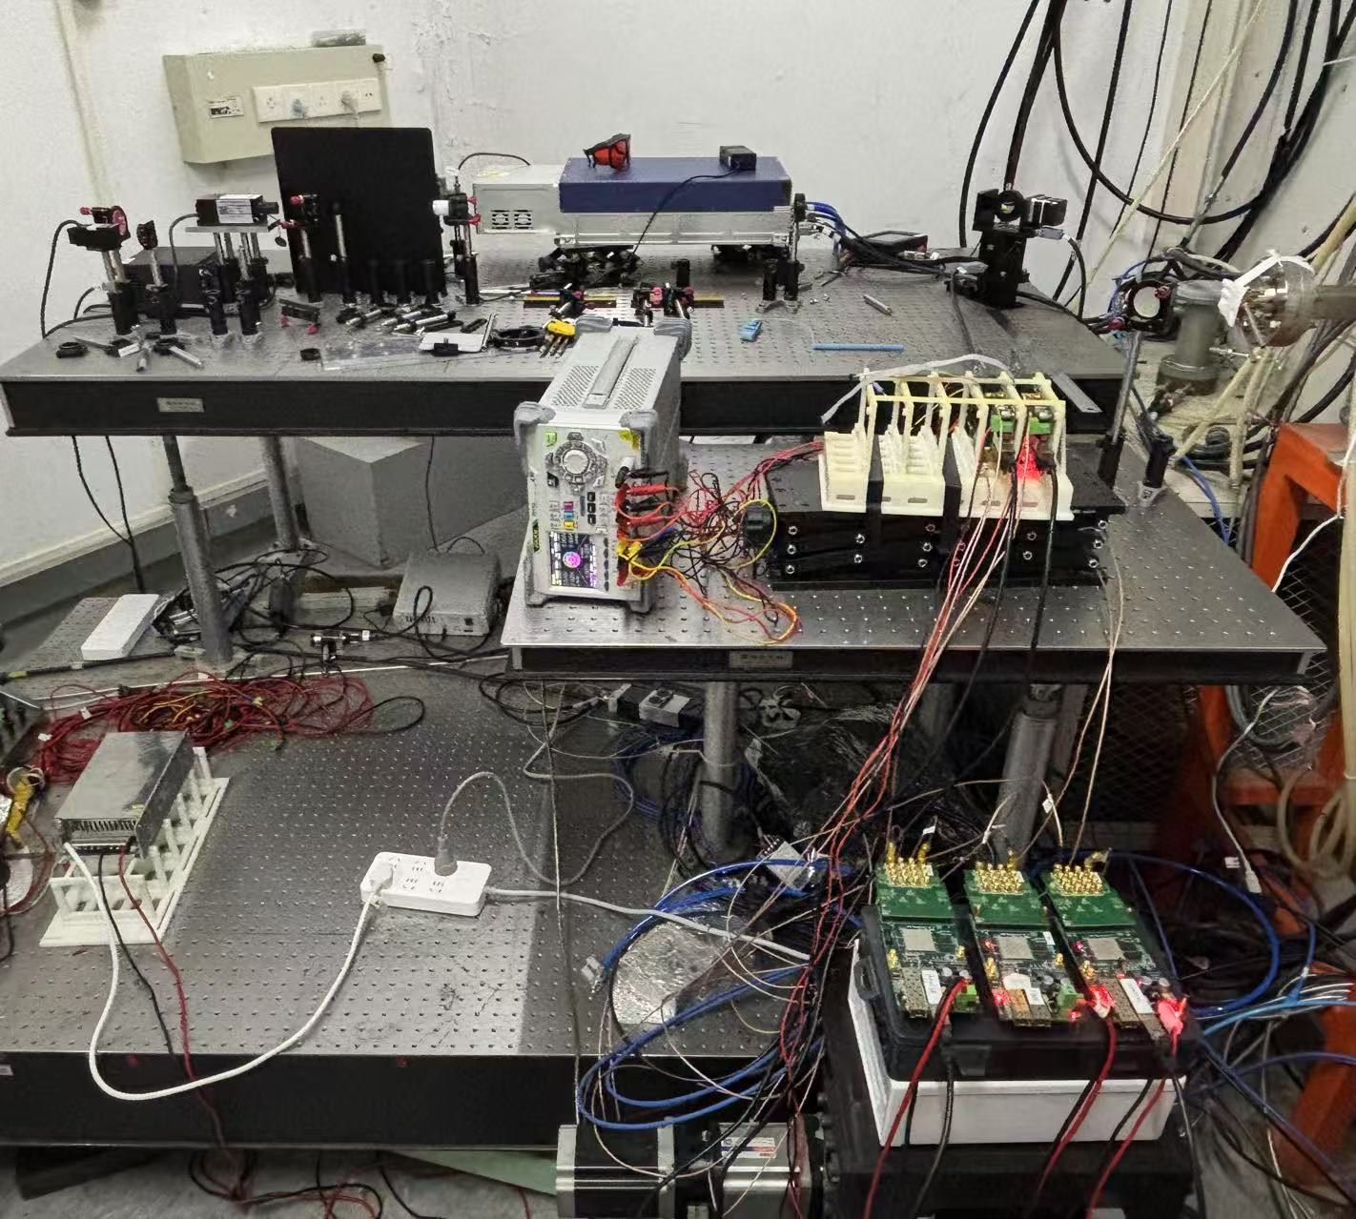
Commissioning status
Beamline vacuum has recovered this morning
Commissioning of laser-electron collision and TaichuPix-3 detector is under way
Goal: first polarization measurement before summer shutdown (July 29th)

Slide 20
Outline
Overview of beam polarization studies for CEPC
Laser-Compton polarimeter @ BEPCII (collaboration with IJCLab team)
Concepts of longitudinal polarization at BEPCII
Summary

Slide 21
Longitudinal polarization upgrade for BEPCII
e- longitudinal polarization as one potential upgrade option after 2030
  Physics motivation (preliminary)
    Entangled hyperon-antihyperon pairs for CP tests
    Spin dependent fragmentation function, nucleon form factor
    ...
  Consider 1.55 GeV (J/ψ) for polarization optimization
A test bed for implementation of e- longitudinal polarization in future colliders including CEPC

Slide 22
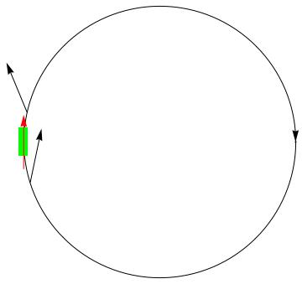
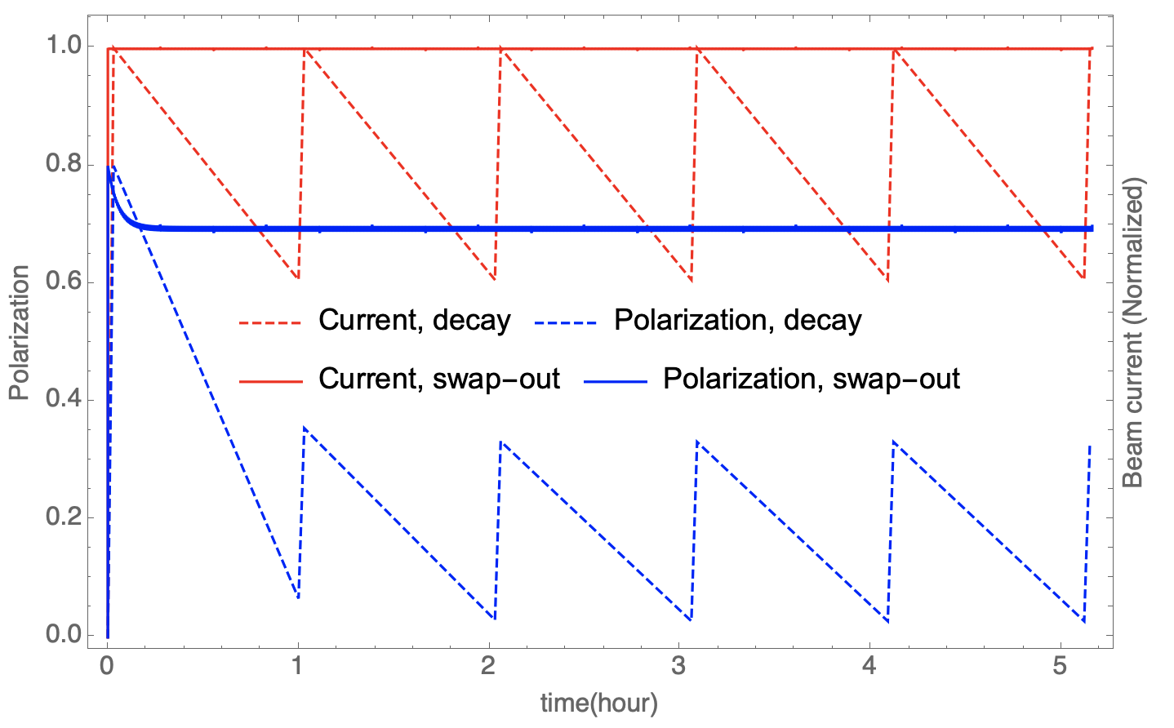
e- longitudinal polarization at 1.55 GeV
Siberian snake for attaining longitudinal polarization at IP
  Depolarization time ( ~24 min) << beam lifetime (1~2 hour)
Swap-out injection: frequently extract depolarized bunches & inject polarized bunches
  Demostrated at APS-U & HEPS, potential applications in future colliders (CEPC, EIC)
  e.g. replace 1/12 of all 120 bunches every 20 seconds
  Assume injected beam polarization ~ 80%, then time-averaged polarization ~ 70%
A single full snake

Slide 23
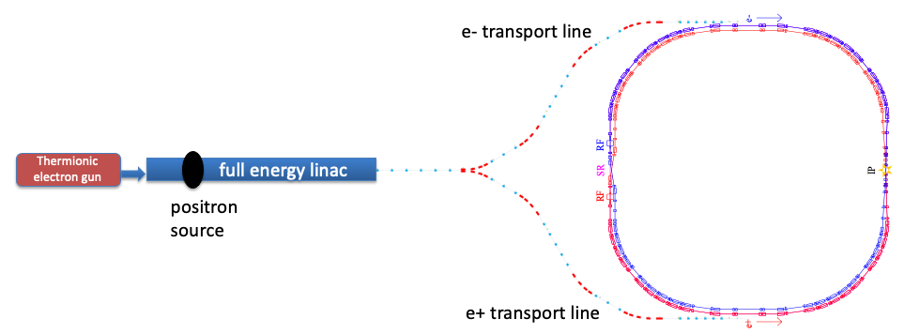
BEPCII layout

Slide 24
Modified layout for longitudinal polarization
on-axis injection
150kV polarized DC gun
wien filter
Mott polarimeter
spin rotator
Compton polarimeter
Siberian
snake
Detailed design study is under way
extraction to beam dump

Slide 25
Summary
Polarized beams are being implemented into the CEPC TDR lattices
A laser Compton polarimeter, partially supported by FCPPN/L, is under commissioning at BEPCII
Longitudinal polarization is one upgrade option for BEPCII in 5 years’ time
These activities will set the basis for polarization applications at CEPC
Thank you for your attention!

