Slide 1
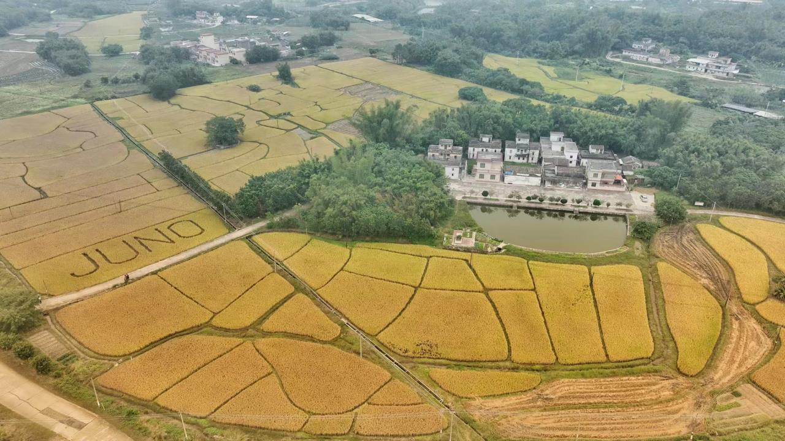
Status of JUNO
Zeyuan Yu (IHEP)
On behalf of the JUNO collaboration
July 22nd, 2025
FCPPN/L 2025 @ Qingdao

Slide 2

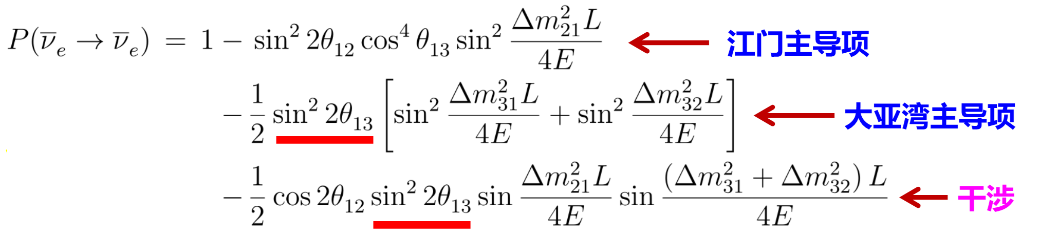
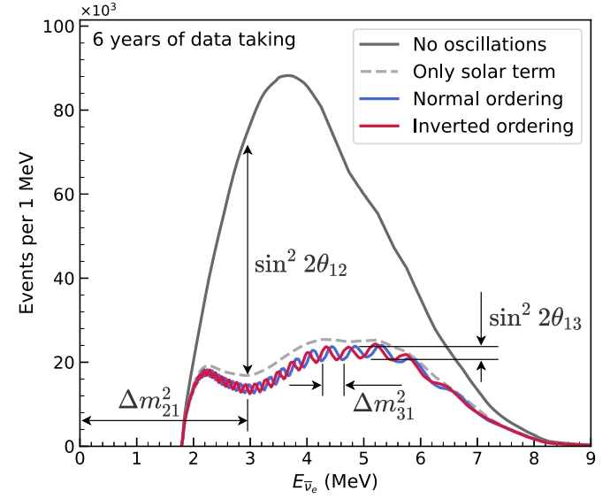
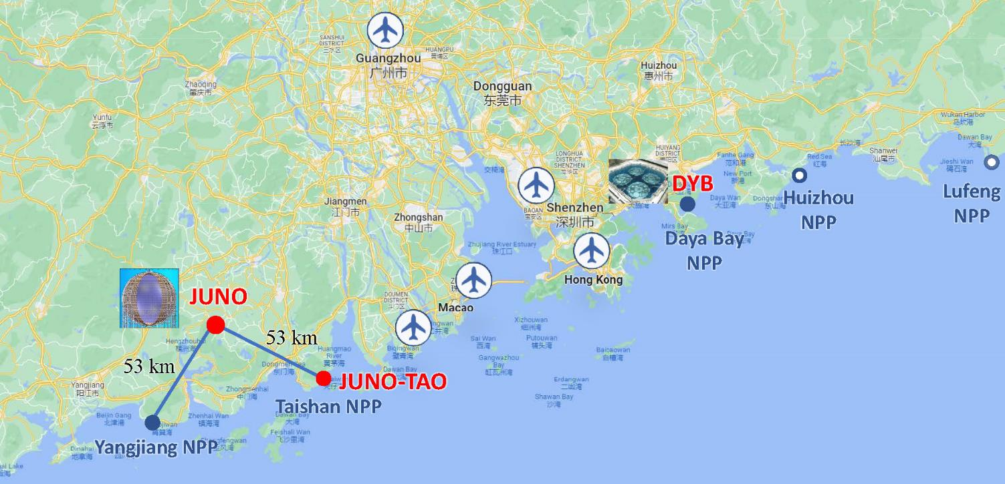
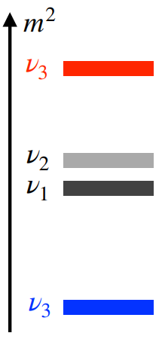

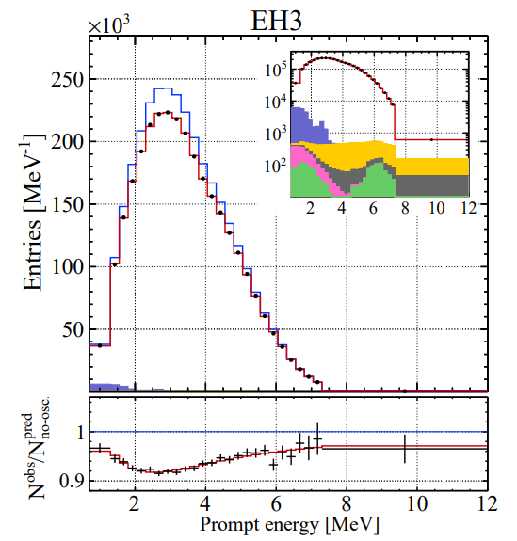
Jiangmen Underground Neutrino Observatory
Leading term at JUNO
Leading term at Daya Bay
Sensitive to mass ordering
Daya Bay Far Hall

Slide 3
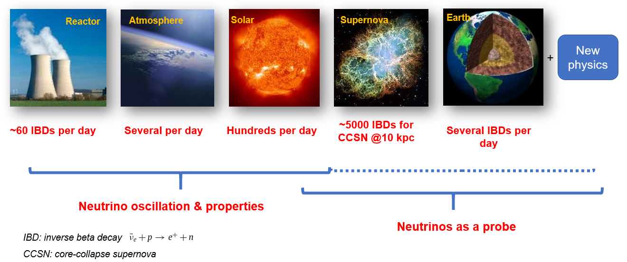
A multiple-purpose neutrino experiment
Neutrino oscillations, mass ordering (3-4 σ), precision measurement (<0.5%)
Astro-particle physics, supernovae neutrinos, geo and solar neutrinos

Slide 4
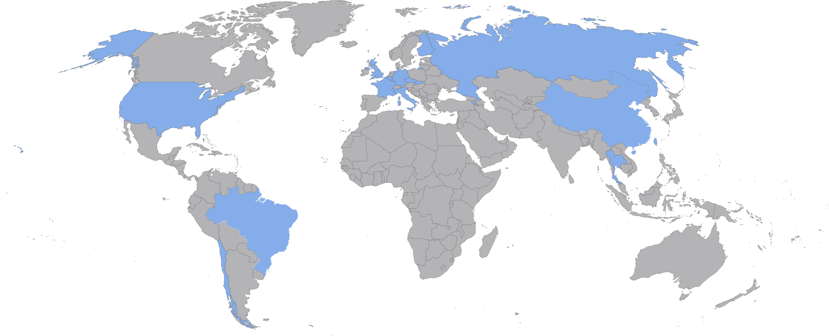
JUNO collaboration
69 institutes and ~700 collaborators
Country | Institute | Country | Institute | Country | Institute
Armenia | Yerevan Physics Institute | China | U. of South China | Italy | INFN Catania
Belgium | Universite Libre de Bruxelles | China | Wu Yi U. | Italy | INFN di Frascati
Brazil | PUC | China | Wuhan U. | Italy | INFN-Ferrara
Brazil | UEL | China | Xi'an JT U. | Italy | INFN-Milano
Chile | SAPHIR | China | Xiamen University | Italy | INFN-Milano Bicocca
Chile | UNAB | China | Zhengzhou U. | Italy | INFN-Padova
China | BISEE | China | NUDT | Italy | INFN-Perugia
China | CAGS | China | CUG-Beijing | Italy | INFN-Roma 3
China | ChongQing University | China | ECUT-Nanchang City | Pakistan | PINSTECH (PAEC)
China | DGUT | China | CDUT-Chengdu | Russia | INR Moscow
China | Guangxi U. | Czech | Charles U. | Russia | JINR
China | Harbin Institute of Technology | Finland | University of Jyvaskyla | Russia | MSU
China | IHEP | France | IJCLab Orsay | Slovakia | FMPICU
China | Jinan U. | France | LP2i Bordeaux | Taiwan-China | National Chiao-Tung U.
China | Nanjing U. | France | CPPM Marseille | Taiwan-China | National Taiwan U.
China | Nankai U. | France | IPHC Strasbourg | Taiwan-China | National United U.
China | NCEPU | France | Subatech Nantes | Thailand | NARIT
China | Shandong U. | Germany | RWTH Aachen U. | Thailand | PPRLCU
China | Shanghai JT U. | Germany | TUM | Thailand | SUT
China | IGG-Beijing | Germany | U. Hamburg | U.K. | U. Liverpool
China | SYSU | Germany | GSI | U.K. | U. Warwick
China | Tsinghua U. | Germany | U. Mainz | USA | UMD-G
China | UCAS | Germany | U. Tuebingen | USA | UC Irvine

Slide 5
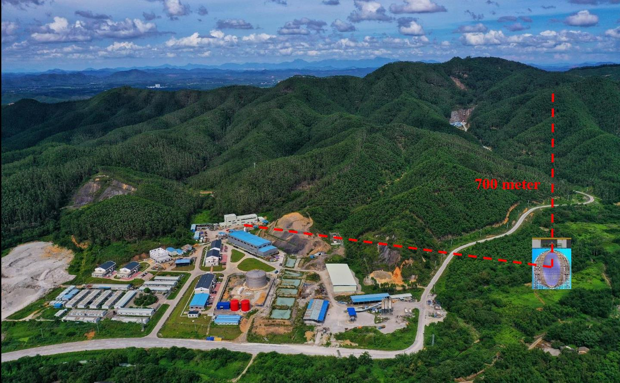
JUNO site
Surface Assembly Building
LAB storage (5k ton)
Water purification
Computing
Power station
Cable train
Office/Dorm
Vertical and slope tunnels
Vertical tunnel: 563 m
1265 m w/ slope of 42%
Muon flux 0.004 Hz/m²
5

Slide 6
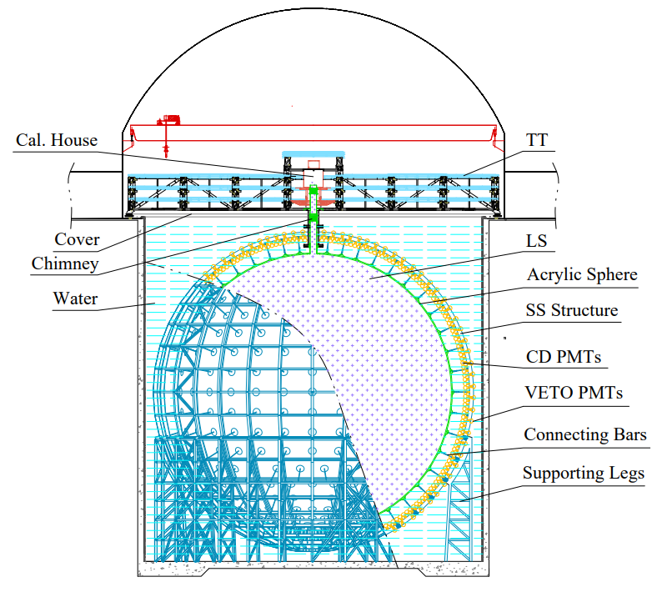
JUNO detector
Stainless Steel structure
  Finished in June 2022
Acrylic sphere with 35.4m diameter
  Done in Oct. 2024
20,012 20’’ PMTs + 25,600 3’’ PMTs
  Installation finished in Dec. 2024
  PMTs + electronics working well
20kt Liquid scintillator
  75% has been filled
6

Slide 7
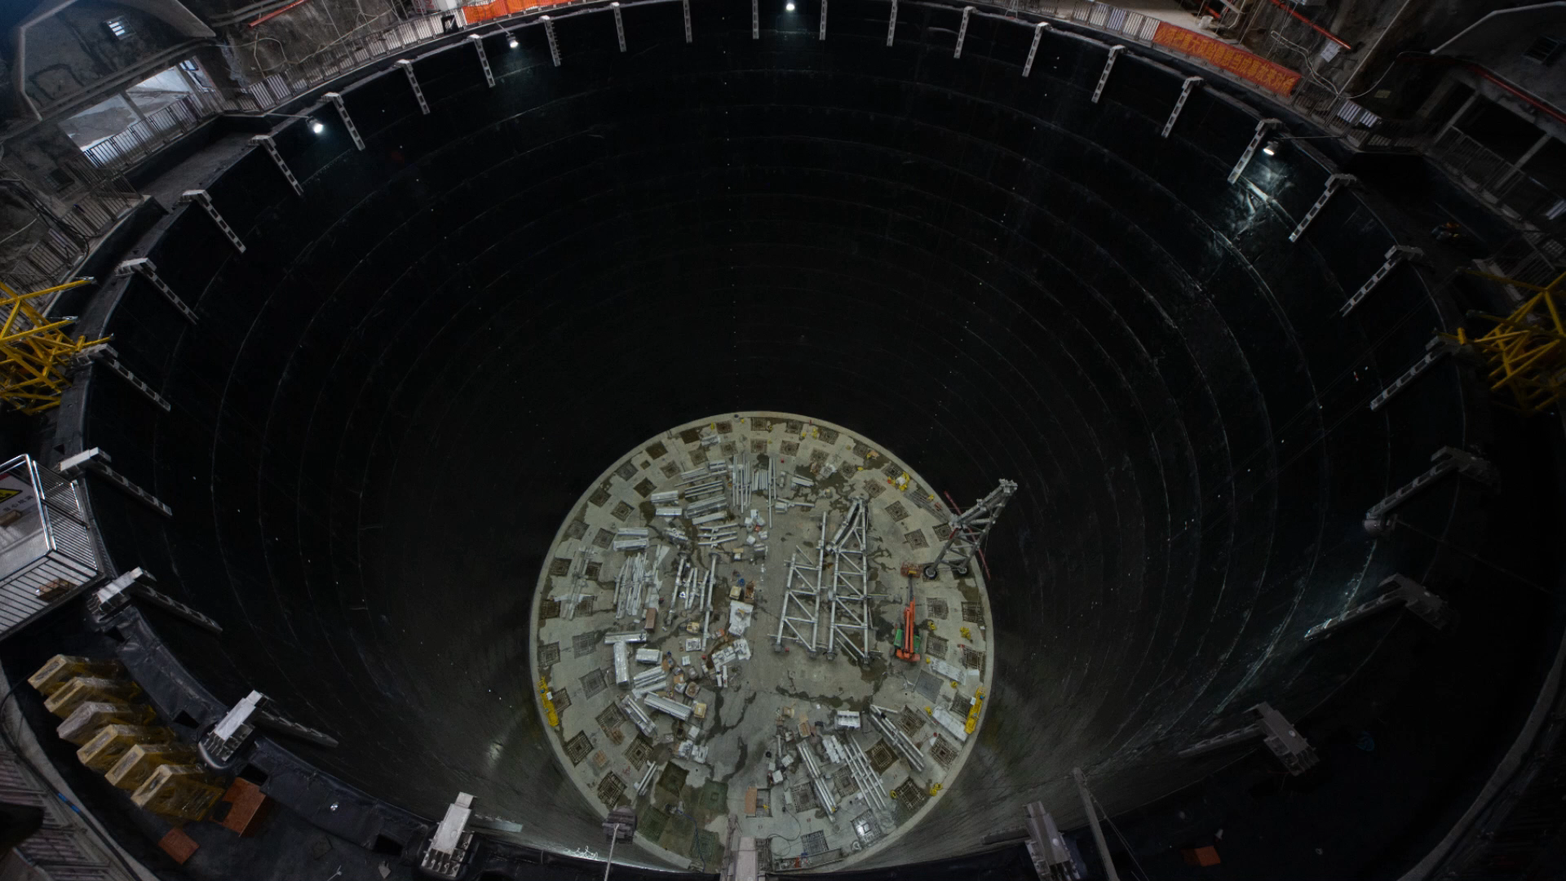
JUNO detector progresses

Slide 8
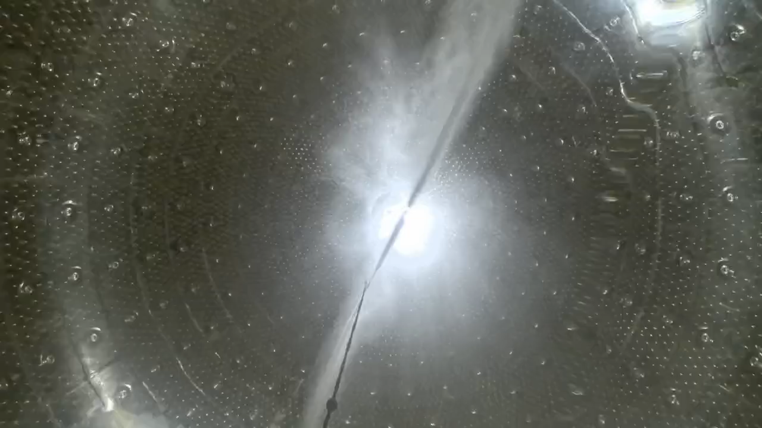
Final cleaning of acrylic sphere
2024.11: detector assembled, filling start soon

Slide 9
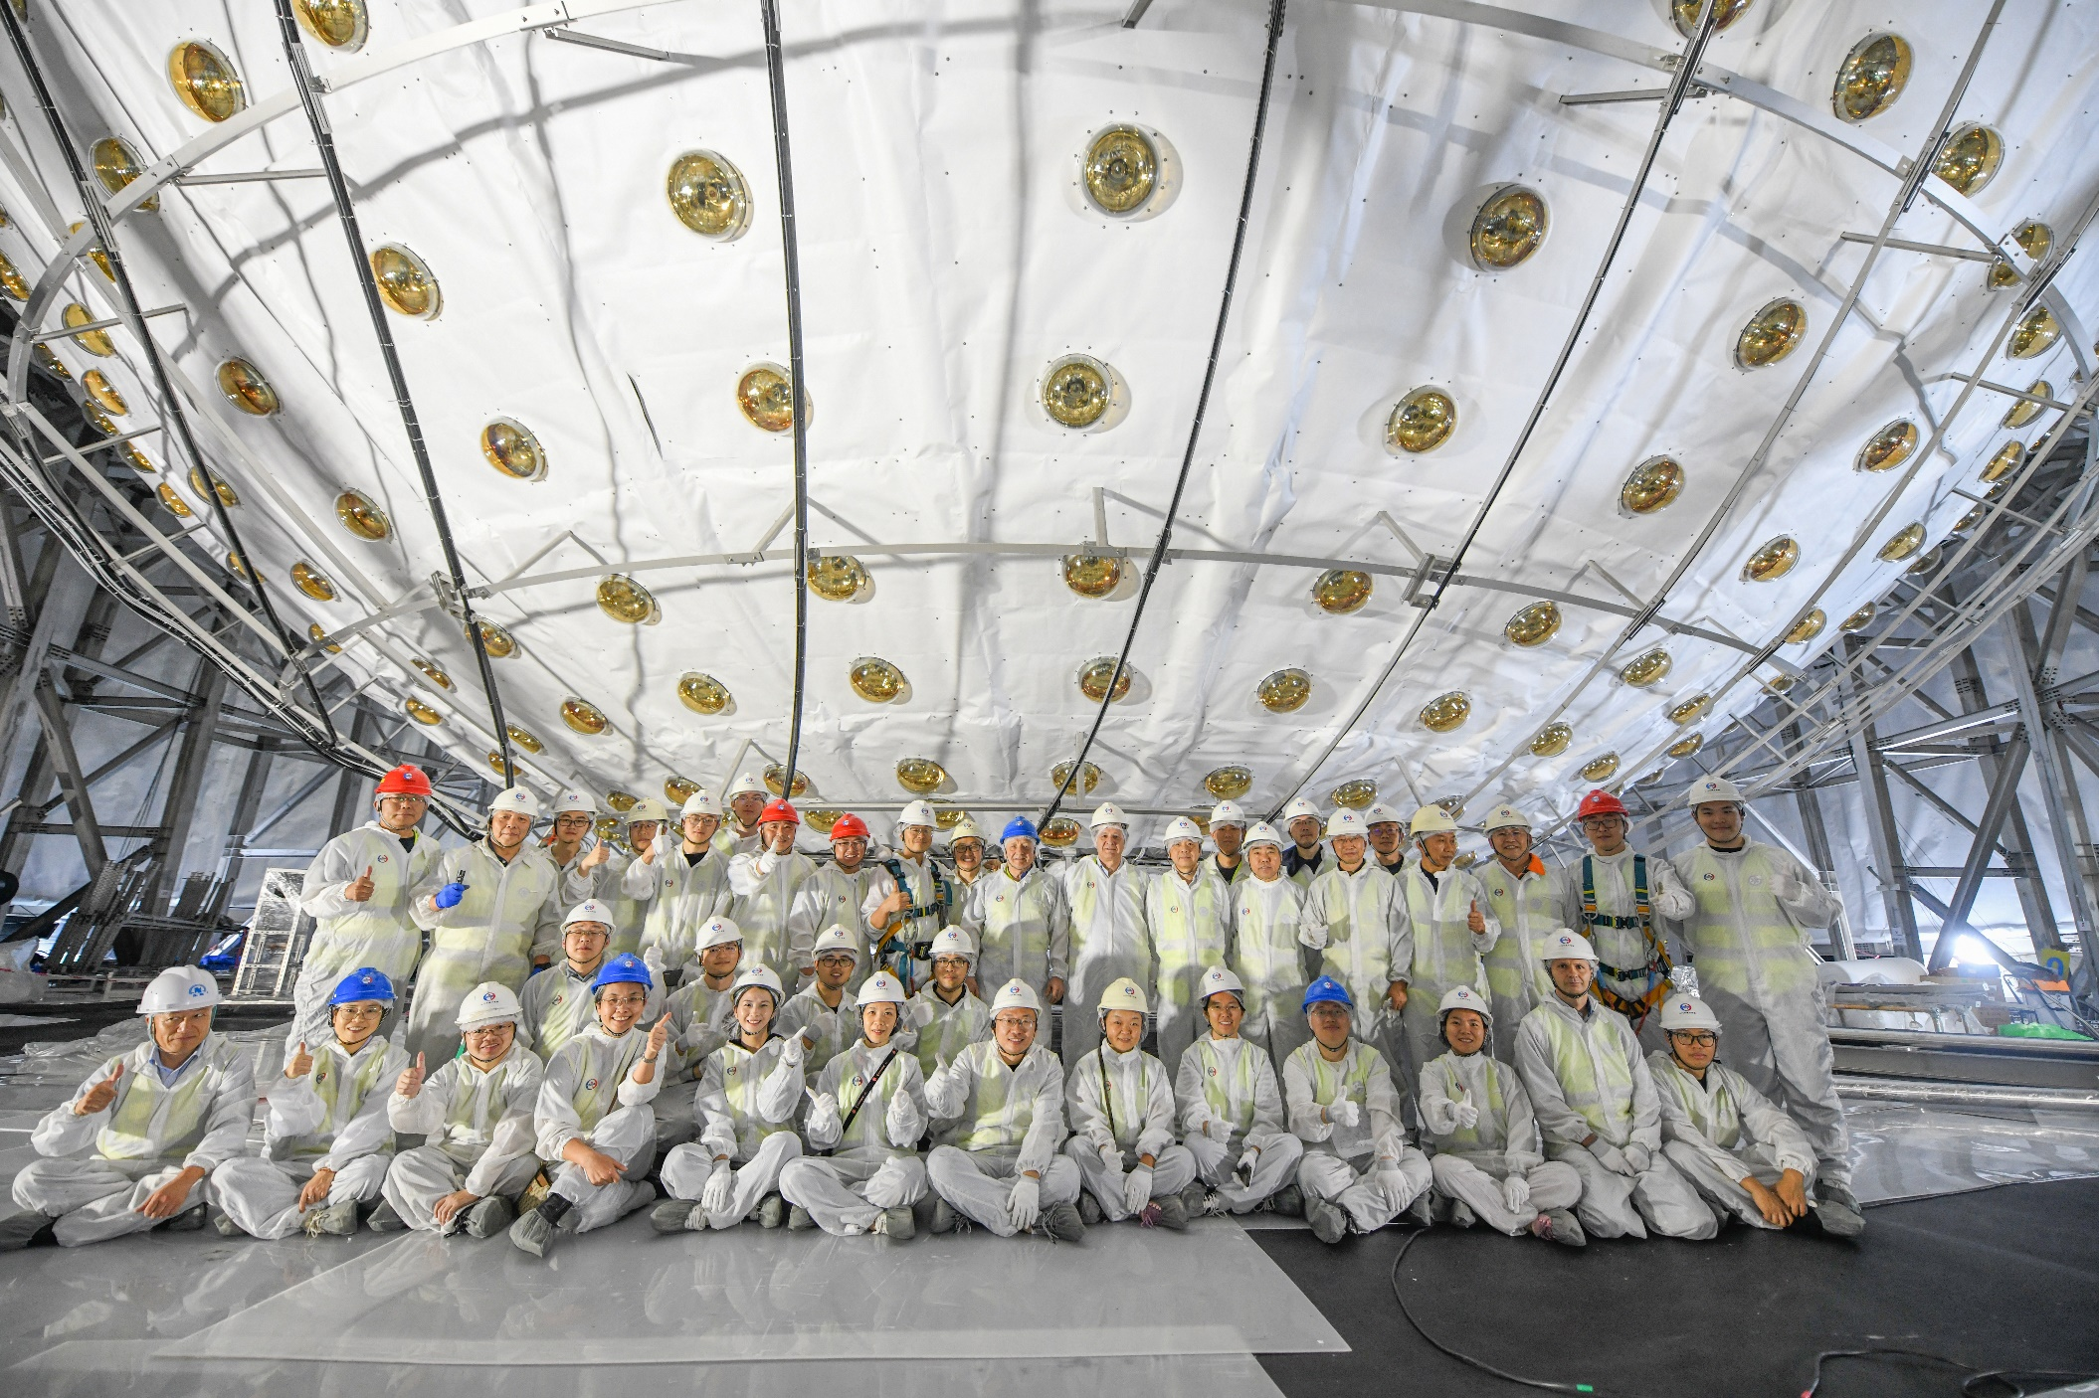
Bottom detector 2024-12-04

Slide 10
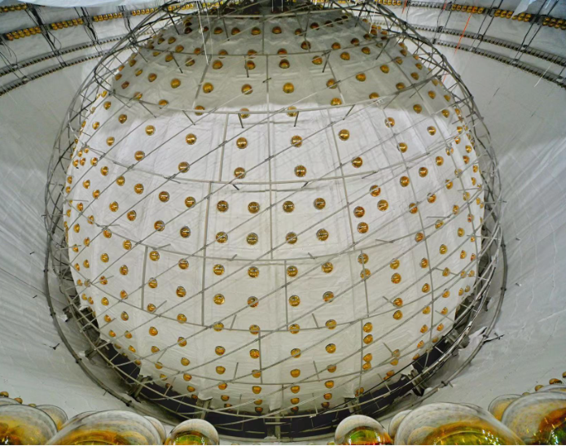
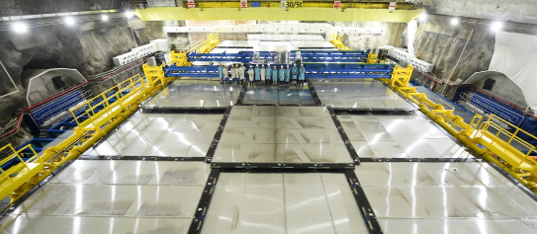
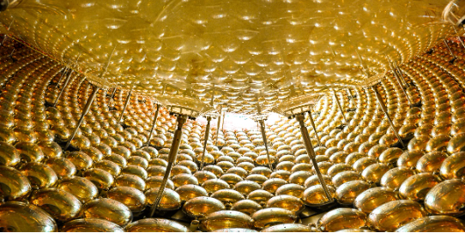
More detector photos
2024.12: detector assembled, filling start soon
2025.6 Top tracker installation finished

Slide 11
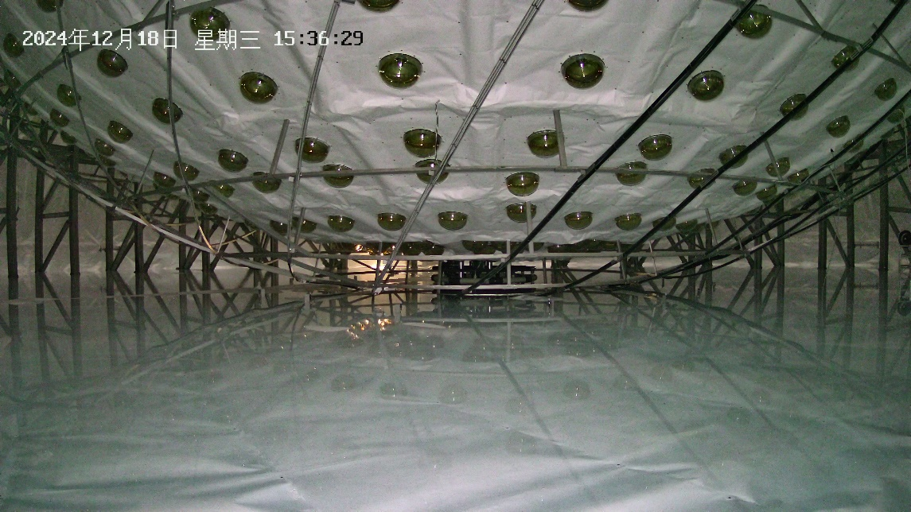
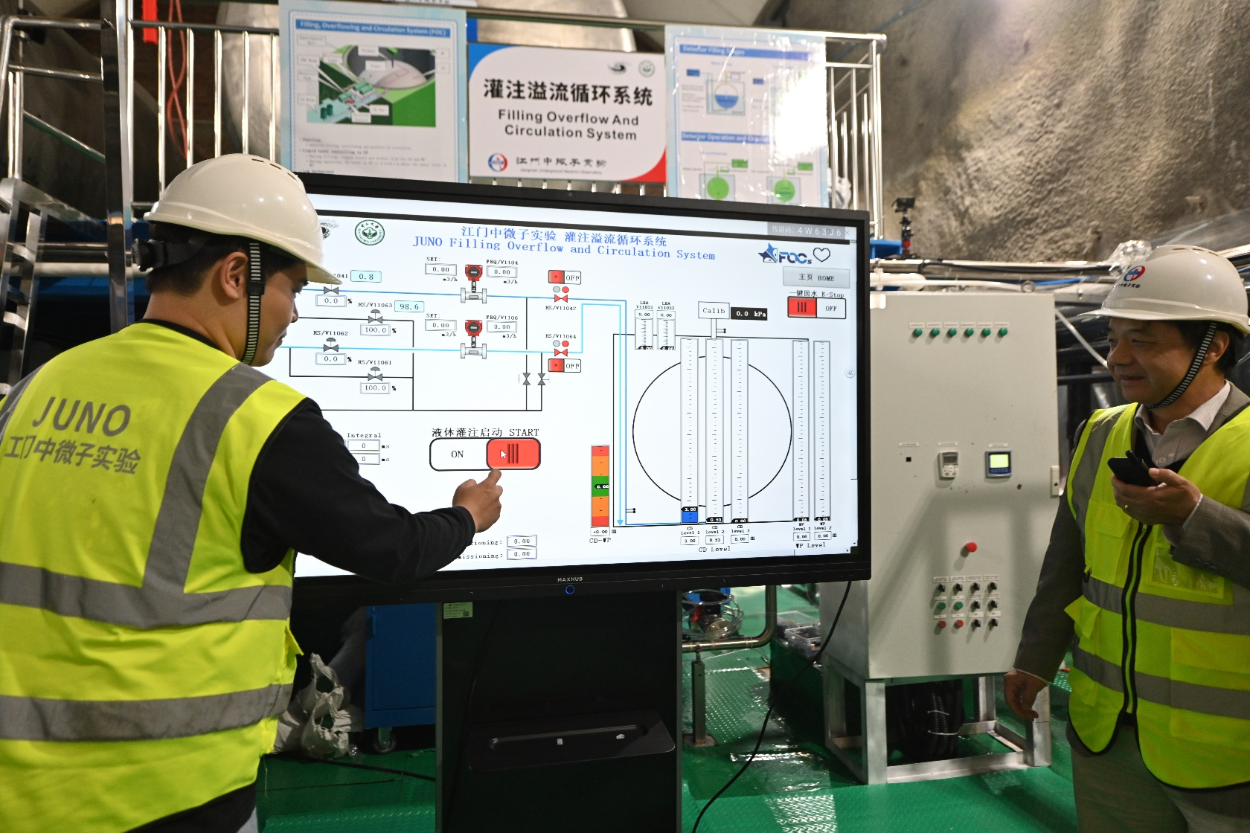
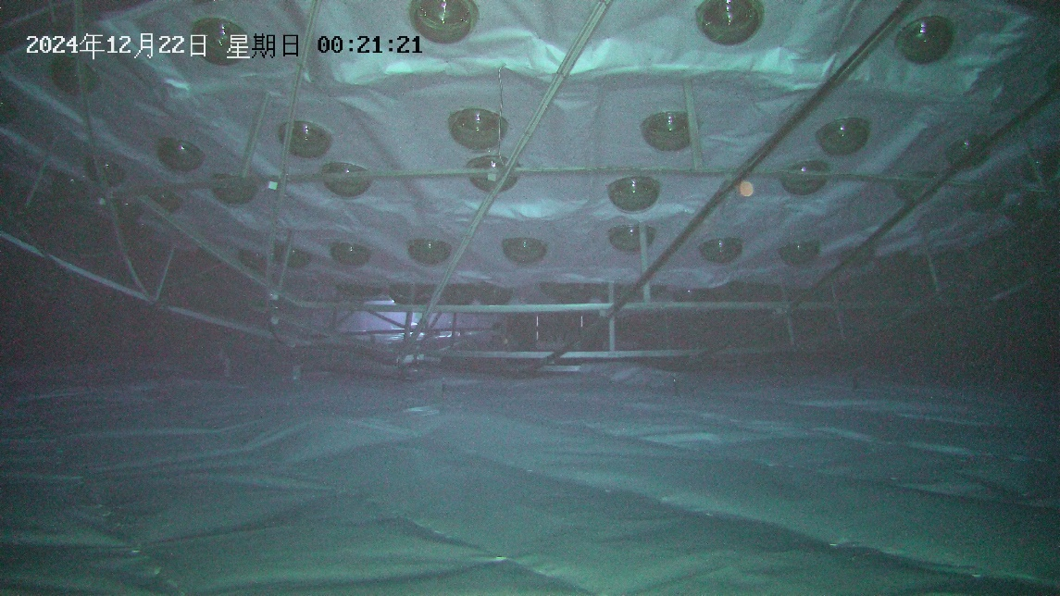
Start of water filling 2024-12-18

Slide 12
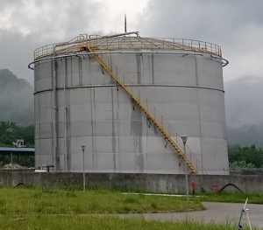
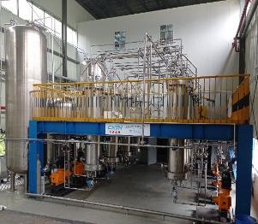
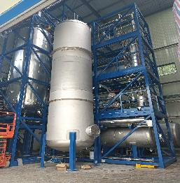
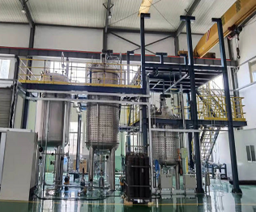

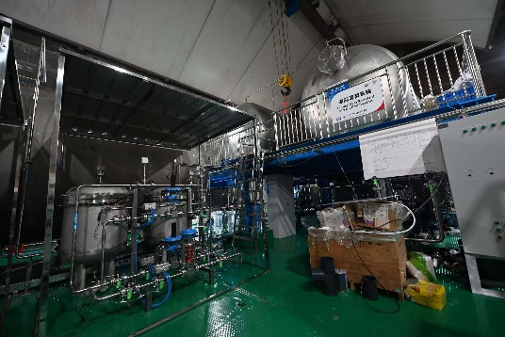
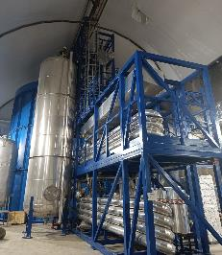
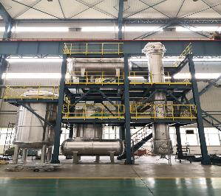
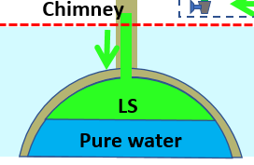
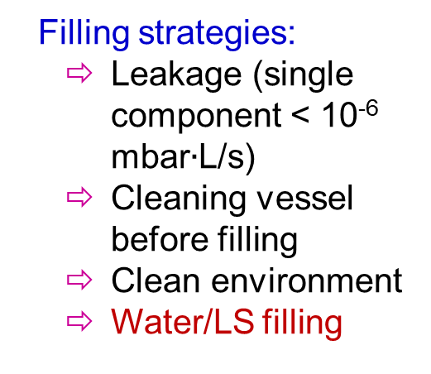
Liquid scintillator
Four purification plants to achieve target radio-purity 10⁻¹⁷ g/g U/Th and 20 m attenuation length
Filling strategies:
  Leakage (single component < 10⁻⁶ mbar$∙$L/s)
  Cleaning vessel before filling
  Clean environment
  Water/LS filling
5000 m³ LAB tank
1) Al₂O₃ for optical
2) Distillation for radiopurity
Mixing PPO and bis-MSB
SS pipes to underground
JUNO detector
CD FOC system
4) Gas stripping to remove Rn and O₂
3) Water extraction to remove radioactive impurities
12

Slide 13
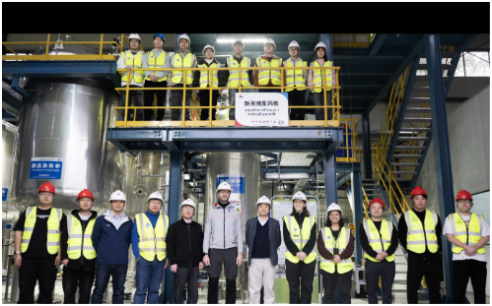
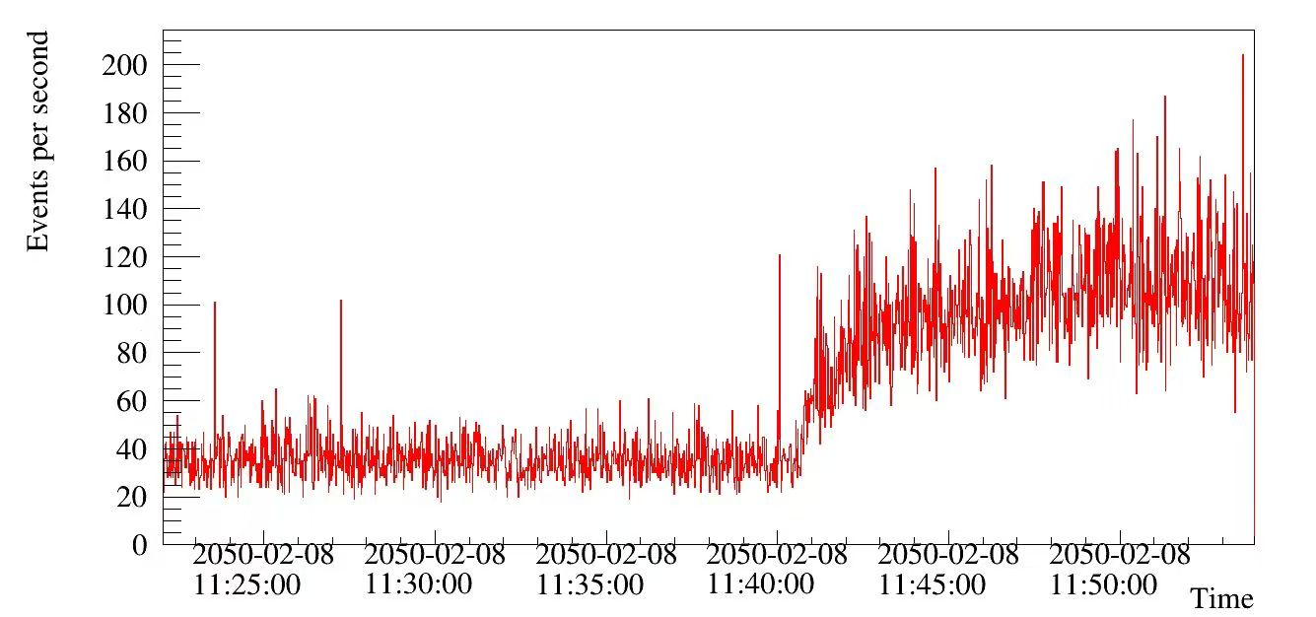
Start of LS production/filling 2025-02-08
2025-02-08
11:25:00
2025-02-08
11:30:00
2025-02-08
11:35:00
2025-02-08
11:40:00
2025-02-08
11:45:00
2025-02-08
11:50:00

Slide 14
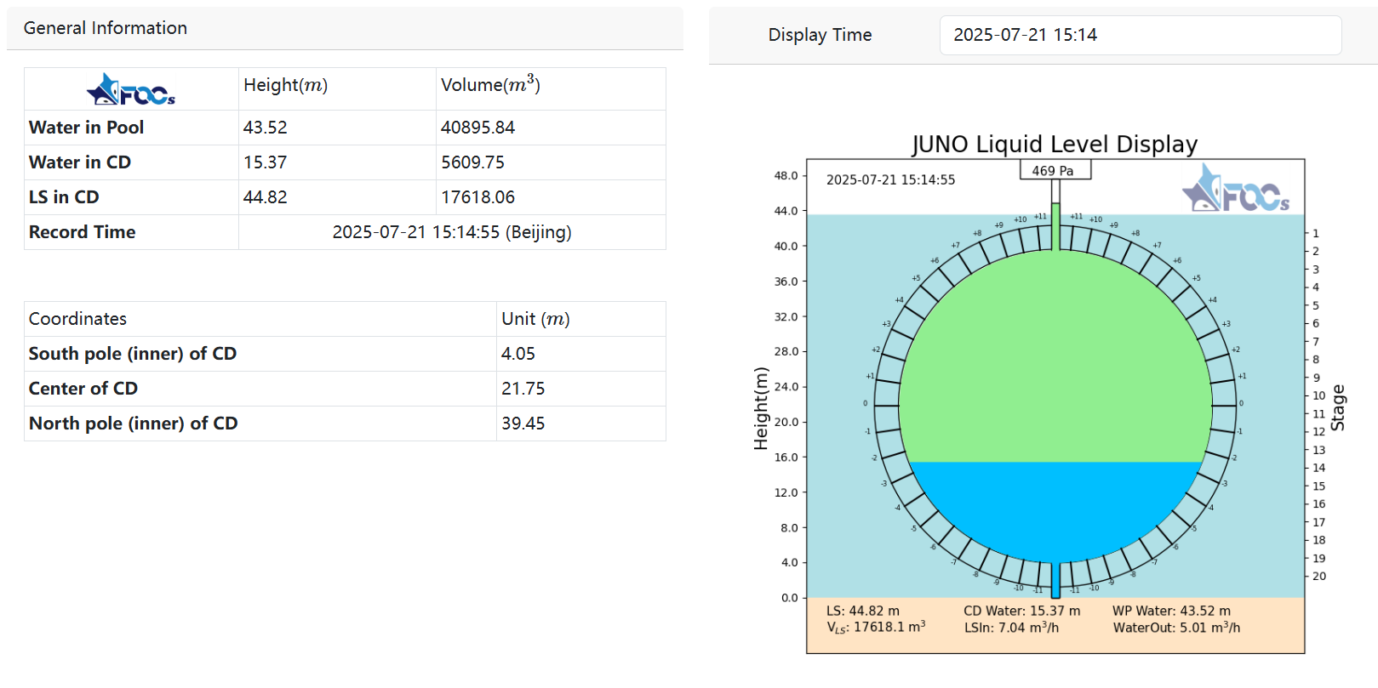
Current status
75% LS has been filled，expect to finish in August
14

Slide 15
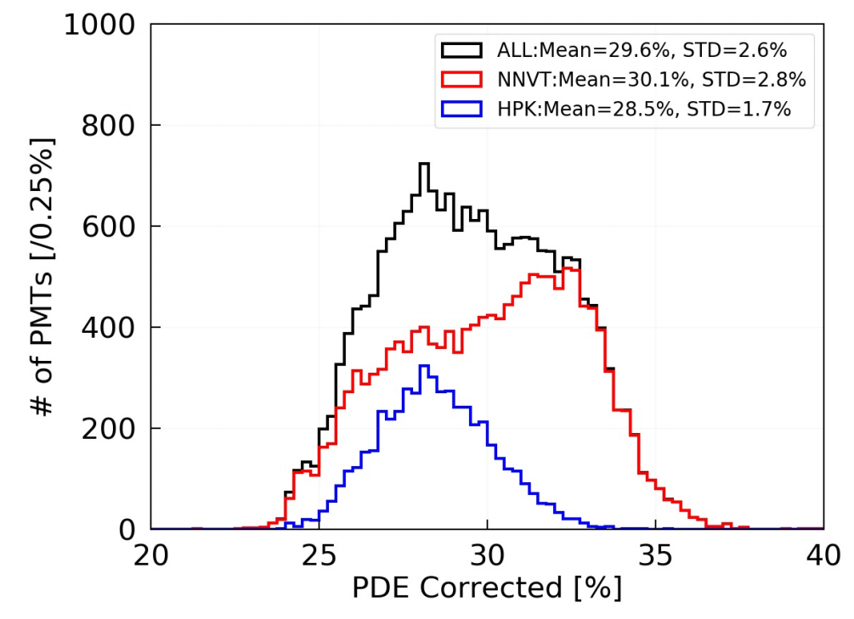
Photomultiplier Tubes
 | LPMT (20-inch) |  | SPMT (3-inch)
 | Hamamatsu | NNVT | HZC
Quantity | 5000 | 15012 | 25600
Charge Collection | Dynode | MCP | Dynode
Photon Detection Efficiency | 28.5% | 30.1% | 25%
Dynamic range for [0-10] MeV | [0, 100] PEs |  | [0, 2] PEs
Coverage | 75% |  | 3%
Reference | Eur.Phys.J.C 82 (2022) 12, 1168 |  | NIM.A 1005 (2021) 165347
PDE larger than required value 27% → expected energy resolution 2.9% @ 1MeV
Synergetic 20-inch and 3-inch PMT systems to ensure energy resolution and charge
15

Slide 16
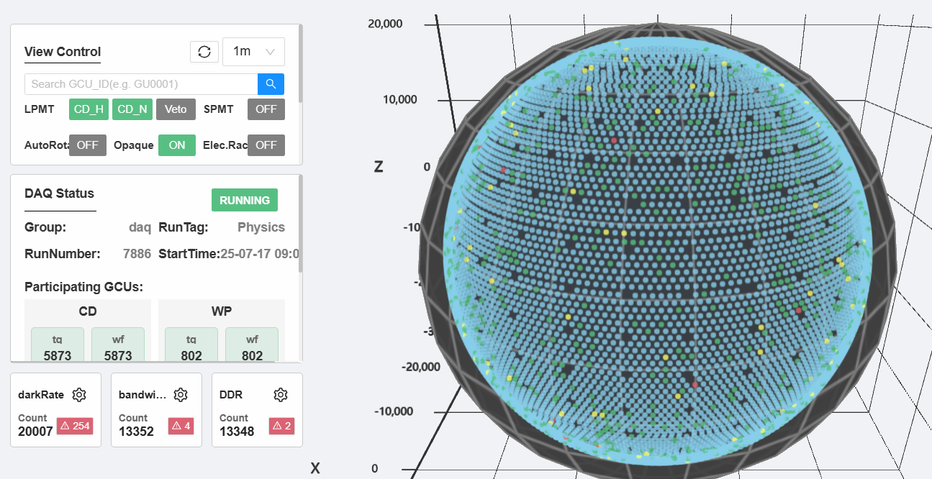
PMTs/electronics running well
Running at mean gain of 8.2×10⁶，dark rate 20-22 kHz, trigger threshold 0.2 p.e.
About 150 20-inch PMTs were turned off due to flashing, HV trip, etc.

Slide 17
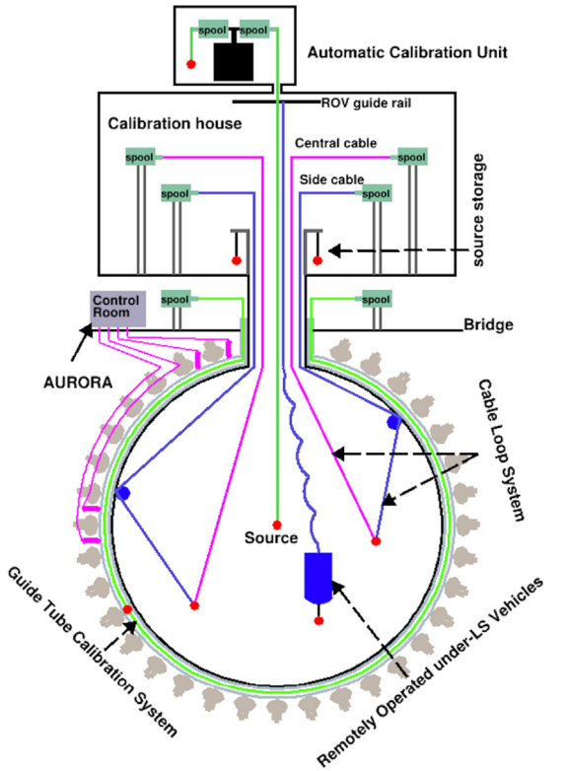
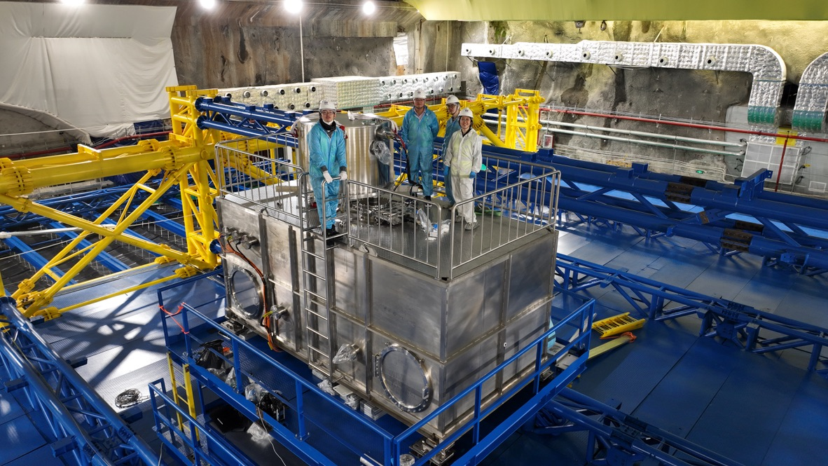
Calibration
1D, 2D, 3D scan systems with multiple calibration sources
Has deployed ⁶⁸Ge, ¹³⁷Cs, ⁵⁴Mn, ⁶⁰Co, ⁴⁰K, ²⁴¹Am-C, laser via ACU
Preliminary light yield > 1600 p.e./MeV, calibrated using n-H 2.22 MeV gamma
17

Slide 18
Low background control
Radiopurity control on raw material:
Careful material screening
Meticulous Monte Carlo Simulation
Accurate detector production handling
ICP-MS and NAA for LS radio-purity QC
With innovative pre-processing, ICP-MS sensitivity on ²³²Th/²³⁸U reached 10⁻¹⁶ g/g
Online ²²²Rn monitoring during filling
In-situ measurement to avoid leakage
Reduced by 15% compared to the design. Ref: JHEP 11 (2021) 102
Singles (R < 17.2 m, E > 0.7 MeV) | Design [Hz] | Change [Hz] | Comment
LS | 2.20 | 0
Acrylic | 3.61 | -3.2 | 10 ppt -> 1 ppt
Metal in node | 0.087 | +1.0 | Copper -> SS
PMT glass | 0.33 | +2.47 | Schott -> NNVT/Ham
Rock | 0.98 | -0.85 | 3.2 m -> 4 m
Radon in water | 1.31 | -1.25 | 200 mBq/m³ -> 10 mBq/m³
Other | 0 | +0.52 | Add PMT readout, calibration sys
Total | 8.5 | -1.3
Preliminary results at 75% LS
²²²Rn in filling LS at 1mBq/m³ level, much better than the requirement of 5mBq/m³
Intrinsic ²³⁸U and ²³²Th < 10⁻¹⁶ g/g
Intrinsic ²¹⁰Po similar with Borexino phase 1
External background agrees with design

Slide 19
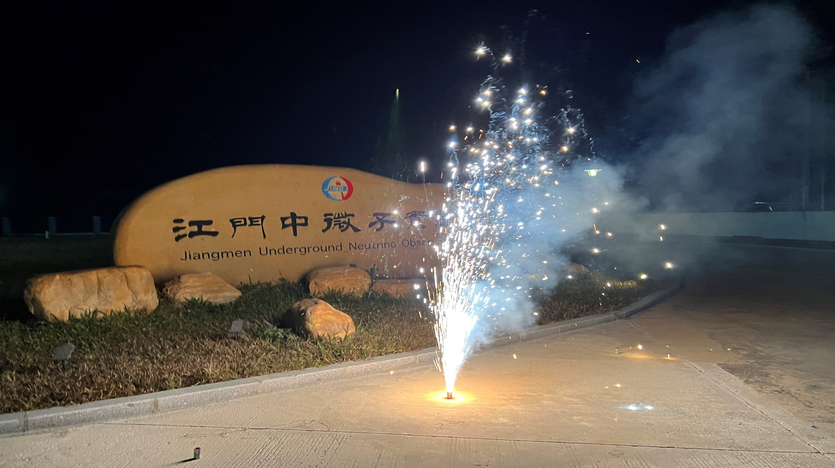
Observing nuclear reactors, the Solar System, and the Milky Way at Jiangmen

Slide 20
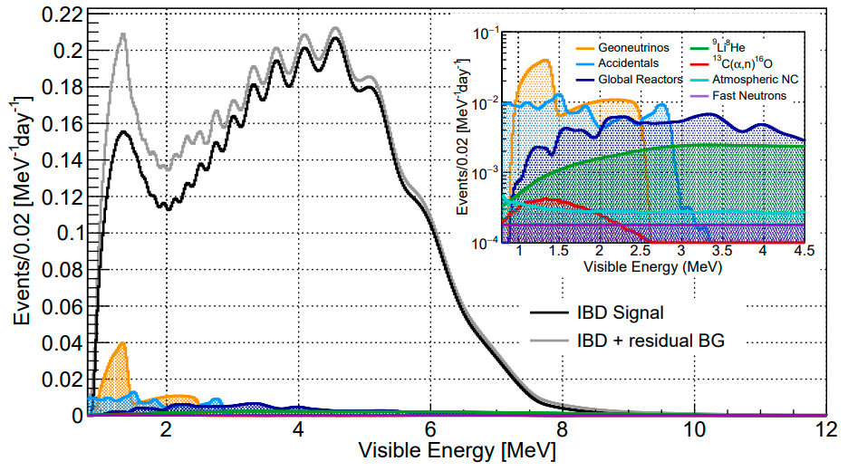
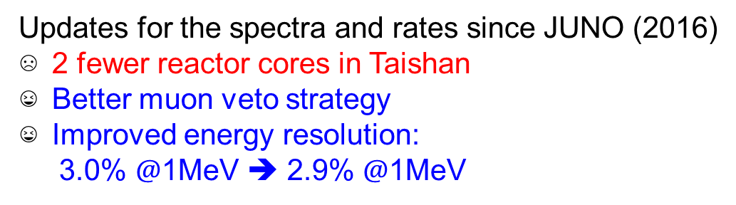
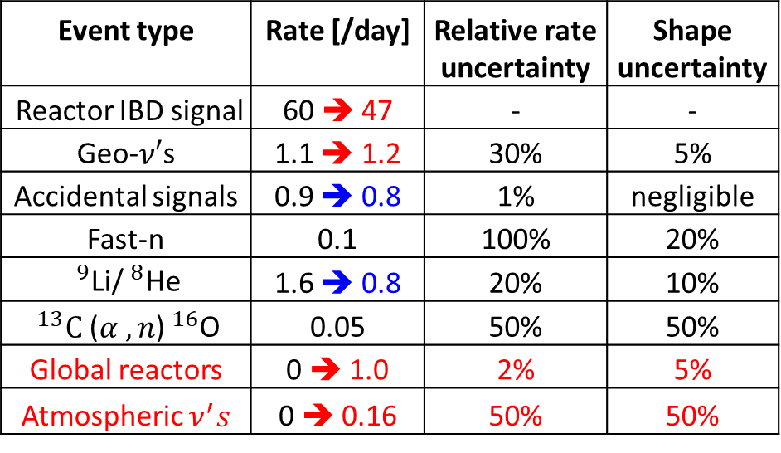


Reactor Antineutrino Oscillations
CPC 46 (2022) 12, 123001
Event type | Rate [/day] | Relative rate uncertainty | Shape uncertainty
Reactor IBD signal | 60 ➔ 47 | - | -
Geo-$ν′$s | 1.1 ➔ 1.2 | 30% | 5%
Accidental signals | 0.9 ➔ 0.8 | 1% | negligible
Fast-n | 0.1 | 100% | 20%
$^{9}$Li/$^{8}$He | 1.6 ➔ 0.8 | 20% | 10%
$^{13}C$($α ,n$)$^{16}$O | 0.05 | 50% | 50%
Global reactors | 0 ➔ 1.0 | 2% | 5%
Atmospheric $ν^{′}s$ | 0 ➔ 0.16 | 50% | 50%
JUNO physics book (J. Phys. G43:030401(2016)) → updated analysis
Updates for the spectra and rates since JUNO (2016)
2 fewer reactor cores in Taishan
Better muon veto strategy
Improved energy resolution:
3.0% $@$1MeV ➔ 2.9% $@$1MeV
More realistic estimate on signals and backgrounds
Slight less overburden
Lower radioactivity background based on latest measurements on material radiopurities

Slide 21
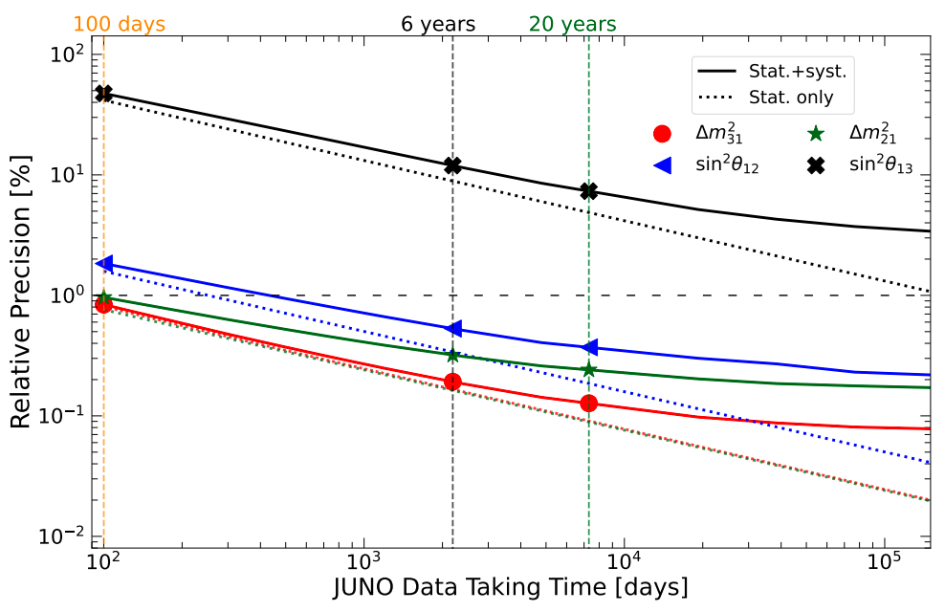
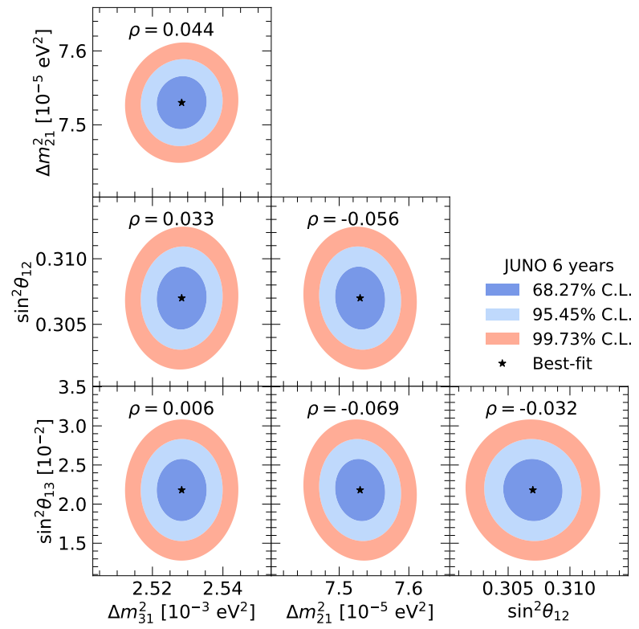
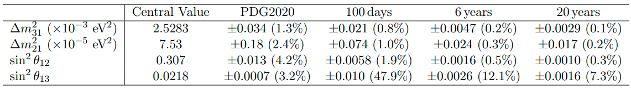
Precision Oscillation Measurement
About one order of magnitude improvements in precision over existing constraints
Precision of sin²$2θ_{12}$, $∆m_{21}^{2}$, |$∆m_{32}^{2}$| < 0.5% in 6 years

Slide 22
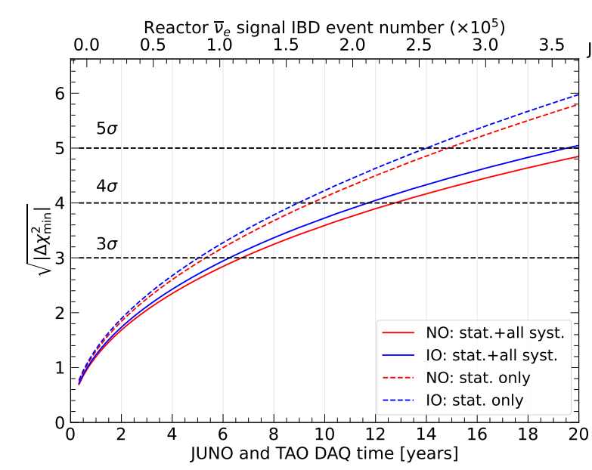
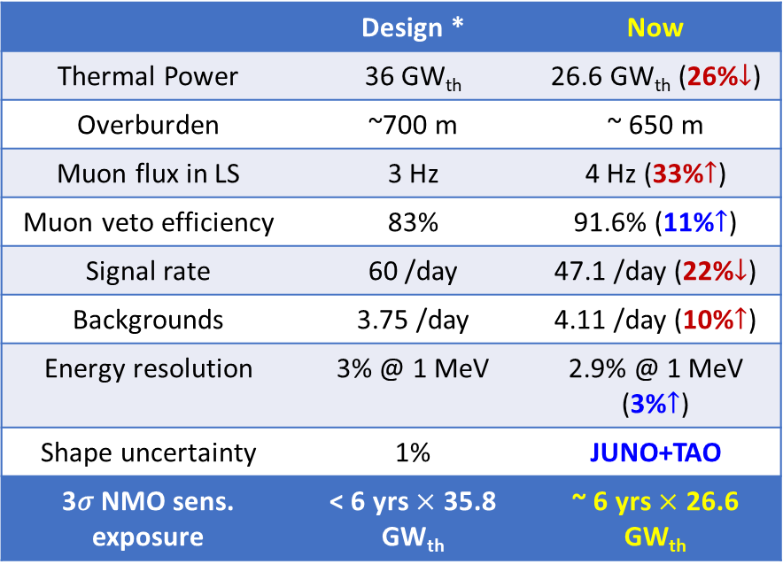
Neutrino Mass Ordering
 | Design * | Now
Thermal Power | 36 GW_{th} | 26.6 GW_{th} (26%$↓$)
Overburden | ~700 m | ~ 650 m
Muon flux in LS | 3 Hz | 4 Hz (33%$↑$)
Muon veto efficiency | 83% | 91.6% (11%$↑$)
Signal rate | 60 /day | 47.1 /day (22%$↓$)
Backgrounds | 3.75 /day | 4.11 /day (10%$↑$)
Energy resolution | 3% @ 1 MeV | 2.9% @ 1 MeV (3%$↑$)
Shape uncertainty | 1% | JUNO+TAO
3𝜎 NMO sens. exposure | < 6 yrs $×$ 35.8 GW_{th} | ~ 6 yrs $×$ 26.6 GW_{th}
Preliminary
* J. Phys. G 43:030401 (2016)
JUNO NMO median sensitivity: 3σ (reactors only) @ ~6 yrs * 26.6 GW_{th} exposure
Combined reactor+atmospheric neutrino analysis in progress: further improve the NMO sensitivity

Slide 23
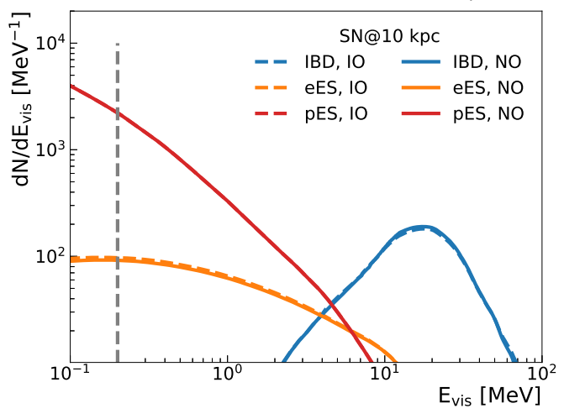
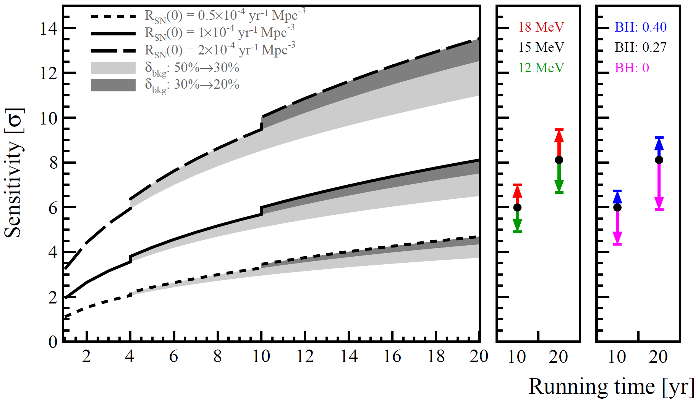
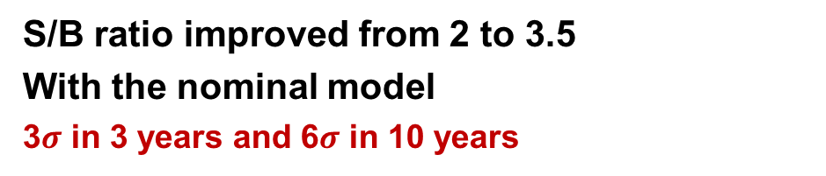
Supernovae neutrinos
SN neutrinos of 30 M⊙ Nakazato mode
Diffuse supernova neutrino background
Reference model
JCAP 01 (2024) 057
JCAP 10 (2022) 033
3 detection channels sensitive to all flavors
Excellent capability for early warning
220~400 kpc with 50% probability
10 ~ 30 ms for typical 10 kpc
S/B ratio improved from 2 to 3.5
With the nominal model
3$σ$ in 3 years and 6$σ$ in 10 years

Slide 24
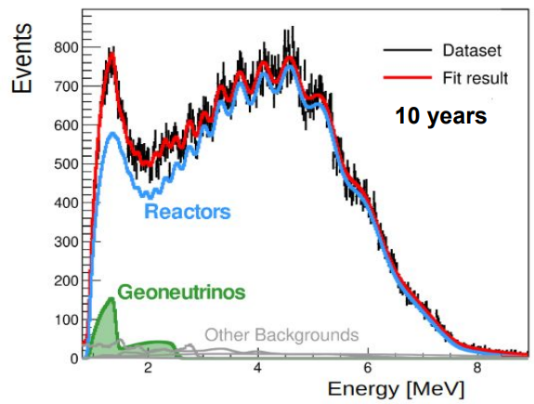
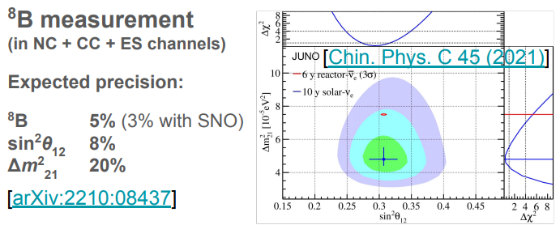
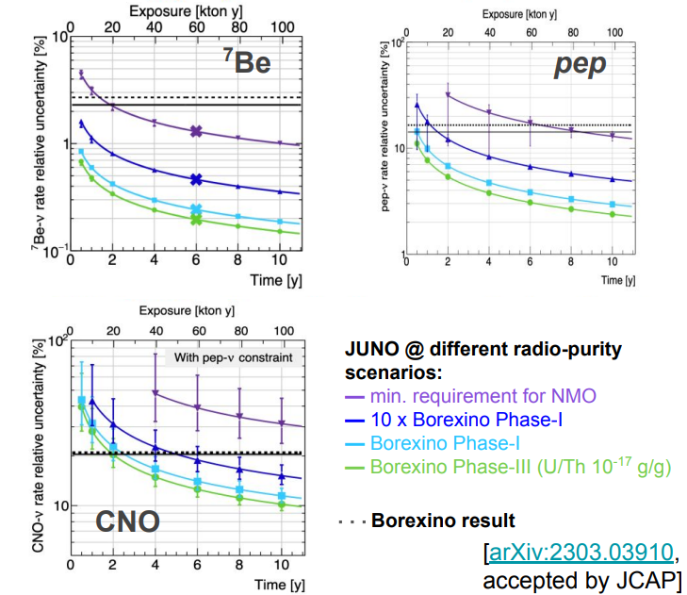
Solar and terrestrial neutrinos
JUNO could improve the measurement of solar ν’s
JUNO will collect the largest dataset of geoneutrinos in about 1 year
Precision of total geoneutrino signal with Th/U ratio fixed: ~8% in 10 years
KamLAND ~15%, Borexino ~17%

Slide 25



JUNO-TAO
Measurement of reactor anti-nu spectrum with no oscillations (within Taishan NPP building)
An innovative apparatus
● ~94% coverage with SiPM (~50% PDE)
● Cooling to -50°C
● 1 ton fiducial volume / 2.8 tons of Gd-LS
● 44 m to the reactor core
Rich Physics
●Sensitive to fine structure
● Model-independent reference spectrum for JUNO
● Improvement of nuclear databases
● Sensitive to sterile neutrino
Installation to be finished;
Expect to run soon
TAO CDR arXiv:2005.08745
25

Slide 26


Future JUNO-0νββ upgrade
Concept of the experiment
JUNO offers an unique opportunity to search for 0νββ after completion of NMO measurements
Large target mass → 100-ton scale isotope loading
Excellent clean LS shielding → low background
Energy resolution < 3% @ 1 MeV
→ Potential to explore inverted mass ordering parameter space of Majorana neutrino mass (SNOWMASS 2021)
Te-LS
or
Xe-LS
Critical R&D in progress
1、Te-loaded LS with high transparency, light yield and stability
2、Cosmogenic and ⁸B solar ν bkg rejection
3、Xenon enrichment w/ a company

Slide 27

Summary
JUNO will start physics data taking in August 2025
Detector in a very good shape
  Smooth filling, light yield and radiopurity better than design values
Keep tuned!
Physics | Sensitivity
Neutrino Mass Ordering | 3σ in ~6 years by reactor neutrinos with full power
Precision Measurement | Precision of $\text{sin}2θ_{12}$, $∆m_{21}^{2}$, |$∆m_{31}^{2}$| < 0.5% in 6 yrs
Supernova Burst (10 kpc) | ∼7300 of all-flavor neutrinos
DSNB | 3σ in 3 years
Solar Neutrino | ⁷Be, pep, CNO, and ⁸B neutrino fluxes depending on the LS radio-purity level
Nucleon Decays ($p→\overline{ν}K^{+}$) | 9.6$×$10³³ years (90% C.L.) in 10 yrs
Geo-neutrino | ∼400 per year, 8% measurement in 10 yrs
27

Slide 28

Thanks!

