Slide 1



Installation and commissioning of the JUNO 3-inch PMT system
Yujie Niu$^{1,2}$ On behalf of the JUNO collaboration
16th France-China Particle Physics Network/Laboratory workshop
July 22nd , 2025
$^{1}$Institute of High Energy Physics, Beijing, China
$^{2}$University of Chinese Academy of Sciences, Beijing, China
E-mail: niuyj@ihep.ac.cn

Slide 2
Outline
SPMT system design, production and test
Installation situation
Commissioning status
  Water phase
  LS-water phase
Summary

Slide 3

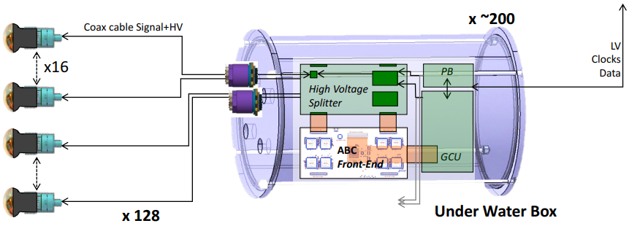
SPMT system introduction
2016-2017
2018-2020
PMT production
2020-2022
PMT instrumentation
Electronics production
2022-2023
Electronics integration
2023-2024
Commissioning
2025
Installation
2021-2022
System design
25600 3-inch PMTs (small PMT, or sPMT) and frontend electronics: all underwater
The primary goal is measuring the charge non-linearity of 20-inch PMTs (Large PMT, or LPMT)
Other physics potentials: measurement of oscillation parameters (sin²2θ₁₂,Δm²₂₁), searching for proton decay, …
CPC 46 (2022) 123001, CPC 47 (2023) 113002
LPMTs and surrounding sPMTs
Electronics with 128 3-inch PMTs

Slide 4
SPMT system production and test

Slide 5
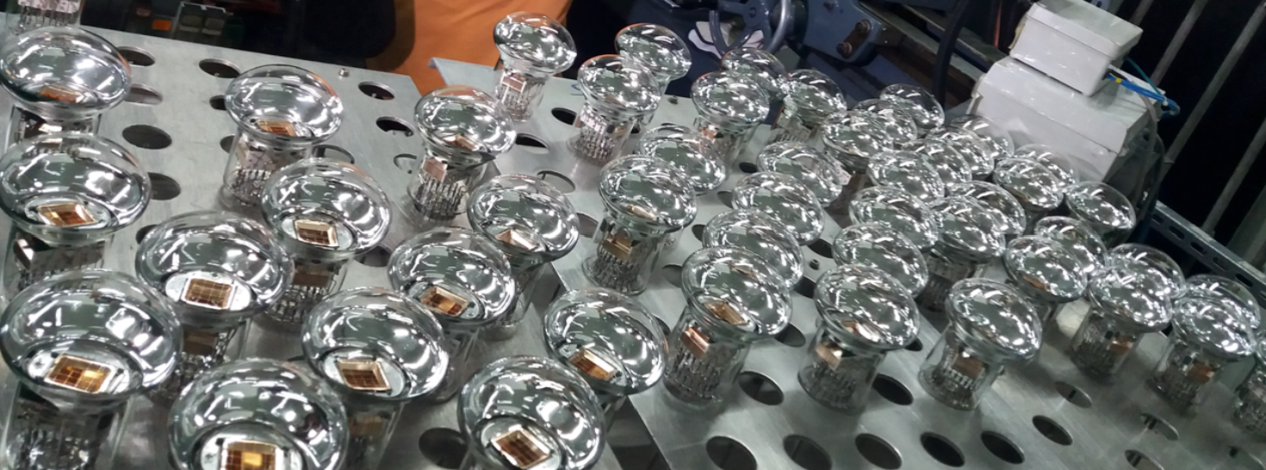
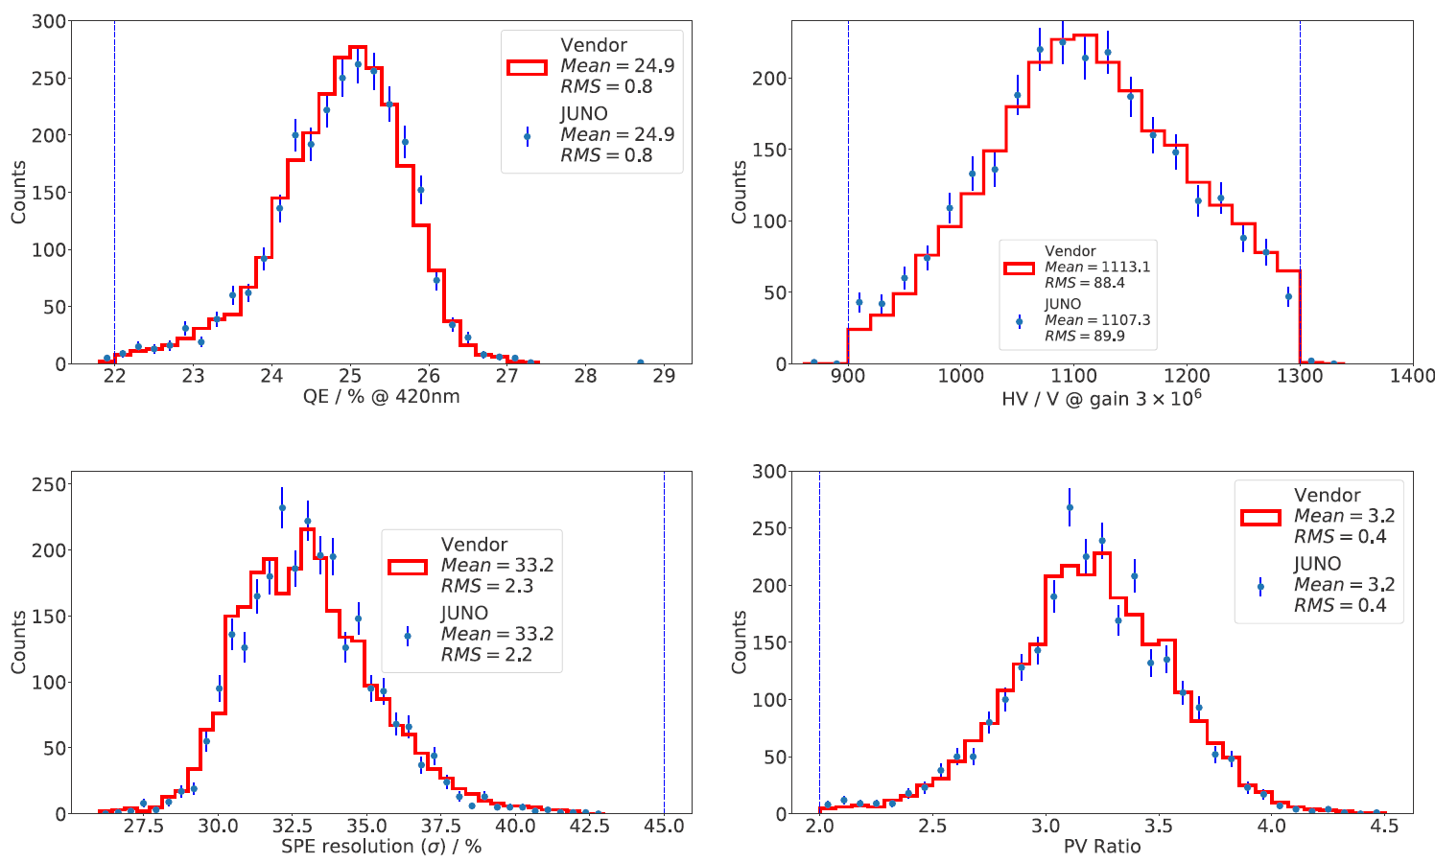
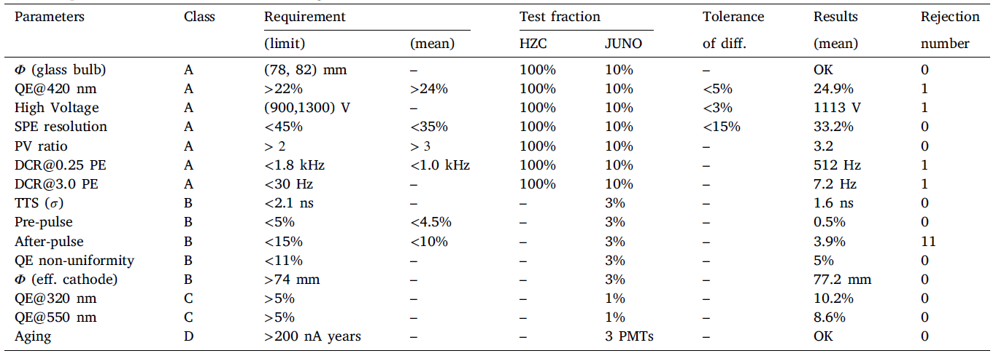
SPMT production and test
Totally 26000 3-inch PMTs produced by Hainan Zhangchuang (HZC)
Performance tests and study for 2 years, meeting the requirement of JUNO
The largest sample of 3-inch PMTs ever produced and studied in detail
HZC-XP72B22
NIM, A 1005 (2021) 165347
3-inch PMTs mass production
All 26000 3-inch PMTs test results summary

Slide 6
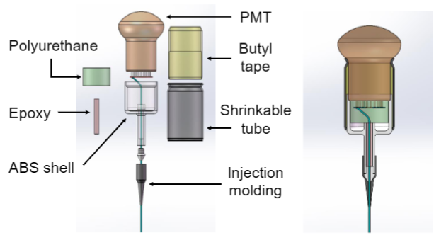
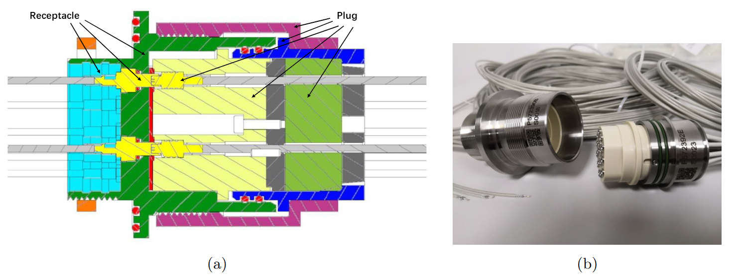
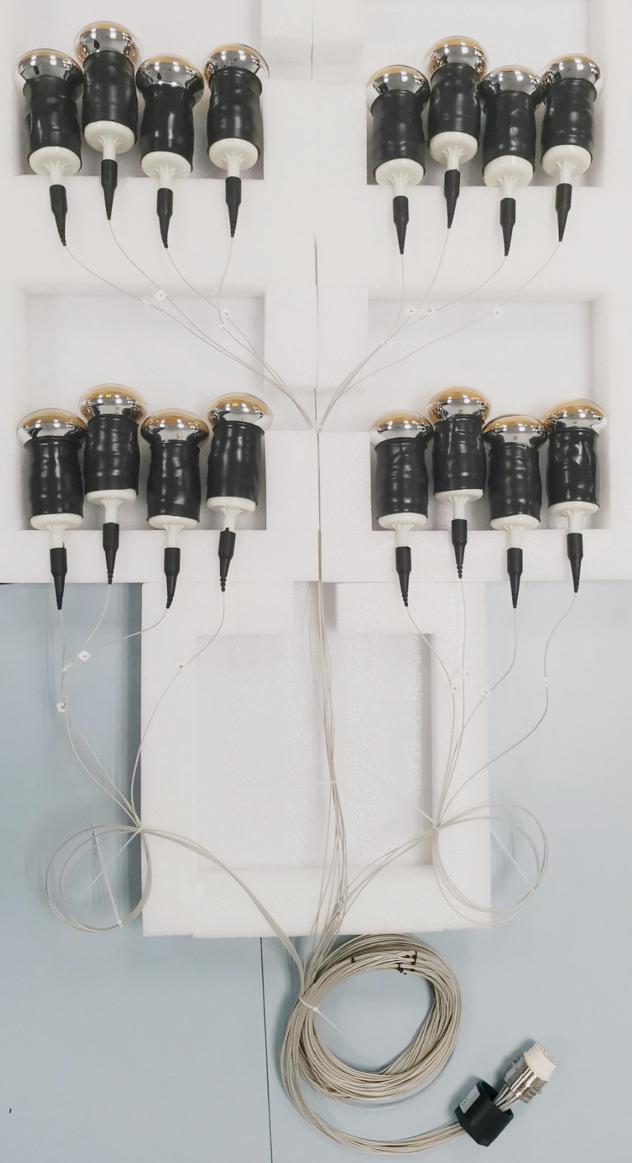
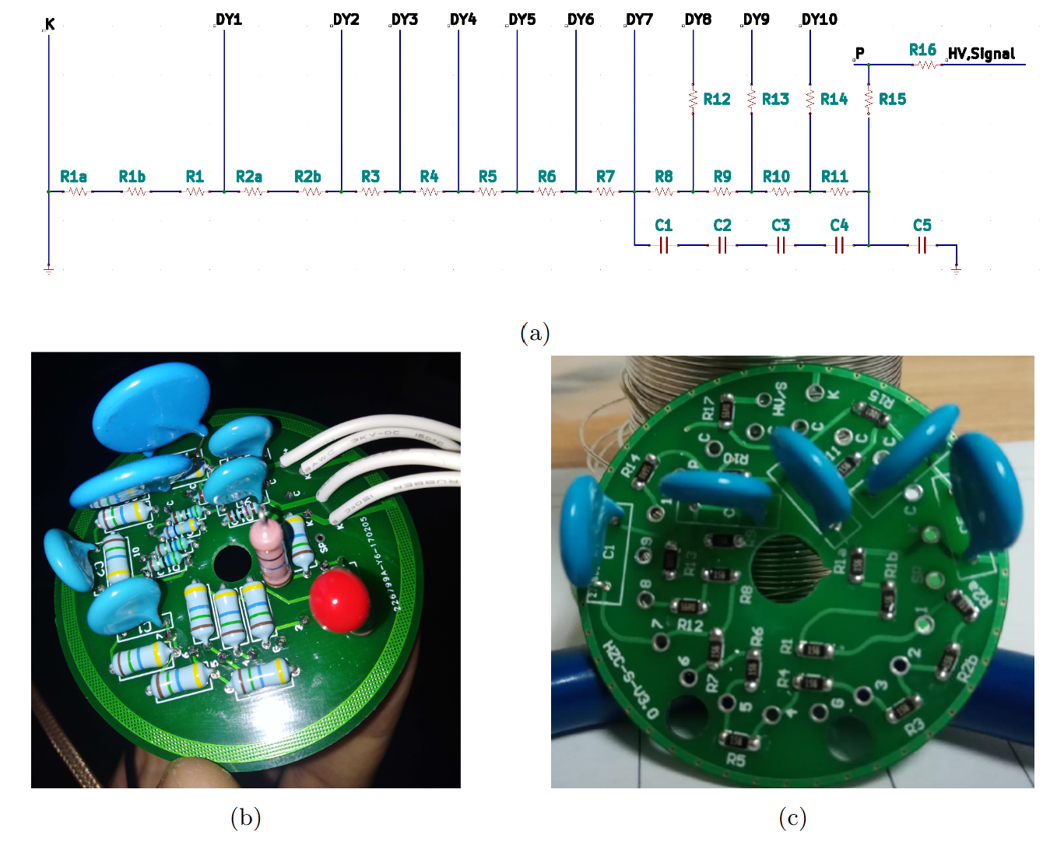
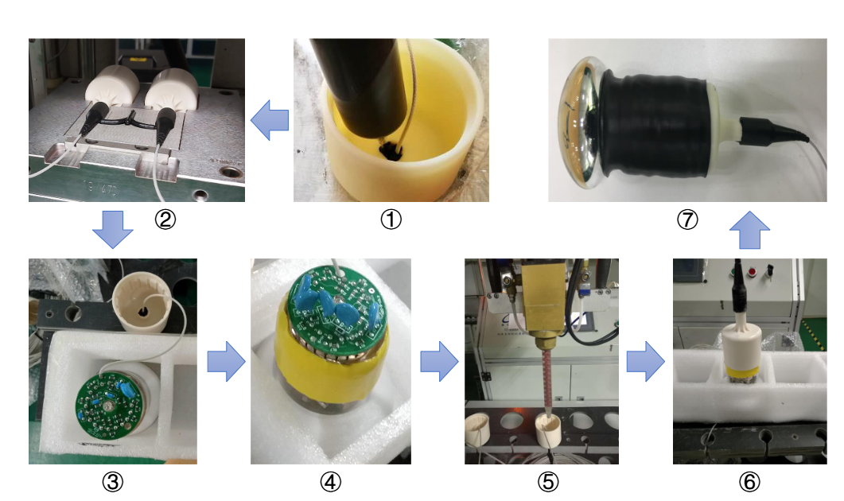
sPMT integration
Waterproof potting design
Cable and HV connector
Final version
A group of 16 PMTs
Integration procedure
HV splitter
sPMT integration with HV splitter, cable, connector and waterproofing
HV tests for all sPMTs and 13% for water pressure test

Slide 7
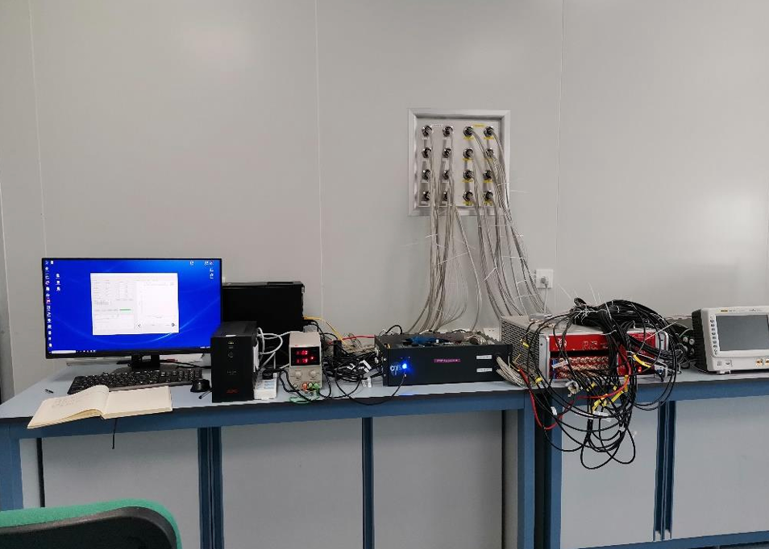
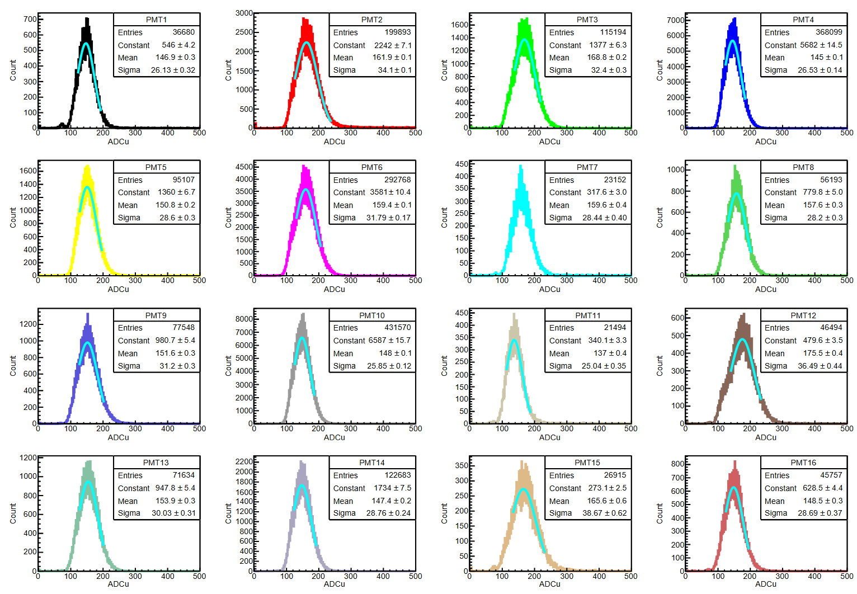
Acceptance tests after integration
PMT functional tests including gain, single photon electron, dark noise, 99.3% qualified.
The rest were replaced due to high DCRs, deviations from the target gain, poor charge resolution, or electrical short circuits.
PMT font-end integration test system using early version of JUNO electronics
PMT single photoelectron spectrum

Slide 8
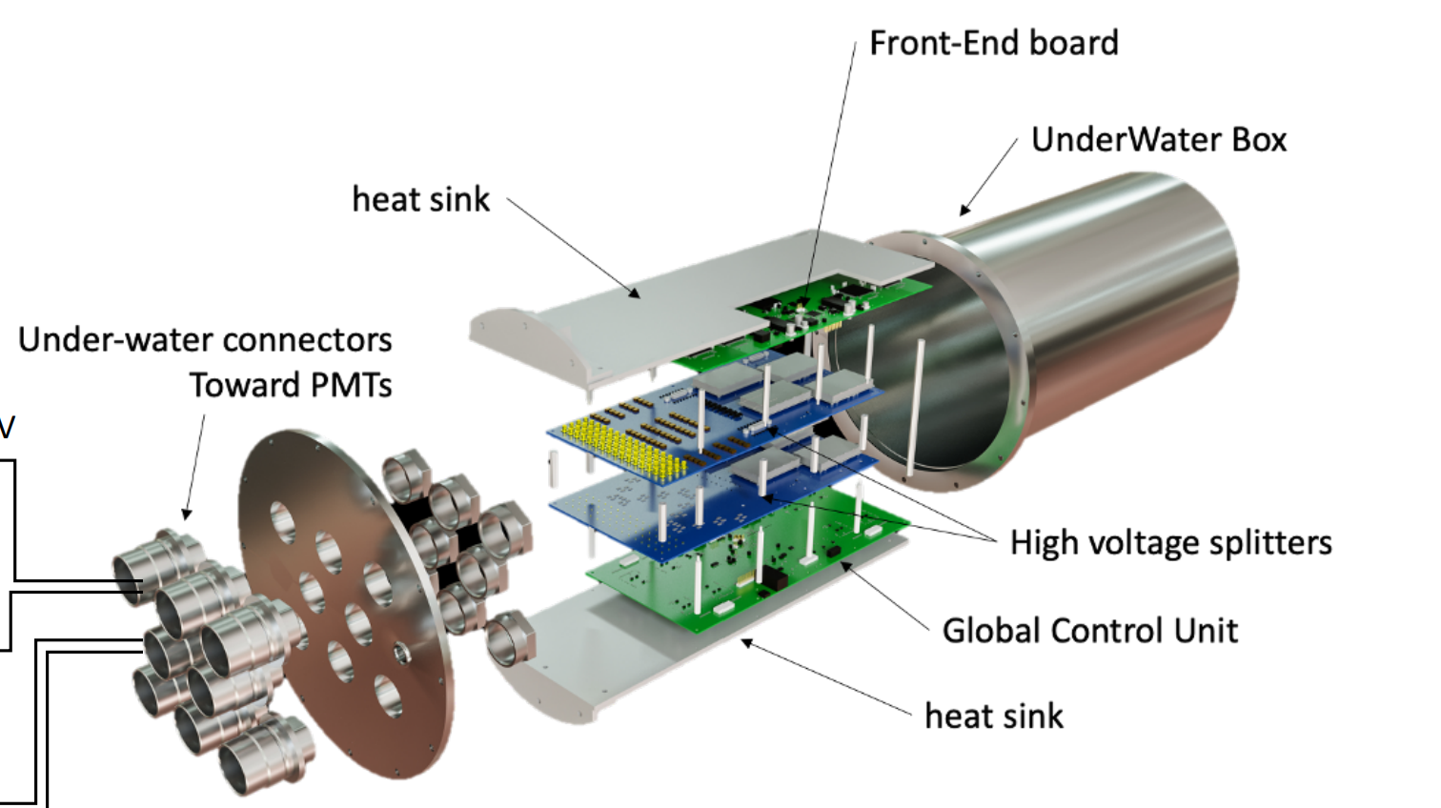
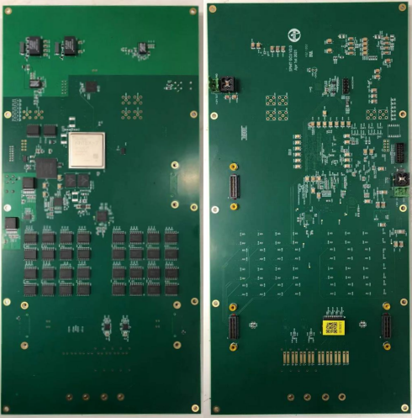
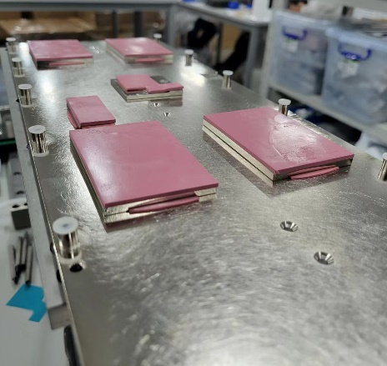
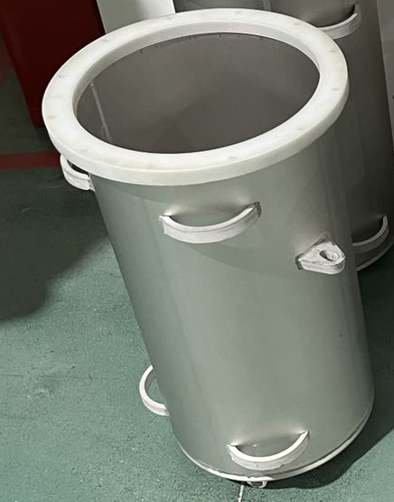
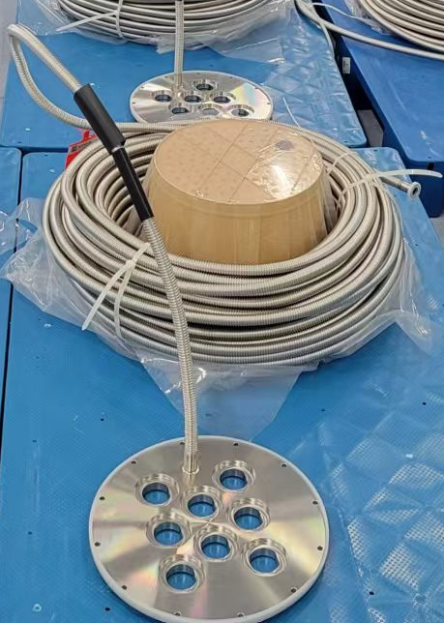
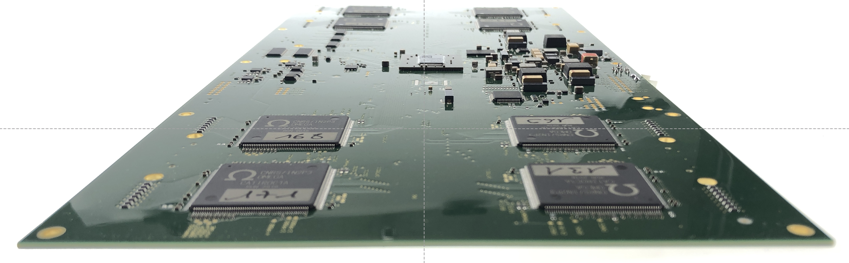
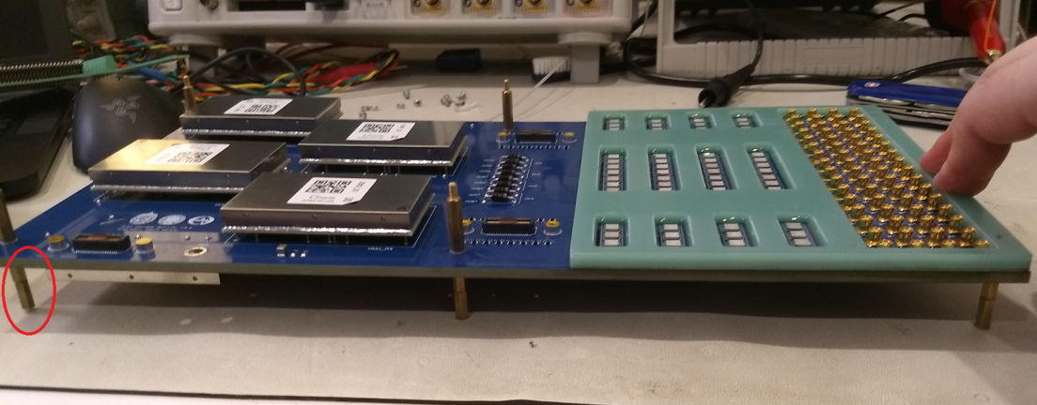
Component of electronics
Global Control Unit: control and transfer data to DAQ
Heat dissipation and mechanical structure
Electronics overview
Front-End board: 8 CATROCs for signal digitization（France）
HV splitter: supply high voltage and split signal (Chile, Russian)
Underwater Box (Chile, US)
128 channels contained in an underwater stainless-steel box

Slide 9
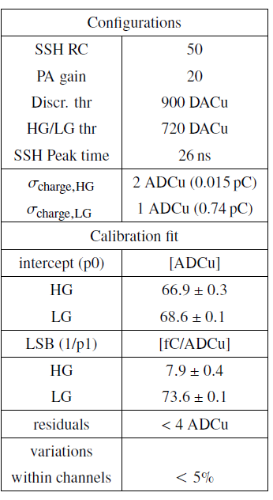
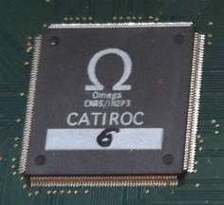
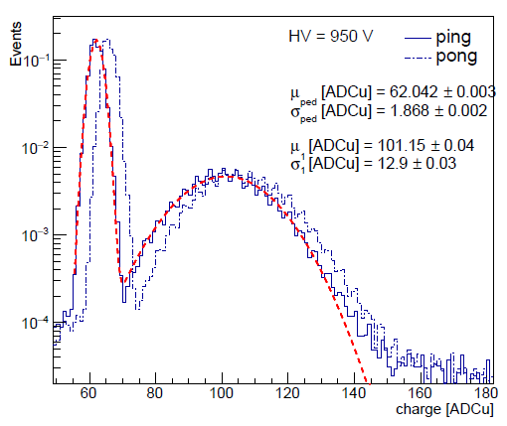
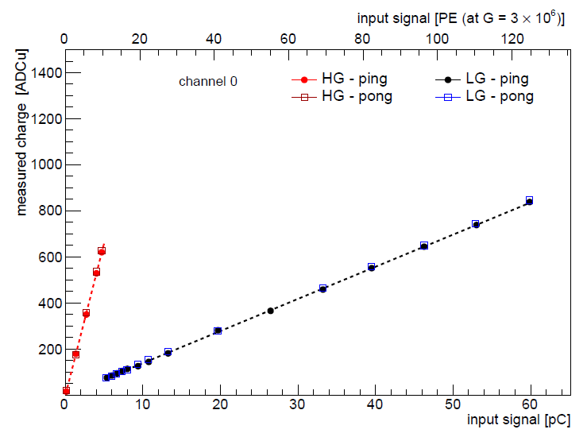
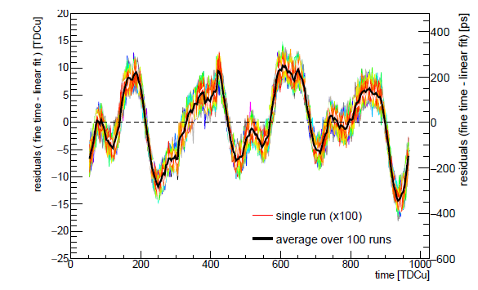
Electronics performance
  CATIROC: an integrated chip designed by the Omega laboratory (2021 JINST 16 P05010)
  Noise: 0.015 pC (0.03 PE), at 3×10^{𝟔} gain
  Time resolution: < 150 ps
SPE spectrum
Charge measuring range
Time measurement
Configuration and performance parameters of CATIROC

Slide 10
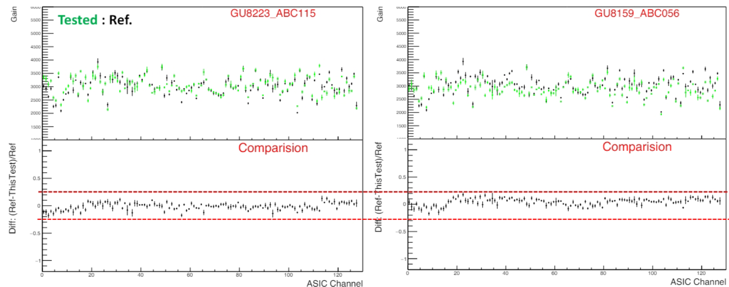
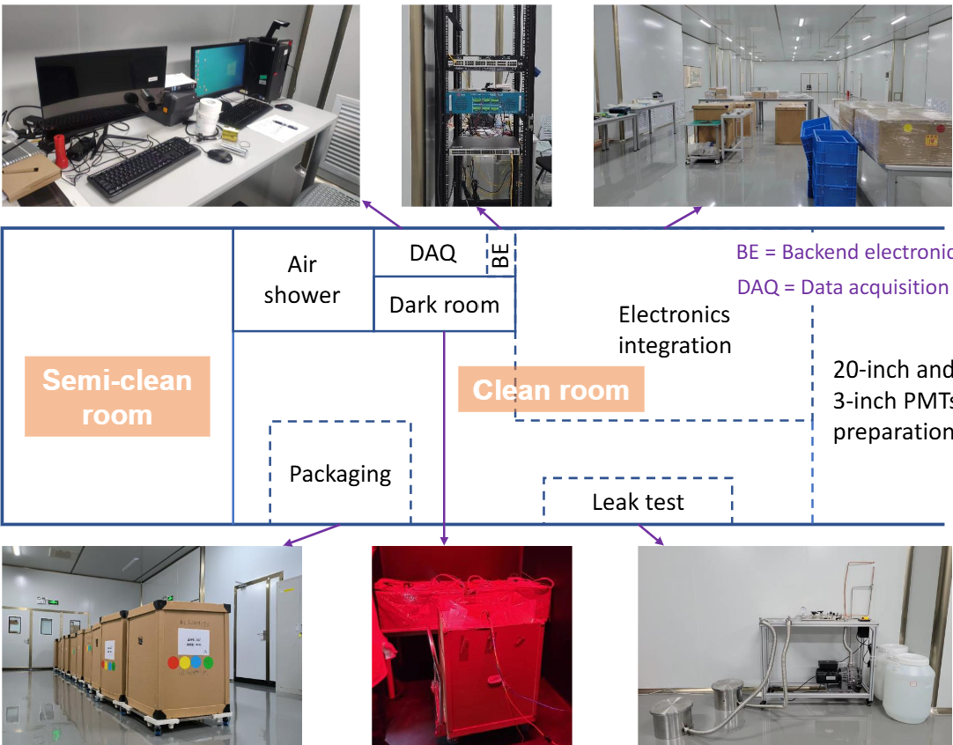
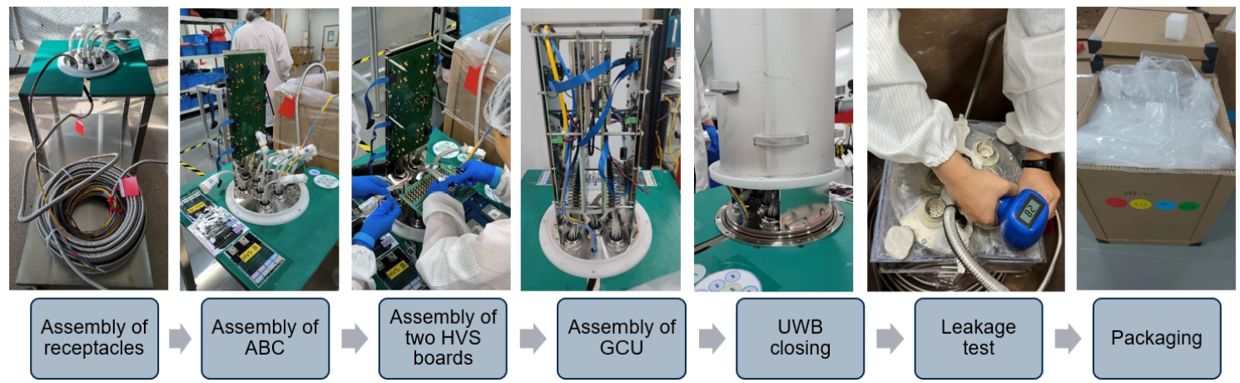
Electronics integration
200+4 spares sets (26,112 channels) of electronics assembled at JUNO
Functional test for all channels with PMTs
Leakage tests for all integrated underwater boxes with a customized SF₆ gas-based system, arXiv:2505.24142
Electronics integration lab
Electronics assembling procedure

Slide 11
SPMT installation and commissioning

Slide 12
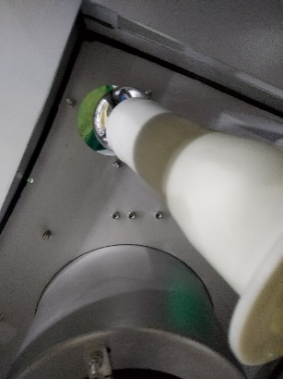
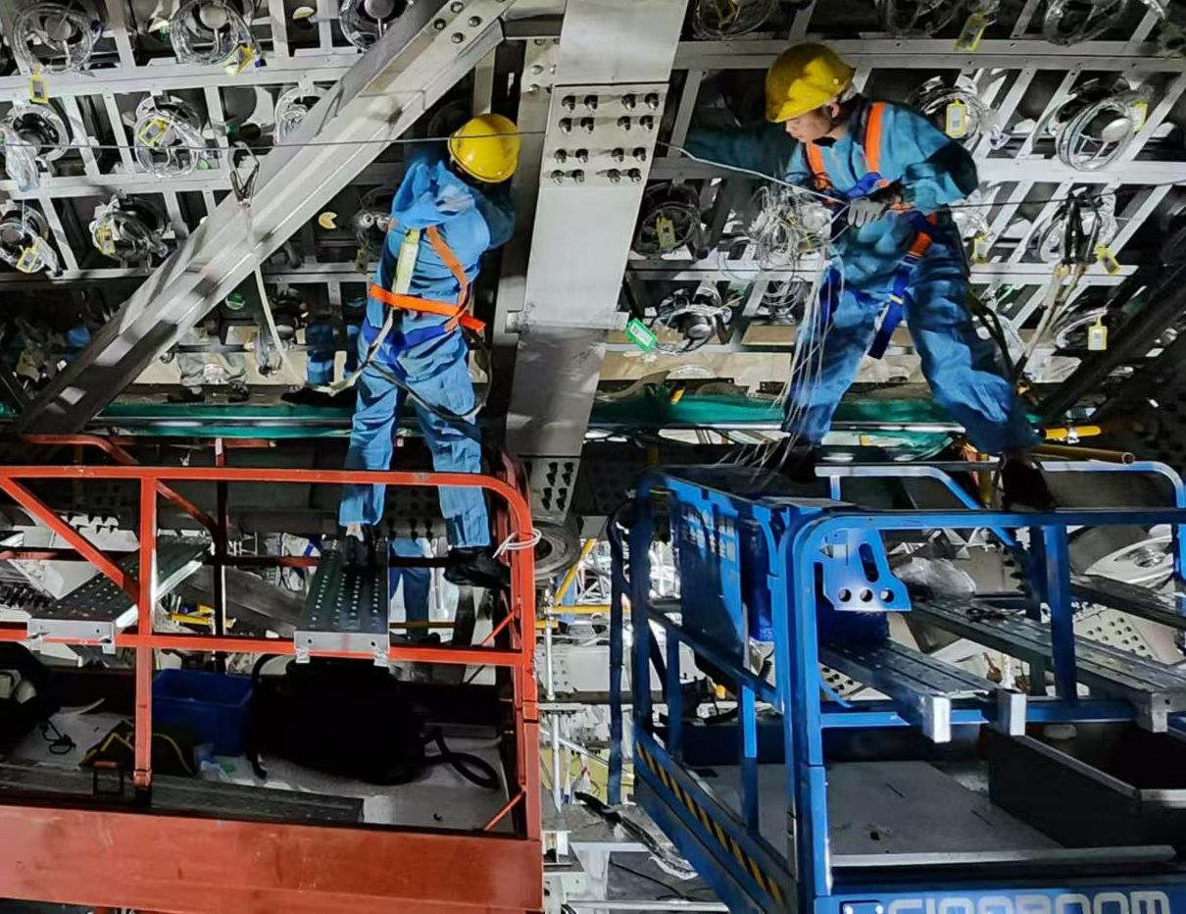
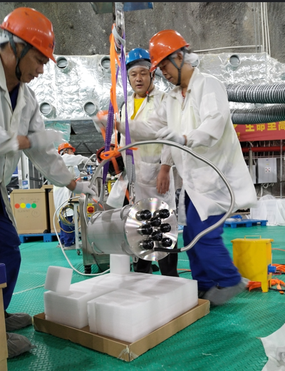
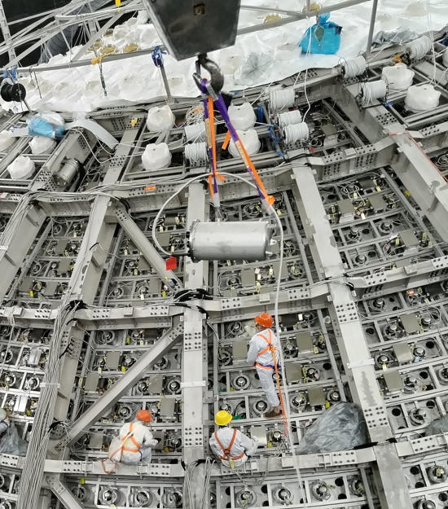
sPMT installation overview
SPMT installation over 2 years and was finished on Dec.5, 2025
Preparation work in the surface assemble building
  Cleaning, cable arrangement, PMT sampling test, electronics test…
Installation for 25,587 PMTs and 200 electronics underwater boxes
  Installation speed: Average 101 PMTs/working day. 1 or 2 group of workers (3-6 workers).
SPMT installation
Electronics lifting and installation

Slide 13
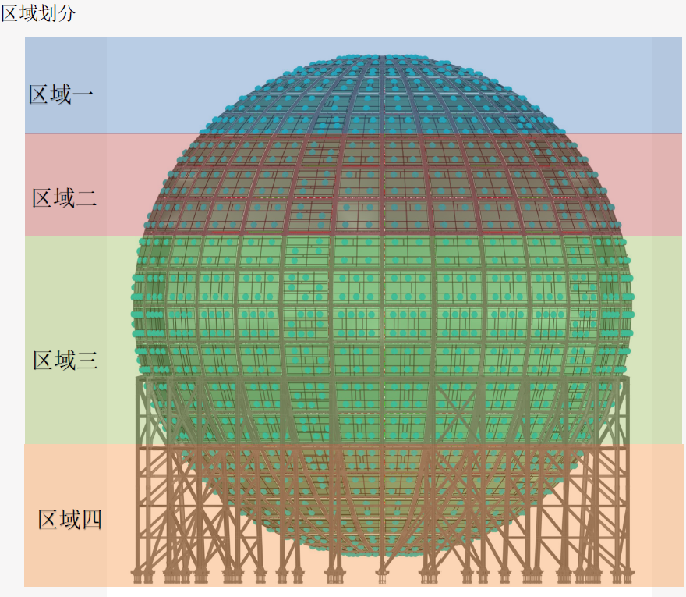
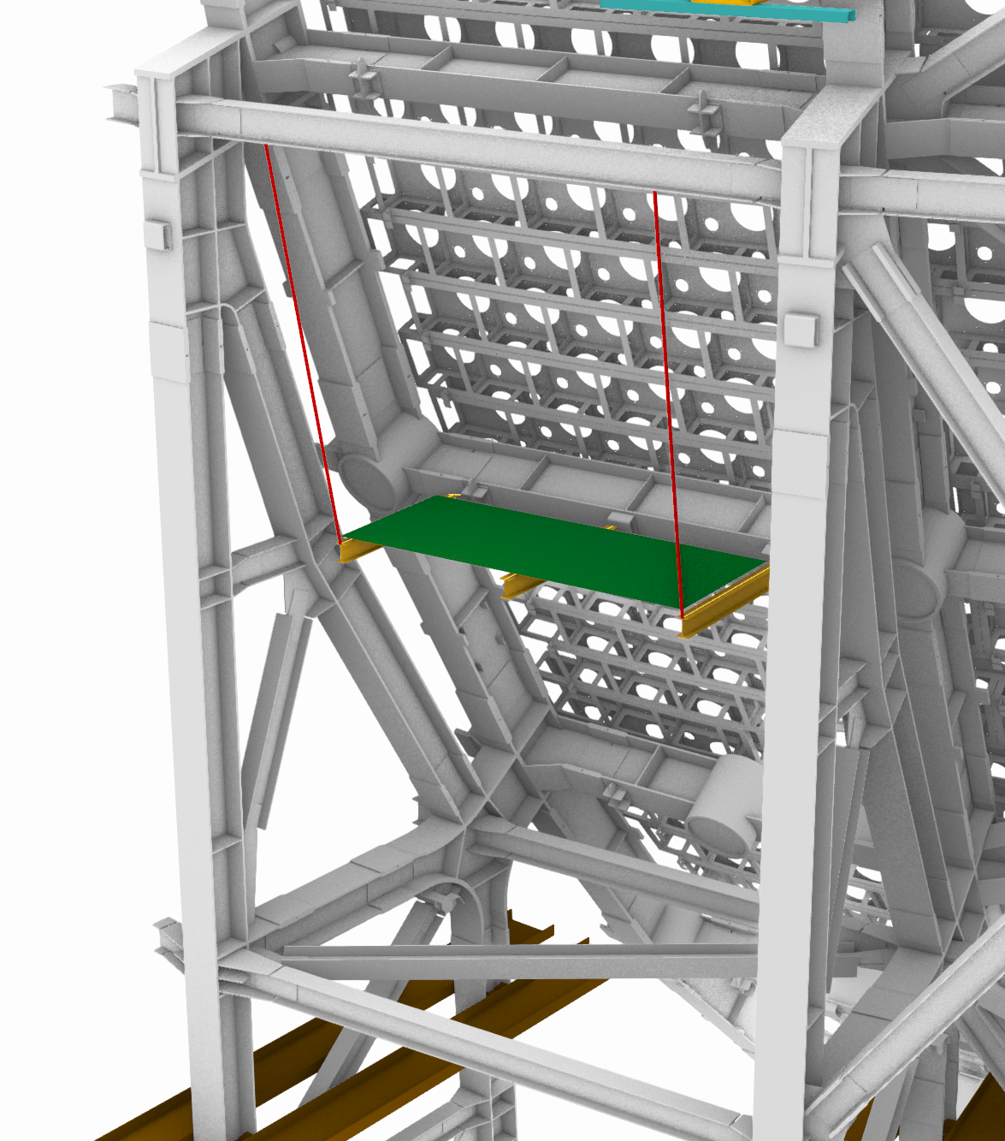
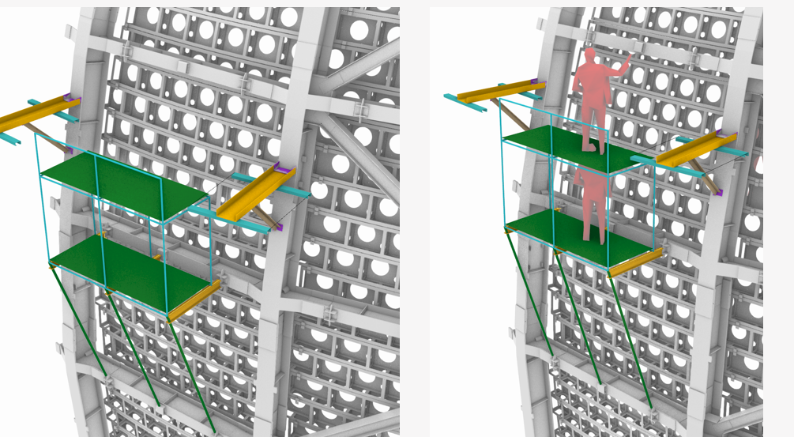
Different regions require different strategies
Region 1 and 2: people directly stand in the windows to install.
Region 3: Outside platform
Region 4: Scissors lift
Region 1
Region 2
Region 3
Region 4

Slide 14
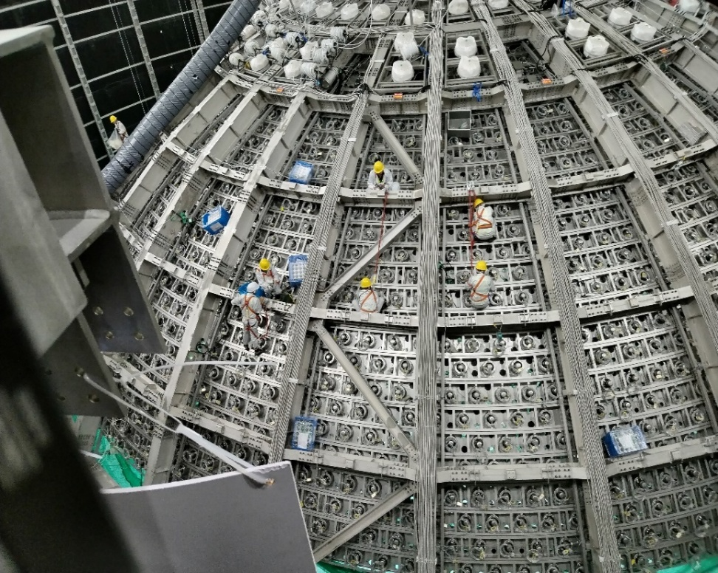
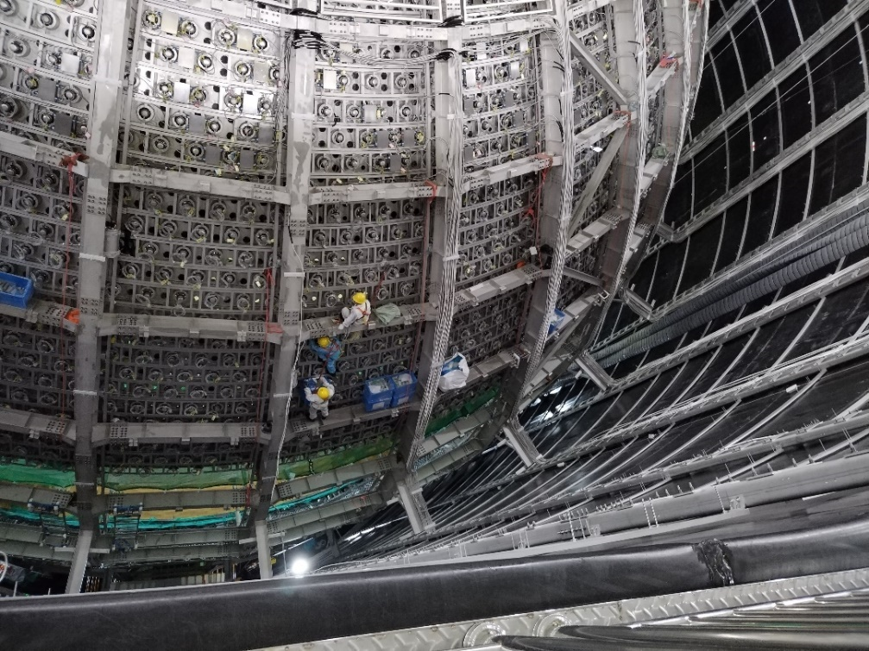
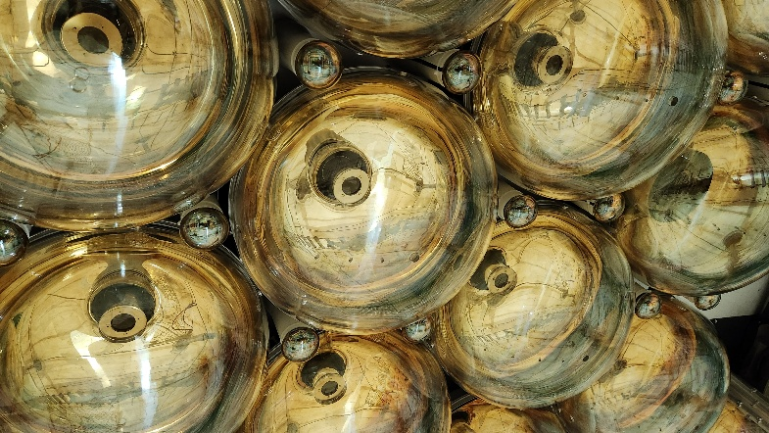
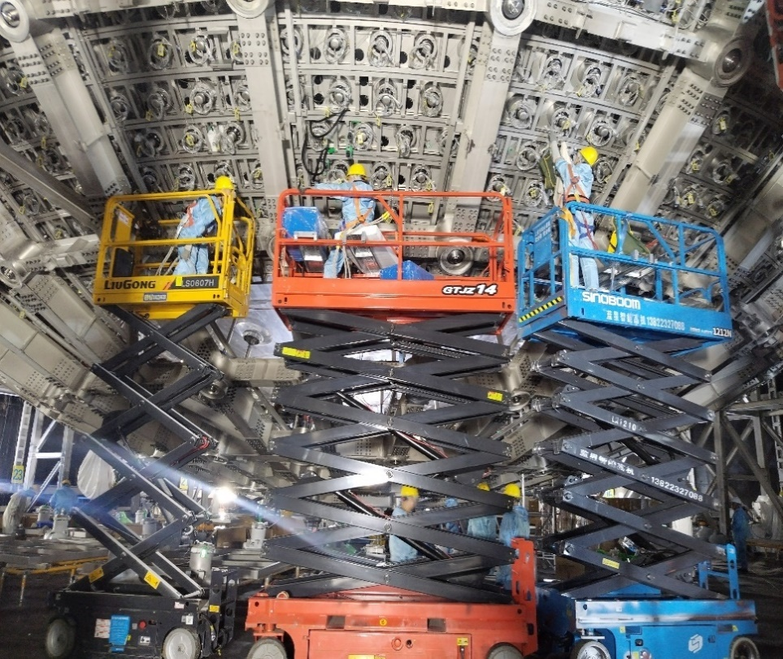
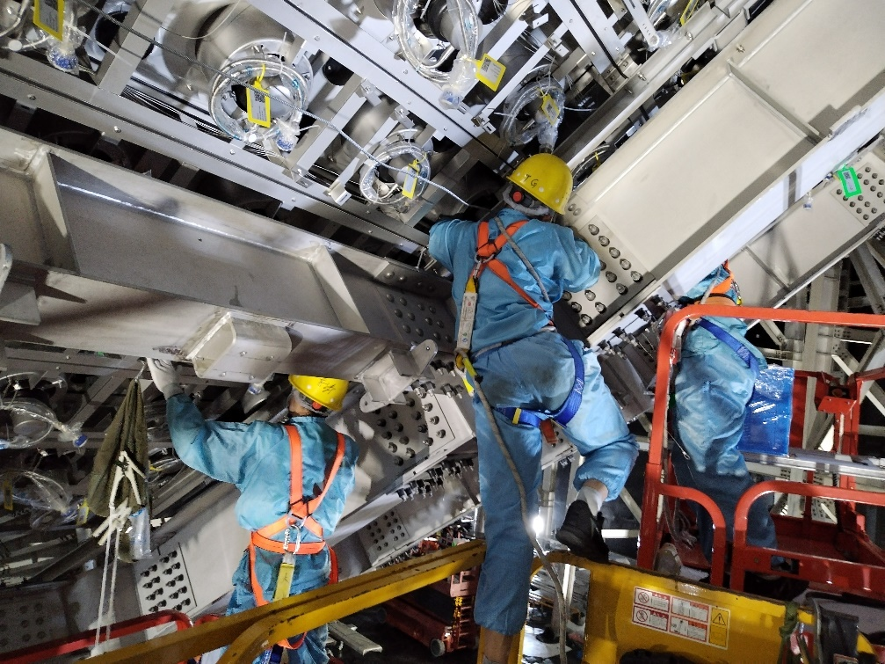
PMT installation
Layer +7
25k sPMTs installed one by one on the stainless steel truss
Checking after installation
  Check cable in each window
  Check safety and cleanness
Layer -7

Slide 15
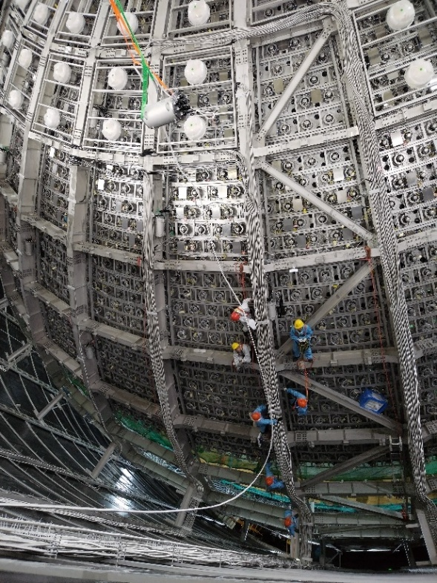
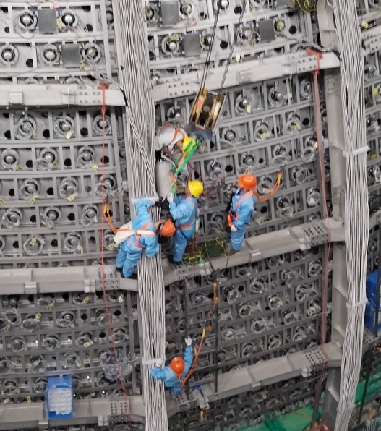
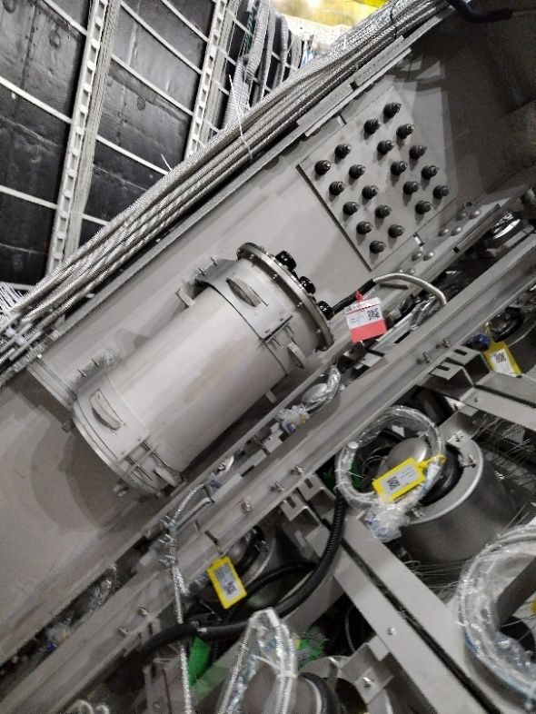
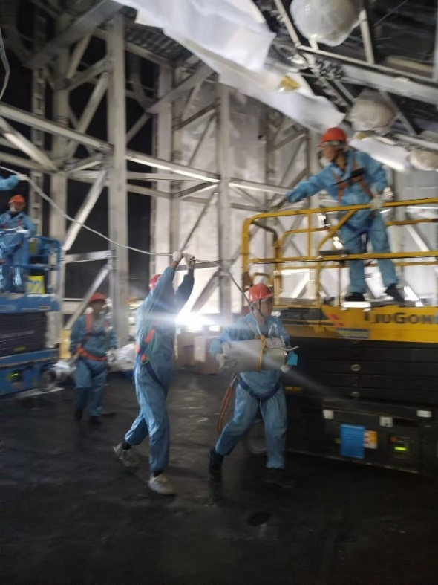
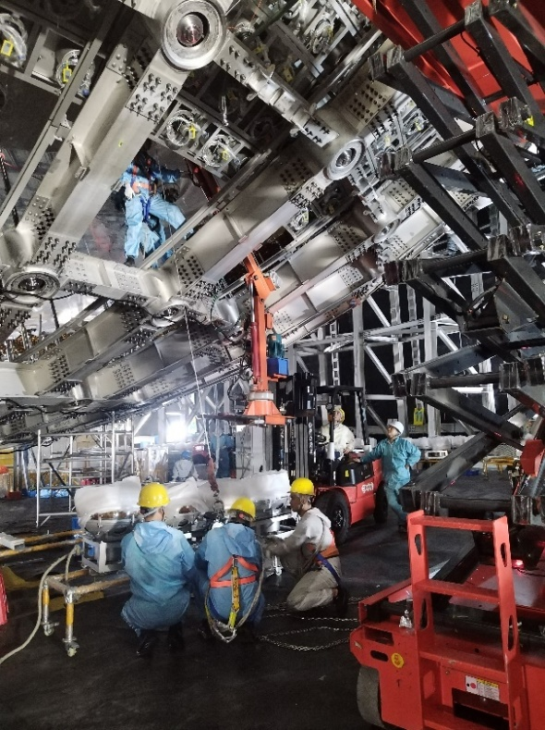
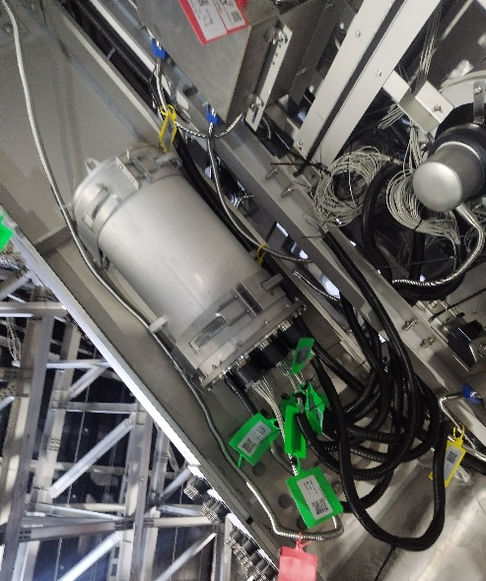
Underwater electronics installation
Supervise on the side
Tests after the installation
  Air vacuum leakage test
  Pedestal test
  Connect to PMTs
  The overall installation checking include label and screw …
  Pedestal test again
  Light-off test
  Check and repair the suspicious PMTs or cables
Layer +5
Layer -8

Slide 16
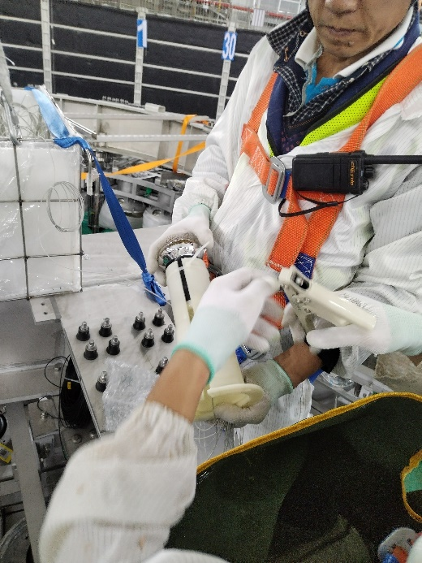
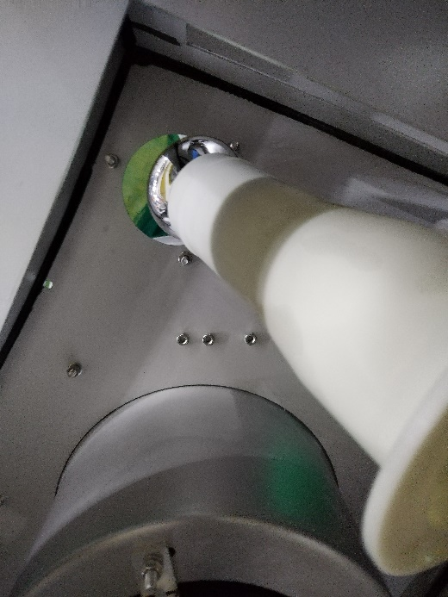
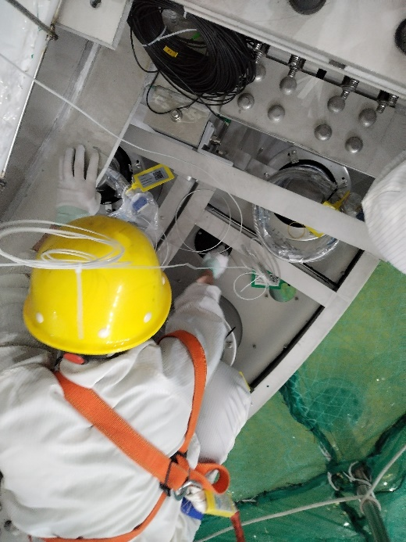
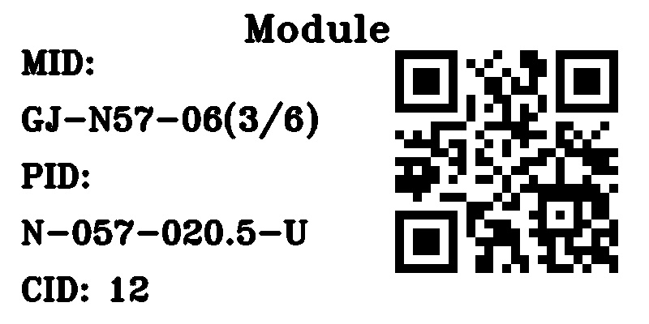
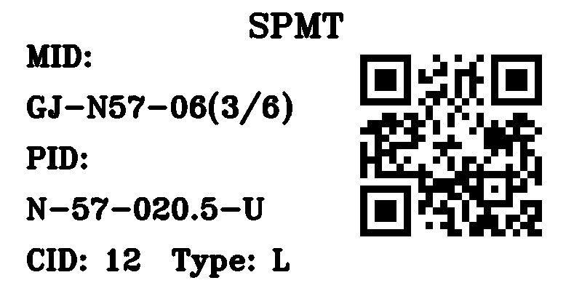
Installation quality assurance
QR code on installation position
Install support
Install PMT
Install Light Barrier
QR code on PMT
Developed a WeChat app to scan QR code to ensure the installation position for each PMT and electronics box
On-site supervision and visual inspection

Slide 17
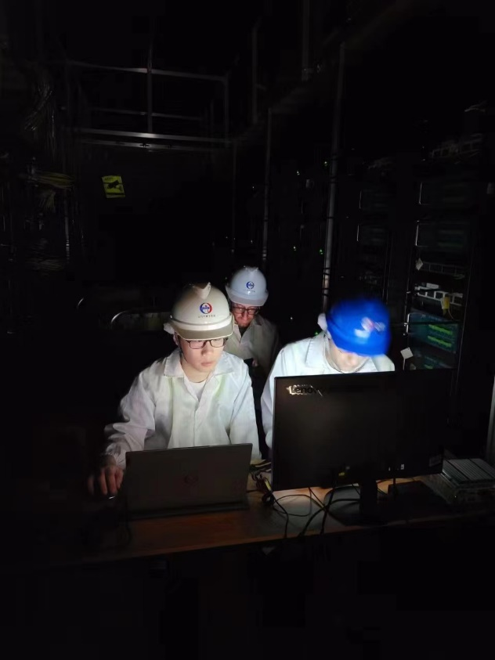




Installation quality control: lights-off tests before water filling
10 times of lights-off tests during installation
Replaced and repaired problematic channels
Operate in electronics room
JUNO detector with lights off
PMT ID
PMT: Hit map
SPE spectrum of 4 SPMTs
The average DCR is ~7kHz

Slide 18


Water phase performance
44 days of water filling from Dec.18th, 2024 to Feb.1st, 2025
PMT dark count rate reduced to 530 Hz due to the covering of the detector
Average gain: 3.8×10⁶
Average hit rate: 530 Hz
RMS ~2.6ADCu (about 0.05PE) for electronics noise

Slide 19




Calibration source performance
$^{60}Co$ (1.333+1.173MeV $γ$)
$^{54}Mn$ (0.835MeV $γ$)
The sPMT system can observe the calibration source clearly
More challenge and excitement are waiting for us!

Slide 20

Summary
After a decade of hard work, sPMT system construction completed
  ~25k 3-inch PMTs with HV divider, frontend cable, connectors and waterproofing
  200 electronics with signal digitizer, control, HV supply and underwater mechanics
Detector commissioning ongoing. Physics data taken coming soon.

