Slide 1
Installation of the Veto 100t/h water system and the detector filling
Cong Guo
On behalf of JUNO collaboration
2025-07-22

Slide 2
Outline
Motivation
  Why does JUNO need a 100 t/h ultrapure water system?
System requirements
  What performance metrics does the system need to meet?
System composition
  How was the 100 t/h water system designed and installed?
System performance
  What are the working conditions of the 100 t/h water system during water filling?
  How does the system perform during circulation mode?
Summary

Slide 3
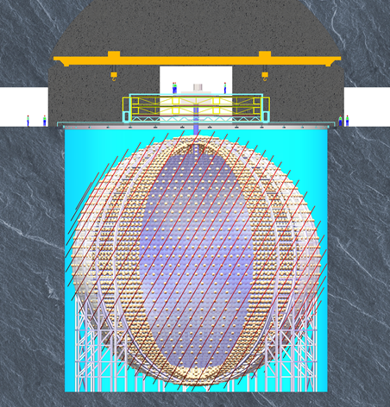
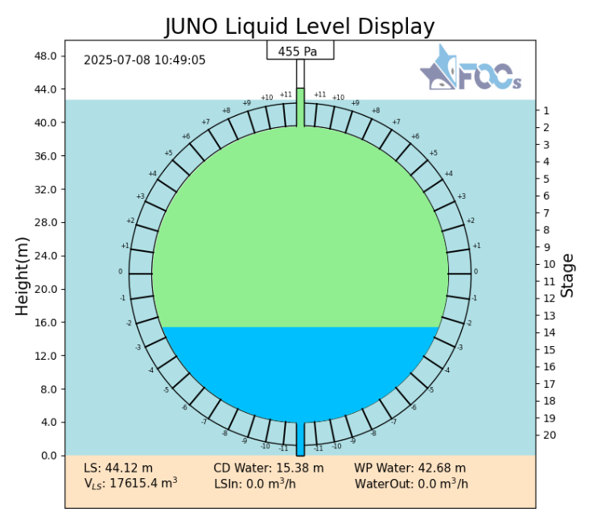
Motivation
WCD
LS
CD
UPW
The Central Detector (CD) is submerged in a Water Cherenkov Detector (WCD), which consists of 40 ktons of Ultra-Pure Water (UPW) and 2400 MCP-PMTs;
For safety and background, the CD was filled with UPW simultaneously with the WCD in the initial filling, 65 ktons of UPW will be used totally ;

Slide 4
Motivation
Water in the WCD:
  Keep the temperature within 21 ± 1℃ for CD stability；
  Keep the attenuation length larger than 40 m for high WCD muon detection efficiency;
  Keep the radon concentration less than 10 mBq/m³ to reduce single rate contribution to CD;
Water in the CD:
  Avoid permanent effects on the LS background;
    Keep particle number meeting JUNO-50 standard (1660 counts/L);
    Keep the radium concentration less than 50 μBq/m³;

Slide 5
System requirements
The UPW system should have 100 t/h water production and circulation ability;
In the output water of the 100 t/h water system:
  The water quality should be good:
    Resistivity ≥ 18 MΩ*cm ；
    Oxygen concentration < 50 ppb;
  The temperature should be adjusted from 15-22 ℃；
  The particle number <1660 counts/L (JUNO-50 standard);
  The radon concentration <10 mBq/m³;
  The radium concentration <50 μBq/m³；
  The ²³⁸U/²³²Th concentration <10⁻¹⁵g/g;

Slide 6
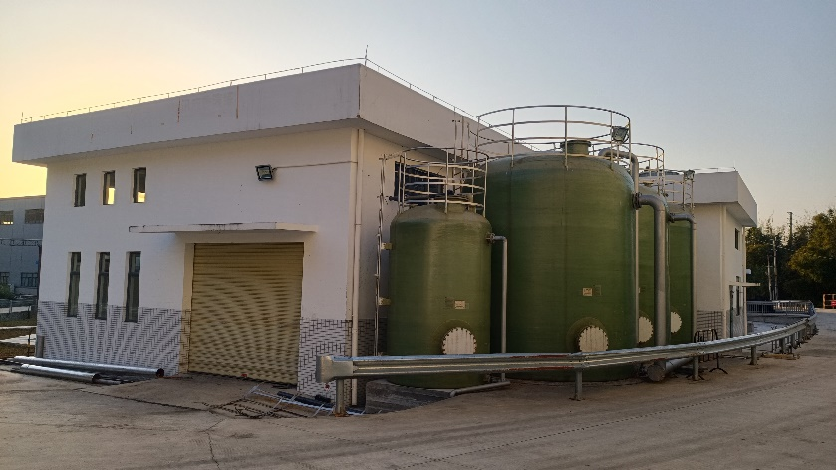
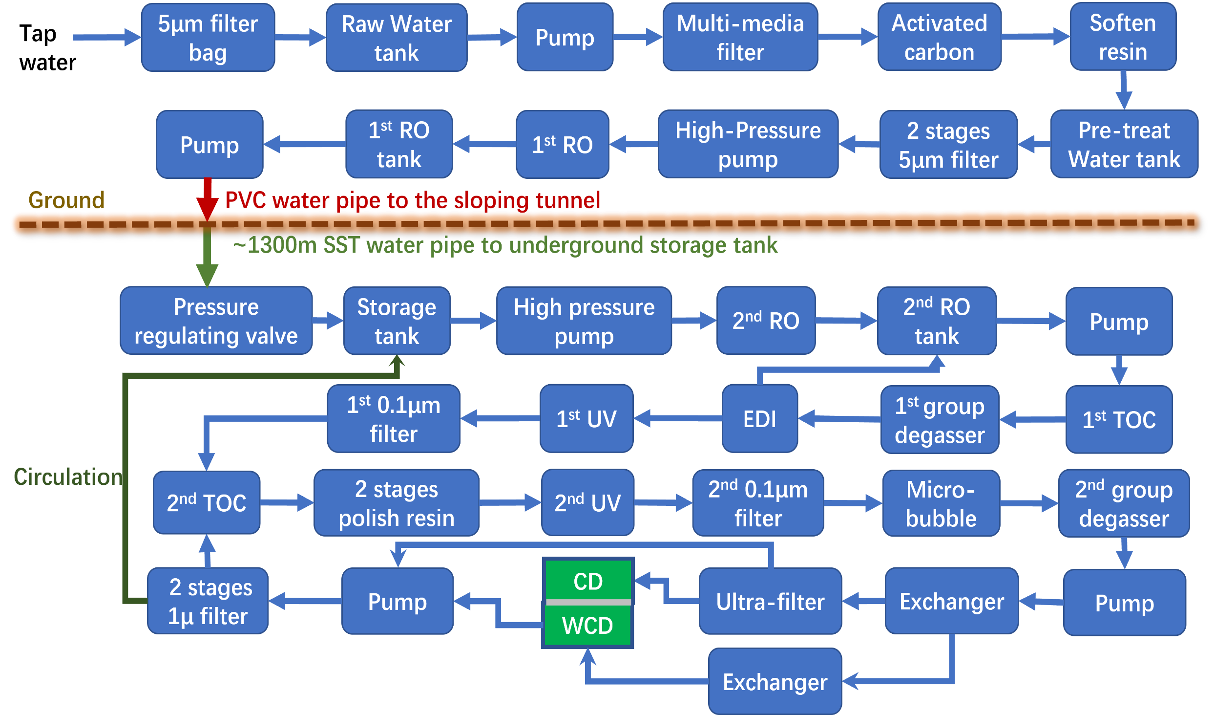
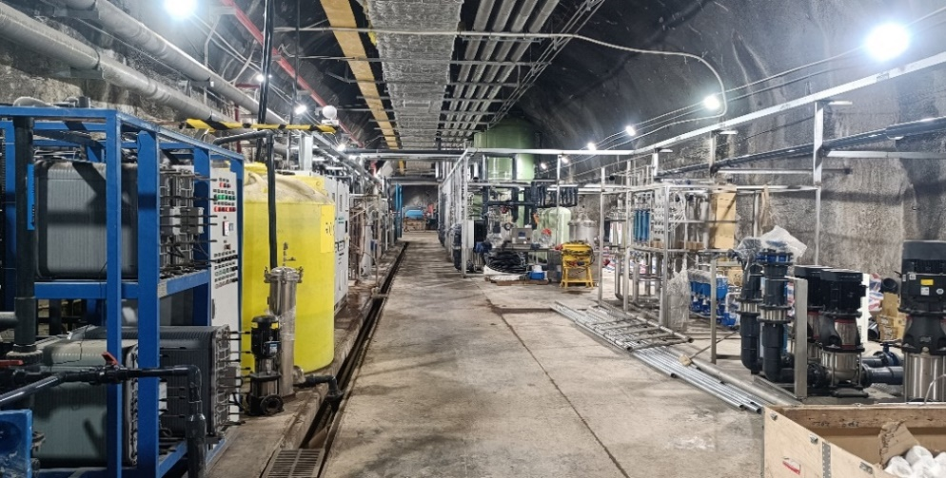
System Composition
Water room on the ground
Water room underground
The water system uses tap water as the source water and passes through 30+ devices to produce UPW.

Slide 7
System Composition
Temperature adjustment:
  3 stages of Exchanger;
Gas removal (Radon/Oxygen):
  Microbubble device + 5 stages of Degassing membrane;
Ion removal (Radium)：
  Radium removal resin + 2 stages of RO + EDI + Polishing resin + Ultra-Filter
Particle removal：
  5 μm filter bags + 5 μm filter cartridge + 0.1 μm filter cartridge + 2 stages of RO + Ultra-Filter

Slide 8
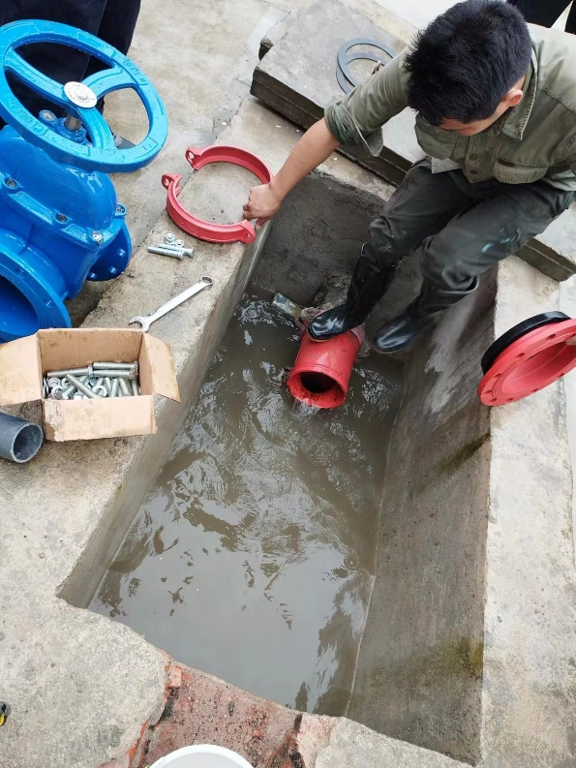
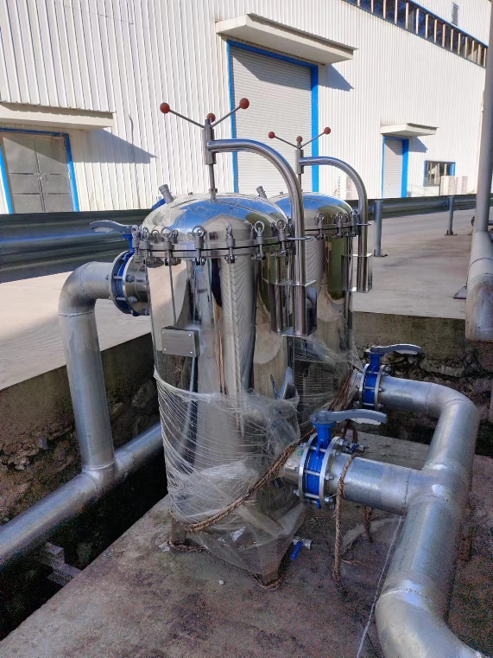
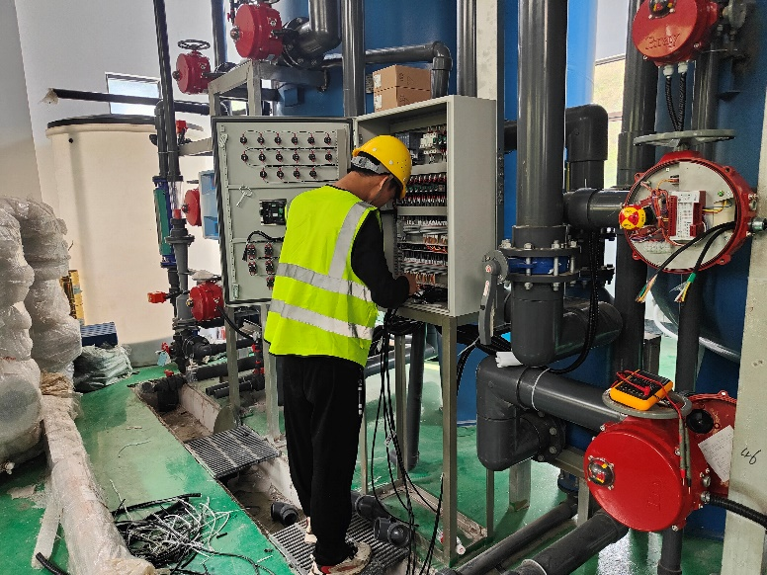
System Composition
Water pipes, valves, filters, and electronic control cabinet installed in the overground water room.

Slide 9
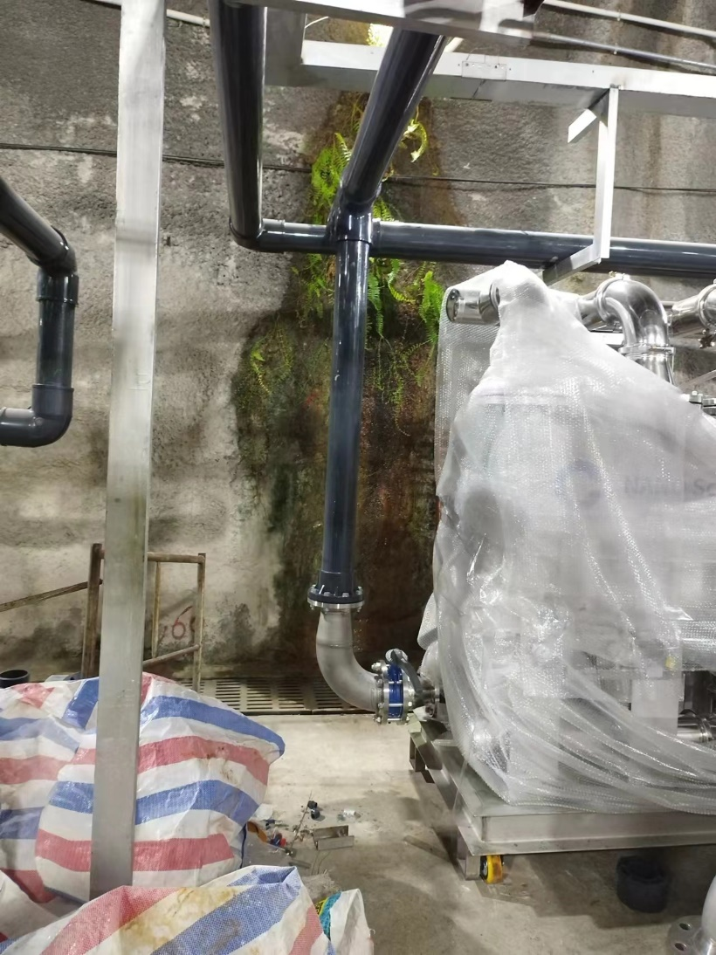
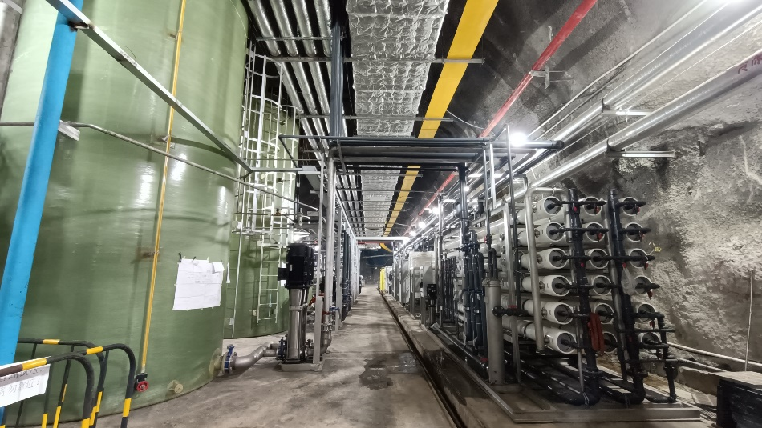
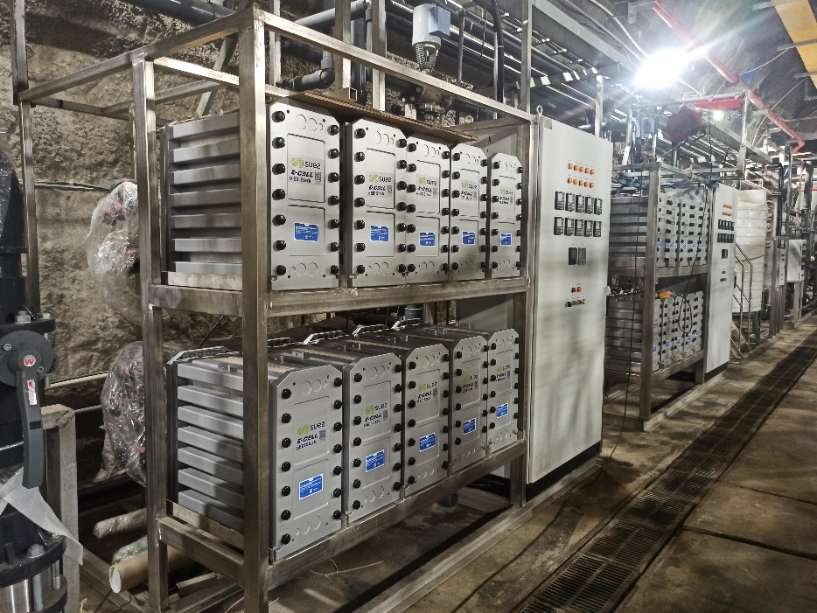
System Composition
RO
EDI
Water tank
Microbubble
Water tanks, RO membranes, EDI modules, and microbubble devices installed in the underground water room.

Slide 10
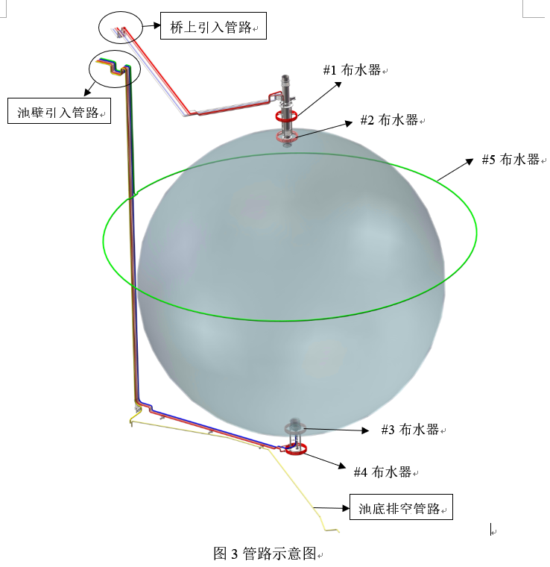
System Composition
One pipelines to CD:
  Supplied UPW to CD in initial filling;
  Pump UPW out from CD in LS filling;
Six pipelines to WCD:
  One to the water inlet located at the corner, supplying UPW during initial WCD filling;
  Four to the water distributors located at the top and bottom of the CD, supplying UPW during water circulation;
  One to the water distributor located near the equator, pumping UPW out from the WCD.
Water inlet

Slide 11
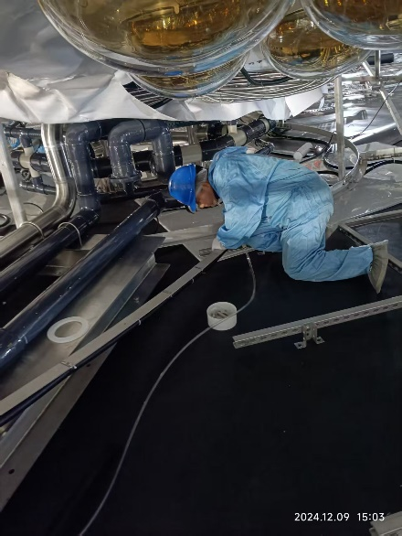
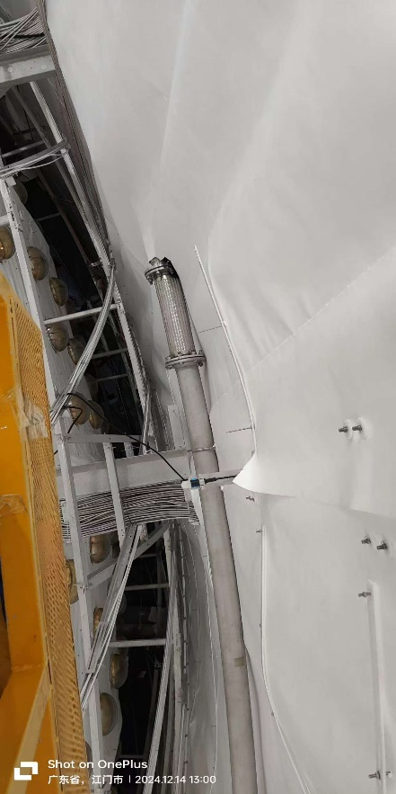
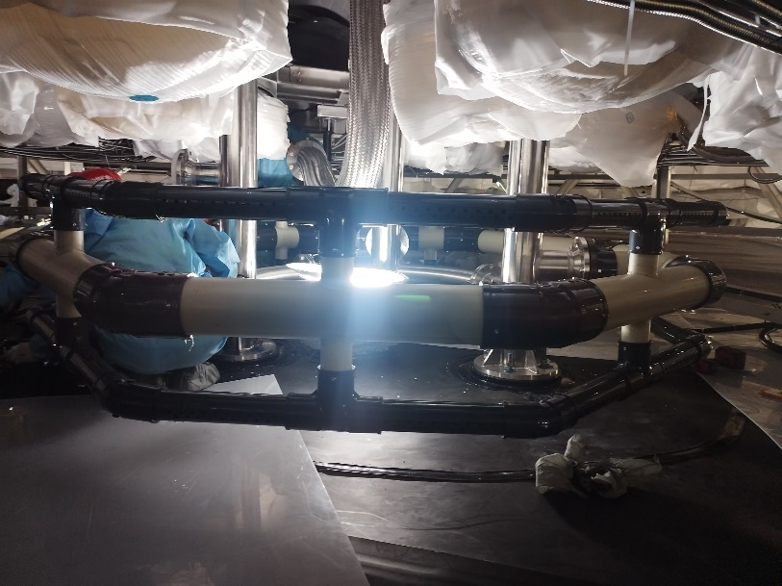
System Composition
Water pipelines, water distributors installed in the water pool;

Slide 12
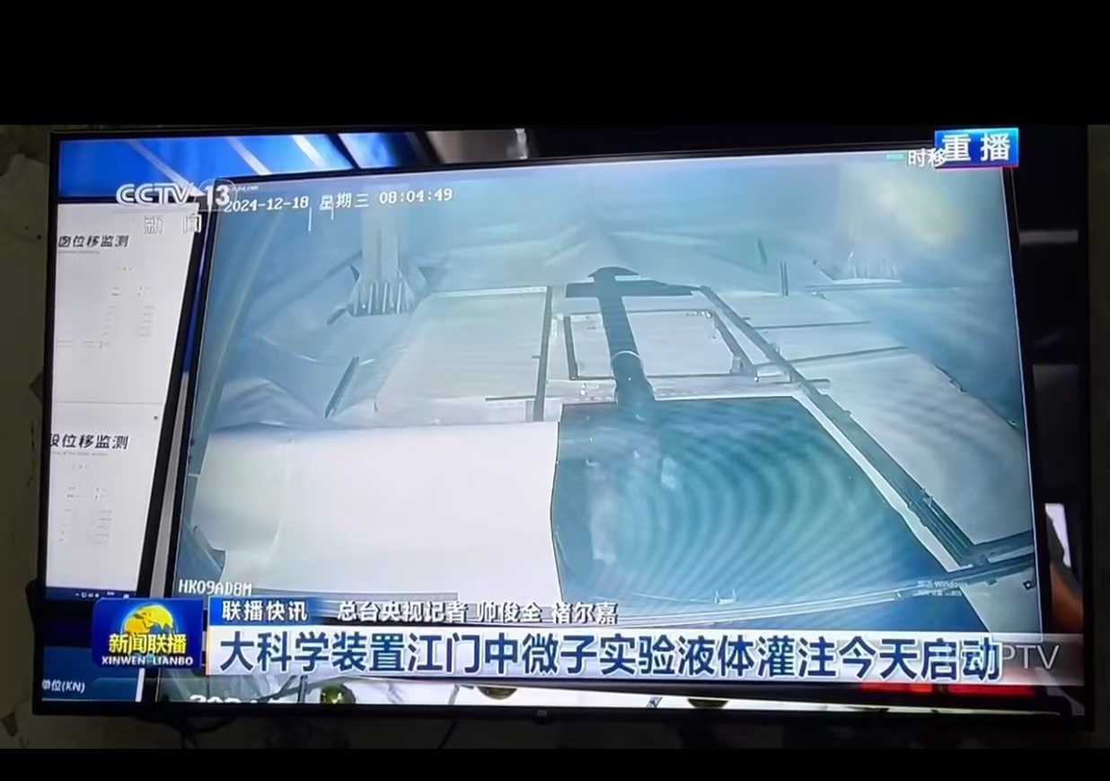
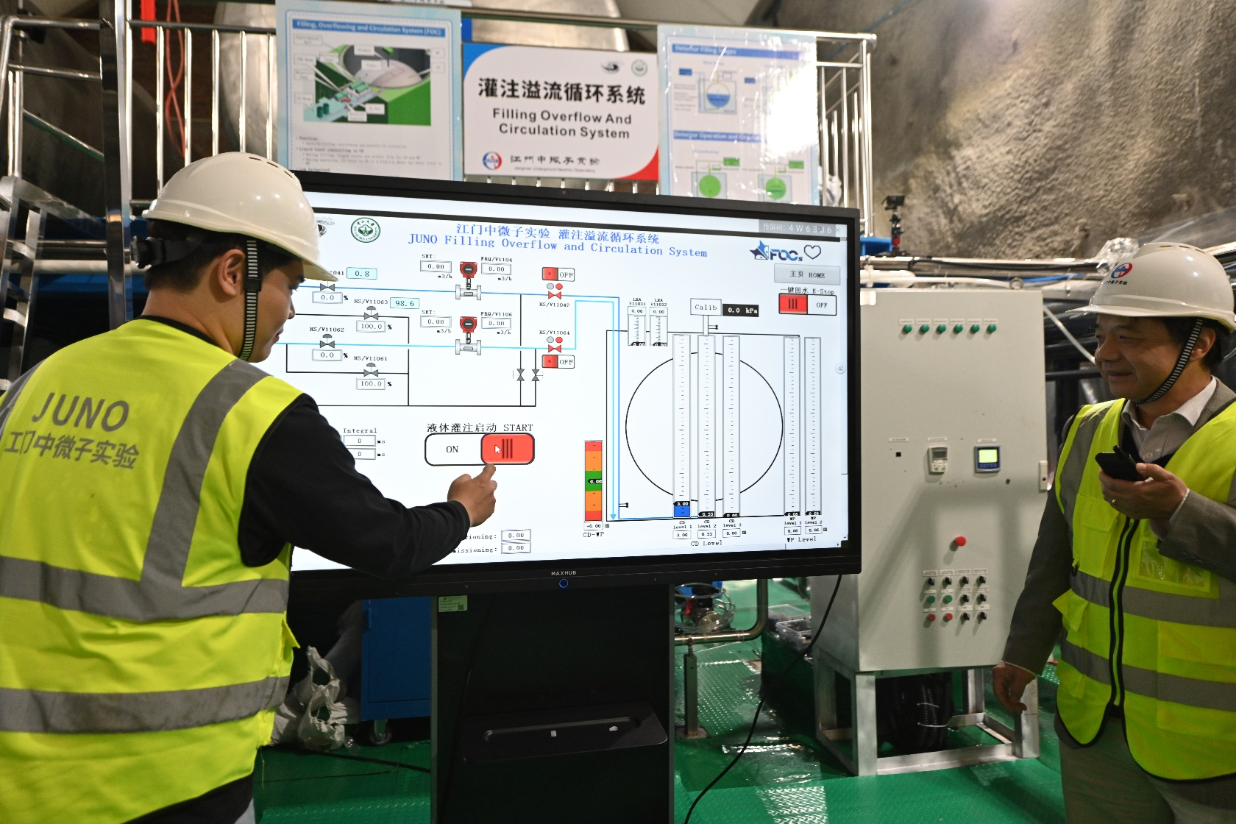
System performance — UPW filling
On Dec 18^{th,} 2024, UPW filling for CD and WCD started.
On Feb 1st, 2025, UPW filling completed, 40 ktons of UPW was filled in the WCD, and 25 ktons of UPW was filled in the CD.

Slide 13
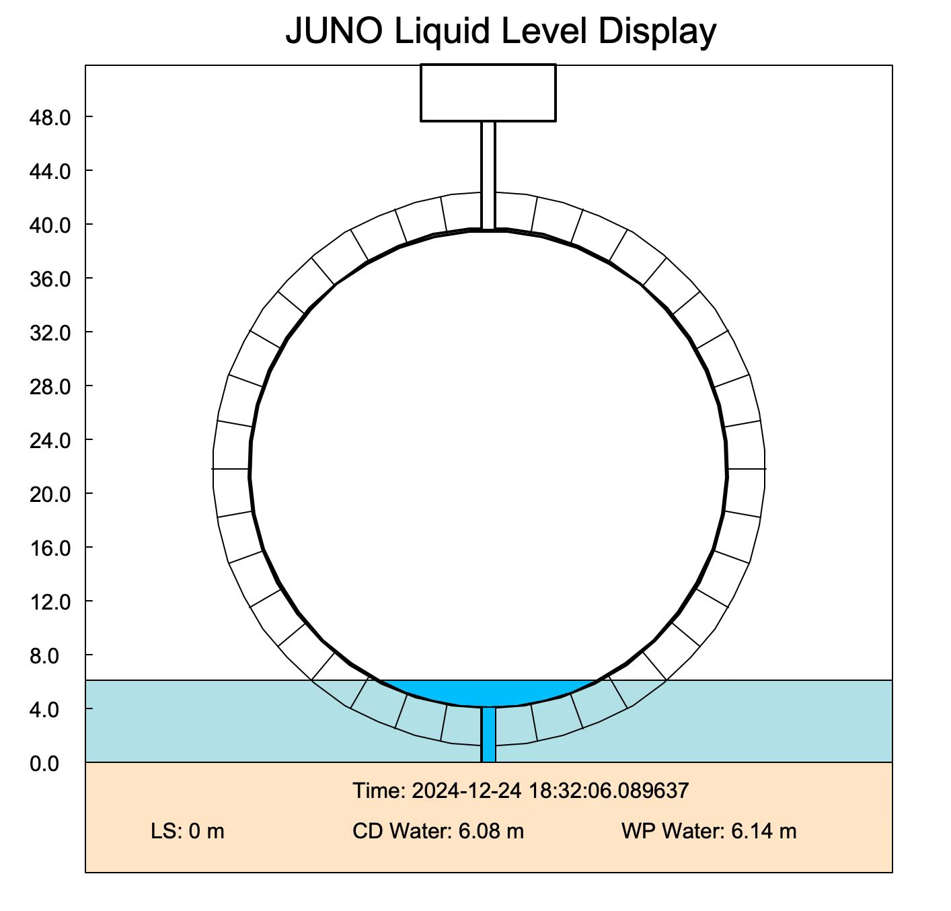
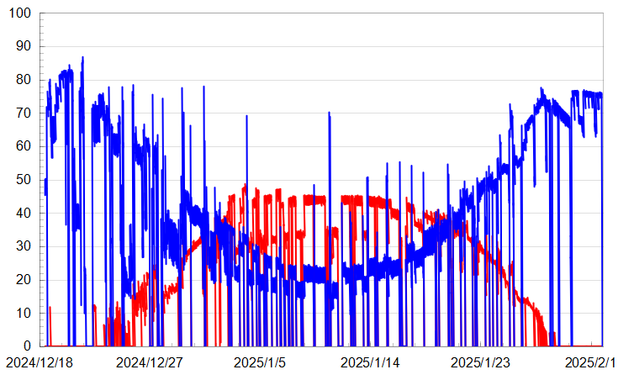
System performance — UPW filling
WP
CD
Filling flux [m³/h]
To maintain the stability of the acrylic sphere, water levels in CD and WCD were well controlled, and UPW was simultaneously filled into the CD and WCD.
Water flow rate in CD varied from 0 to 50 t/h, and that in WP varied from 20 to 90 t/h;

Slide 14
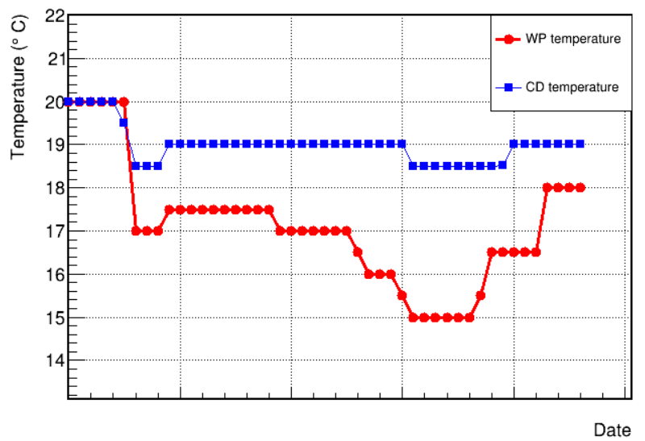
System performance — UPW filling
The temperature of the water sending to CD and WCD can be controlled separately;
Water sending to CD will be in direct contact with the acrylic;
Water sending to WCD through the water inlet near the WP wall;
Water in the pool needed to counteract the heat generated by the electronics and dissipated by the pool walls.
The temperature for CD stabilizes at 18.5 ~19.0 ℃, while for WCD, it changes from 15 ~ 20 ℃.
Water entering CD
12-18
12-28
01-07
01-17
01-27

Slide 15
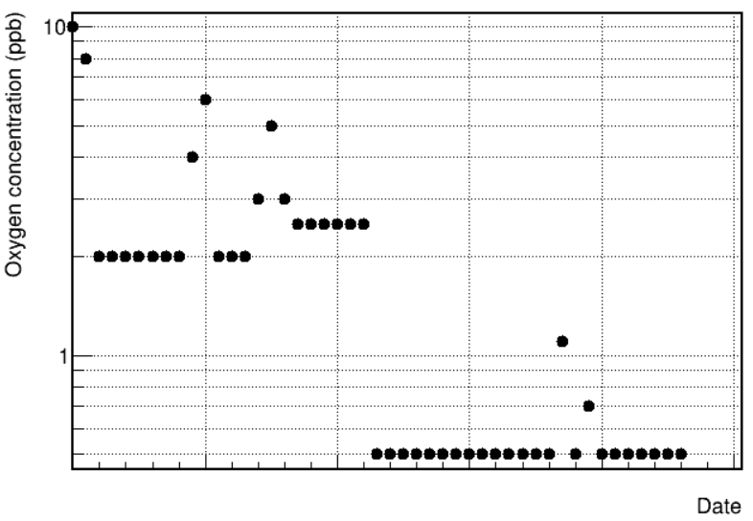
System performance — UPW filling
Water quality was good during filling, the resistivity and oxygen concentration in water were measured online:
  The resistivity of the produced water has been maintained at 18.2 MΩ*cm;
  The oxygen concentration in the water was ~10 ppb at the beginning of filling, and then it was continuously reduced through the optimization of the system, and finally stabilized between 1-2 ppb.
12-18
12-28
01-07
01-17
01-27
Oxygen concentration

Slide 16
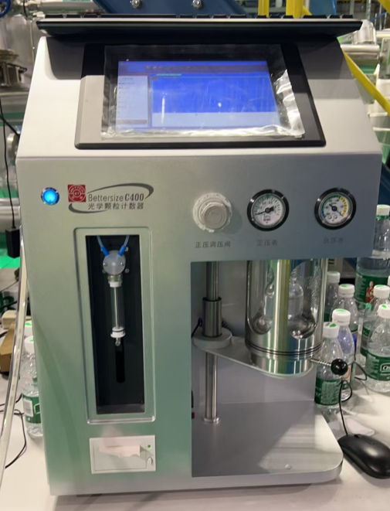
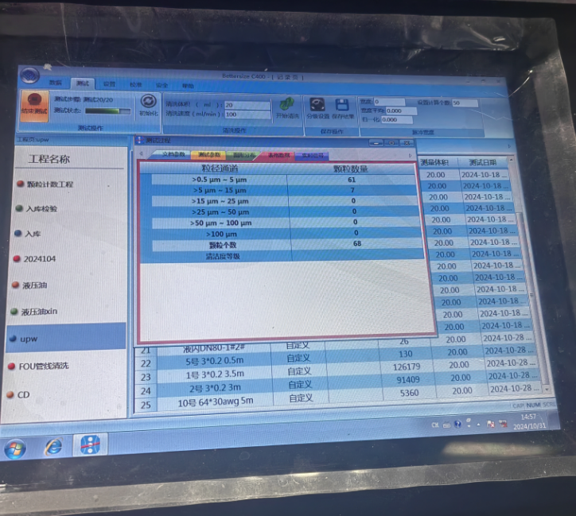
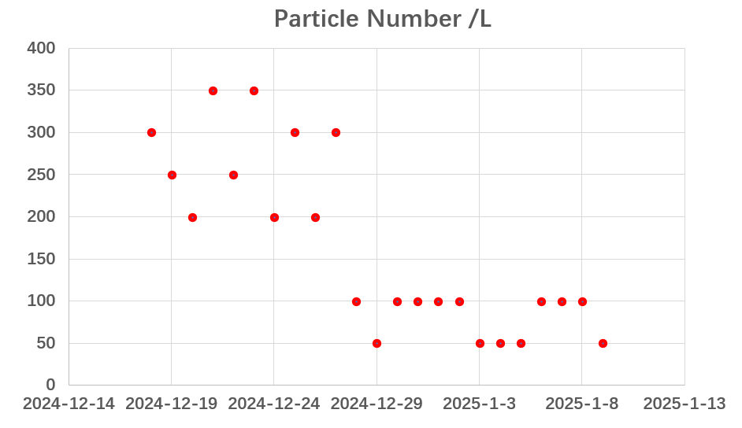
System performance — UPW filling
Device changed afterwards
The particle numbers in the water was measured using a commercial instrument, the bettersize C400.
The sample volume for each measurement is 20 mL;
The particle number is between 50~350 counts/L, meeting the JUNO-50 standards (1660 counts/L);

Slide 17
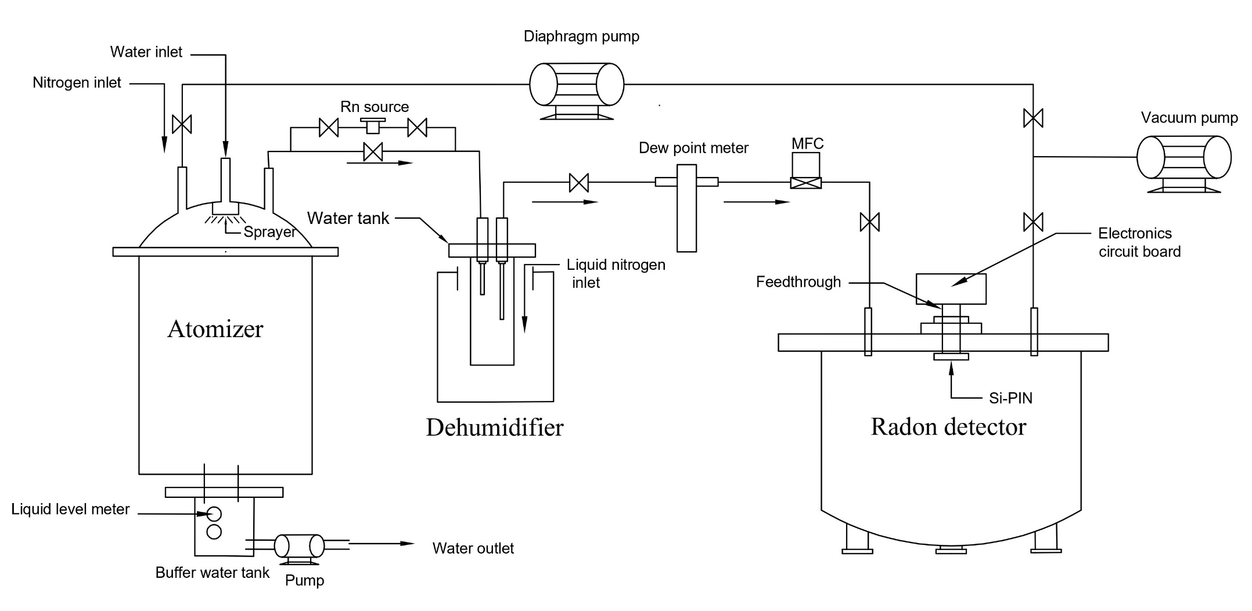
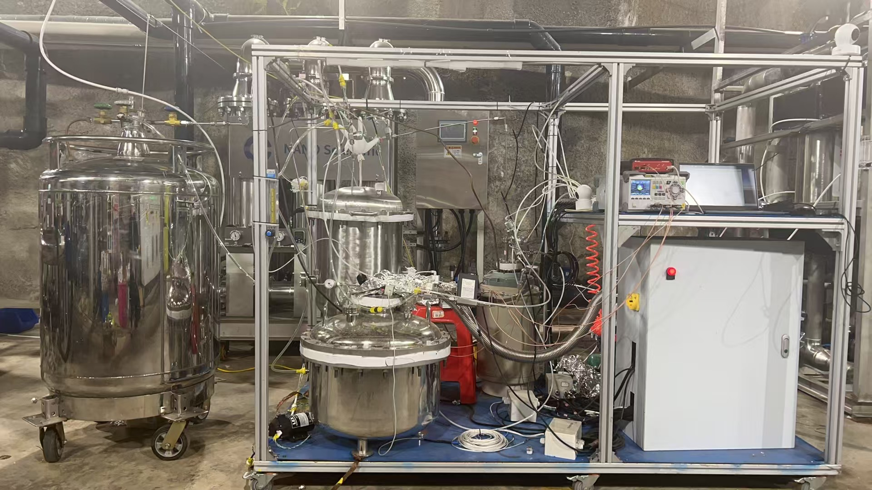
System performance — UPW filling
The radon concentration in water is measured with a self-developed system, which consists of:
  Atomizer: transfers radon from water into gas;
  Dehumidifier: reduces the humidity of the gas for radon detection;
  Radon detector: determines the radon concentration based on the electro-collection.
The sensitivity for this system is 0.42 mBq/m³, details can be found in NIM A 1063 (2024) 169244;

Slide 18
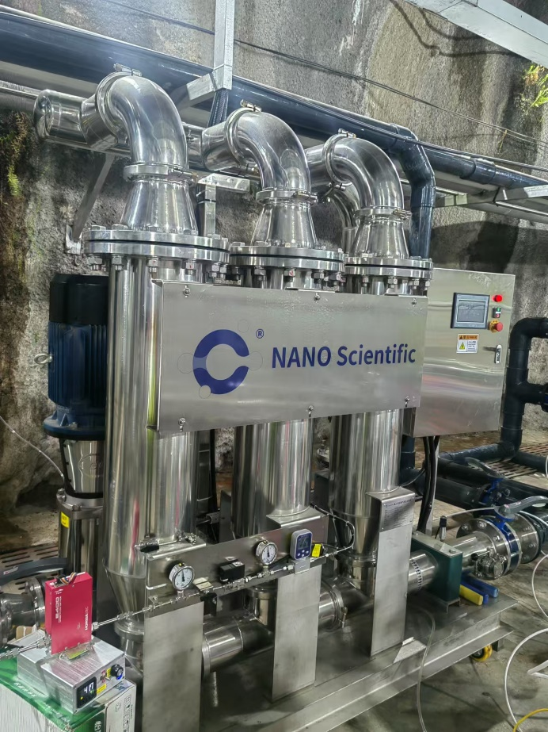
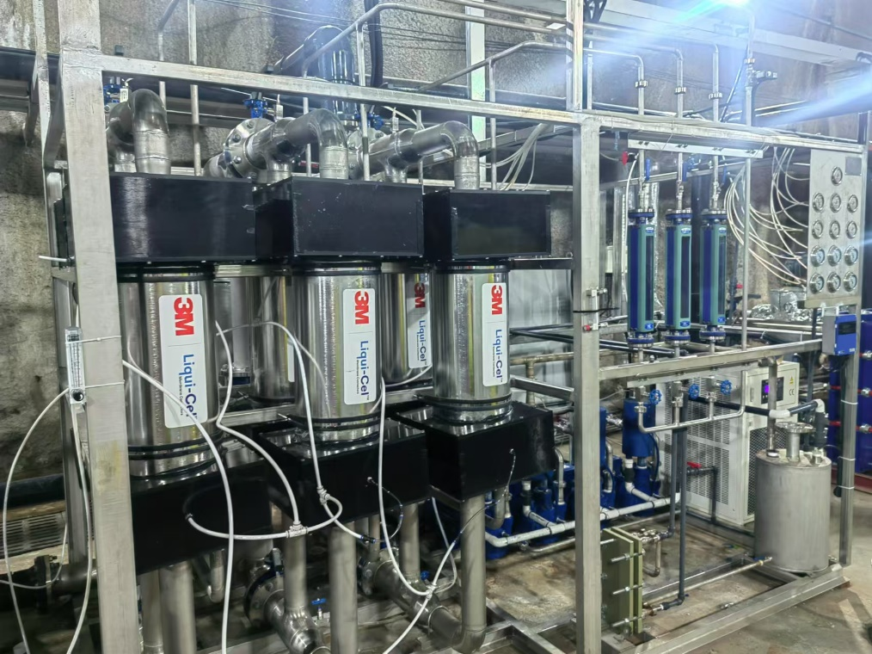
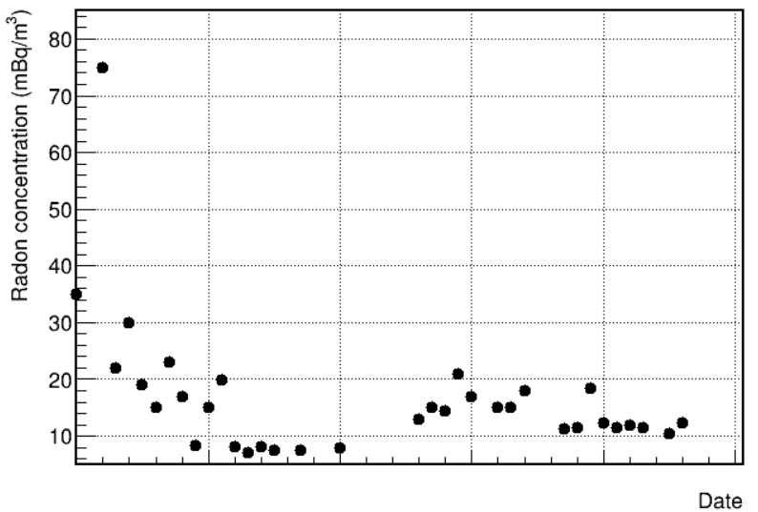
System performance — UPW filling
A microbubble device and five stages of degassing membranes are used to remove radon from water;
The degassing efficiency decreases as the gas concentration in water decreases;
Microbubble device can generate bubbles in the size of nm~μm, thus increase the gas concentration in water;
The combined application of microbubbles and degassing membranes reduced the radon concentration in water from 10 Bq/m³ to ~5 mBq/m³; realized >99.9% radon removal for single pass.
Radon concentration
12-18
12-28
01-07
01-17
01-27

Slide 19
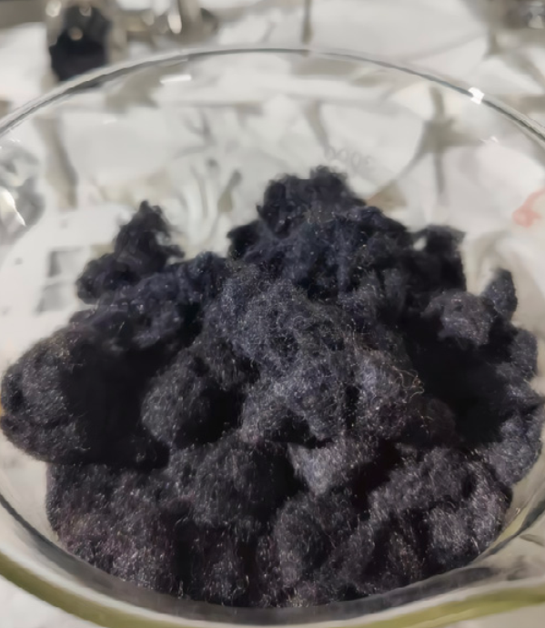
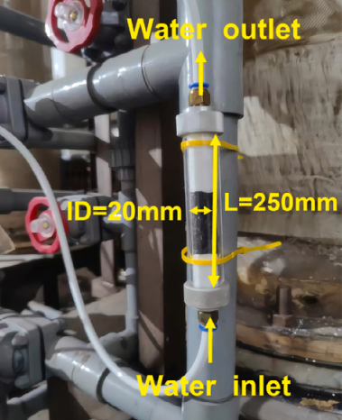
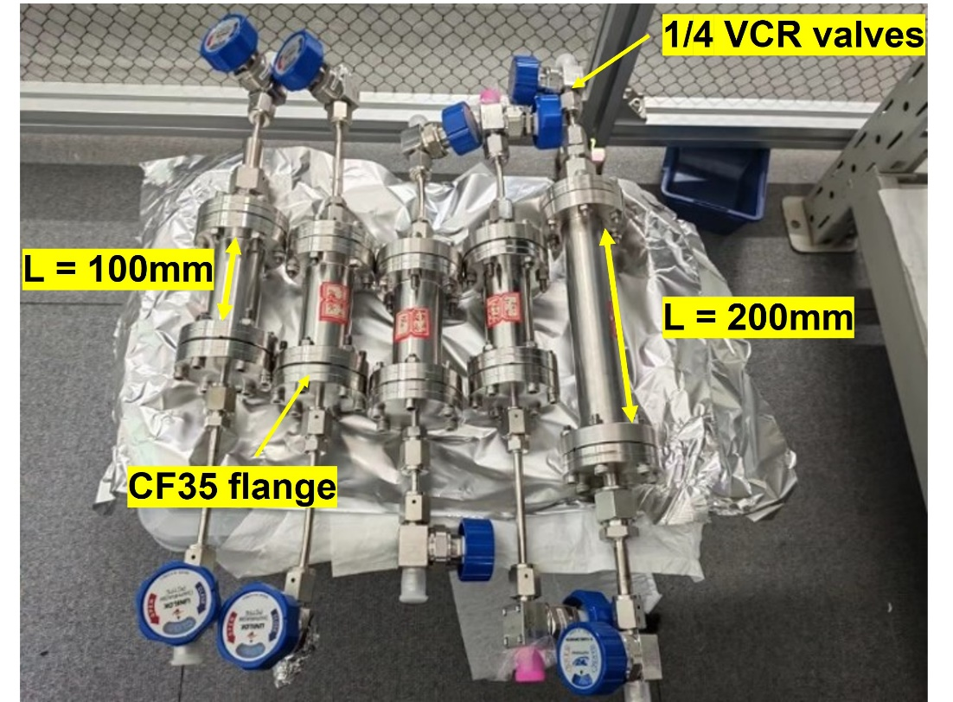
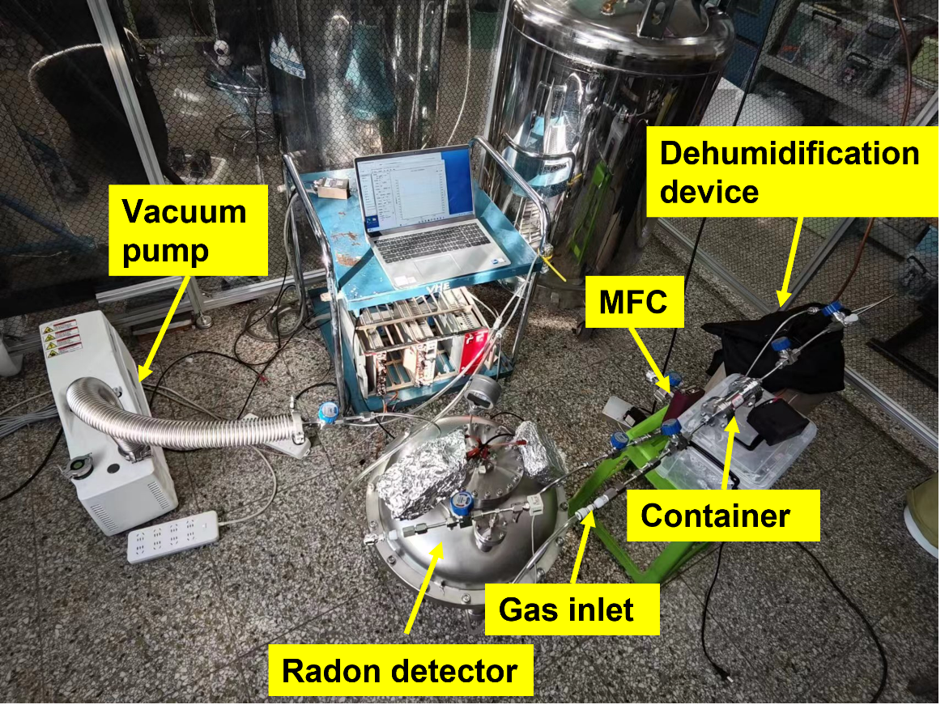
System performance — UPW filling
Mn-fiber
The Radium concentration in water is determined with a self-developed system, which consists of:
  Low-background Mn-fiber, which is used to extract radium from water;
  Extraction column, in which water flows through;
  Emanation chamber, in which radium decays and produces radon;
  Radon emanation measurement system, which is used to determine the radium concentration;
The sensitivity of this system is 6 μBq/m³, details can be found in NIM A 1063 (2024) 169257;

Slide 20
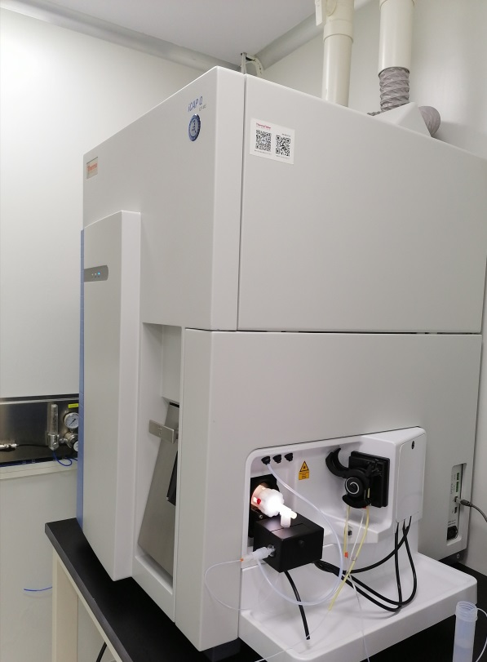
System performance — UPW filling
The ²³⁸U/²³²Th concentration in water is measured by a commercial ICP-MS;
Device sensitivity for UPW measurement:
  ~0.1 ppq (10⁻¹⁷g/g) for ²³⁸U;
  ~0.4 ppq for ²³²Th;
Measurement results:
  0.4 ± 0.1ppq for ²³⁸U;
  <0.4 ppq for ²³²Th;

Slide 21
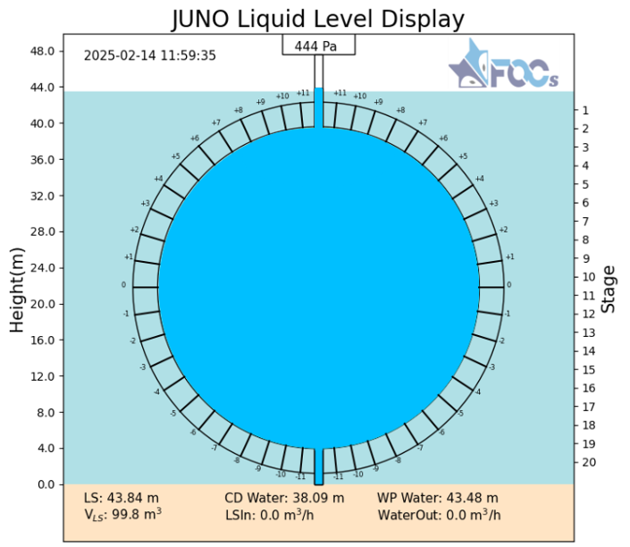

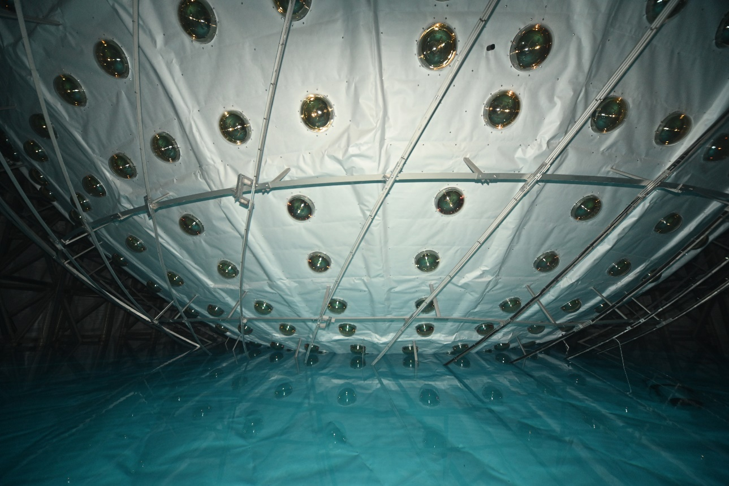
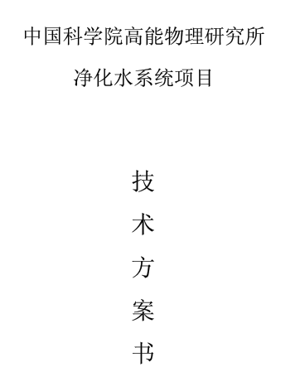
Milestones of the UPW system
Equipment sent to onsite
Underground
system installation
Circulation
started
May, 2019
Dec, 2023
Dec 18th, 2024
Company bidding
Apr, 2022
Overground
system installation
Nov, 2024
UPW filling
started
Feb 2nd, 2025

Slide 22
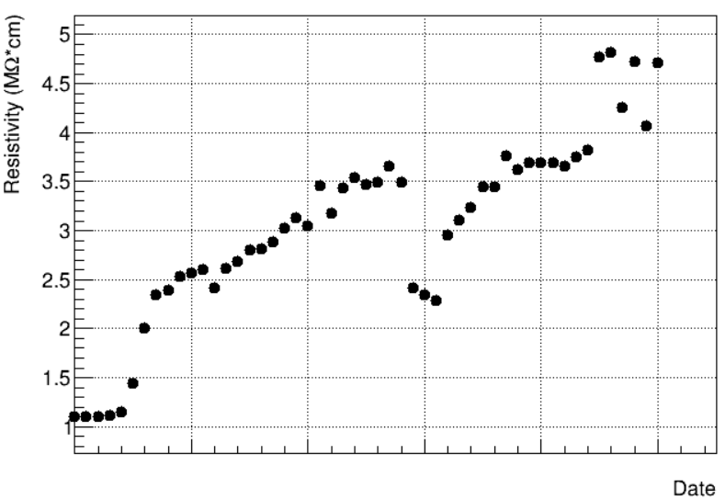
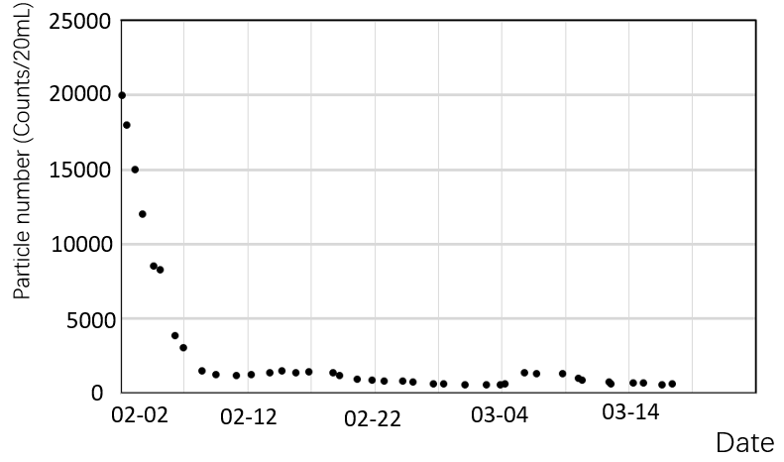
System performance — WP circulation
Water inlet changed from bottom to top
02-02
02-12
02-22
03-04
03-14
03-24
Resistivity of the WP output water
Particle number in the WP output water
The water system has been transferred to WP circulation since 2nd Feb. After 2 volumes of circulation, the output water of the WP:
  The resistivity increased from 1.1 MΩ*cm to 4.8 MΩ*cm;
  The particle number in the water reduced from ~20000 counts/20mL to ~1000 counts/20mL;

Slide 23
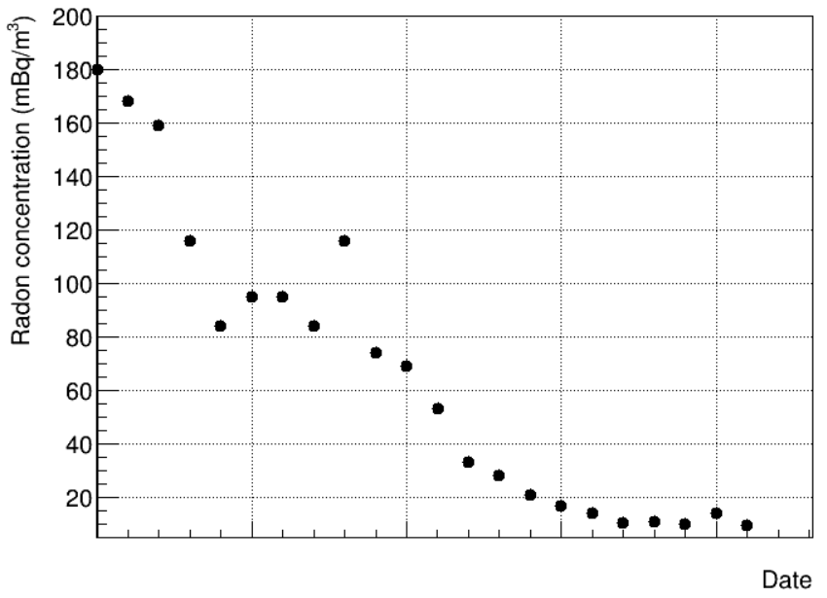
System performance — WP circulation
With 2 volumes of circulation:
  The radon concentration reduced from 180 mBq/m³ to 9.5 mBq/m³, which is mainly due to the radon decay;
  The radium concentration reduced from 5 mBq/m³ to 1 mBq/m³ ;
  The ²³⁸U concentration reduced from 229 ppq to 62 ppq;
  The ²³²Th concentration reduced from 23.8 ppq to 8.8 ppq;
The radon concentration in the water system output water was <1mBq/m³, which is mainly due to the radon reduction in the source water of the system.
02-02
02-12
02-22
03-04
03-14
Radon concentration in the WP output water

Slide 24
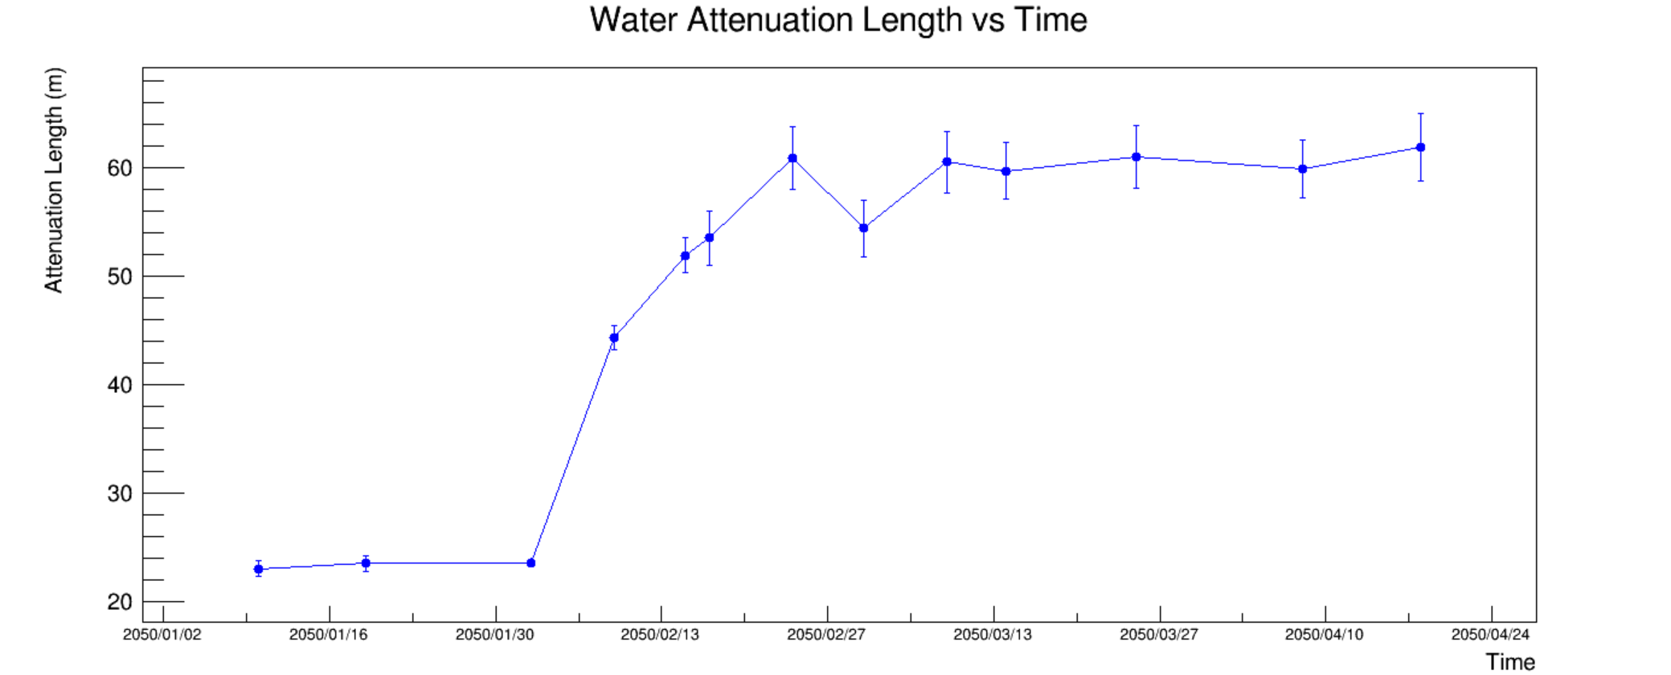
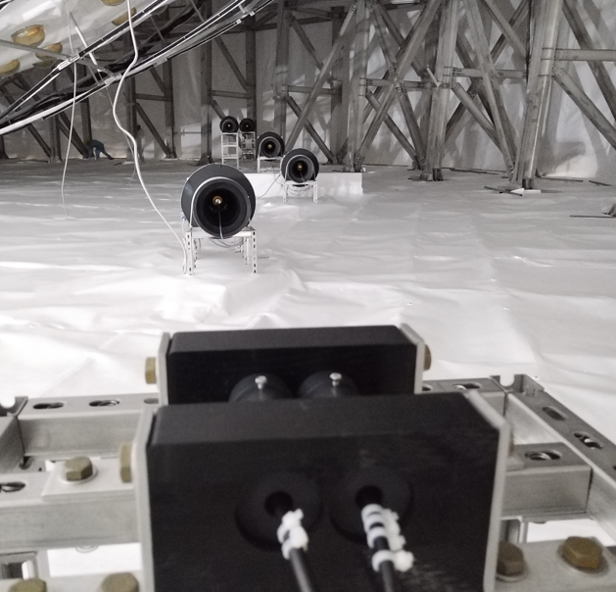
System performance — WP circulation
Water circulation started
The water attenuation length is measured by an online system located at the bottom of the WP;
Attenuation length increased from ~23 m to 61.7 ± 3.1 m.

Slide 25
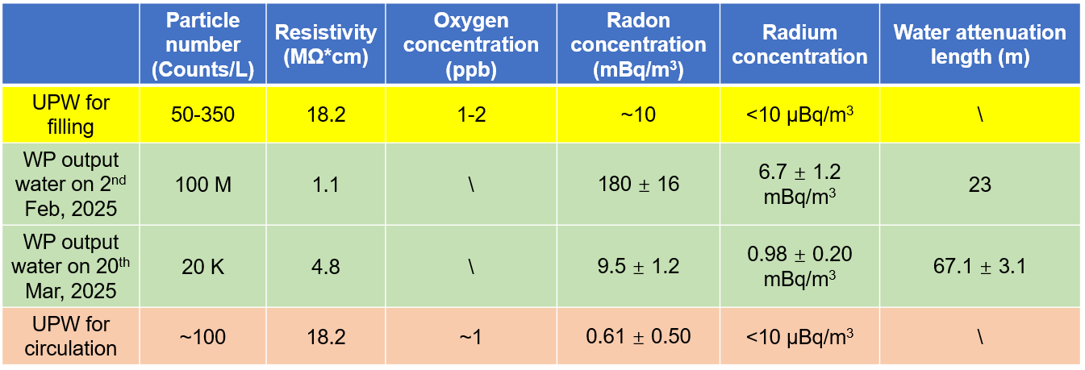
Summary
A 100 t/h UPW production and circulation system is built to supply UPW for WCD and CD;
In the production mode, the quality of water fully met the requirements for JUNO filling;
In circulation mode, it continuously improved the water quality in the WP.
The 100 t/h water system will be running for 30 years along with the JUNO experiment.

