Slide 1
Proposal for a next generation neutrino telescope
Zhen Cao
Institute of high energy physics, China

Slide 2
Outline
1, Motivation
2, HUNT and its potential
3, R&D of detector
4, Prototype strings
5, Summary

Slide 3
Motivation

Slide 4
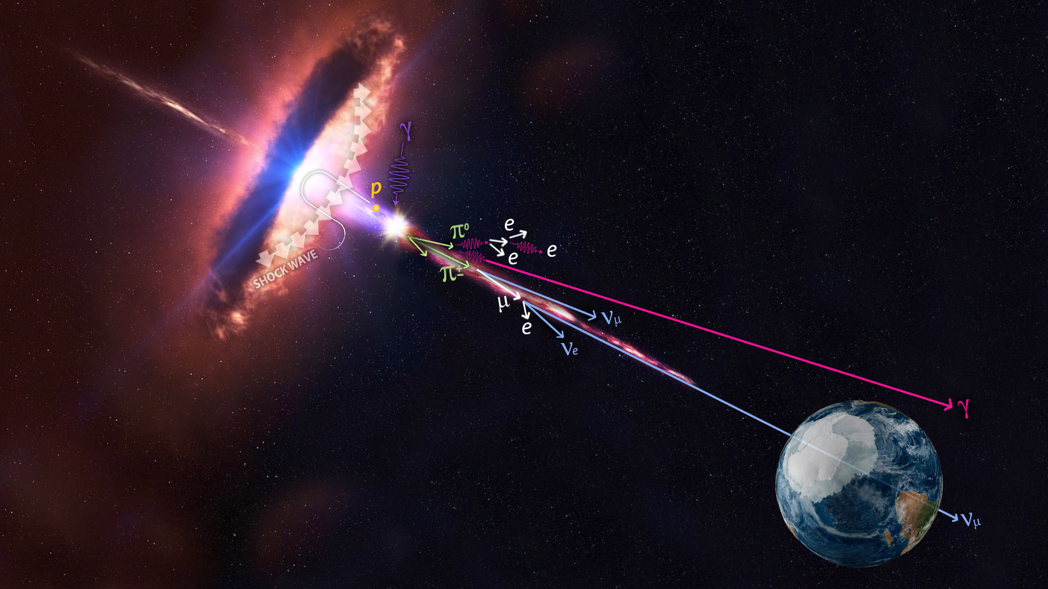
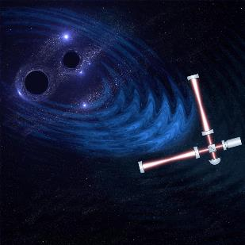

Mutli-messenger astronomy
Four Messengers：
Gravitational wavers： sensitivity
Gamma-ray：absorption
Cosmic ray(proton)：deflection by magnetic field.
4. Neutrino
Almost the only messenger to find the origin of high-energy cosmic rays:
Electrically neutral, unaffected by magnetic fields, direction of arrival points to the source; Weak interaction with matter, can travel far, able to escape from dense sources.

Slide 5
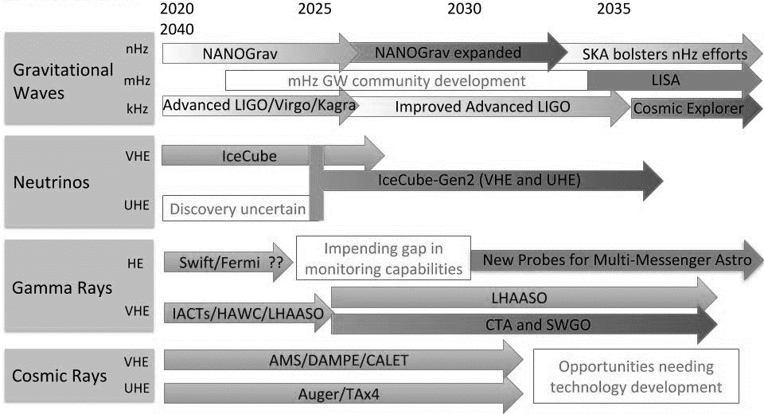
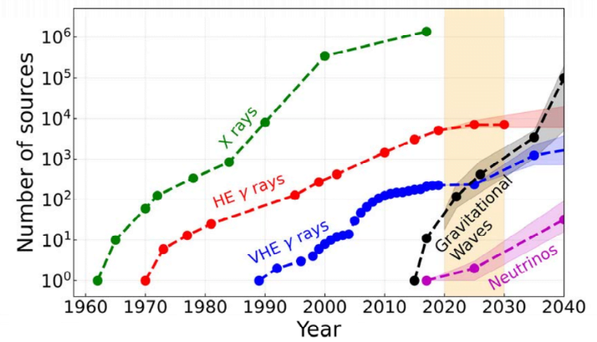
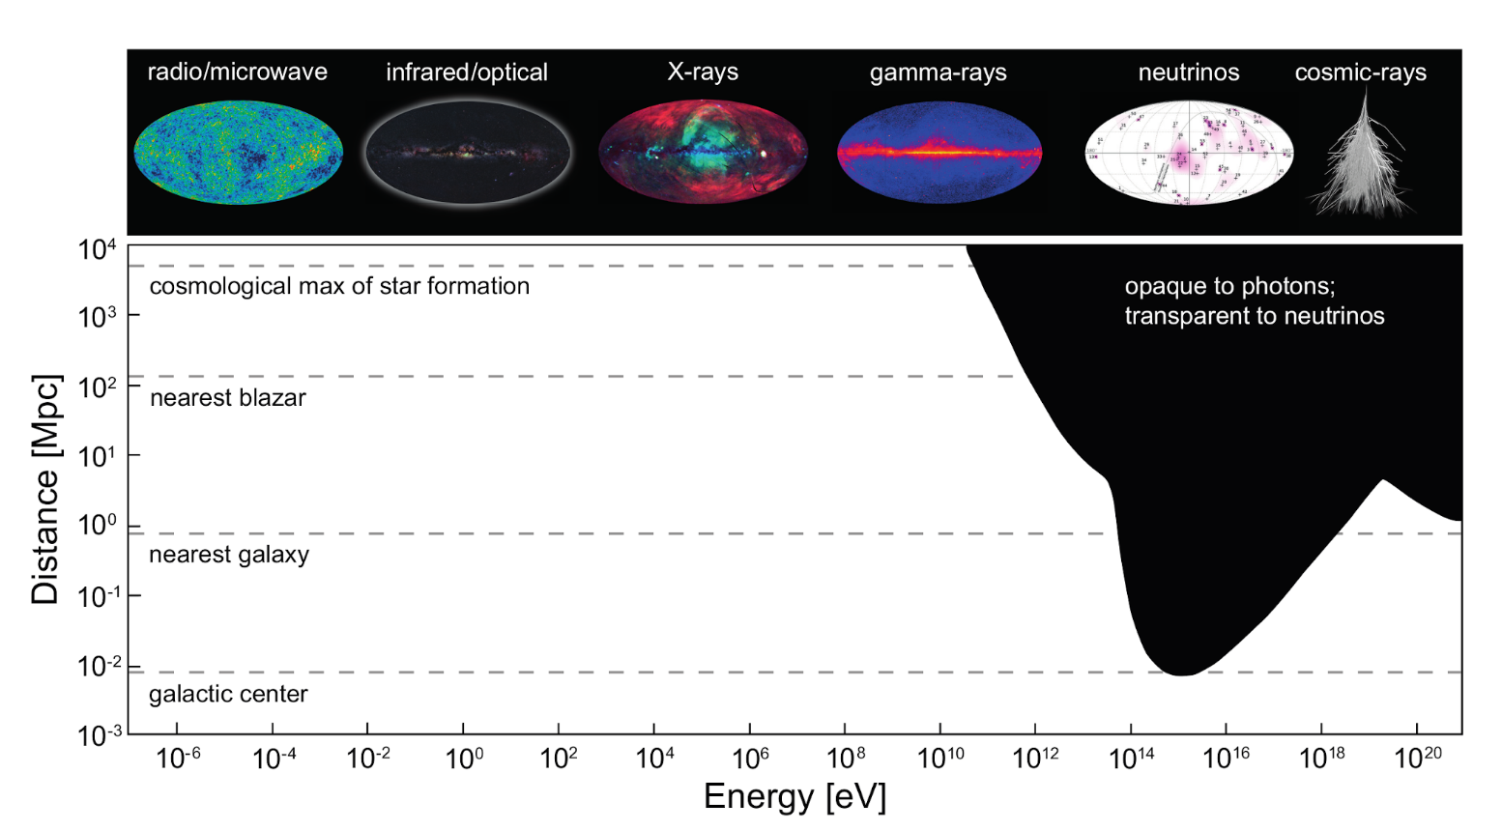
Status | Multi-messenger Astronomy
GW and neutrino astronomies are just starting and hold the promise of similar growth.
Opaque to photons,
transparent to neutrinos
Neutrinos
Gamma Rays

Slide 6
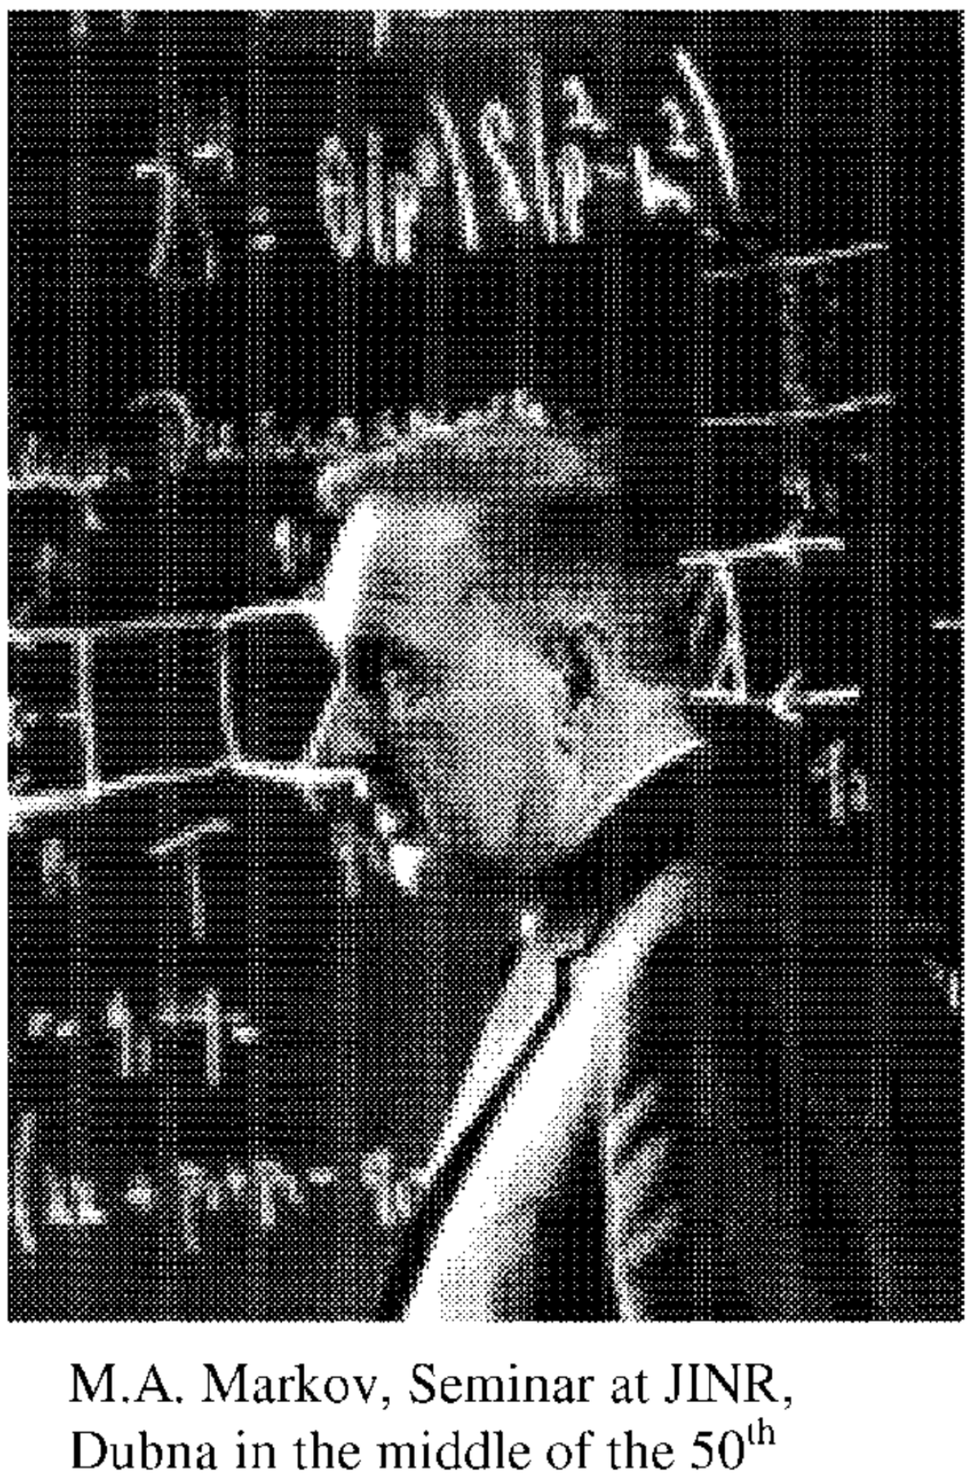
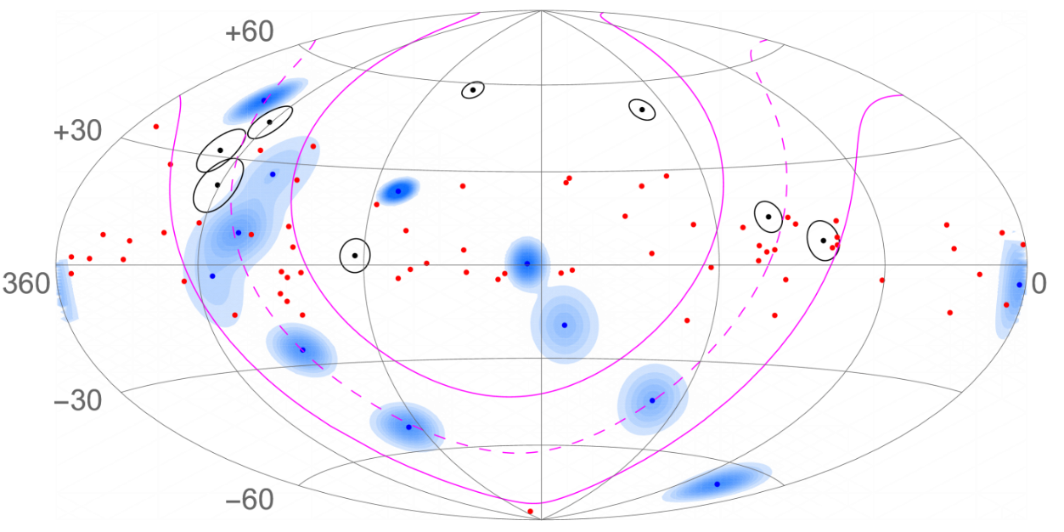
Status | Neutrino Astronomy
1960: deep underground and deep underwater detection of high-energy cosmic neutrinos were firstly suggested by Moisey Markov.
1976 - Now
Hawaii（4,500m）：DUMAND
Mediterranean（3,000m）：ANTARES, KM3NeT
South Pole（2,500m）：AMANDA, IceCube
Lake Baikal（1,300m）：NT series, Baikal-GVD ……
IceCube观测到的第一个高能中微子事例
1998-2003: NT200, Detection principle was verify for the first time.
2013: First high energy neutrino event (290 TeV).
2018 - Now
Blazar TXS 0506+056 (3.5σ)
NCG1068 ( 2.9σ – 4.2 σ)
Diffuse neutrino source in the Milky Way，~4σ.
Galactic neutrinos with Baikal-GVD
Baikal-GVD Collaboration, Astrophys. J. 982 (2025) 73
5σ is not reached, and the neutrino source is not confirmed!

Slide 7
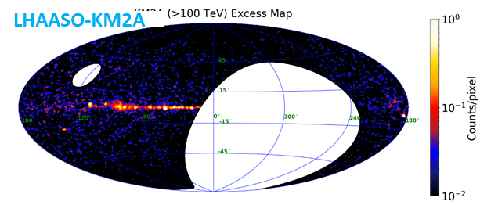


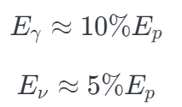
LHAASO discovered UHE γ sources in the Milky Way
1st LHAASO Catalog: 43 UHE gamma ray sources
Main process:
Two sources of PeV photons:
Simultaneous detection: neutrinos and photon signals, can point back to the source.
Completely solve the problem of the origin of high-energy cosmic rays!
Leptonic origin Synchrotron radiation produced by relativistic electrons and inverse Compton scattering of low-energy photons No neutrinos
Hadronic origin Interaction of PeV energy cosmic rays with source region matter or photon fields
a large number of neutrinos
LHAASO Collaboration, 2021, Nature, 594, 33.
LHAASO Collaboration, 2024, ApJS, 271, 25.

Slide 8
HUNT and its potential

Slide 9
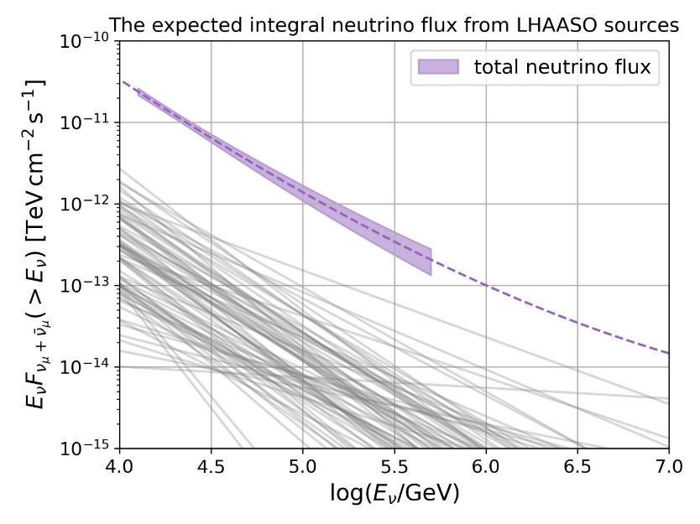
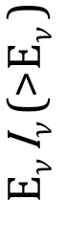
Requirement for next generation NT
Integral Sensitivity(E_{𝜈} I_{𝜈} (>E_{𝜈} )= ∫_{E𝜈} J_{𝜈}(E_{𝜈} ) d E_{𝜈 :}
better than 10⁻¹³ TeV/cm²/s @10TeV
5σ 1n 10 years
To observe the neutrino sources in the Milky Way, then we can combine with photon and other data (such as LHAASO)
Equal to LHAASO’s sensitivity
Threshold：10TeV
Grey lines：neutrino flux of 43 LHAASO gamma ray sources.
30 times volume of IC ！
  Candidates of PeV cosmic ray in the Milky Way；
  Lots of neutrino sources in the extragalactic space.
Notes:
银河系中微子观测，敲定宇宙线起源
强大的发现能力，河外中微子源，真正进入中微子天学时代。

Slide 10
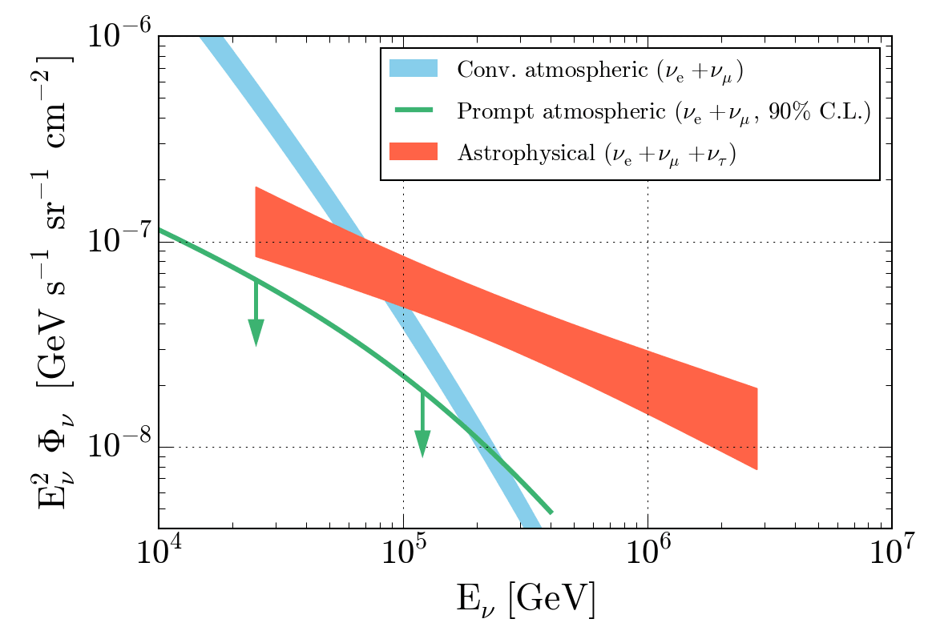
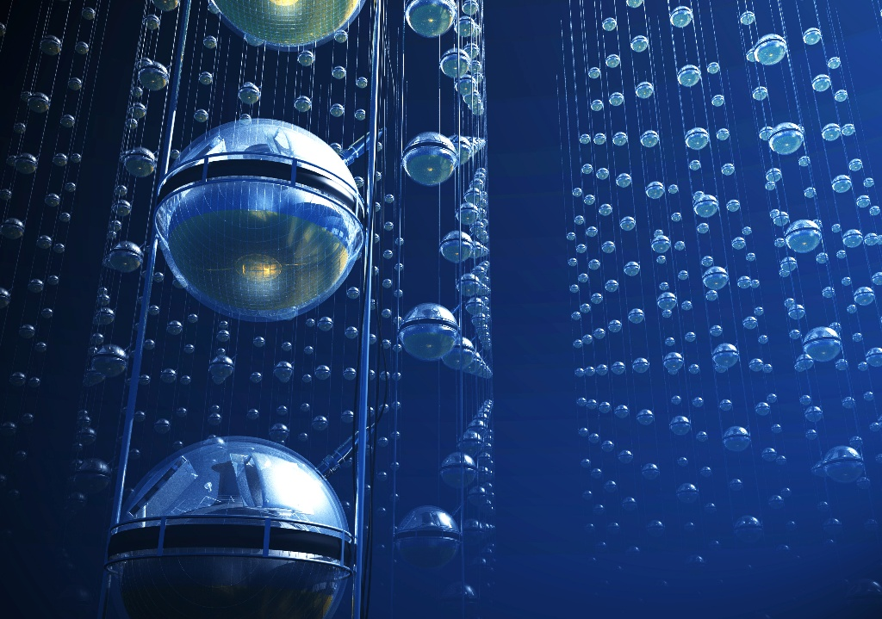
Scientific Goals
Identifying the hadronic PeVatrons in our Galaxy(>100TeV)
Resolving the high energy neutrino sky
Understanding the propagation mechanism of high energy cosmic-rays
Exploring the frontiers of neutrino physics and new physics
Energy spectrum of the astrophysical neutrino flux

Slide 11
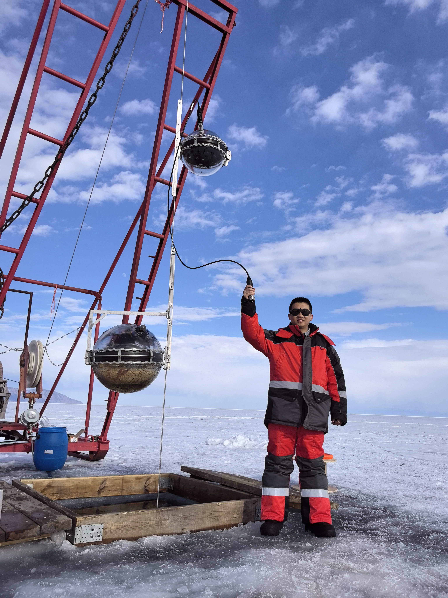
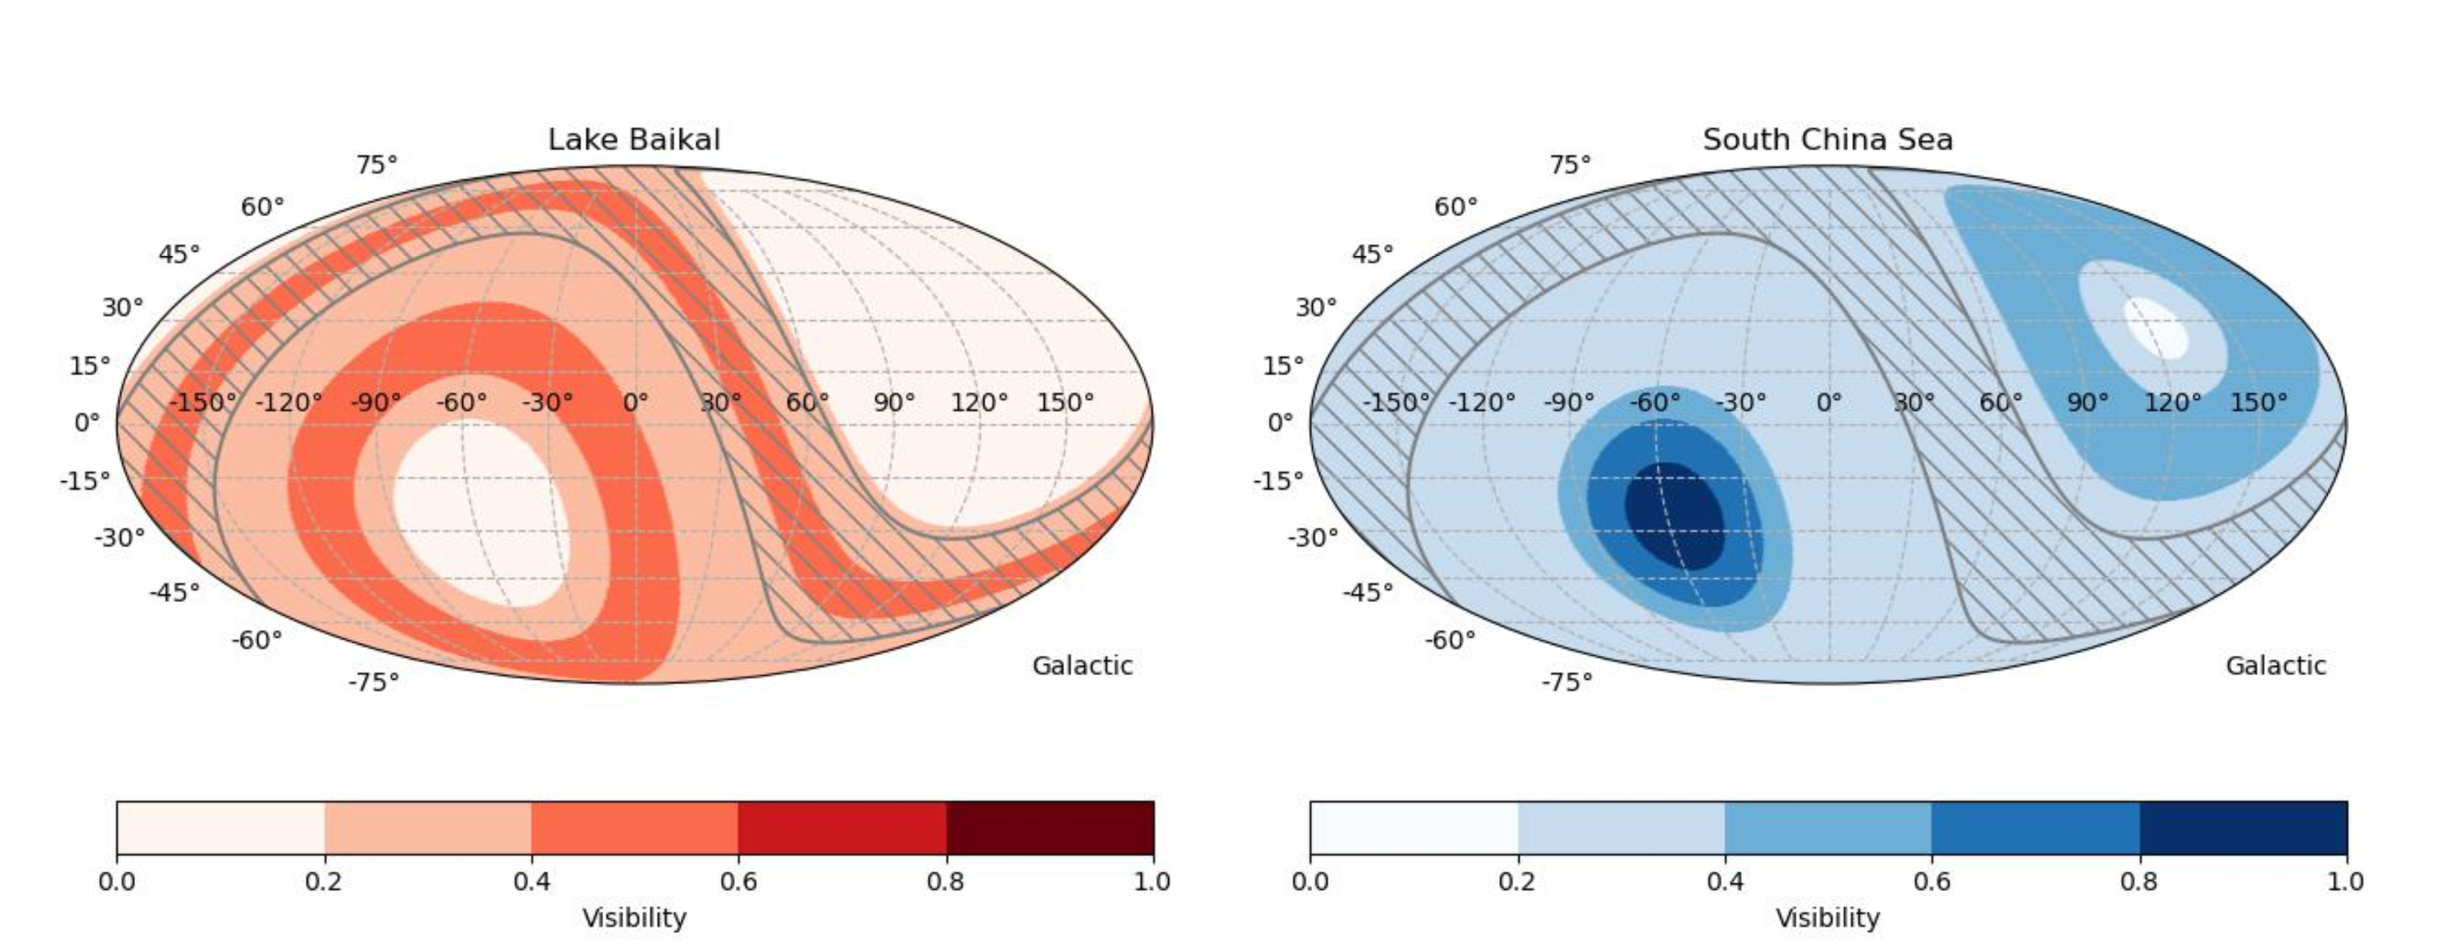
Lake Baikal: Unique site for HUNT
Very flat lakebed within 100km²: 1366 ±1 m
Very transparent water
Very close to shore station： ~4 km
No high light background.
Stable ice cover for 7 weeks a year:
Extreme low deployment cost!
Lake Baikal has better FOV for the center of the Milky Way.

Slide 12
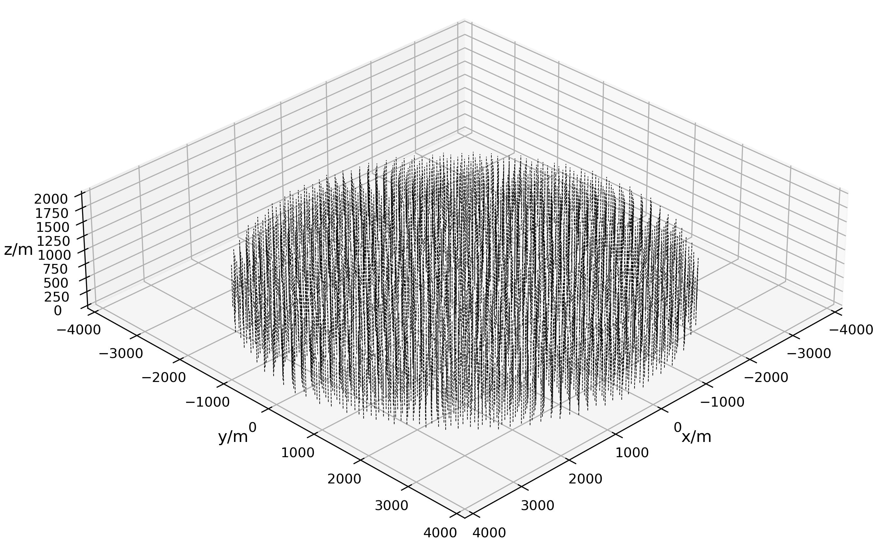
Configuration
Lake Baikal (water depth ~ 1300 m)
30 km³
Height of string: ~720 m
Radius: ~3.8 km
2,212 strings
Specifications:
Angular resolution: ~0.1° (tracks), <3°(cascades)
Energy resolution: ΔlogE~0.3(tracks), ΔE~10-30% (cascades)

Slide 13
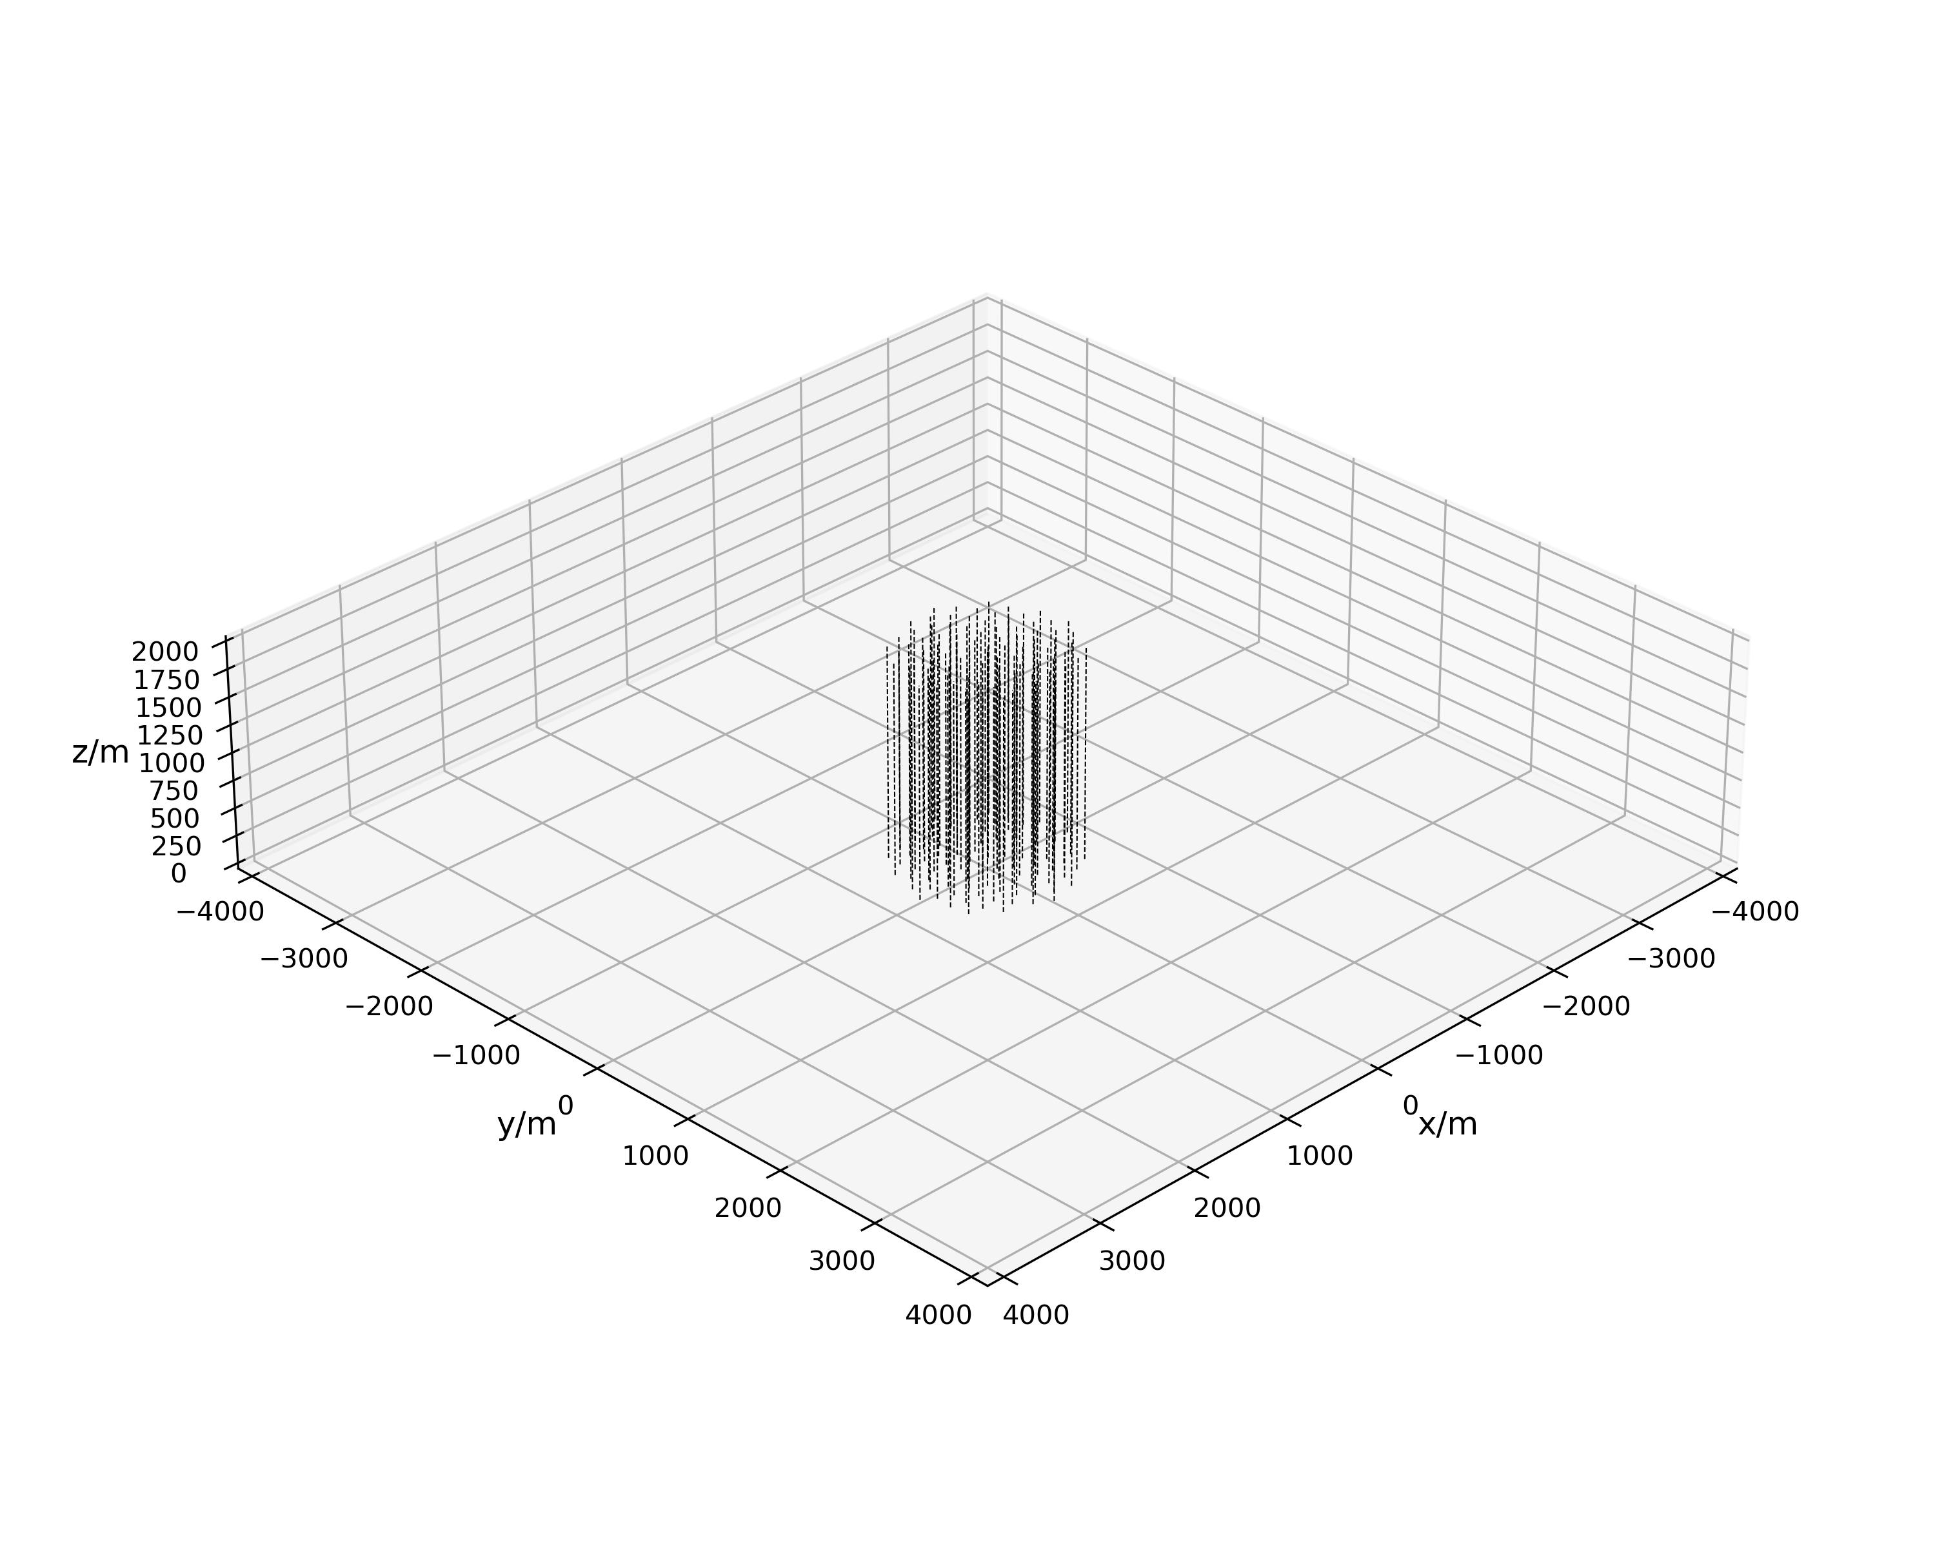
Configuration
Type 1
Height: 720 m
Radius: 3.8 km
2212-strings
1-cluster
Type 2
Height: 1890 m
Radius: 800 m
96-strings
9-clusters
×9
South China Sea (water depth ~ 3000 m)
Lake Baikal (water depth ~ 1300 m)
More configurations in ICRC2025

Slide 14
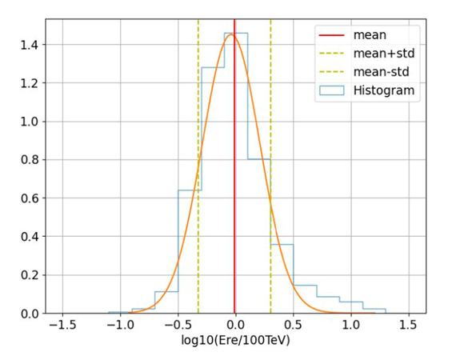
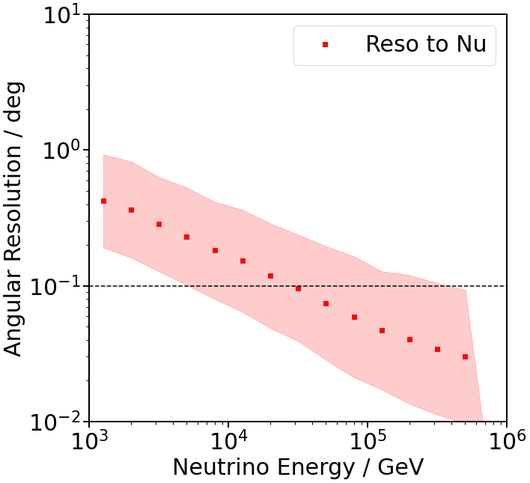
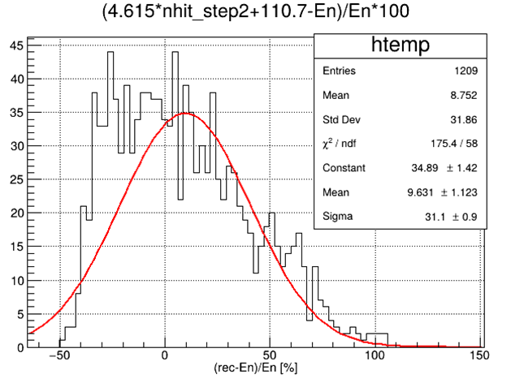

Performance expectation
Energy resolution (track)
Δlog(Erec) = 0.27
Angle resolution ~0.1°@>100TeV
Energy resolution(cascade)
: ~31%
(100-300TeV)

Slide 15
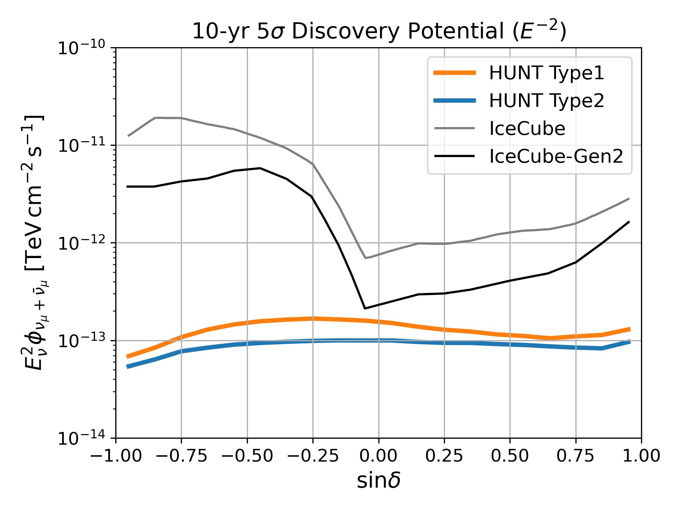

Discovery Potential
Background
Atmospheric neutrinos (MCEq)
Diffuse astrophysical neutrinos (dN/dE ~ E^{-2.37})
Binned Likelihood
$L=\prod{e^{−n_{s}S_{i}−n_{b}B_{i}}{(n_{s}S_{i}+n_{b}B_{i})}^{n_{i}}/n_{i}!}$
Spatial bin size ~${0.1}^{°}×{0.1}^{°}$ (HEALPix Nside = 512)
Energy bin size $∆\text{log}E_{rec}$=0.4
the energy resolution is assumed to be $∆\text{log}E_{rec}$=0.3
$n_{s, 5σ}≥3$
* Only up-going tracks (zenith > 80 deg) are used.
PRELIMINARY

Slide 16
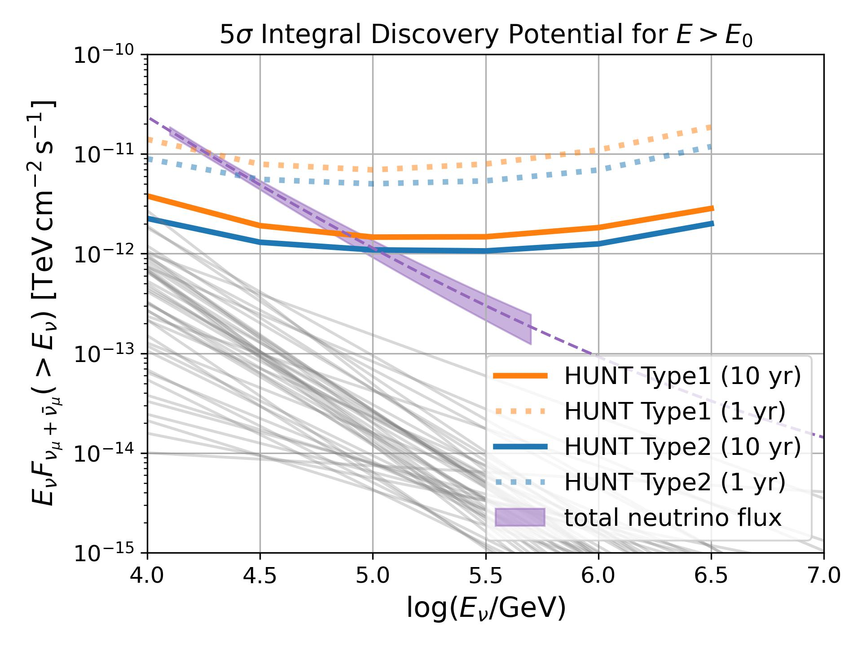
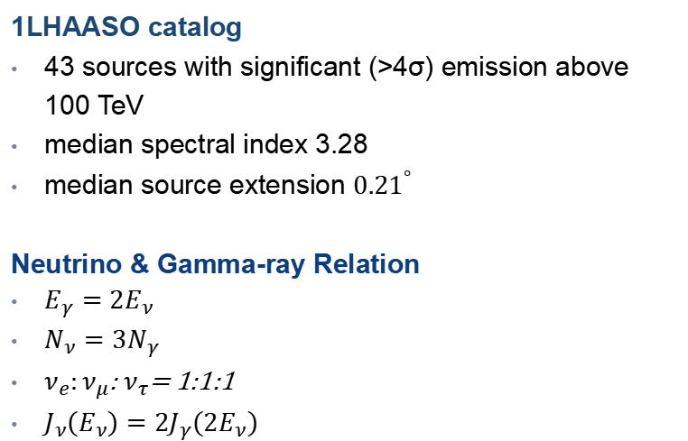
Discovery Potential | Stacking LHAASO PeVatrons
1LHAASO catalog
43 sources with significant (>4σ) emission above 100 TeV
median spectral index 3.28
median source extension ${0.21}^{°}$
Neutrino & Gamma-ray Relation
${E_{γ}=2E}_{ν}$
${N_{ν}=3N}_{γ}$
$ν_{e}:ν_{μ}$: $ν_{τ}$= 1:1:1
$J_{ν}\left(E_{ν}\right)={2J}_{γ}\left(2E_{ν}\right)$

Slide 17
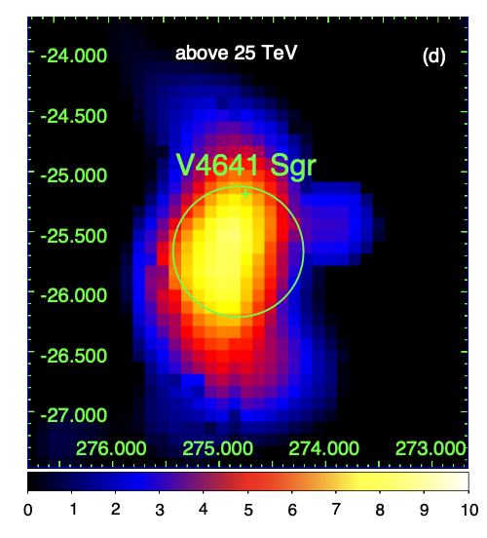
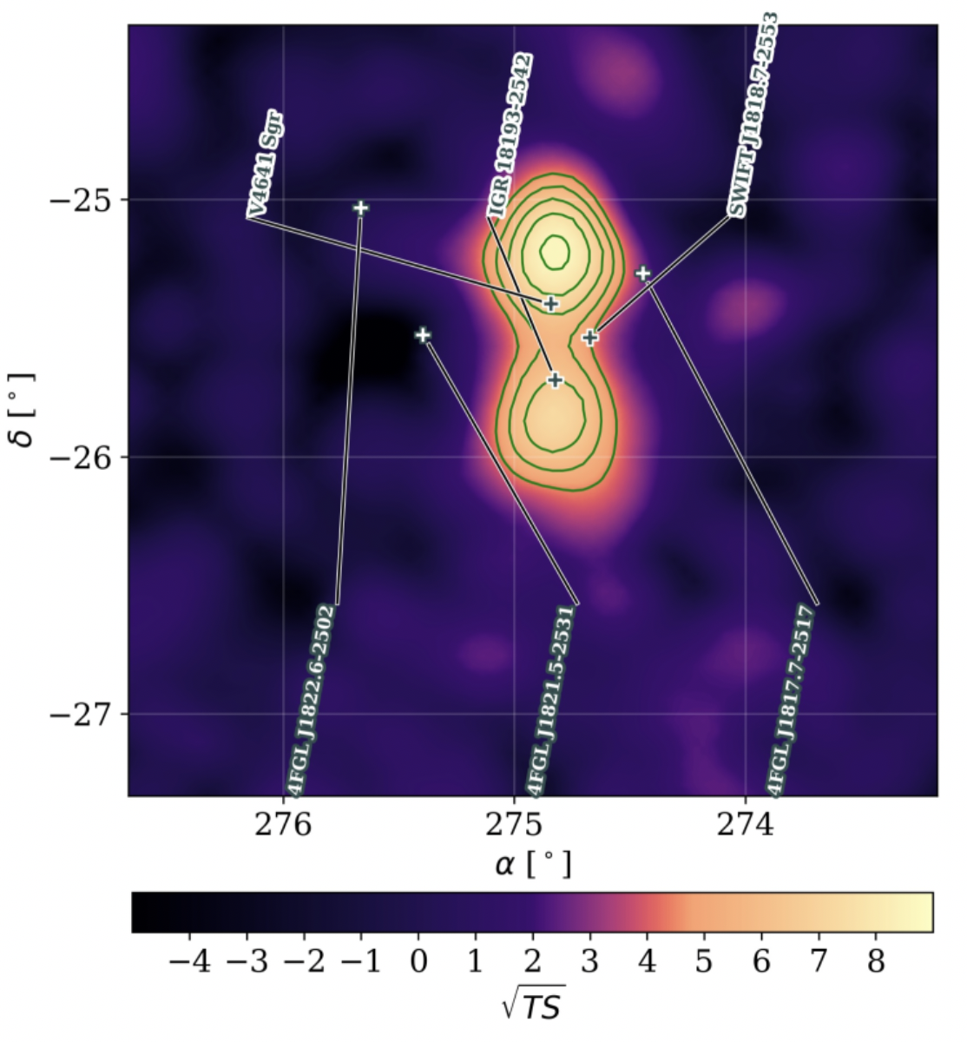
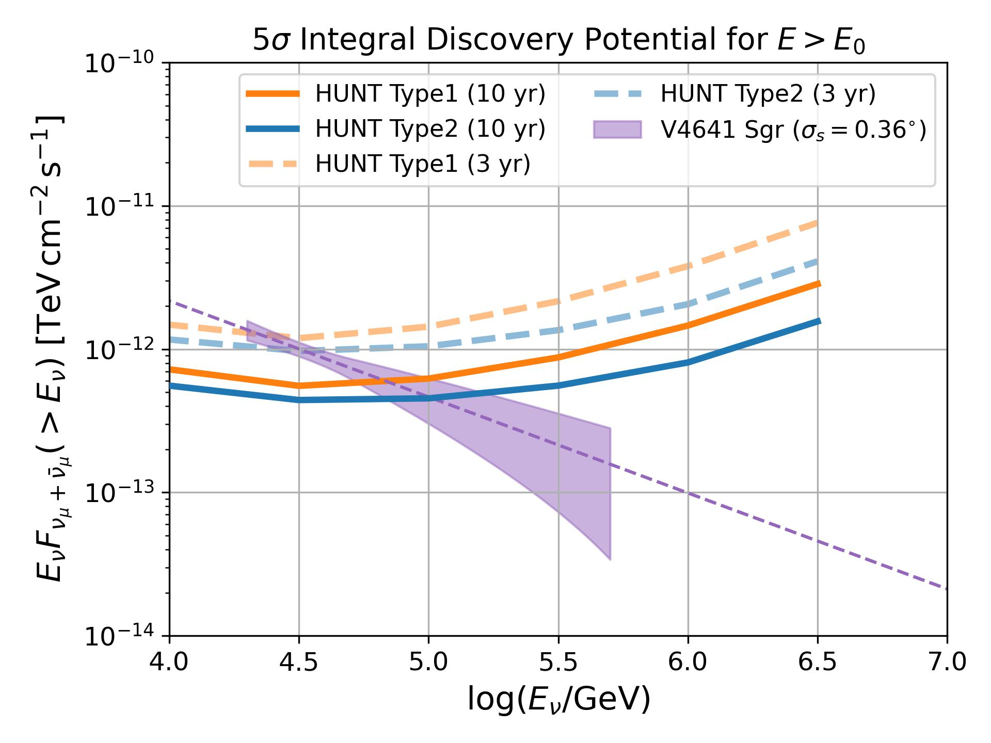
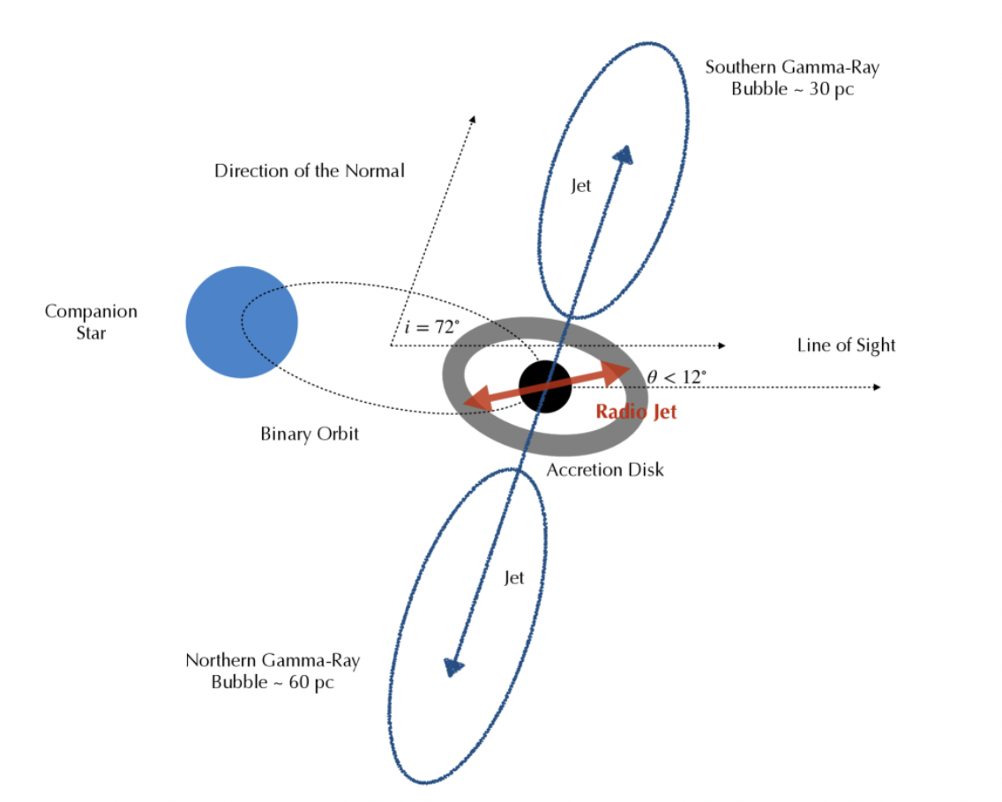
Discovery Potential | Microquasar
LHAASO, 2024, arXiv:2410.08988
Alfaro R., et al., 2024, Nature
PRELIMINARY

Slide 18
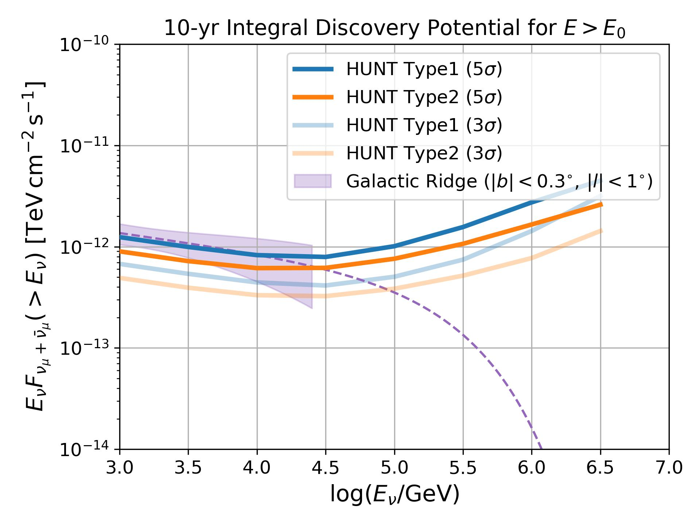
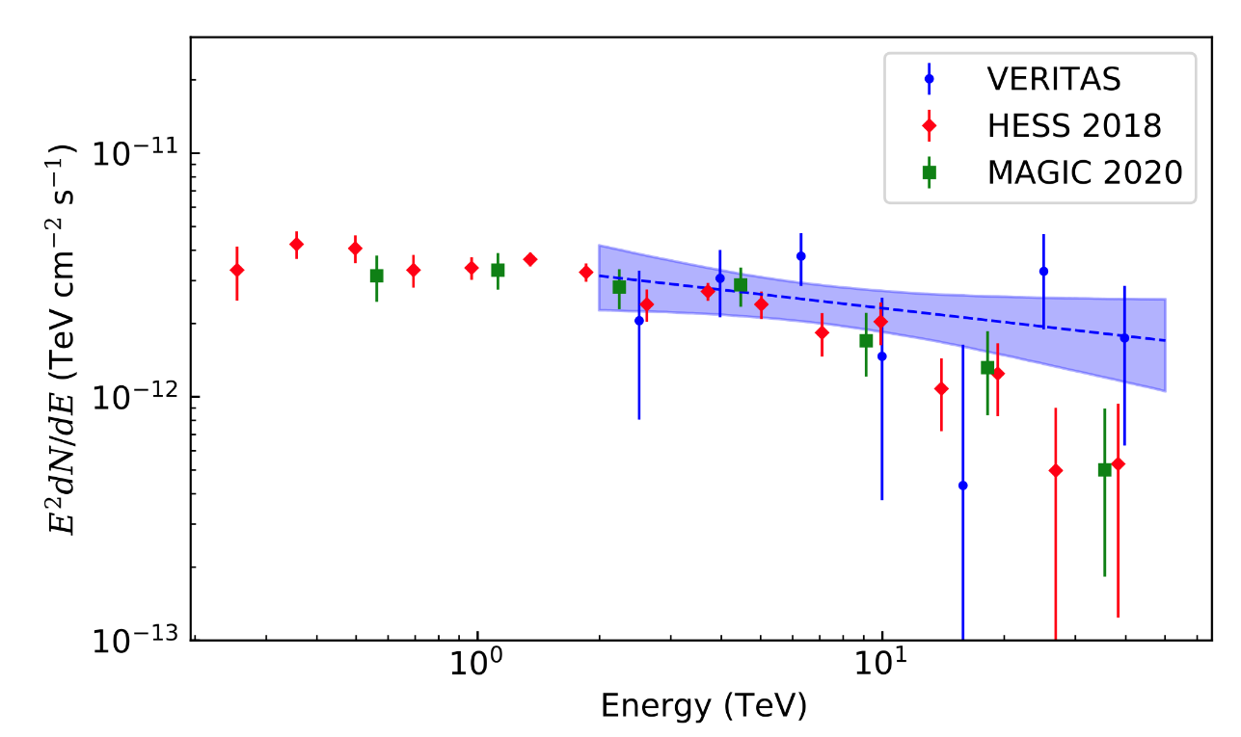
Discovery Potential | Galactic Ridge
Diffuse gamma-rays from Galactic ridge
adding cascades
E_{cut}=500 TeV
PRELIMINARY

Slide 19
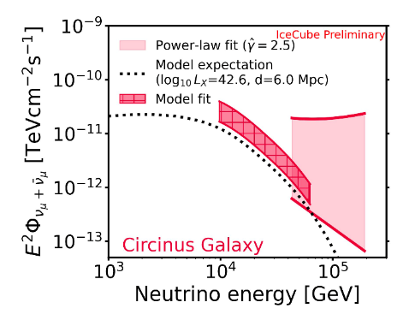
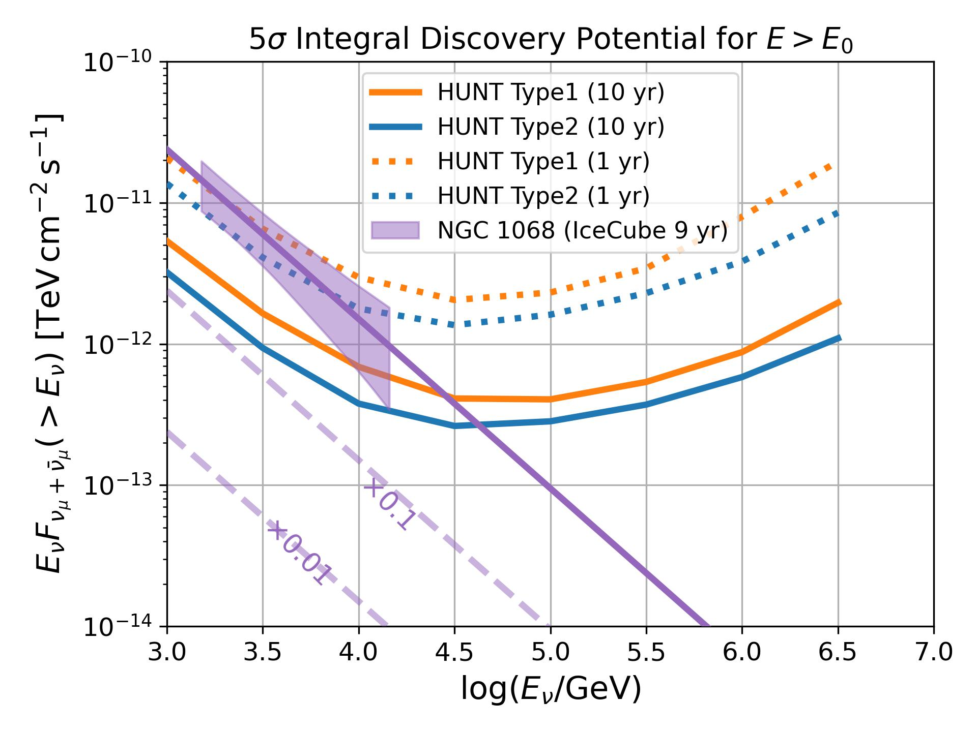
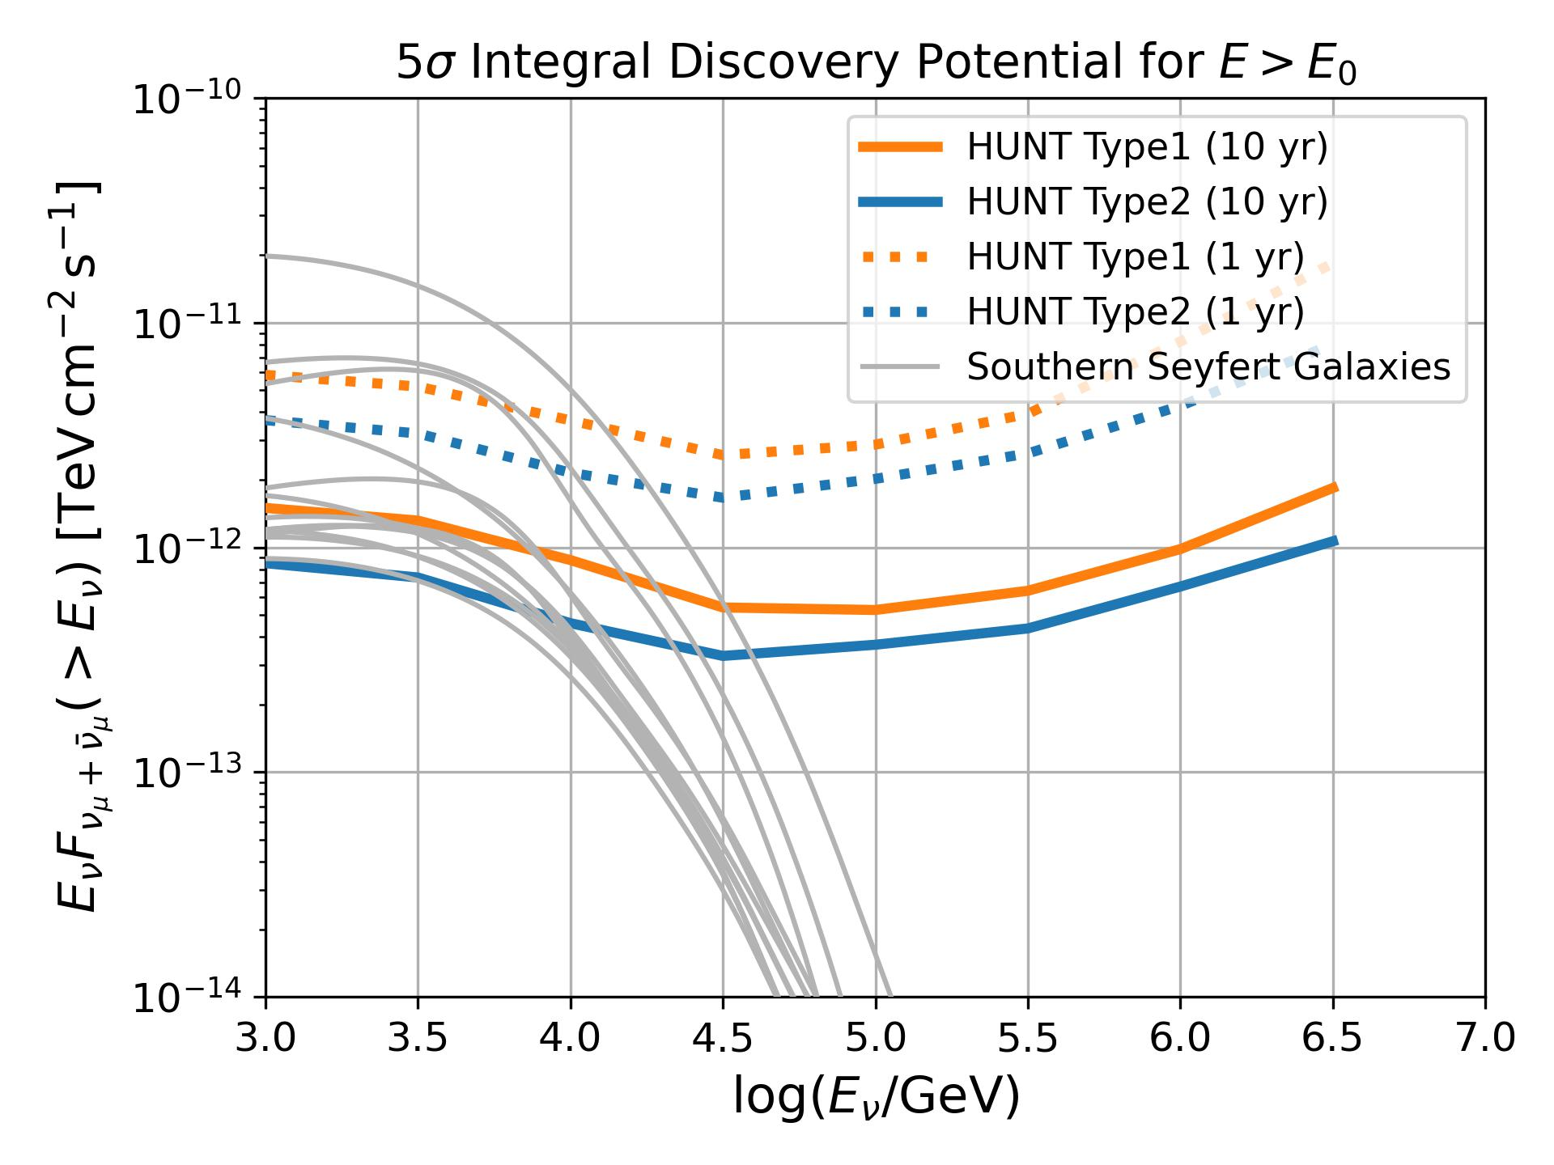
Discovery Potential | Seyfert Galaxies
Circinus Galaxy
Shiqi Yu, TeVPA2024
disk-corona model
(Kheirandish, KM & Kimura 21 ApJ )
PRELIMINARY
PRELIMINARY
HUNT will discover tens of neutrino sources.

Slide 20
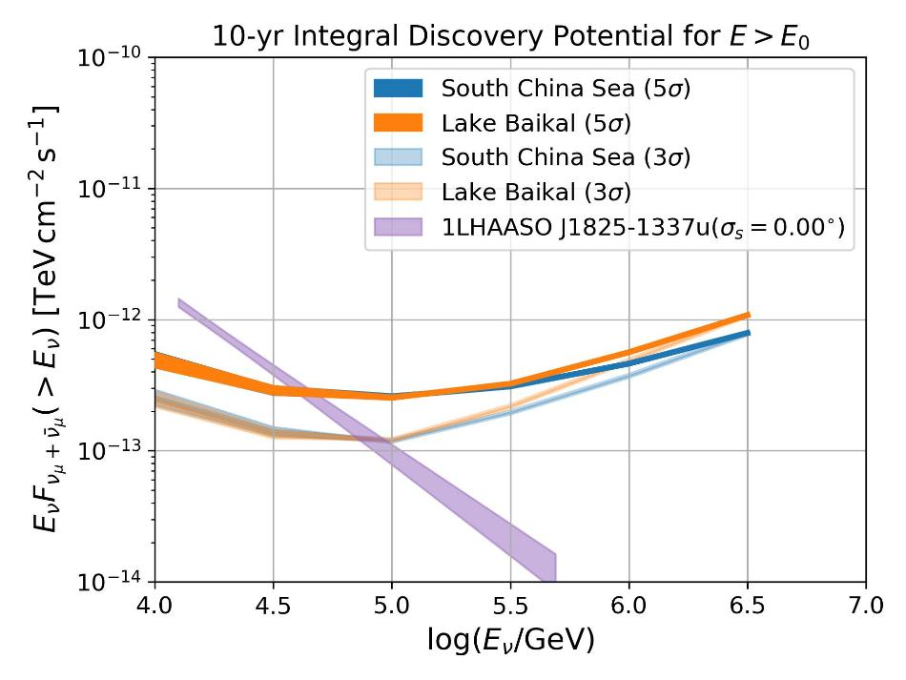
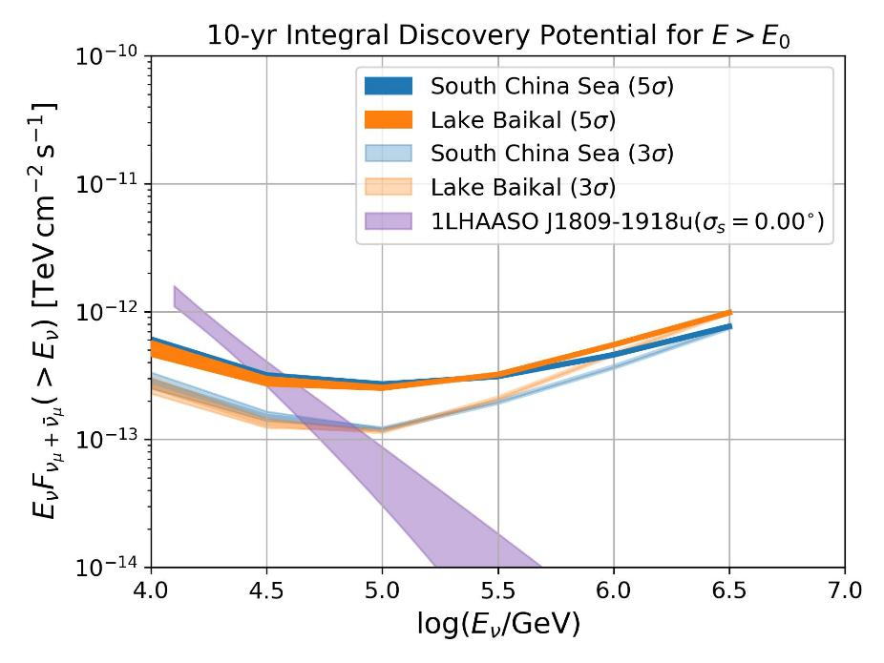
Discovery Potential | LHAASO’s UHE γ sources.
1LHAASO 1825-1337u
1LHAASO J1809-1918u

Slide 21
R&D of detector

Slide 22
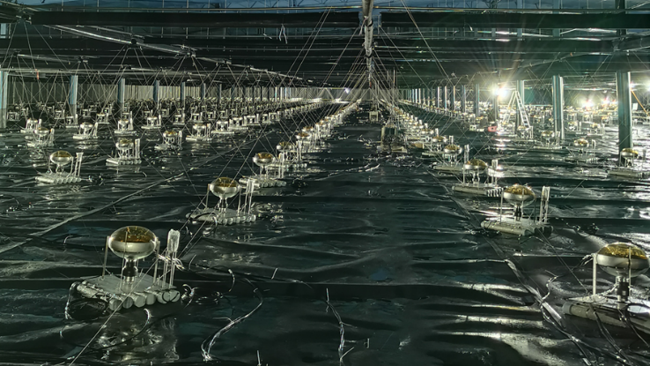
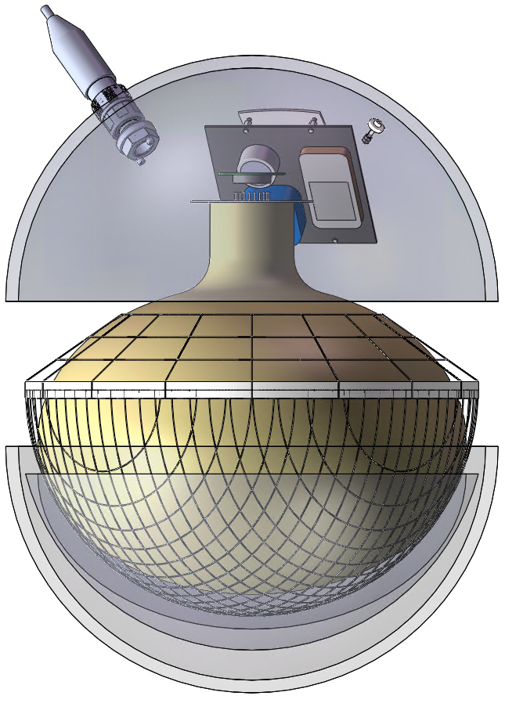
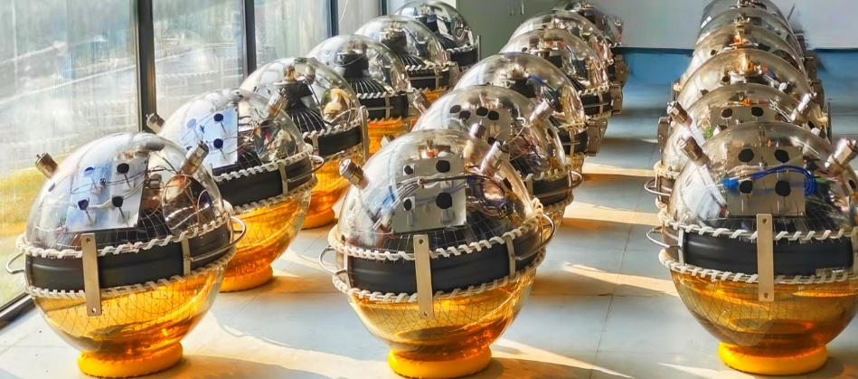
NEW super-scale Optical Module
Much simpler, Lower cost and better stability.
D~60cm
20-inch PMTs in LHAASO
20-inch PMT
The number of detected signals is 1.6 times that of GVD’s OM
This makes the arrangement of OM very sparse(Density of OMs is smaller)

Slide 23
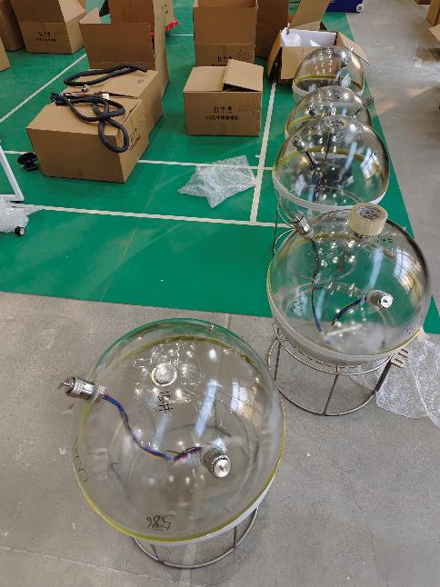
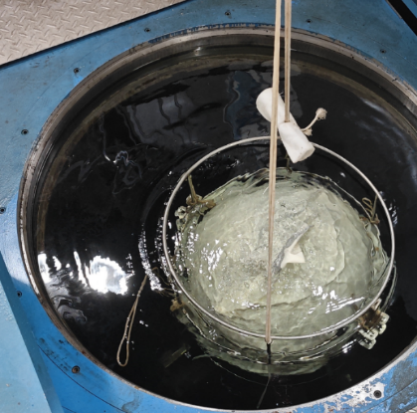
Largest pressure-resistant glass sphere
23-inch Diameter
Light transmittance: ~ 90%;
Ultra-pressure resistance: water depth > 3000m
Super-large: the outer diameter ~23 inches (58.5cm)
The sample passed the pressure test of 50Mpa.

Slide 24

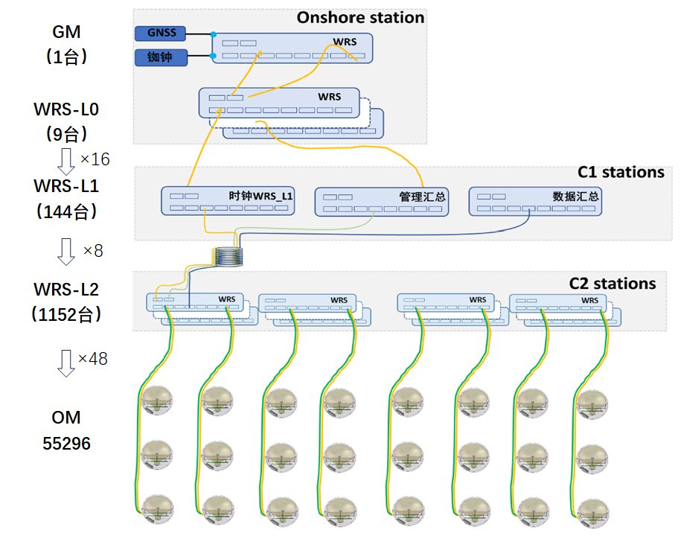
White rabbit clock synchronization technology
  High precision clock synchronization （<0.2ns）
Successfully applied in LHAASO and Baikal-GVD prototypes.
1,300 WR switches in LHAASO

Slide 25
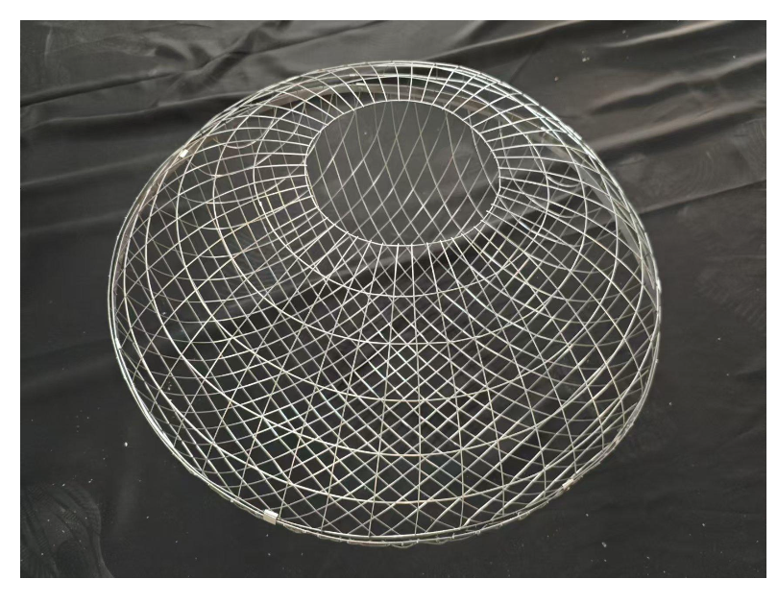
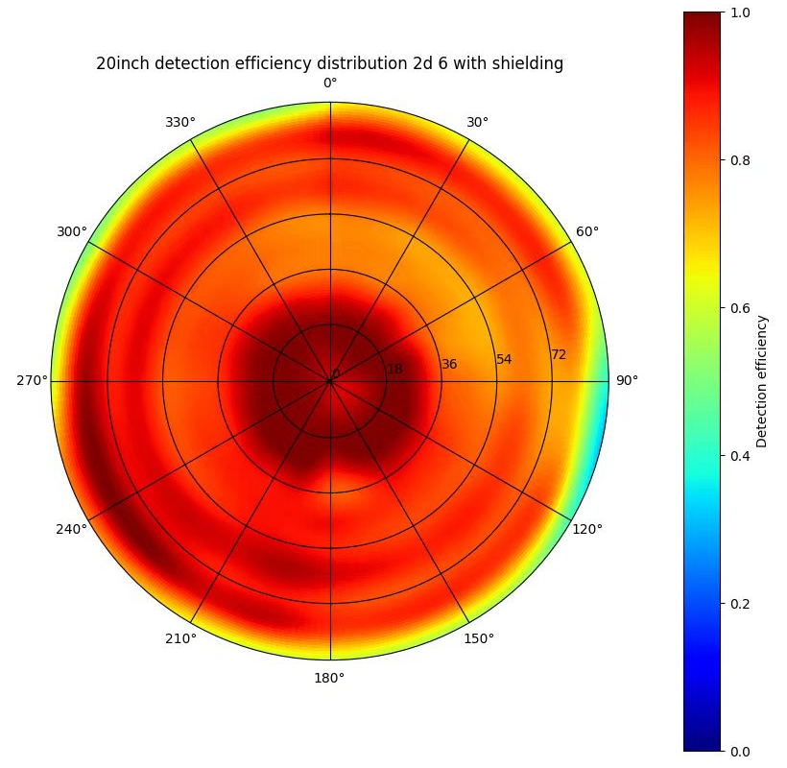
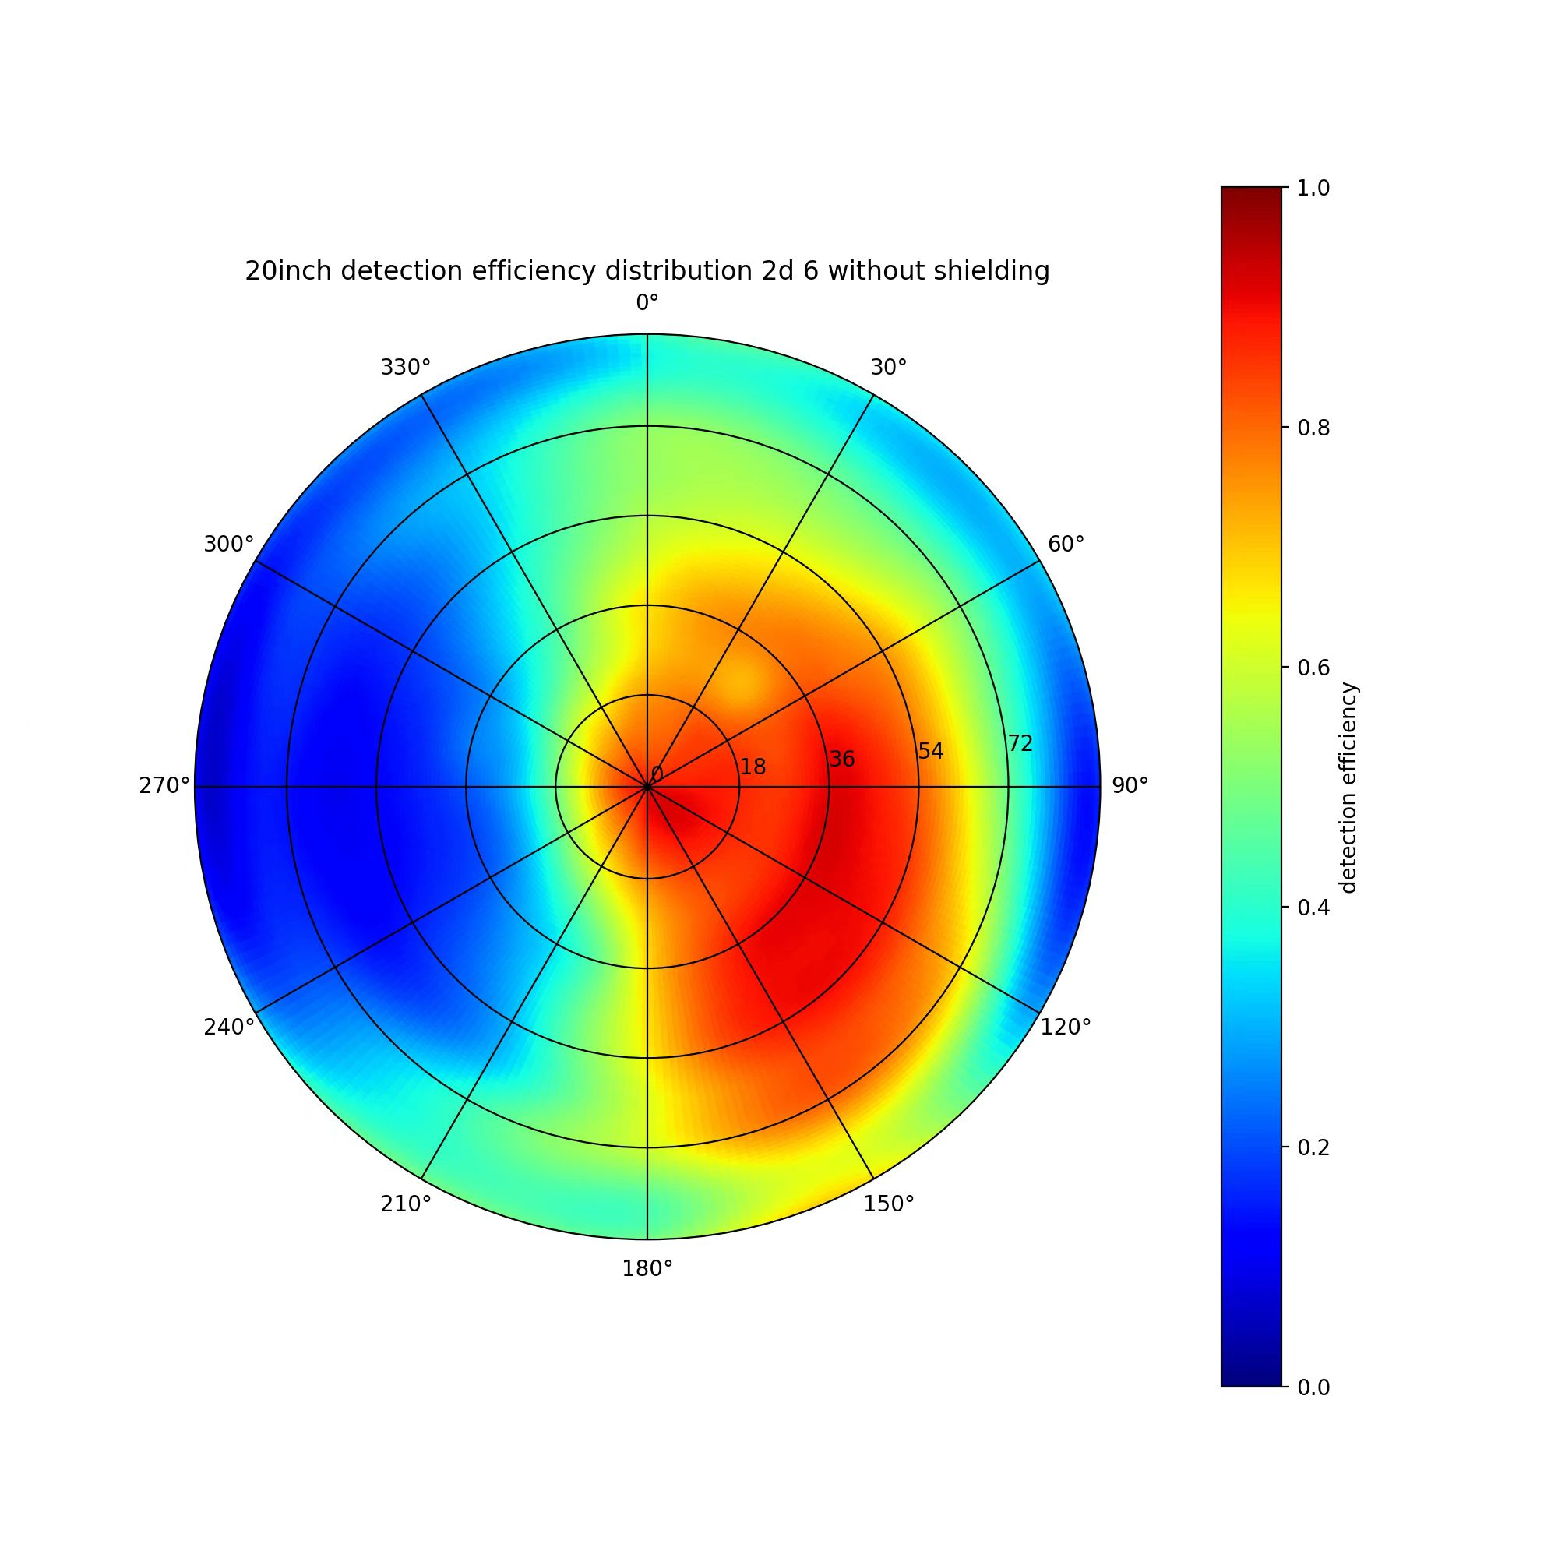
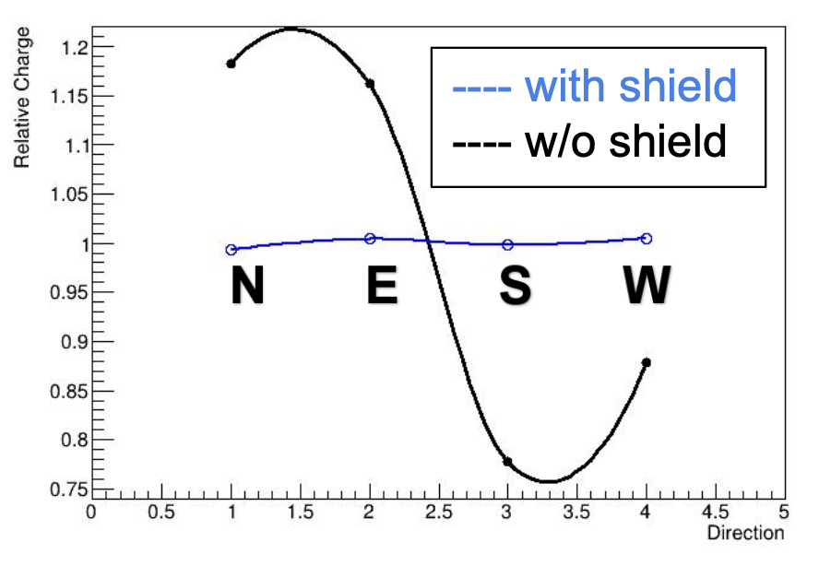
Instruments | Geomagnetic shielding
Improve PMT’s performance with Geomagnetic fielding
Relative Transit time & TTS
Charge distribution
Detection efficiency
Geomagnetic shielding produced in China recently.
high-permeability materials: Permalloy
Modeling and design via COSMOL software
Notes:
Permalloy 坡莫合金，一种镍铁合金

Slide 26
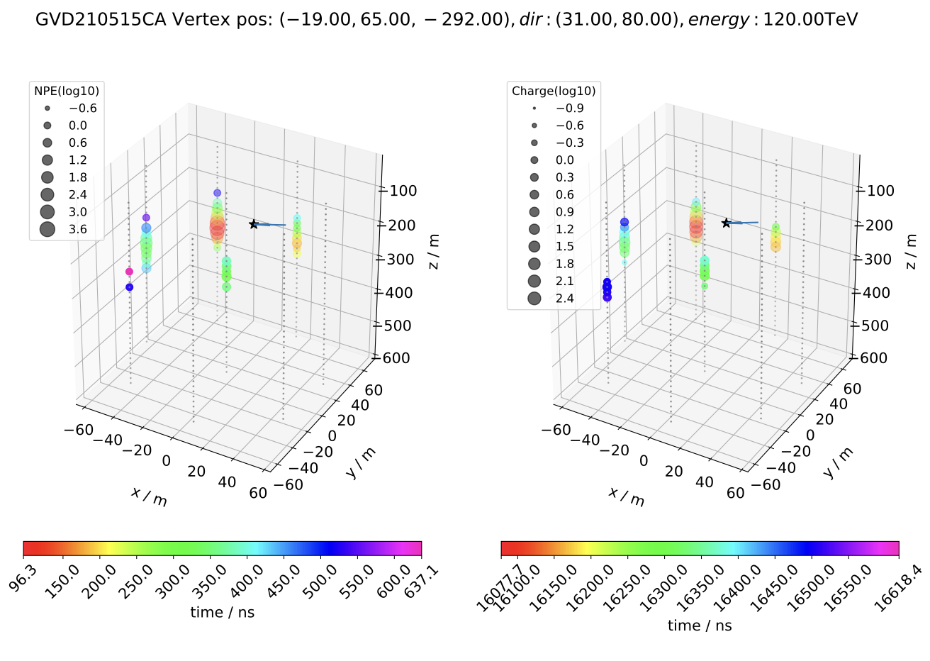
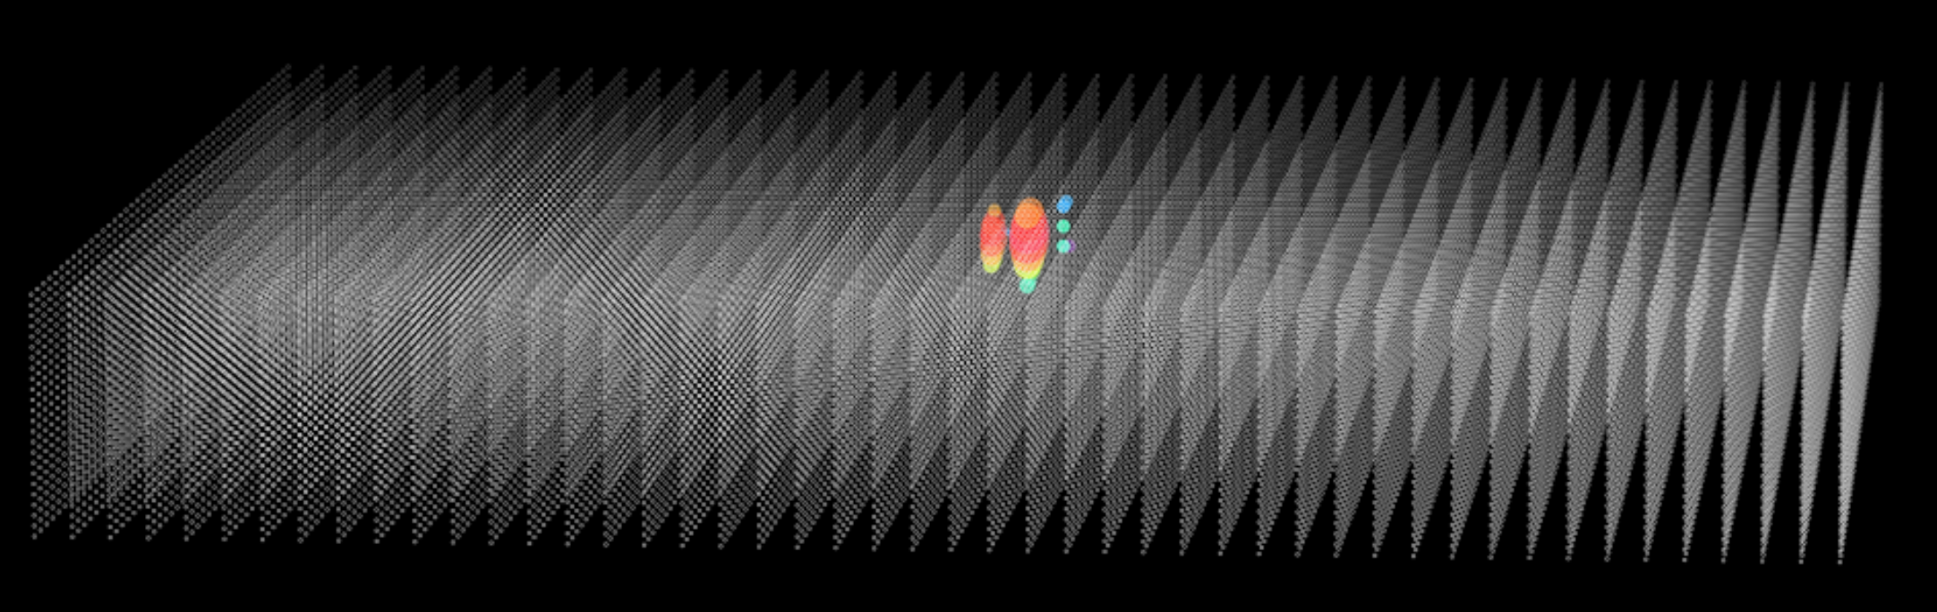
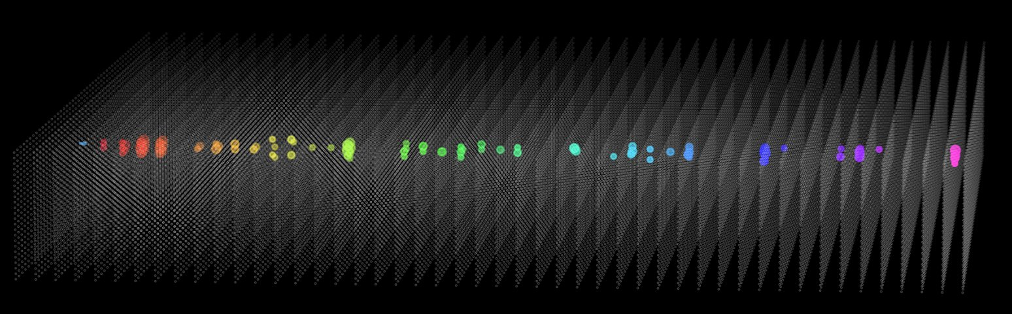
Simulation program
16 Baikal-GVDc cascade events observed.
We simulate the GVD observation (e.g., NPE) using the reconstructed parameters of these events.
Our simulations are consistent with the GVD observations considering the systematic uncertainty.
HUNTSimNeT
Geant4: simulating particle interactions inside the array
CRMC: hadronic interactions above 100 TeV
Two libraries, G4ART and G4DMT, are developed to accelerate the simulation above 100 TeV.
This work
Baikal-GVD
Morphology
Simulating Baikal-GVD observations
Left: Cascade event induced by an 1 PeV electron;
Right: Track event induced by an 100 TeV muon
Wang, et al., 2024, CPC

Slide 27
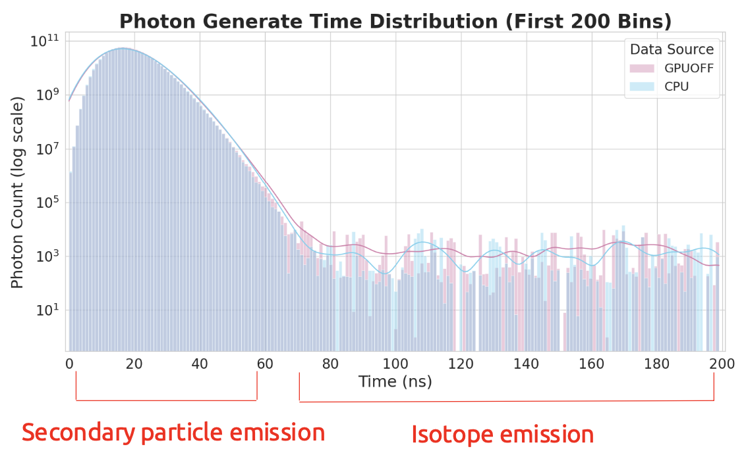
Simulation | Parallel algorithm
Full simulation need deal with the transport process of billions of photons generated by neutrino
G4DMT: Geant4 Distributed Multiple Threads（CPU Parall）
call all CPUs to simulate a primary particle.
G4ART: Geant4 Accelerated Ray Tracing（GPU parall）
optical photon simulation.
One electron (1 PeV)
CPU: AMD 7950X
GPU: Nvidia 4090D 24G
default Geant4: 40 hours
G4ART only: 4 hours
G4ART + G4DMT: 2000 s
  number of threads: 4
Validation
Start time, Photon absorption length, arrival time and energy
| Photon generation time
50X speedup
the difference between W/ and W/O G4ART is within 10%.

Slide 28
Prototype strings

Slide 29
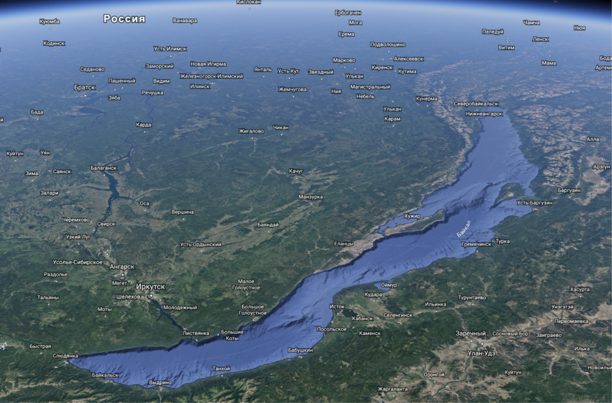


Canditate sites
The largest neutrino astronomy telescope in the northern hemisphere
Baikal-GVD

Slide 30






PMT tested in the lab.
No.
Burn-in
Q-T
GAIN
TT
P/V
2D Scan
Non-linearity
TTS

Slide 31



1st Prototype String @ Lake Baikal
12 OMs with 20-inch PMTs
4 LED calibration systems
120m
3m
228m
30m
340m
30m
~330m
“Nerpa string”
Anchor
March 2024

Slide 32




1st Prototype String @ Lake Baikal
Size of signal
Arrival time
Q-T correction -> Same Light intensity : ~0.4ns
PMT calibration : ~0.5ns
Module shape correction : ~1ns
418nm: 137.5ns @ 30m -> 1.374 [refractive index]
460nm: 135.2ns @ 30m -> 1.351 [refractive index]
Around 10 muon-like events (>=4 hits) per day.

Slide 33


Joint analysis of 1st String and GVD
Dataset: HUNT LED calibration on April 7, 2024.
HUNT LED light No.4, 3, 2 and 1 were turn on in order;
The nearby GVD OMs can detect the LED signals ;
These data can be used to calibrate the time delay between HUNT and GVD strings ,and detection efficiency lately；
HUNT LED lighting nearby GVD strings
Calibration Time delay by event by events
GVD-HUNT= -38s - 488510850ns
Notes:
This slide shows
we turn on led ball 4/3/2/1/in sequence
This pic shows
GVD time faster~ 38 sec than HUNT

Slide 34


Status of 2nd prototype string
The 2nd prototype string, including 24 Optical Modules(OMs) + 4 LED calibration modules, was deployed in this March.
Operation Mode 1: Gain at 1E7 with a threshold of ~0.5 p.e.
Operation Mode 2: Gain at 1E5 with a threshold of ~1.6 p.e.
For short of disk storage, operation Mode 2 since April 15.
the deeper the water depth, the lower the noise rate.
To today, all of OMs without any waterproof issues.
depth：1300m
580m
720m
th@0.5 p.e
×
The relationship between single-channel noise rate
vs different water depth.
Notes:
And now，HUNT with two operation mode。

Slide 35

Data analysis of 2nd Prototype string
Preliminary Results：
Dataset：2025/04/30 - 2025/05/05 with Operation Mode 2.
Number of down-going events > up-going events.
nHit > 6, down-going events(muon-like), 0.07Hz.
nHit > 6, up-going events(neutrino-like), 0.02Hz.
θ
direction
Next：
Develop MC Geant4 simulation program to check the charge and time distribution with experimental data, and study the detection eff. Of OM.
@1.6 p.e.
Notes:
This slide shows nHit distribution of trigger events
The sample around 6 days data, with OM2
Obvious

Slide 36



Prototype strings @ South China Sea
7strings，56 OMs
Phase I: Long-term monitor string (Jan 2025)
4 OMs, vertical spacing ~10 m
Phase II: Seven-string array (2025-2026)
R&D of OM, APS, waterproof connectors, deployments,…….
Measure the neutrino oscillation parameters.
KM3NeT-ORCA6 (510 days, 433 kton-years)
Supported by Deepsea Network China.

Slide 37

Summary
LHAASO has discovered tens of Galactic PeVatron candidates which are good candidates for high-energy neutrino sources.
HUNT will realize unprecedented potential in discovering the neutrino counterparts of Galactic PeVatrons and resolving the high-energy neutrino sky.
Prototype string in Lake Baikal has observed muon-like events. We are going to deploy another string in 2026. The seven-string array in South China Sea is coming.

Slide 38



The Next Generation Neutrino Telescope
Requirements
sensitivity $∝$ Aeff ^{0.5} → Large effective
sensitivity $∝$ σ ⁻¹ → Directional resolution ~ 0.1 deg → lower background within ROI (Ω=πσ²)
differential/segmented spectrum measurements → Energy resolution ~ 30%
Isotropic muon neutrinos → muons entering the telescope
$φ_{ν_{μ}+{\overline{ν}}_{μ}}=1×{10}^{−18}{\left(\frac{E}{\text{100 }\text{TeV}}\right)}^{−2}{\text{GeV}}^{−1}{\text{cm}}^{−2}{\text{s}}^{−1}$
$E_{μ}≥$ 10 ΤeV
Surface density of muons = Nμ/A_{proj}
Nμ: number of muons enetering the telescope
A_{proj}: projection area of telescope
👉 A taller array has a larger effective area.

Slide 39


PeVatrons discovered in the Milky Way
Neutrino observation will decisively solve the problem of the origin of cosmic rays!
PeVatrons neutrinos above 50 TeV & gamma-rays above 100 TeV.
LHAASO observed tens of gamma-ray sources above 100 TeV.
Gamma-rays above 100 TeV can be produced in both leptonic and hadronic scenarios.
Main process:
E_{γ}>100 Te
1st LHAASO Catalog: 43 UHE gamma-ray sources (>4σ).
* LHAASO Collaboration, 2021, Nature, 594, 33.
* LHAASO Collaboration, 2024, ApJS, 271, 25.

Slide 40


Discovery Potential | diffuse neutrinos
Sensitivity for 1 year
IceCube, science, Vol 380, Issue 6652
Notes:
哪类源的贡献不清楚，
小于30TeV，可能Seyfert星系。
大于30TeV不清楚，

Slide 41


Simulation | reconstruction
Qi et al. 2024
Track events: ΔΨ=0.1 deg for Eν > 30 TeV
Likelihood method using the PDF(δt, d)
  δt: time residual between seed and this hit
  d: distance from OM to track
Track events: The energy resolution is around Δlog(E_{rec}) = 0.27
The connection between the line density of photons along the track and the muon initial energy
Cascade events: the energy resolution is around ΔΕ=31%
Οnly Nhit is used
Notes:
track, cascades,

Slide 42



Trigger ｜ track events
Configuration: H860 R3385 C1 VS36 HS130
muon tracks
Notes:
5% events didn’t illuminate a single OM

Slide 43


Trigger ｜ cascade events
Configuration: H860 R3385 VS36 HS130
cascades
cascades
Notes:
20% events don’t illuminate a single OM

Slide 44





水平朝向
地中海ANTARES和加拿大P-one实验均观测到朝上看探头的探测效率: ~10%/year下降（由于表面污染）
俄罗斯Baikal-GVD，1年朝上看的探头就失效。
斜上看40度
地中海ANTARES
加拿大P-one（探头朝上看）
各个方向都有
HUNT’s OM
中微子簇射过程的光子角度分布

Slide 45


Simulation | in-OM
left (L)
right (R)
anticlockwise (N)
clockwise (S)
Forward: 100%
Lateral: 45%
Backward: 3%

Slide 46




Sensitive to the neutrino events with all directions
向下的径迹型事例
（20多个单元着火）
水平 簇射事例
10-600TeV的$全向ν_{e}$事例探测效率
（反应顶点包含探测器内和探测器外）

Slide 47





Pathfinder Experiment
Pathfinder Experiment Apparatus
Experimental Site
The water of Xisha Islands in South China Sea
Experimental Objectives
Test of long-distance LED calibration system
  Time resolution 0.4 ns for bright pulses
Pressure resistance test of 23-inch glass sphere
In-situ measurement of gamma ray background
  The radioactivity for ⁴⁰K and ²¹²Pb
2023.2
20 m
1,800m
1800 m (12.8 hours)
20 m
1100 m (5.5 hours)
1,800m
1,800m

