Slide 1




The Population and Subclassification of Long Gamma-ray Bursts
Speaker: Guangxuan LAN
Co-authors：Jean-Luc Atteia (IRAP); Junjie Wei, Houdun Zeng, Ye Li, Xuefeng Wu (PMO)
2025/07 FCPPN
Notes:
Hello every one. First of all, I really appreciate the organization of this meeting and the opportunity to present works here. I am a postdoc affiliated with PKU and a French astrophysical institute IRAP. My research interest is the origins of GRBs, and today I will talk about our studies on the population and subclassification of LGRBs.

Slide 2
Outline
Gamma-ray bursts, the redshift and luminosity distributions, the applications
The biases caused by the observational effects and the correction
The population of and possible subgroup of long gamma-ray bursts
SVOM
Notes:
This is a brief look of my talk. I will introduce the GRBs, and their z and L distributions which are two key properties to reflect GRB population, and their applications in cosmological studies. I will also introduce some observational effects and how to correct these effects to study the intrinsic GRB distribution. Based on our models, we also find some conditions that could preselect LGRBs that may have origins different from typical LGRBs. Finally, I will have a short introduction of a new GRB detection platform SVOM.

Slide 3
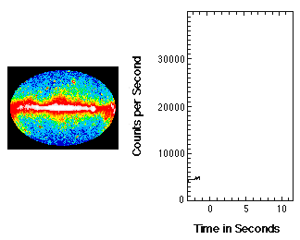
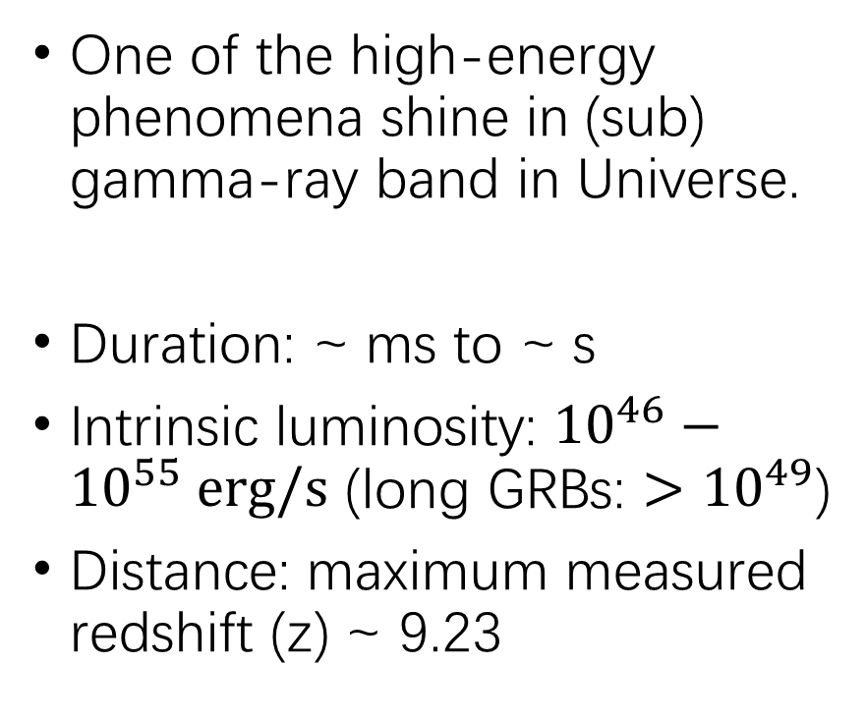
Gamma-ray burst (GRB)
One of the high-energy phenomena shine in (sub) gamma-ray band in Universe.
Duration: ~ ms to ~ s
Intrinsic luminosity: ${10}^{46}−{10}^{55} erg/s$ (long GRBs: ${>10}^{49}$)
Distance: maximum measured redshift (z) ~ 9.23
Notes:
GRB is a kind of very short and very intense explode in universe, lasting from a few ms to a few s, having luminosity 100 times greater than SN. It can occur very far away from us. In astronomical study, we use the red shift of optical spectrum to show the distance of objects and the age of universe. Larger redshift, larger distance and earlier universe. 9 means every high redshift, and so far, the information of universe in this phase is also less.

Slide 4
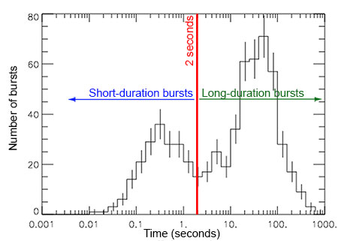
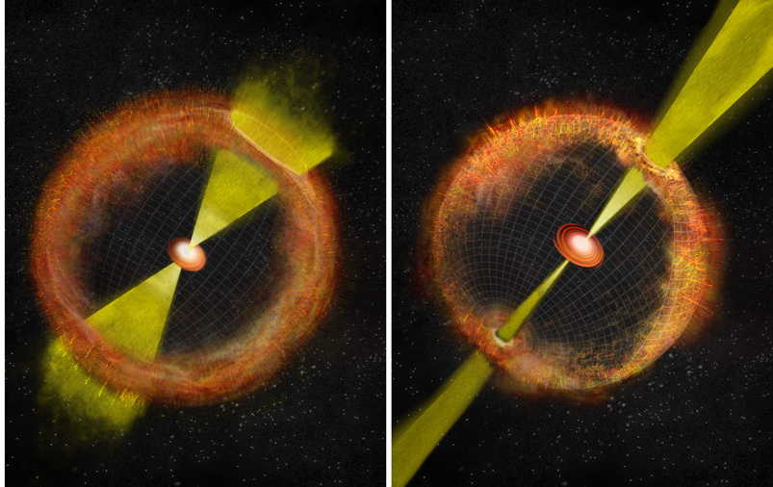
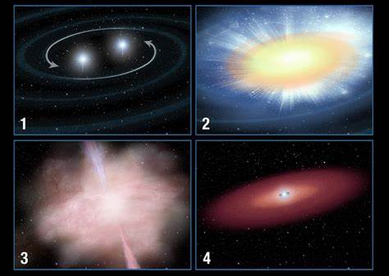
Typical classification for GRBs
(Merger model)
(Collapsar model)
Notes:
According to the bimodal distribution of GRB duration, we separate GRBs into 2 groups based on this valley value 2s. Short GRBs are believed to come from the merger of compact stars. And a part of long GRBs have been confirmed in observation that have association with SNe which come from the collapsing of massive stars.

Slide 5
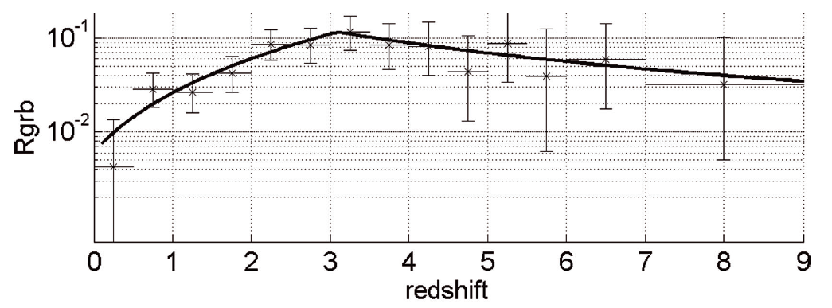
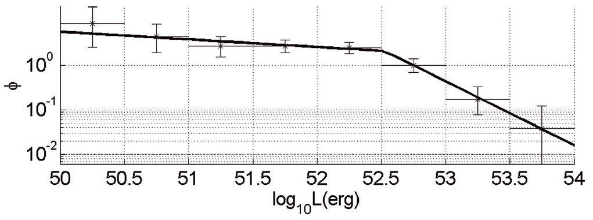
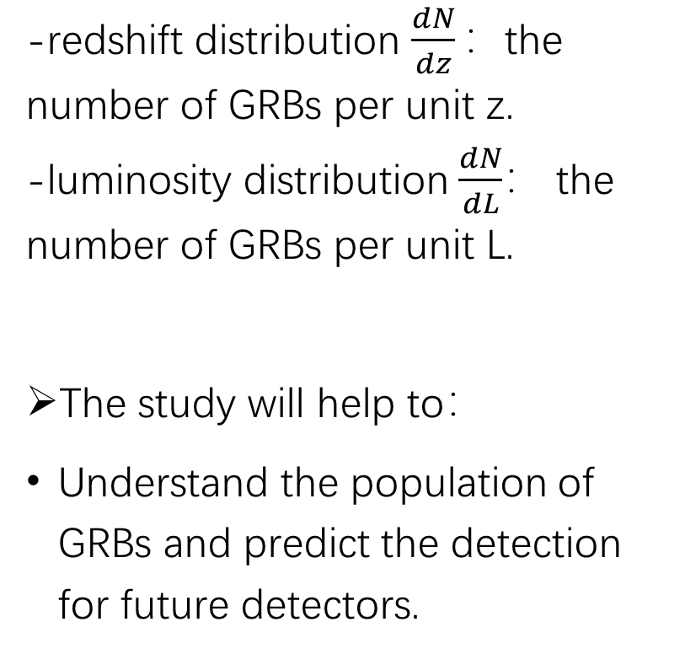
The redshift and luminosity distributions
-redshift distribution $\frac{dN}{dz}：$the number of GRBs per unit z.
-luminosity distribution$\frac{dN}{dL}$： the number of GRBs per unit L.
The study will help to：
Understand the population of GRBs and predict the detection for future detectors.
D.Wanderman & T.Piran (2010)
Notes:
These are typical LGRB z and l distributions in early studies. The redshift distribution peaks within 2 and 3, and for luminous LGRBs, the l distribution is broken PL form. These two are key properties of LGRB population, so they can be adopted to predict the detection for future GRB detectors.

Slide 6
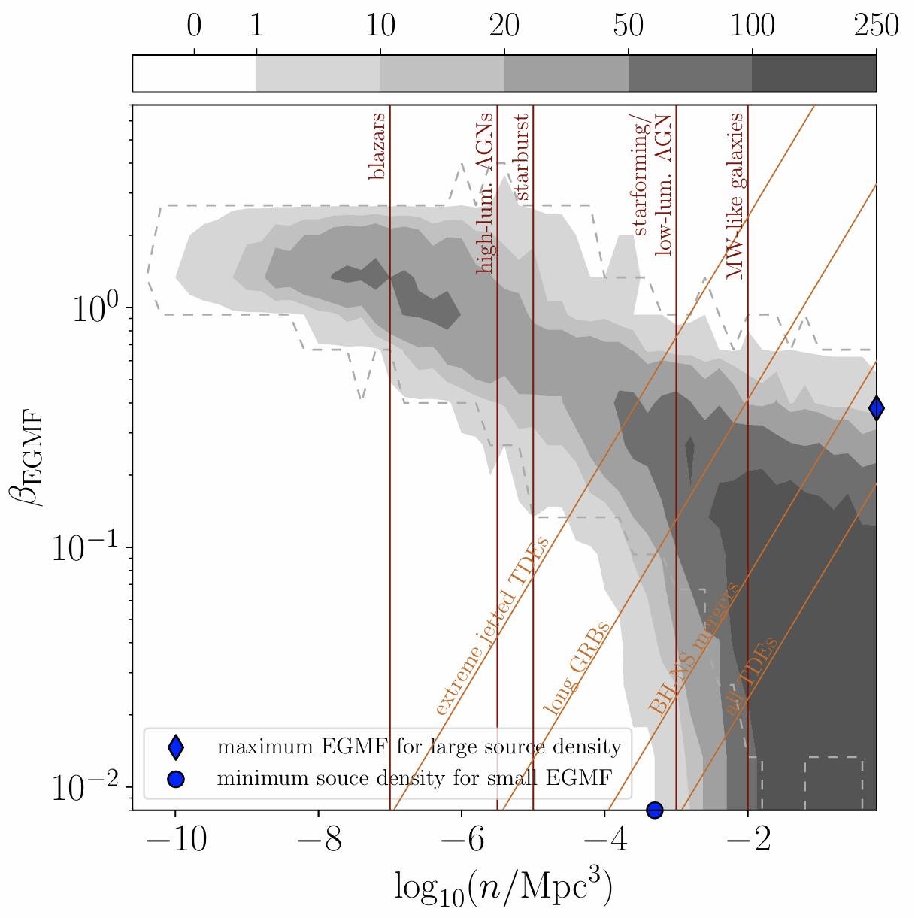
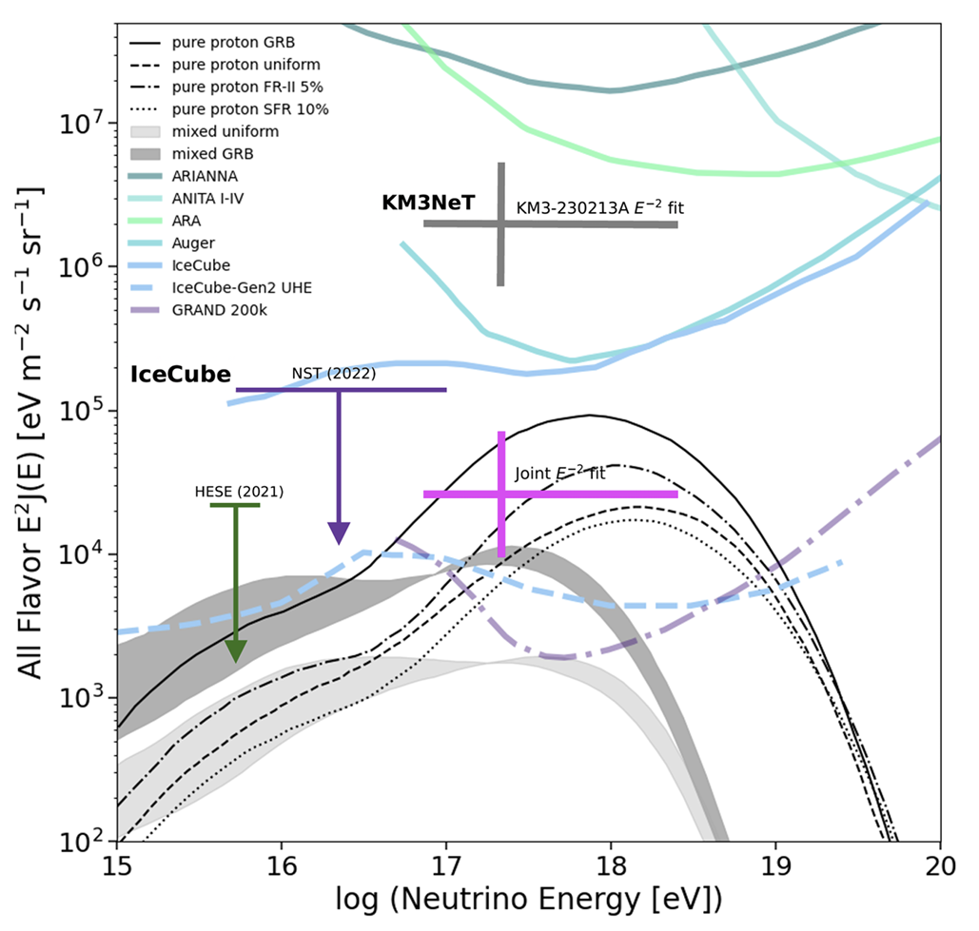
Assuming GRB is one of the origins of UHECRs, the number density of GRB can be used to
predict all-flavour cosmogenic neutrino background
constrain the extragalactic magnetic field
Bister & Farrar, 2024
Globus & Blandford, 2025
Notes:
If GRB is one of the origins of UHECRs, the number of GRBs per volume will be useful to constrain the extragalactic magnetic field and the cosmic neutrino bg.

Slide 7
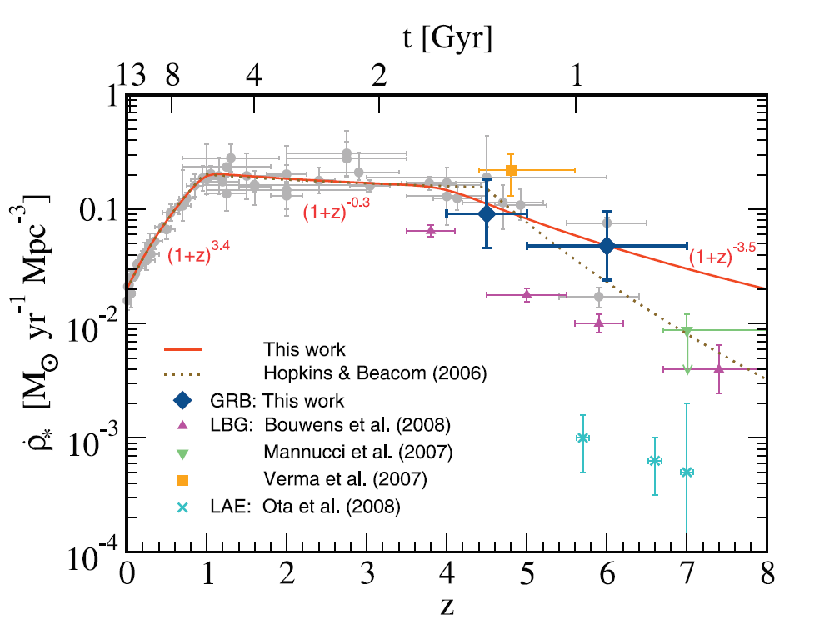
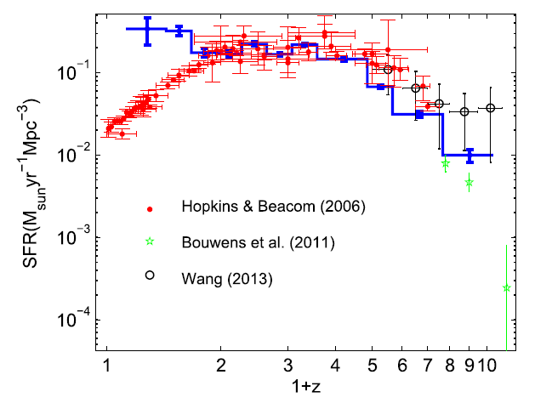
Since LGRBs come from the collapsing of massive stars, and massive stars live short, LGRBs are expected be a tool to trace the cosmic star formation rate (cSFR).
Yuksel et al., 2008
Yu et al., 2015
LGRB rate is higher than cSFR at high z?
LGRB rate is higher than cSFR at low z?
Notes:
Since LGRBs come from the death of massive stars, and the massive stars will collapse soon after the birth, LGRBs are expected to be a useful tool to trace the cosmic star formation rate, especially in early universe. However, we find many questions in this study. In the left hand side picture, the red curve is the LGRB rate, and the grey curve is the cSFR. We can see that the LGRB rate is higher than the cSFR at high redshift. But in some works, the excess is found at low redshift. It is strange.

Slide 8
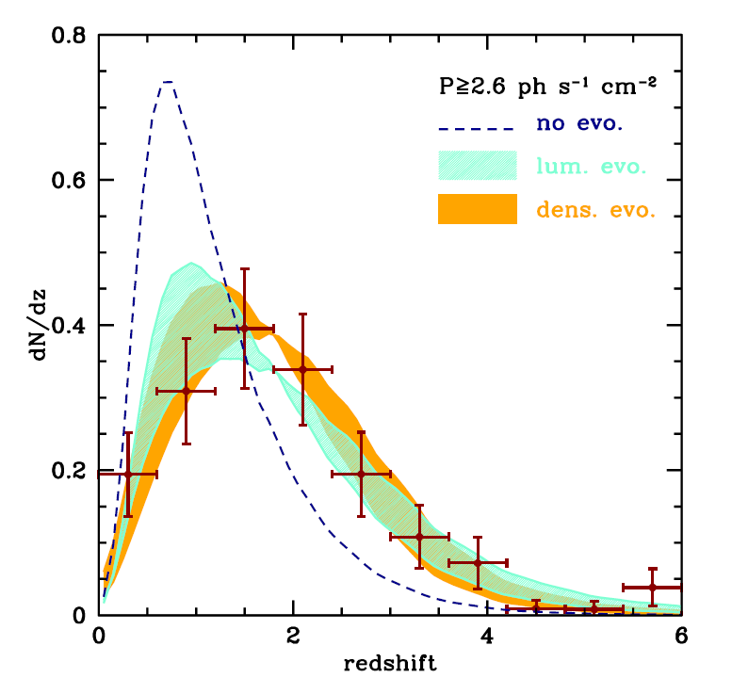
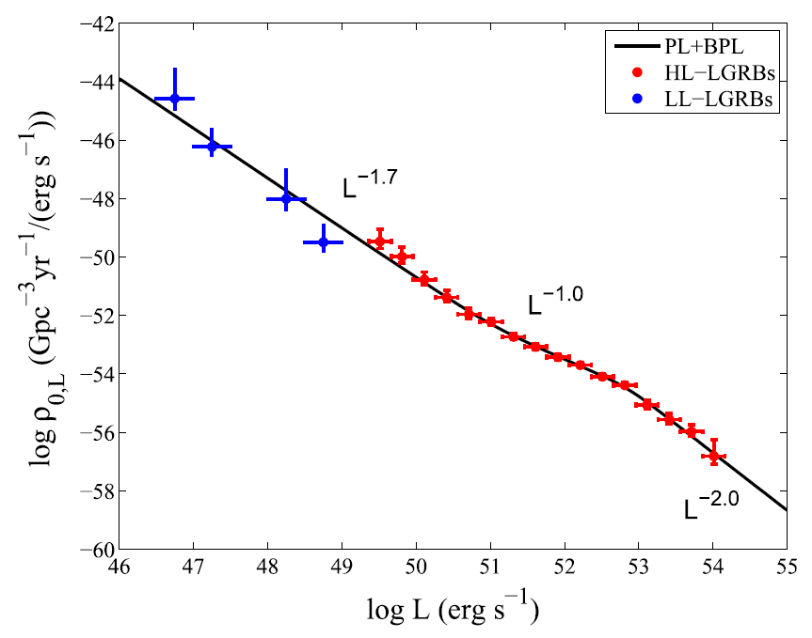
cSFR+redshift evolution is needed to reproduce LGRB rate?
The luminosity distribution of entire LGRBs is triple-power-law form?
Salvaterra et al., 2012
Sun et. al. (2015)
Notes:
A common opinion is that, to reproduce the LGRB redshift distribution, an evolutionary cSFR model should be considered for the LGRB rate. Specifically, the LGRB luminosity should evolve with redshift if the LGRB rate follow the cSFR, or the LGRB density should evolve with redshift based on the cSFR model. Besides, the updated results from Swift satellite show that the L distribution of entire LGRBs may be triple power law. It is also a little strange, because the luminosity distribution of a sort of Astron objects is usually broken power law

Slide 9
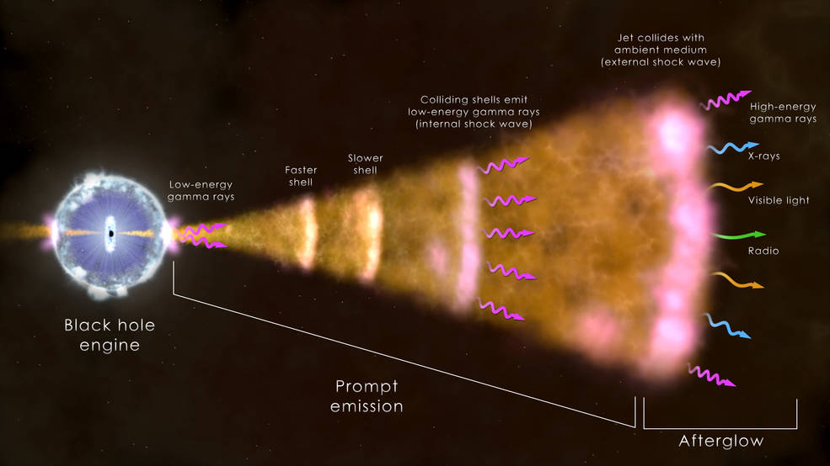
The observational effects
1. Detector triggered by gamma-ray photons
2.Get location from X-ray afterglows
3.Get redshift from optical afterglows
-The detector may be no-trigger if GRB is too weak;
-No redshift information if no detected optical counterpart.
Sun et. al. (2015)
NASA Sees 'Watershed' Cosmic Blast in Unique Detail | NASA
Notes:
This series of questions let us think about the sample biases caused by the observational effects. This plot shows the LGRB emission and detection. When the massive star is collapsing, the relativistic jets will be produced and the matter collision inside the jets will emit gamma-ray photons, which will trigger the gamma-ray detectors. Then the jets will expend and crash the interstellar matters. This will produce the X-ray, optical, and radio afterglows. The X-ray afterglow can let us know the LGRB location quickly so that the optical telescopes can point to the location to measure the LGRB redshift. However, in fact, not every GRB can trigger the detectors and not every GRB has a measured redshift. This means, the observed sample of GRBs with measured redshifts is not complete and is not a good representative of the entire GRB population.

Slide 10
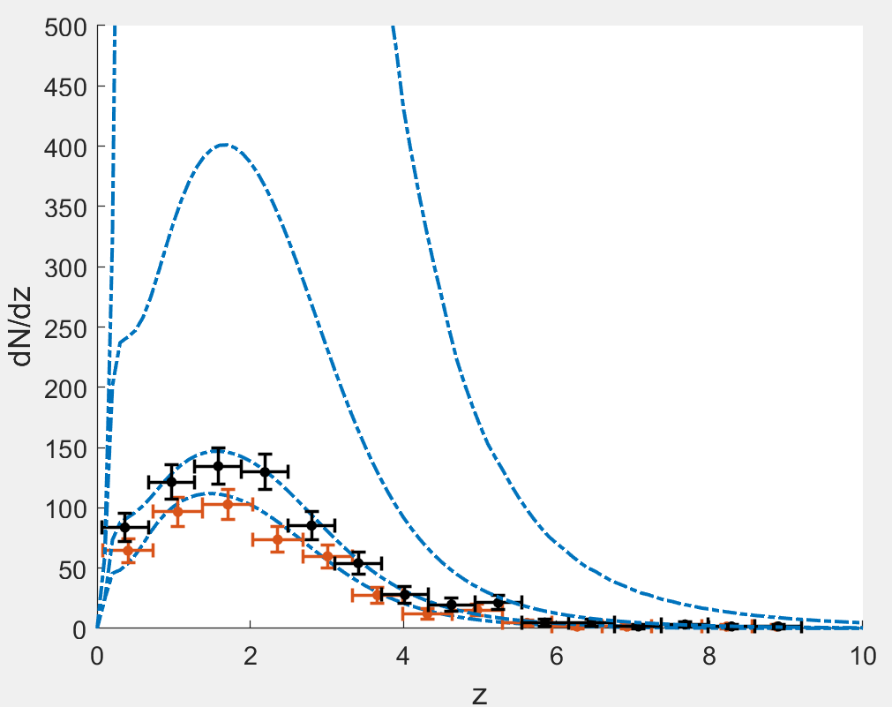
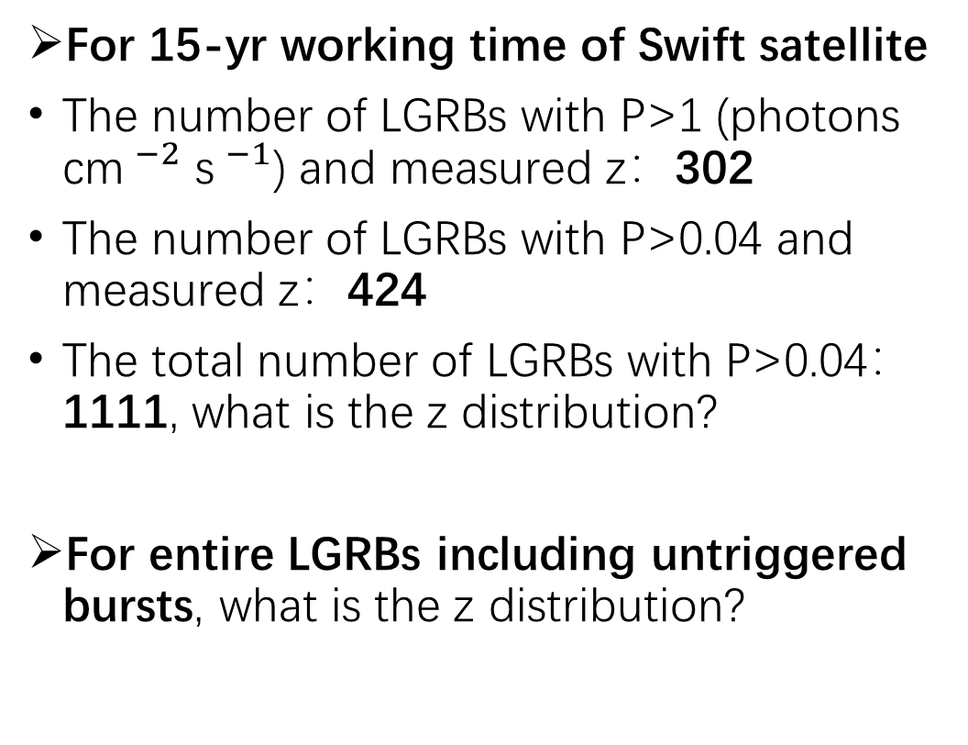
The peak flux (P) selection
For 15-yr working time of Swift satellite
The number of LGRBs with P>1 (photons cm$^{−2}$ s$^{−1}$) and measured z：302
The number of LGRBs with P>0.04 and measured z：424
The total number of LGRBs with P>0.04： 1111, what is the z distribution?
For entire LGRBs including untriggered bursts, what is the z distribution?
z dist. for total 1111 observed LGRBs with P> 0.04?
z dist. for entire LGRBs with P>0.04?
Obs. z dist. for 424 LGRBs with P>0.04
Obs. z dist. for 302 LGRBs with P>1
Notes:
For instance, these red points show the obs. z distribution for LGRBs with peak flux>1 and these black points are the obs. z distribution for peak flux>0.04. All data come from Swift satellite, but these two z dists are obviously different. Moreover, the total obs. Number of LGRBs with P>0.04 is actually > 1000. what does their z dist. Look like? And what dose the z dist. Of the entire LGRBs look like? An application of GRBs should base on the intrinsic population but not the observed cases.

Slide 11
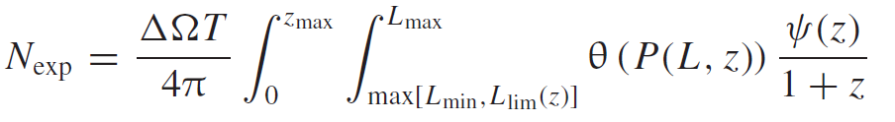

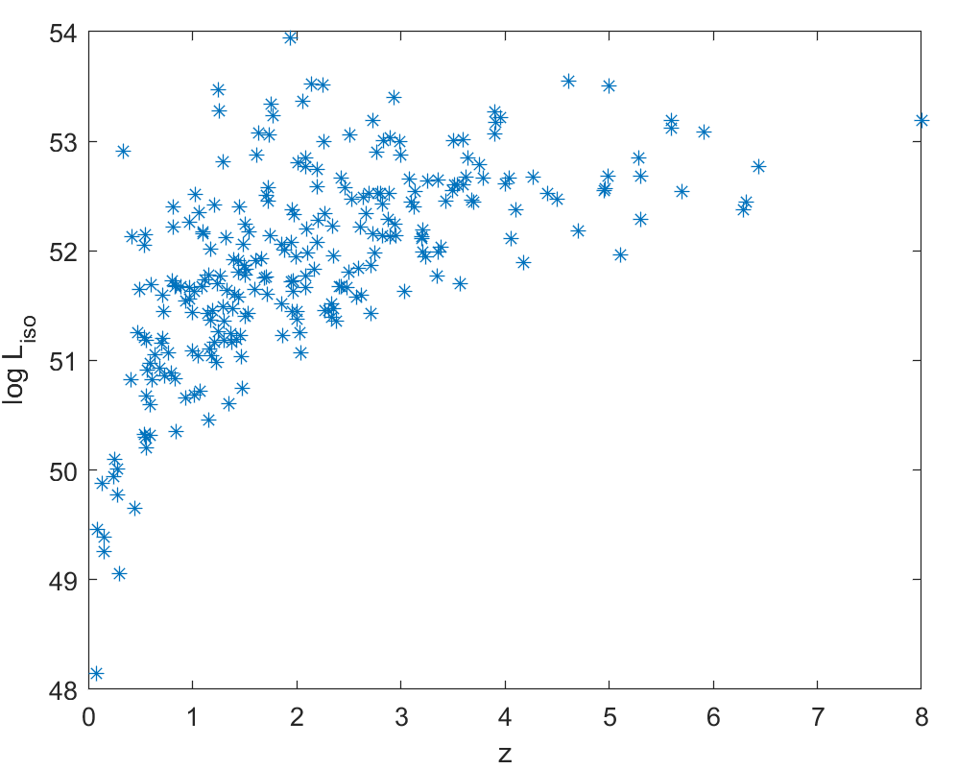
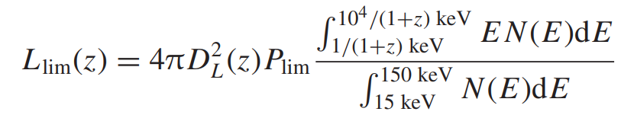
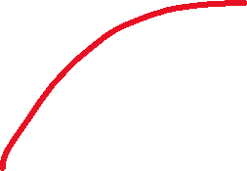

The observable number of LGRBs in theory
The z-measurement probability and trigger probability to correct the intrinsic distribution (number) to the observed distribution (number).
The intrinsic formation rate
The intrinsic luminosity function
(Swift energy band: 15-150keV)
Notes:
Here we take LGRBs as an example to show a method to estimate the intrinsic distributions. In this function, the last term is the intrinsic L function, the middle term in the intrinsic rate, the former term includes the redshift measurement probability and the trigger probability to correct the intrinsic distribution to the obs. Distribution. Integrating them within certain range of L and z, and considering the detector properties, we can get the observable number of LGRB in expectation. This limiting L is also a kind of observational effects caused by the instrumental sensitivity. It depends on the distance and peak flux limit, the final term in a K correction to correct the observed L to the intrinsic L. we usually use LGRB spectra to do the K correction.

Slide 12
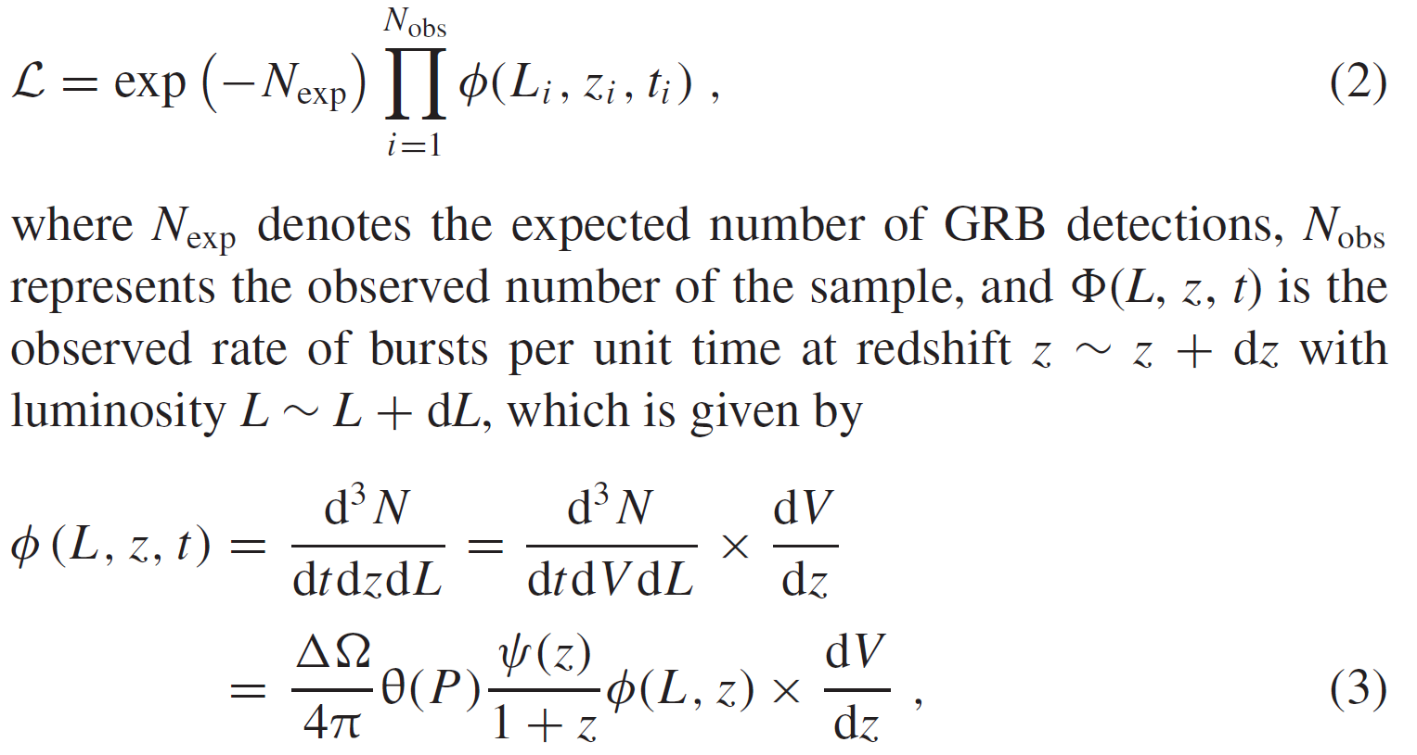
The maximum likelihood method to estimate free parameters
Notes:
We will consider some models with free parameters for the rate and luminosity functions to fit the observed results. With the MLM, we can get the fitting results for the free parameters.

Slide 13
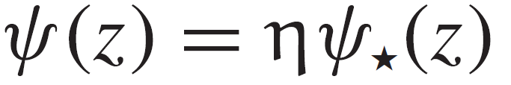
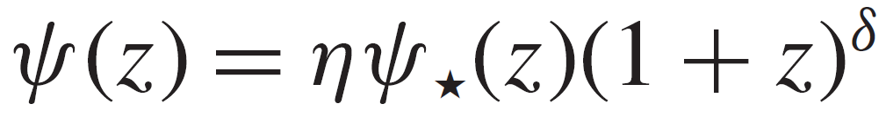
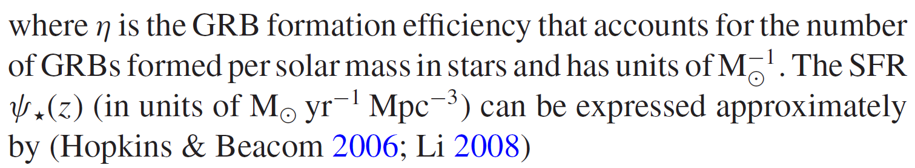
The LGRB formation rate
Proportional to cSFR:
Or having redshift evolution relative to cSFR:
η δ are free parameters
Notes:
In this work, We also consider the cSFR model as the LGRB rate, if it cannot reflect the observed LGRB results, we will consider an evolutionary model that is the cSFR with a redshift evolution factor.

Slide 14
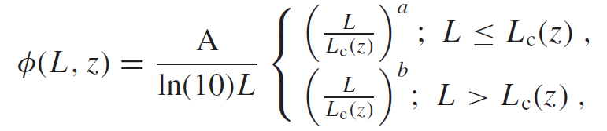
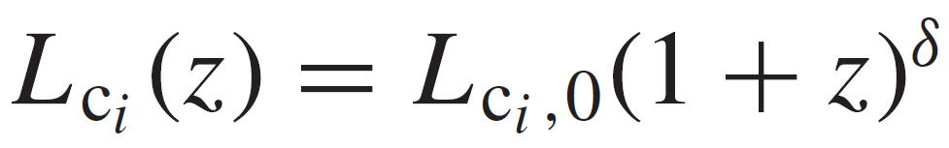
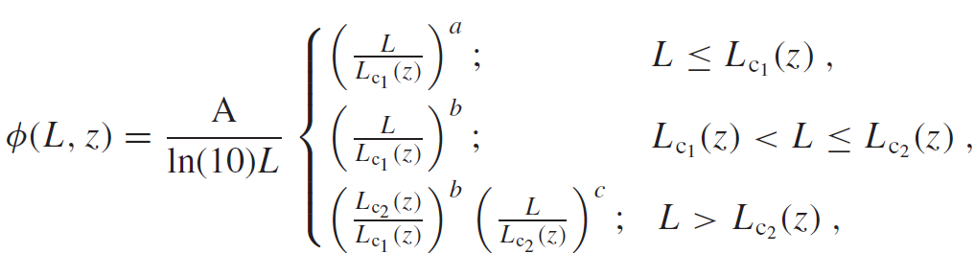
The LGRB luminosity function
Theoretically and traditionally broken power-law:
Empirically triple power-law:
If luminosity is evolutionary with z：
A a b Lc δ are free parameters
Notes:
Or a model that the luminosity evolves with redshift. For the form of the luminosity function, we consider two cases, the traditional broken PL form, and the empirical triple PL form.

Slide 15
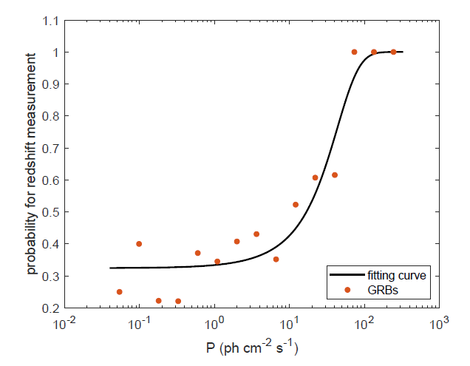
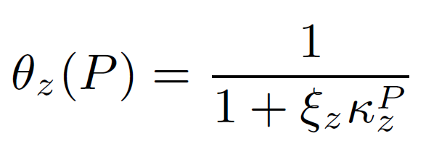

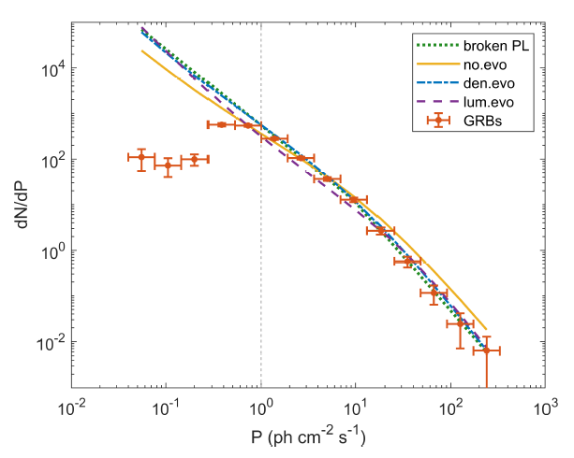
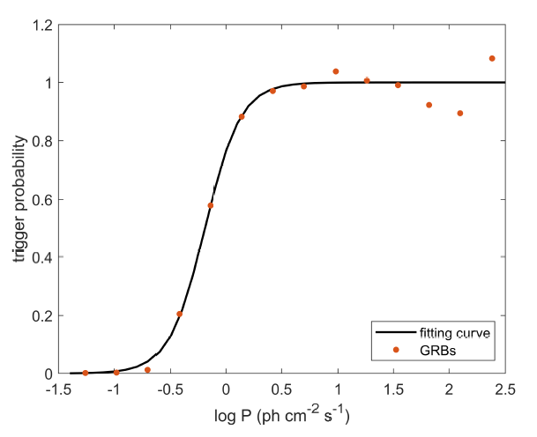
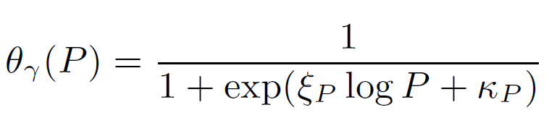

The z-measurement probability and trigger probability
Separating P to i bins
$θ_{z}\left(P\right)=\frac{{Number}_{i}^{z} (P)}{{Number}_{i}^{total}(P)}$
The z-measurement probability:
Assuming P dist. is broken power law
The trigger probability:
Notes:
These are the most important. For the z-measurement probability, we separate peak flux into several bins and in each bin we use the number of LGRBs with measured z to over the total number. Then we can get these red points which reflect the ratio of z measurement in each peak flux bin. They can be well fitted by a sigmoid function. For The trigger probability, we assume the intrinsic P distribution is broken PL, then use data with P>1, where we think the trigger probability is almost 100%, to acquire the intrinsic P dis., that is this green curve. Then, we extrapolate it to the faint region and use these red points to over this green curve, so that we can get these trigger ratios. It can also be well fitted by another sigmoid function.

Slide 16
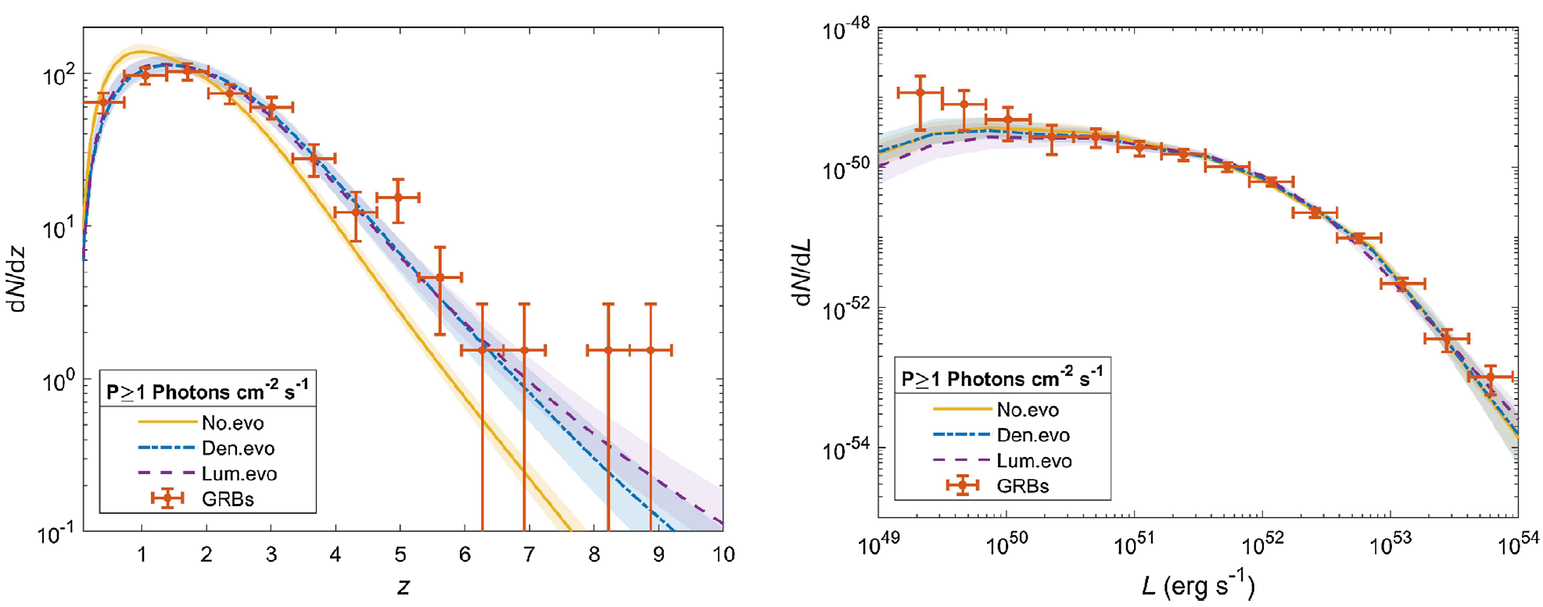
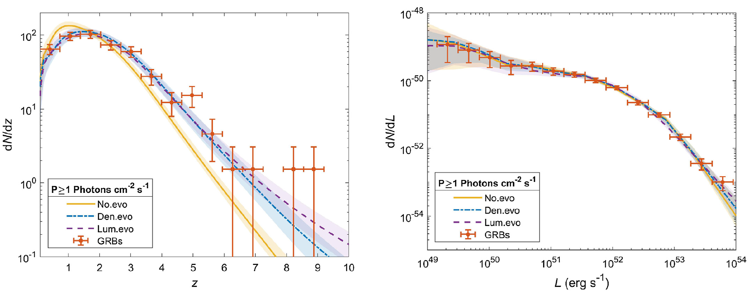
Results for LGRBs with P>1
Assuming the Trigger Probability is 100% for LGRBs with P>1 to estimate the free parameters (no T. P. is included in the phase of estimating parameters) .
A redshift evolution model is necessary.
The LGRB LF prefers triple-PL form.
Notes:
With the models above, we can get the free parameters in the rate and luminosity functions. in case our trigger probability is incorrect, We only use LGRBs with P>1, where we think the trigger probability is 100%, to estimate the free parameters. Our results show that the simple cSFR model that is the orange curve cannot reproduce the LGRB observed redshift distribution. A density or luminosity evolution model, shown as purple or blue curve respectively, has to be taken into account. In addition, rather than the broken PL form, the LGRB luminosities prefer a triple PL like distribution. while the observational biases already have a good consideration.

Slide 17
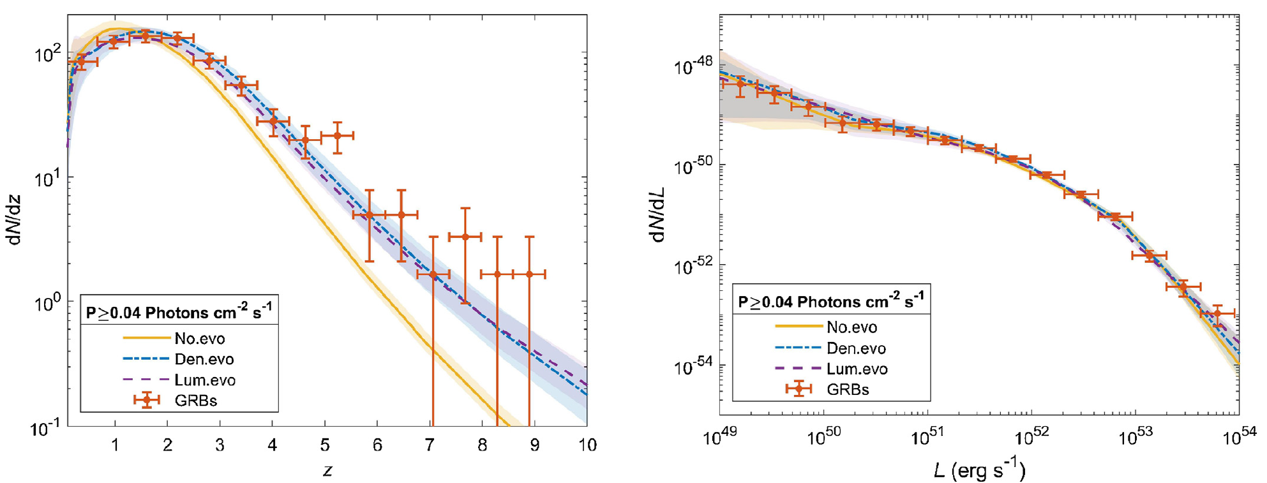
Results for LGRBs with P>0.04
With the estimated parameters above, considering the trigger probability, the observed distribution of LGRBs with P>0.04 can be reproduced by still redshift evolution models and triple-PL LF.
Notes:
Without changing any parameter, we include all observed redshift data by considering the trigger probability introduced before. We can see that the observed distributions can still be well reproduced by our models, but still by the evolution models and the triple PL LF.

Slide 18
Summary
We provide empirical methods to estimate the z-measurement probability and the trigger probability of Swift LGRBs, and use them to study the intrinsic z and L distributions；
We find LGRBs can not trace the cSFR directly without considering a redshift evolution.
Unlike traditional broken PL LF, LGRBs prefer a triple PL LF ➔ potential sub-class LGRBs
“The authors have a nice approach to addressing the completeness problem......”
MNRAS 508, 52–68 (2021)
Notes:
This is the summary of this work. We provide a method to address the incomplete issues of an observational sample, we estimate the LGRB int. z and L dis. Our results show that LGRBs cannot be a direct tracer of cSFR, and the most important, the LGRB LF prefers a triple PL form. We also got a nice comment in reviewing.

Slide 19
What is the population of LGRBs?
Notes:
So a question is remained. Why it is triple PL form? What the LGRB population should be?

Slide 20
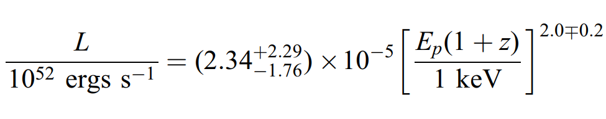
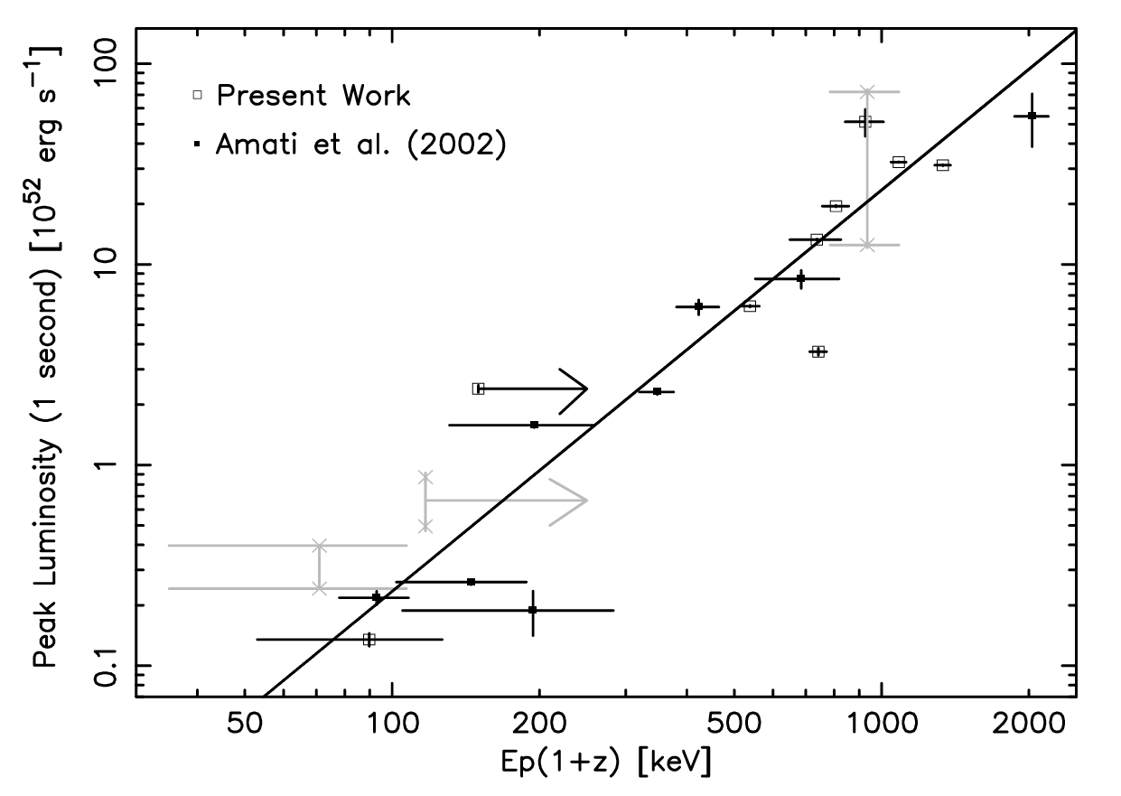
Epi-Liso correlation: intrinsic nature?
Standardizing LGRBs
(Wang et. al., 2015)
Constraining LGRB emission physics
(Ito et. al., 2019)
Estimating LGRB pseudo redshifts
(Tan et. al., 2013)
Yonetoku et. al., 2004
Notes:
For this study, we need the help of a LGRB fundamental correlation between LGRB intrinsic spectral peak energy and LGRB luminosity. This correlation is widely used for standardizing LGRBs to estimate some cosmological properties. the tool is similar like SNe Ia . It is also used to constrain LGRB emission mechanism and estimate pseudo redshift of LGRBs.

Slide 21
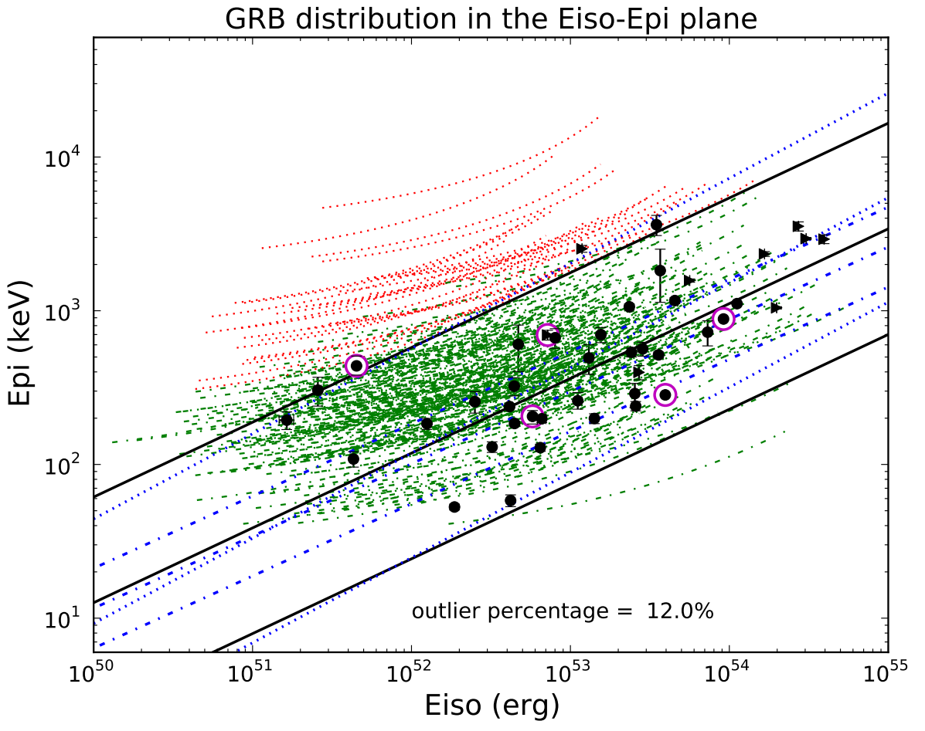
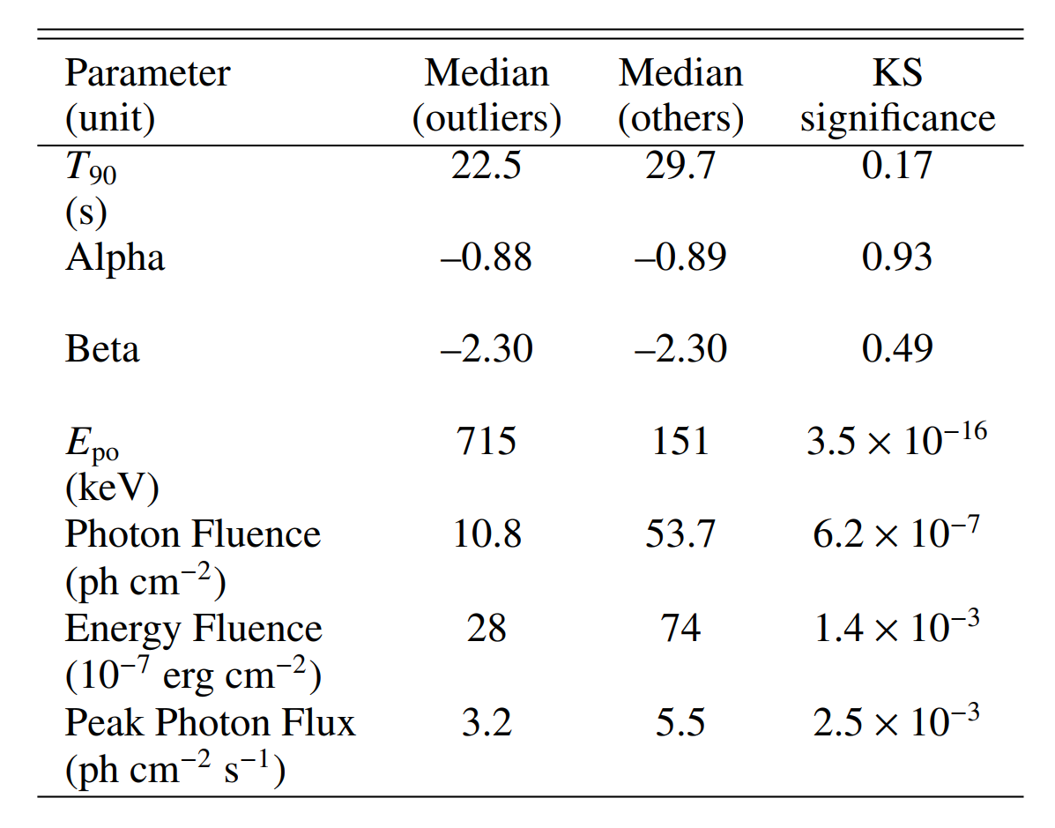
Possible P selection effects
One curve, one burst with z
from low to high
Red curves, lower fluence / peak flux
Green curves, higher fluence / peak flux
Heussaff et. al. (2013)
Notes:
But there are also some questions in this correlation. In this picture, the black points are LGRBs with measured redshifts, and the central line is the best-fit result for these black points, these two lines by side present 2sigma confidence interval of the fitting result. These curves are LGRBs without measured redshifts. One curve is one burst with giving redshift from low to high. These green curves mean, whatever their redshifts are, these LGRBs probably locate in the 2sigma interval and these red curves are probably outside 2sigma interval. Obviously, if we consider all bursts, the best-fit result will be certainly not this central line. We notice that the fluence and the peak flux of red curves are averagely smaller than green curves. So we suspect that the Epi-Liso correlation is affected by the peak flux.

Slide 22
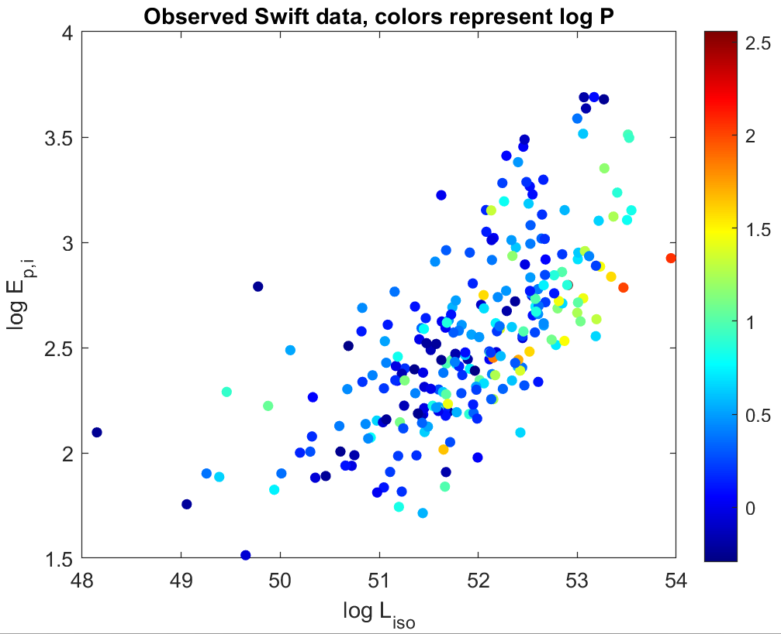
Need a large sample
The (Epi, Liso) distribution looks like changing with P, but not significant. Probably because the number of LGRBs with measured z is small.
➔simulate a large sample that can represent the observed sample.
log P (ph cm^-2 s^-1)
Notes:
Then we plot this picture with Swift satellite data. The colors represent the value of log P. red color means high peak flux, and along this direction, we can see the peak flux is weaker and weaker. But this trend is not significant. We think it is because the number of measured redshifts is still too still small. So we finally decide to simulate a large sample to study this trend of P distribution.

Slide 23

The observable number of LGRBs in theory
The z-measurement probability and trigger probability to correct the intrinsic distribution (number) to the observed distribution (number).
The intrinsic formation rate
The intrinsic luminosity function
${N\left(E\right)\sim \left(\frac{E}{50}\right)}^{α}∗exp\left(−E∗\frac{2+α}{E_{p,o}}\right)$
Notes:
Then we go back this function, which reflect the LGB population, again. Because it is a simulation, and we need unified LGRB properties, a cut-off PL form is considered for all LGRB spectra. The best-fit results for these two spectral parameters can be directly downloaded from Swift GRB catalog.

Slide 24
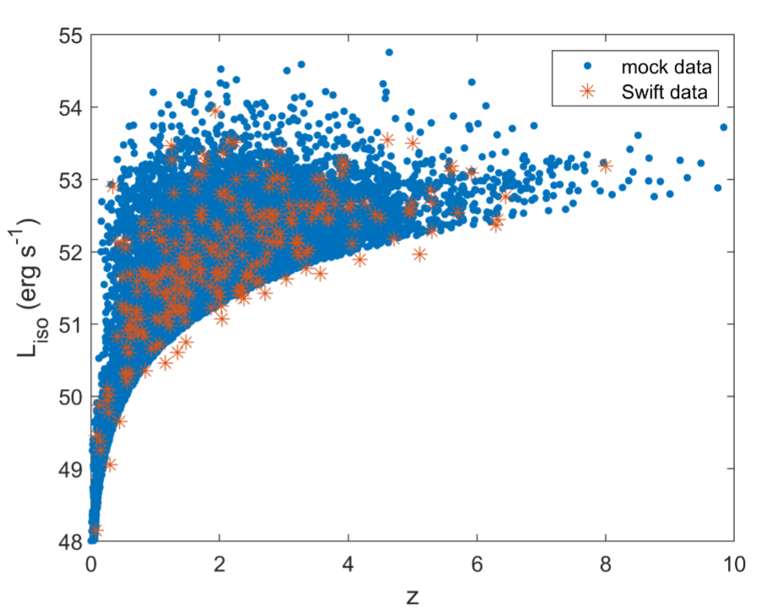
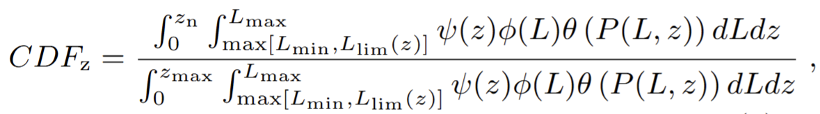
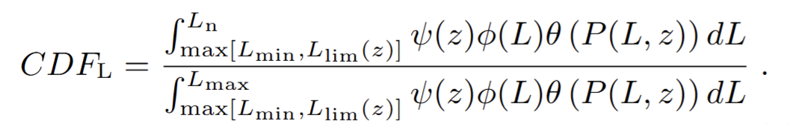

1. Obtain 10,000 mock redshifts from the redshift cumulative distribution.
2. For each mock $z_{j}$, estimate corresponding $L_{lim}\left(z_{mock, j}\right)$, then draw one value from the cumulative luminosity distribution as the observable mock $L_{iso, j}$ for $z_{mock, j}$ .
Notes:
Based on the above function, we have the cumulative observed z distribution of LGRBs. Then we draw 10,000 data as the mock z from the CD. for each mock z, we estimate the corresponding limiting luminosity, then draw 1 value from the luminosity CD as the observable luminosity for this mock z. we finally can have these blue points which are the simulated data. They are consistent with these red symbols which are the Swift observed results.

Slide 25
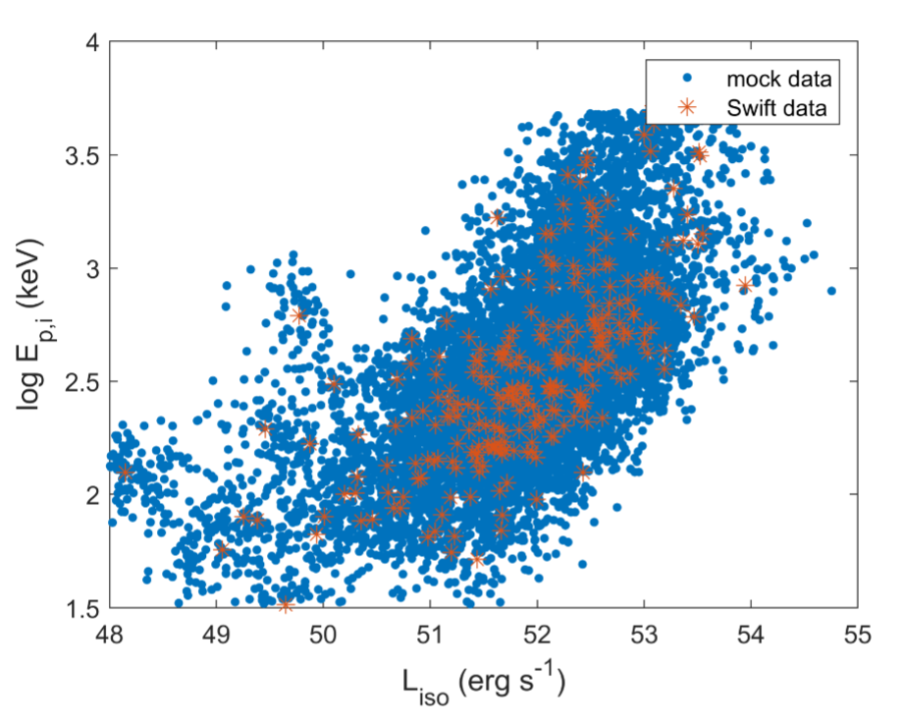
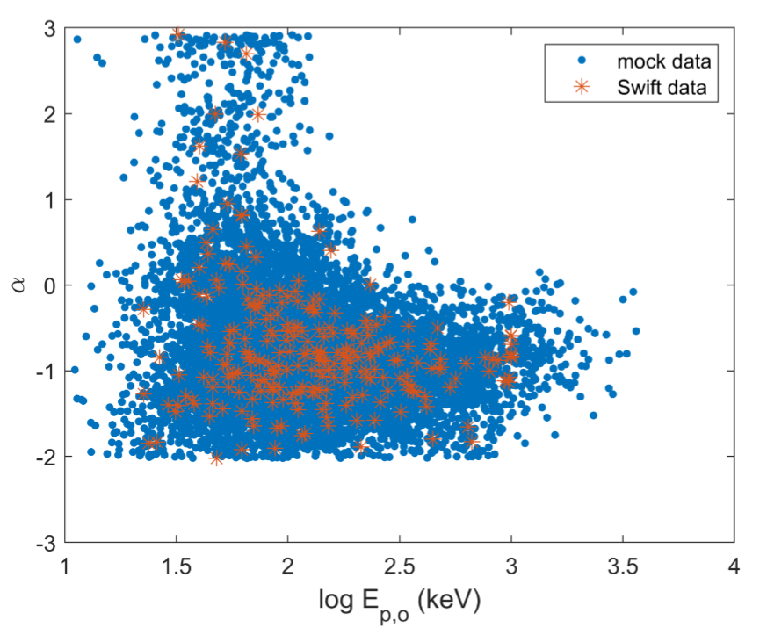
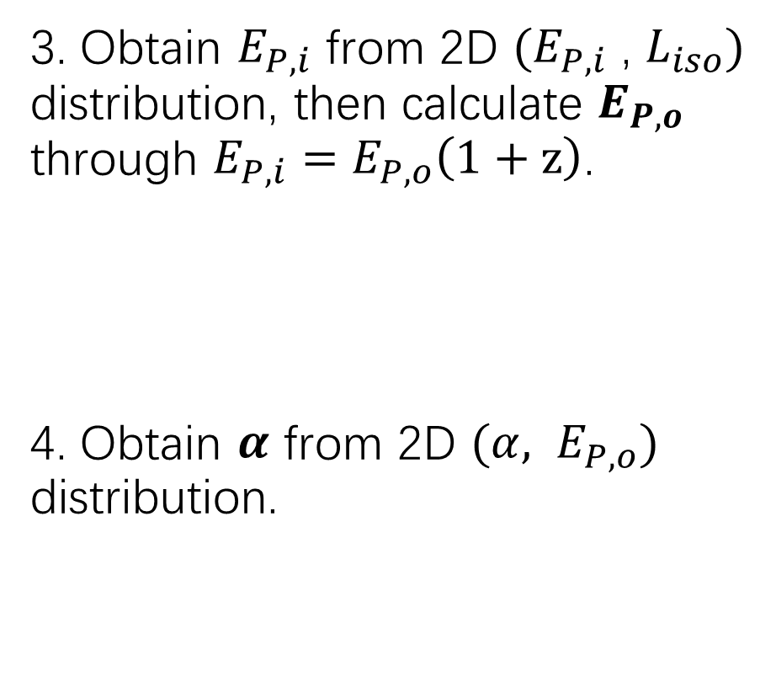
3. Obtain $E_{P,i}$ from 2D $(E_{P,i}$ , $L_{iso})$ distribution, then calculate $E_{P,o}$ through $E_{P,i}=$ $E_{P,o}\left(1+z\right)$.
4. Obtain $α$ from 2D $({α, E}_{P,o})$ distribution.
Notes:
With the mock z and L, we can get mock Epi based on the 2D Epi,Liso distribution, then we use the mock Epi to calculate the observational spectral peak energy Epo. I need to emphasize that even though we have observed Epo data, the mock Epo has to be obtained through the Epi, Liso distribution, otherwise in the final, the mock peak flux distribution cannot agree with the observed results. After having the mock Epo, we can obtain the spectral PL index alpha through the alpha, Epo distribution

Slide 26
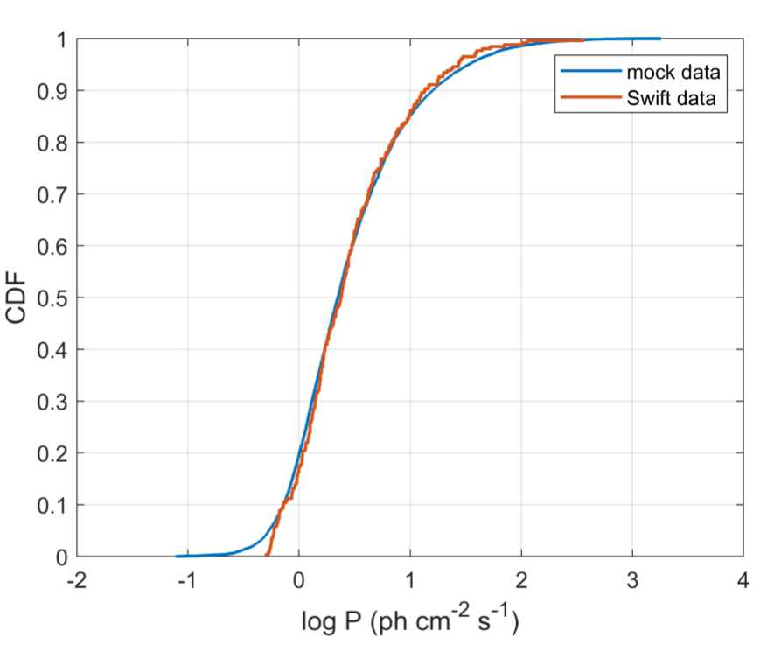

5. Calculate P through mock L, z, alpha, Epo
Swift energy band: 15-150keV
The KS test proves, for all parameters, the mock data follow the same 1D or 2D distributions of the observed data.
Notes:
Finally, we can complete the simulated sample by calculating peak flux through the mock L, z, alpha, Epo. This approach can ensure all parameters of a simulated burst are connected and observable. The KS test can also prove our simulated sample is a good representative of the observed results in both 1D and 2D distributions.

Slide 27

The P distribution in the Epi-Liso diagram
The colors (the value of P) are not uniform in the Epi-Liso diagram➔ The fitting result of the Epi-Liso relation will be directly affected by peak flux selection.
The color distribution in the lower-left region is different from in the upper-right region ➔ LGRBs with high P in the low-Epi & Liso region may have origins different from the main-sequence LGRBs
log P (ph cm^-2 s^-1)
Notes:
Then we can have the Epi-Liso diagram with the simulated sample. It is obvious that the Epi and Liso distributions of these red, green and blue points are different, which means the best-fit Epi-Liso relation will be directly affected by the peak flux selection. Moreover, with the trend of color shift in this region, like red green blue, this lower-left corner should be dominated by the blue points. But actually, there are many high peak-flux points here. This means the P distribution here is different from the main-sequence LGRBs. We suppose there may be some LGRBs having origins different from the main-sequence LGRBs in this region. To quickly verify this idea, based on this condition log P>0.5

Slide 28



In the observed sample, there are 4 LGRBS with log Epo<2.5, log Liso <50, and log P>0.5.
Two of them, GRB 060614 and GRB 191019A, have observational results showing probably not associated with collapsars.
(Gehrels et. al., 2006)
(Levan et. al., 2023)
Notes:
In this region of observed data, can finally pick out 4 LGRBs. And in these 4 bursts, there are two have been confirmed in observation that probably are not associated with massive stars. So this supports our idea that the high peak flux LGRBs with low-Epi&Liso may have alternative origins instead of massive stars. This may link to the triple PL LF introduced before.

Slide 29
Summary
Based on the 2D distributions of parameters, we simulate a large LGRB sample to study the selection effects in the Epi-Liso correlation.
To reproduce the observed results, the mock Epo should be obtained through the (Epi, Liso) distribution ➔ The Epi-Liso correlation should the intrinsic property of GRBs.
With our mock sample, we find that the best-fit Epi-Liso relation will be affected by peak flux selection;
We also find that the P distribution in the low-Epi&Liso region is different from in main-sequence region ➔ LGRBs with high P, low Epi, and low Liso may have alternative origins.
2025 ApJ 988 117
Notes:
This is the summary of this work. We simulate a large LGRB sample that can well reproduce the observed results. Based on this sample, we find the LGRB Epi-Liso relation will be directly affected by peak flux selection. We also find high peak flux, low Epi and low Liso could be useful conditions to preselect LGRBs that may not belong to massive-star origins.

Slide 30

The SVOM mission
Eclairs
Energy band: 4-150 keV
can help to study the lower edge of GRBs
Measured-z ratio: ~45%
GRM
Energy band: 15-5000 keV
can help to study very high-energy
photons & phenomena in Universe
Redshift is available
with the whole SVOM system
?
sub gamma ray
good location
optical
very high energy
Notes:
In the end, please let me introduce a new GRB mission, a Chinese and French cooperating satellite SVOM. I am working at SVOM Eclairs group. It is a GRB trigger detector in energy band from 4 to 150 keV. The lower energy limit is a little smaller than Swift’s, and the ratio of z measurement is a little greater than Swift’s. So we expect Eclairs can help to understand the GRB edges and have a better classification for whole GRBs. And there is also another GRB detector GRM on SVOM satellite, it is energy range is larger, so we may have a more complete view for a GRB spectrum. Since it is a part of SVOM, GRM can also have a redshift to understand the intrinsic properties of high-energy transients in gamma-ray band. To sum up, we hope the SVOM mission can bring us a deeper and clearer understanding in the field of GRBs and high-energy particles in universe.

