Slide 1
Introduction of CEE experiment and eTOF
Shihao Zhang
Tsinghua University
On behalf of CEE eTOF subsystem
Notes:
Bonjour, everyone! I am very glad to have the opportunity to share with you all the details of the CEE project and its eTOF subsystem here. OK, let's get to the point.

Slide 2
Outline
CSR External-target Experiment (CEE) at Lanzhou, China
Multigap Resistive Plate Detector (MRPC)
Gas-related challenges and the sealed MRPC
CEE-eTOF physical functions
  Particle identification
  Participation in global triggers
The results of Cosmic Test and Beam Test
Conclusion
Notes:
I will introduce the project from the following aspects:

Slide 3
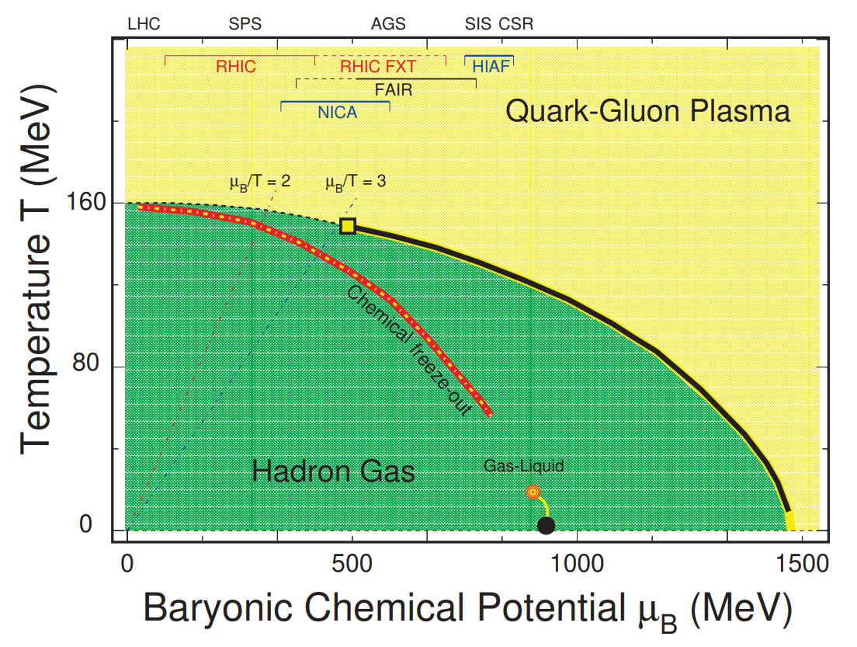
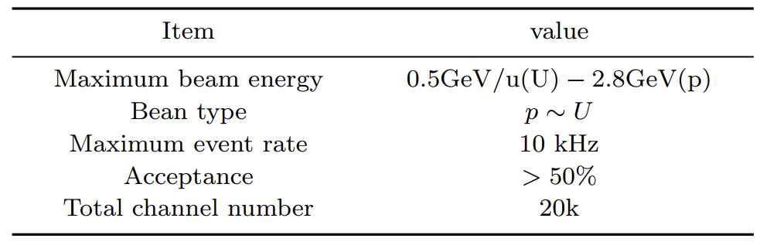

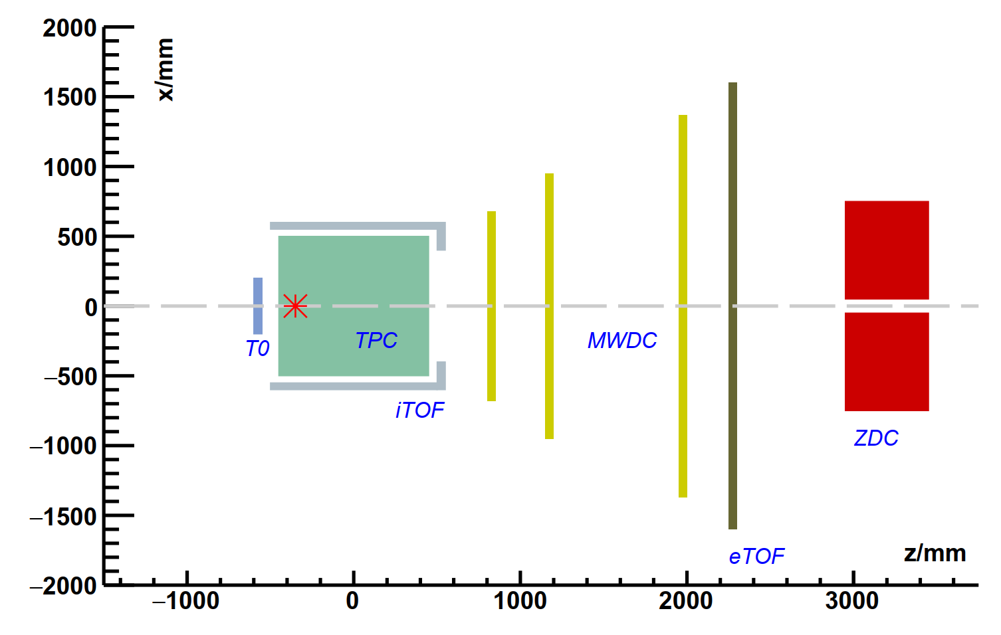
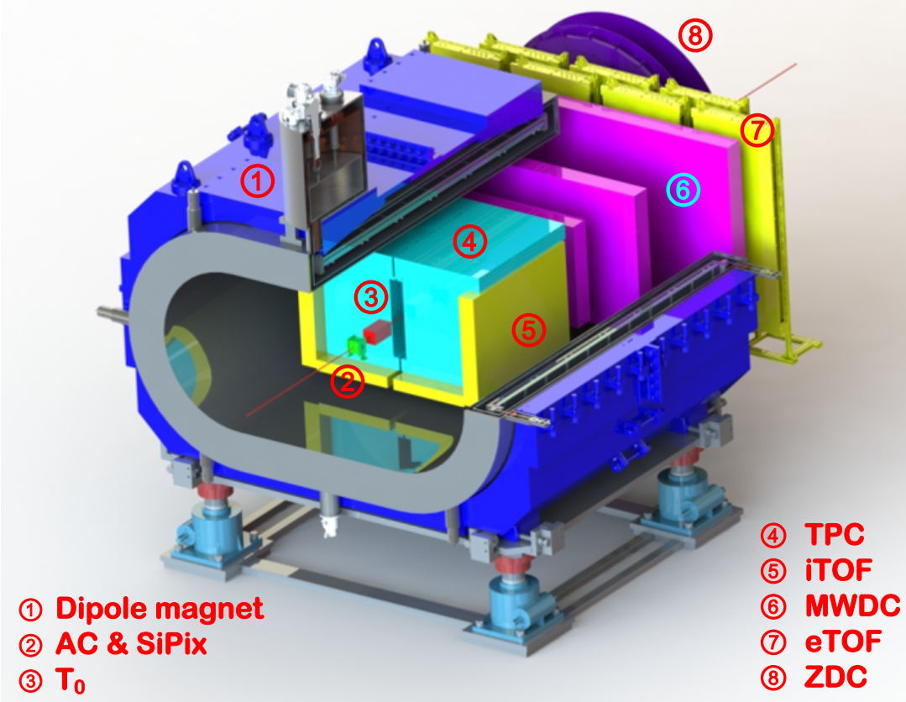
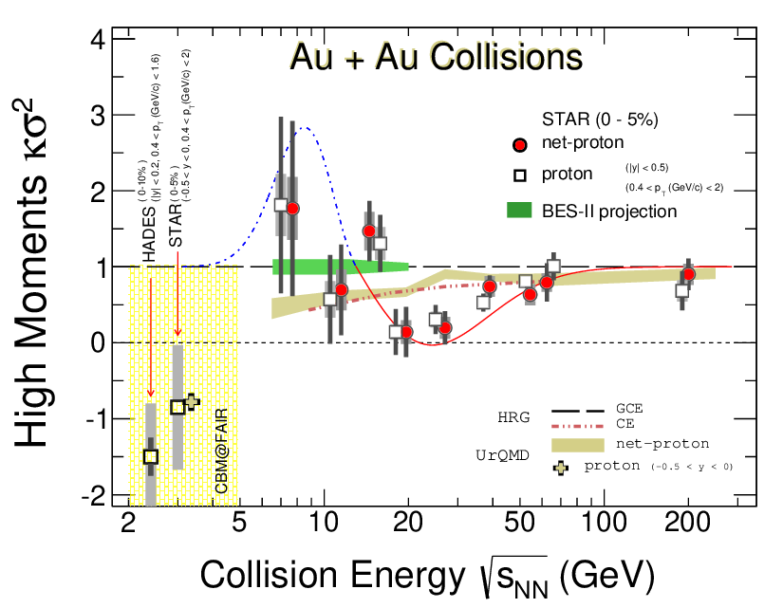
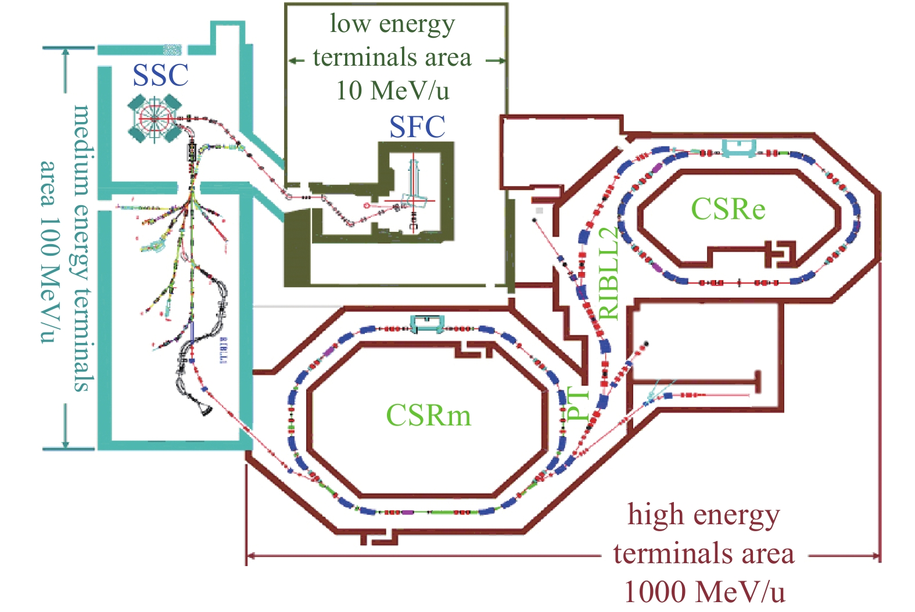
CSR External-target Experiment (CEE)
CEE is under construction for the studies of the Equation of State (EoS) of nuclear matters
  QCD phase structure
  EoS and Asymmetry energy
  Hyperon and features
  Take data from 2025
CEE is a spectrometer which measures the secondary particles in heavy ion collisions with Time-Of-Flight (TOF) methods
  Front angle: MWDC+eTOF
  Large angle: TPC+iTOF
  Multigap Resistive Plate Chamber (MRPC) technology
25°
CEE
Notes:
Quantum chromodynamics is a modern theory that describes the interactions among fundamental particles such as quarks and gluons. The state of nuclear matter can be described by the QCD phase diagram, which contains rich phase structures. When a phase transition occurs between hadronic state and QGP(Quark-Gluon Plasma), depending on the density of nuclear matter, it manifests as a smooth transition or a first-order phase transition. Then, there will be a critical point in between the two states. In 2021, the STAR experiment released the results of analyzing the data from the first stage energy scan, finding evidence of the existence of the critical point of the first-order phase transition. However, the experimental statistics in the low-energy region were very low. The construction of the external target experiment at the heavy ion cooling storage ring in Lanzhou will make an important contribution in this field. It can conduct fixed-target experiments between U(uranium) nuclei at 500 AMeV(maga electron volt), with a typical reaction rate of up to 10^4 Hz. In the future, we might continue conducting experiments in Huizhou to achieve higher energy levels. The main task of CEE is to identify the secondary charged particle products through the flight time method. The CEE spectrometer sets up two detector arrays with a 25° polar angle as the boundary. The time projection chamber TPC and the internal flight time detector iTOF installed inside the magnet are responsible for the measurement of particles with large angles and medium momentum, while the multi-wire drift chamber MWDC and the external flight time detector eTOF located downstream are responsible for the measurement of particles with high forward momentum.

Slide 4
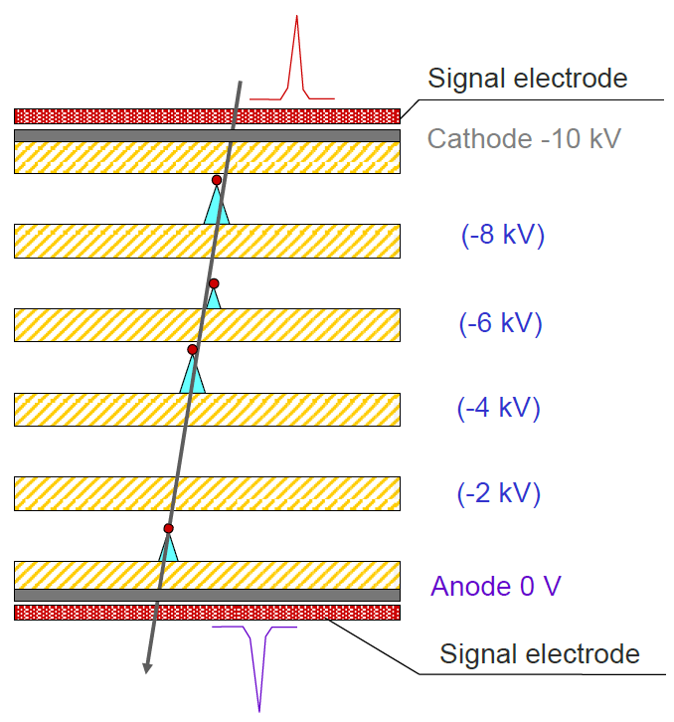
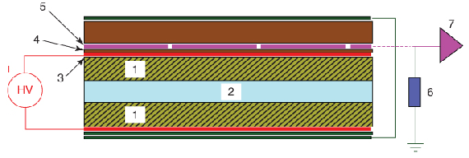
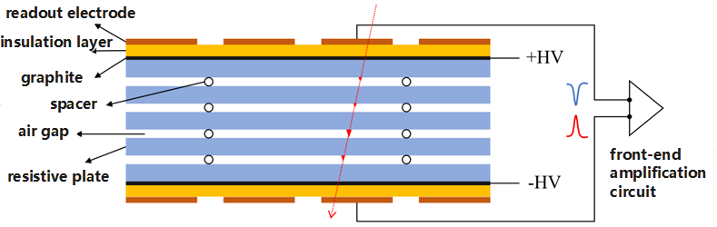
Multigap Resistive Plate Chamber
In 1981, the first Resistive Plate Chamber (RPC) gas detector.
Utilizes avalanche to generate signals with high count rate compared to streaming.
Resistive materials electrically shocked and the discharge is limited to localization.
Materials are cheap and readily available, making it easy to build large area detectors.
First proposed by E. C. Zeballos
In 1996, the design of the multi-gap resistive plate chamber (MRPC) detector was first proposed.
The multigap structure brings:
Narrow gap thus high time precision
Necessary gap thickness for good efficiency
Notes:
The TOF systems of CEE are all constructed from multi-gap resistive plate chambers MRPC. It is a new type of gas detector developed based on the resistive plate chamber RPC. RPC generates signals through ionization and Townsend Discharge effect, operating in a limited proportional region. Glass, bakeliteand other resistive materials are used as electrodes. Its advantage lies in being able to confine the discharge locally and effectively read out fast signals. Because the materials are cheap and readily available, RPC has the advantage of large-scale production and is thus used as large-scale trigger detectors. MRPC is designed with multiple layers of resistive plates, dividing a single wide gap into multiple parallel narrow gaps, enabling the detector to operate at a higher field strength. Due to the narrow gaps, MRPC has better time resolution, and the multi-layer structure ensures that MRPC has sufficient efficiency. Therefore, MRPC is widely used in the TOF systems that constitute large particle physics experiments.

Slide 5
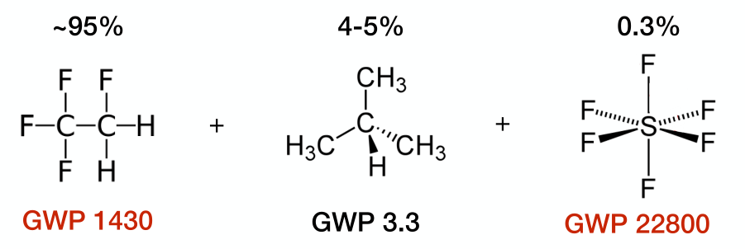
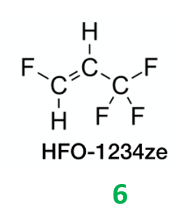
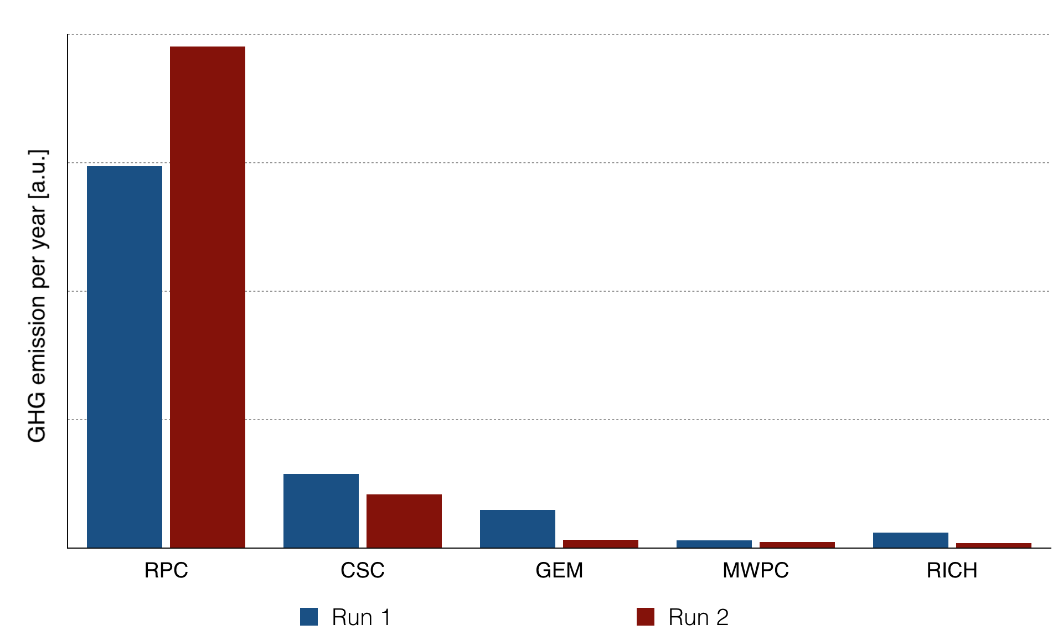
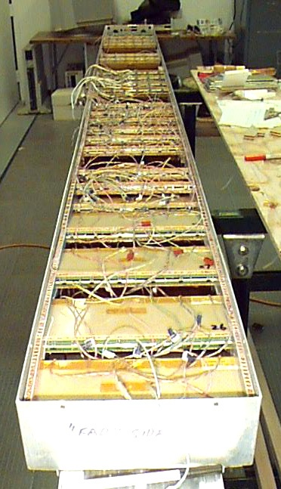
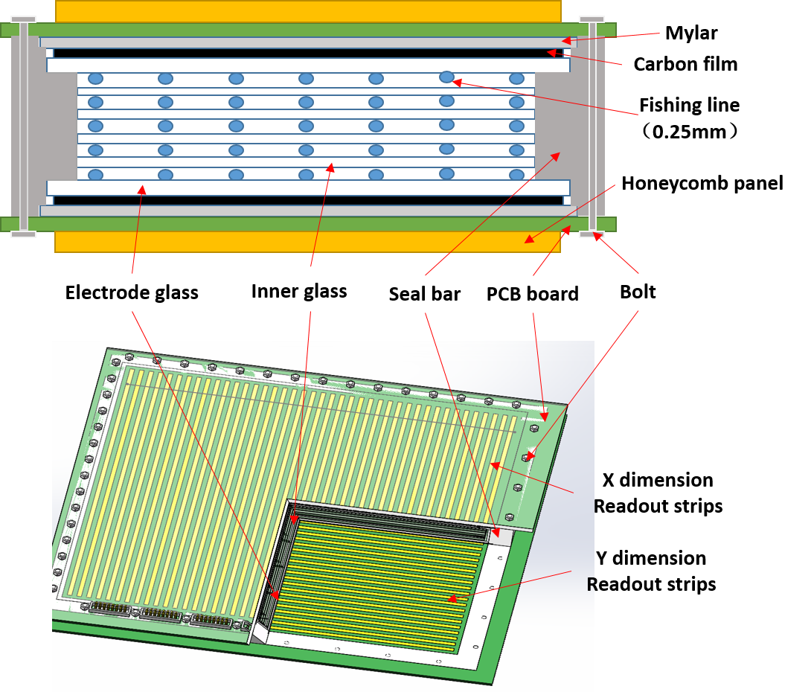
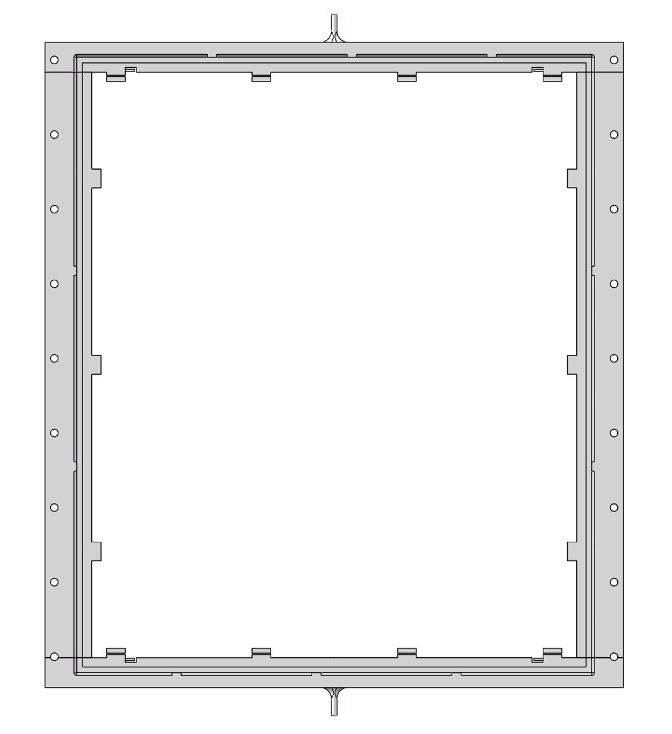
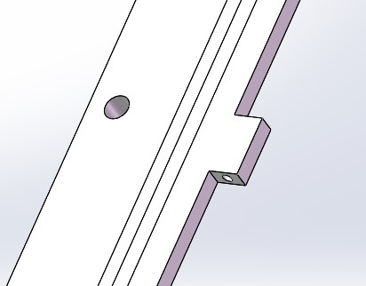
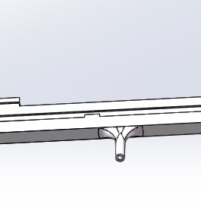
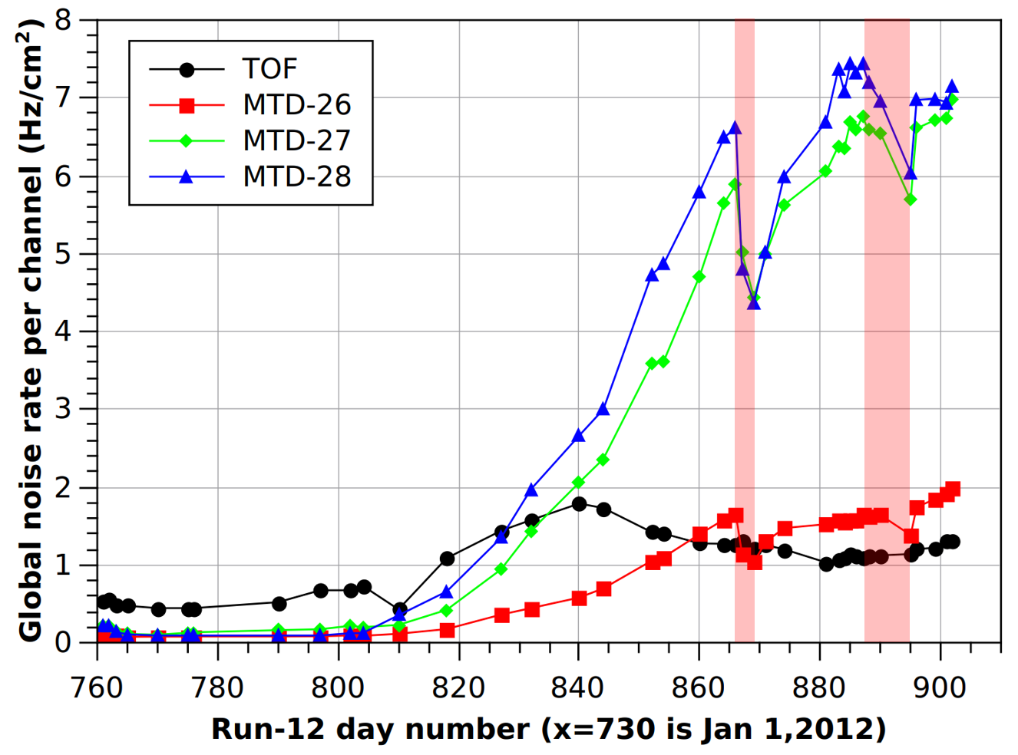
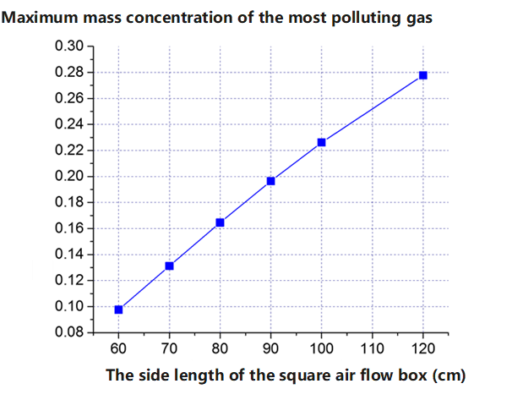
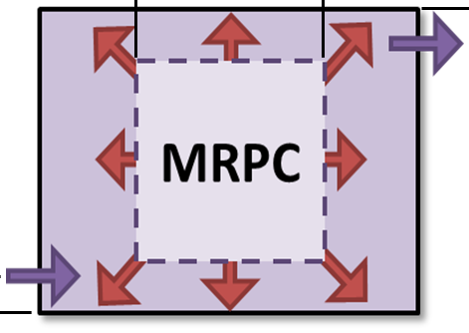
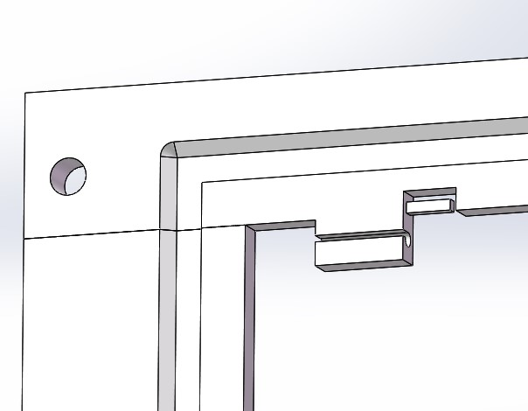
Gas-related challenges of MRPC
Regulations against greenhouse gases causes uncertainty:
availability, cost, eco-impact, …
Motivation: A wise design of the gas volume shall promote the gas exchange and decrease the gas consume.
RPC type detectors accounted for 87% of the GHG emissions of all detectors during CERN's Run 2 period
Gas pollution effect in high rate conditions
Narrow gap of MRPC and large gas volume ---
ionization products exchanged slowly by diffusion
…observed in HEP experiments and lab tests.
Gas tube
Inlet/outlet
Fishline hook
Pollution caused noise and current rise
Notes:
With the development of high-energy physics experiments, the MRPC detector has encountered various application challenges. In recent years, the gas effect has become one of the most significant challenges. The gas effect is manifested in the following three aspects: First, the working gas of the MRPC has a significant greenhouse effect. The regulatory measures of various countries have brought risks to the availability and cost of working gases such as Freon. Second, the large consumption and leakage of gas lead to significant costs and environmental impacts. Third, the gas contamination effect of MRPC in high-count-rate environments. The various ions and groups produced by ionization and avalanche in the gas gap cannot be promptly discharged, resulting in the cumulative increase of dark current and noise. To solve these problems, on the one hand, we can consider more friendly working gases or conduct gas circulation and filtration. However, the method we adopted is the self-sealing method. Compared with the traditional flow gas box operation mode, the self-sealing flow gas structure reduces the volume of the flowing gas and more effectively discharges the pollutants generated by ionization avalanche inside the MRPC. Through numerical simulation, it can be found that the concentration of gas pollutants decreases as the flow gas box shrinks. This is achieved by increasing the diffusion rate of pollutants and directly blowing fresh gas. Regarding the specific implementation of self-sealing, we are achieved by 3D(three dimensional) printing a sealing frame and adhering the outer layer glass to it.

Slide 6
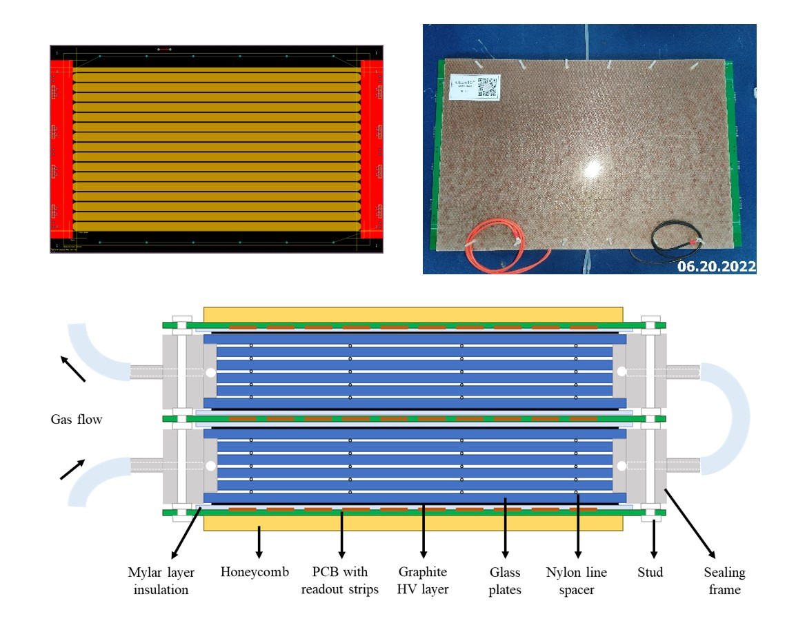
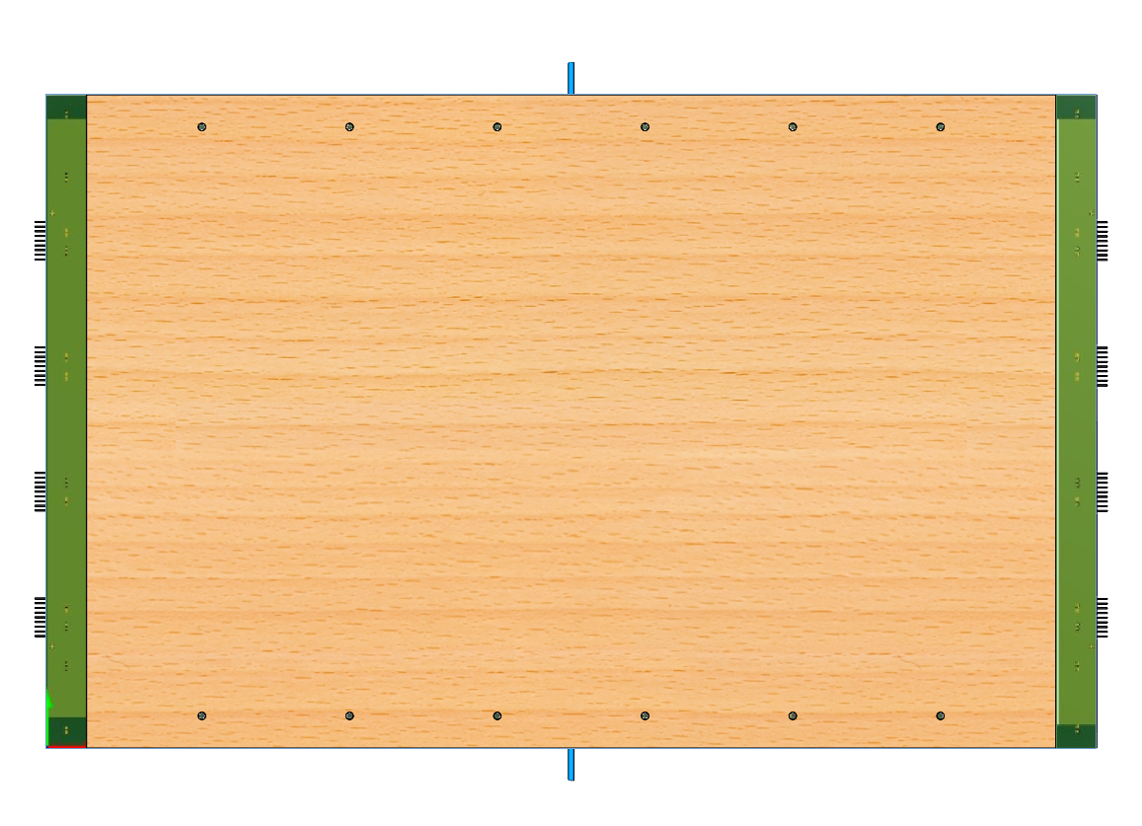
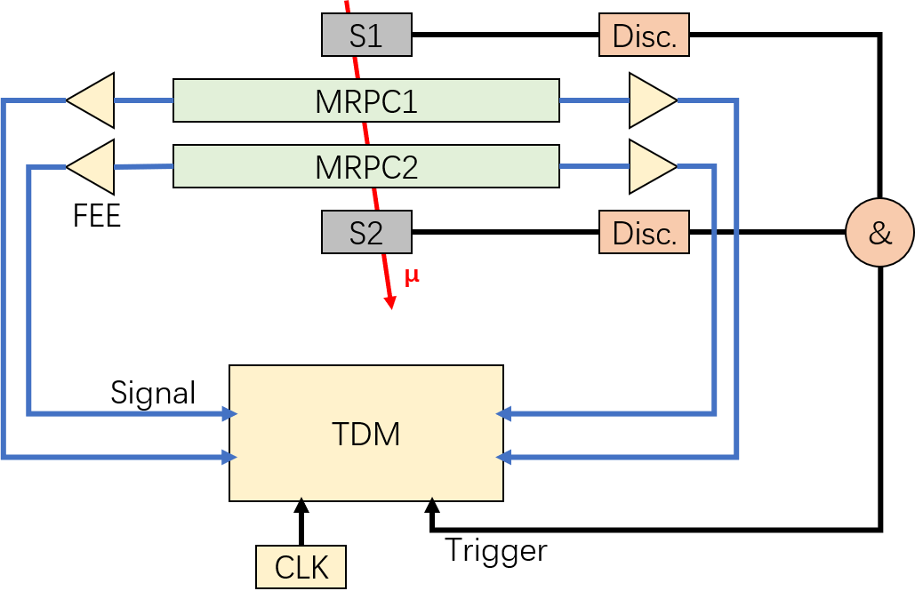
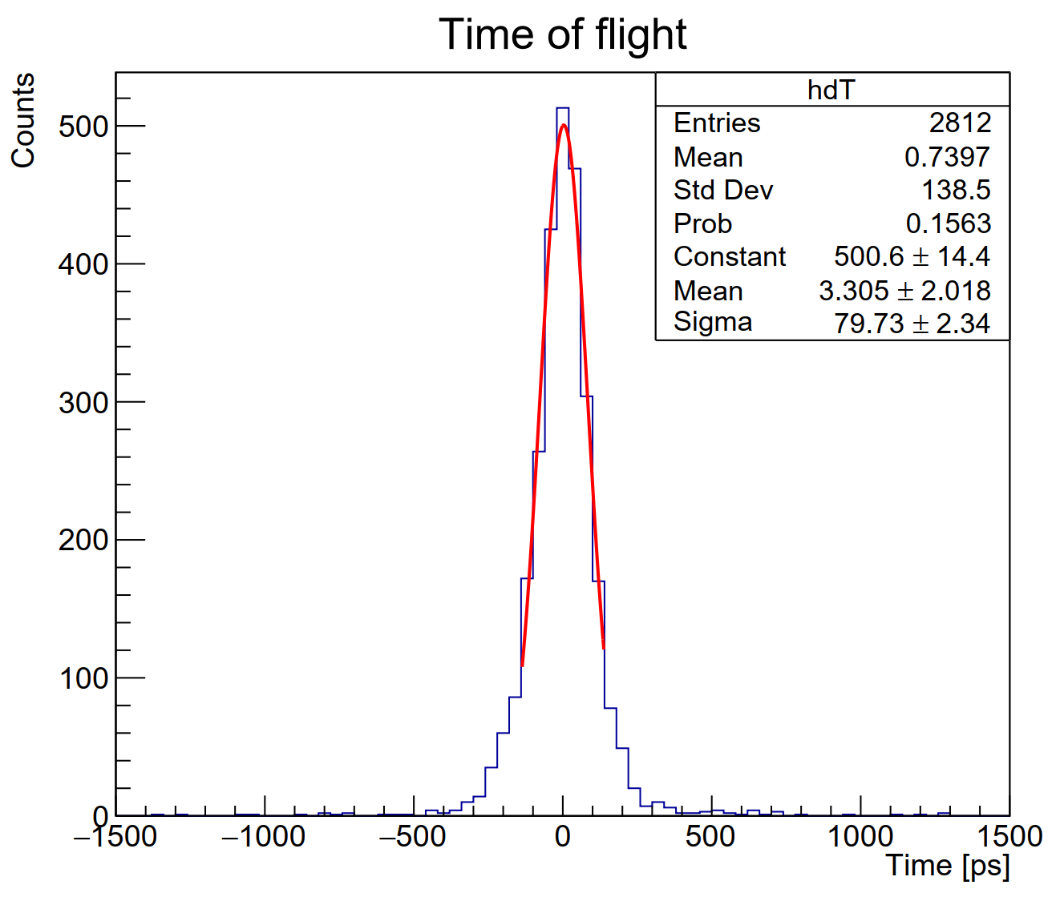
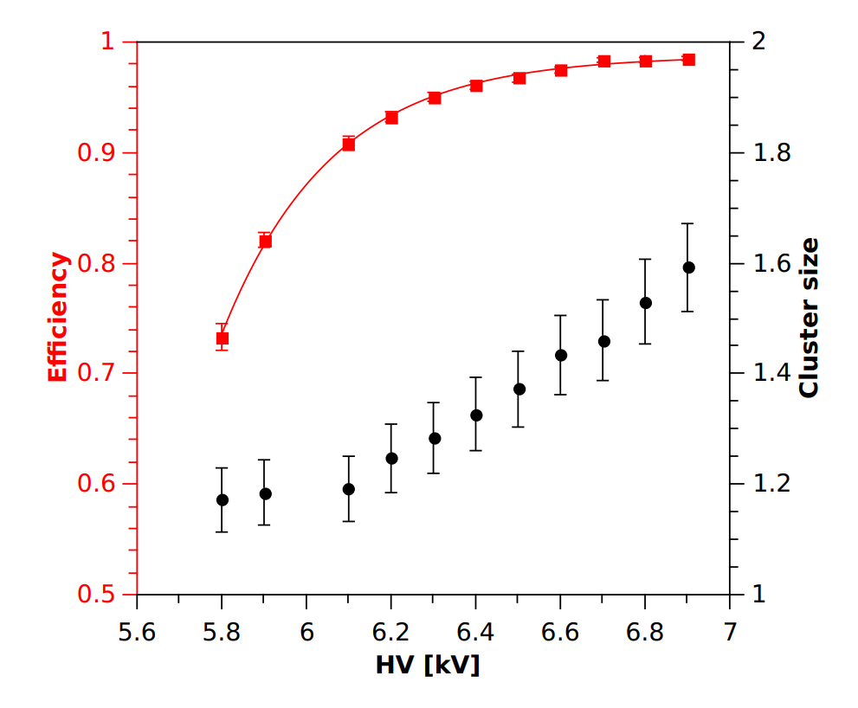
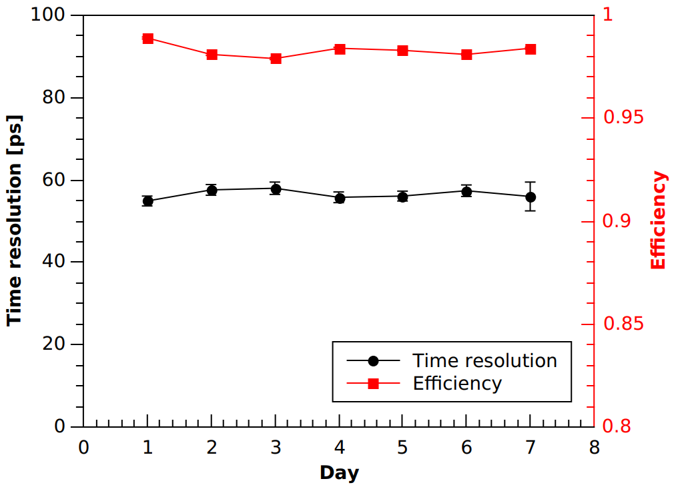
The sealed MRPC for eTOF
Features of the Sealed MRPC:
Novel structure: 3D-printed sealing frame
Gas saving: 10 sccm/m² active area in common rate conditions
Fast preparation: 2 h from gas-purging to working HV.
Promoted gas exchange: invisible gas pollution effect at 10 kHz/cm² counting rate (MRPC built with low resistive glass).
Cosmic test results:
Over 97% efficiency at 6.9 kV (110 kV/cm).
56 ps time resolution at working point.
Stable behavior in tested 7 days.
Detector parameters | values
Gas gaps | 2x5
Gas gap thickness | 0.25 mm
Glass thickness | 0.5 mm
Readout strips | 32 or 16
Strip size | 48 cm x 1.5 cm
Strip gap | 0.2 cm
Gas flow | 10 sccm
79.73/√2 = 56.38 ps
Notes:
Furthermore, in order to ensure sufficient efficiency and time resolution, we adopted a dual-chamber structure. Through dual-end pressurization, the signals can be differentially extracted. Through experimental testing, our detector can achieve an air consumption rate of 10 milliliters per minute per square meter, and it can completely discharge the air within 2 hours to reach the working voltage state. After using low-resistance glass, a count rate of 10 kHz per square meter can be achieved without causing any pollution effect. In terms of performance, our efficiency can reach over 97%, and the time resolution can be as low as 56 ps(picosecond).

Slide 7
CEE-eTOF Physical Functions
Particle identification (core functionality)
  Effective coverage of particles in the anterior horn region
  Ability to discriminate typical particles in the CEE energy region
Participation in global triggering
  First large-scale physics experiment to
  generate triggers primarily using MRPC
  Effective incorporation of real events (nuclear reactions),
  reduction of chance conformity
Conducted central example selection
  Ability to predict collision parameters
Acceptance, Efficiency, Time Resolution
Noise Rate, Noise Multiples
Regression Accuracy, Classification Performance
Notes:
OK，Let’s get back to CEE eTOF. As an external flight time detector, the physical functions of eTOF can be mainly divided into the following three aspects: First, particle identification. According to the requirements of particle coverage and identification capabilities, it is necessary to set specific requirements for the reception degree, detection efficiency and time resolution of eTOF; Second, participation in global triggering. In order to enable the developed MRPC to provide the correct nuclear reaction signals for the triggering system, it is necessary to specifically limit the noise level of MRPC; Third, conducting the selection of central events. It is necessary to conduct specific research on the prediction ability of the eTOF system for collision parameters.

Slide 8
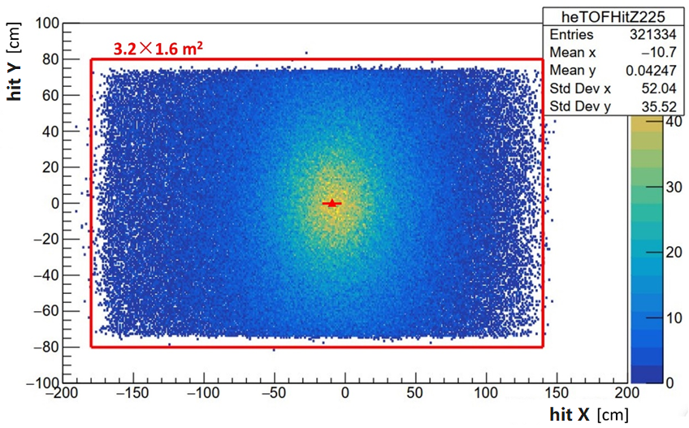
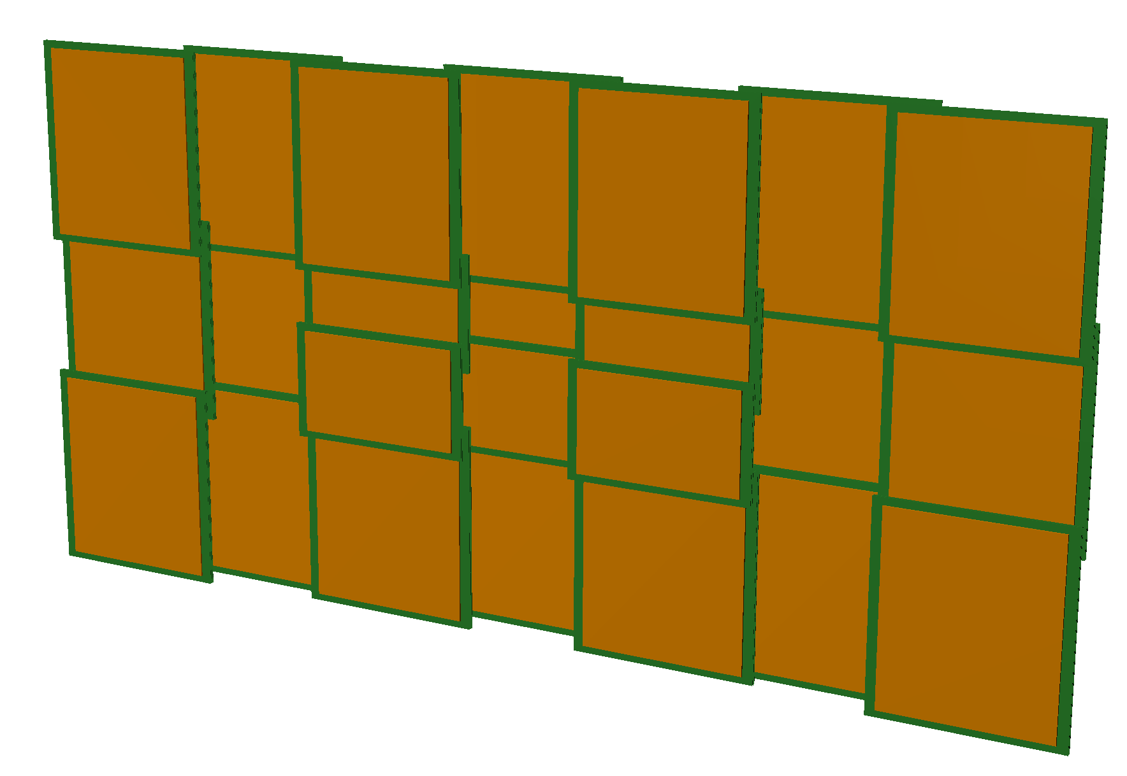
Acceptance
Sensitive area design: distribution of charged particles in the z = 225 cm plane where the eTOF is located
  Sensitive area 3.2 × 1.6 m2, offset -15 cm
Coverage: proportion of the MWDC trajectory that is covered by the eTOF detector model
  Coverage >98%, including energy loss effects
Simulation Condition
Physical model | The IQMD model, UU@500AMeV,has the most accurate estimation for the highest percentage of baryon products
Incident generation | 10k instances, minimum bias collision (bdb distribution)
Geometry | Sensitive volume/complete structure of each detector
Transport model | Geant4 EMStandard, based on the Landau model
25°
Detector layout
Notes:
In terms of detection efficiency, a sensitive area of 3.2 x 1.6 m2 was designed based on the distribution of charged particles on the plane where the eTOF is located. This is because the magnets limit the size of the MWDC, which in turn determines the design area of the eTOF. Due to the effect of the magnetic field, the eTOF wall as a whole shifts towards the negative direction. Additionally, in the structural design, it is necessary to avoid damage to the detector and electronics caused by the main beam. Therefore, we designed two sizes of detectors, as shown in the figure. The small detector in the central area can be moved up and down to achieve beam avoidance. The completed eTOF wall can cover more than 98% of the desired tracks, and the lost part mainly comes from particle energy loss.

Slide 9
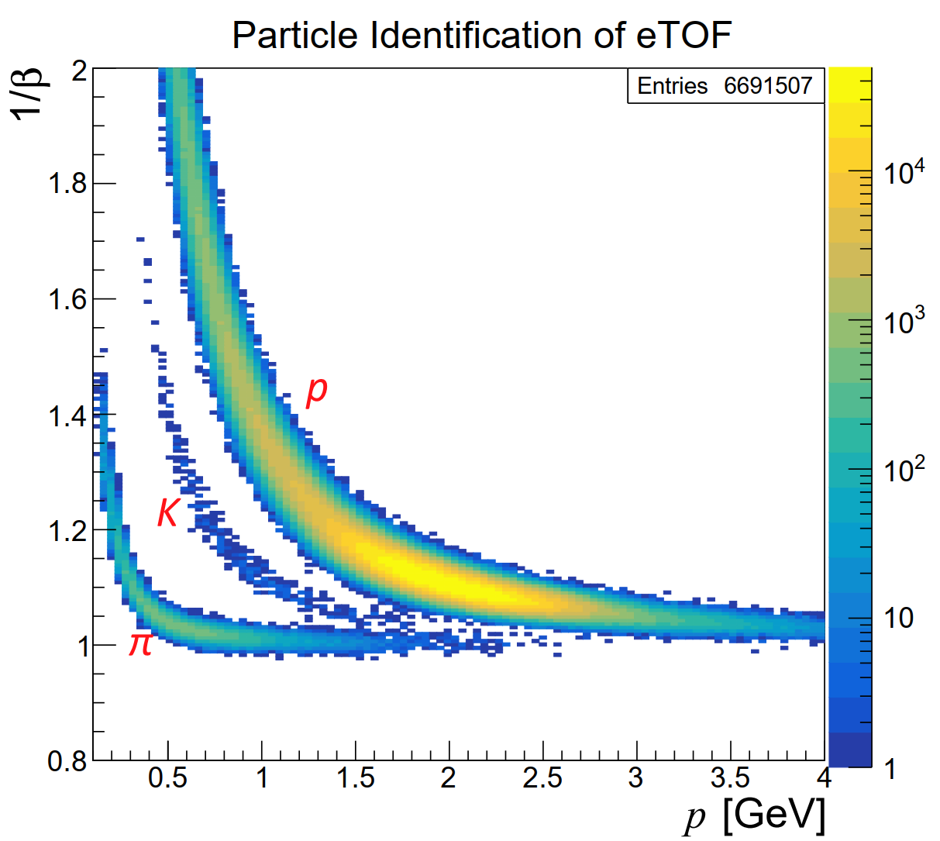
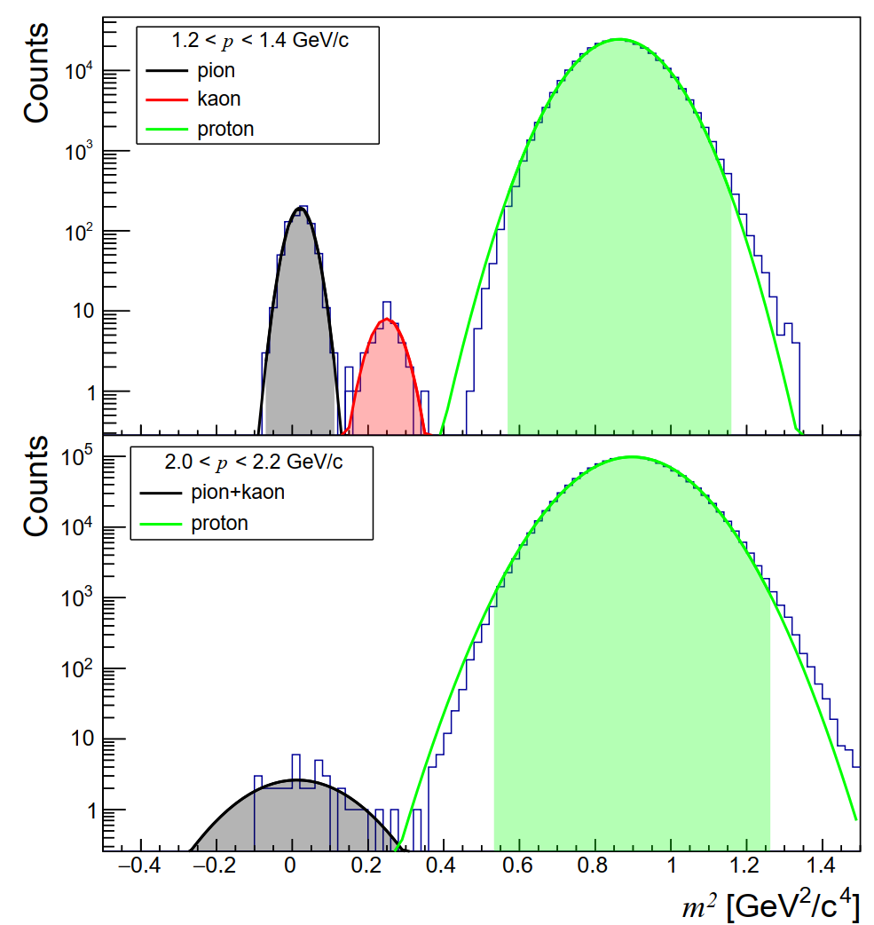
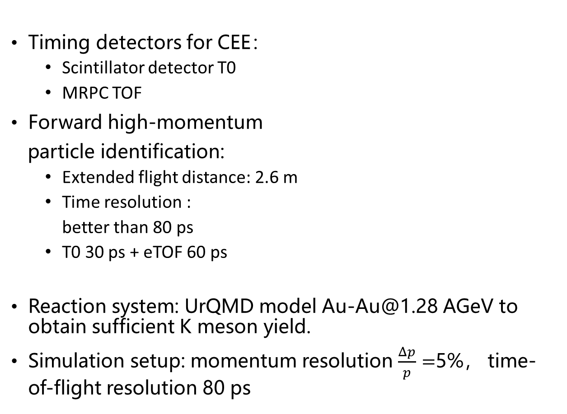
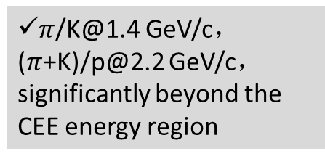

Particle Identification
$π$/K@1.4 GeV/c， ($π$+K)/p@2.2 GeV/c，significantly beyond the CEE energy region
$$n_{σTOF}=\frac{|t_{1}−t_{2}|}{σ_{TOF}}=\frac{Lc}{2p^{2}σ_{TOF}}|m_{1}^{2}−m_{2}^{2}|$$
Timing detectors for CEE：
  Scintillator detector T0
  MRPC TOF
Forward high-momentum
particle identification:
  Extended flight distance: 2.6 m
  Time resolution :
  better than 80 ps
  T0 30 ps + eTOF 60 ps
Reaction system: UrQMD model Au-Au@1.28 AGeV to obtain sufficient K meson yield.
Simulation setup: momentum resolution $\frac{Δp}{p}=$5%， time-of-flight resolution 80 ps
3σ
Notes:
The time-of-flight method for particle identification requires the collaboration of a track detector and a timing detector. When the momentum resolution of the track detector is fixed, the longer the flight distance, the stronger the particle identification capability; the better the time resolution of the timing detector, the stronger the particle identification capability. For the forward high-momentum particle identification in the CEE experiment, on the one hand, a longer flight distance is required, and on the other hand, a high time resolution of the timing detector is needed. The experiment requires the T0 scintillation detector to have a time resolution of 30 ps, and the eTOF MRPC to have a time resolution of 60 ps. Three typical particles, namely 𝜋, K, and p, were selected to evaluate the particle identification capability of eTOF. The momentum of the particles was broadened by 5% based on the resolution of the detector, and the flight time was broadened by 80 ps. The left figure shows the eTOF particle identification diagram, where clear bands of 𝜋, K, and p particles can be seen, and their distribution in the momentum direction is significantly higher than the simulated distribution of the actual energy region. The right figure shows the typical particle identification effect under the selected momentum intervals of 1.2-1.4 and 2.0-2.2. The boundary of the colored area is the 3σ boundary, and it can be concluded that eTOF achieves a 𝜋/K resolution of 1.4 GeV/c and a (𝜋+K)/p resolution of 2.2 GeV/c under the current time resolution requirements, significantly exceeding the requirements of the CEE energy region.

Slide 10
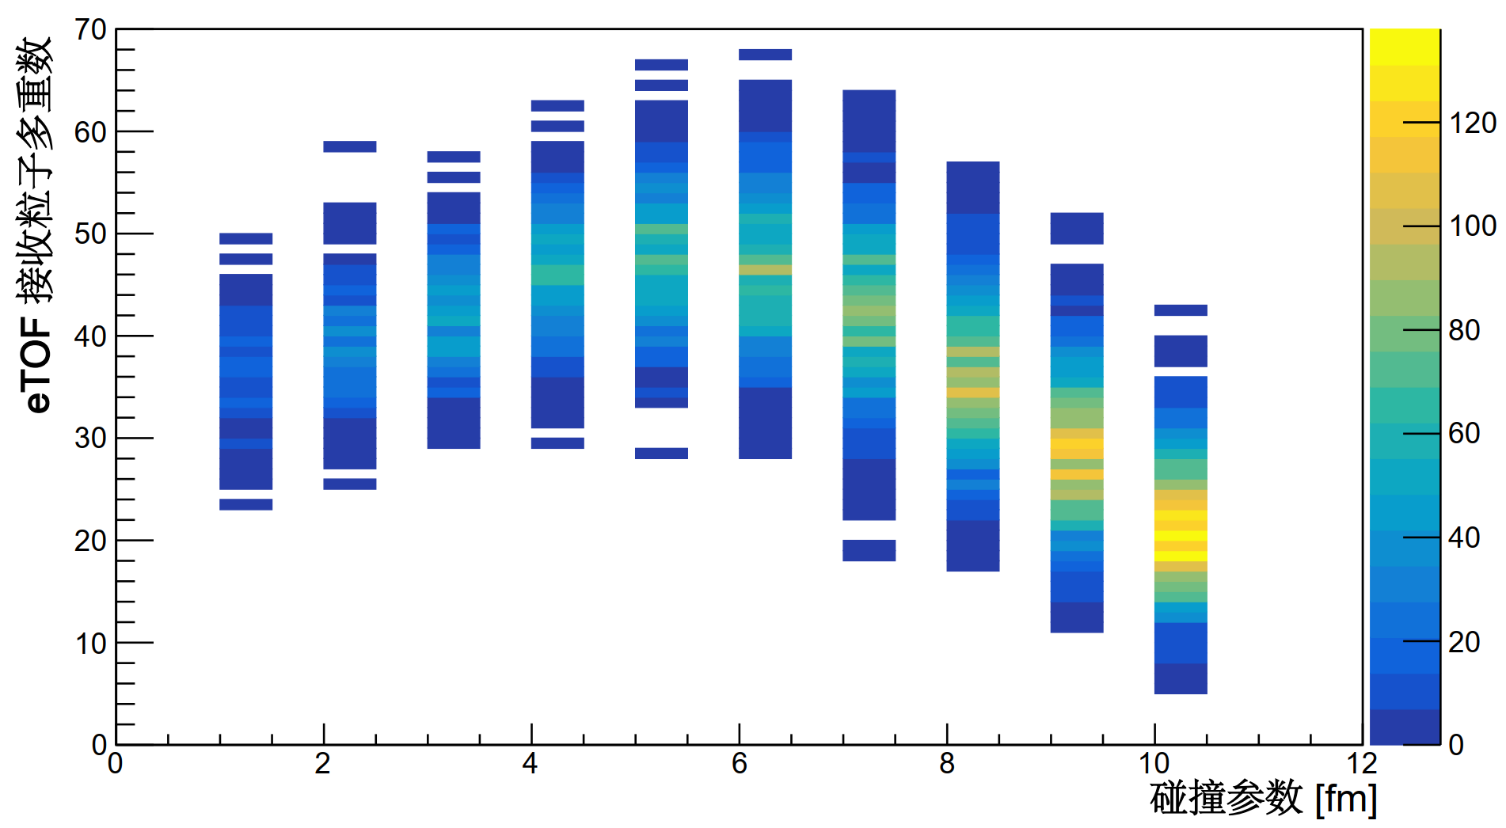
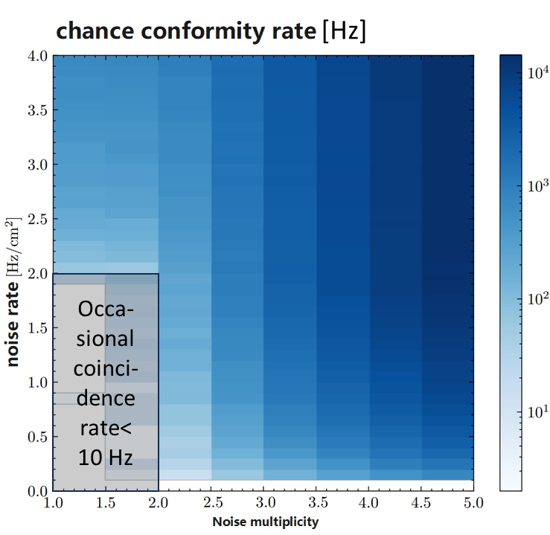
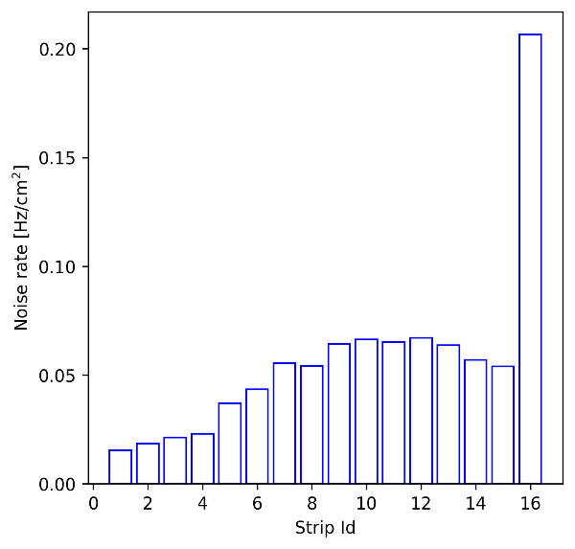
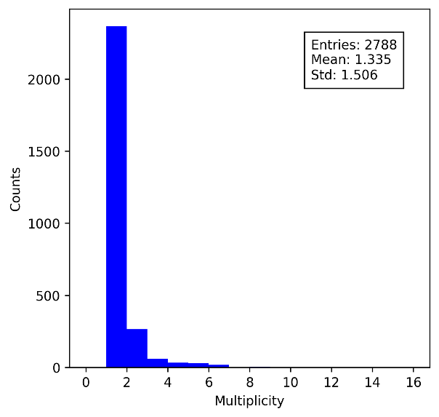
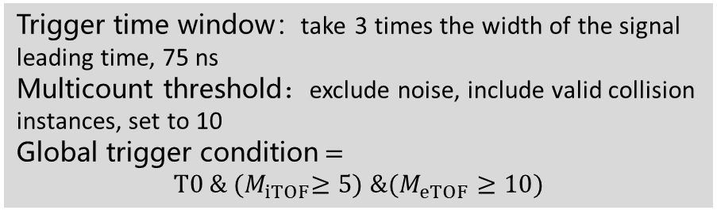
Participation in global triggers
MRPC-based trigger system:
large reception, high granularity, fast detectors
Logic: number of channel multiplexes (1344 channels in eTOF)
多重数阈值
  Trigger time window：take 3 times the width of the signal leading time, 75 ns
  Multicount threshold：exclude noise, include valid collision instances, set to 10
  Global trigger condition$=$
  $$T0 \& {(M}_{iTOF}≥5) \&(M_{eTOF}≥10)$$
The accidental coincidence count rate of eTOF uploaded under different noise levels was obtained through simulation.
Request:
  Average noise rate <2 Hz/cm²
  Average noise multiplicity<2
Occasional compliance does not exceed 1/1000 of the CEE design count rate
Notes:
The trigger system adopts MRPC as the trigger detector, thanks to the large acceptance, high granularity and ns(nanosecond)-level signal formation speed of the TOF system. The logic of eTOF participating in the global trigger is to count the total number of ignition channels within the trigger time window. If it exceeds a certain threshold, the trigger condition is met. This is because multiple secondary particles produced by the nuclear reaction will generate signals concentratedly on multiple detector channels. The simulation work of eTOF provides a basis for the parameter design of the trigger system. Through the distribution of signal arrival times, an appropriate time window for trigger multiplicity statistics can be obtained; through the particle distribution received by eTOF under different collision center degrees, the multiplicity threshold required for triggering can be obtained. The final design of the global trigger condition is the T0 signal, and the AND of iTOF and eTOF satisfying the multiplicity condition. Under the multiplicity trigger logic, not only does the trigger detector need to have a low noise rate, but also the simultaneous response of multiple channels caused by the same noise source needs to be limited. Based on the probability distribution of the total multiplicity, the accidental coincidence count rate under different noise rates and multiplicity conditions can be simulated. It can be seen that, under the condition of requiring an average noise rate of less than 2Hz/cm2 and a noise multiplicity of less than 2, the accidental coincidence can be controlled within one-thousandth of the CEE design count rate. And the two middle figures are the actual noise multiplicity distribution and the noise rate of different readout strips.

Slide 11
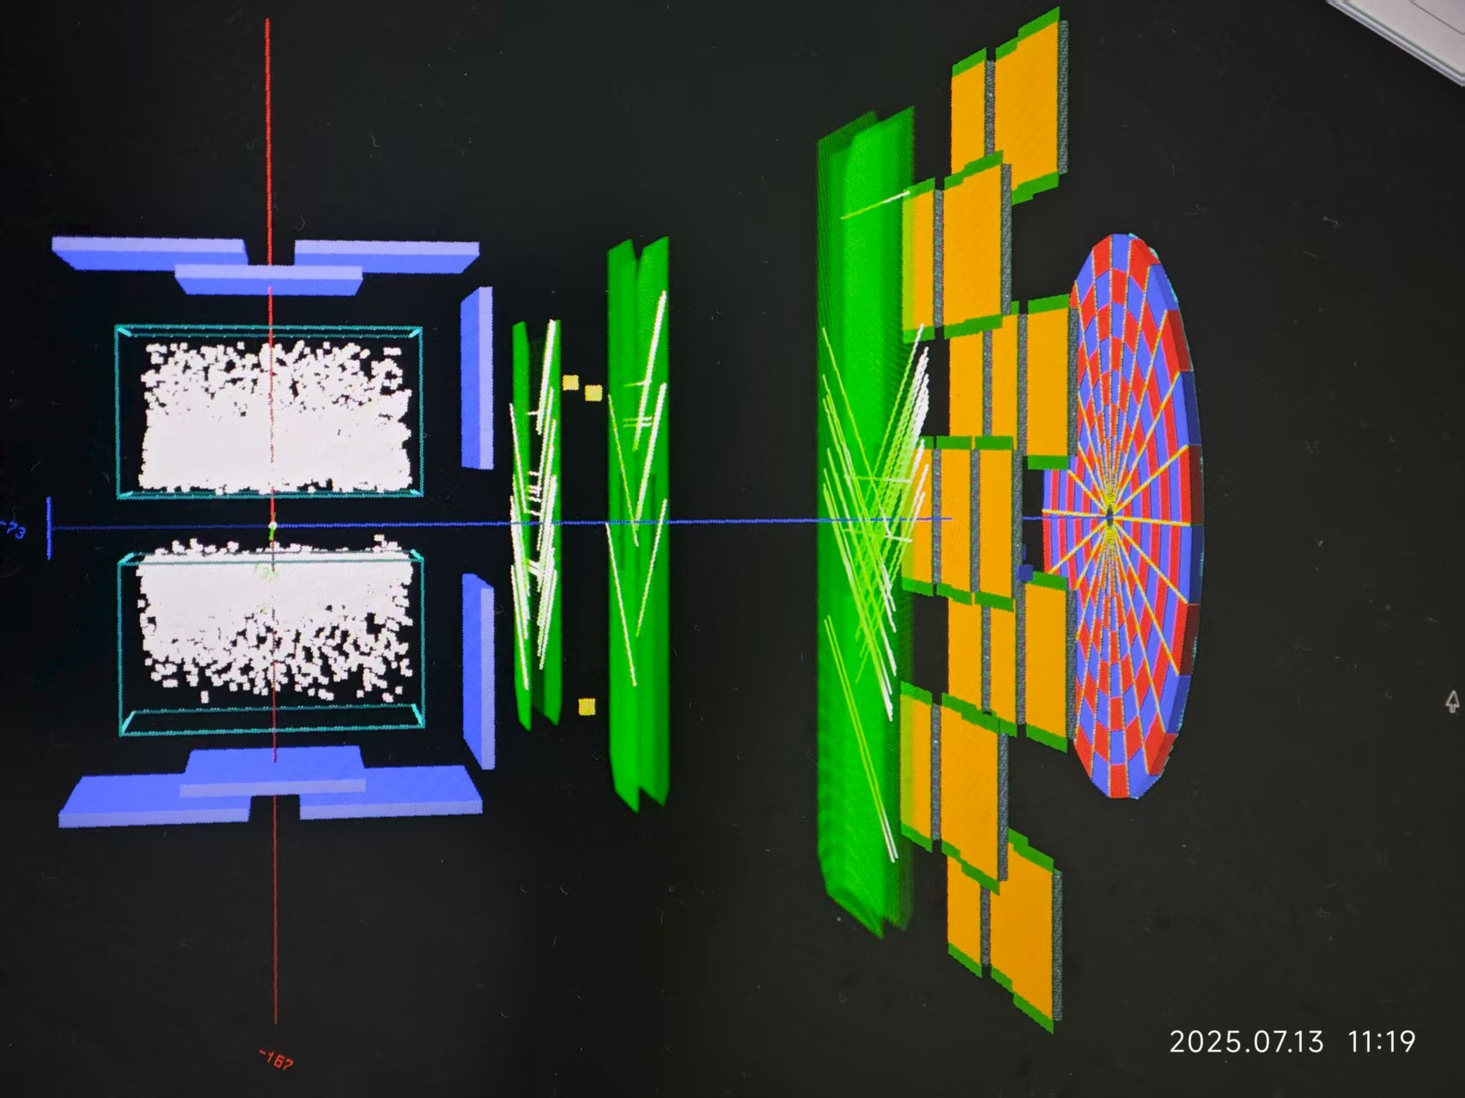
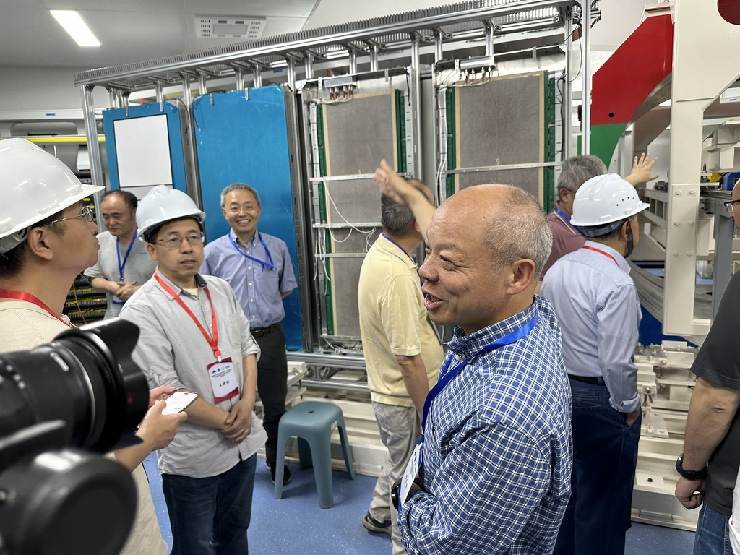
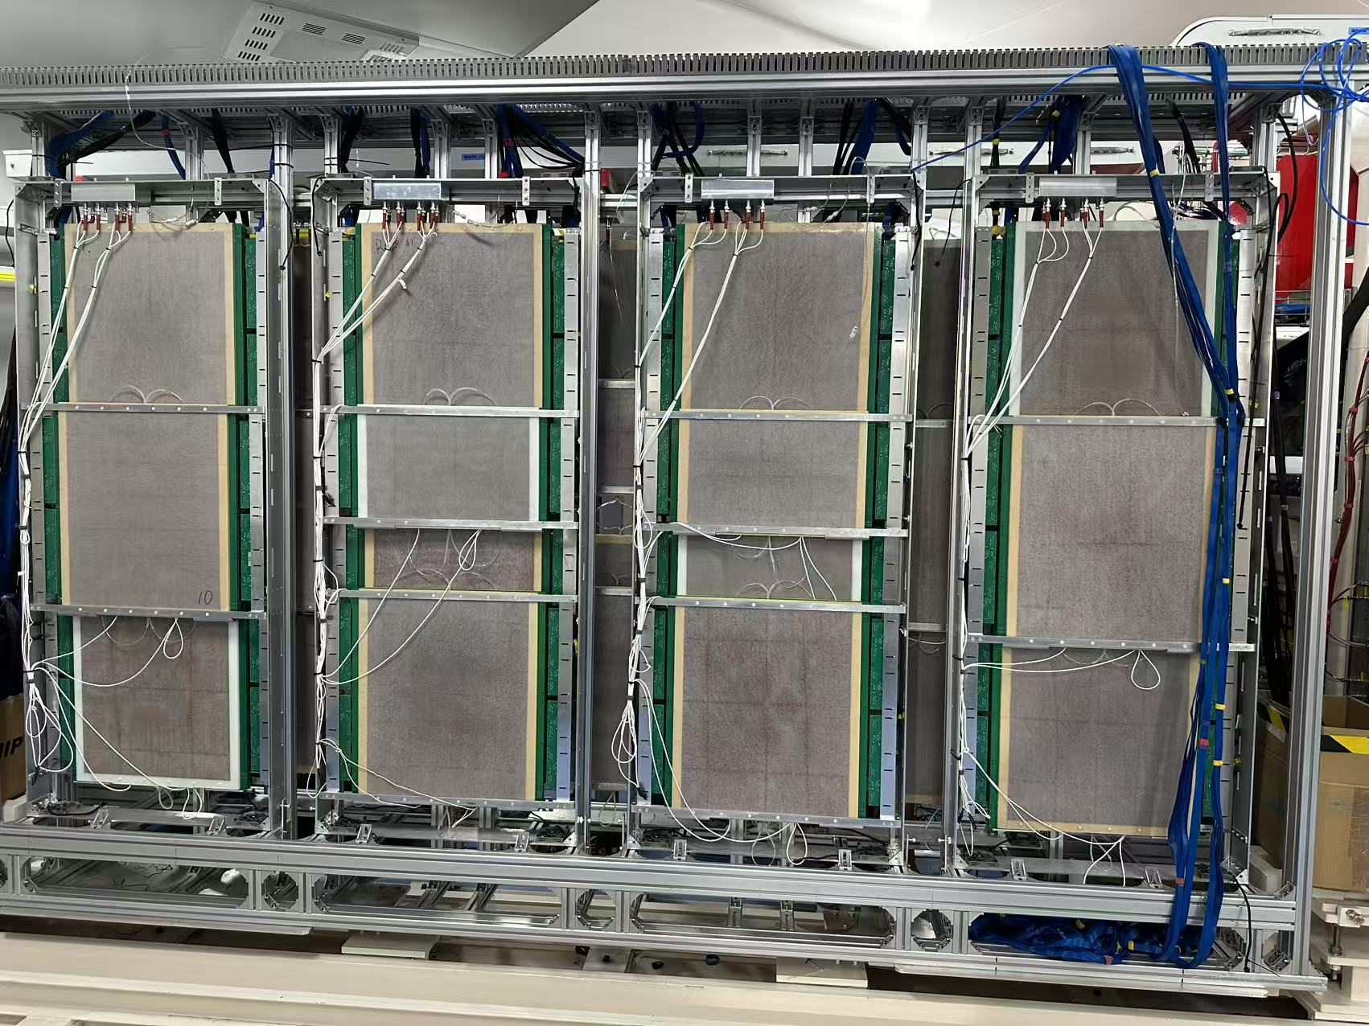
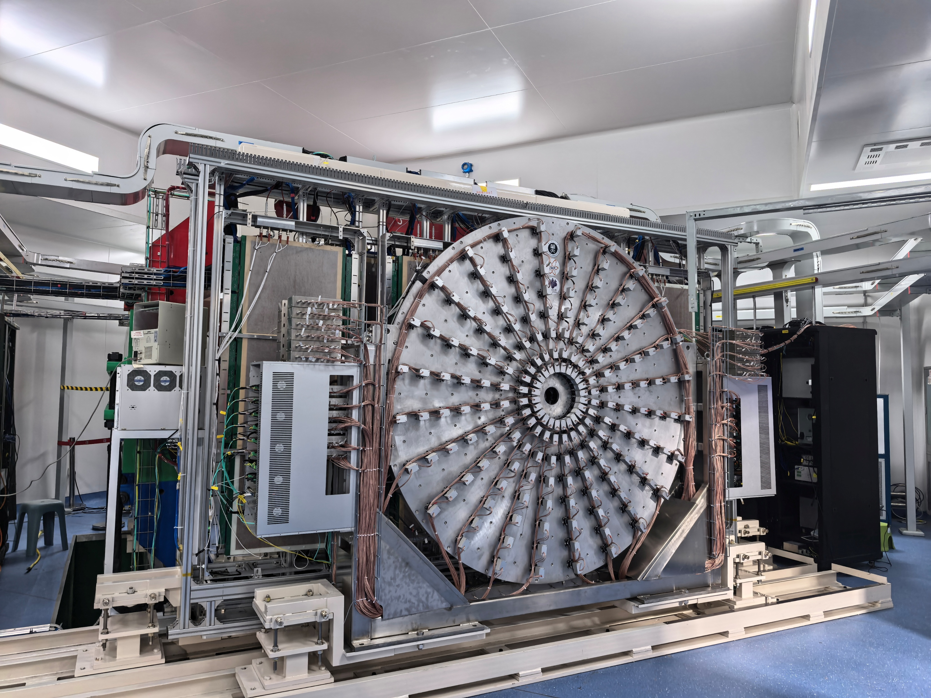
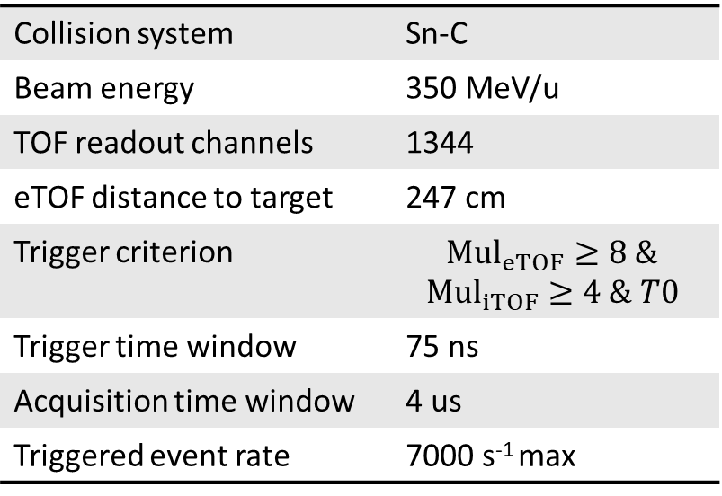
Beamtime setup
Collision system | Sn-C
Beam energy | 350 MeV/u
TOF readout channels | 1344
eTOF distance to target | 247 cm
Trigger criterion | $$Mul_{eTOF}≥8 \&$$ $$Mul_{iTOF}≥4 \& T0$$
Trigger time window | 75 ns
Acquisition time window | 4 us
Triggered event rate | 7000 s⁻¹ max
Target
T0
TPC
ZDC
iTOF
MWDC
eTOF
Notes:
At present, the CEE project has completed the mass production of all subsystems except for the magnets, and has passed the acceptance test successfully. And in June of this year, the overall construction began. It was fully assembled in July and a five-day joint debugging of the Magnetic-free experiment was conducted. At present, all systems are operating normally and the official beam experiment is expected to be carried out in September this year.

Slide 12
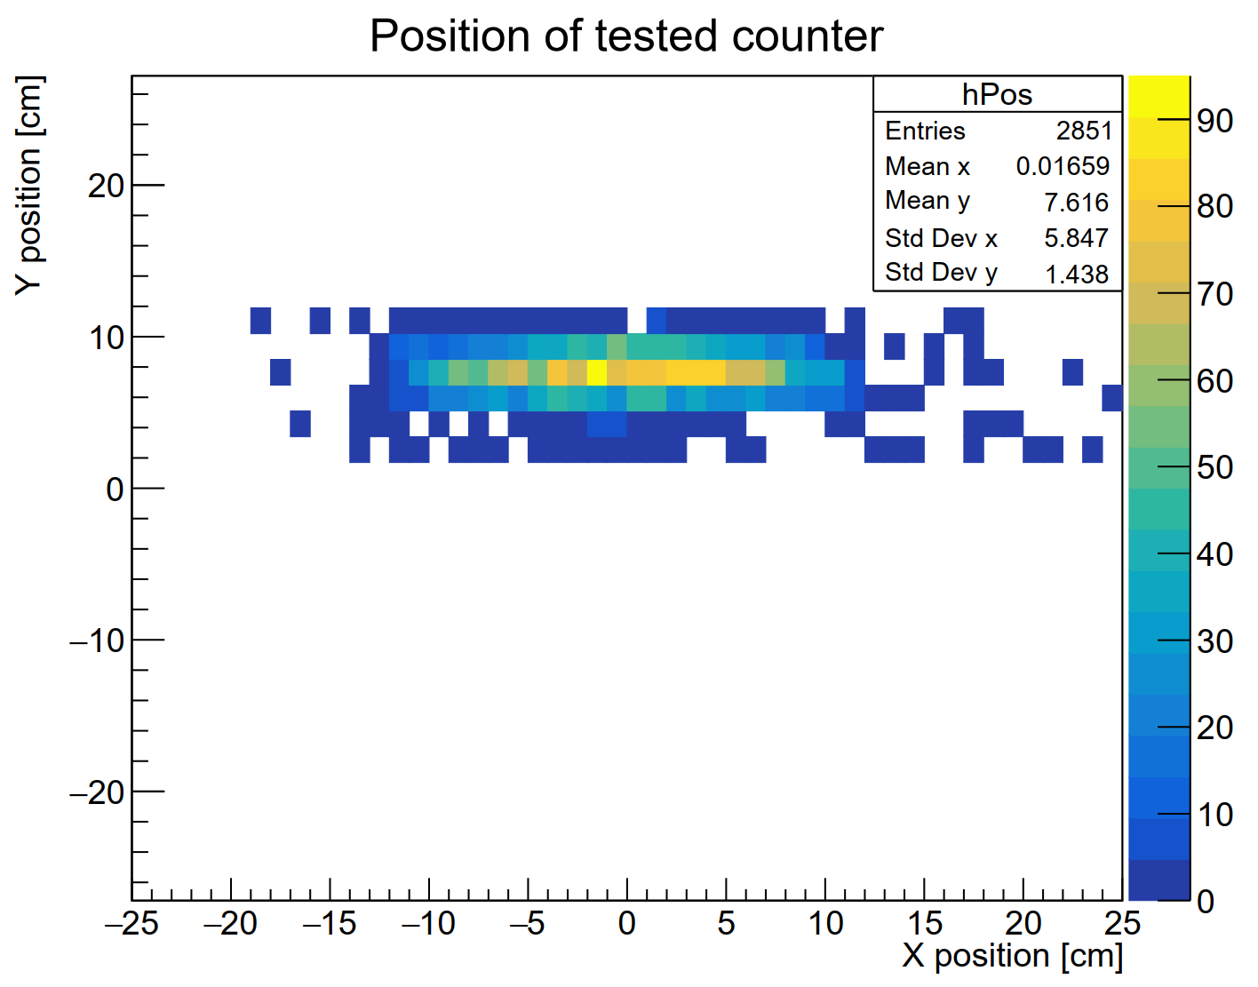
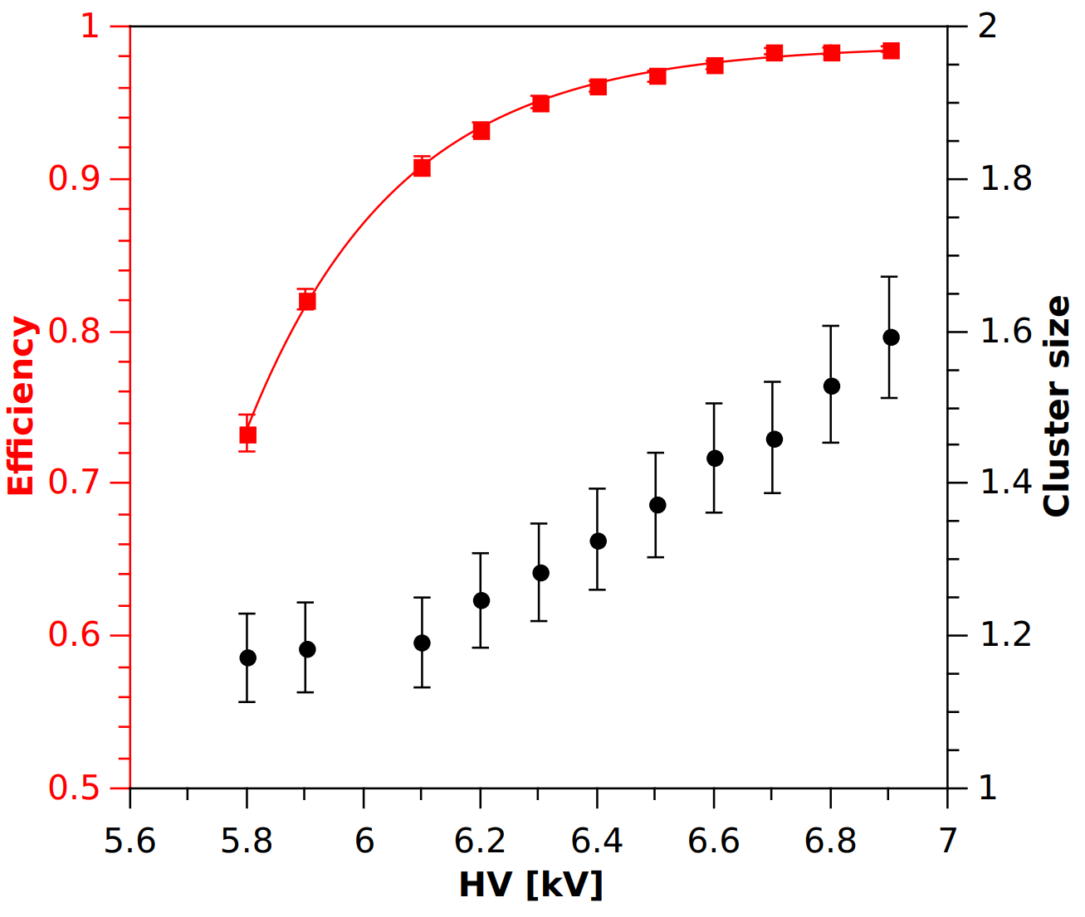
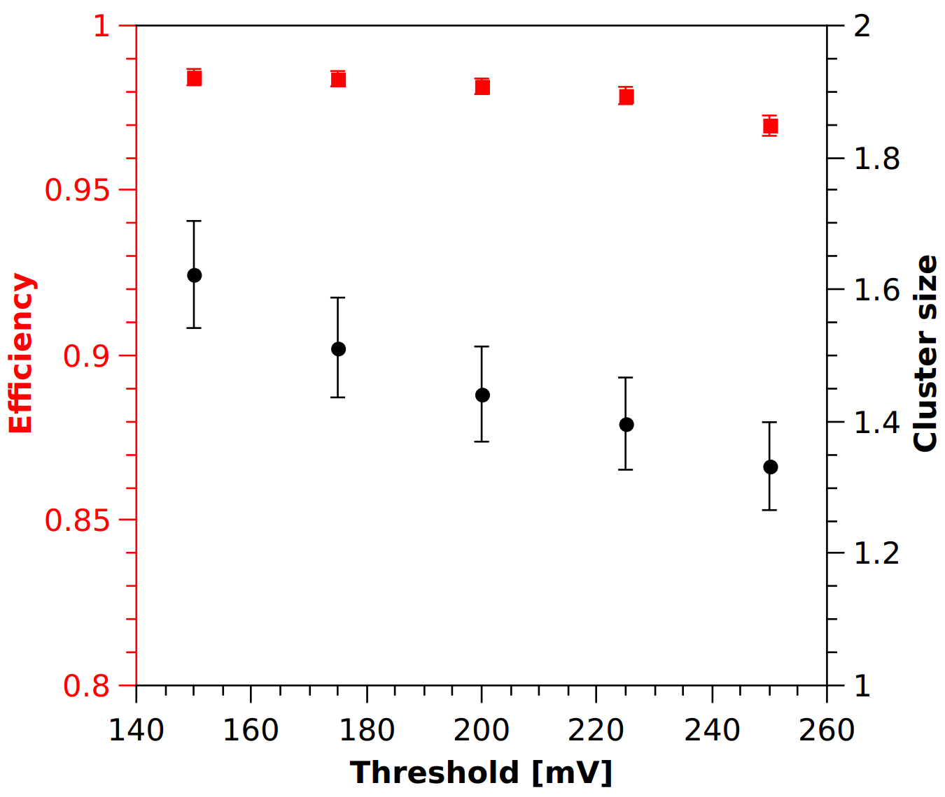
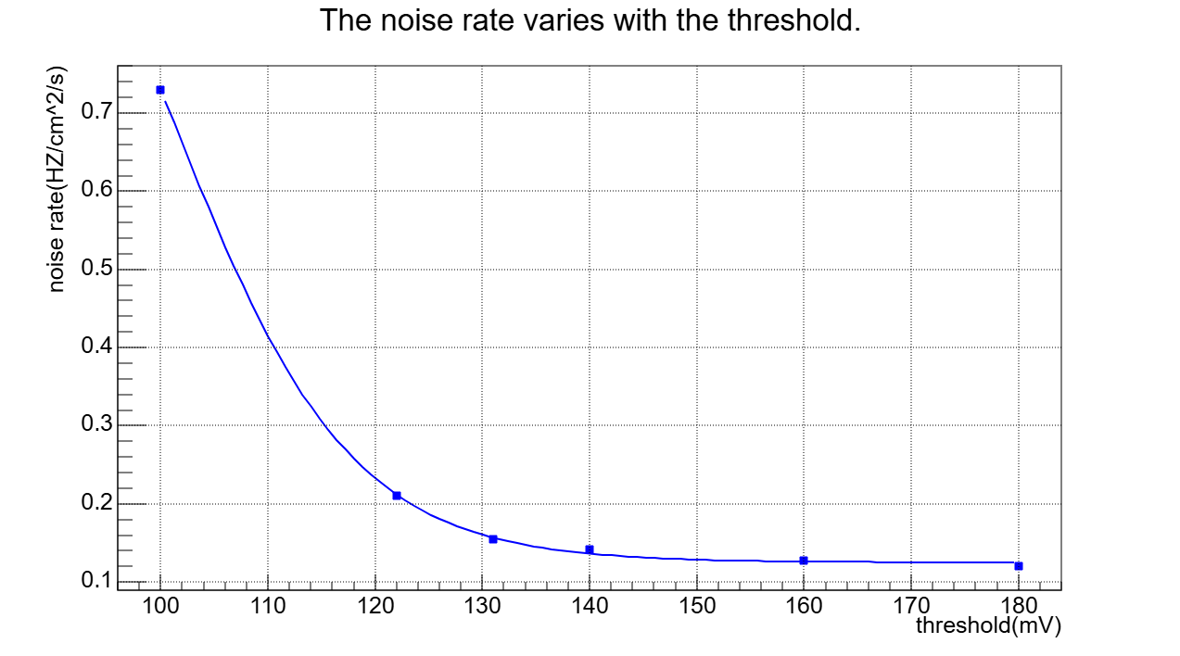
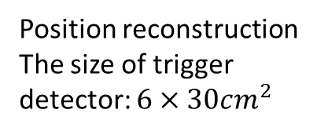
The result of Cosmic Test
Position reconstruction
The size of trigger detector: $6×30cm^{2}$
voltage sweep
Efficiency at working point > 97%
Time resolution 79.7/√2 = 56 ps
位置重建
Electronic threshold scanning
Notes:
Finally, I will present the results obtained by the eTOF detector under cosmic ray tests and beam current tests respectively. First, there is the efficiency plateau mentioned earlier. At 6900V(volt), it can achieve an efficiency of 97%. This efficiency is affected by the local atmospheric pressure and the composition of the working gas. Furthermore, in order to obtain valid signals and filter out noise, a threshold needs to be set at the electronic front-end amplification stage. The following two figures respectively show the changes of efficiency and noise rate with the electronic threshold. Considering both of these factors comprehensively, it is advisable to set the electronic threshold at 150 mV.

Slide 13
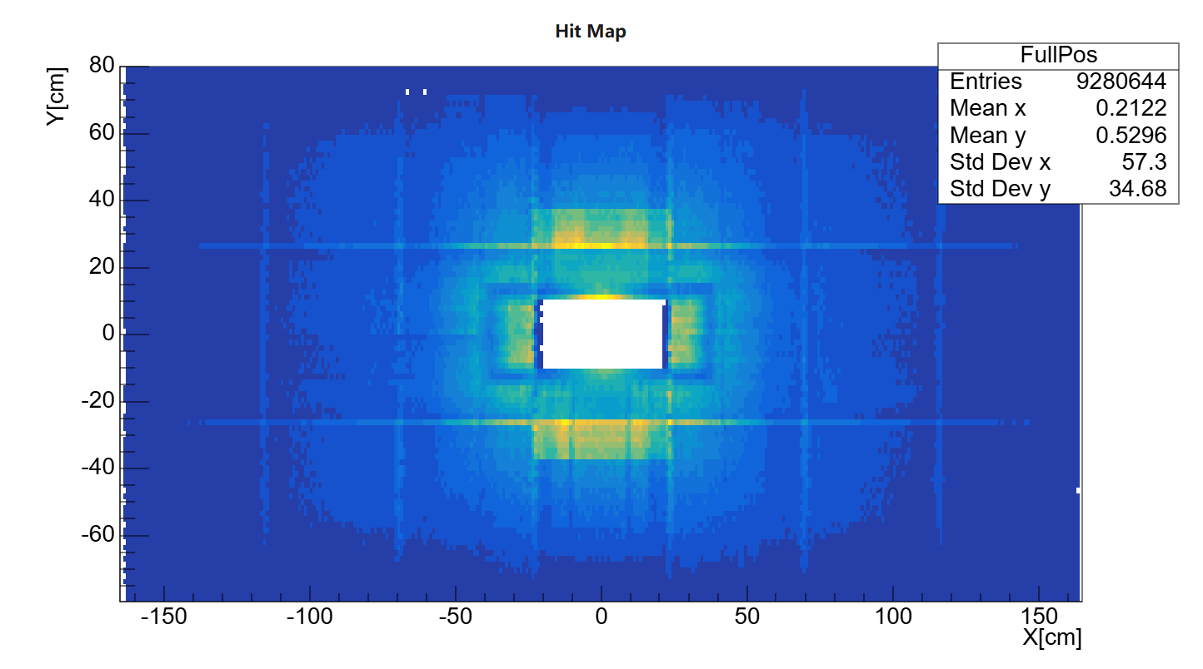
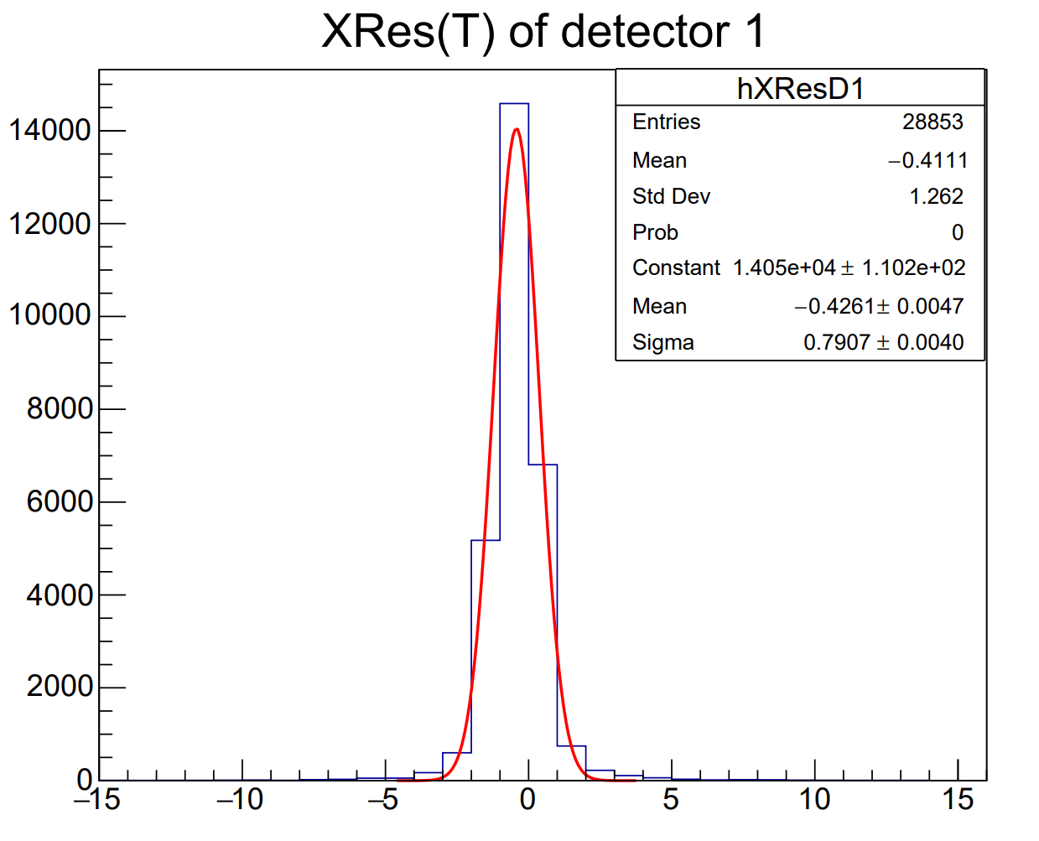


Reconstruction and analysis
Reconstruction:
  X: position along the strip, reconstructed from the both-end signal times.
  Y: position across the strips.
  Z: position of the detector.
  T: average signal time from both ends.
Correction:
  Position correction
  Time-slewing correction
Efficiency:
  All detector > 97%
Resolution:
  $σ_{x} ≈0.8cm, σ_{y}≈0.5cm$
  $σ_{t}<60ps$
82.35/√2 = 58.24 ps
dX [cm]
Notes:
In the latest beam experiment, we reconstructed the positions of all the detectors and placed them on the same graph. Due to the existence of electronic delay and time drift effects, it is necessary to calibrate each other using different detectors. Therefore, the highlighted area in the figure represents the overlap between different detectors. Furthermore, in the previous beam experiments, we verified the resolution capability of the detector. In the x and y directions, we were able to achieve resolutions of 0.8 and 0.5 centimeters respectively. After the momentum selection was carried out, the time resolution capability also met the requirement of within 60 ps.

Slide 14
Conclusion
Sealed MRPCs are applied to the eTOF wall of CEE with a time resolution requirement of 60 ps.
To reduce the use of greenhouse gases, a sealed design is adopted.
eTOF mainly performs the functions of global triggering and particle identification in CEE.
97% efficiency and 60 ps resolution obtained, with stopping effect .
The mass production and testing have been completed. After the acceptance in May, the TOF wall was installed in June, and the beam current test was conducted in July to verify the reliability of the functions.
Thanks for your attention!
Notes:
That’s all.

Slide 15


Material
接地屏蔽条
高压pad，与屏蔽条间使用Mylar绝缘
下面两页主要是后端的处理，包括能损效应和动量效应，此外还有延时矫正和时间游走，有点拿不准讲这些是否合适

Slide 16



效率和能损效应
效率扫描：坪区电压6000V，低于北京实验室测试结果，为低气压导致。探测器探测效率达到98%以上。
通过时间谱分析确定了次级粒子的能损效应，评估得到下游MRPC的本征效率>95%
两探测器具有相似的簇团大小曲线，也说明了探测器性能的一致性。
Notes:
在束流实验期间对两个MRPC探测器进行了效率扫描。由于兰州气压较低，电压为6000V时即进入了效率坪区，探测效率达到98%以上。在测试中发现最下游的1号MRPC重建效率较低，考虑到碰撞产物大部分都是电离能力很强的重子，因此对这些粒子的能损效应进行研究。我们分别给出了完整径迹和1号探测器未探测到的径迹的相对飞行时间分布，从右下图中明显看出无探测径迹具有相对较长的飞行时间，更容易在到达1号探测器之前就损失了动能。如果设置合理的相对飞行时间作为挑选径迹的条件，可以看到1号探测器对快径迹的探测效率大于95%。据此，我们认为1号MRPC的效率也处于较高的水平。同时，从簇团大小的关系上也可以看出两探测器的性能具有一致性。

Slide 17


时间分辨和动量效应
原始时间分辨包含动量分散的贡献
将iTOF相对飞行时间作为筛选粒子飞行速度的依据，筛选快径迹进行速度拟合，得到校正后的时间谱
时间分辨在6400V达到58 ps
82.35/√2 = 58.24 ps
Notes:
对不同高压下探测器的时间分辨进行分析，得到左下图所示的时间分辨结果，单个探测器测量得到的时间离散包含显著的动量分散的贡献，在82 ps左右。我们将iTOF的相对飞行时间作为筛选粒子飞行速度的依据，选取较高速度的粒子并且对时间依赖进行拟合，最终得到校正后的时间谱，探测器在6400V的电压下时间分辨为58 ps，满足实验要求。

Slide 18

Material
这几页是或许可以用来展示的素材，感觉不是很美观

Slide 19



Material

Slide 20



Material
占有率模拟结果
123321式气路
112233式气路

Slide 21

Material

Slide 22
Backup: facility
HIRFL：Heavy Ion Research Facility in Lanzhou
CSR: Cooler Storage Ring

Slide 23



Backup: time-slewing correction

