Slide 1
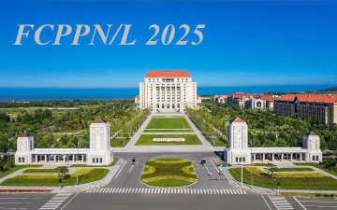
R&D on Photodetectors
Ping Chen
On behalf of the XIOPM Photodetector Group
chenping1@opt.ac.cn
Xi’an Institute of Optics and Precision Mechanics
Chinese Academy of Sciences (XIOPM-CAS)
25/07/2025

Slide 2
Outline
Introduction
Overview of MCP detectors
MCP detector characteristics
Prototypes and applications
Future plans

Slide 3


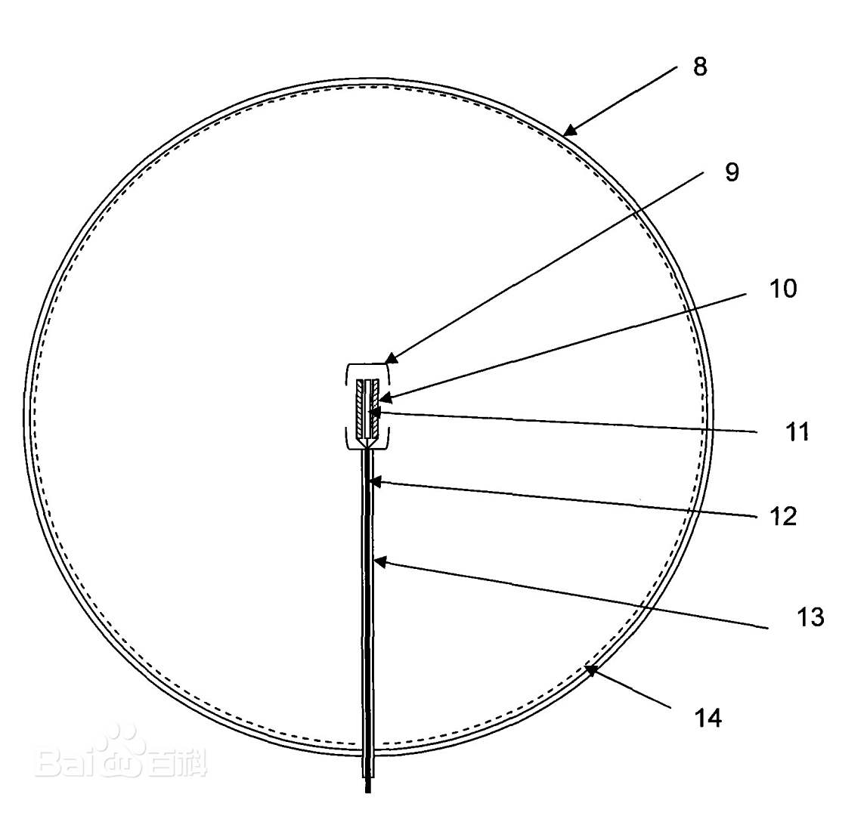
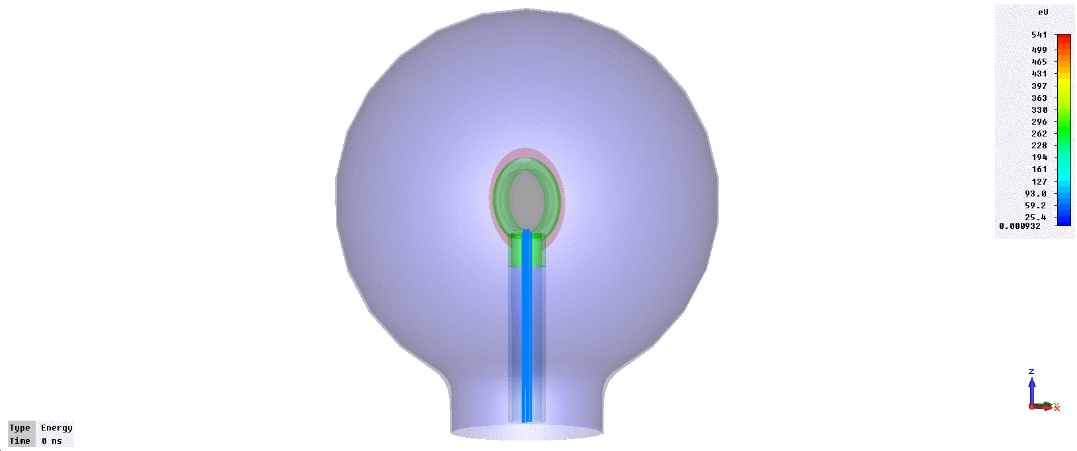
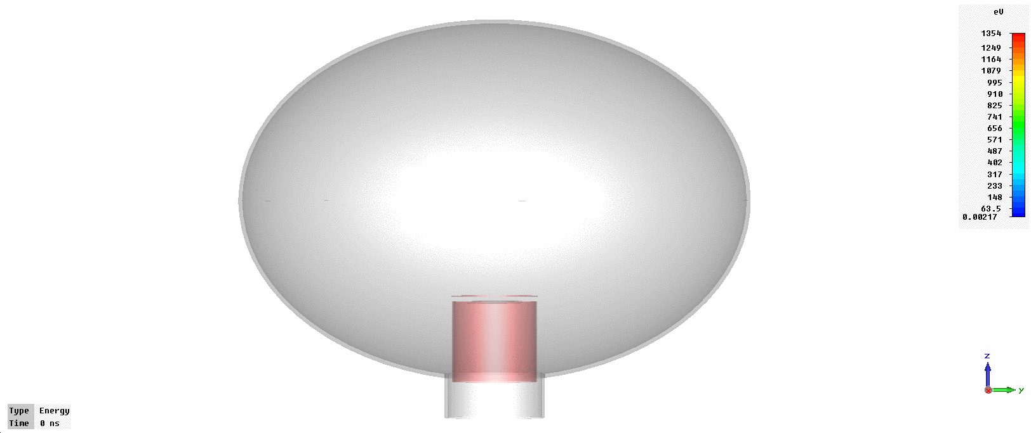
Preface
2013.03-2015.02 Master &PhD student at XIOPM
Large aperture MCP-PMT simulations
Just getting to know MCP-PMTs
Learnt a lot from the collaboration meetings held very two months
Inspired a lot
MCP
Proposed and Patented by Yifang Wang et. al

Slide 4

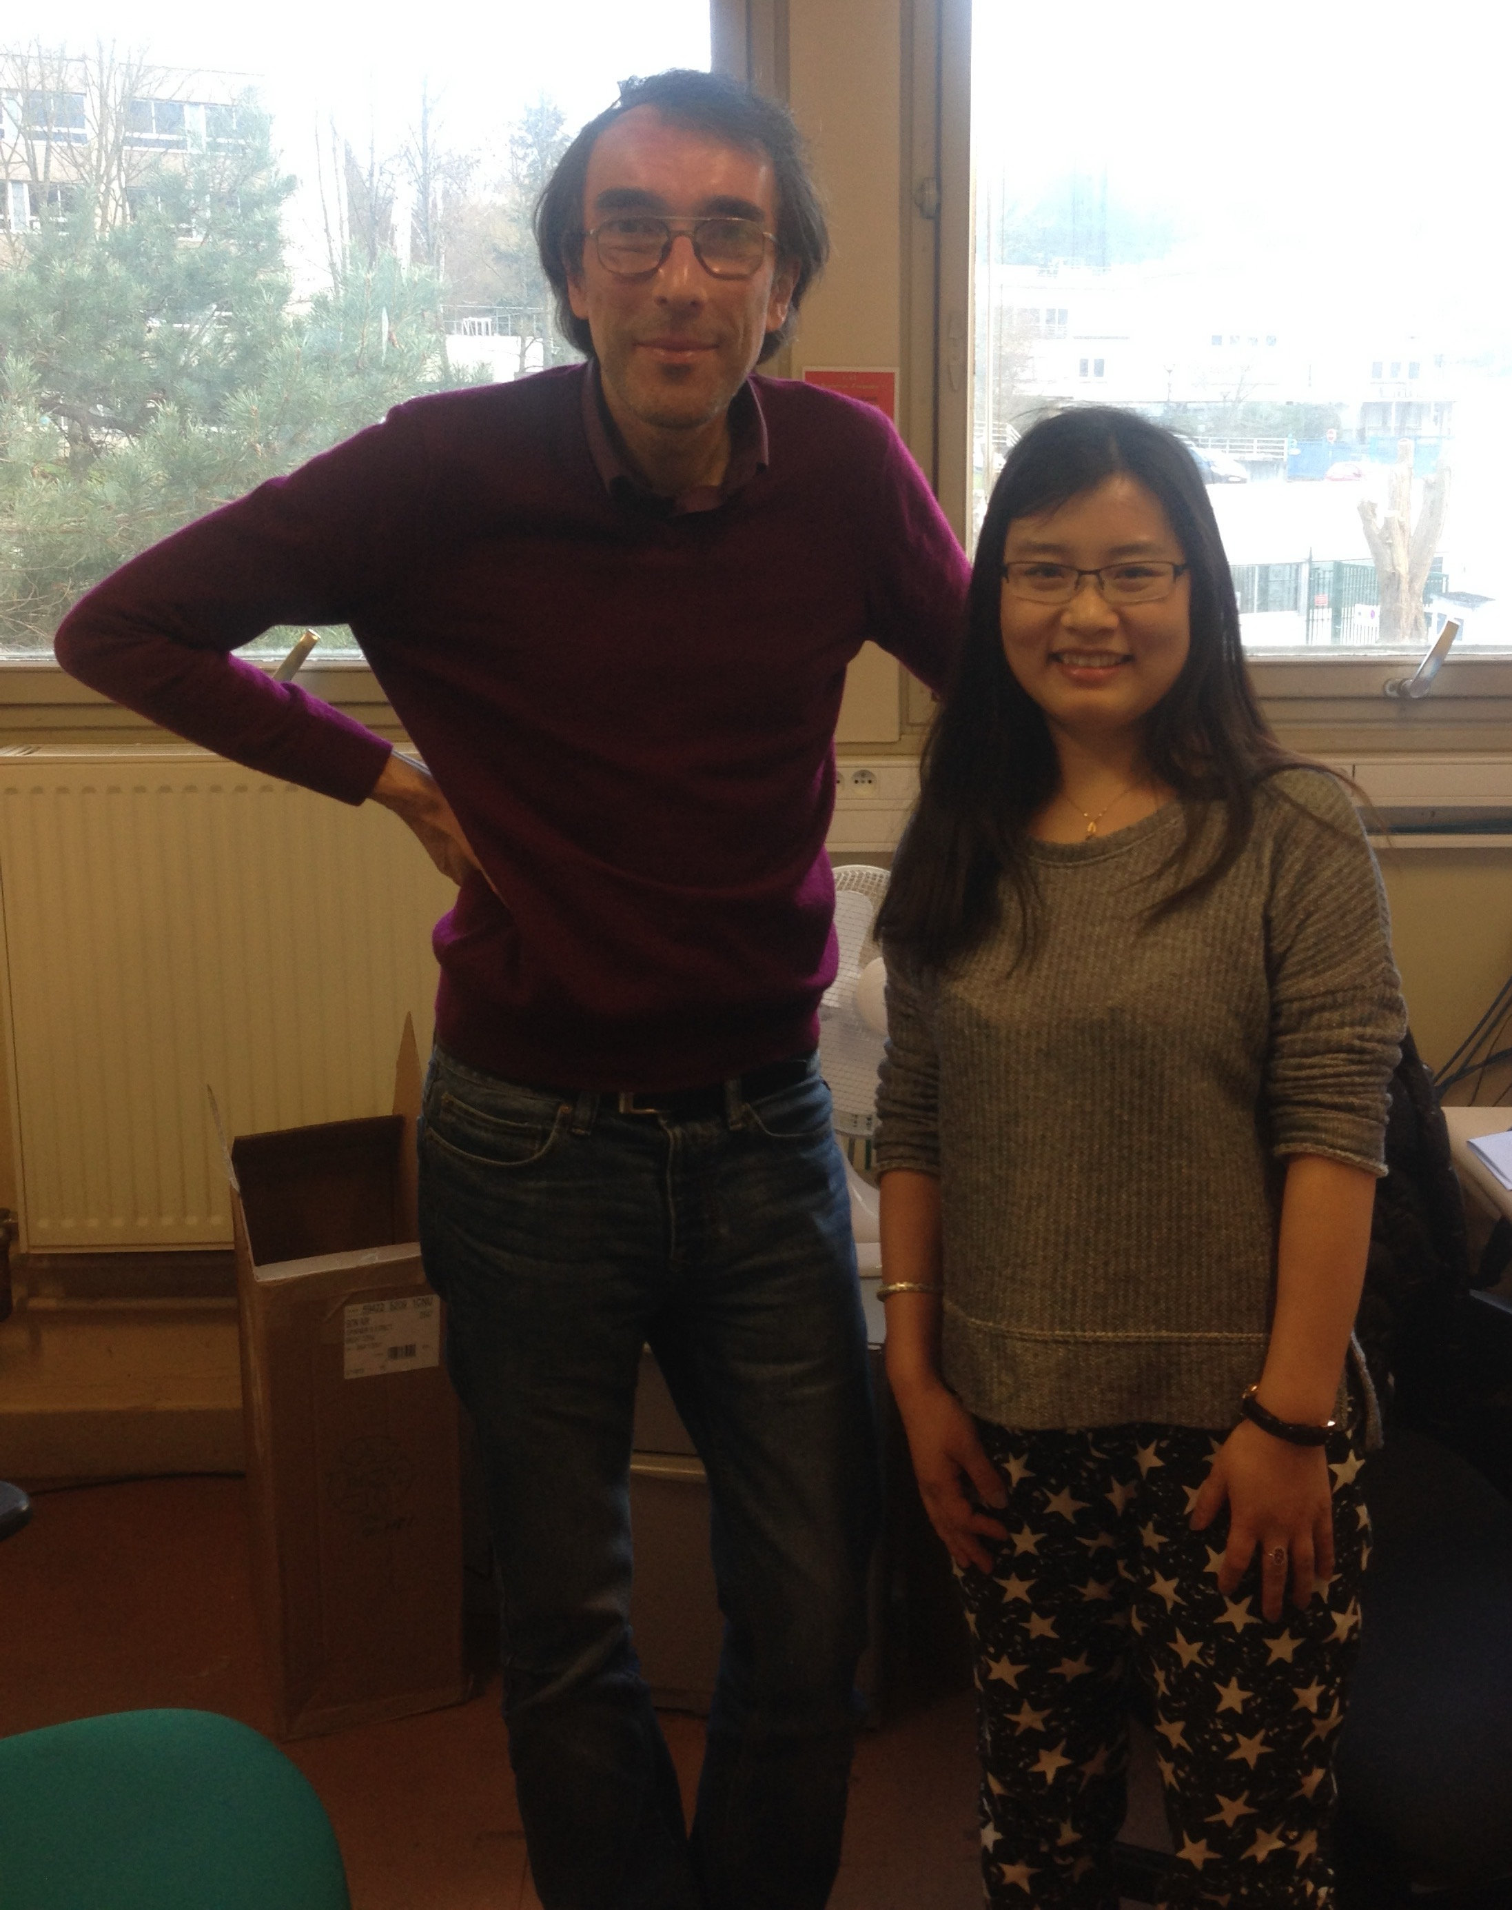
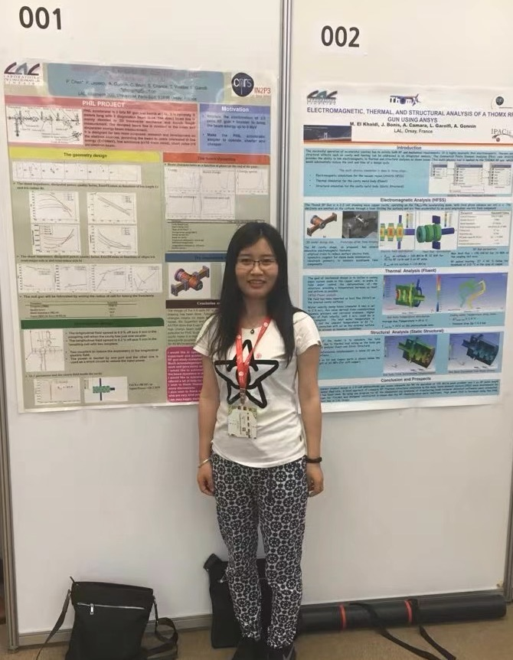
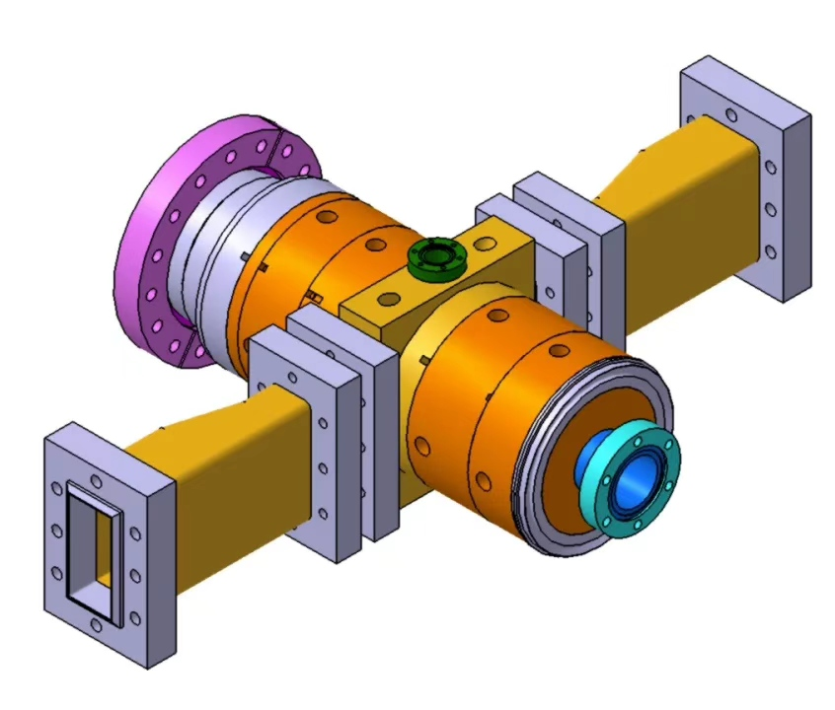

Preface
2015.03-2016.02 CAS-CNRS joint PhD at LAL
RF gun simulations
Supervised by Pierre Lebercq
Optimized 4.6-cell RF gun
La vie est bellle

Slide 5
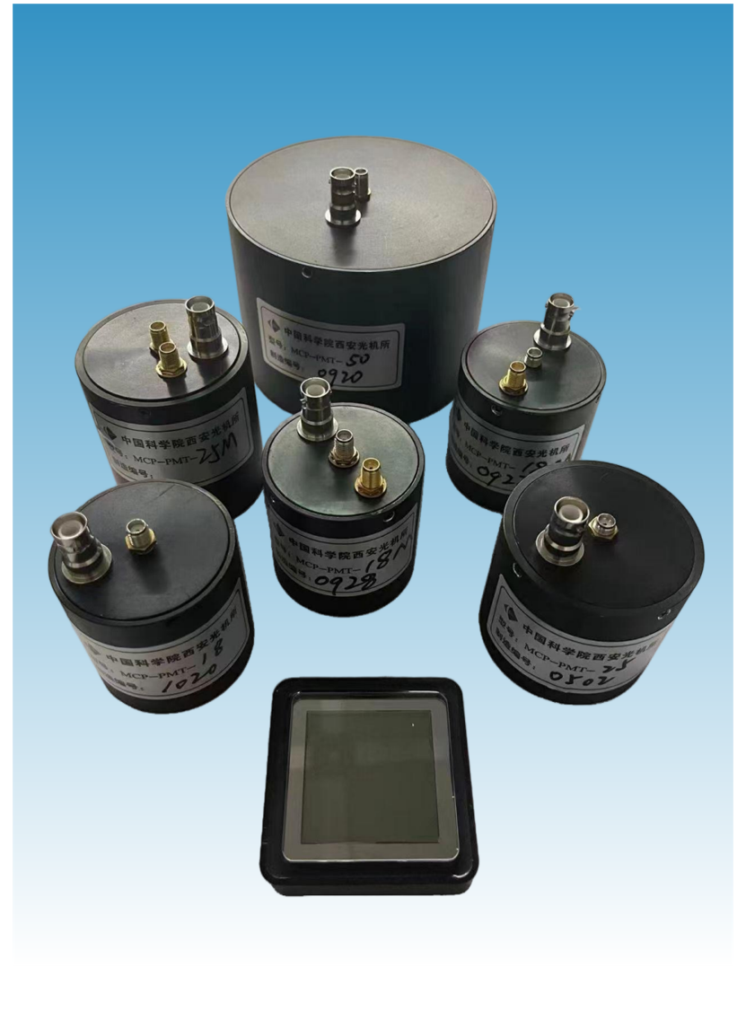
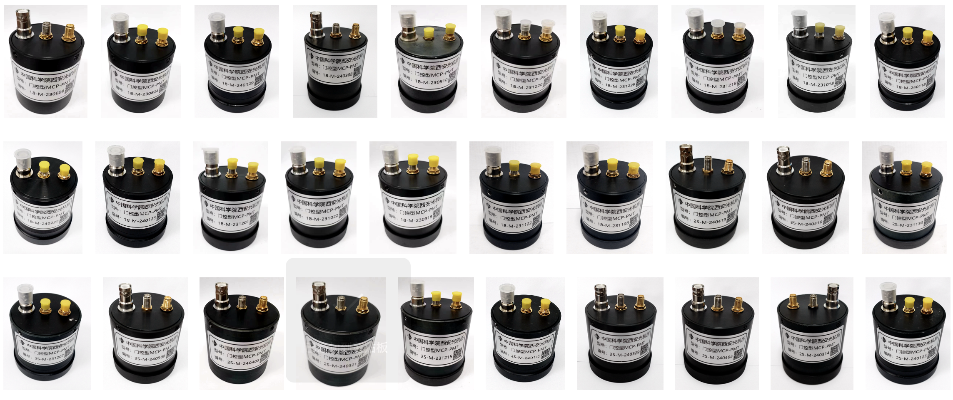
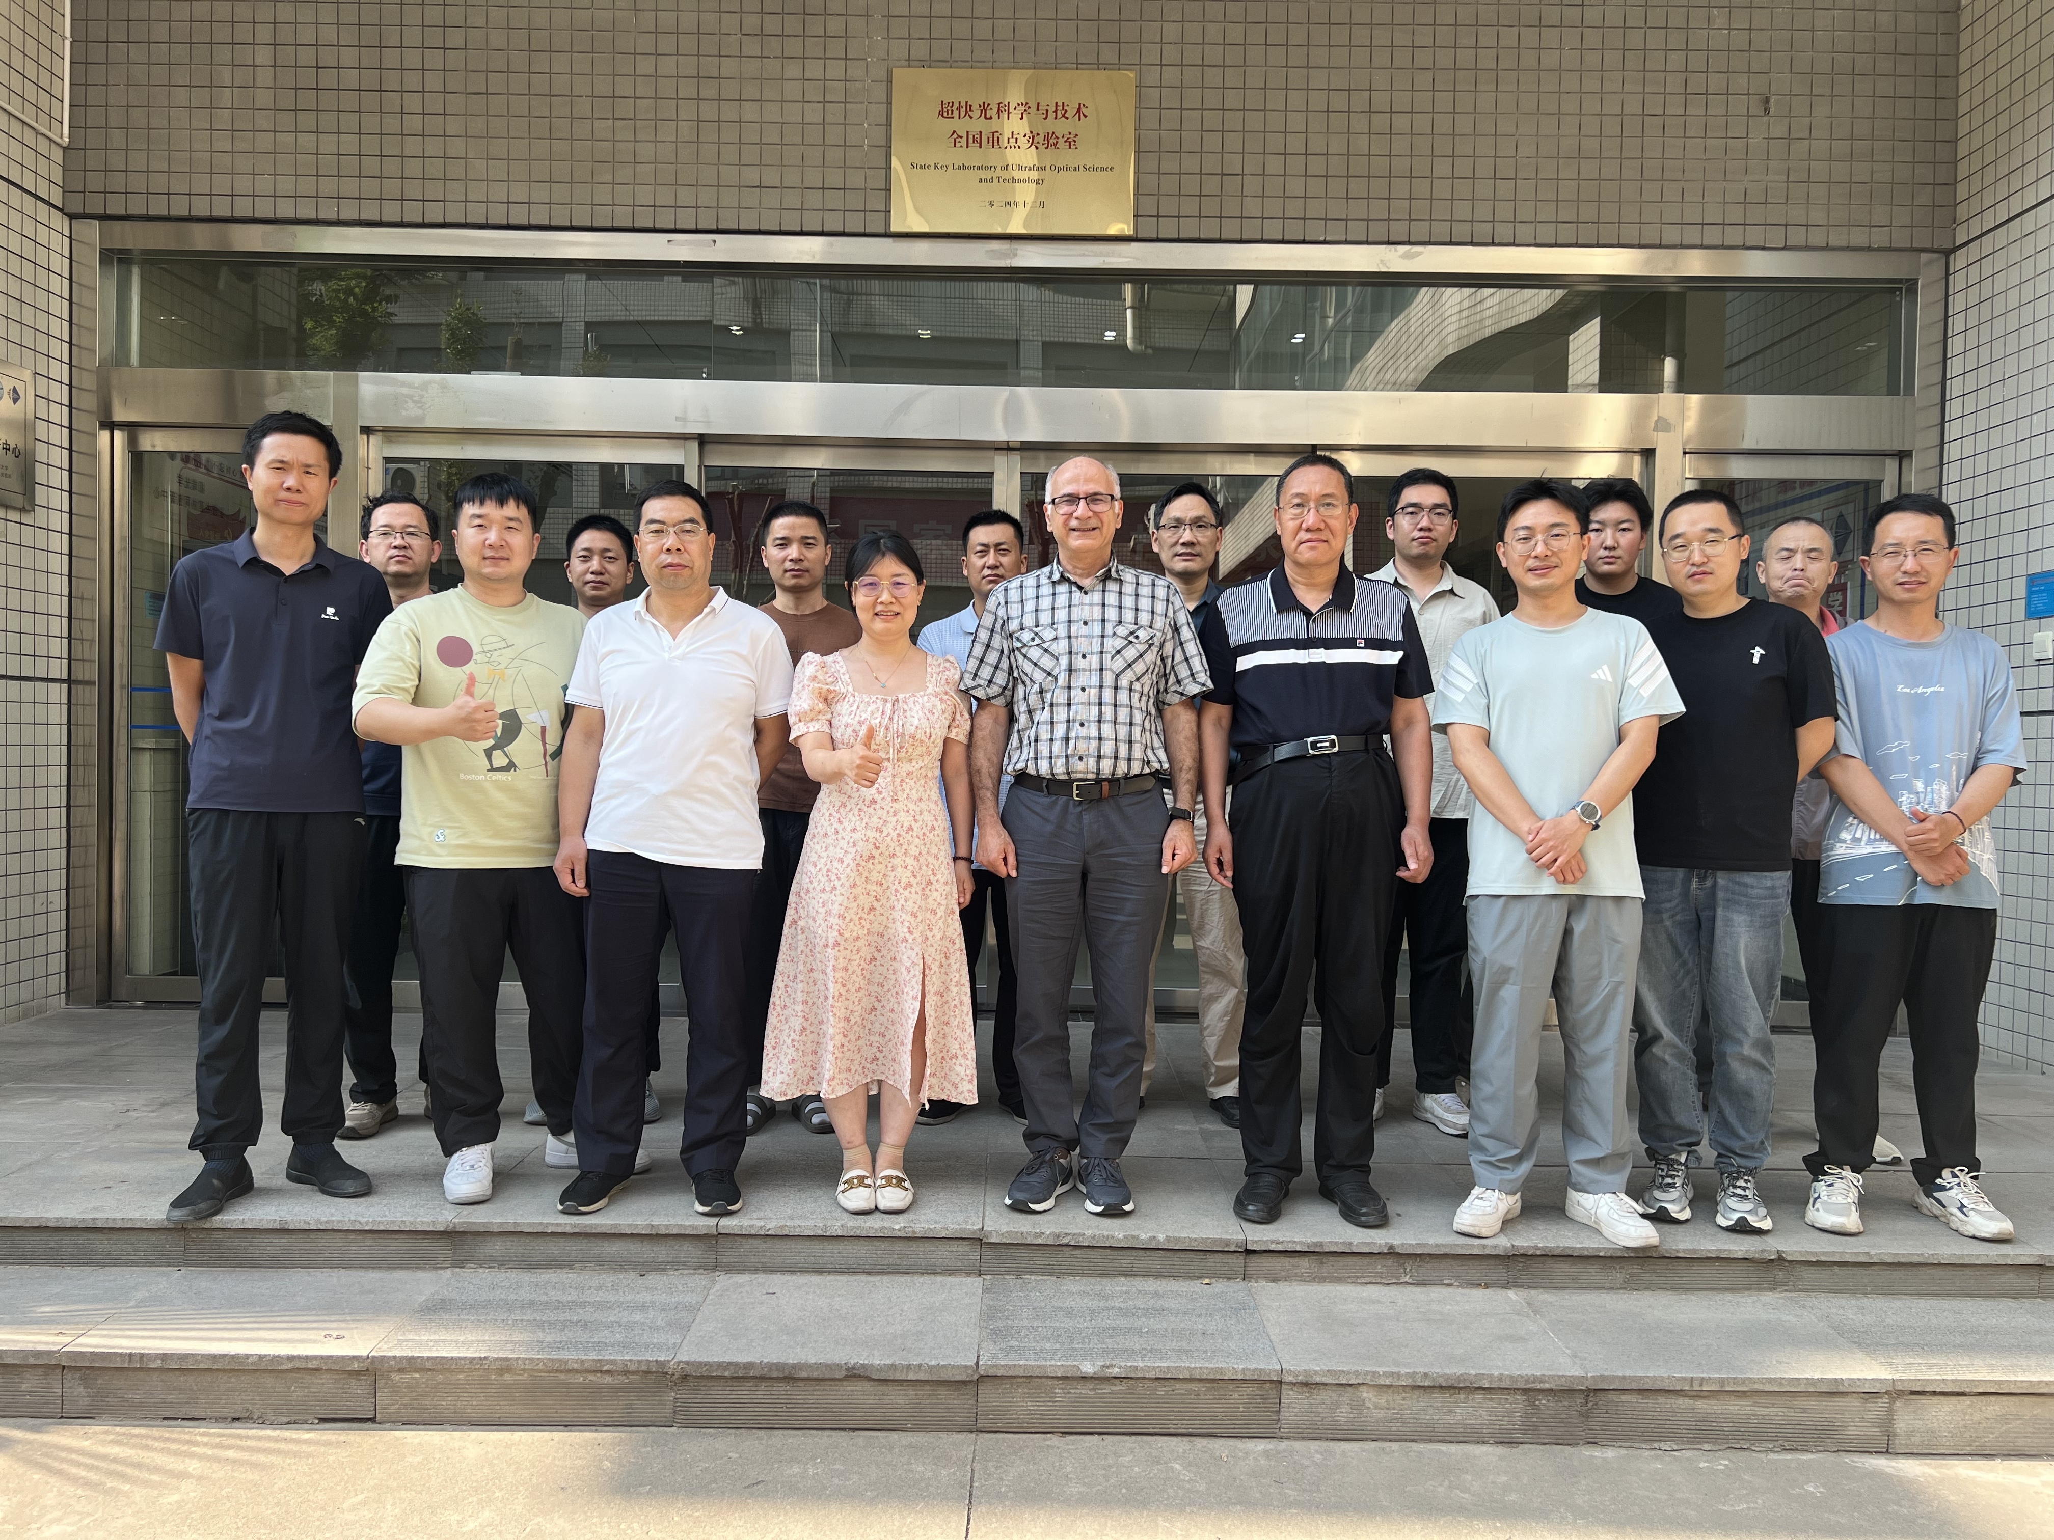
Preface
2017.02- Working at XIOPM
MCPs, MCP-PMTs, Imaging Intensifier, Hybrid photodetectors
2024.06- Joined in CERN DRD4 recommend by Guy Wilkinson
Development of Photon Detectors and Particle Identification Techniques
Working Package 2 (vacuum photodetectors ) leaded by Imad Laktineh

Slide 6
Outline
Outlines
Introduction
Overview of MCP detectors
MCP detector characteristics
Prototypes and applications
Future plans

Slide 7
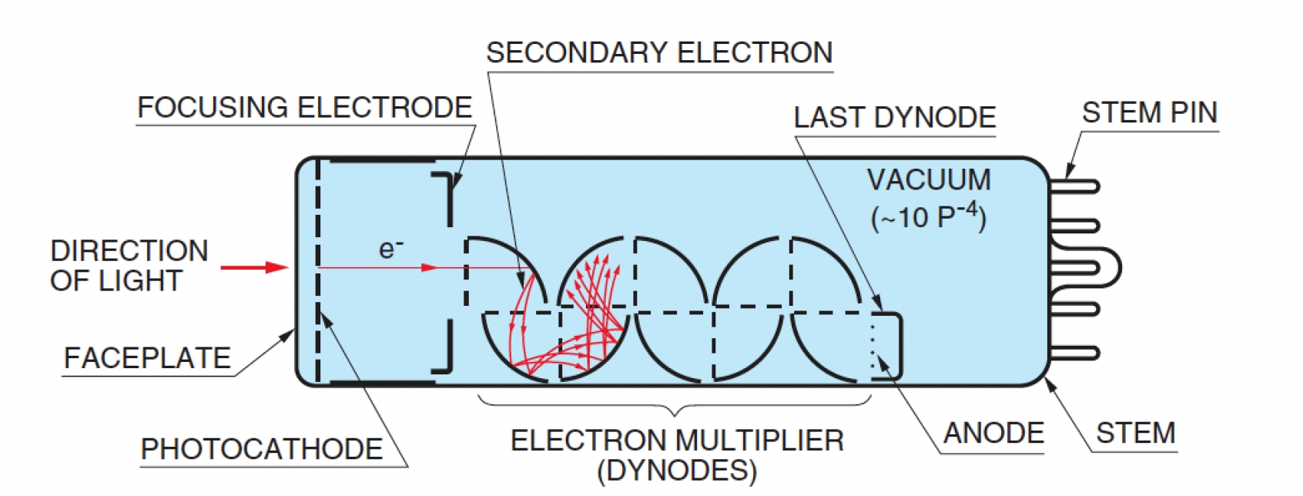
Photomultiplier tubes (PMTs)
PMTs are the most common photodetectors in particle and nuclear detection
Single photon sensitive
High gain and low noise
Large sensitive area
Sensitive to scintillation light and Cherenkov light
Construction and Operation Principle of dynode PMTs
Hamamatsu Handbook

Slide 8
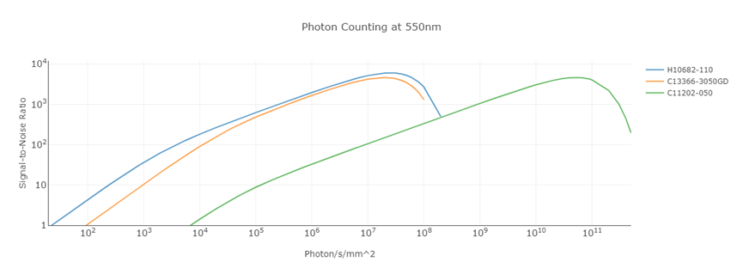
Photomultiplier tubes (PMTs)
The signal-to-noise ratio of PMT is better than that of SiPM especially for few
photon detections.
PMT
SiPM
SiPM
Hamamatsu website

Slide 9
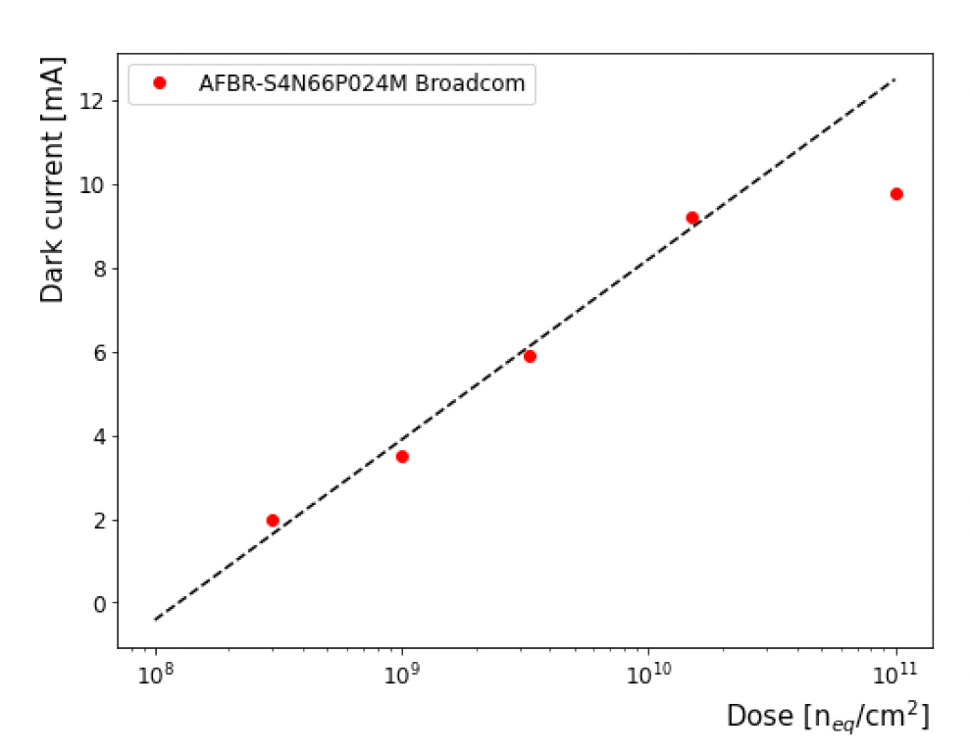
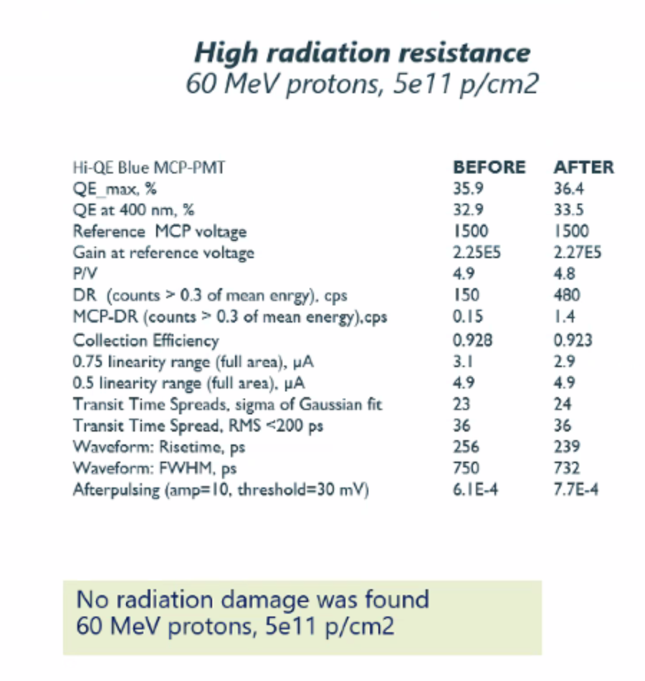
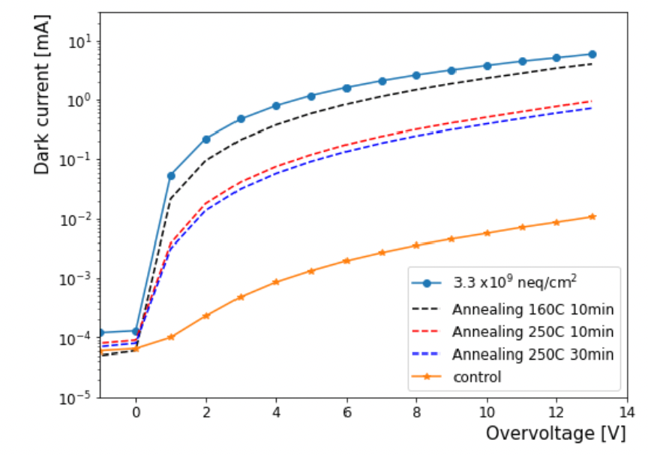
Photomultiplier tubes (PMTs)
SiPM radiation resistance assessment by J. Pe˜na-RodrÅLıguez
Assessment of 6 × 6mm² SiPMs (Hamamatsu, Broadcom, OnSemi)
before/after neutron irradiation at the ˇReˇz Cyclotron (7 samples)
SiPM dark current increases drastically with the irradiation dose
Loss of the SiPM photon resolution after irradiation (Φ > 3×10⁸neq/cm²)
MCP-PMT radiation resistance assessment by Photonis
J. Pe˜na-RodrÅLıguez. DRD4 meeting 2025 (BUW)

Slide 10
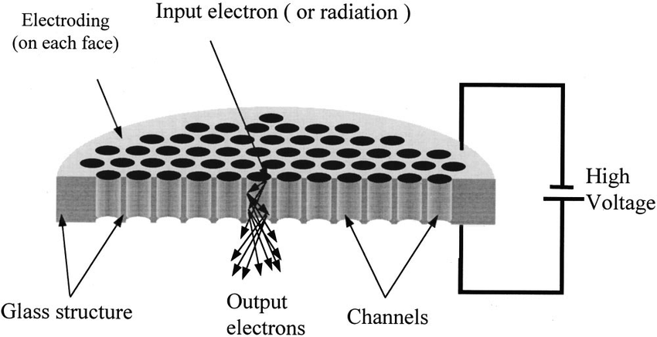
Microchannel plate (MCP)
MCP is an excellent secondary electron emission multiplier
Two-dimensional array of glass capillaries (channels with ~2-25 μm diameter) bundled in parallel in a MCP plate
Sensitive to electrons, ions, UV light
Able to detect soft or hard X-rays, neutrons etc if coated with proper photocathode like CsI, Au, CsTe or doped with proper material like B, Li for neutron detection and Pb for hard X-ray…
Construction and Operation Principle of MCPs

Slide 11

Microchannel plate (MCP) detectors
MCP-PMTs
photon
PC
2-stage MCPs
Single photon sensitive
Fast timing resolution
<30 ps for single P.E. , <10 ps for multi P.Es
electron
MCP
< 10⁻⁵pa
electron cloud
anode
Image intensifier
signal
Usually one-stage MCP for high spatial resolution
Replace anode with phosphor screen for imaging
High spatial resolution
< 8 μm viewed with naked eye, < 20 μm with CMOS
photon
PC
electron
MCP
Position sensitive MCP detectors
electro cloud
Replace single anode with position sensitive anodes
Anodes could be WSZ, resistive strip line, cross strip, pixelated chip…
Pixelated
anode
image

Slide 12
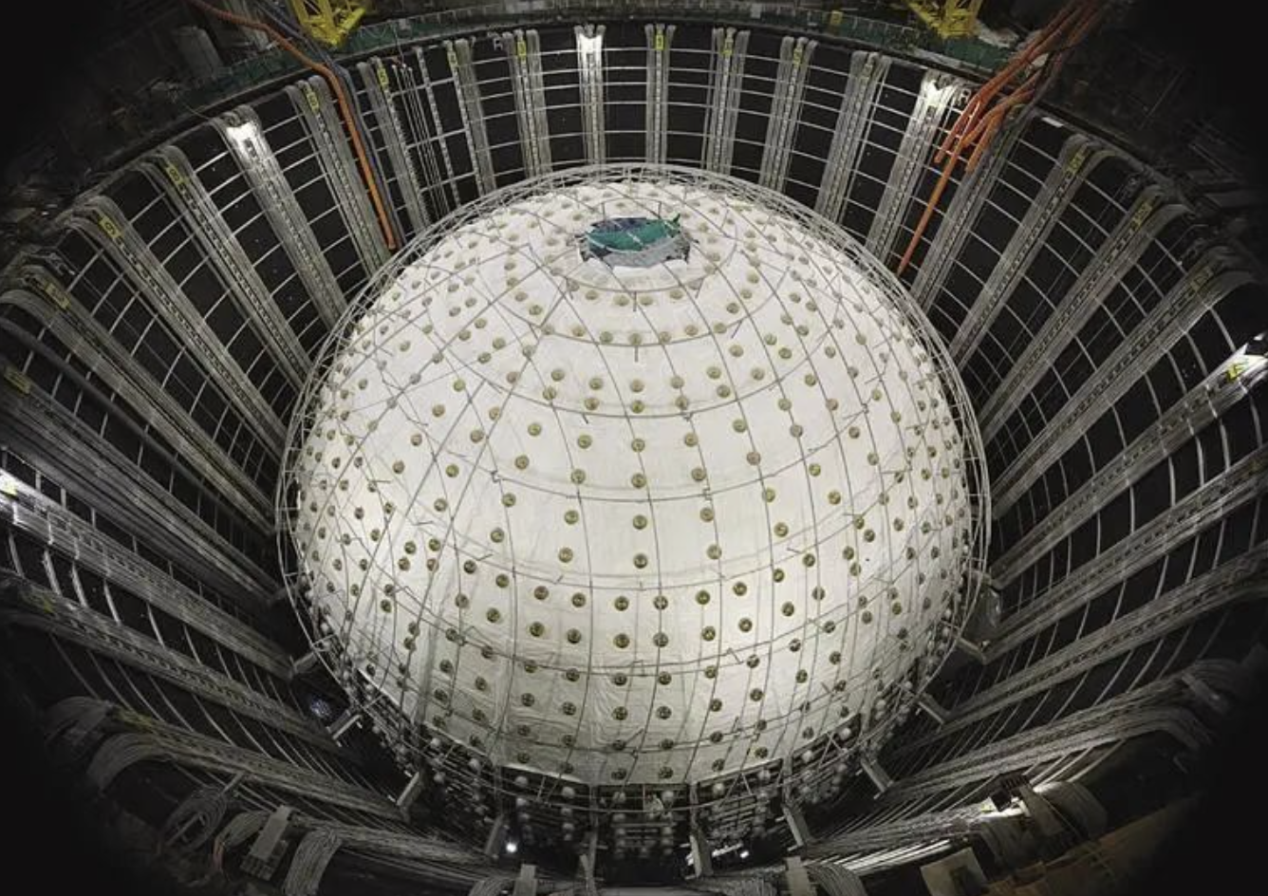
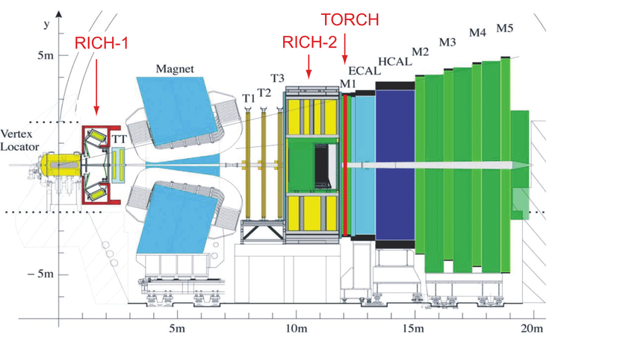
PMT applications
Large aperture PMTs
Large coverage for rare instances
Neutrino, comic rays, dark matter…
Small PMTs and MCP detectors
PID, TOF
Space satellites for particle or photon detection
Lidar
Fluorescence lifetime measurements…

Slide 13
Outline
Outlines
Introduction
Overview of MCP detectors
MCP detector characteristics
Prototypes and applications
Future plans

Slide 14
PMT characteristics
Dynamic range
Photocathode sensitivity
Counting rate
Maximum output current
Recovery time
Response wavelength
photon
Quantum efficiency
PC
electron
Time resolution
MCP
Collection efficiency
< 10⁻⁵pa
Rise time, Transit time, TTS
Pulse width, fall time, after pulse,
Late pulse
electron cloud
anode
Detection efficiency
signal
Position resolution
Gain
Current gain, pulse gain
Magnetic field effects
Lifetime
Radiation resistance

Slide 15
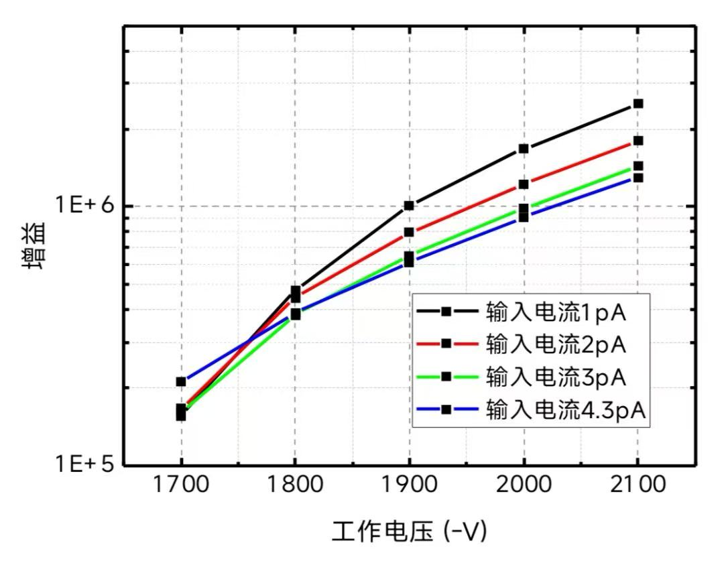
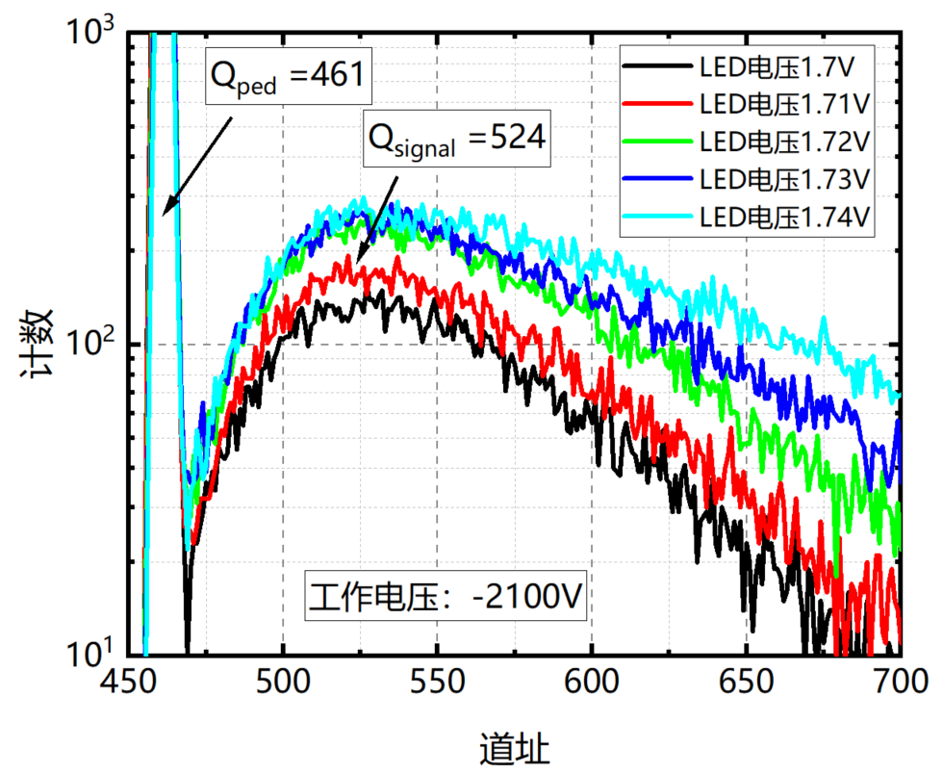
Gain
Determined by the secondary electron emission yield, L/D, basis angle, supply voltage, resistance
Input current
Vary with different input intensities
because of limited maximum output charge.
1 pA
3 pA
2 pA
Single P.E. gain could be one magnitude higher than the current gain
Gain
4.3 pA
Counting
Gain 1.2e7
Supply voltage
channel
Single photoelectron spectrum

Slide 16
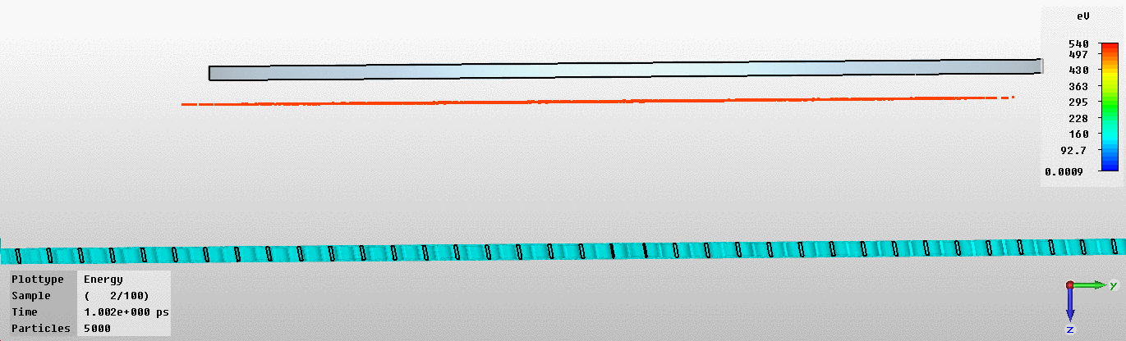
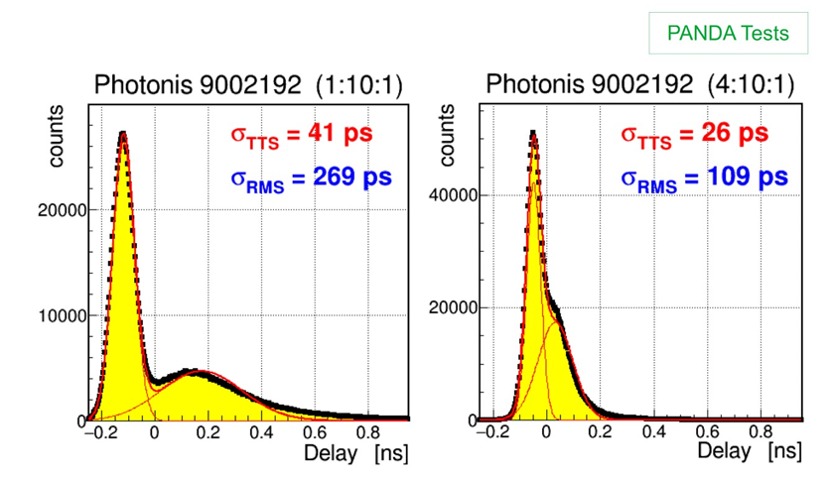
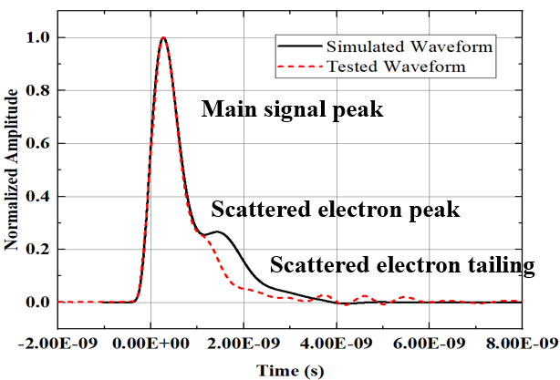
Time performance
Delayed pulses worsen time performance, which caused by the electron backscattering on the MCP input surface
Photocathode
Electron trajectories
Larger open area ratio could minimize
late pulses
MCP
Ref. Albert Lehmann, Status/Limitations of MCP-PMT Performance

Slide 17
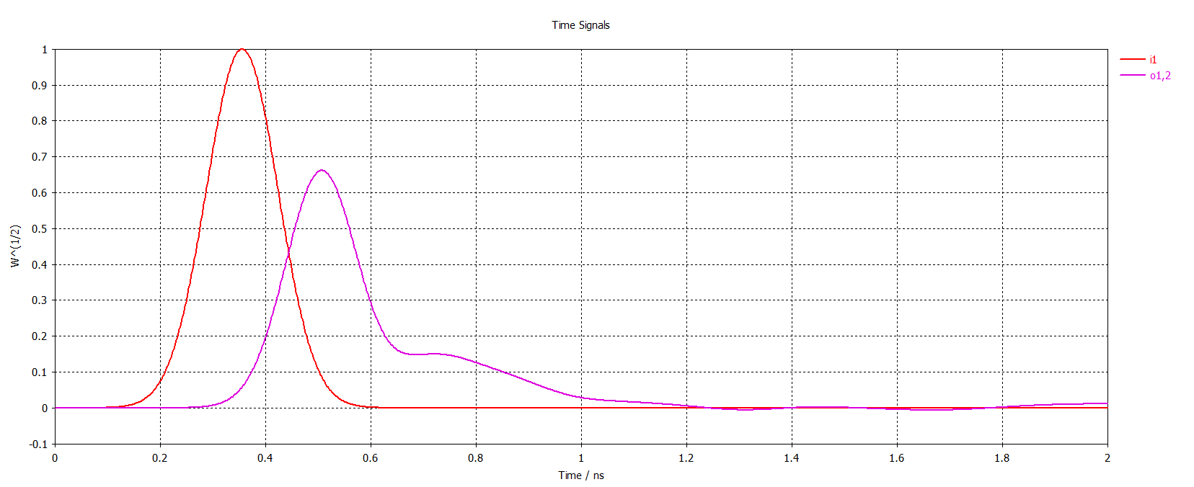
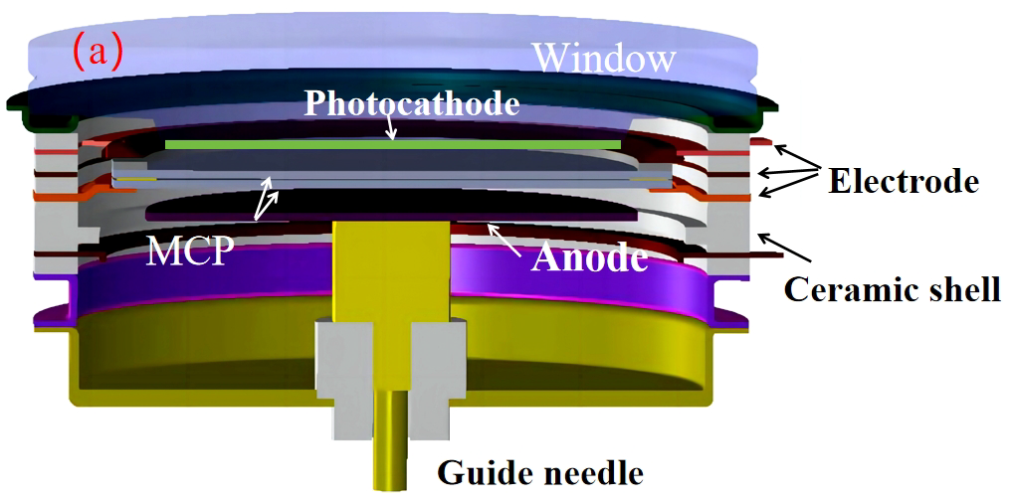
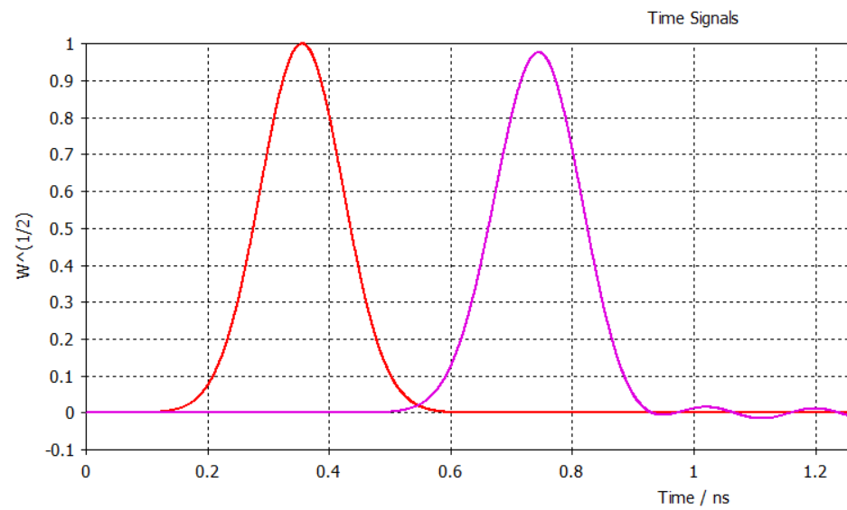
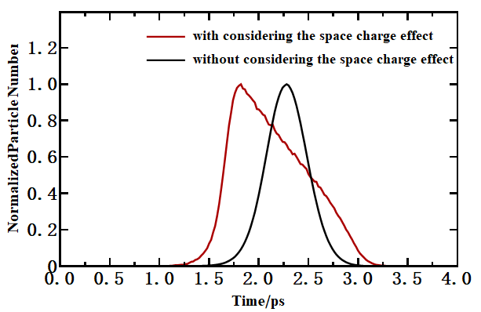
Time performance
TTS could deteriorate as it becomes saturated
Impedance mismatch
The waveform is usually not perfect because of impedance mismatch between the metal anode and the coaxial line.
input
output
impedance matched
input
output

Slide 18
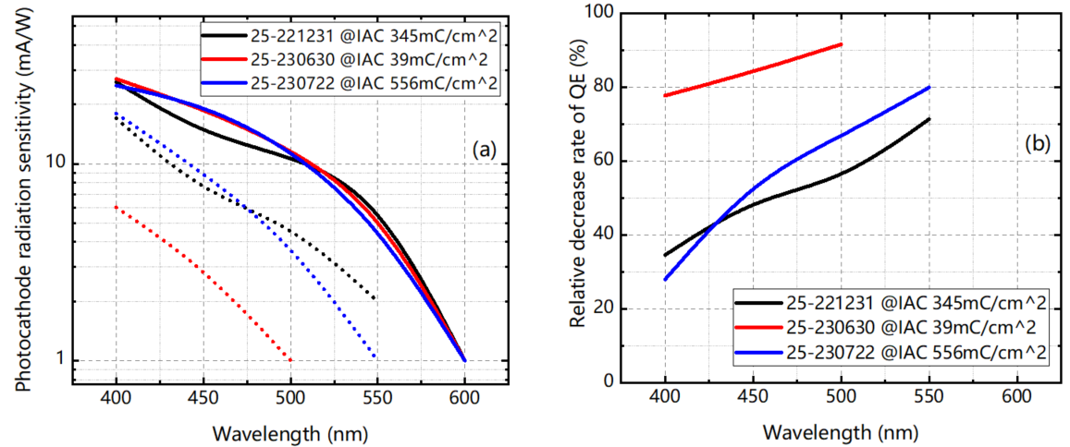
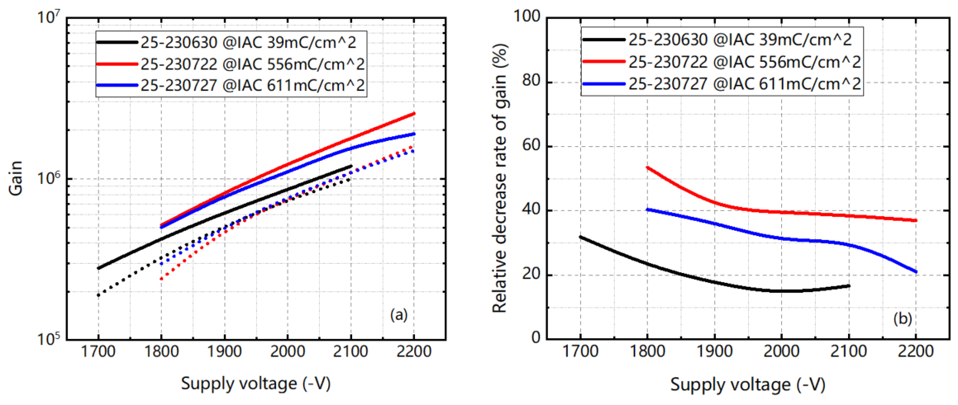
Lifetime
Both photocathode sensitivity
and MCP gain decrease as
illuminated for a long time.
Photocathode QE decreases
more significantly at longer
wavelengths.
QE could decrease by 80%
while gain decreases by less
than 20% for an integrated
output current of 39 mC/cm² .

Slide 19
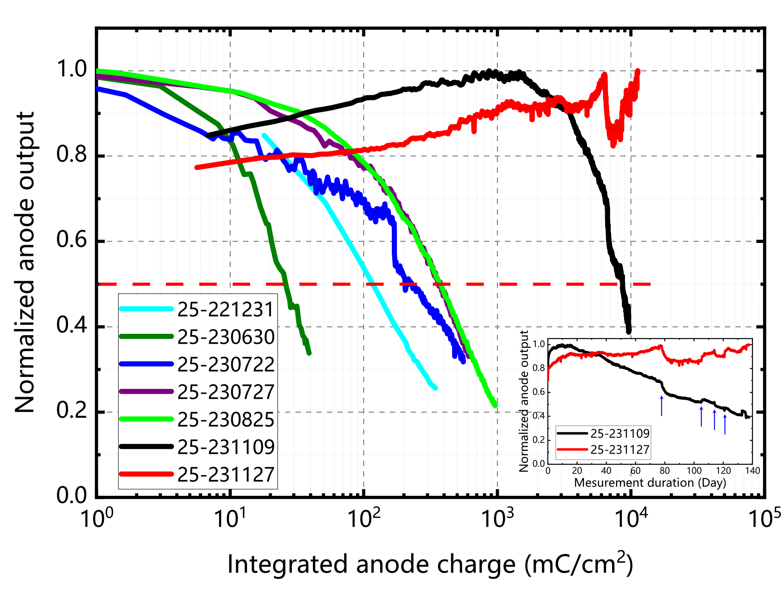
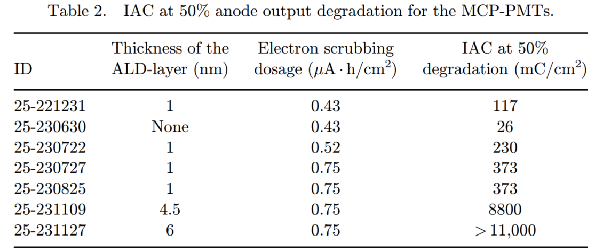
Lifetime
Coated Al₂O₃ layer by ALD technique and optimized the electron scrubbing volume to improve the lifetime.
Lifetime increased from 373 mC/cm²
to 11000 mC/cm² as increase the
thickness of the ALD-layer from 1 nm
to 6 nm.
Lifetime increased from 117 mC/cm²
to 373 mC/cm² as increase the scrubbing volume from 0.43 µA·h/cm² to 0.75 µA·h/cm².
Lifetime increased more than 400 times.

Slide 20
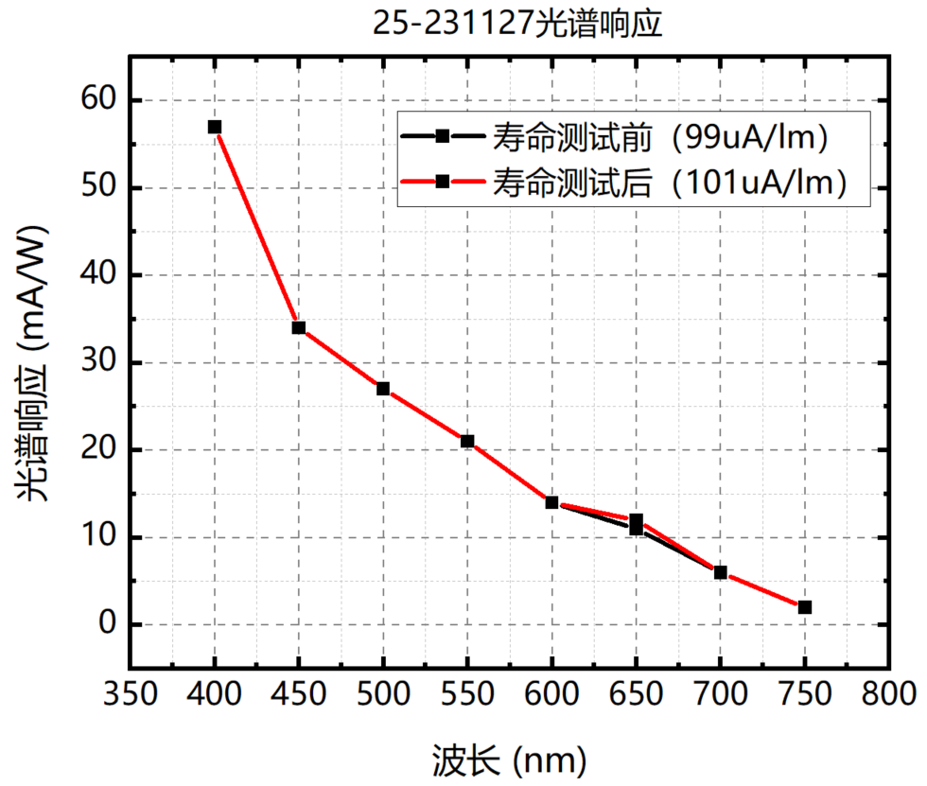
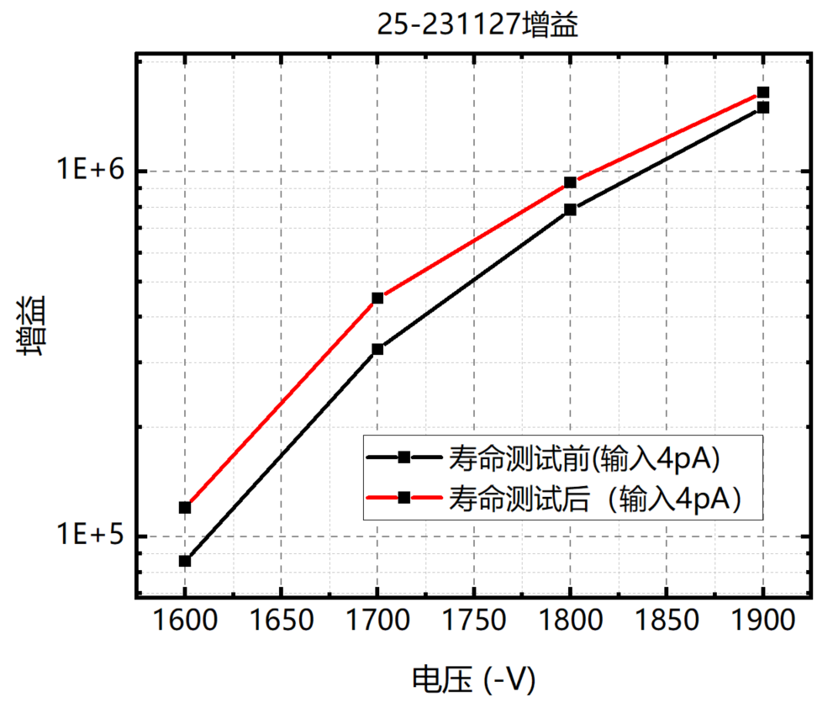
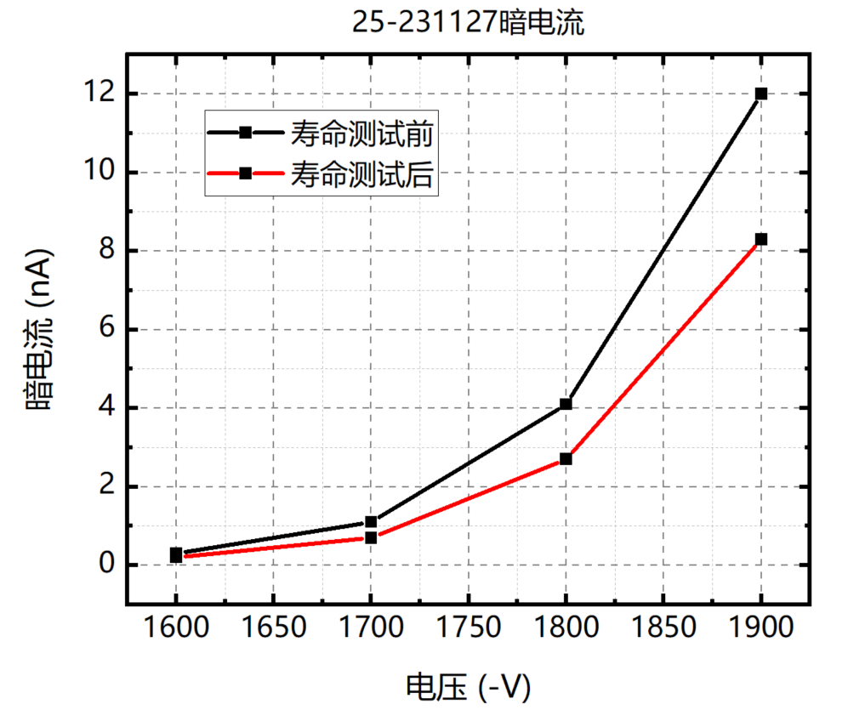
Lifetime
Lifetime
No degradation in photocathode and MCP, dark current decreased.
The increase in gain may be due to the multiplication from both the ALD layer and the MCP, which requires further study.
Continue to optimize the ALD and scrubbing processes.
Pre-test
Pre-test
Post-test
Post-test
Spectral response(mA/W)
Gain
Dark current (nA）
Pre-test
Post-test
Wavelength(nm)
HV(-V)
HV(-V)

Slide 21
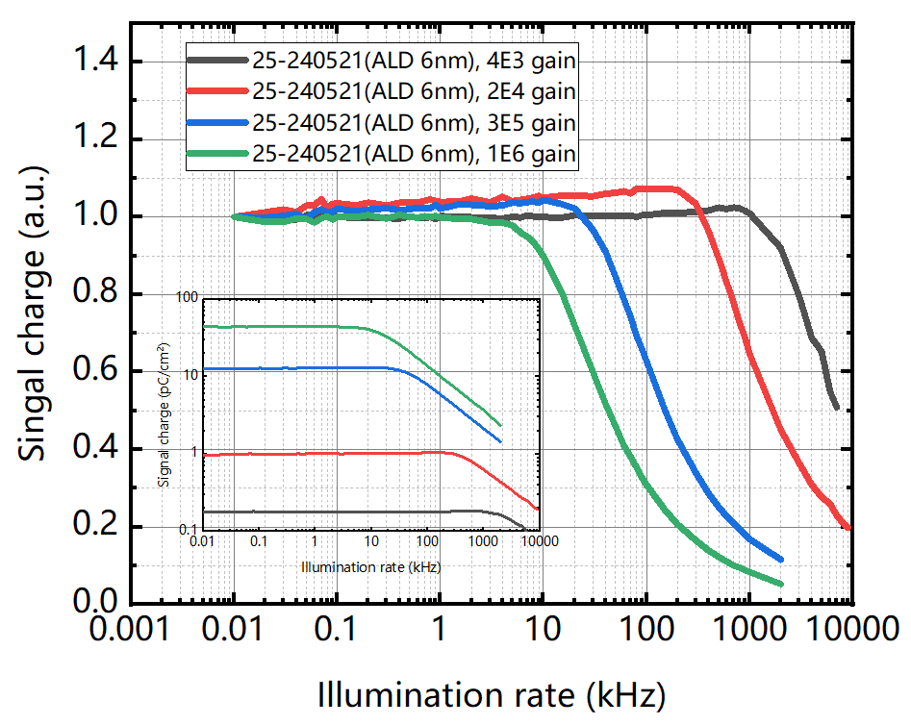
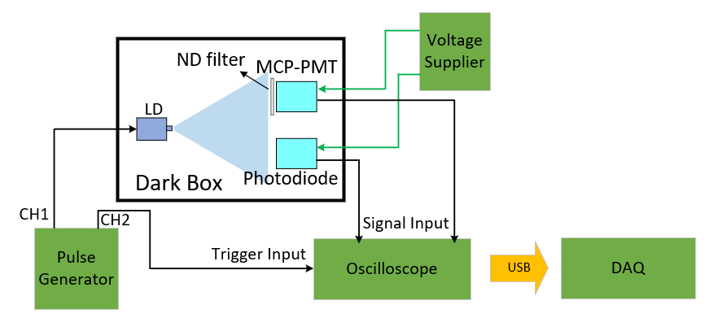
Rate capability
Measurement setup
LD driven by a pulse generator
10 ns pulse width
~3500 photons/cm²/pulse
Counting rate of ALD-MCP PMT
3 MHz@4e3 gain
600 kHz@2e4 gain
50 kHz@3e5 gain
15 kHz@1e6 gain
52.5 MHz for single P.E @ 1e6 gain

Slide 22
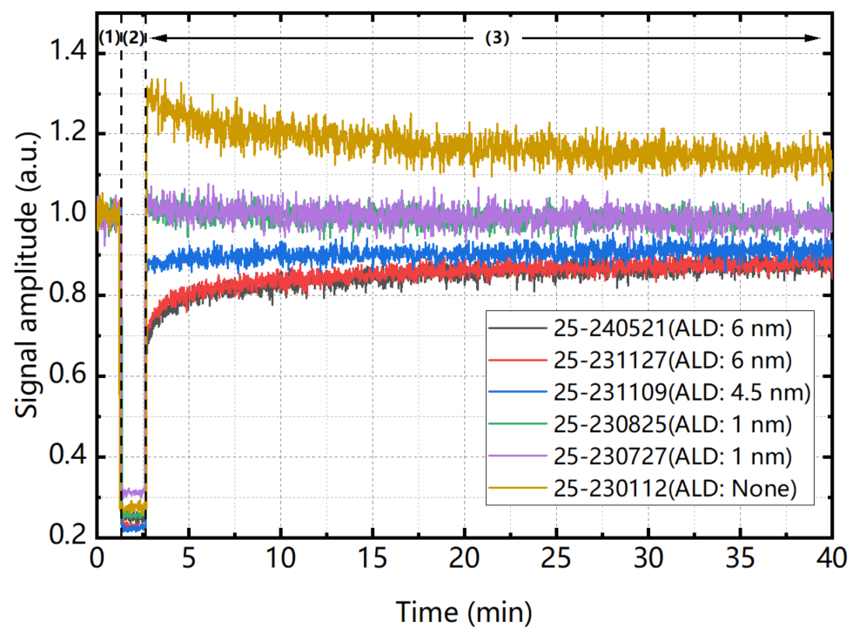
Saturation recovery behaviors
Measurement setup
MCP-PMTs with different thickness of ALD films were operated at 1E5 gain.
Illuminated by LD at rates of 10 Hz for phase (1) and (3), 500 kHz for phase (2).
0 nm
1 nm
Longer recovery time for thicker ALD-layer
The MCP without the ALD layer appears to exhibit superlinearity and a long recovery time.
4.5 nm
6 nm
Recovery of the MCP with the ALD layer of 1 nm is fast.
saturated
Further research will be conducted to confirm the phenomena and causes.

Slide 23
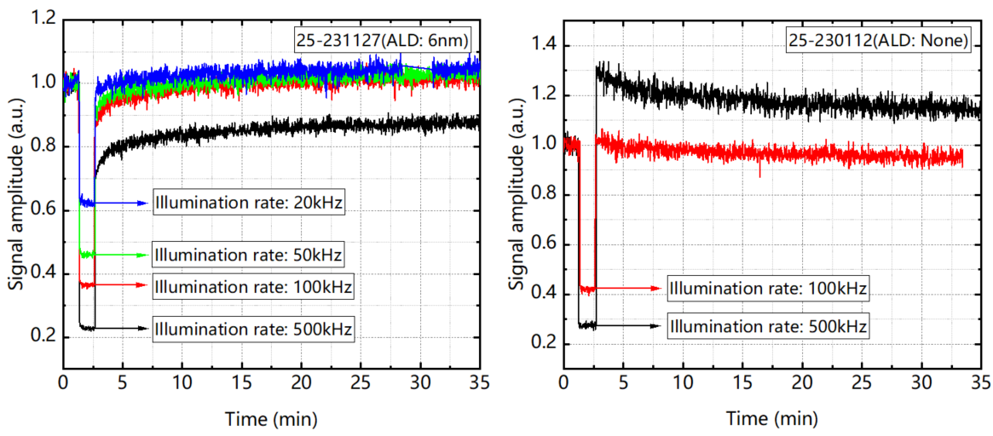
Saturation recovery behaviors
Heavier saturation, longer recovery time.
A higher supply voltage appears to be more effective in the recovery of the ALD-MCP.
The super-linearity can be lower for none ALD-MCP.

Slide 24
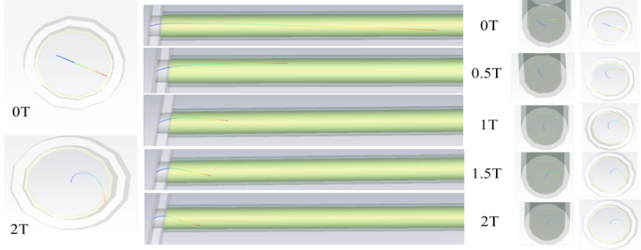
Magnetic field effects
To figure out how magnetic field decreases gain, electron trajectories in the MCP channel under the magnetic fields are simulated with CST program.
Electrons move in a spiral under the influence of a magnetic field.
Shorter accelerating distance, lower striking energy.

Slide 25
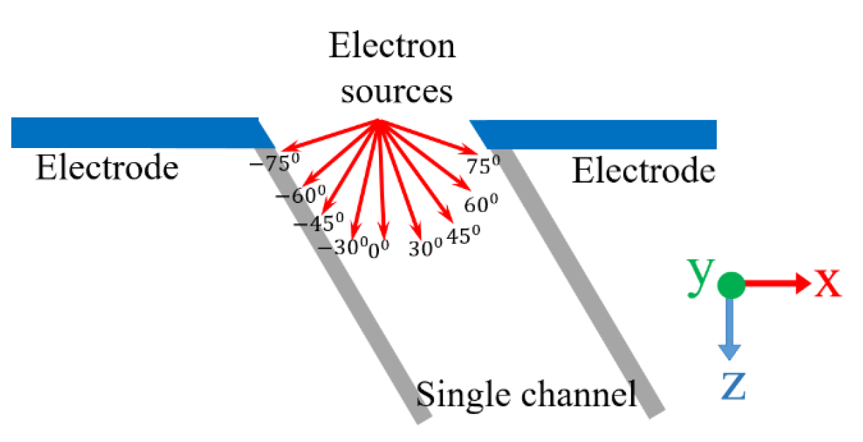
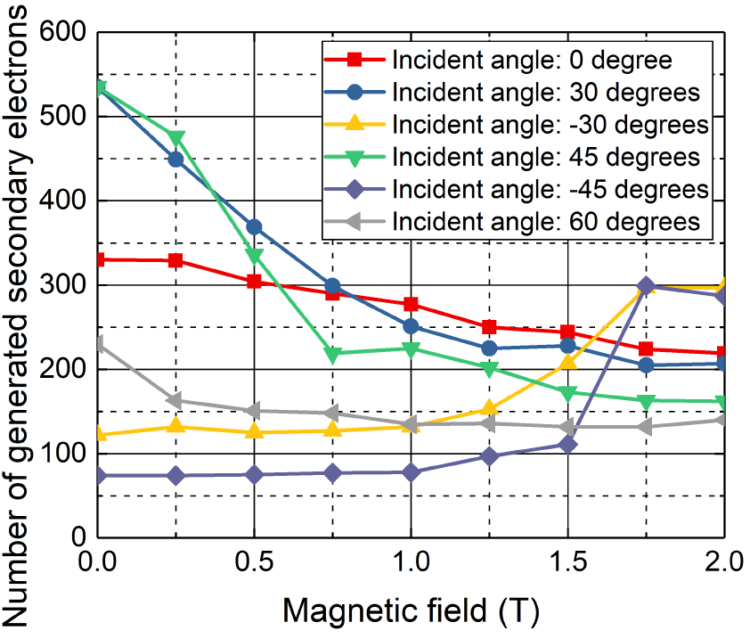
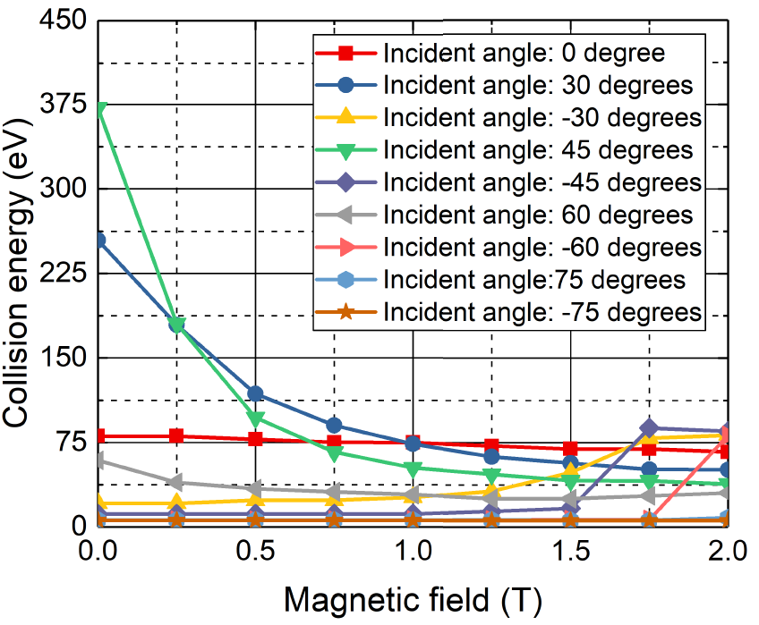
Magnetic field effects
Fewer secondary electrons are emitted when primary electrons strike the MCP with lower energy.

Slide 26
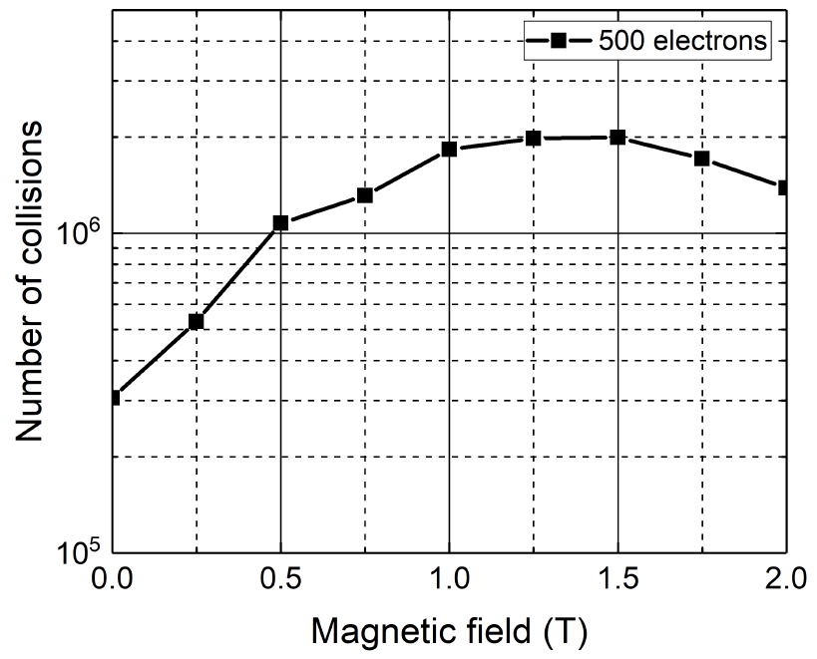
Magnetic field effects
The number of electron collisions with the MCP channel increases and then decreases.
Gain is the result of the combined effect of the number of collisions and the collision energy.

Slide 27
Outline
Outlines
Introduction
Overview of MCP detectors
MCP detector characteristics
Prototypes and applications
Future plans

Slide 28
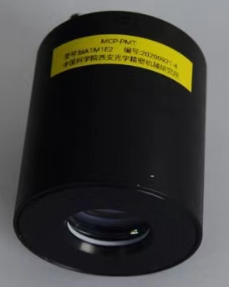
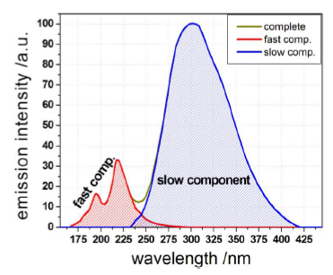
MCP-PMT prototypes and applications
Solar-blind MCP-PMT for fast X-ray detections
Solar-blind MCP-PMT+BaF₂
Photocathode : CsTe
Peak wavelength：250 nm
Gain＞1E6
Rise time: ＜350 ps
TTS @ SPE：＜50 ps
Better than 1 ns time resolution for X-ray detection.
The fast and slow components of BaF₂ fluorescence have difference wavelengths.
The CsTe cathode is mainly sensitive to the fast component of BaF_{2.}
Spectrum response of CsTe MCP-PMT
BaF₂ fluorescence
x-ray pulses detection in DCI laser fusion experiment

Slide 29
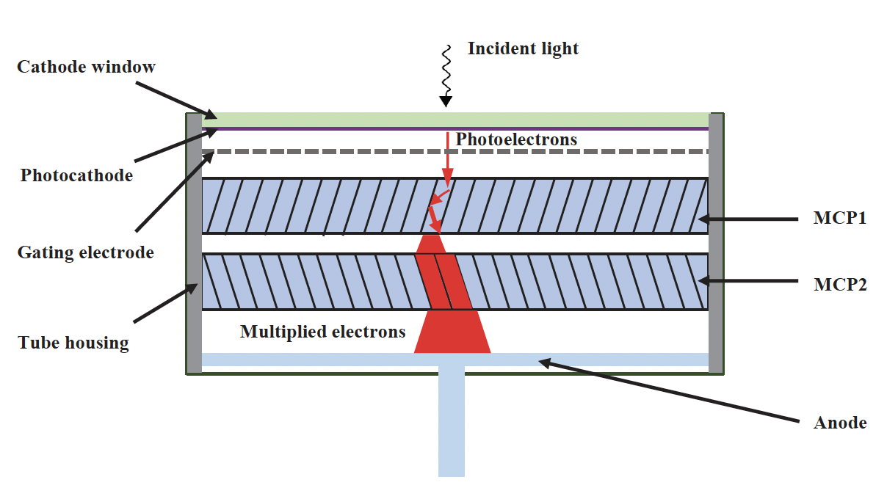
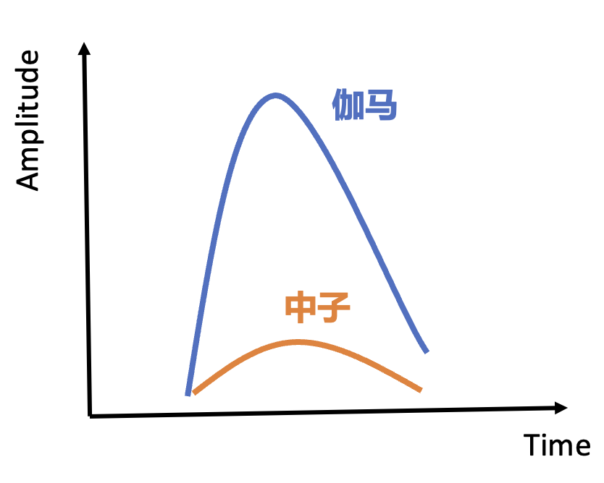
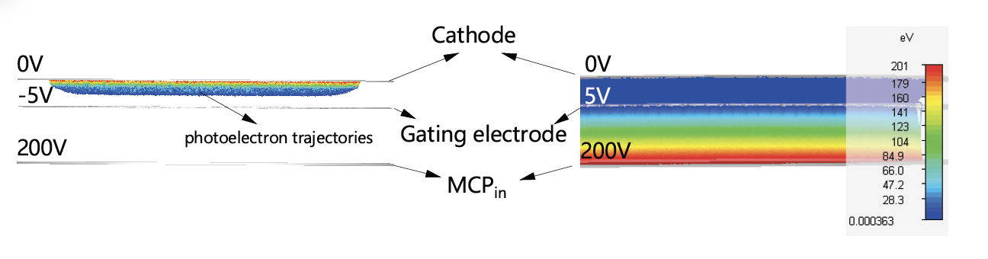
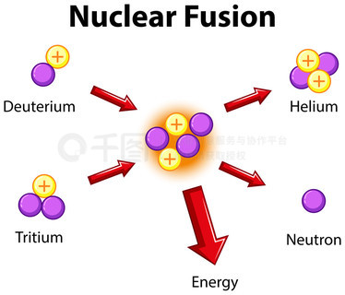
MCP-PMT prototypes and applications
Gated MCP-PMT for neutron detection in strong γ rays
Neutron yield and spectrum detection are key
to optimize the nuclear fusion experiment.
The intensity of the γ rays produced together
with neutron is about 5 orders of magnitude
higher than that of neutrons.
The MCP-PMT with a gating function is developed.
Photoelectron trajectory is controlled by the electric field between the photocathode and the gating electrode.
gamma
neutron

Slide 30
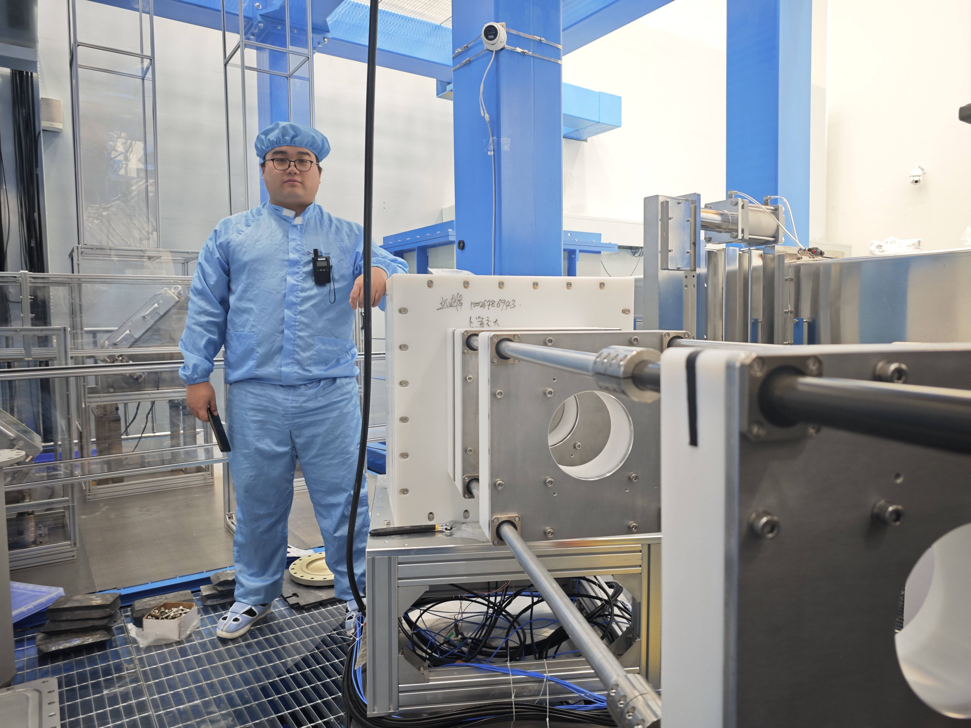











MCP-PMT prototypes and applications
Gated MCP-PMT for neutron detection in strong γ rays
Photocathode : bialkali
Gain:＞1E6
Rise time: ＜350 ps
Gating response time: ＜5 ns
Gating width: 5 ns ~10 ms
Gating noise: ＜ ±2 mV
nTOF
Single neutron sensitive
Gated PMT
nTOF
$$t_{n}$$
Gating ON
neutron
$$t_{γ}$$
$$t_{n}$$
No gating
saturated
$$t_{γ}$$
Liquid
scintillator
DCI laser fusion facility
$$t_{gate}$$
Gated PMT

Slide 31
MCP-PMT prototypes and applications
More than 30 gated MCP-PMTs were delivered to the DCI laser nuclear fusion exp.
for neutron yield detection.
About 500 gated MCP-PMTs are set to be delivered before the end of 2026 for the the neutron energy spectrum detection.

Slide 32


MCP-PMT prototypes and applications
Large current MCP-PMT for strong radiation detection
Photocathode : bialkali
Gain:＞1E4
Maximum output current: ＞250 nA @100ns
Nonlinearity ＜ 5%
Time resolution (FWHM) : ＜ 1ns
100ns
250mA

Slide 33
Outline
Outlines
Introduction
Overview of MCP detectors
MCP detector characteristics
Prototypes and applications
Future plans

Slide 34

Position sensitive Hybrid MCP detectors
MCP + Chip anode
Expected performance
Single photon/x-ray/UV/ ion/ electron sensitive
＜50 ps timing resolution
＜20 µm spatial resolution
photon
PC
electron
MCP
electro cloud
  Chip 1
  Sensitive to electrons with nearly 0 eV
  70 × 70, 20 μm is ready
  Ceramic base is being fabricated
  Hybrid MCP-PMT based the chip is expected in Sep.
  1.3k ×1.3k, 10 μm is expected in Sep.
  Output frequency 200 Hz
Pixelated
anode
image
  Chip 2
  Sensitive to electrons with nearly 0 eV
  400 × 400，10 μm is expected end of 2025
  Time resolution ∽50 ps
  Counting mode output

Slide 35
Large dynamic Hybrid MCP detectors
Gain: 10^{3 ~}10⁴
One-stage MCP
Large dynamic chip
/ multi channel readout with
tens of gain
photon
PC
electron
MCP
electro cloud
Large dynamic chip anode

Slide 36



Improve photocathode QE
  Micro-Nano gratings
  Micro-nano gratings, with subwavelength periodic structures, could boost photoelectric conversion efficiency by manipulating light-photocathode interactions and charge carrier dynamics.
  Dielectric gratings (e.g., SiO₂/TiO₂) create photonic bandgaps via Bragg scattering, forcing light to reflect multiple times within the photocathode.
  Localized surface plasmons
When light interacts with metallic nanostructures (such as nanoparticles, nanorods, or nanogratings) on the photocathode surface, it excites localized surface plasmons.
The electromagnetic field could be enhanced dramatically.
localized surface plasmons can modify the density of states near the material's surface, reducing the energy barrier for electron emission and promoting the escape of photoexcited electrons

Slide 37

New photocathode material
AI-assisted design of new materials
  Can survive in atmosphere
  High QE
  Can survive in atmosphere

Slide 38
Thank you for your attention！

