Slide 1
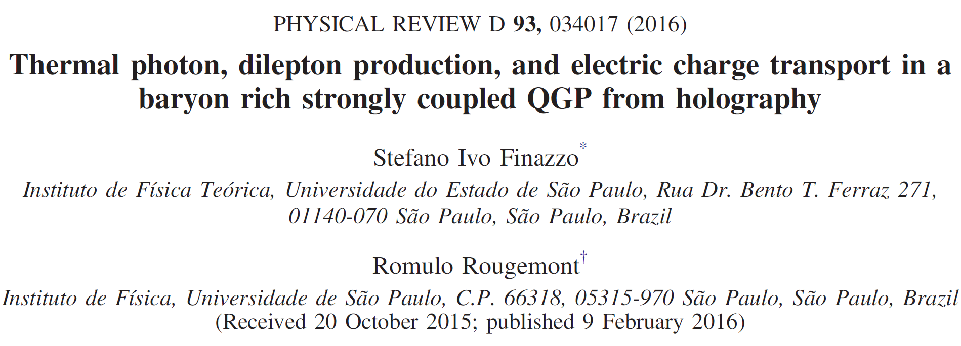
arXiv: 1510.03321

Slide 2
1.Introduction
Some of the cleanest observables in ultrarelativistic heavy ion collisions which provide sensitive information about the initial state conditions of the QGP are the spectra of photons and dileptons.
Since they’re colorless, photons and dileptons escape away from the medium after weakly interacting with the bulk of the plasma, carrying local information about it.

Slide 3
1.Introduction
QGP produced at RHIC and LHC is expected to be strongly coupled around the QCD crossover transition, nonperturbative methods are required in order to investigate the production of these electromagnetic probes in the plasma for temperatures in the range T ∼ 150 MeV–300 MeV.
The use of lattice gauge theory methods to compute the needed production rates is also challenging at finite chemical potential.
Gauge/gravity duality presents itself as a useful approach to study such phenomena.

Slide 4
2.Ouline
(1) Holographic model: Einstein-Maxwell-Dilaton
(2) Fix parameters (functions) according to lattice data (speed of sound, pressure, dc electric conductivity $σ$)
(3) Calculate correlator using $σ$ (different from usual way of using on-shell action as generating function)
(4) Correlator $⇒$ emission/production rate

Slide 5
3.Notation:
In this paper, some notations are used, they are not complicated but can be sometimes very troublesome and easily mistaken:
(1) Quantities with a tilde: $\tilde{r}$ for example, denotes quantities under the so-called “standard coordinates”, where $\tilde{r}=∞$ represents the boundary, and the blackening function goes to unity at the boundary.
(2) Quantities without tilde: $r$, denotes quantities under the “numerical coordinates”, with which EOMs are solved.
(3) ) Quantities with a hat: $\hat{s}$ for example, denotes observables in natural unit and the AdS radius set to 1.

Slide 6
4.EMD--action and metric :

Slide 7
4.EMD:
After solving EOMs for $h(r)$, $A(r)$, $φ(r)$ and $Φ(r)$, one can calculate some thermodynamic quantities and by fitting the results to the lattice data, the parameter/function $V(φ)$ and $f_{B}(φ)$ can be determined:

Slide 8
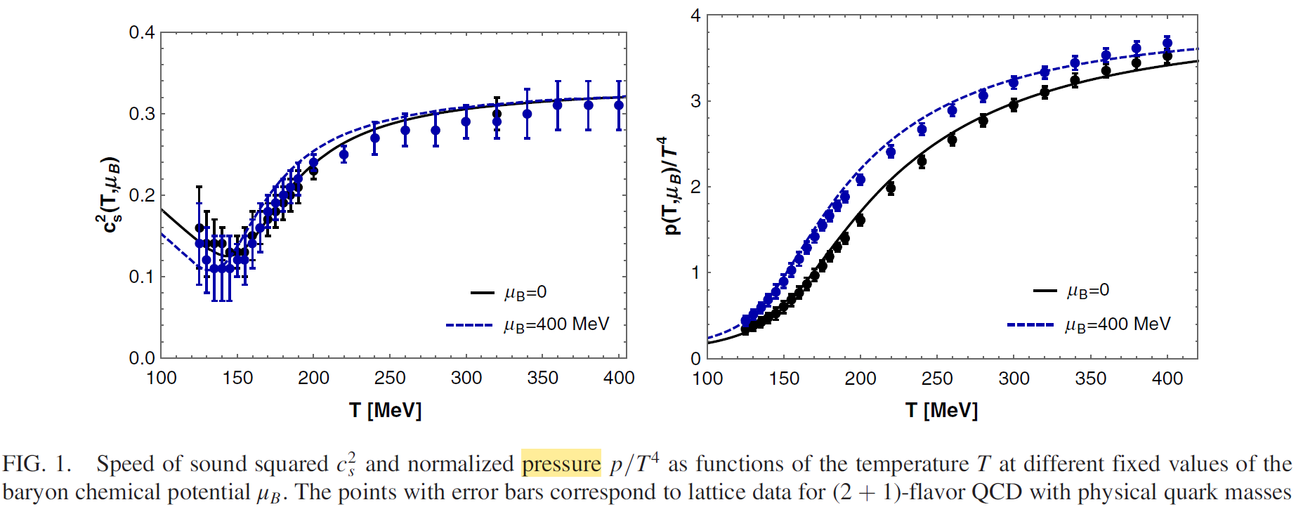
4.EMD:

Slide 9
4.EMD--probe action:
The action of this part has no influence on the background geometry

Slide 10
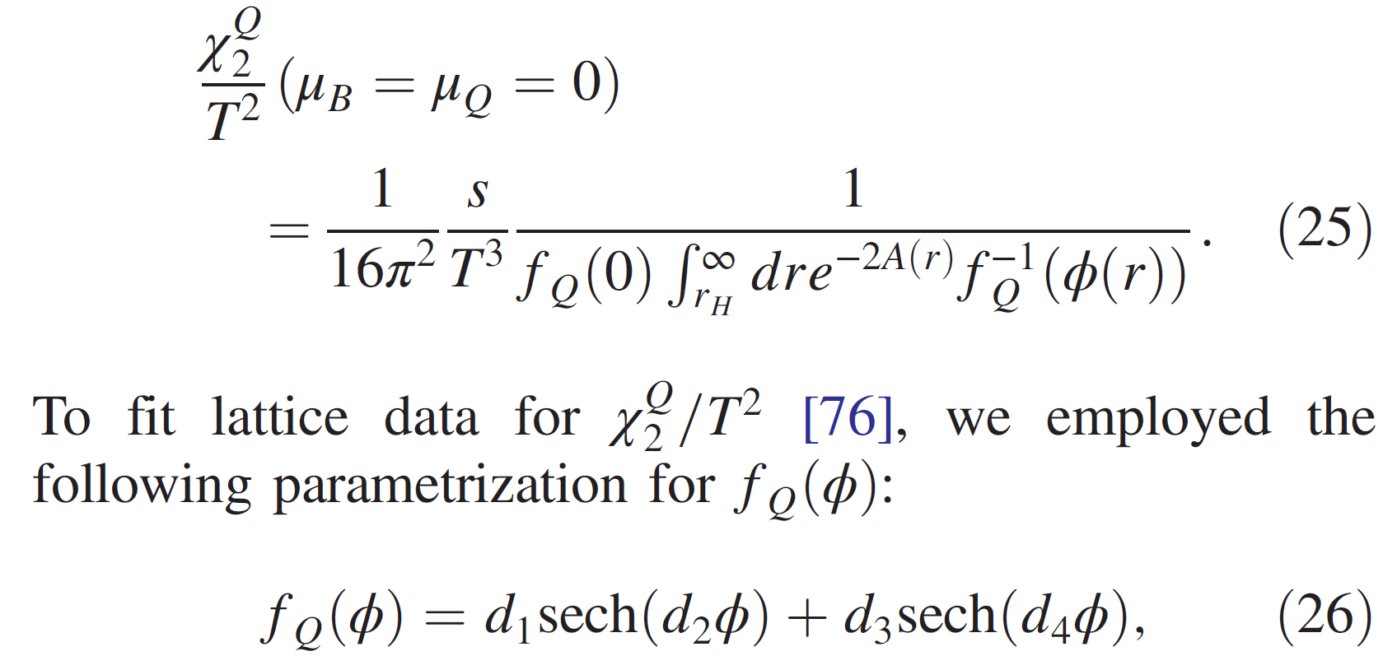
4.EMD--probe action:
$f_{Q}(φ)$ is fixed according to the fitness of the Electric charge susceptibility to lattice data.

Slide 11
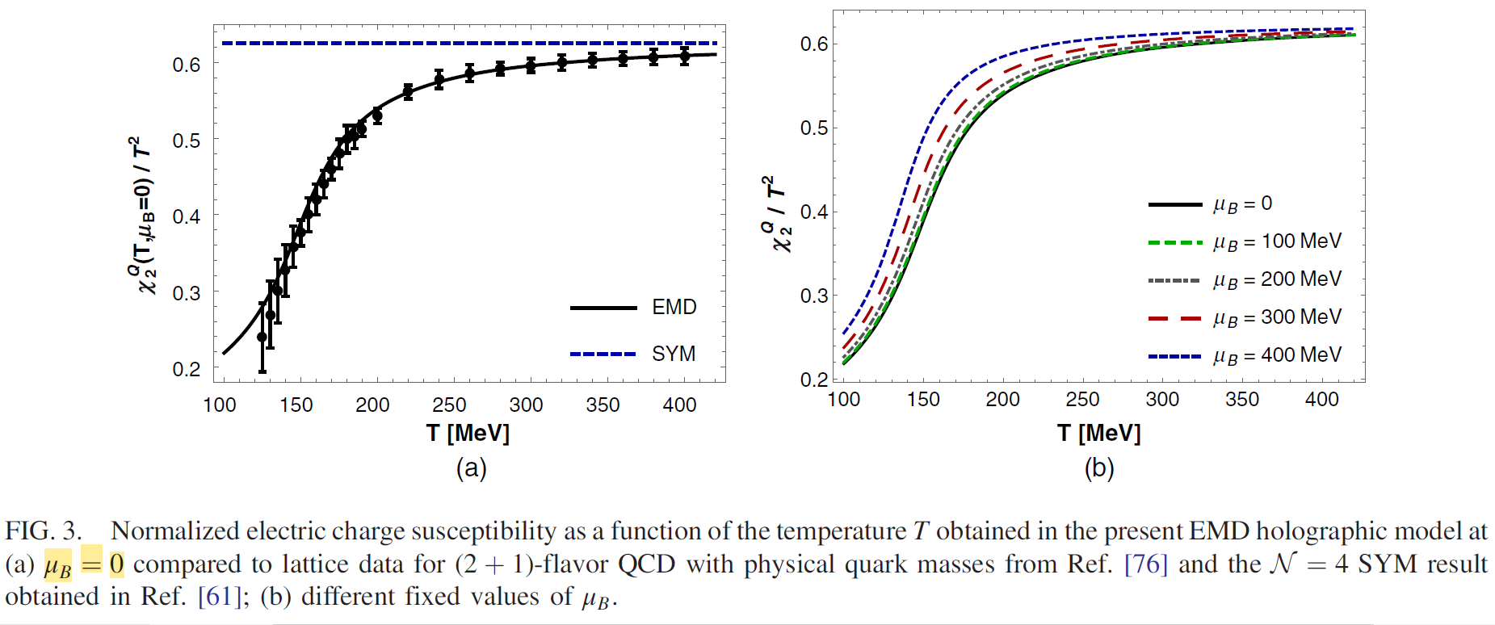
4.EMD--probe action:

Slide 12
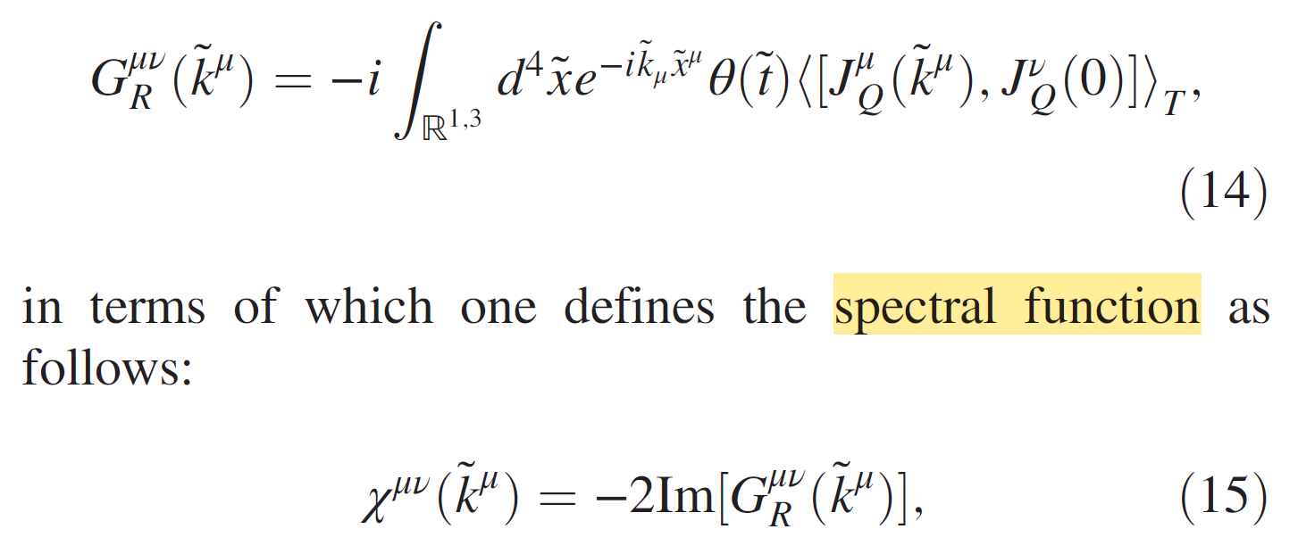
5.Emission rate:

Slide 13
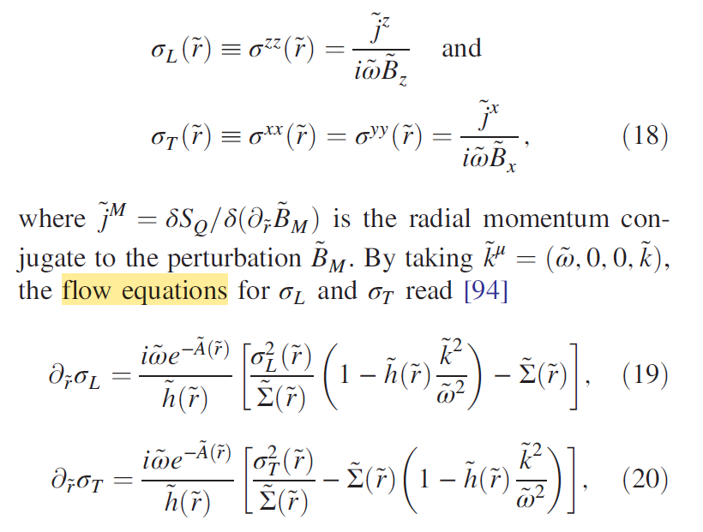
5.Emission rate:

Slide 14
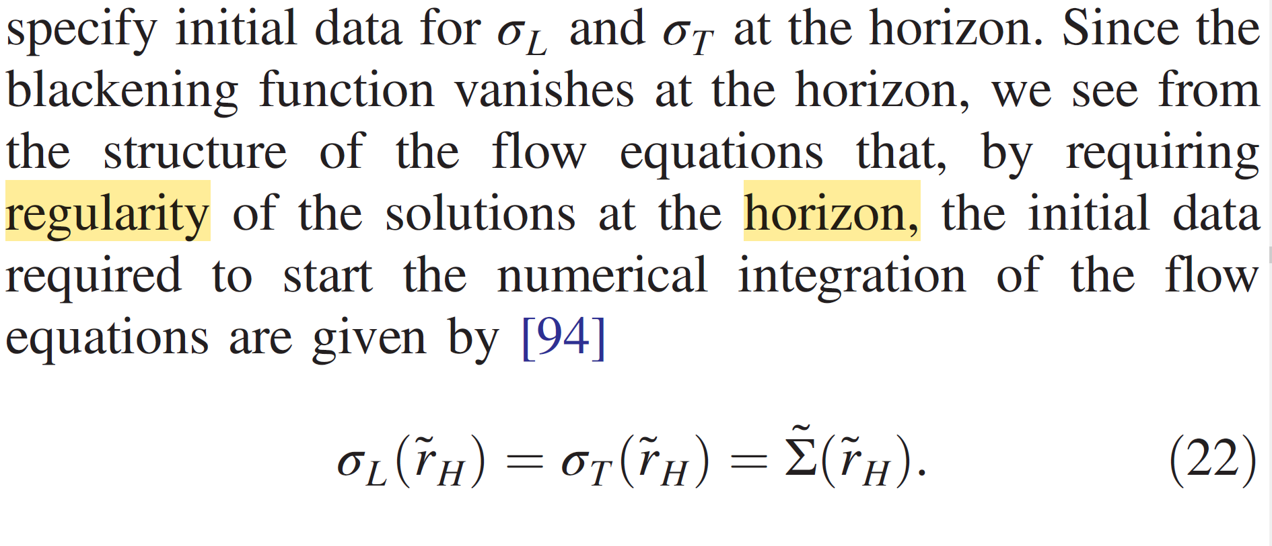
5.Emission rate:

Slide 15
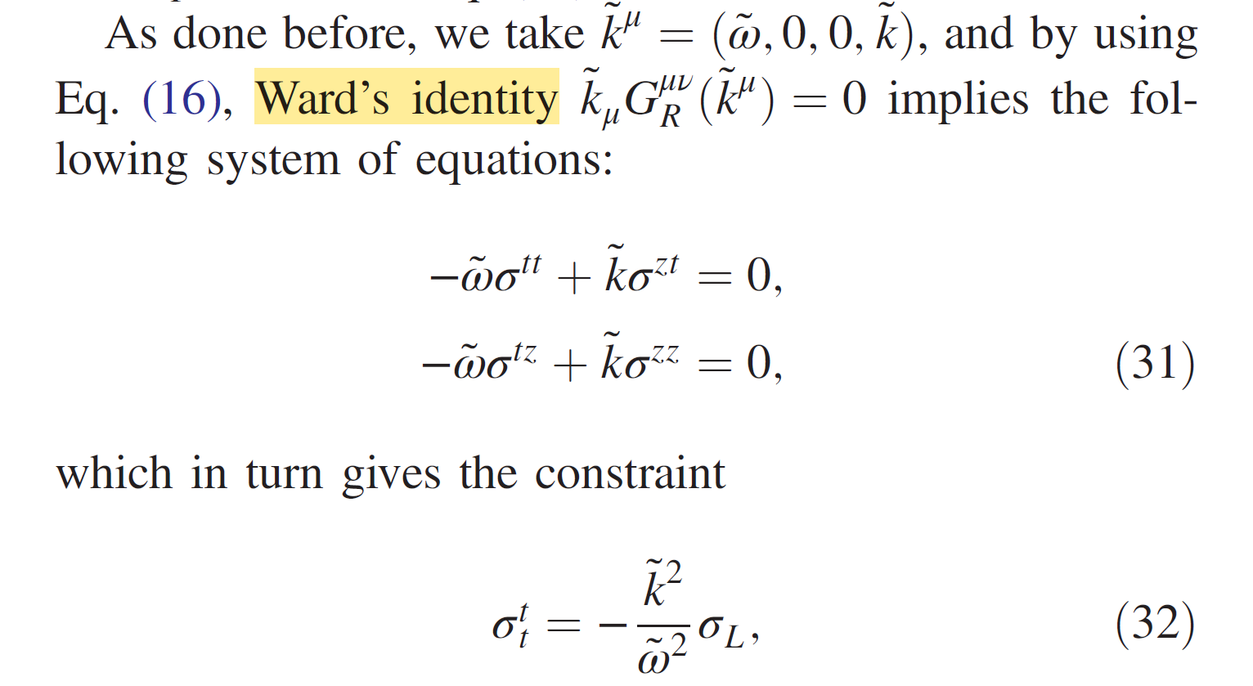
5.Emission rate:

Slide 16
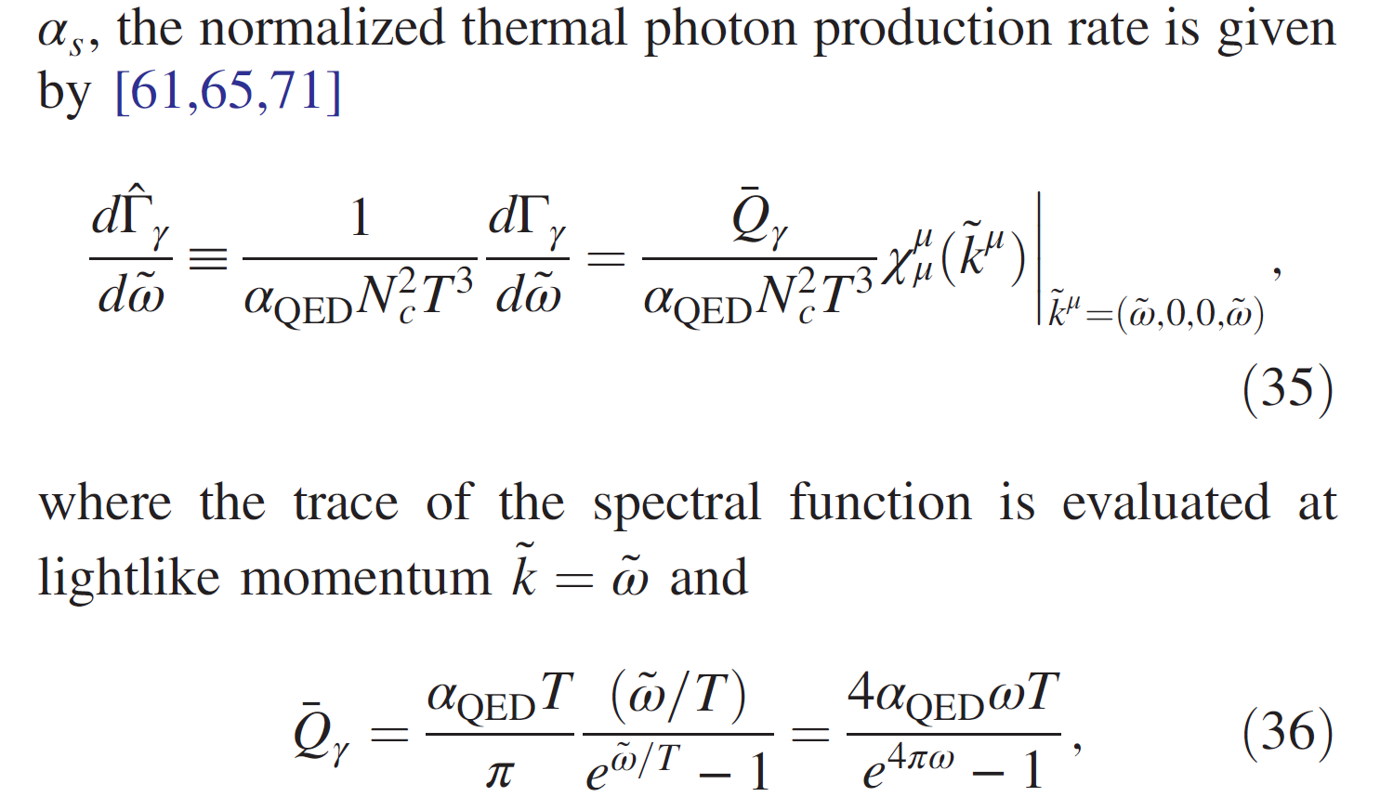
5.Emission rate:

Slide 17
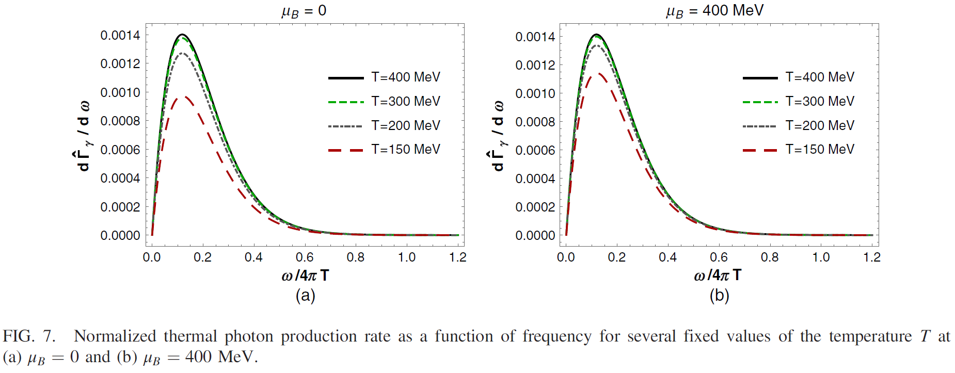
5.Emission rate:
Increasing $T$ will rise the peak, increasing $μ$ has similar effect but milder.

Slide 18
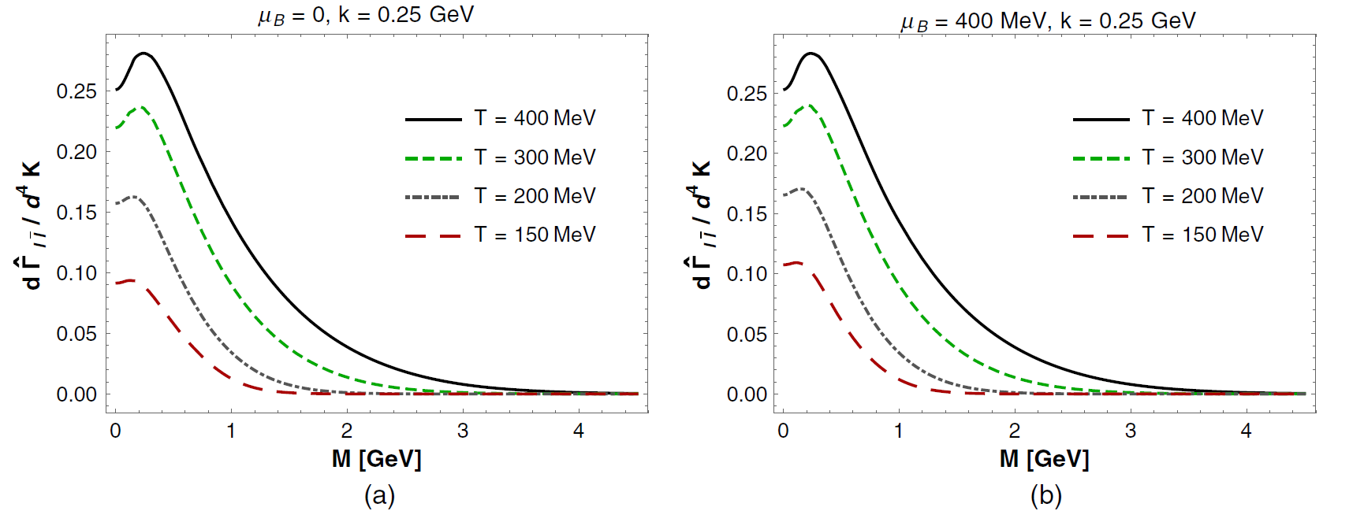
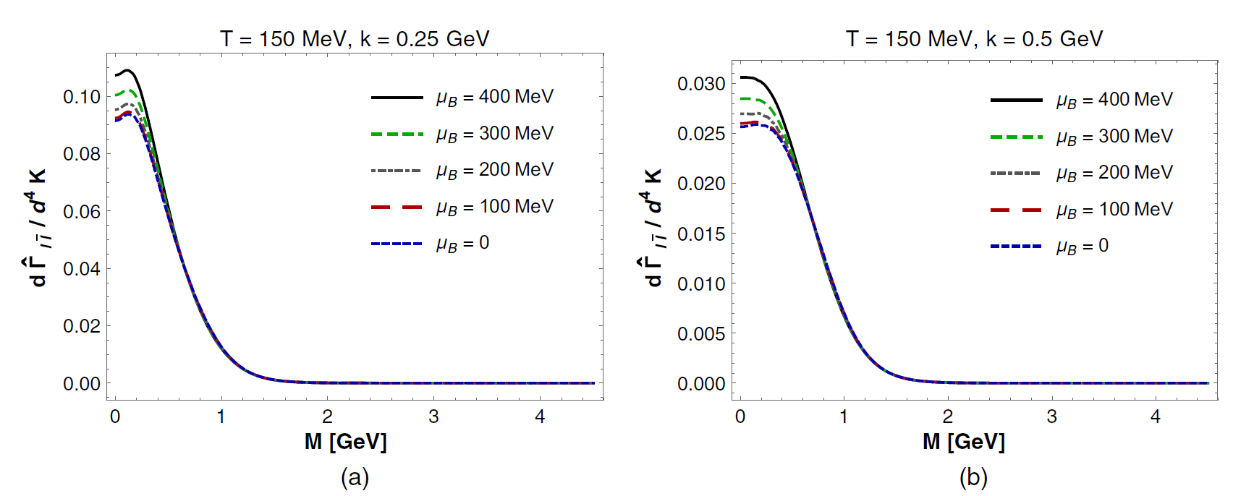
5.Emission rate--dileptons:

Slide 19
5.Conclusion:
(1) Increasing T and/or $μ_{B}$ enhances the peak present in both spectra
(2) For values of the dilepton mass M ≳ 1 GeV the dilepton spectrum is insensitive to variations in $μ_{B}$.

Slide 20
Thanks For Listening!

