Slide 1

CEPC Trk & PID meeting
H_recoil Status Report
Yuji Li(Fudan university)

Slide 2


Status
In this formula, the width of Z/H should be measured as a constant with H invisible events.
We use a chi square method to find the best lepton pair.
Clear relation between Z boson momenta and H recoil.
BKG Inputs: /cefs/higgs/liugeliang/CEPC/202501/Production/4fermions/
/cefs/higgs/liugeliang/CEPC/202501/Production/2fermions/

Slide 3
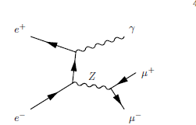
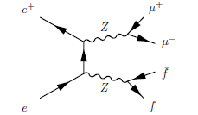
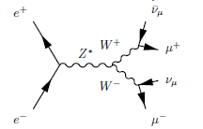
Irreducible bkgs
4fermions
2fermions

Slide 4
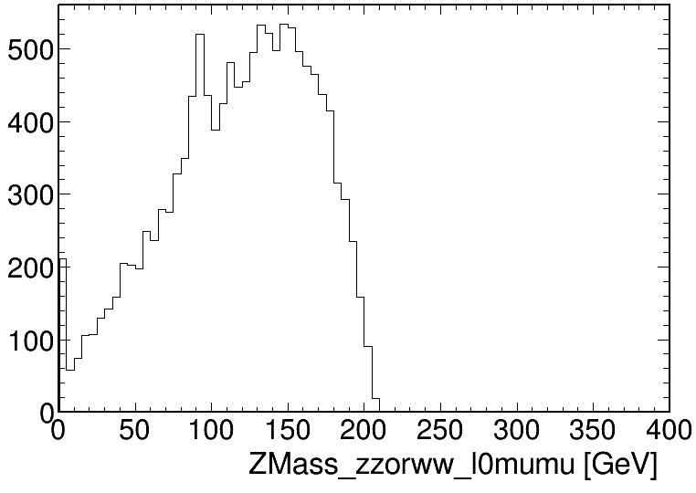
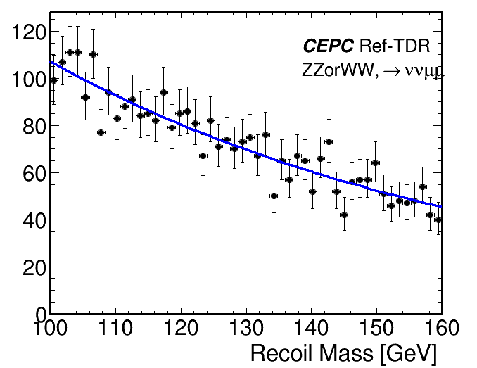
BKG Samples: eeTo(anything)To2l2nu
Fitted by exponential

Slide 5
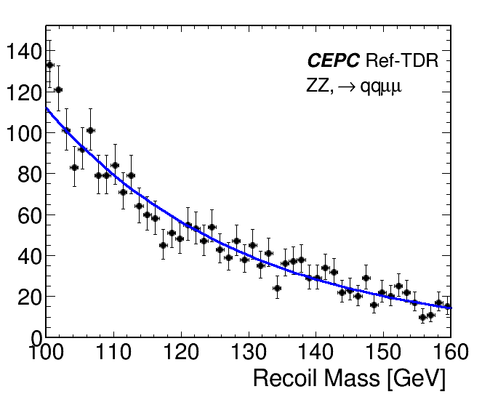
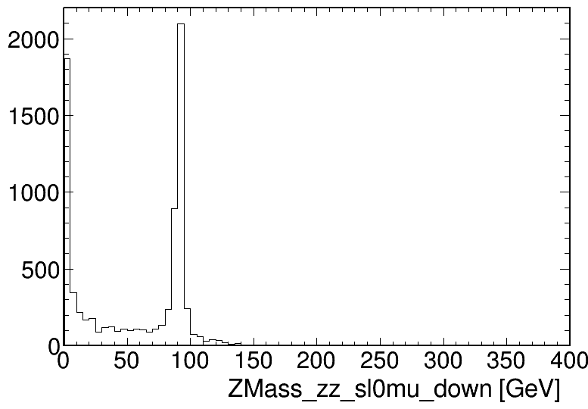
BKG Samples: eeTo(anything)To2l2q
Fitted by exponential

Slide 6
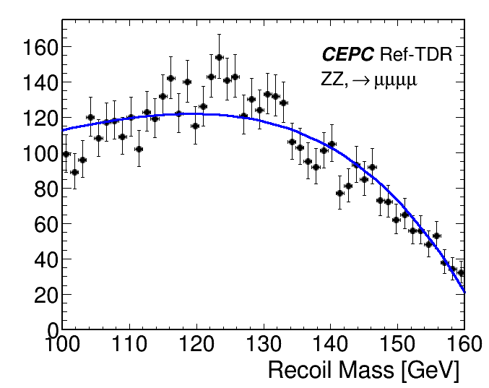
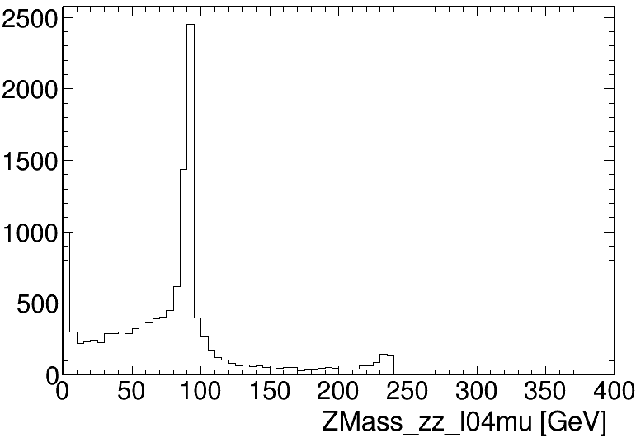
BKG Samples: eeToZZ4L
Fitted by polynomial

Slide 7
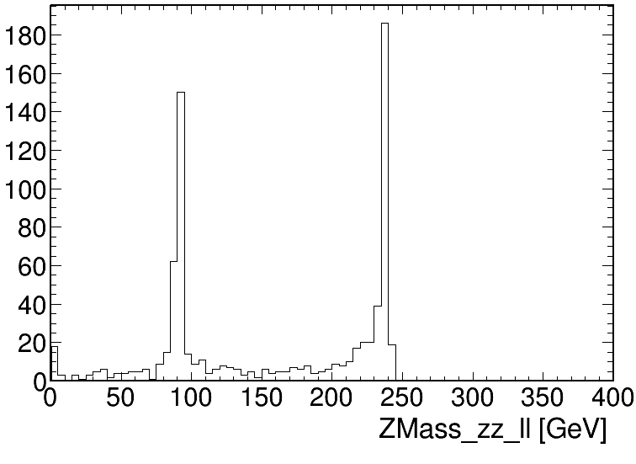
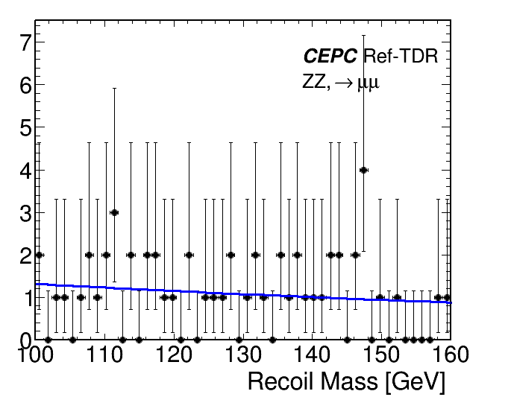
BKG Samples: Zll_isr
Fitted by exponential

Slide 8
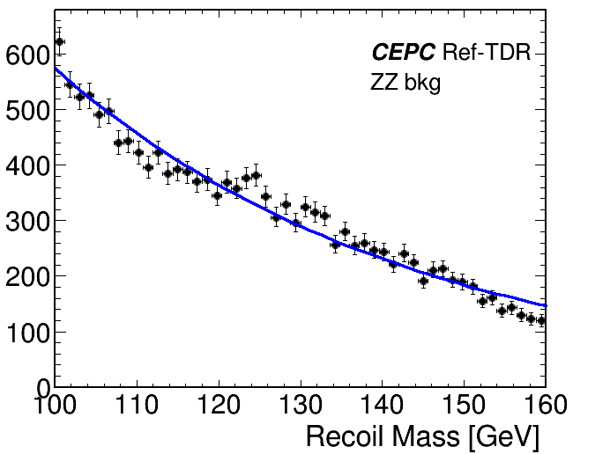
BKG Combination
Lumi: 20(fb-1)
xs zz_l0mumu=2*19.38;
xs 4mu=15.56;
xs sl0mu_down=136.14;
xs sl0mu_up=87.39;
xs zzorww_l0=221.10;
xs ll=5332.71;
Fitted by exponential

Slide 9
Summary and plans
All the bkg from MC for irreducible bkg has been ready.
Muon detector has been constructed in CEPCSW, will update the muon selection in this study.
Final fit of H recoil shape is debugging.

Slide 10
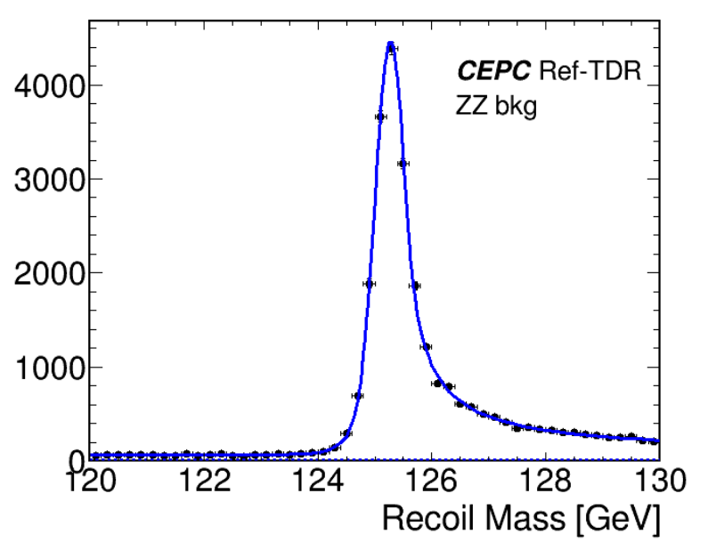
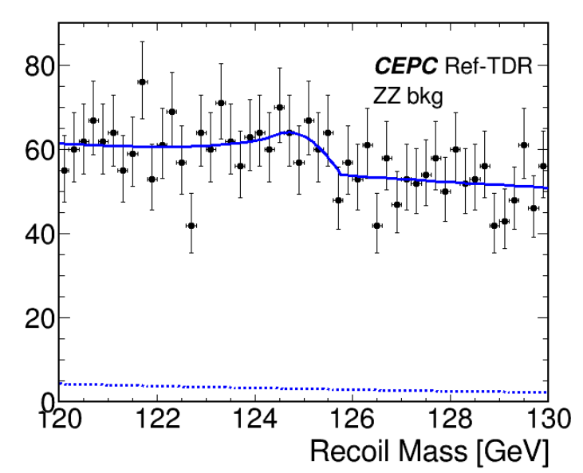
S+B
B

