Slide 1


Potential contributions to the CEPC
Alexey Kharlamov
Budker Institute of Nuclear Physics

Slide 2
Outline
Z → 2lγ from LEP to ATLAS, ideas of the analysis
High precision Z → 2lγ measurement at CEPC
Potential contributions to CEPC
Person power
Summary
I will start from the Z → 2lγ analysis proposal for CEPC, then will go to what is needed to get high precision and what our group could contribute to it.

Slide 3
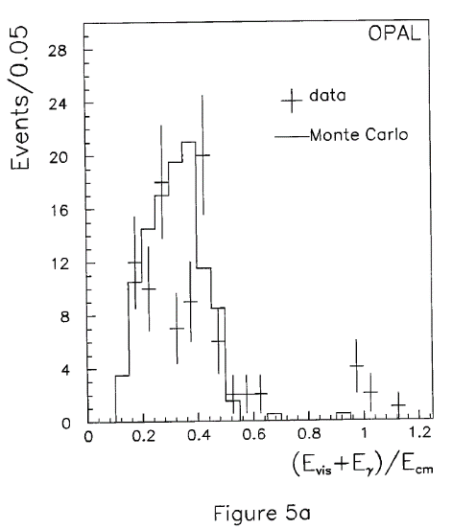
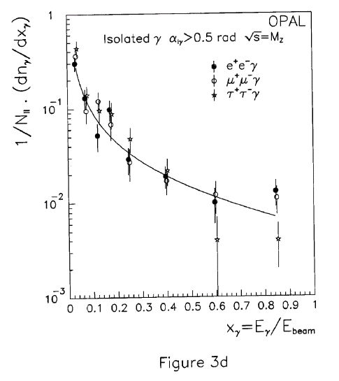
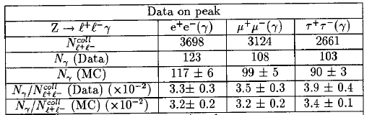
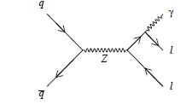
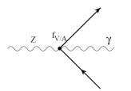
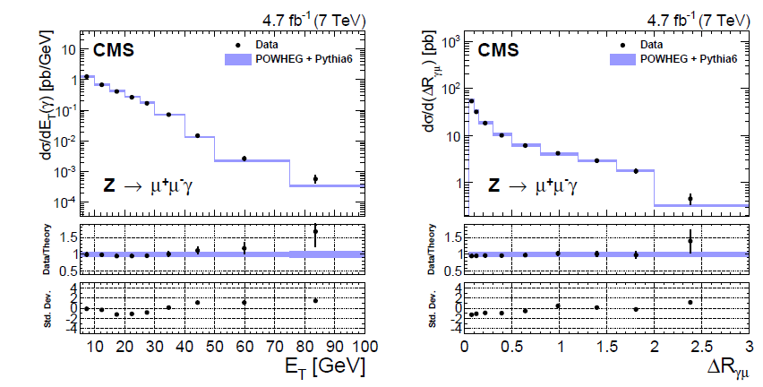
Introduction
What could we study in the Z→2Lγ process?
LEP-I Total cross section, photon energy distribution E_{γ}. QED at tree level. Upper limit for direct vertex contribution.
LHC CMS Z→µ⁺µ⁻γ: p_{T}^{γ}, ΔR.
E_{γ}>150 МэВ
OPAL
Phys. Lett. B 273 (1991) 338-354
Phys. Rev. D 91 (2015) 092012
CMS accuracy Z→µ⁺µ⁻γ ~5%

Slide 4
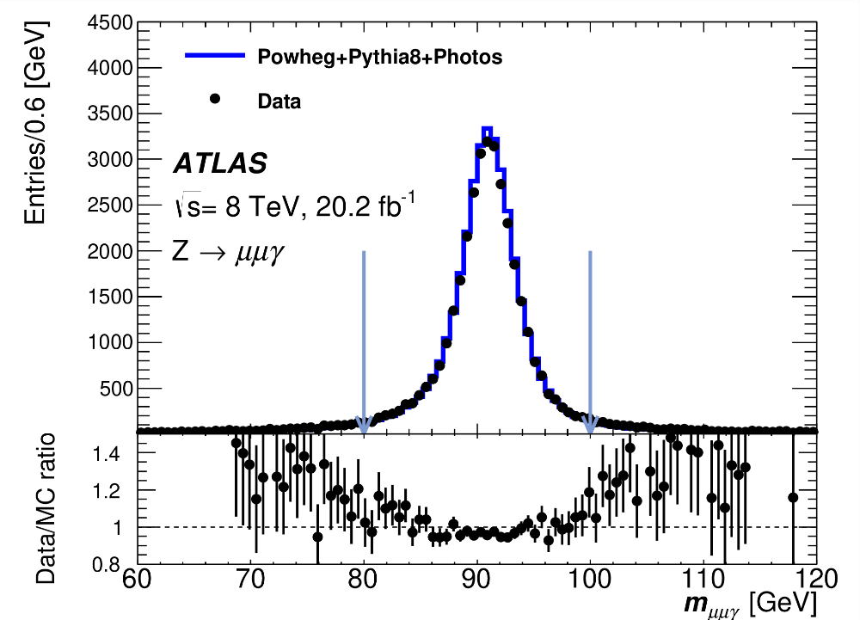
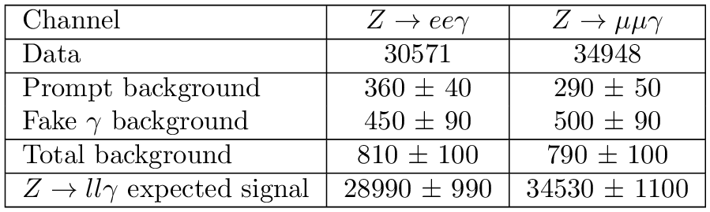
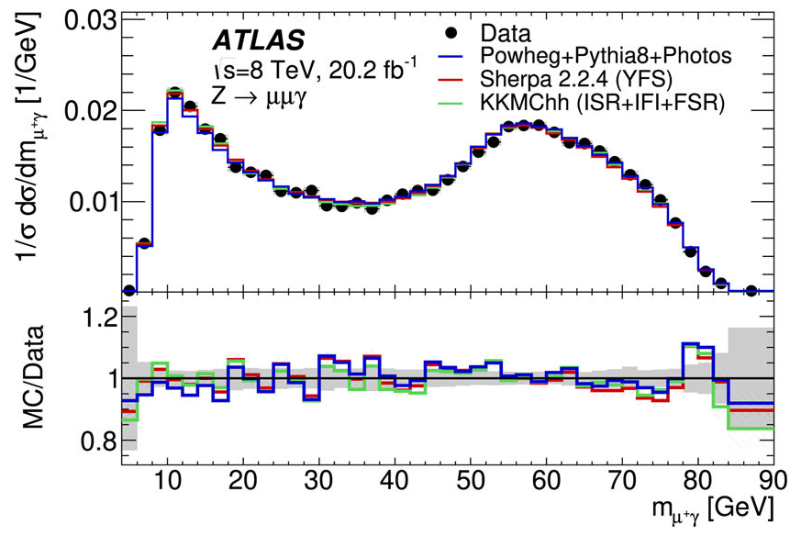
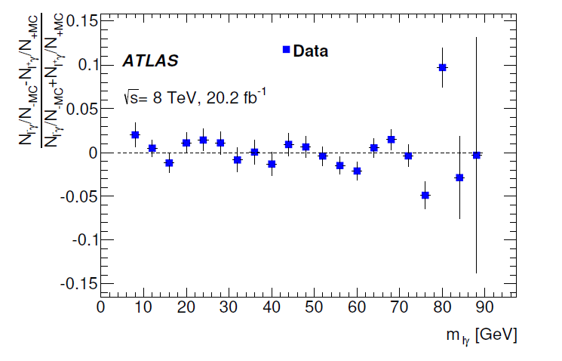
Atlas Z→llγ analysis
High precision measurement, systematical uncertainty ~0.6%
M(ly) measured for the first time, Z → 2l2γ first observation.
Eur. Phys. J. C 84, 195 (2024).
Some hint of the charge asymmetry at Mly ~ 80 GeV

Slide 5
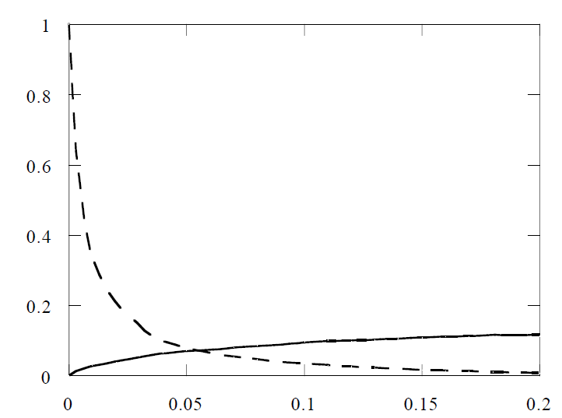
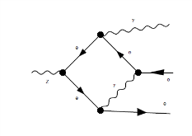
Introduction
We propose Z→2lγ analysis which is a follow-up of the ATLAS at LHC analysis: paper
Measure m_{l±γ}, ∆R, p_{t}^{γ} differential cross sections
Systematical uncertainty for differential cross sections was 0.6% and could be reduced at CEPC.
Direct vertex contribution was extracted from ATLAS Data: Physics of Particles and Nuclei Letters, 2024, Vol. 21, No. 4, pp. 893–901 https://rdcu.be/dQYL2
The significance of the direct vertex addition to state of the art MC predictions is up to 5σ.
Main idea of the analysis:
Invariant mass of the lepton and photon M(Lγ) is distributed from 0 to M(Z).
So, the virtual lepton in this process have the mass up to 91 GeV.
FSR
Dotted line – FSR contribution,
Solid line – New physics contribution from the work
D.Bruss, O.Nachtmann, P.Overmann,
Eur.Phys.J.C1:191-199,1998
(arXiv:hep-ph/9703216v1)
Direct vertex is also present as SM loops correction.
Direct vertex
(Mly/MZ)²

Slide 6
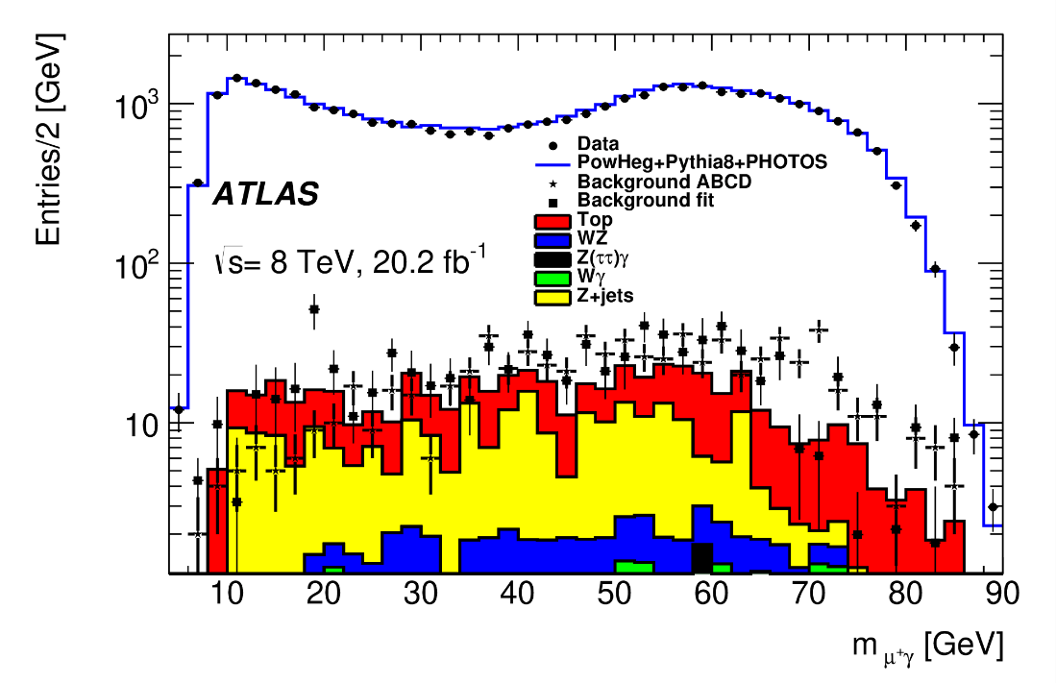
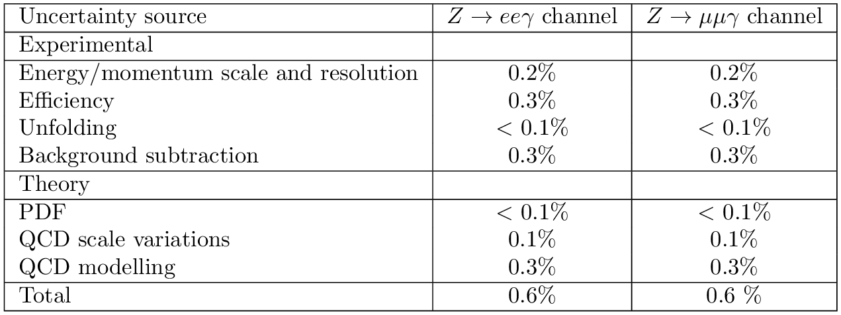
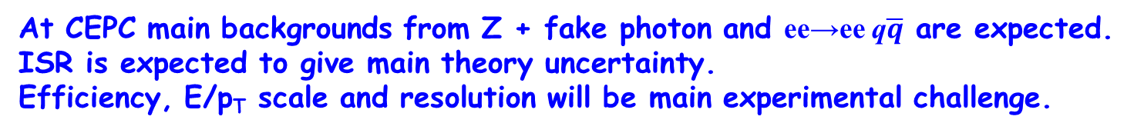

High precision measurement at CEPC
Z → 2lγ cross section = 13.1±0.1pb (CompHep simulation with ISR, selections close to ATLAS). One month data taking at Z yields 10⁷ events. This is enough to have 0.2% stat uncertainty with the same binning as in ATLAS. 3x10⁸ events expected at 2 year data taking at Z. Only 30K events were obtained in ATLAS.
Main background t$\overline{t}$ is absent at CEPC
QCD related uncertainties are absent at CEPC
At CEPC main backgrounds from Z + fake photon and ee→ee q$\overline{q}$ are expected. ISR is expected to give main theory uncertainty.
Efficiency, E/p_{T} scale and resolution will be main experimental challenge.

Slide 7
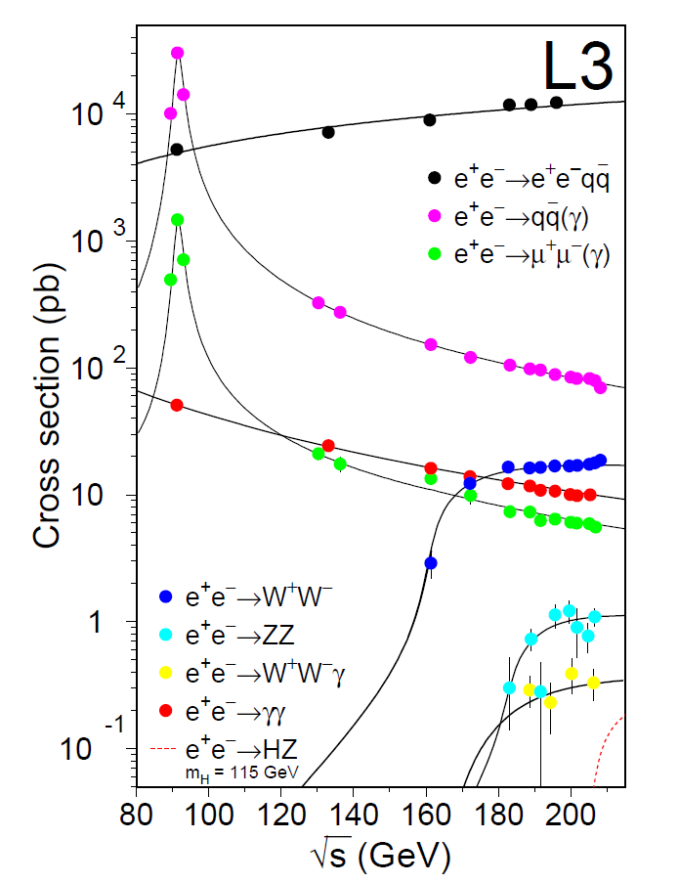
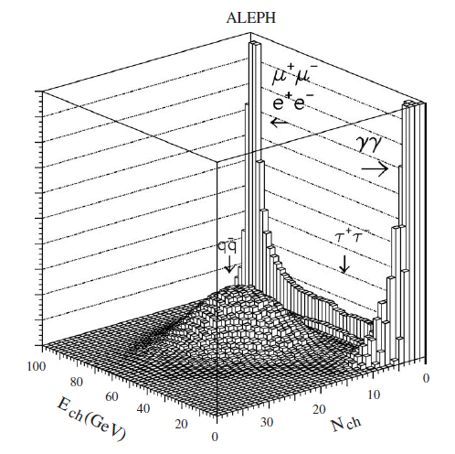
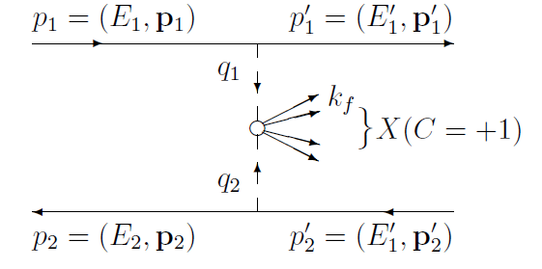
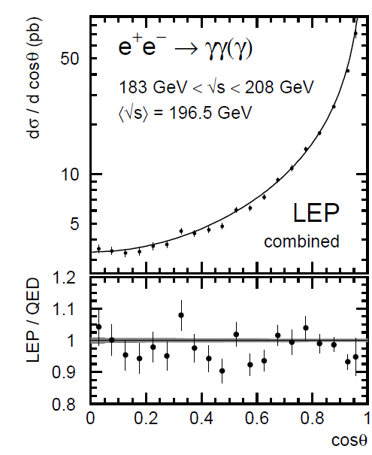
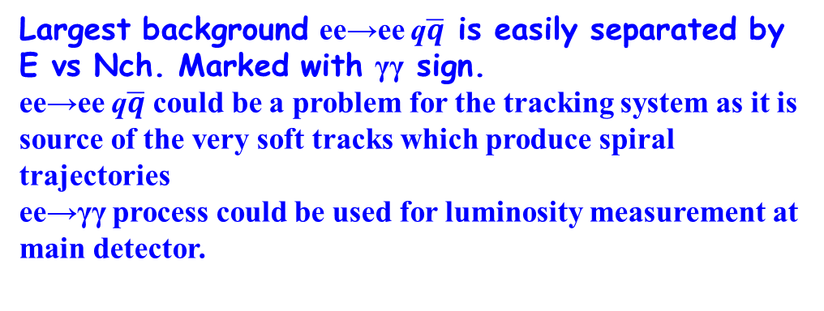
Selections at LEP near Z
Two photon hadrons production
Largest background ee→ee q$\overline{q}$ is easily separated by E vs Nch. Marked with γγ sign.
ee→ee q$\overline{q}$ could be a problem for the tracking system as it is source of the very soft tracks which produce spiral trajectories
ee→γγ process could be used for luminosity measurement at main detector.

Slide 8
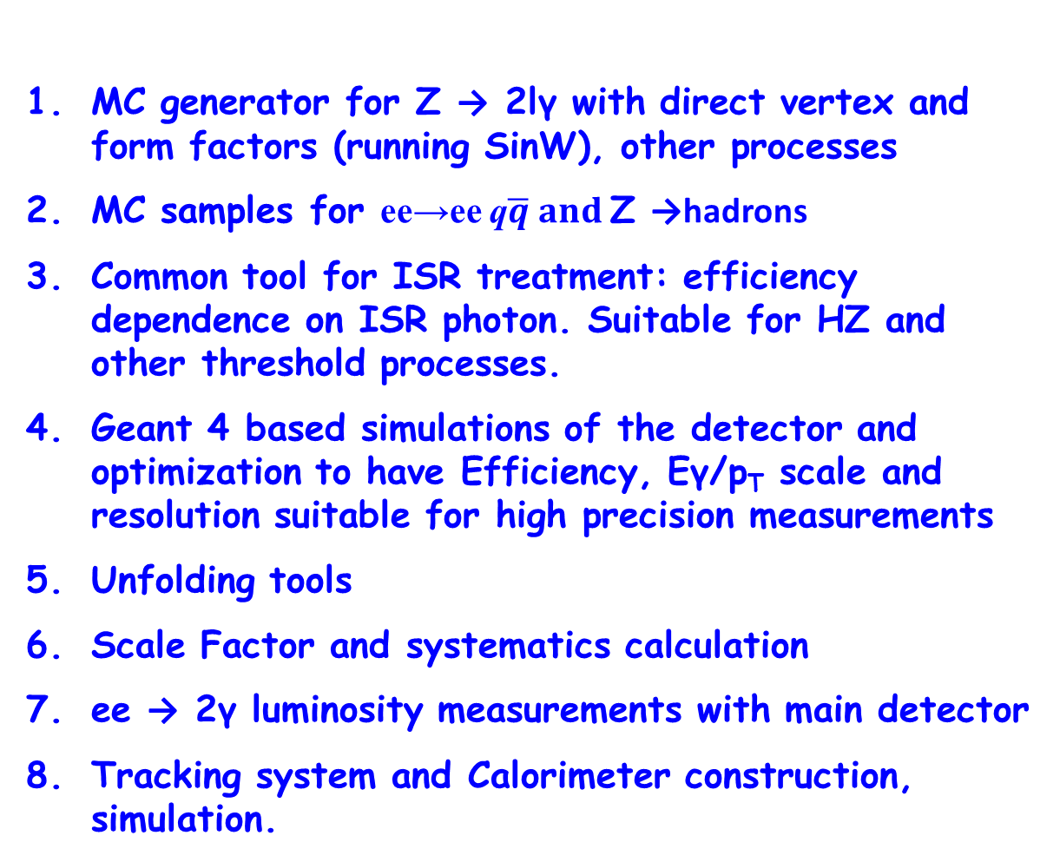
Potential contributions to CEPC
MC generator for Z → 2lγ with direct vertex and form factors (running SinW), other processes
MC samples for ee→ee q$\overline{q} and$Z →hadrons
Common tool for ISR treatment: efficiency dependence on ISR photon. Suitable for HZ and other threshold processes.
Geant 4 based simulations of the detector and optimization to have Efficiency, Eγ/p_{T} scale and resolution suitable for high precision measurements
Unfolding tools
Scale Factor and systematics calculation
ee → 2γ luminosity measurements with main detector
Tracking system and Calorimeter construction, simulation.

Slide 9
Person power:
Kharlamov Alexey, Associate Professor: Physics analysis, MC generators,
Geant4 simulation (Tracking system, calorimetry), calibration, reconstruction,
photon identification, systematics study
Kharlamova Tatyana, Associate Professor: Physics analysis, MC generators, unfolding, overlay, Tracking system: calibration, reconstruction, dE/dx identification,
Krachkov Peter, Associate Professor: Theoretical support, QED, EW loop calculations, effective models
Kupich Andrey, research fellow: Physics analysis, SF with tag and probe, Tracking system, reconstruction
Zhabin Victor, junior research fellow: Physics analysis, MC generators, digitization
Potential 2-3 students
Expertise at LHC: Z→lly, H→4l, Z→4l, Z→llyy at ATLAS, MC preparation/production,
SF with tag and probe, photon identification, effective models, fits, MVA etc.
Expertise at BINP: ee →π⁺π⁻, ee →π⁺π⁻π⁰π⁰, etc., R measurement, Luminosity measurements, Tracking system: construction, simulation and exploitation; Calorimeter: assembly, exploitation; beam spot calibration.
We have experience working on experiments at the VEPP-2000, VEPP-4M, LHC colliders...

Slide 10
Summary
High precision Z → 2lγ analysis is proposed for CEPC. The measurement could be done with one month data taking at Z during luminosity demonstration, calibration runs. Statistics at x100 from ATLAS is expected.
We could contribute to software, MC simulation, analysis tools and hardware Tracking system and Calorimeter construction, calibration, systematics.
ee → 2γ luminosity study with main detector is proposed.

Slide 11
Backup slides

Slide 12
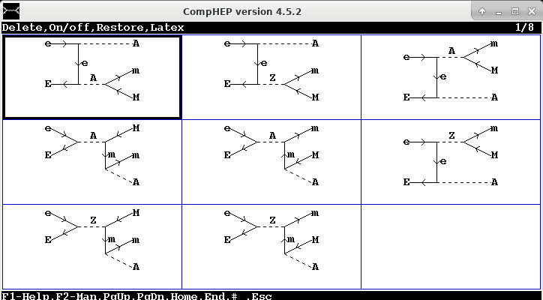
ee→Z→µµγ at 2E = 91.2 GeV with CompHep
Cross section = 13.1±0.1pb and without ISR (18.0±0.1pb)
ISR is included with structure functions.
Selections: P_{T}^{γ}>15 GeV, P_{T}^{L}>10 GeV, 20<MLL<80 GeV, 4<ML±γ<90 GeV

Slide 13
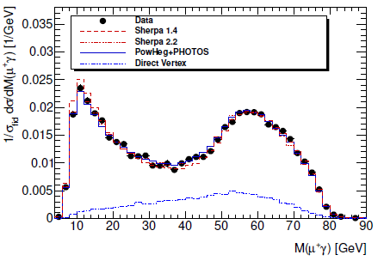
ee→Z→µµγ at 2E = 91.2 GeV with CompHep
MLL
P_{T}^{γ}
One month data taking x100 ATLAS Data
ATLAS
ML±γ

Slide 14
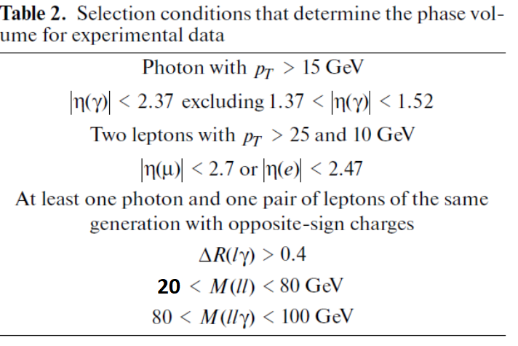
Atlas selections

